Slide 2
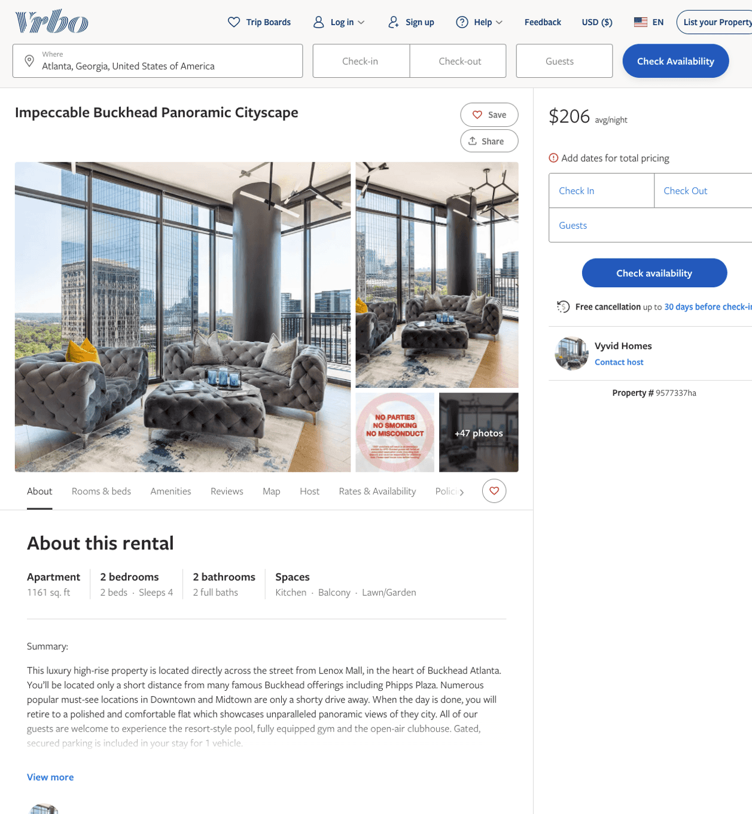
Listing 9577337
2
4
$180 - $363
4.5454545
1
Vyvid Homes
https://www.vrbo.com/9577337ha
Aug 2022

Slide 3
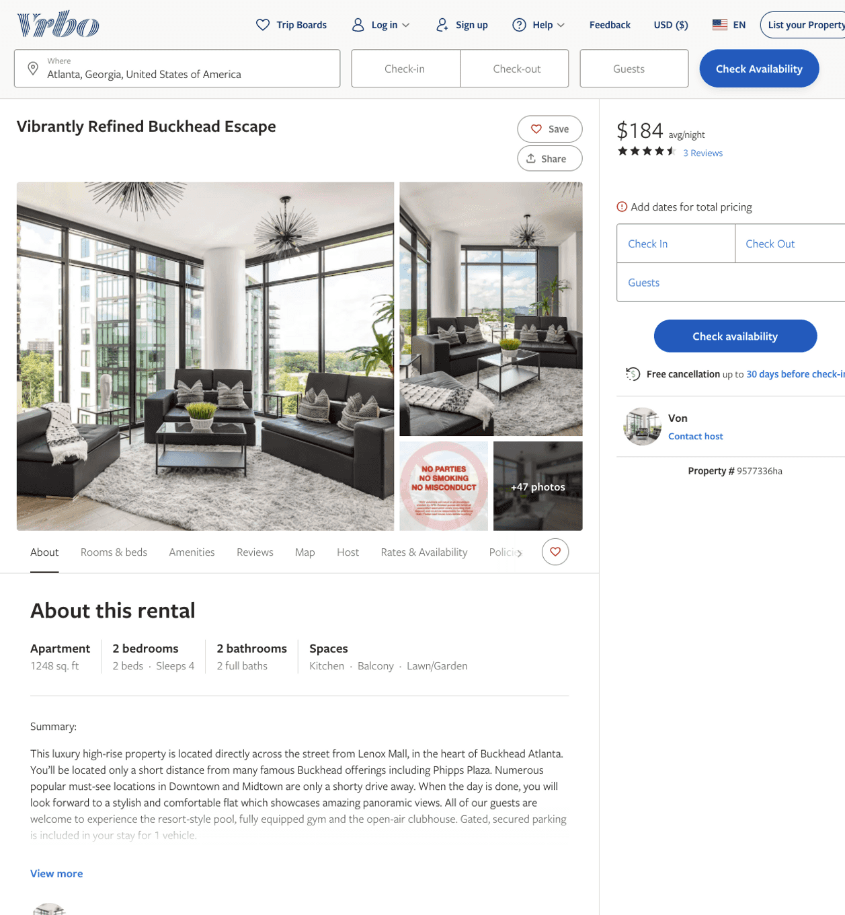
Listing 9577336
2
4
$150 - $283
4.571429
1
Von
https://www.vrbo.com/9577336ha
Aug 2022

Slide 4
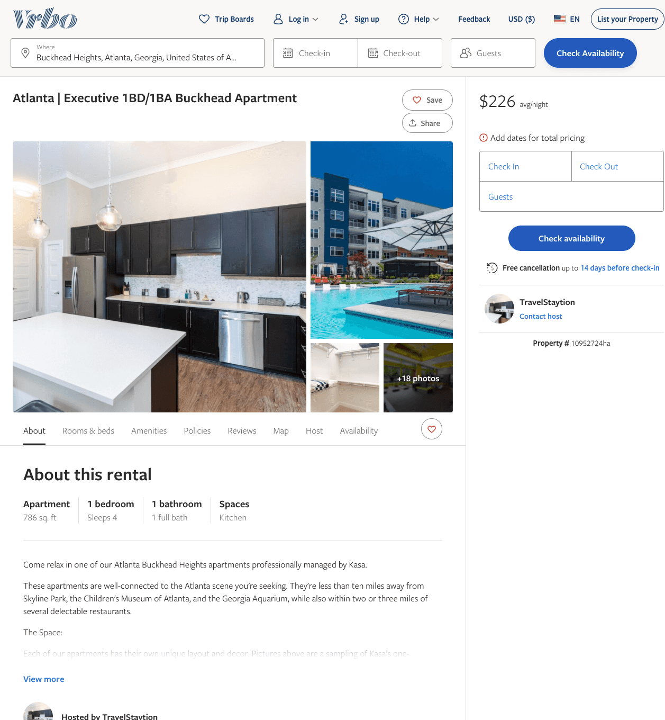
Listing 10952724
1
2
$192 - $226
1
TravelStaytion
https://www.vrbo.com/10952724ha
Aug 2022

Slide 5
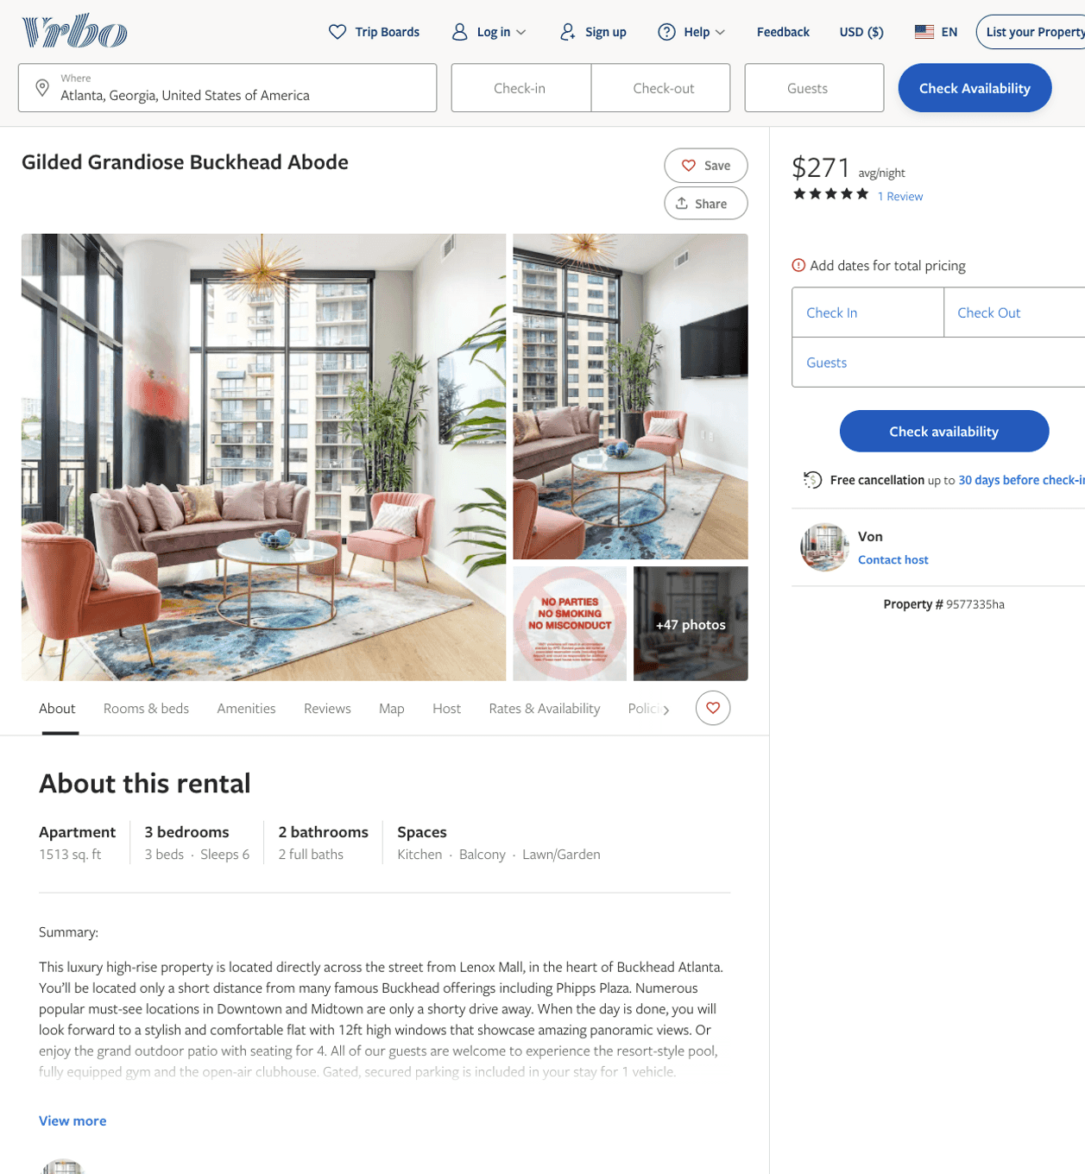
Listing 9577335
3
7
$212 - $307
4.7777777
1
Von
https://www.vrbo.com/9577335ha
Aug 2022

Slide 6
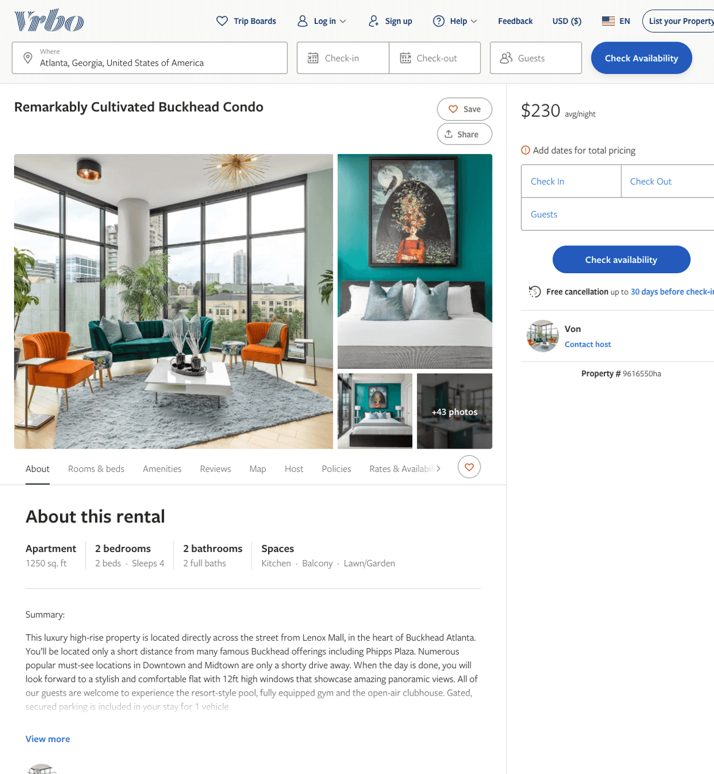
Listing 9616550
2
6
$147 - $270
3.75
1
Von
https://www.vrbo.com/9616550ha
Aug 2022

Slide 7
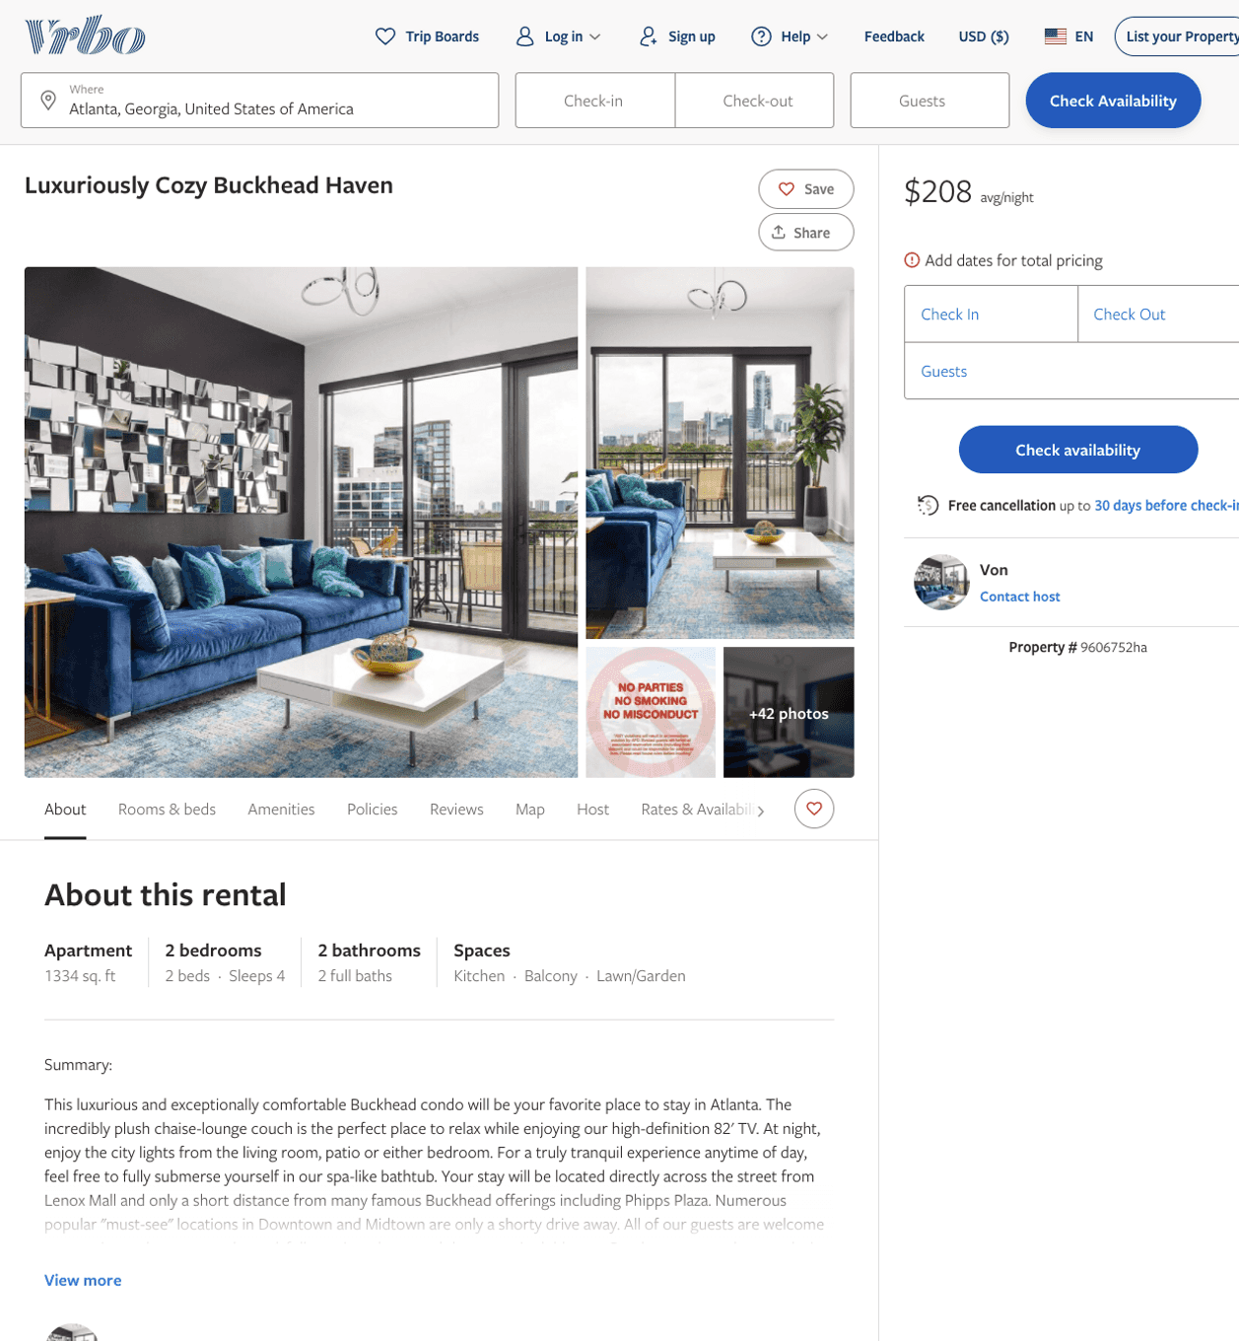
Listing 9606752
1
5
$198 - $261
4.75
1
Von
https://www.vrbo.com/9606752ha
Aug 2022

Slide 8
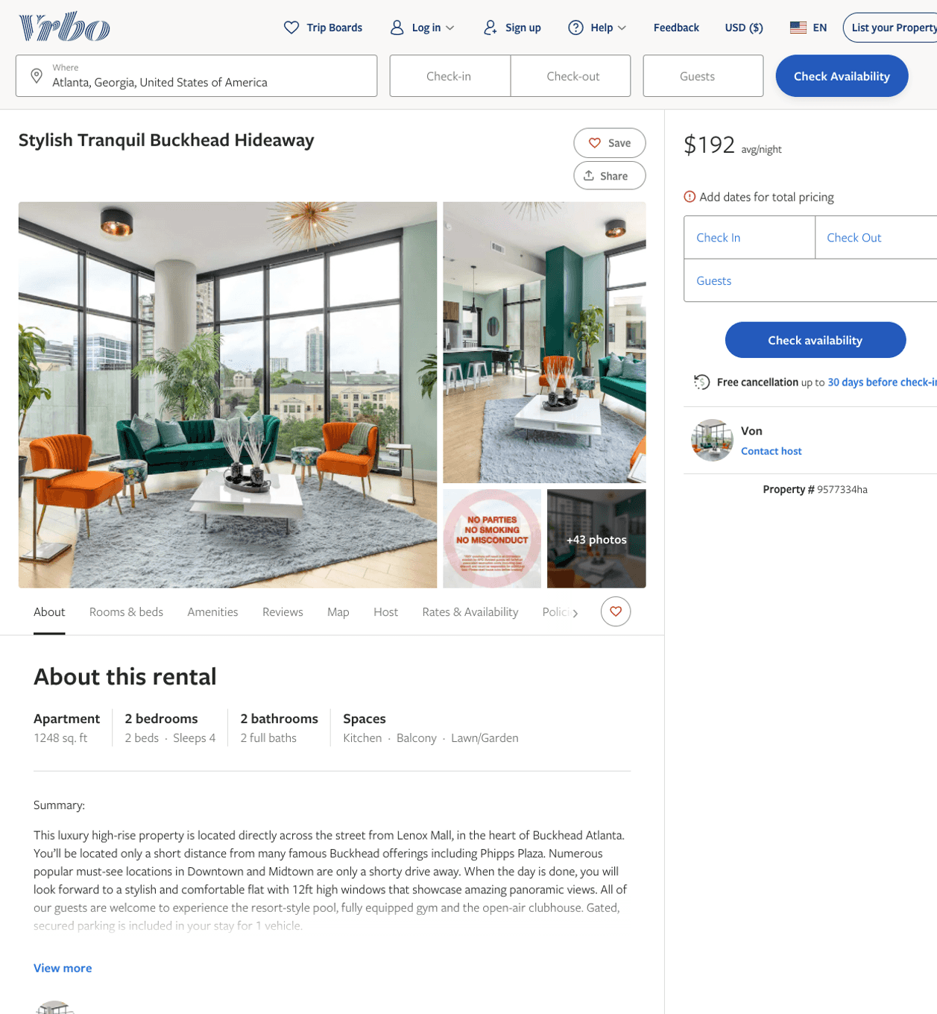
Listing 9577334
2
5
$161 - $292
4.6666665
1
Von
https://www.vrbo.com/9577334ha
Aug 2022

Slide 9
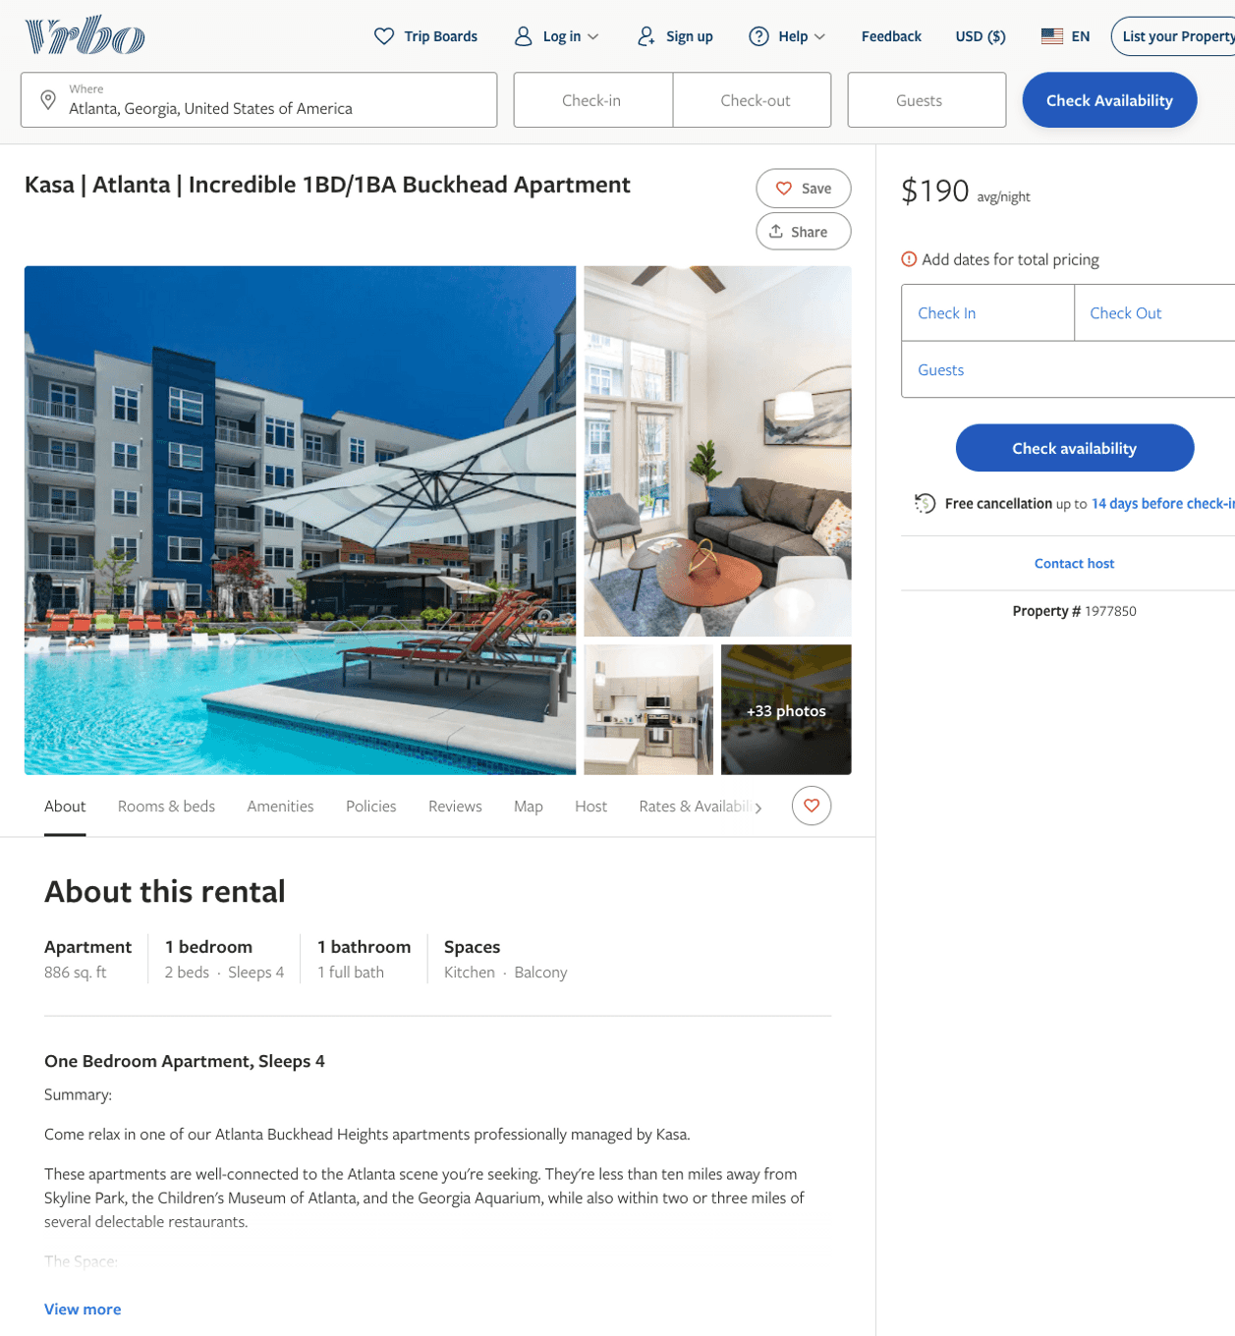
Listing 1977850
1
2
$130 - $192
5
2
Kasa
https://www.vrbo.com/1977850
Aug 2022

Slide 10
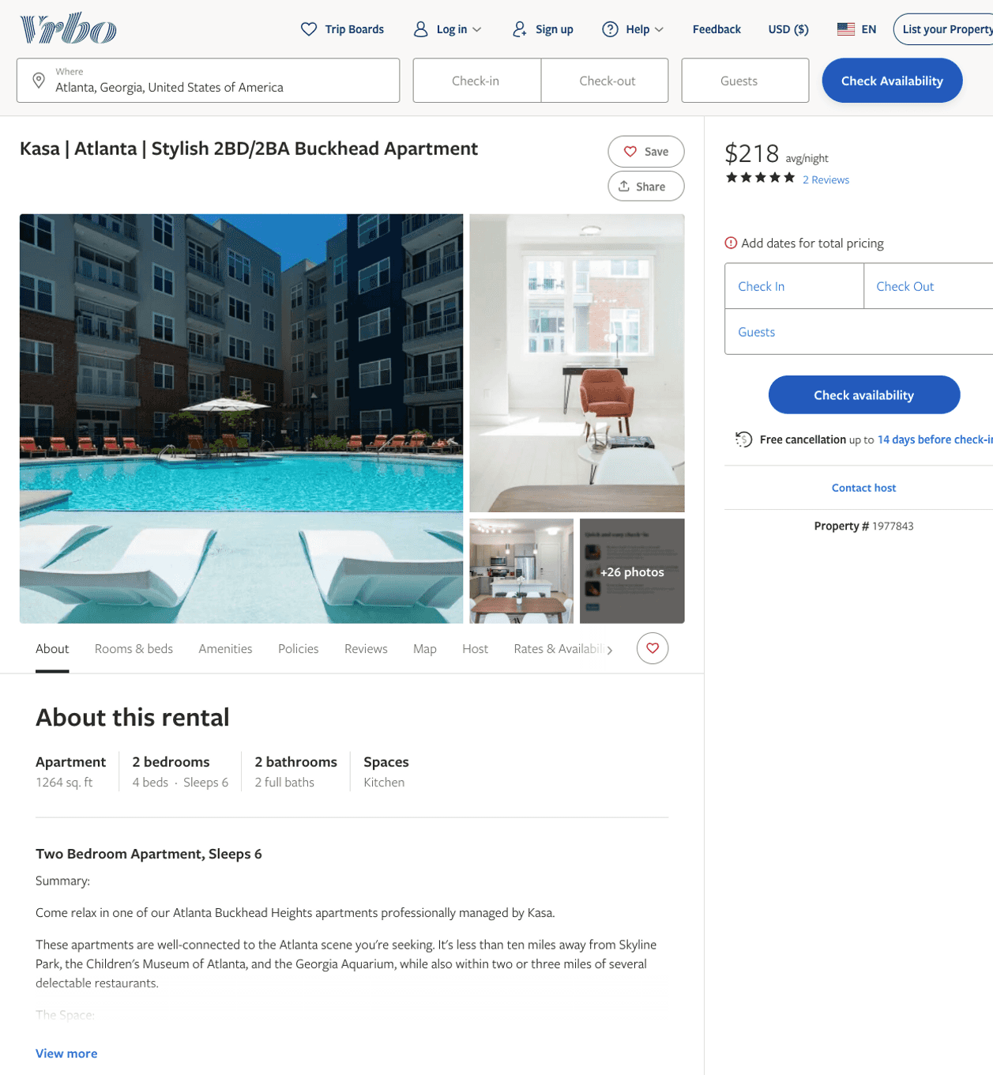
Listing 1977843
2
6
$163 - $241
3.8
2
Kasa
https://www.vrbo.com/1977843
Aug 2022

Slide 11
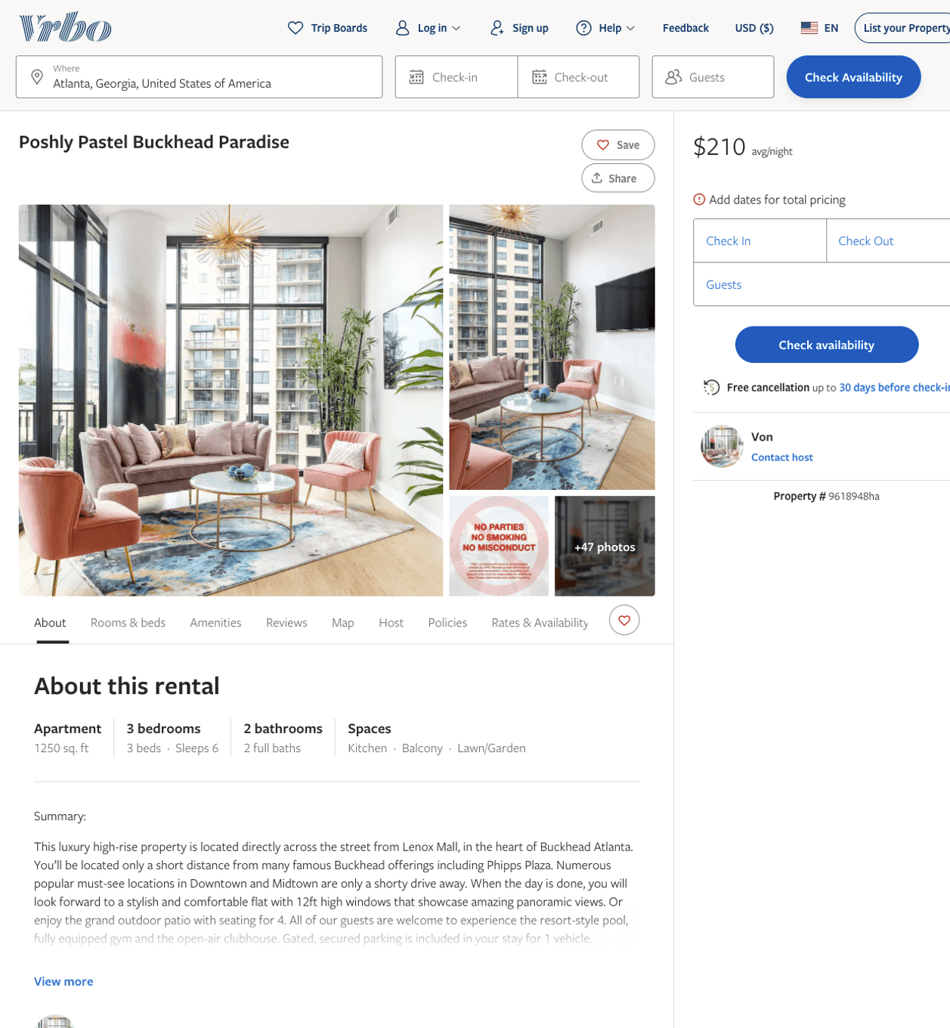
Listing 9618948
3
7
$140 - $285
4.2
1
Von
https://www.vrbo.com/9618948ha
Aug 2022

Slide 12
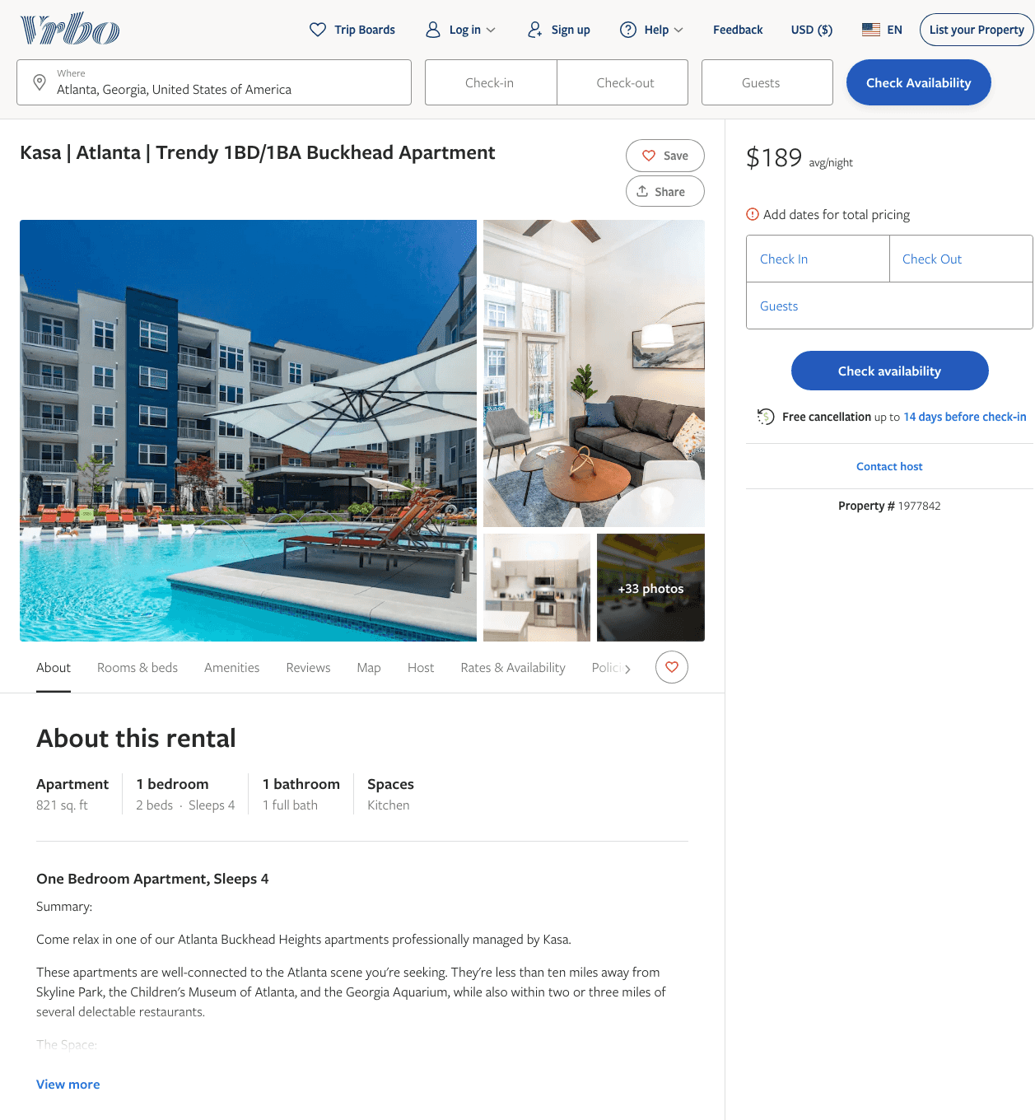
Listing 1977842
1
2
$129 - $199
2
Kasa
https://www.vrbo.com/1977842
Aug 2022

Slide 13
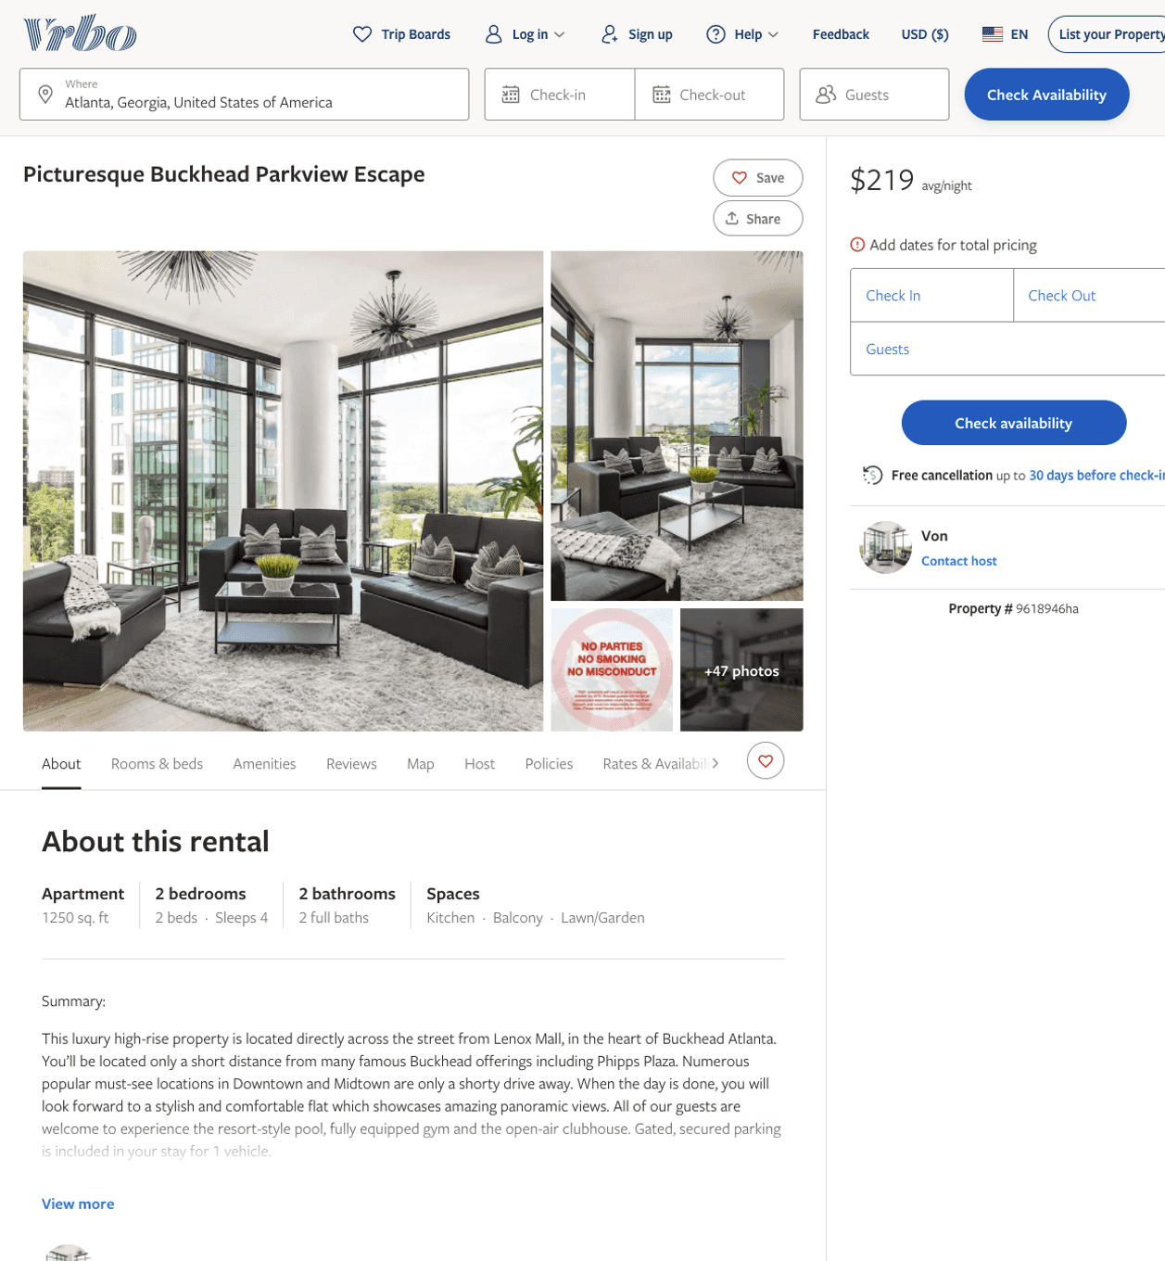
Listing 9618946
1
5
$121 - $273
5
1
Von
https://www.vrbo.com/9618946ha
Aug 2022

Slide 14
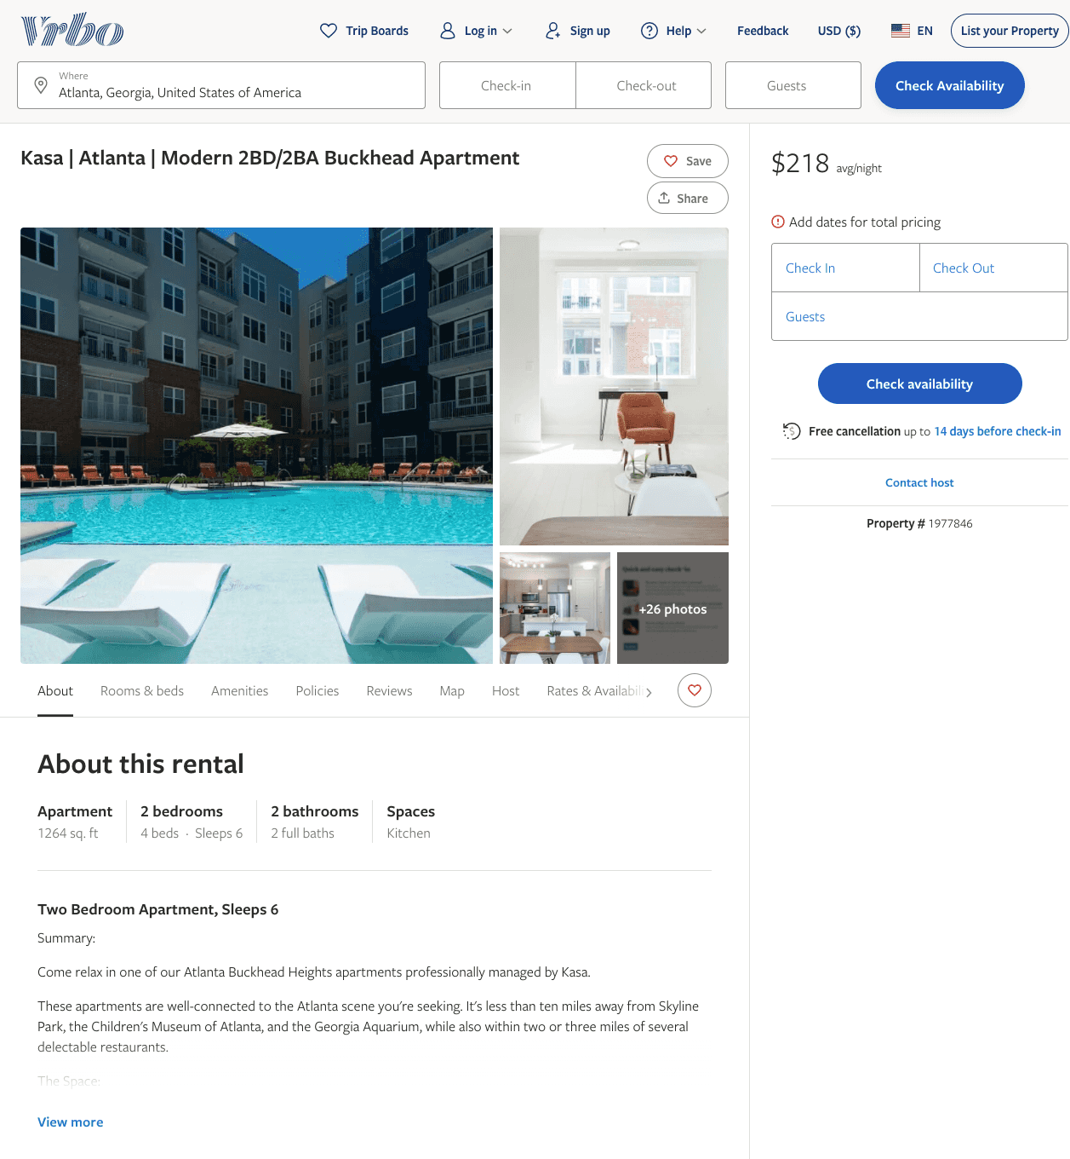
Listing 1977846
2
6
$163 - $223
2
Kasa
https://www.vrbo.com/1977846
Aug 2022

Slide 15
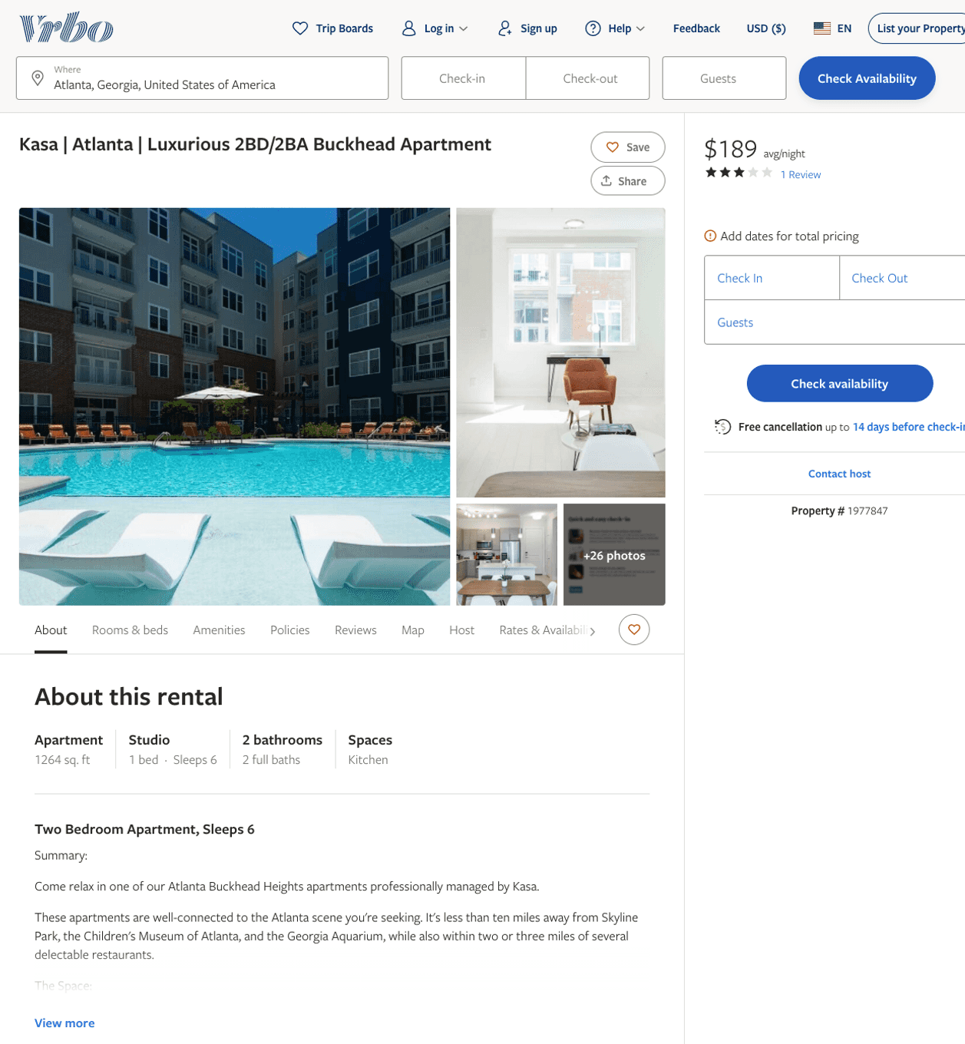
Listing 1977847
2
6
$163 - $229
3
2
Kasa
https://www.vrbo.com/1977847
Aug 2022

Slide 16
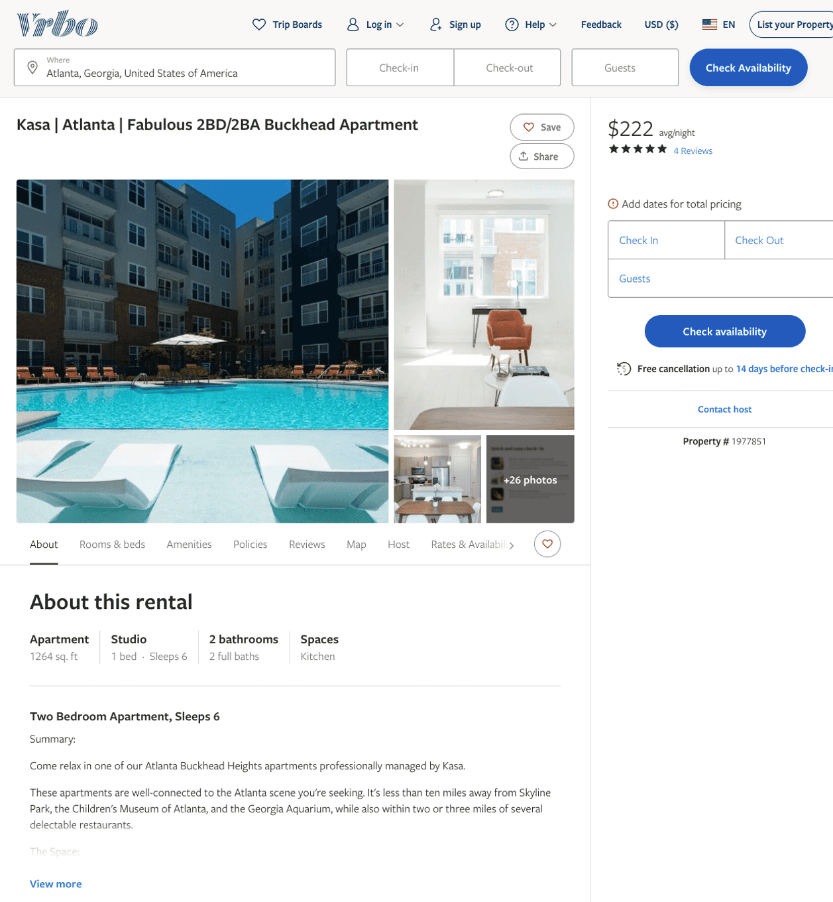
Listing 1977851
2
6
$163 - $238
5
2
Kasa
https://www.vrbo.com/1977851
Aug 2022

Slide 17
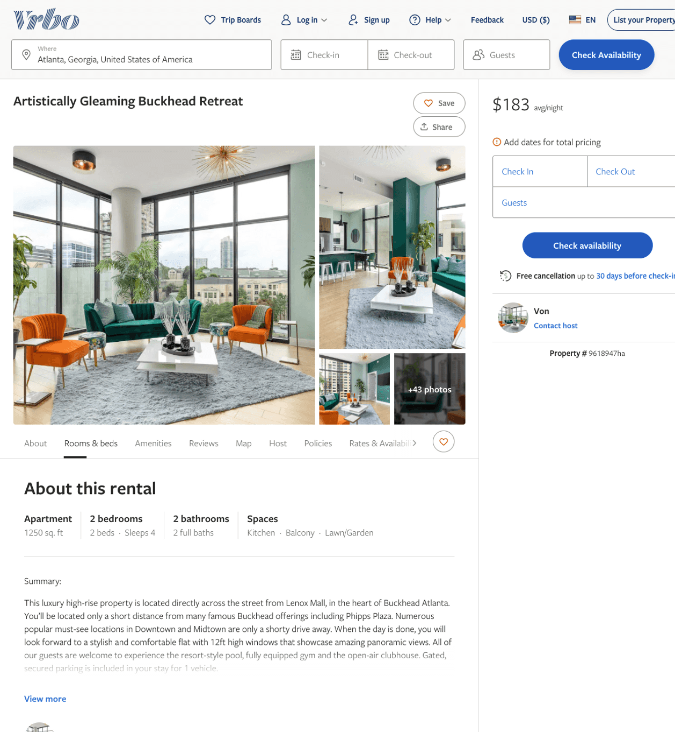
Listing 9618947
2
5
$142 - $260
3
1
Von
https://www.vrbo.com/9618947ha
Aug 2022

Slide 18
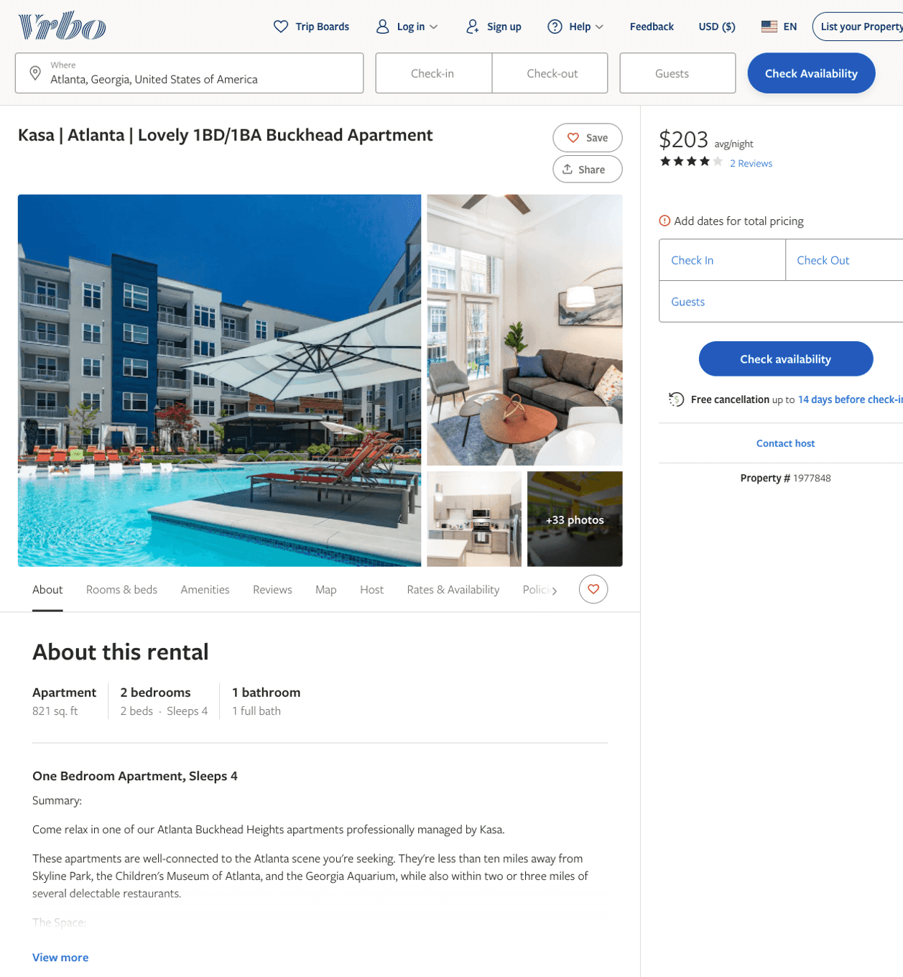
Listing 1977848
1
2
$125 - $201
4
2
Kasa
https://www.vrbo.com/1977848
Aug 2022

Slide 19
Listing 1977845
2
6
$164 - $223
2
Kasa
https://www.vrbo.com/1977845
Aug 2022

Slide 20
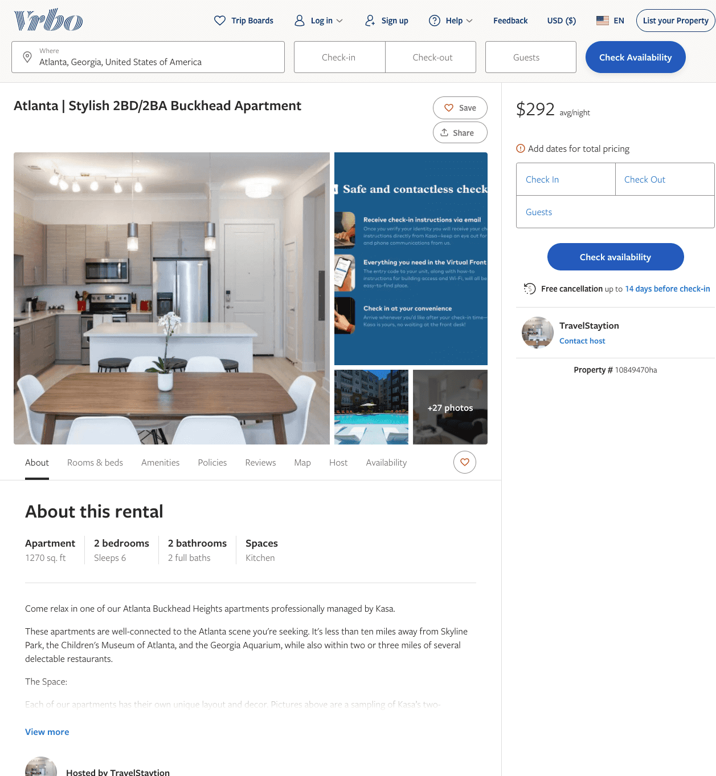
Listing 10849470
2
6
$235 - $329
1
TravelStaytion
https://www.vrbo.com/10849470ha
Aug 2022

Slide 21
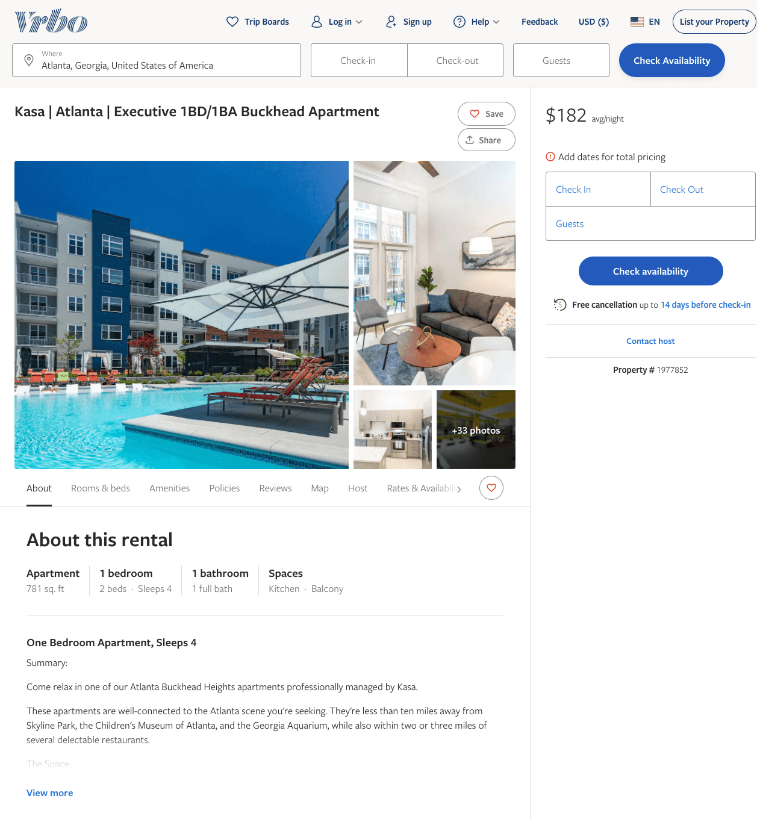
Listing 1977852
1
2
$132 - $194
2
Kasa
https://www.vrbo.com/1977852
Aug 2022

Slide 22
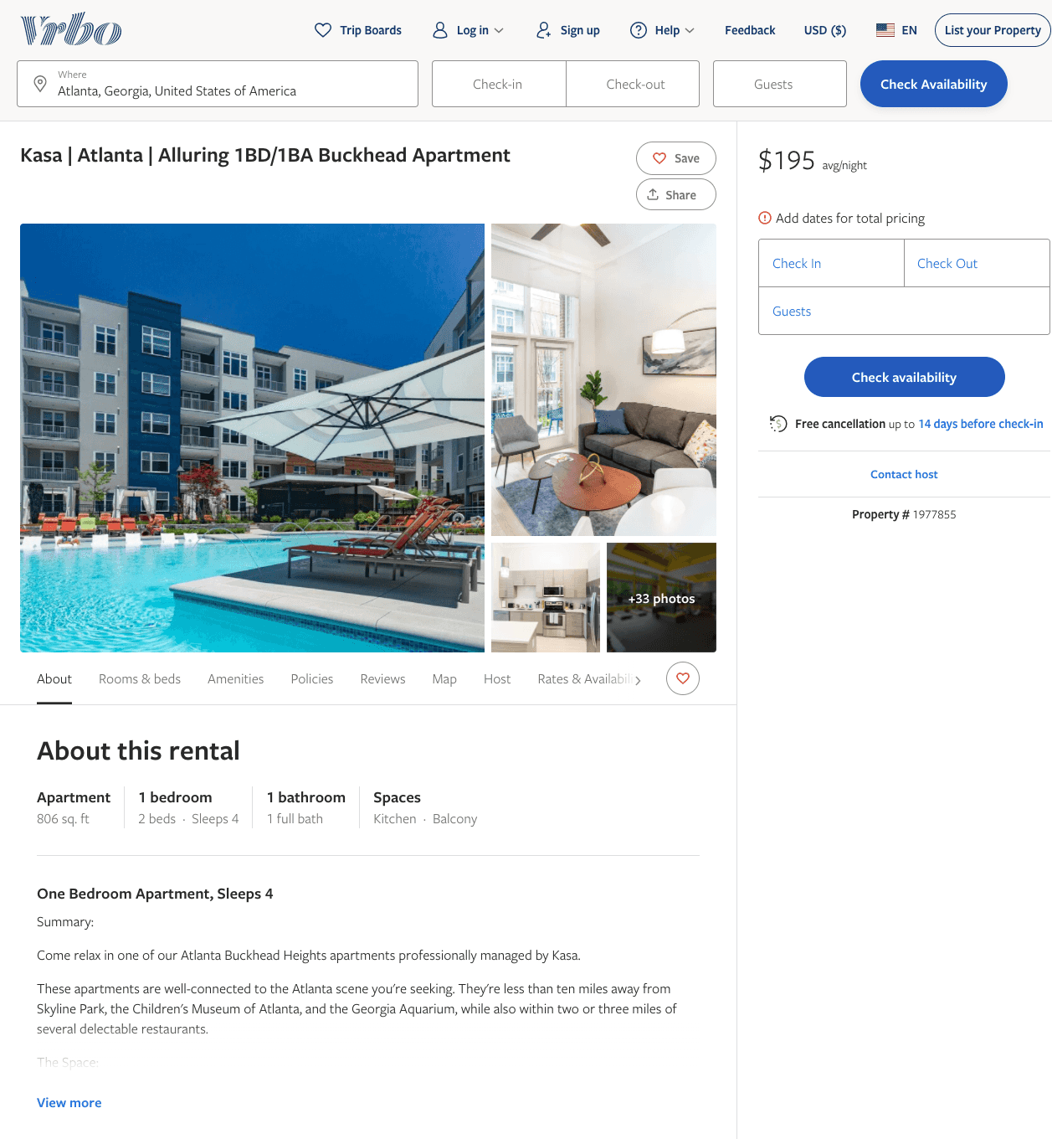
Listing 1977855
1
2
$135 - $201
2
Kasa
https://www.vrbo.com/1977855
Aug 2022

Slide 23
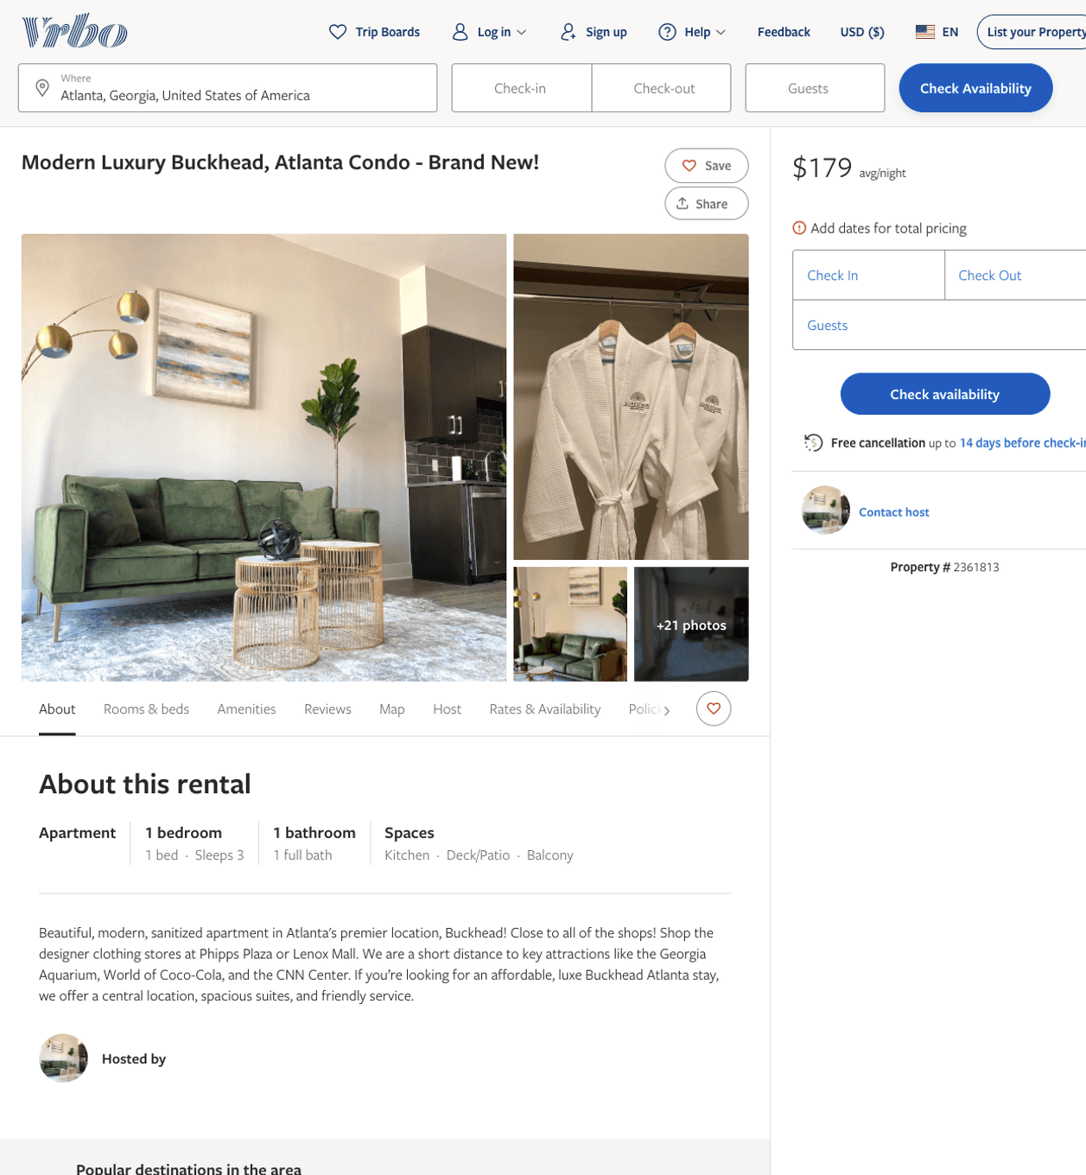
Listing 2361813
1
3
$160 - $179
1
2
https://www.vrbo.com/2361813
Aug 2022

Slide 24
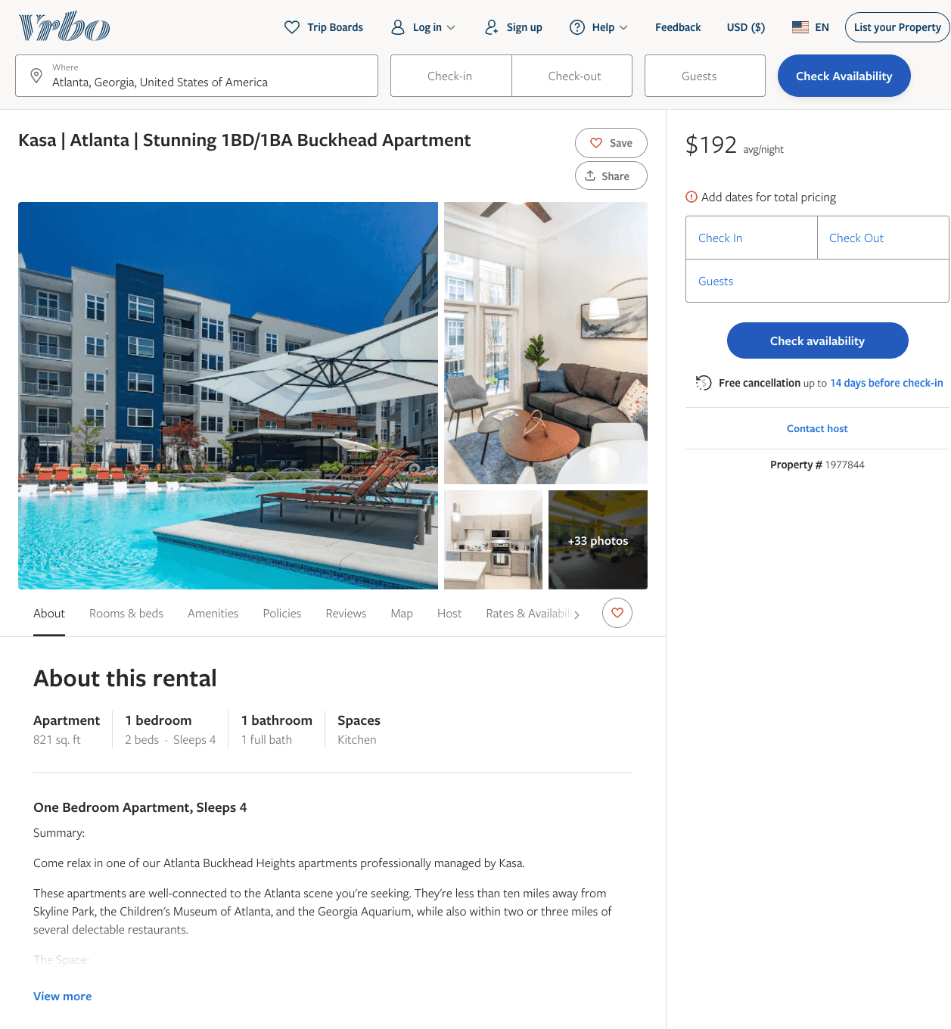
Listing 1977844
1
2
$129 - $199
2
Kasa
https://www.vrbo.com/1977844
Aug 2022

Slide 25
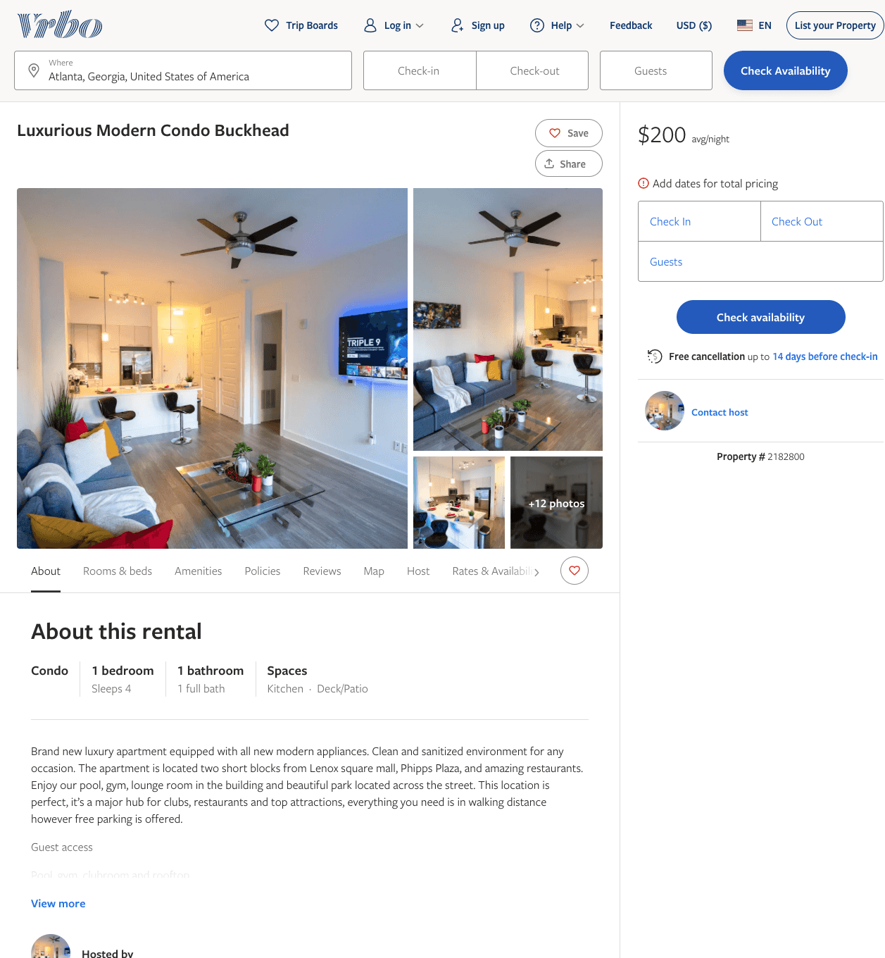
Listing 2182800
1
4
$120 - $200
2
https://www.vrbo.com/2182800
Aug 2022

Slide 26
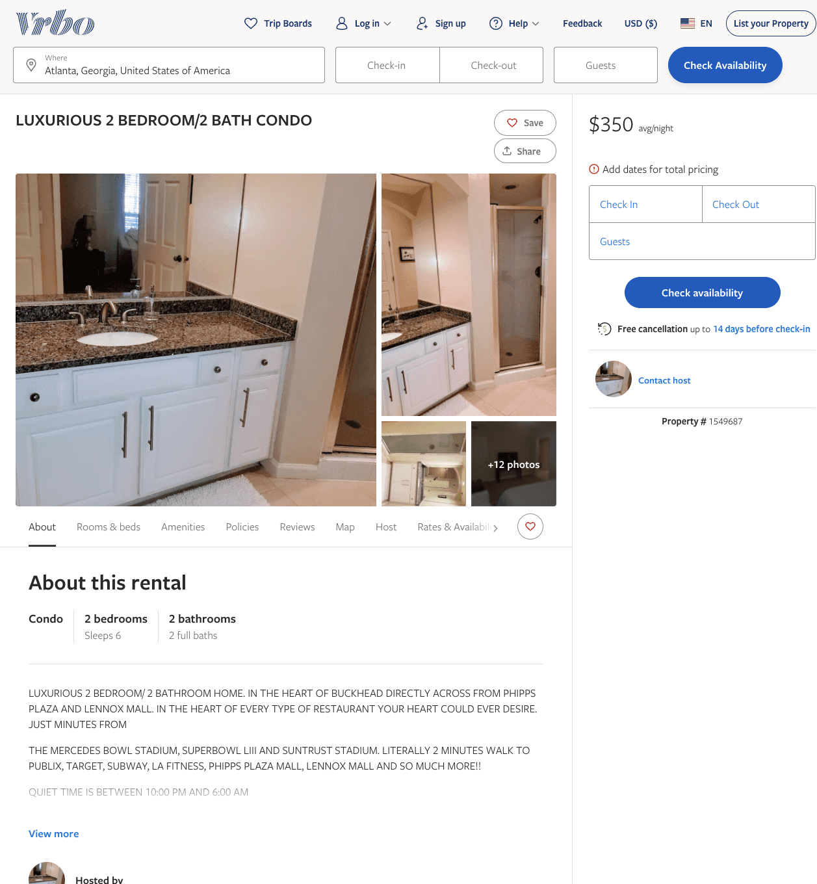
Listing 1549687
2
6
$350
2
https://www.vrbo.com/1549687
Aug 2022

Slide 27
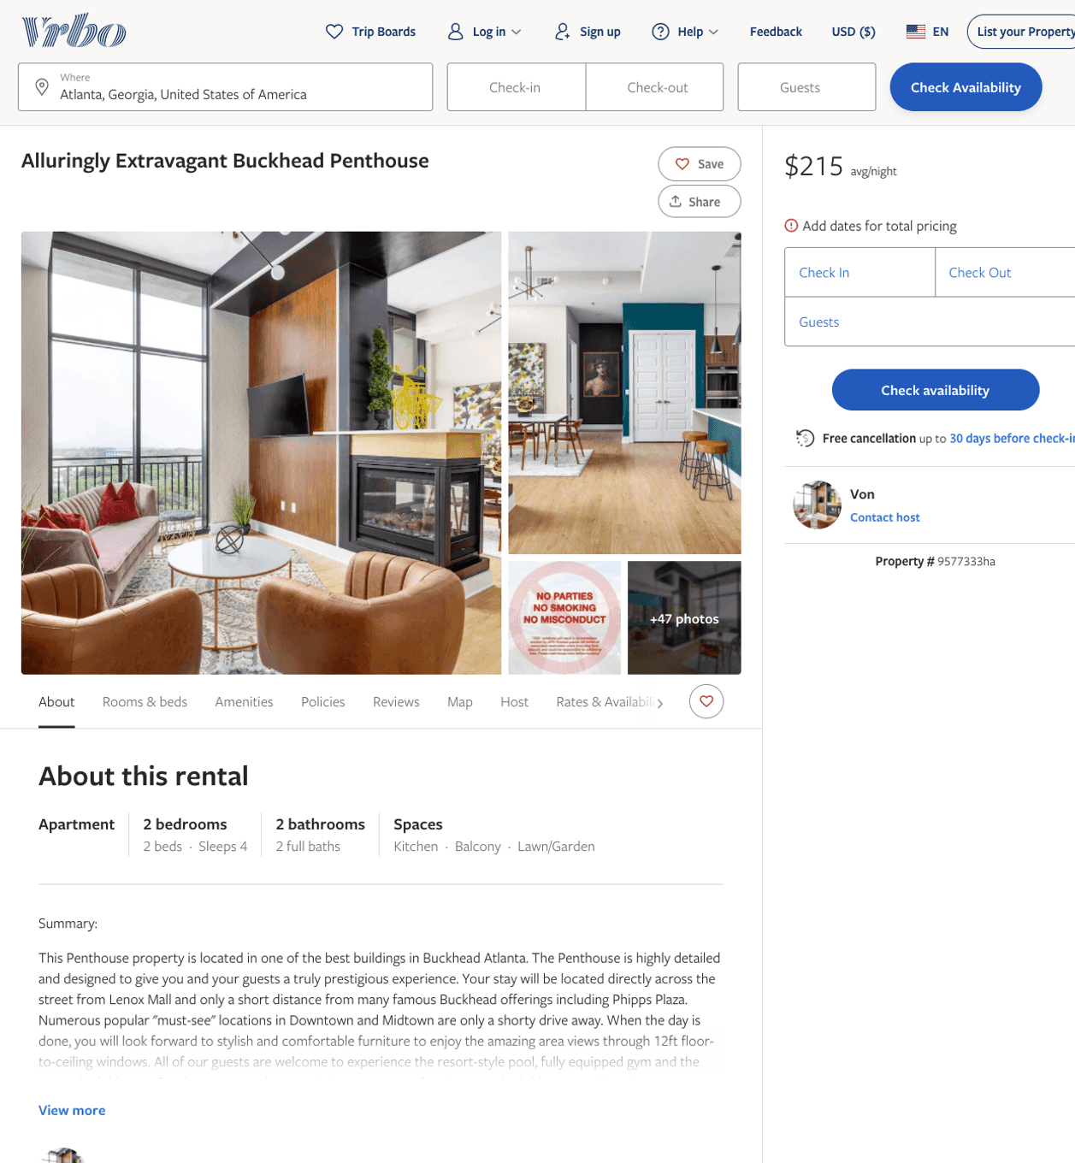
Listing 9577333
2
5
$213 - $289
4
2
Von
https://www.vrbo.com/9577333ha
Aug 2022

Slide 28
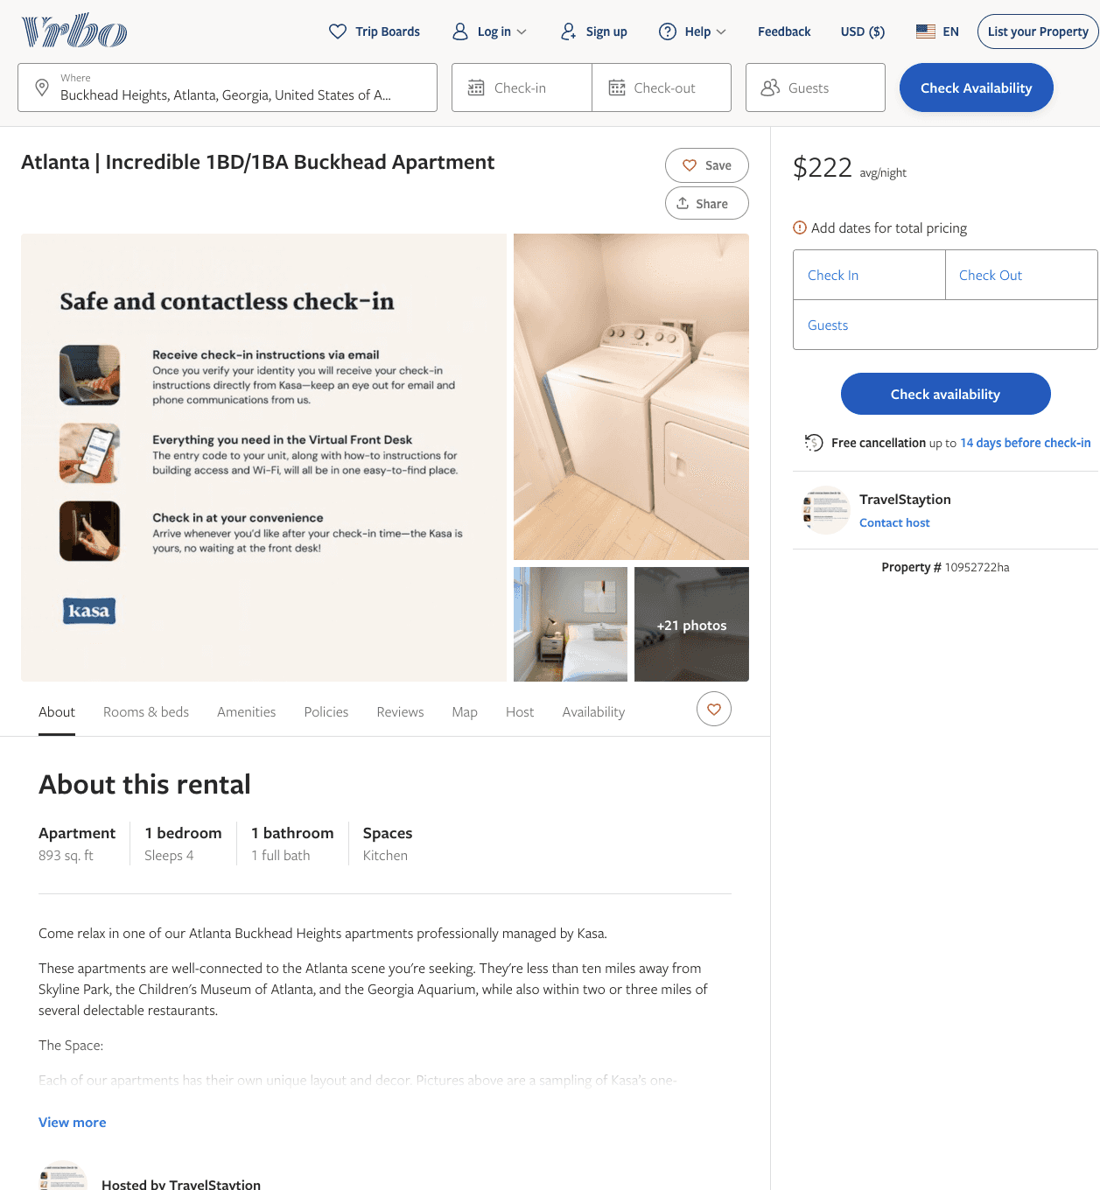
Listing 10952722
1
2
$188 - $227
1
TravelStaytion
https://www.vrbo.com/10952722ha
Aug 2022

Slide 29
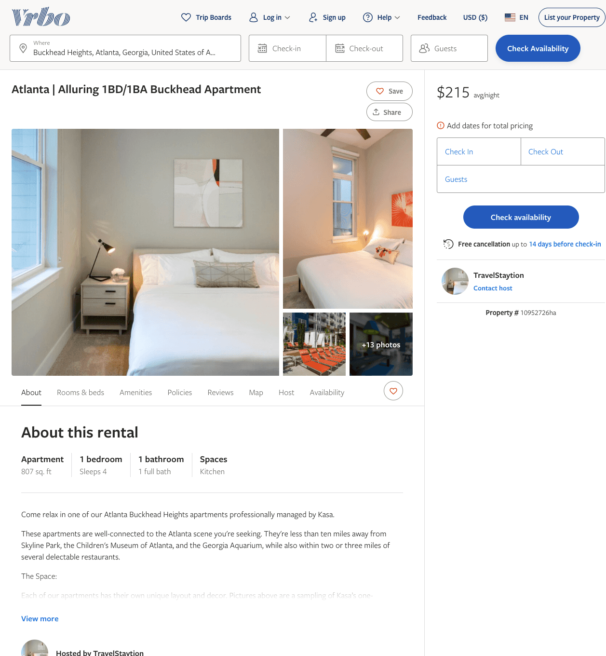
Listing 10952726
1
2
$174 - $217
1
TravelStaytion
https://www.vrbo.com/10952726ha
Aug 2022

Slide 30
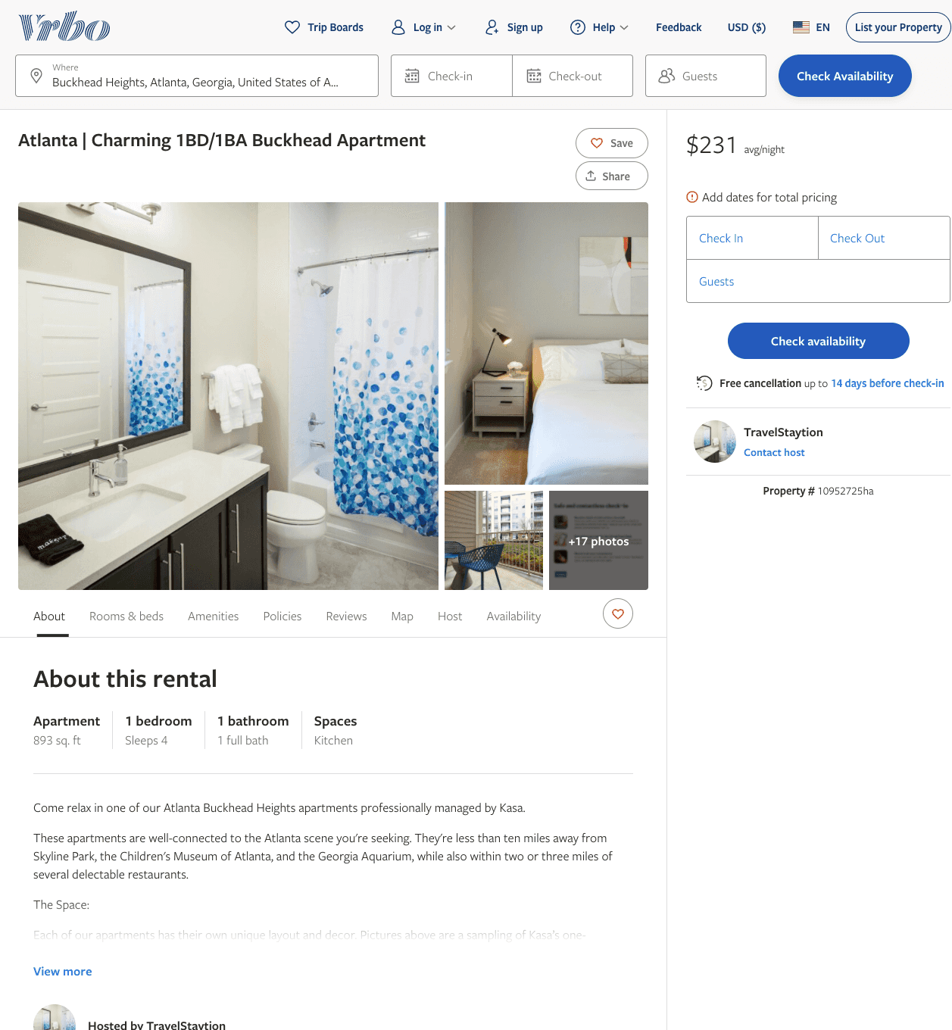
Listing 10952725
1
2
$188 - $231
1
TravelStaytion
https://www.vrbo.com/10952725ha
Aug 2022

Slide 31
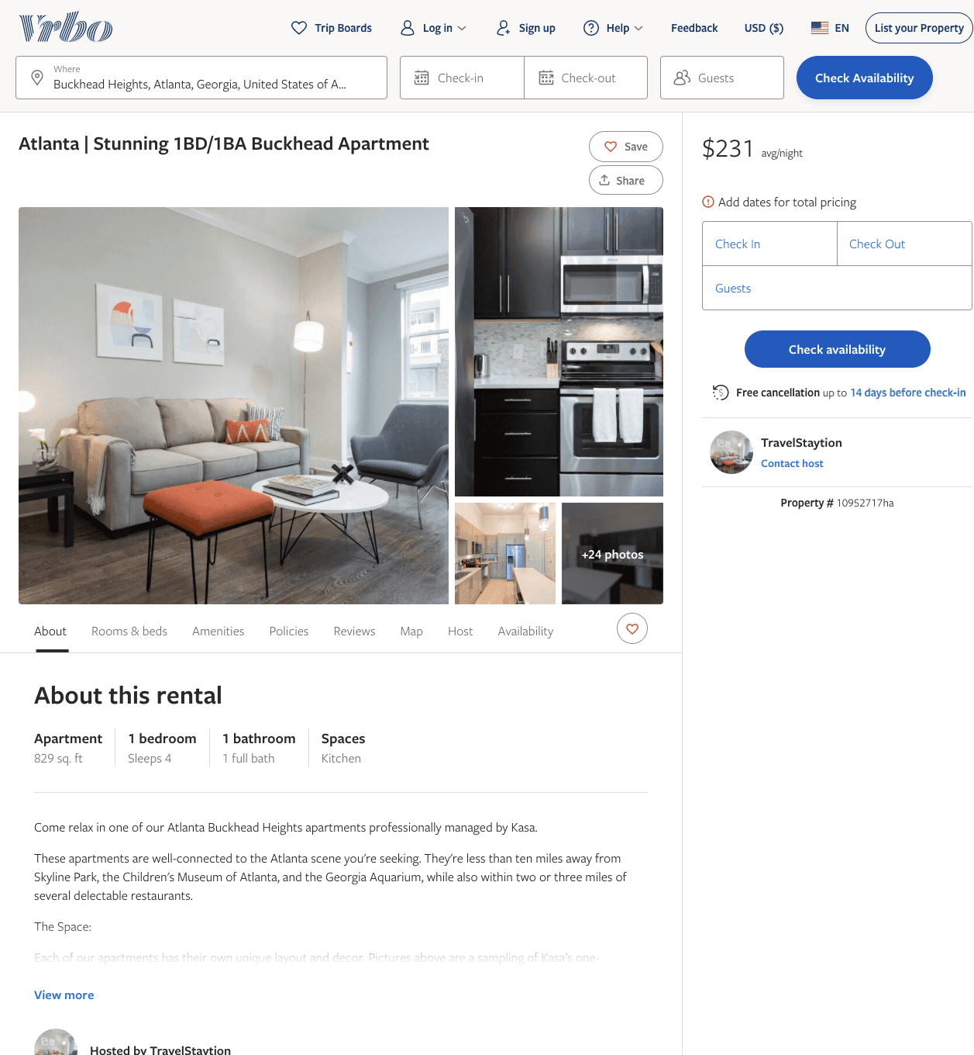
Listing 10952717
1
2
$192 - $231
1
TravelStaytion
https://www.vrbo.com/10952717ha
Aug 2022

Slide 32
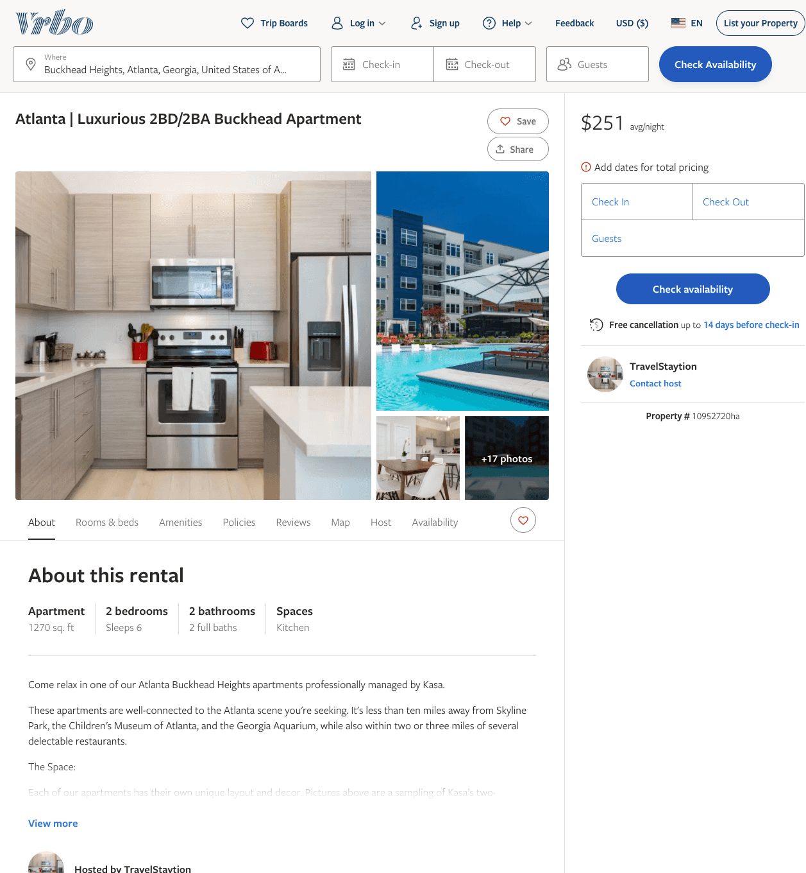
Listing 10952720
2
6
$238 - $295
1
TravelStaytion
https://www.vrbo.com/10952720ha
Aug 2022

Slide 33
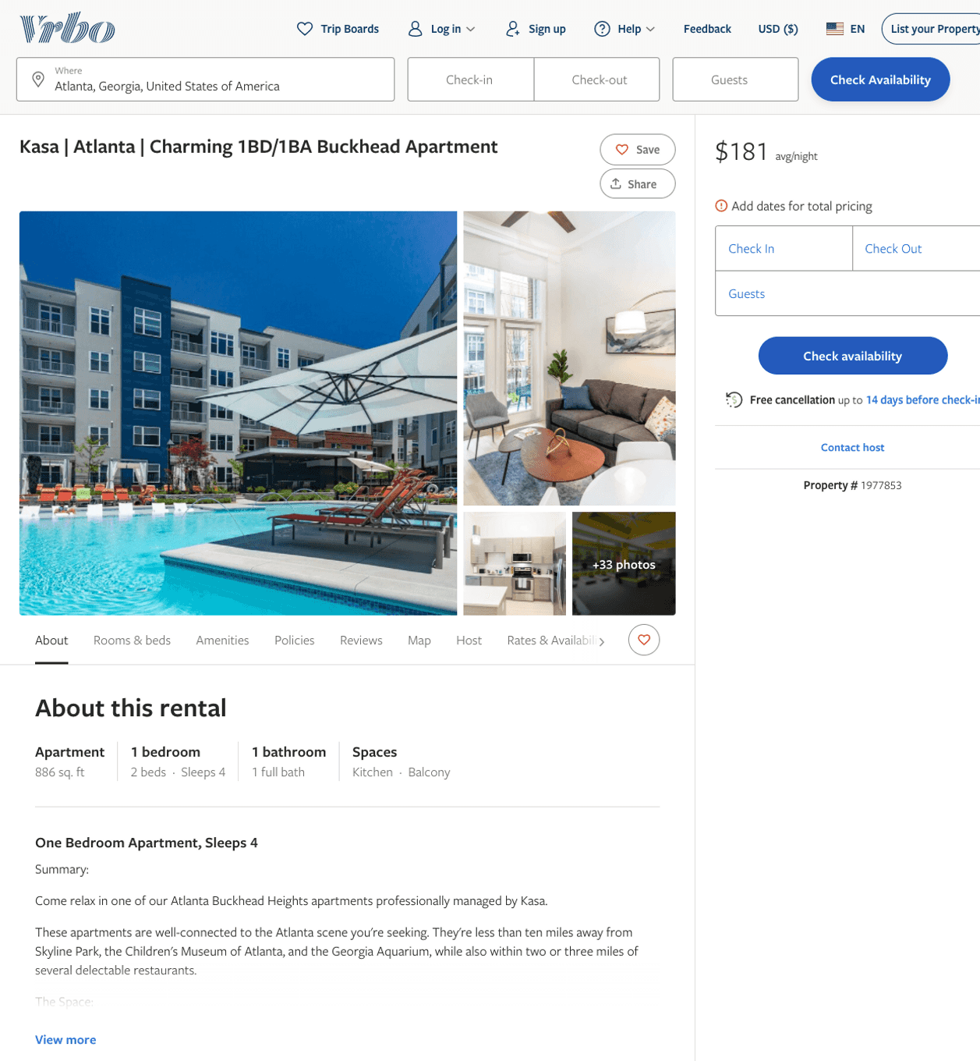
Listing 1977853
1
2
$127 - $201
2
Kasa
https://www.vrbo.com/1977853
Aug 2022

Slide 34
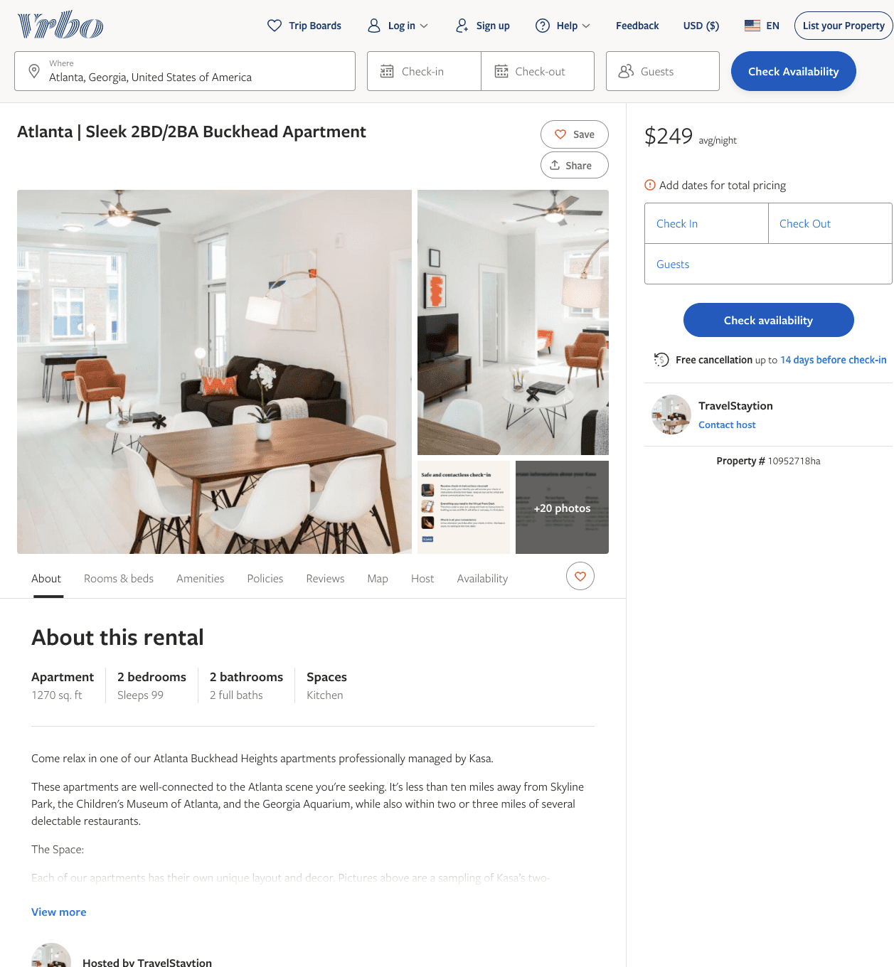
Listing 10952718
2
6
$220 - $311
1
TravelStaytion
https://www.vrbo.com/10952718ha
Aug 2022

Slide 35
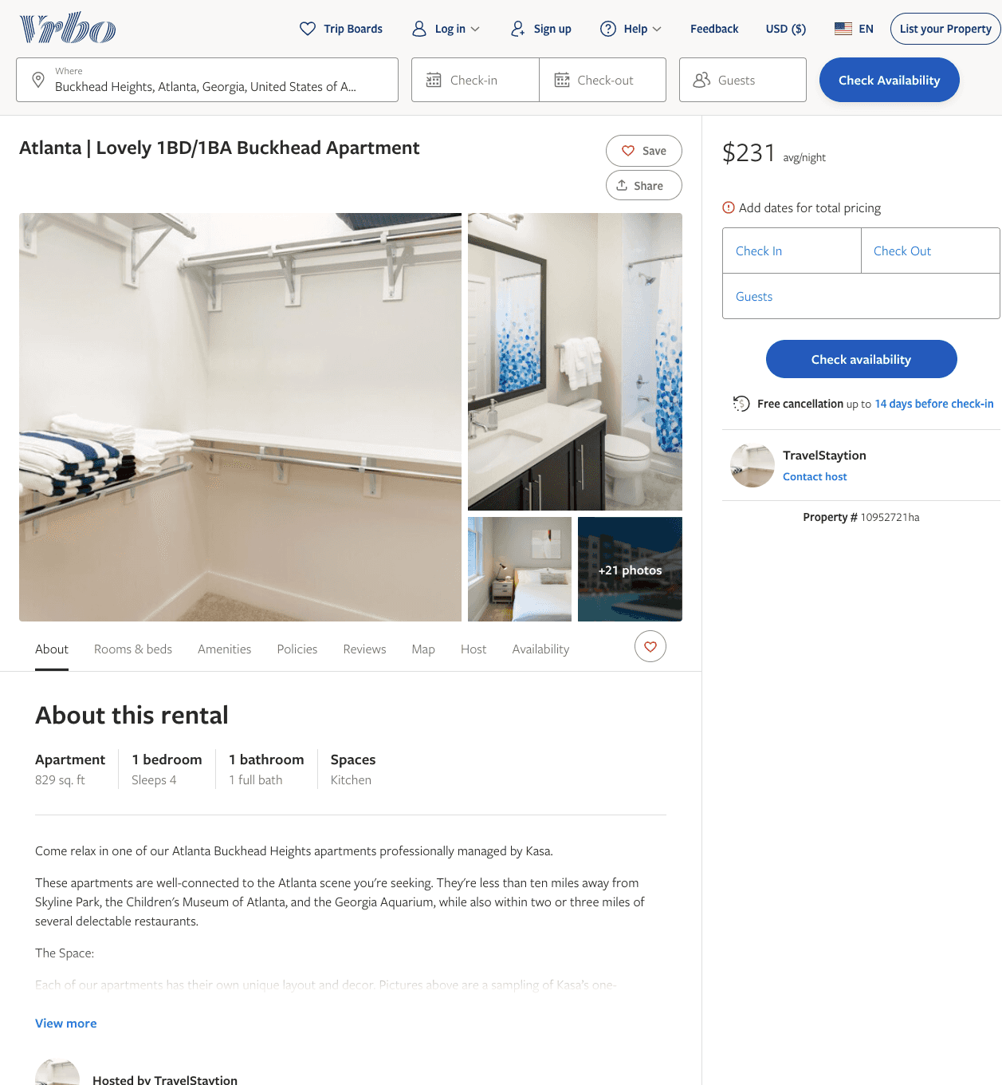
Listing 10952721
1
2
$180 - $231
1
TravelStaytion
https://www.vrbo.com/10952721ha
Aug 2022

Slide 36
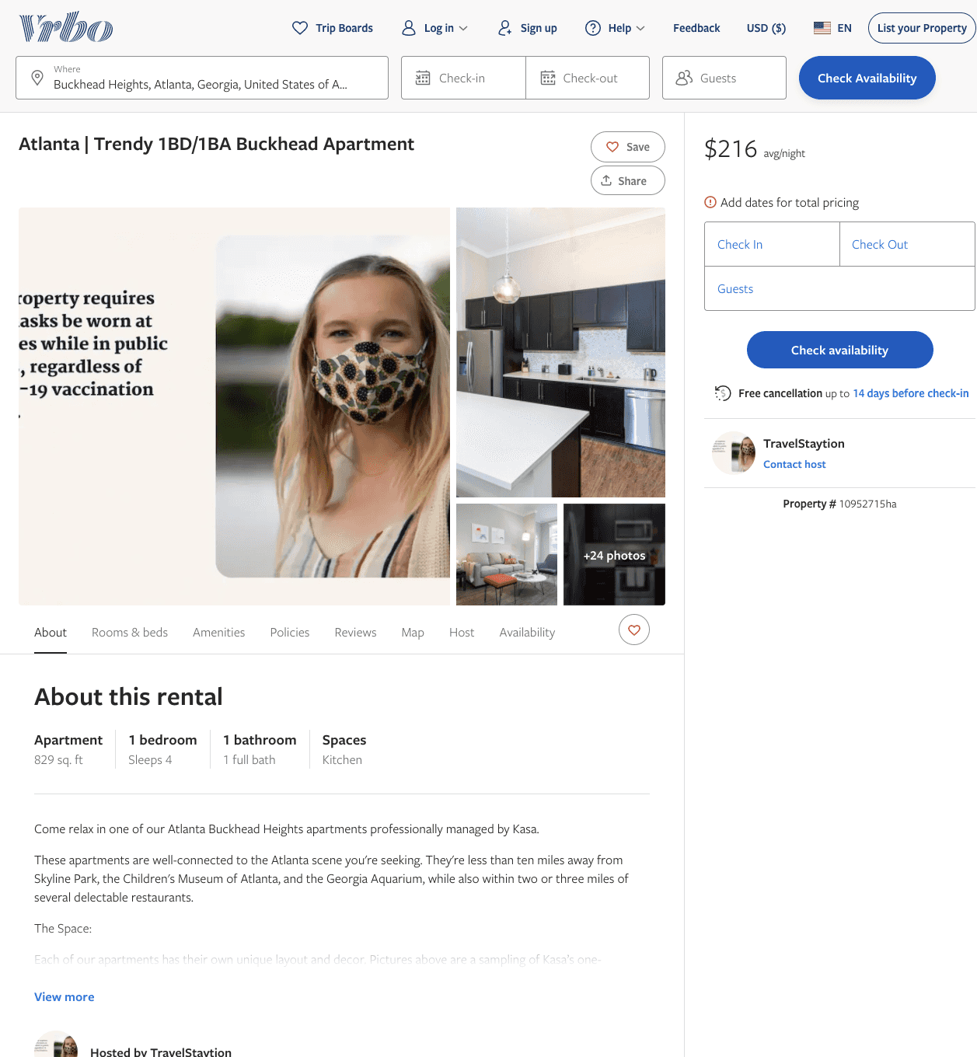
Listing 10952715
1
2
$184 - $227
1
TravelStaytion
https://www.vrbo.com/10952715ha
Aug 2022

Slide 37
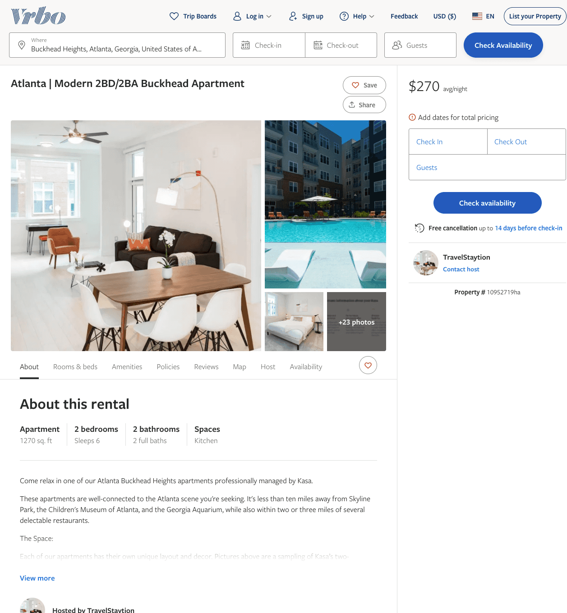
Listing 10952719
2
6
$243 - $296
1
TravelStaytion
https://www.vrbo.com/10952719ha
Aug 2022

Slide 38
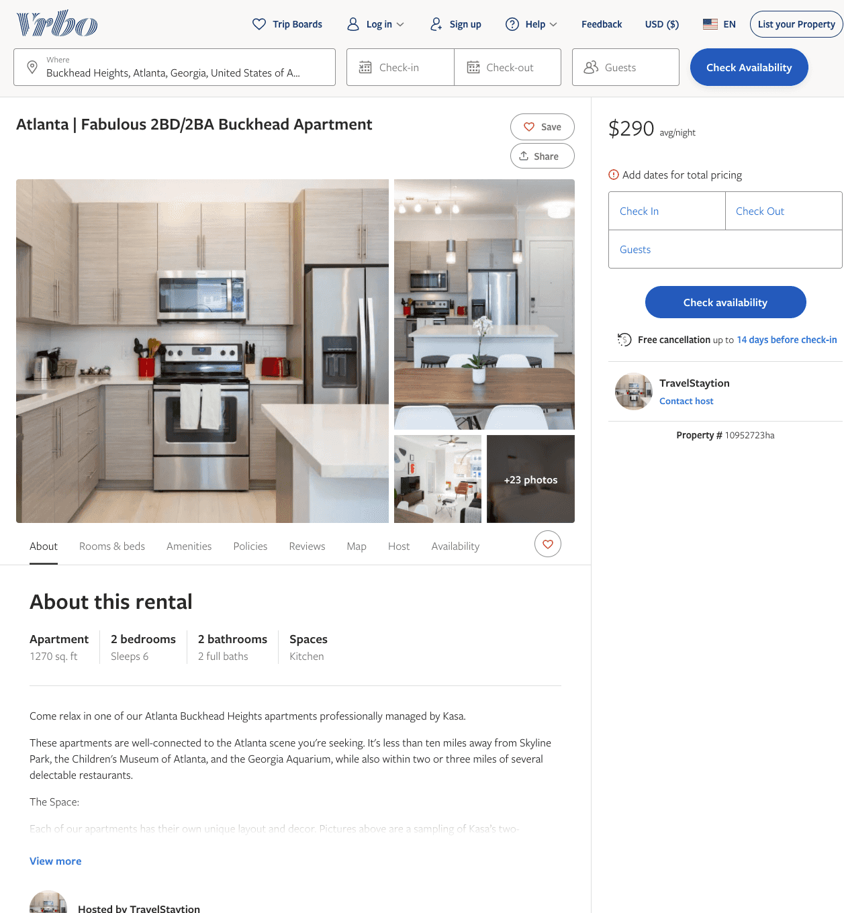
Listing 10952723
2
6
$247 - $299
1
TravelStaytion
https://www.vrbo.com/10952723ha
Aug 2022

Slide 39
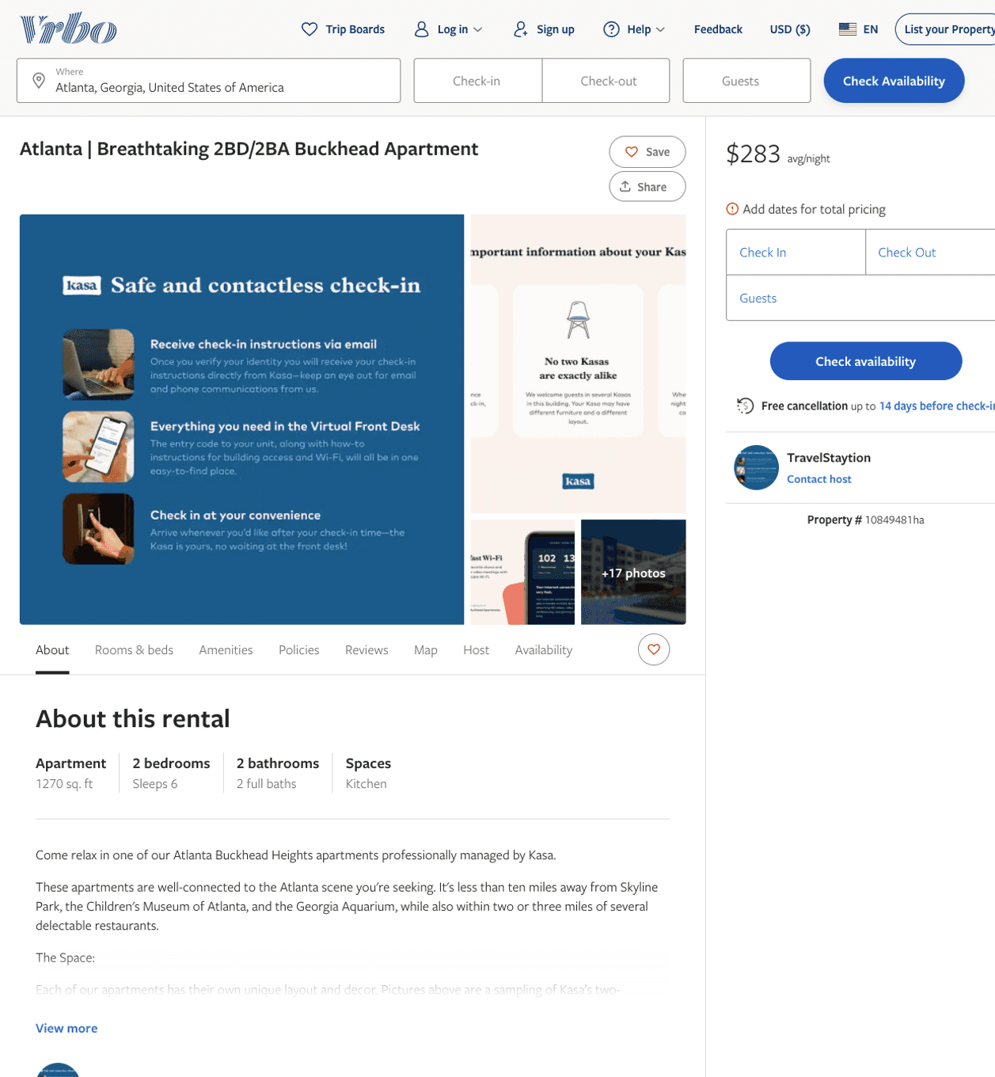
Listing 10849481
2
6
$248 - $331
1
TravelStaytion
https://www.vrbo.com/10849481ha
Aug 2022

Slide 40
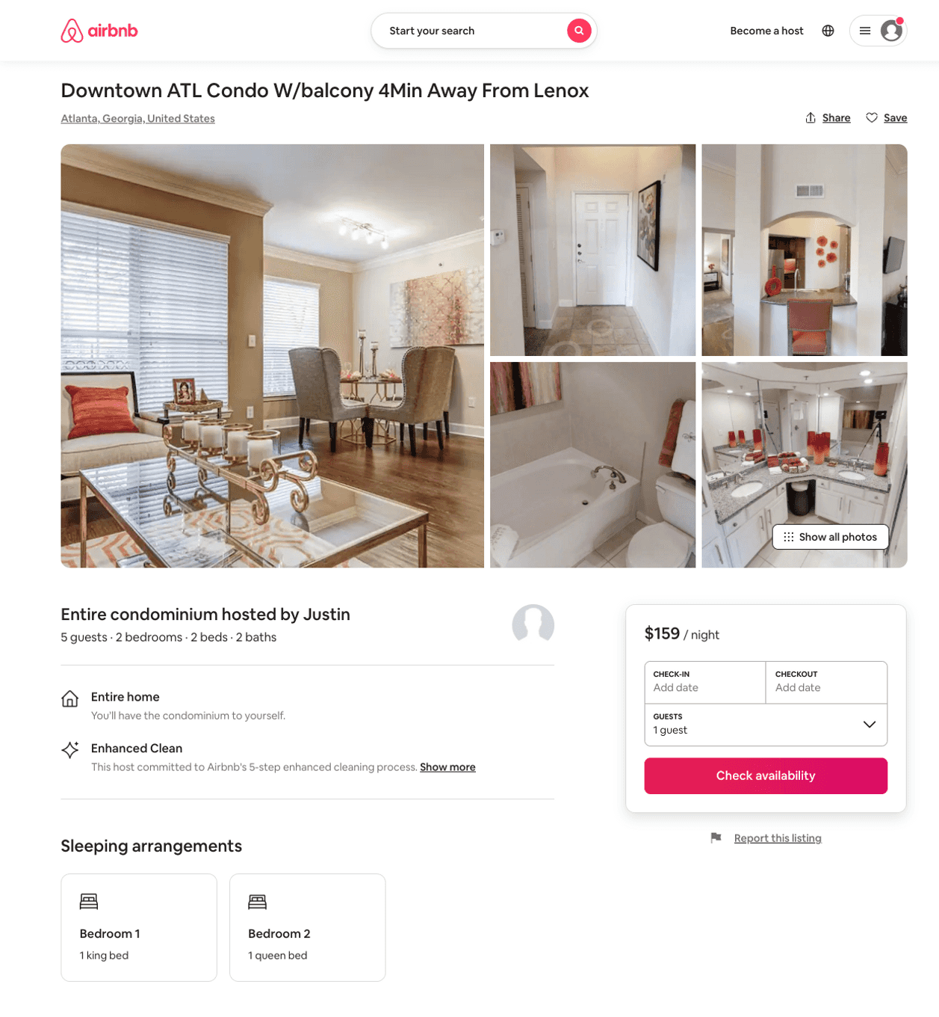
Listing 50436897
2
5
$199 - $273
4.57
1
Justin
199771109
1
https://www.airbnb.com/rooms/50436897
Aug 2022

Slide 41
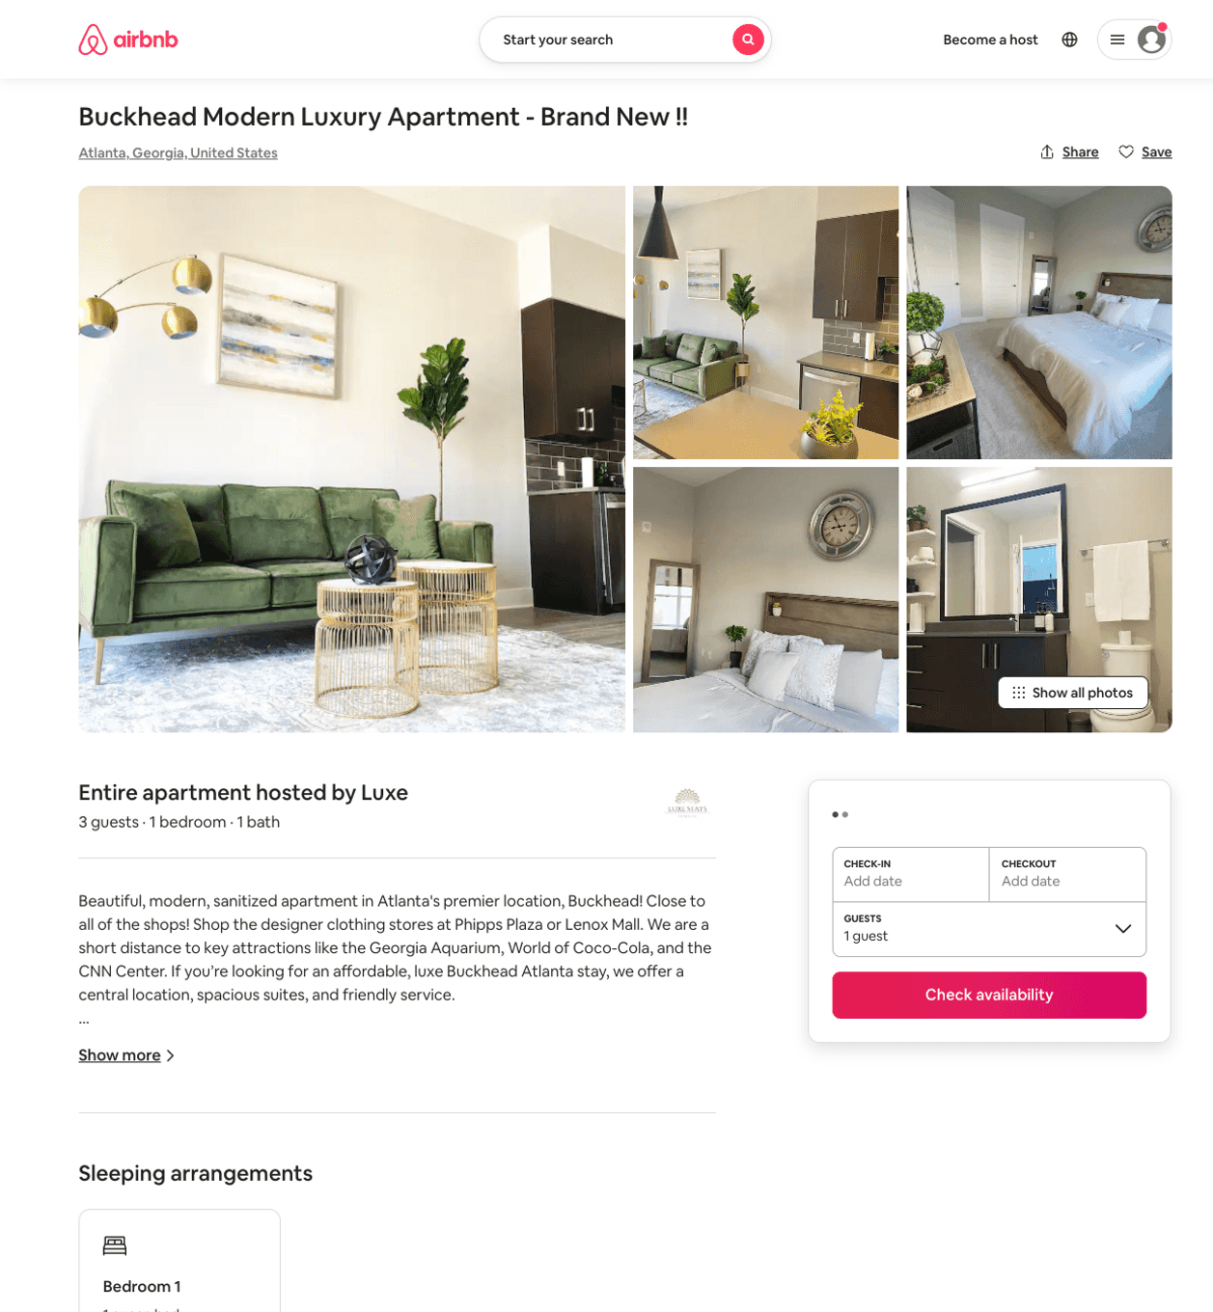
Listing 49648218
1
3
$152 - $176
3
Luxe
389942310
1
https://www.airbnb.com/rooms/49648218
Aug 2022

Slide 42
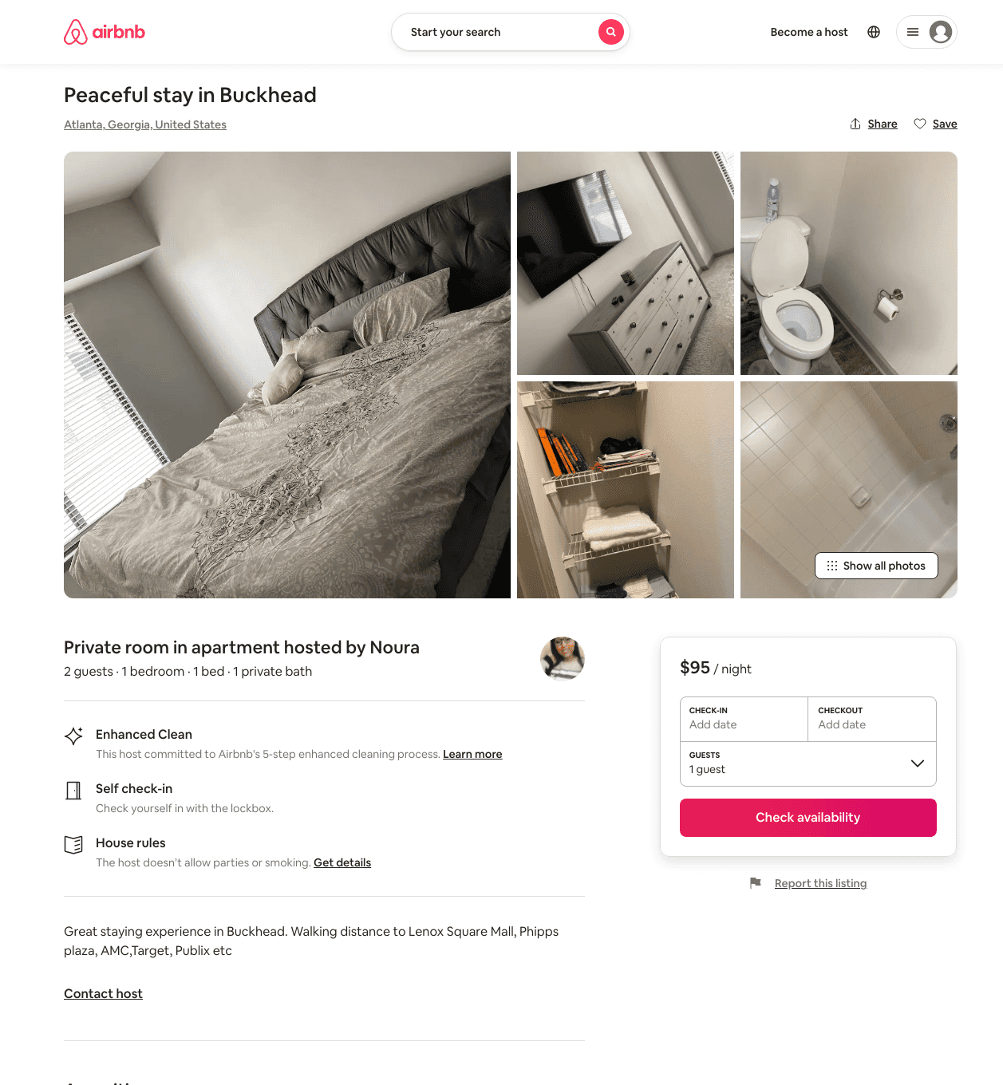
Listing 48958409
1
2
$95
1
Noura
369387692
1
https://www.airbnb.com/rooms/48958409
Jun 2022

Slide 43
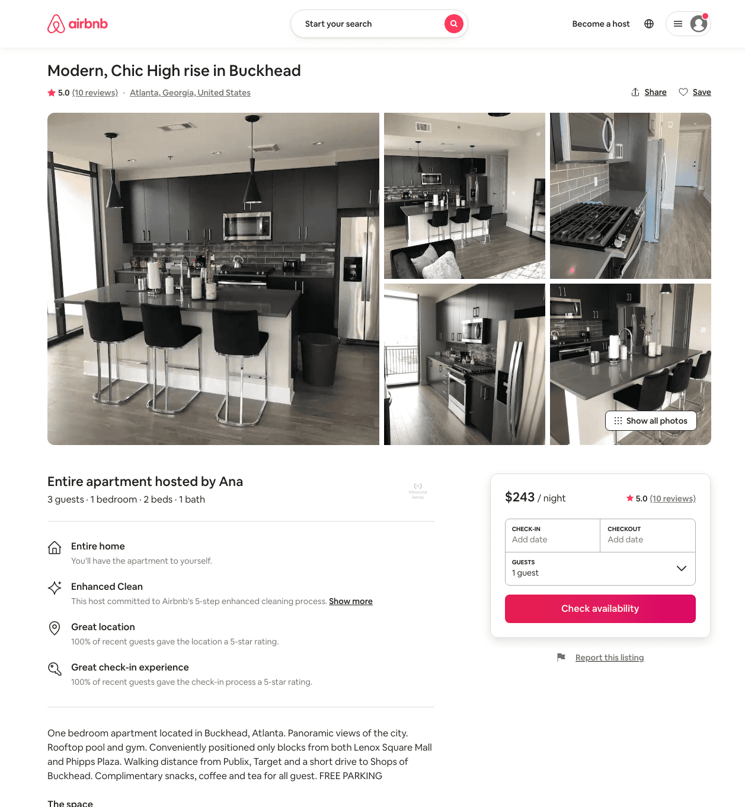
Listing 42515576
1
3
$200 - $204
4.87
2
Ana
109857171
2
https://www.airbnb.com/rooms/42515576
Jul 2022

Slide 44
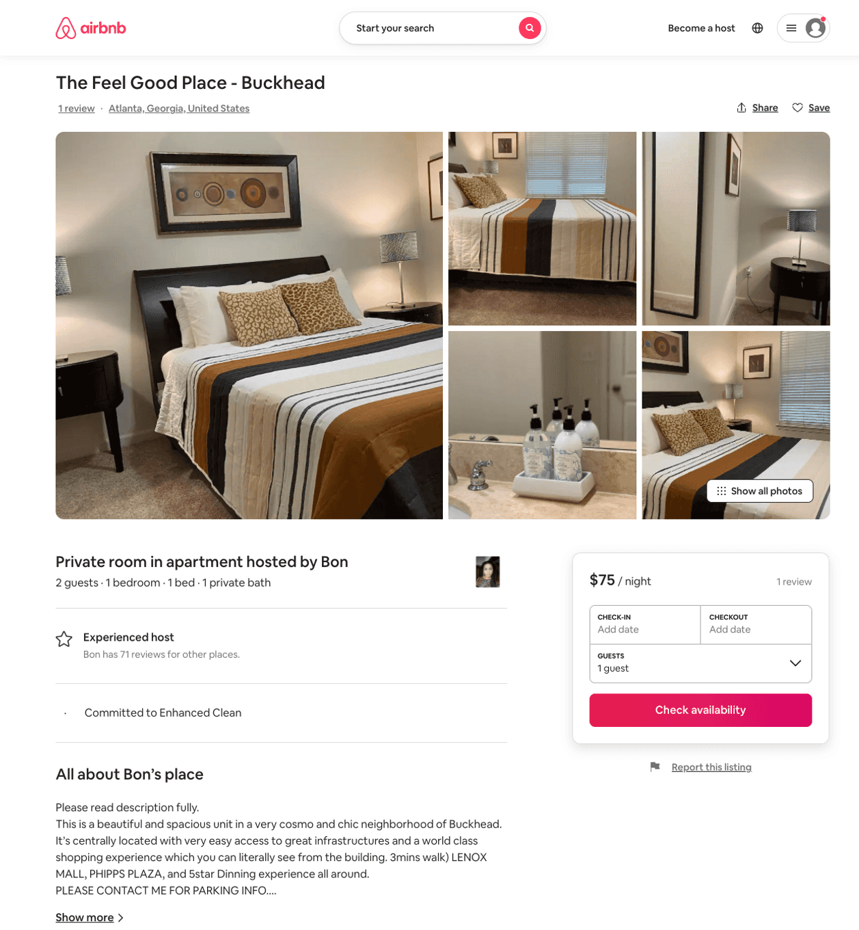
Listing 50374738
1
2
$75 - $90
4.75
1
Bon
100764104
5
https://www.airbnb.com/rooms/50374738
Aug 2022

Slide 45
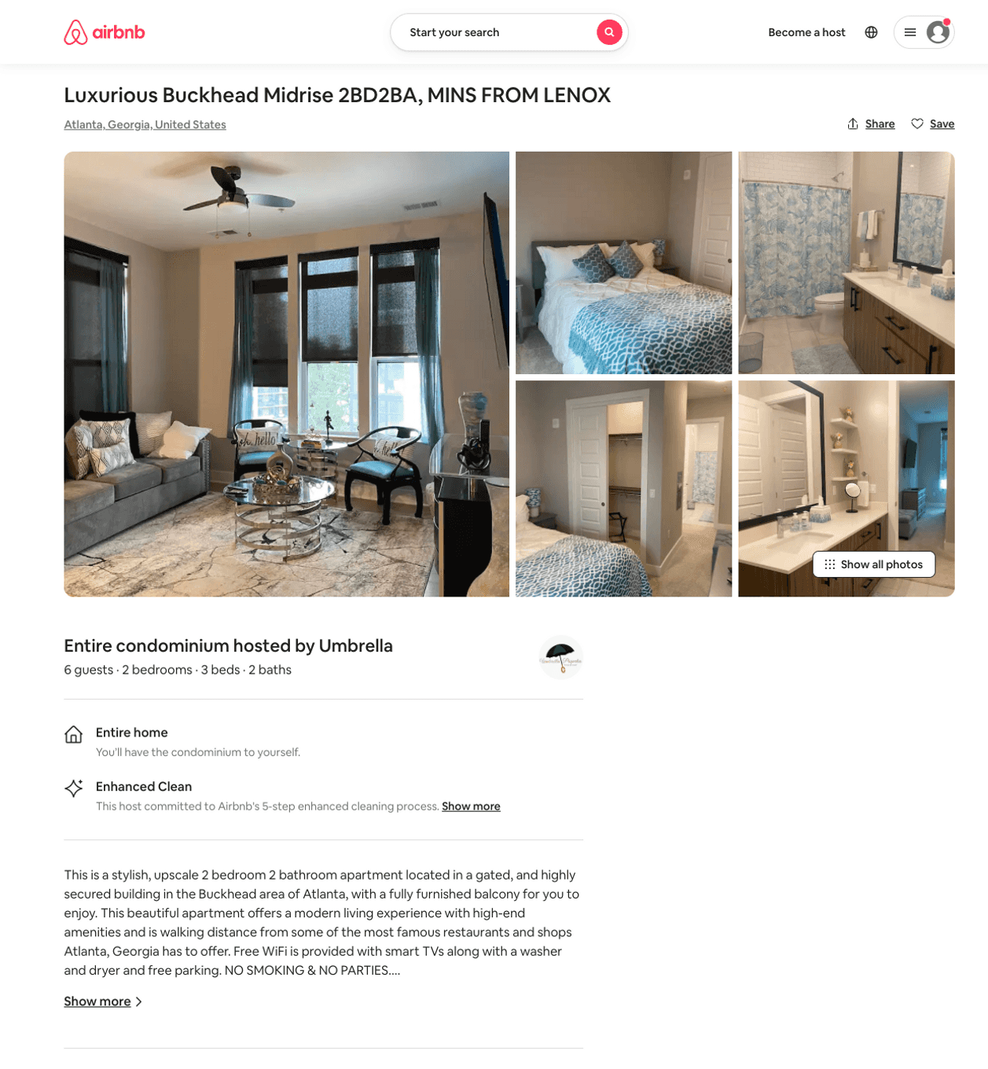
Listing 50805062
2
6
$175 - $250
2
Umbrella
400507133
1
https://www.airbnb.com/rooms/50805062
Aug 2022

Slide 46
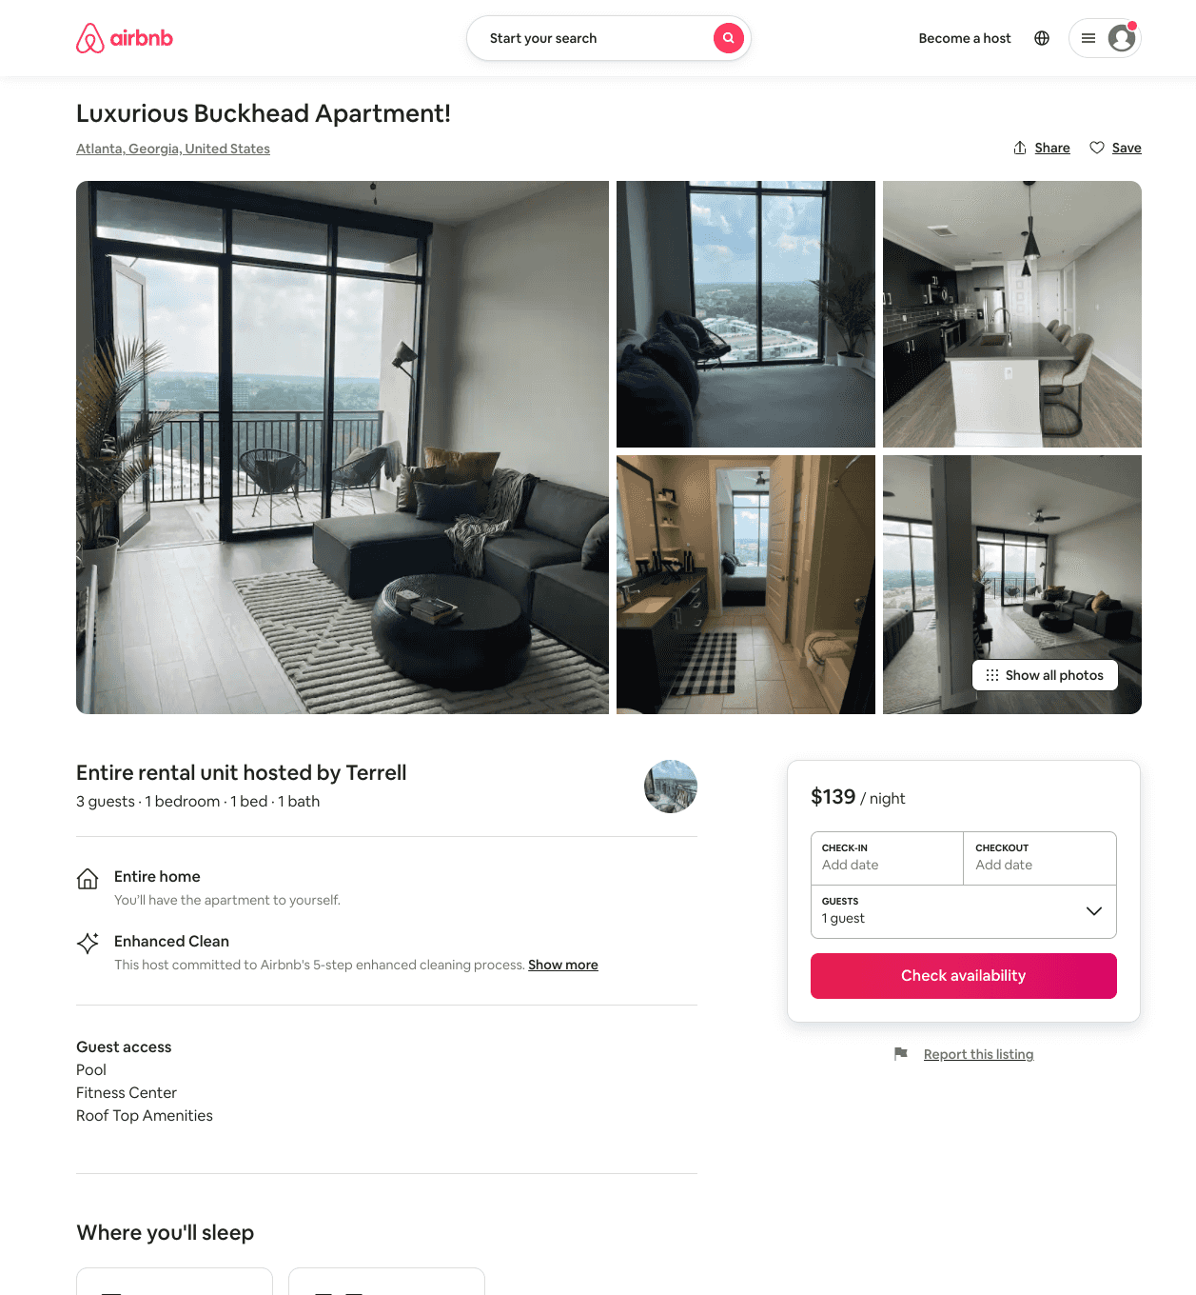
Listing 51282636
1
2
$120 - $218
4.86
1
Terrell
31362189
3
https://www.airbnb.com/rooms/51282636
Aug 2022

Slide 47
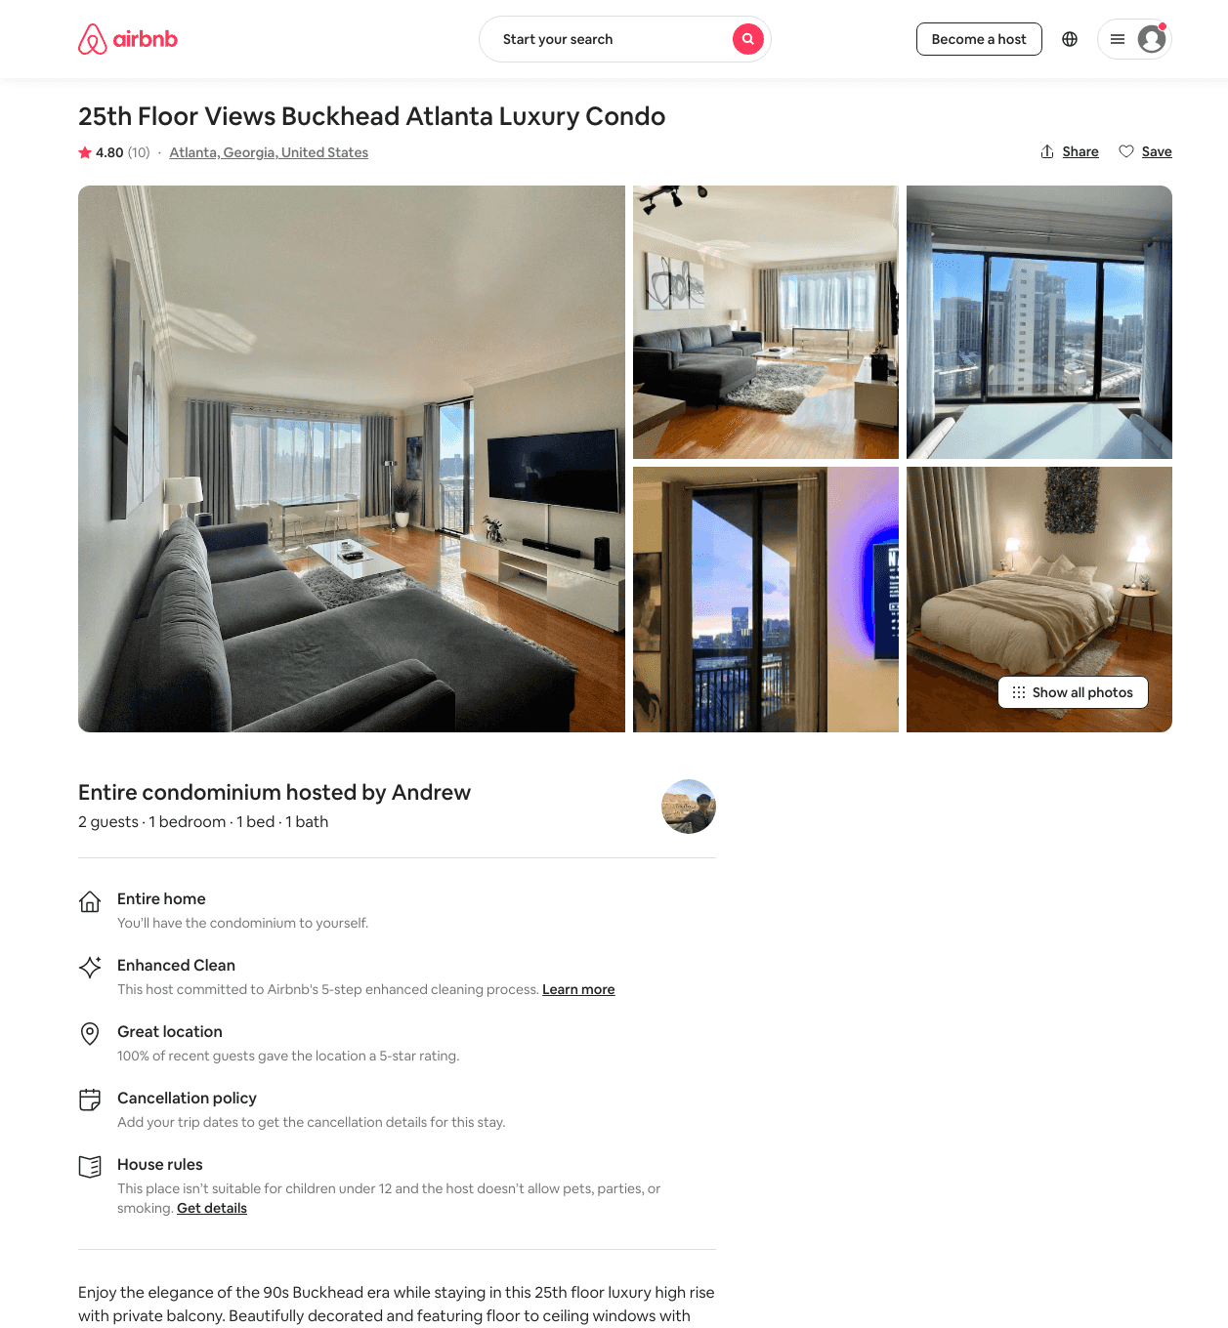
Listing 25551359
1
2
$119 - $182
4.63
5
Andrew
52879181
1
https://www.airbnb.com/rooms/25551359
Aug 2022

Slide 48
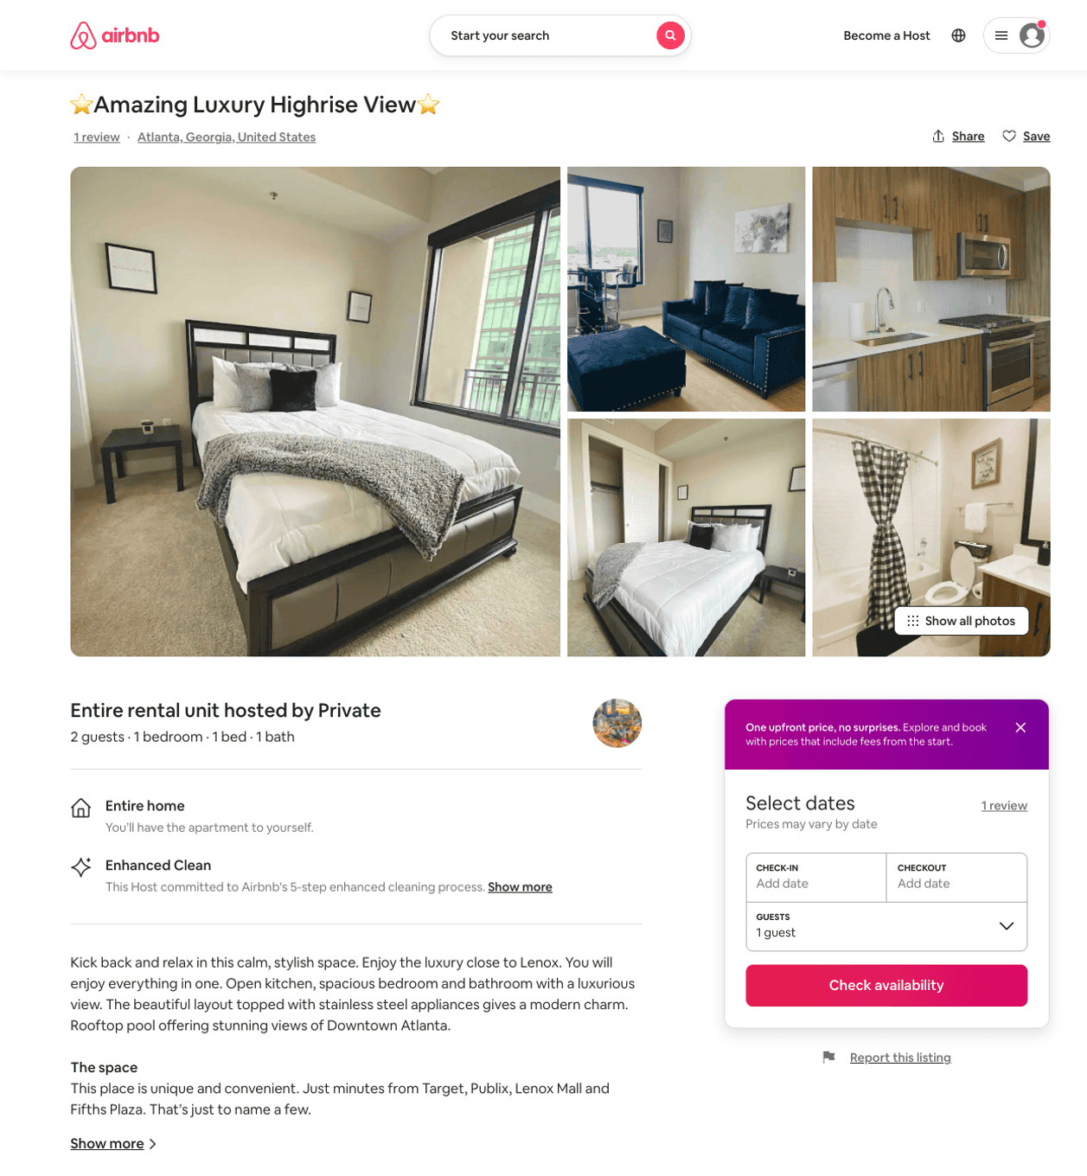
Listing 50985183
1
2
$125 - $154
4.56
2
Andre
412330321
1
https://www.airbnb.com/rooms/50985183
Jun 2022

Slide 49
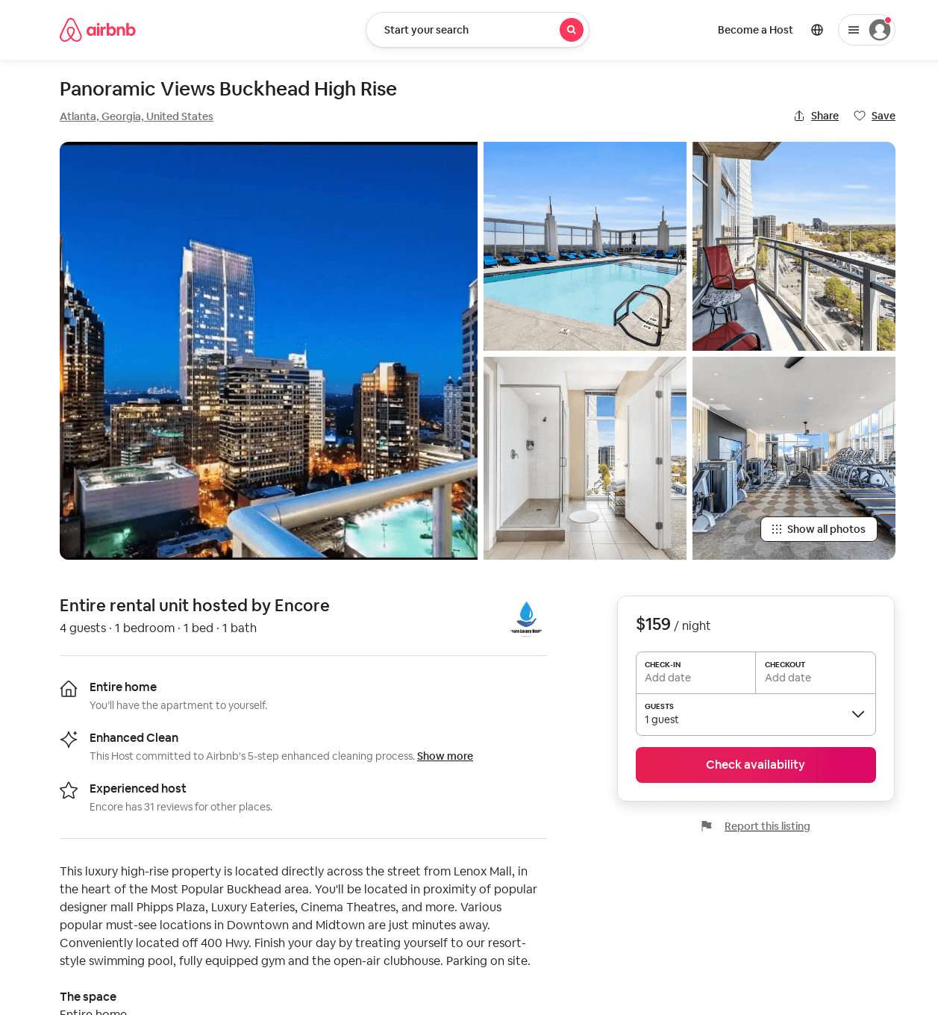
Listing 52694008
1
4
$89 - $196
4.27
2
Encore
105737026
1
https://www.airbnb.com/rooms/52694008
Aug 2022

Slide 50
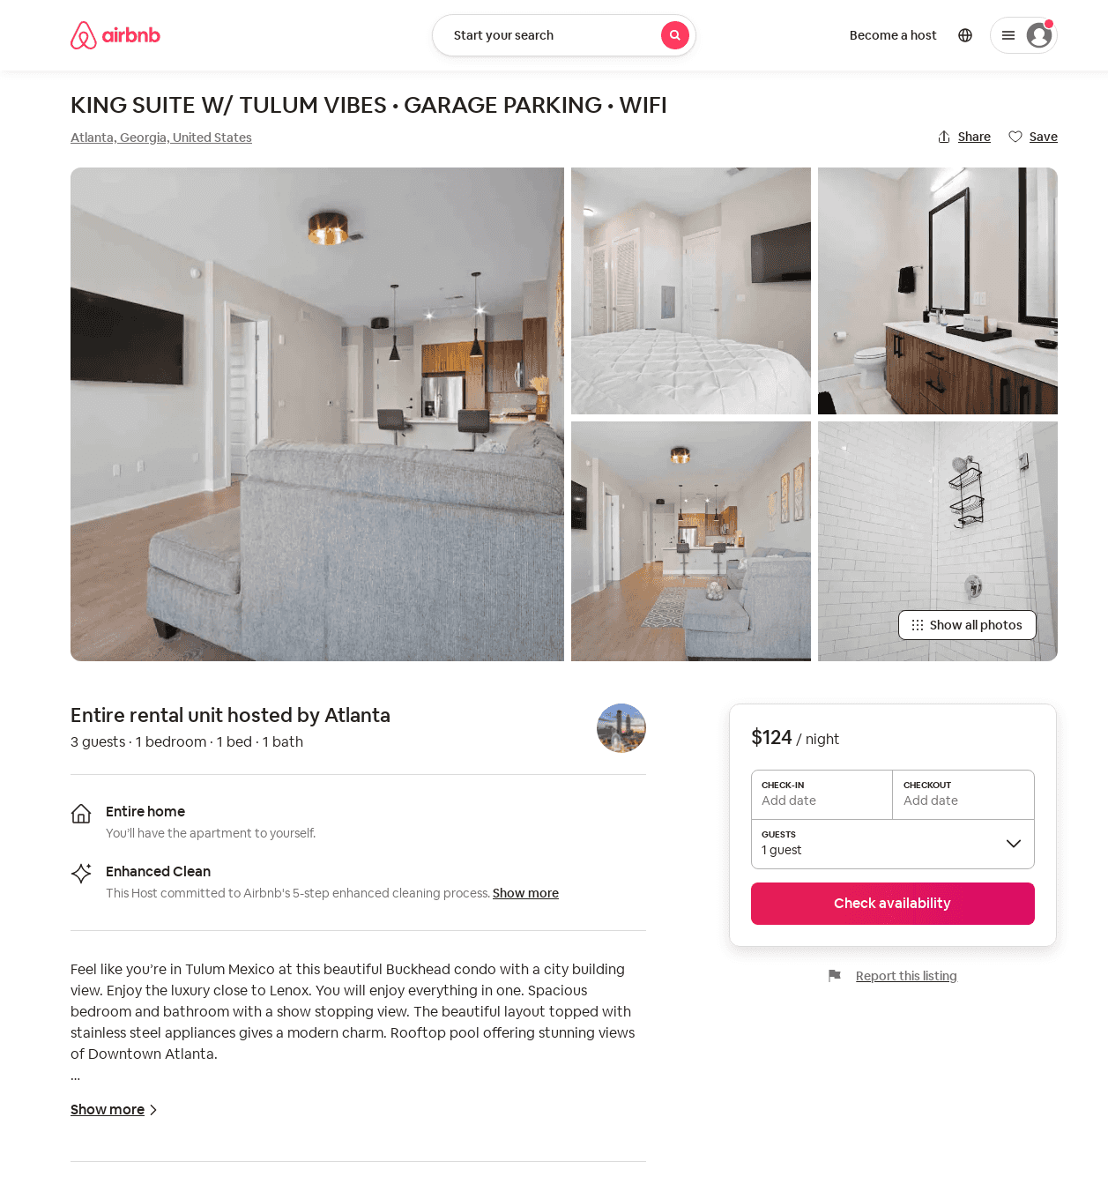
Listing 52618176
1
3
$71 - $157
4.87
1
Rich
417695971
1
https://www.airbnb.com/rooms/52618176
Aug 2022

Slide 51
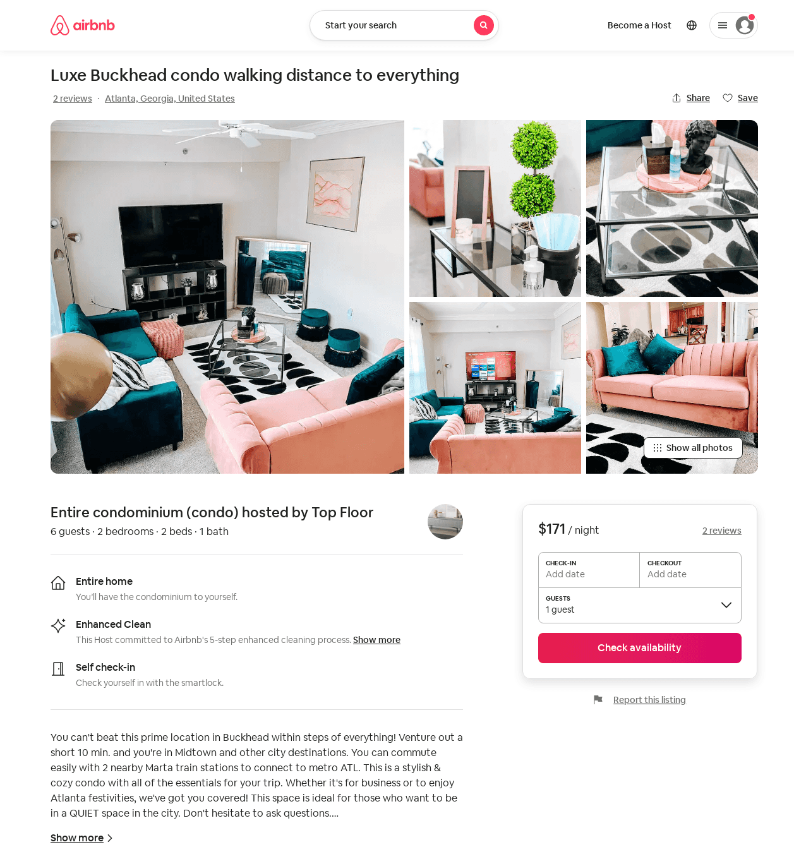
Listing 52826290
2
6
$105 - $204
4.97
2
Top Floor
334365978
1
https://www.airbnb.com/rooms/52826290
Aug 2022

Slide 52
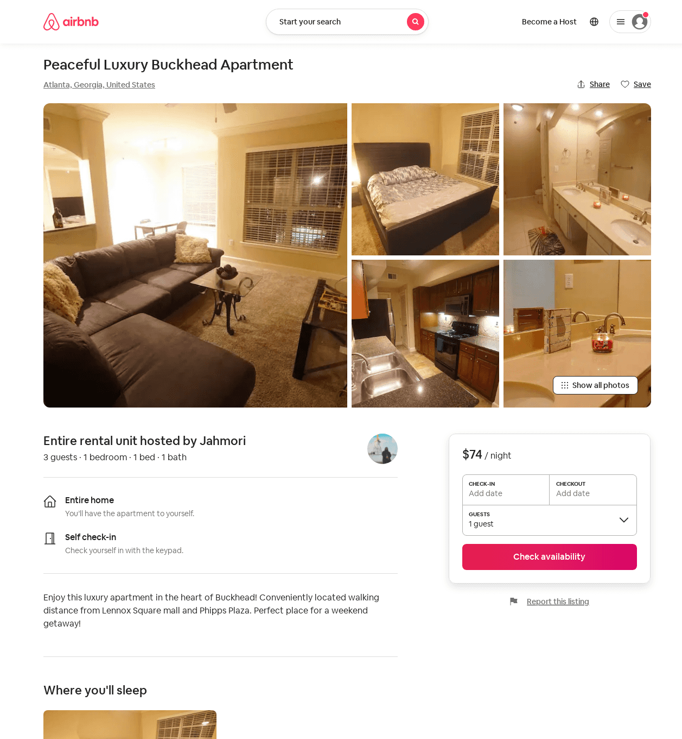
Listing 53189688
1
5
$67 - $96
4.69
1
Jahmori
430585355
1
https://www.airbnb.com/rooms/53189688
Aug 2022

Slide 53
Listing 53419597
1
2
$86 - $157
4.85
2
JoJo
432532267
1
https://www.airbnb.com/rooms/53419597
Aug 2022

Slide 54
Listing 53260353
1
2
$350
2
Julius
431181051
1
https://www.airbnb.com/rooms/53260353
Aug 2022

Slide 55
Listing 9636579
2
5
$168 - $222
1
Von
https://www.vrbo.com/9636579ha
Aug 2022

Slide 56
Listing 2580430
2
5
$284
1
Kyandria Smith
https://www.vrbo.com/2580430
Aug 2022

Slide 57
Listing 29122227
2
6
$550
1
Marc
78664642
2
https://www.airbnb.com/rooms/29122227
Aug 2022

Slide 58
Listing buckhead-suite-steps-away-from-phipps-plaza
undefined
2
7.5
https://www.booking.com/hotel/us/buckhead-suite-steps-away-from-phipps-plaza.html
Sep 2022

Slide 59
Listing alluringly-extravagant-buckhead-penthouse
3478 LAKESIDE DR NE
undefined
1
9.4
https://www.booking.com/hotel/us/alluringly-extravagant-buckhead-penthouse.html
Sep 2022

Slide 60
Listing gilded-grandiose-buckhead-abode
3478 LAKESIDE DR NE
undefined
6
8.8
https://www.booking.com/hotel/us/gilded-grandiose-buckhead-abode.html
Sep 2022

Slide 61
Listing 54162079
2
6
$130 - $256
5.0
2
Justin
439111957
1
https://www.airbnb.com/rooms/54162079
Jul 2022

Slide 62
Listing 52804662
1
2
$129 - $204
4.78
4
Chauncey
28692091
1
https://www.airbnb.com/rooms/52804662
Jul 2022

Slide 63
Listing 53414998
1
2
$500
3
Julius
179577323
1
https://www.airbnb.com/rooms/53414998
Aug 2022

Slide 64
Listing 54377890
1
4
$95 - $172
2
Opulence
388034151
1
https://www.airbnb.com/rooms/54377890
Aug 2022

Slide 65
Listing home-in-buckhead
undefined
6
9
https://www.booking.com/hotel/us/home-in-buckhead.html
Sep 2022

Slide 66
Listing kasa-atlanta-apartments
undefined
2
8
https://www.booking.com/hotel/us/kasa-atlanta-apartments.html
Sep 2022

Slide 67
Listing luxurious-buckhead-midrise-2bd2ba-mins-from-lenox
undefined
6
10
https://www.booking.com/hotel/us/luxurious-buckhead-midrise-2bd2ba-mins-from-lenox.html
Sep 2022

Slide 68
Listing stylish-tranquil-buckhead-hideaway
undefined
4
10
https://www.booking.com/hotel/us/stylish-tranquil-buckhead-hideaway.html
Sep 2022

Slide 69
Listing 2710073
1
2
$185
3
feyisayo
https://www.vrbo.com/2710073
Aug 2022

Slide 70
Listing 53522937
1
3
$84 - $85
4.78
2
Luxury Royalty
392483456
1
https://www.airbnb.com/rooms/53522937
Aug 2022

Slide 71
Listing 2773244
1
4
$130
3
https://www.vrbo.com/2773244
Aug 2022

Slide 72
Listing 47334964
1
2
$200
4.93
1
Home From Home
117506125
1
https://www.airbnb.com/rooms/47334964
Aug 2022

Slide 73
Listing 2901597
1
4
$185
1
https://www.vrbo.com/2901597
Aug 2022

Slide 74
Listing 686062858203555000
1
3
31
Casey
359231771
601
https://www.airbnb.com/rooms/686062858203555000
Aug 2022

Slide 75
Listing 52992322
1
3
4.67
1
Lacey
328103769
1
https://www.airbnb.com/rooms/52992322
Aug 2022

Slide 76
Listing 52745850
2
2
1
Miroslav
226804666
16
https://www.airbnb.com/rooms/52745850
Aug 2022

Slide 77
Listing 52745857
2
2
1
Miroslav
226804666
16
https://www.airbnb.com/rooms/52745857
Aug 2022

Slide 78
Listing 50089446
1
4
2
Maximum Home
404061224
1
https://www.airbnb.com/rooms/50089446
Aug 2022

