Slide 2
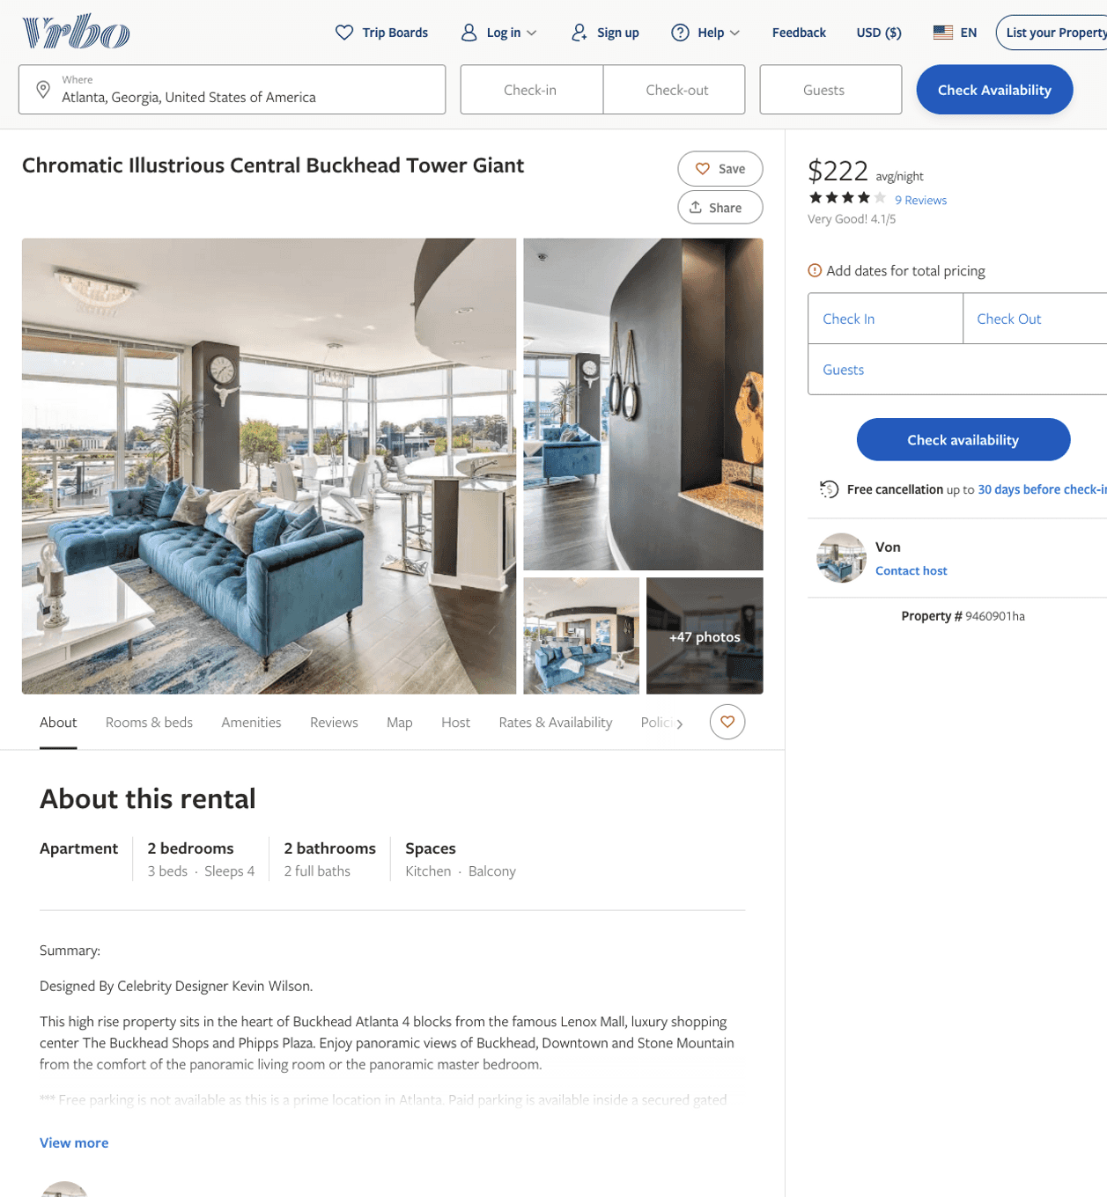
Listing 9460901
2
4
$181 - $239
4.2727275
1
Von
https://www.vrbo.com/9460901ha
Aug 2022

Slide 3
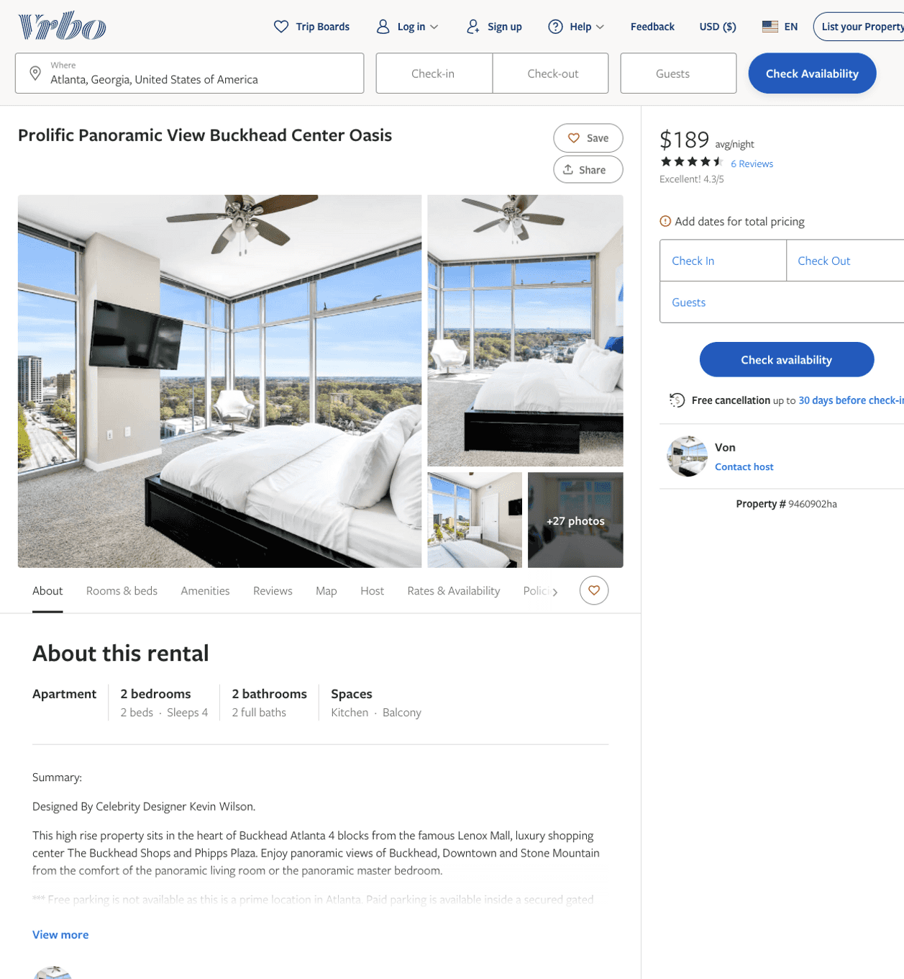
Listing 9460902
2
4
$176 - $245
4.3333335
1
Von
https://www.vrbo.com/9460902ha
Aug 2022

Slide 4
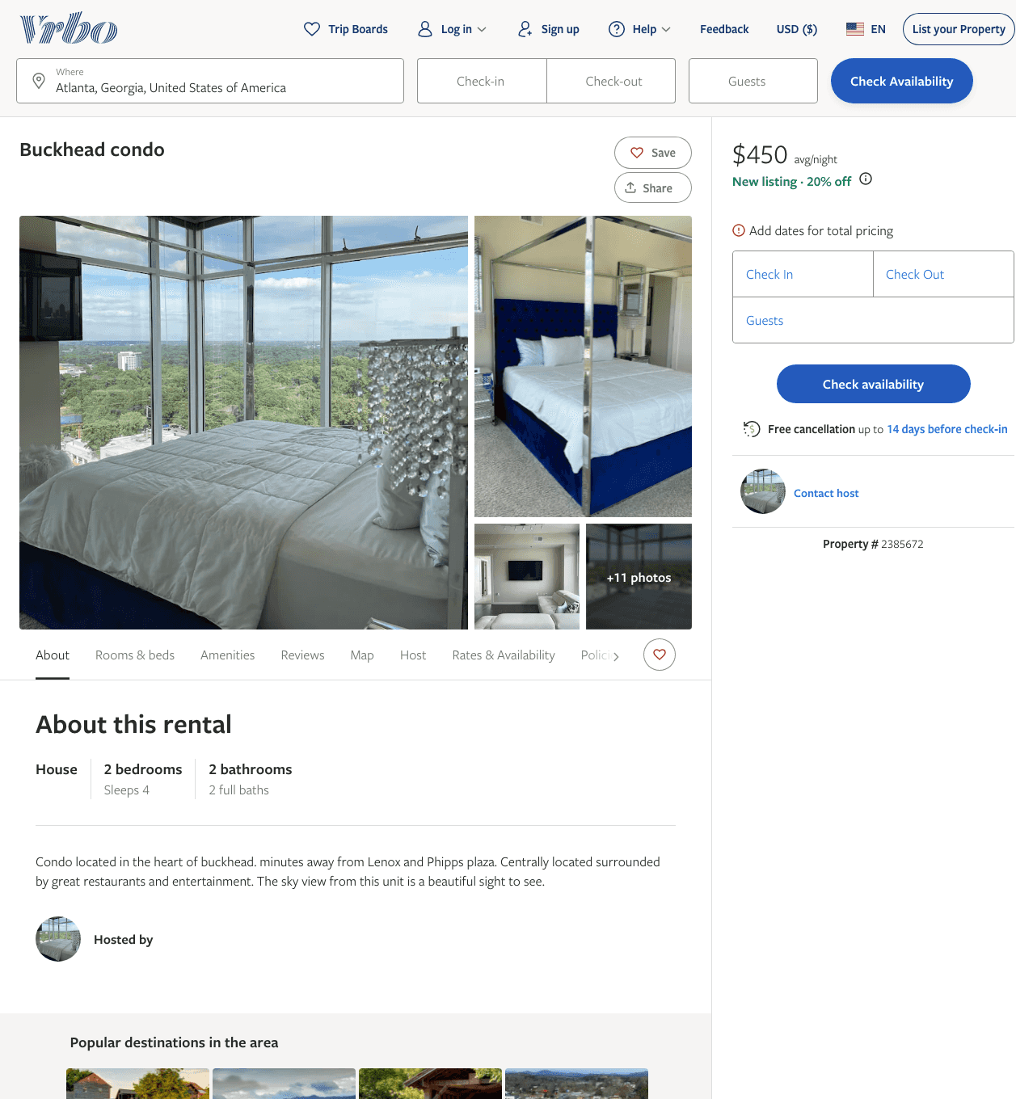
Listing 2385672
2
4
$441 - $462
5
3
https://www.vrbo.com/2385672
Aug 2022

Slide 5
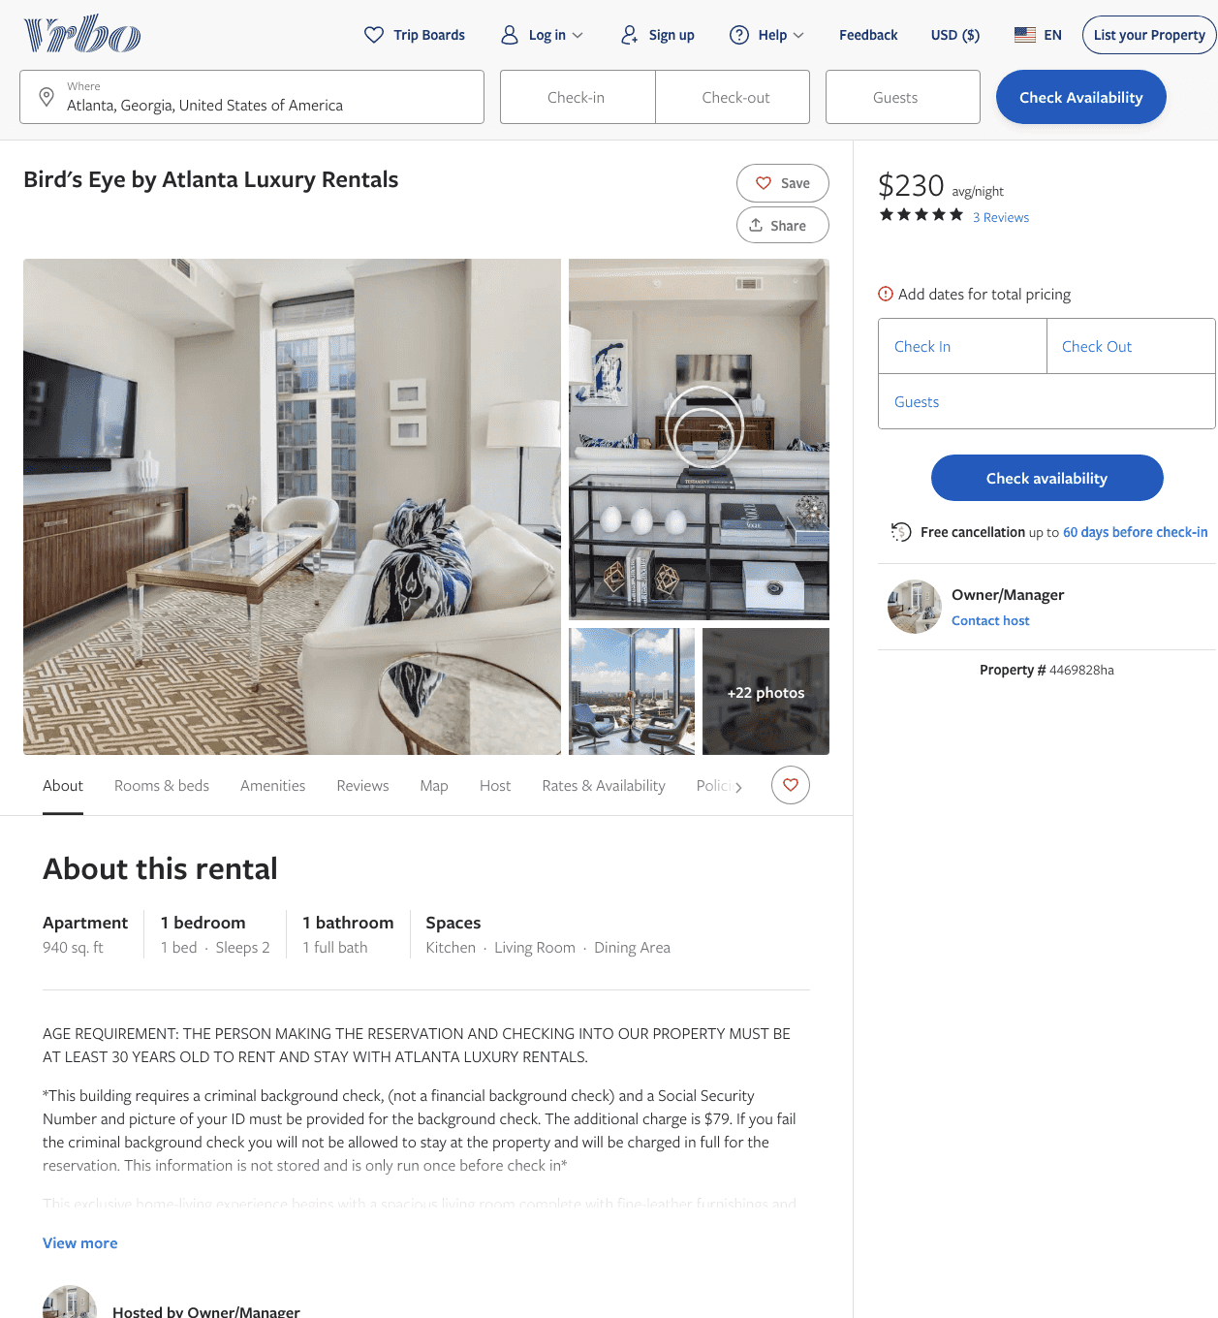
Listing 4469828
1
2
$234 - $328
5
2
Owner/Manager
https://www.vrbo.com/4469828ha
Aug 2022

Slide 6
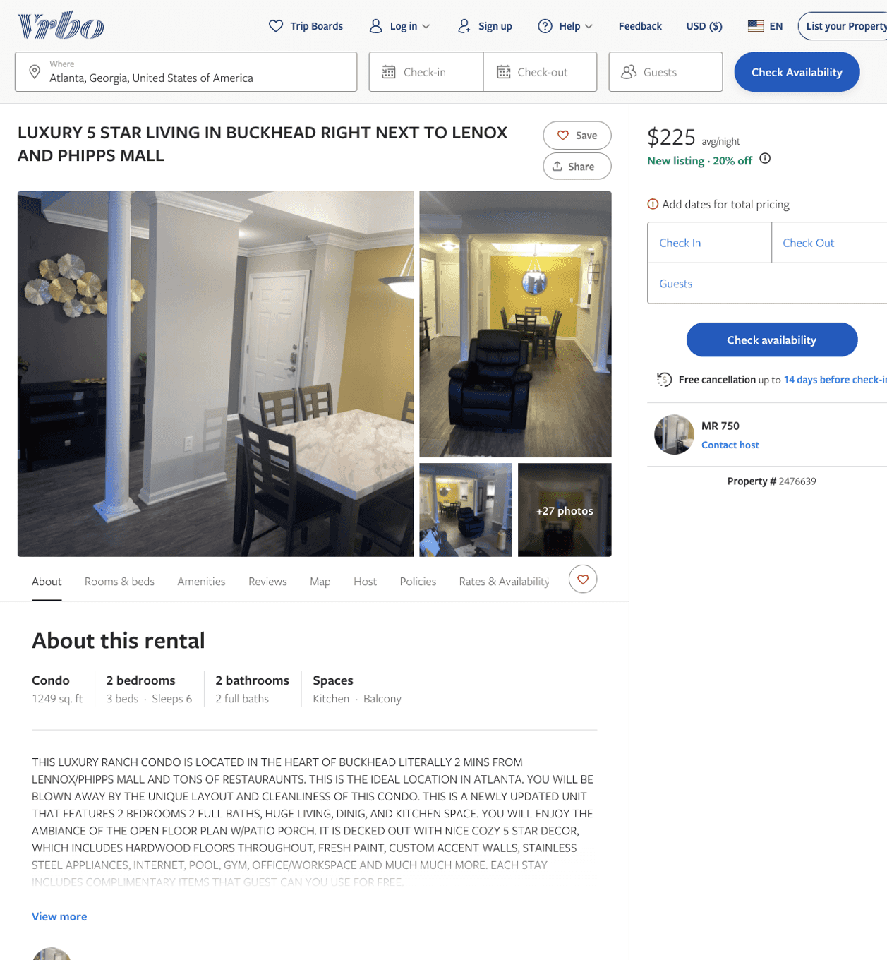
Listing 2476639
2
5
$180 - $248
5
3
MR 750
https://www.vrbo.com/2476639
Aug 2022

Slide 7
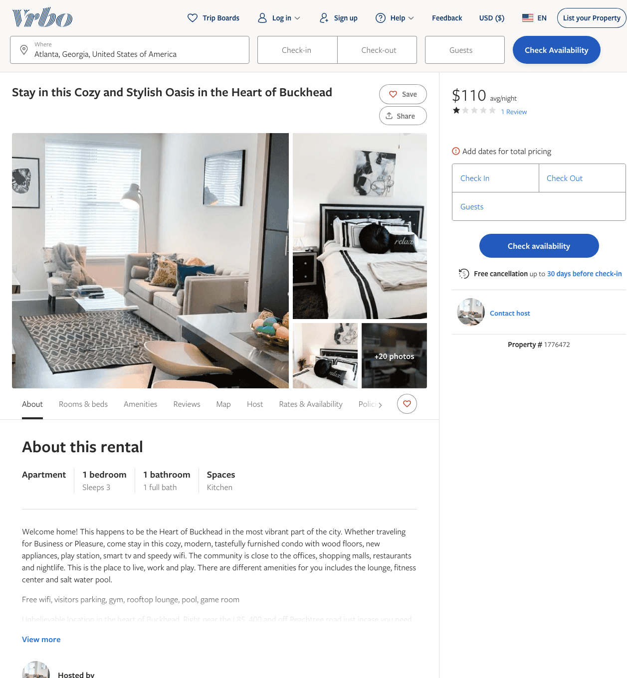
Listing 1776472
1
3
$110
1
1
https://www.vrbo.com/1776472
Aug 2022

Slide 8
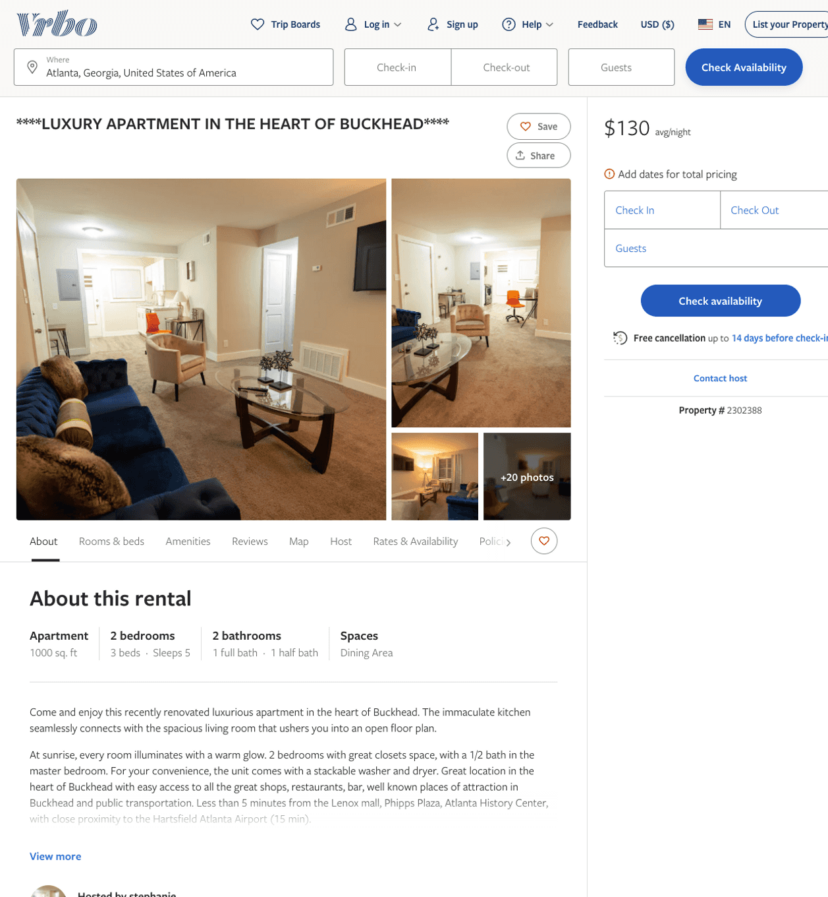
Listing 2302388
2
5
$130
1
stephanie
https://www.vrbo.com/2302388
Aug 2022

Slide 9
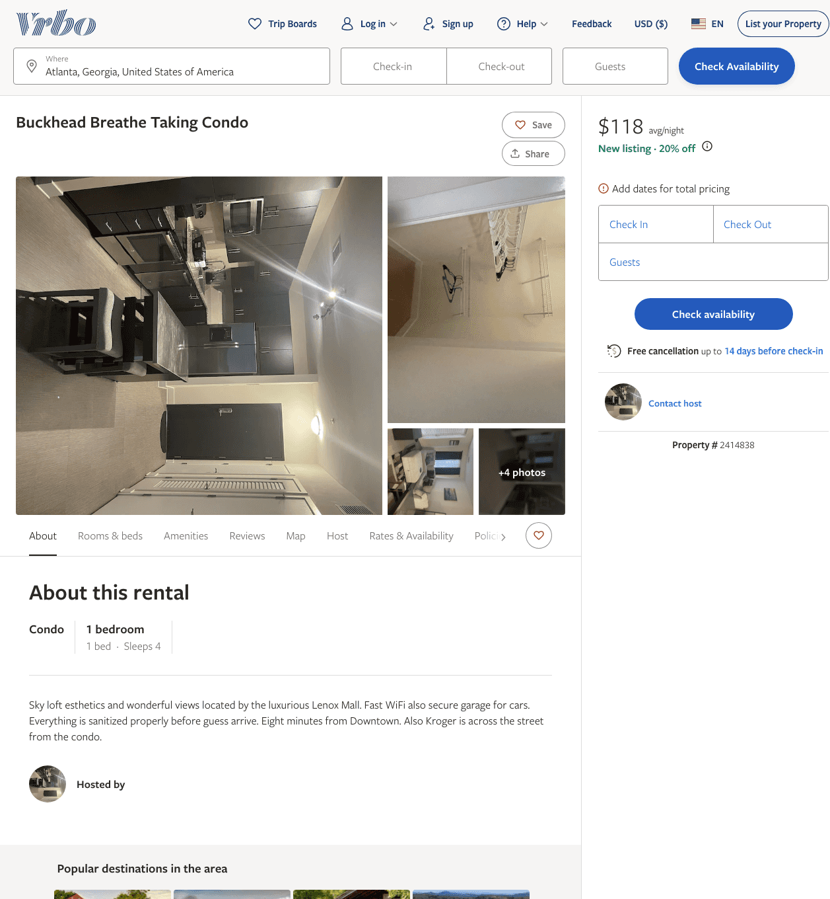
Listing 2414838
1
4
$118 - $143
1
https://www.vrbo.com/2414838
Aug 2022

Slide 10
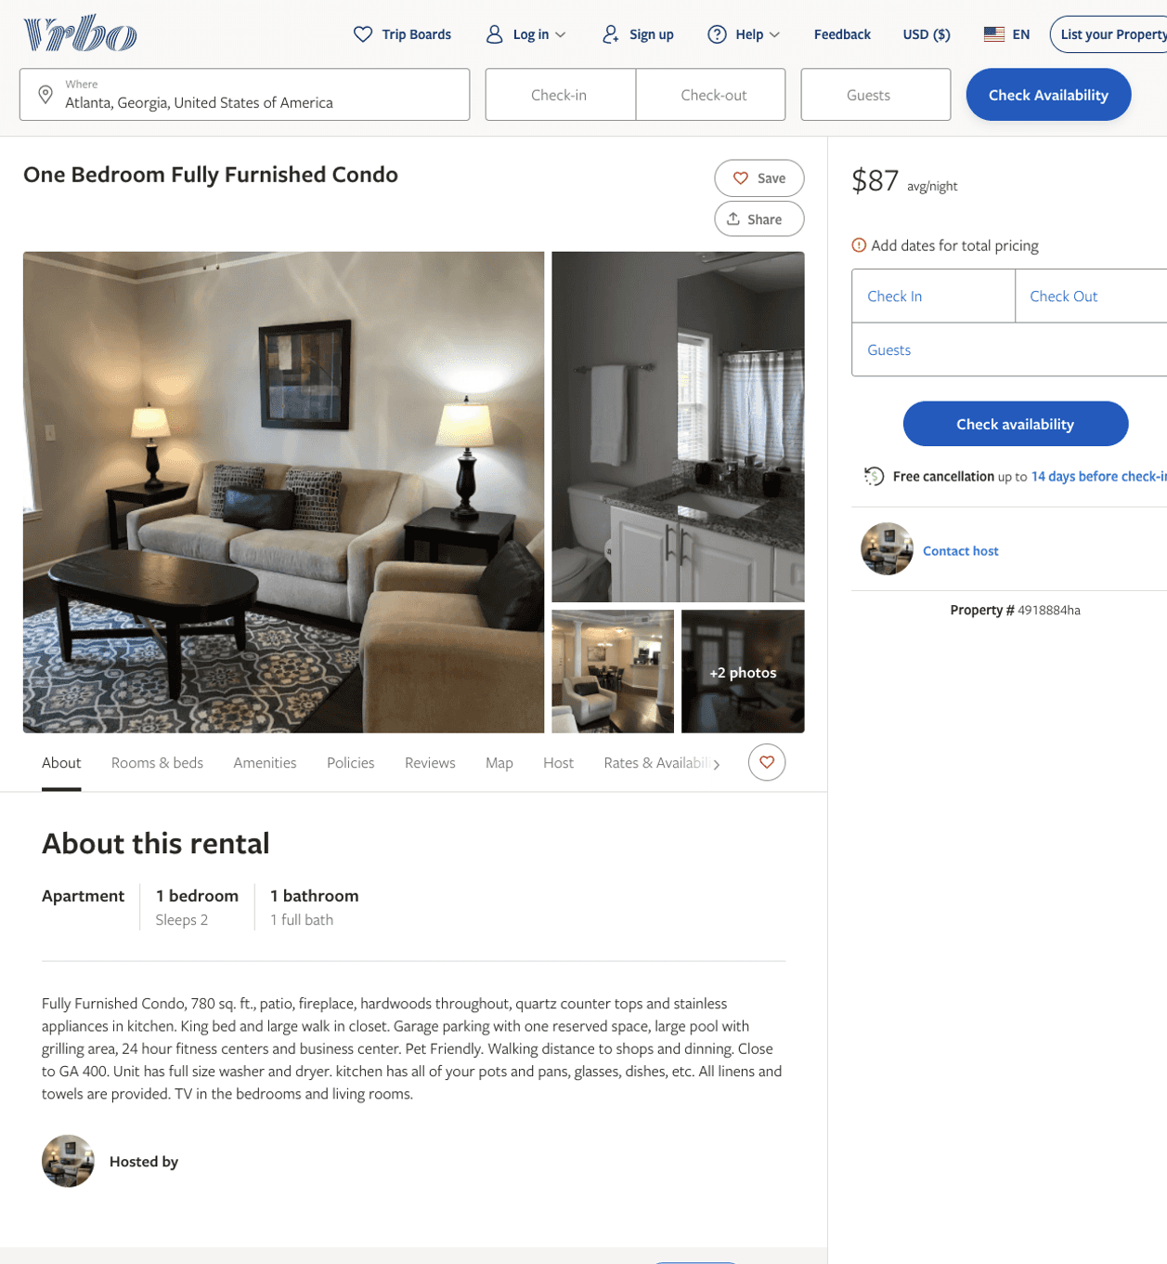
Listing 4918884
1
2
$87
30
https://www.vrbo.com/4918884ha
Aug 2022

Slide 11
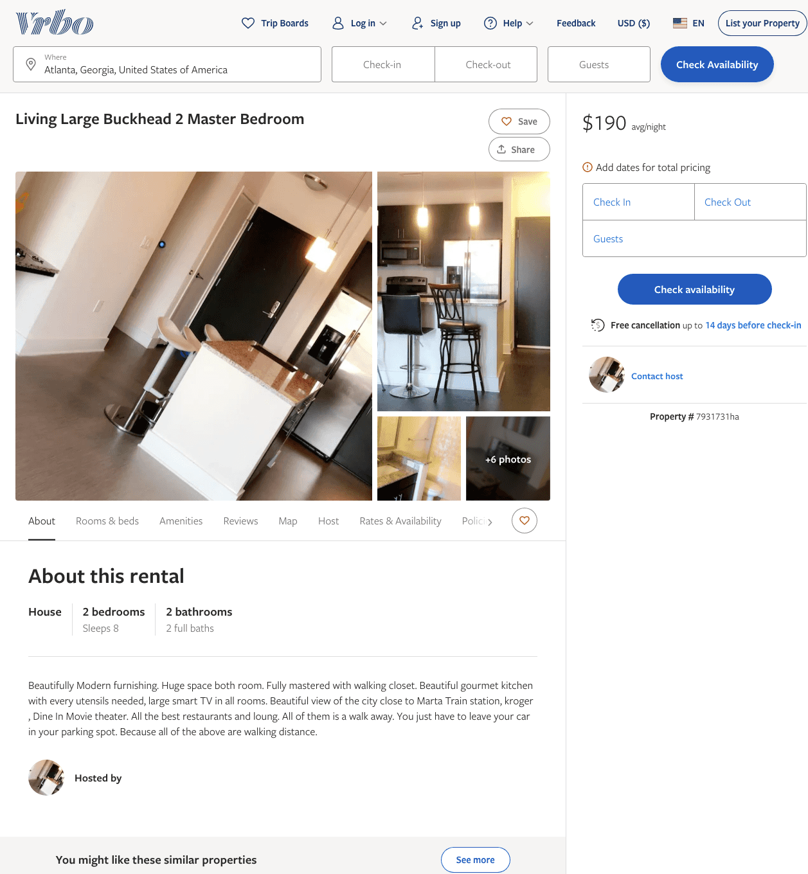
Listing 7931731
2
8
$190
1
https://www.vrbo.com/7931731ha
Aug 2022

Slide 12
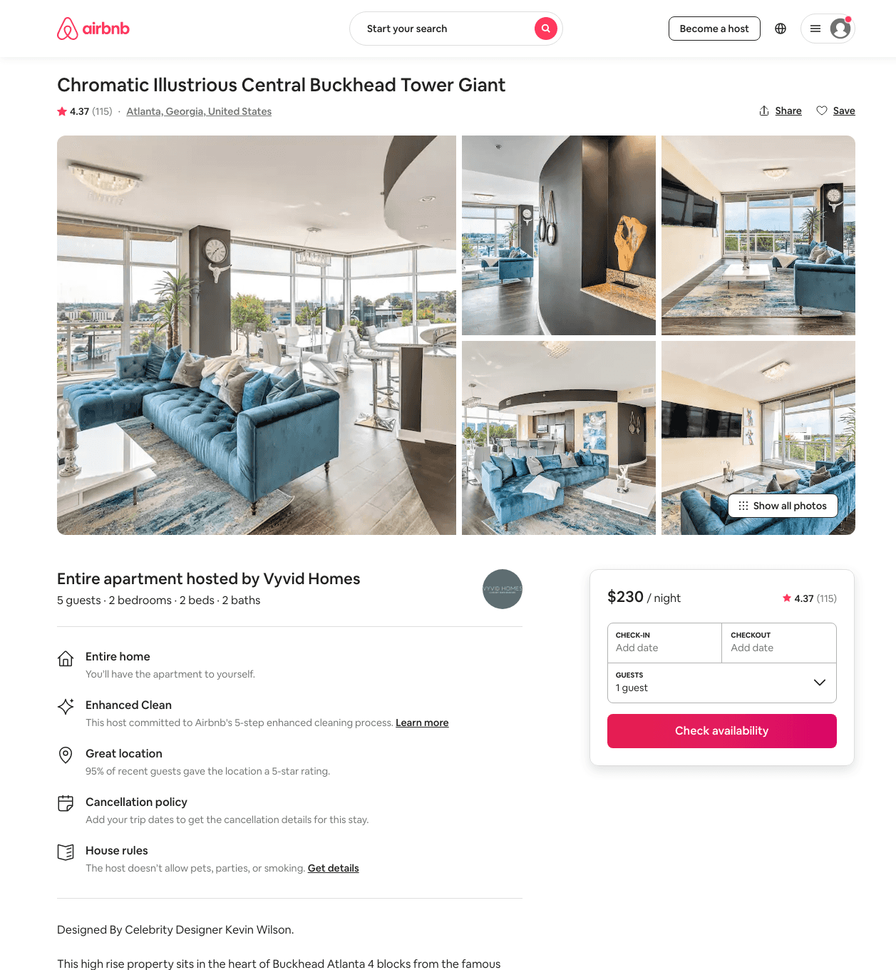
Listing 38168113
2
5
$156 - $264
4.31
2
Vyvid Homes
31816953
20
https://www.airbnb.com/rooms/38168113
Jun 2022

Slide 13
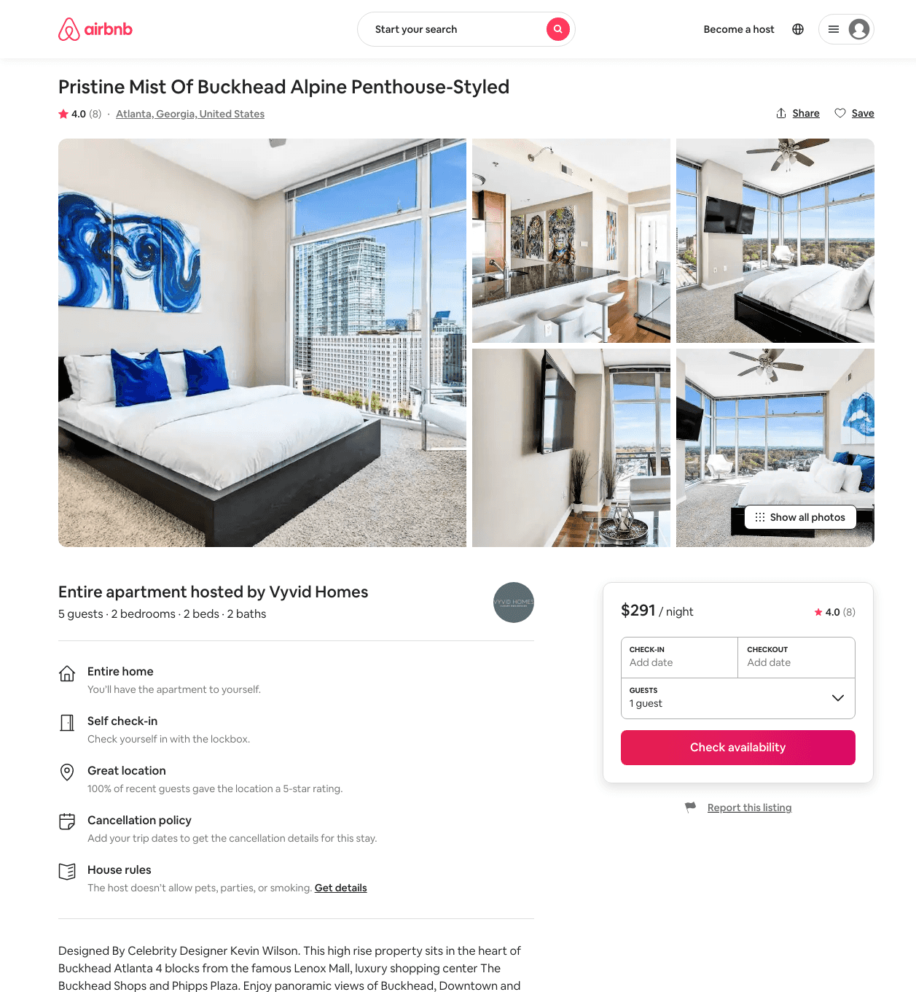
Listing 38215646
2
4
$154 - $255
4.08
2
Vyvid Homes
31816953
20
https://www.airbnb.com/rooms/38215646
Aug 2022

Slide 14
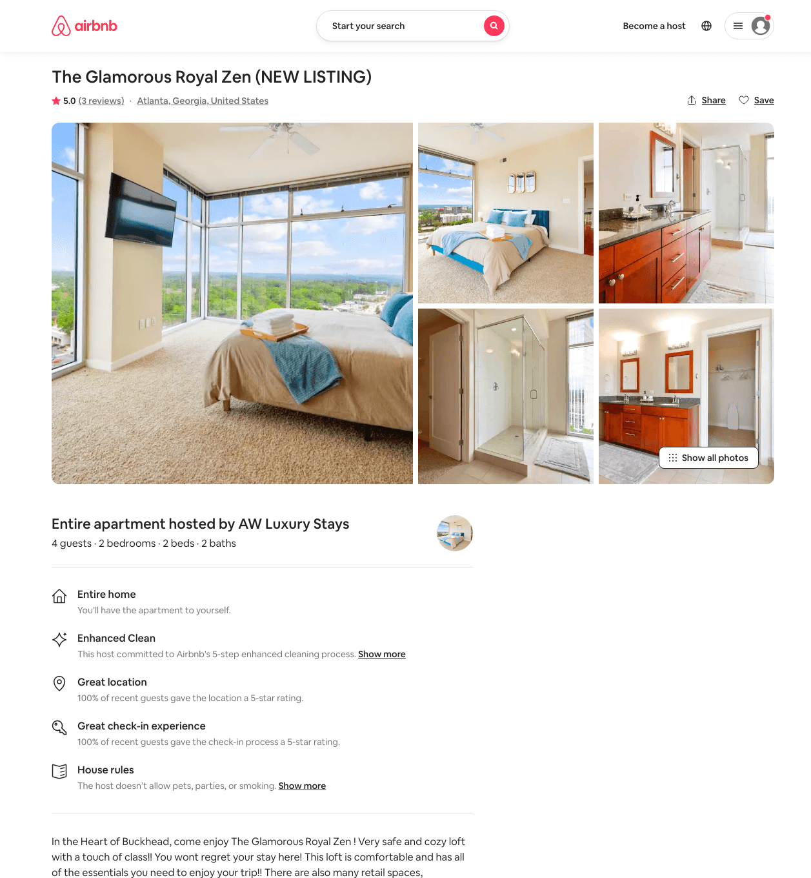
Listing 49739347
2
4
$130 - $257
4.96
30
Luxury Stays
38708901
3
https://www.airbnb.com/rooms/49739347
Jun 2022

Slide 15
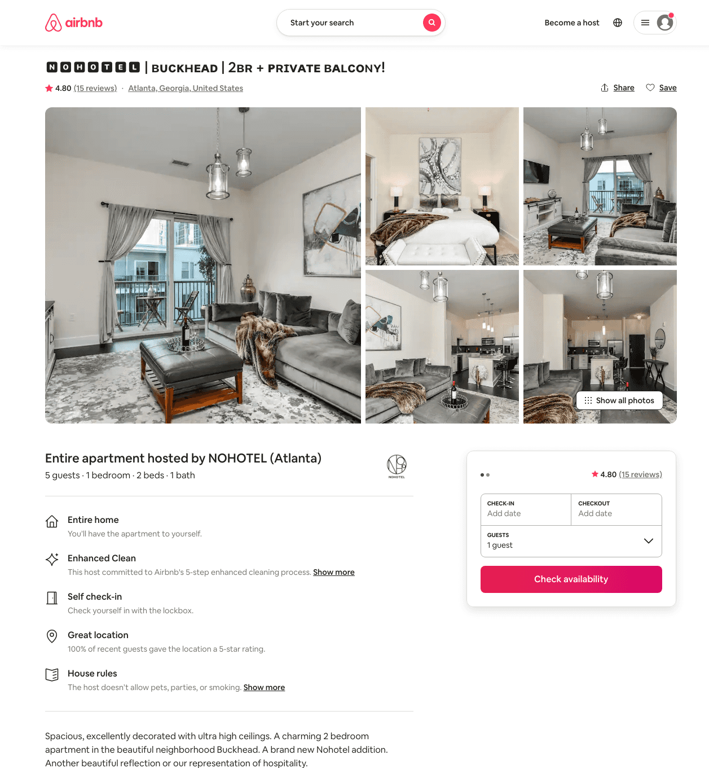
Listing 45797062
1
5
$104 - $150
4.56
30
NOHOTEL (Atlanta)
269120575
10
https://www.airbnb.com/rooms/45797062
Aug 2022

Slide 16
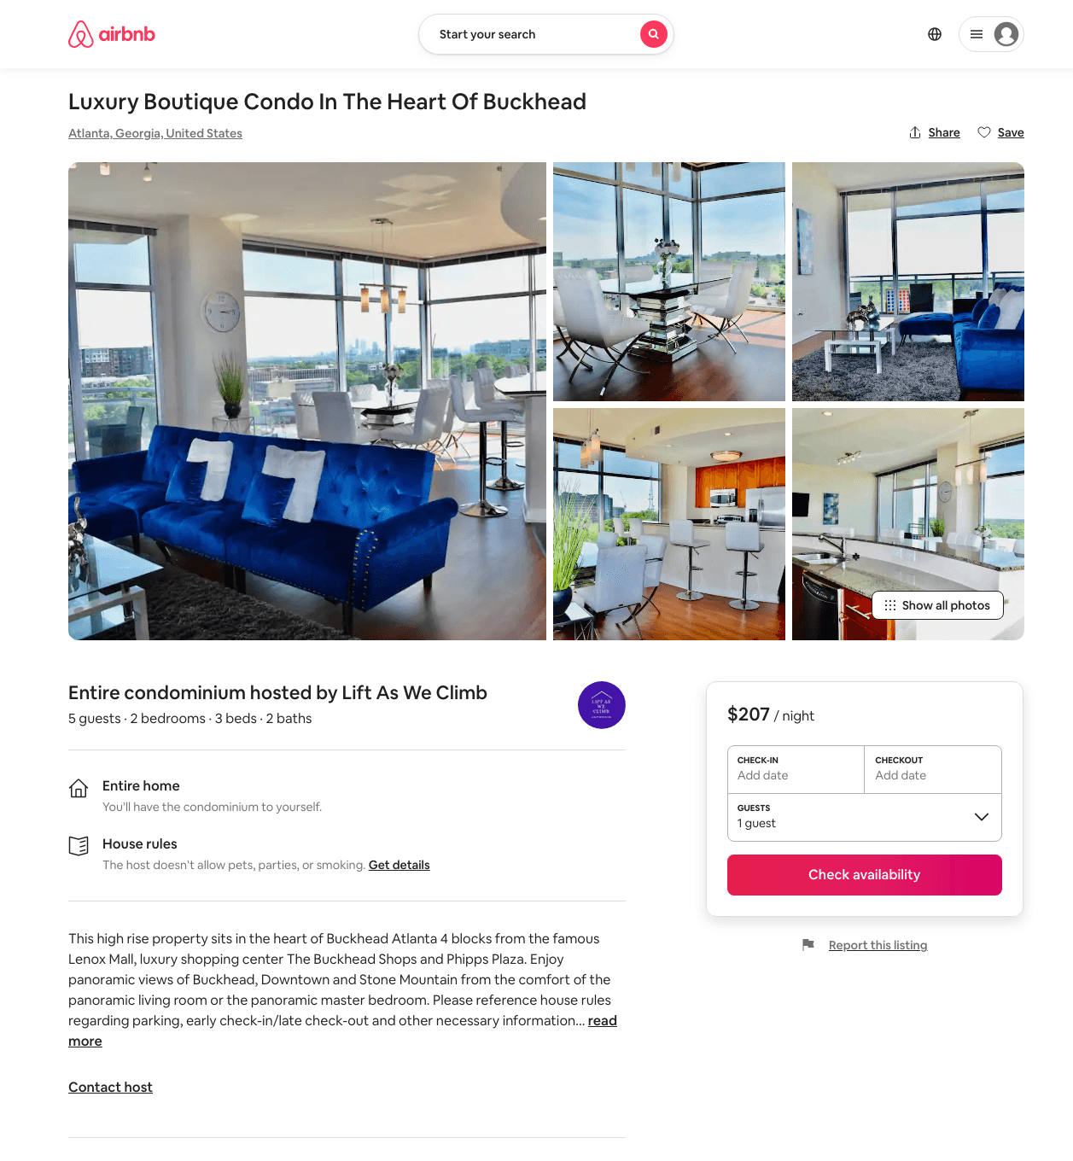
Listing 49233696
2
5
$207 - $506
4.83
2
Lift As We Climb
99632022
1
https://www.airbnb.com/rooms/49233696
Aug 2022

Slide 17
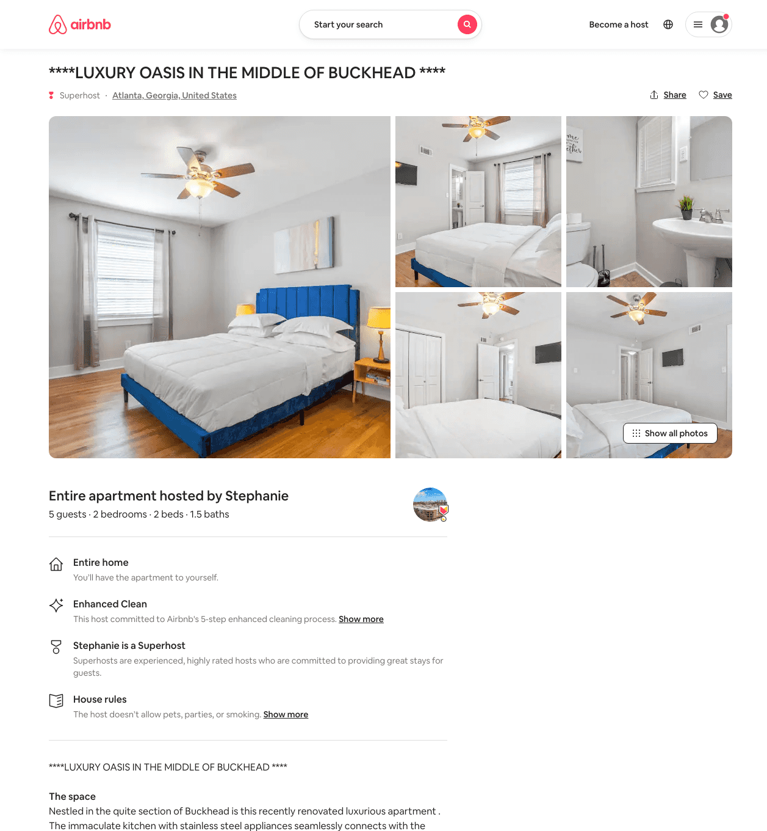
Listing 49639125
2
5
$109 - $136
4.40
1
Stephanie
380724467
3
https://www.airbnb.com/rooms/49639125
Aug 2022

Slide 18
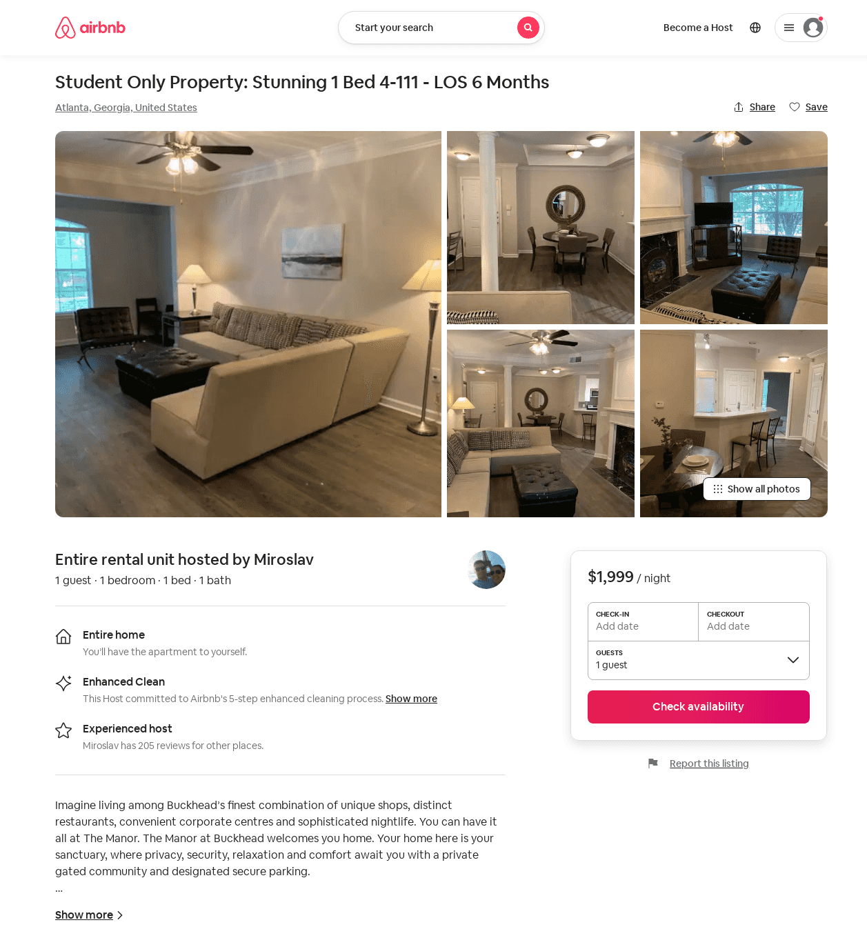
Listing 52628191
1
1
$1797 - $2021
1
Miroslav
226804666
16
https://www.airbnb.com/rooms/52628191
Jun 2022

Slide 19
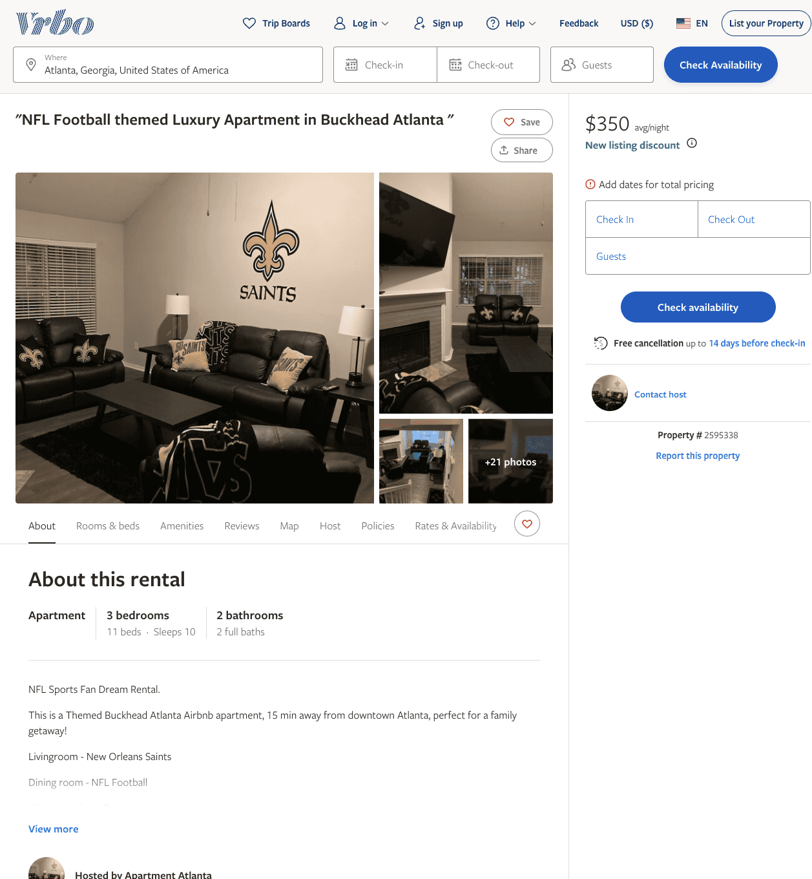
Listing 2595338
5
15
$231 - $353
4.2
1
Amberula Levitt
https://www.vrbo.com/2595338
Aug 2022

Slide 20
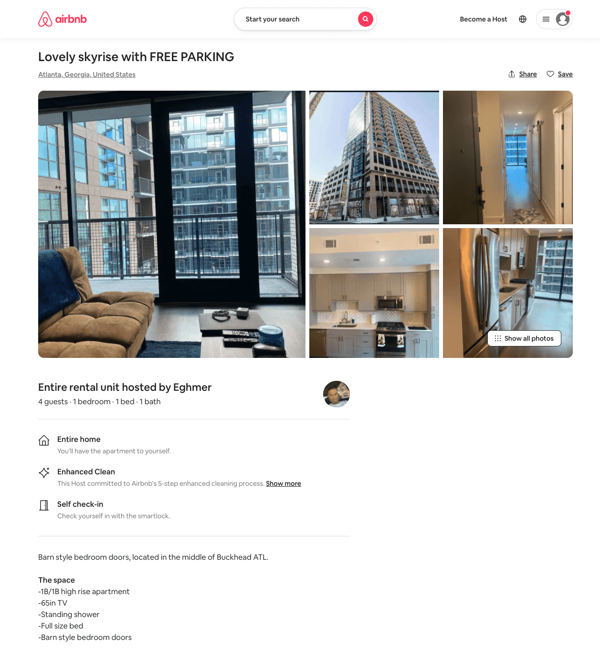
Listing 54007169
1
2
$86 - $163
4.97
5
Crown
297738997
1
https://www.airbnb.com/rooms/54007169
Aug 2022

Slide 21
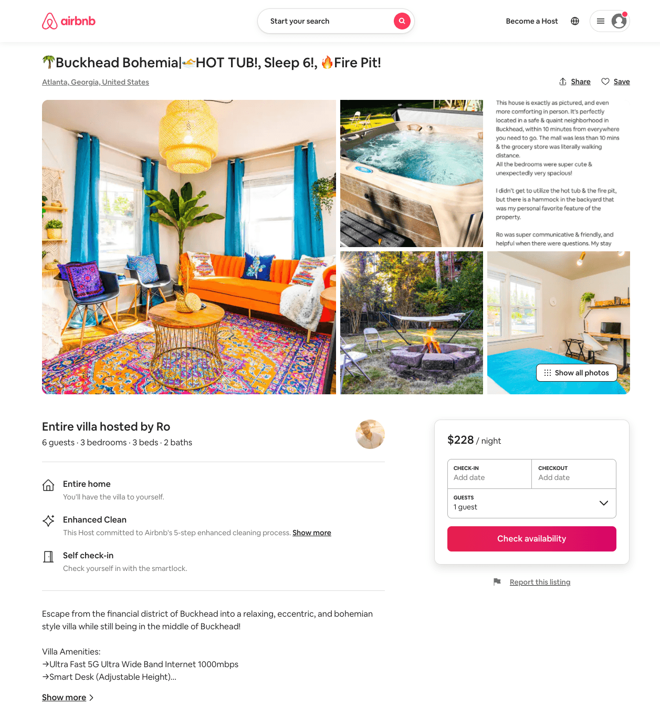
Listing 54127032
3
6
$154 - $424
4.87
1
Ro
428066966
3
https://www.airbnb.com/rooms/54127032
Aug 2022

Slide 22
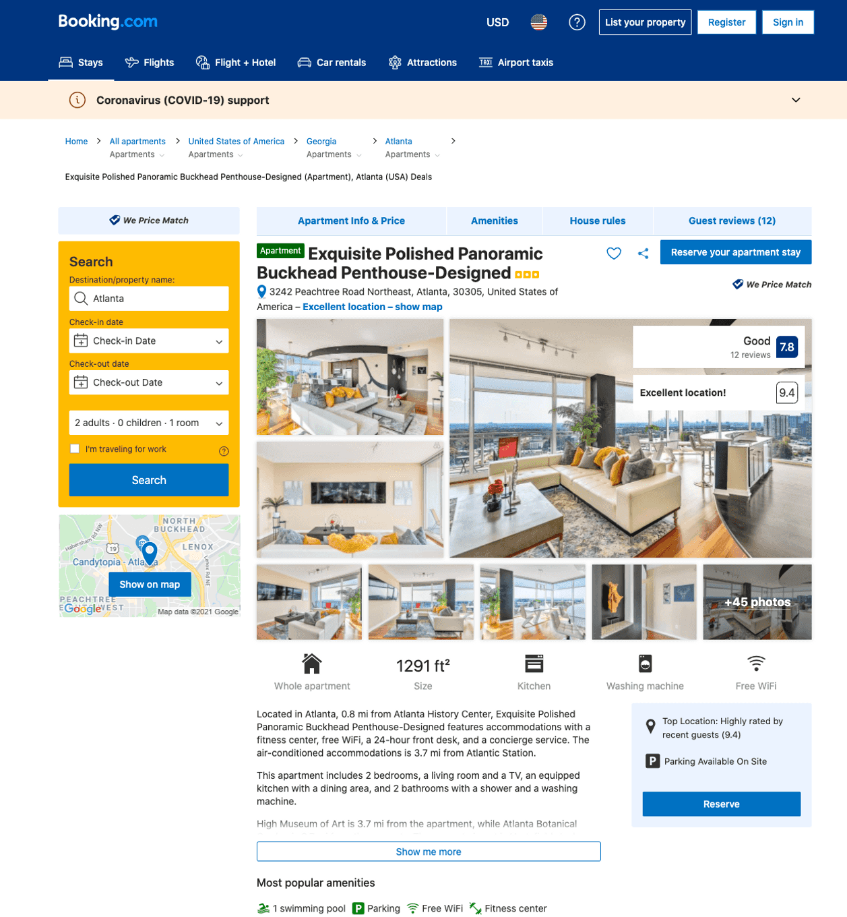
Listing exquisite-polished-panoramic-buckhead-penthouse
undefined
5
7.5
https://www.booking.com/hotel/us/exquisite-polished-panoramic-buckhead-penthouse.html
Sep 2022

Slide 23
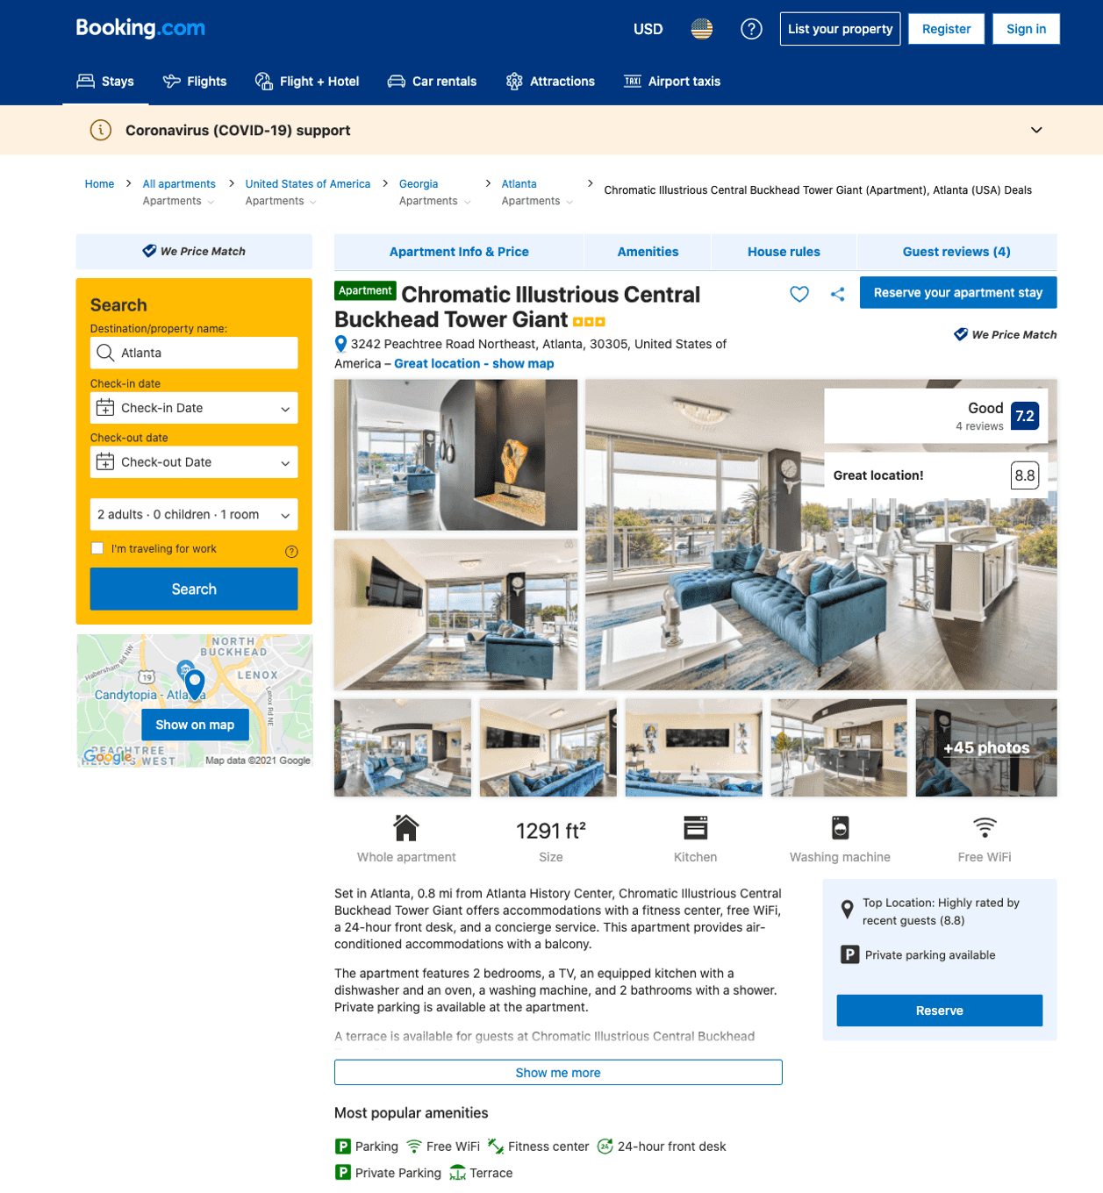
Listing chromatic-illustrious-central-buckhead-tower-giant
undefined
5
7.2
https://www.booking.com/hotel/us/chromatic-illustrious-central-buckhead-tower-giant.html
Sep 2022

Slide 24
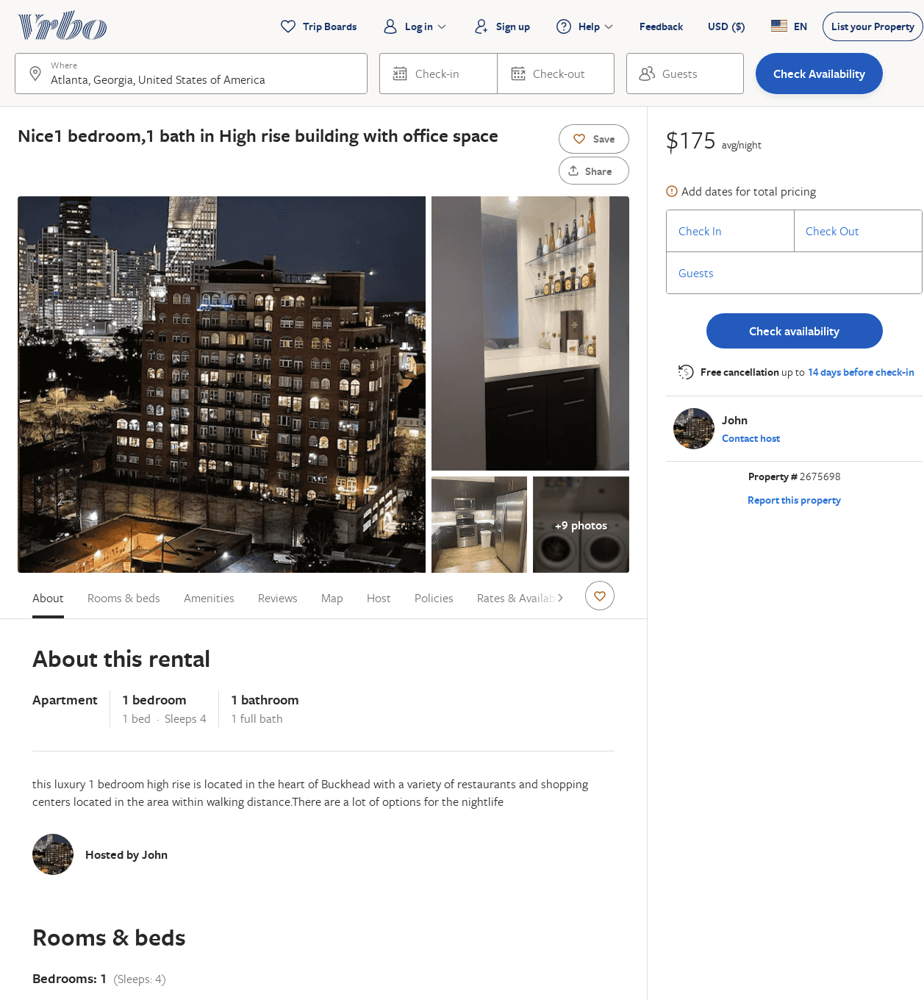
Listing 2675698
1
4
$175
1
John
https://www.vrbo.com/2675698
Aug 2022

Slide 25
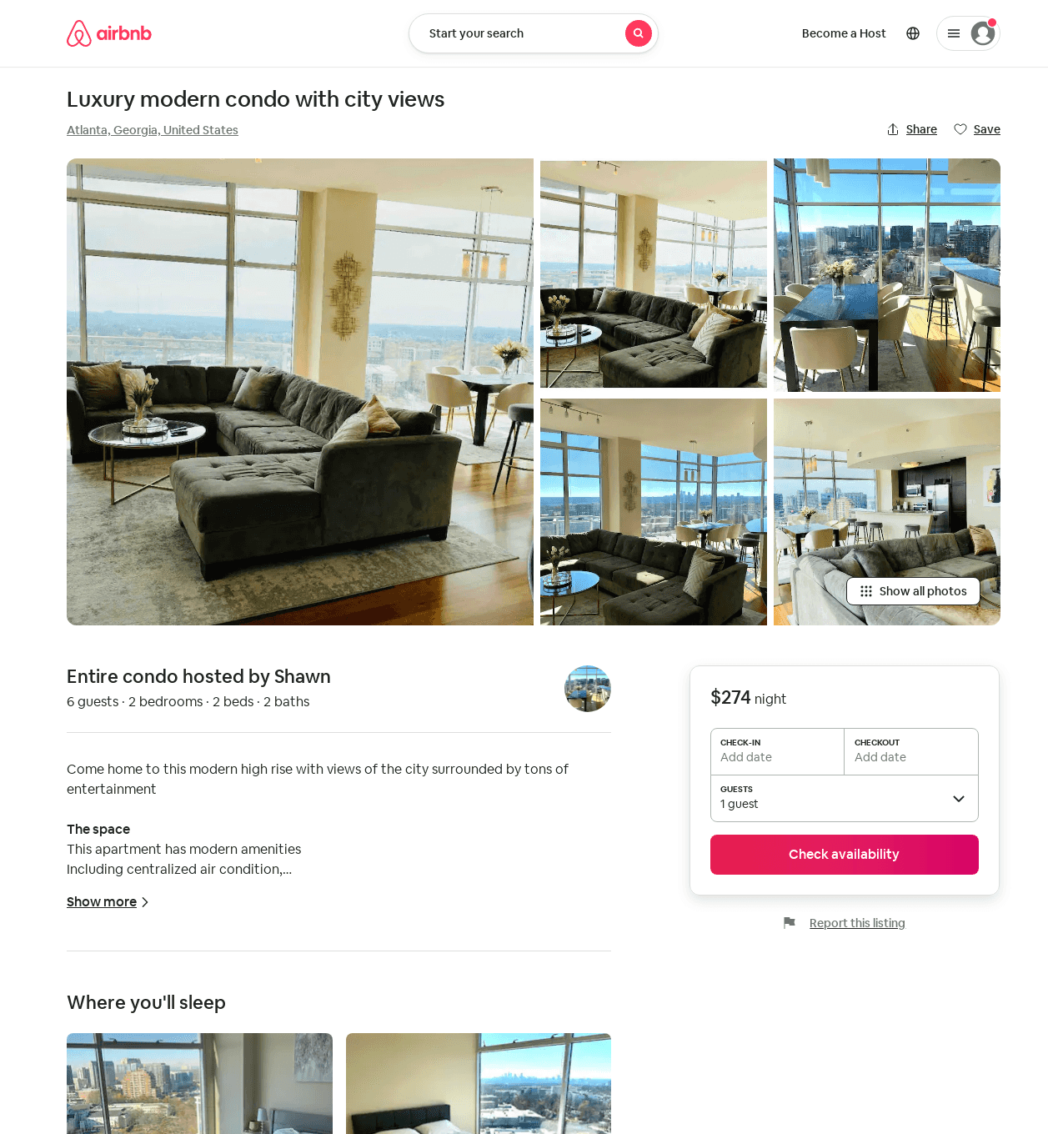
Listing 52821776
2
5
$274 - $342
5.0
1
Shawn
384849147
2
https://www.airbnb.com/rooms/52821776
Aug 2022

Slide 26
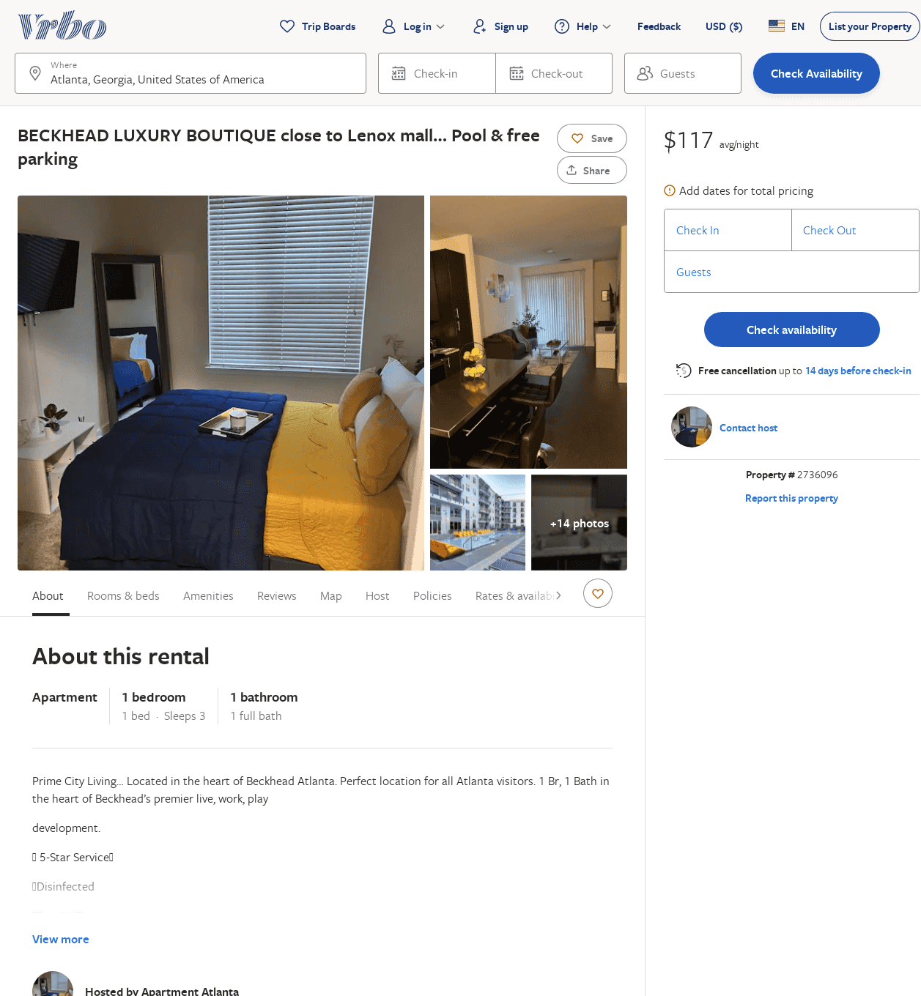
Listing 2736096
1
3
$115
5
3
https://www.vrbo.com/2736096
Aug 2022

Slide 27
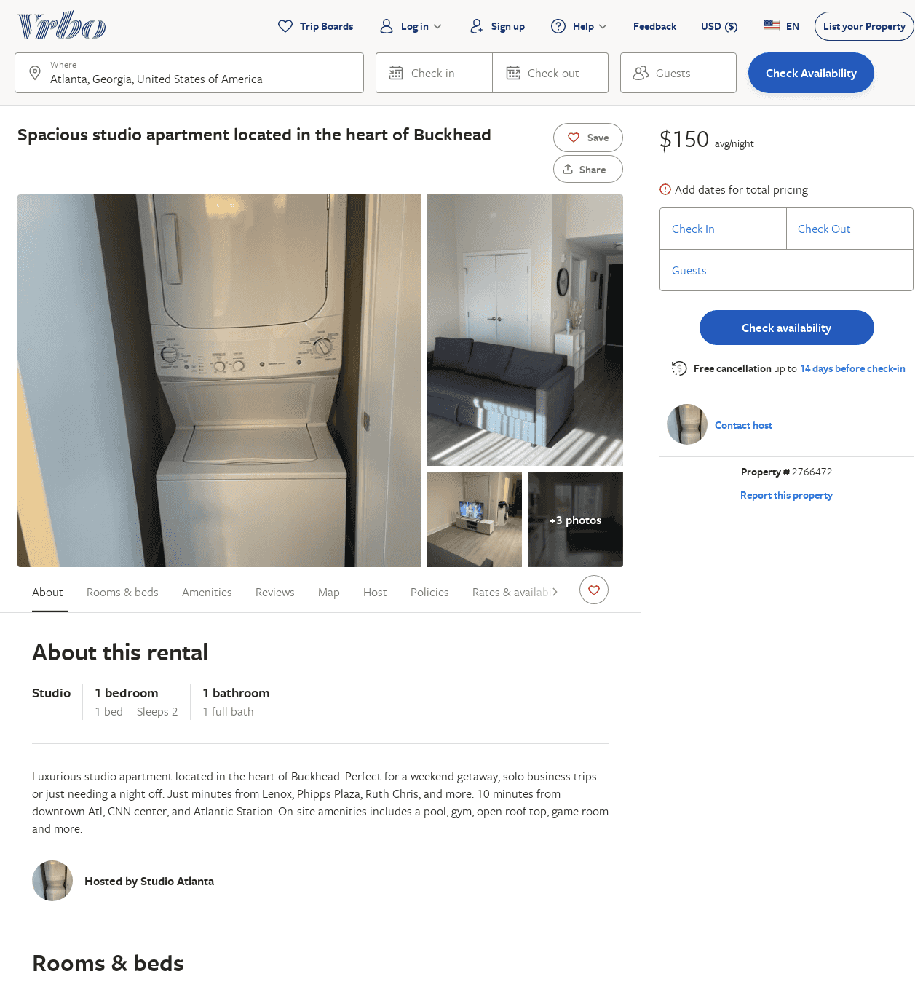
Listing 2766472
1
2
$150
1
https://www.vrbo.com/2766472
Aug 2022

Slide 28
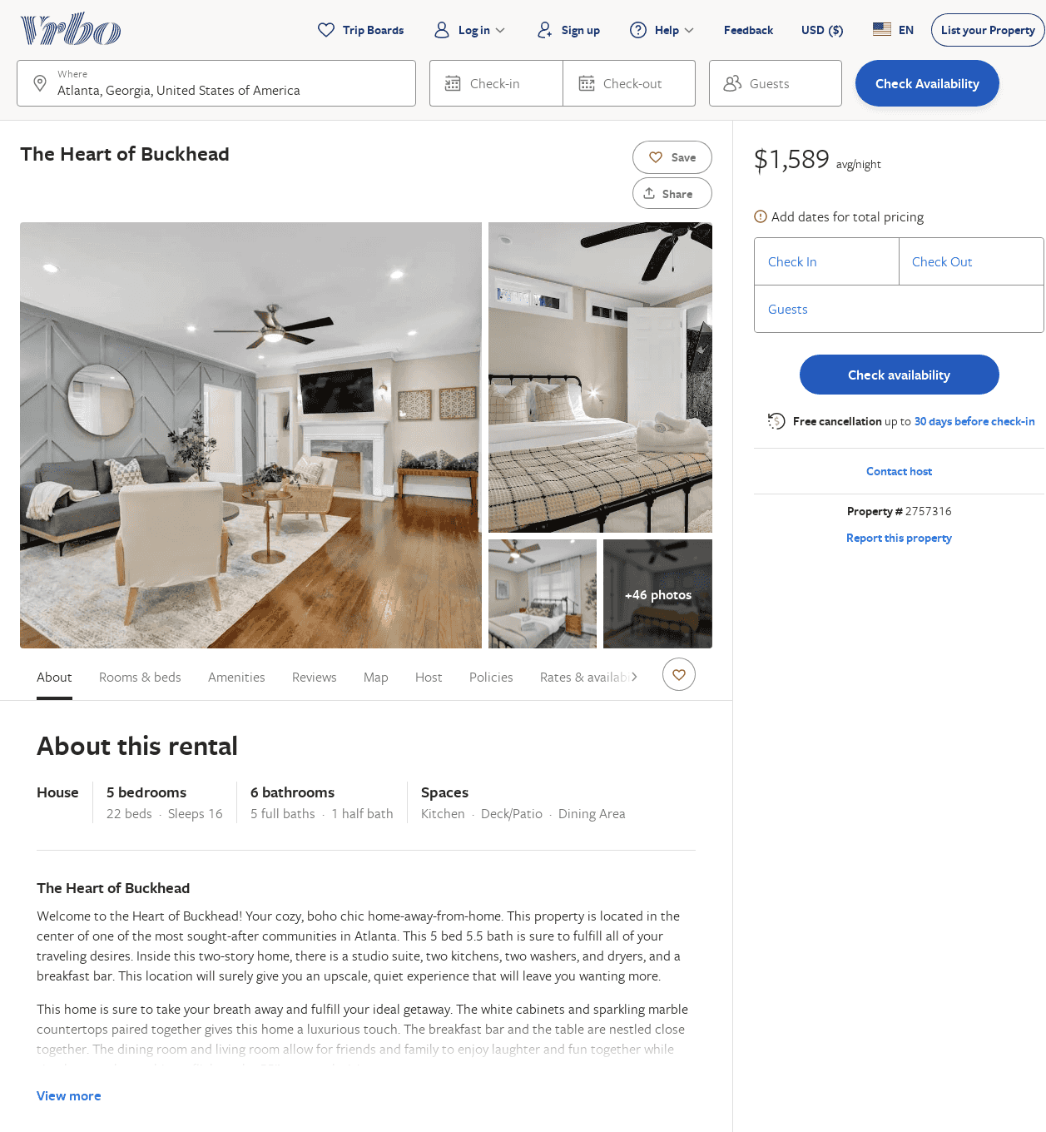
Listing 2757316
5
16
$1,100
1
anthony williams
https://www.vrbo.com/2757316
Aug 2022

Slide 29
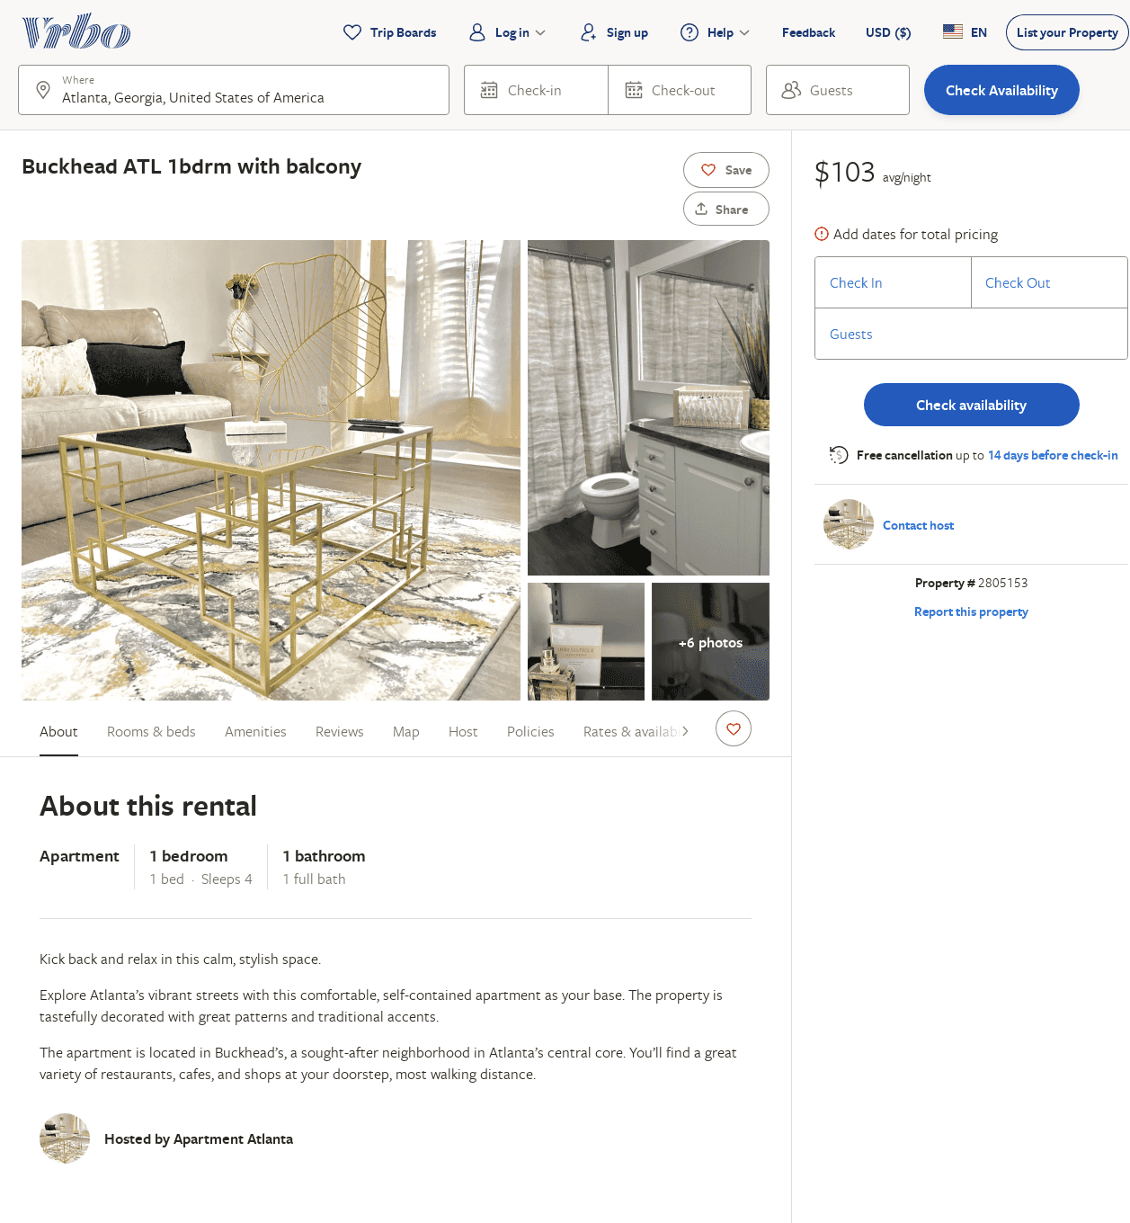
Listing 2805153
1
4
$103
1
https://www.vrbo.com/2805153
Aug 2022

Slide 30
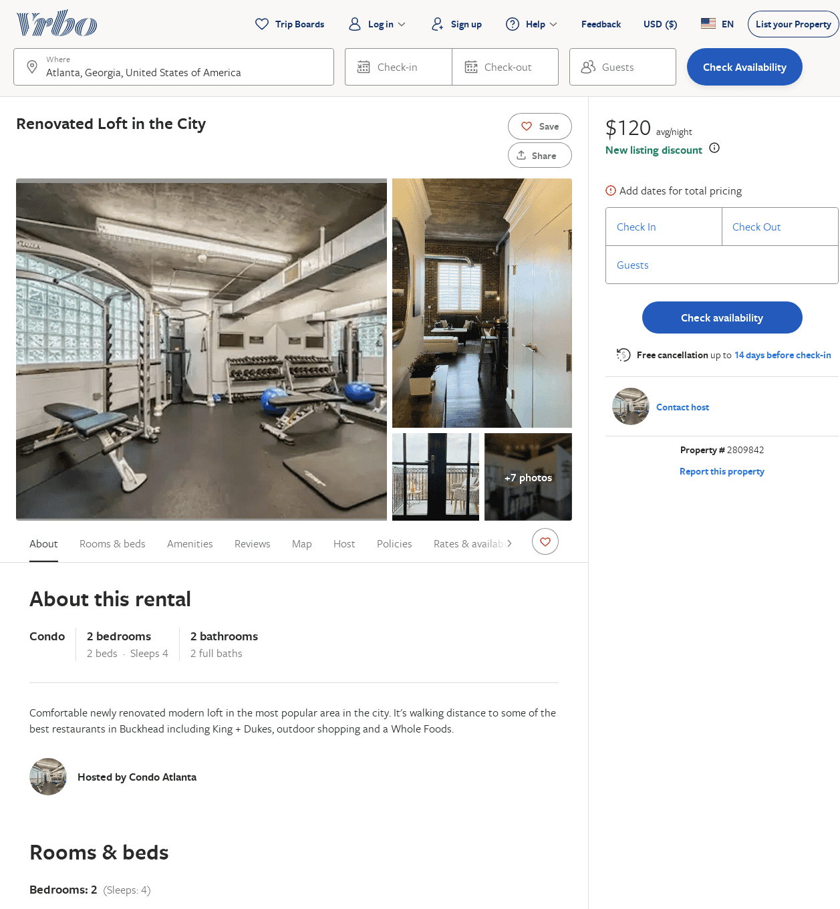
Listing 2809842
2
4
$150
5
3
Cryselle Stewart
https://www.vrbo.com/2809842
Aug 2022

Slide 31
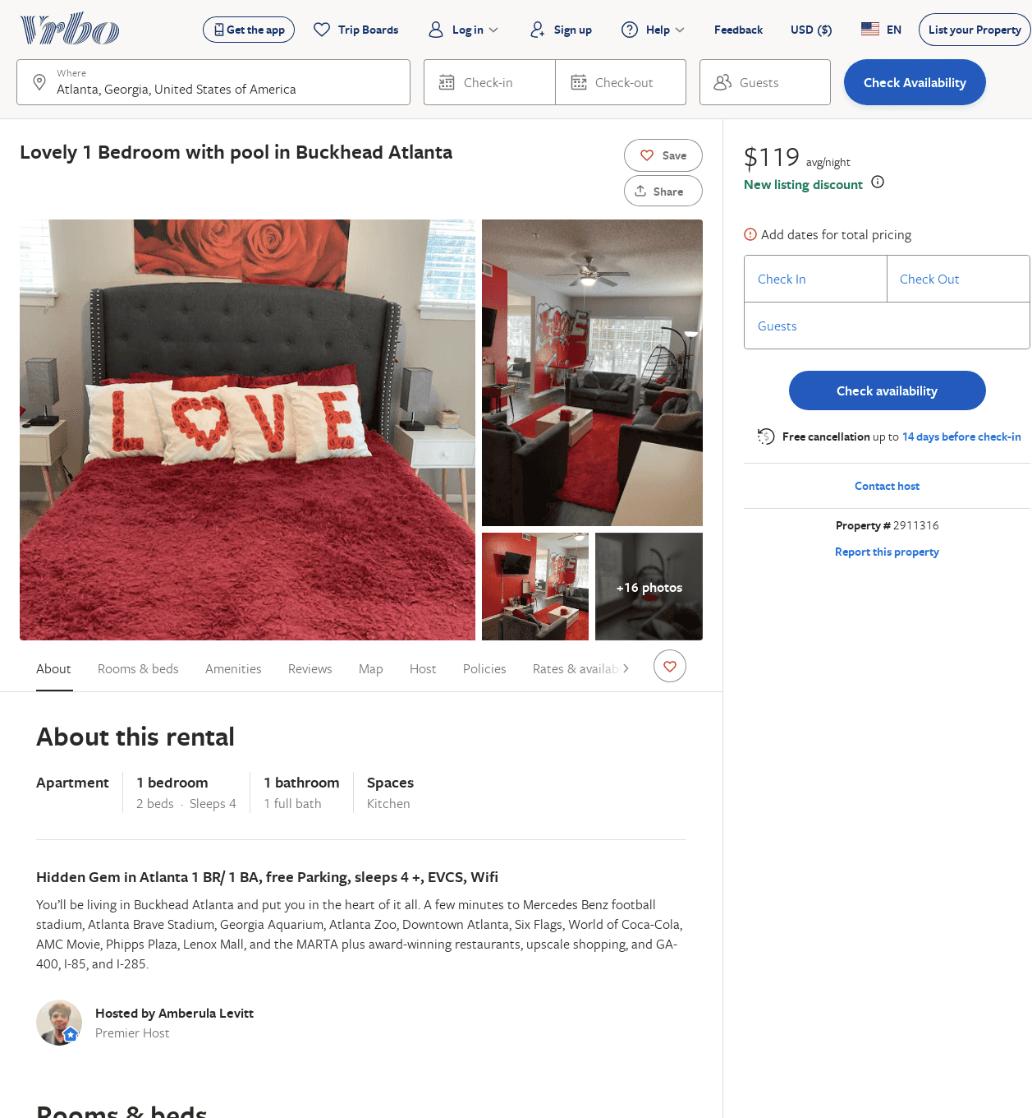
Listing 2911316
1
4
$104
1
Amberula Levitt
https://www.vrbo.com/2911316
Aug 2022

Slide 32
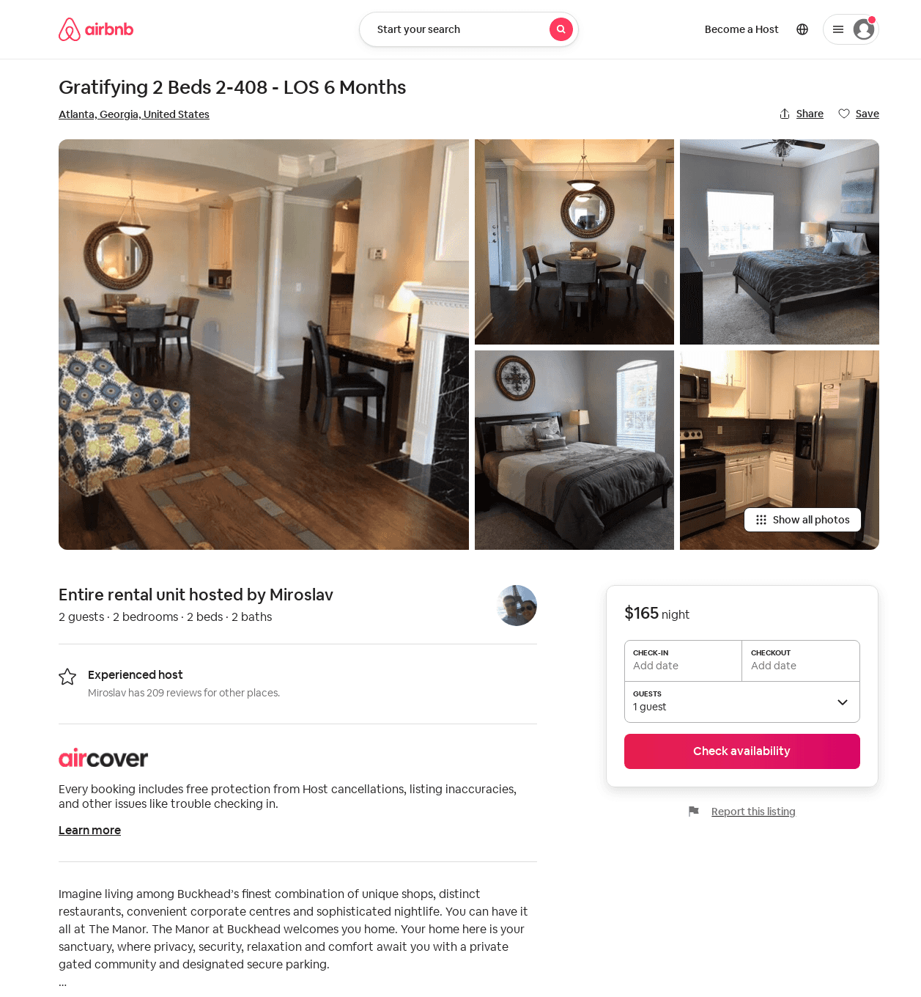
Listing 52682075
2
2
1
Miroslav
226804666
16
https://www.airbnb.com/rooms/52682075
Aug 2022

Slide 33
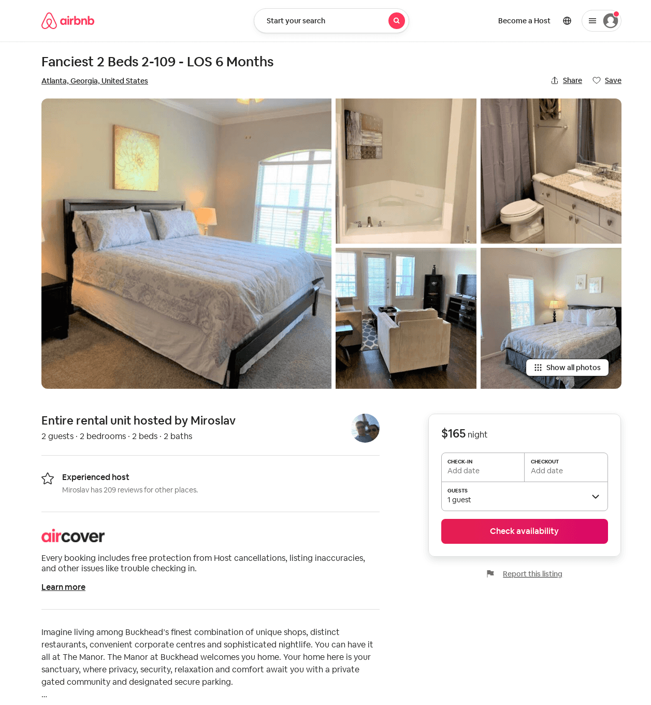
Listing 52682153
2
2
1
Miroslav
226804666
16
https://www.airbnb.com/rooms/52682153
Aug 2022

Slide 34
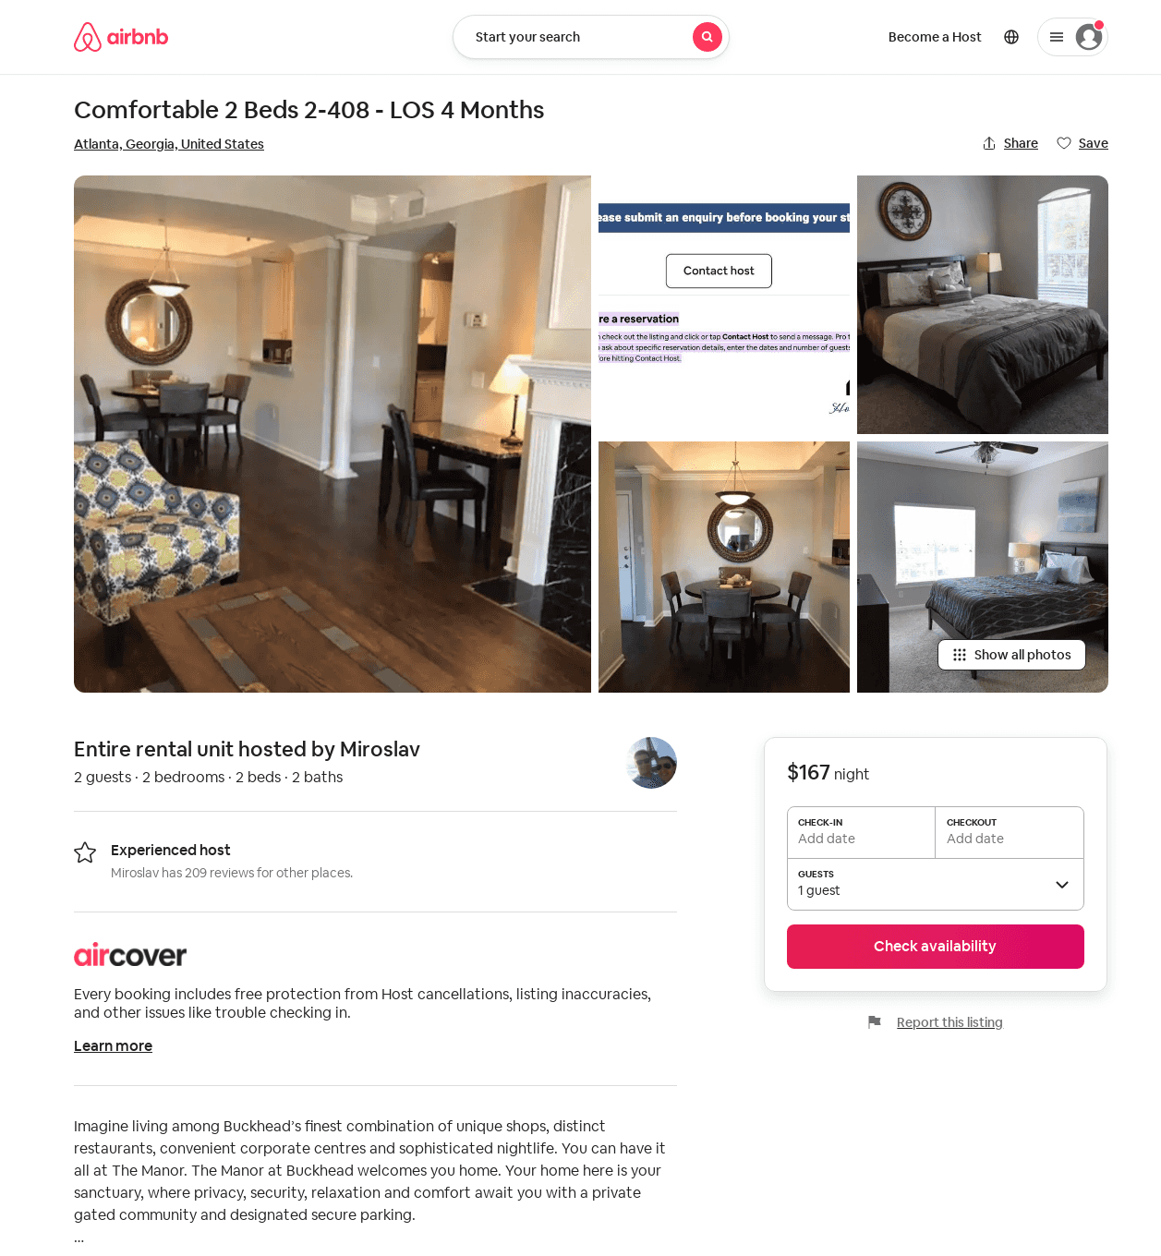
Listing 52686718
2
2
1
Miroslav
226804666
16
https://www.airbnb.com/rooms/52686718
Aug 2022

Slide 35
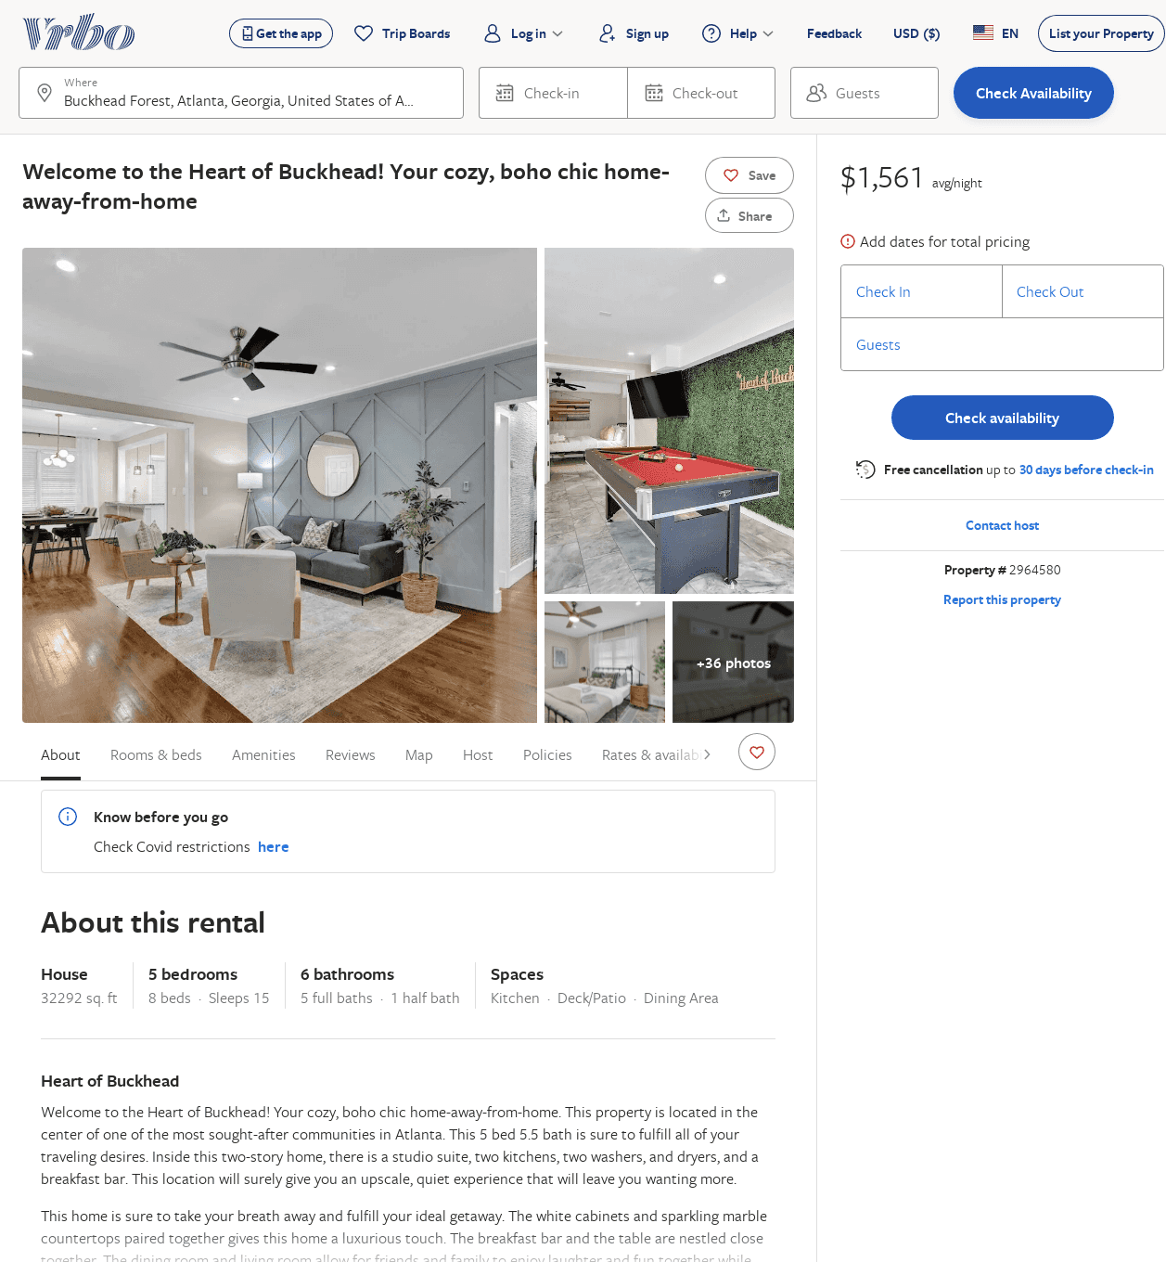
Listing 2964580
4
15
$1,543
1
anthony williams
https://www.vrbo.com/2964580
Aug 2022

