Slide 2
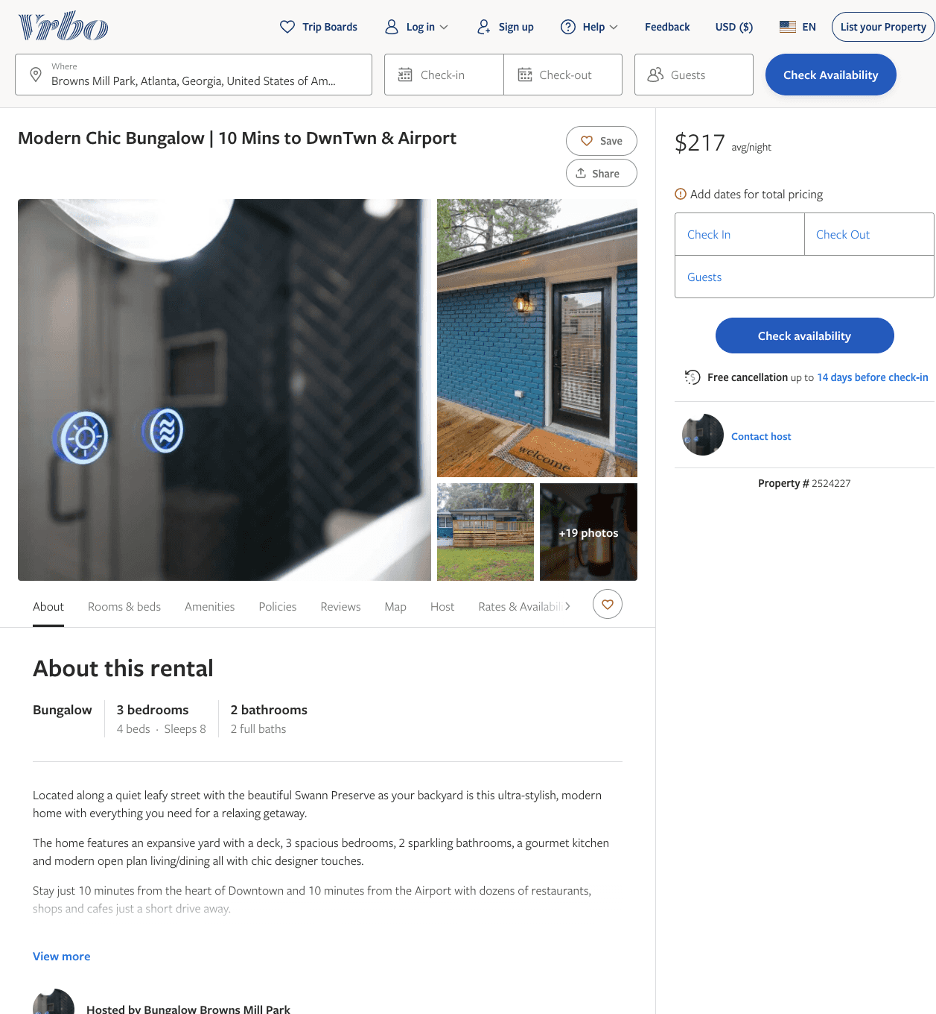
Listing 2524227
3
8
$190 - $223
2
https://www.vrbo.com/2524227
Aug 2022

Slide 3
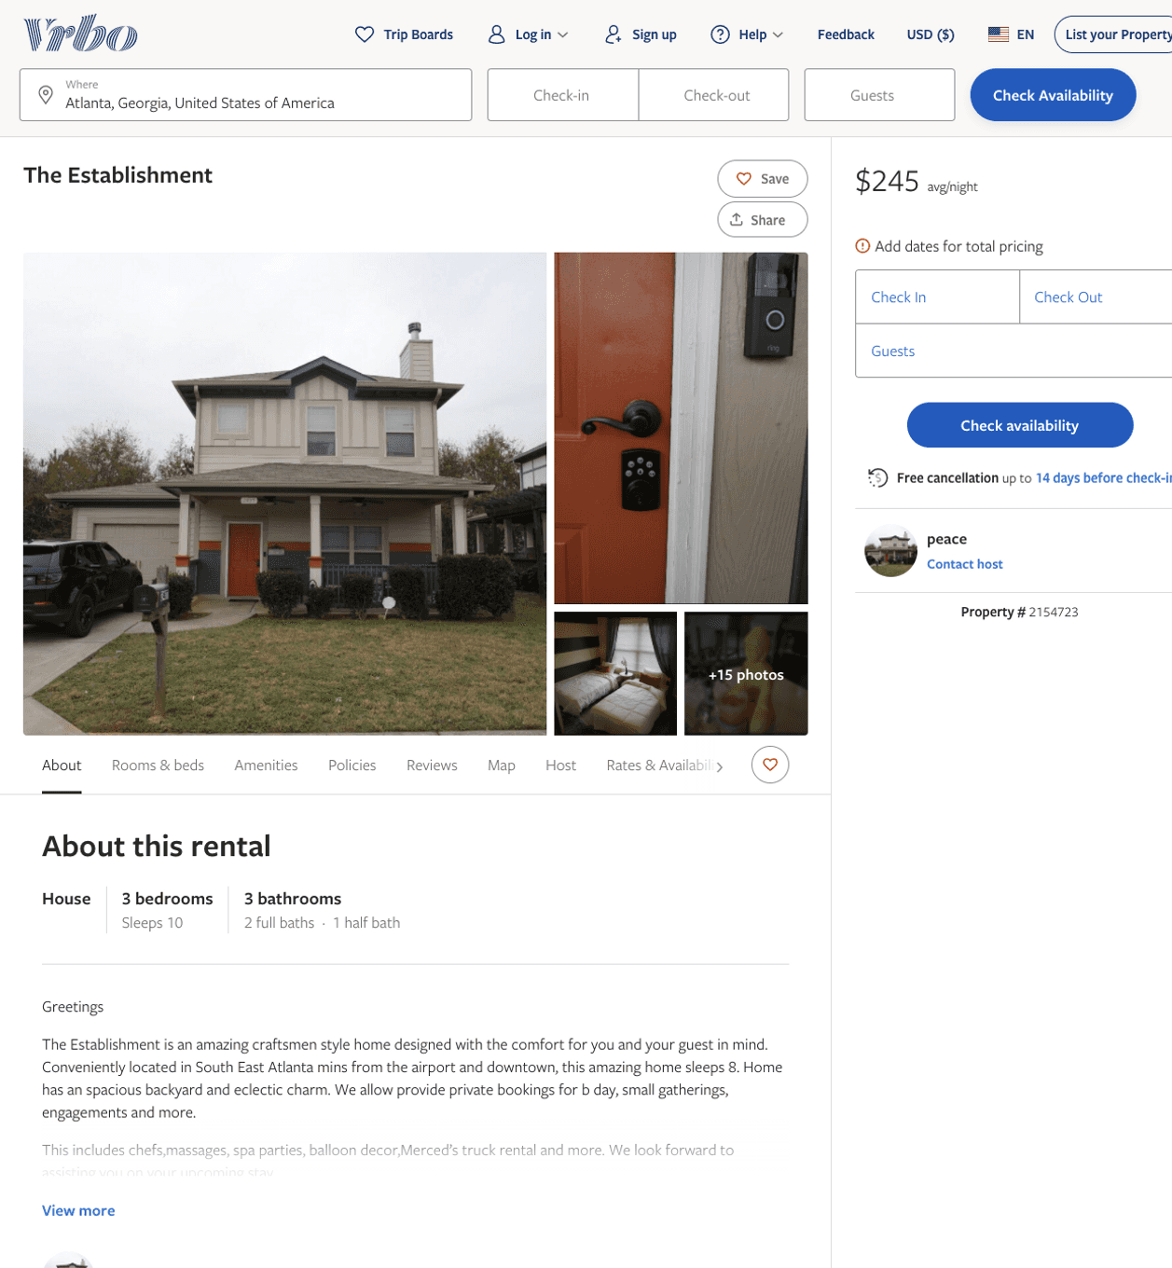
Listing 2154723
3
10
$245
2
peace
https://www.vrbo.com/2154723
Aug 2022

Slide 4
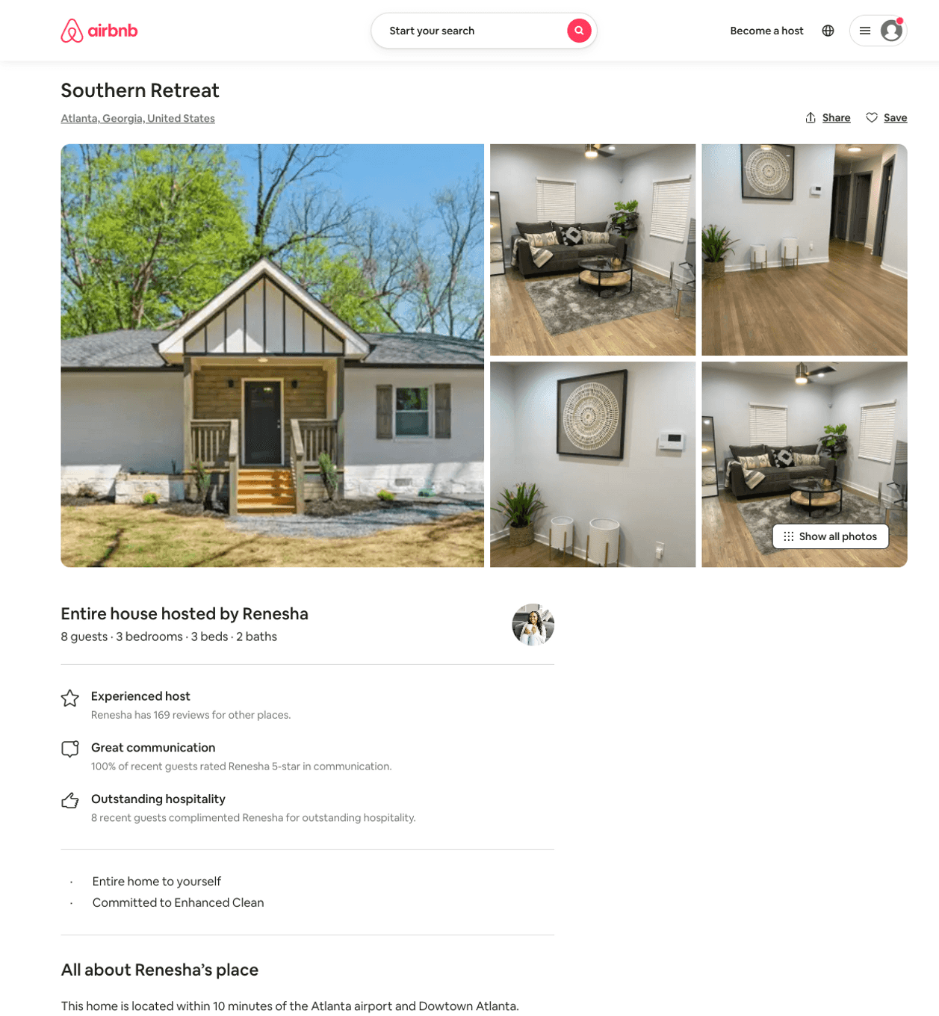
Listing 50682823
3
8
$113 - $250
4.70
2
Renesha
35038747
3
https://www.airbnb.com/rooms/50682823
Jul 2022

Slide 5
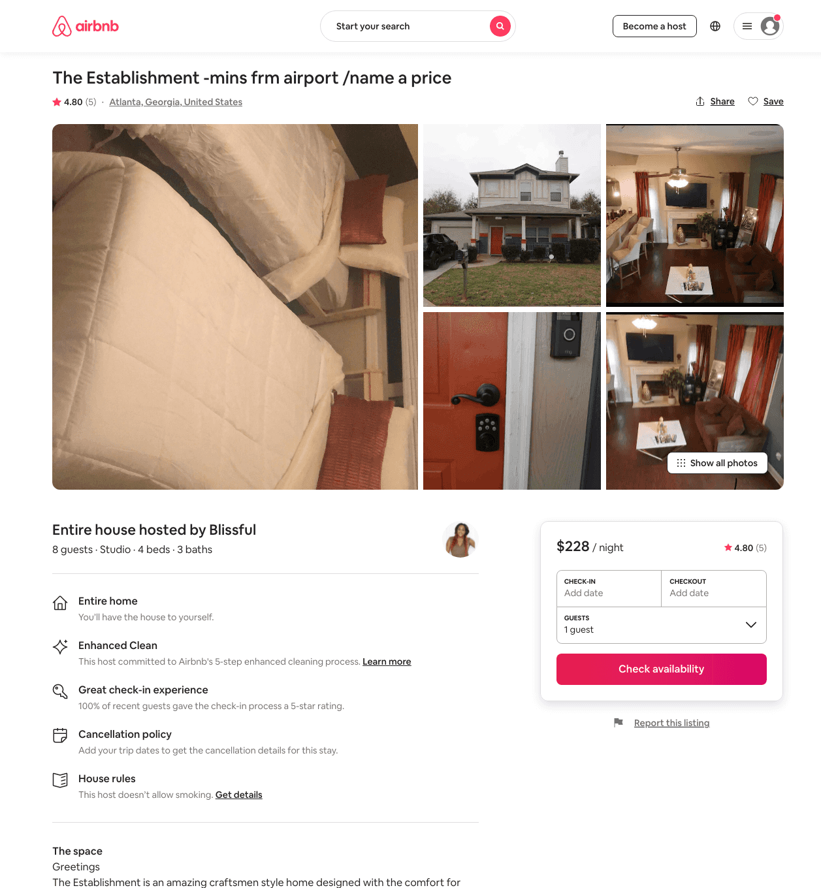
Listing 46661459
Studio
8
$197 - $236
4.44
1
Blissful
200438127
2
https://www.airbnb.com/rooms/46661459
Jun 2022

Slide 6
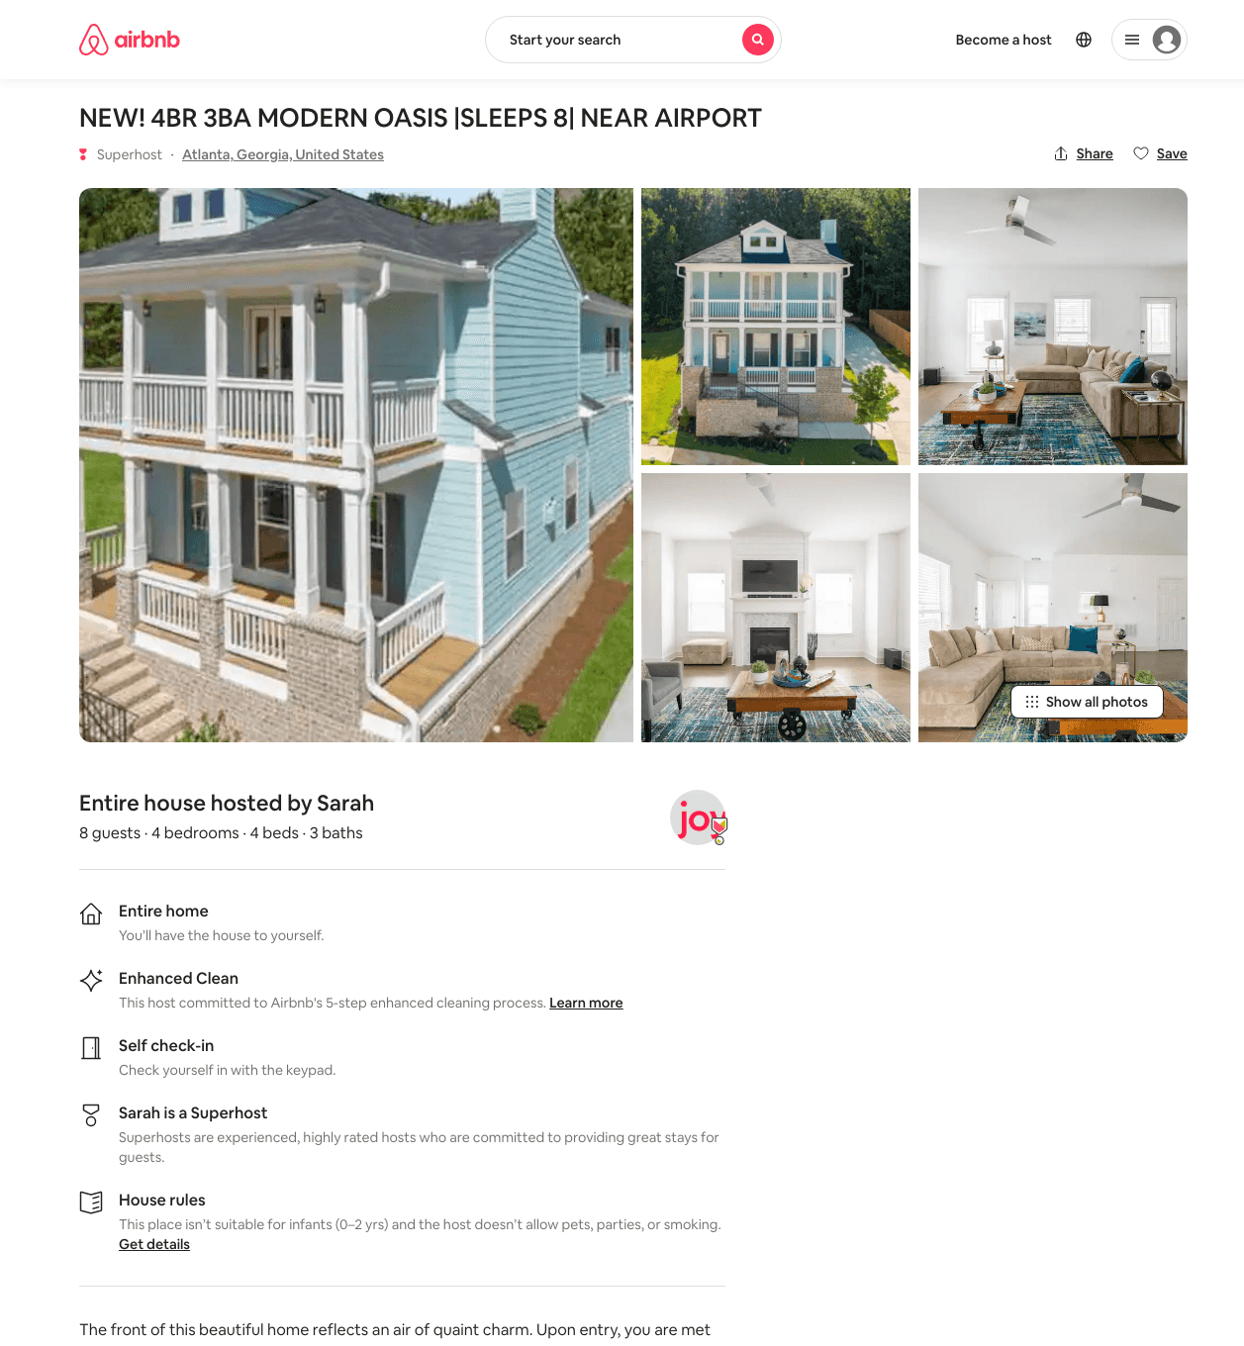
Listing 48960677
4
8
$199 - $699
4.75
2
Joy
238053341
13
https://www.airbnb.com/rooms/48960677
Jul 2022

Slide 7
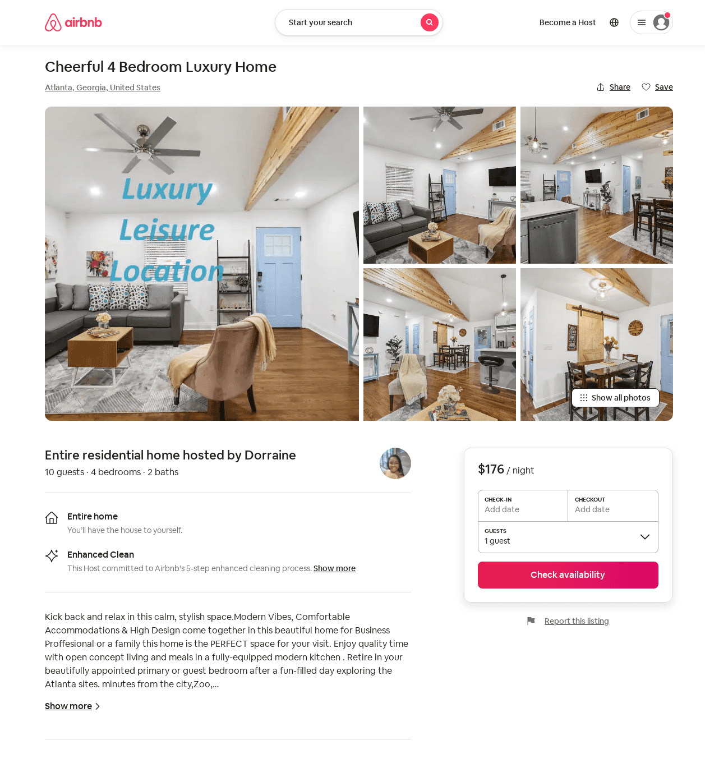
Listing 53273886
4
10
$159 - $200
4.76
2
Dorraine
357076572
1
https://www.airbnb.com/rooms/53273886
Aug 2022

Slide 8
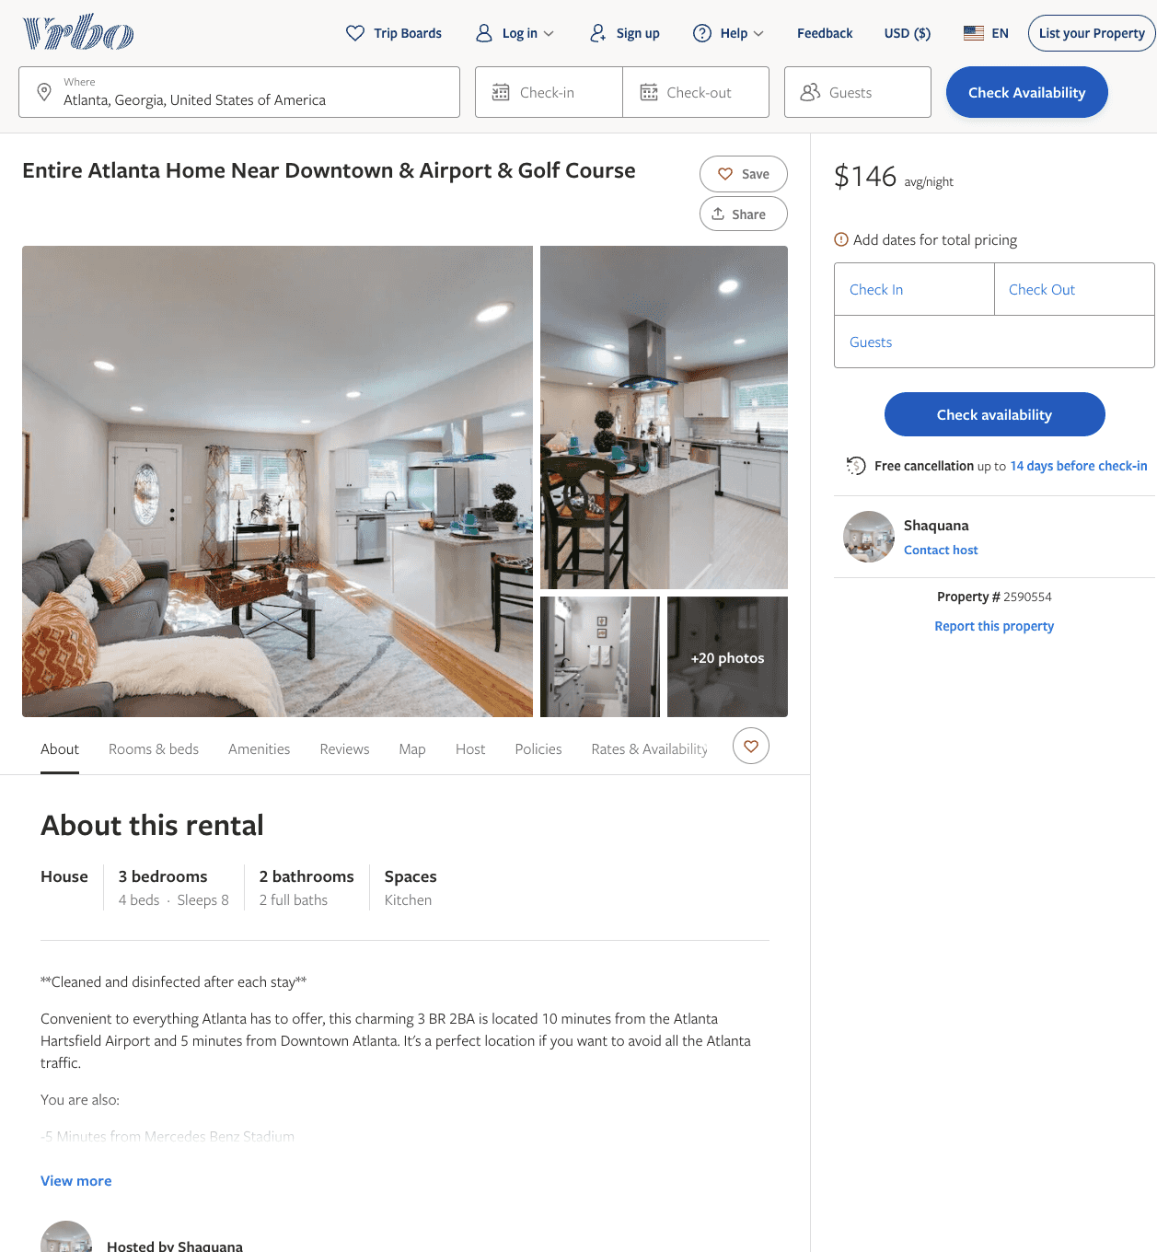
Listing 2590554
4
8
$145 - $150
5
2
Shaquana
https://www.vrbo.com/2590554
Aug 2022

Slide 9
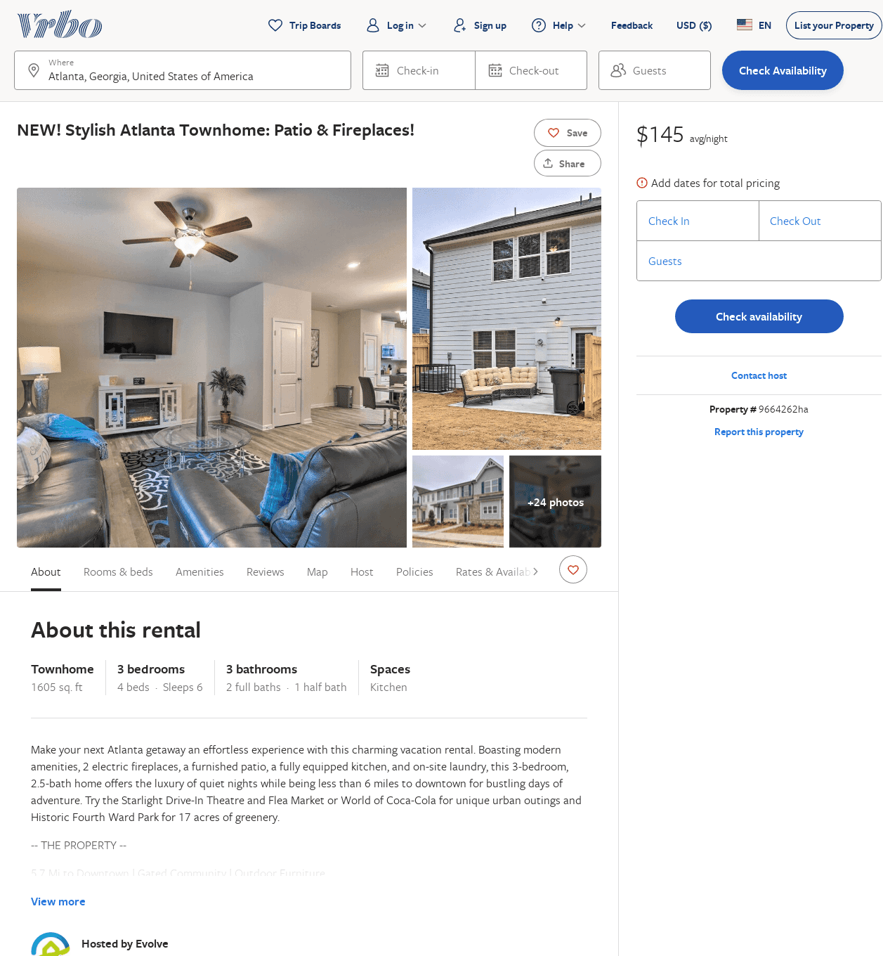
Listing 9664262
3
6
$117
2
Evolve
https://www.vrbo.com/9664262ha
Aug 2022

Slide 10
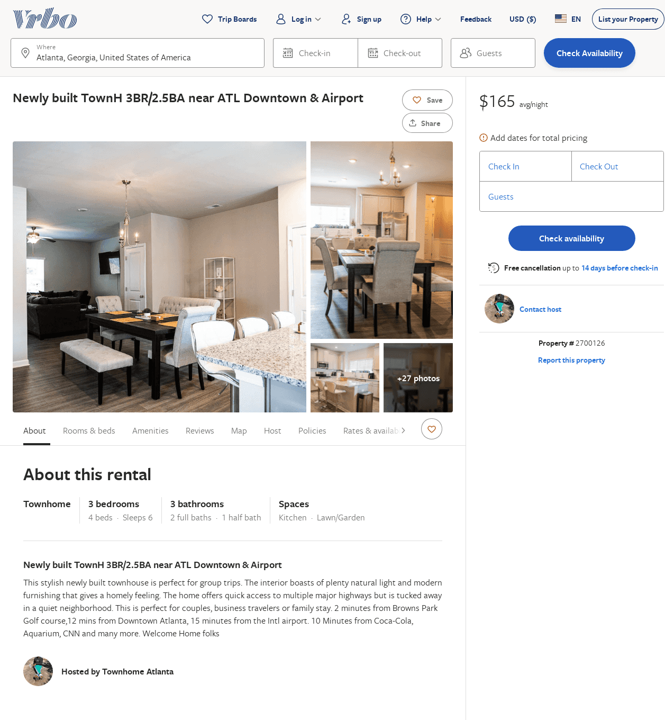
Listing 2700126
3
6
$167
1
https://www.vrbo.com/2700126
Aug 2022

Slide 11
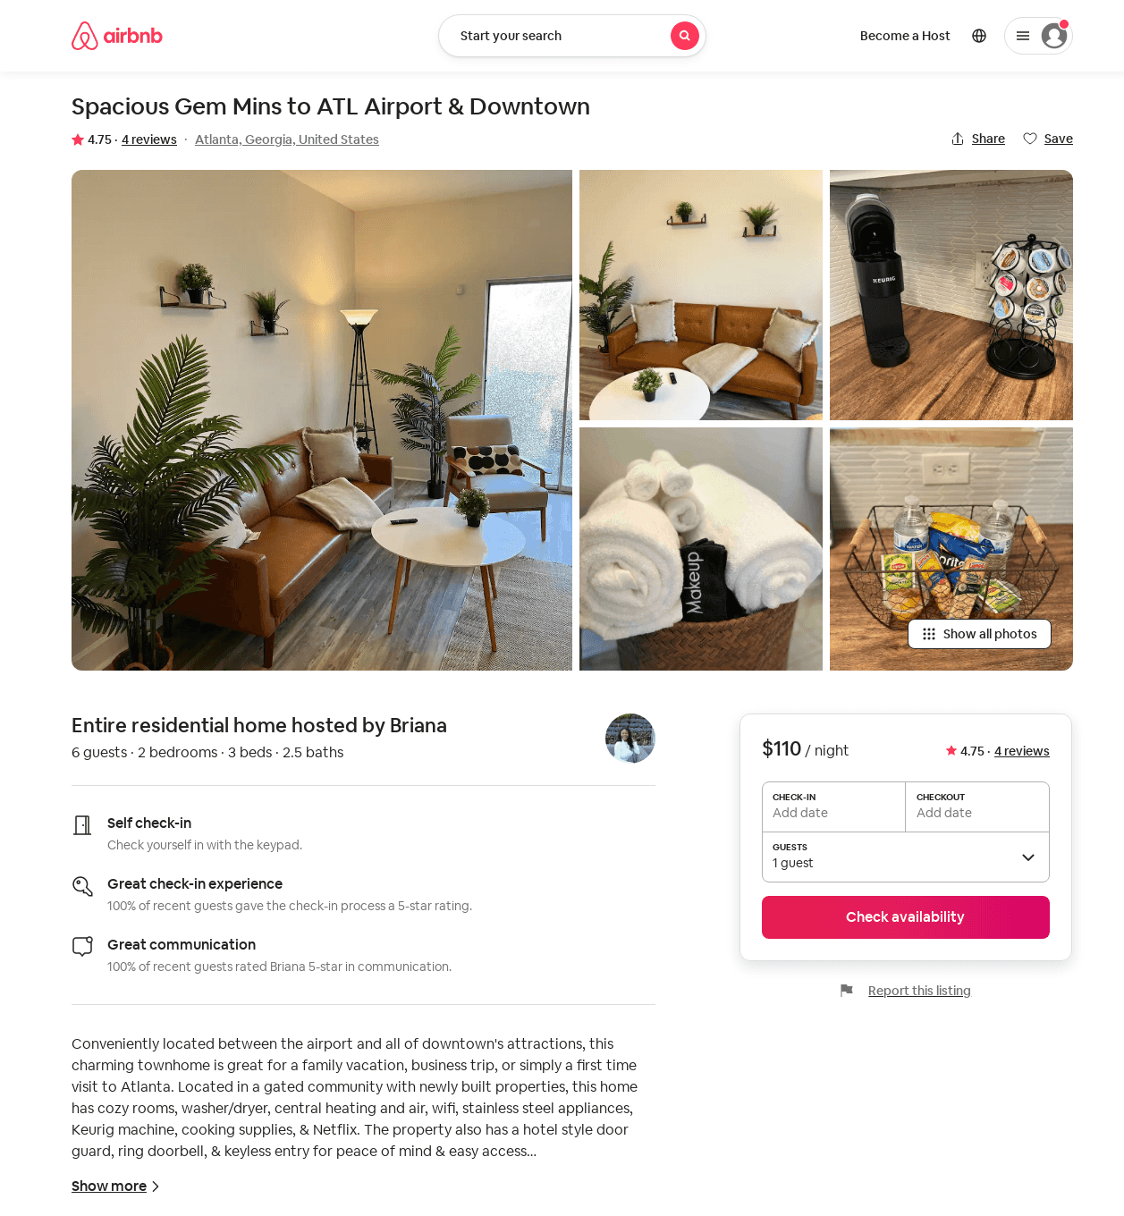
Listing 51797824
2
6
$96 - $123
4.86
2
Briana
160840134
1
https://www.airbnb.com/rooms/51797824
Jul 2022

Slide 12
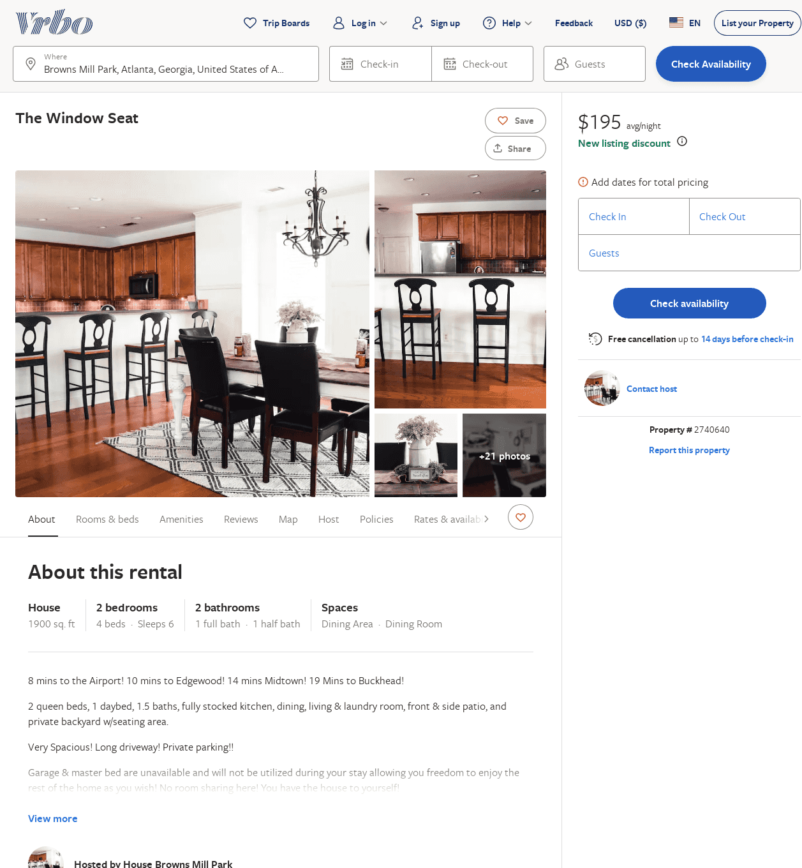
Listing 2740640
2
6
$195
2
https://www.vrbo.com/2740640
Aug 2022

Slide 13
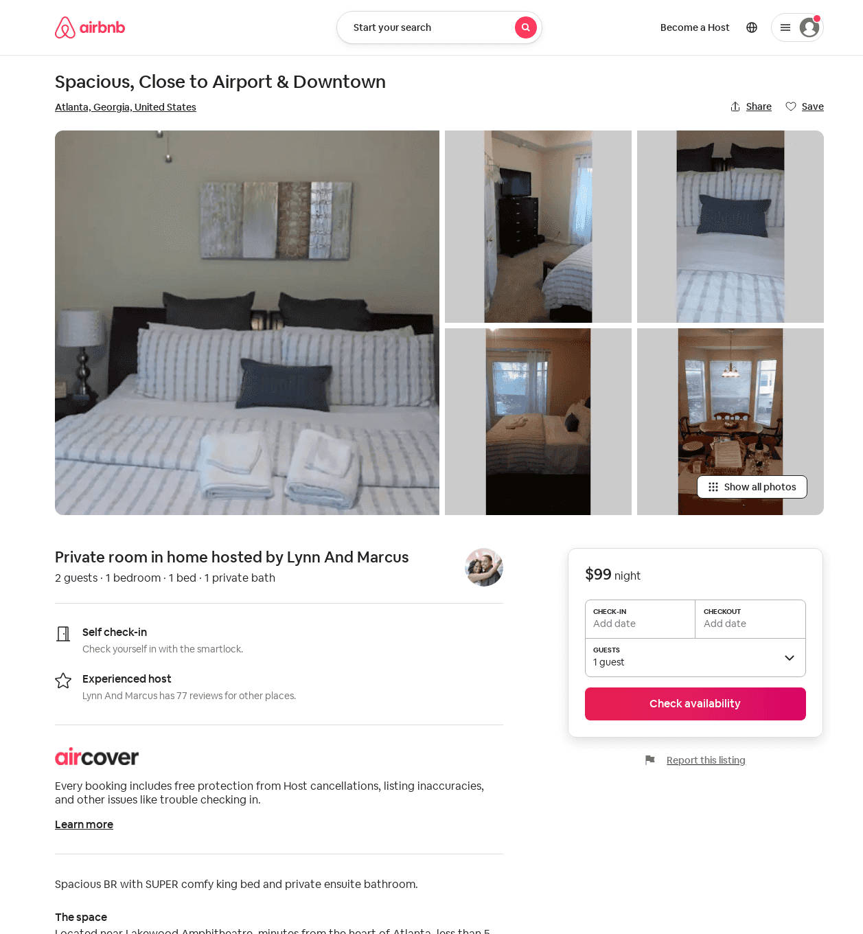
Listing 32026609
1
2
$99
1
Lynn And Marcus
3309046
1
https://www.airbnb.com/rooms/32026609
Aug 2022

Slide 14
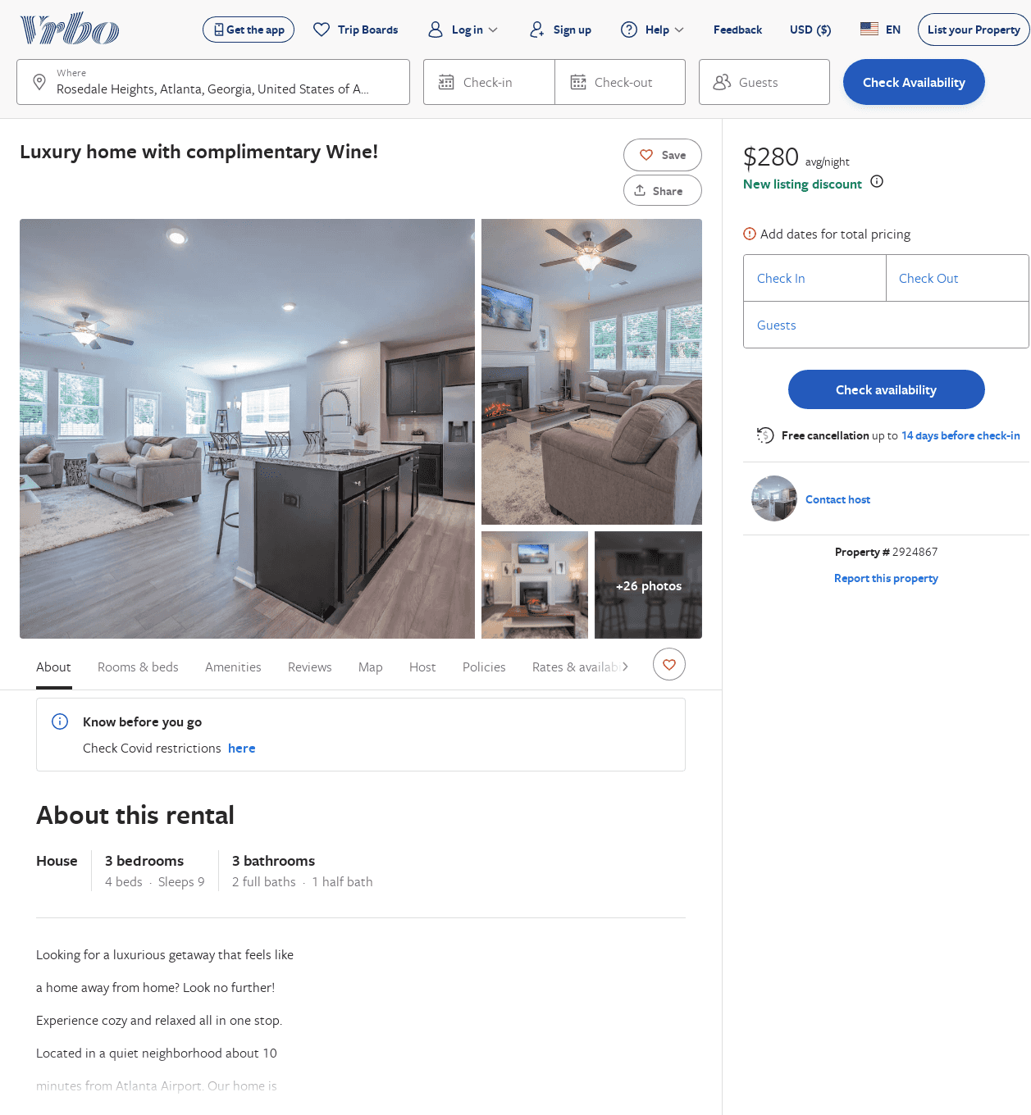
Listing 2924867
3
9
$214
2
natnail belete
https://www.vrbo.com/2924867
Aug 2022

Slide 15
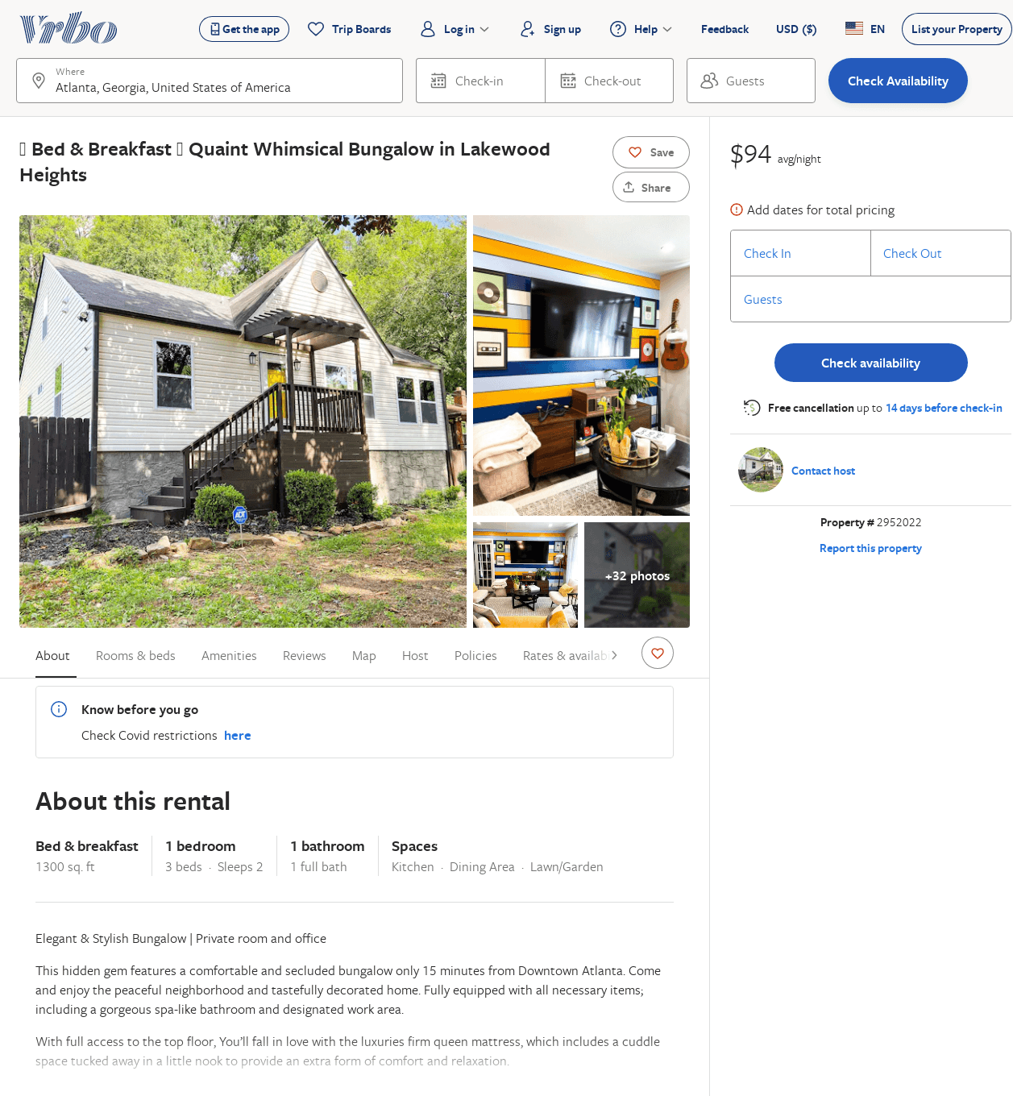
Listing 2952022
1
2
$101
1
https://www.vrbo.com/2952022
Aug 2022

