Slide 2
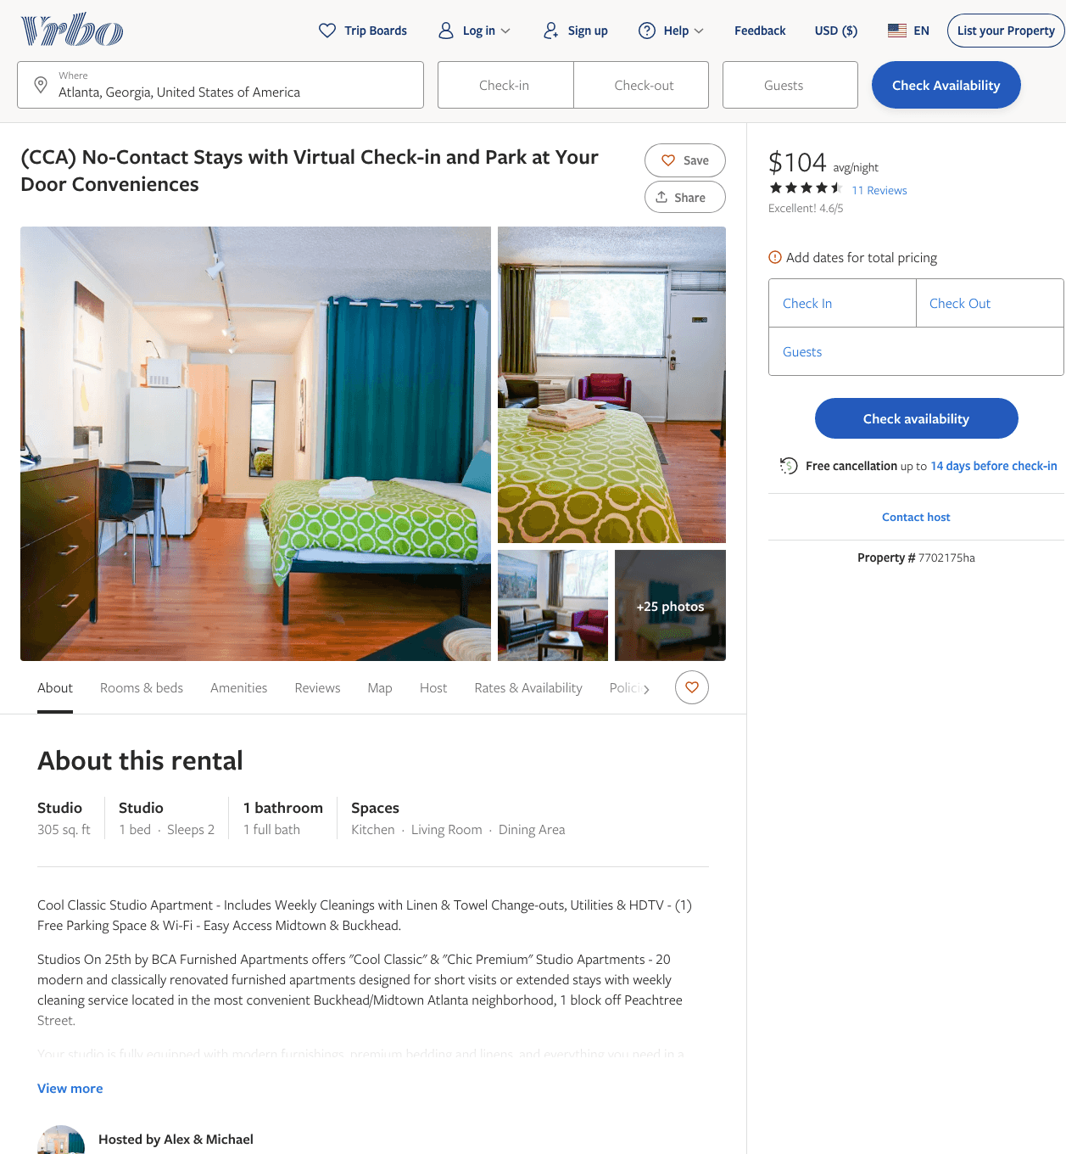
Listing 7702175
0
2
$100 - $99
4.7777777
1
Alex & Michael
https://www.vrbo.com/7702175ha
Aug 2022

Slide 3
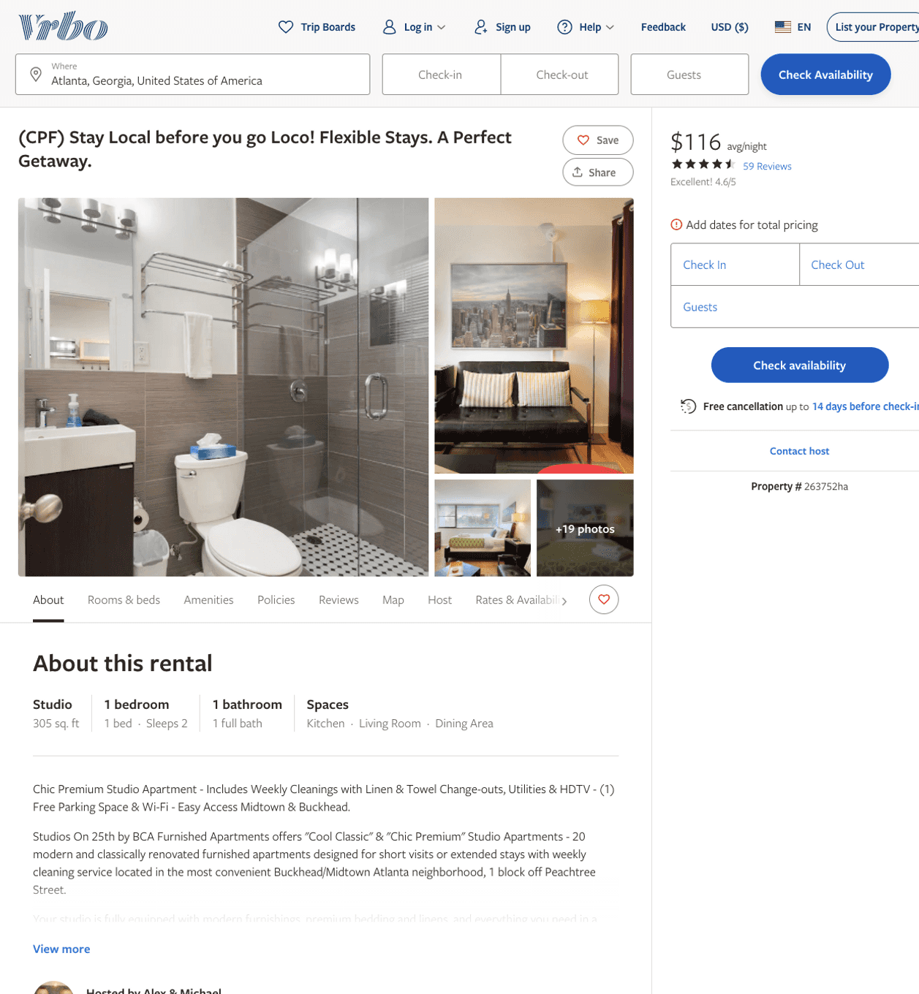
Listing 263752
1
2
$101 - $125
4.671642
1
Alex & Michael
https://www.vrbo.com/263752ha
Aug 2022

Slide 4
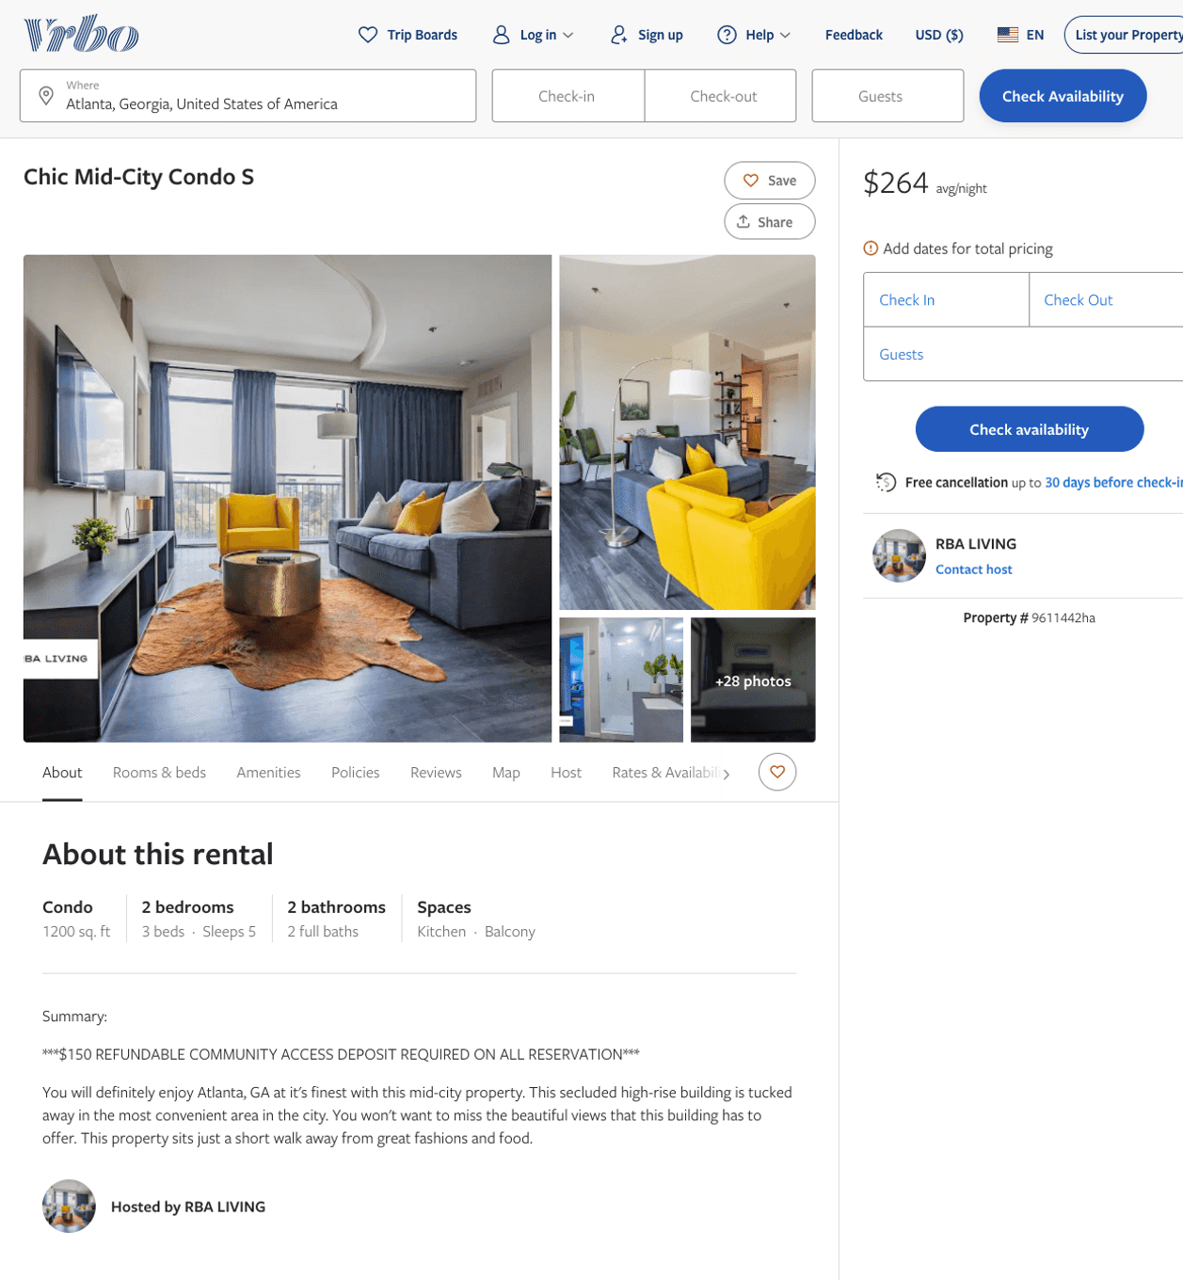
Listing 9611442
2
5
$206 - $290
1
RBA LIVING
https://www.vrbo.com/9611442ha
Aug 2022

Slide 5
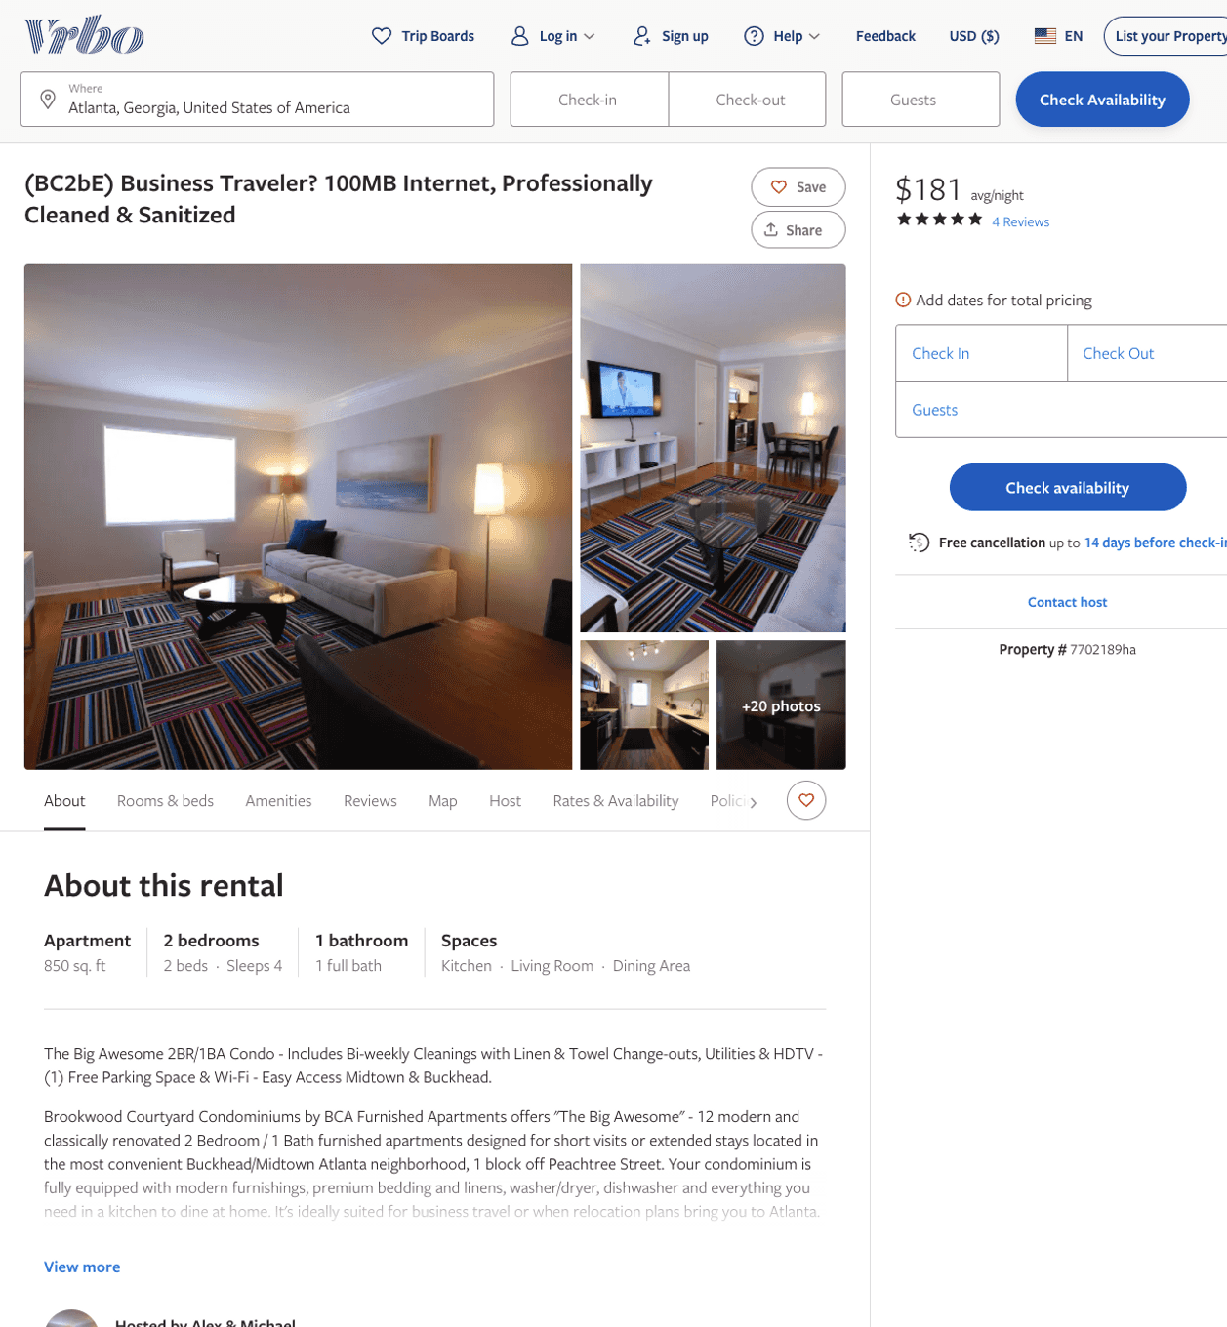
Listing 7702189
2
4
$173 - $191
5
1
Alex & Michael
https://www.vrbo.com/7702189ha
Aug 2022

Slide 6
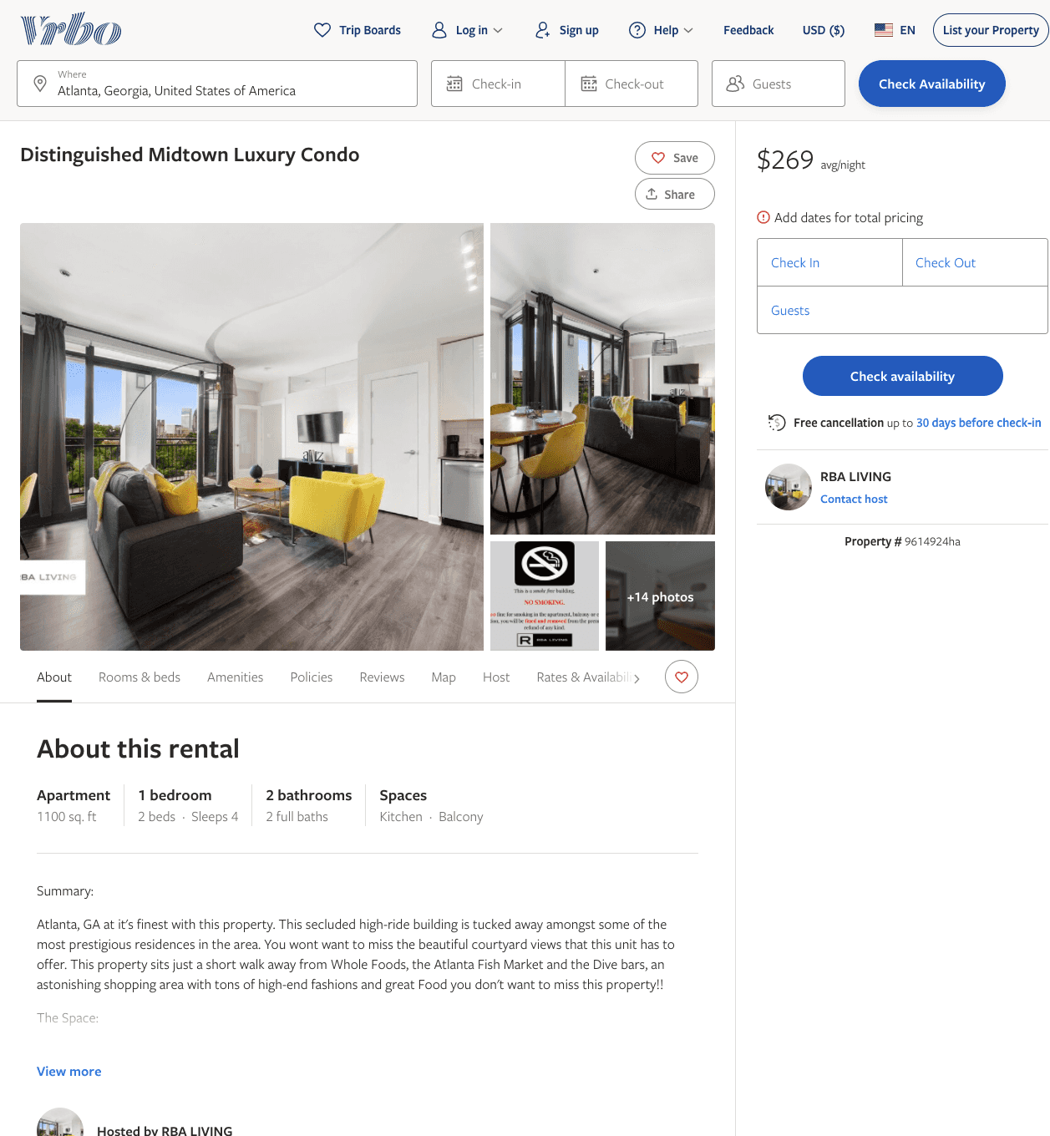
Listing 9614924
1
4
$216 - $277
2
RBA LIVING
https://www.vrbo.com/9614924ha
Aug 2022

Slide 7
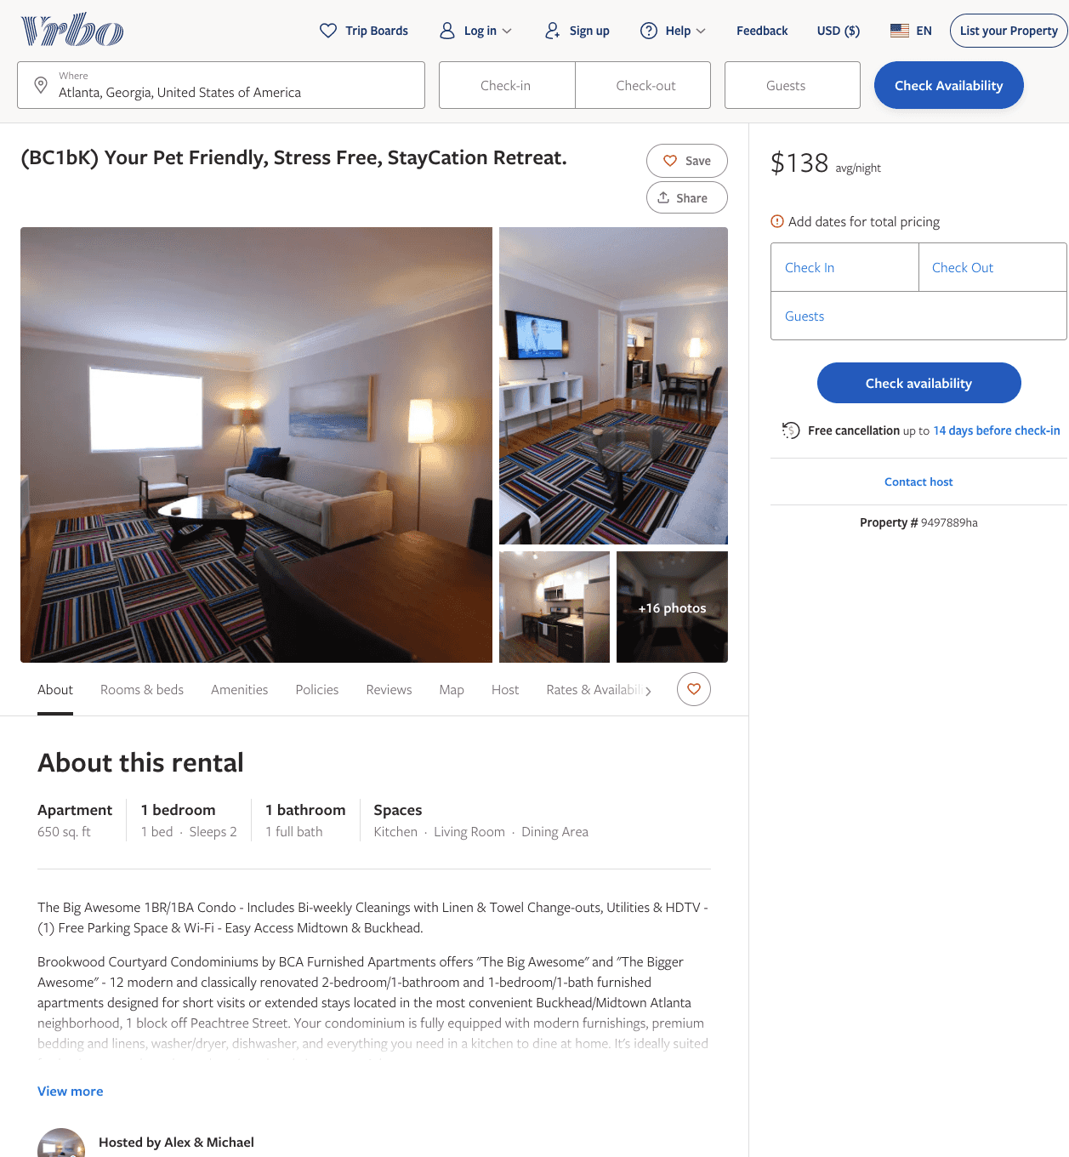
Listing 9497889
1
2
$130 - $161
5
1
Alex & Michael
https://www.vrbo.com/9497889ha
Aug 2022

Slide 8
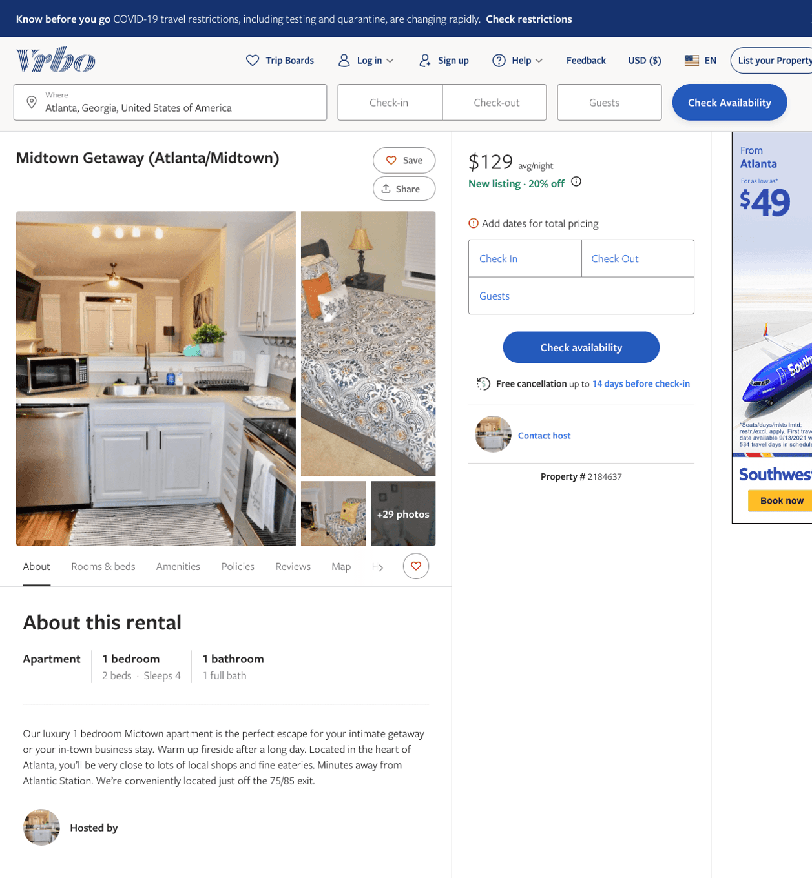
Listing 2184637
1
4
$129
1
1
https://www.vrbo.com/2184637
Aug 2022

Slide 9
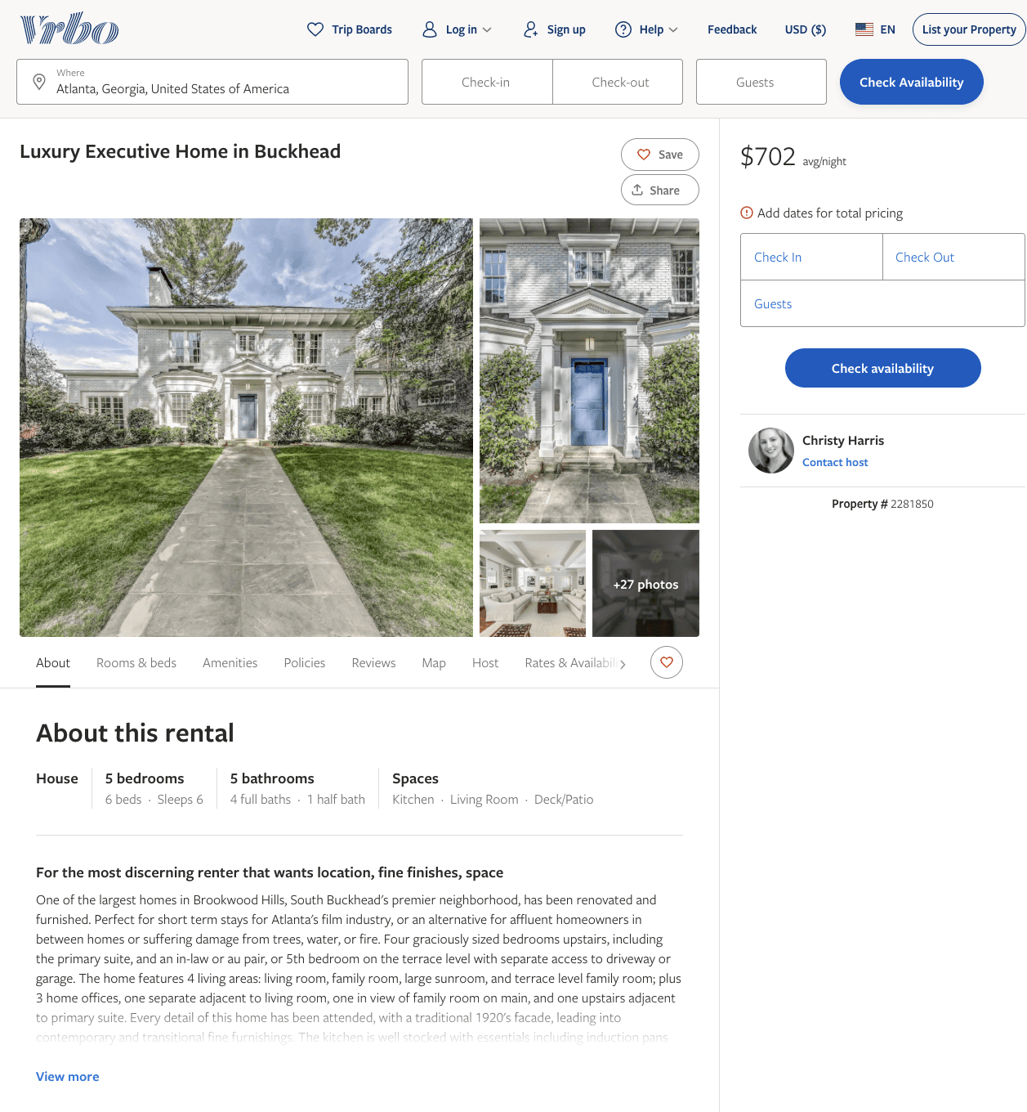
Listing 2281850
5
6
$702
30
Christy Harris
https://www.vrbo.com/2281850
Aug 2022

Slide 10
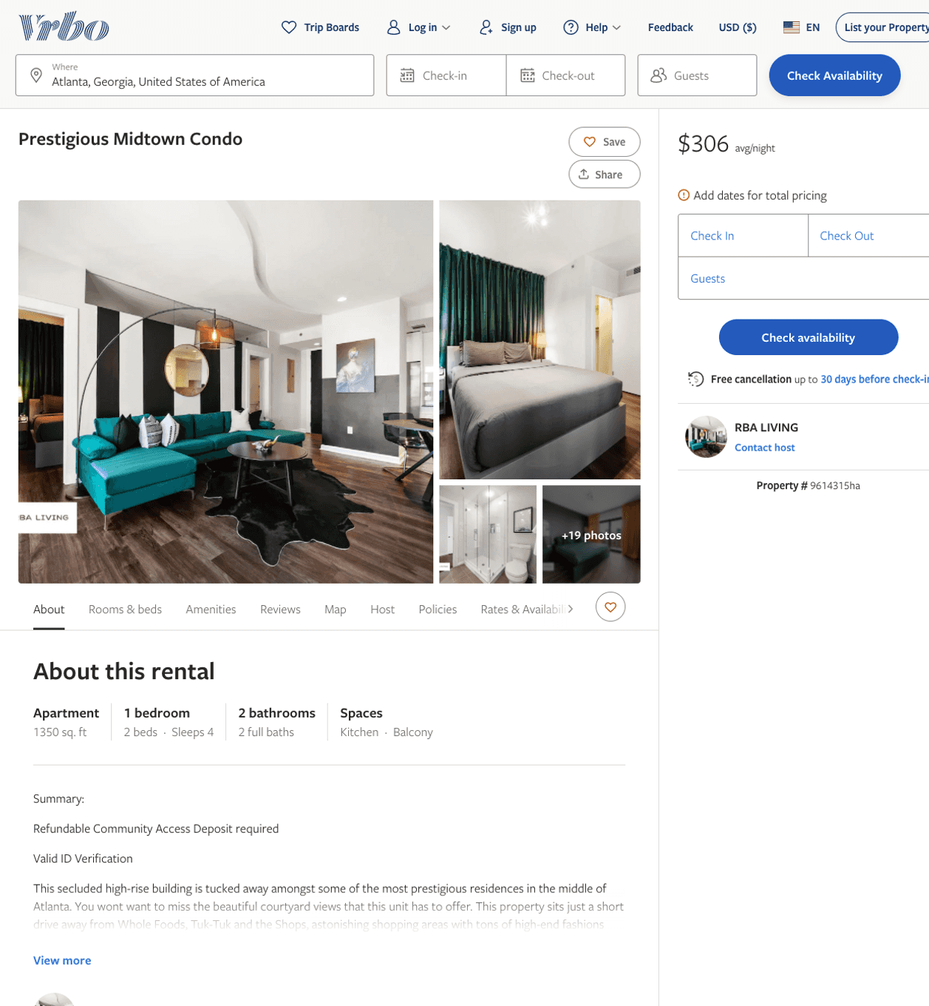
Listing 9614315
1
4
$207 - $306
2
RBA LIVING
https://www.vrbo.com/9614315ha
Aug 2022

Slide 11
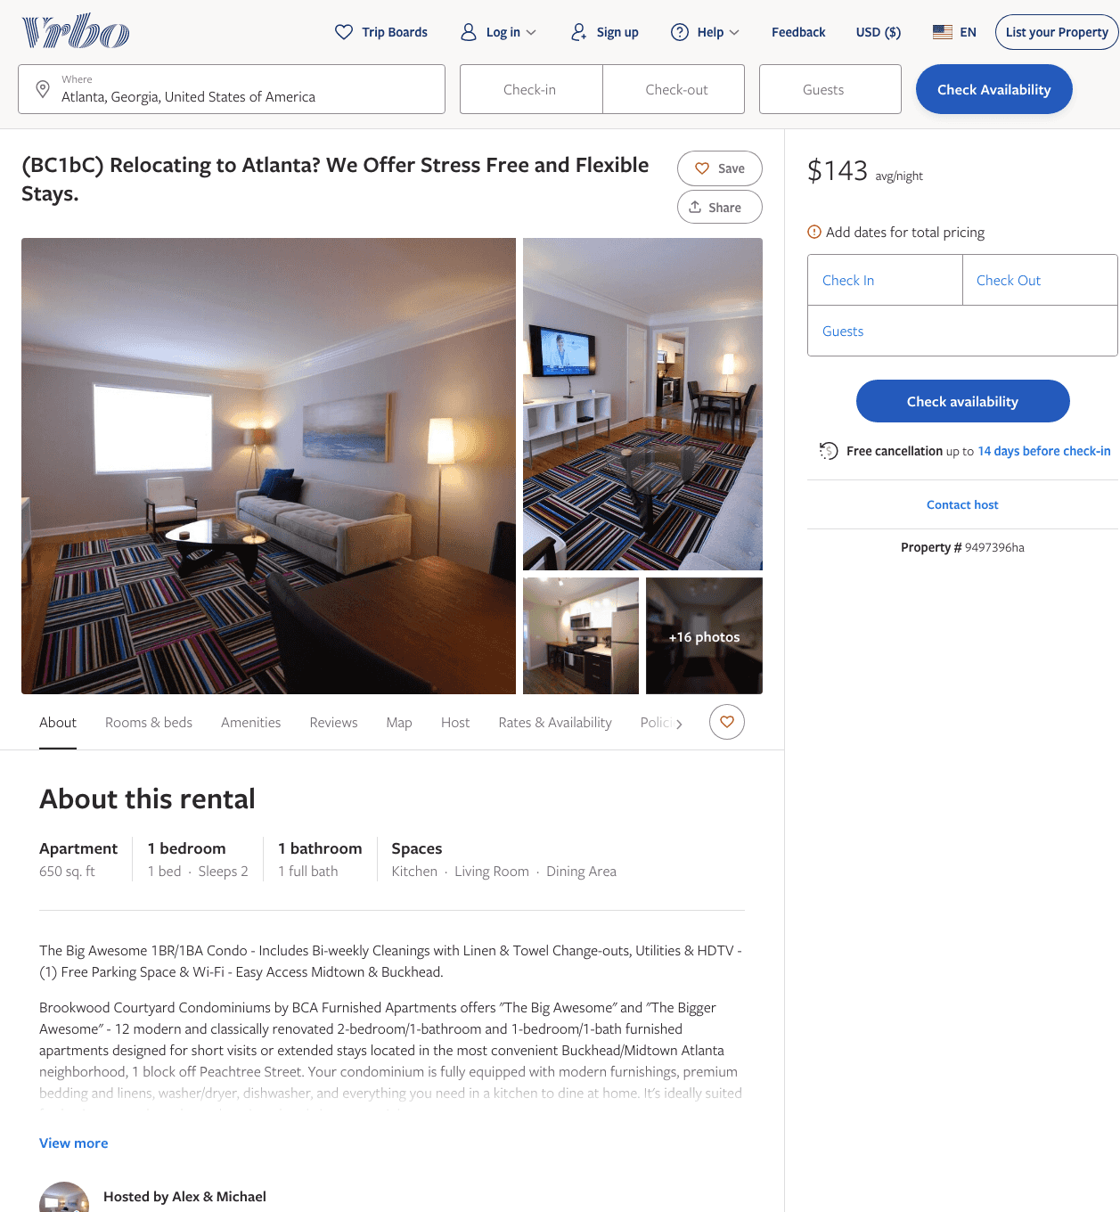
Listing 9497396
1
2
$130 - $145
5
1
Alex & Michael
https://www.vrbo.com/9497396ha
Aug 2022

Slide 12
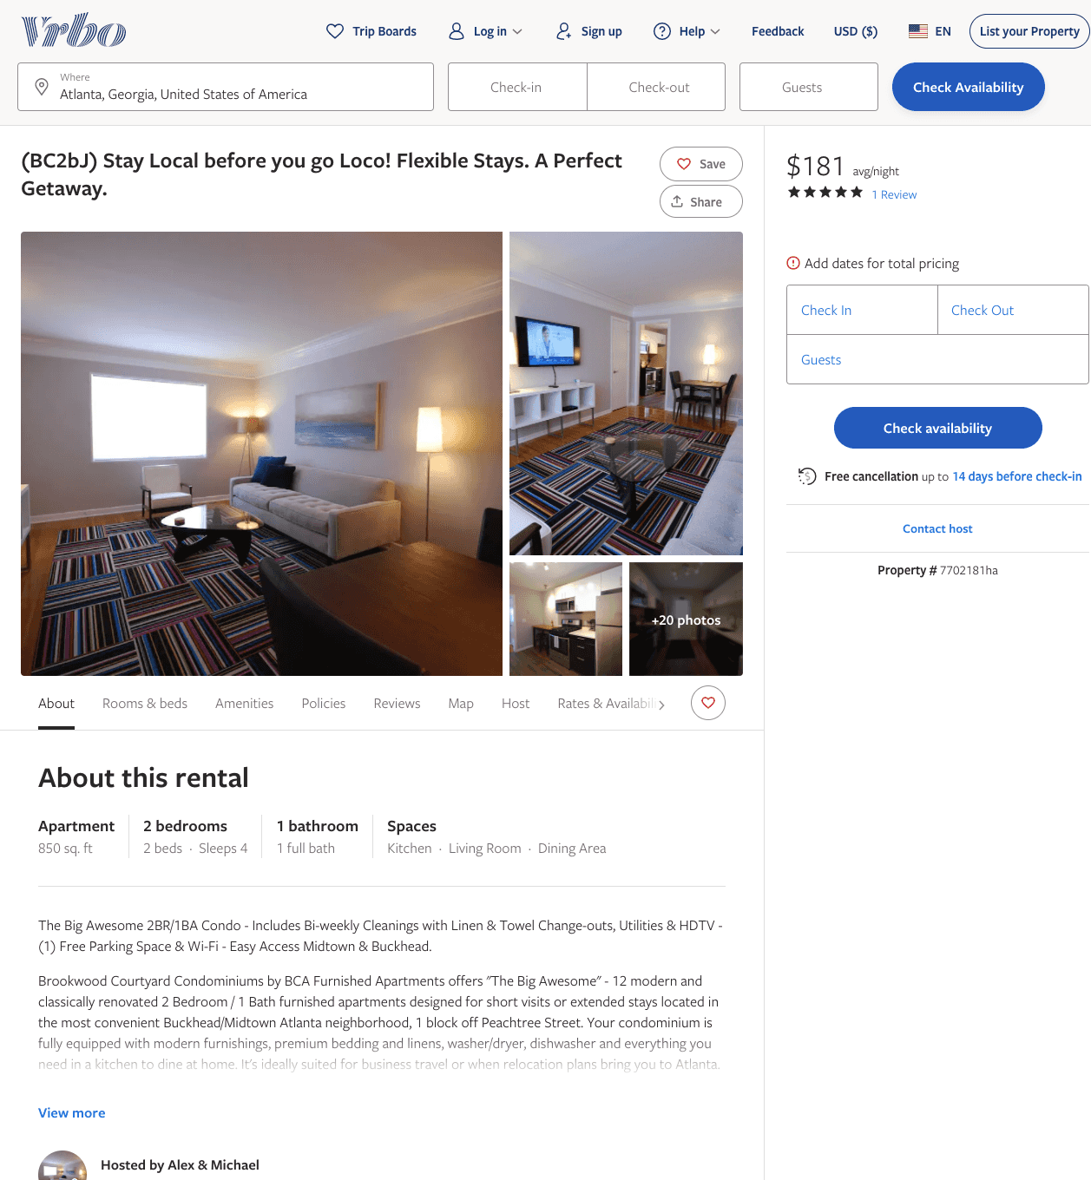
Listing 7702181
2
4
$159 - $191
5
1
Alex & Michael
https://www.vrbo.com/7702181ha
Aug 2022

Slide 13
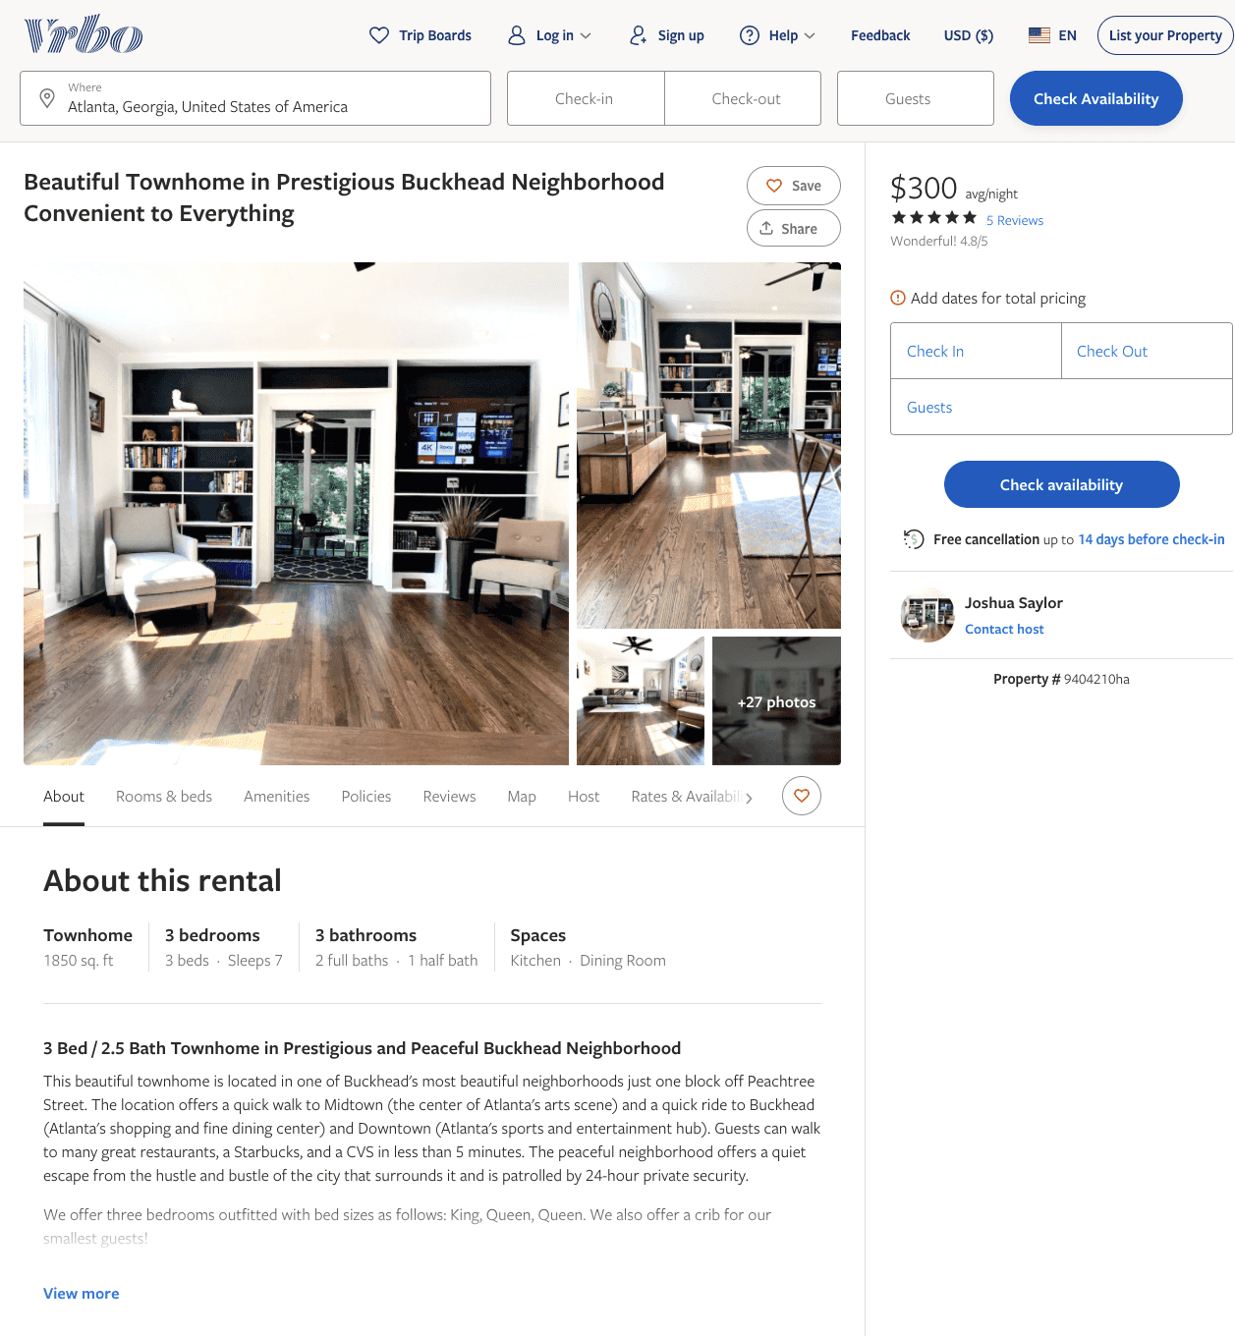
Listing 9404210
3
7
$300 - $400
4.8
2
Joshua Saylor
https://www.vrbo.com/9404210ha
Aug 2022

Slide 14
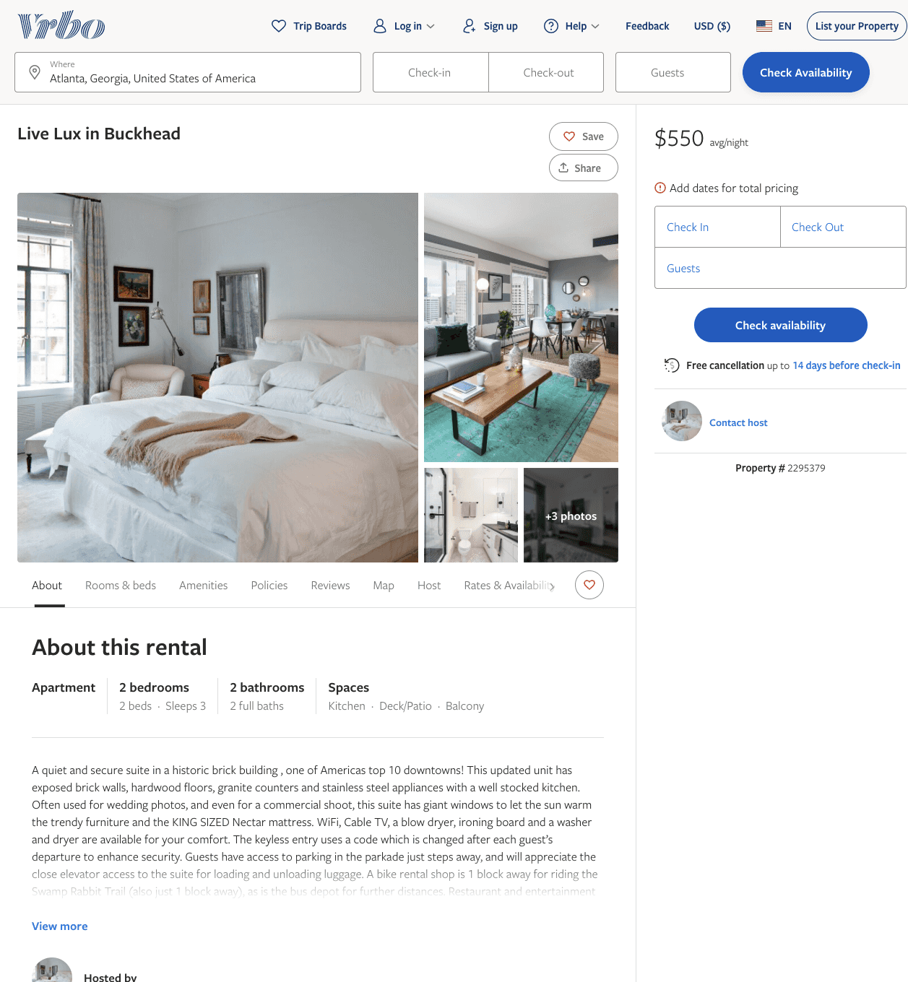
Listing 2295379
2
3
$550
2
https://www.vrbo.com/2295379
Aug 2022

Slide 15
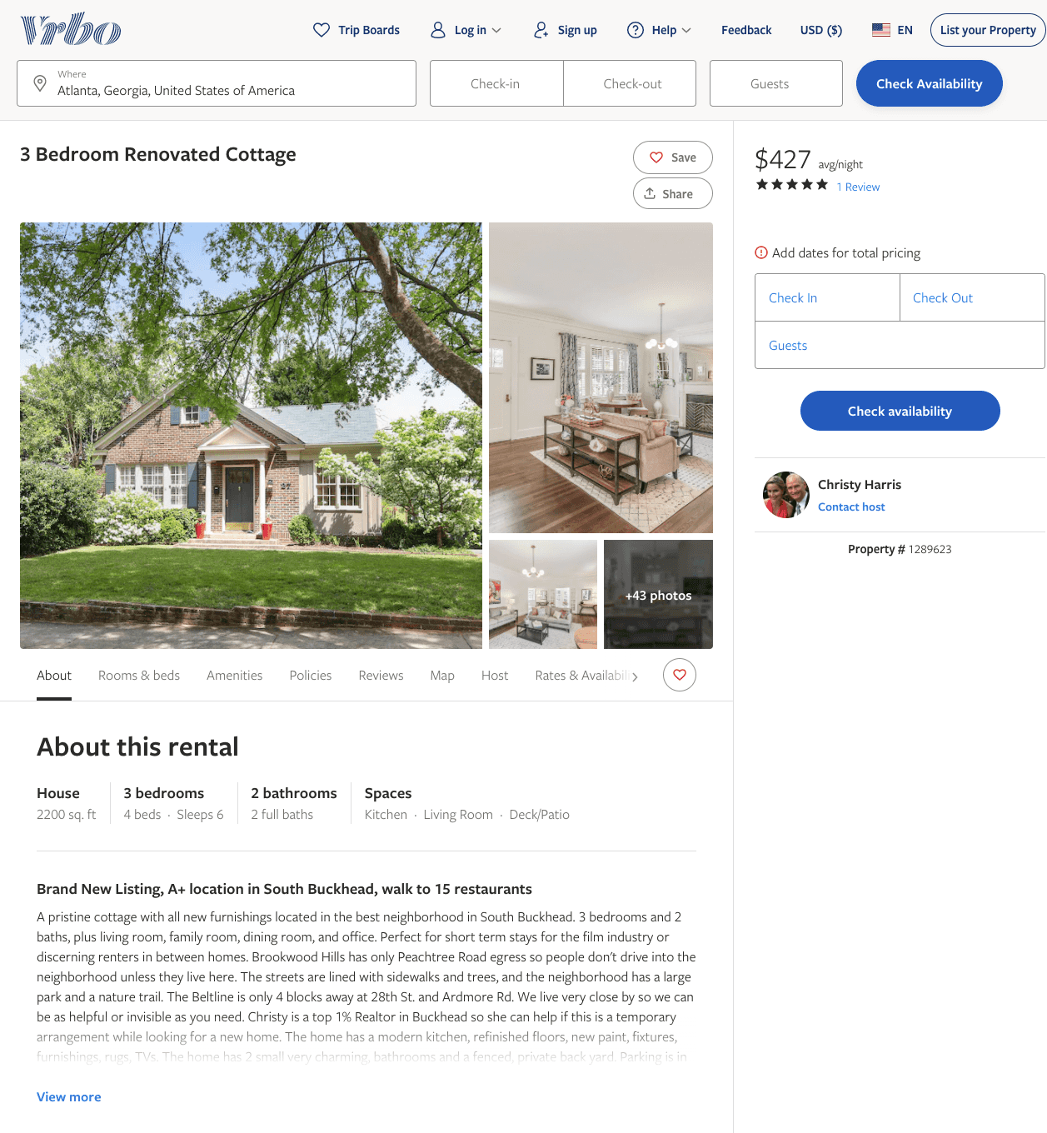
Listing 1289623
3
6
$427
5
5
Christy Harris
https://www.vrbo.com/1289623
Aug 2022

Slide 16
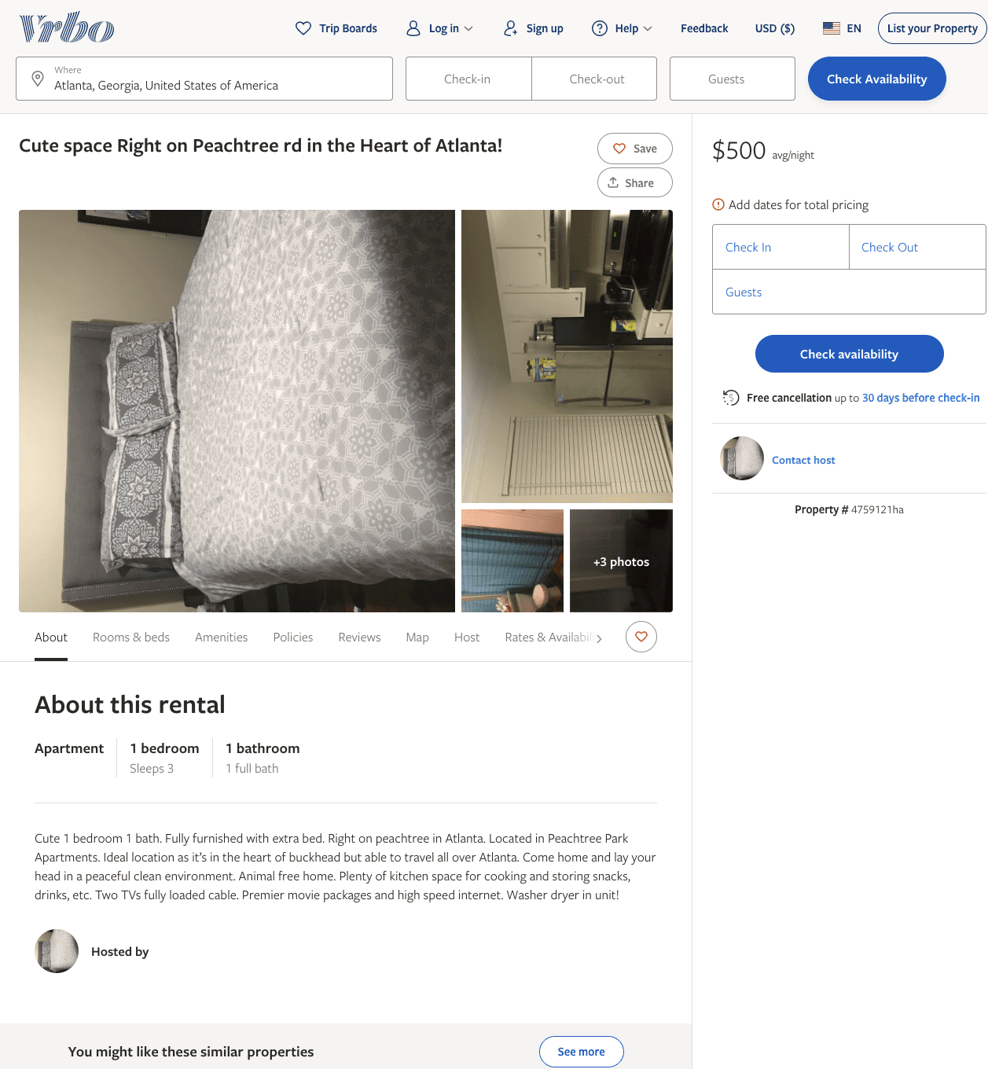
Listing 4759121
1
3
$500
3
https://www.vrbo.com/4759121ha
Aug 2022

Slide 17
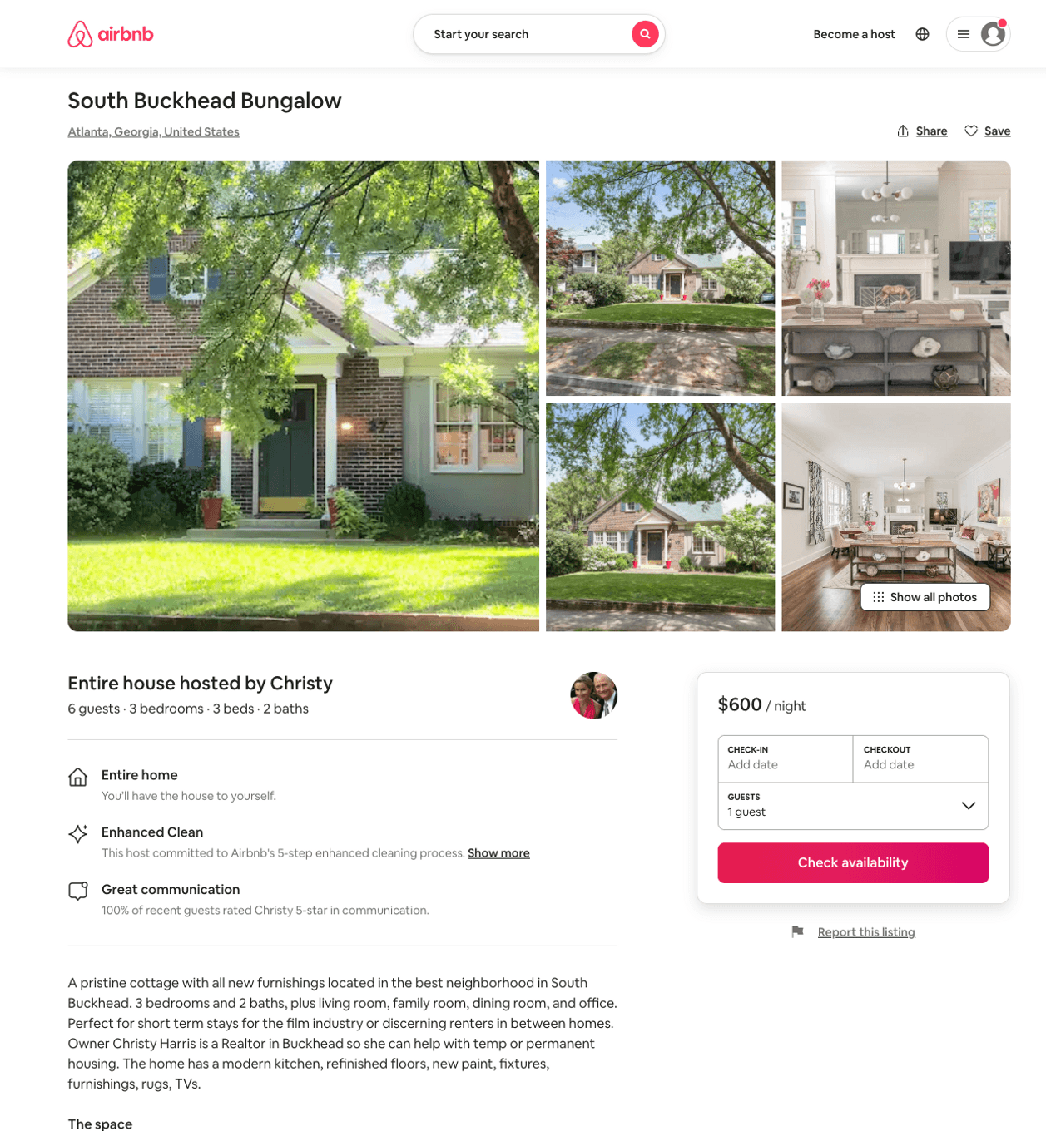
Listing 28977664
3
6
$600
30
Christy
21749915
3
https://www.airbnb.com/rooms/28977664
Aug 2022

Slide 18
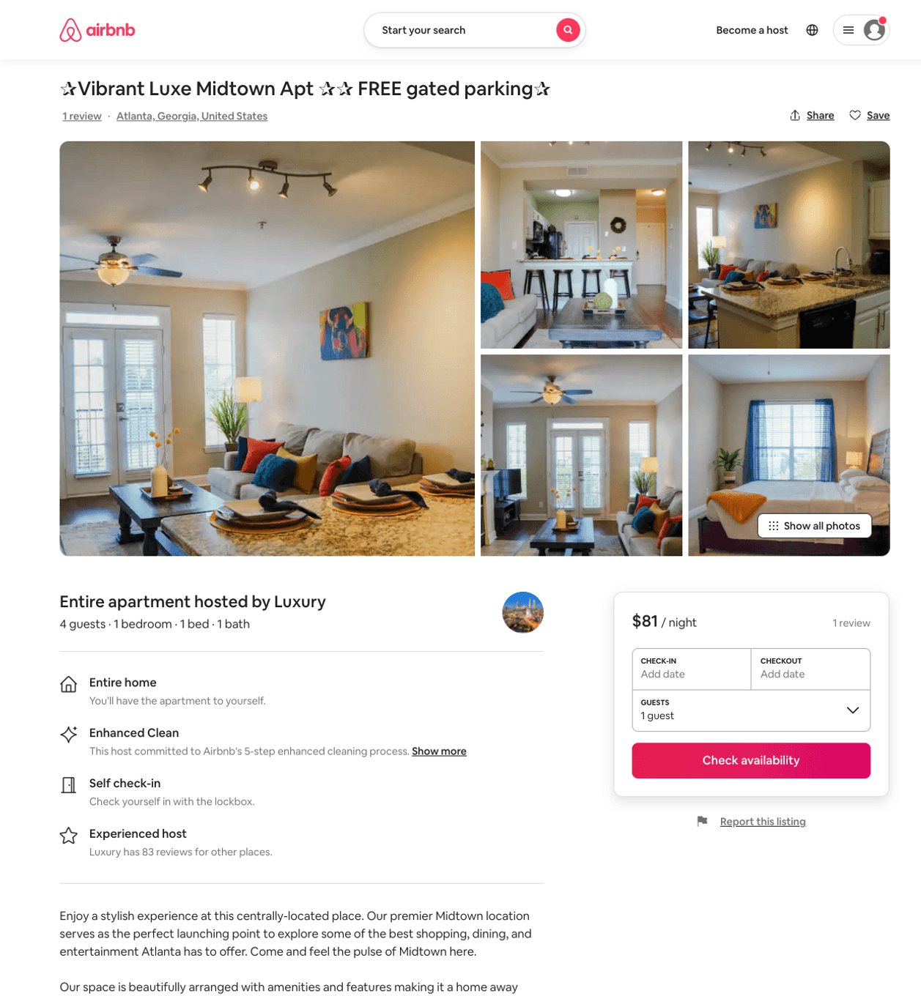
Listing 50578086
1
4
$77 - $141
4.78
2
Luxury
303777726
2
https://www.airbnb.com/rooms/50578086
Aug 2022

Slide 19
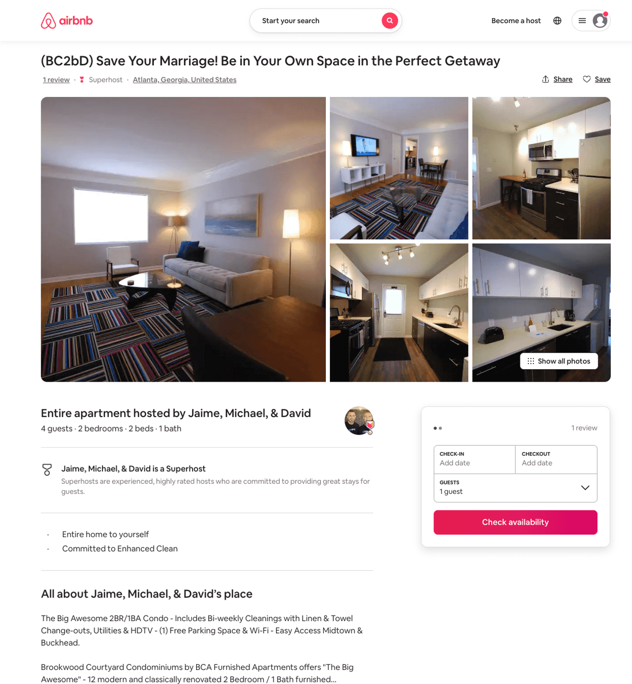
Listing 33563765
2
4
$160 - $223
1
Jaime, Michael, & David
16469655
56
https://www.airbnb.com/rooms/33563765
Jun 2022

Slide 20
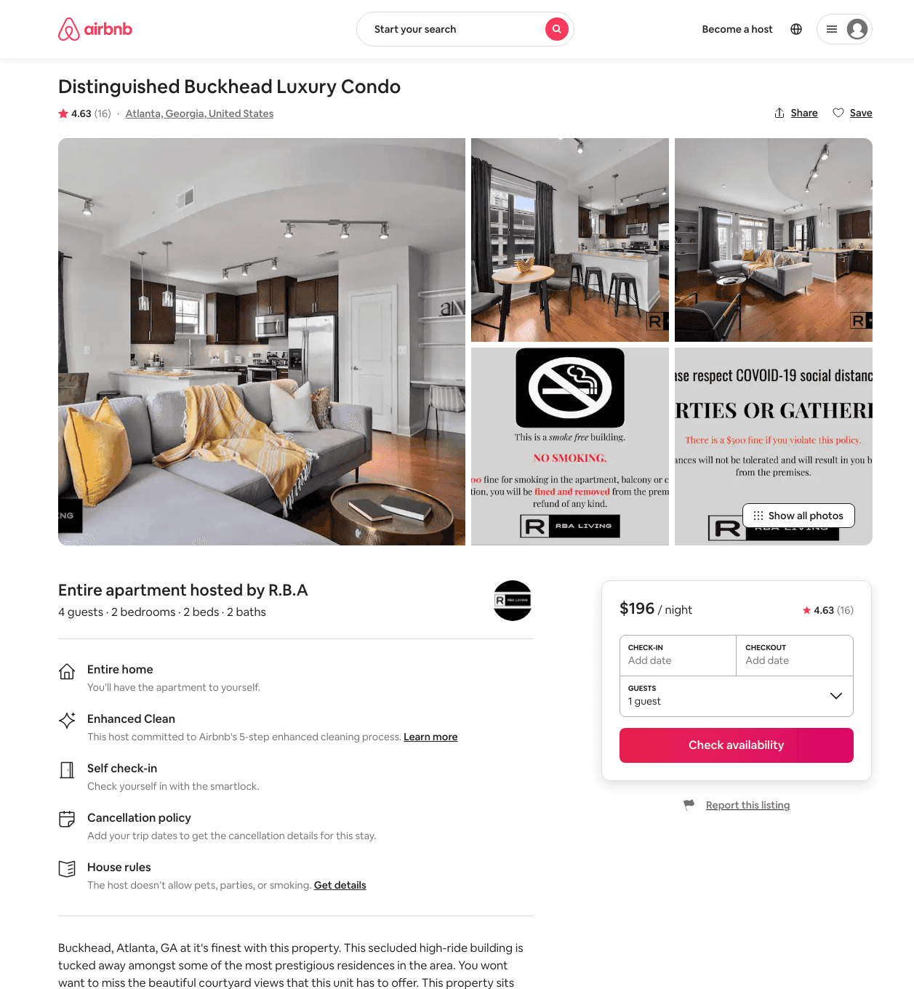
Listing 44018975
2
4
$148 - $253
4.39
2
R.B.A
26534449
17
https://www.airbnb.com/rooms/44018975
Aug 2022

Slide 21
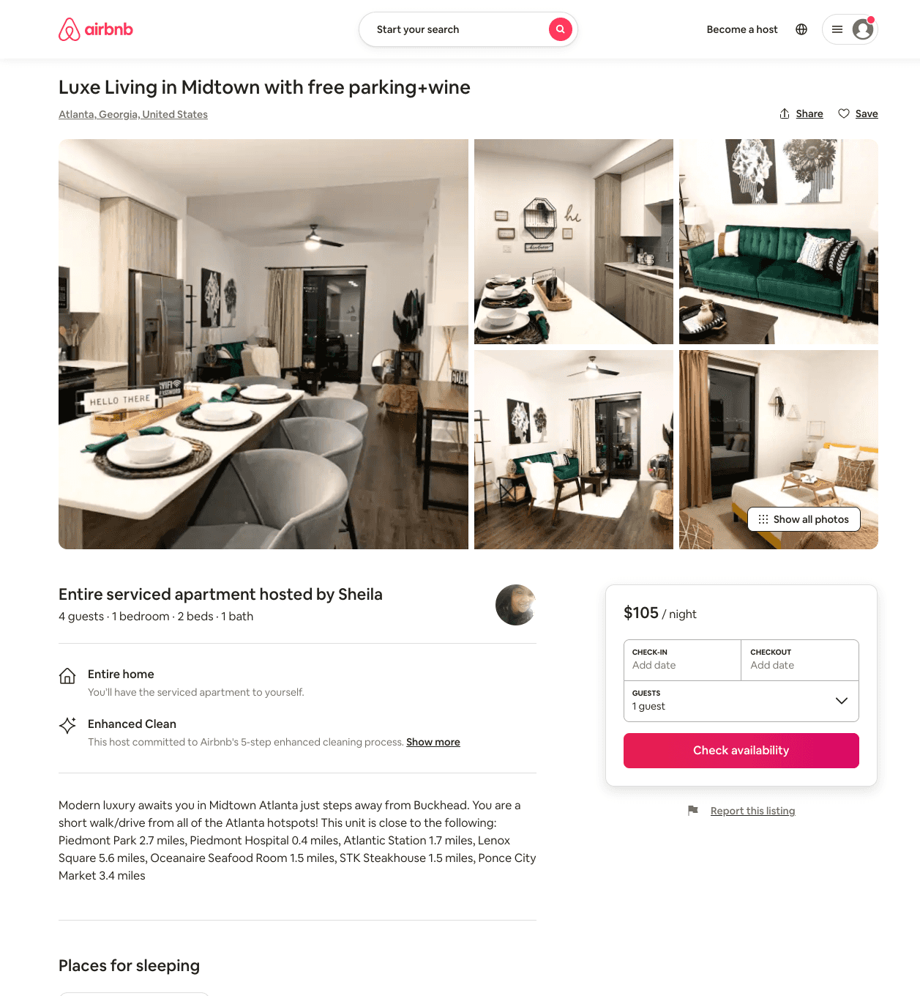
Listing 51112048
2
6
$106 - $156
4.89
2
BellaLife Stays
412818521
2
https://www.airbnb.com/rooms/51112048
Aug 2022

Slide 22
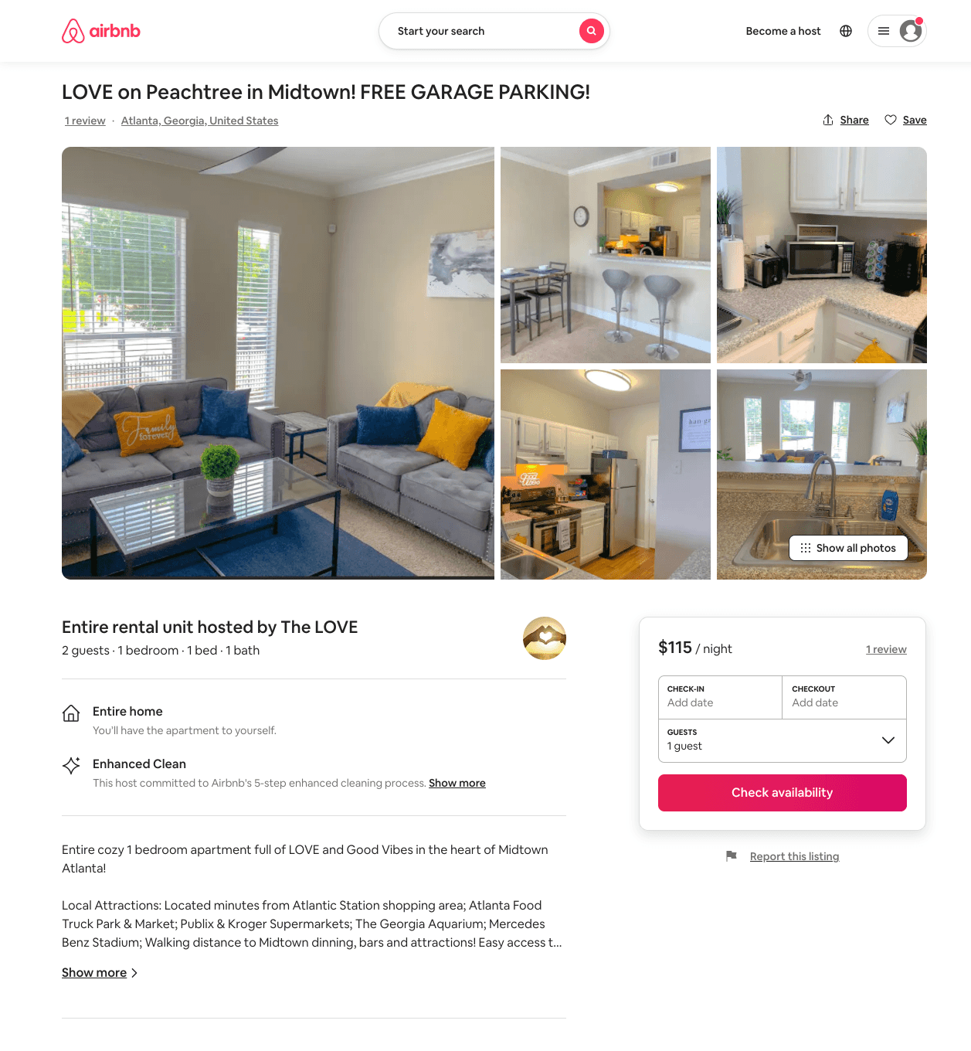
Listing 51168087
1
2
$99 - $115
4.87
2
The LOVE
414110088
1
https://www.airbnb.com/rooms/51168087
Jul 2022

Slide 23
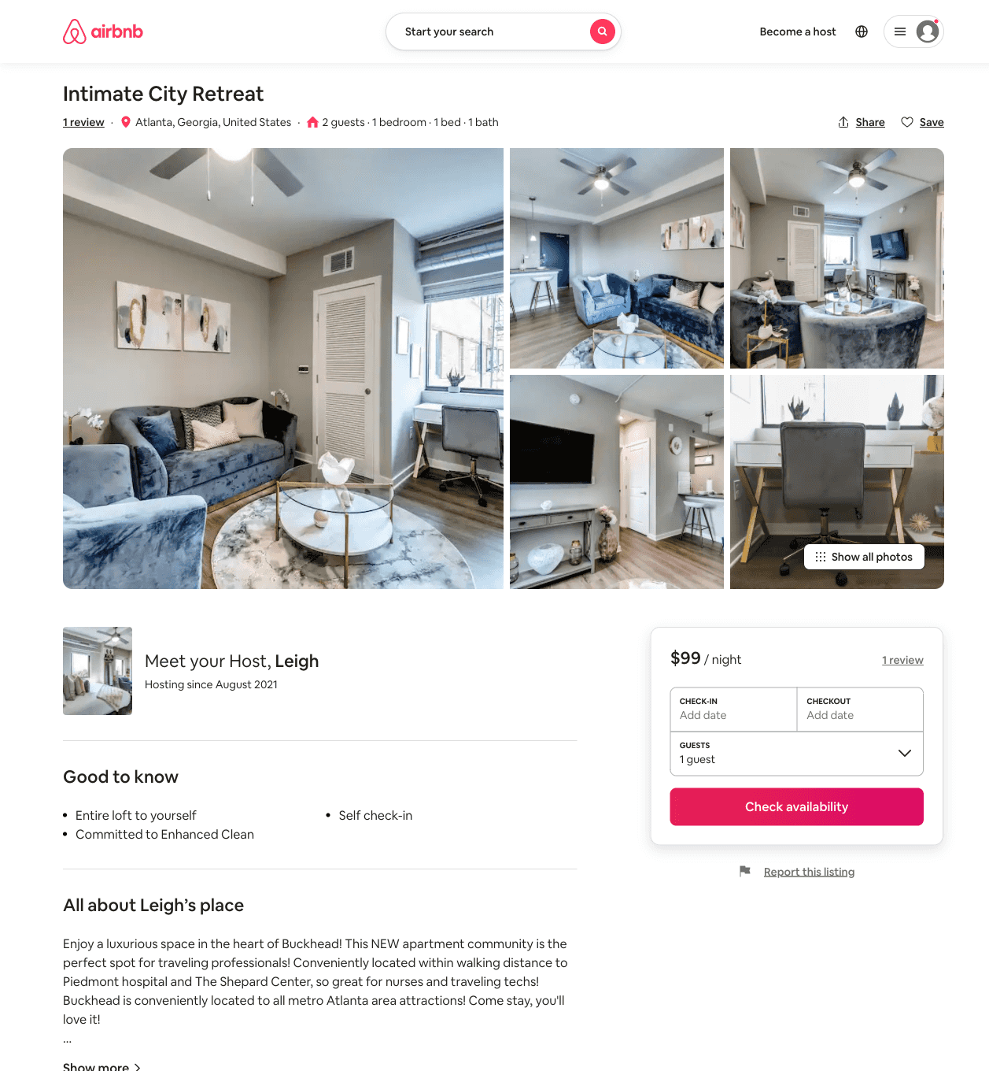
Listing 51432837
1
2
$95 - $126
4.92
3
Leigh
416544096
1
https://www.airbnb.com/rooms/51432837
Jul 2022

Slide 24
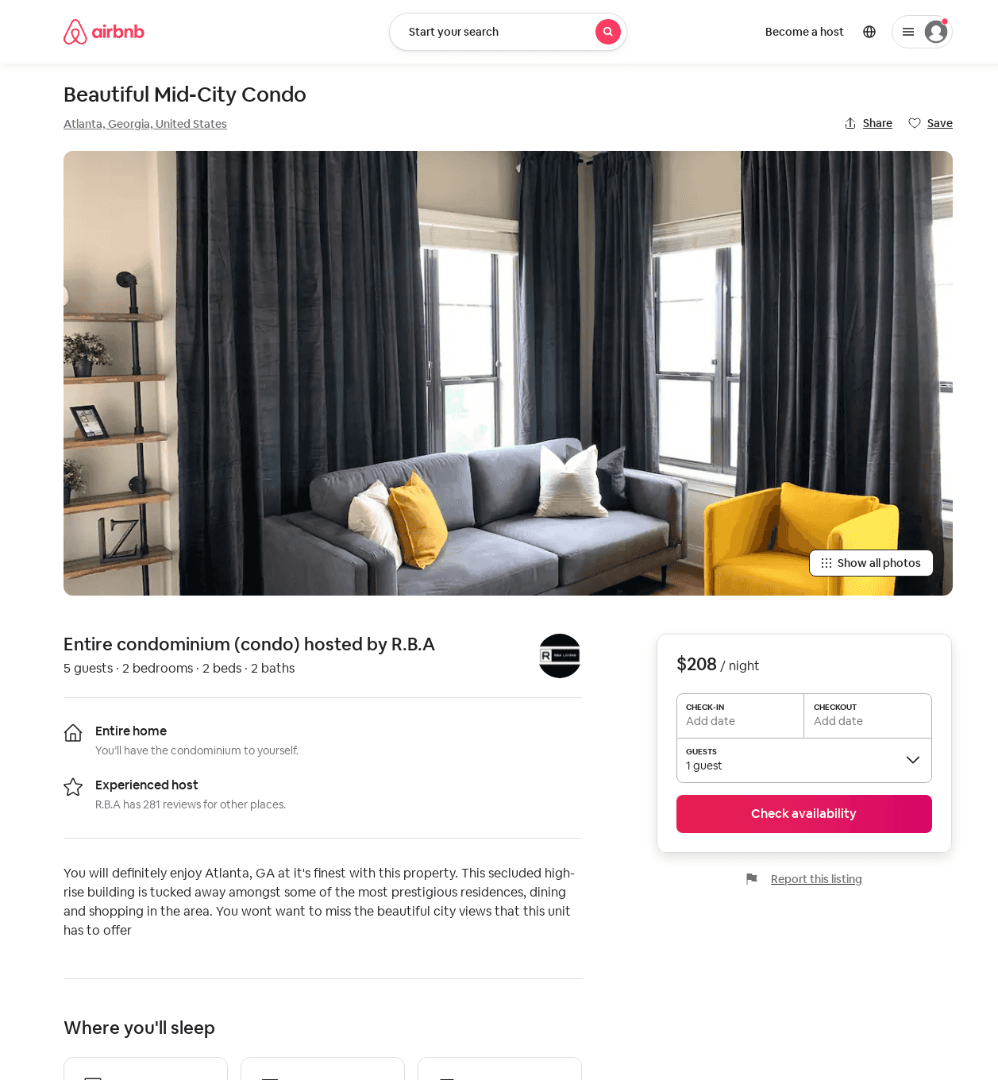
Listing 52075932
2
5
$155 - $399
4.86
3
R.B.A
26534449
17
https://www.airbnb.com/rooms/52075932
Aug 2022

Slide 25
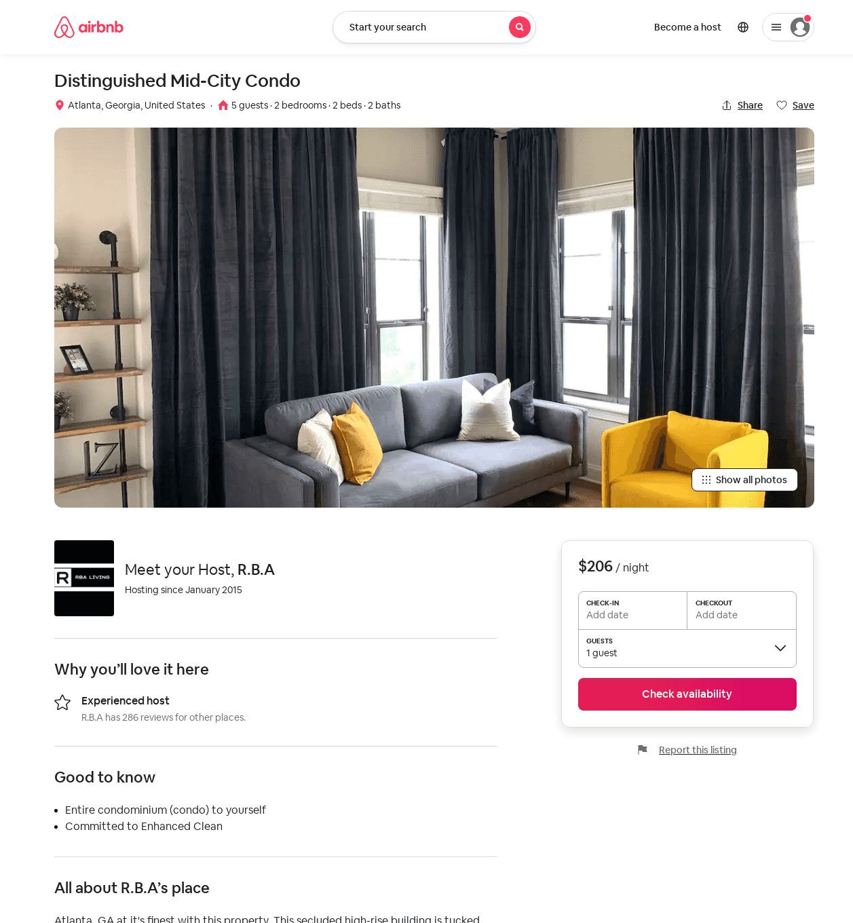
Listing 52084954
1
3
$125 - $236
2
R.B.A
26534449
17
https://www.airbnb.com/rooms/52084954
Aug 2022

Slide 26
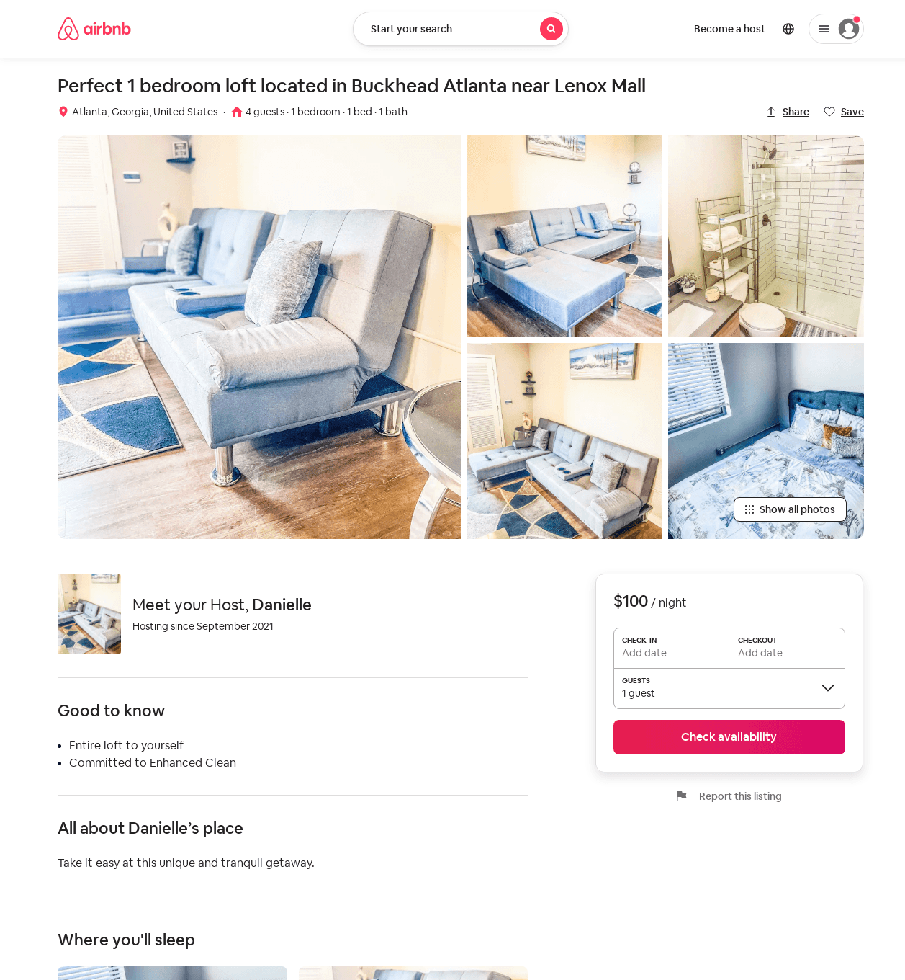
Listing 52151466
1
3
$94 - $164
4.32
1
Keith
422203157
1
https://www.airbnb.com/rooms/52151466
Aug 2022

Slide 27
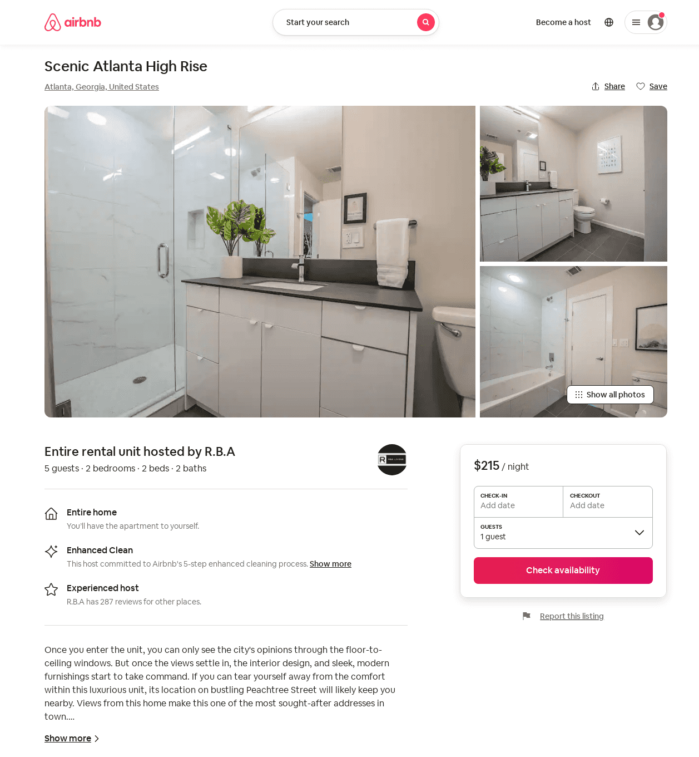
Listing 52309385
1
3
$121 - $237
4.36
2
R.B.A
26534449
17
https://www.airbnb.com/rooms/52309385
Aug 2022

Slide 28
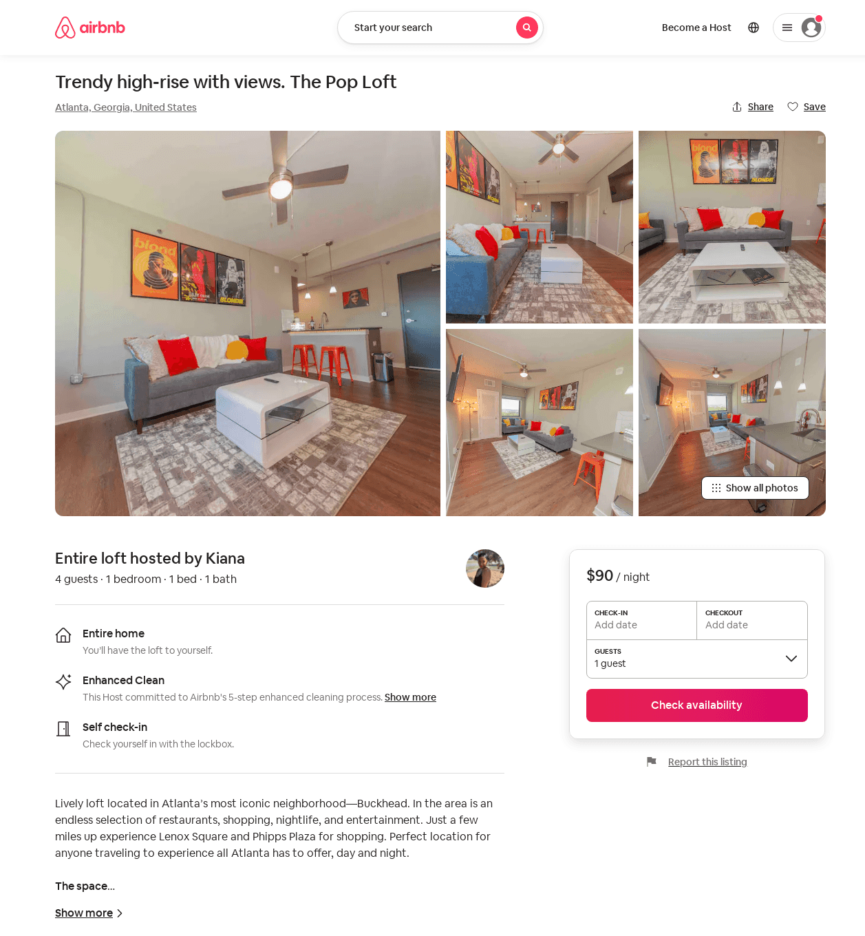
Listing 52916753
1
2
$84 - $95
4.92
28
Kiana
141026295
1
https://www.airbnb.com/rooms/52916753
Aug 2022

Slide 29
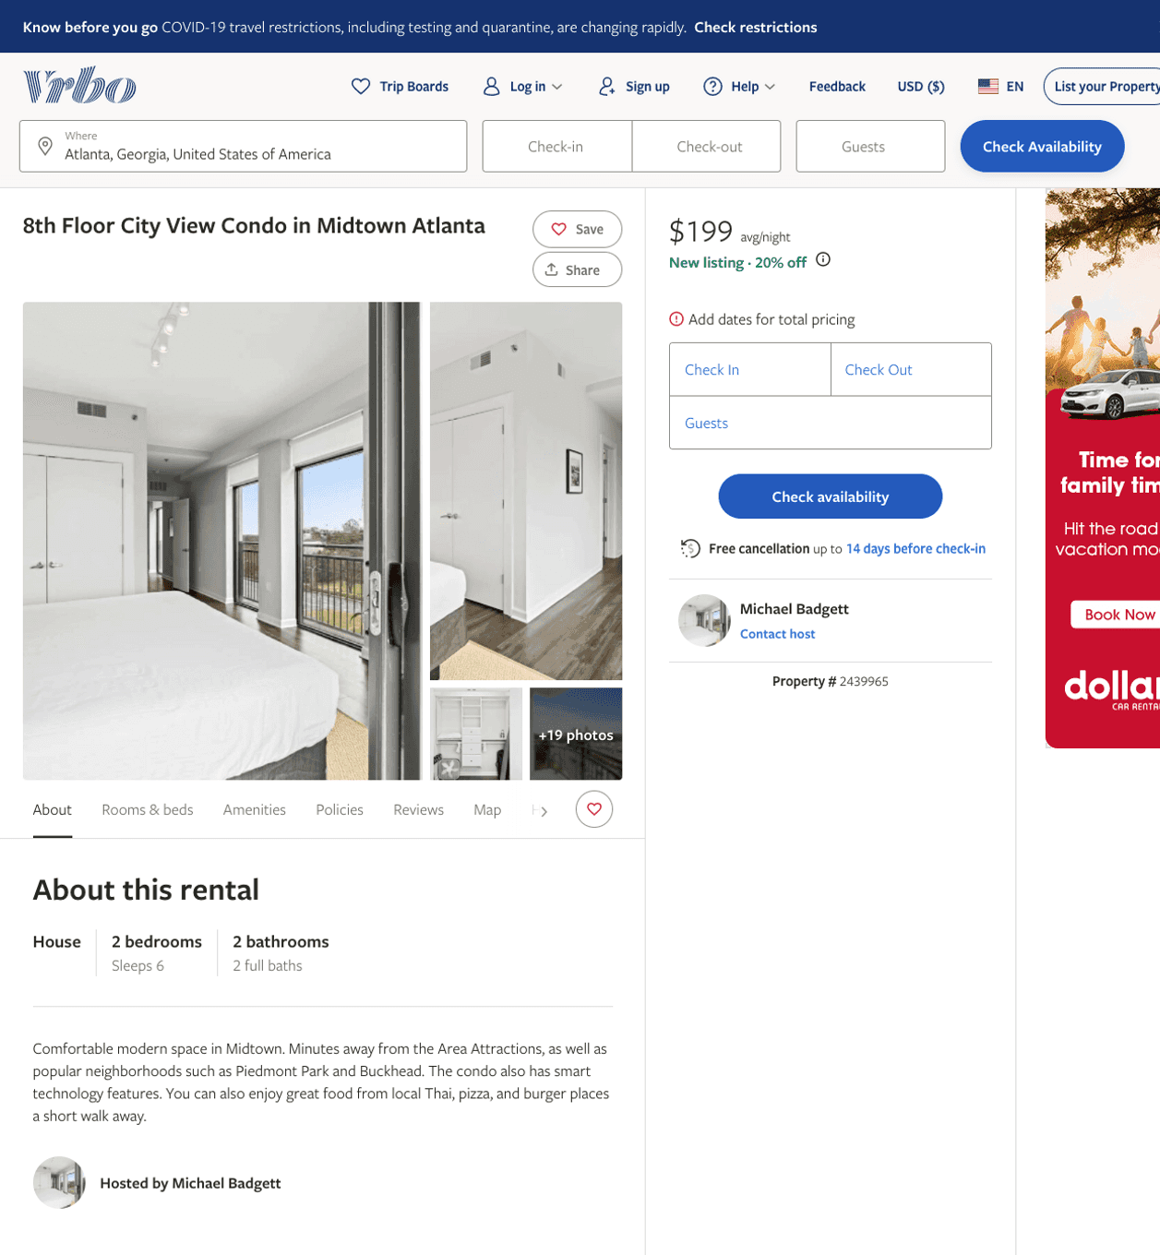
Listing 2439965
2
6
$199
7
Michael Badgett
https://www.vrbo.com/2439965
Aug 2022

Slide 30
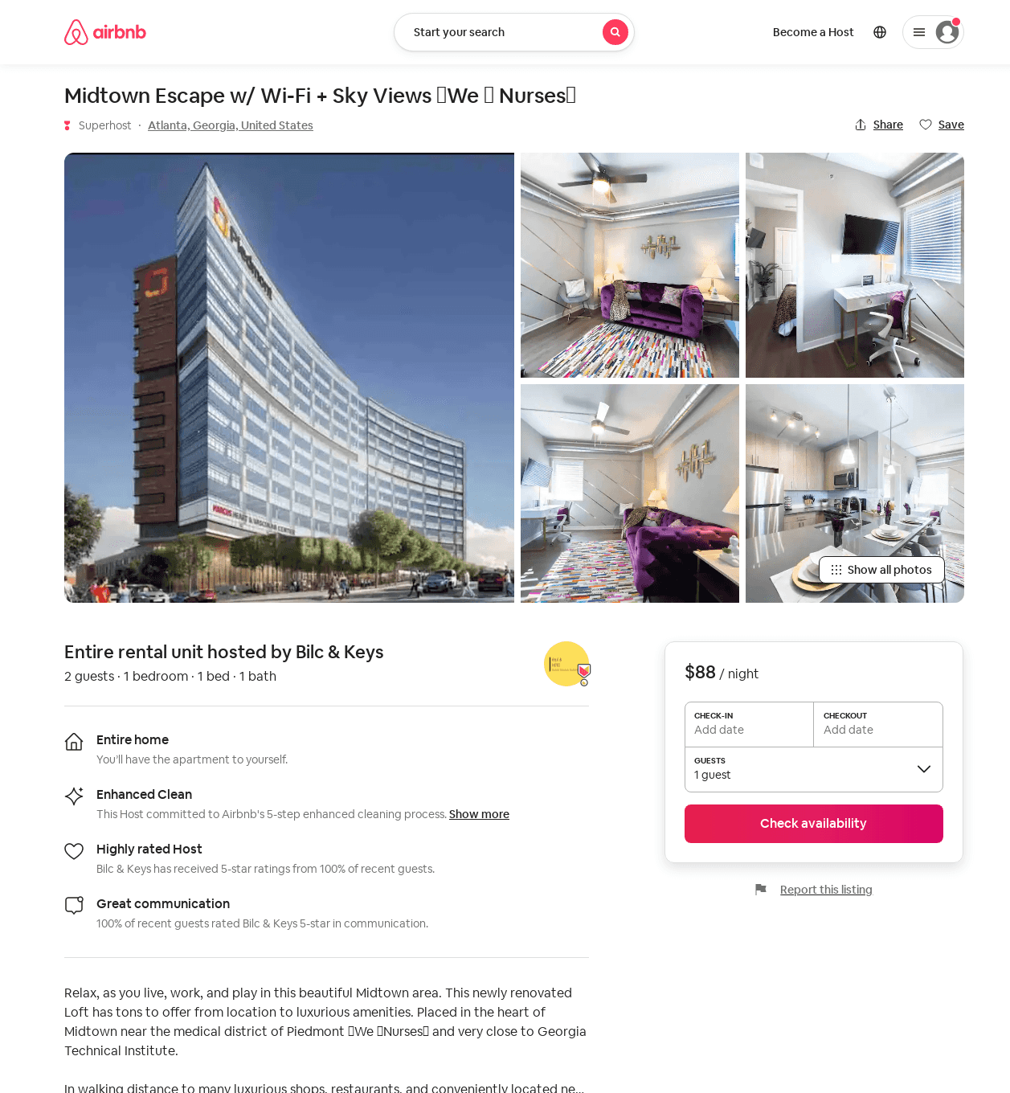
Listing 53257791
1
2
$73 - $109
4.0
2
Bilc & Keys
416385478
1
https://www.airbnb.com/rooms/53257791
Aug 2022

Slide 31
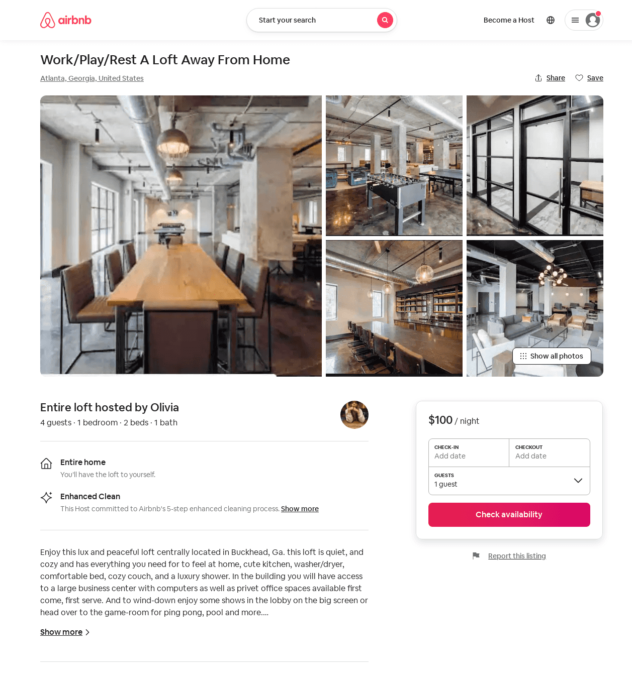
Listing 52893025
1
4
$80 - $108
4.67
1
Olivia
349886666
1
https://www.airbnb.com/rooms/52893025
Aug 2022

Slide 32
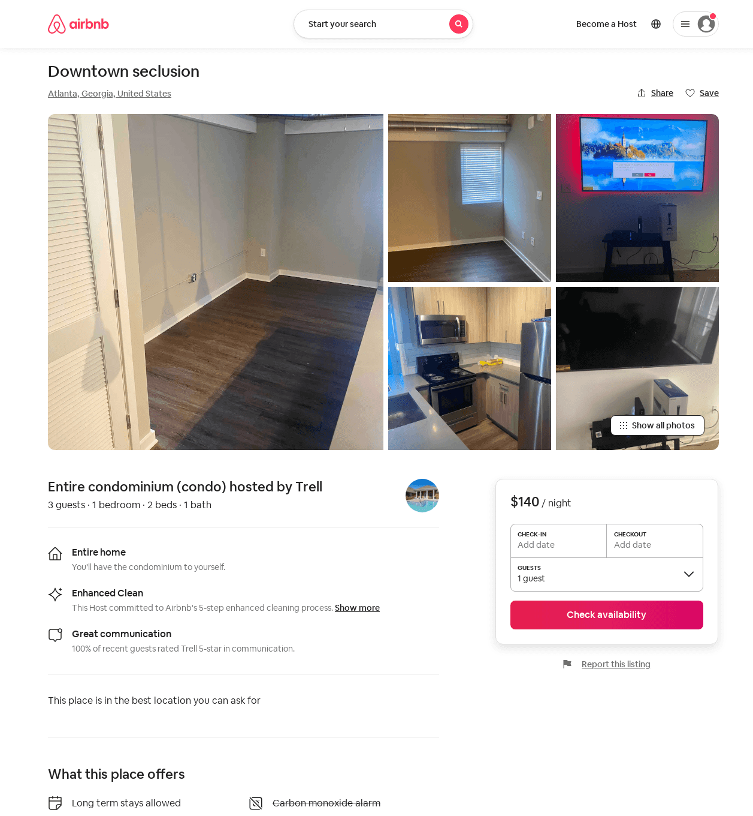
Listing 53563867
1
3
$140 - $300
3
Trell
235303101
1
https://www.airbnb.com/rooms/53563867
Aug 2022

Slide 33
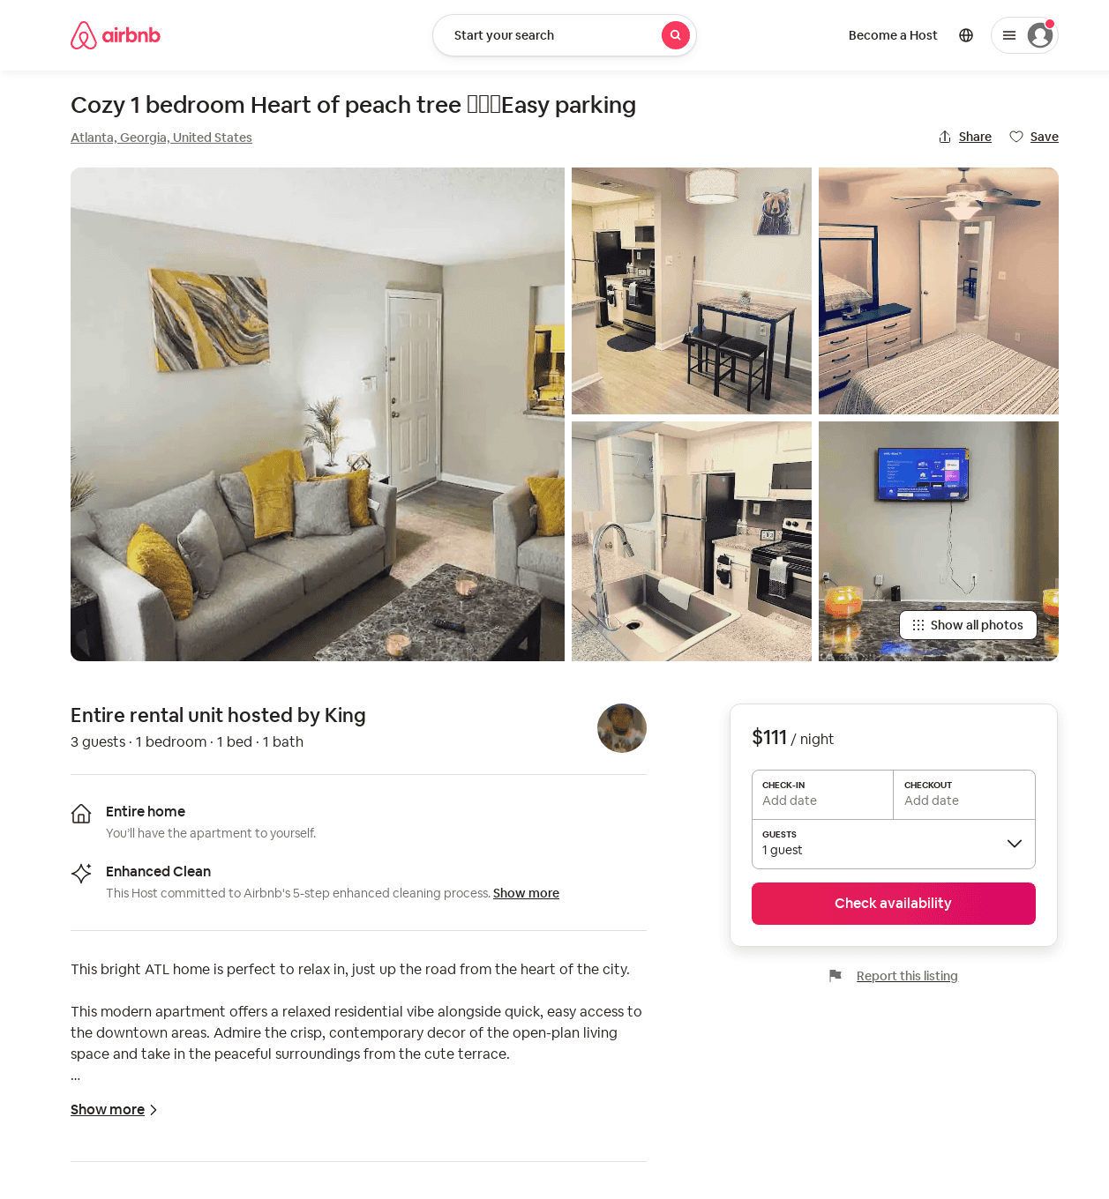
Listing 53640447
1
3
$95 - $130
4.73
1
King
321524739
1
https://www.airbnb.com/rooms/53640447
Aug 2022

Slide 34
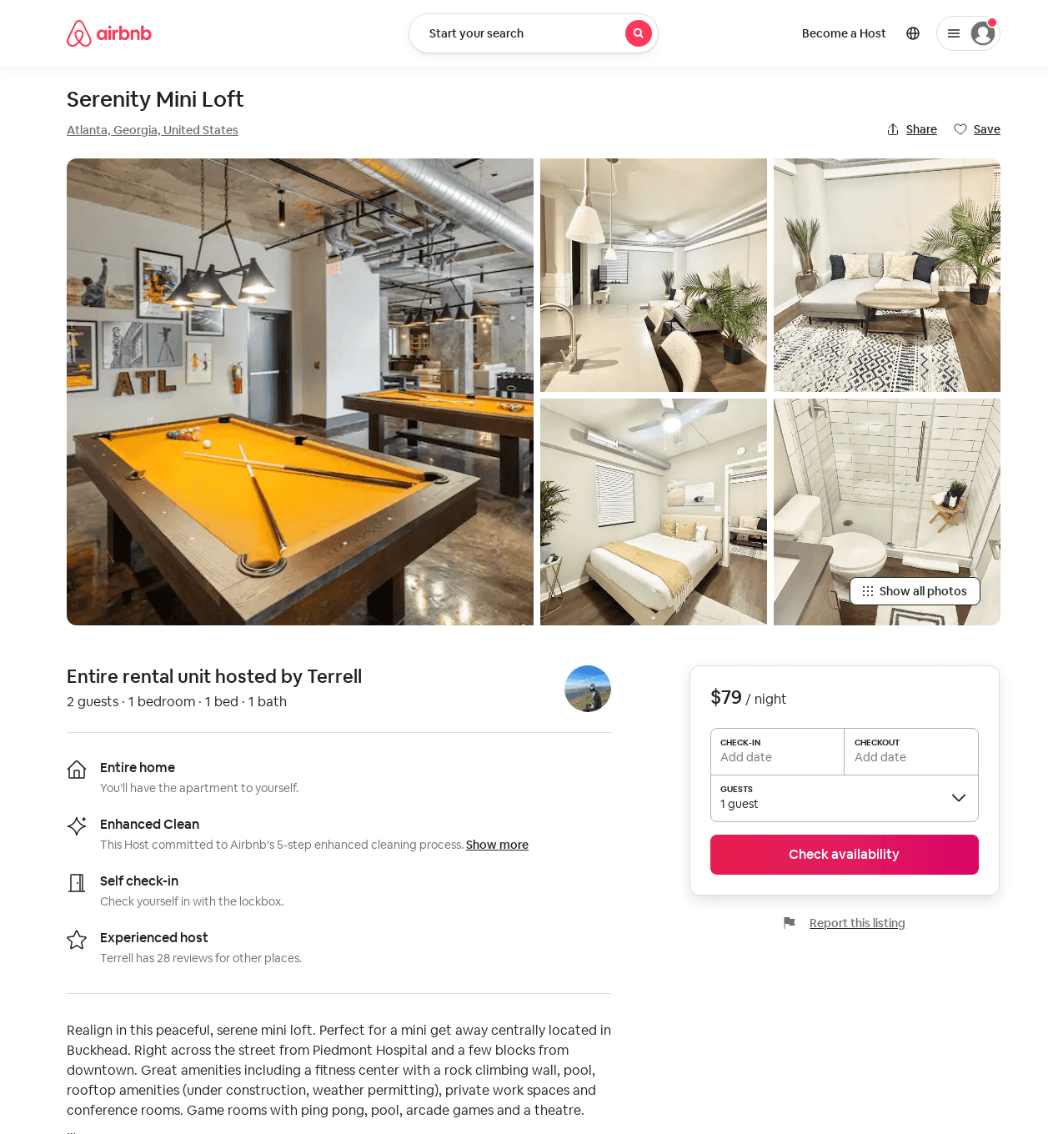
Listing 49486277
1
2
$74 - $149
4.33
2
Terrell
31362189
3
https://www.airbnb.com/rooms/49486277
Jul 2022

Slide 35
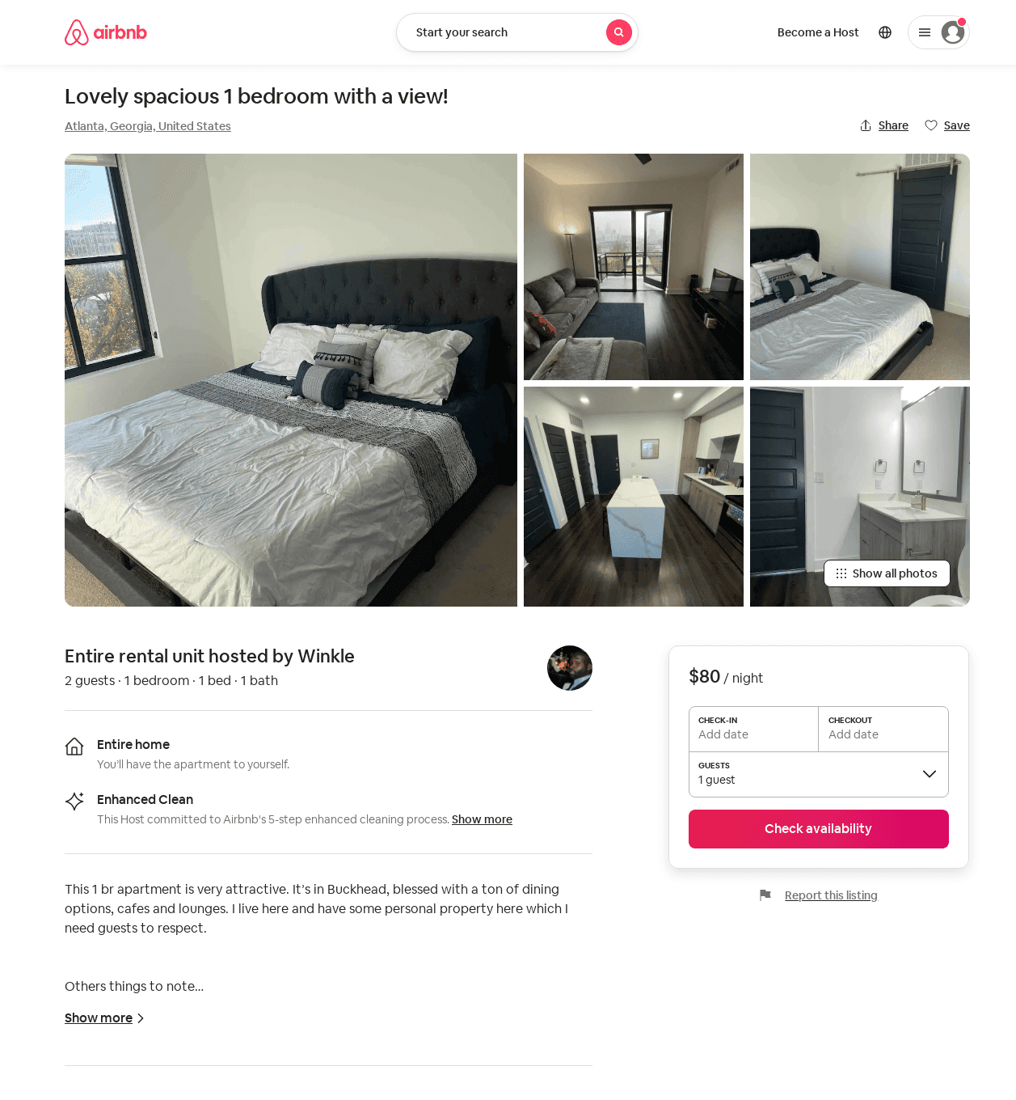
Listing 53025289
1
2
$80 - $105
5.0
30
Winkle
182932688
1
https://www.airbnb.com/rooms/53025289
Aug 2022

Slide 36
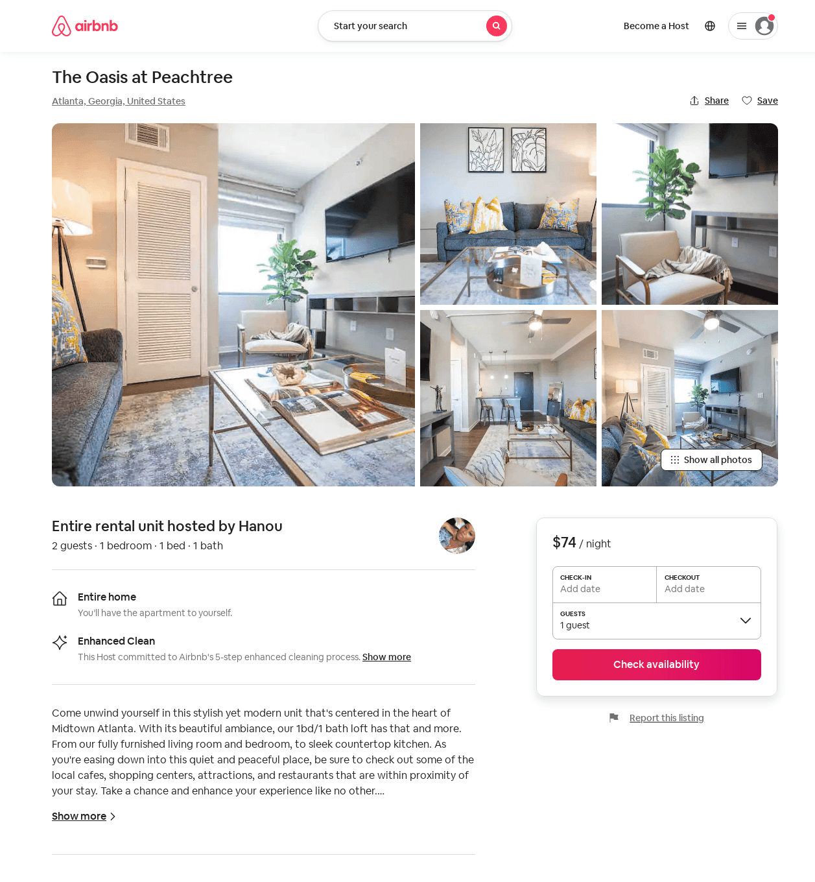
Listing 53646847
1
2
$62 - $125
4.75
1
Hanou
263864503
1
https://www.airbnb.com/rooms/53646847
Aug 2022

Slide 37
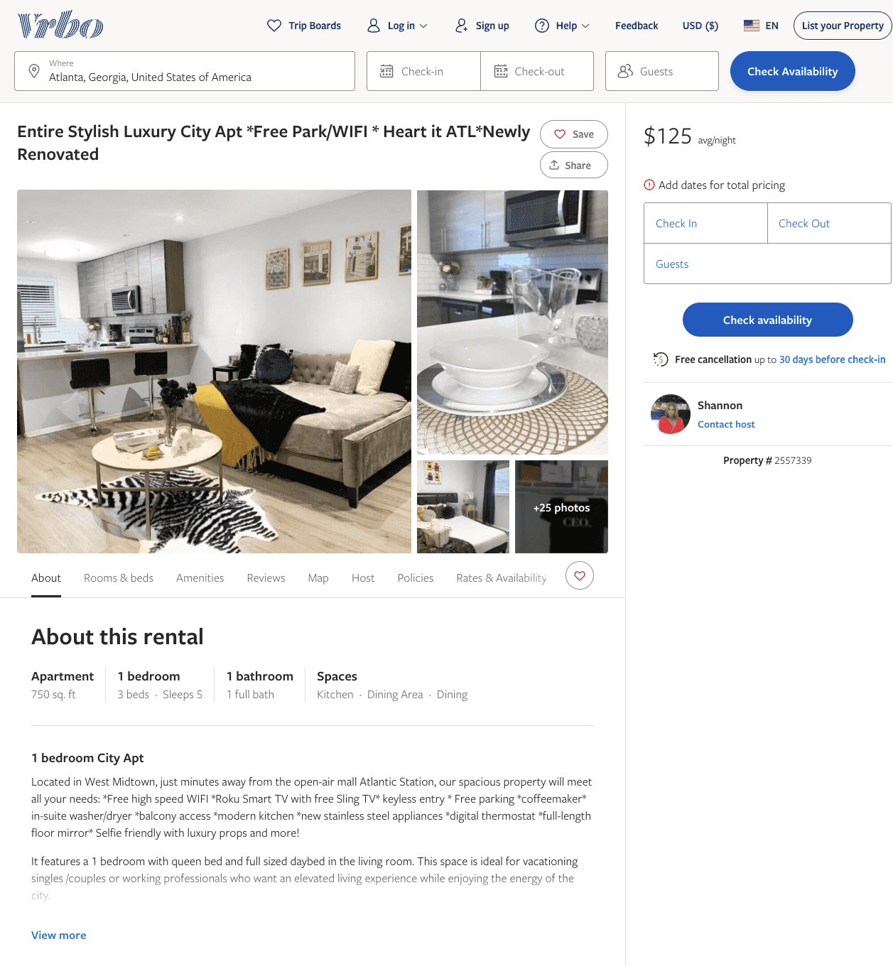
Listing 2557339
1
5
$106 - $125
4
2
Shannon
https://www.vrbo.com/2557339
Aug 2022

Slide 38
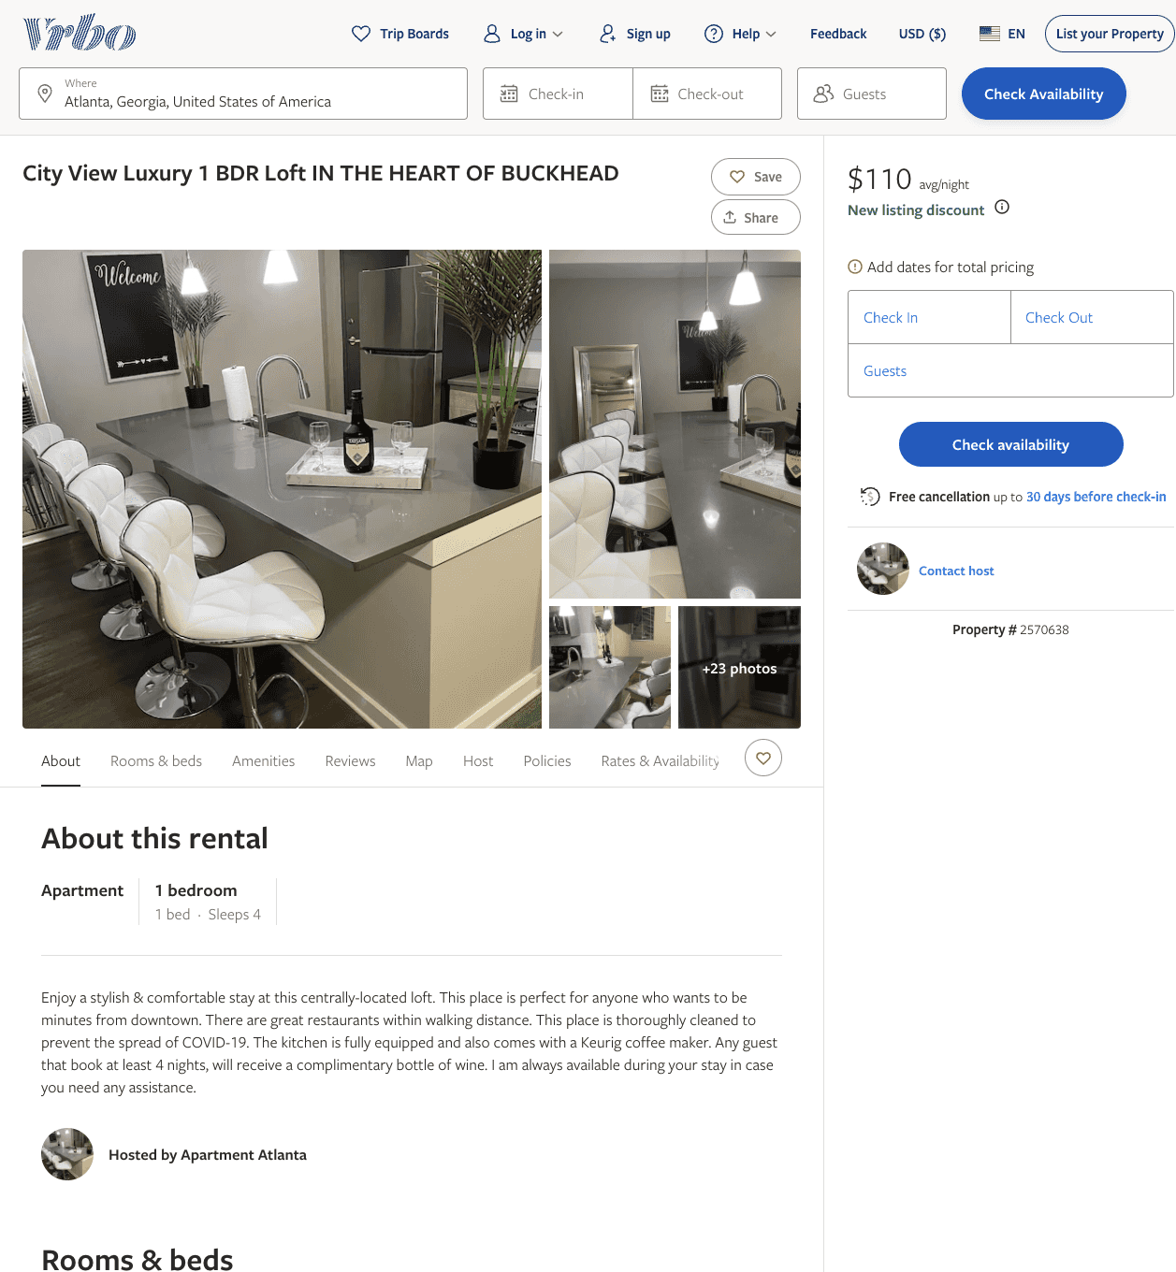
Listing 2570638
1
4
$110 - $115
2
https://www.vrbo.com/2570638
Aug 2022

Slide 39
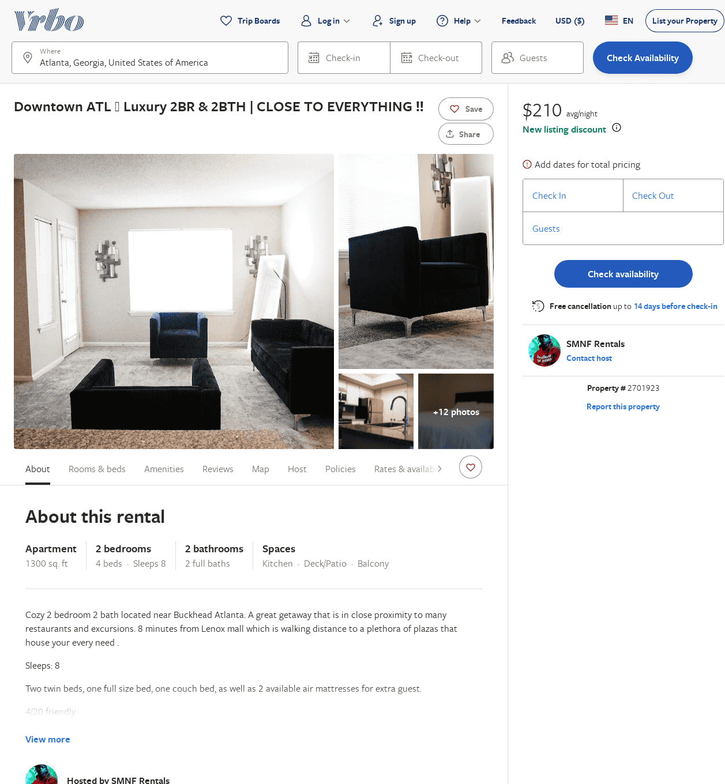
Listing 2701923
2
8
$223
2
SMNF Rentals
https://www.vrbo.com/2701923
Aug 2022

Slide 40
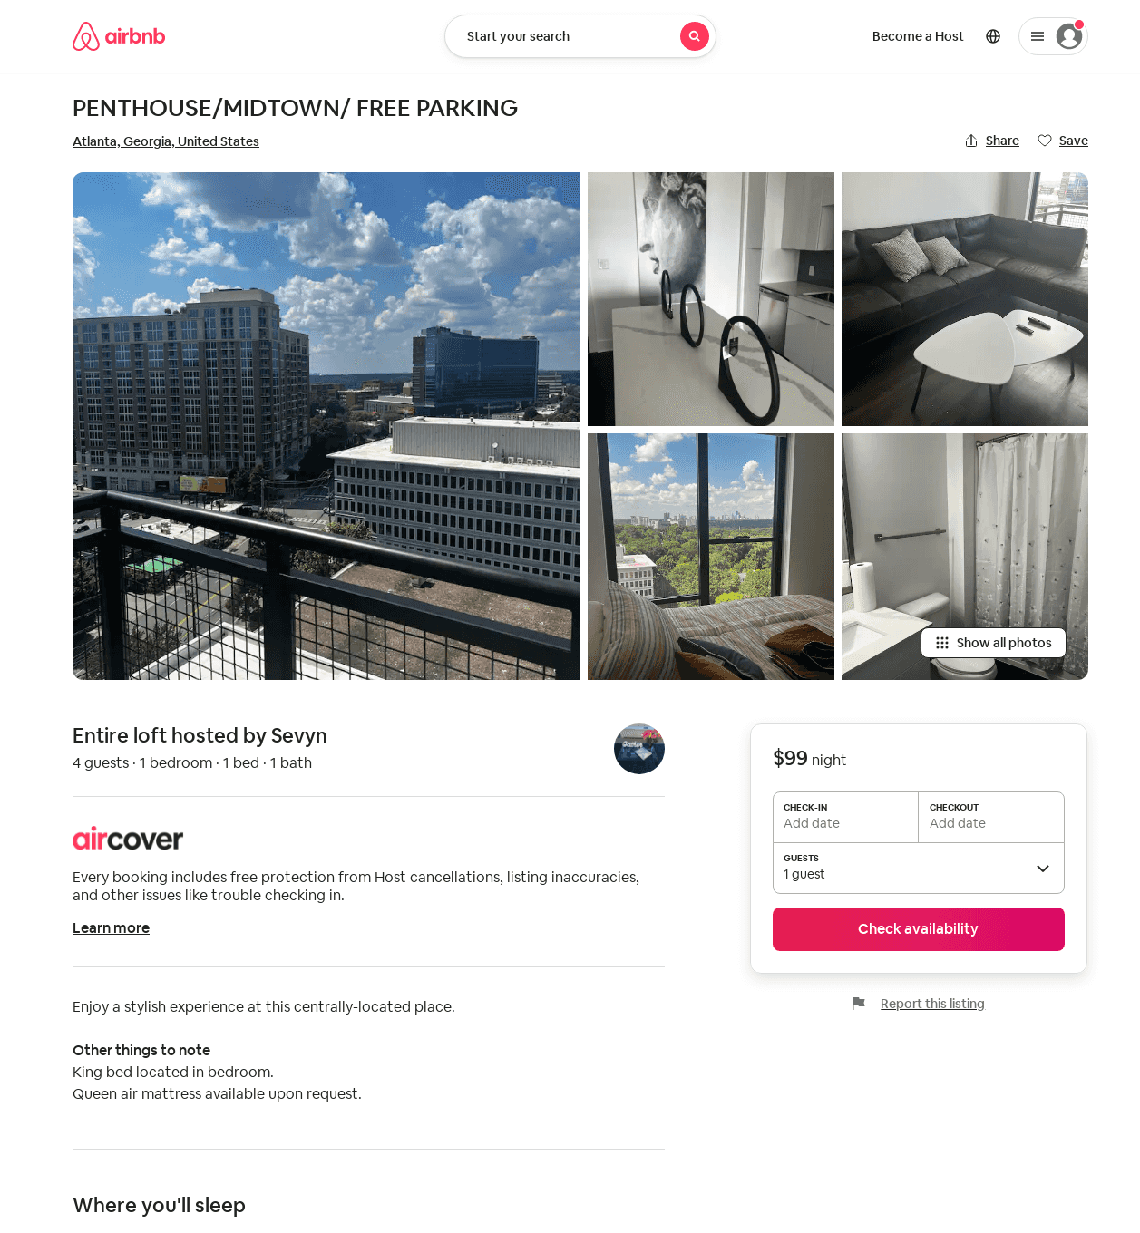
Listing 53216832
1
2
$99 - $122
4.71
1
Sevyn
256810955
1
https://www.airbnb.com/rooms/53216832
Jul 2022

