Slide 2
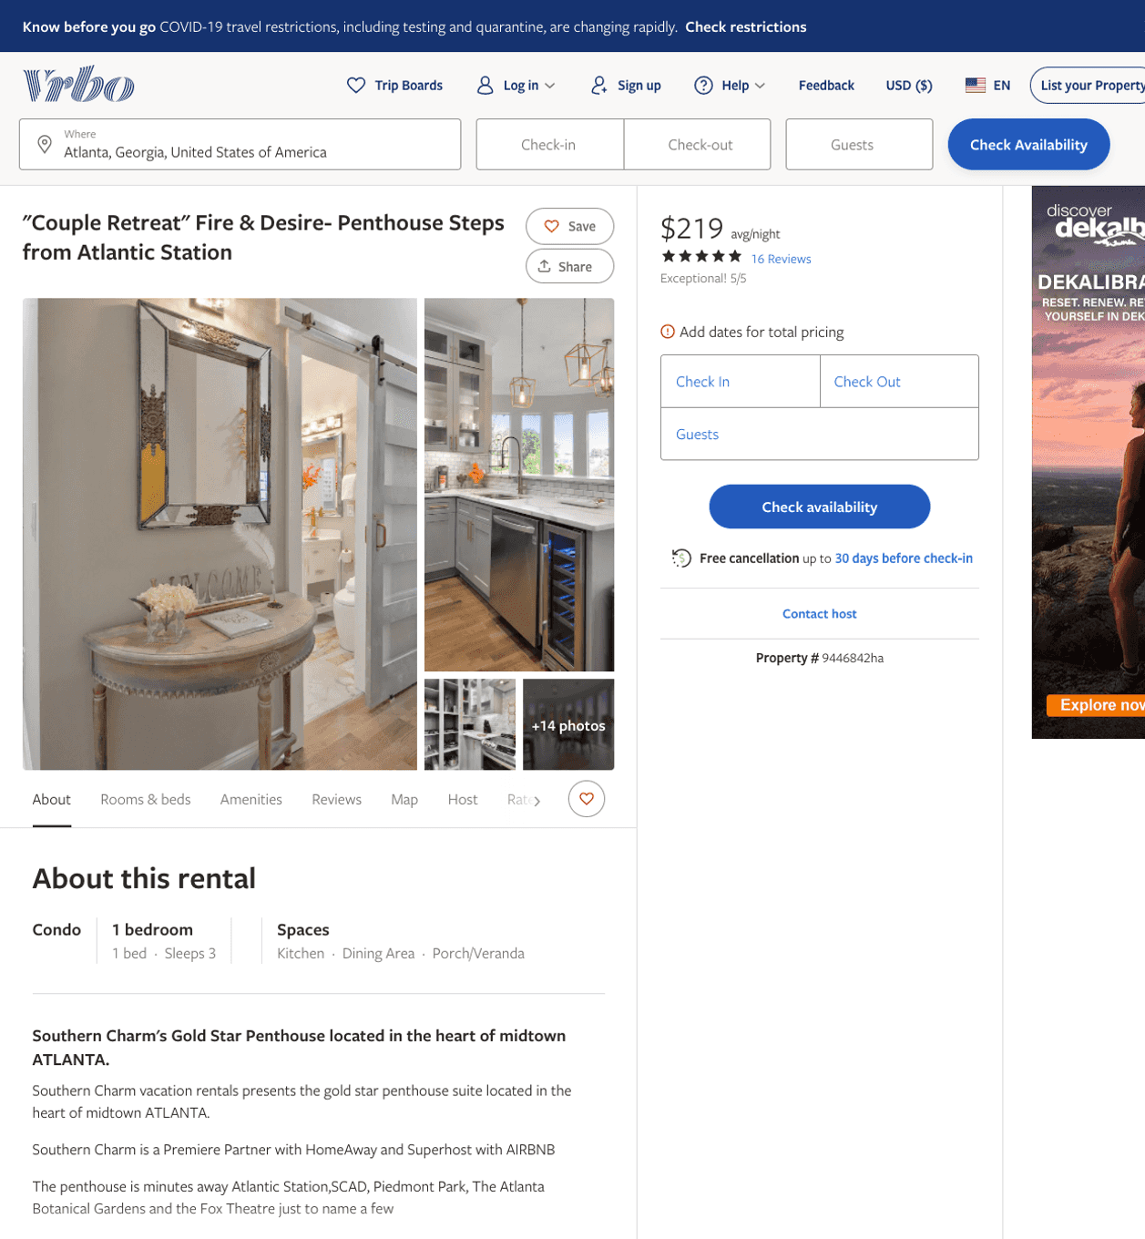
Listing 9446842
1
3
$204 - $244
4.9666667
1
Southern Charm Comfort
https://www.vrbo.com/9446842ha
Aug 2022

Slide 3
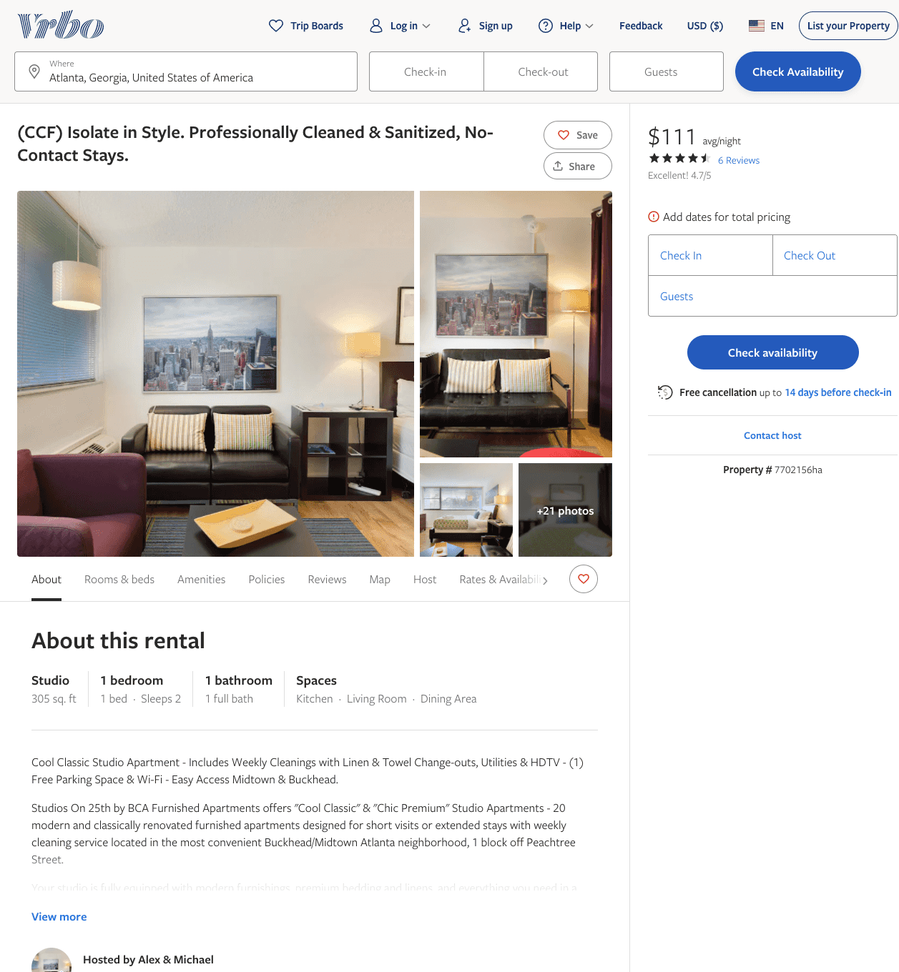
Listing 7702156
1
2
$100 - $99
4.818182
1
Alex & Michael
https://www.vrbo.com/7702156ha
Aug 2022

Slide 4
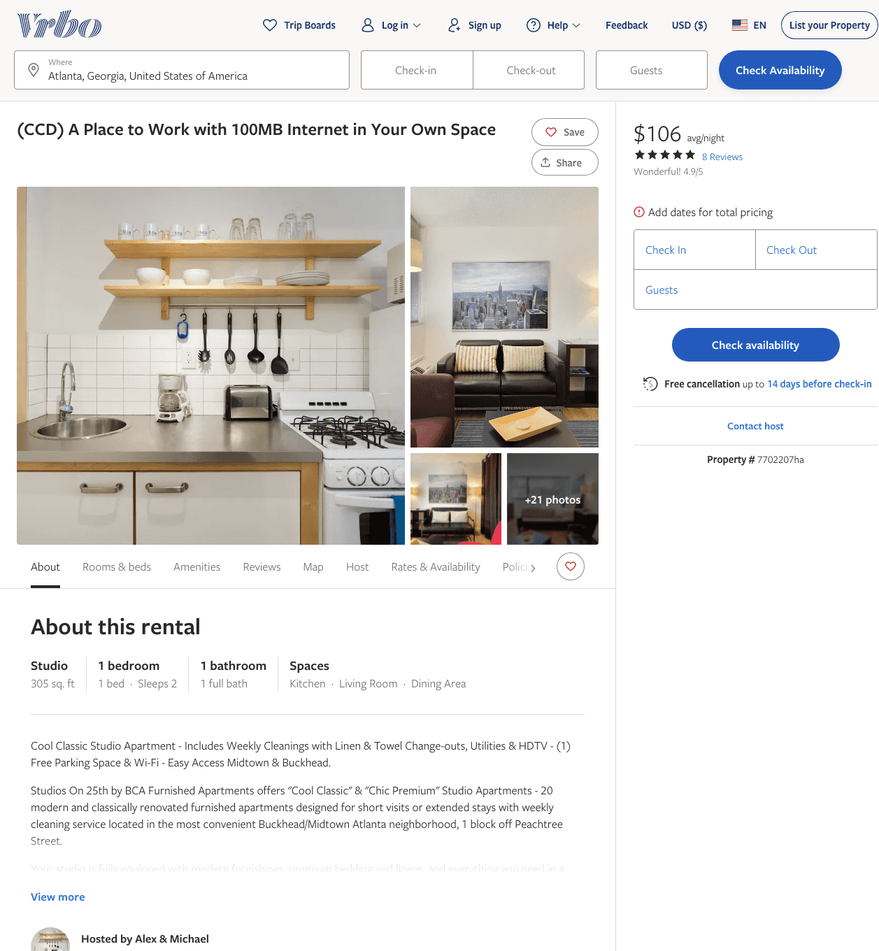
Listing 7702207
1
2
$100 - $115
4.6666665
1
Alex & Michael
https://www.vrbo.com/7702207ha
Aug 2022

Slide 5
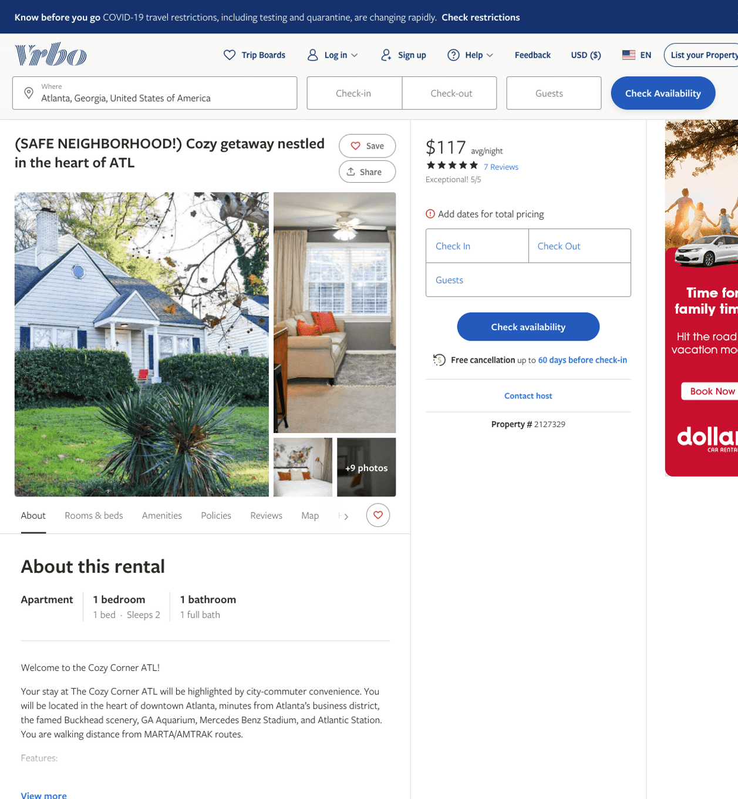
Listing 2127329
1
2
$117 - $145
5
2
https://www.vrbo.com/2127329
Aug 2022

Slide 6
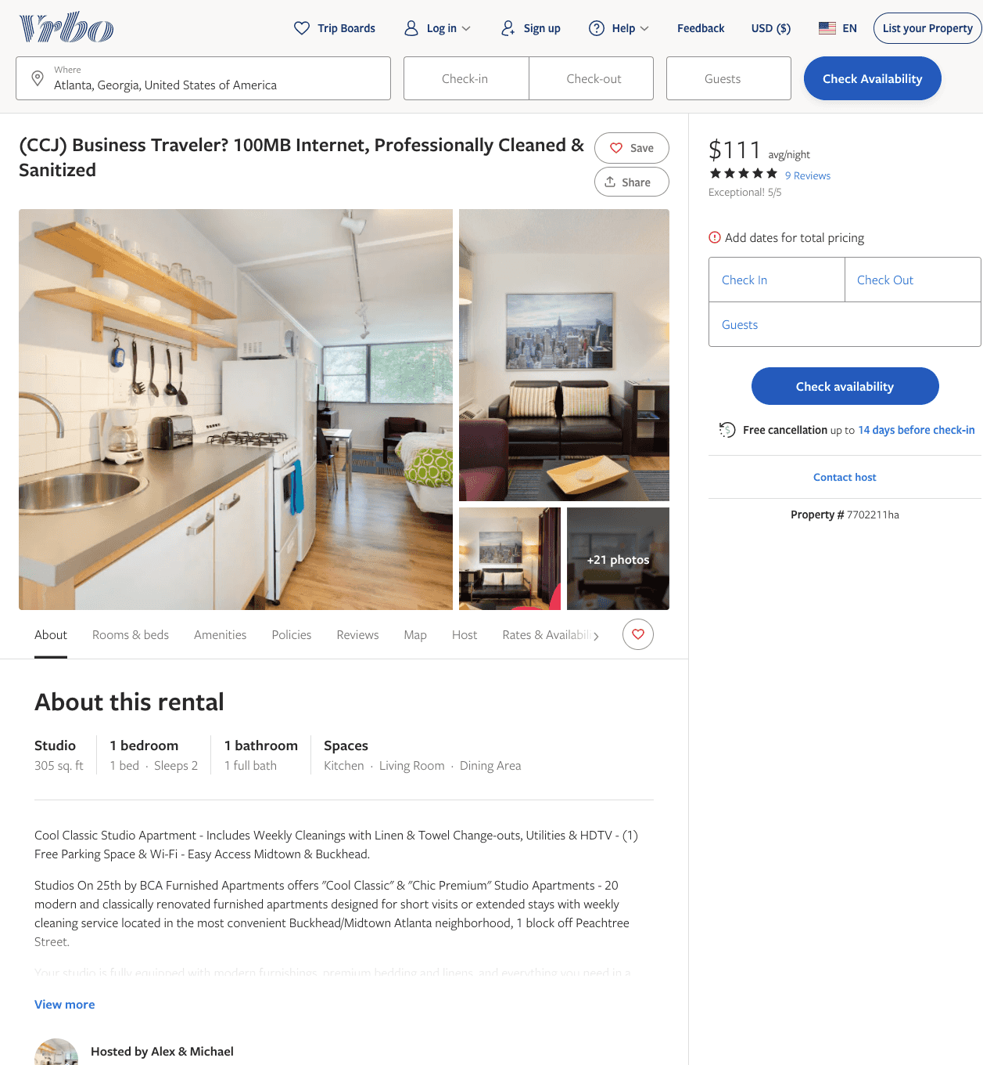
Listing 7702211
1
2
$100 - $99
4.9166665
1
Alex & Michael
https://www.vrbo.com/7702211ha
Aug 2022

Slide 7
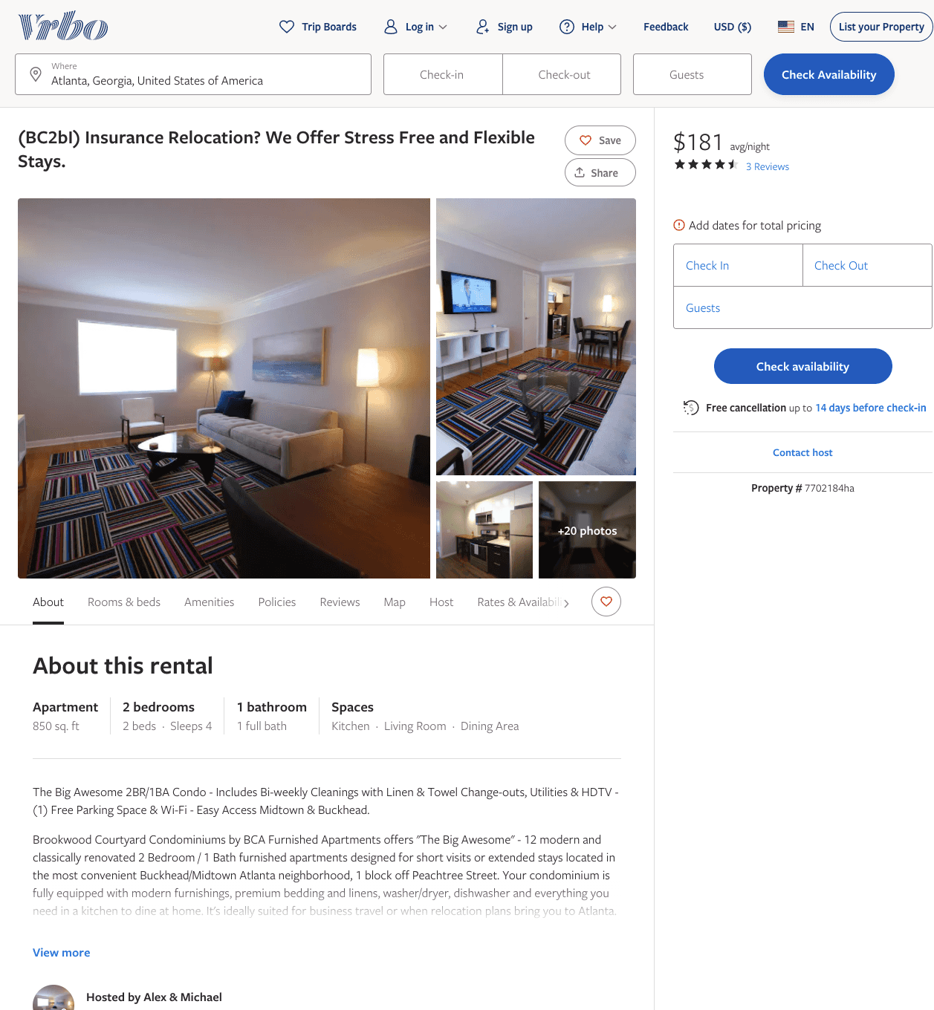
Listing 7702184
2
4
$172 - $189
4.6666665
1
Alex & Michael
https://www.vrbo.com/7702184ha
Aug 2022

Slide 8
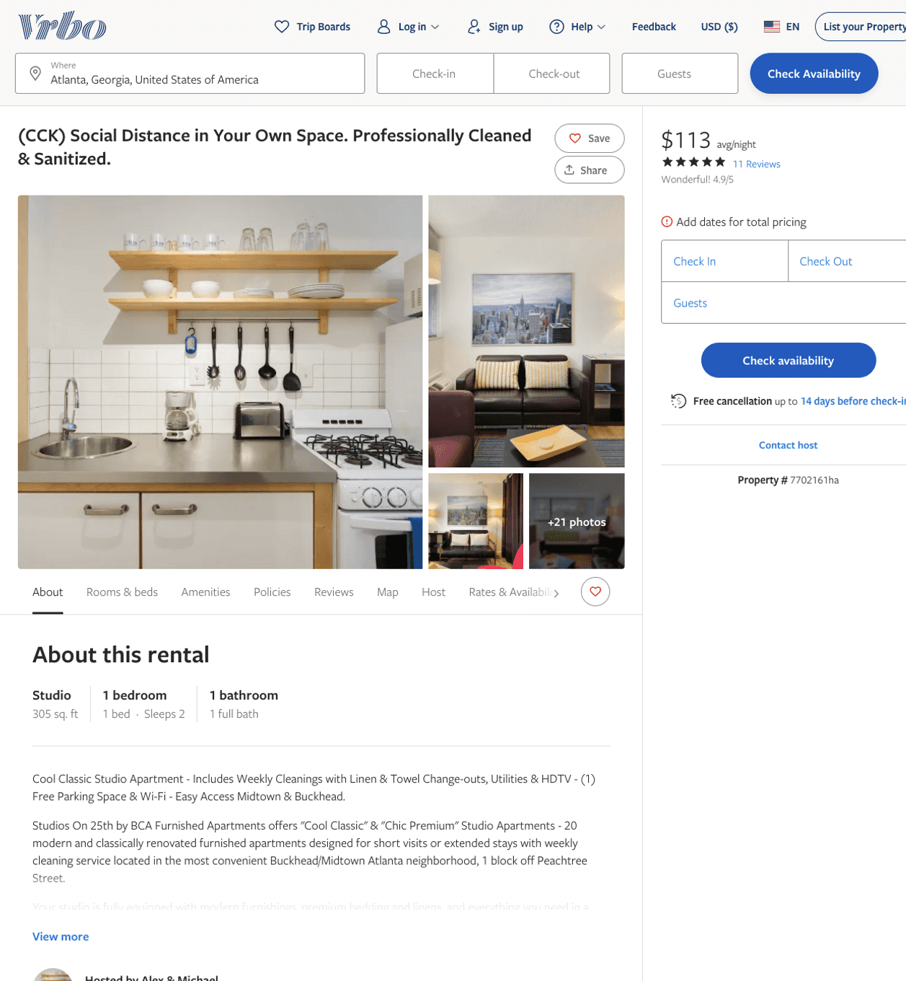
Listing 7702161
1
2
$100 - $93
4.9333334
1
Alex & Michael
https://www.vrbo.com/7702161ha
Aug 2022

Slide 9
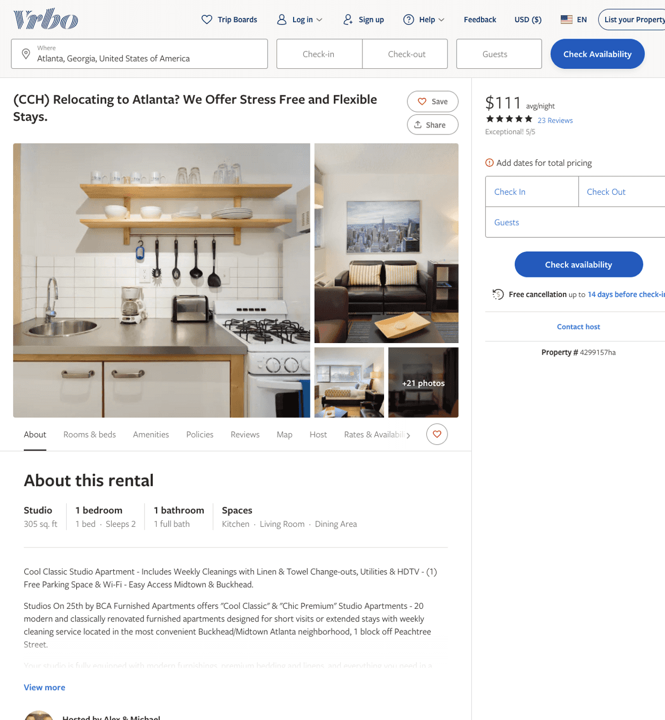
Listing 4299157
1
2
$100 - $99
4.9615383
1
Alex & Michael
https://www.vrbo.com/4299157ha
Aug 2022

Slide 10
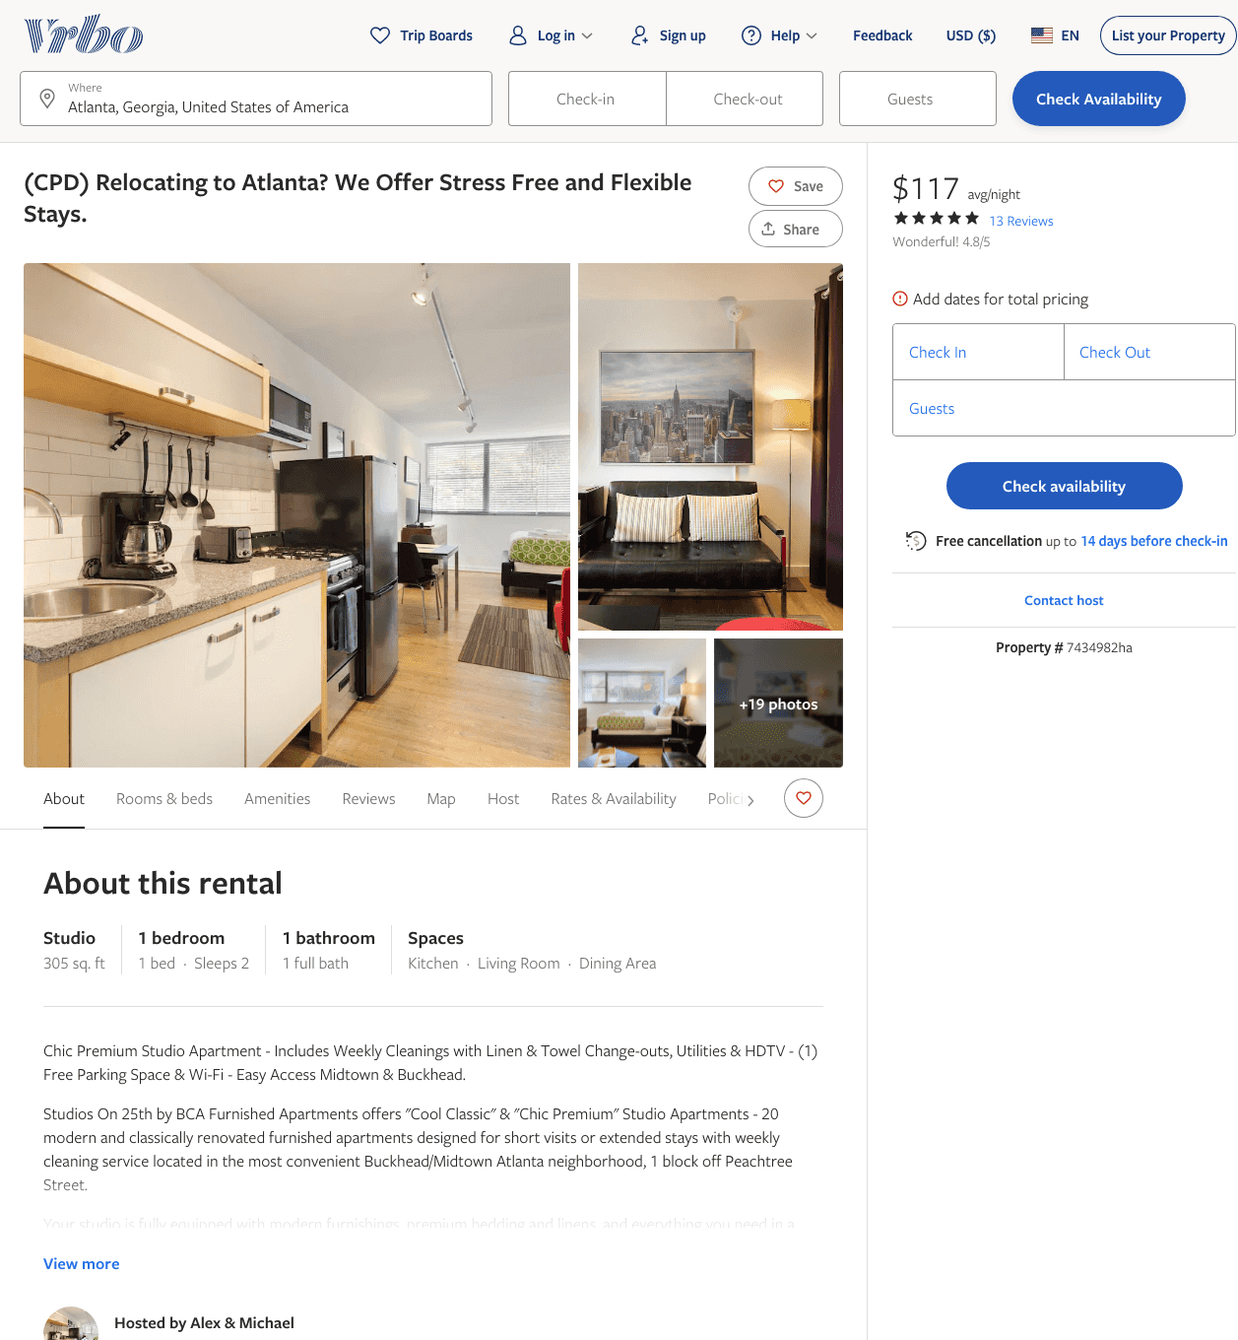
Listing 7434982
1
2
$108 - $126
4.909091
1
Alex & Michael
https://www.vrbo.com/7434982ha
Aug 2022

Slide 11
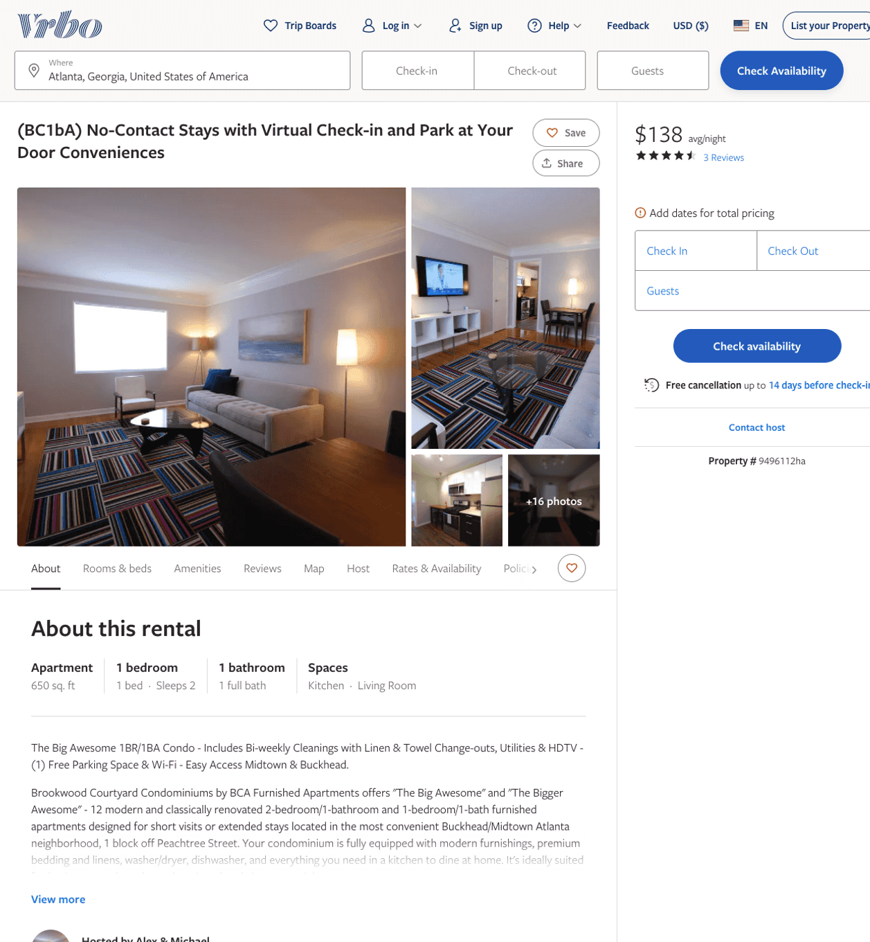
Listing 9496112
1
2
$130 - $143
4.75
1
Alex & Michael
https://www.vrbo.com/9496112ha
Aug 2022

Slide 12
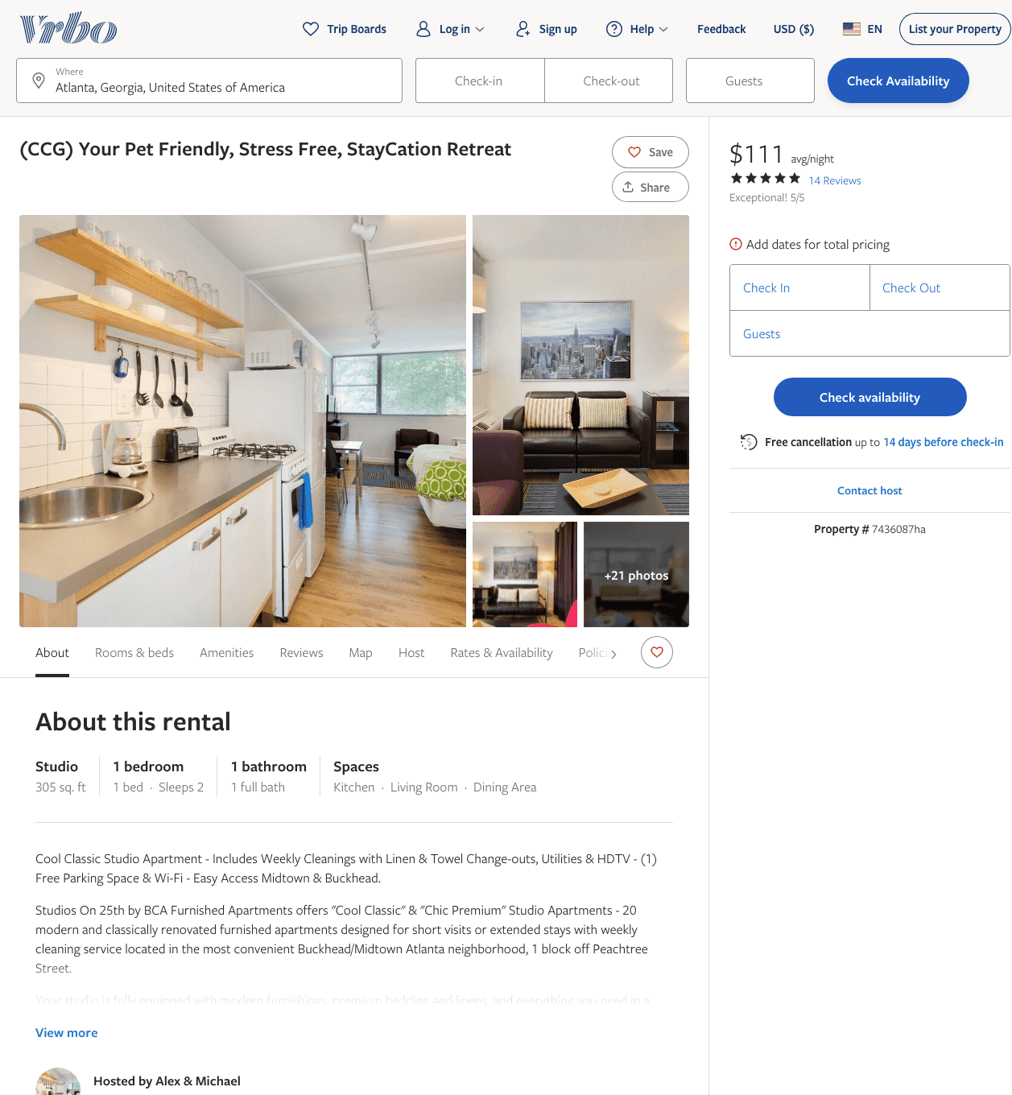
Listing 7436087
1
2
$100 - $99
4.9473686
1
Alex & Michael
https://www.vrbo.com/7436087ha
Aug 2022

Slide 13
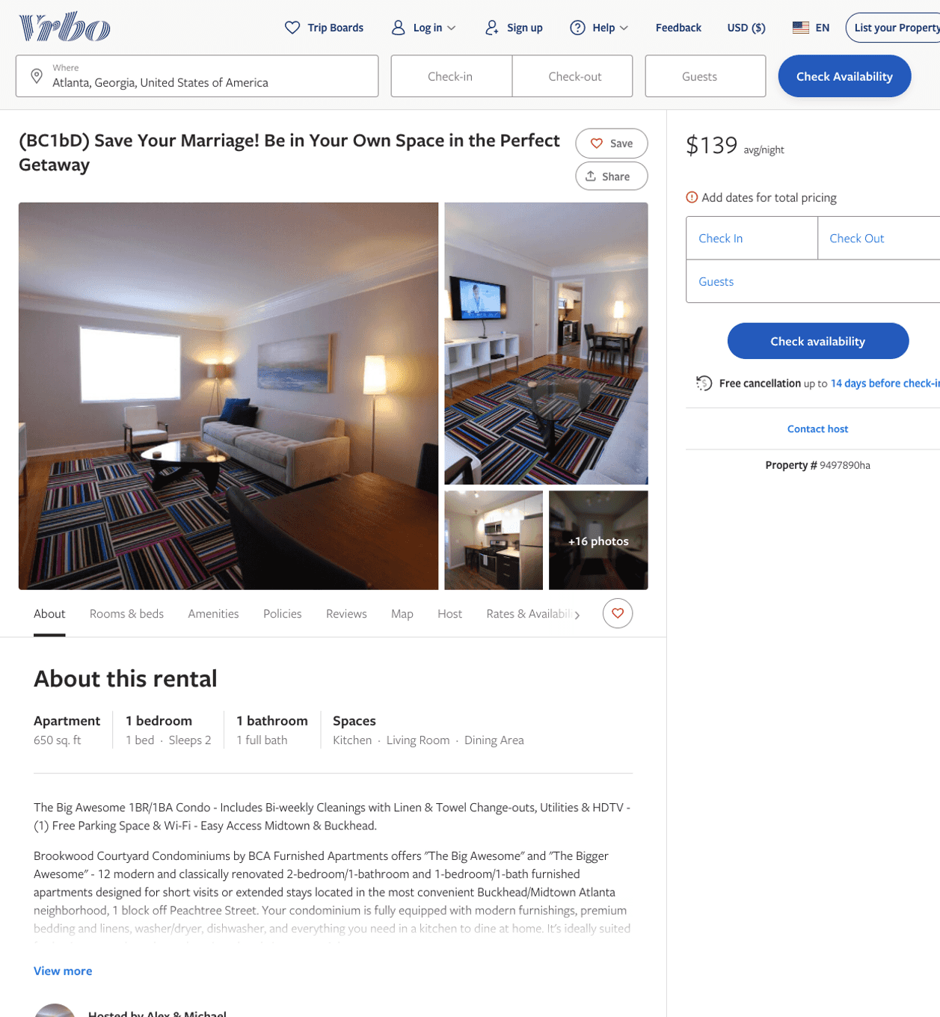
Listing 9497890
1
2
$117 - $145
1
Alex & Michael
https://www.vrbo.com/9497890ha
Aug 2022

Slide 14
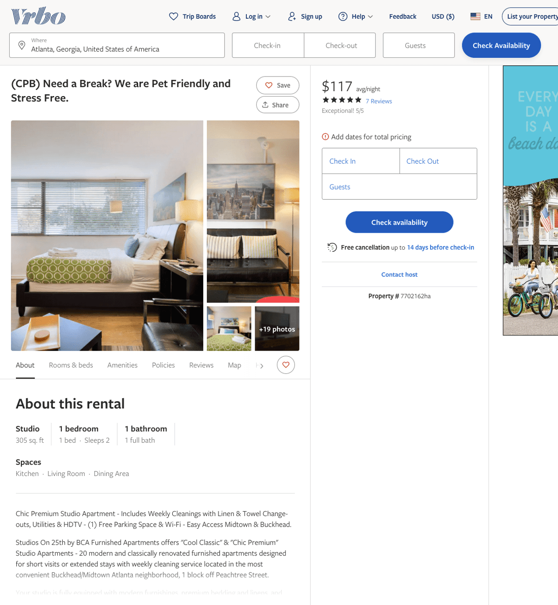
Listing 7702162
1
2
$109 - $134
5
1
Alex & Michael
https://www.vrbo.com/7702162ha
Aug 2022

Slide 15
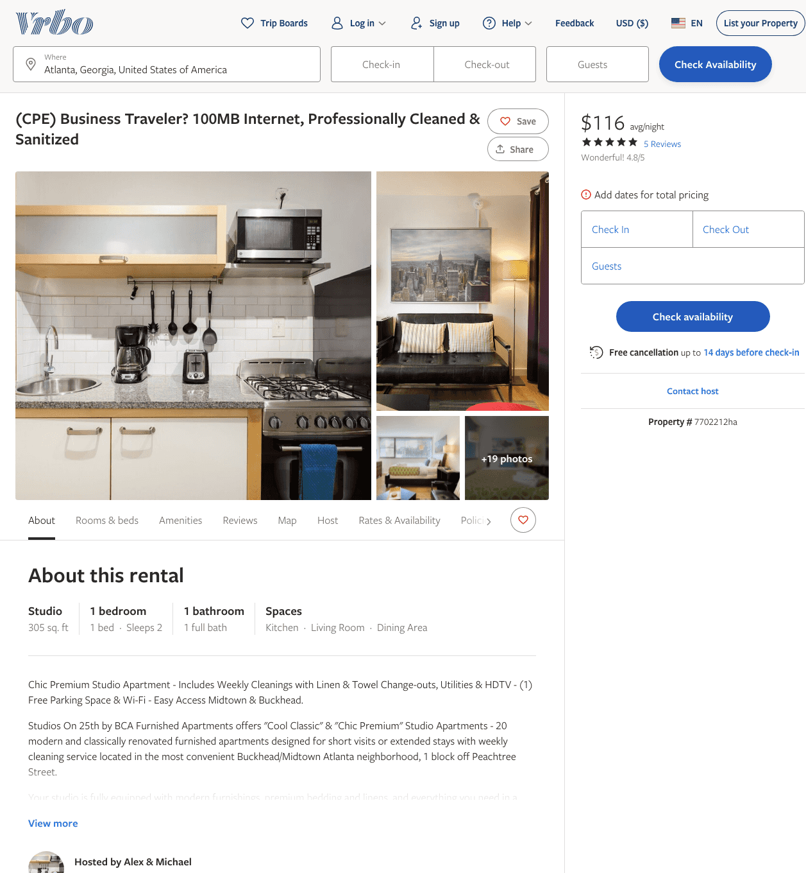
Listing 7702212
1
2
$101 - $125
4.6666665
1
Alex & Michael
https://www.vrbo.com/7702212ha
Aug 2022

Slide 16
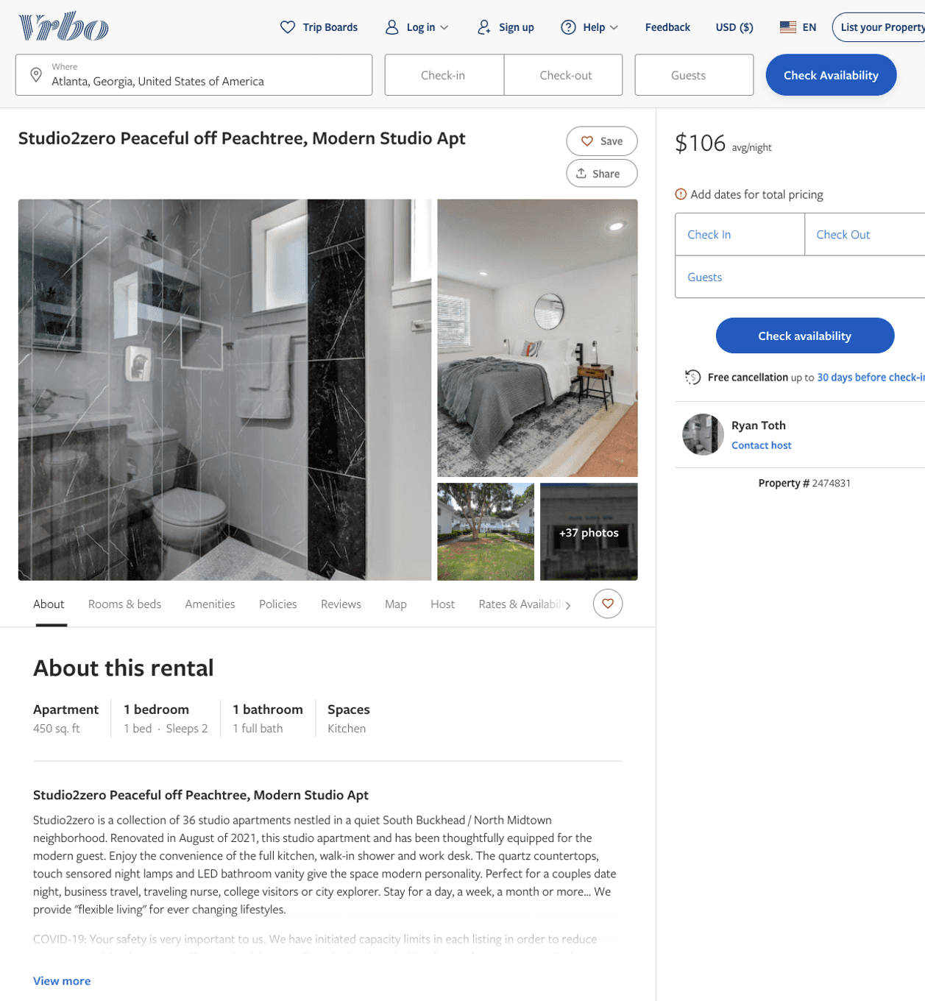
Listing 2474831
0
2
$104 - $99
1
Stay-ATL
https://www.vrbo.com/2474831
Aug 2022

Slide 17
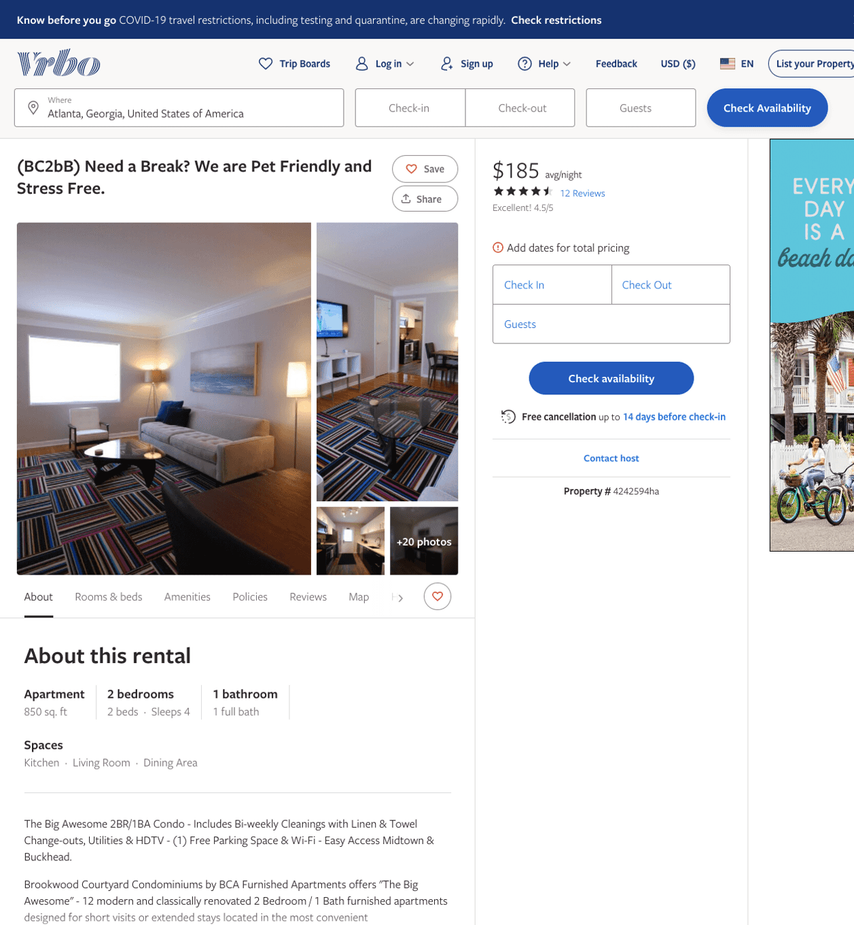
Listing 4242594
2
4
$159 - $191
4.571429
1
Alex & Michael
https://www.vrbo.com/4242594ha
Aug 2022

Slide 18
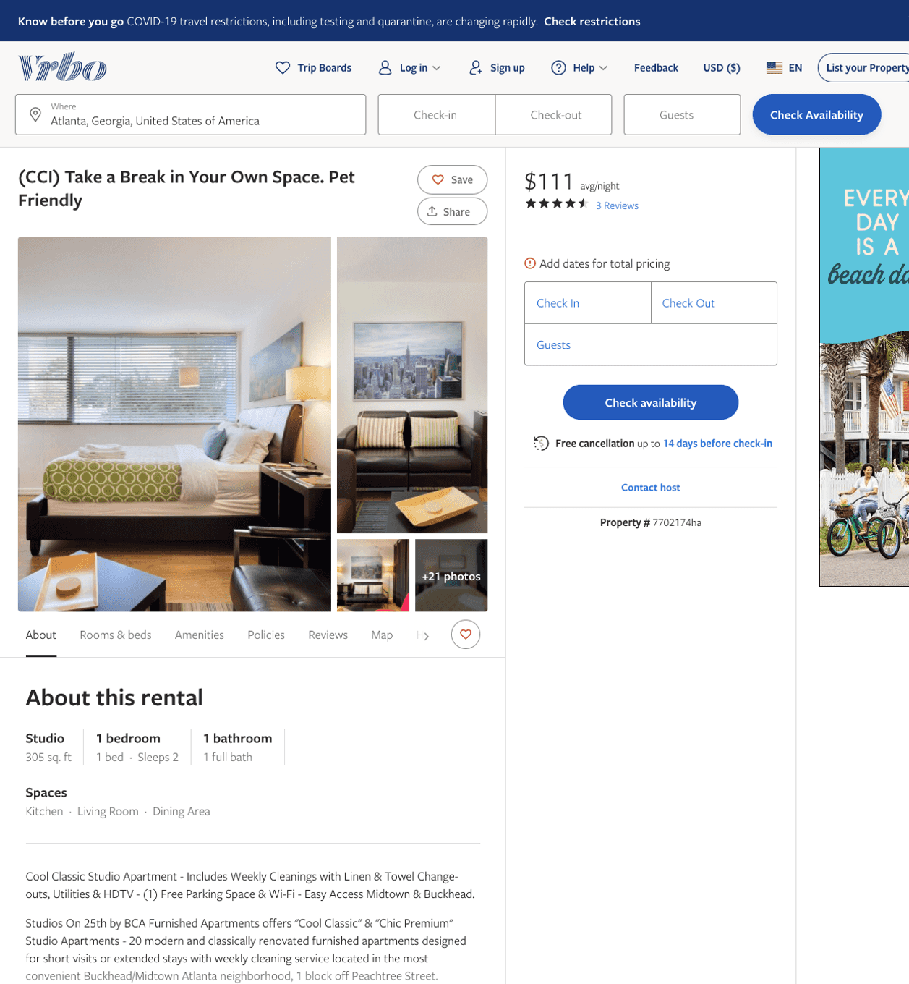
Listing 7702174
1
2
$100 - $111
4.857143
1
Alex & Michael
https://www.vrbo.com/7702174ha
Aug 2022

Slide 19
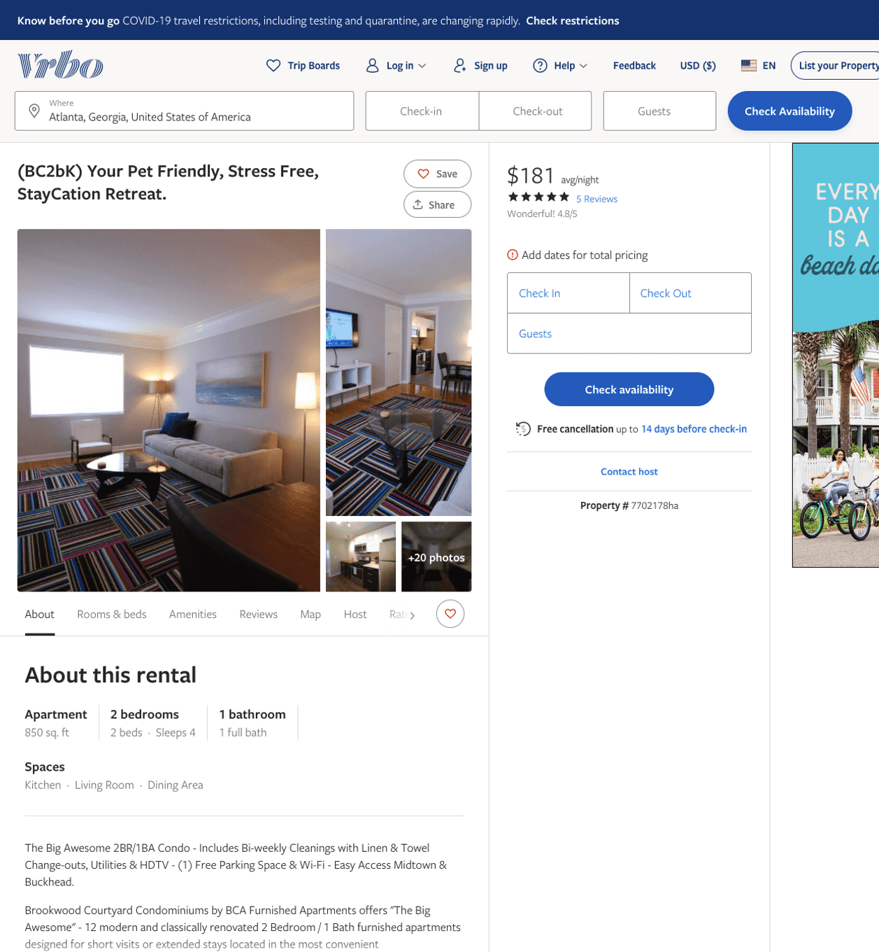
Listing 7702178
2
4
$172 - $213
4.8
1
Alex & Michael
https://www.vrbo.com/7702178ha
Aug 2022

Slide 20
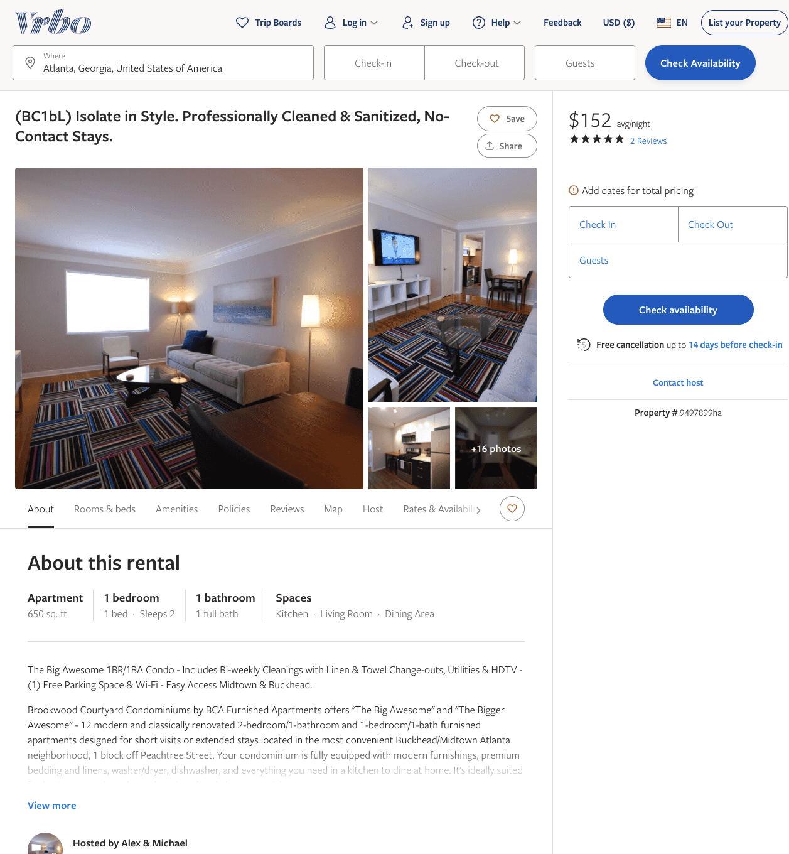
Listing 9497899
1
2
$130 - $151
5
1
Alex & Michael
https://www.vrbo.com/9497899ha
Aug 2022

Slide 21
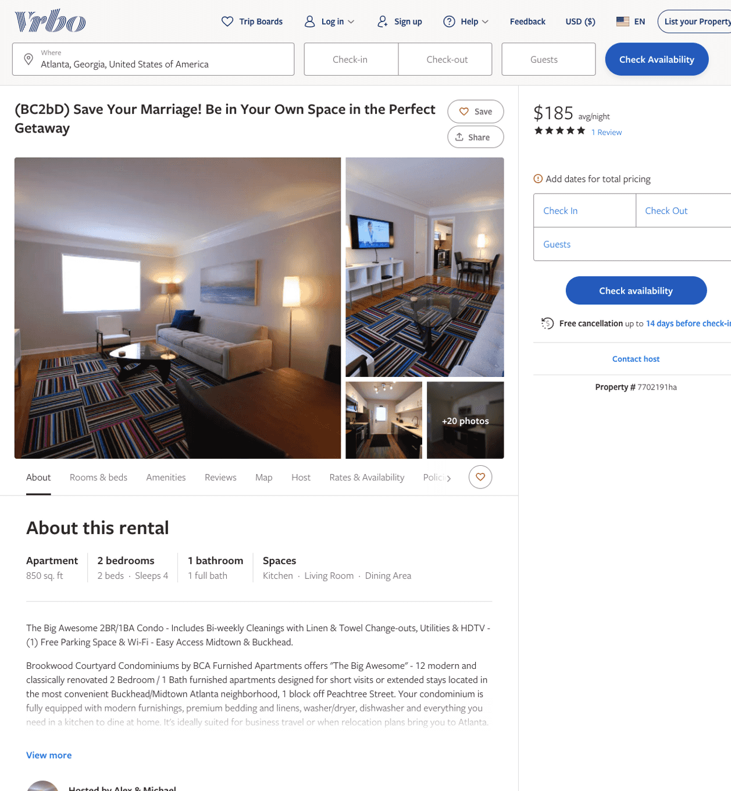
Listing 7702191
2
4
$159 - $191
5
1
Alex & Michael
https://www.vrbo.com/7702191ha
Aug 2022

Slide 22
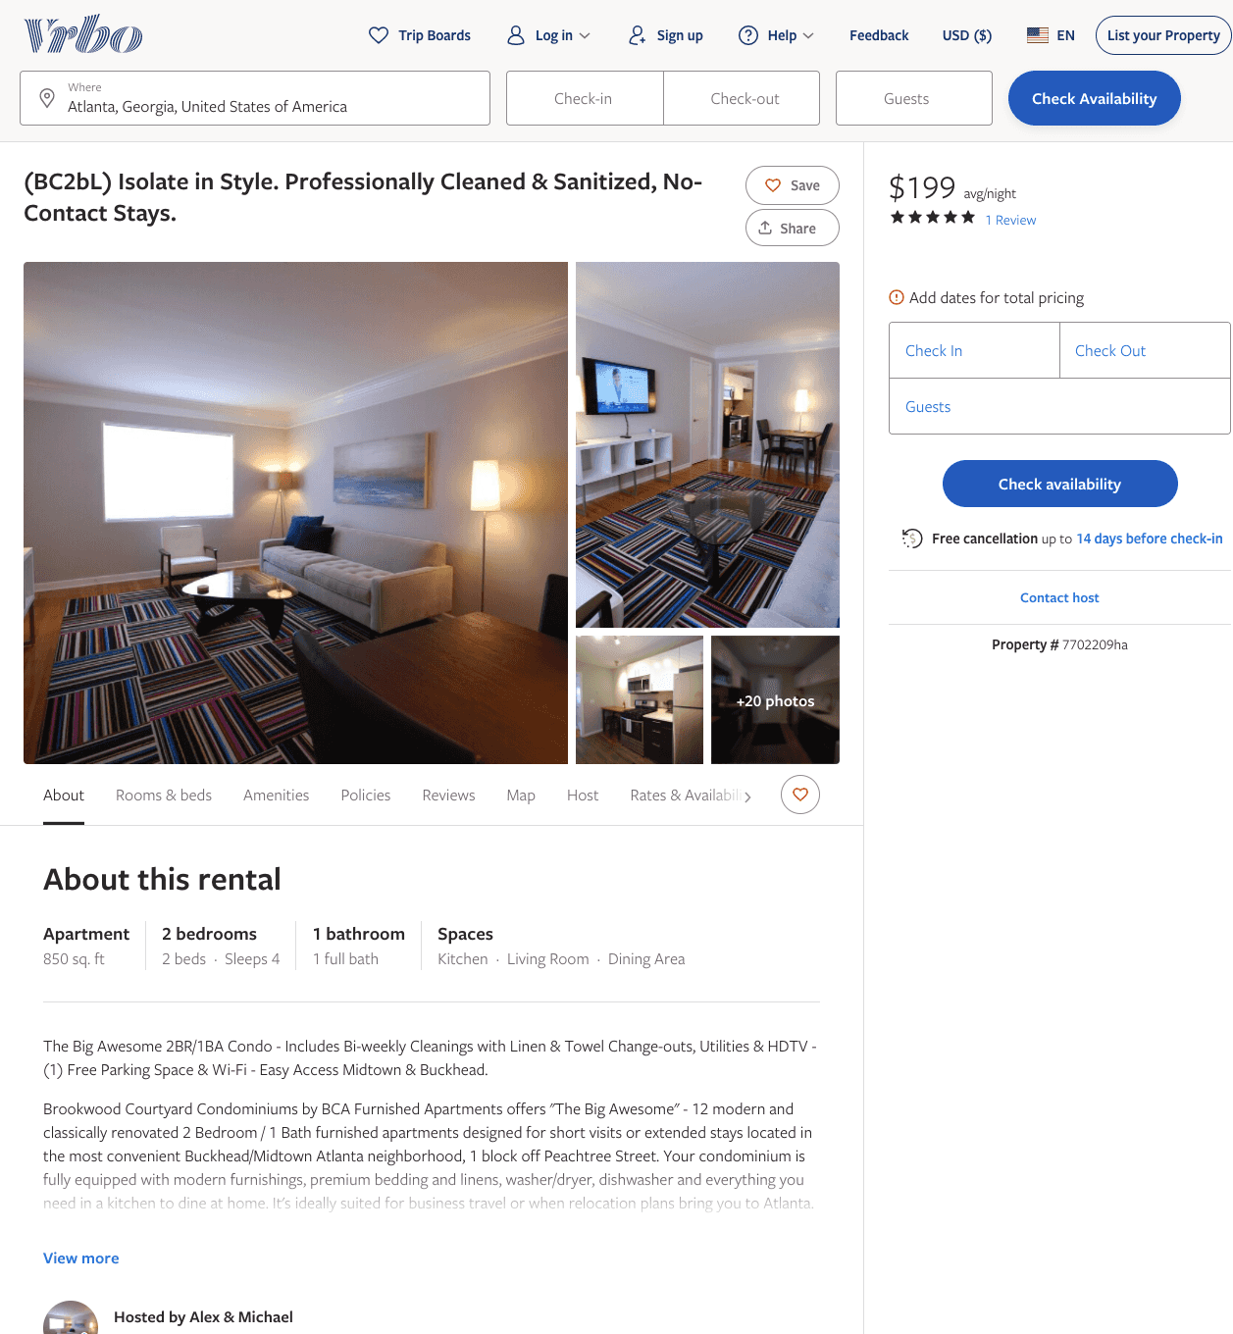
Listing 7702209
2
4
$173 - $193
5
1
Alex & Michael
https://www.vrbo.com/7702209ha
Aug 2022

Slide 23
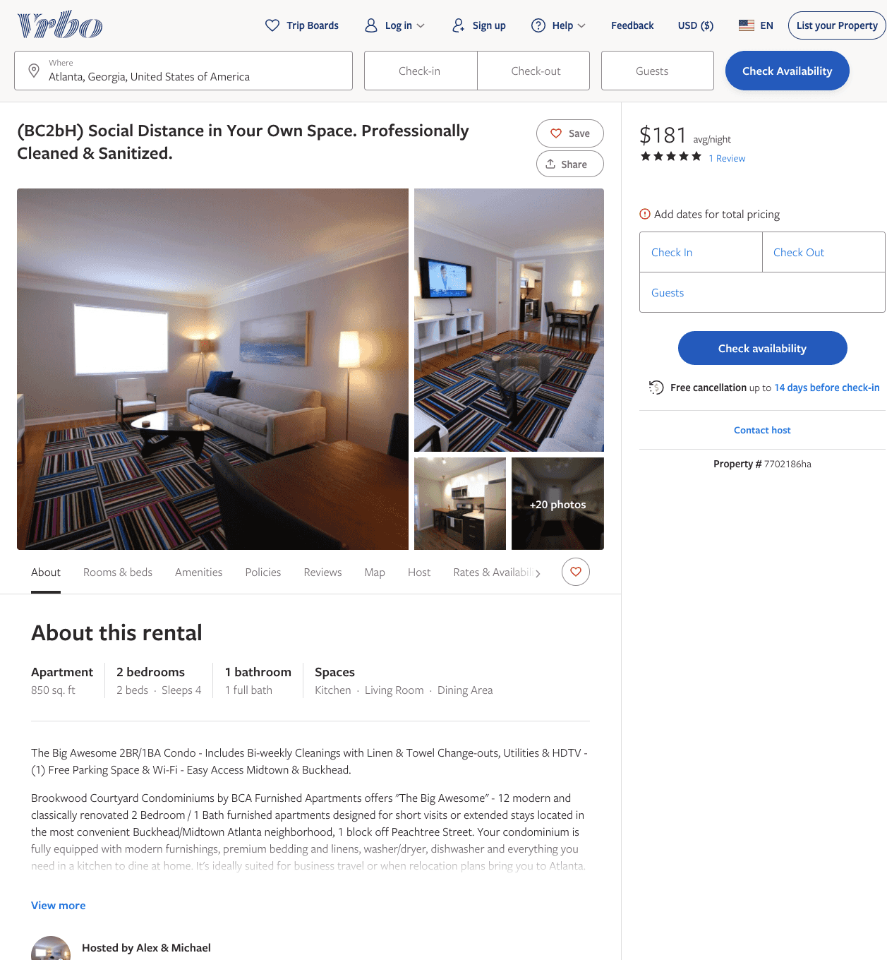
Listing 7702186
2
4
$172 - $191
5
1
Alex & Michael
https://www.vrbo.com/7702186ha
Aug 2022

Slide 24
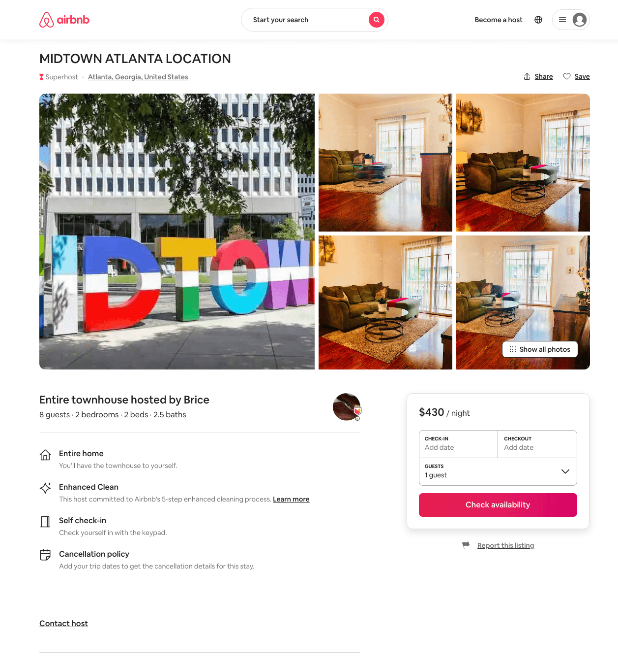
Listing 48448613
2
8
$406 - $430
3
Brice
47827549
4
https://www.airbnb.com/rooms/48448613
Aug 2022

Slide 25
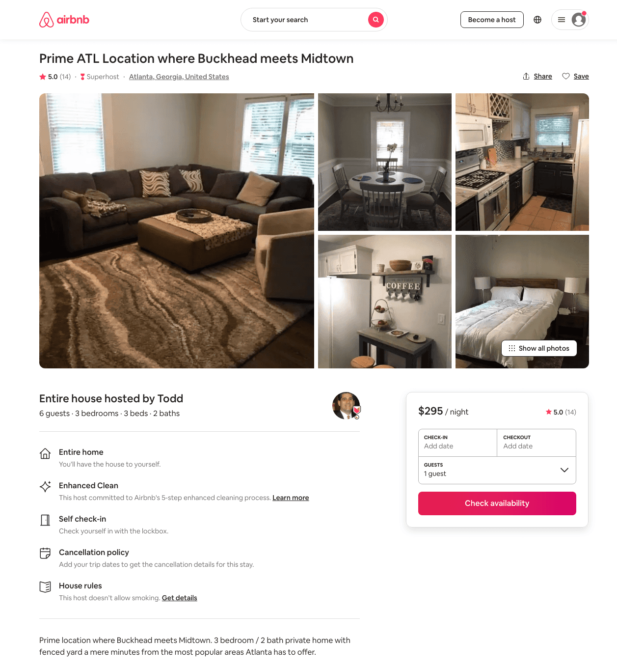
Listing 37983685
3
6
$295 - $325
4.93
2
Todd
288038161
1
https://www.airbnb.com/rooms/37983685
Aug 2022

Slide 26
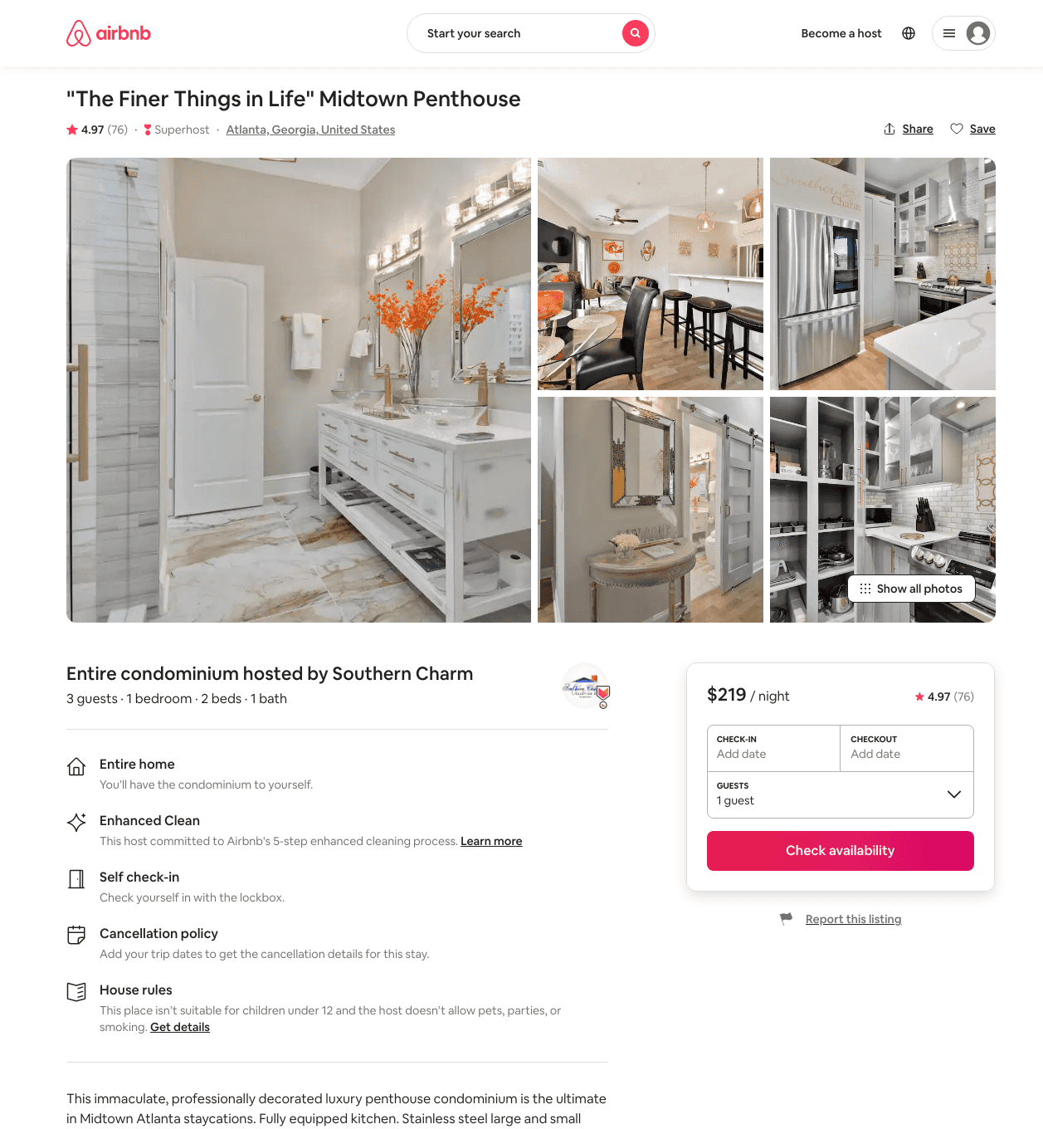
Listing 41462182
1
3
$178 - $246
4.97
1
Southern Charm
230851237
1
https://www.airbnb.com/rooms/41462182
Aug 2022

Slide 27
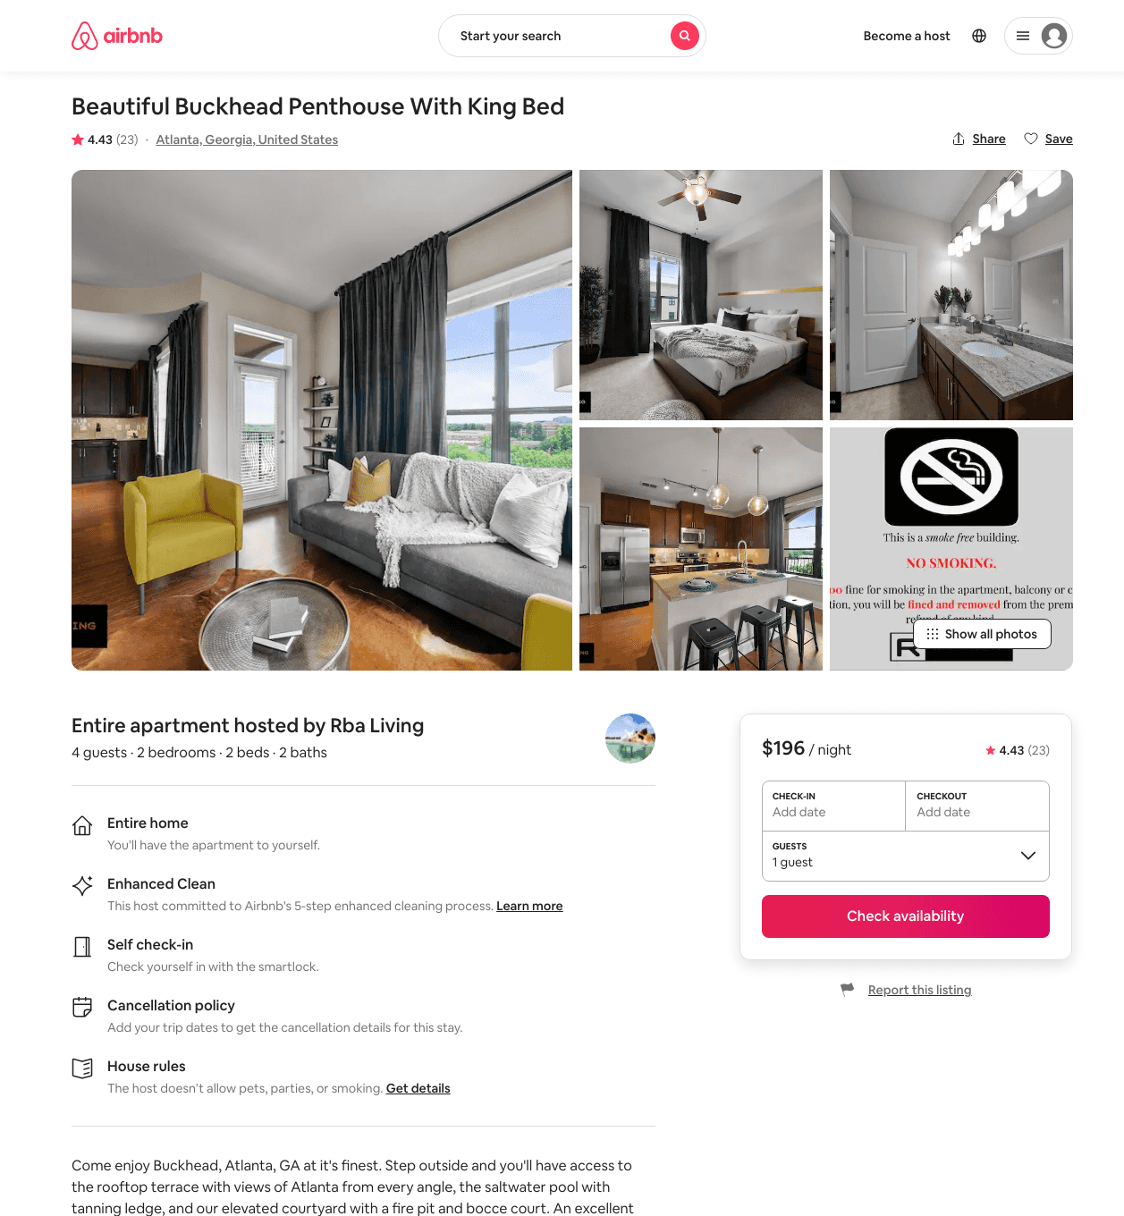
Listing 44137670
2
5
$143 - $252
4.36
2
Rba Living
97150171
6
https://www.airbnb.com/rooms/44137670
Aug 2022

Slide 28
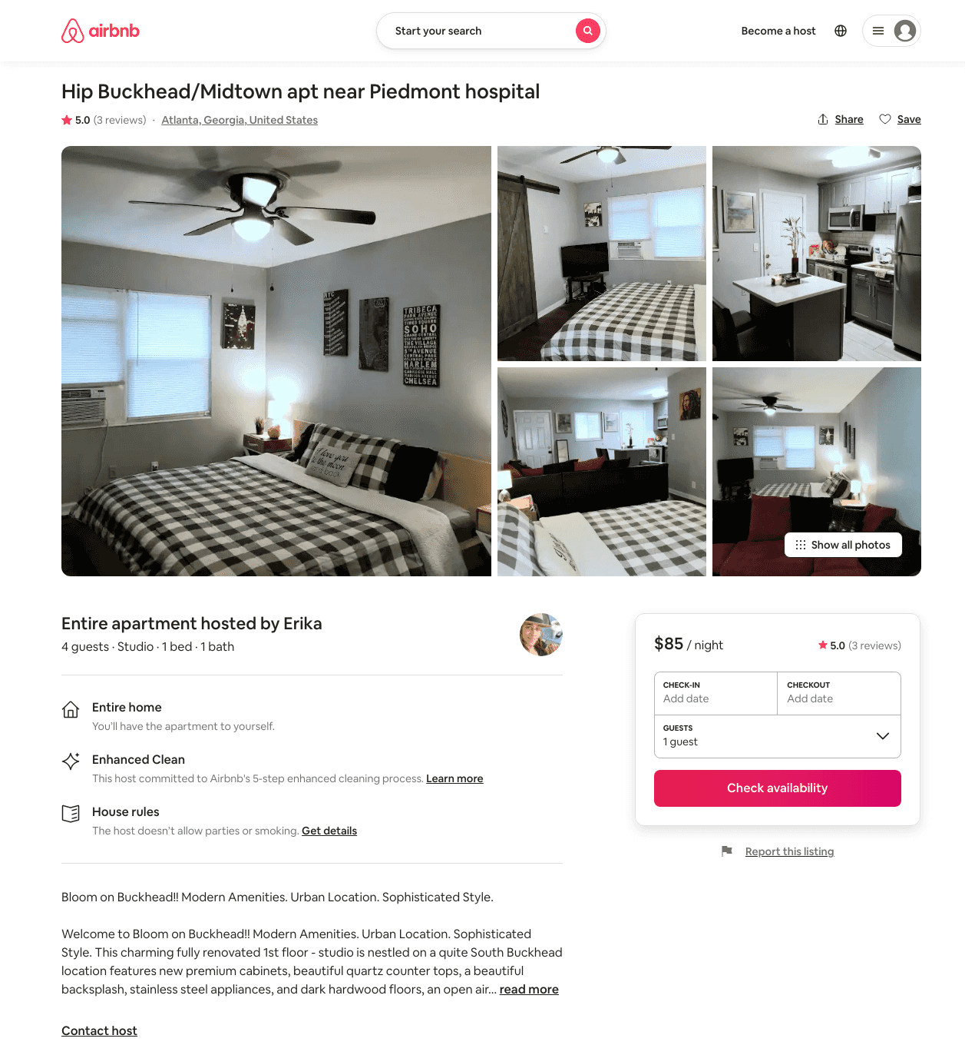
Listing 41961436
1
2
$71 - $153
4.79
2
Erika
72139261
1
https://www.airbnb.com/rooms/41961436
Jun 2022

Slide 29
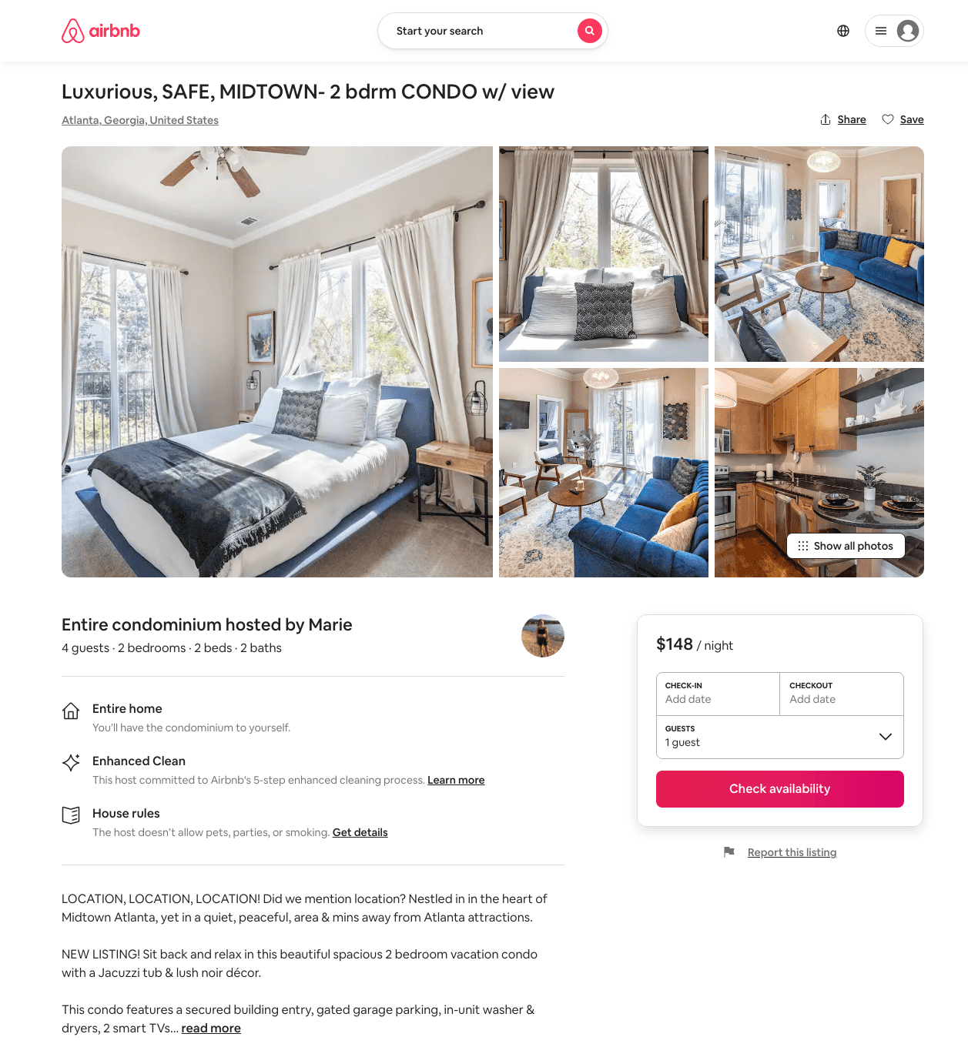
Listing 48933474
2
4
$132 - $215
4.93
4
Marie
347338061
1
https://www.airbnb.com/rooms/48933474
Aug 2022

Slide 30
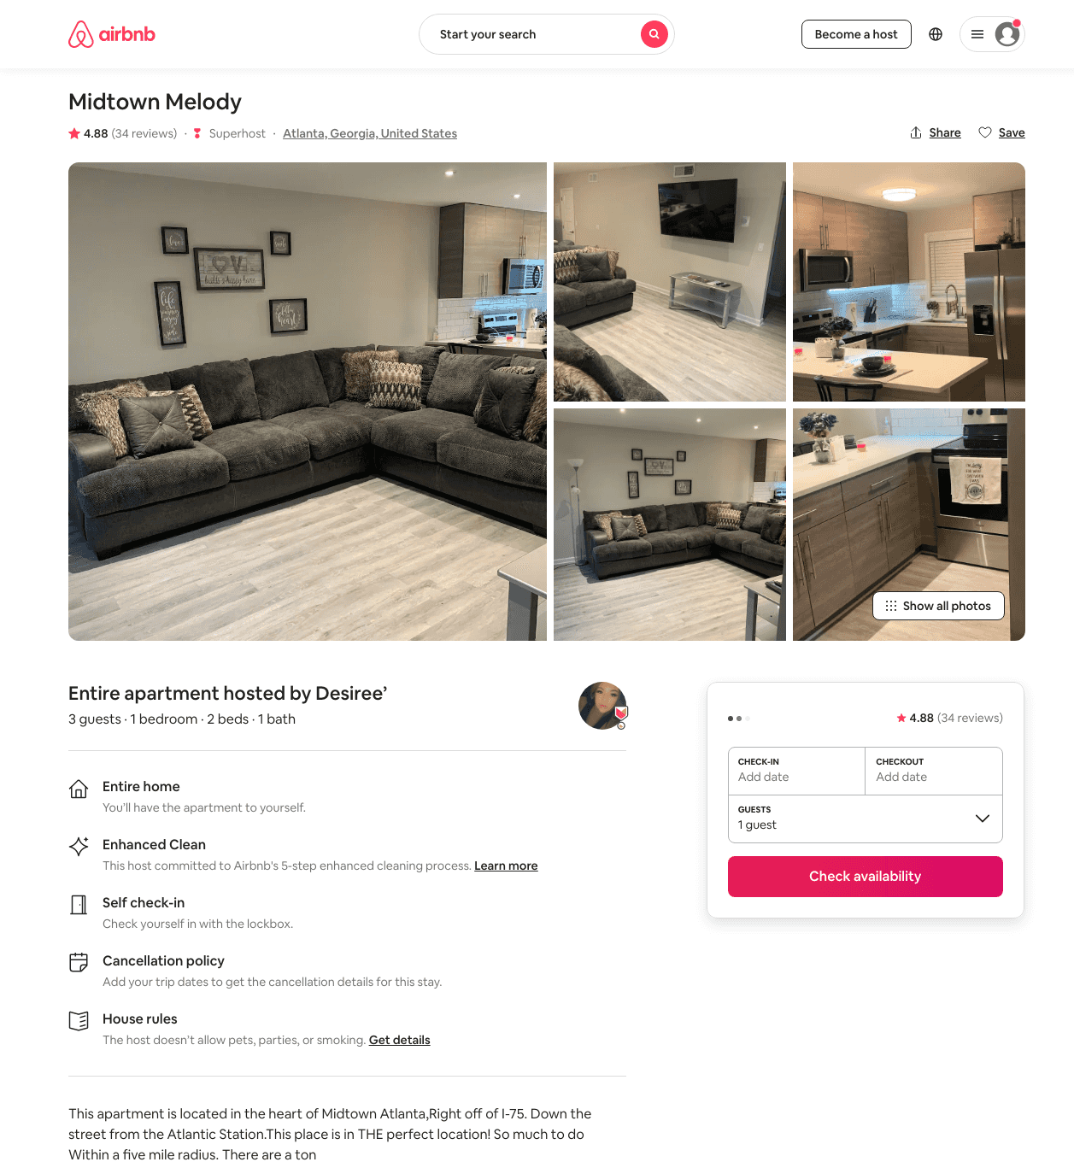
Listing 41498556
1
3
$99 - $139
4.76
1
Desiree’
318816172
2
https://www.airbnb.com/rooms/41498556
Jul 2022

Slide 31
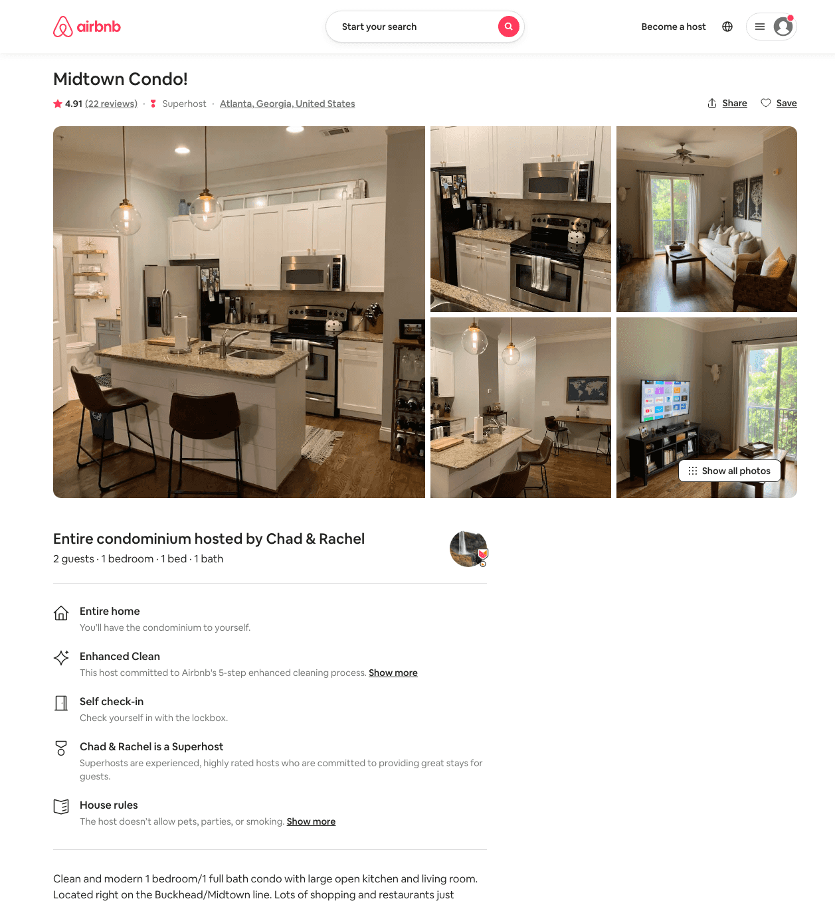
Listing 28753453
1
2
$89 - $178
4.94
2
Chad & Rachel
35379988
1
https://www.airbnb.com/rooms/28753453
Aug 2022

Slide 32
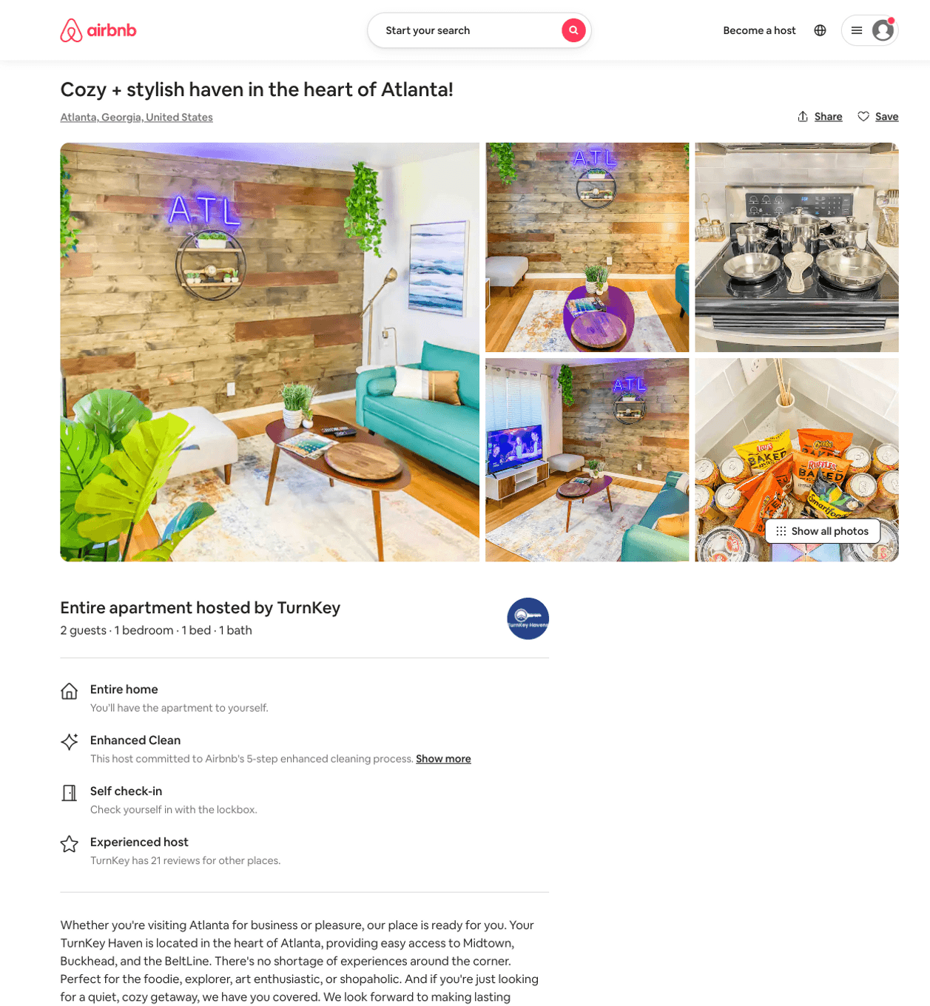
Listing 49950112
1
4
$73 - $135
4.58
2
TurnKey
10468807
2
https://www.airbnb.com/rooms/49950112
Jul 2022

Slide 33
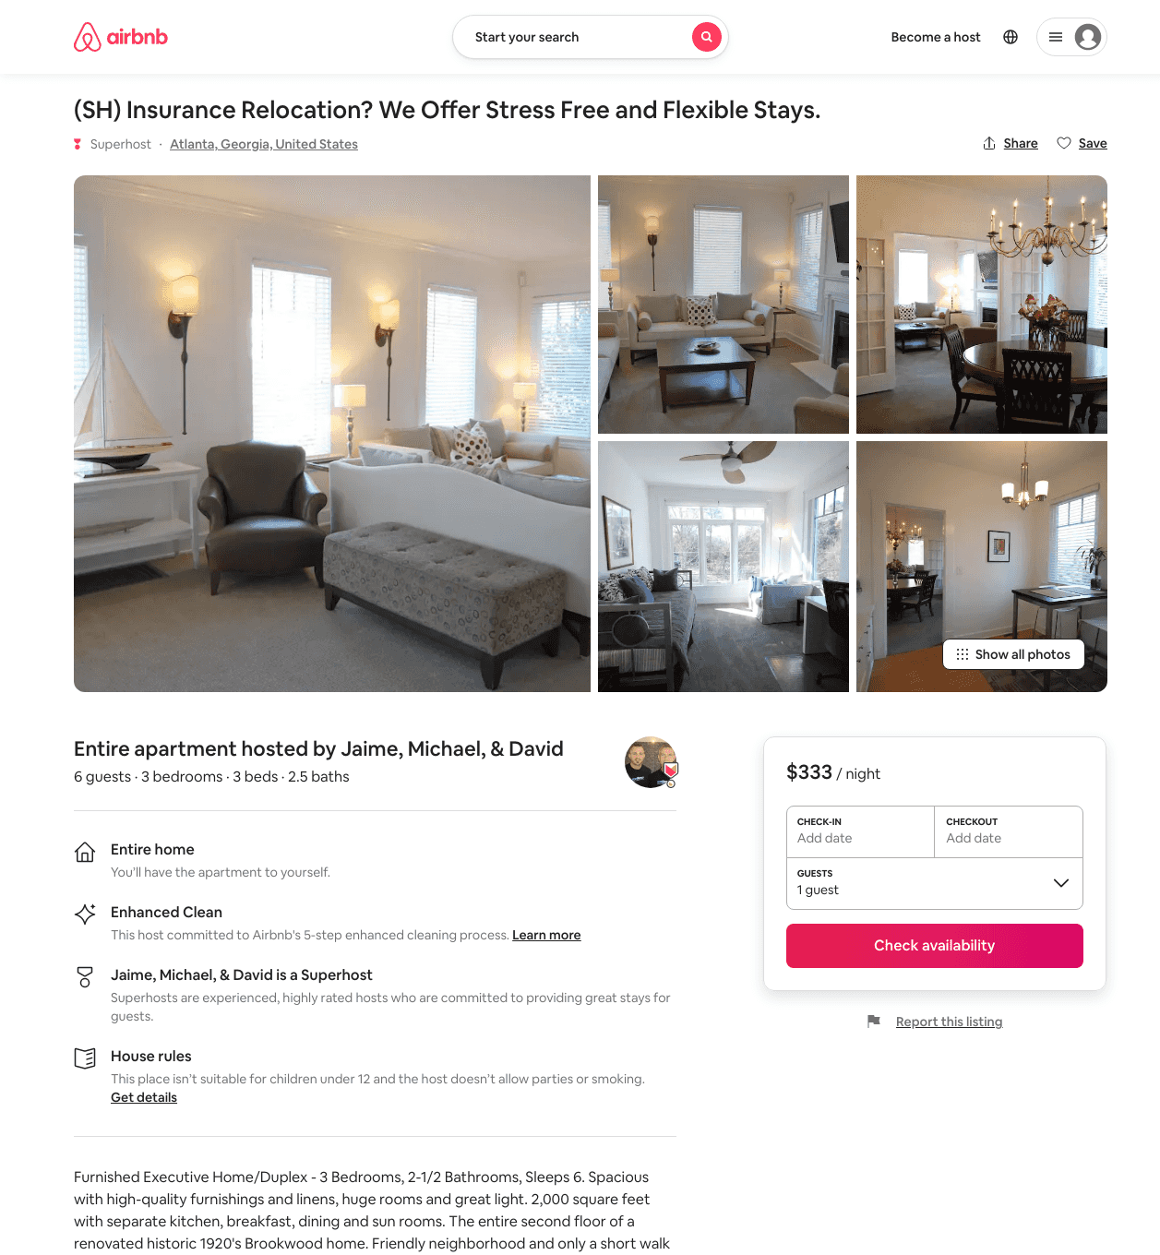
Listing 33581287
3
6
$318 - $361
1
Jaime, Michael, & David
16469655
56
https://www.airbnb.com/rooms/33581287
Aug 2022

Slide 34
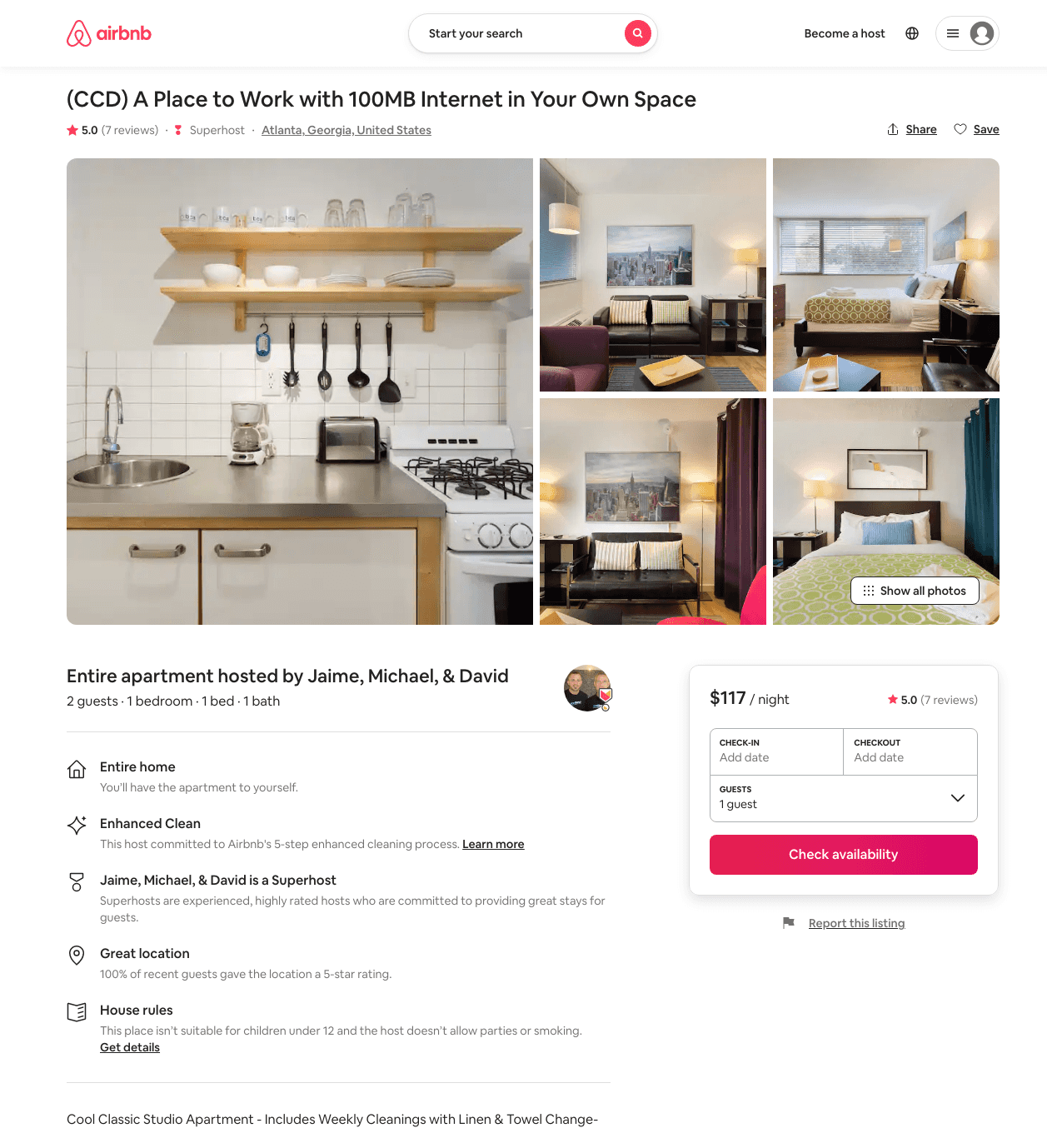
Listing 33581254
1
2
$105 - $124
5.0
1
Jaime, Michael, & David
16469655
56
https://www.airbnb.com/rooms/33581254
Jun 2022

Slide 35
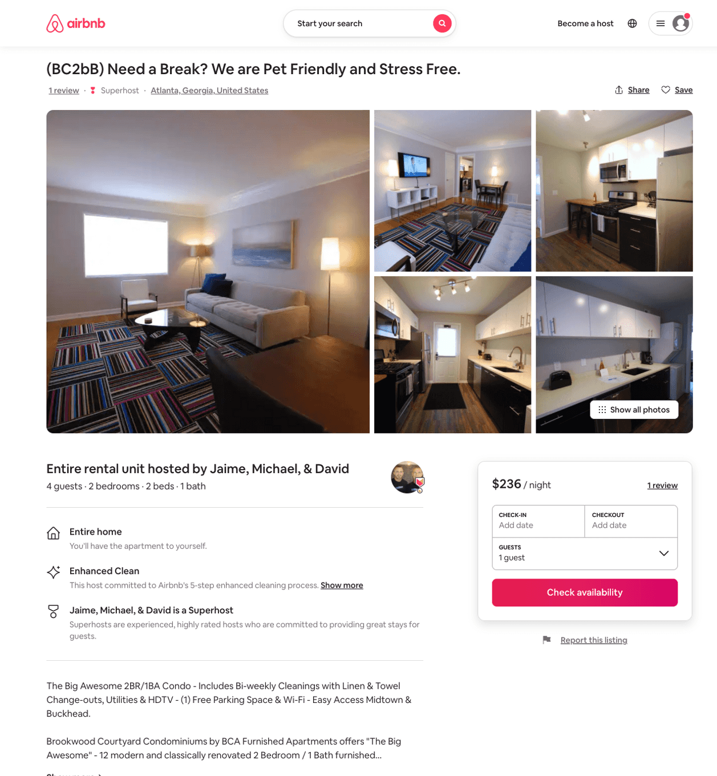
Listing 33581260
15 STANDISH AVE NW
2
4
$160 - $223
1
Jaime, Michael, & David
16469655
56
https://www.airbnb.com/rooms/33581260
Jun 2022

Slide 36
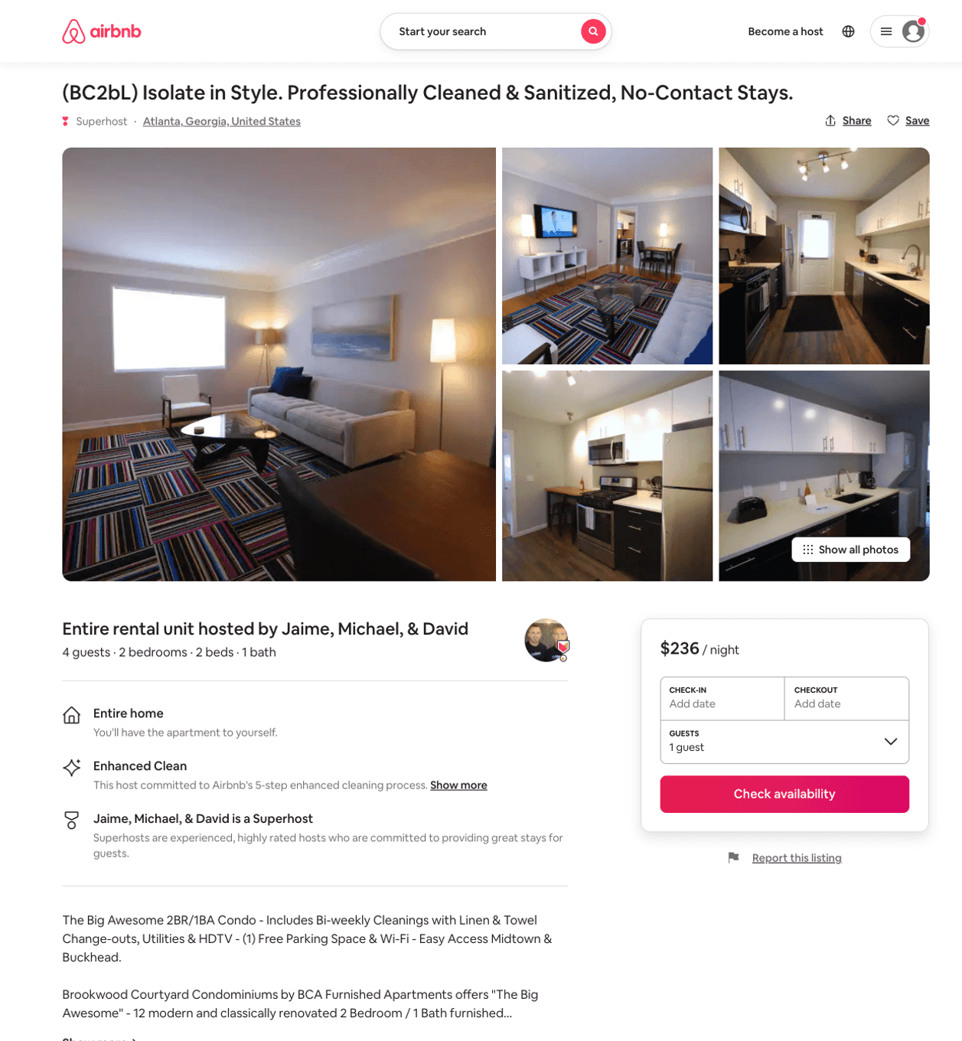
Listing 33581263
15 STANDISH AVE NW
2
4
$160 - $223
1
Jaime, Michael, & David
16469655
56
https://www.airbnb.com/rooms/33581263
Jul 2022

Slide 37
Listing 33581261
15 STANDISH AVE NW
2
4
$160 - $223
5.0
1
Jaime, Michael, & David
16469655
56
https://www.airbnb.com/rooms/33581261
Aug 2022

Slide 38
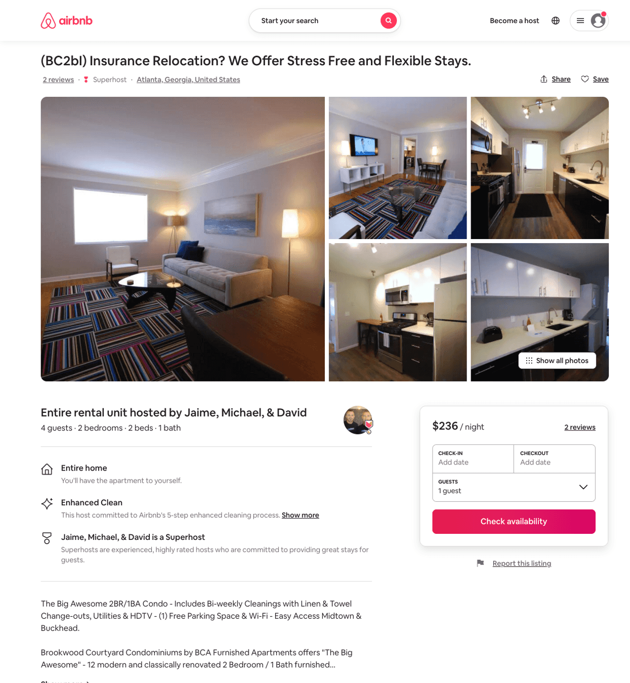
Listing 33581258
15 STANDISH AVE NW
2
4
$160 - $223
1
Jaime, Michael, & David
16469655
56
https://www.airbnb.com/rooms/33581258
Aug 2022

Slide 39
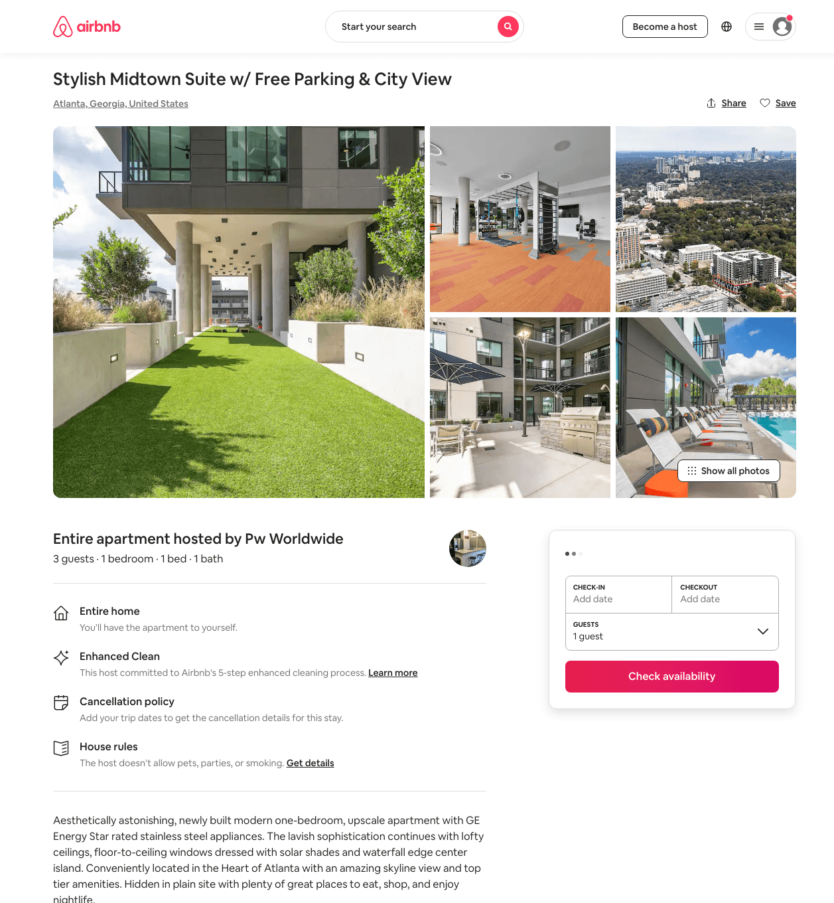
Listing 48141013
1
3
$125 - $149
5.0
2
Pw Worldwide
382563817
1
https://www.airbnb.com/rooms/48141013
Aug 2022

Slide 40
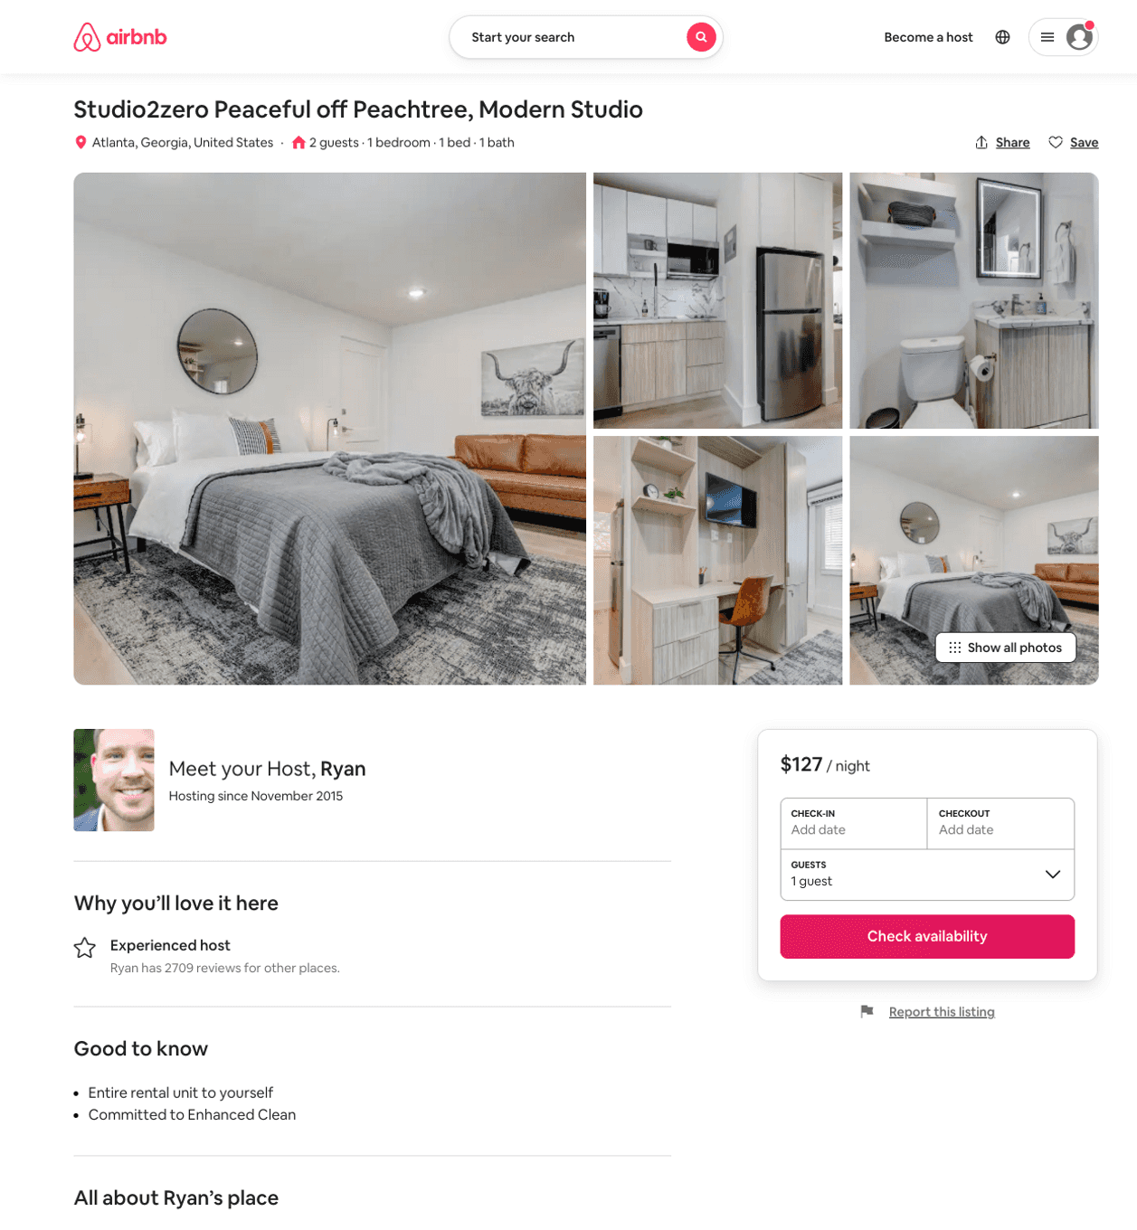
Listing 51943314
Studio
2
$96 - $127
3.60
1
StayATL
382221244
54
https://www.airbnb.com/rooms/51943314
Aug 2022

Slide 41
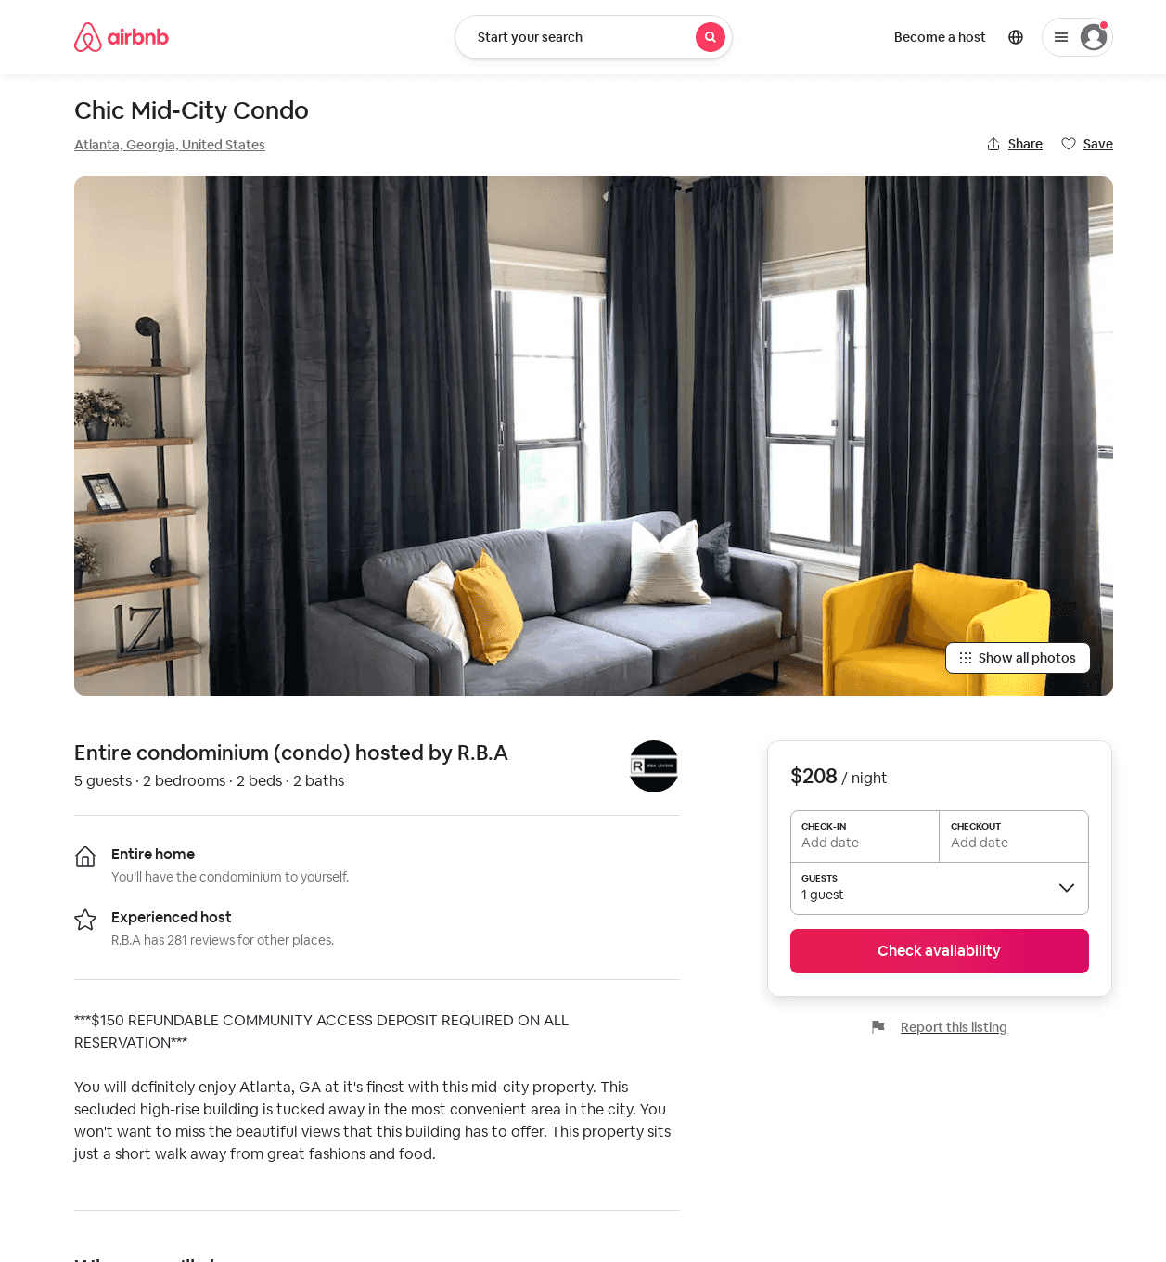
Listing 52075741
2
5
$155 - $272
4.37
1
R.B.A
26534449
17
https://www.airbnb.com/rooms/52075741
Aug 2022

Slide 42
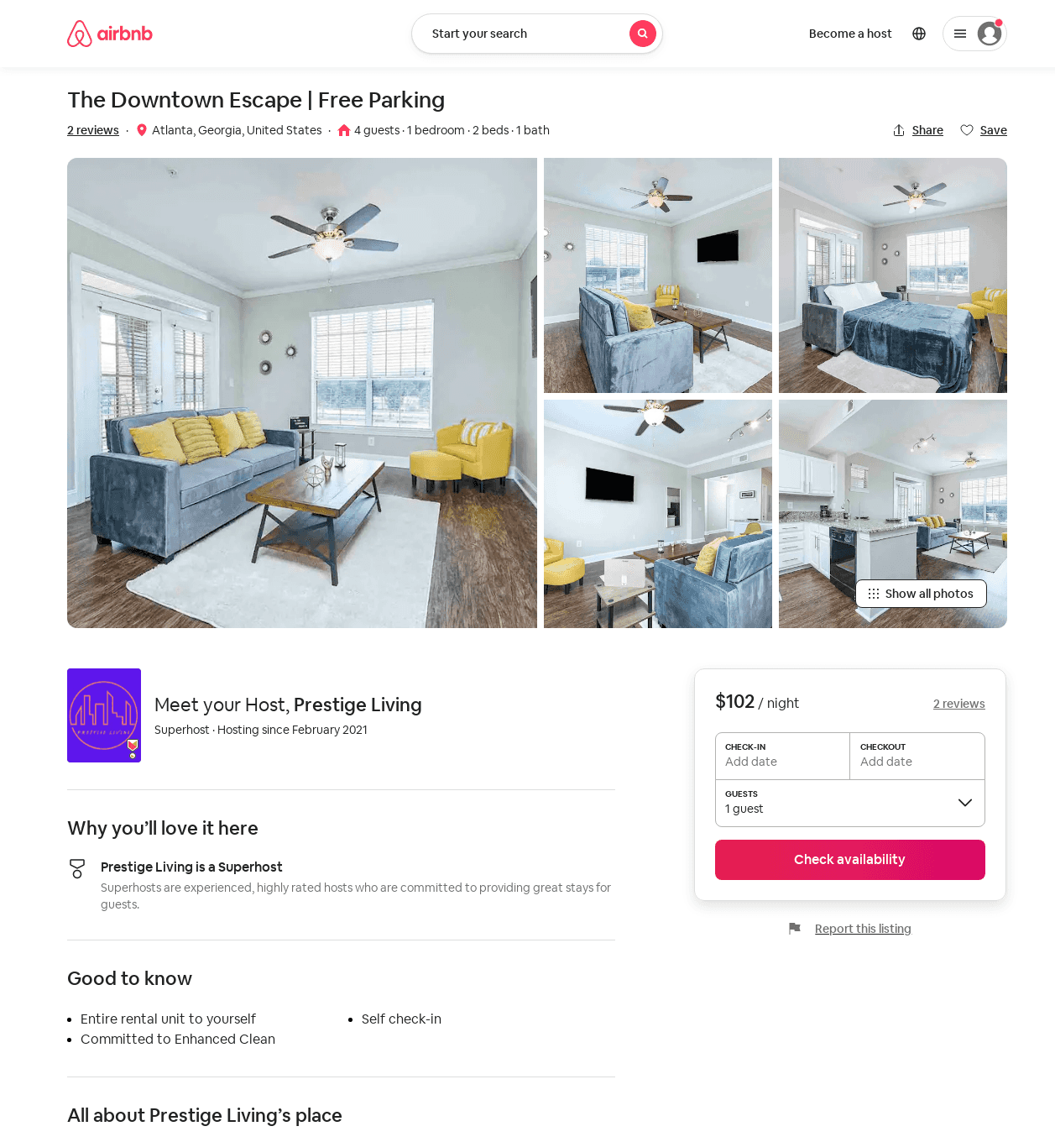
Listing 52012140
1
4
$90 - $102
5.0
1
Prestige Living
388068651
3
https://www.airbnb.com/rooms/52012140
Aug 2022

Slide 43
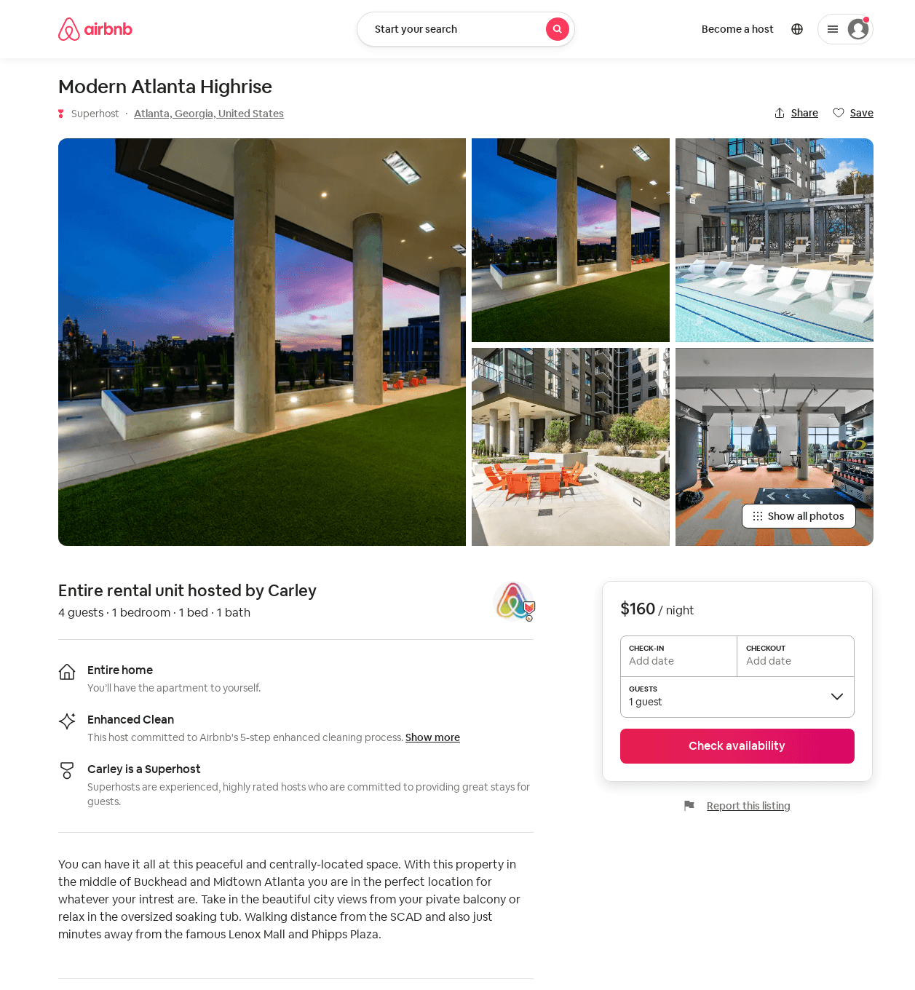
Listing 51980383
1
4
$107 - $179
4.92
2
Carley
72377500
2
https://www.airbnb.com/rooms/51980383
Aug 2022

Slide 44
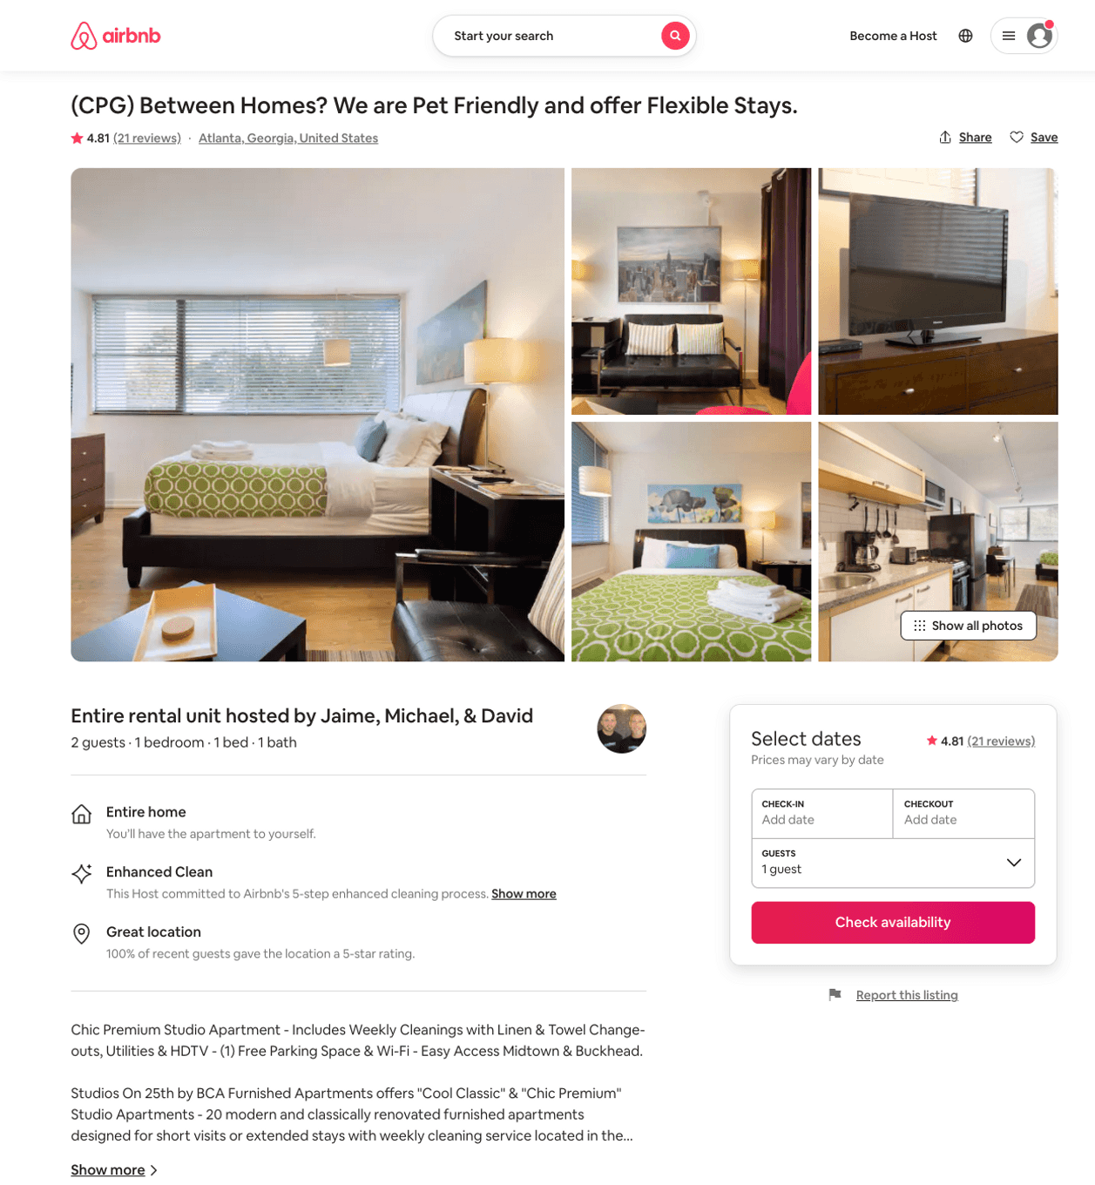
Listing 13203138
1
2
$115 - $140
4.83
1
Jaime, Michael, & David
16469655
56
https://www.airbnb.com/rooms/13203138
Aug 2022

Slide 45
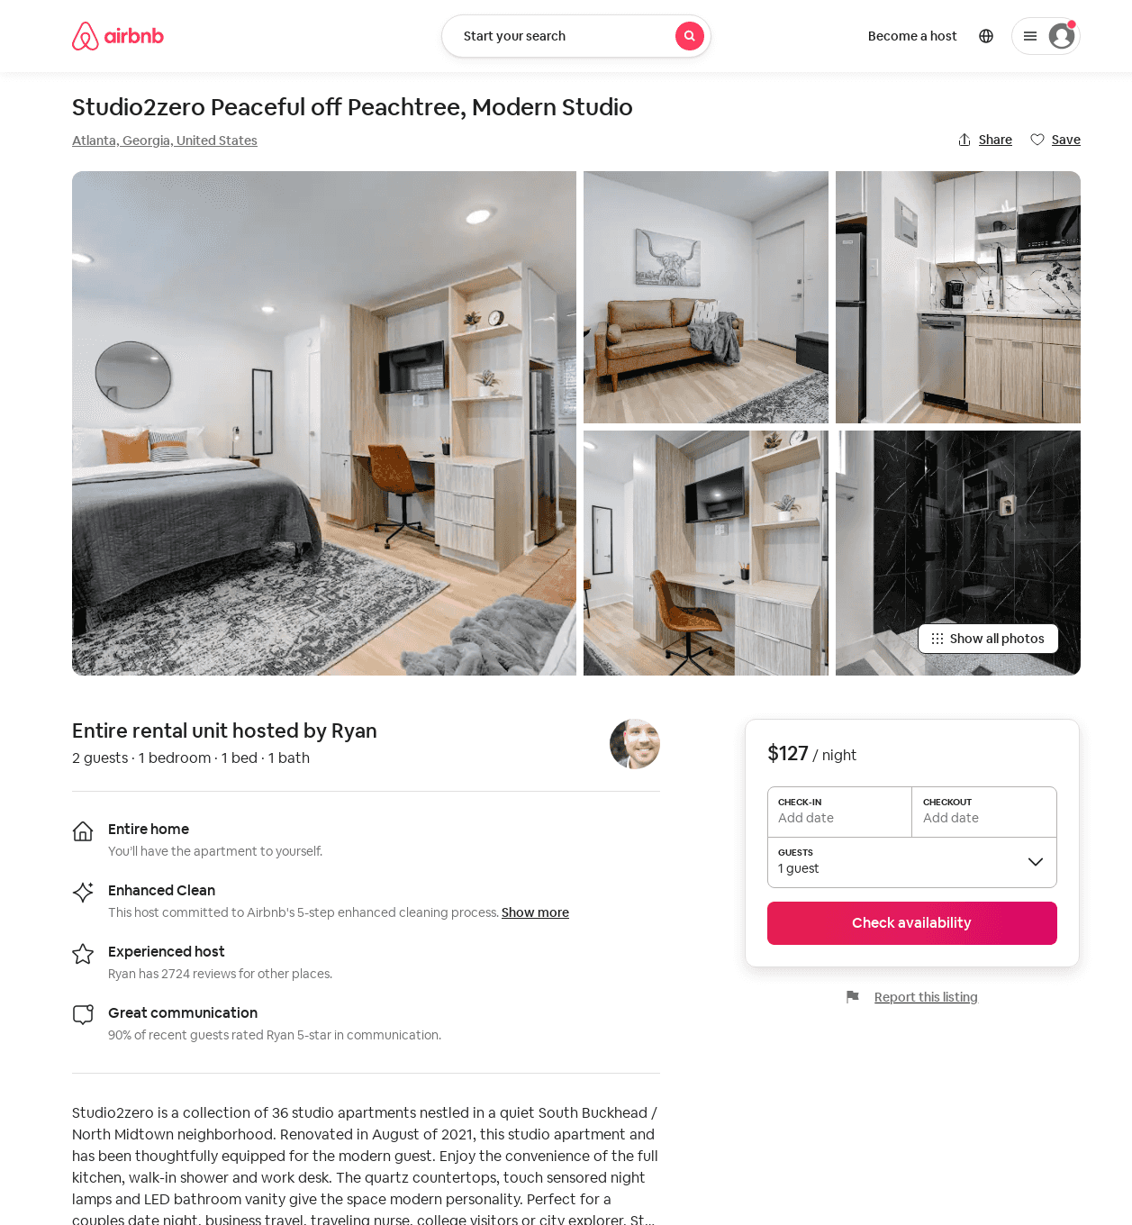
Listing 52007158
Studio
2
$96 - $192
4.86
1
StayATL
382221244
54
https://www.airbnb.com/rooms/52007158
Aug 2022

Slide 46
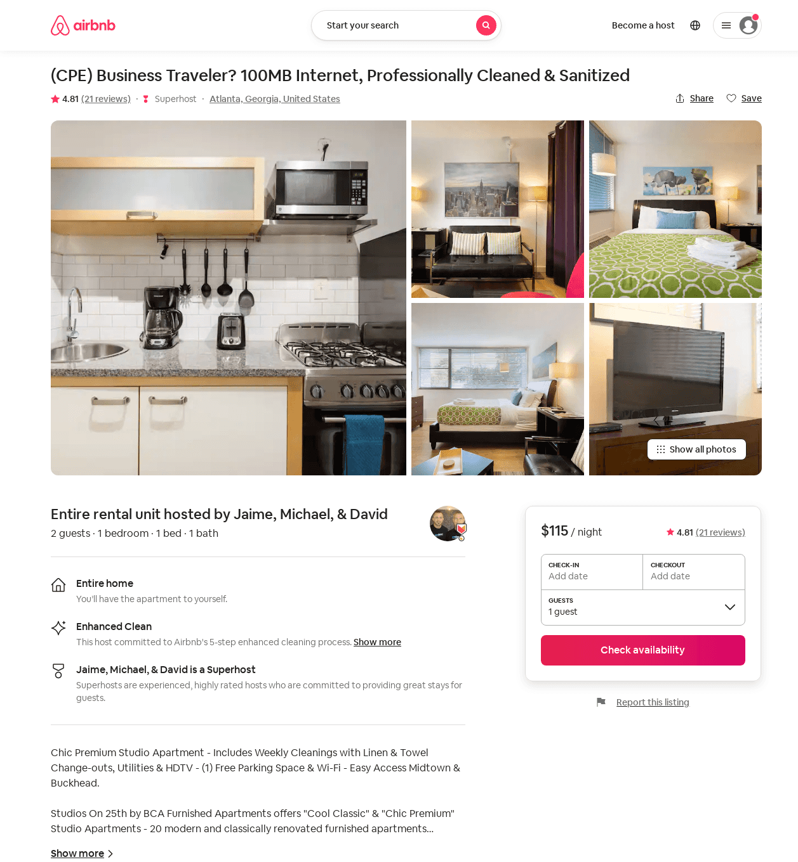
Listing 3256655
1
2
$115 - $128
4.82
1
Jaime, Michael, & David
16469655
56
https://www.airbnb.com/rooms/3256655
Jul 2022

Slide 47
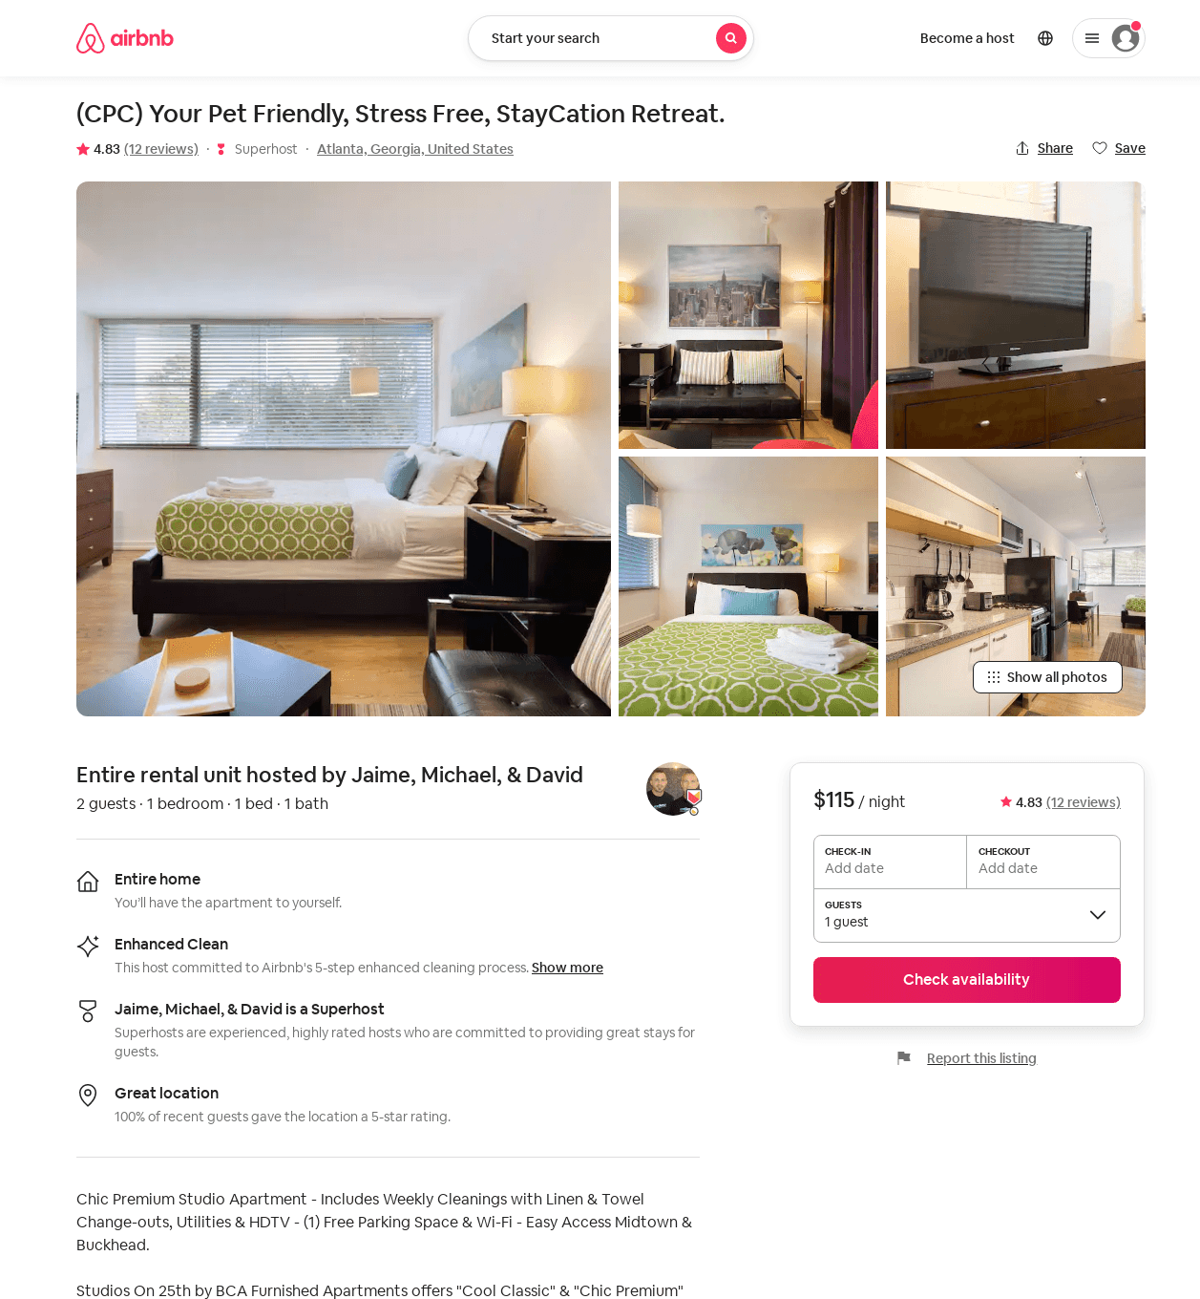
Listing 33581246
1
2
$115 - $135
4.79
1
Jaime, Michael, & David
16469655
56
https://www.airbnb.com/rooms/33581246
Jul 2022

Slide 48
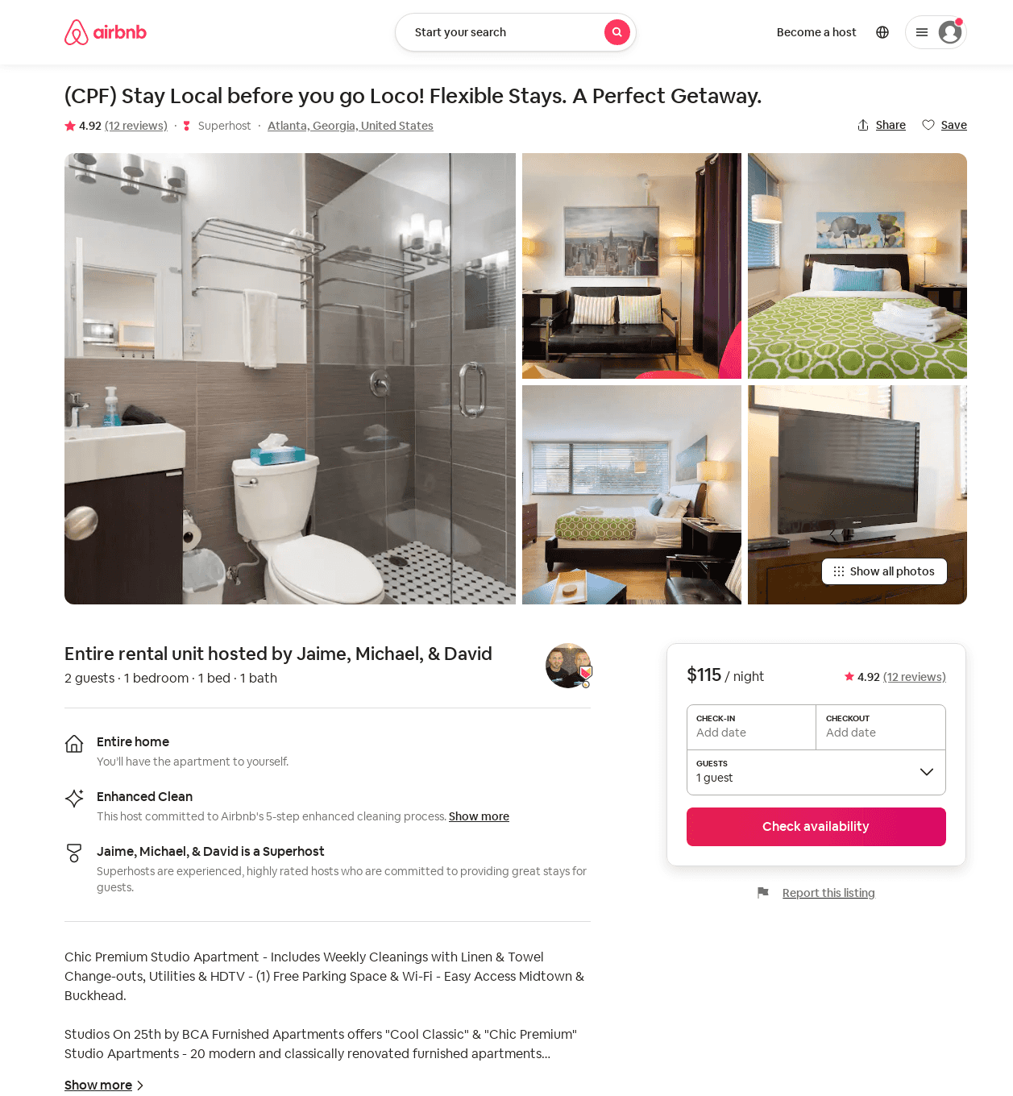
Listing 13169814
1
2
$115 - $135
4.77
1
Jaime, Michael, & David
16469655
56
https://www.airbnb.com/rooms/13169814
Jul 2022

Slide 49
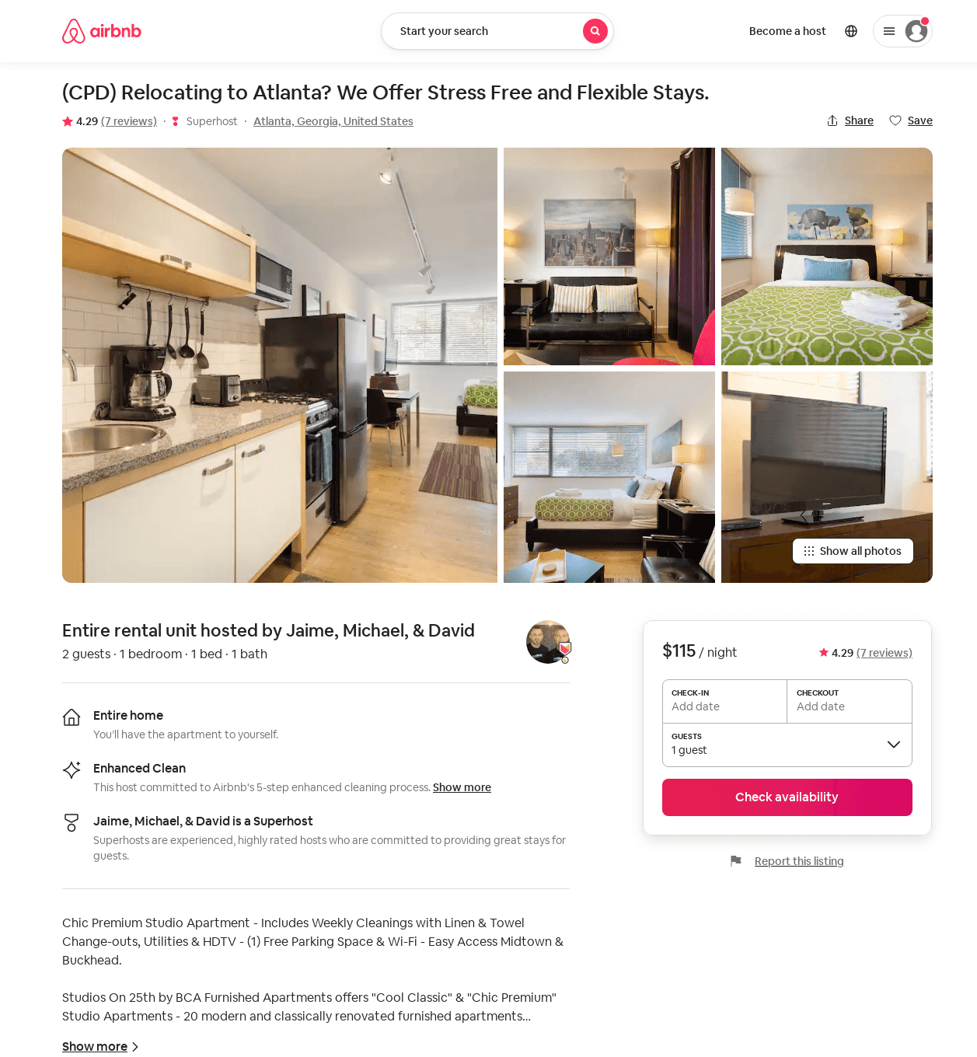
Listing 33581244
1
2
$115
4.29
1
Jaime, Michael, & David
16469655
56
https://www.airbnb.com/rooms/33581244
Jul 2022

Slide 50
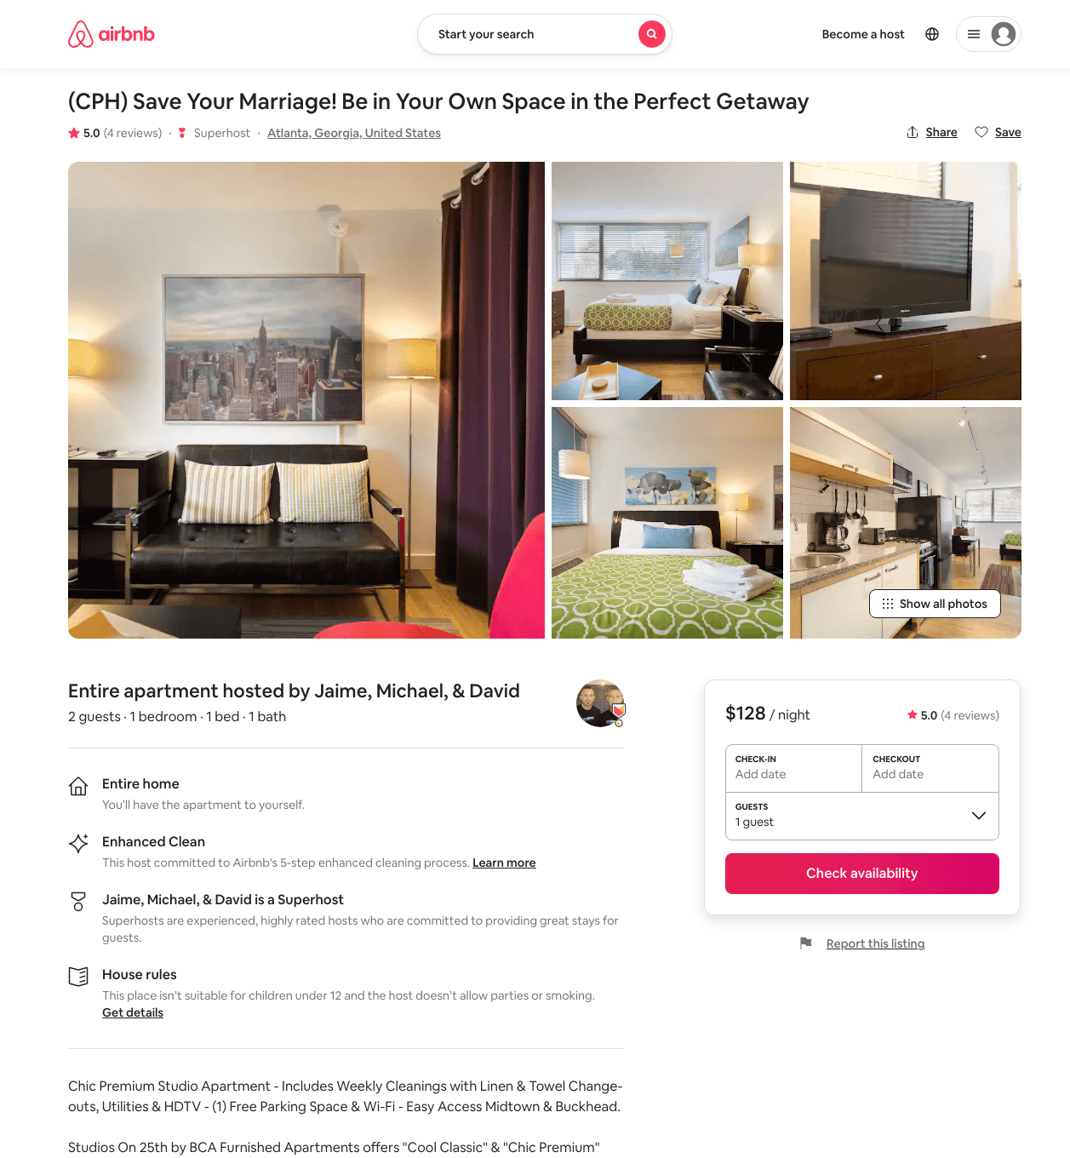
Listing 33581232
1
2
$115 - $135
5.0
1
Jaime, Michael, & David
16469655
56
https://www.airbnb.com/rooms/33581232
Jul 2022

Slide 51
Listing 33581242
1
2
$115 - $135
4.80
1
Jaime, Michael, & David
16469655
56
https://www.airbnb.com/rooms/33581242
Jul 2022

Slide 52
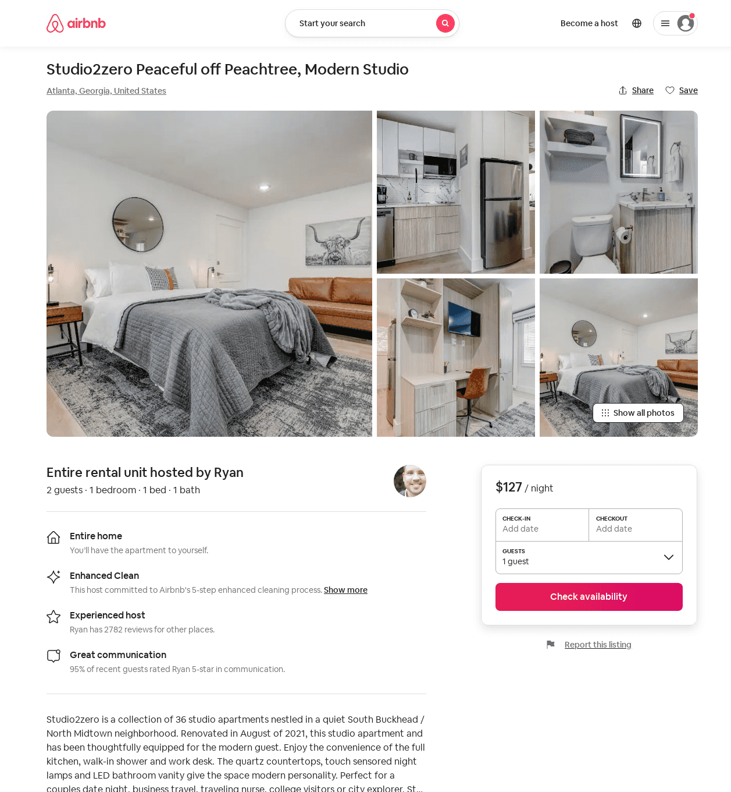
Listing 52381279
Studio
2
$96 - $127
1
StayATL
382221244
54
https://www.airbnb.com/rooms/52381279
Aug 2022

Slide 53
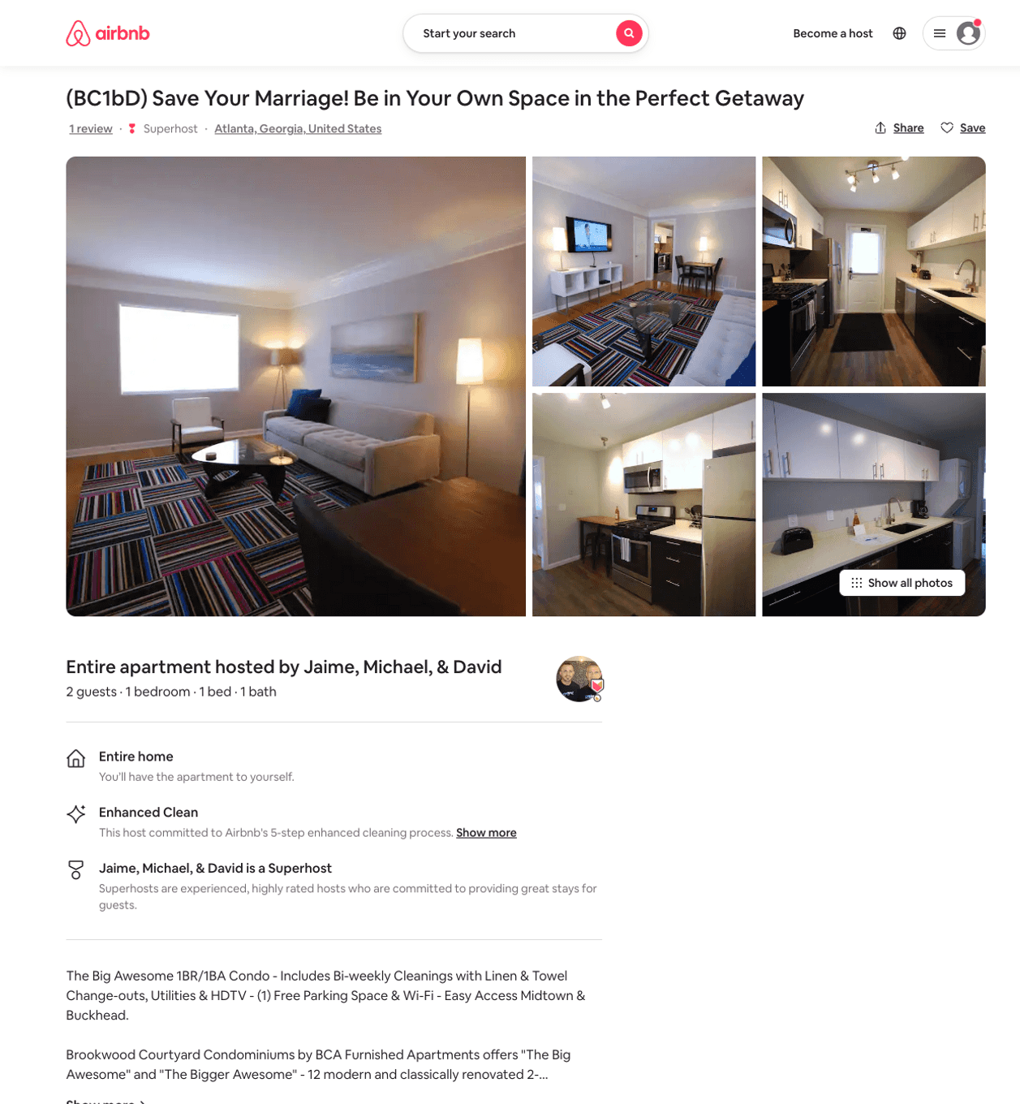
Listing 45453717
1
2
$139 - $147
1
Jaime, Michael, & David
16469655
56
https://www.airbnb.com/rooms/45453717
Jun 2022

Slide 54
Listing 45453718
1
2
$133 - $162
1
Jaime, Michael, & David
16469655
56
https://www.airbnb.com/rooms/45453718
Aug 2022

Slide 55
Listing 45440339
1
2
$133 - $162
1
Jaime, Michael, & David
16469655
56
https://www.airbnb.com/rooms/45440339
Jun 2022

Slide 56
Listing 45453723
1
2
$139 - $147
1
Jaime, Michael, & David
16469655
56
https://www.airbnb.com/rooms/45453723
Jun 2022

Slide 57
Listing 45453720
1
2
$133 - $162
1
Jaime, Michael, & David
16469655
56
https://www.airbnb.com/rooms/45453720
Jun 2022

Slide 58
Listing 45453714
1
2
$133 - $162
1
Jaime, Michael, & David
16469655
56
https://www.airbnb.com/rooms/45453714
Aug 2022

Slide 59
Listing 45453715
1
2
$133 - $162
1
Jaime, Michael, & David
16469655
56
https://www.airbnb.com/rooms/45453715
Aug 2022

Slide 60
Listing 45437993
1
2
$133 - $162
1
Jaime, Michael, & David
16469655
56
https://www.airbnb.com/rooms/45437993
Aug 2022

Slide 61
Listing 45453724
1
2
$133 - $162
1
Jaime, Michael, & David
16469655
56
https://www.airbnb.com/rooms/45453724
Jul 2022

Slide 62
Listing 45453716
1
2
$133 - $162
1
Jaime, Michael, & David
16469655
56
https://www.airbnb.com/rooms/45453716
Aug 2022

Slide 63
Listing 45453719
1
2
$133 - $162
1
Jaime, Michael, & David
16469655
56
https://www.airbnb.com/rooms/45453719
Aug 2022

Slide 64
Listing 33581249
1
2
$105 - $120
4.74
1
Jaime, Michael, & David
16469655
56
https://www.airbnb.com/rooms/33581249
Jun 2022

Slide 65
Listing 33581234
1
2
$117 - $120
5.0
1
Jaime, Michael, & David
16469655
56
https://www.airbnb.com/rooms/33581234
Jun 2022

Slide 66
Listing 2400781
1
1
$56
28
https://www.vrbo.com/2400781
Aug 2022

Slide 67
Listing 53323891
1
2
$91 - $115
4.79
1
Holy Trinity
423784504
2
https://www.airbnb.com/rooms/53323891
Aug 2022

Slide 68
Listing brookwood-courtyard-by-bca-furnished-apartments
undefined
4
9.3
https://www.booking.com/hotel/us/brookwood-courtyard-by-bca-furnished-apartments.html
Sep 2022

Slide 69
Listing 2214740
1
4
$50
3
1
https://www.vrbo.com/2214740
Aug 2022

Slide 70
Listing 9669399
1
3
$115
1
https://www.vrbo.com/9669399ha
Aug 2022

Slide 71
Listing 2857648
2
4
$159
1
https://www.vrbo.com/2857648
Aug 2022

Slide 72
Listing 47238619
1
5
$90 - $92
3.88
1
Soleezy
88046324
2
https://www.airbnb.com/rooms/47238619
Aug 2022

