Slide 2
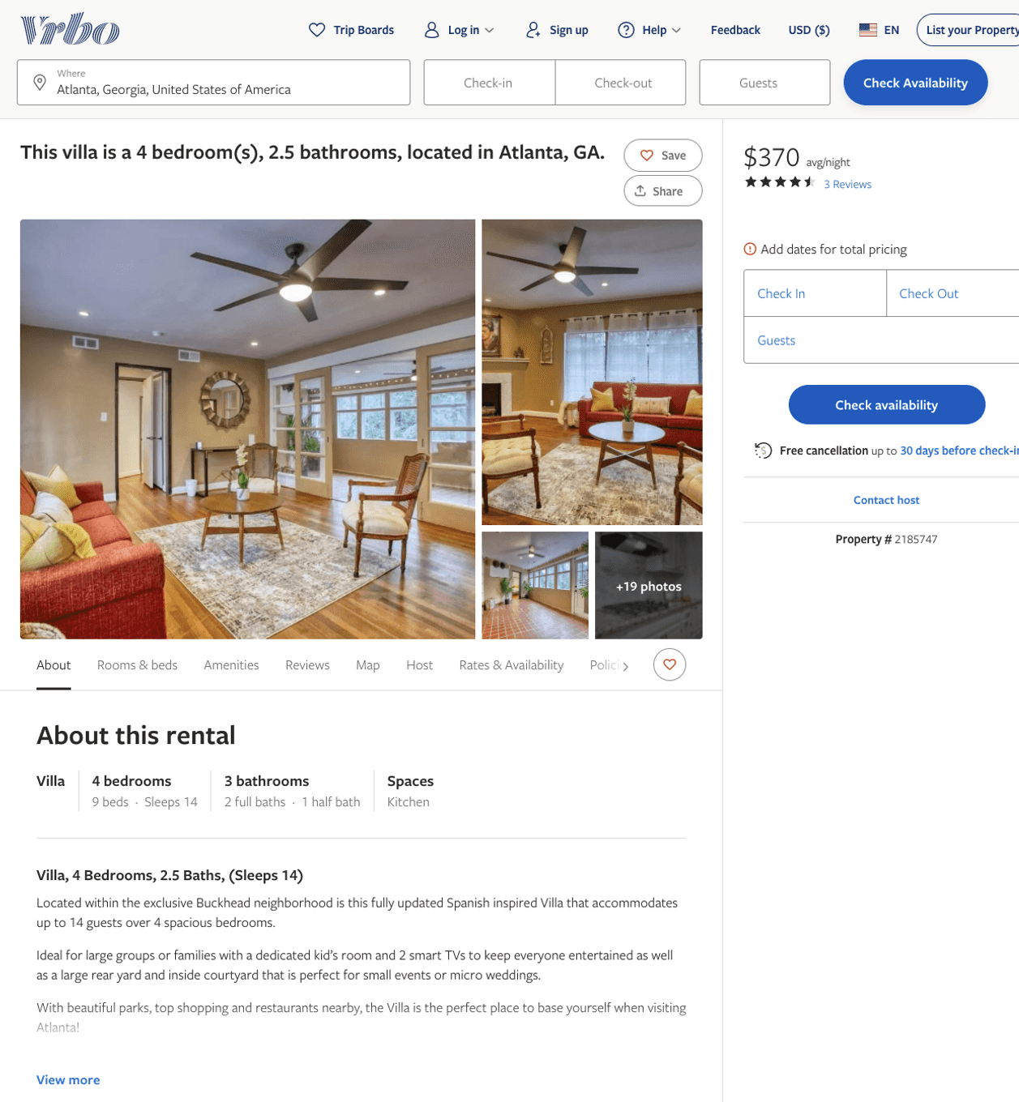
Listing 2185747
4
14
$372 - $542
4.875
1
Brittany Jones
https://www.vrbo.com/2185747
Aug 2022

Slide 3
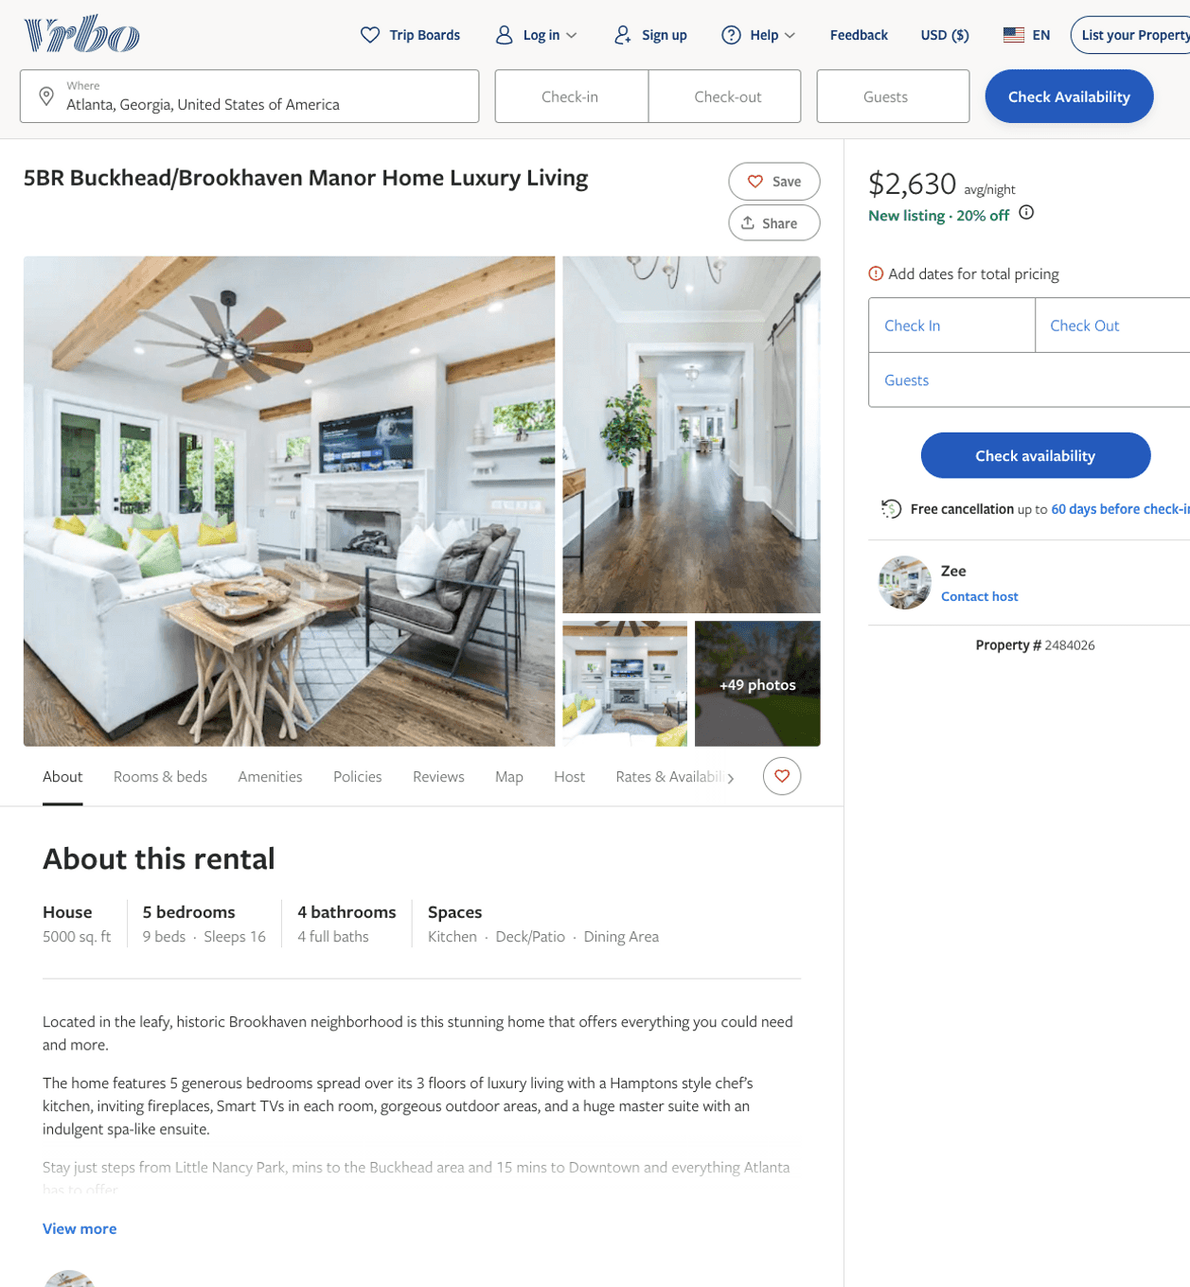
Listing 2484026
5
16
$2,500 - $2,760
2
Zee
https://www.vrbo.com/2484026
Aug 2022

Slide 4
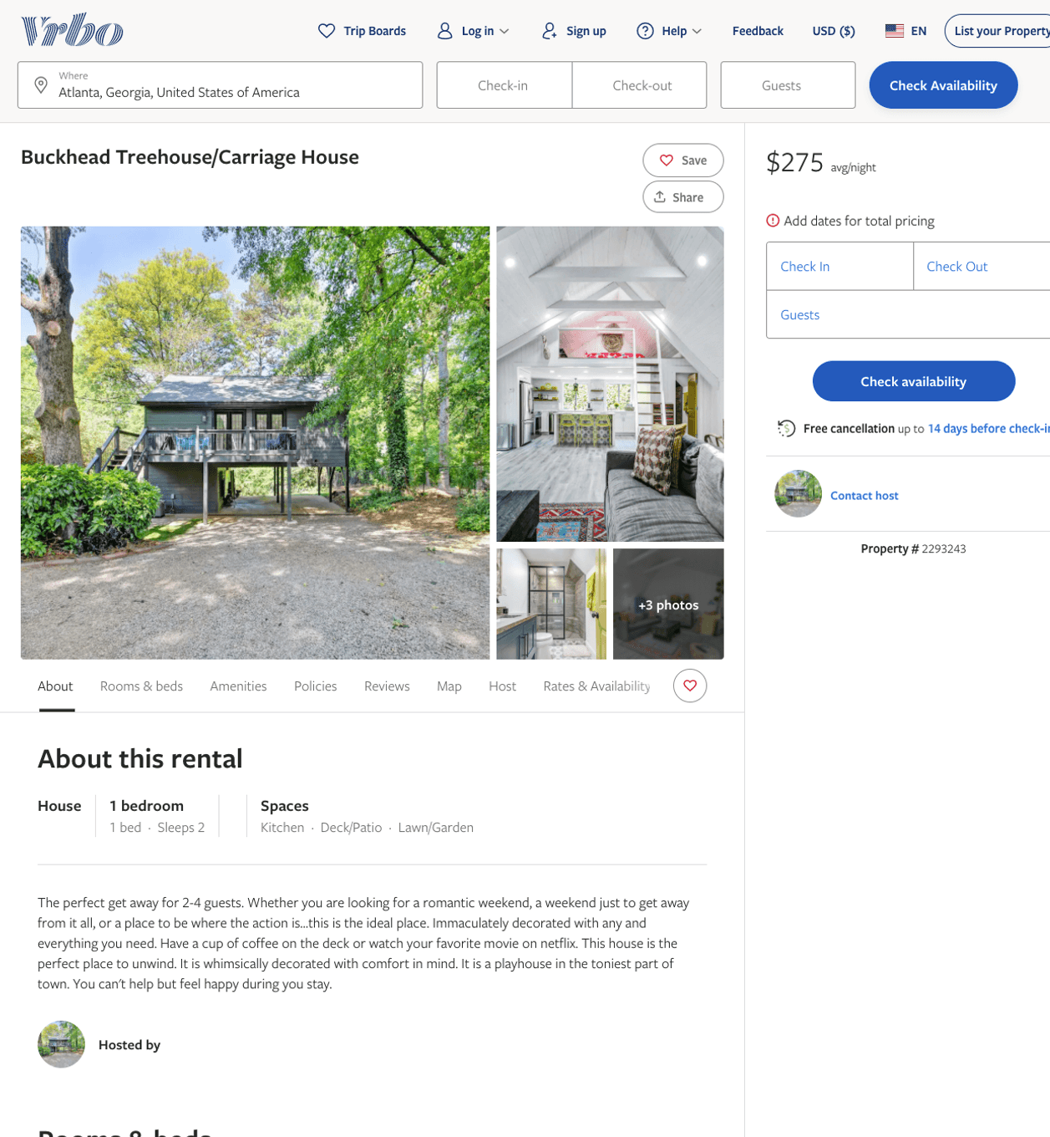
Listing 2293243
1
2
$275
2
https://www.vrbo.com/2293243
Aug 2022

Slide 5
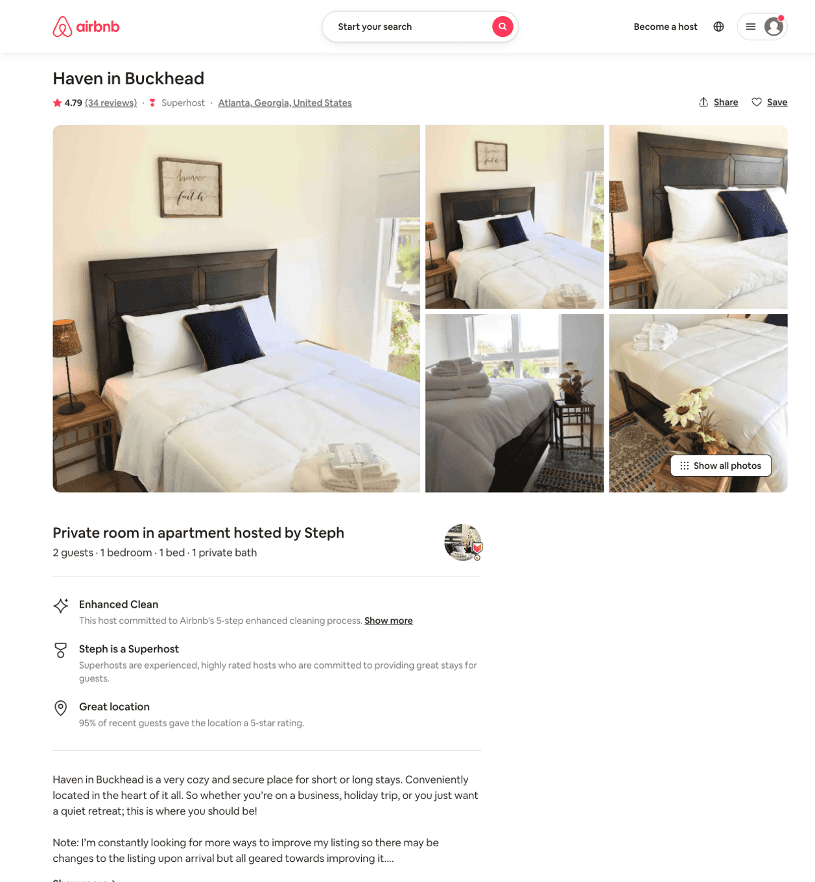
Listing 42429920
1
2
$74 - $80
4.79
1
Steph
337740616
3
https://www.airbnb.com/rooms/42429920
Aug 2022

Slide 6
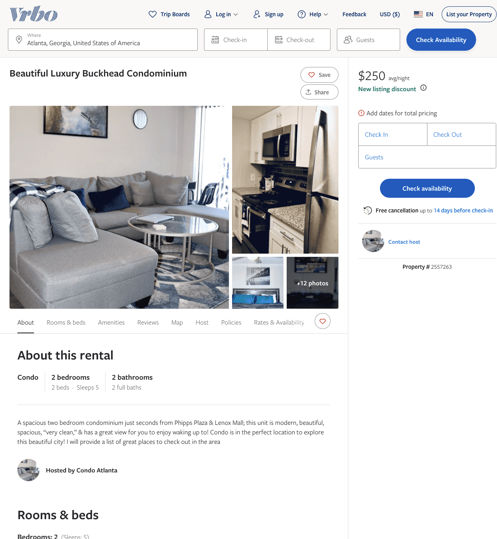
Listing 2557263
2
5
$250
2
Henry C
https://www.vrbo.com/2557263
Aug 2022

Slide 7
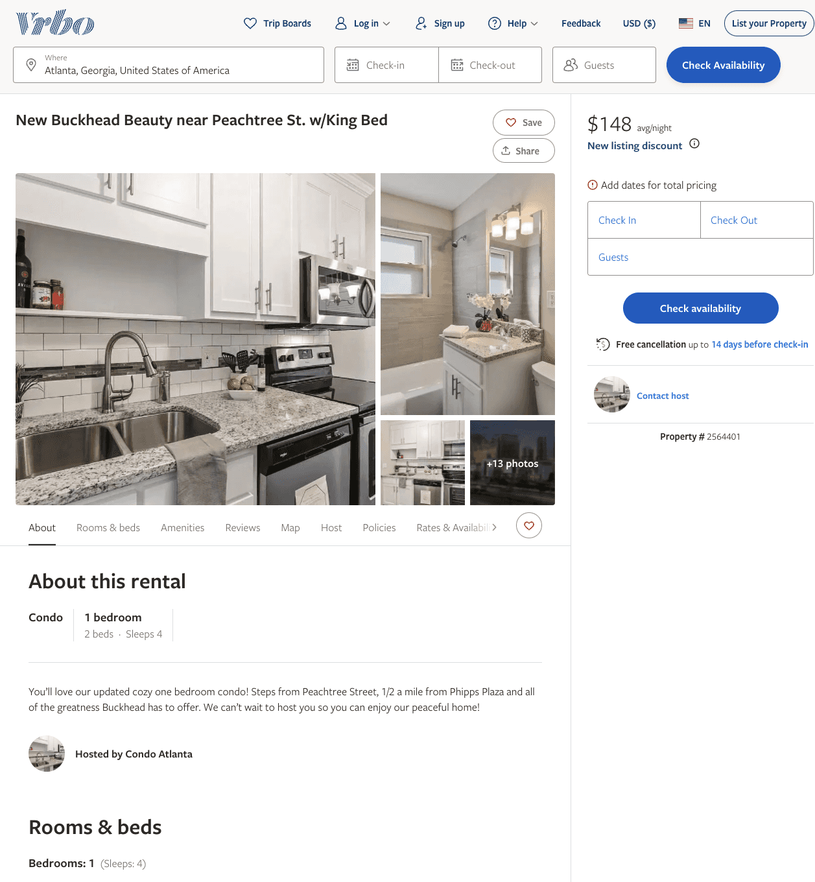
Listing 2564401
1
4
$106 - $148
5
2
Samora Smith
https://www.vrbo.com/2564401
Aug 2022

Slide 8
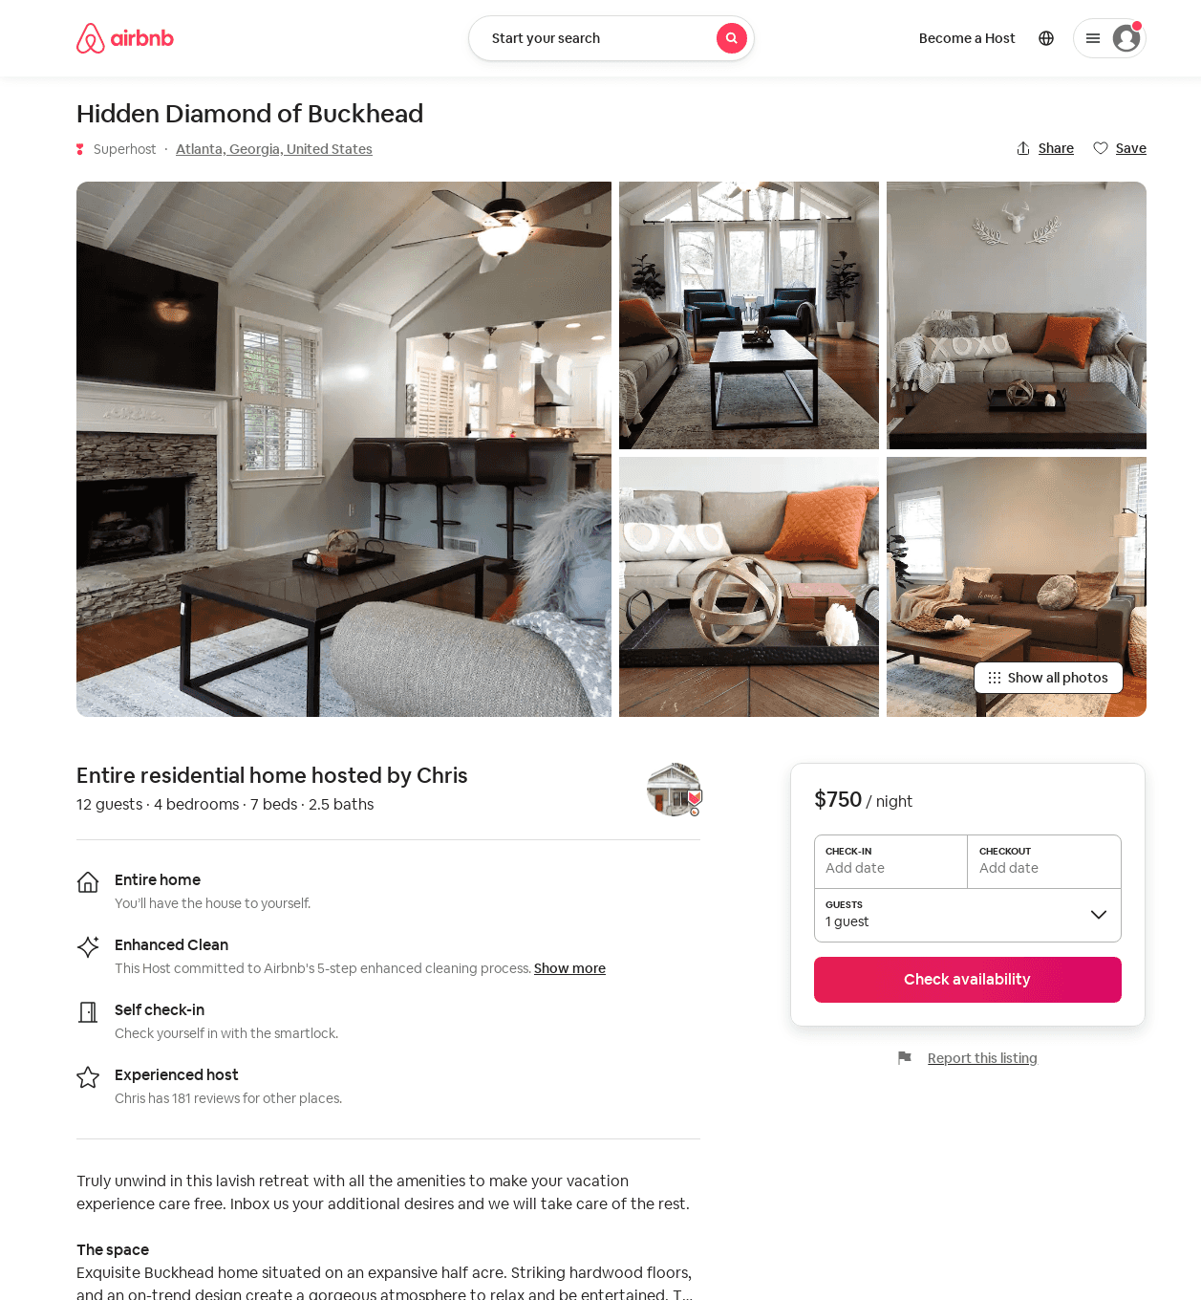
Listing 52209170
4
12
$460 - $750
5.0
3
Chris
92997198
2
https://www.airbnb.com/rooms/52209170
Aug 2022

Slide 9
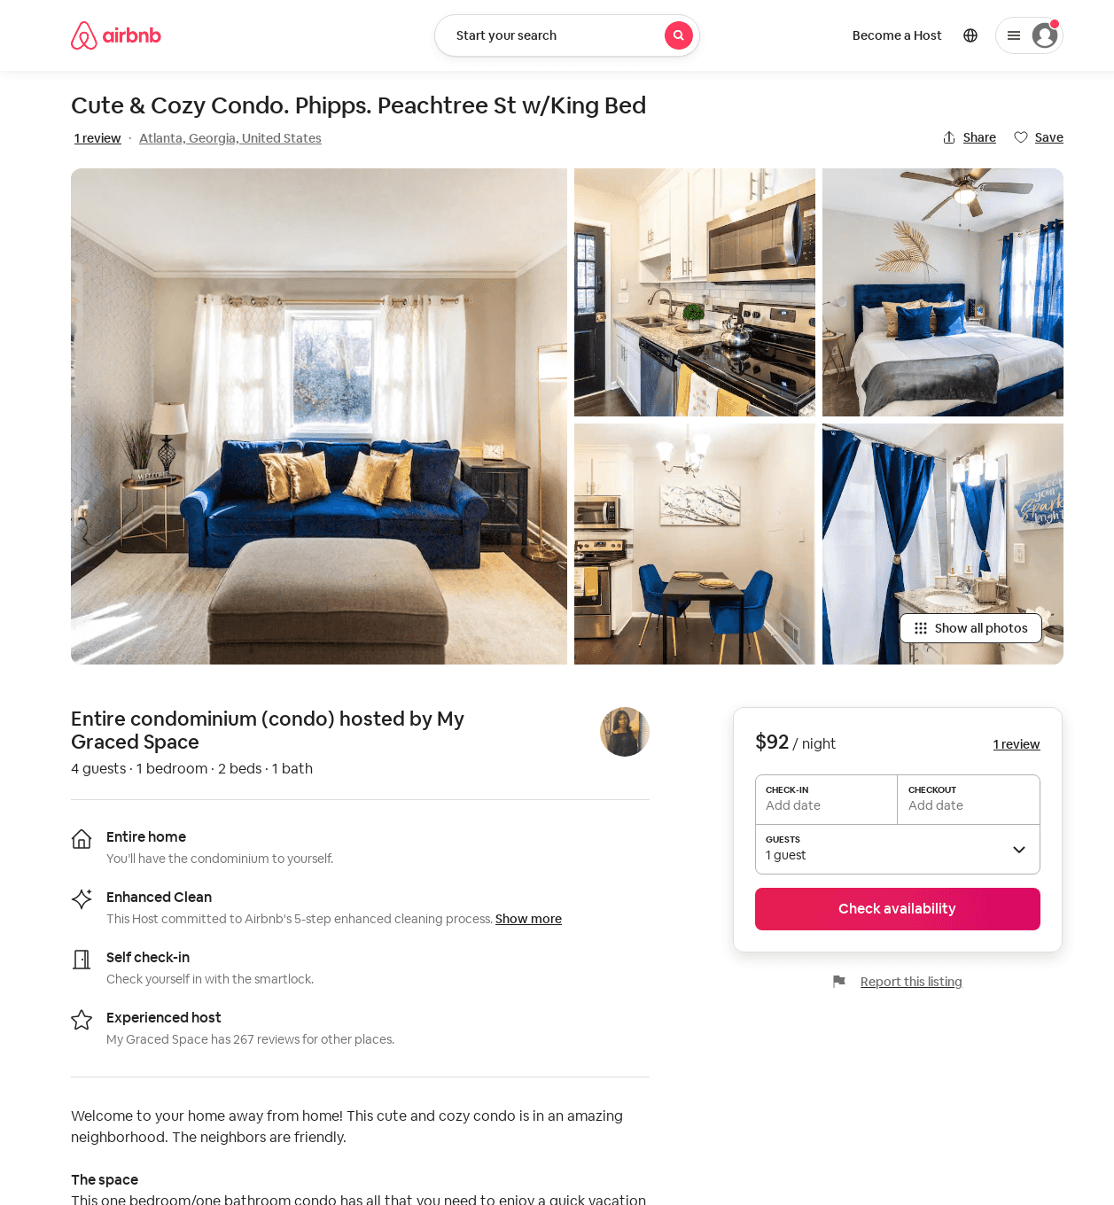
Listing 53576959
1
4
$92 - $145
4.64
3
My Graced Space
81181717
2
https://www.airbnb.com/rooms/53576959
Aug 2022

Slide 10
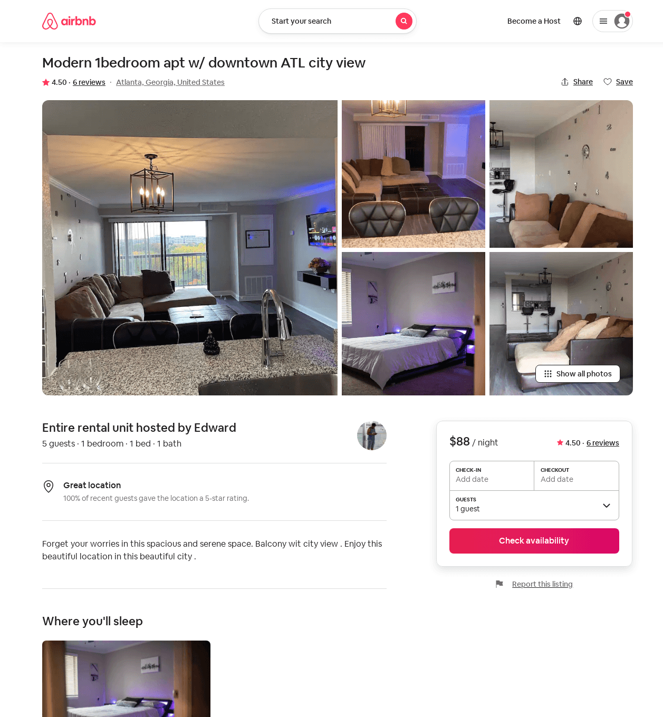
Listing 52238278
1
5
$88 - $99
4.25
1
Edward
222294463
1
https://www.airbnb.com/rooms/52238278
Jun 2022

Slide 11
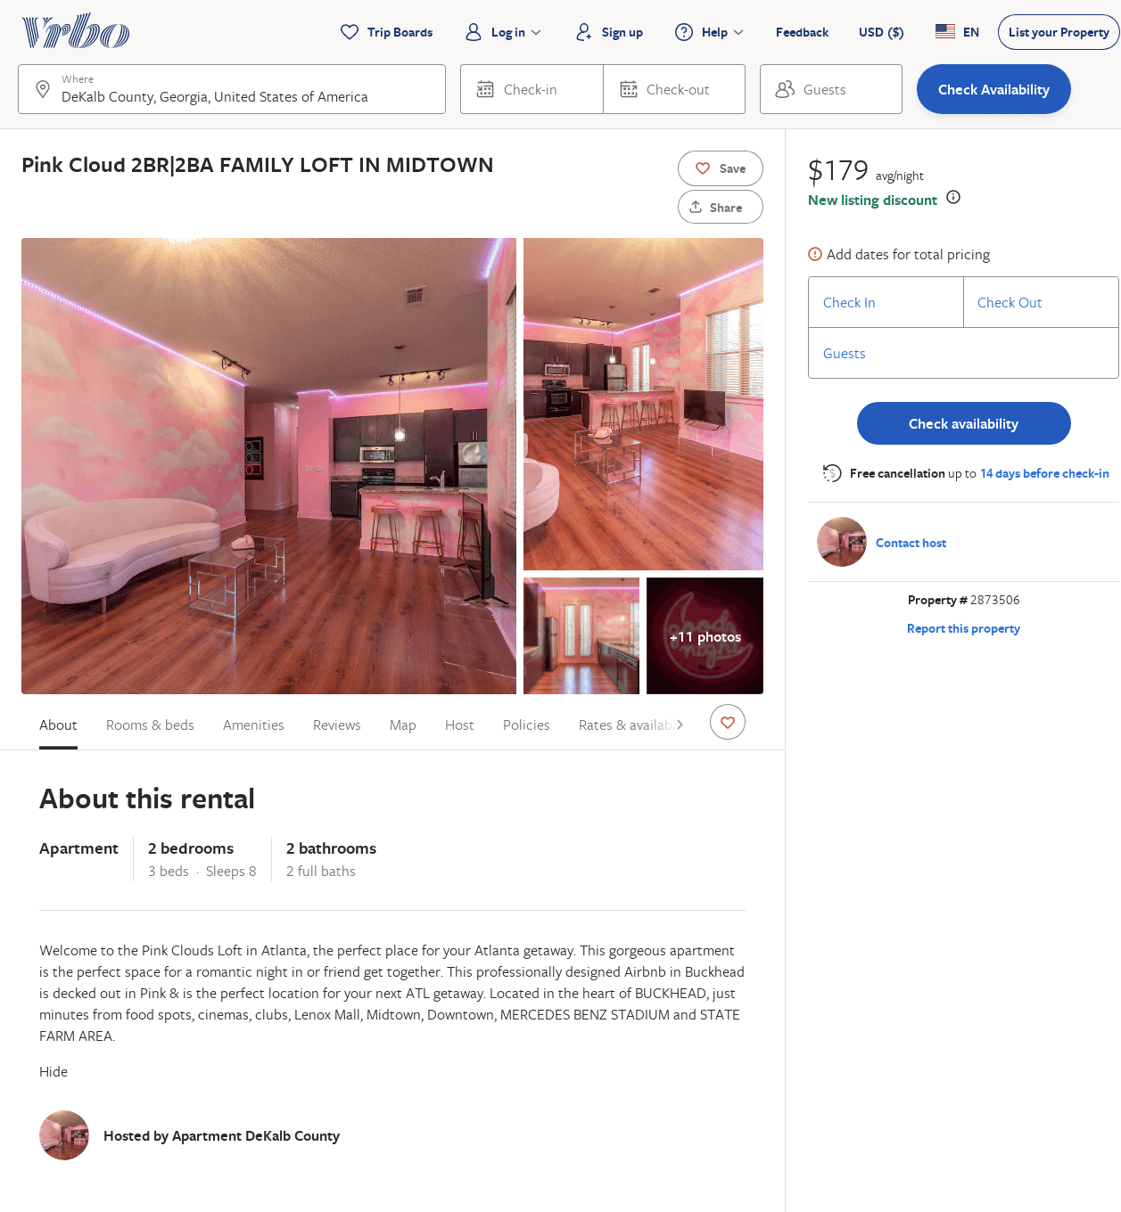
Listing 2873506
2
8
$179
2
https://www.vrbo.com/2873506
Aug 2022

