Slide 2
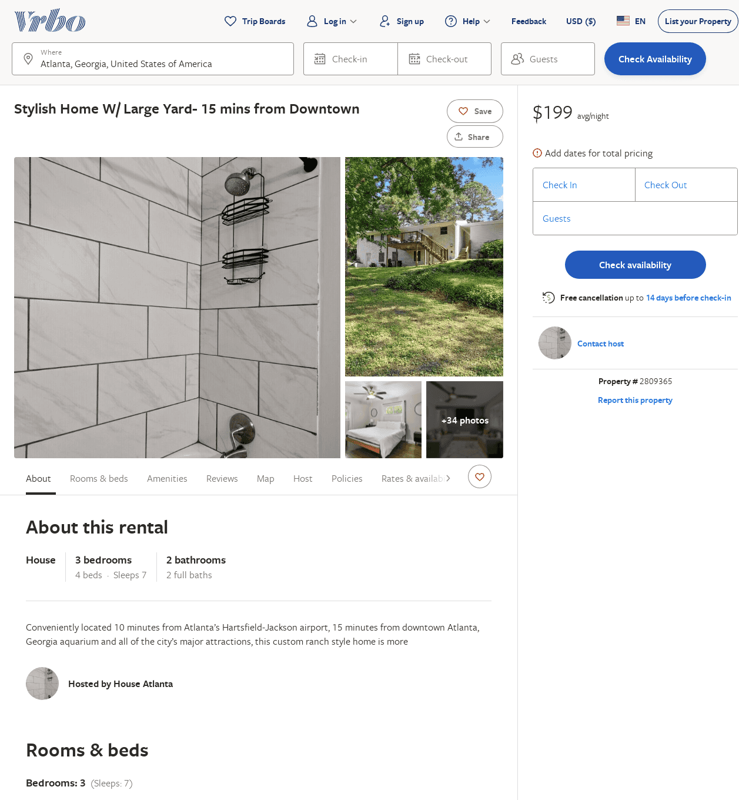
Listing 2809365
3
7
$220
1
https://www.vrbo.com/2809365
Aug 2022

Slide 3
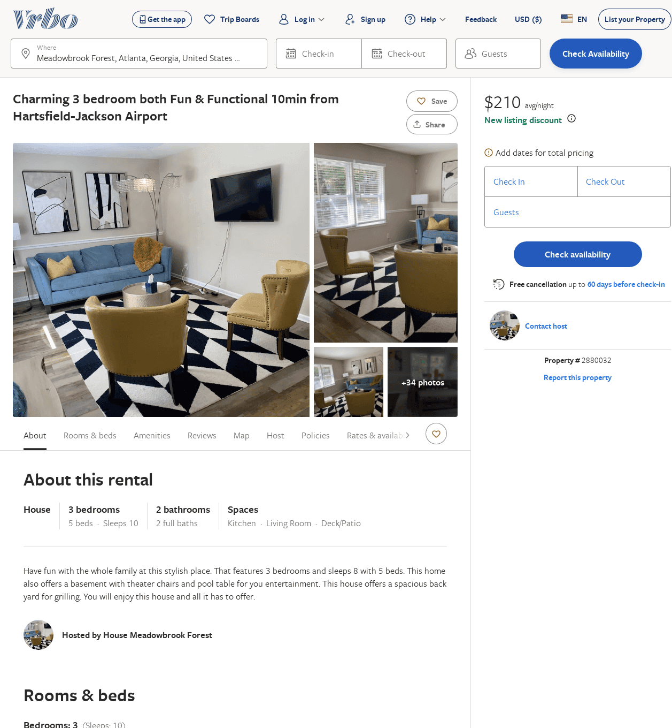
Listing 2880032
3
10
$163
4.6666665
2
https://www.vrbo.com/2880032
Aug 2022

