Slide 2
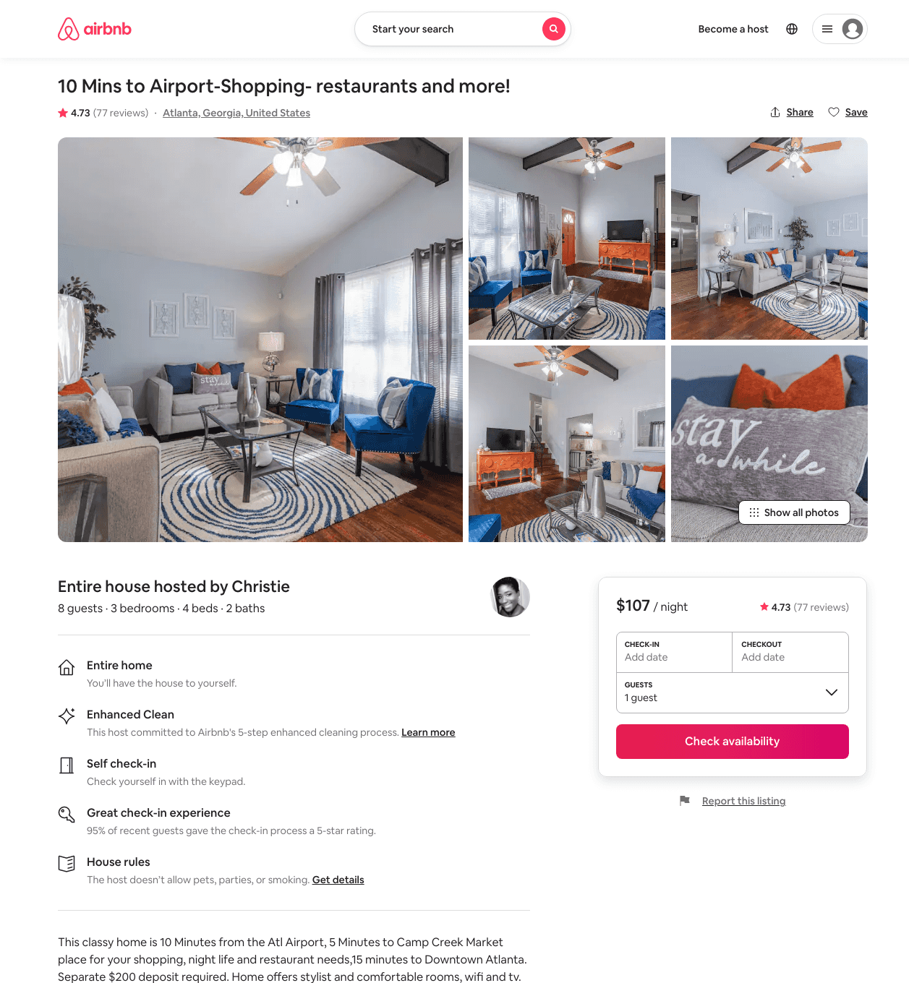
Listing 38805034
3
8
$107 - $171
4.72
2
Christie
83975273
1
https://www.airbnb.com/rooms/38805034
Aug 2022

