Slide 2
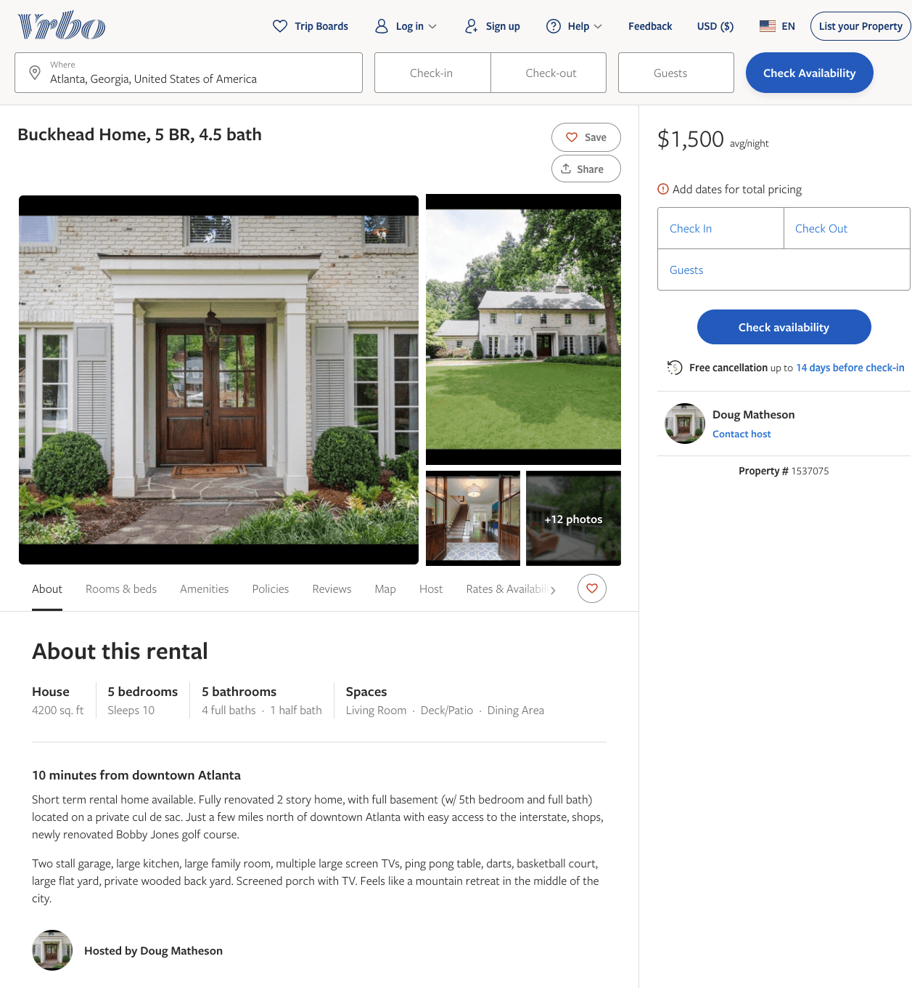
Listing 1537075
5
10
$1,500
3
Doug Matheson
https://www.vrbo.com/1537075
Aug 2022

Slide 3
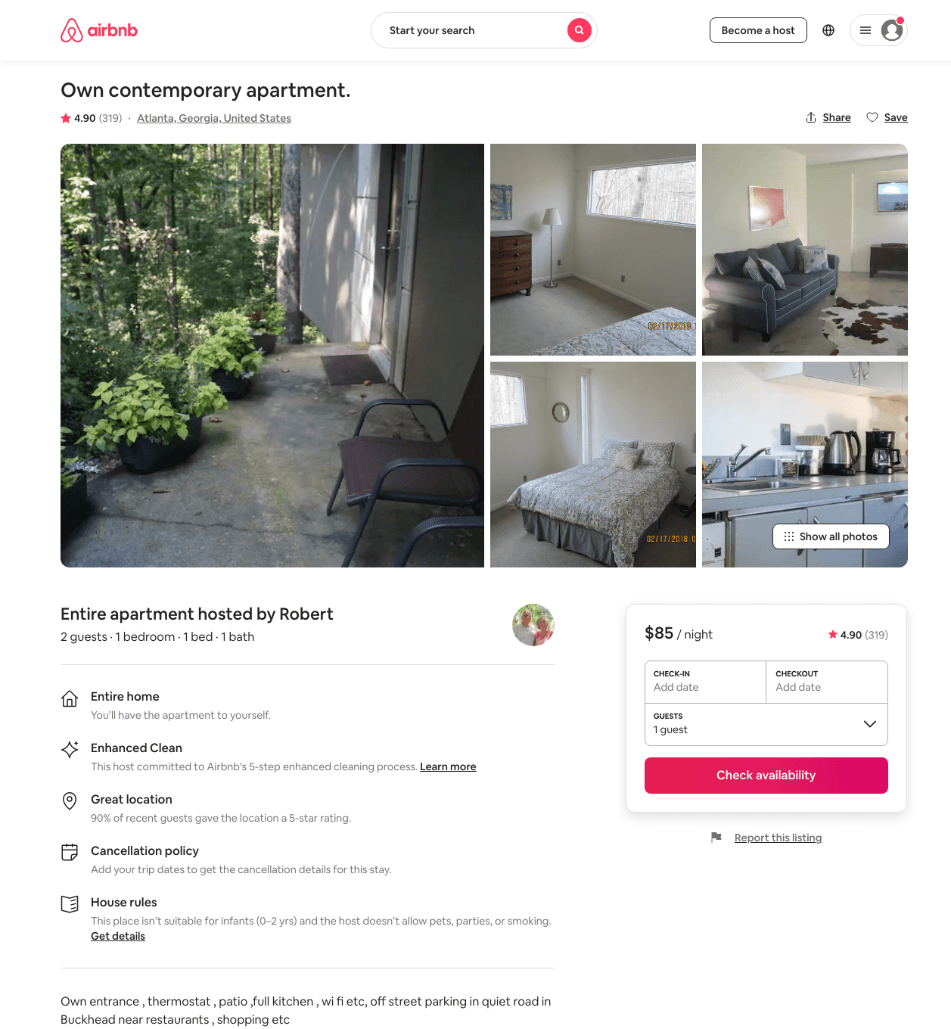
Listing 11788393
1
2
$75 - $85
4.90
2
Robert
58708076
2
https://www.airbnb.com/rooms/11788393
Aug 2022

Slide 4
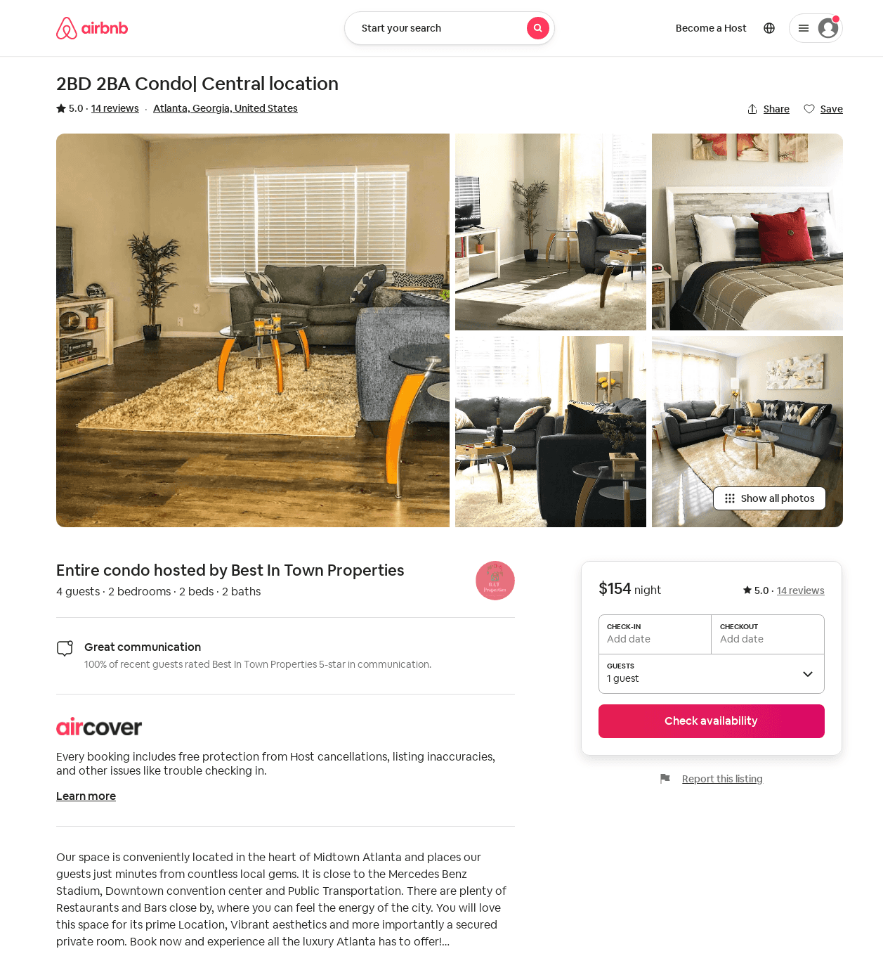
Listing 31921157
2
4
$154 - $159
5.0
30
Best In Town Properties
237845983
1
https://www.airbnb.com/rooms/31921157
Jul 2022

