Slide 2
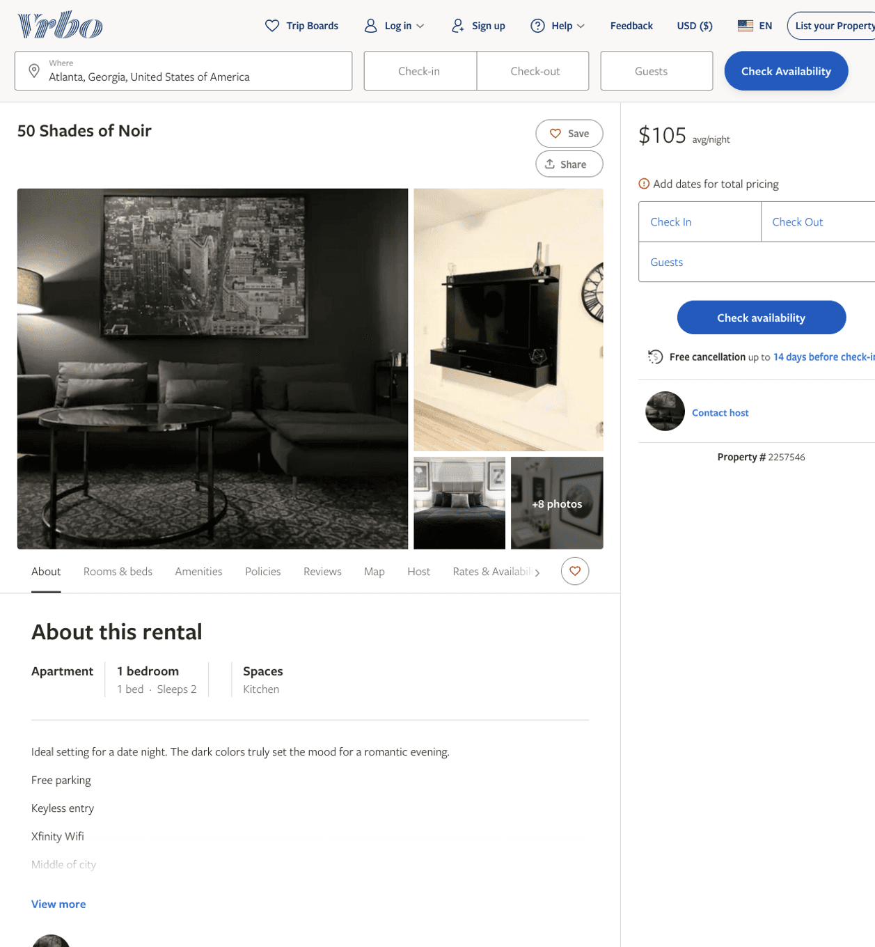
Listing 2257546
1
2
$105
30
https://www.vrbo.com/2257546
Aug 2022

Slide 3
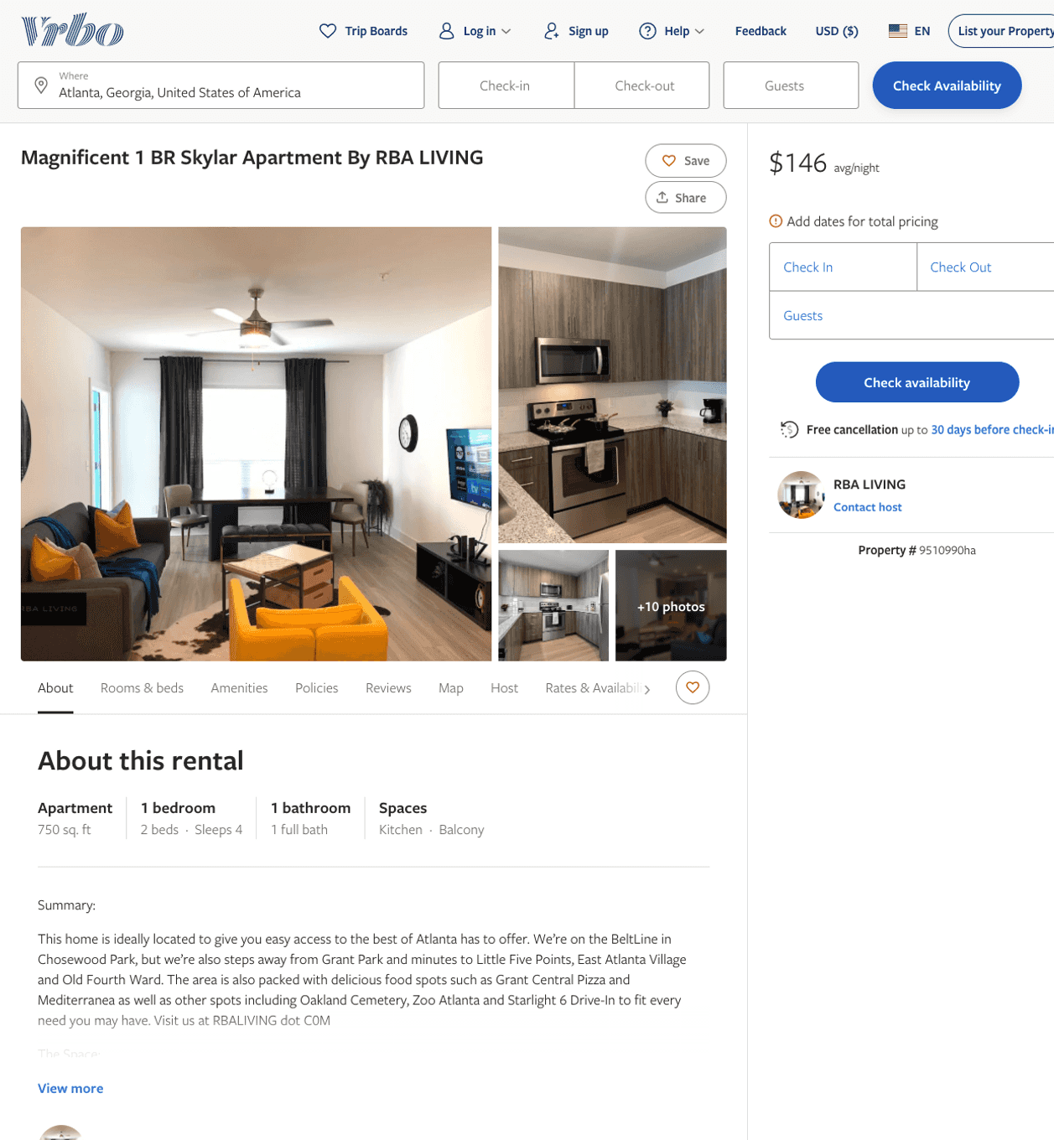
Listing 9510990
1
4
$134 - $160
1
RBA LIVING
https://www.vrbo.com/9510990ha
Aug 2022

Slide 4
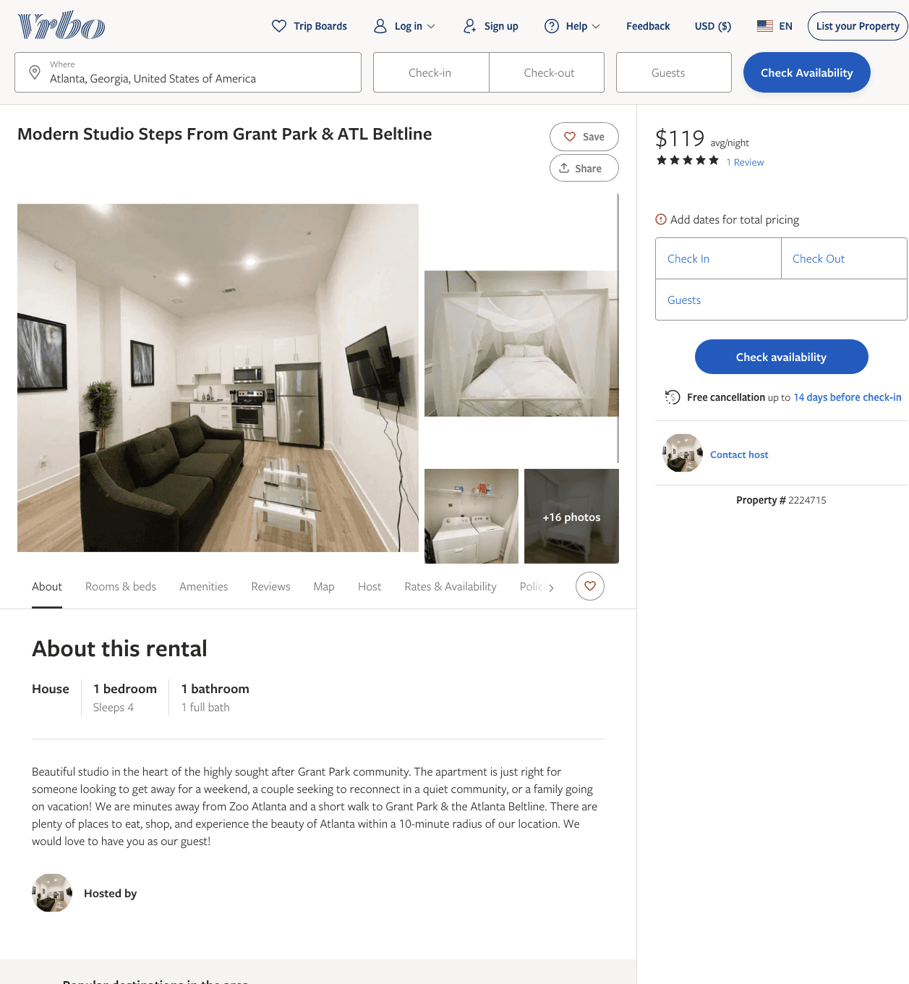
Listing 2224715
1
4
$119 - $75
5
1
Cedric Brown
https://www.vrbo.com/2224715
Aug 2022

Slide 5
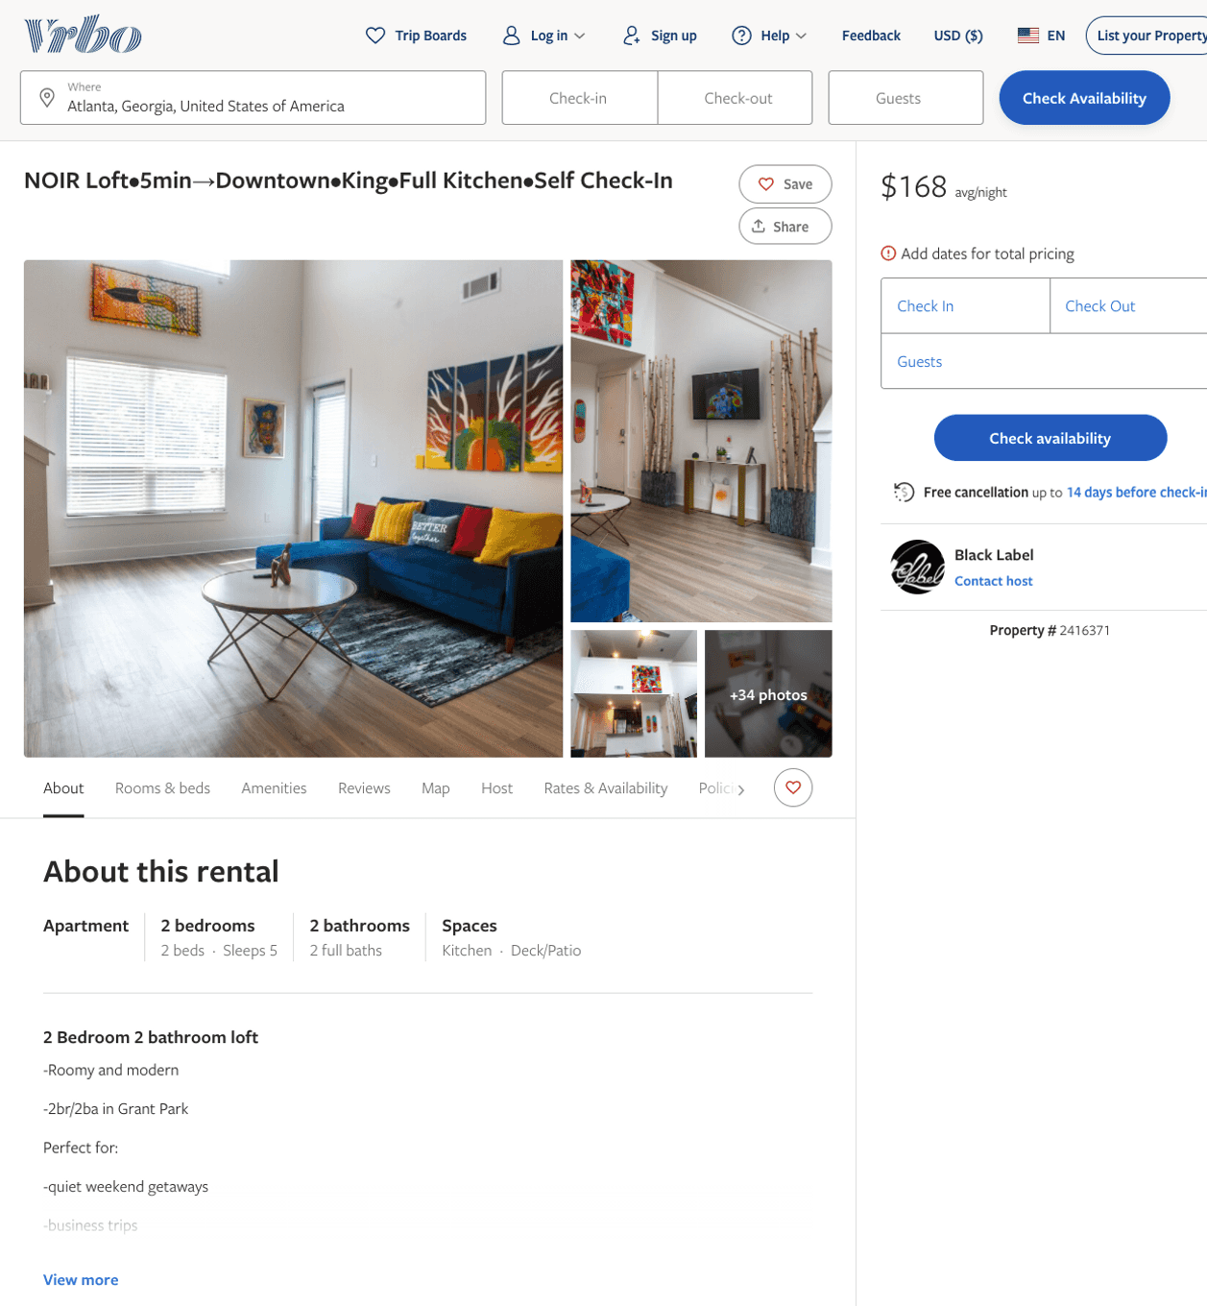
Listing 2416371
2
5
$161 - $237
1
2
Black Label
https://www.vrbo.com/2416371
Aug 2022

Slide 6
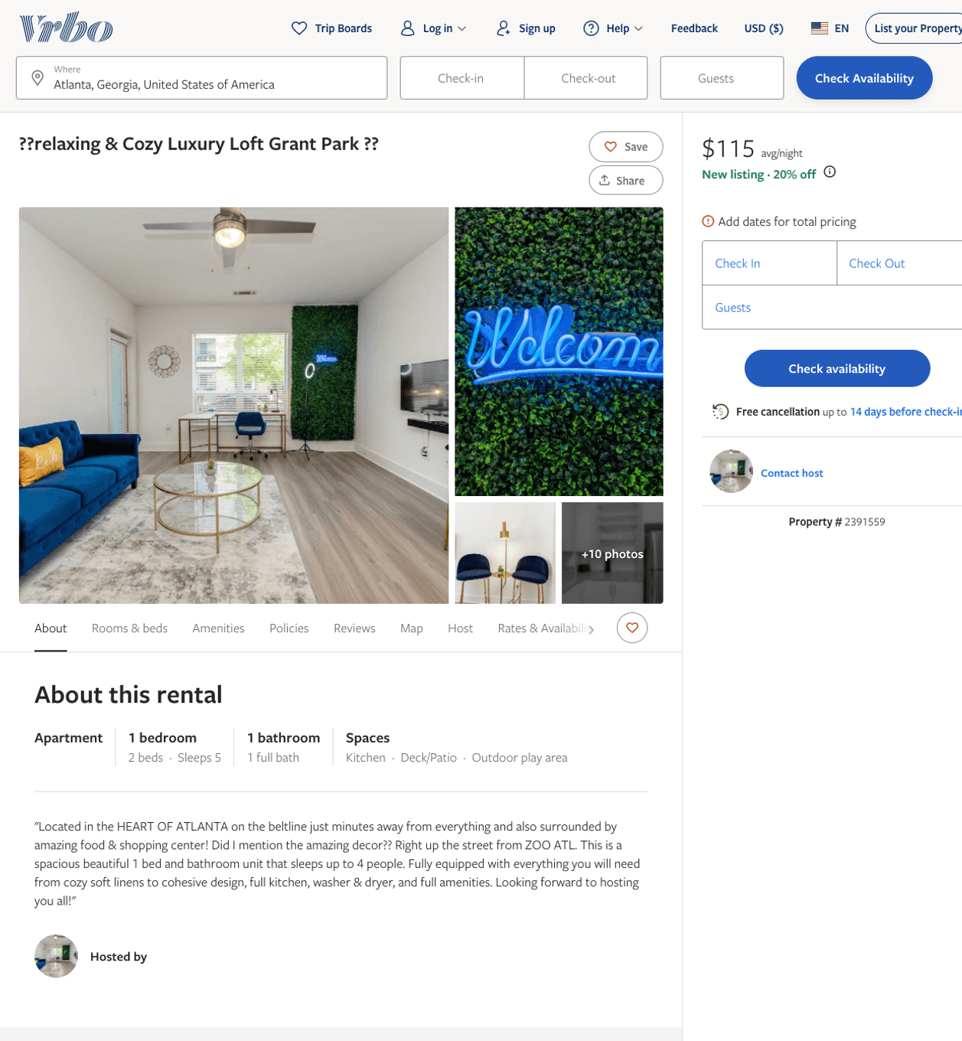
Listing 2391559
1
5
$115
2
https://www.vrbo.com/2391559
Aug 2022

Slide 7
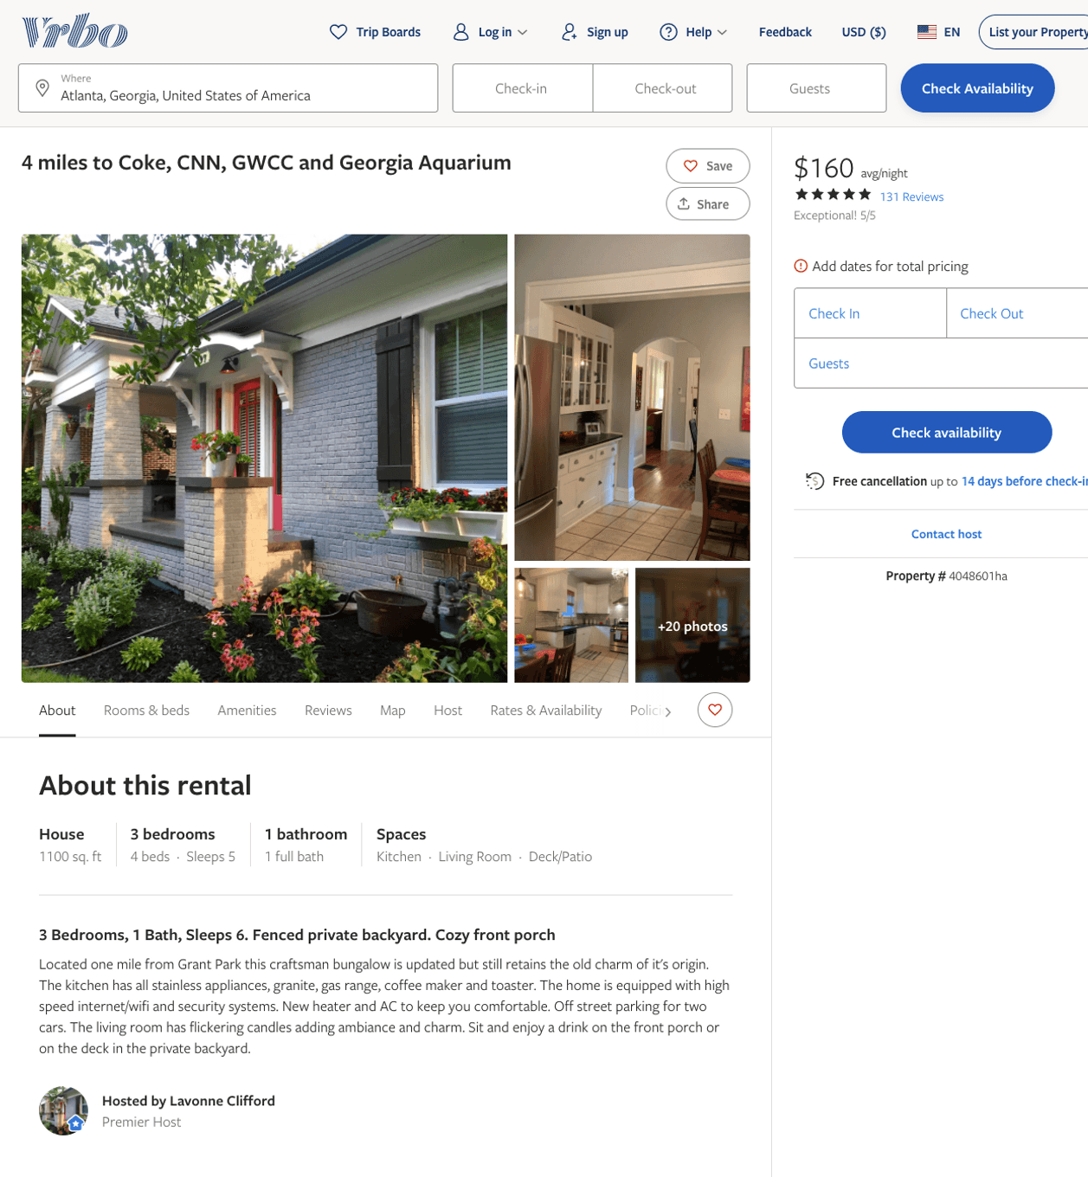
Listing 4048601
3
5
$150 - $204
4.9736843
2
Lavonne Trueblood
https://www.vrbo.com/4048601ha
Aug 2022

Slide 8
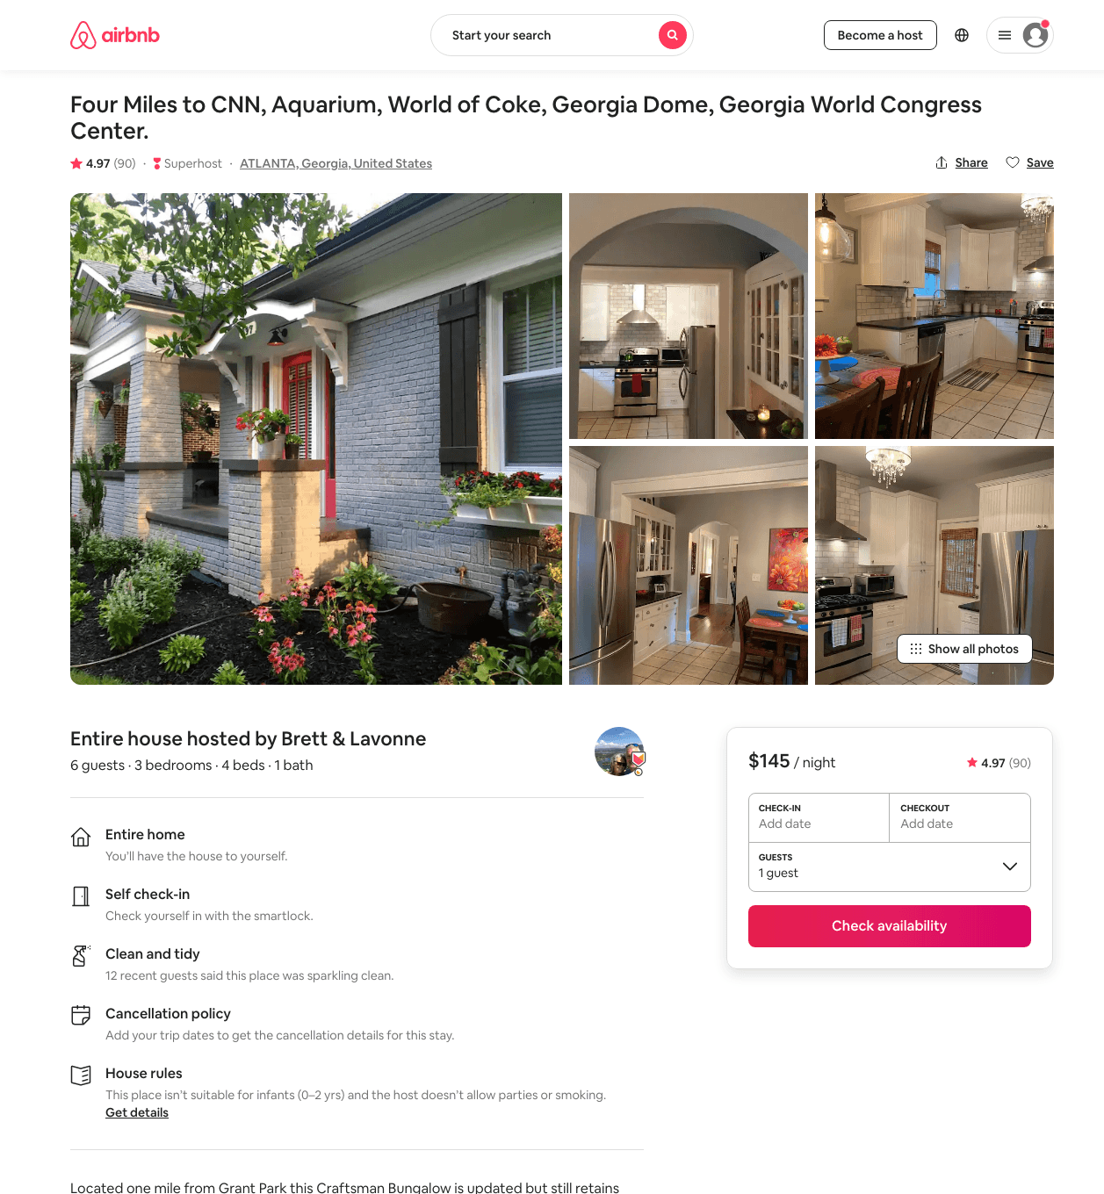
Listing 17156228
3
6
$145 - $204
4.97
2
Lavonne
383034001
1
https://www.airbnb.com/rooms/17156228
Aug 2022

Slide 9
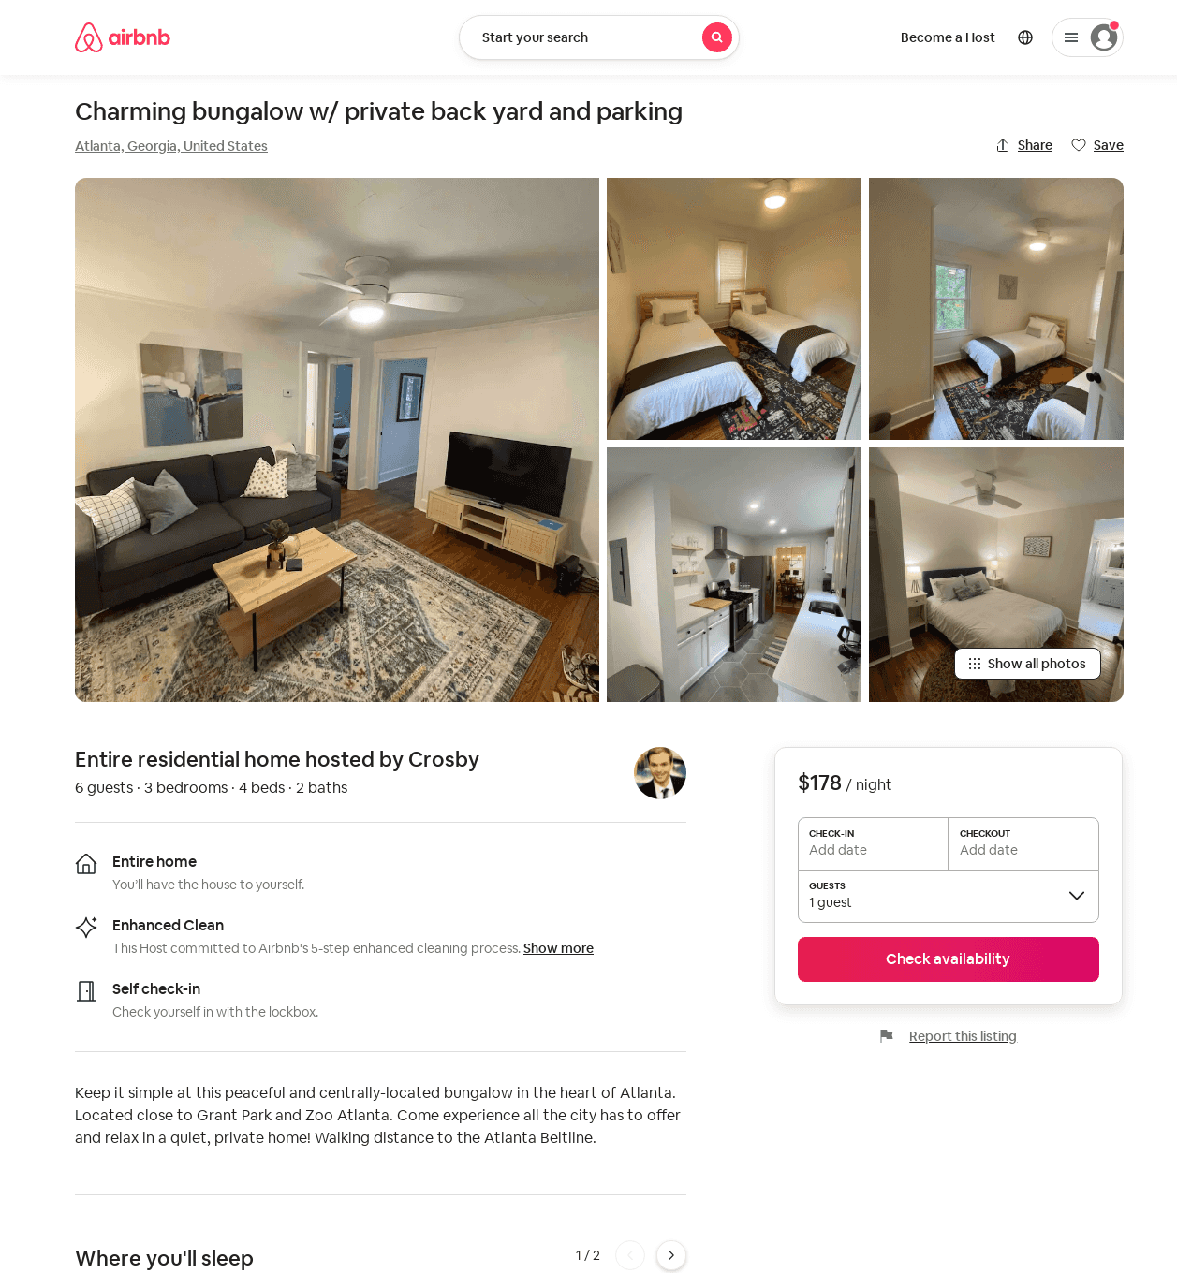
Listing 52646269
3
6
$150 - $178
4.57
2
Crosby
28174370
1
https://www.airbnb.com/rooms/52646269
Jun 2022

Slide 10
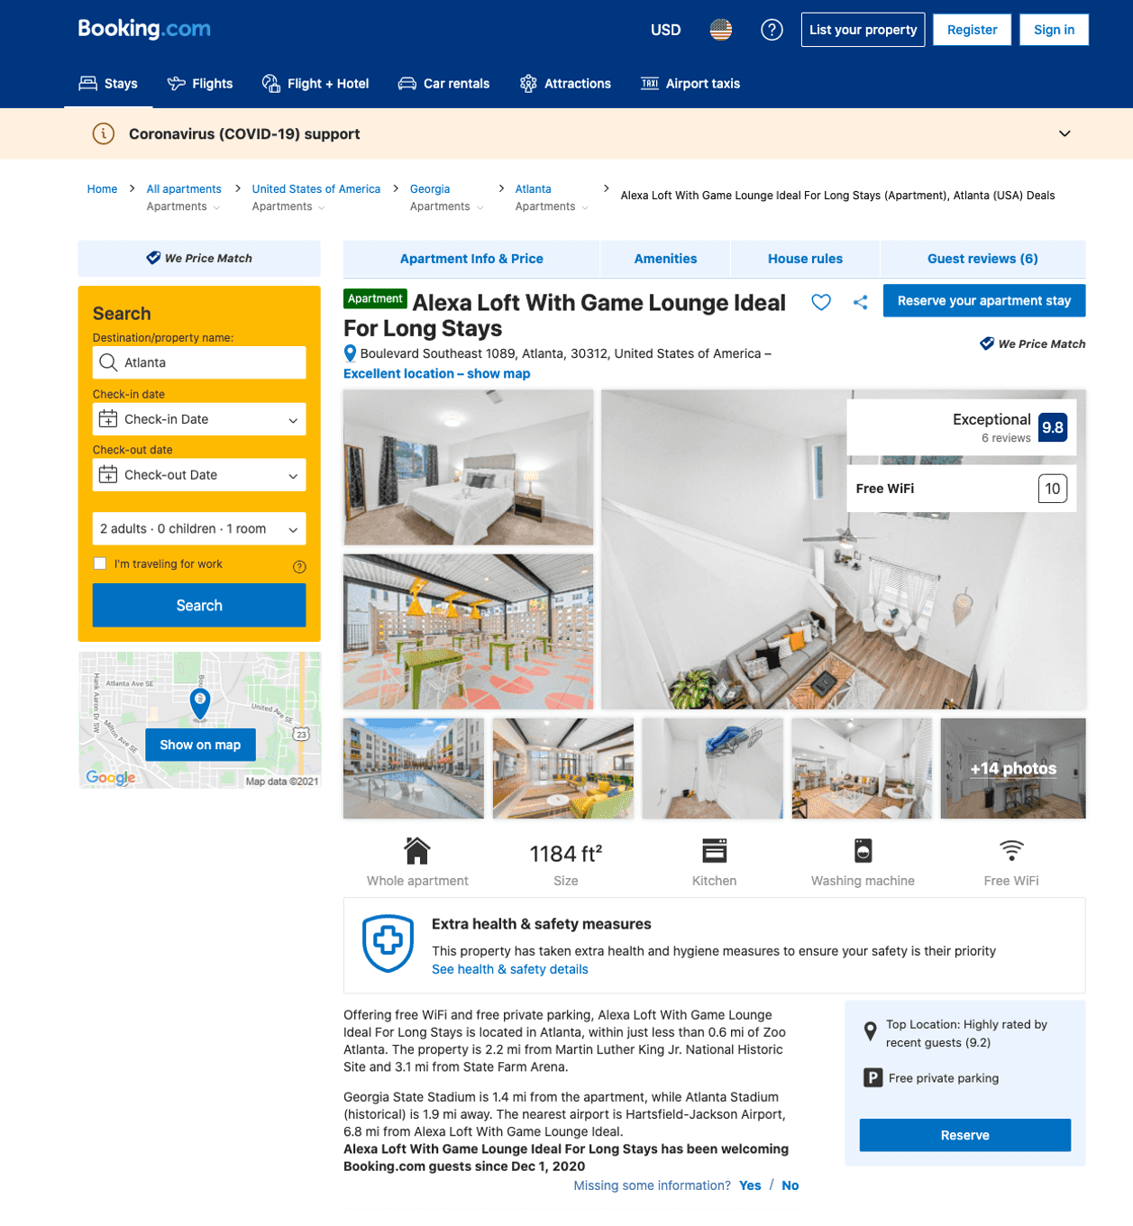
Listing smart-loft-w-47-game-lounge-ideal-4-month-stays
undefined
5
8
https://www.booking.com/hotel/us/smart-loft-w-47-game-lounge-ideal-4-month-stays.html
Sep 2022

Slide 11
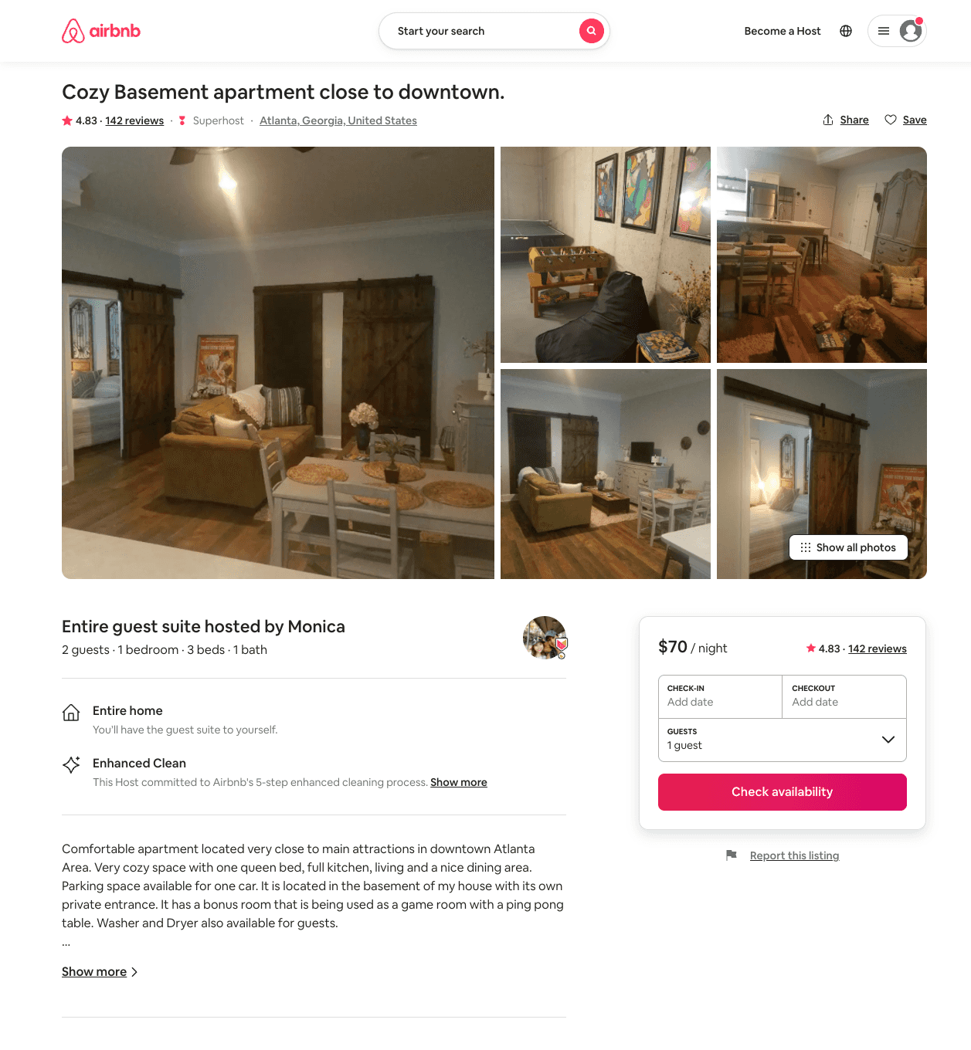
Listing 19639008
1
2
$70 - $71
4.83
2
Monica
138201858
1
https://www.airbnb.com/rooms/19639008
Aug 2022

Slide 12
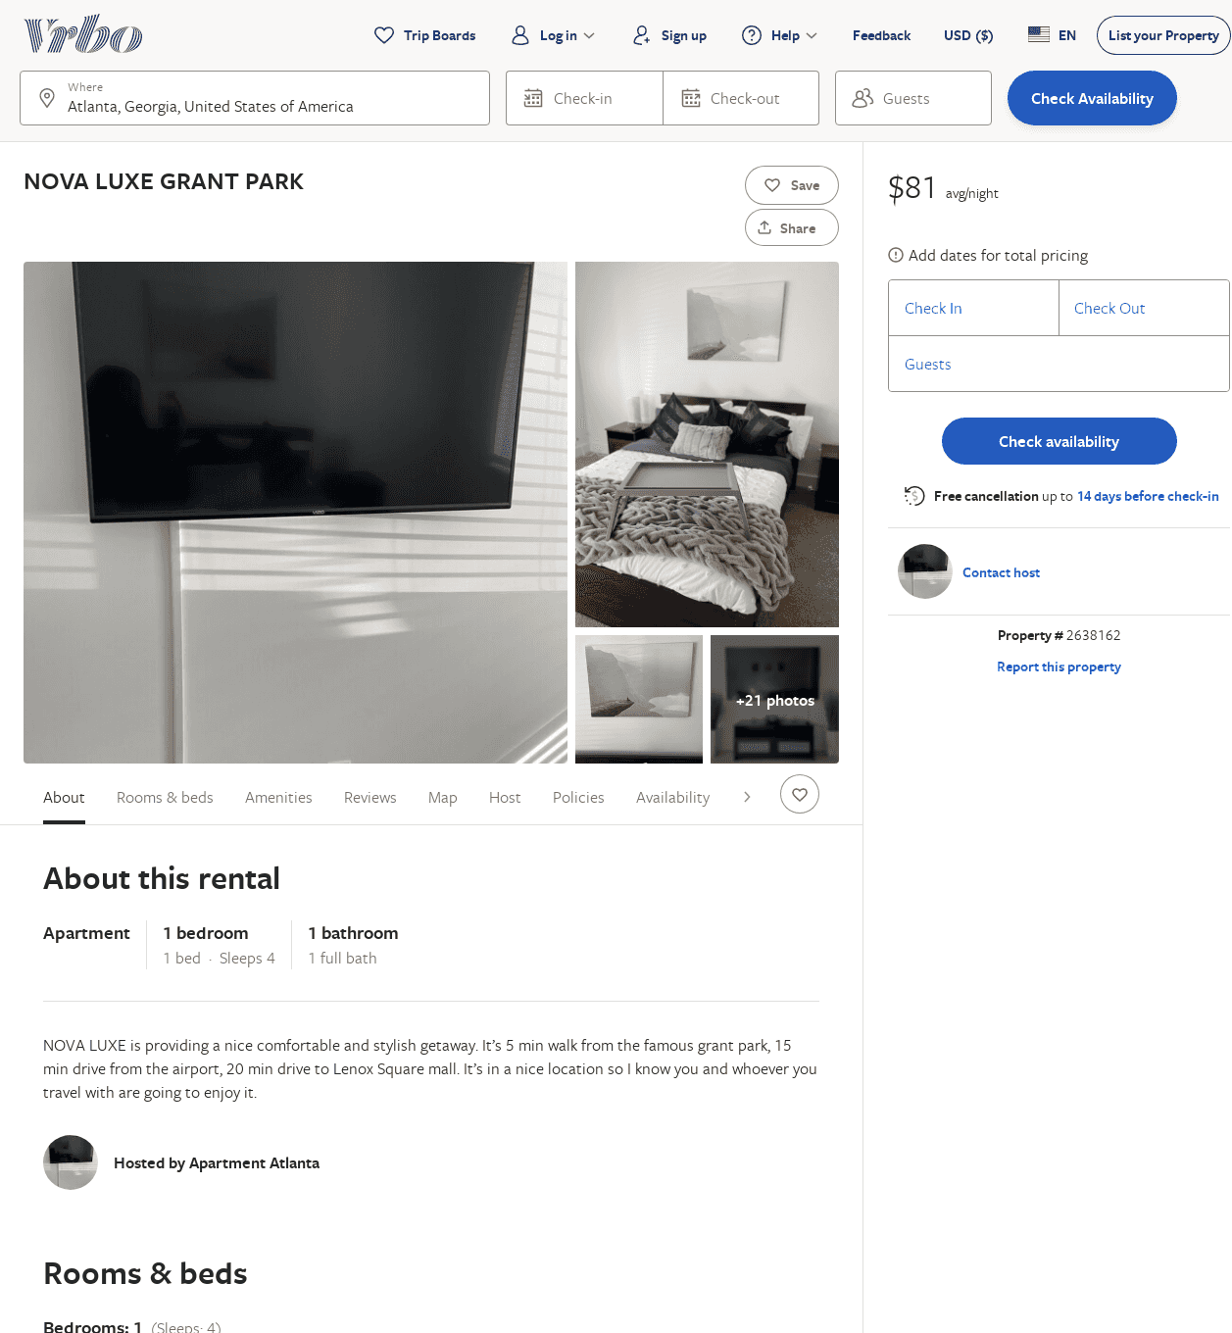
Listing 2638162
1
4
$81
1
https://www.vrbo.com/2638162
Aug 2022

Slide 13
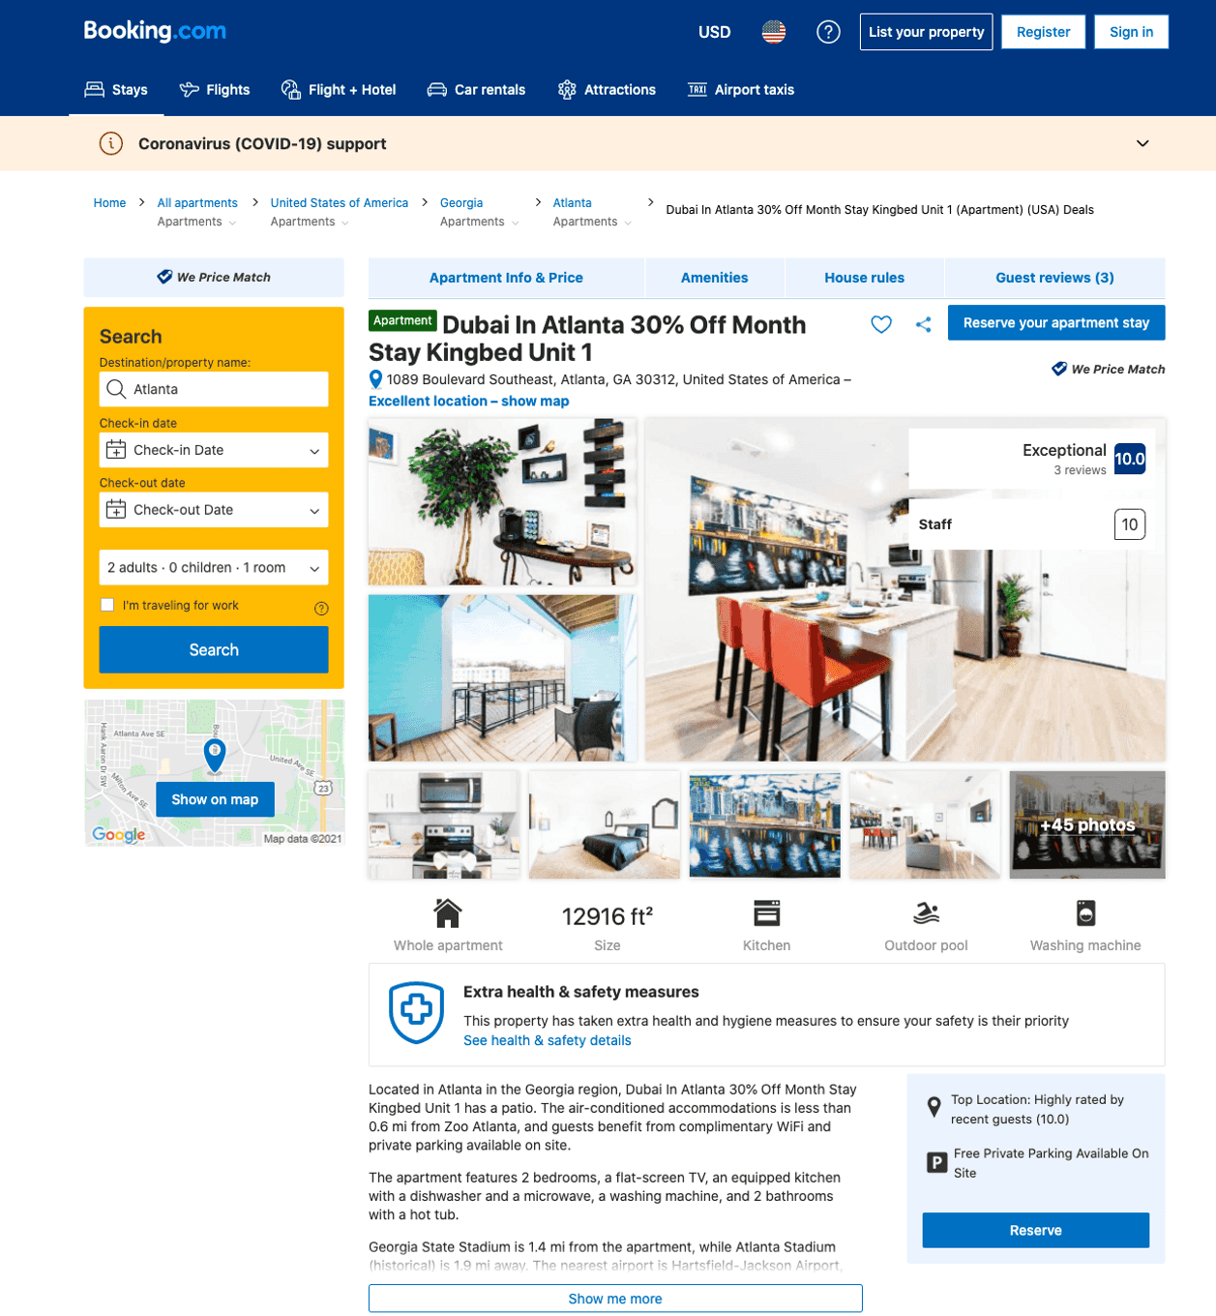
Listing dubai-in-atlanta-30-off-month-stay-kingbed-unit-1
undefined
5
8.3
https://www.booking.com/hotel/us/dubai-in-atlanta-30-off-month-stay-kingbed-unit-1.html
Sep 2022

Slide 14
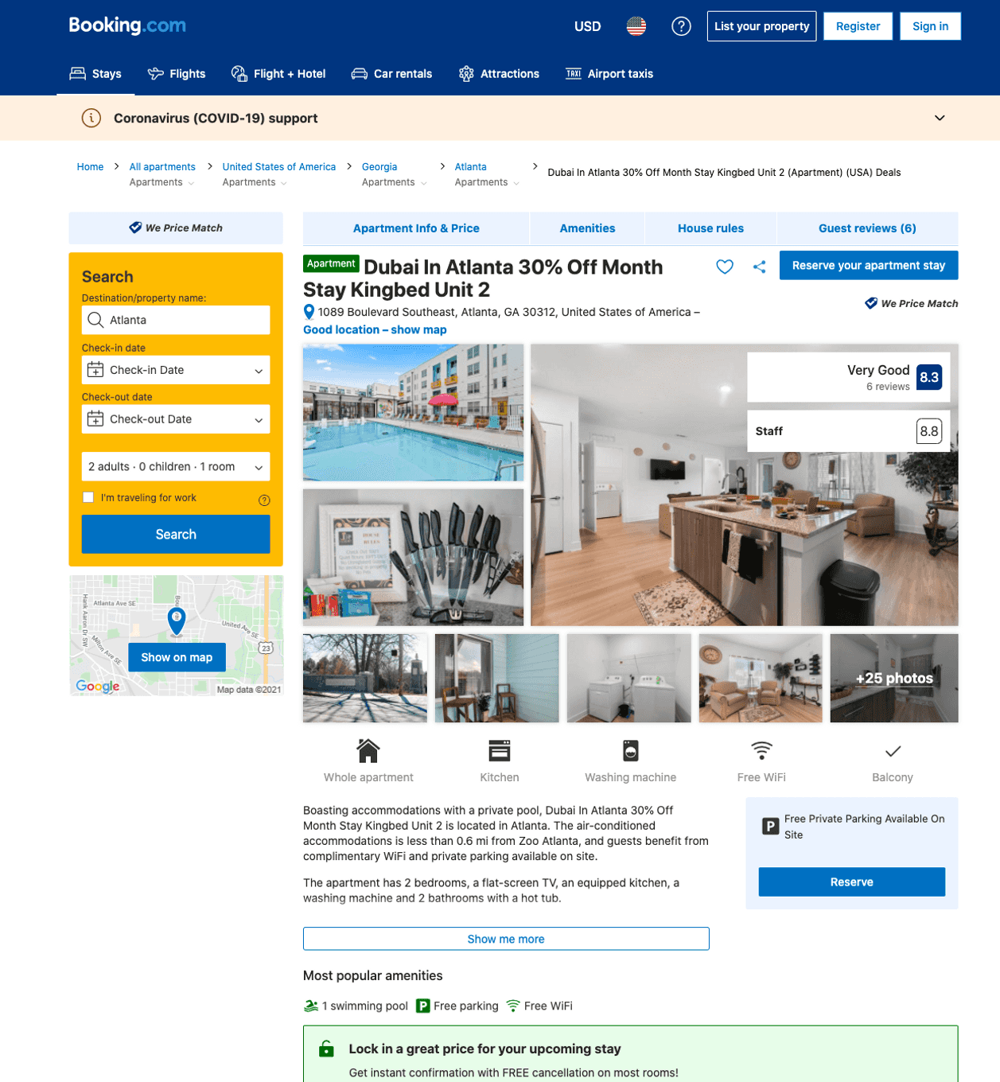
Listing dubai-in-atlanta-30-off-month-stay-kingbed-unit-2
undefined
5
8.3
https://www.booking.com/hotel/us/dubai-in-atlanta-30-off-month-stay-kingbed-unit-2.html
Sep 2022

Slide 15
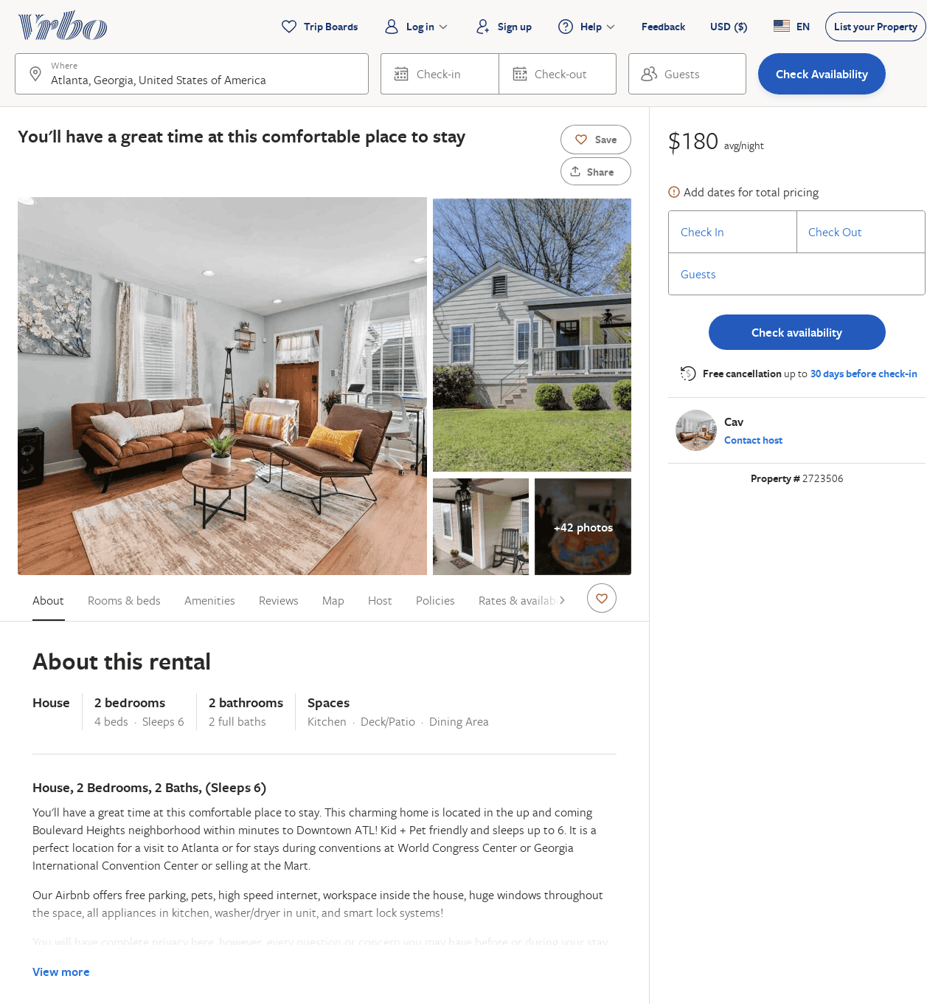
Listing 2723506
2
6
$172
3.25
2
Cav
https://www.vrbo.com/2723506
Aug 2022

Slide 16
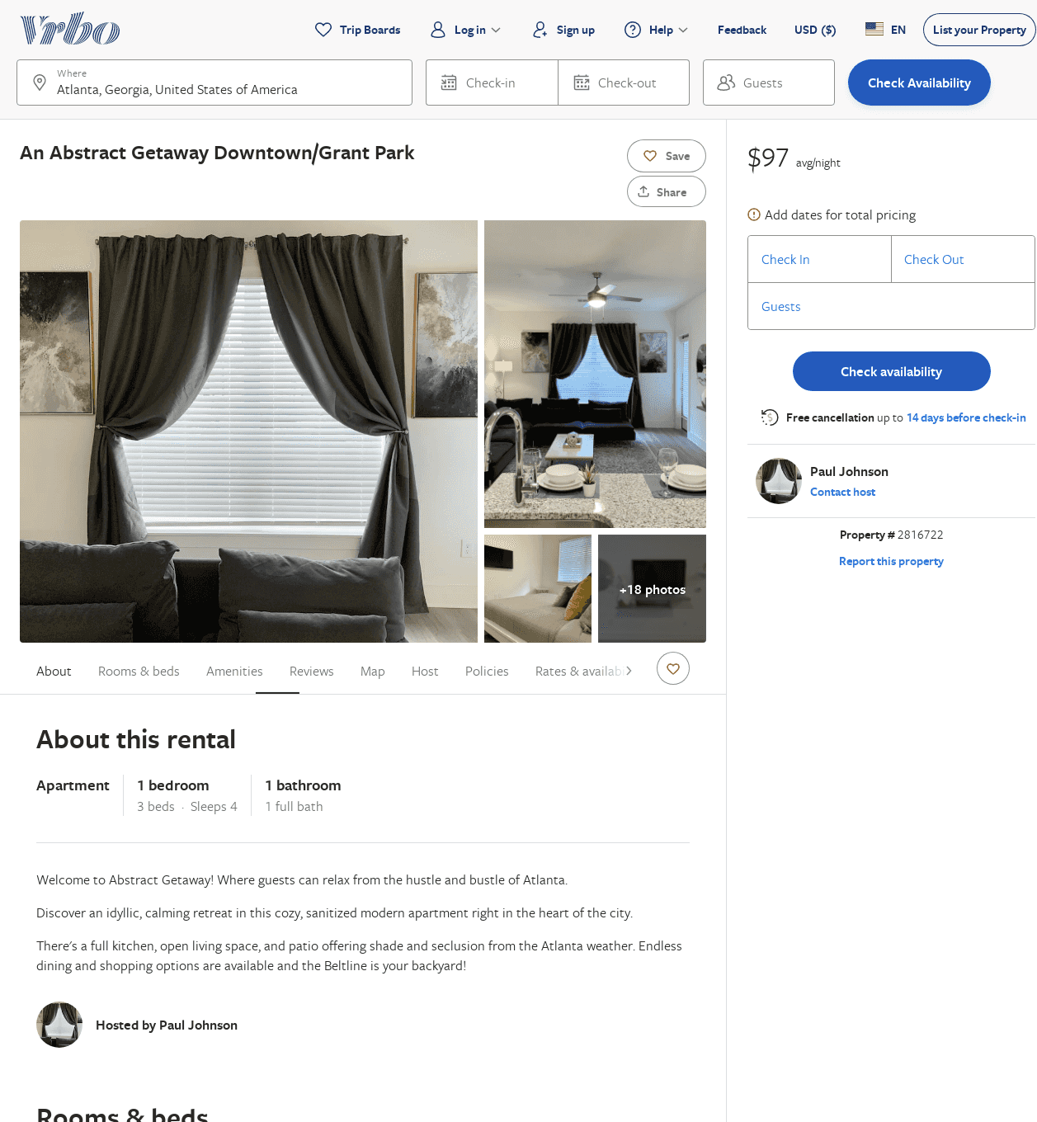
Listing 2816722
1
4
$104
1
Paul Johnson
https://www.vrbo.com/2816722
Aug 2022

Slide 17
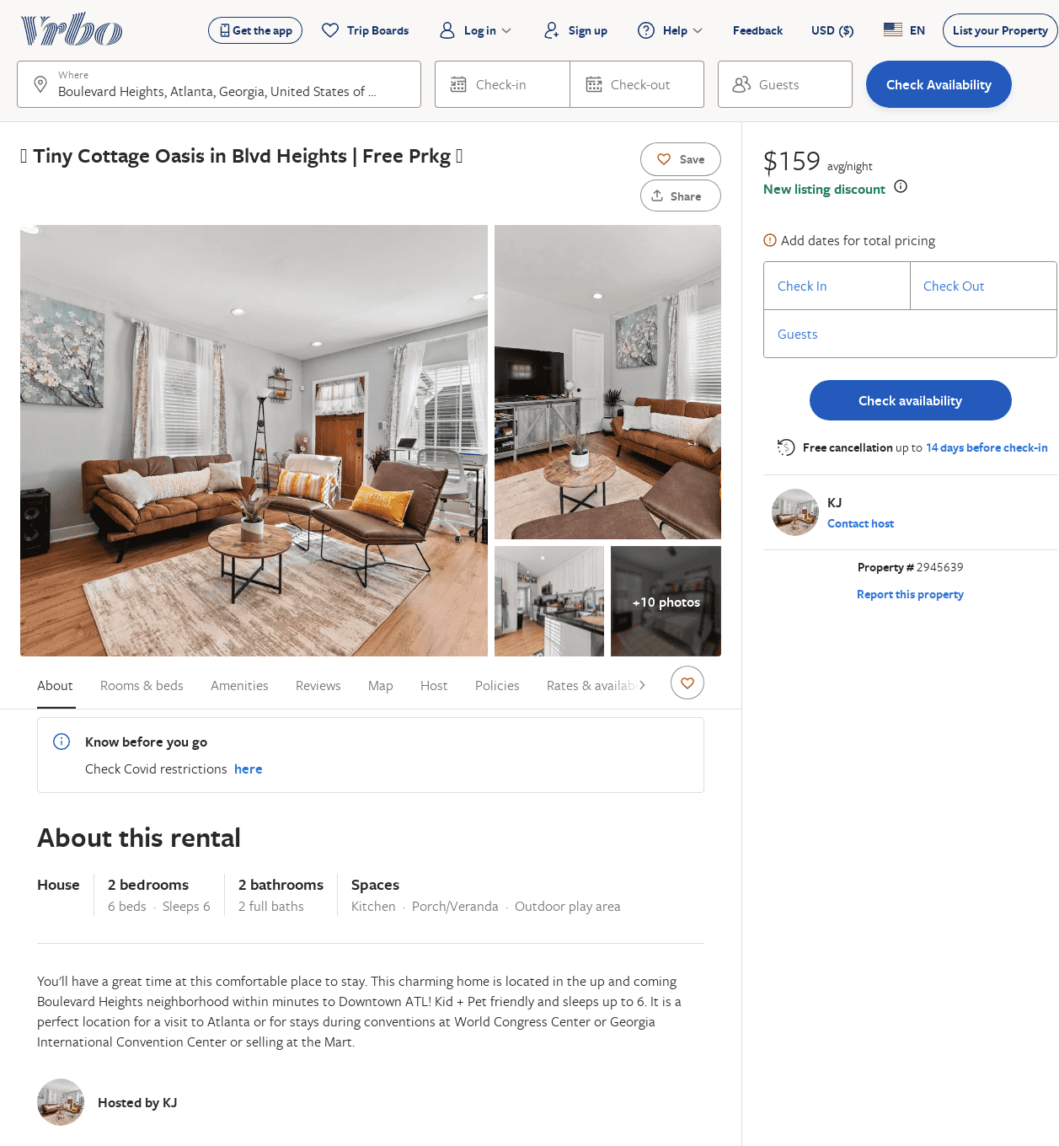
Listing 2945639
2
6
$159
2
KJ
https://www.vrbo.com/2945639
Aug 2022

