Slide 2
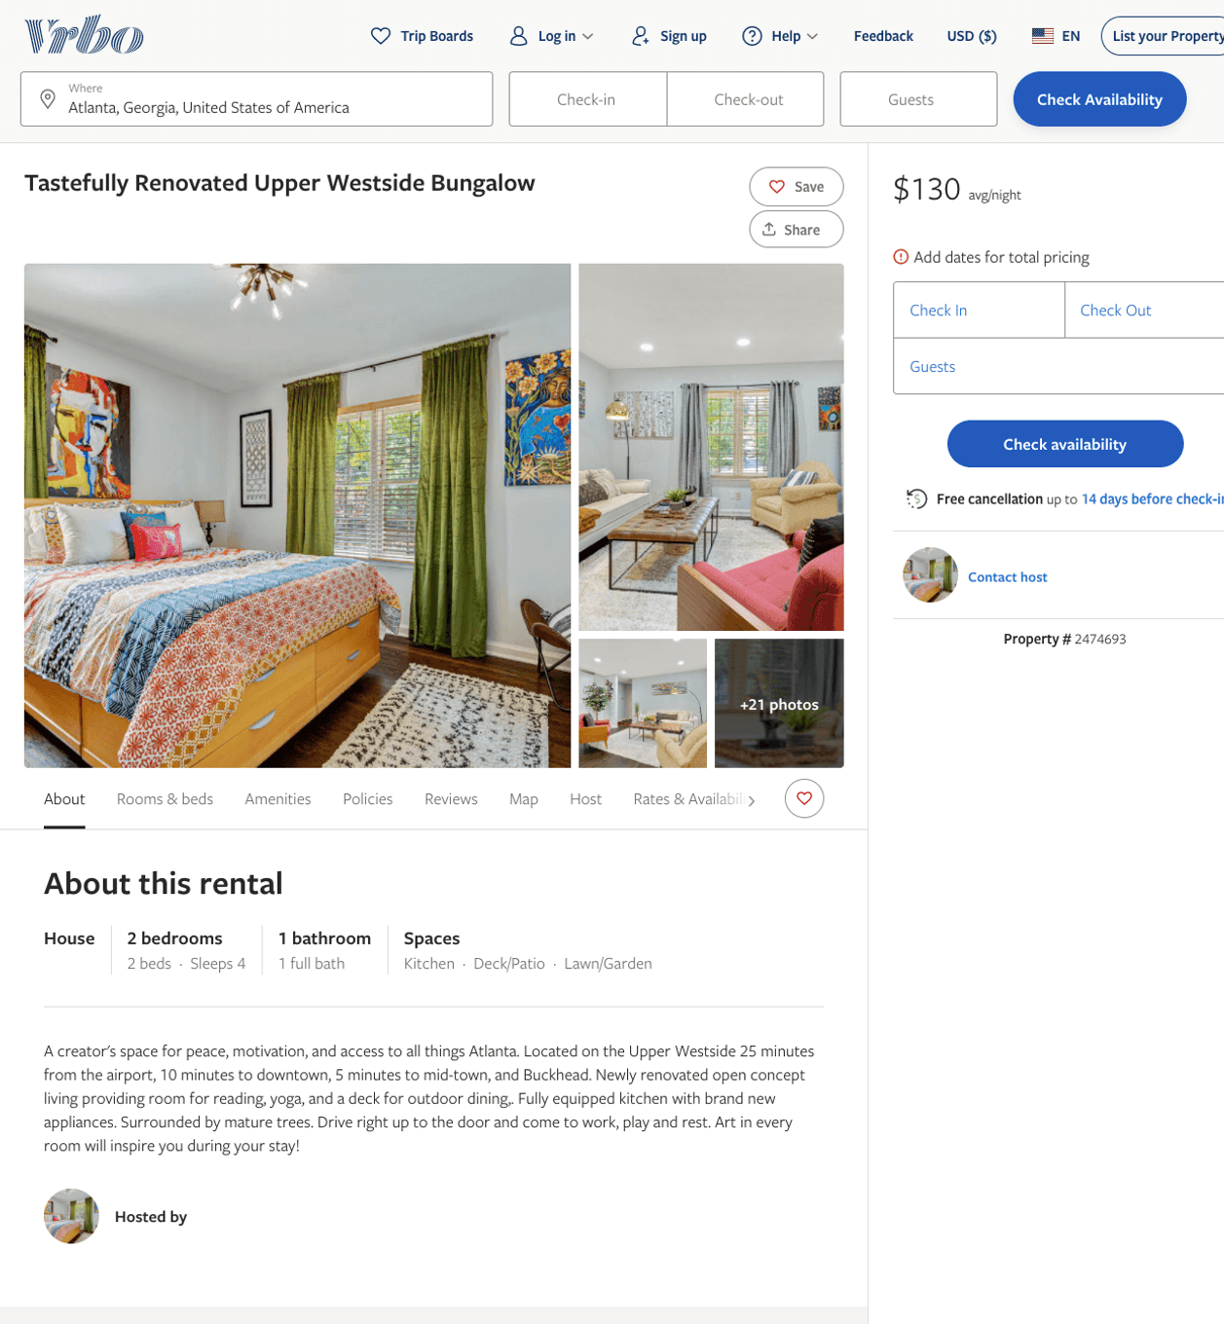
Listing 2474693
2
4
$130 - $181
4.2
2
Cheryl Shaw
https://www.vrbo.com/2474693
Aug 2022

Slide 3
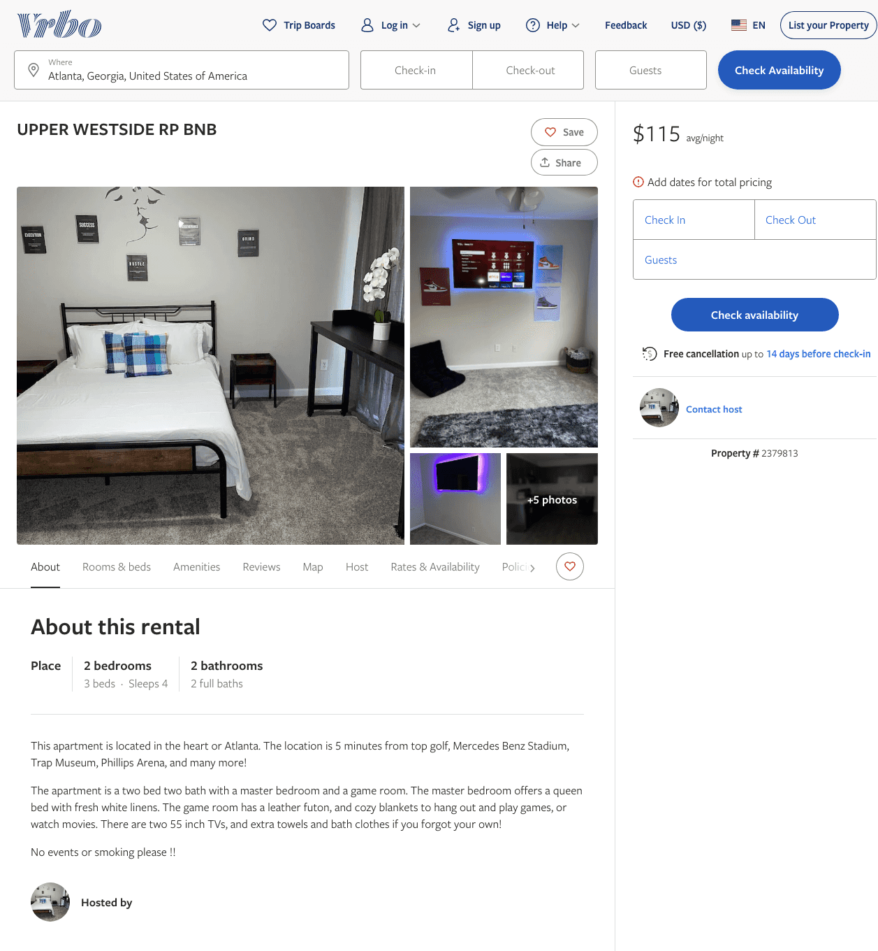
Listing 2379813
2
4
$102 - $115
2.25
1
https://www.vrbo.com/2379813
Aug 2022

Slide 4
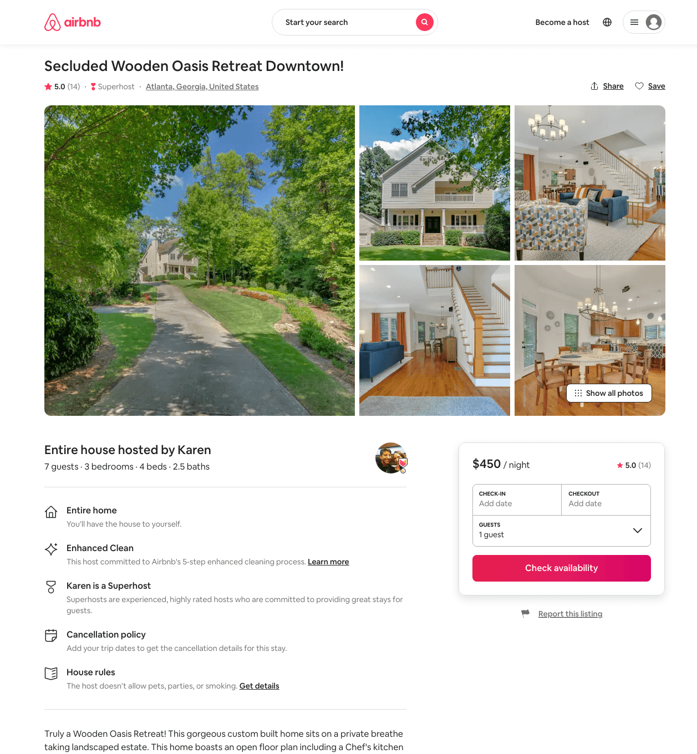
Listing 38405436
3
7
$450
5.0
2
Karen
292557861
2
https://www.airbnb.com/rooms/38405436
Aug 2022

Slide 5
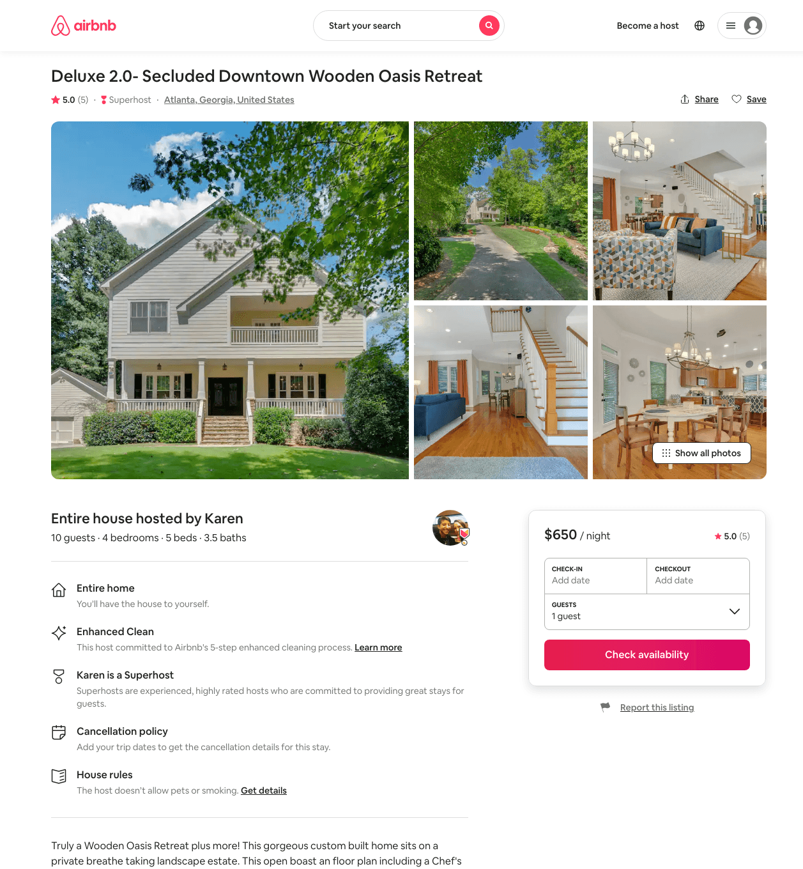
Listing 40585848
4
10
$650
5.0
2
Karen
292557861
2
https://www.airbnb.com/rooms/40585848
Aug 2022

Slide 6
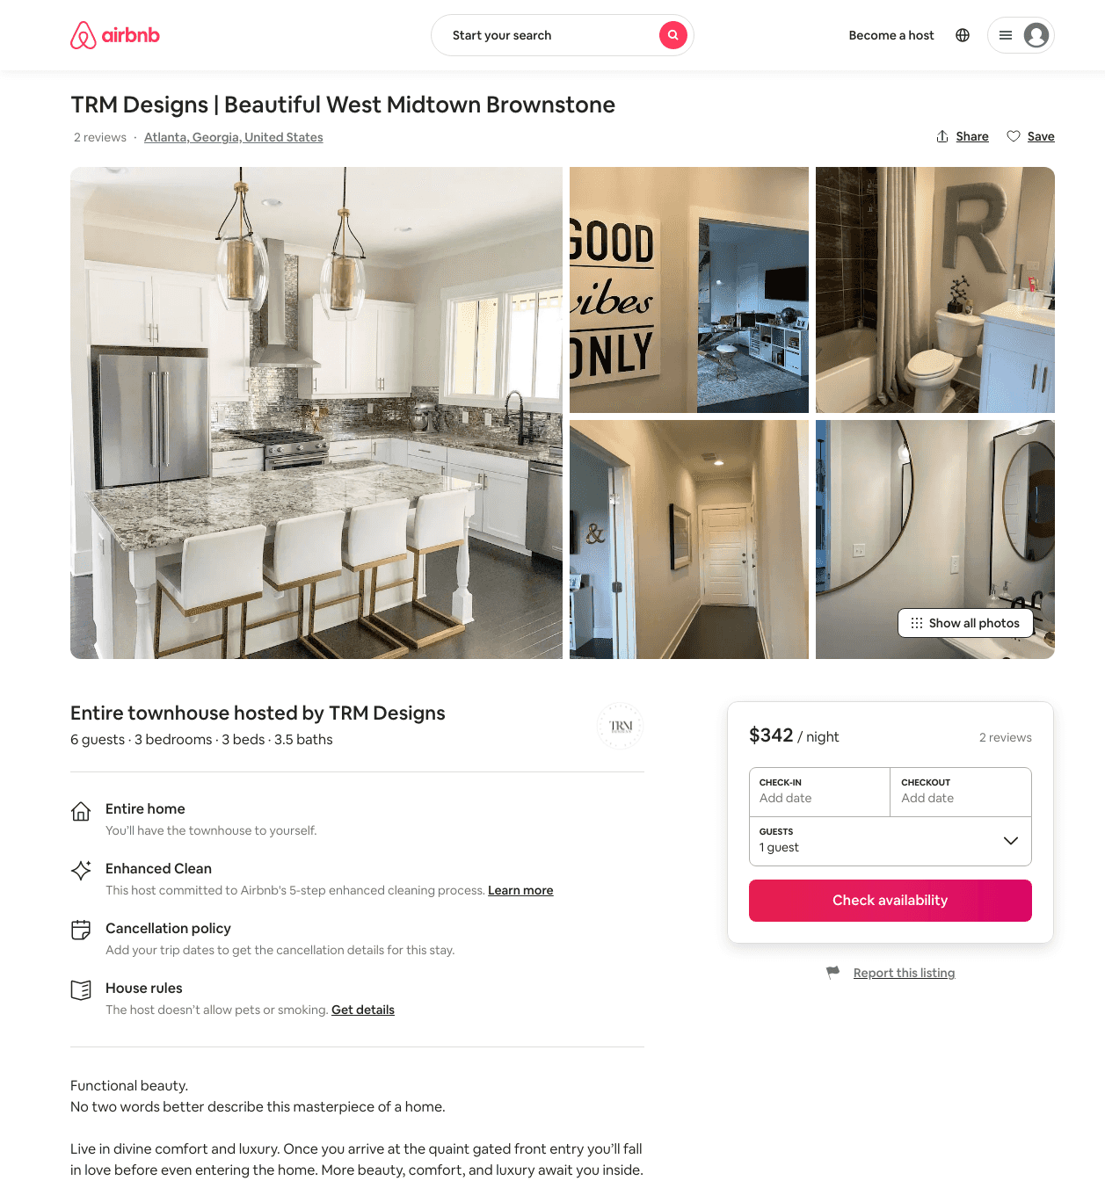
Listing 47487782
3
6
$342 - $484
5.0
3
TRM Designs
114570489
2
https://www.airbnb.com/rooms/47487782
Aug 2022

Slide 7
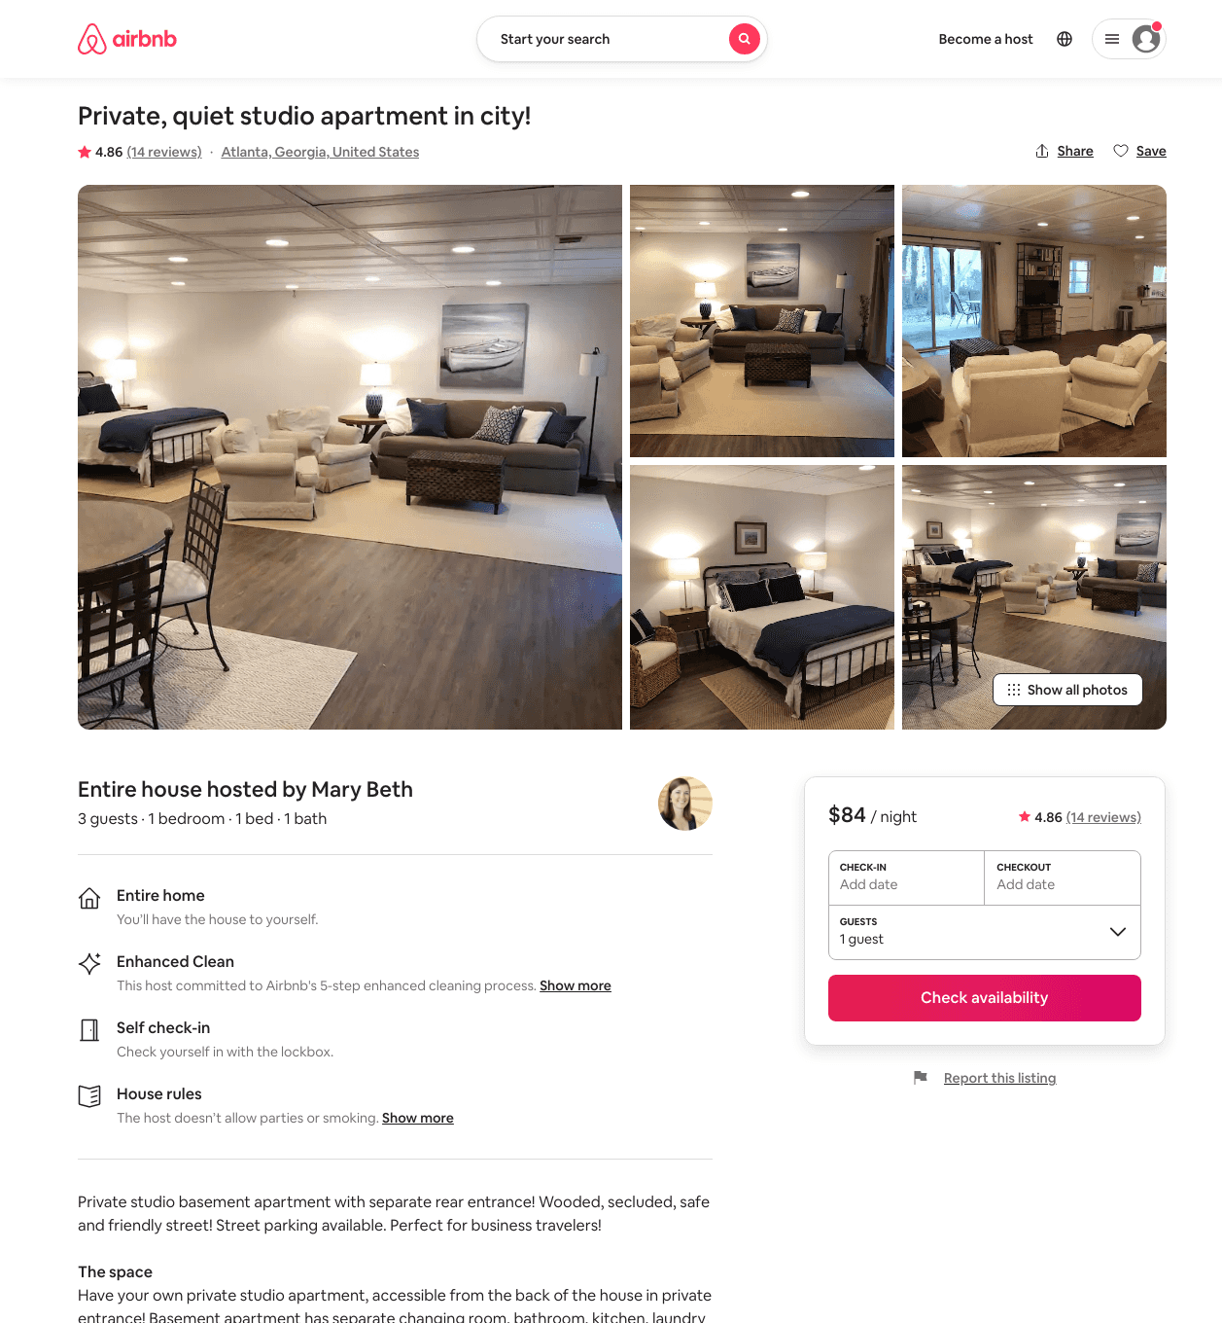
Listing 31600406
1
3
$84 - $86
4.90
6
Mary Beth
16687155
1
https://www.airbnb.com/rooms/31600406
Aug 2022

Slide 8
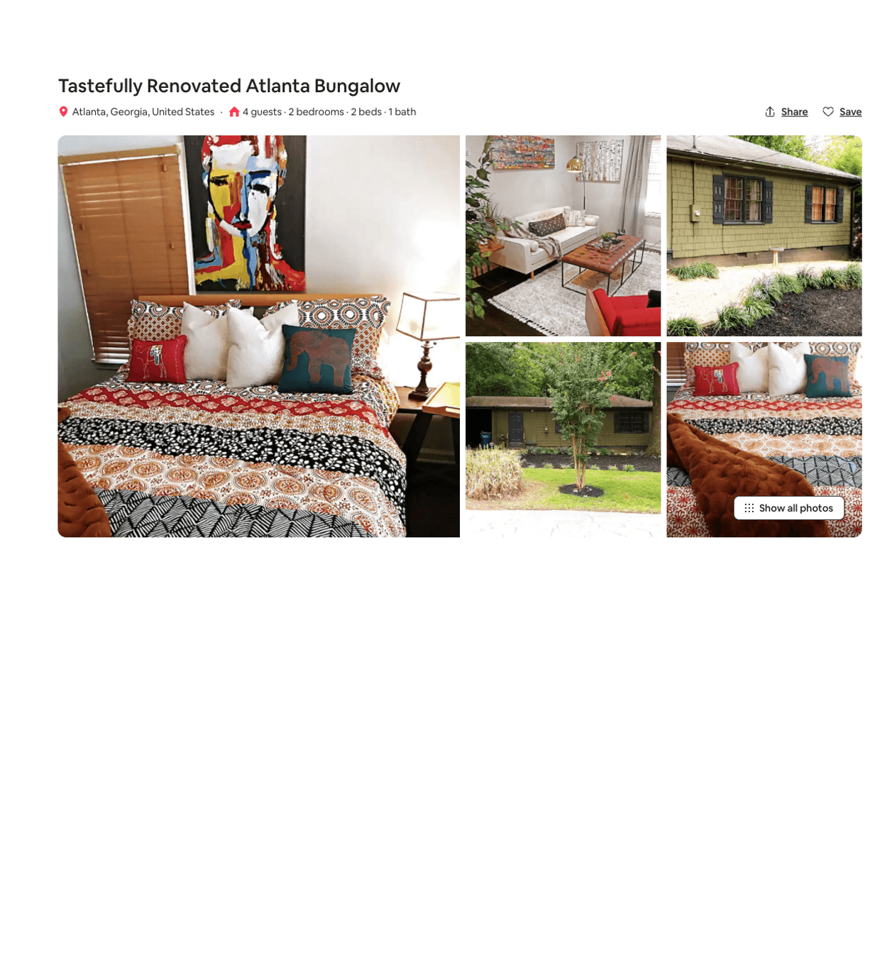
Listing 49180122
2
4
$130 - $207
4.91
2
Cheryl
245100504
1
https://www.airbnb.com/rooms/49180122
Aug 2022

Slide 9
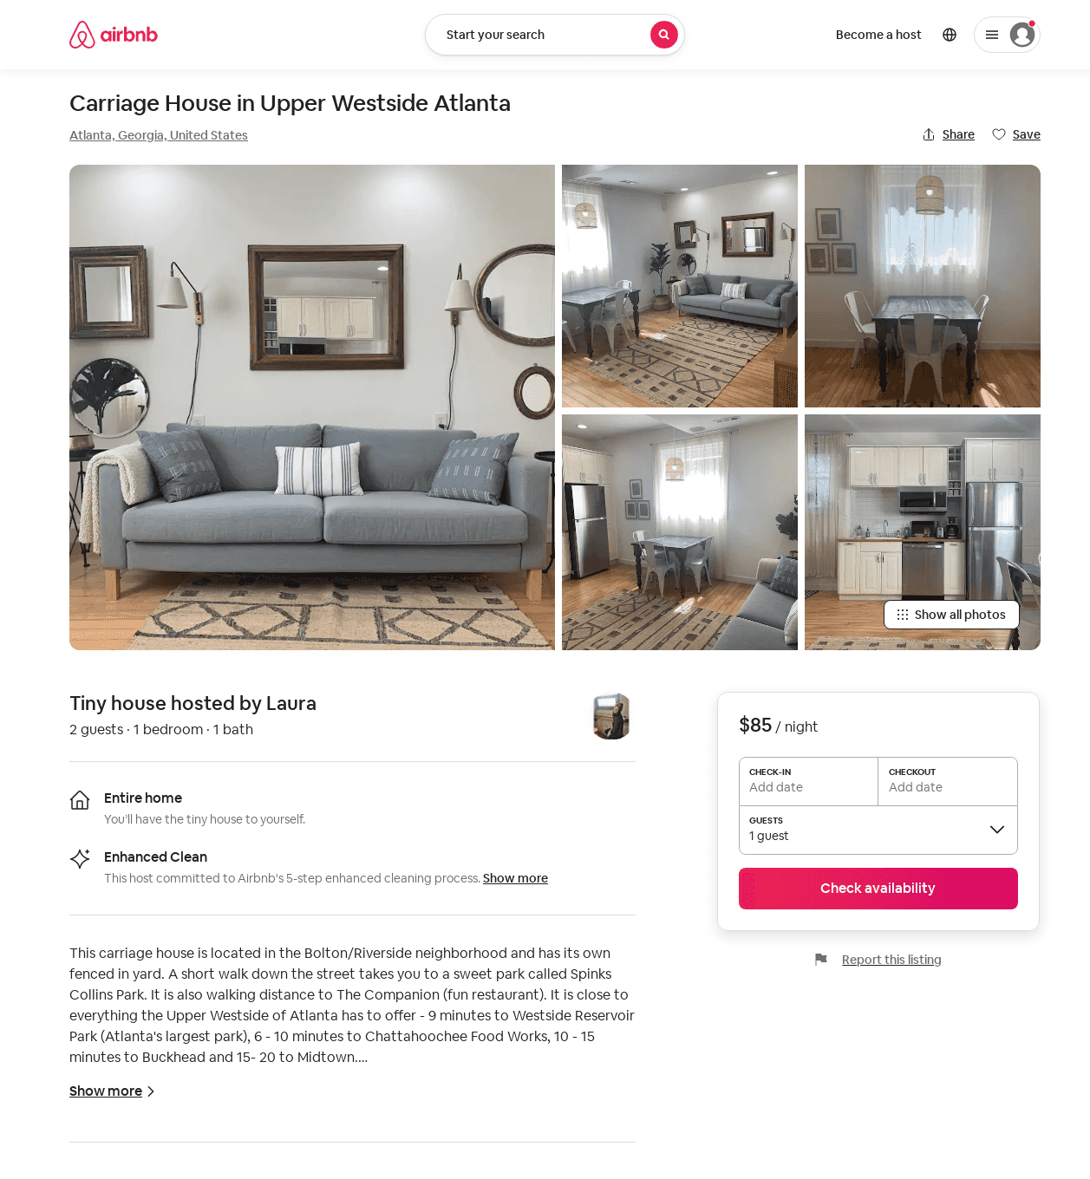
Listing 48451131
1
2
$85 - $89
5.0
2
Laura
30176788
2
https://www.airbnb.com/rooms/48451131
Aug 2022

Slide 10
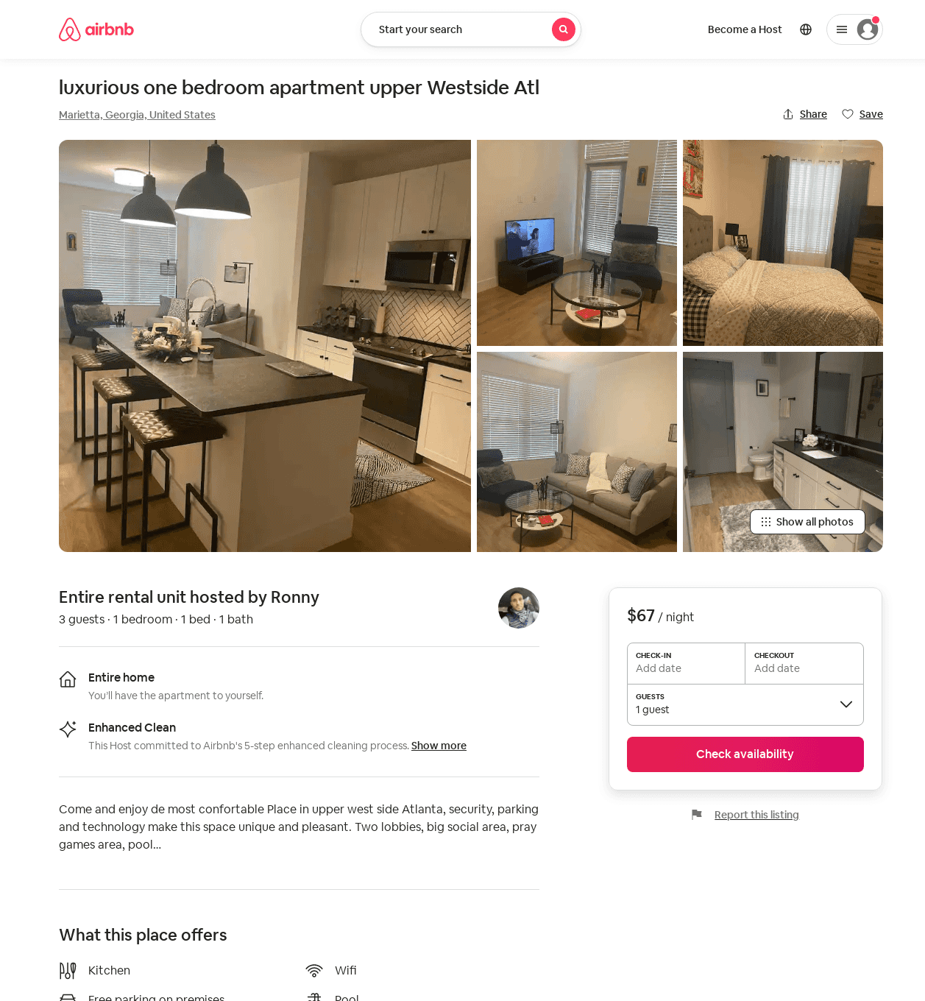
Listing 54316037
1
3
$67
2
Ronny
440599624
1
https://www.airbnb.com/rooms/54316037
Aug 2022

Slide 11
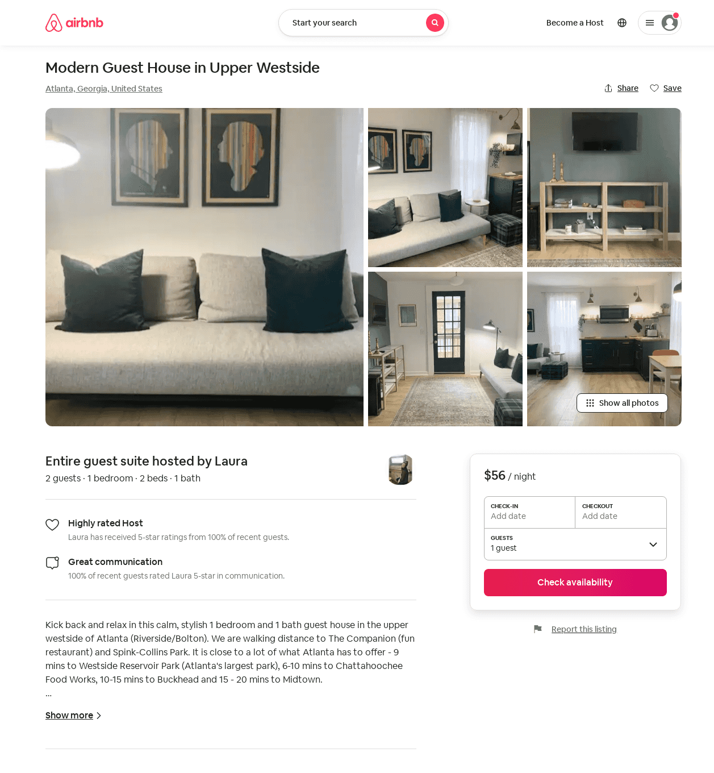
Listing 46132569
1
2
$56 - $70
7
Laura
30176788
2
https://www.airbnb.com/rooms/46132569
Aug 2022

Slide 12
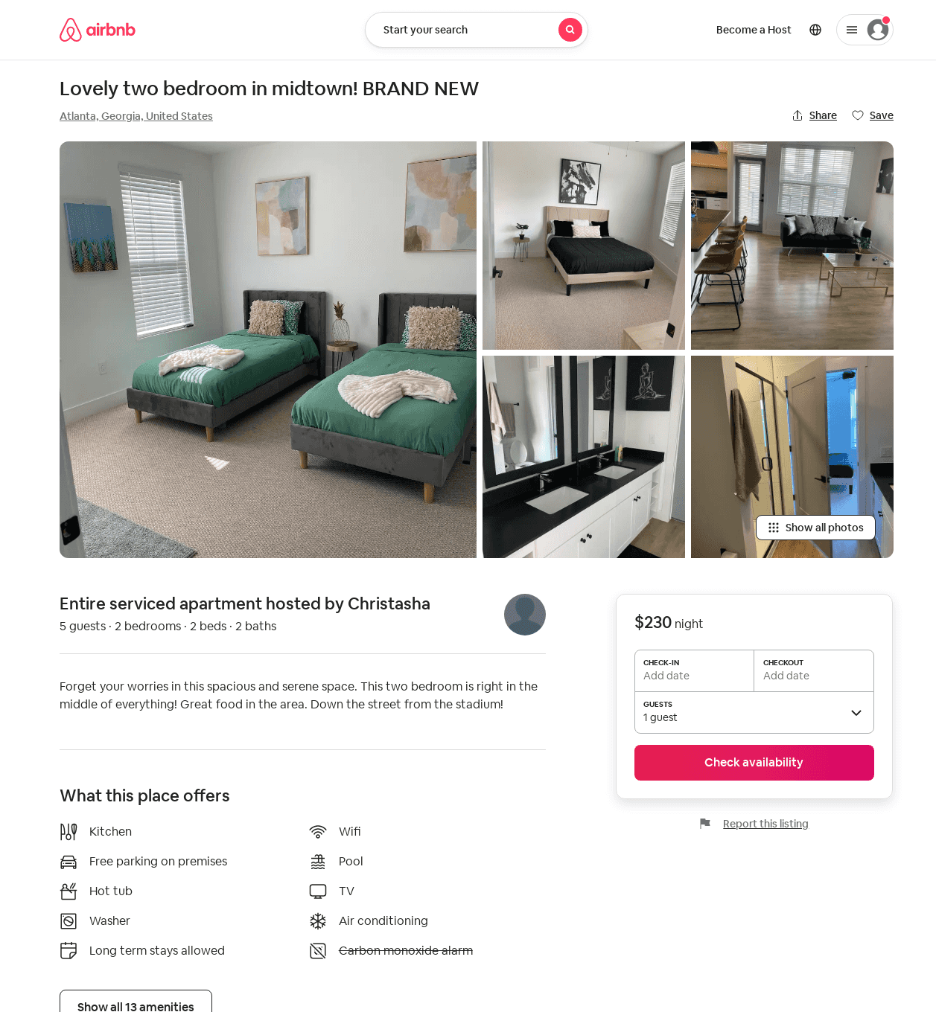
Listing 607046728861632900
2
5
$230
4.0
2
Christasha
441187173
1
https://www.airbnb.com/rooms/607046728861632900
Aug 2022

Slide 13
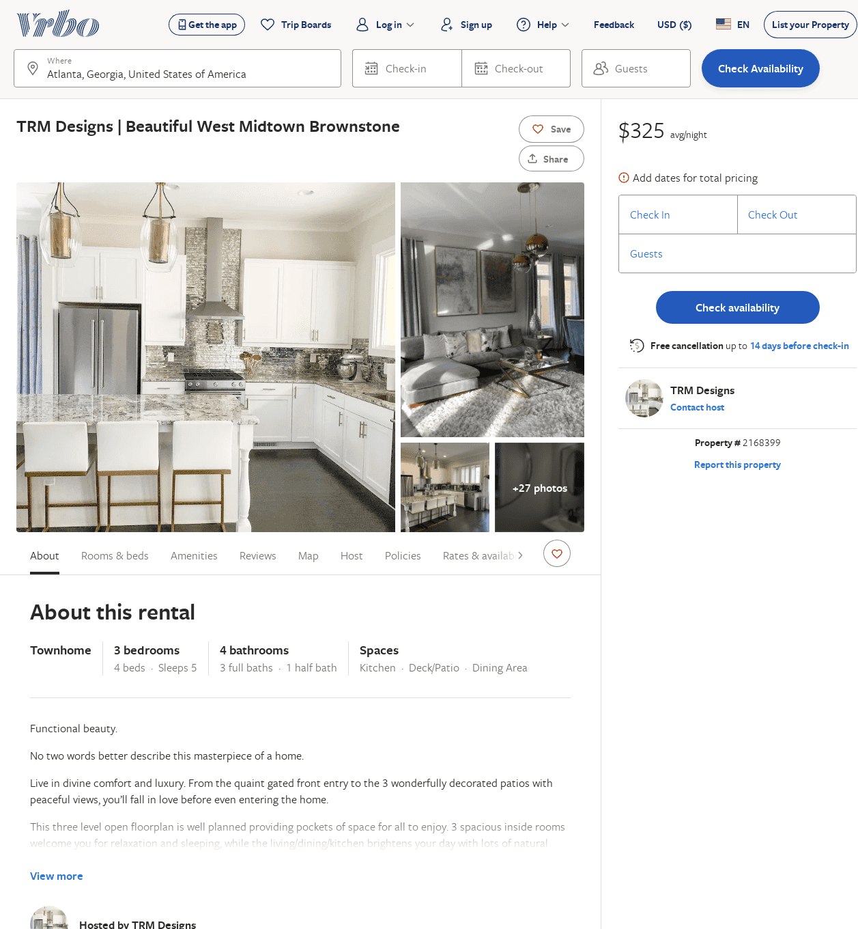
Listing 2168399
3
5
$325
3
TRM Designs
https://www.vrbo.com/2168399
Aug 2022

Slide 14
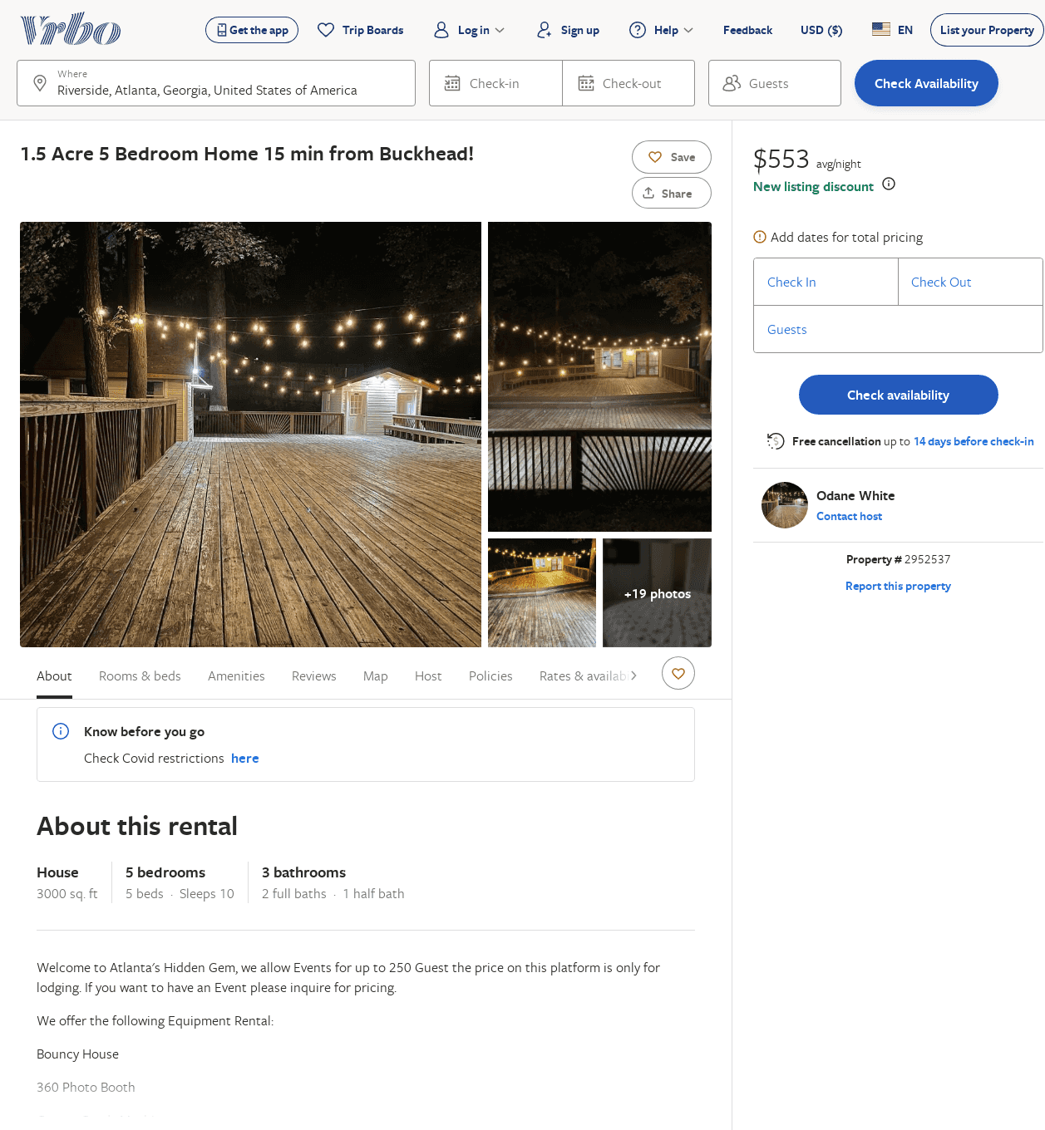
Listing 2952537
5
10
$553
1
Odane White
https://www.vrbo.com/2952537
Aug 2022

