Slide 2
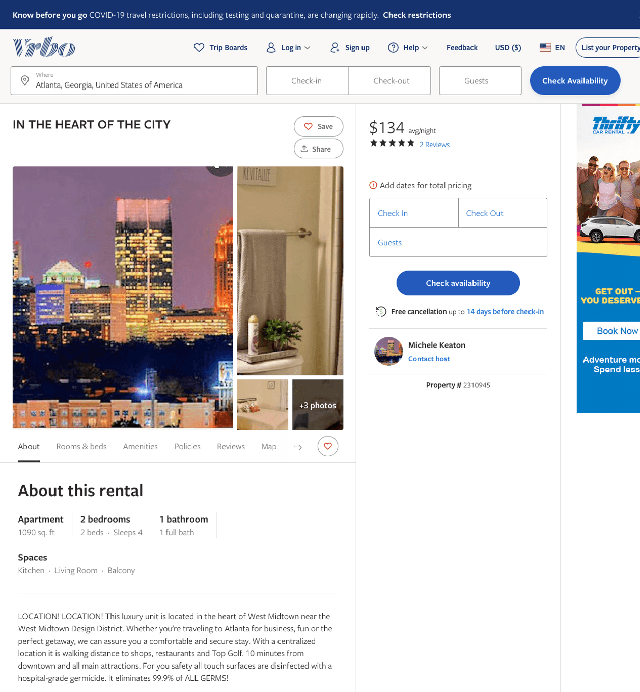
Listing 2310945
2
4
$134 - $141
5
3
Michele Keaton
https://www.vrbo.com/2310945
Aug 2022

Slide 3
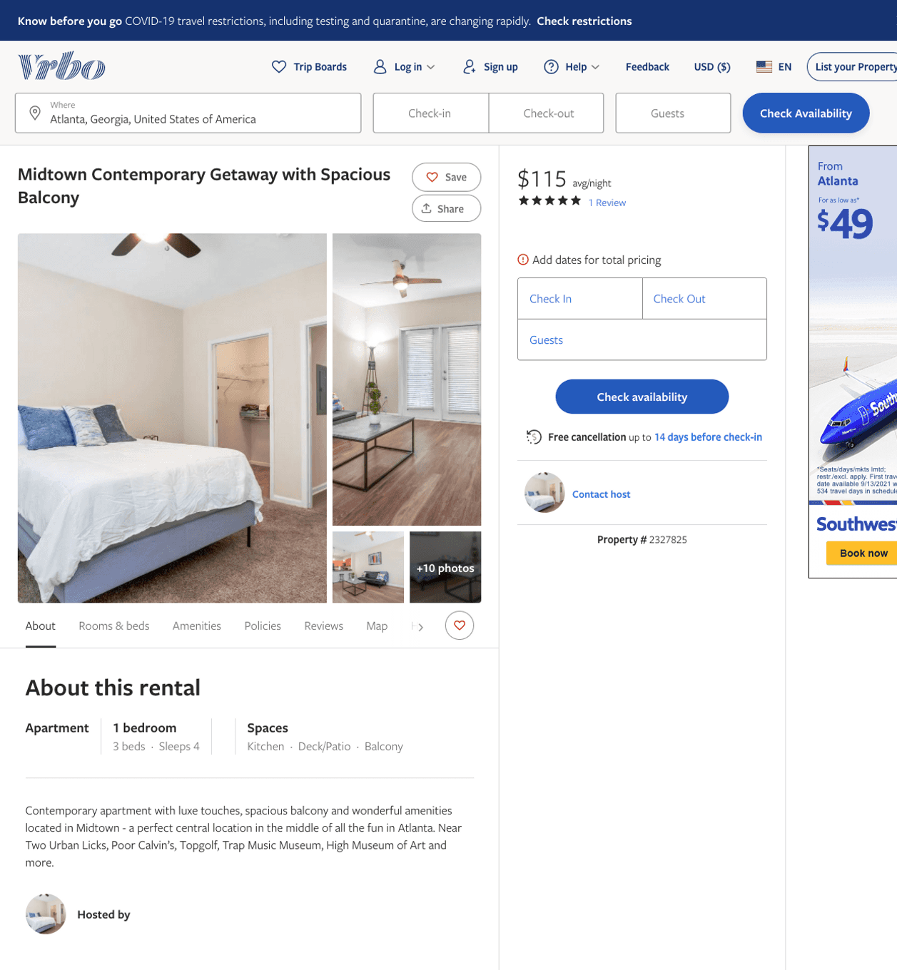
Listing 2327825
1
4
$115
5
2
https://www.vrbo.com/2327825
Aug 2022

Slide 4
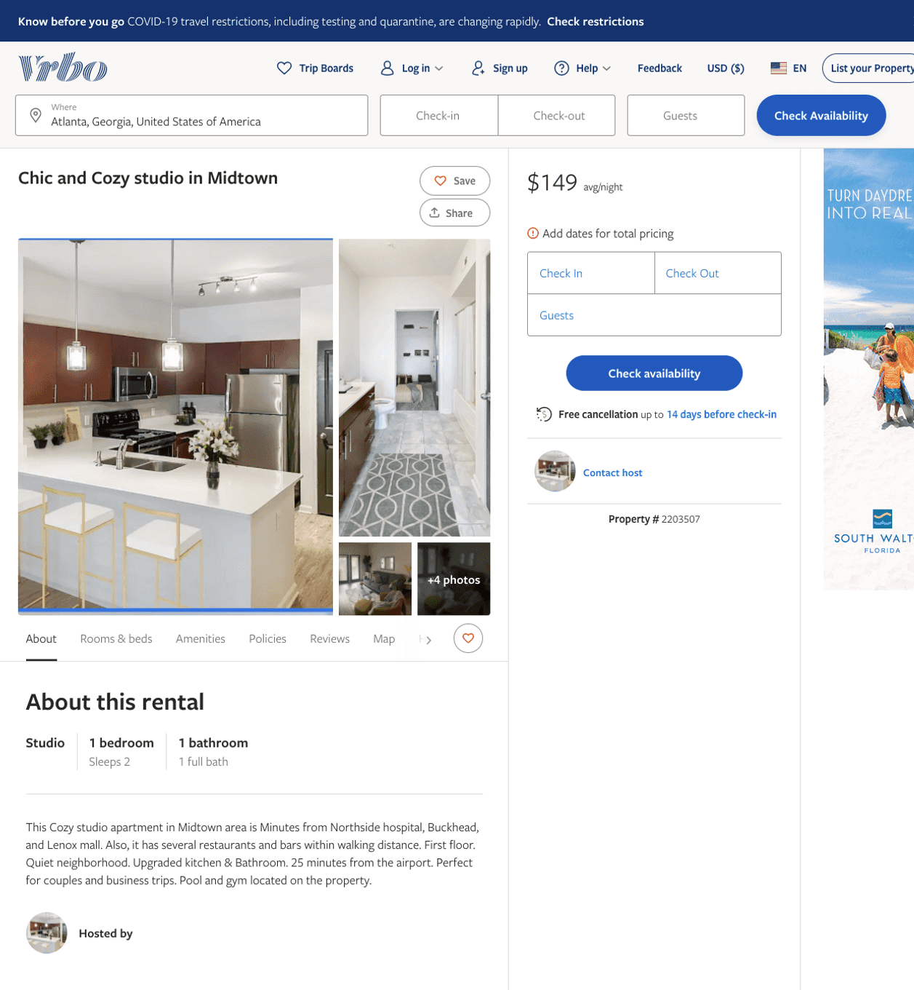
Listing 2203507
1
2
$127 - $165
2
2
https://www.vrbo.com/2203507
Aug 2022

Slide 5
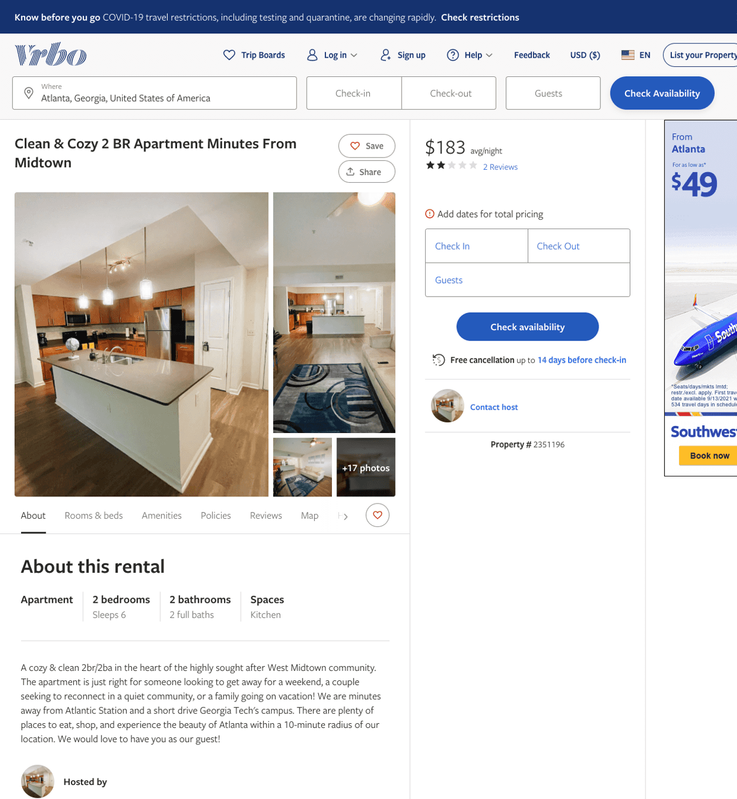
Listing 2351196
2
6
$100 - $183
2
1
Cedric Brown
https://www.vrbo.com/2351196
Aug 2022

Slide 6
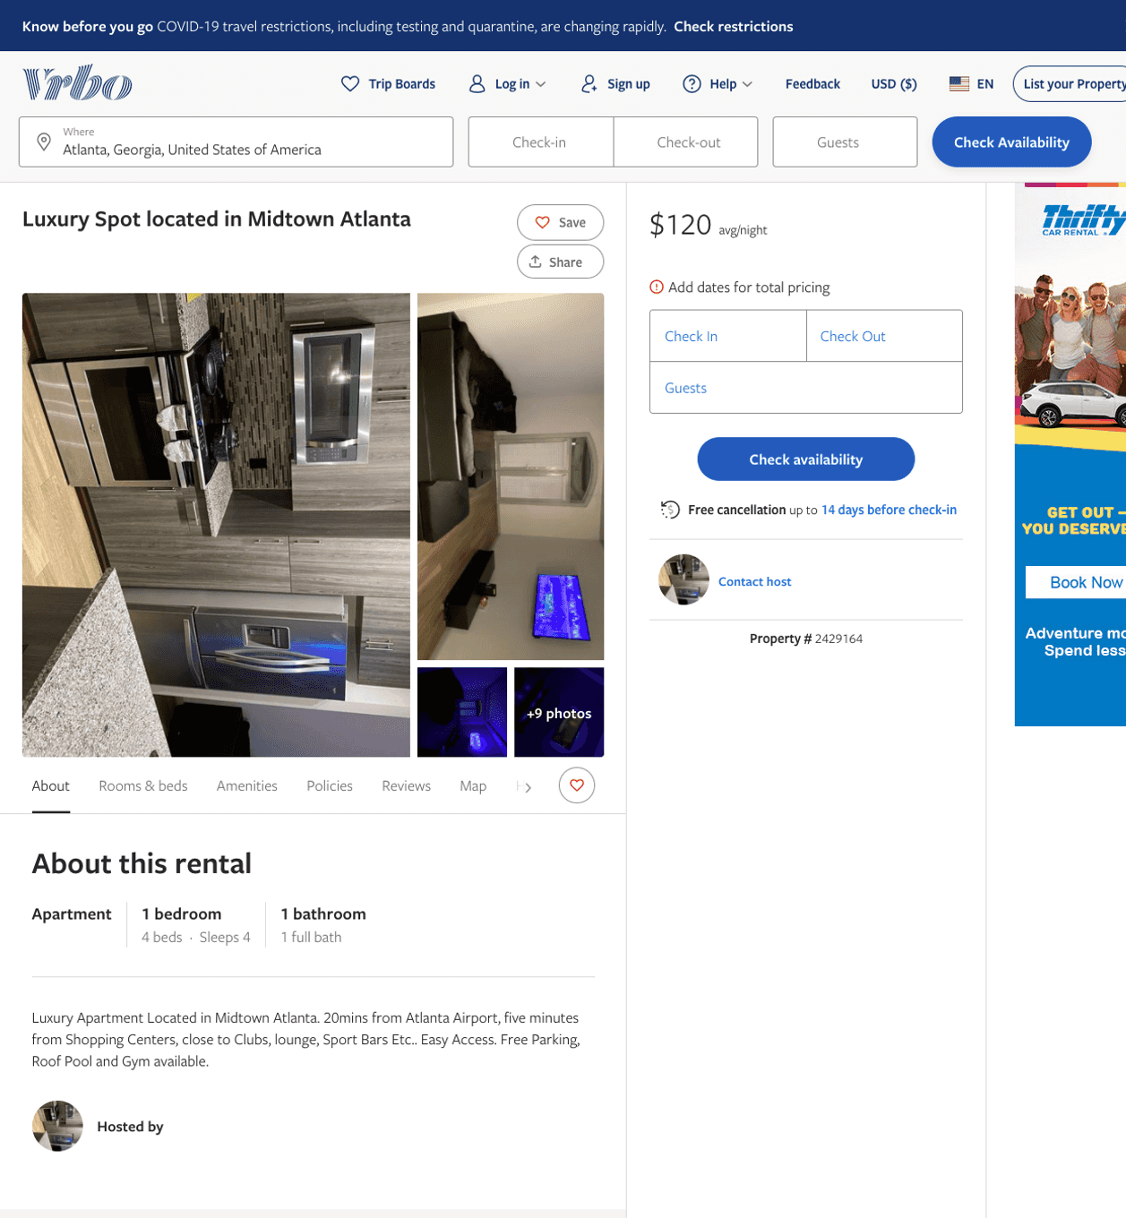
Listing 2429164
1
4
$120
1
https://www.vrbo.com/2429164
Aug 2022

Slide 7
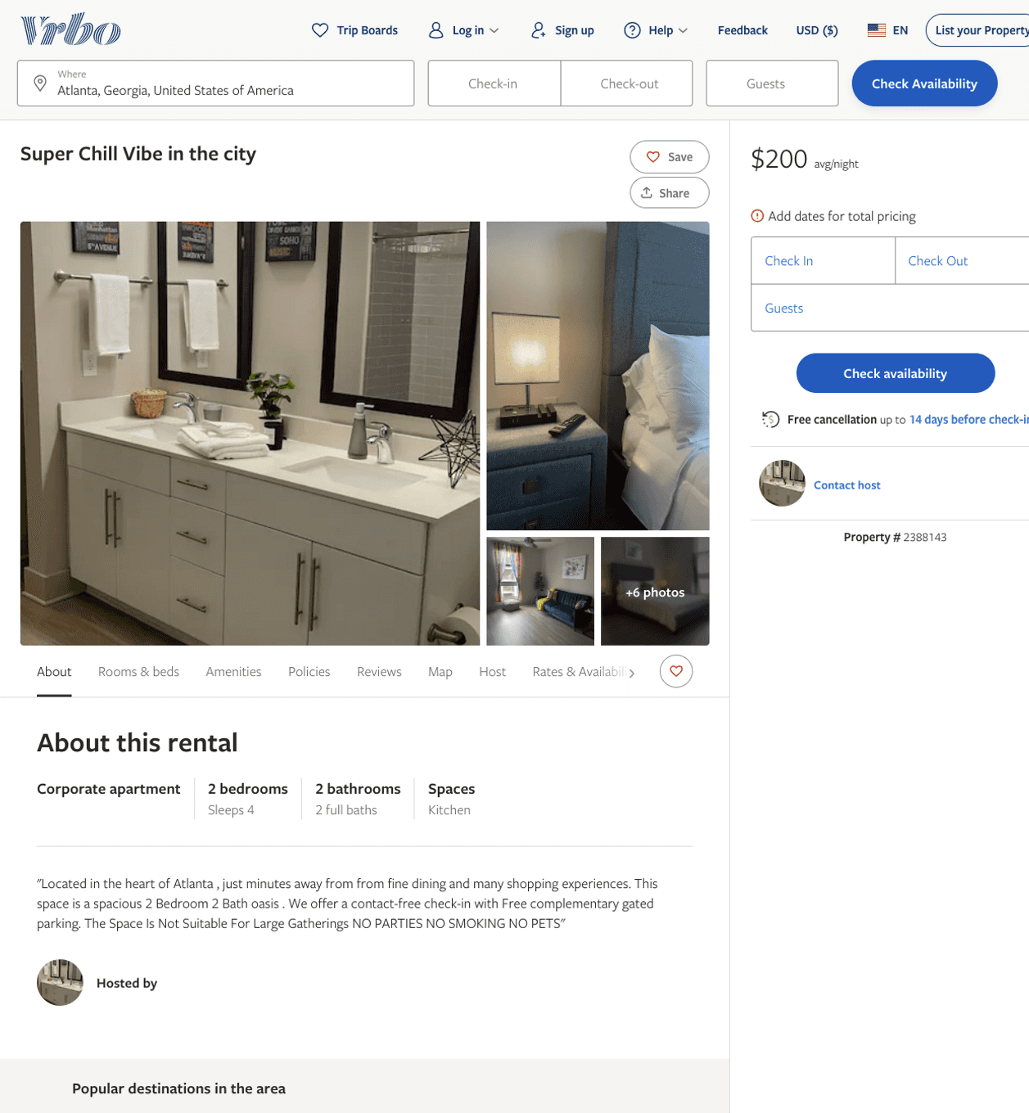
Listing 2388143
2
4
$200
3
https://www.vrbo.com/2388143
Aug 2022

Slide 8
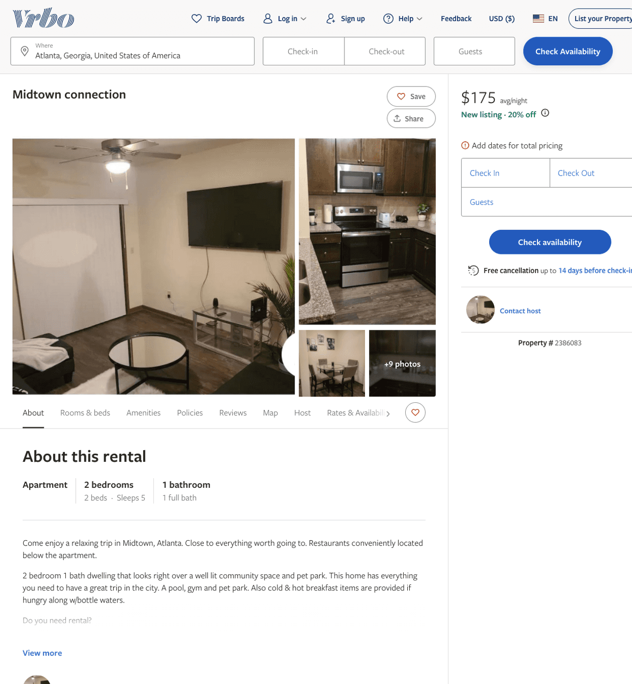
Listing 2386083
2
5
$175
1
https://www.vrbo.com/2386083
Aug 2022

Slide 9
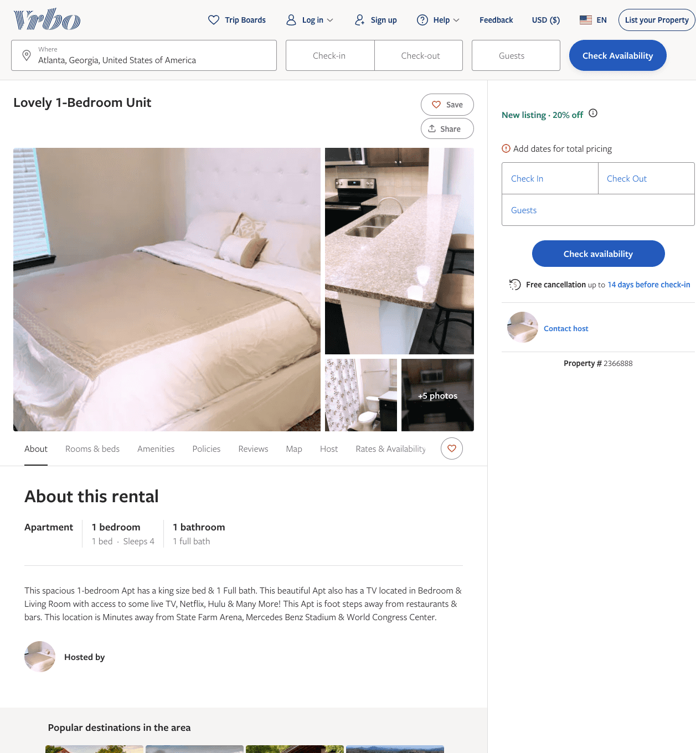
Listing 2366888
1
4
$150
2
https://www.vrbo.com/2366888
Aug 2022

Slide 10
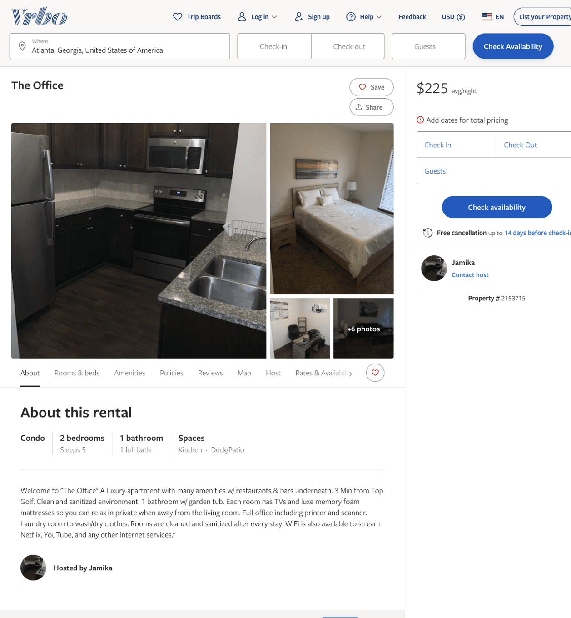
Listing 2153715
2
5
$225
2
Jamika
https://www.vrbo.com/2153715
Aug 2022

Slide 11
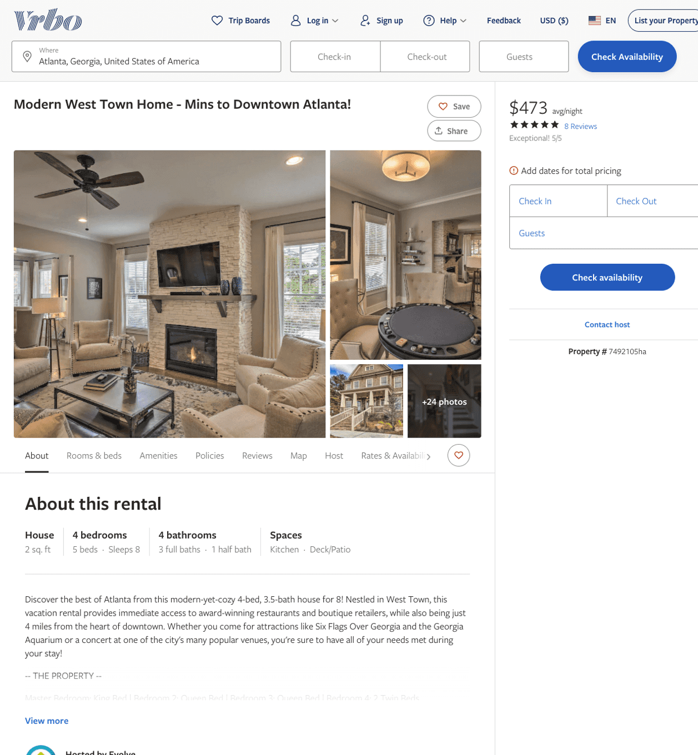
Listing 7492105
4
8
$466 - $532
5
3
Evolve
https://www.vrbo.com/7492105ha
Aug 2022

Slide 12
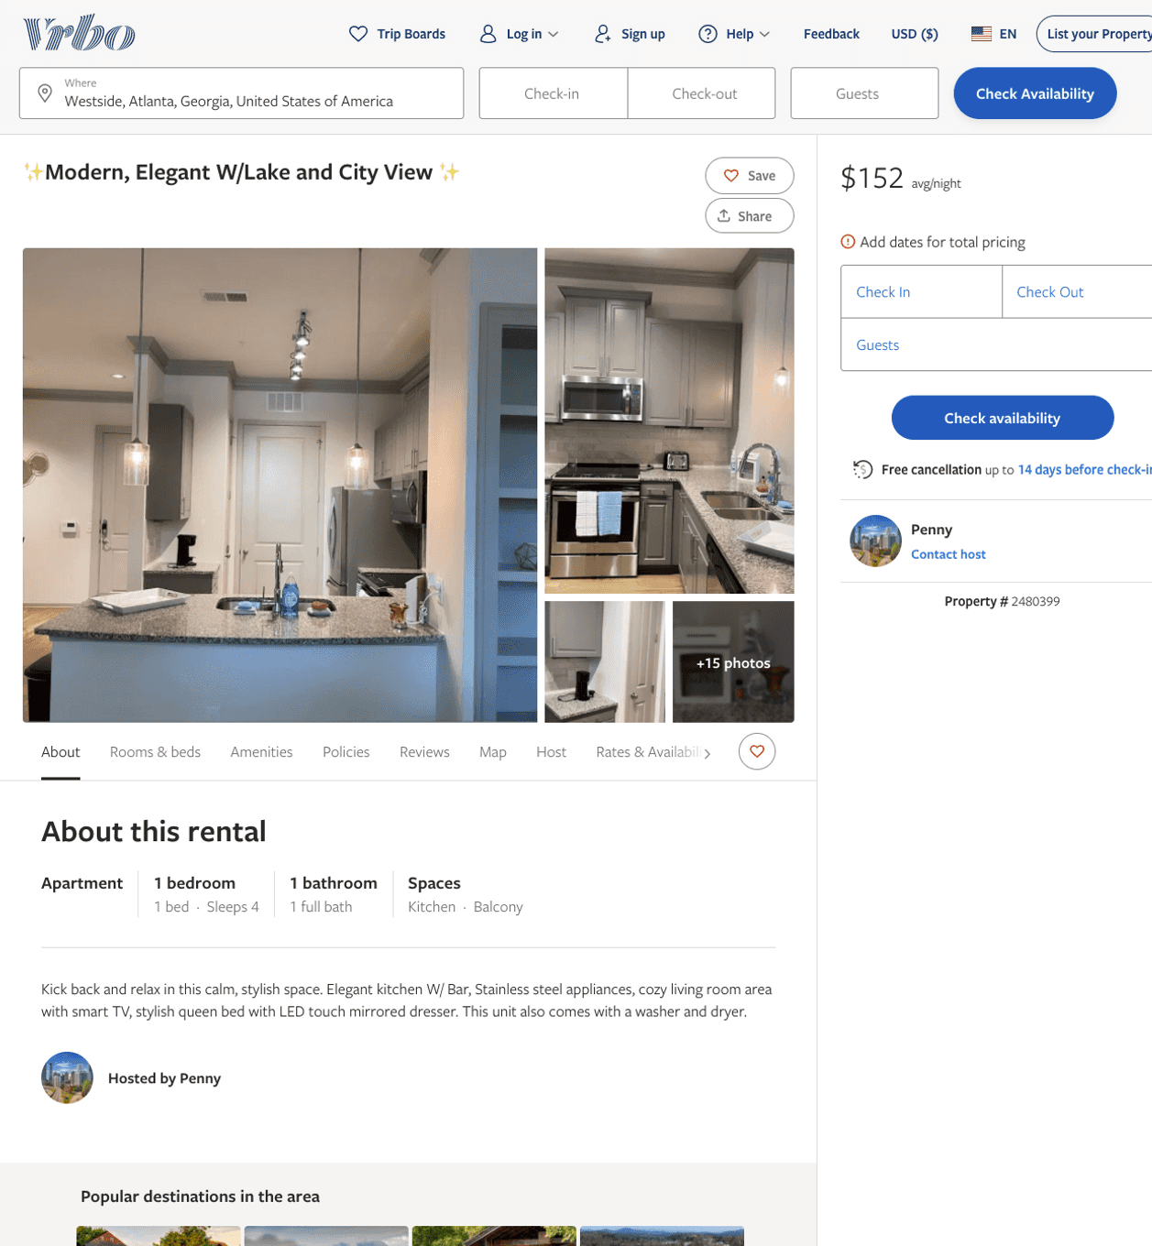
Listing 2480399
1
4
$144 - $174
2
Penny
https://www.vrbo.com/2480399
Aug 2022

Slide 13
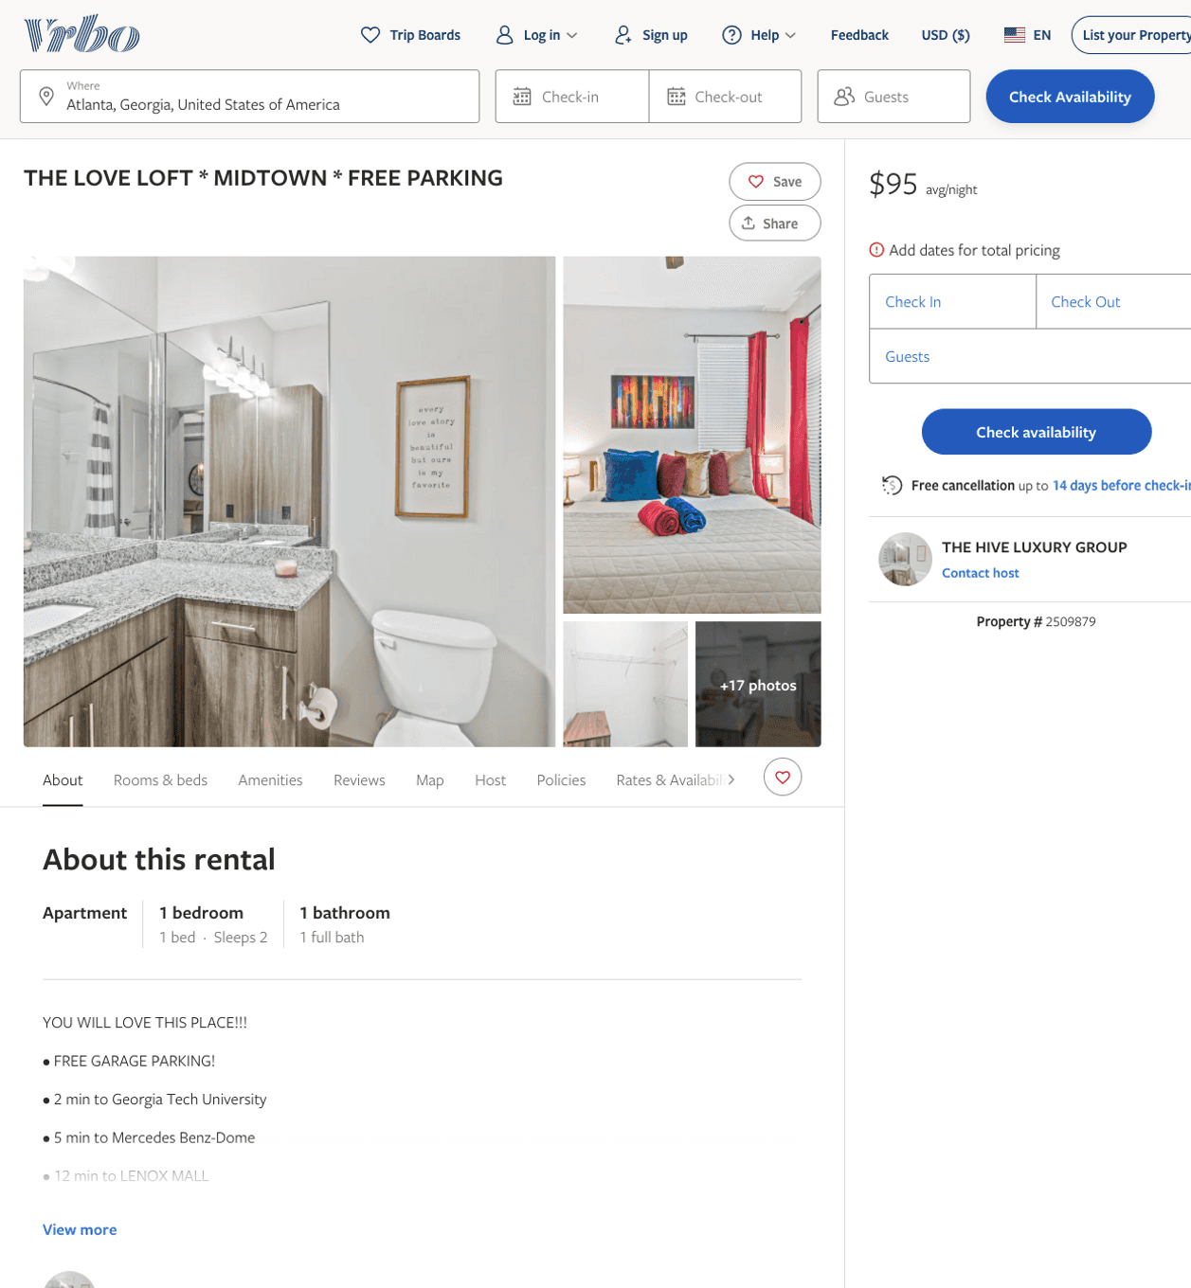
Listing 2509879
1
2
$110 - $95
4.642857
1
THE HIVE LUXURY GROUP
https://www.vrbo.com/2509879
Aug 2022

Slide 14
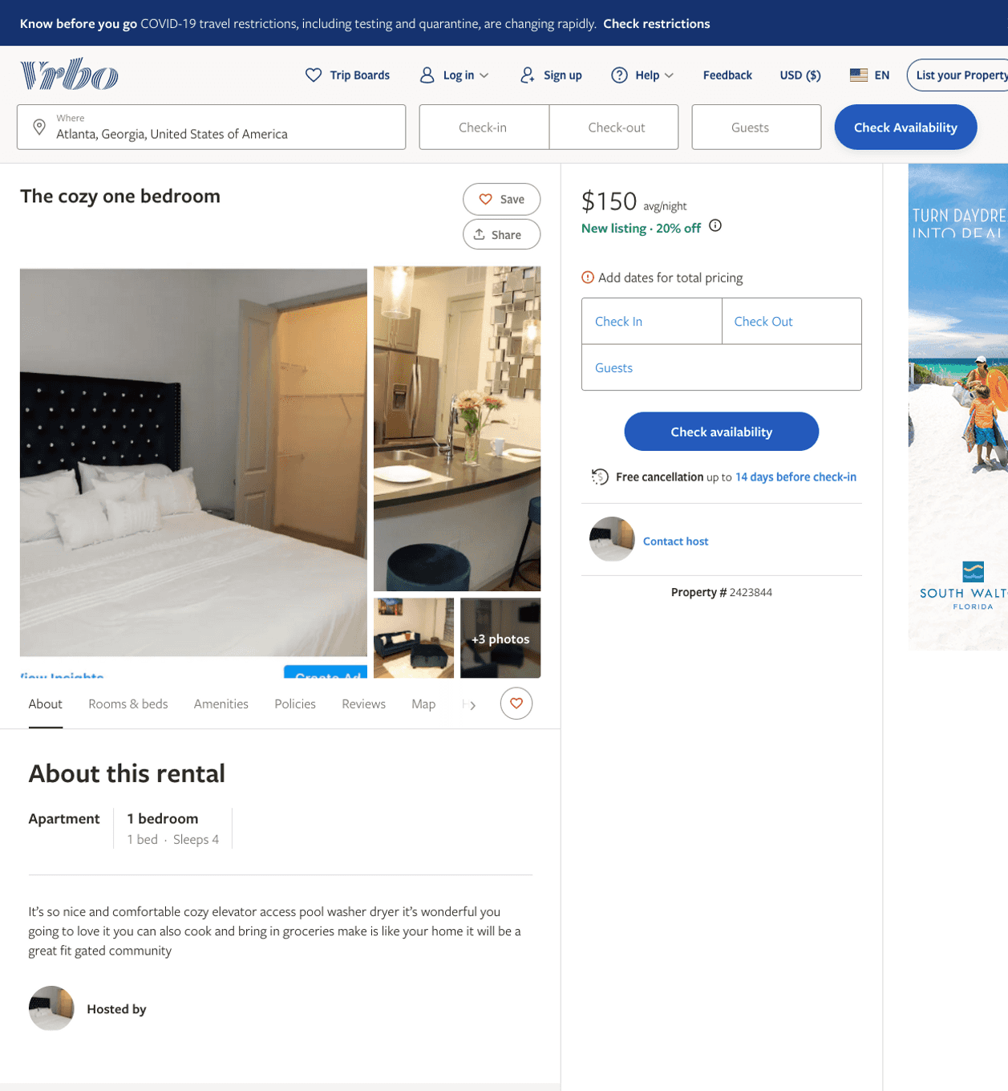
Listing 2423844
1
4
$150
1
https://www.vrbo.com/2423844
Aug 2022

Slide 15
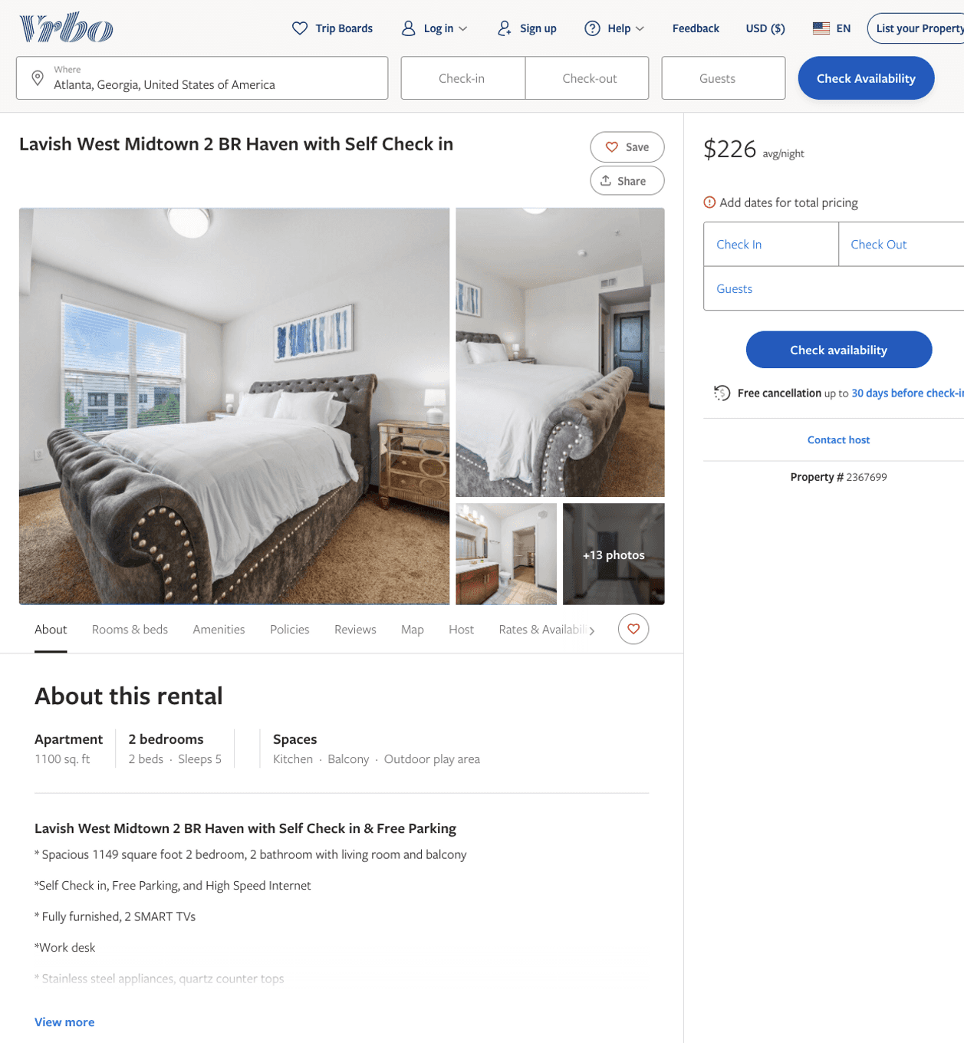
Listing 2367699
2
5
$151 - $247
2
Rickey Lane
https://www.vrbo.com/2367699
Aug 2022

Slide 16
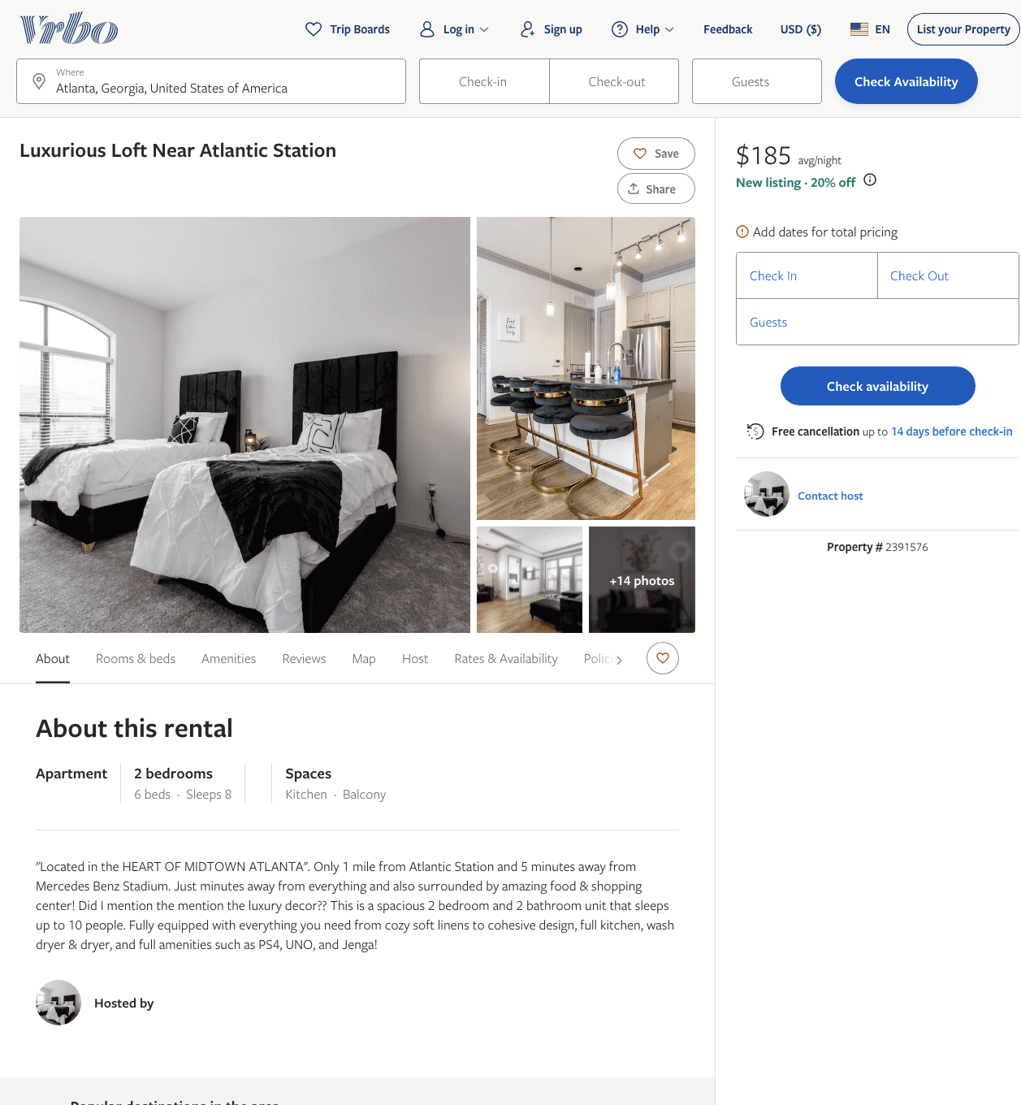
Listing 2391576
2
8
$185
2
https://www.vrbo.com/2391576
Aug 2022

Slide 17
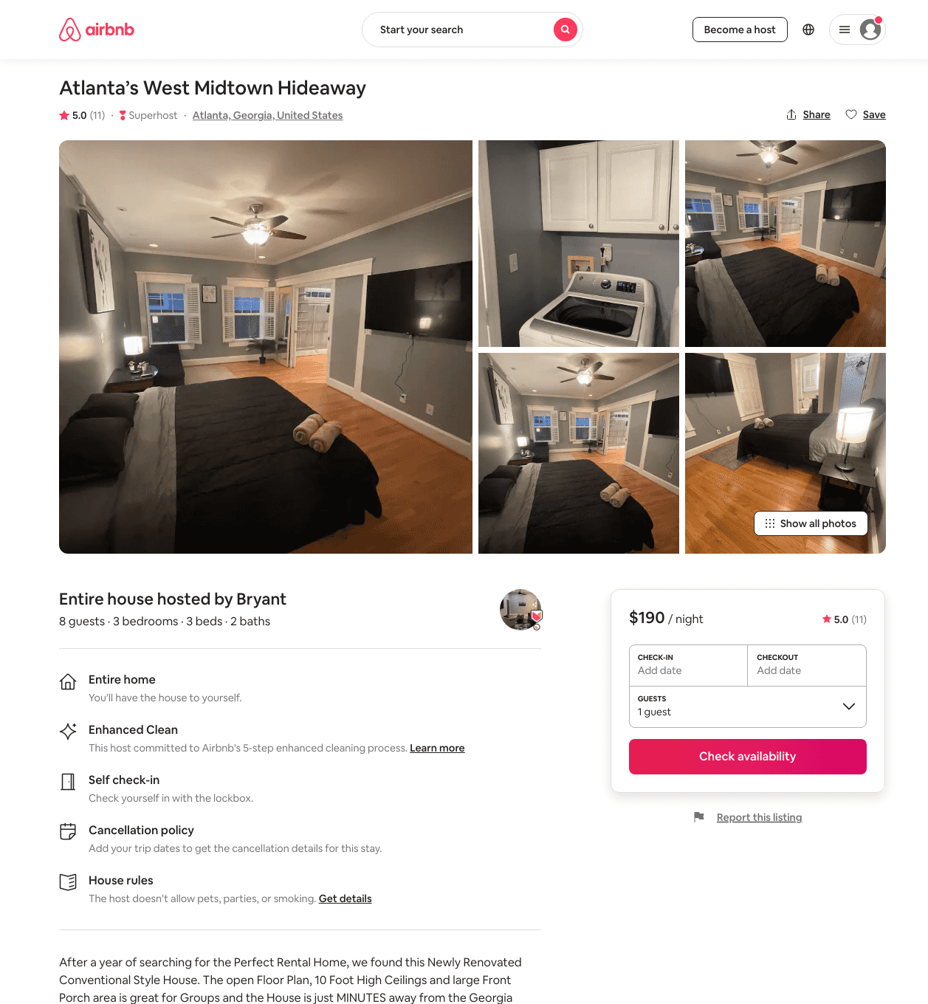
Listing 47336834
3
8
$154 - $250
4.79
2
Bryant
250716419
22
https://www.airbnb.com/rooms/47336834
Jun 2022

Slide 18
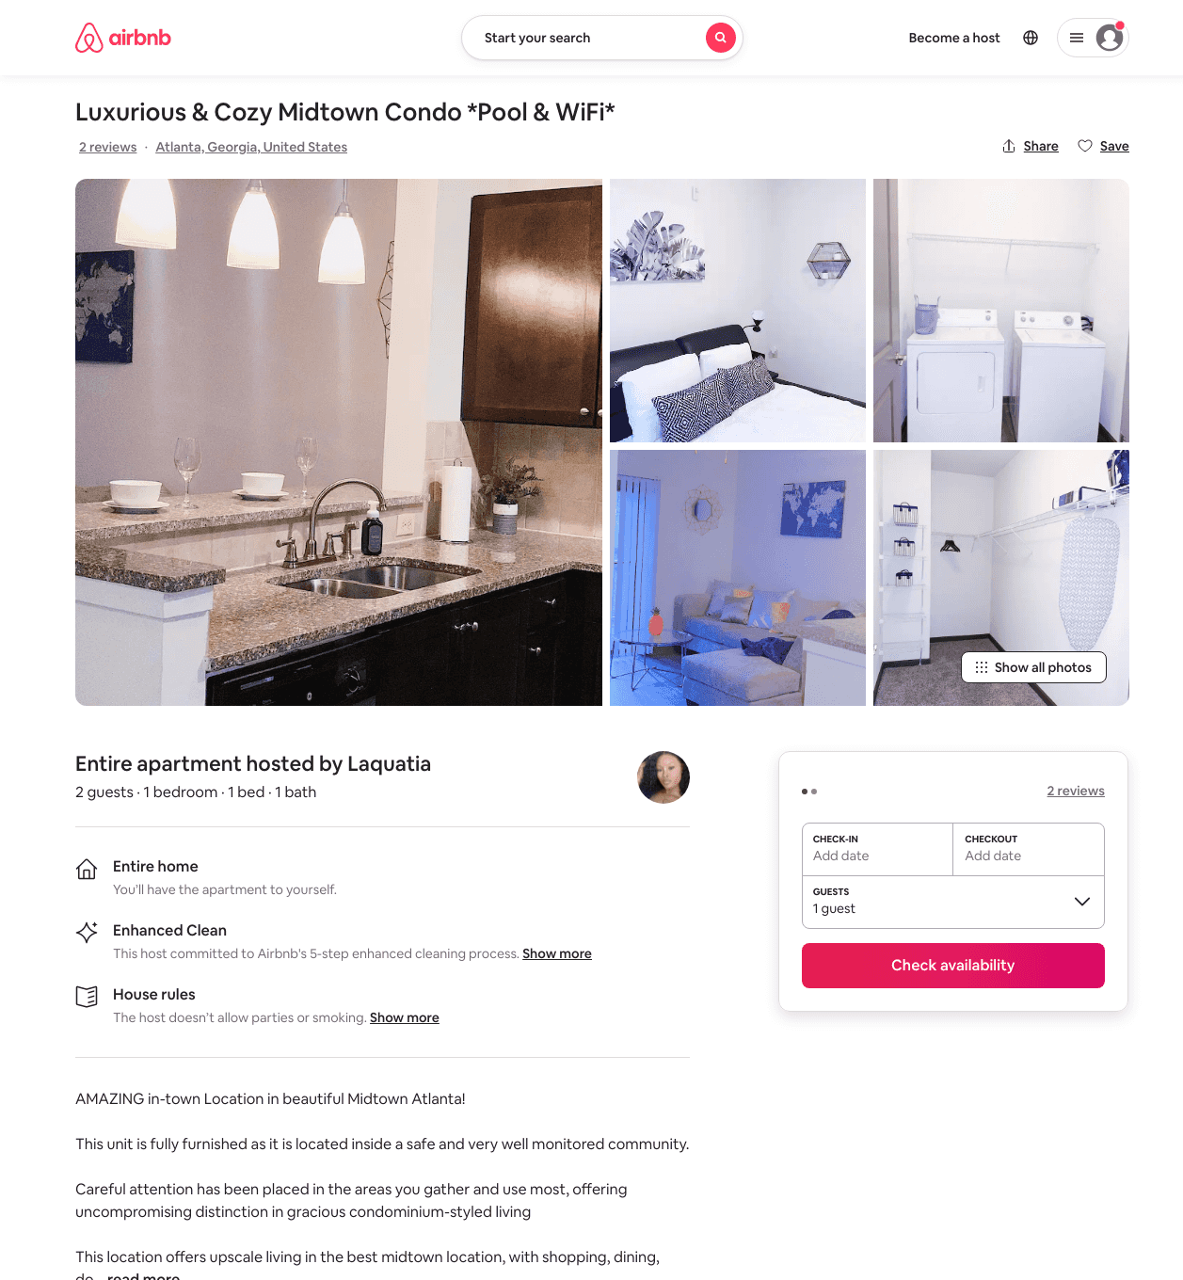
Listing 49423938
1
2
$86 - $150
4.94
2
Laquatia
275391333
2
https://www.airbnb.com/rooms/49423938
Aug 2022

Slide 19
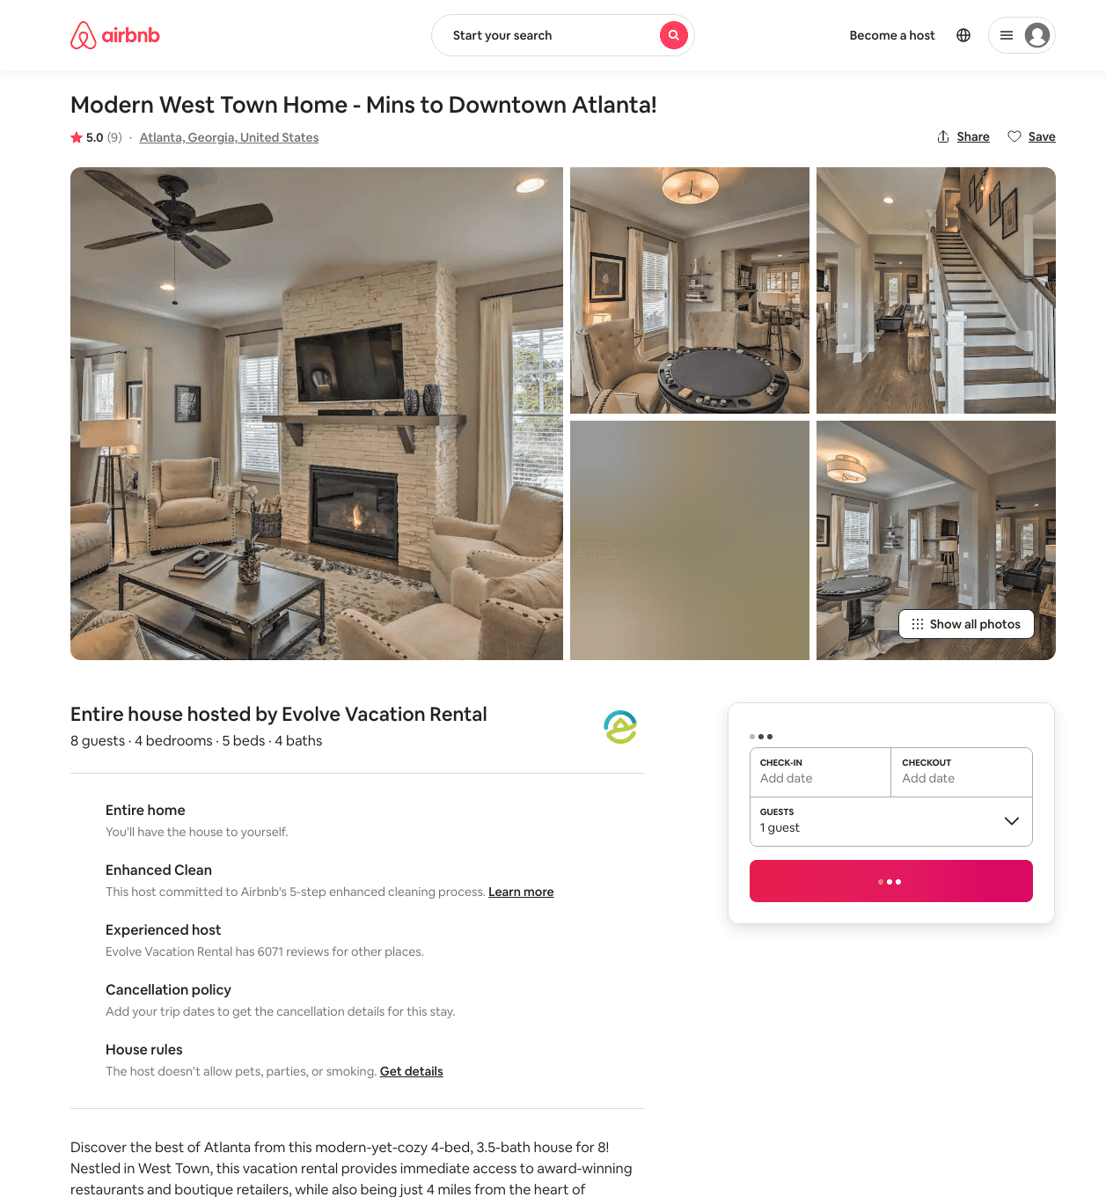
Listing 30821798
4
8
$454 - $554
5.0
3
Evolve
121682456
51
https://www.airbnb.com/rooms/30821798
Aug 2022

Slide 20
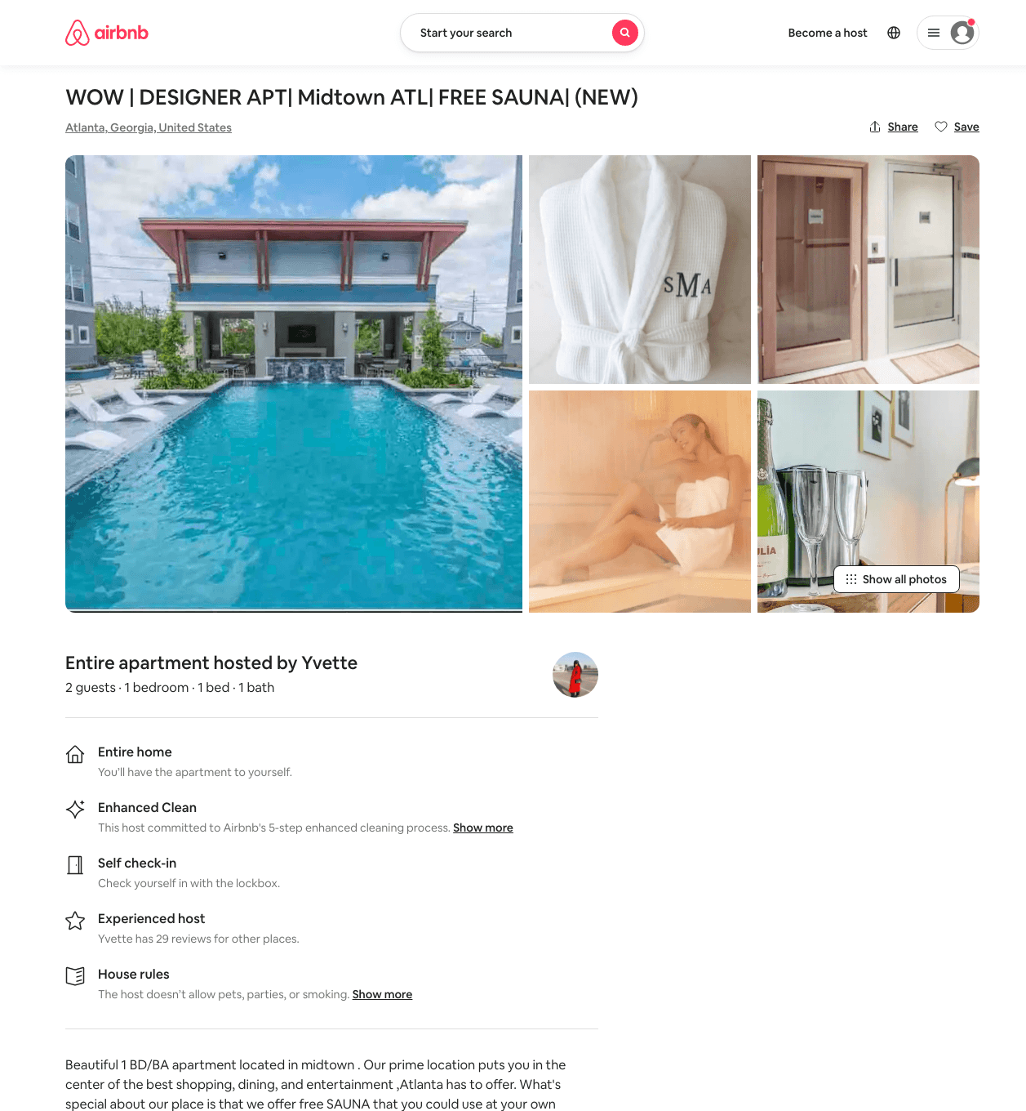
Listing 49924181
1
2
$70 - $144
4.87
2
Yvette
148180620
2
https://www.airbnb.com/rooms/49924181
Jun 2022

Slide 21
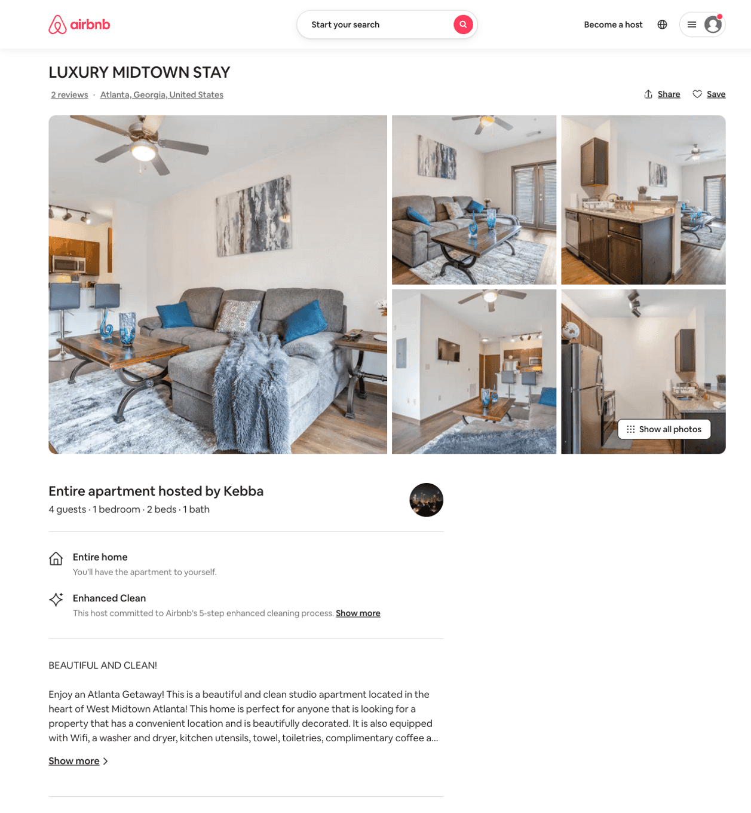
Listing 50268349
1
4
$91 - $108
4.80
2
Kebba
211351303
1
https://www.airbnb.com/rooms/50268349
Aug 2022

Slide 22
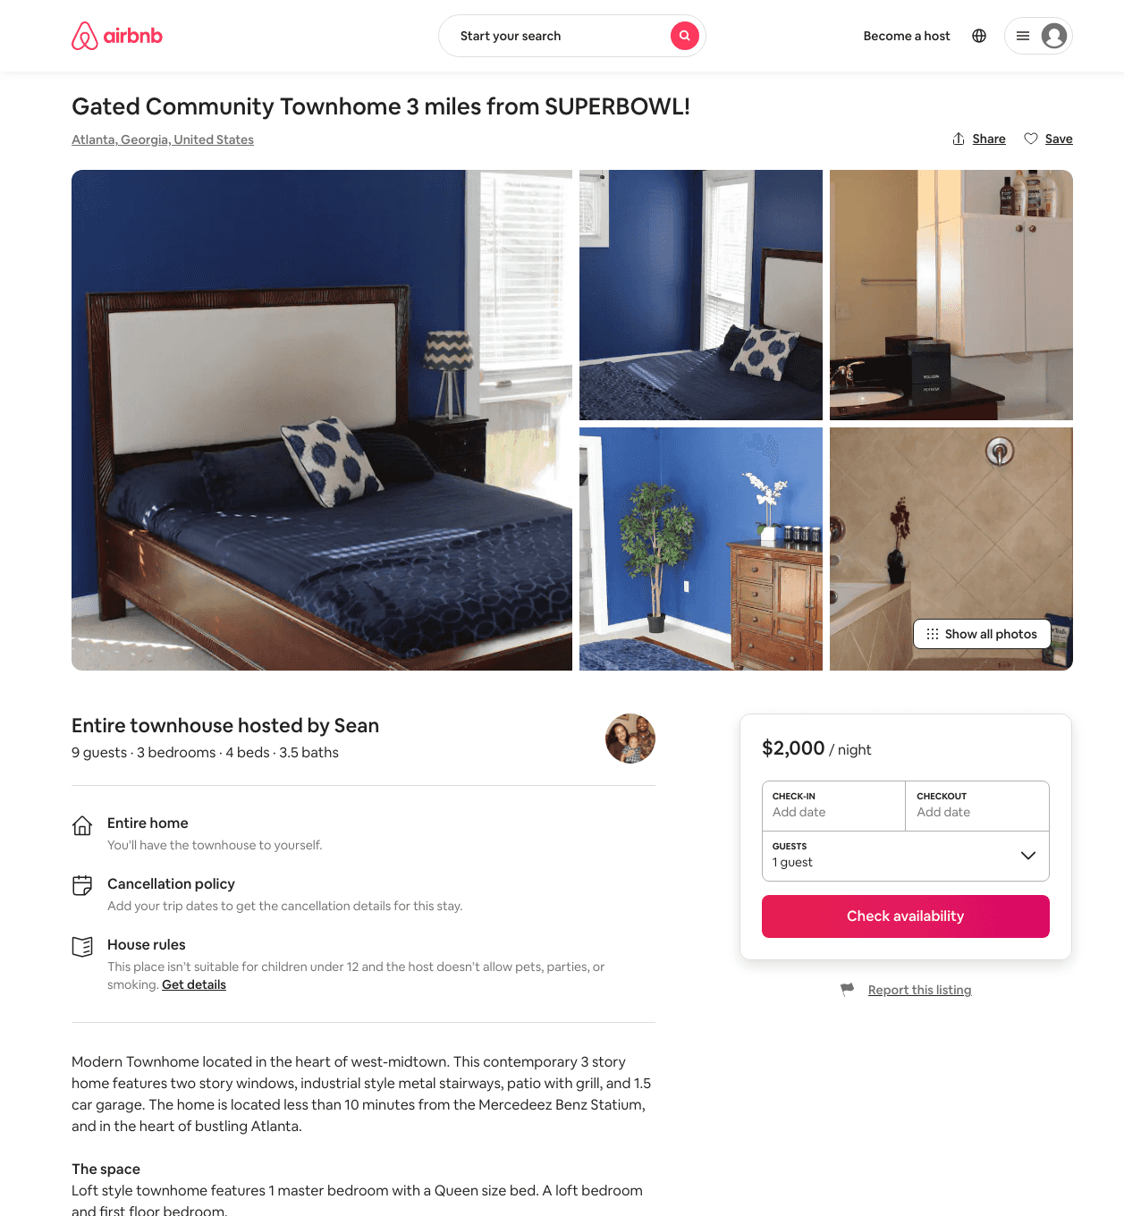
Listing 31494438
3
9
$2000
1
Sean
235963030
1
https://www.airbnb.com/rooms/31494438
Aug 2022

Slide 23
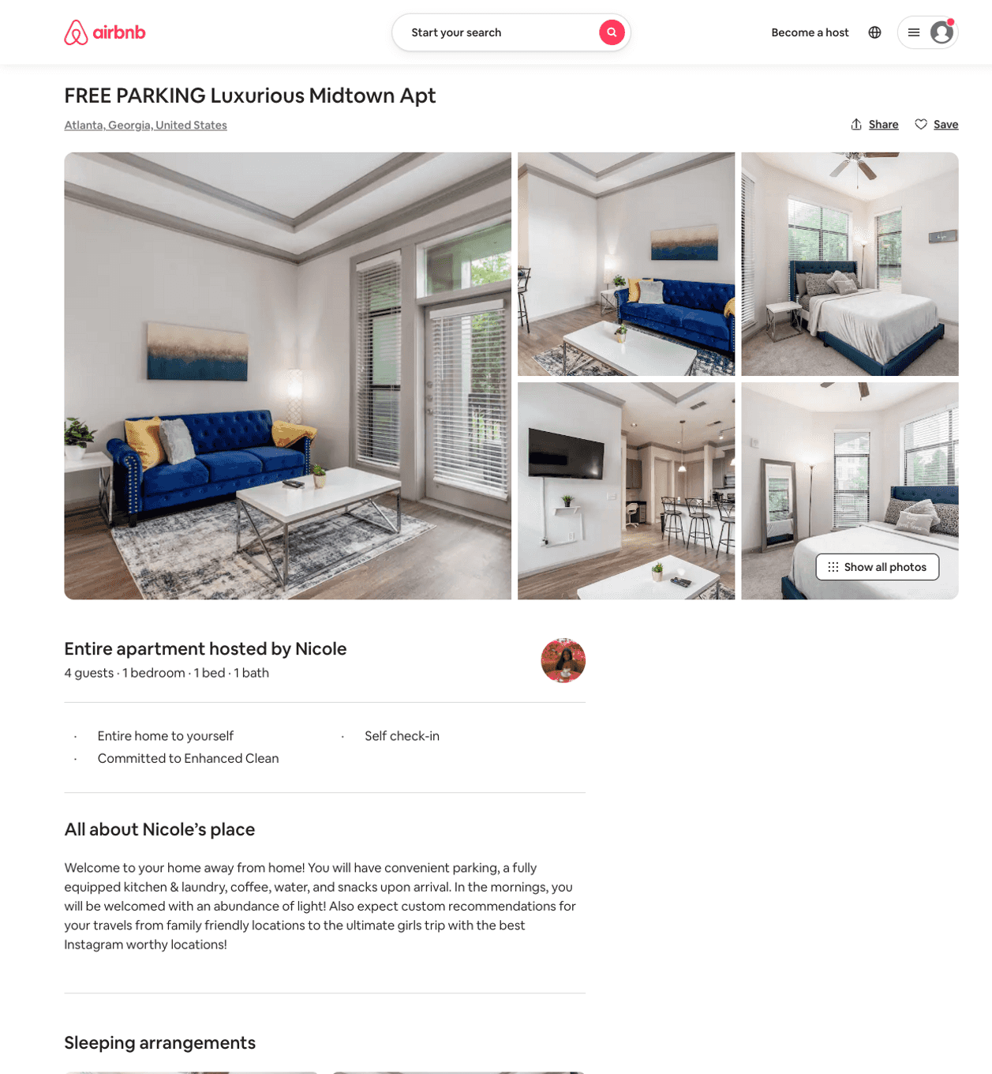
Listing 50399698
1
2
$73 - $133
4.80
2
Lux Rentals
111837440
1
https://www.airbnb.com/rooms/50399698
Jun 2022

Slide 24
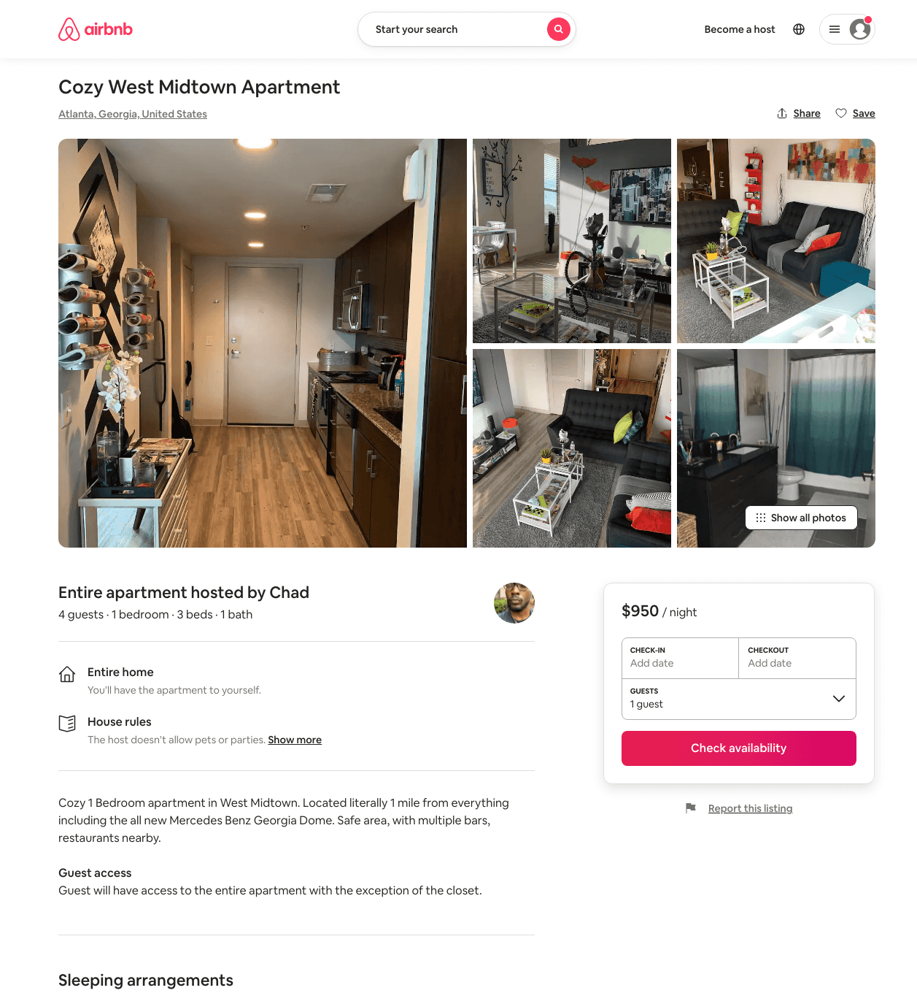
Listing 31873385
1
4
$950
3
Chad
236780233
2
https://www.airbnb.com/rooms/31873385
Aug 2022

Slide 25
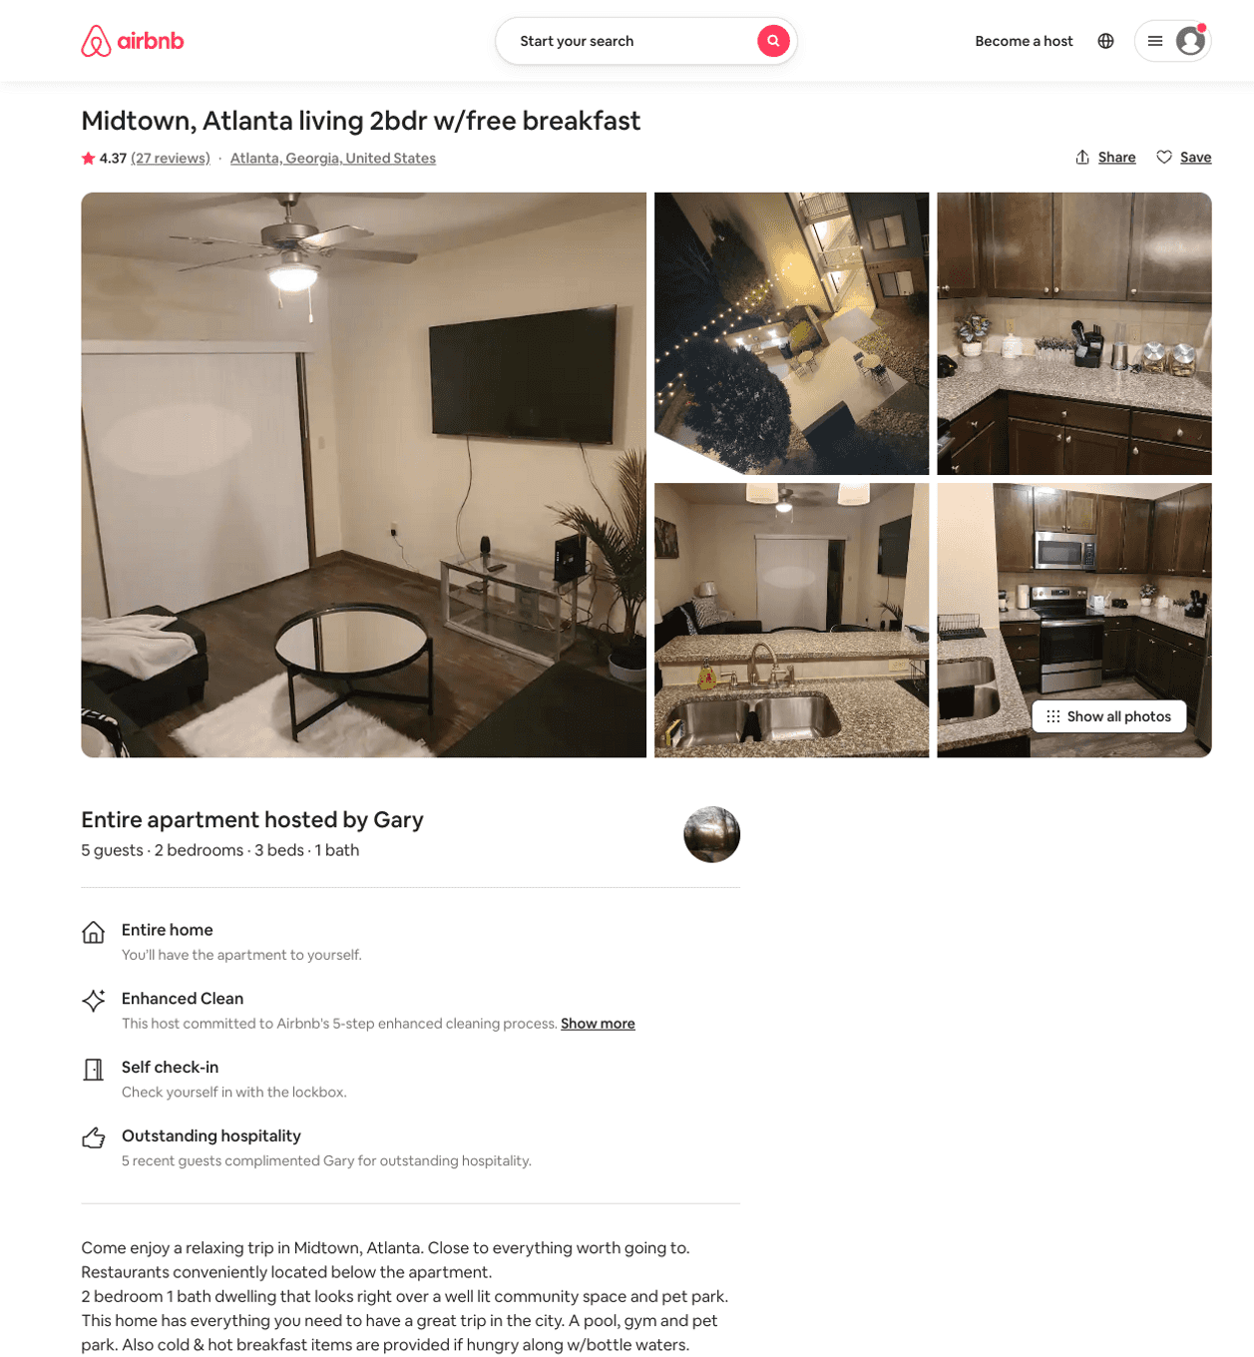
Listing 46284917
2
6
$94 - $146
4.50
1
Gary
374718246
1
https://www.airbnb.com/rooms/46284917
Aug 2022

Slide 26
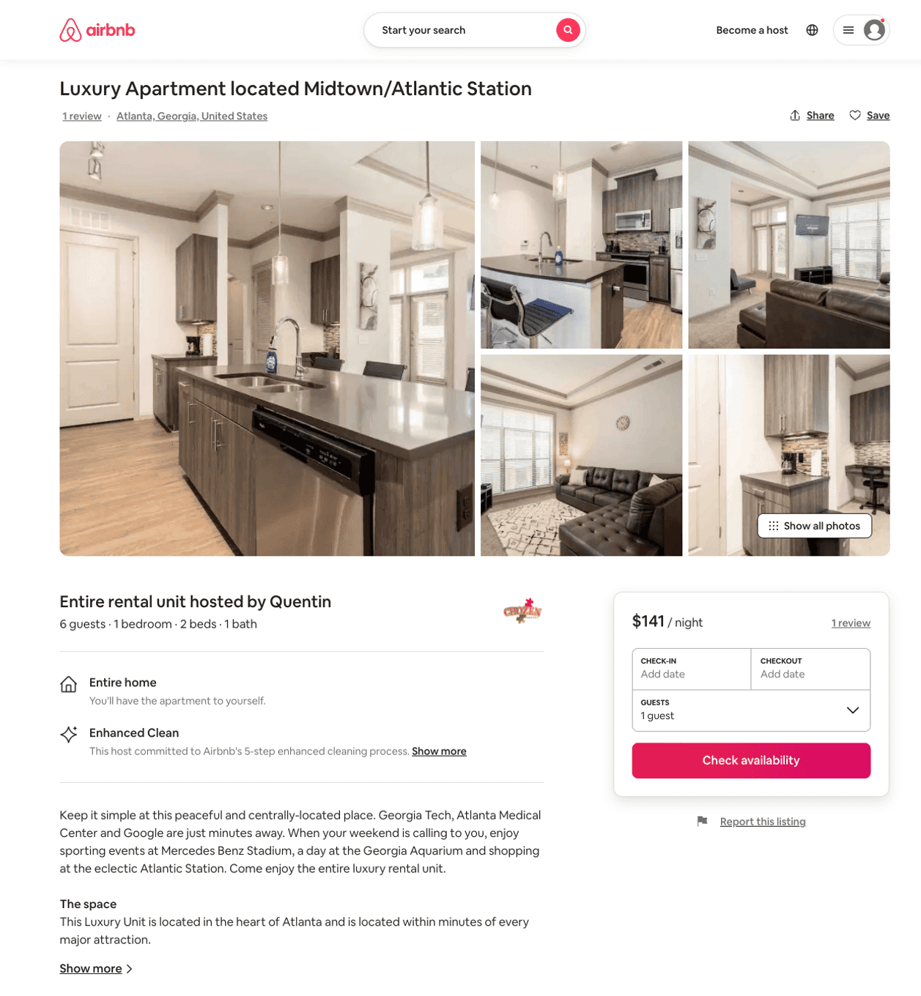
Listing 51449341
1
6
$114 - $170
4.62
2
Quentin
369532084
1
https://www.airbnb.com/rooms/51449341
Aug 2022

Slide 27
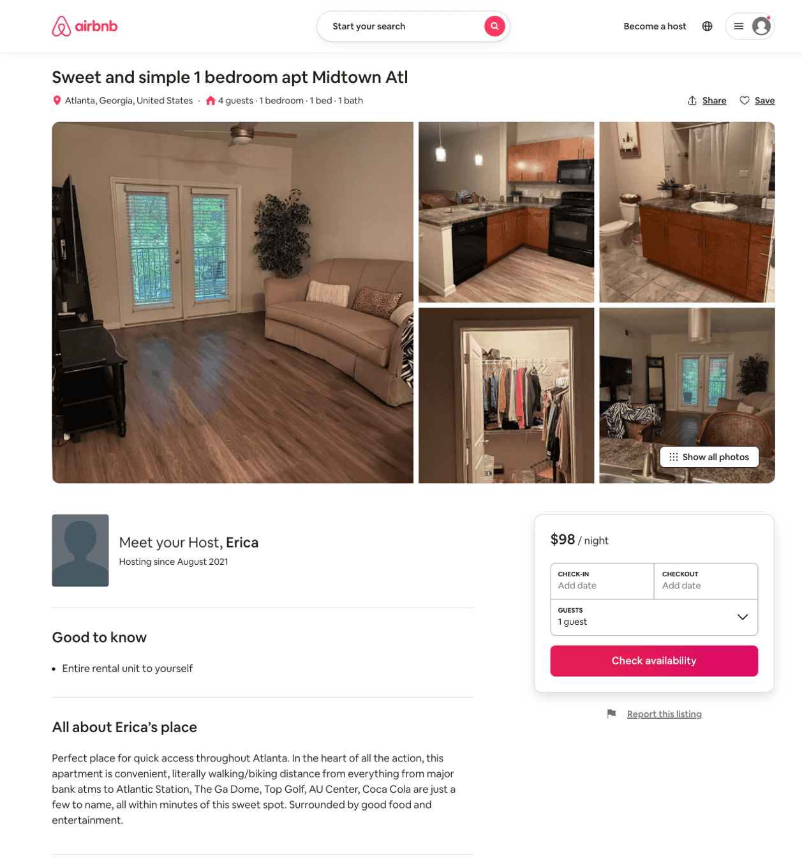
Listing 51755817
1
4
$98 - $293
5.0
3
Erica
419279963
1
https://www.airbnb.com/rooms/51755817
Aug 2022

Slide 28
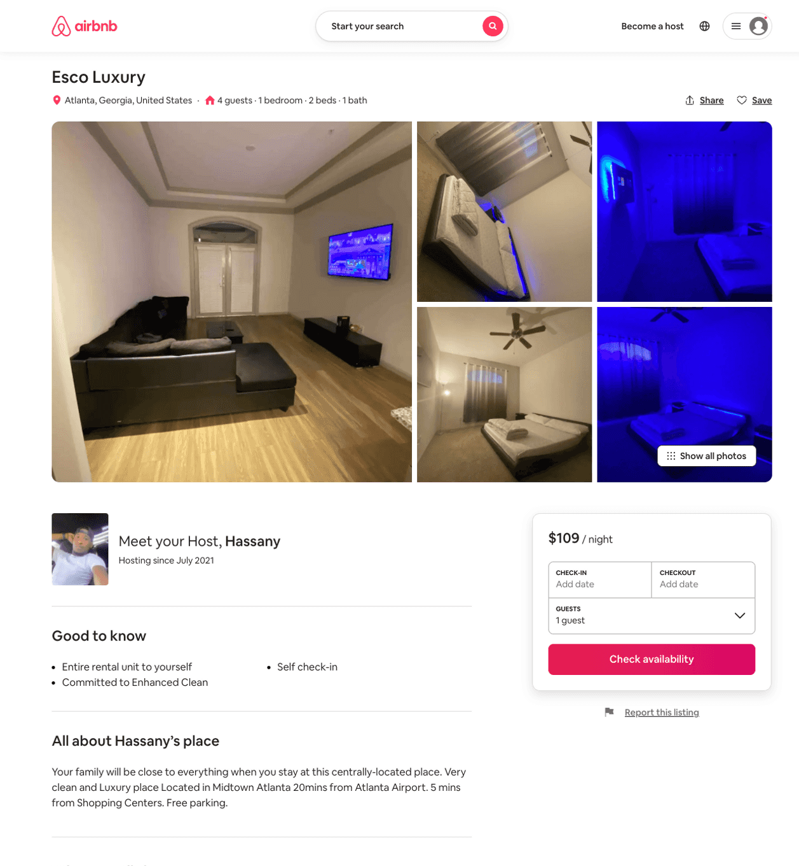
Listing 51655800
1
4
$100 - $160
5.0
1
Hassany
411815831
1
https://www.airbnb.com/rooms/51655800
Jun 2022

Slide 29
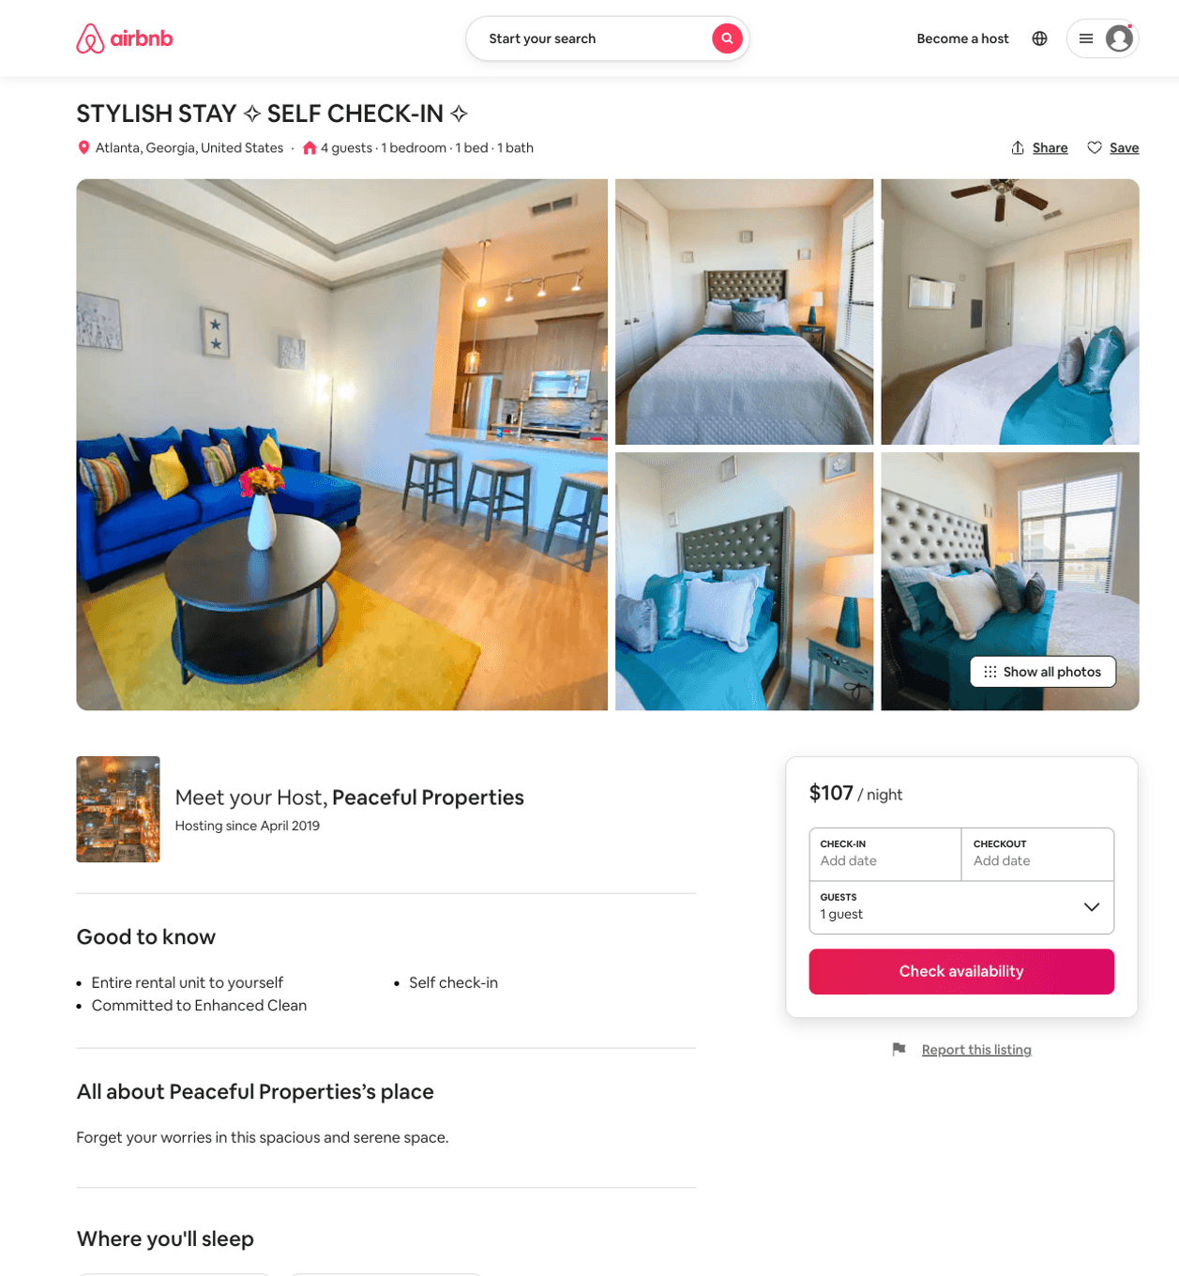
Listing 51641568
1
4
$110 - $143
5.0
2
Peaceful Properties
252906466
1
https://www.airbnb.com/rooms/51641568
Aug 2022

Slide 30
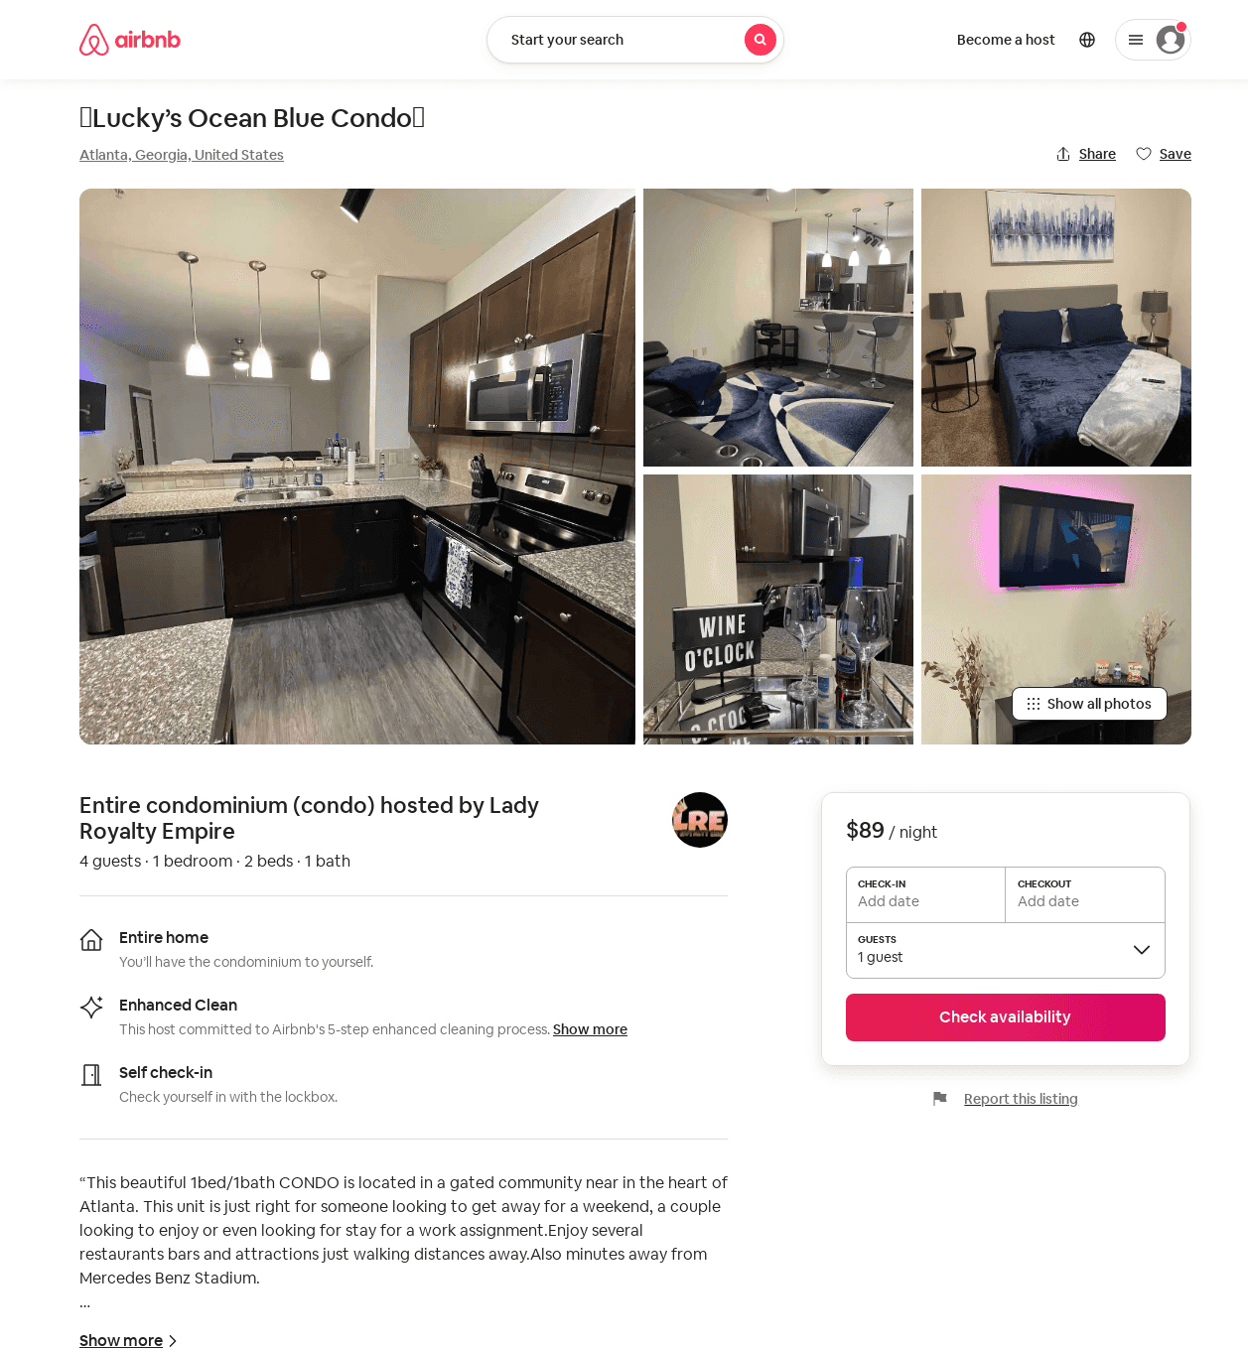
Listing 52174080
1
4
$83 - $130
2
Lady Royalty Empire
192073030
4
https://www.airbnb.com/rooms/52174080
Aug 2022

Slide 31
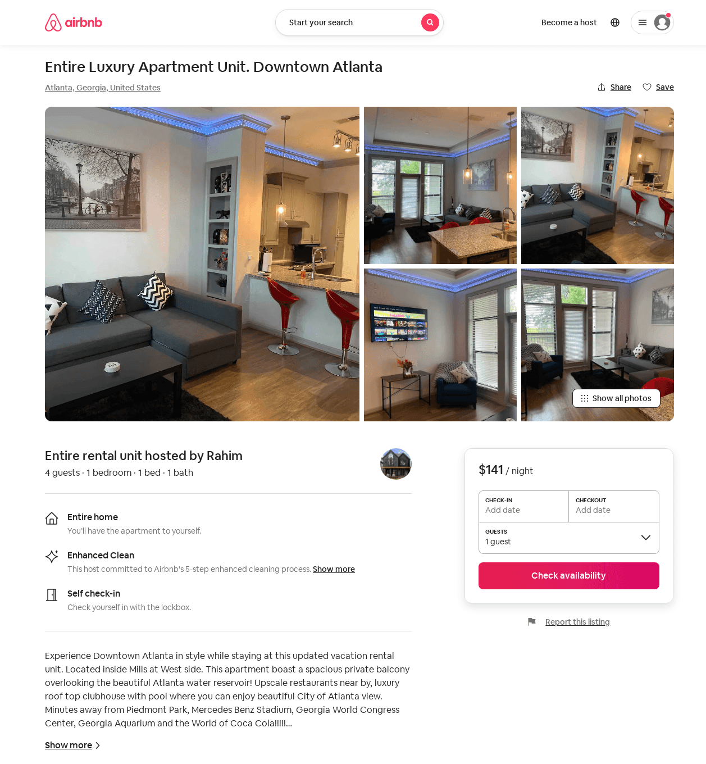
Listing 52054552
1
4
$128 - $168
4.67
2
Rahim
188736273
1
https://www.airbnb.com/rooms/52054552
Jul 2022

Slide 32
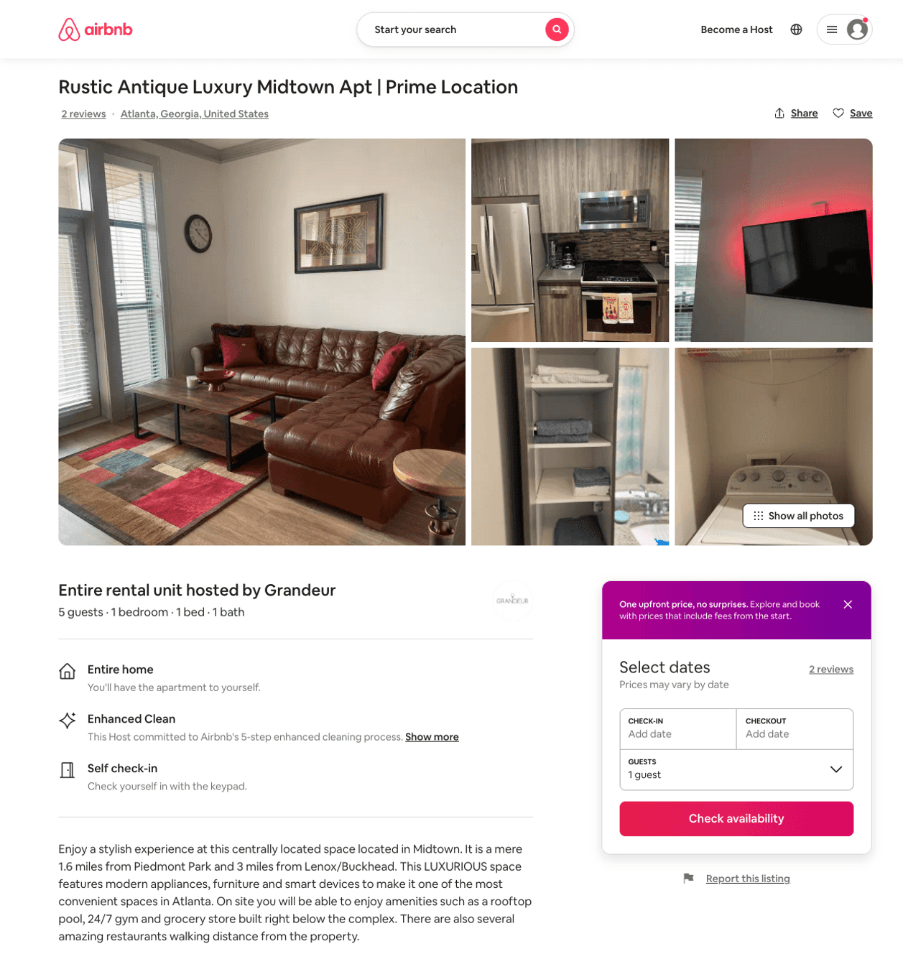
Listing 52278049
1
4
$85 - $152
4.44
1
Grandeur
77956307
2
https://www.airbnb.com/rooms/52278049
Jul 2022

Slide 33
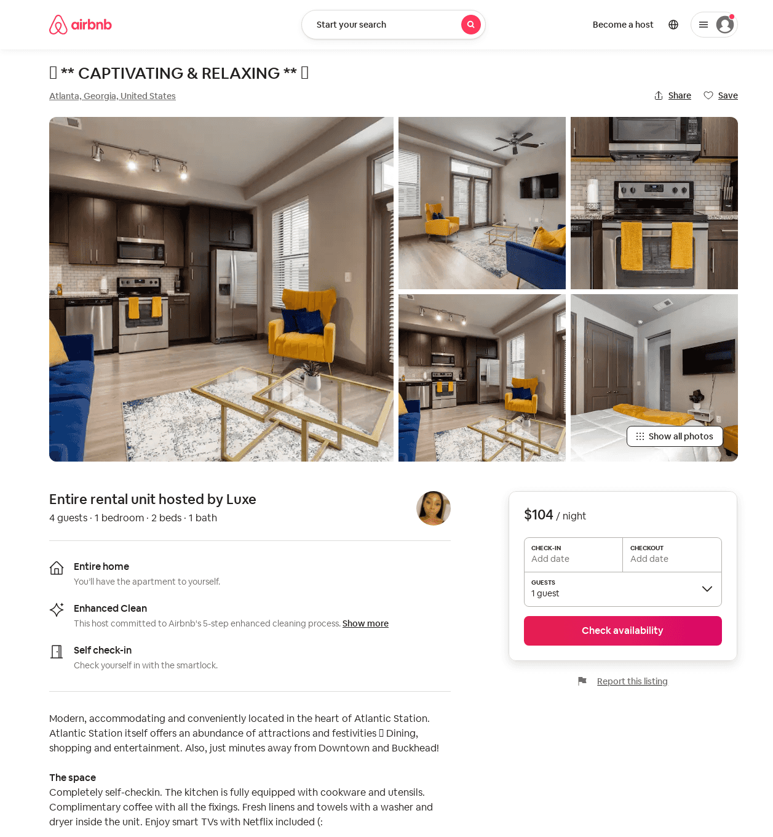
Listing 34503641
1
4
$87 - $109
4.76
1
Luxe
260416724
1
https://www.airbnb.com/rooms/34503641
Aug 2022

Slide 34
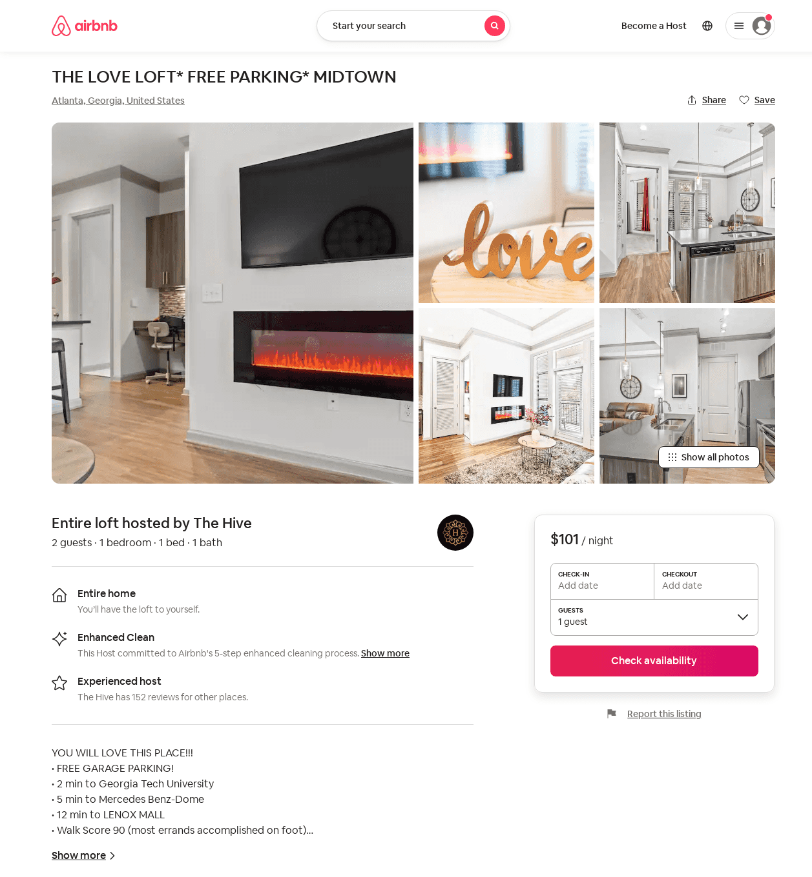
Listing 52882375
1
2
$95 - $150
4.73
1
The Hive
295549667
5
https://www.airbnb.com/rooms/52882375
Aug 2022

Slide 35
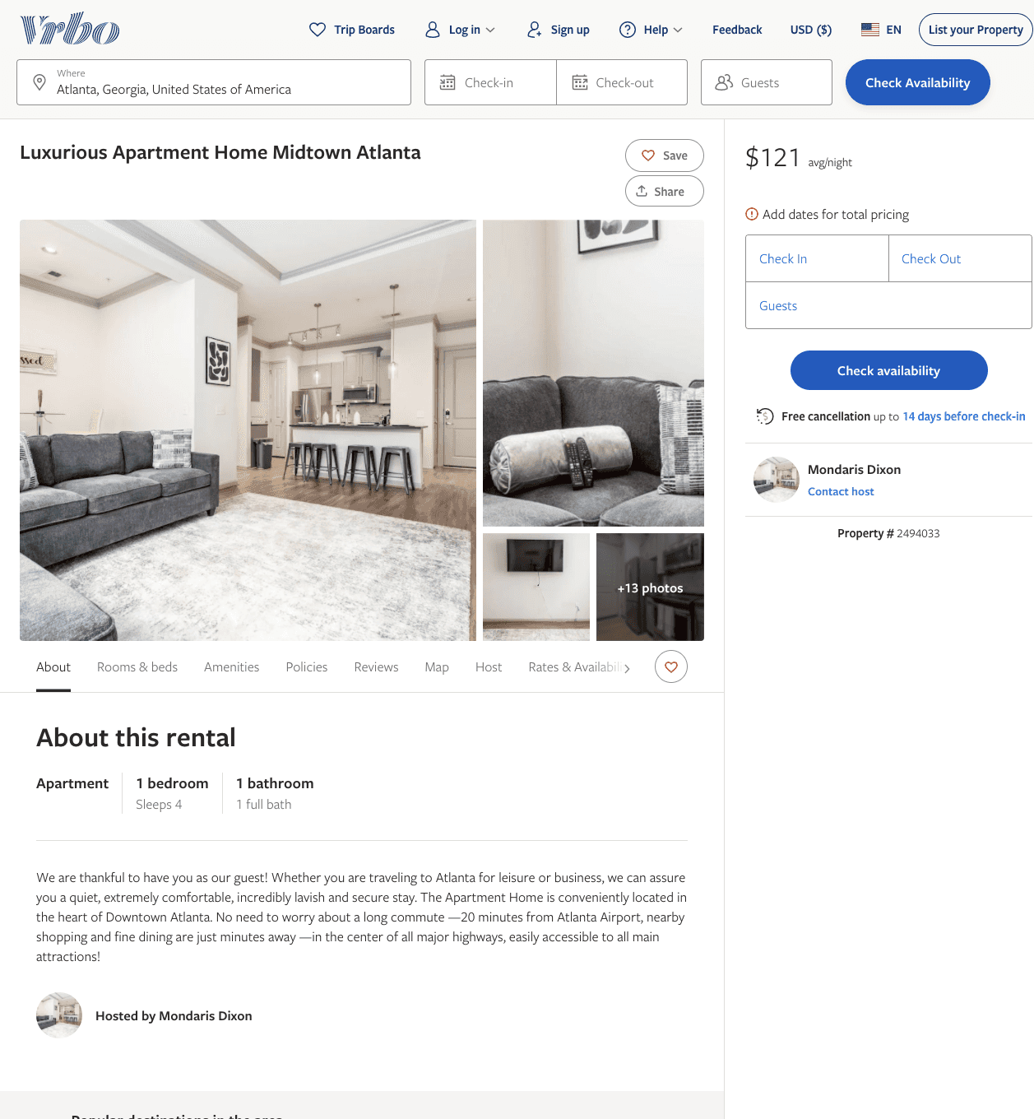
Listing 2494033
1
4
$121 - $210
2
Mondaris Dixon
https://www.vrbo.com/2494033
Aug 2022

Slide 36
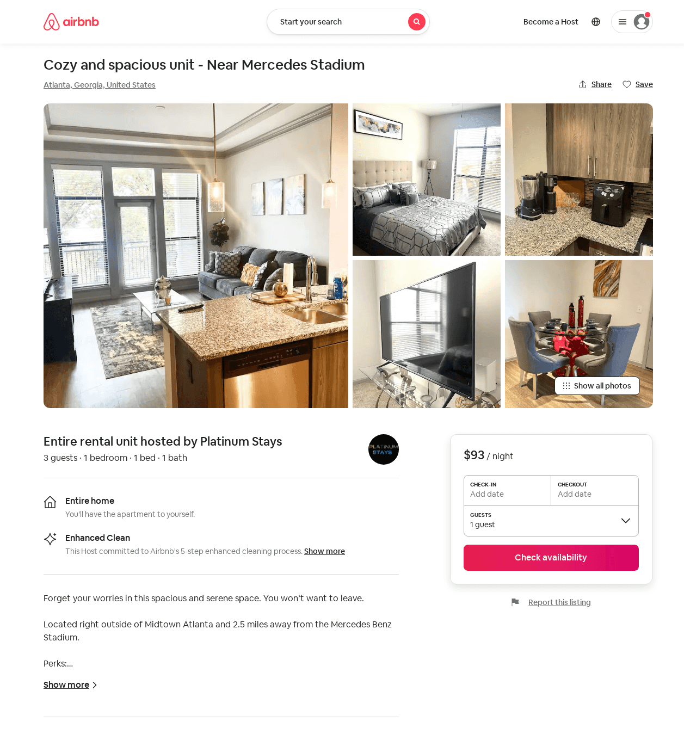
Listing 53187170
1
3
$85 - $121
4.96
1
Platinum Stays
387666327
1
https://www.airbnb.com/rooms/53187170
Aug 2022

Slide 37
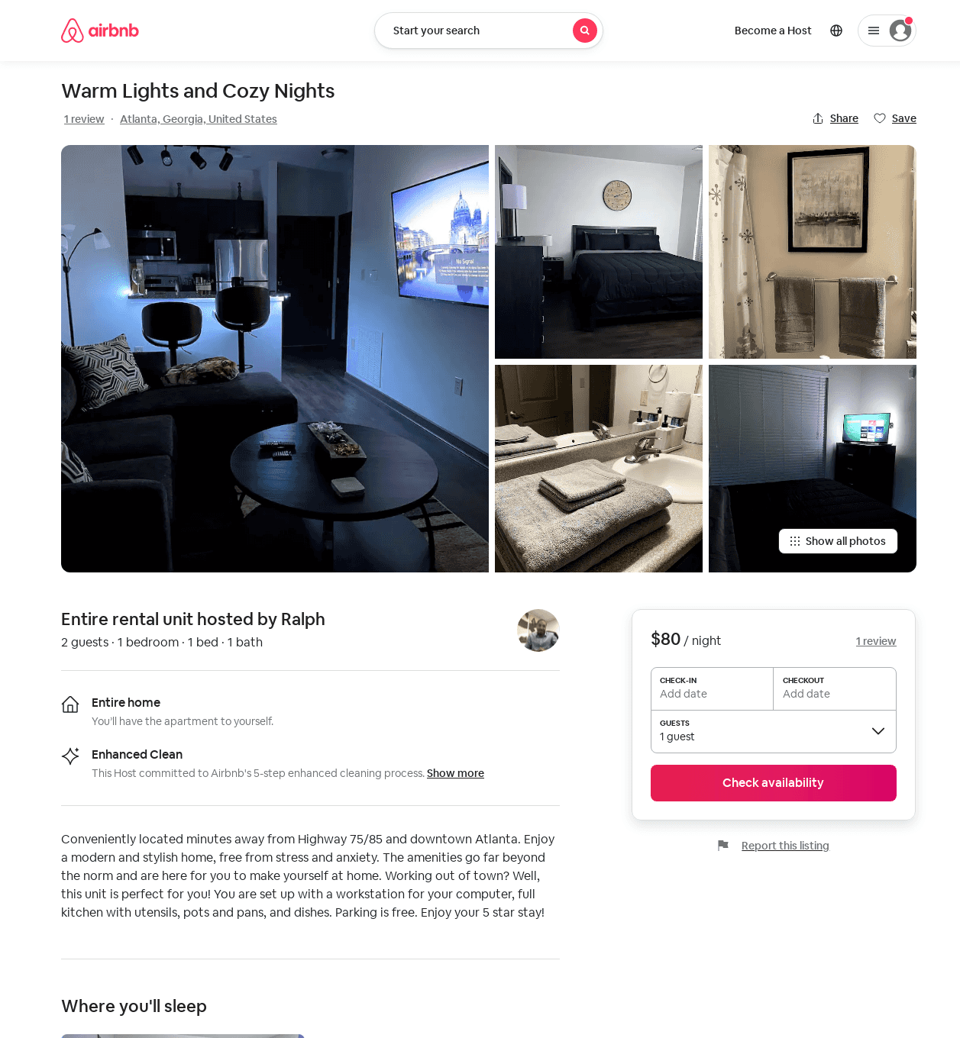
Listing 53242528
1
2
$75 - $90
4.96
2
Ralph
201696475
1
https://www.airbnb.com/rooms/53242528
Aug 2022

Slide 38
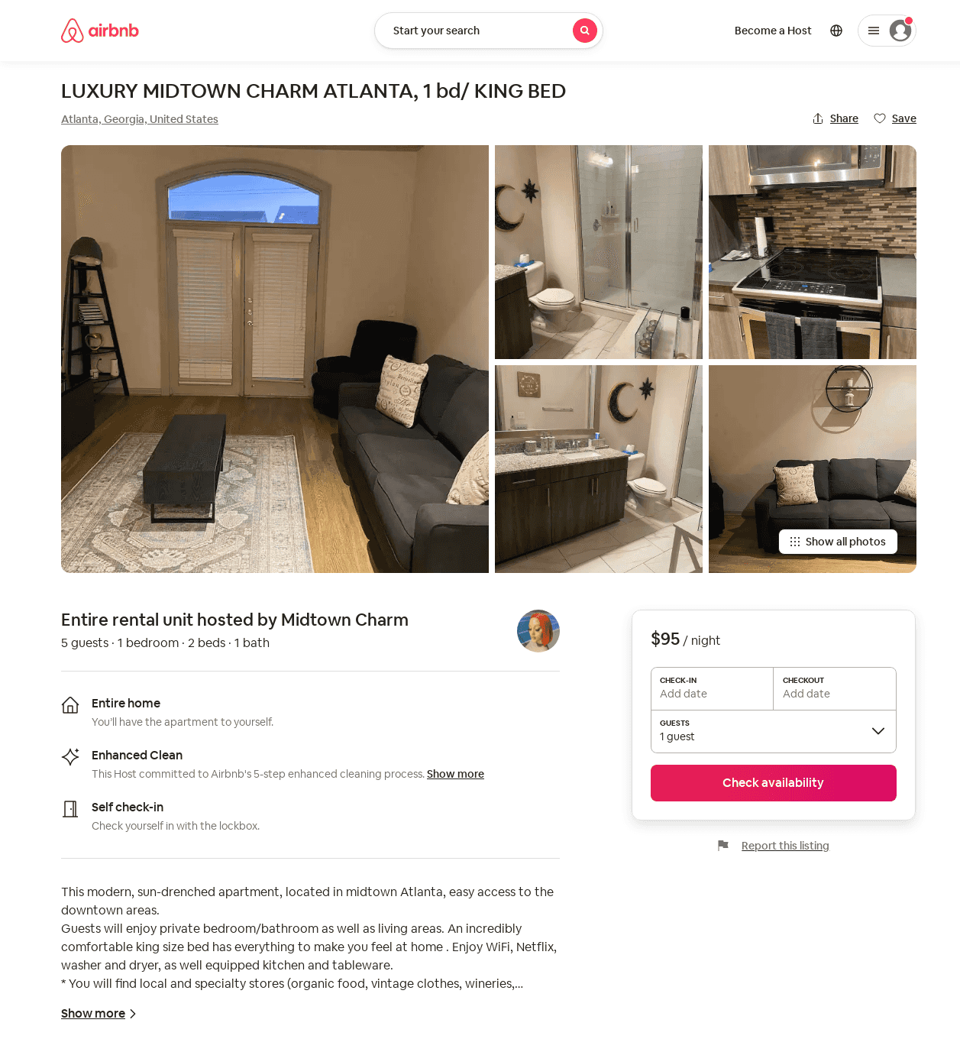
Listing 53069708
1
4
$87 - $127
4.08
2
Midtown ATL
73354540
1
https://www.airbnb.com/rooms/53069708
Aug 2022

Slide 39
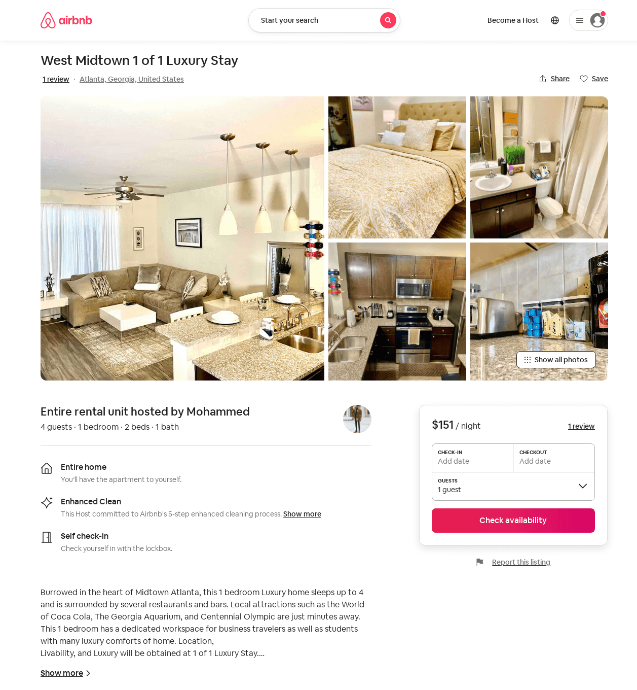
Listing 53715864
1
4
$121 - $171
4.83
1
Antwan
433333309
1
https://www.airbnb.com/rooms/53715864
Aug 2022

Slide 40
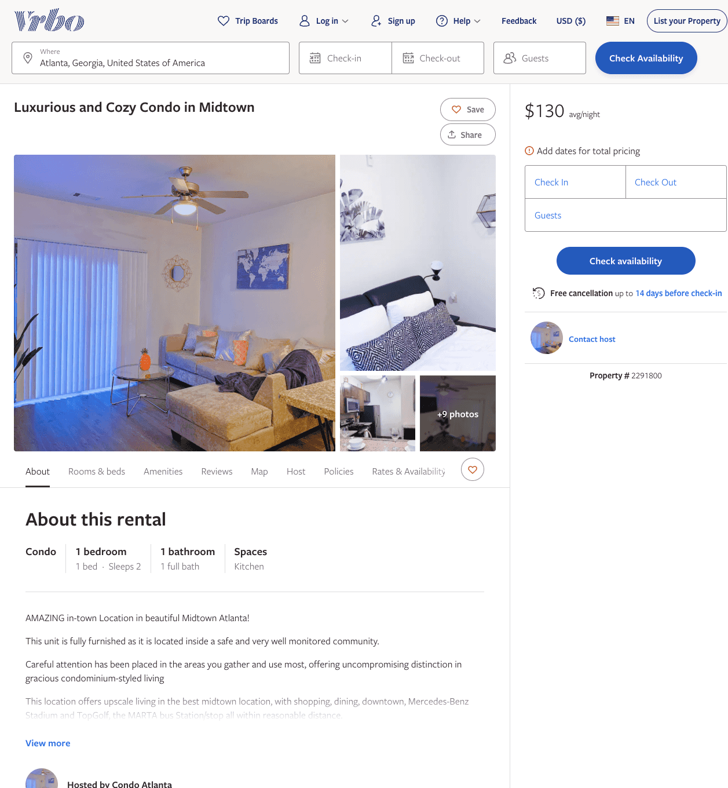
Listing 2291800
1
2
$130
1
https://www.vrbo.com/2291800
Aug 2022

Slide 41
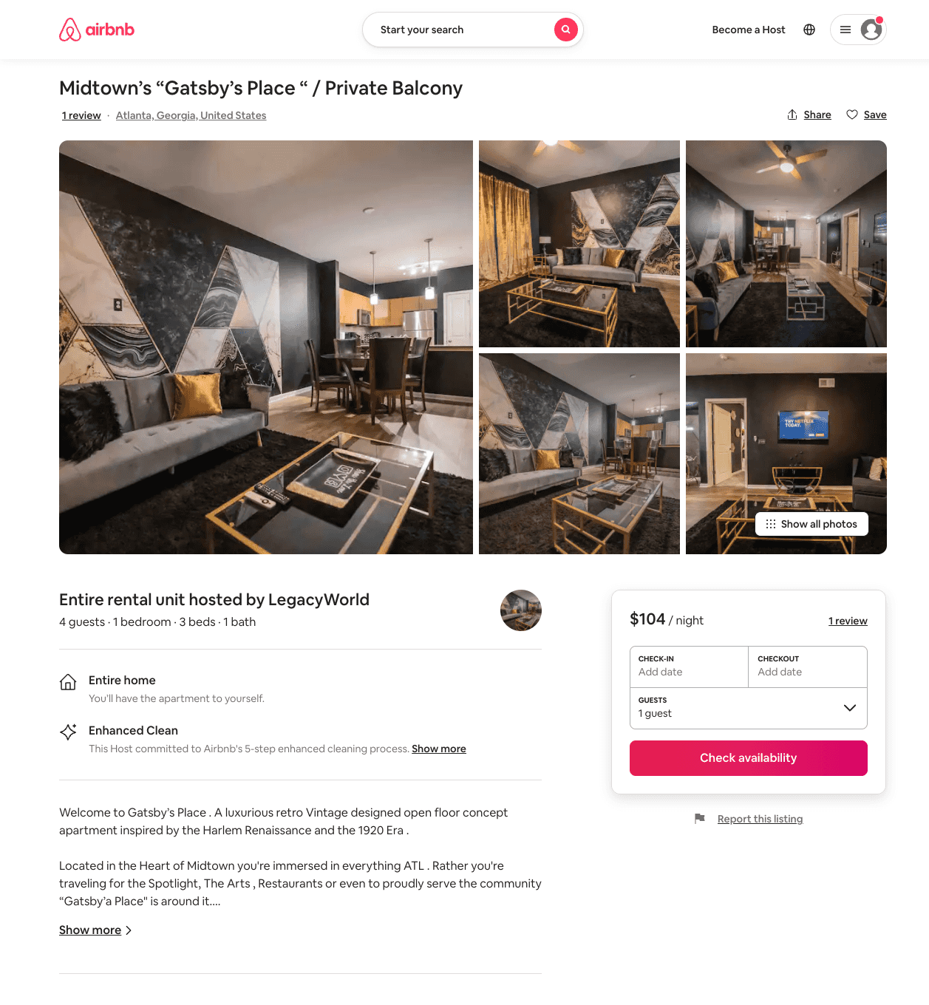
Listing 53980413
1
4
$102 - $155
4.75
1
LegacyWorld
437183462
1
https://www.airbnb.com/rooms/53980413
Aug 2022

Slide 42
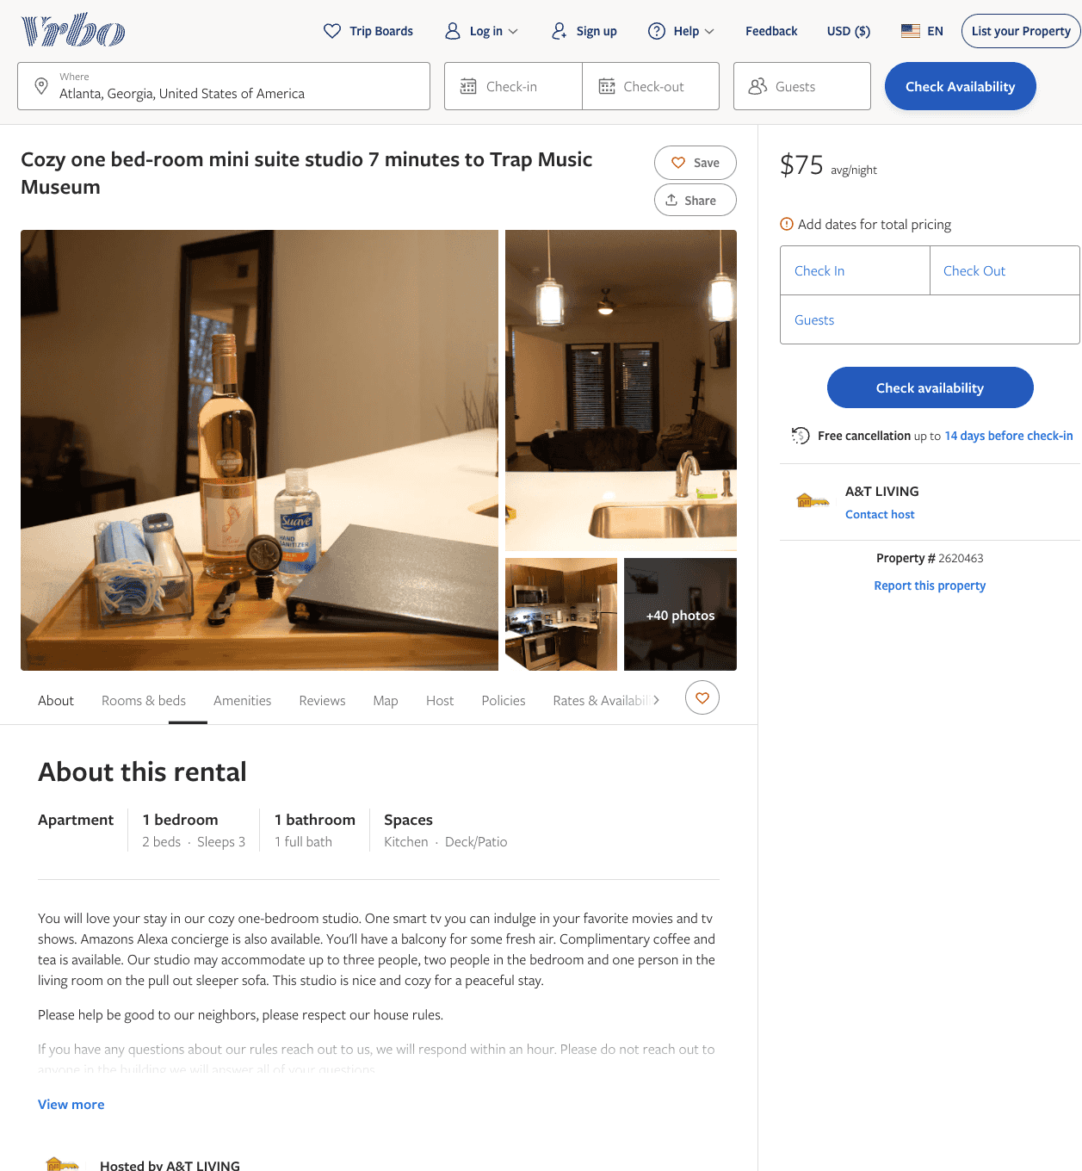
Listing 2620463
1
3
$95
5
1
A&T LIVING
https://www.vrbo.com/2620463
Aug 2022

Slide 43
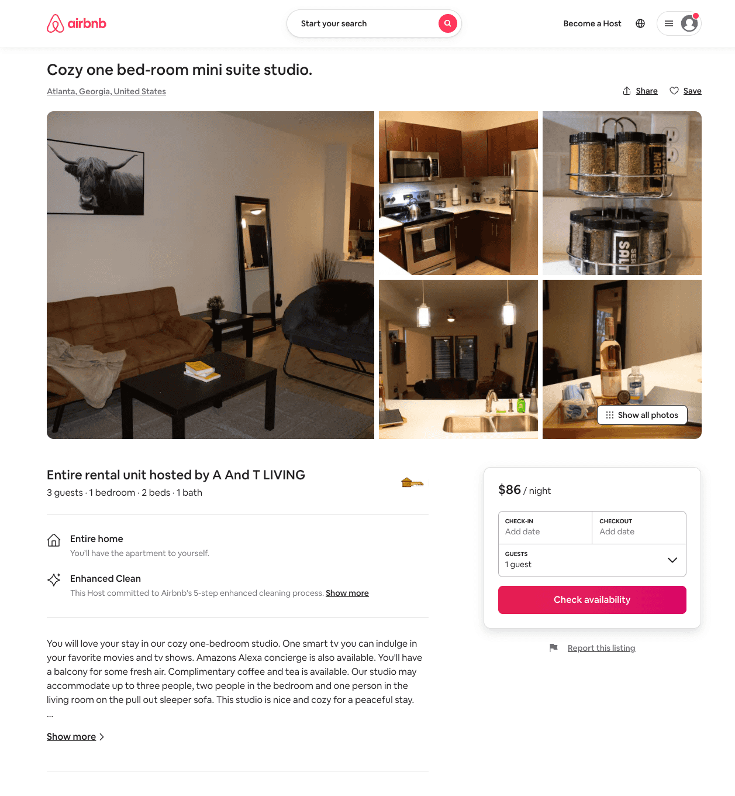
Listing 53909413
1
3
$67 - $95
4.87
1
A And T LIVING
436713016
1
https://www.airbnb.com/rooms/53909413
Aug 2022

Slide 44
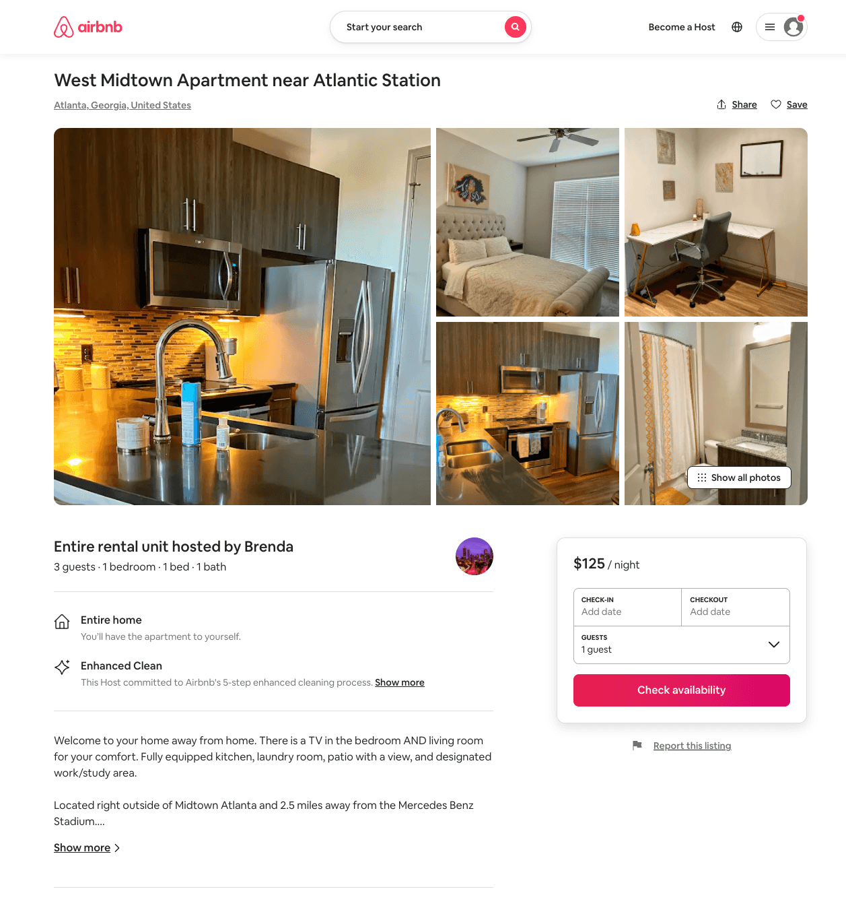
Listing 53605385
1
3
$125 - $145
4.90
1
Brenda
434103535
1
https://www.airbnb.com/rooms/53605385
Jul 2022

Slide 45
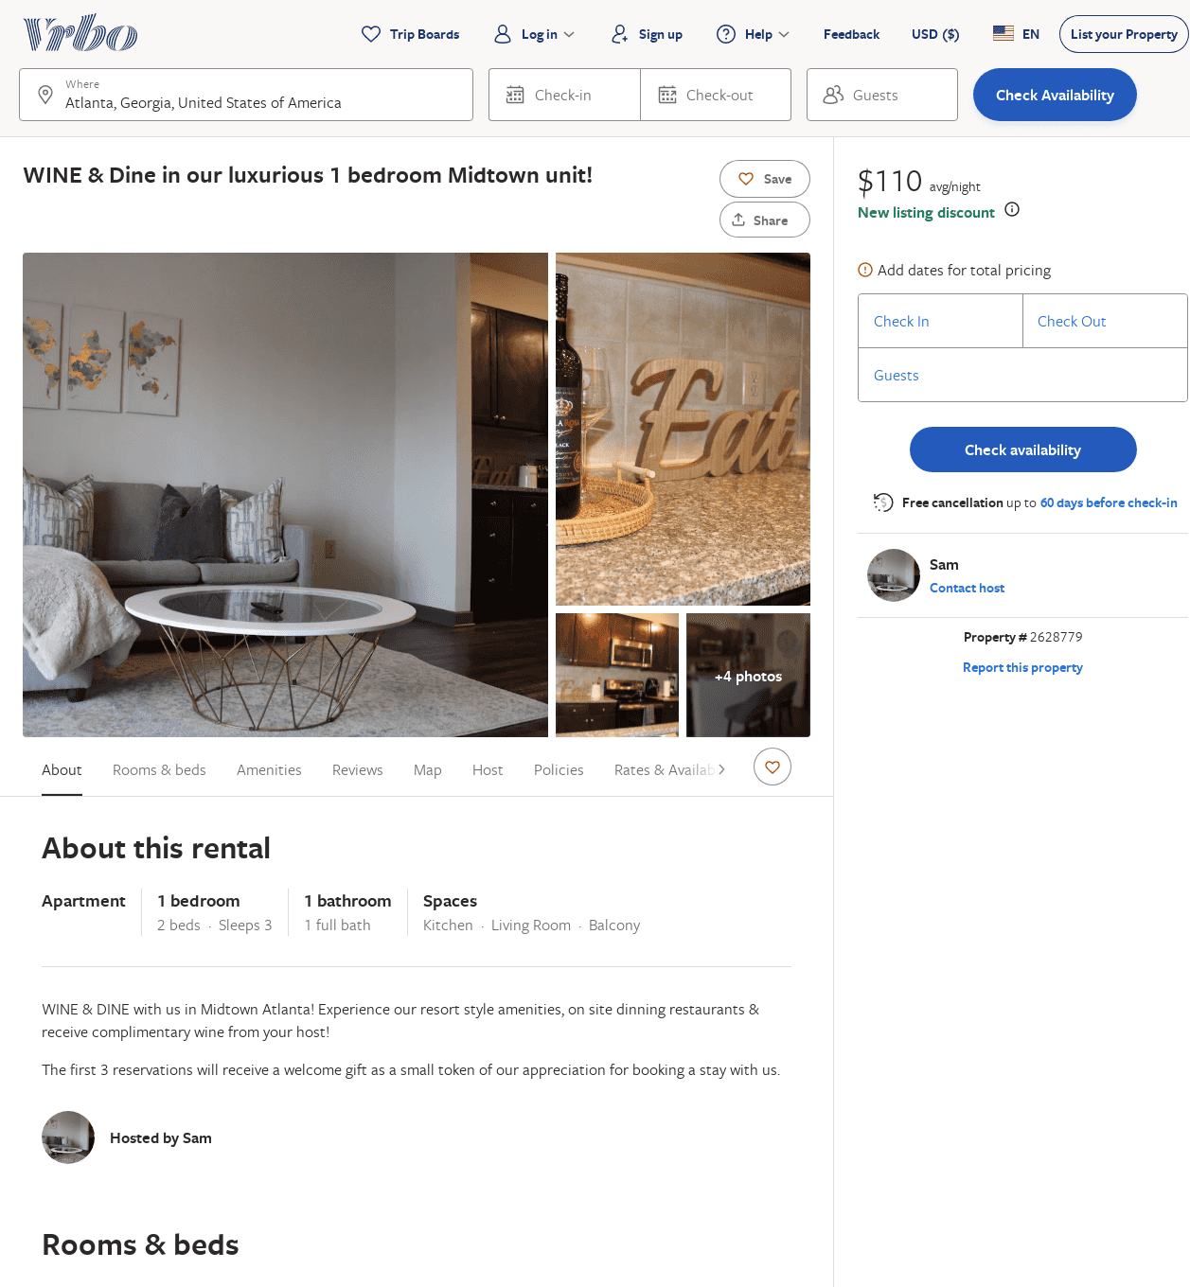
Listing 2628779
1
3
$110
2
Sam
https://www.vrbo.com/2628779
Aug 2022

Slide 46
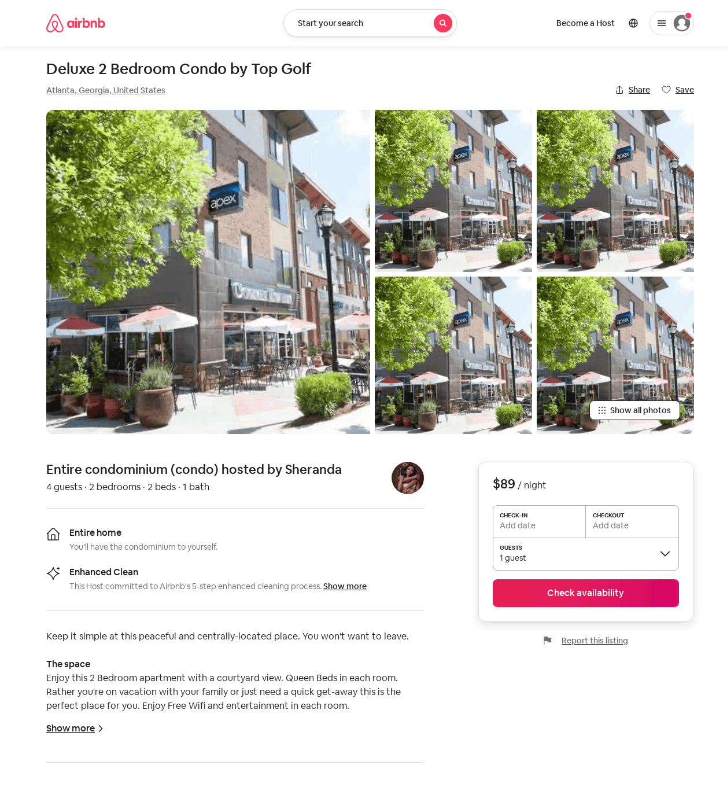
Listing 54350222
2
4
$89 - $163
4.46
2
Sheranda
430640335
1
https://www.airbnb.com/rooms/54350222
Aug 2022

Slide 47
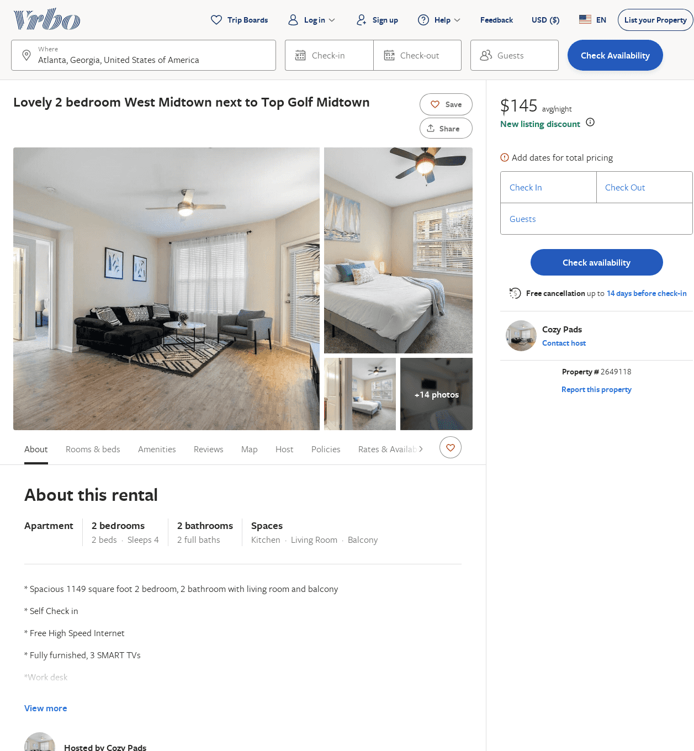
Listing 2649118
2
4
$173
2
Cozy Pads
https://www.vrbo.com/2649118
Aug 2022

Slide 48
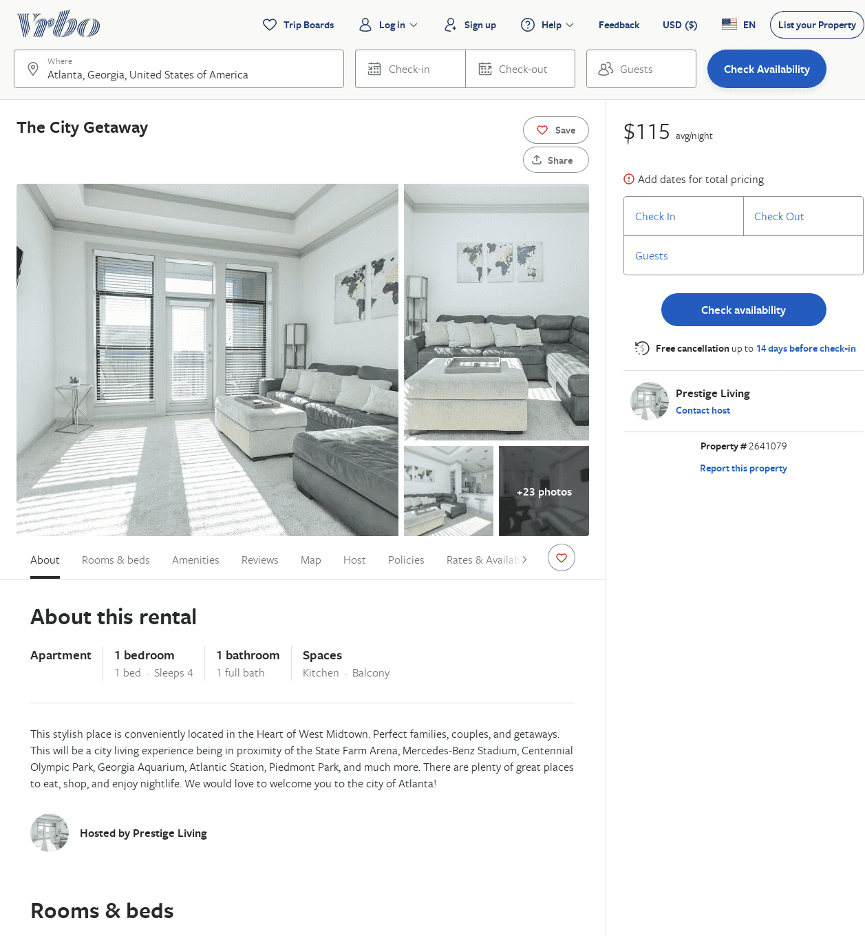
Listing 2641079
1
4
$118
2
Prestige Living
https://www.vrbo.com/2641079
Aug 2022

Slide 49
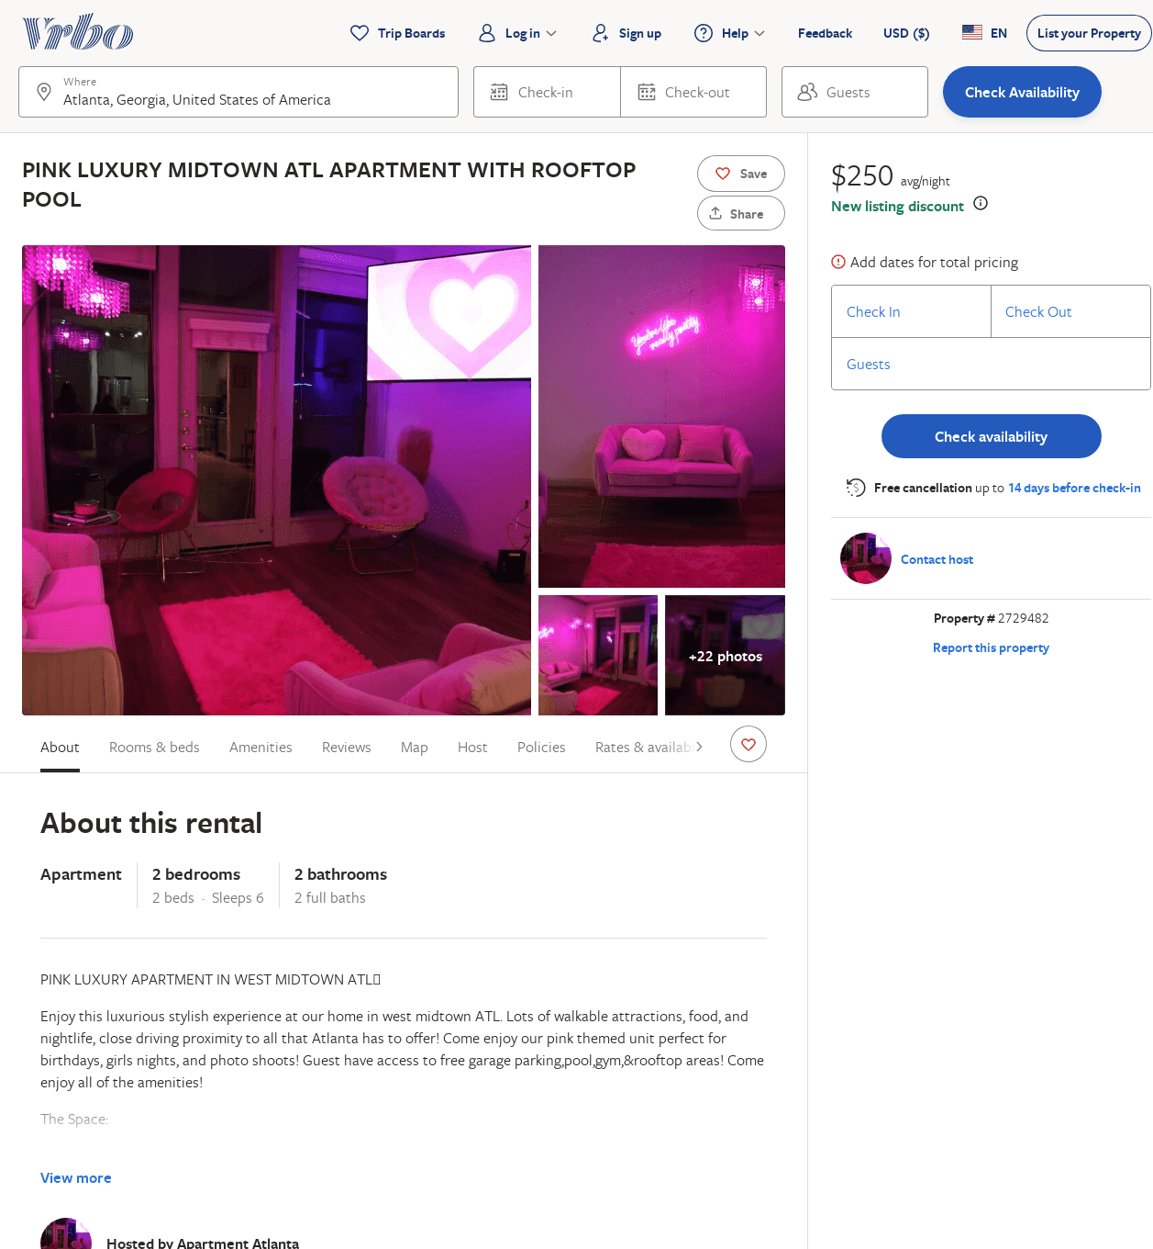
Listing 2729482
2
6
$250
2
https://www.vrbo.com/2729482
Aug 2022

Slide 50
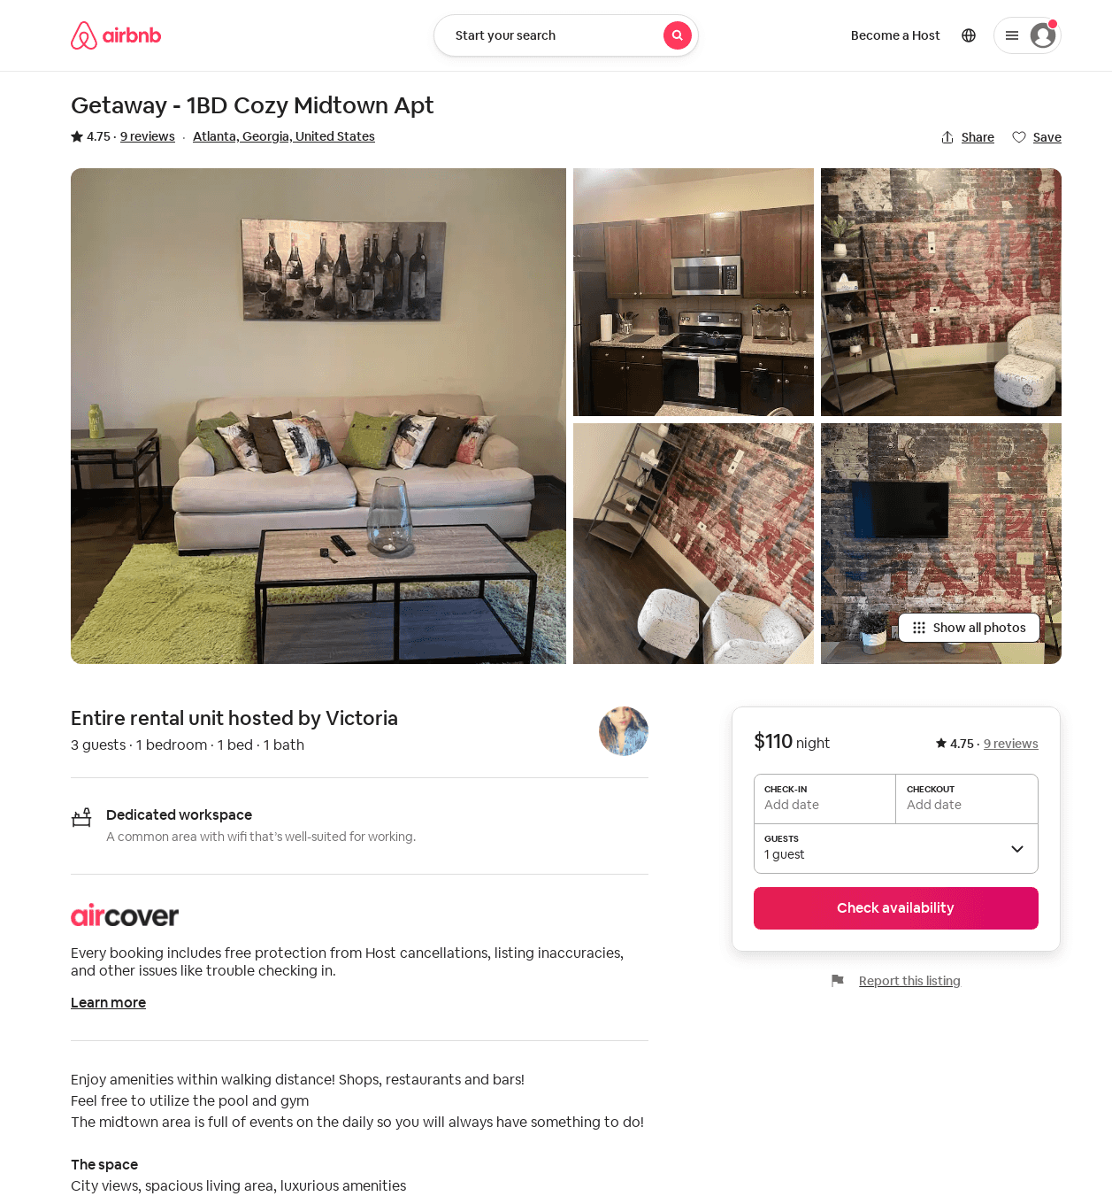
Listing 26166824
1
3
$110
4.75
2
Victoria
112431108
1
https://www.airbnb.com/rooms/26166824
Jun 2022

Slide 51
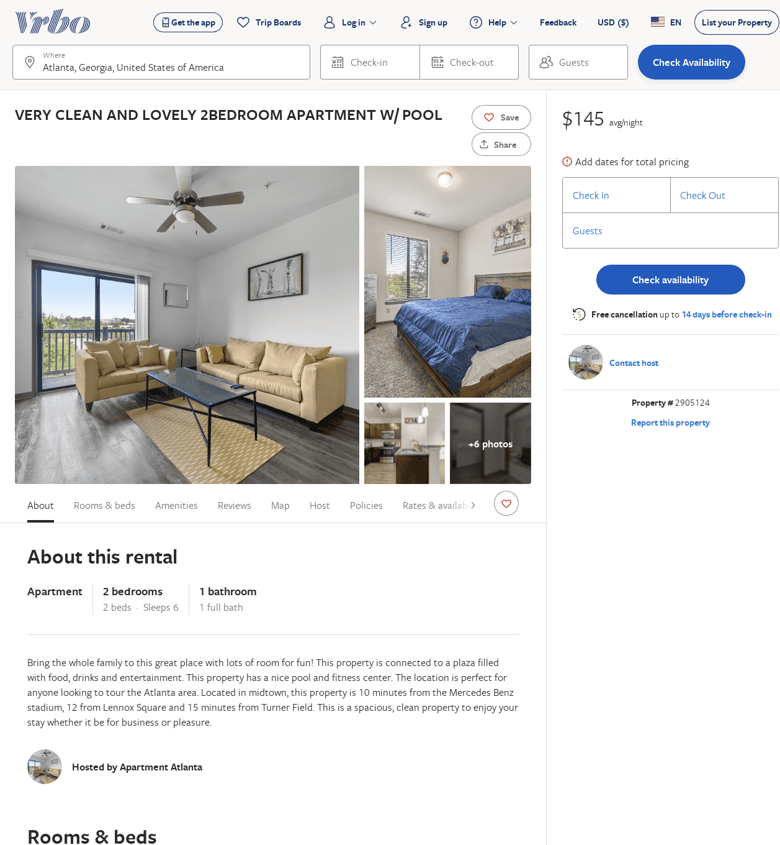
Listing 2905124
2
6
$145
2
https://www.vrbo.com/2905124
Aug 2022

Slide 52
Listing 2388692
1
2
$125
2
Mister Overstreet
https://www.vrbo.com/2388692
Aug 2022

Slide 53
Listing 2962086
3
5
$326
4
Minty Living
https://www.vrbo.com/2962086
Aug 2022

