Slide 2
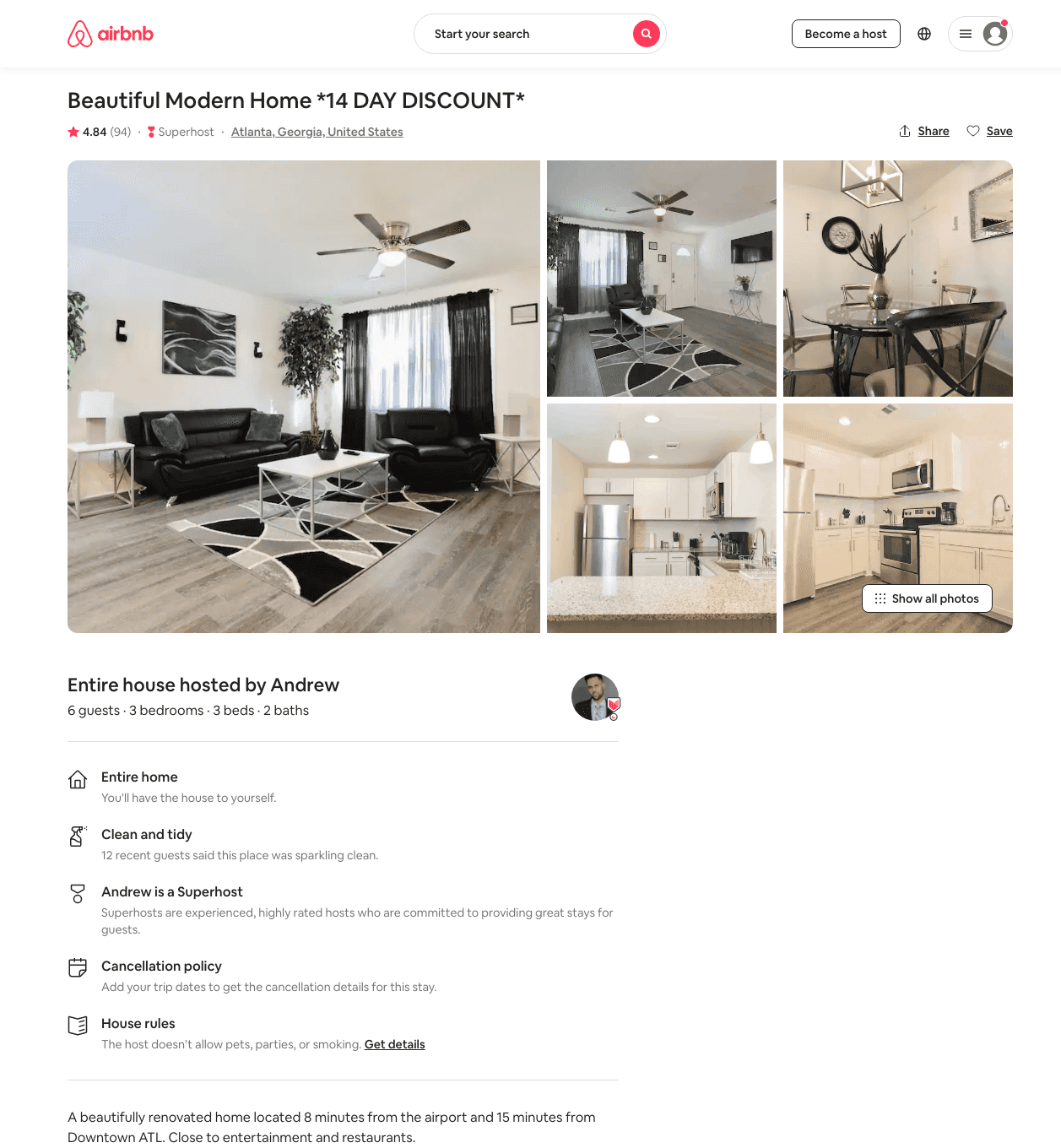
Listing 40869691
3
6
$82 - $139
4.61
1
Andrew
228013133
8
https://www.airbnb.com/rooms/40869691
Aug 2022

Slide 3
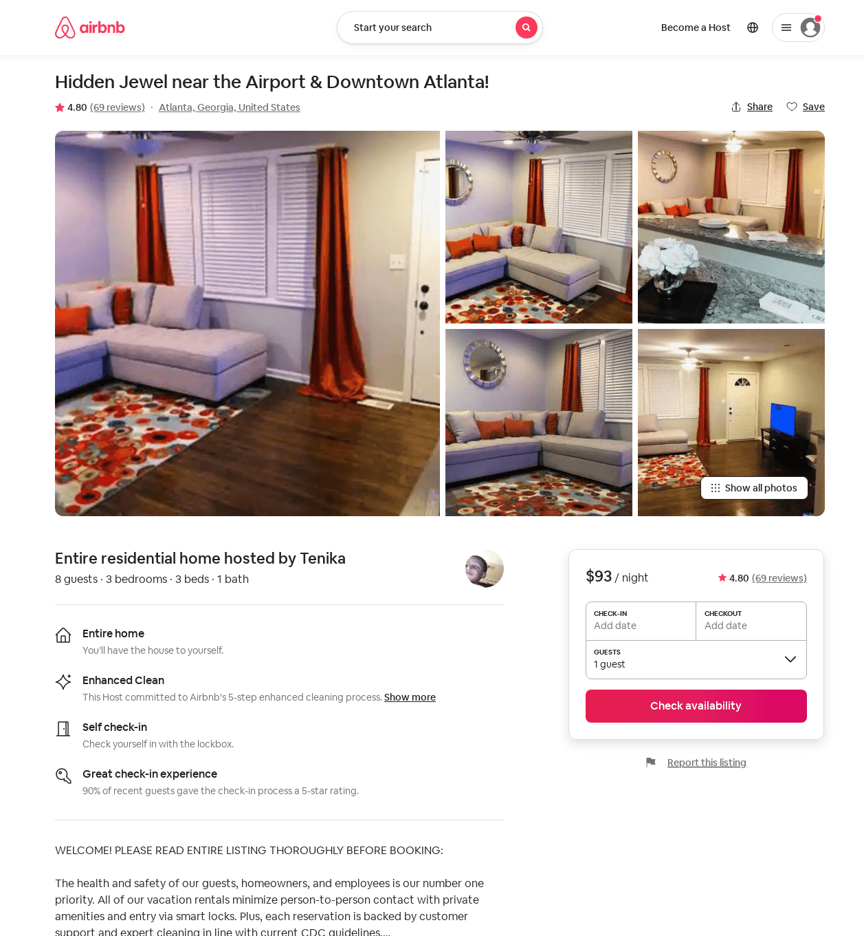
Listing 37422546
3
8
$90 - $93
4.75
1
Tenika
236194643
1
https://www.airbnb.com/rooms/37422546
Aug 2022

Slide 4
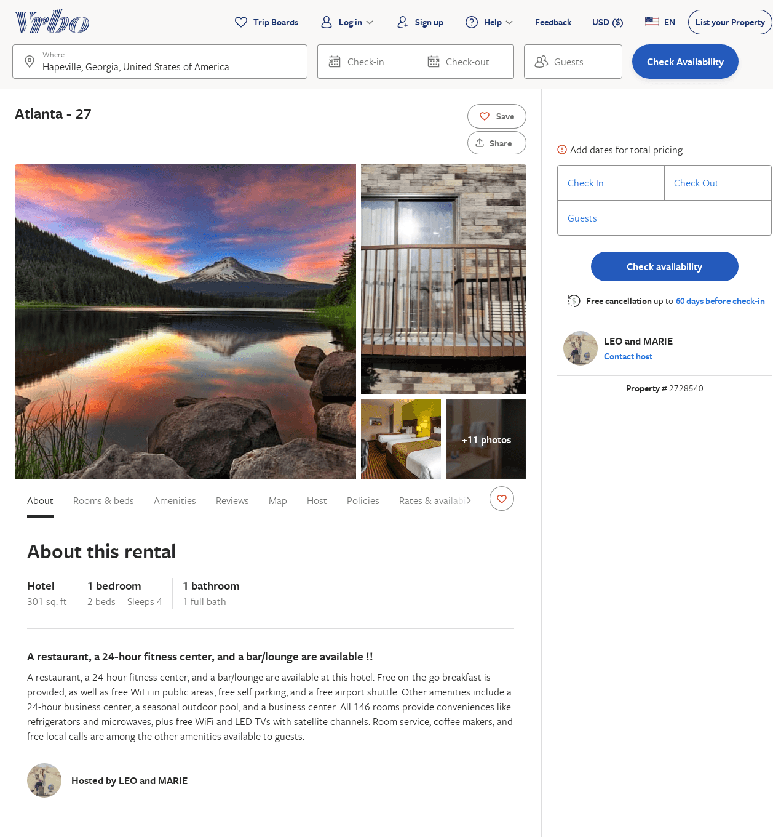
Listing 2728540
1
4
$228
2
LEO and MARIE
https://www.vrbo.com/2728540
Aug 2022

Slide 5
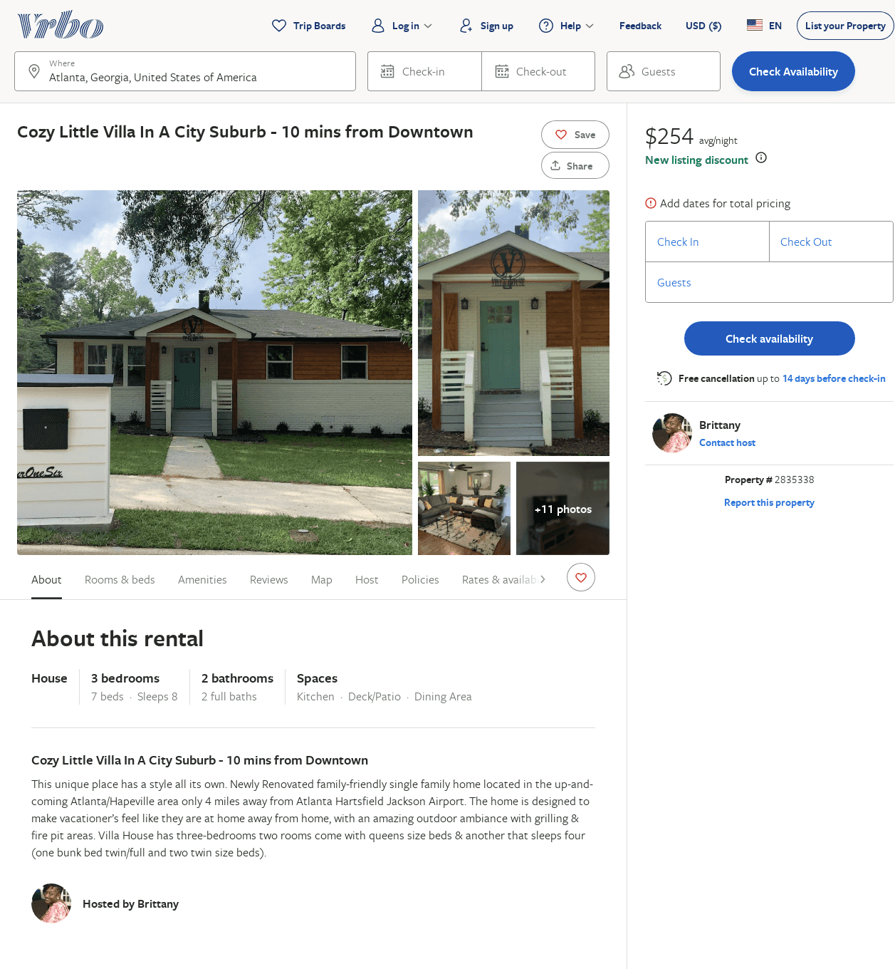
Listing 2835338
3
8
$254
4.6666665
2
Brittany
https://www.vrbo.com/2835338
Aug 2022

Slide 6
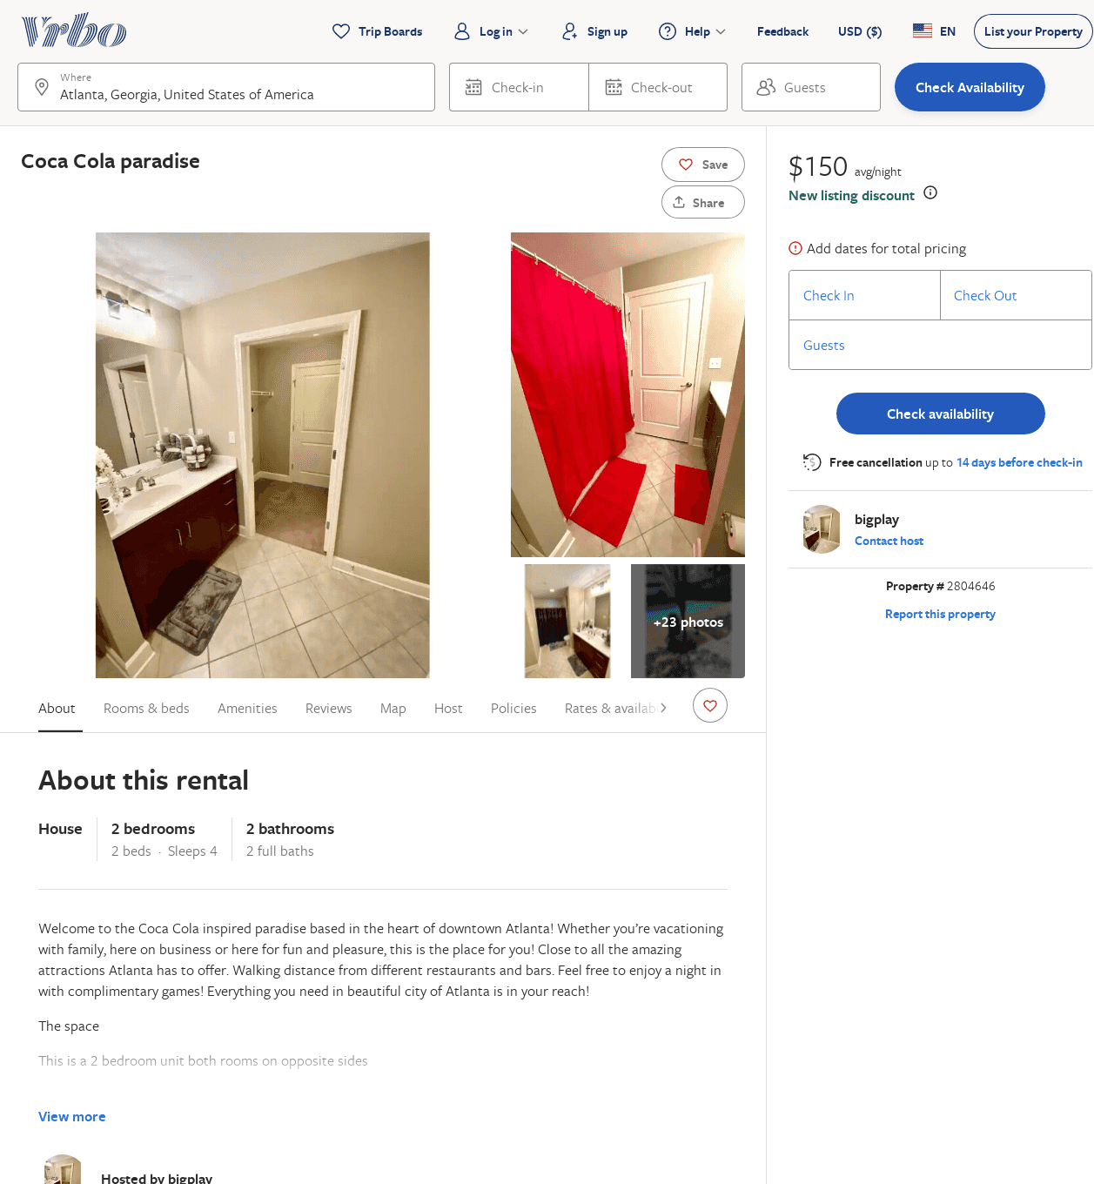
Listing 2804646
2
4
$150
2
bigplay
https://www.vrbo.com/2804646
Aug 2022

