Slide 2
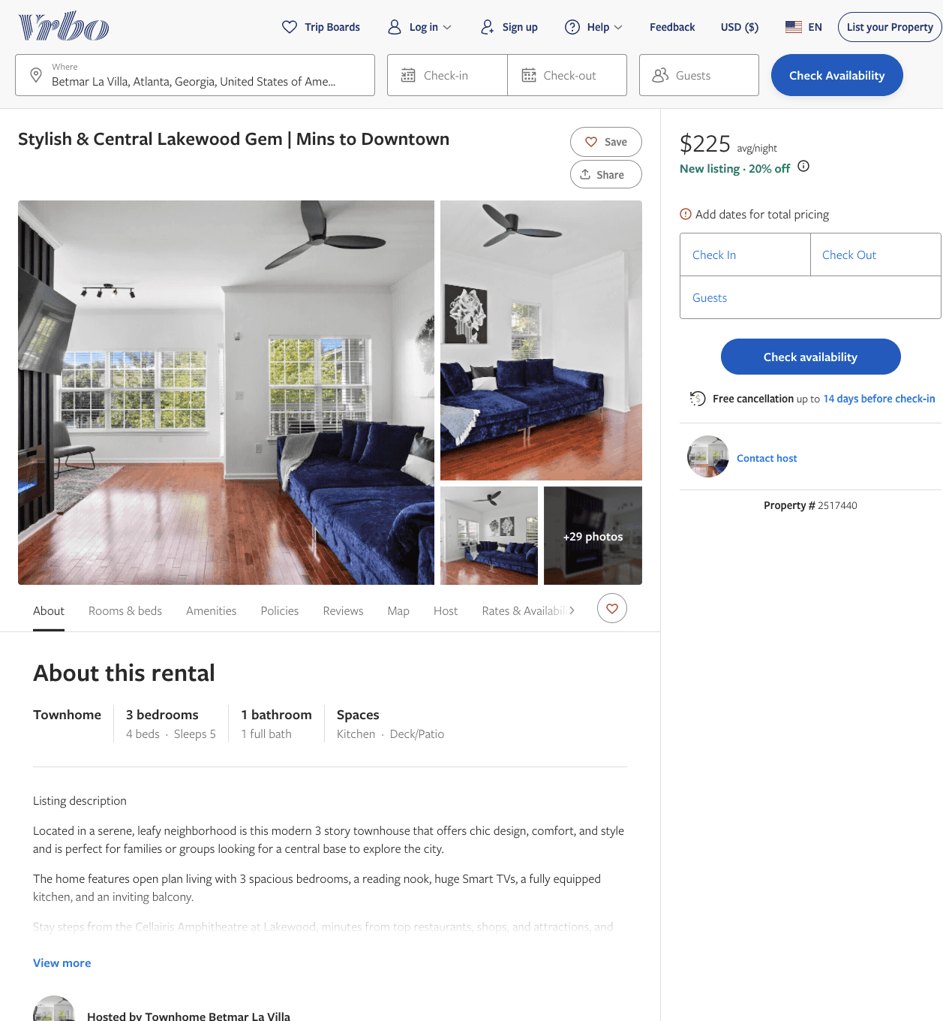
Listing 2517440
3
5
$192 - $255
1
https://www.vrbo.com/2517440
Aug 2022

Slide 3
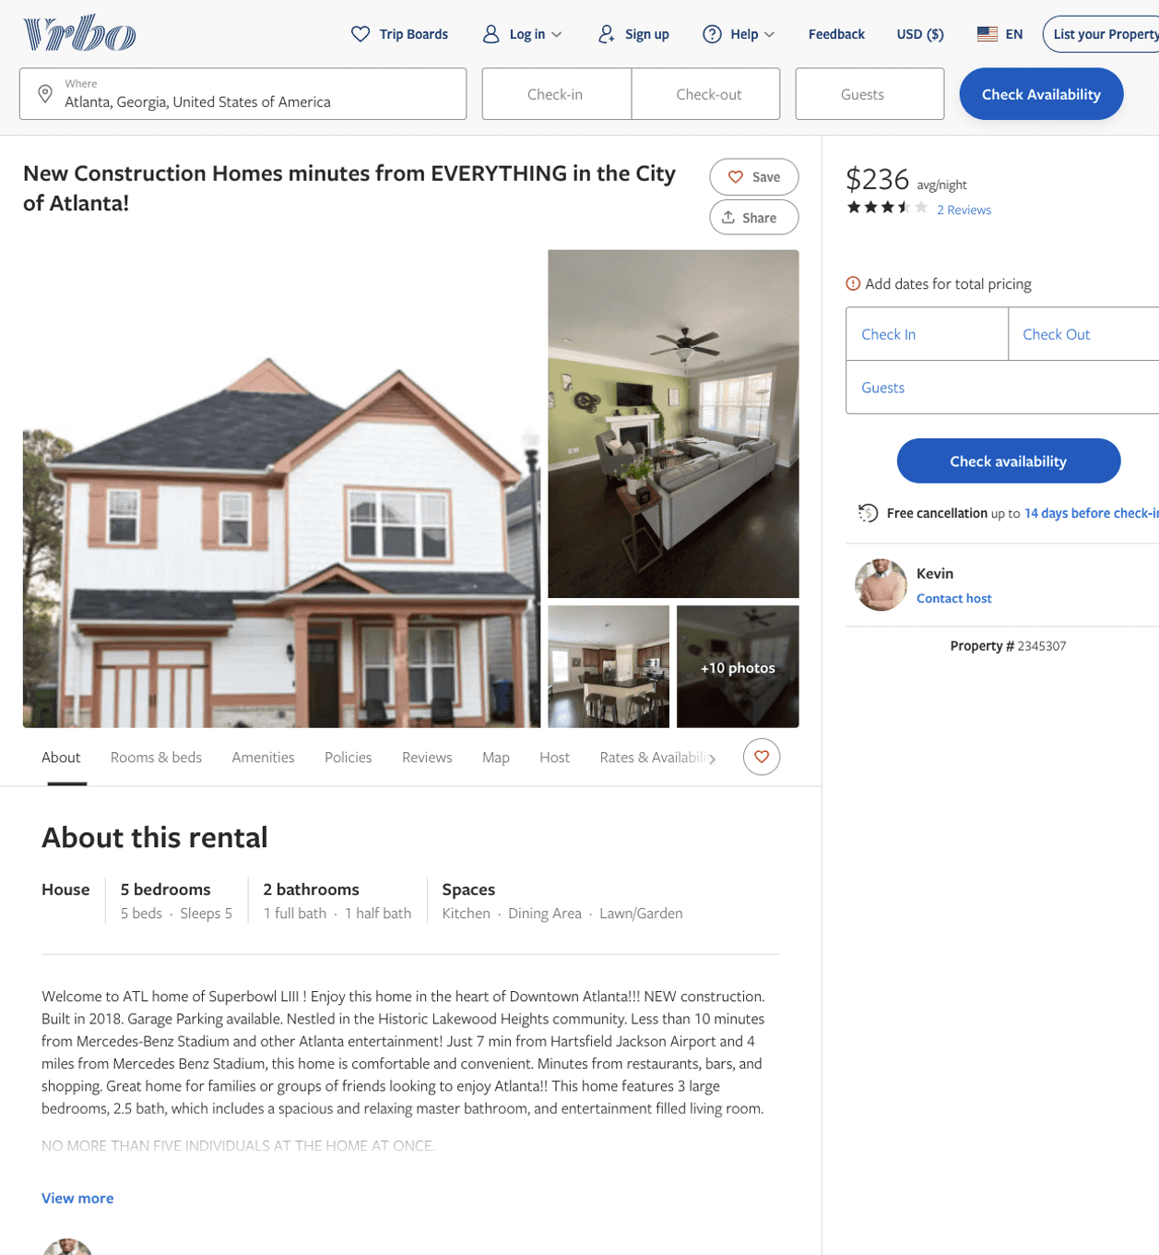
Listing 2345307
3
5
$174 - $324
4
3
Kevin
https://www.vrbo.com/2345307
Aug 2022

Slide 4
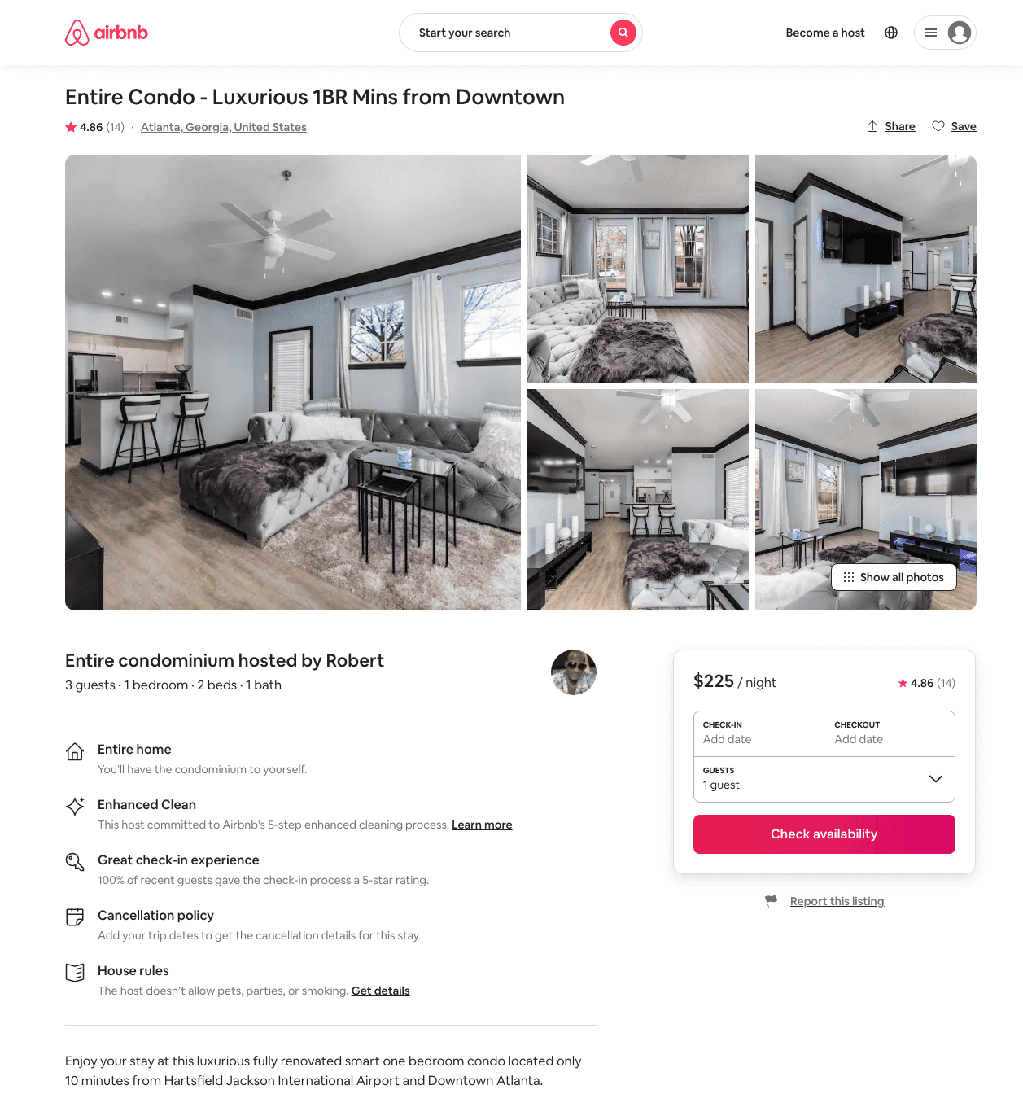
Listing 47388898
1
2
$200 - $250
4.87
1
Ree
382561731
1
https://www.airbnb.com/rooms/47388898
Aug 2022

Slide 5
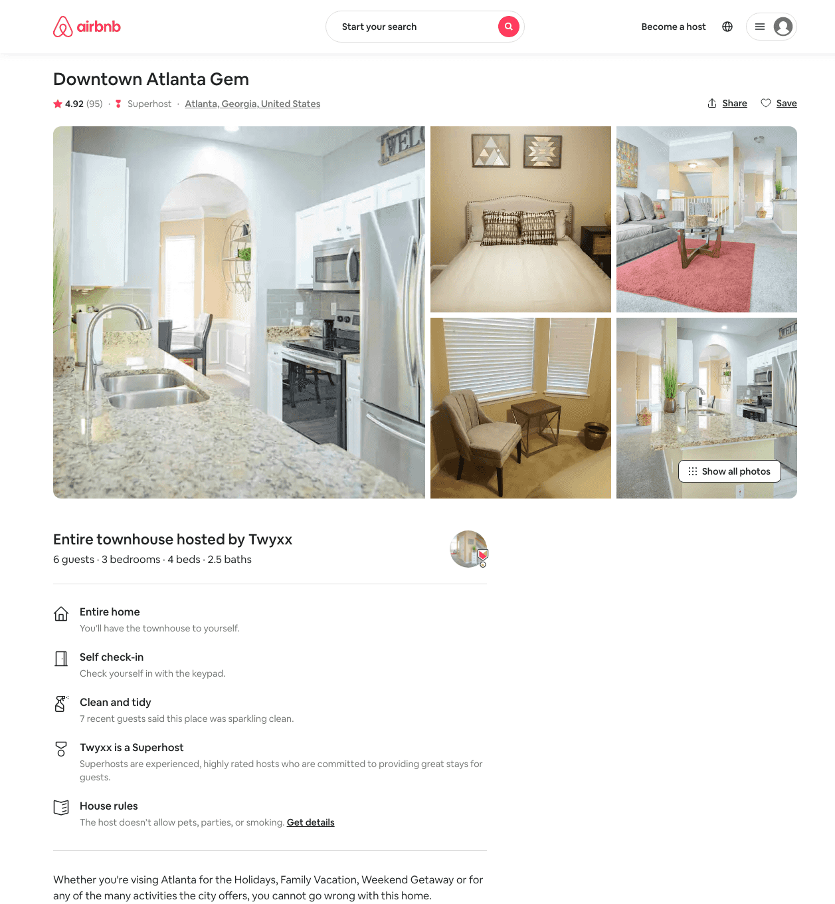
Listing 21384260
3
8
$169 - $246
4.84
4
Twyxx
154888613
1
https://www.airbnb.com/rooms/21384260
Jun 2022

Slide 6
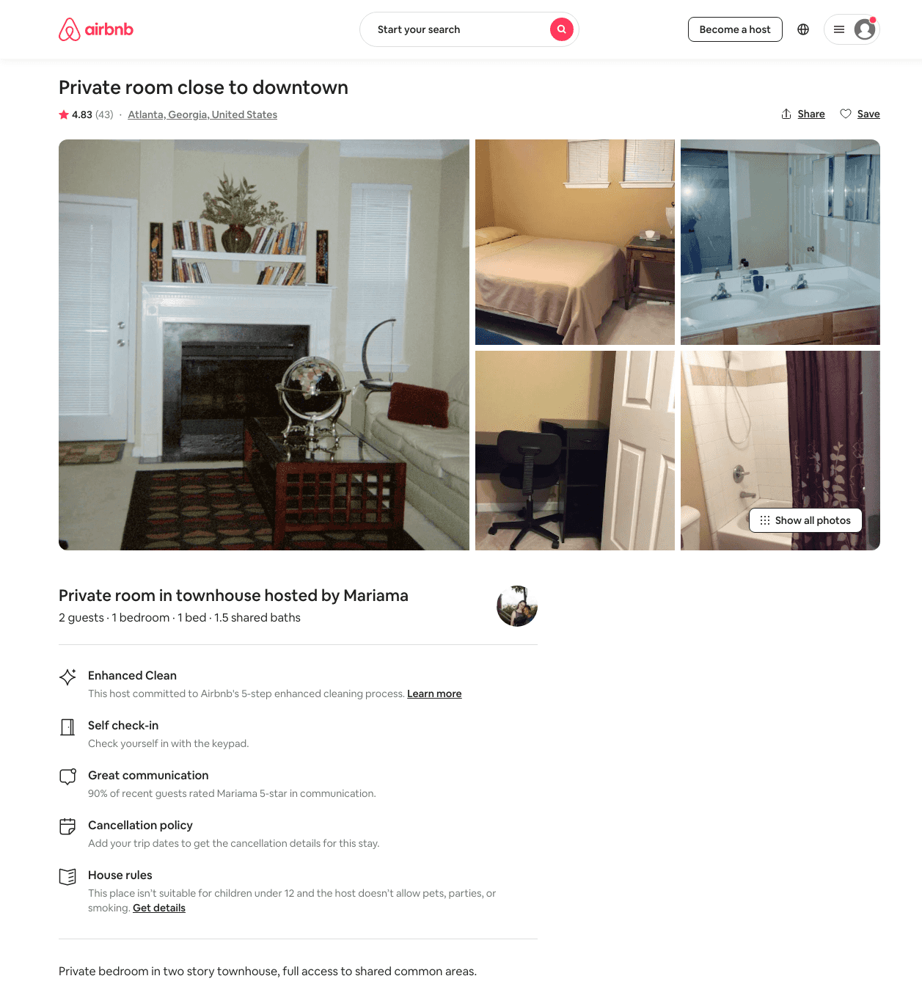
Listing 14094015
1
2
$25 - $27
4.78
2
Mariama
2822498
4
https://www.airbnb.com/rooms/14094015
Aug 2022

Slide 7
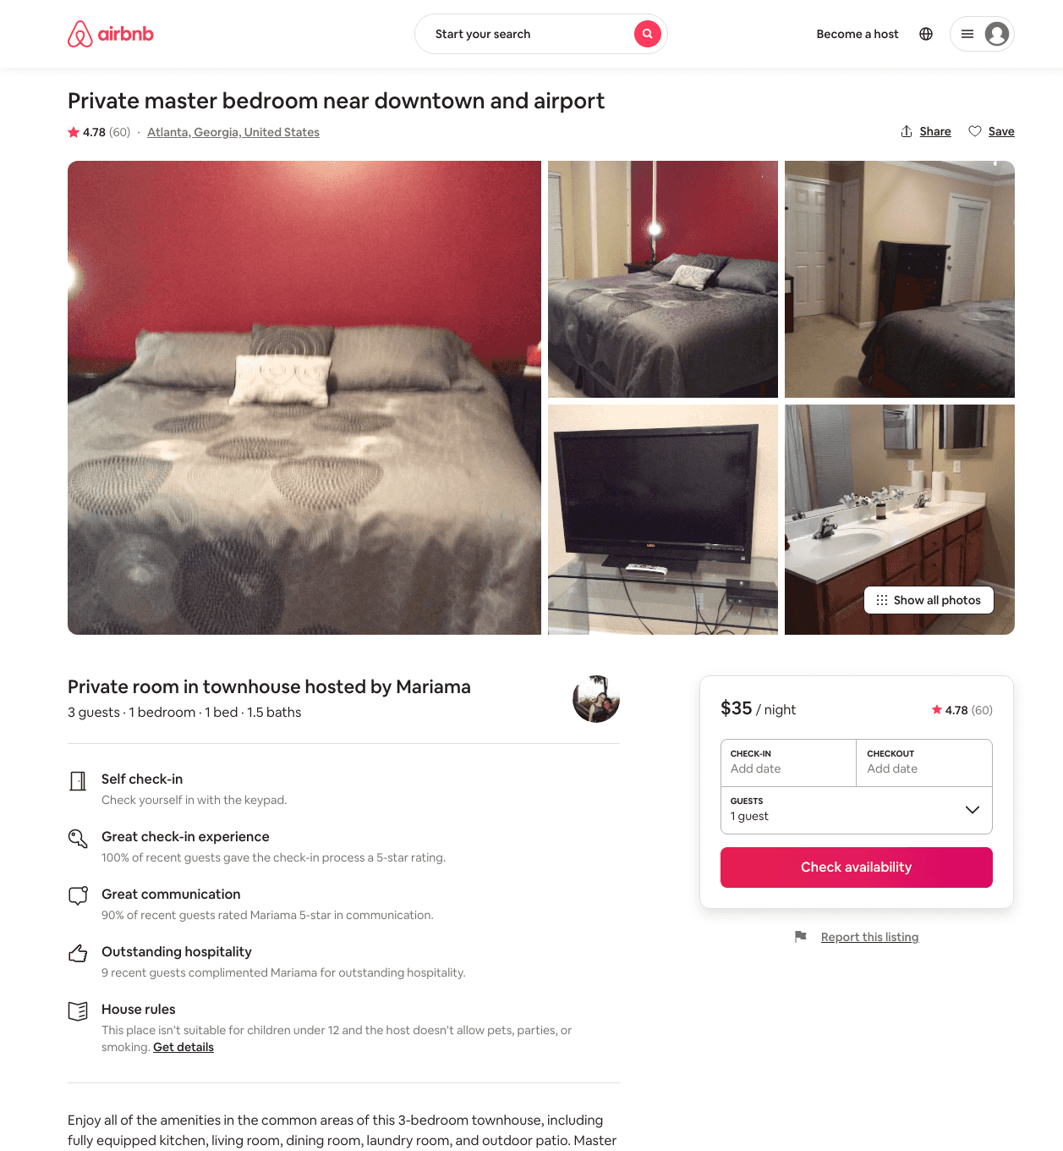
Listing 13210082
1
3
$35 - $48
4.78
3
Mariama
2822498
4
https://www.airbnb.com/rooms/13210082
Aug 2022

Slide 8
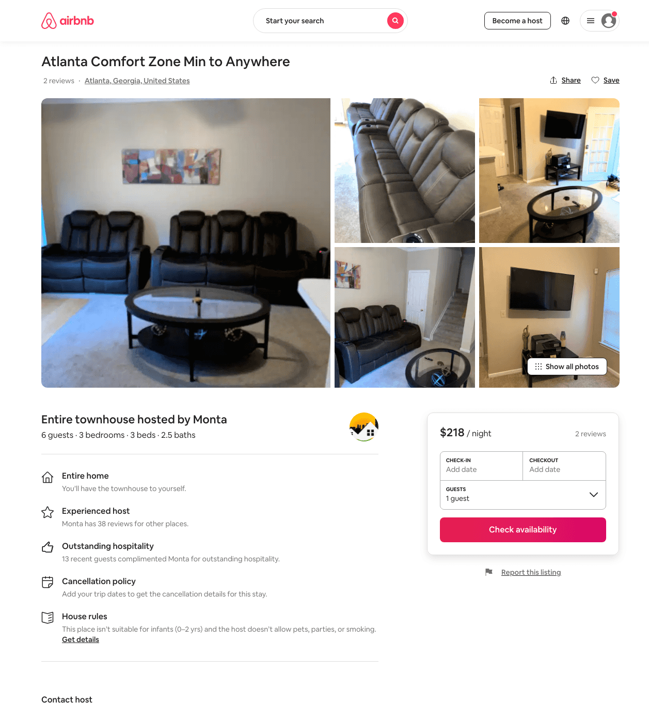
Listing 48451577
3
6
$188 - $220
4.55
1
Monta
181665900
2
https://www.airbnb.com/rooms/48451577
Jun 2022

Slide 9
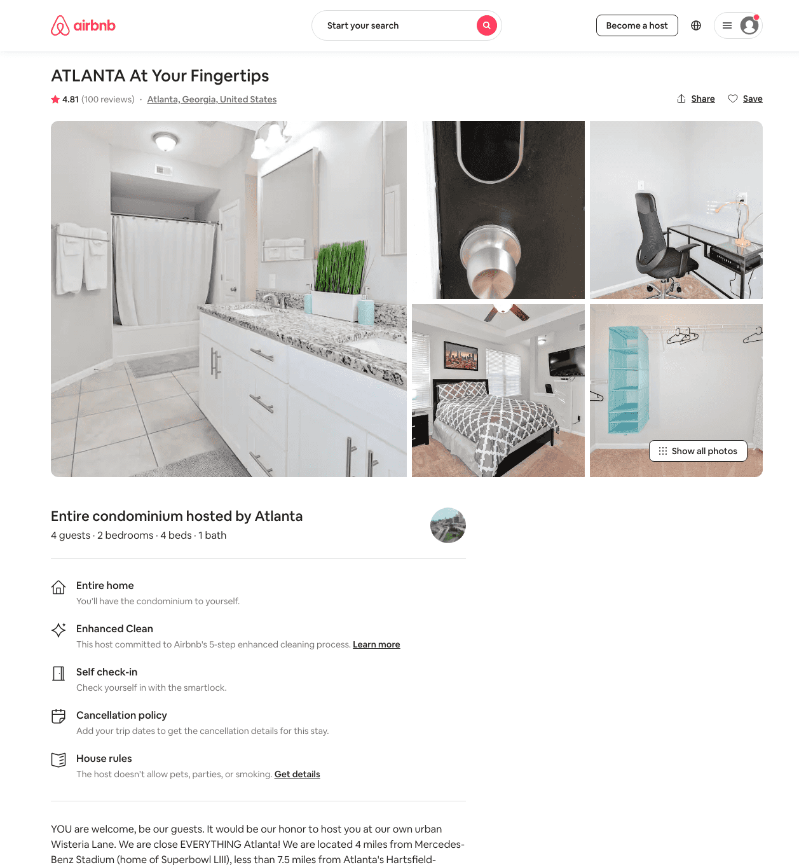
Listing 25234603
2
4
$133 - $154
4.81
4
Atlanta
174095187
2
https://www.airbnb.com/rooms/25234603
Aug 2022

Slide 10
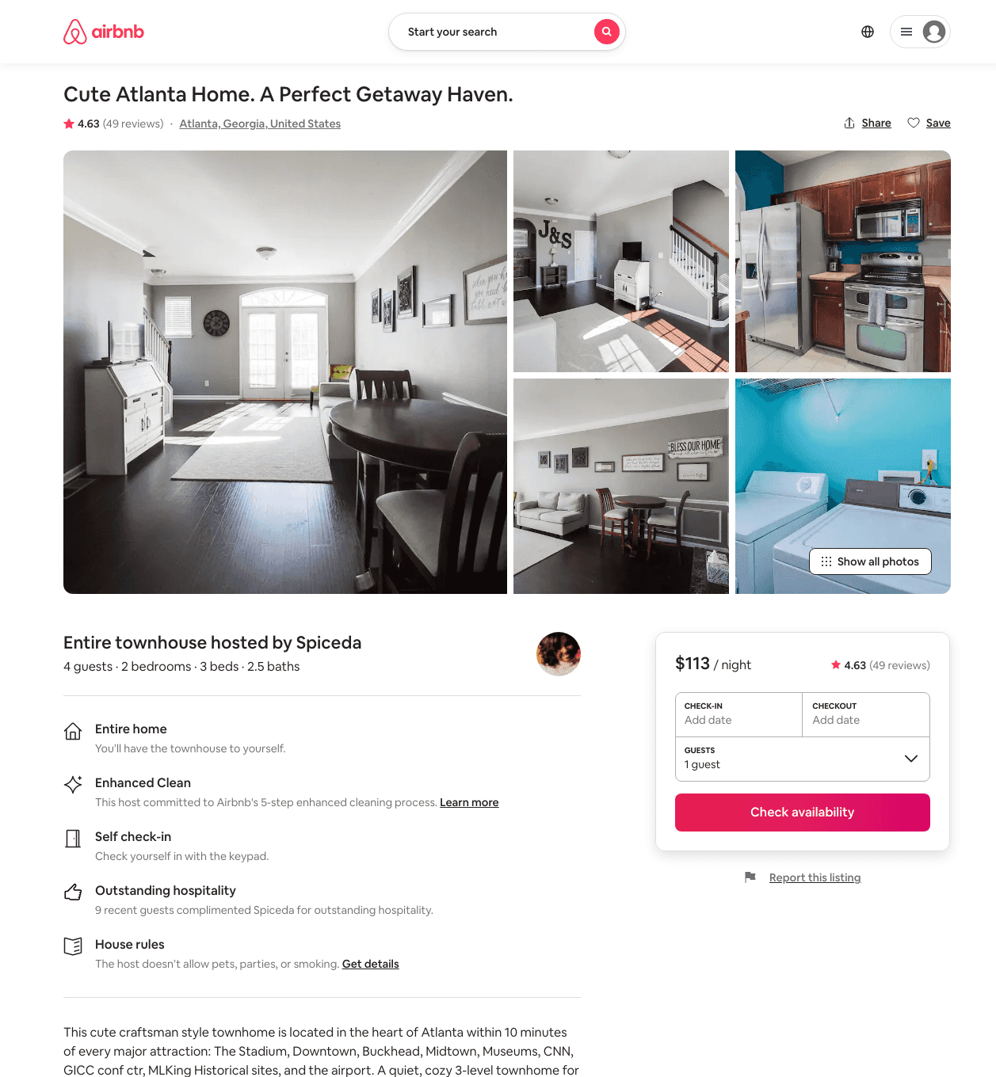
Listing 24189969
2
6
$102 - $189
4.63
2
Spiceda
148899752
1
https://www.airbnb.com/rooms/24189969
Jul 2022

Slide 11
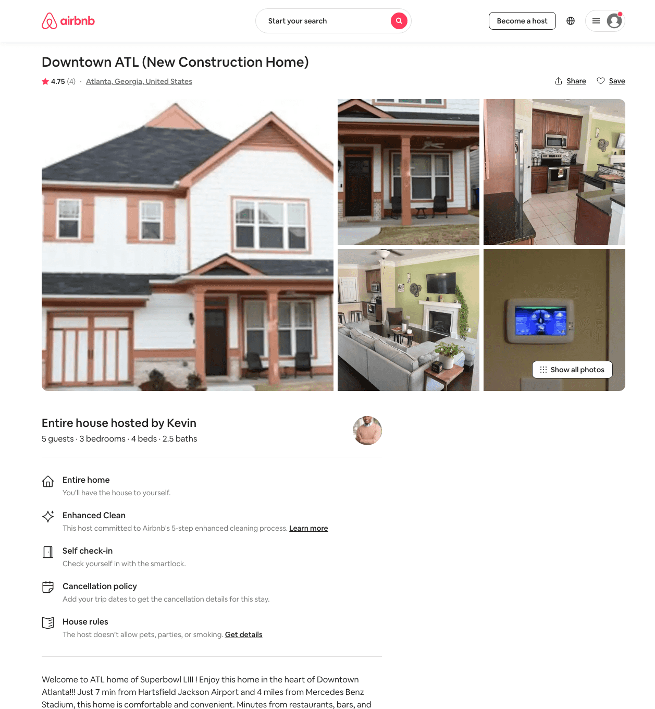
Listing 27215517
3
6
$148 - $406
4.73
2
Kj
45619552
4
https://www.airbnb.com/rooms/27215517
Aug 2022

Slide 12
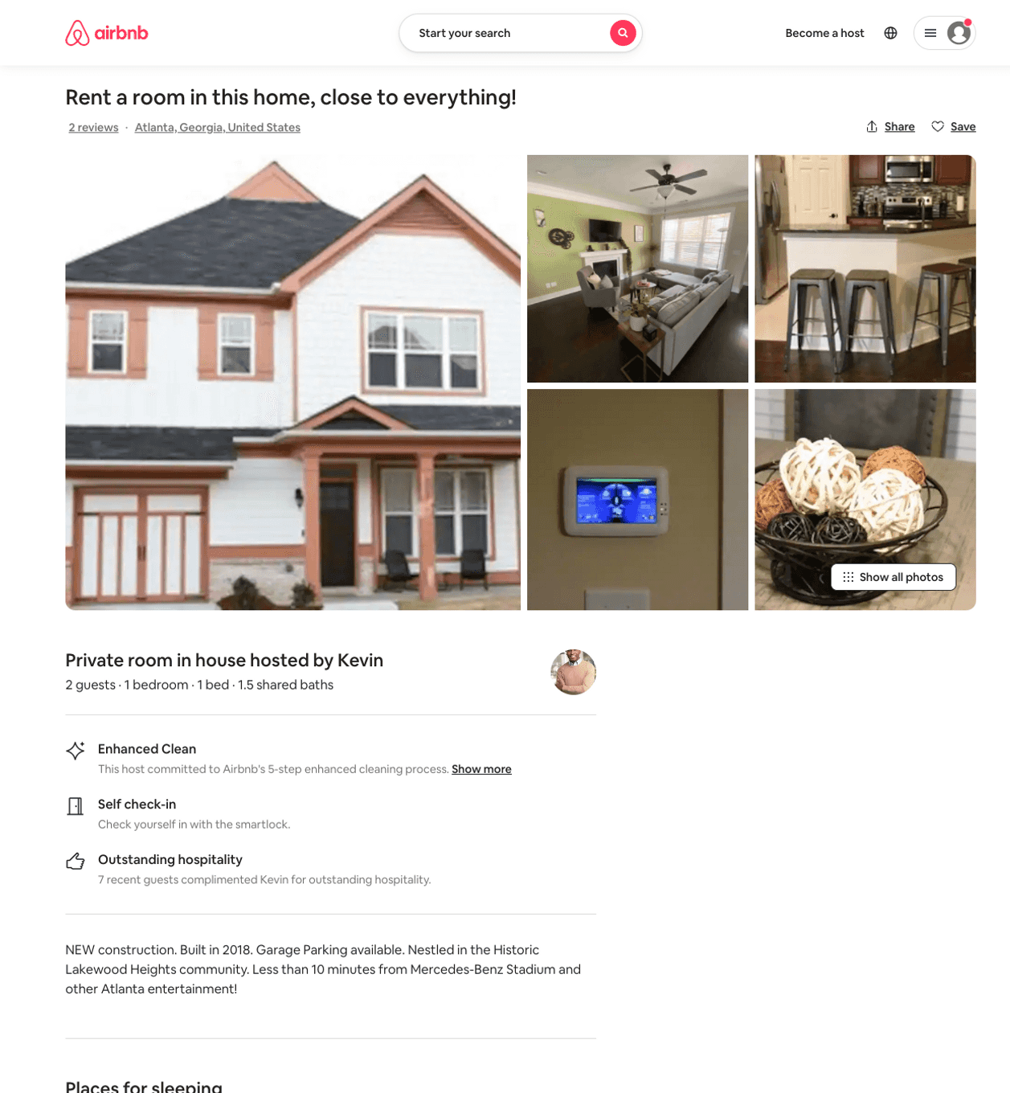
Listing 41602463
1
2
$80
2
Kj
45619552
4
https://www.airbnb.com/rooms/41602463
Jul 2022

Slide 13
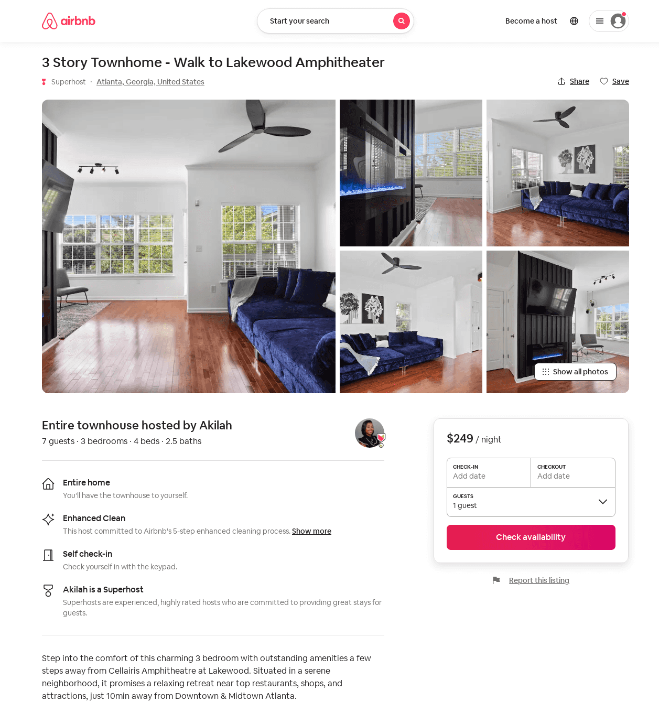
Listing 52002286
3
7
$131 - $273
4.94
7
Akilah
397684566
1
https://www.airbnb.com/rooms/52002286
Aug 2022

Slide 14
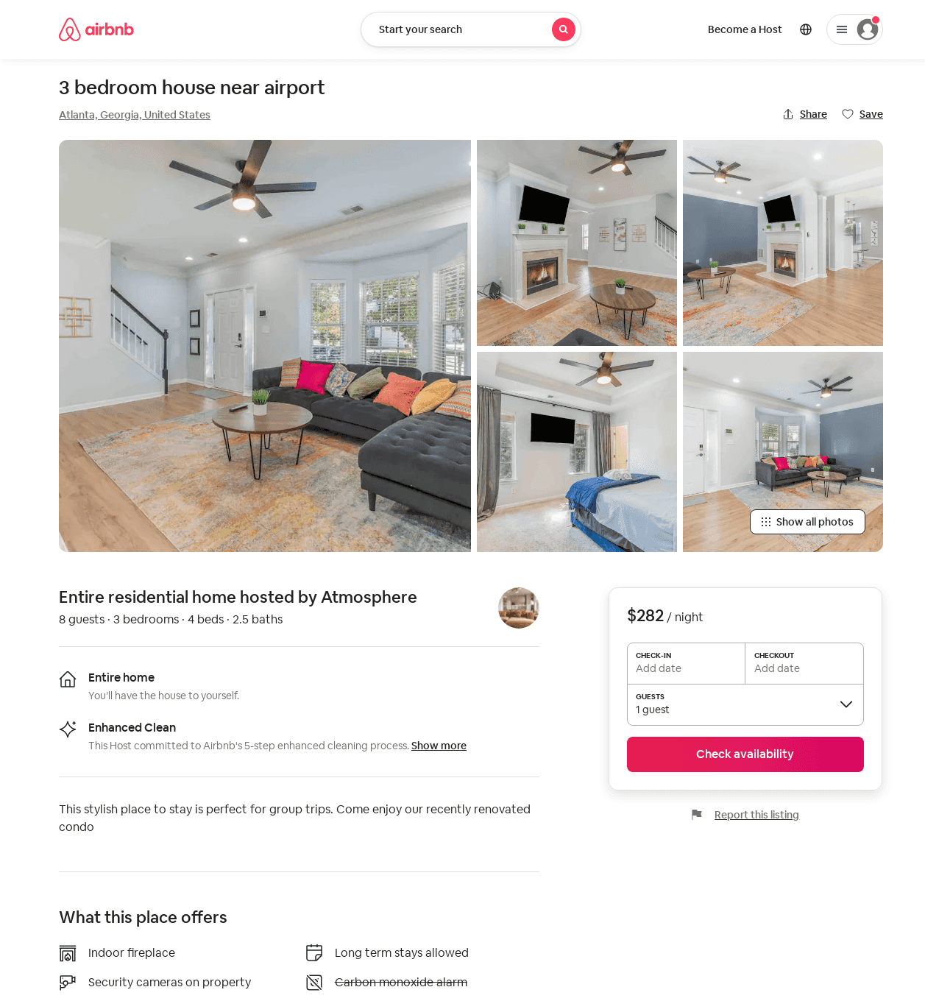
Listing 52585966
3
8
$282 - $353
2
Atmosphere
423076182
2
https://www.airbnb.com/rooms/52585966
Jun 2022

Slide 15
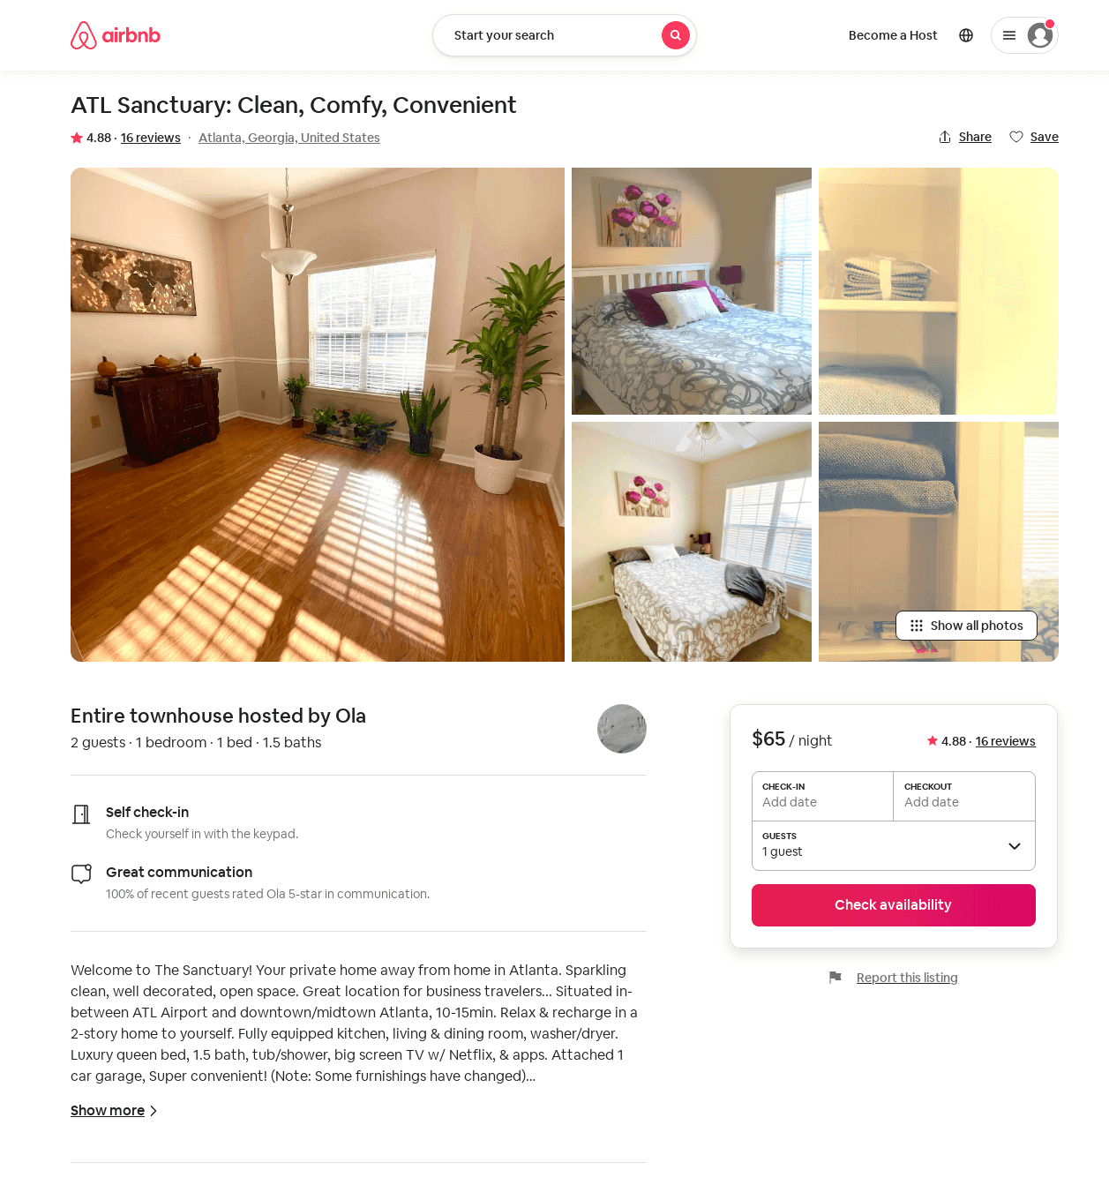
Listing 29545198
1
2
$65
4.88
90
Ola
5663714
3
https://www.airbnb.com/rooms/29545198
Aug 2022

Slide 16
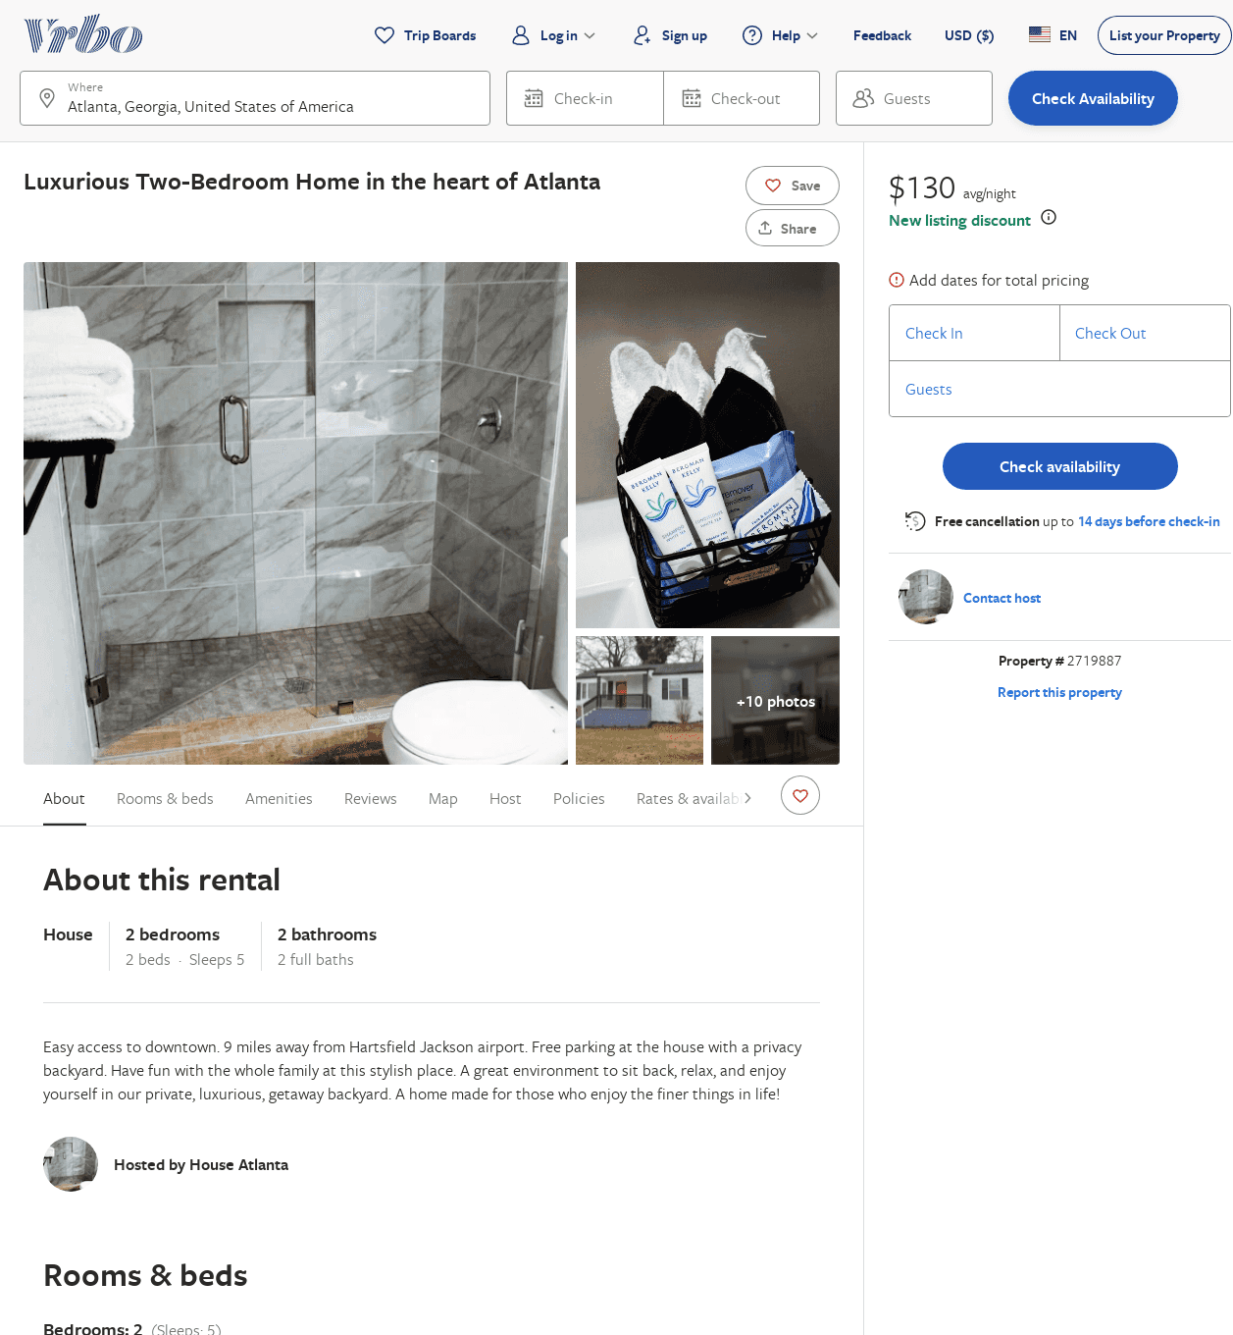
Listing 2719887
2
5
$151
2
Jairus Reed
https://www.vrbo.com/2719887
Aug 2022

Slide 17
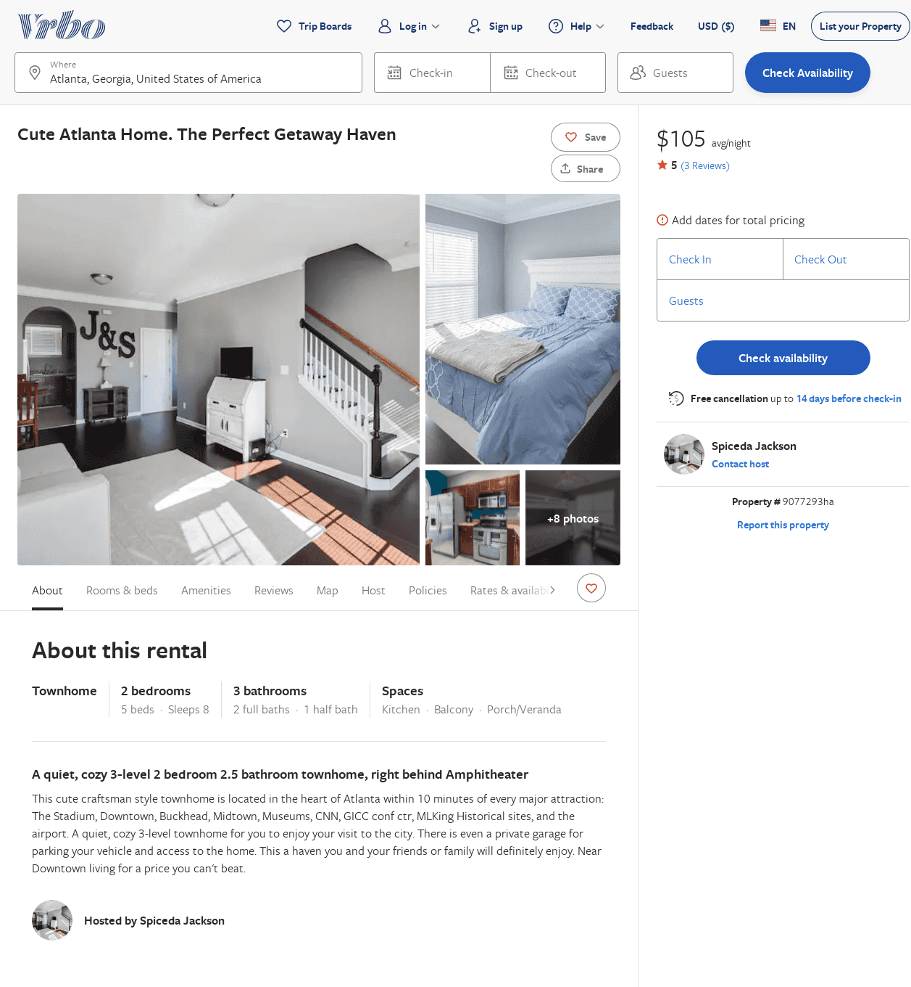
Listing 9077293
2
8
$104
5
2
Spiceda Jackson
https://www.vrbo.com/9077293ha
Aug 2022

Slide 18
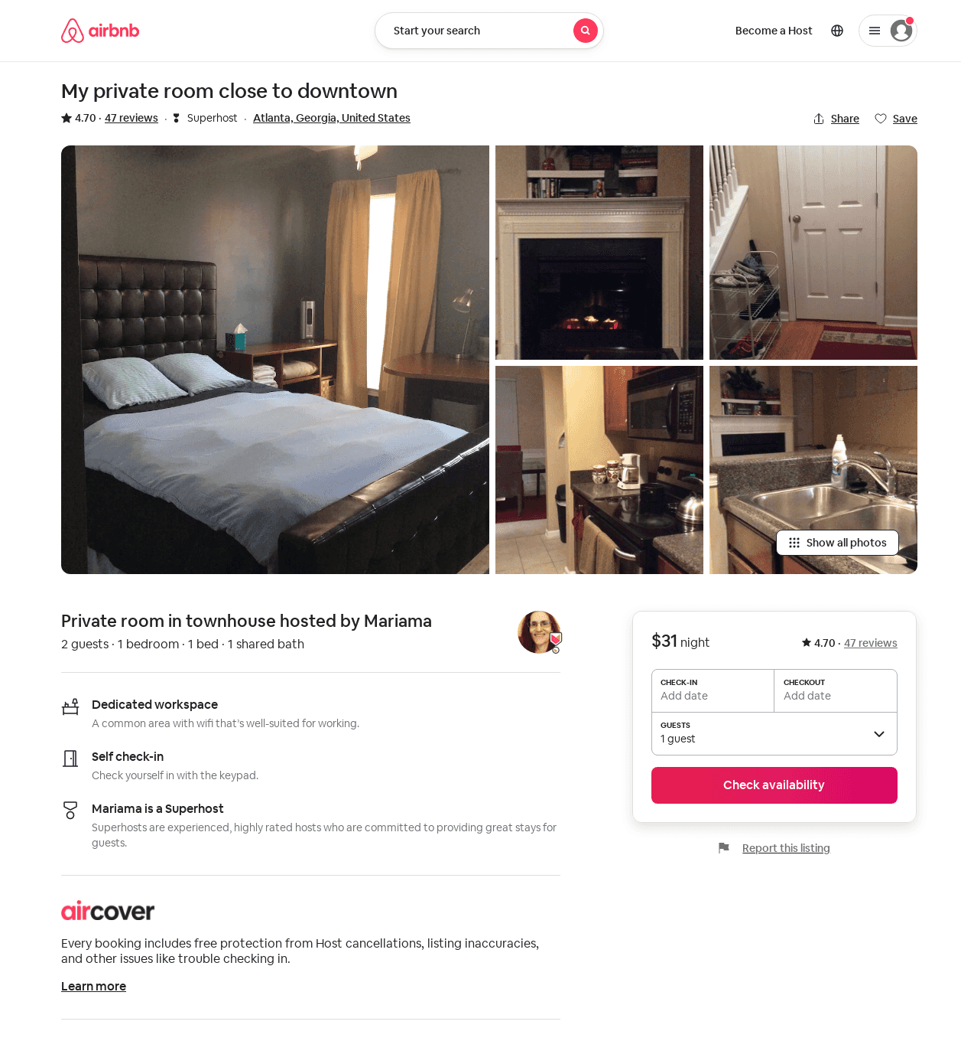
Listing 21985080
1
2
$31
4.70
1
Mariama
2822498
4
https://www.airbnb.com/rooms/21985080
Jul 2022

Slide 19
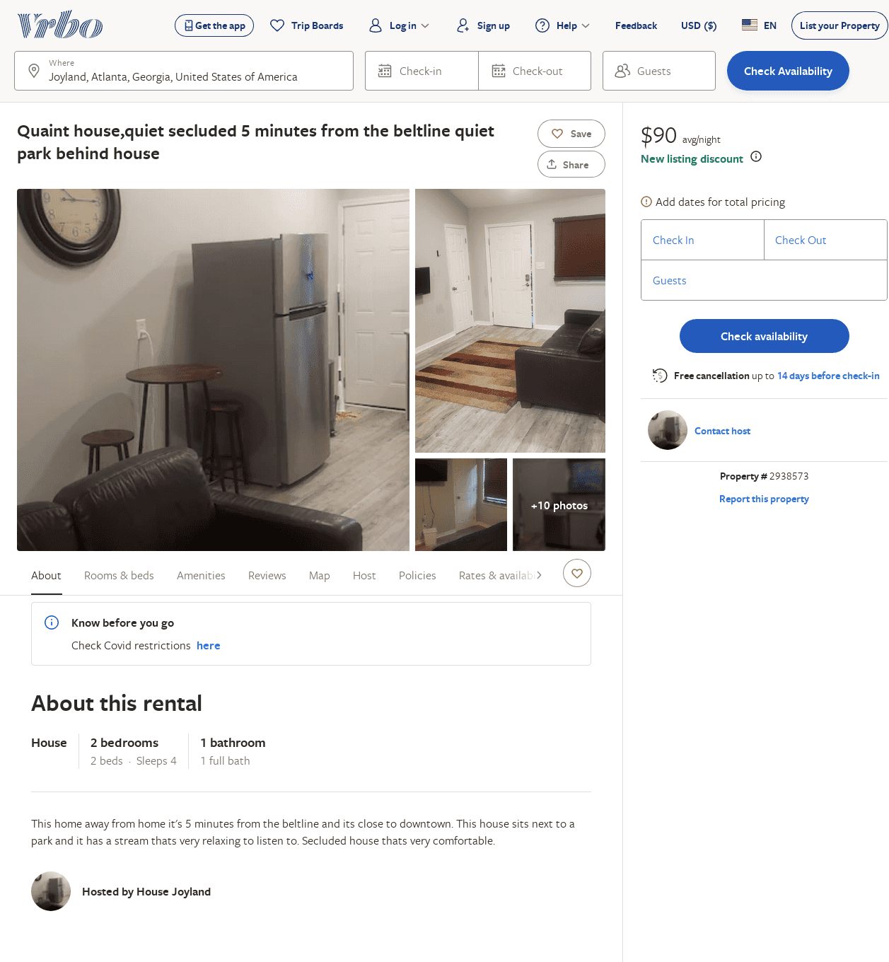
Listing 2938573
2
4
$90
5
https://www.vrbo.com/2938573
Aug 2022

