Slide 2
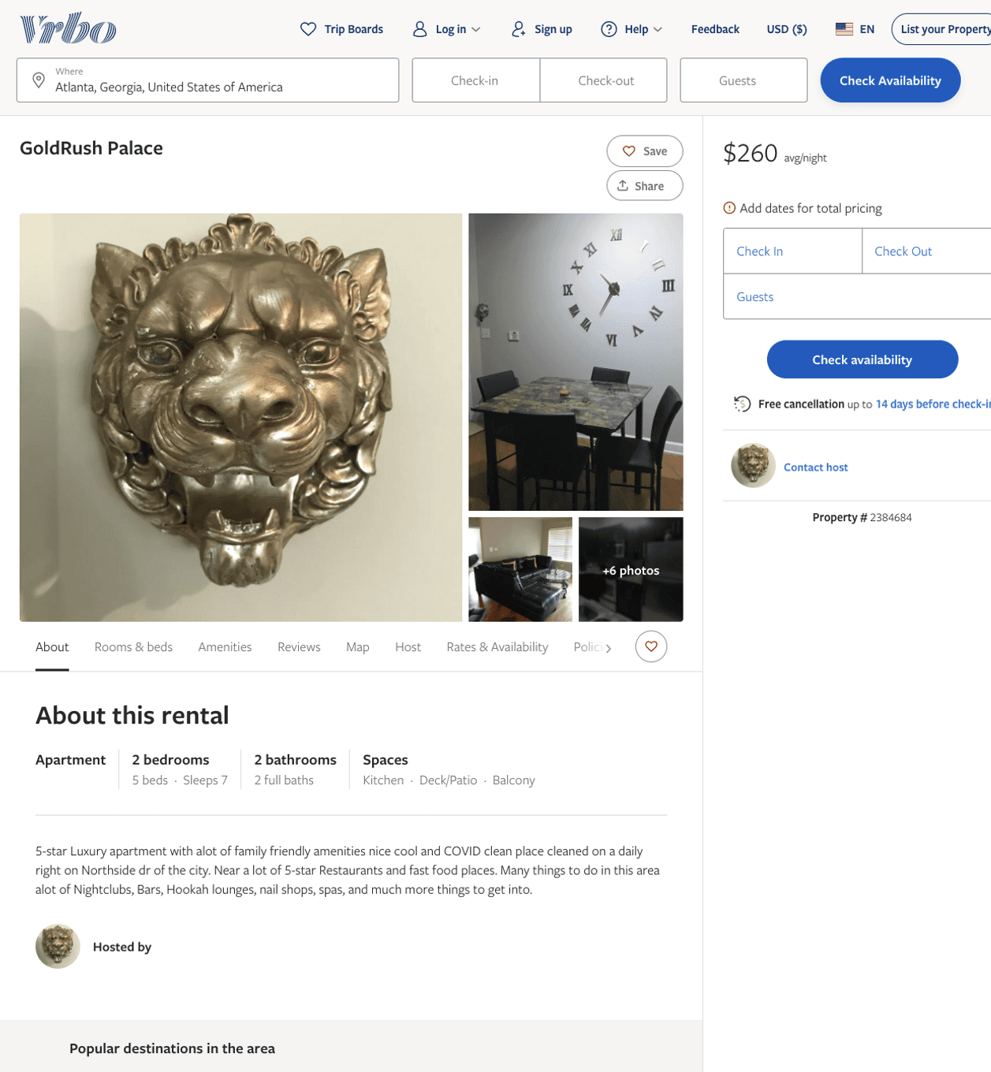
Listing 2384684
2
7
$224 - $260
5
1
https://www.vrbo.com/2384684
Aug 2022

Slide 3
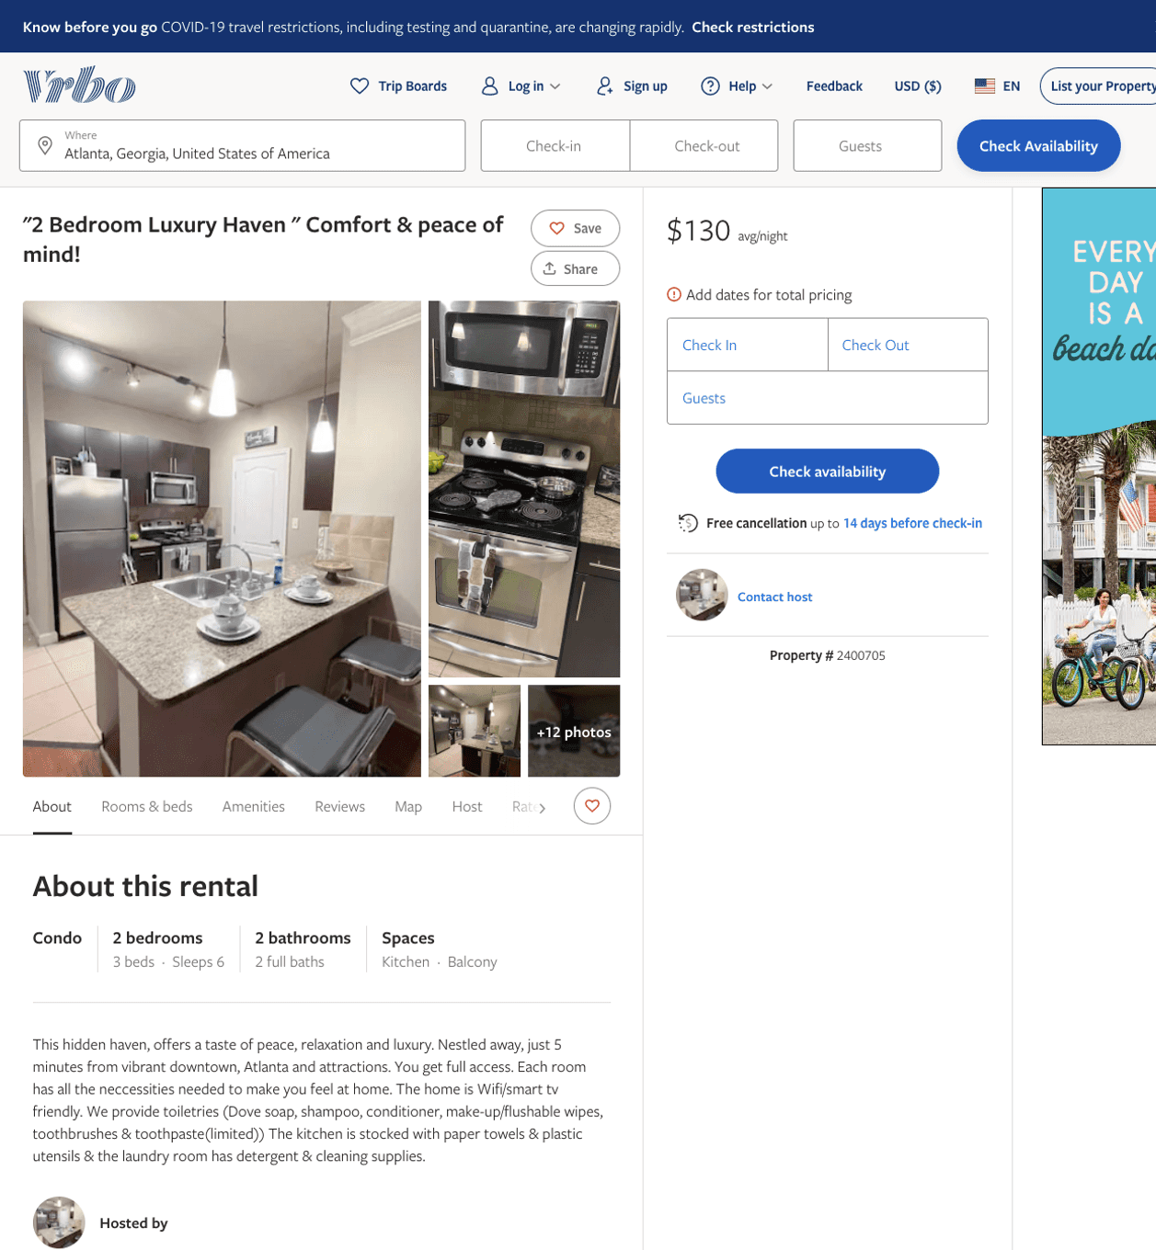
Listing 2400705
2
6
$105 - $131
1
1
https://www.vrbo.com/2400705
Aug 2022

Slide 4
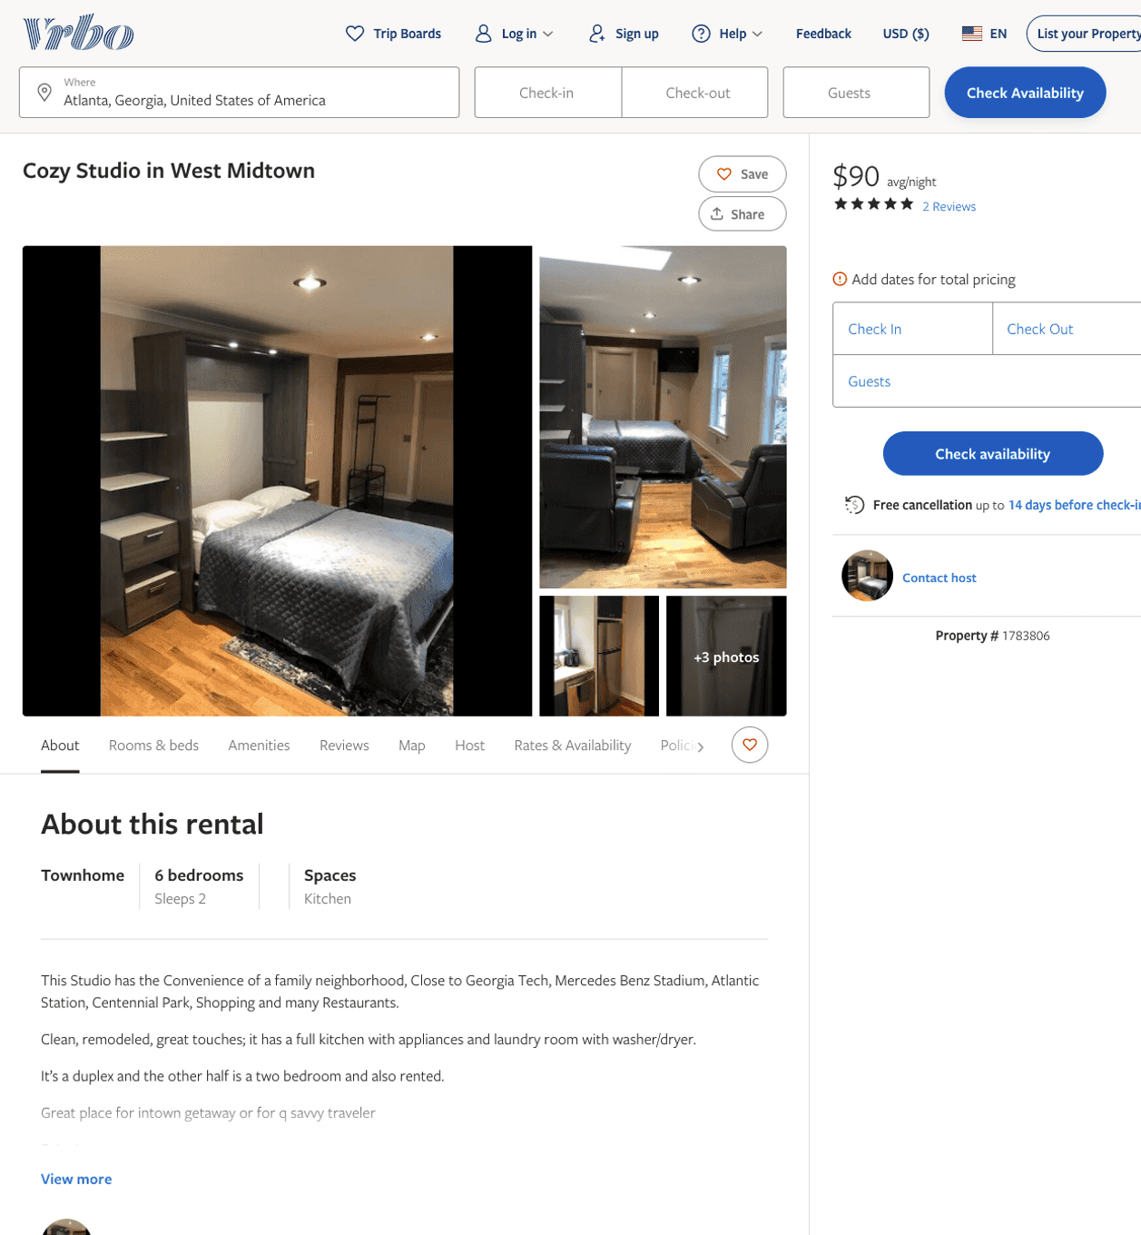
Listing 1783806
1
2
$180 - $90
5
1
https://www.vrbo.com/1783806
Aug 2022

Slide 5
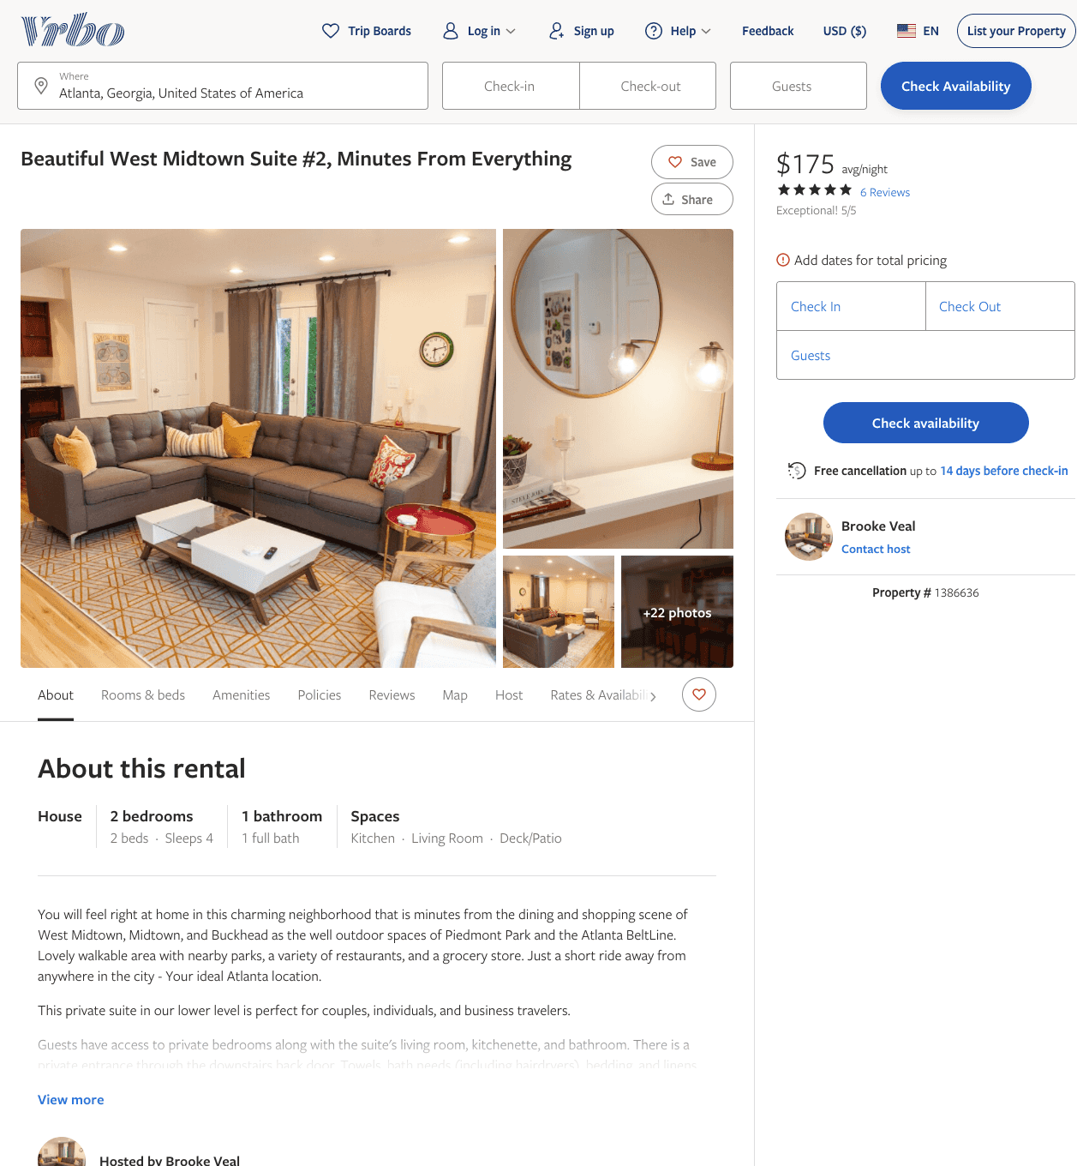
Listing 1386636
2
4
$175
5
2
Brooke Veal
https://www.vrbo.com/1386636
Aug 2022

Slide 6
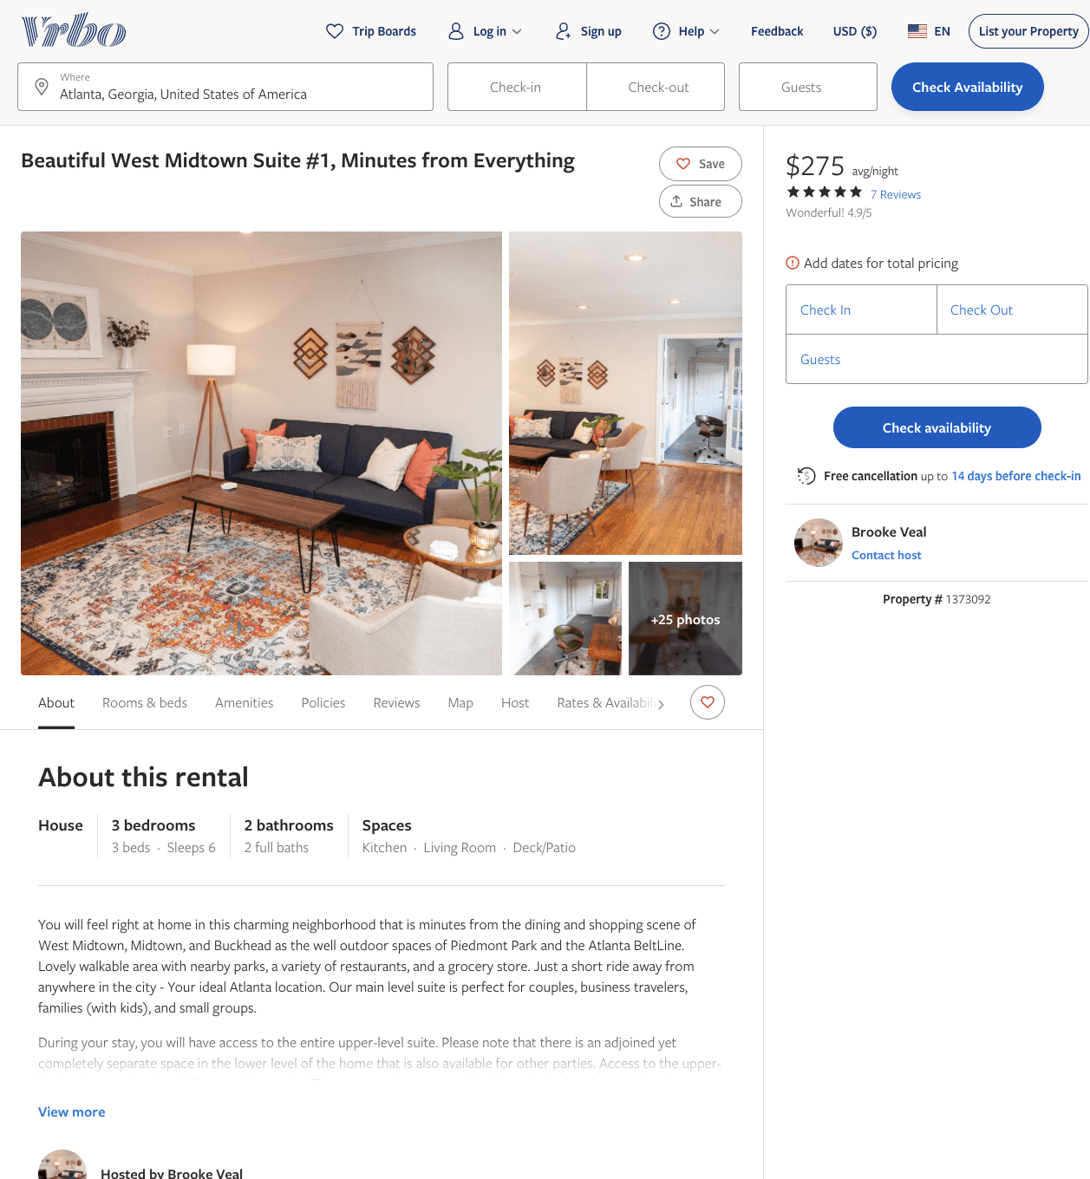
Listing 1373092
3
6
$275
4.857143
2
Brooke Veal
https://www.vrbo.com/1373092
Aug 2022

Slide 7
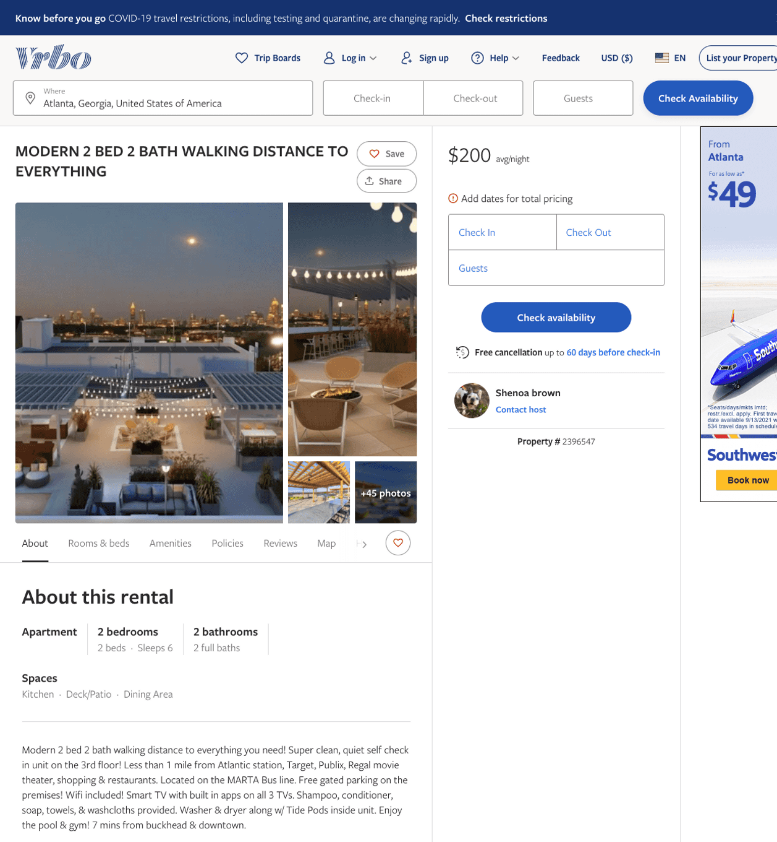
Listing 2396547
2
6
$190 - $213
2
Shenoa brown
https://www.vrbo.com/2396547
Aug 2022

Slide 8
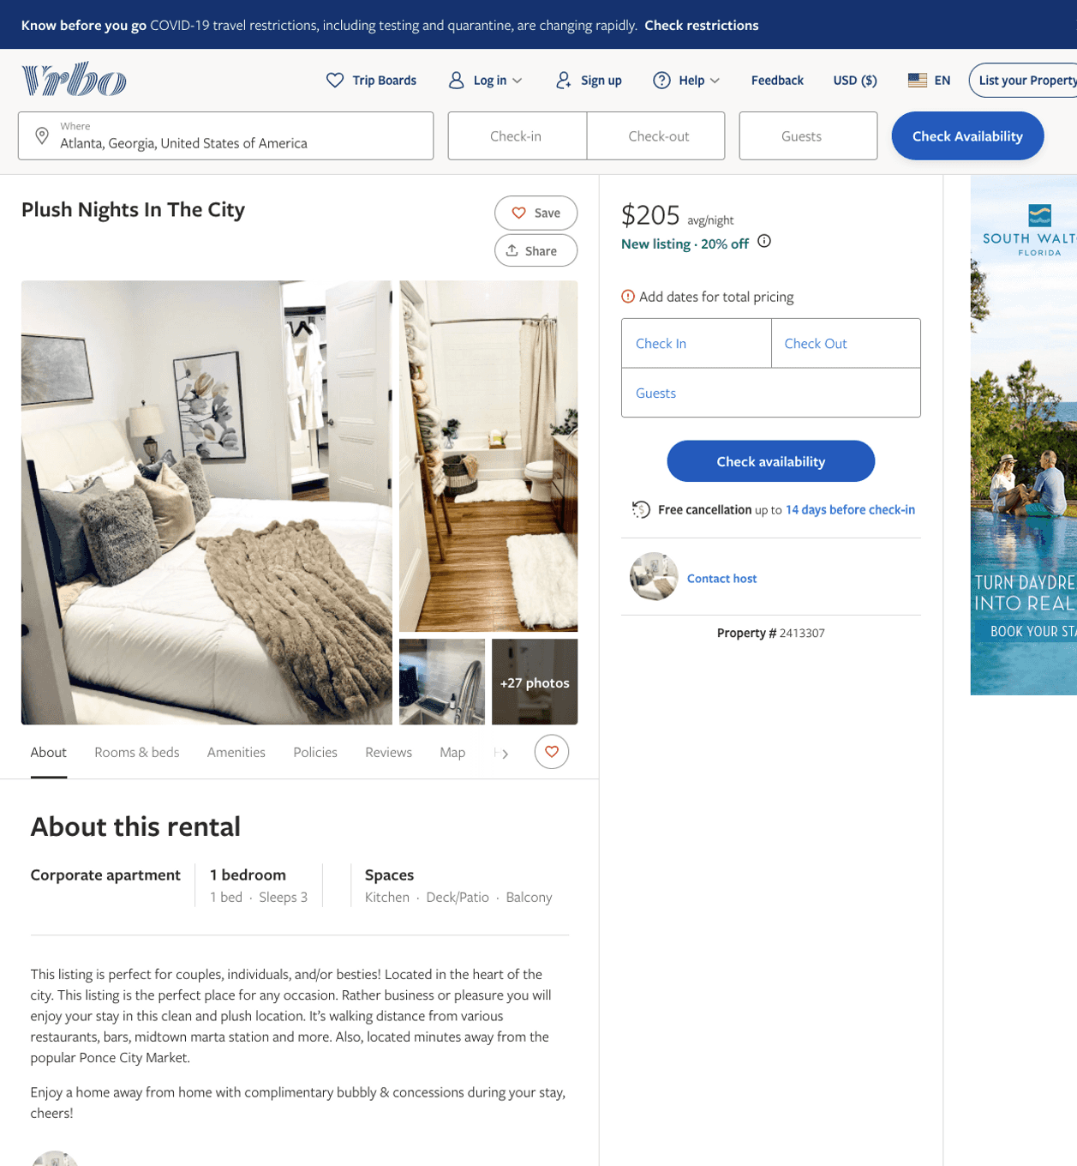
Listing 2413307
1
3
$205 - $212
1
https://www.vrbo.com/2413307
Aug 2022

Slide 9
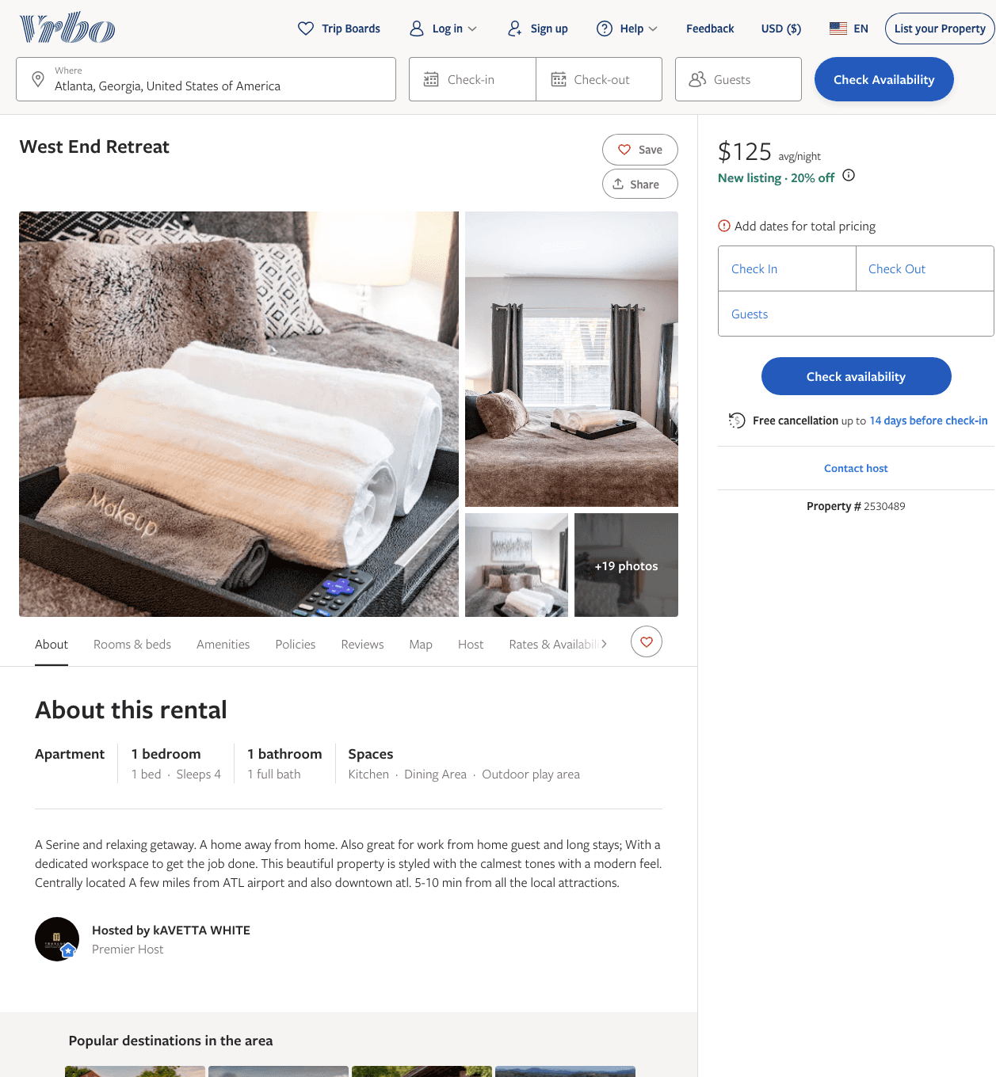
Listing 2530489
1
4
$125
1
kAVETTA WHITE
https://www.vrbo.com/2530489
Aug 2022

Slide 10
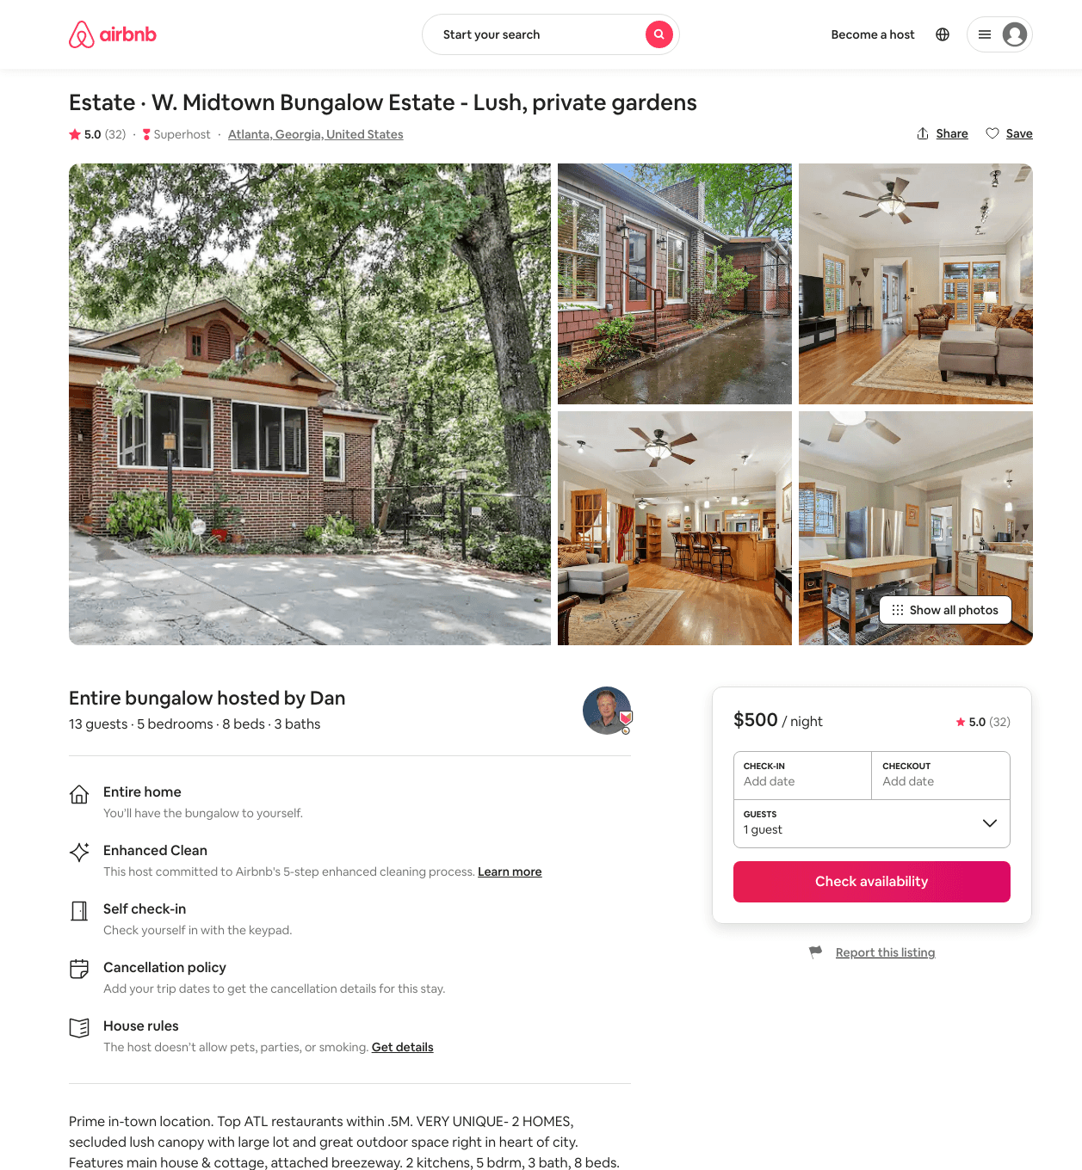
Listing 39859820
5
13
$400 - $537
4.94
3
Dan
294012697
2
https://www.airbnb.com/rooms/39859820
Aug 2022

Slide 11
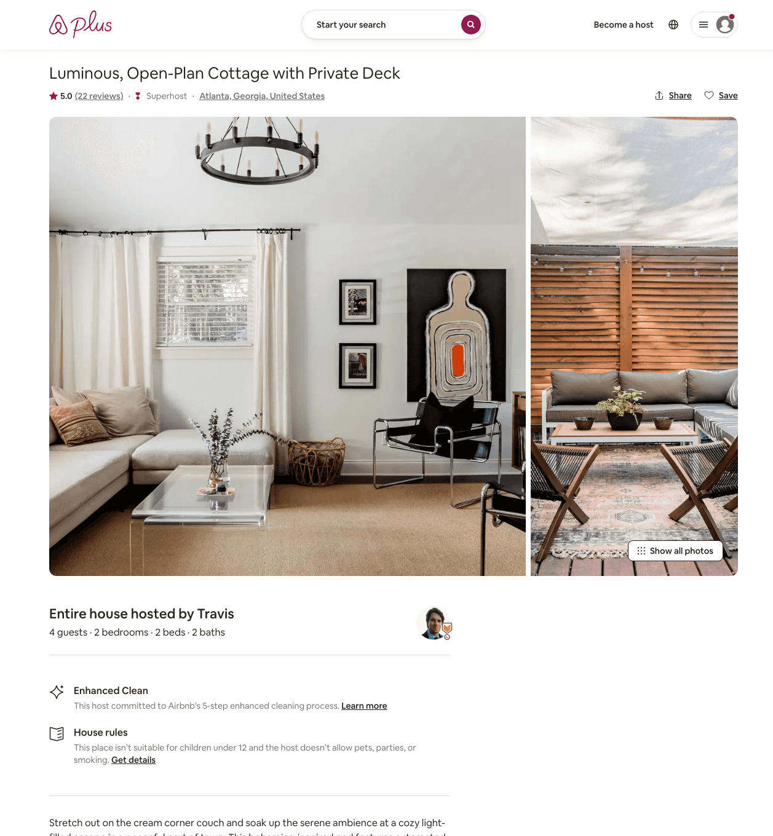
Listing 31268397
2
4
$200 - $495
5.0
3
Travis
33298148
1
https://www.airbnb.com/rooms/31268397
Aug 2022

Slide 12
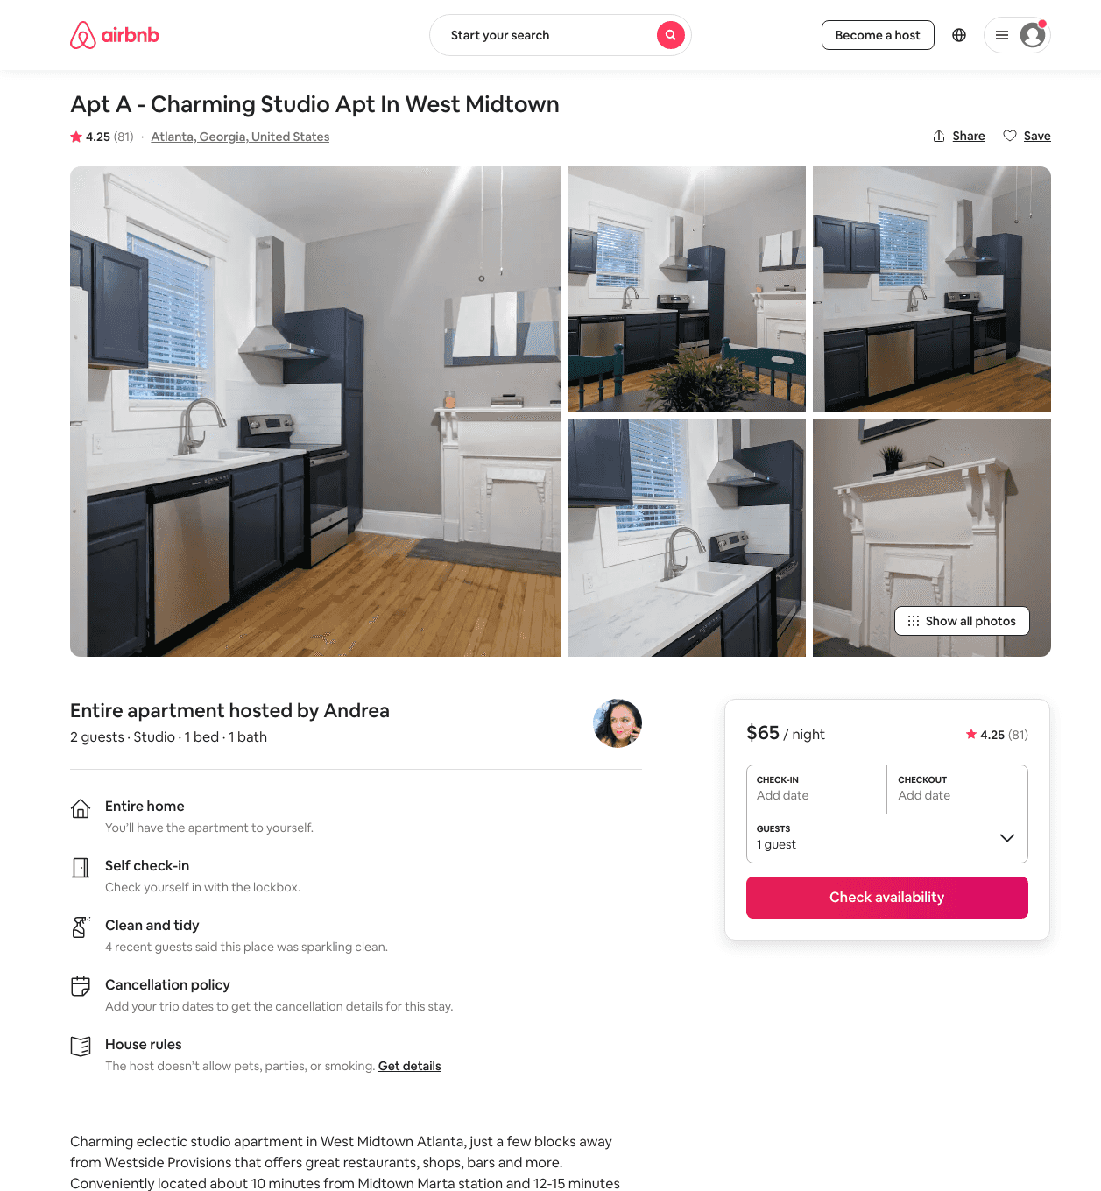
Listing 14840137
Studio
2
$65 - $73
4.25
31
Andrea
25567237
5
https://www.airbnb.com/rooms/14840137
Aug 2022

Slide 13
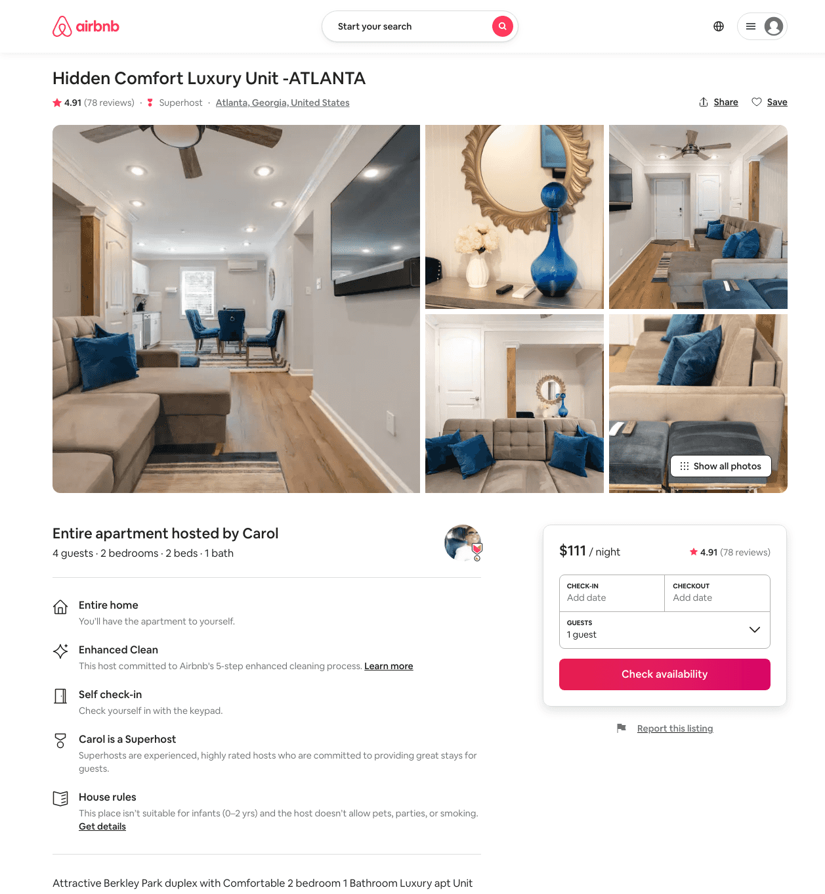
Listing 31840878
2
4
$111 - $143
4.93
2
Carol
14301034
6
https://www.airbnb.com/rooms/31840878
Aug 2022

Slide 14
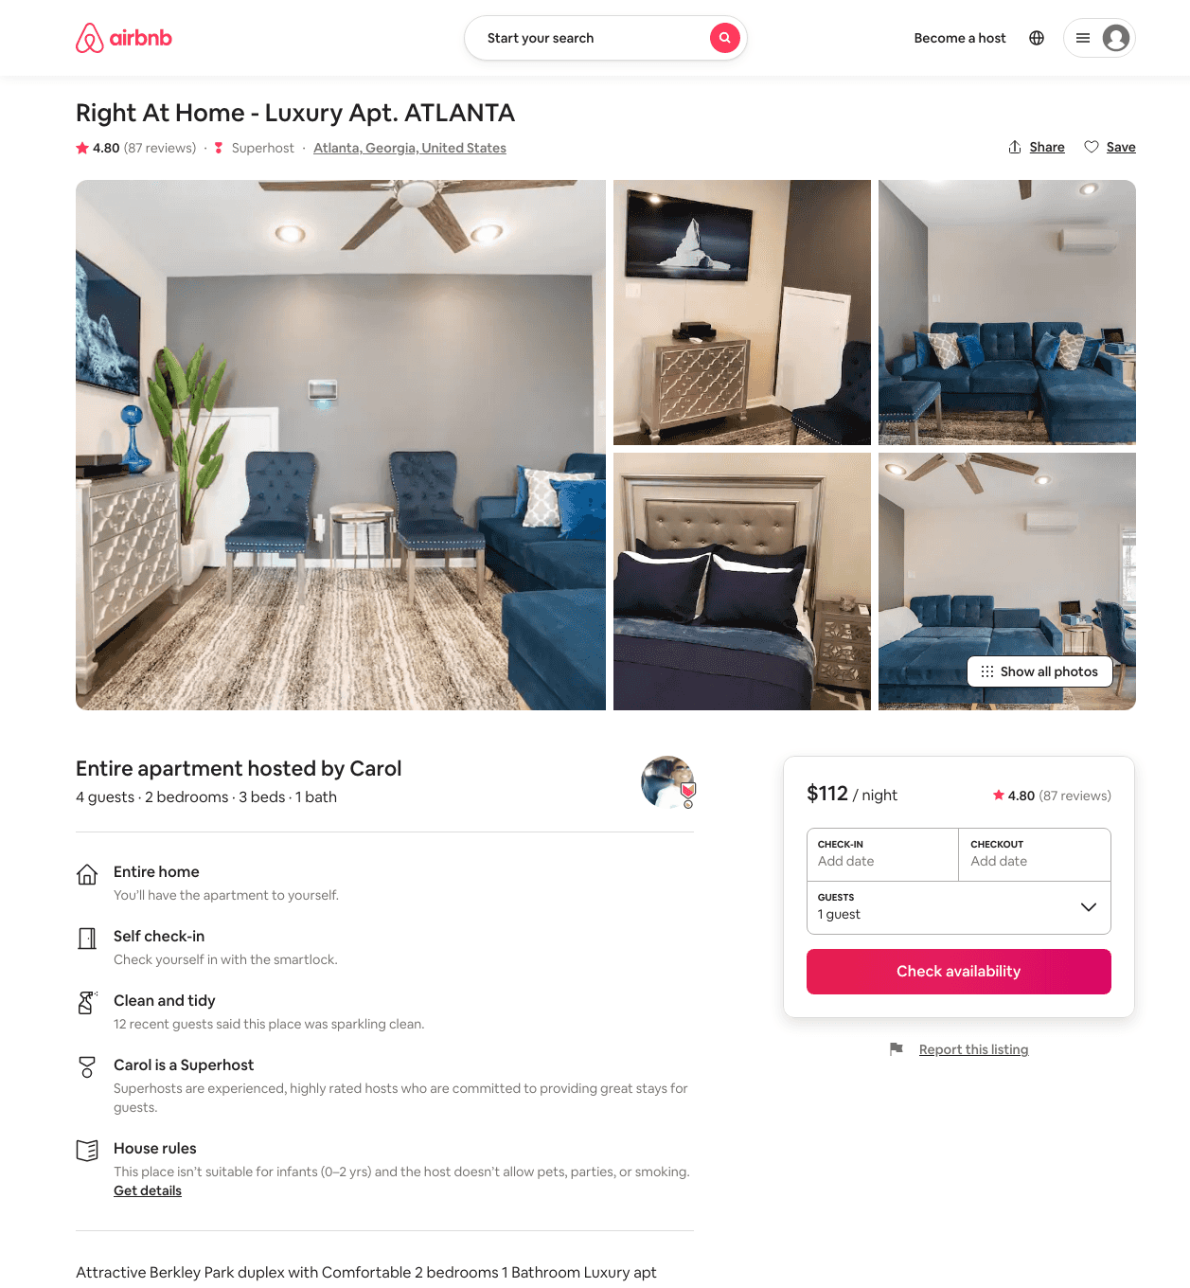
Listing 31519942
2
4
$111 - $132
4.82
2
Carol
14301034
6
https://www.airbnb.com/rooms/31519942
Aug 2022

Slide 15
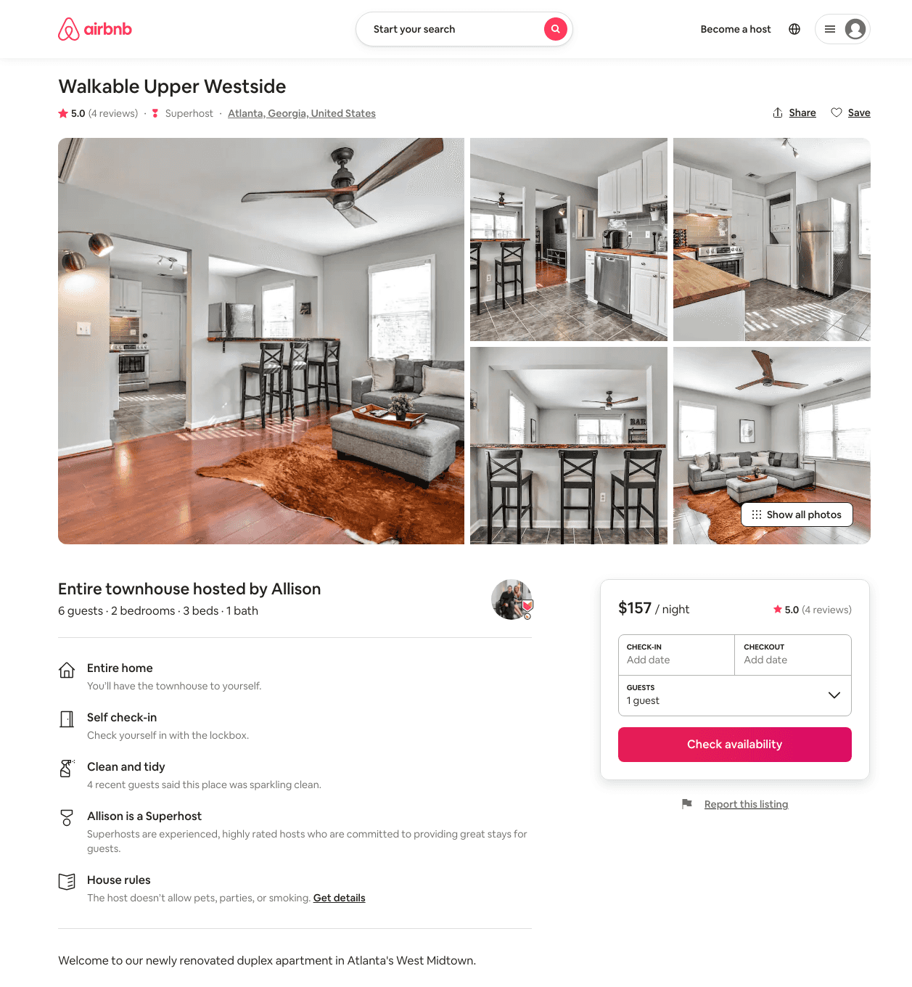
Listing 48200998
2
4
$143 - $179
4.79
4
Allison
84995223
1
https://www.airbnb.com/rooms/48200998
Jun 2022

Slide 16
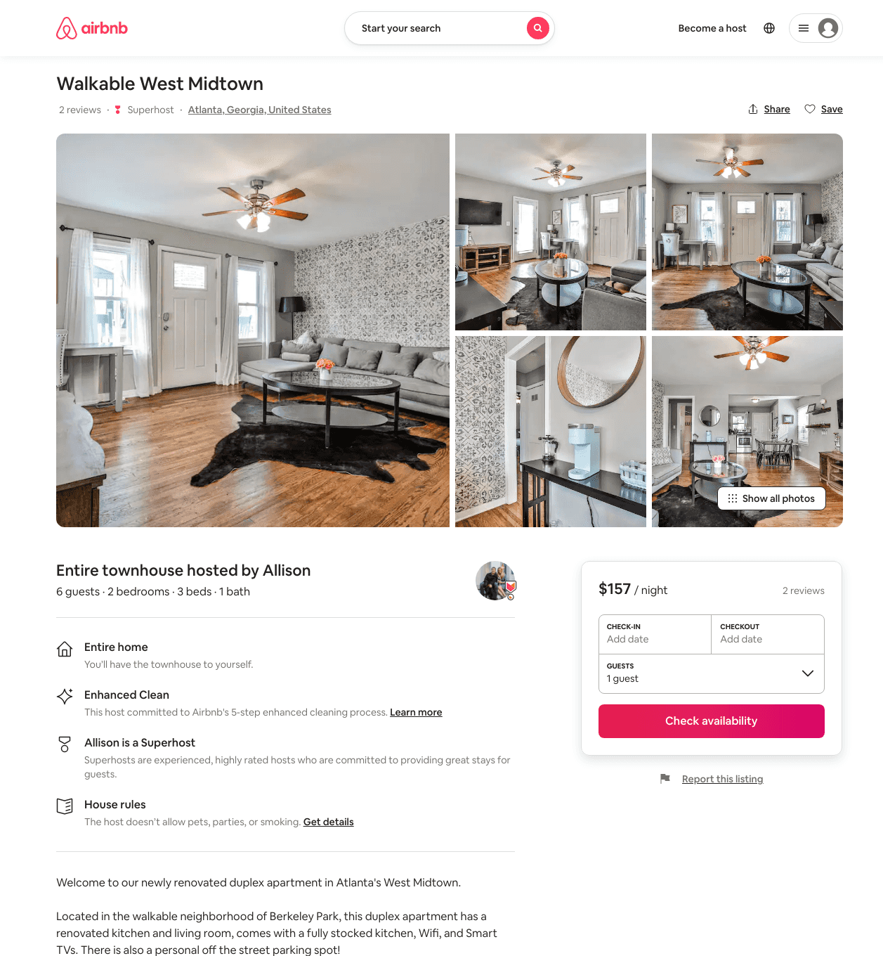
Listing 48186423
2
4
$157 - $214
4.67
4
Diana
475357747
1
https://www.airbnb.com/rooms/48186423
Aug 2022

Slide 17
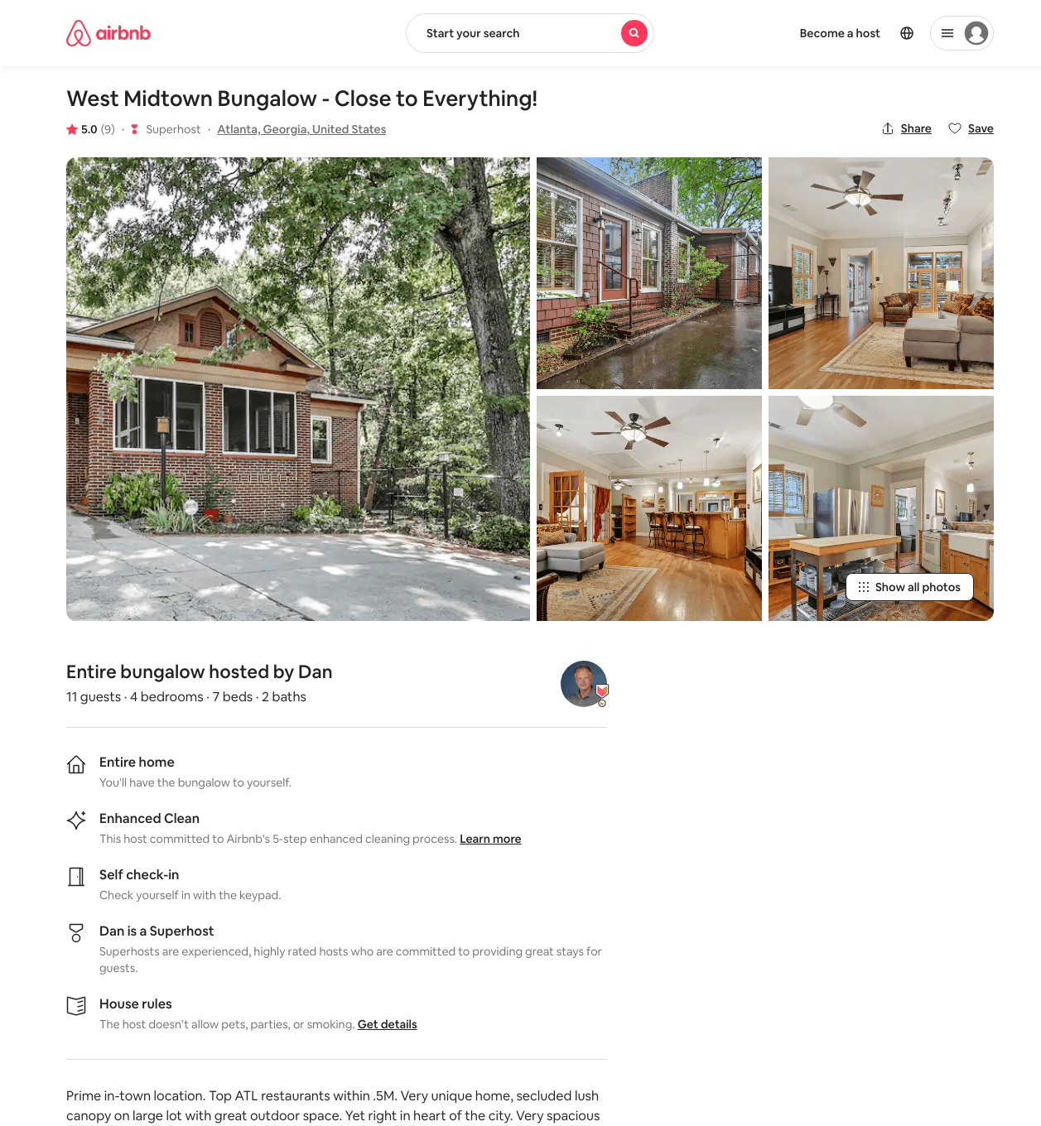
Listing 39863328
4
11
$454 - $478
5.0
3
Dan
294012697
2
https://www.airbnb.com/rooms/39863328
Aug 2022

Slide 18
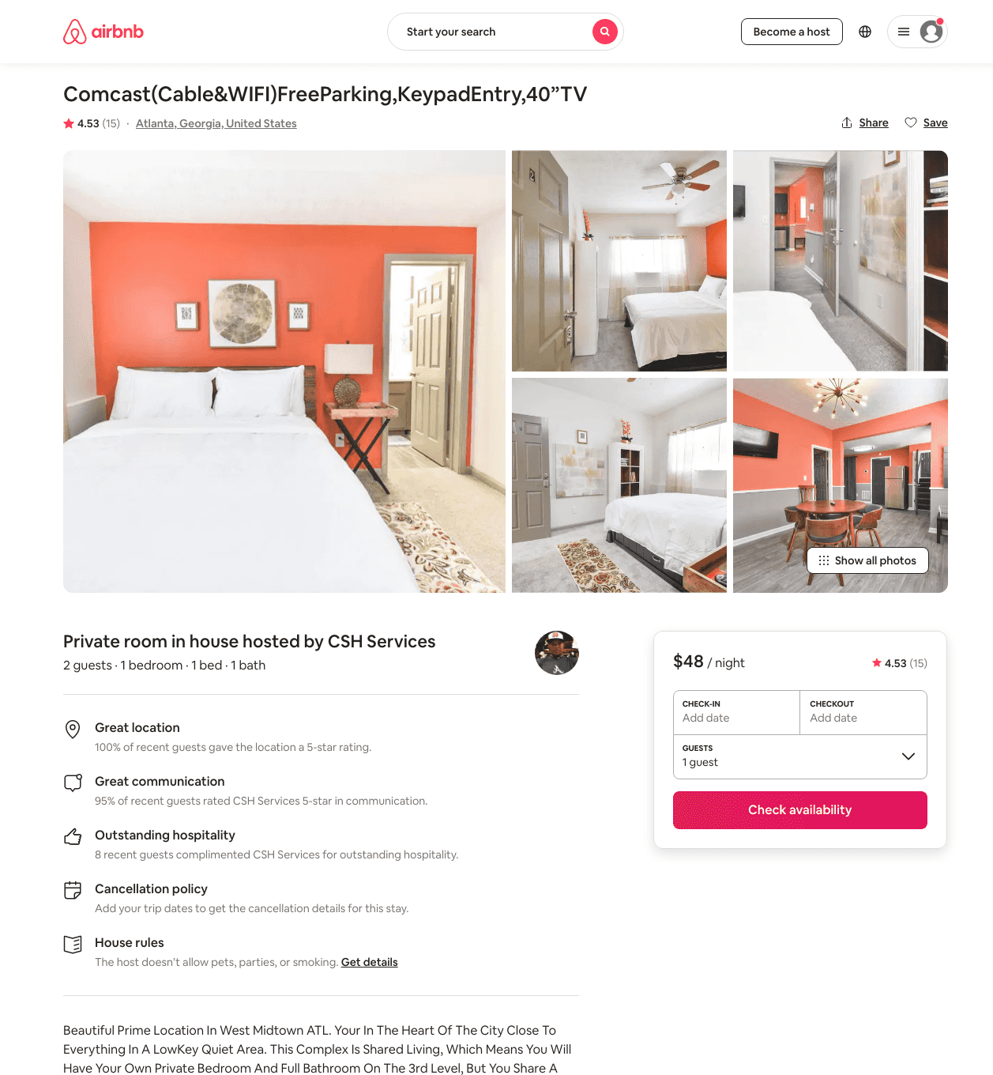
Listing 38905782
1
2
$54 - $70
4.63
1
CSH Services
47225529
4
https://www.airbnb.com/rooms/38905782
Aug 2022

Slide 19
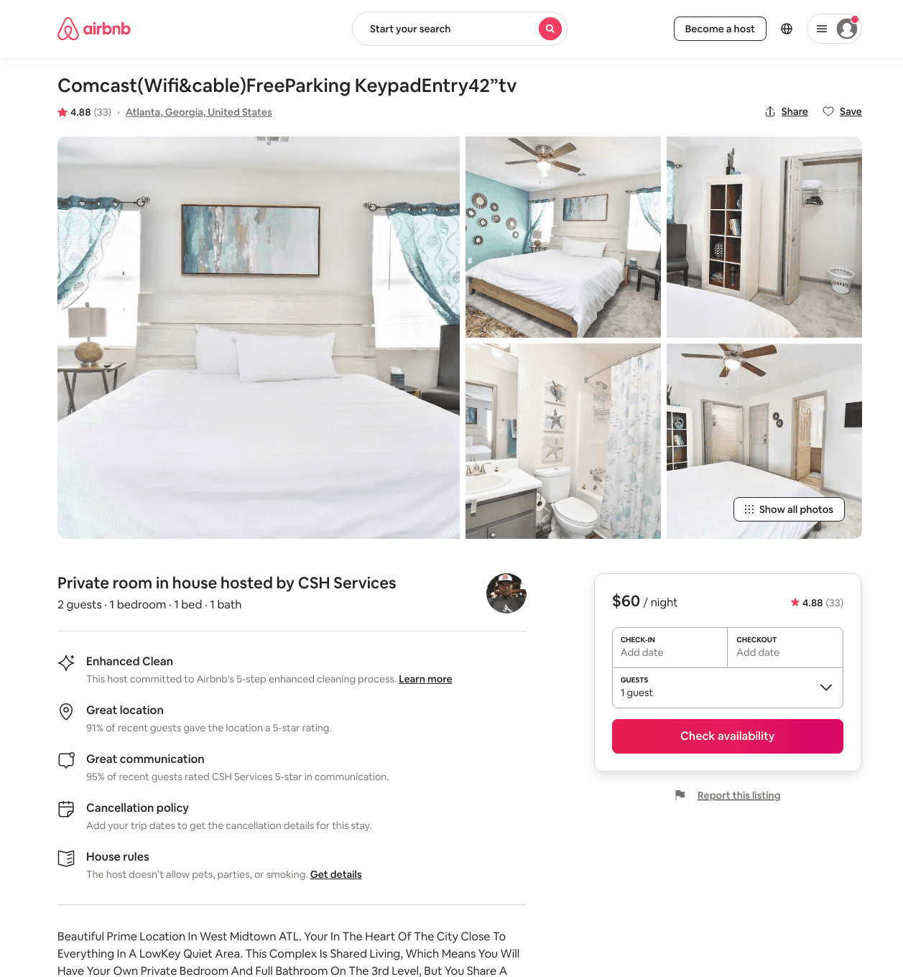
Listing 38897114
1
2
$60 - $67
4.89
1
CSH Services
47225529
4
https://www.airbnb.com/rooms/38897114
Aug 2022

Slide 20
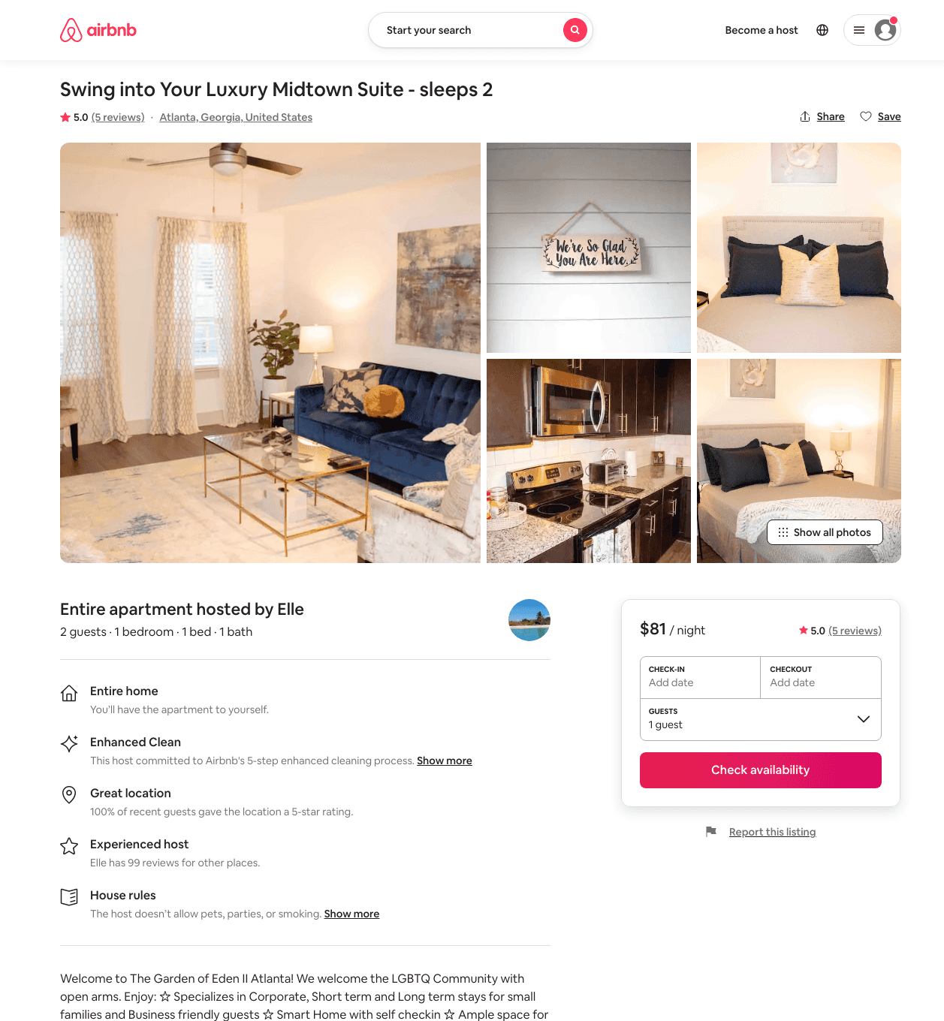
Listing 46092896
1
2
$78 - $153
5.0
28
Jhanelle
102668570
2
https://www.airbnb.com/rooms/46092896
Aug 2022

Slide 21
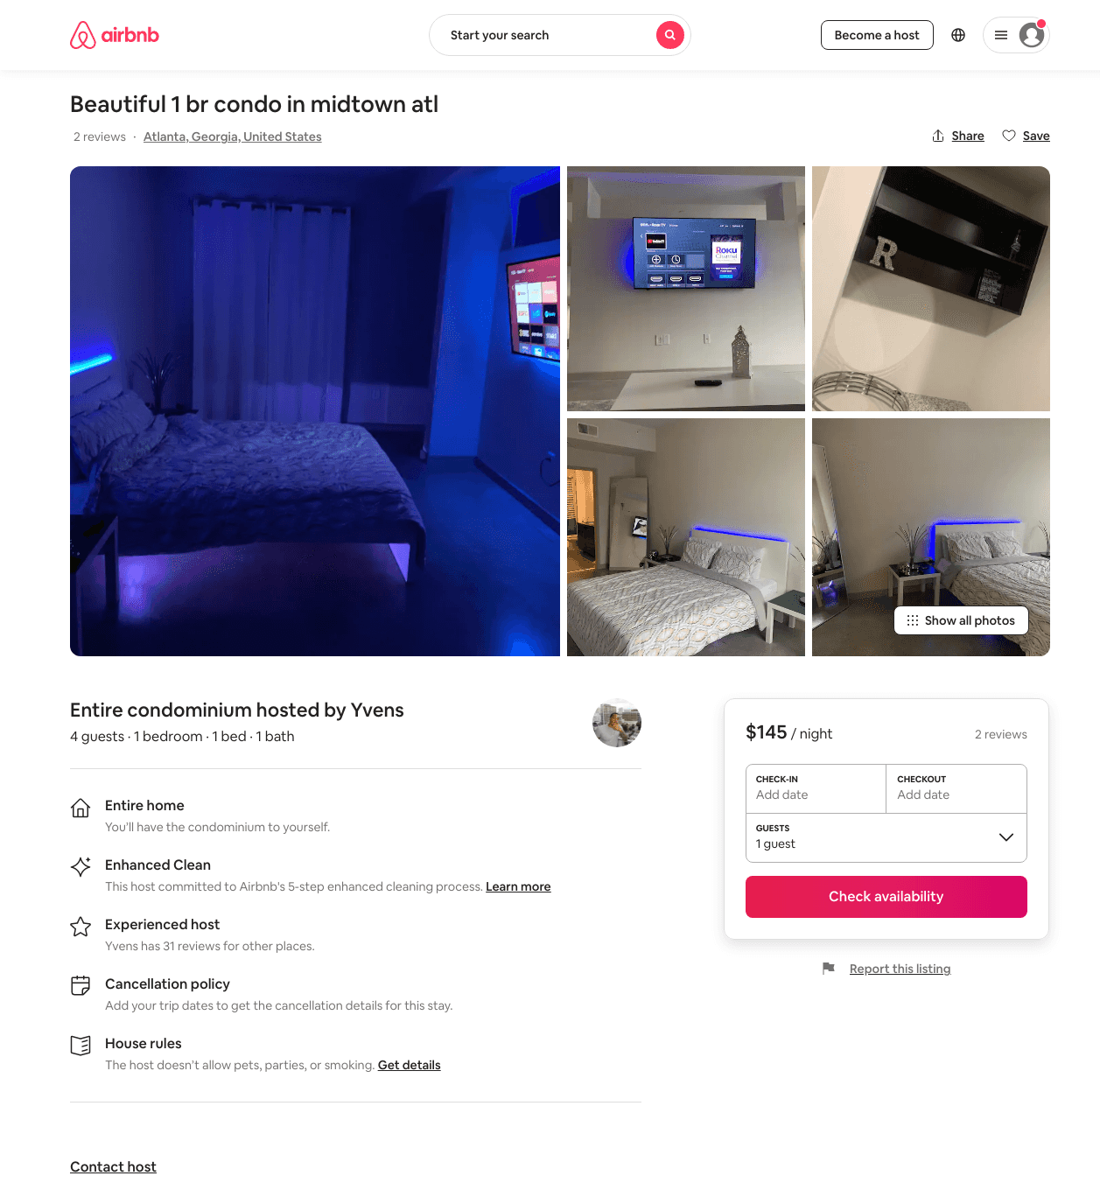
Listing 48348761
1
4
$145 - $785
2.33
1
Yvens
62174166
2
https://www.airbnb.com/rooms/48348761
Jul 2022

Slide 22
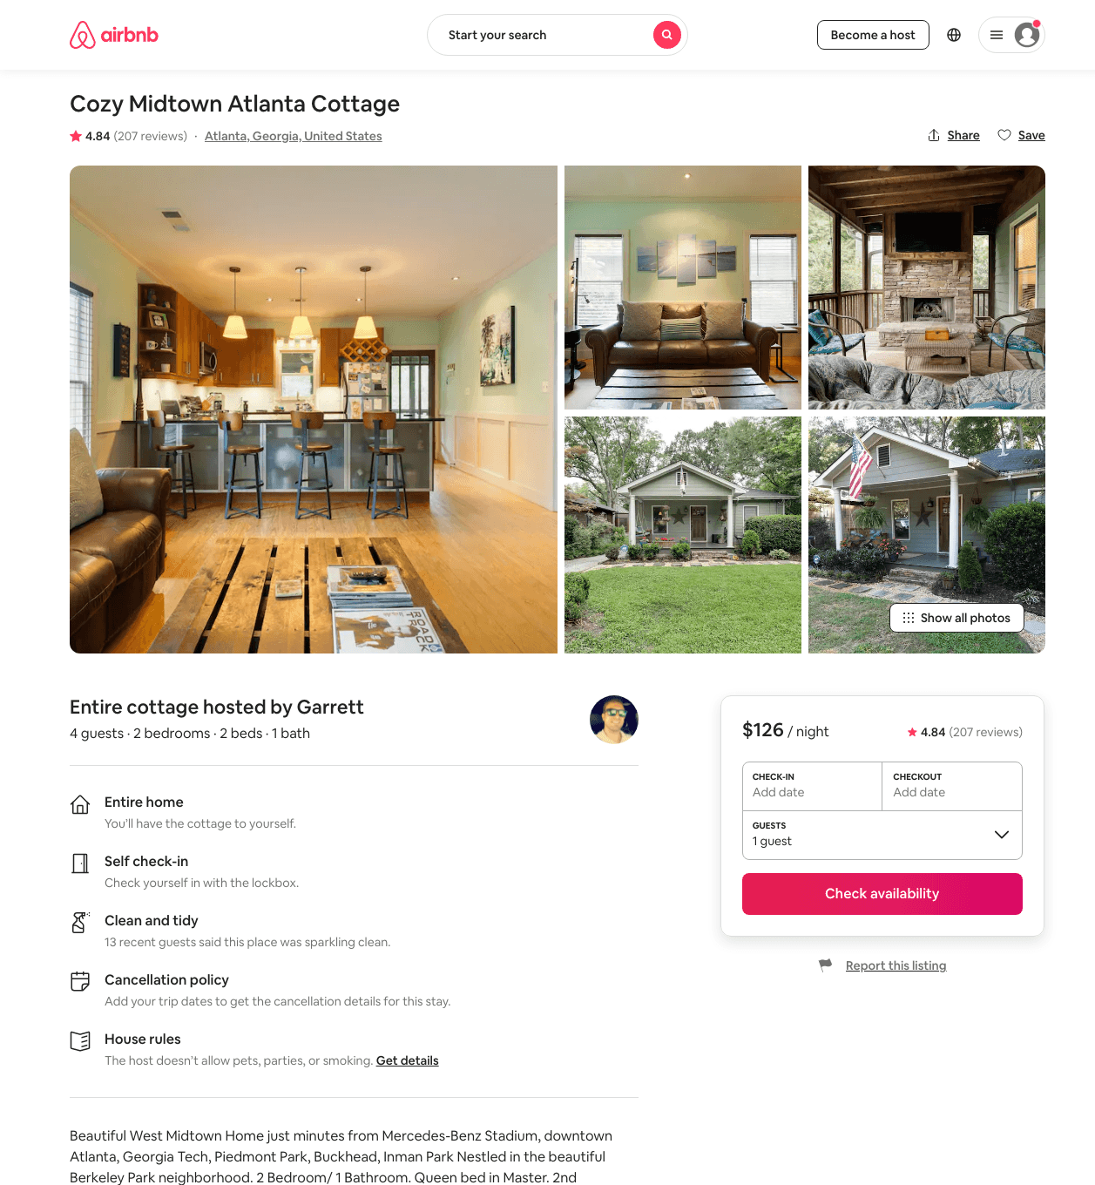
Listing 21345319
2
4
$118 - $163
4.85
1
Garrett
129500764
1
https://www.airbnb.com/rooms/21345319
Aug 2022

Slide 23
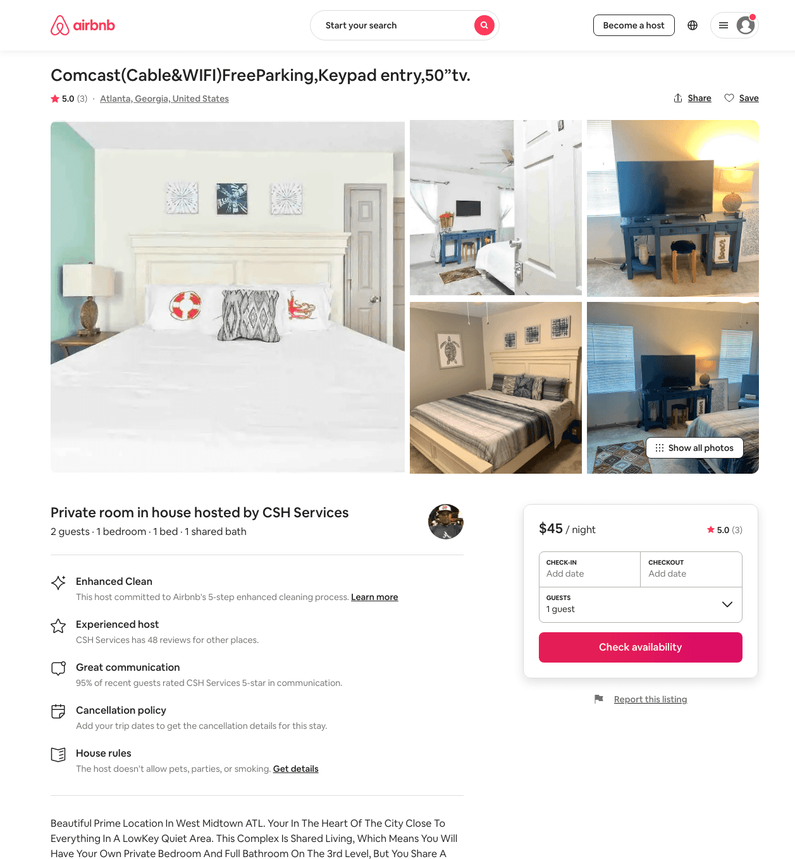
Listing 38880846
1
2
$45 - $70
5.0
1
CSH Services
47225529
4
https://www.airbnb.com/rooms/38880846
Aug 2022

Slide 24
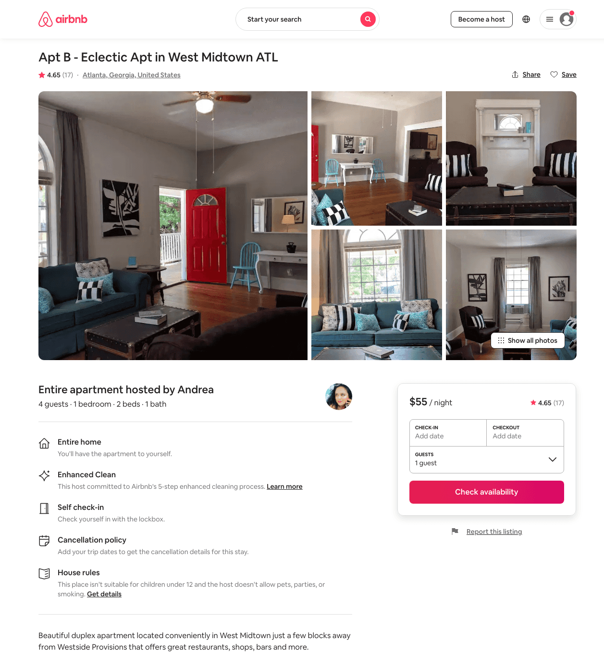
Listing 27391036
1
2
$53 - $75
4.59
30
Andrea
25567237
5
https://www.airbnb.com/rooms/27391036
Aug 2022

Slide 25
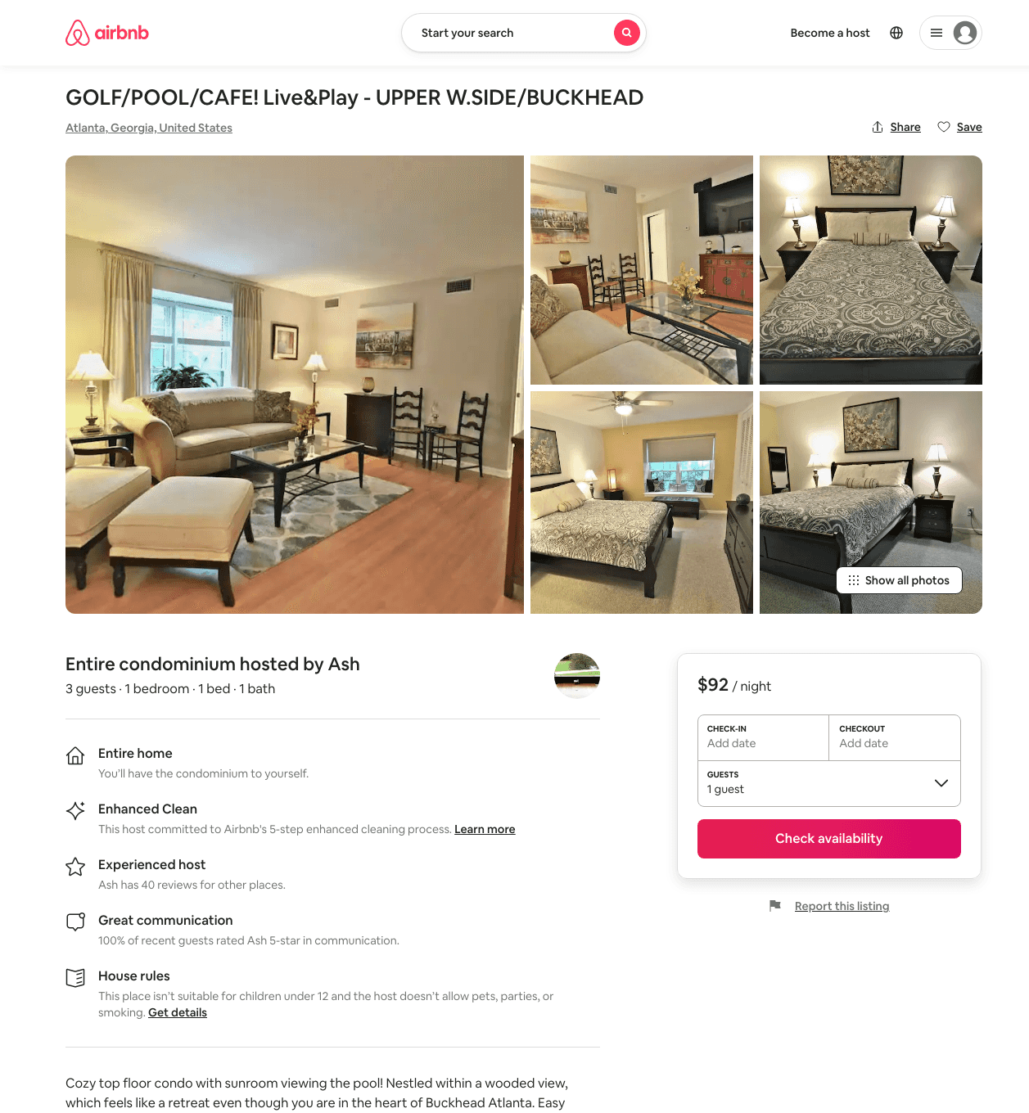
Listing 45253771
1
3
$92 - $98
5.0
14
Ash
169125503
2
https://www.airbnb.com/rooms/45253771
Aug 2022

Slide 26
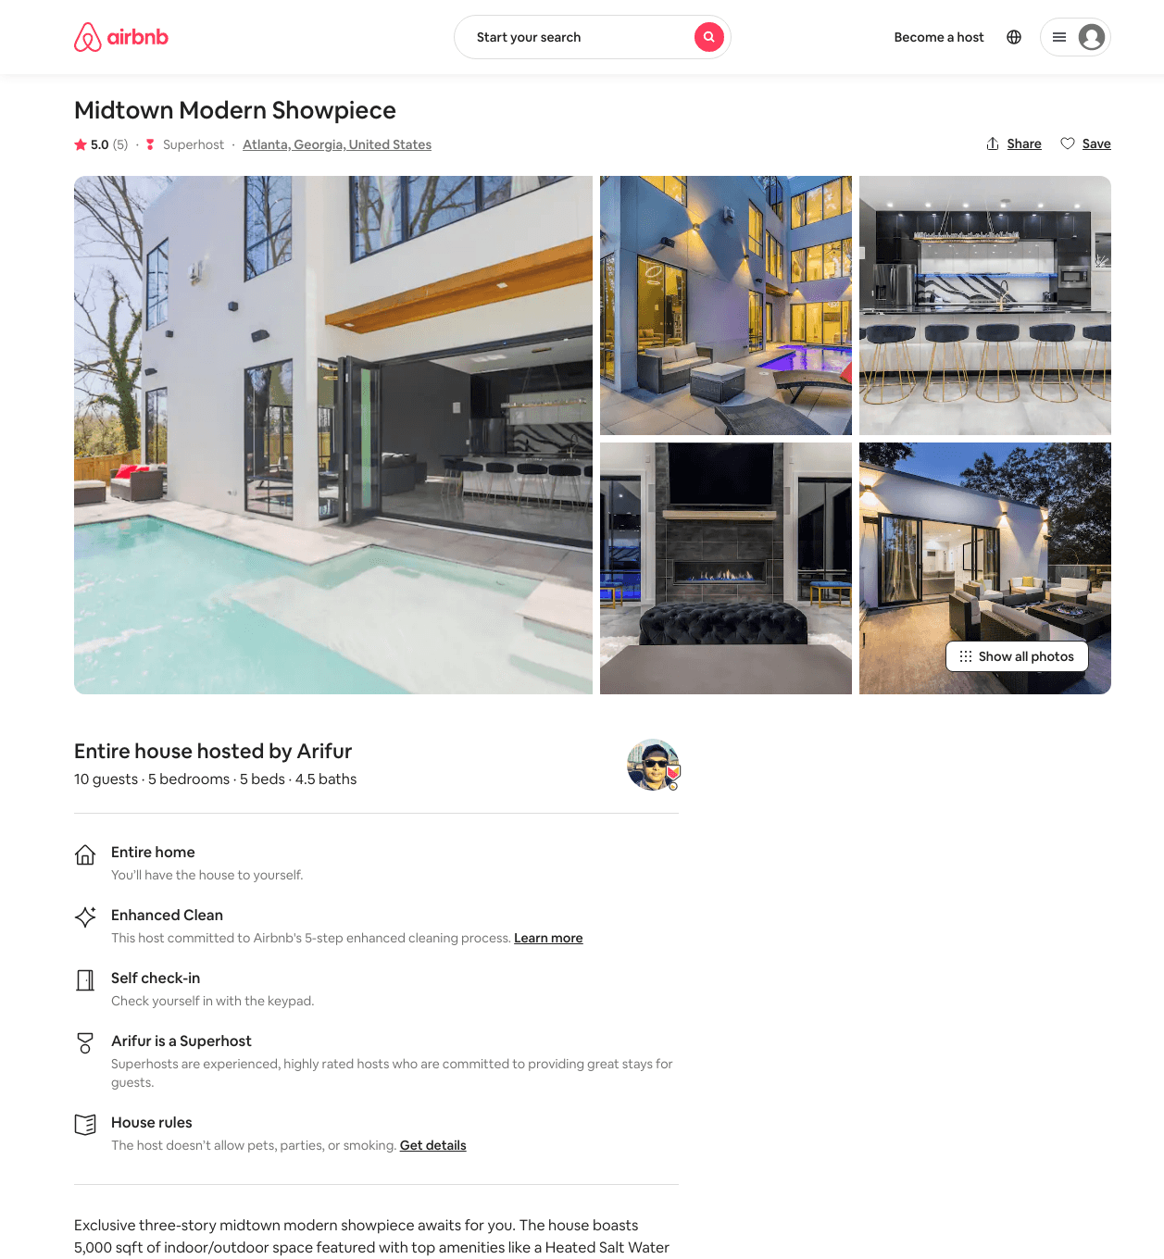
Listing 47050065
6
10
$1462 - $2127
5.0
28
Arifur
229448368
3
https://www.airbnb.com/rooms/47050065
Aug 2022

Slide 27
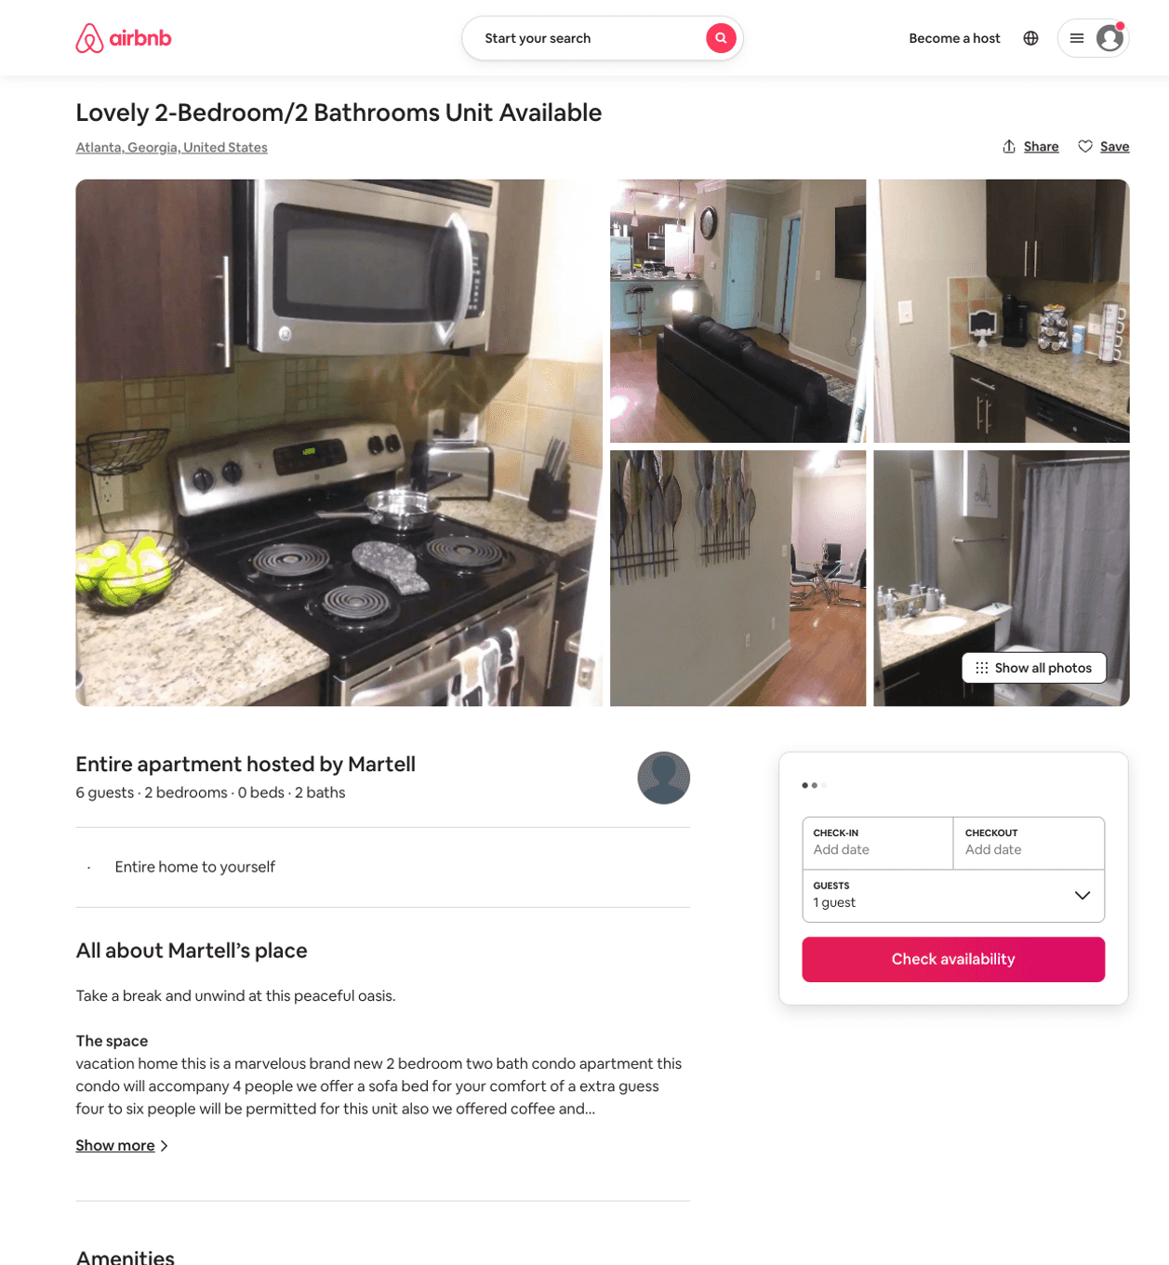
Listing 50775756
2
6
$40 - $145
4.24
1
Martell
409174015
3
https://www.airbnb.com/rooms/50775756
Aug 2022

Slide 28
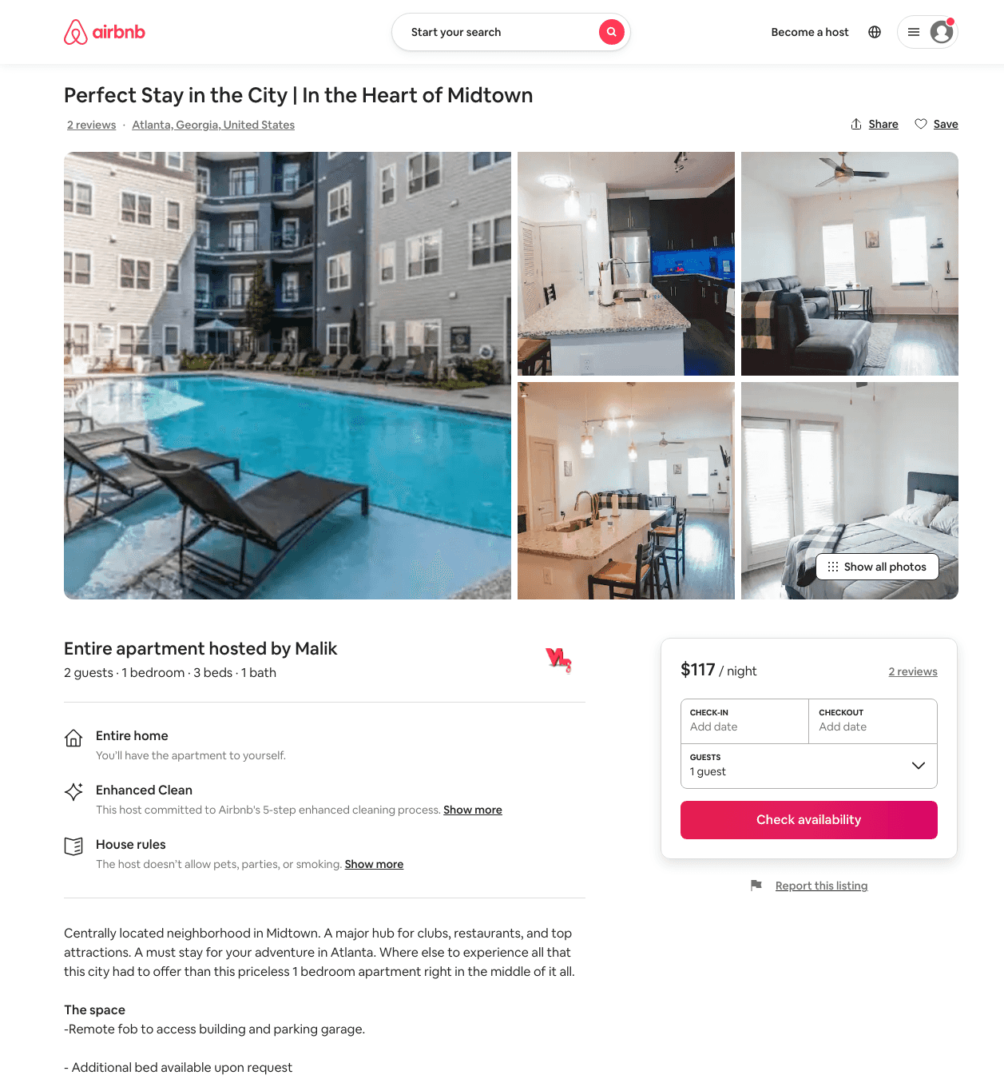
Listing 49465844
1
2
$114 - $128
4.72
1
Malik
233041840
1
https://www.airbnb.com/rooms/49465844
Aug 2022

Slide 29
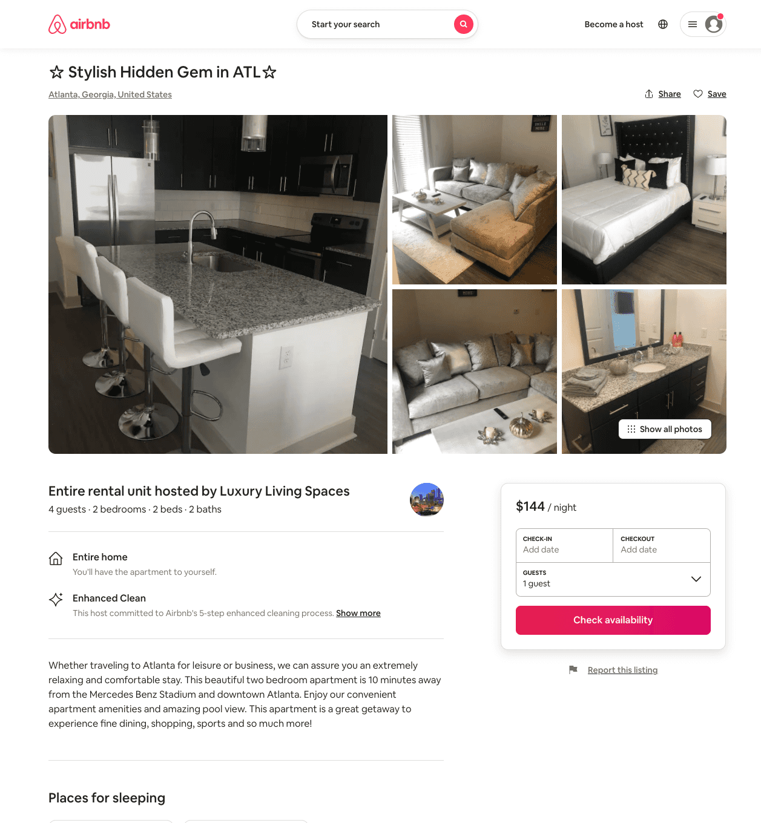
Listing 50959557
2
4
$94 - $200
4.88
1
Luxury Living Spaces
36302745
1
https://www.airbnb.com/rooms/50959557
Jul 2022

Slide 30
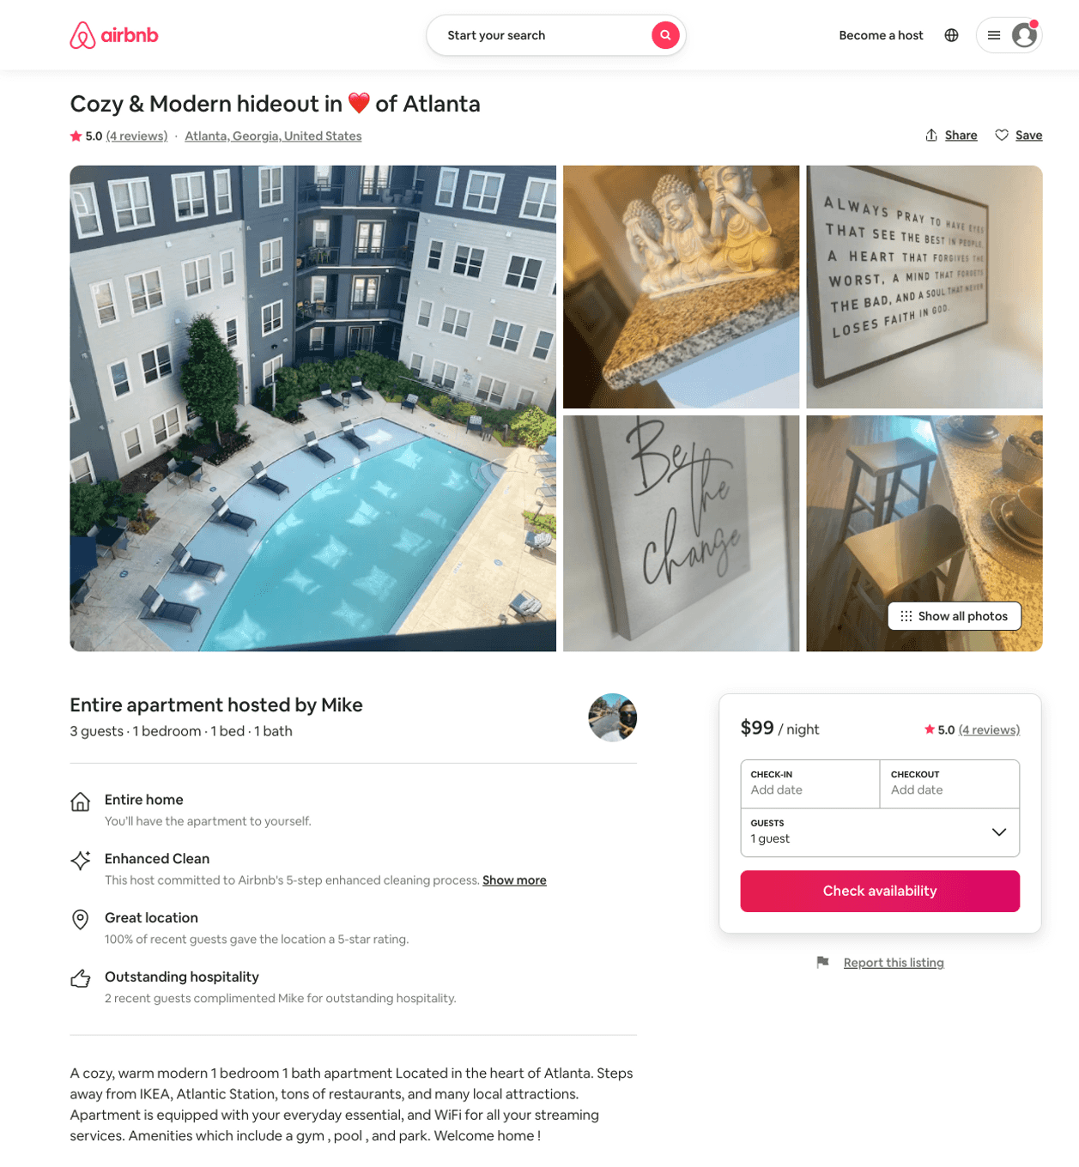
Listing 49775228
1
3
$73 - $110
4.56
2
Mike
367882473
4
https://www.airbnb.com/rooms/49775228
Aug 2022

Slide 31
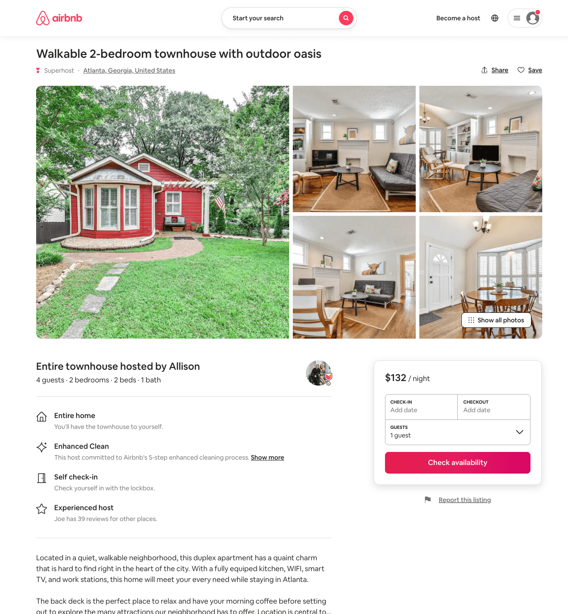
Listing 51216515
2
4
$132
4.65
3
Joe
23917427
2
https://www.airbnb.com/rooms/51216515
Aug 2022

Slide 32
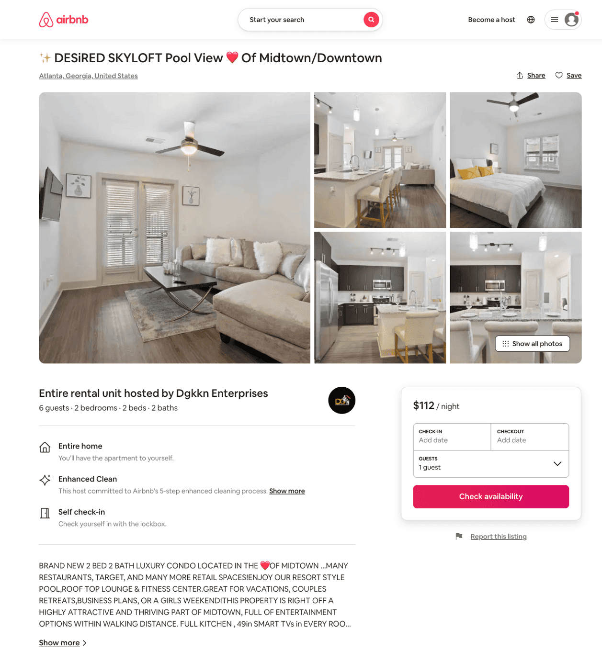
Listing 51302239
2
6
$127 - $198
4.78
2
Dgkkn Enterprises
389246623
4
https://www.airbnb.com/rooms/51302239
Aug 2022

Slide 33
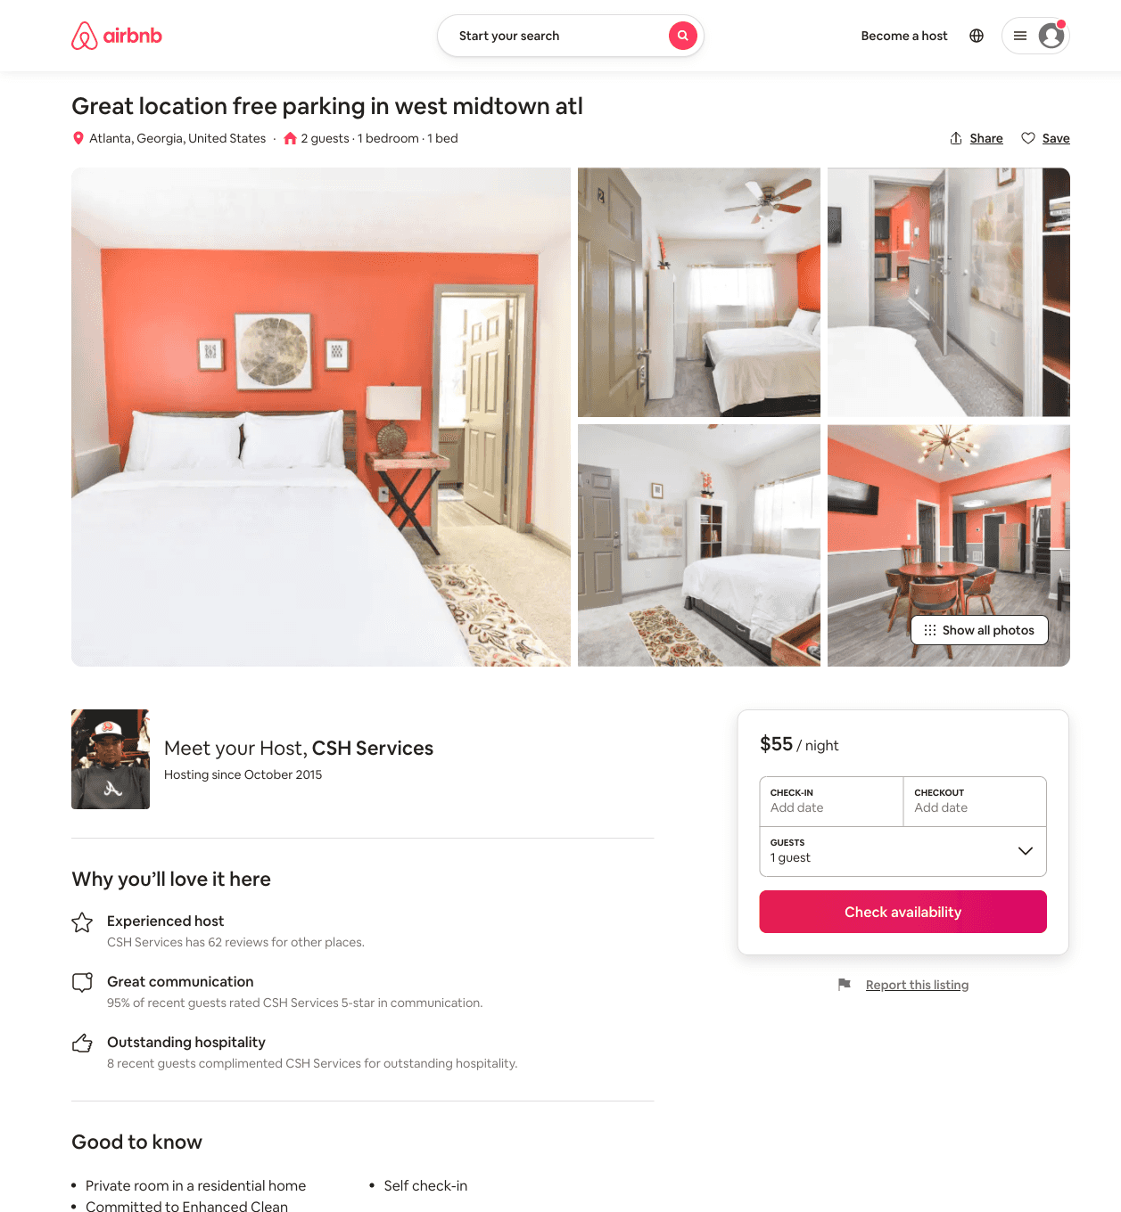
Listing 51462282
1
2
$55 - $60
4.50
1
CSH Services
47225529
4
https://www.airbnb.com/rooms/51462282
Jul 2022

Slide 34
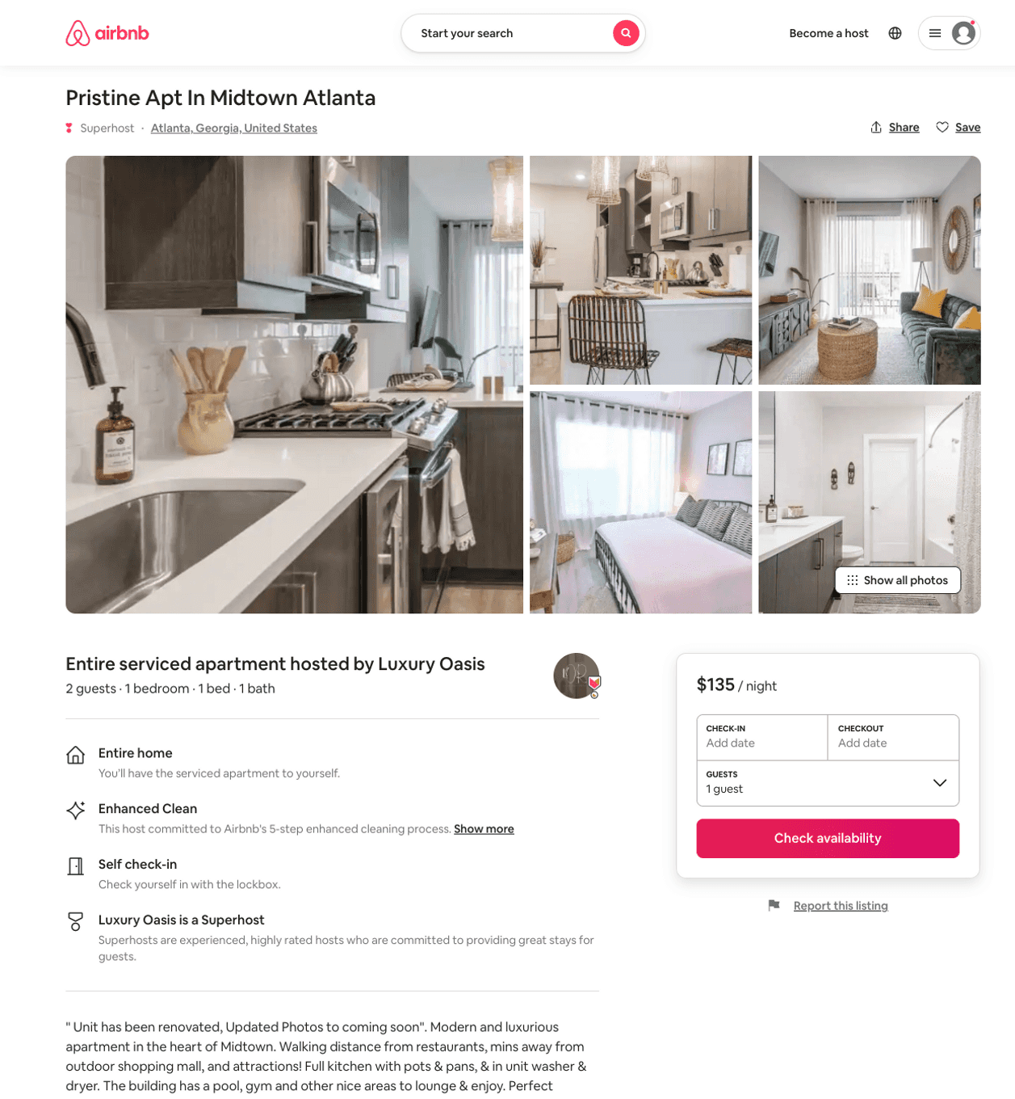
Listing 51722785
3
6
$118 - $258
5.0
2
Luxury Oasis
211826760
6
https://www.airbnb.com/rooms/51722785
Aug 2022

Slide 35
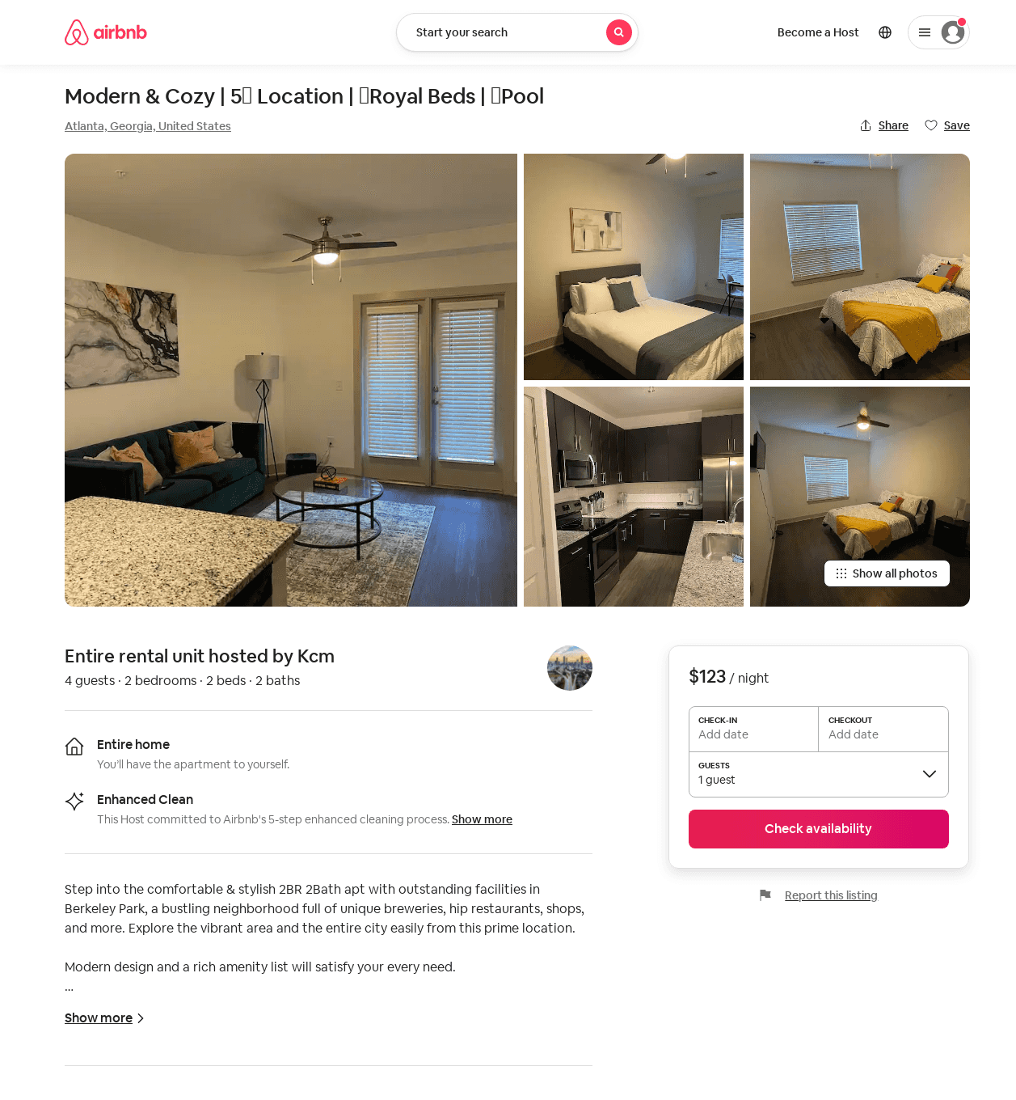
Listing 52486854
2
4
$94 - $154
4.84
1
Kcm Management
424840845
2
https://www.airbnb.com/rooms/52486854
Aug 2022

Slide 36
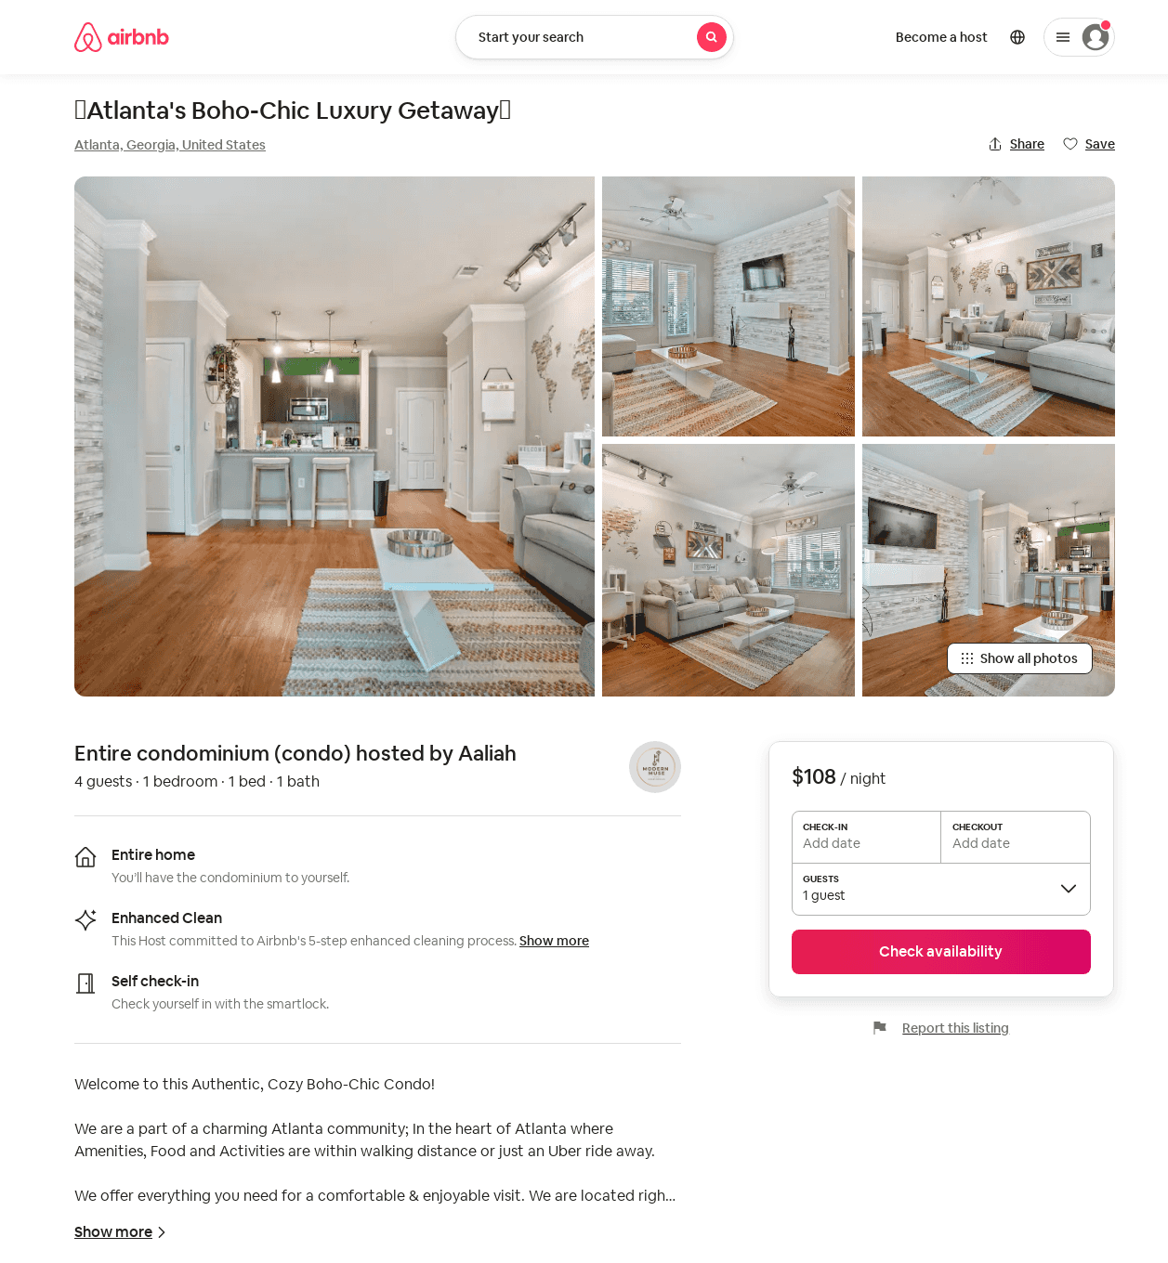
Listing 52769526
1
4
$92 - $250
4.56
1
Aaliah
426895084
1
https://www.airbnb.com/rooms/52769526
Jul 2022

Slide 37
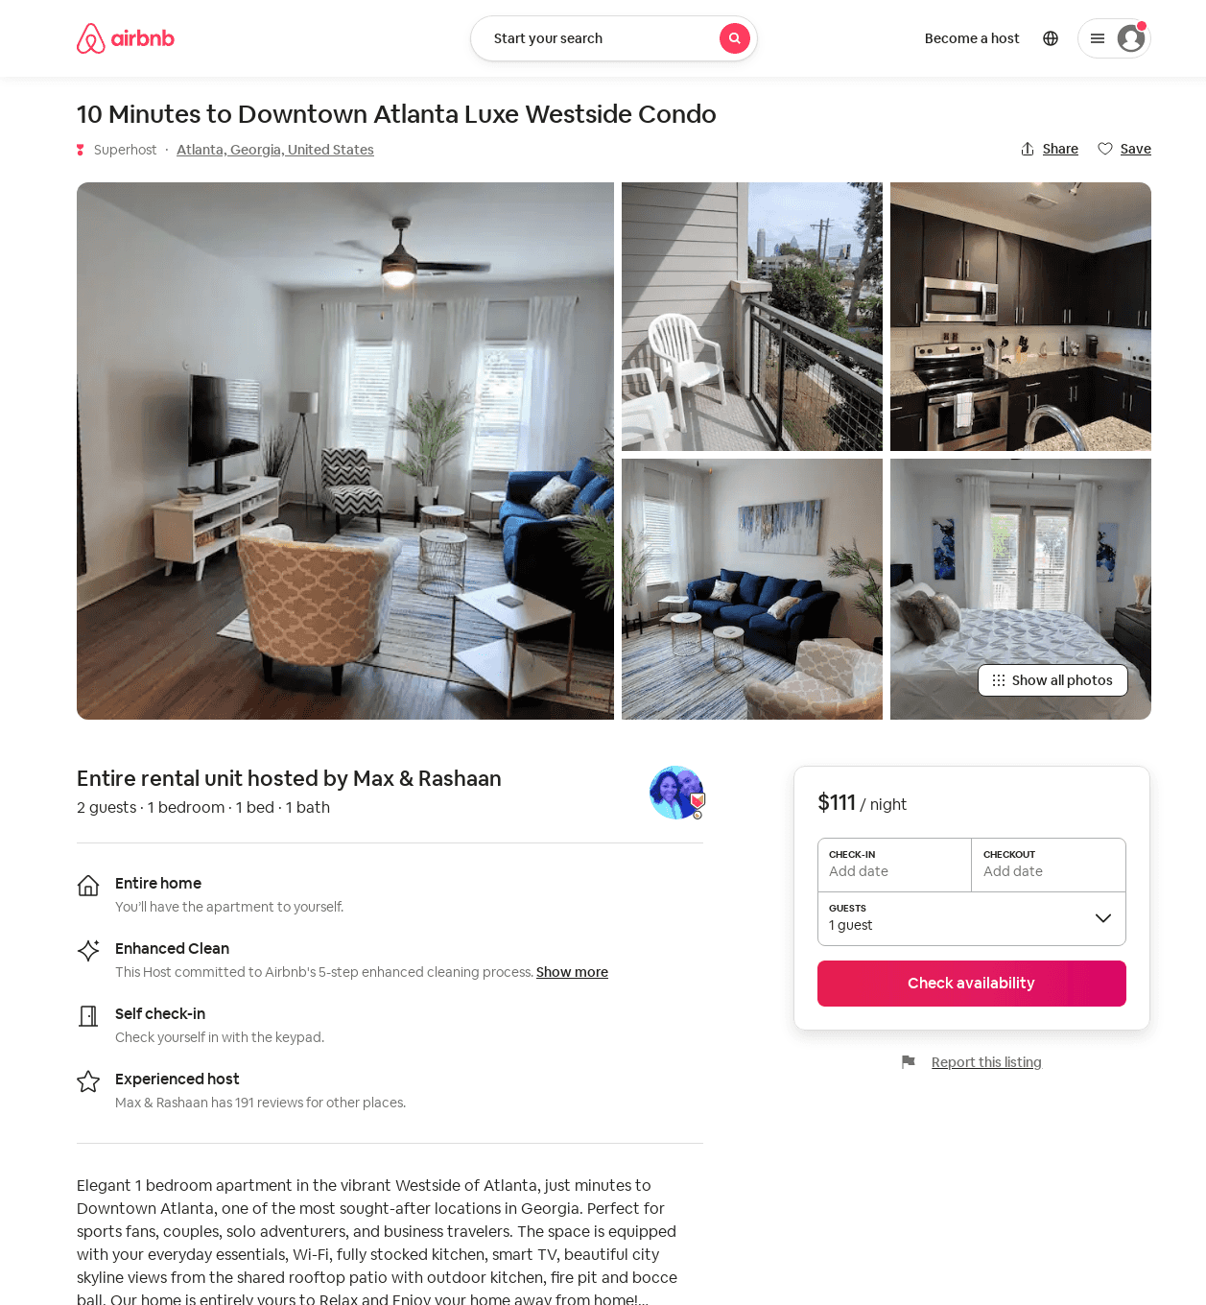
Listing 52820666
1390 NORTHSIDE DR NW
1
2
$81 - $141
4.88
1
Max & Rashaan
135506496
5
https://www.airbnb.com/rooms/52820666
Aug 2022

Slide 38
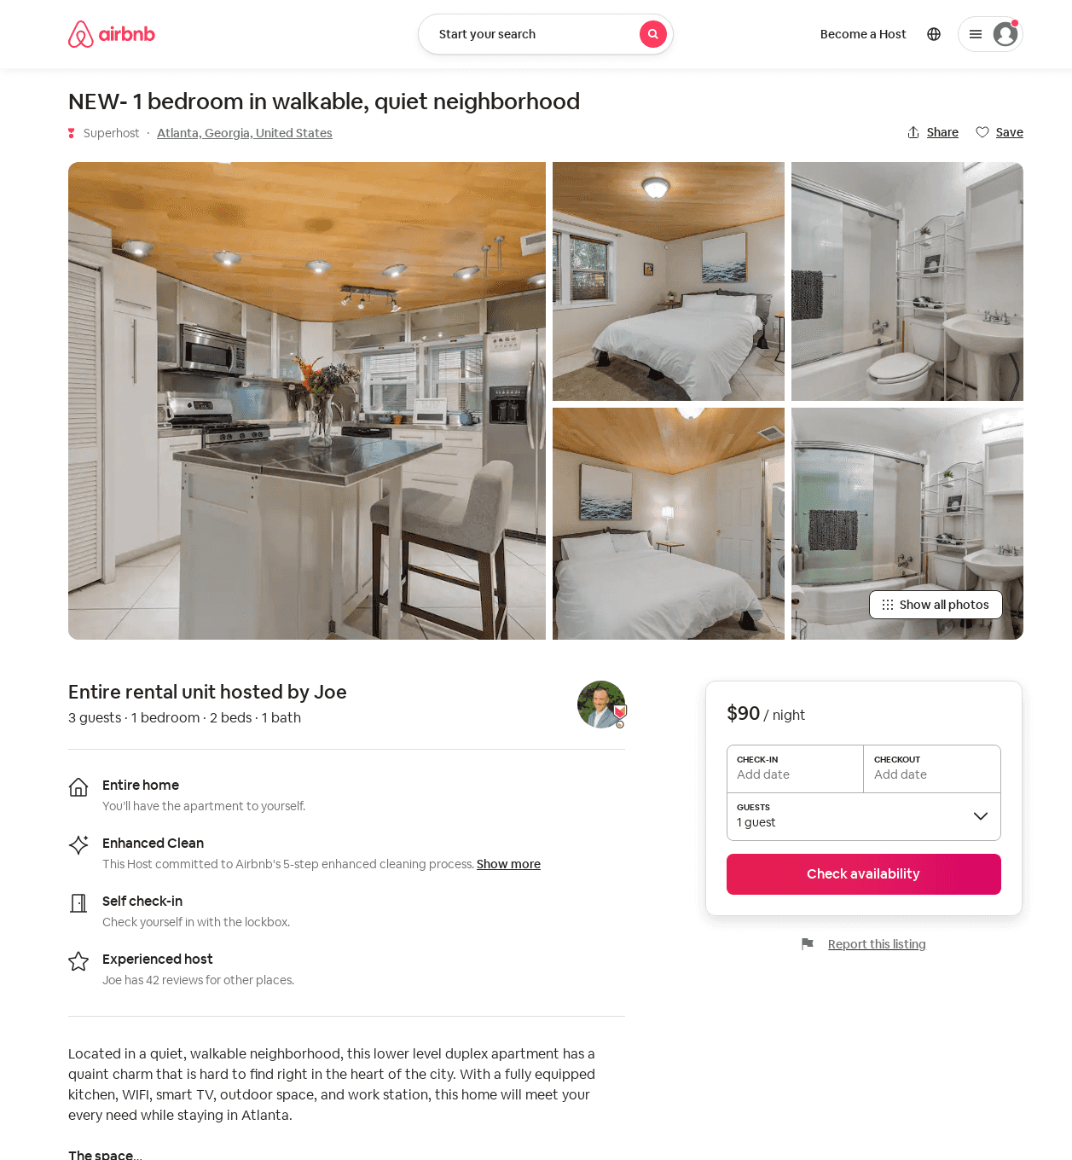
Listing 52729276
1
3
$90
4.57
4
Joe
23917427
2
https://www.airbnb.com/rooms/52729276
Aug 2022

Slide 39
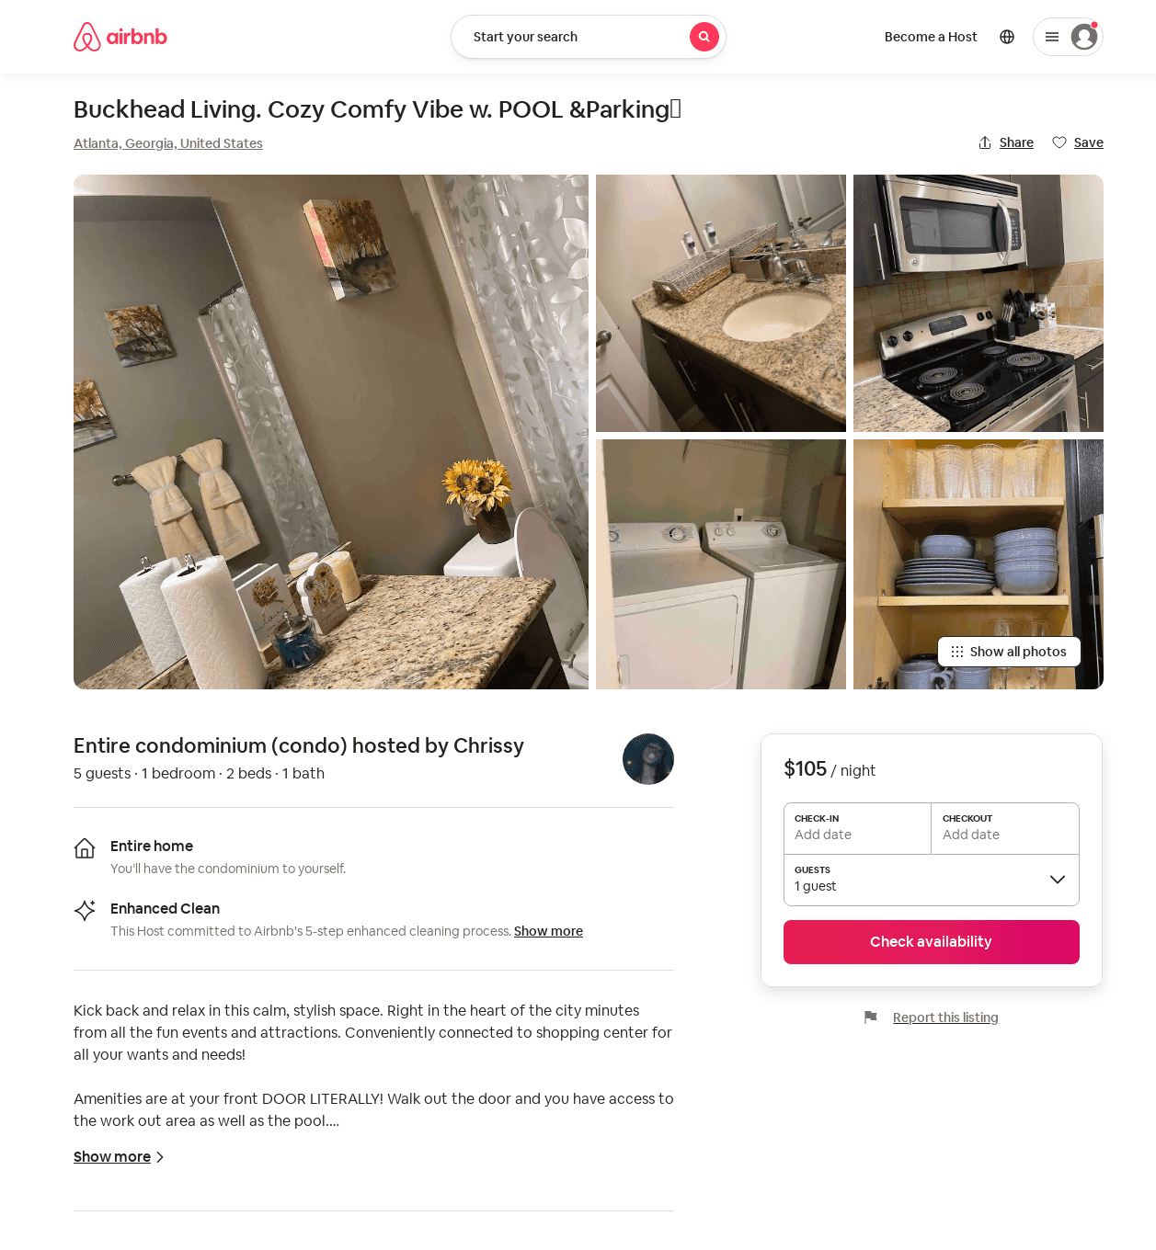
Listing 50342039
1
4
$80 - $146
4.77
2
Chrissy
187365620
2
https://www.airbnb.com/rooms/50342039
Aug 2022

Slide 40
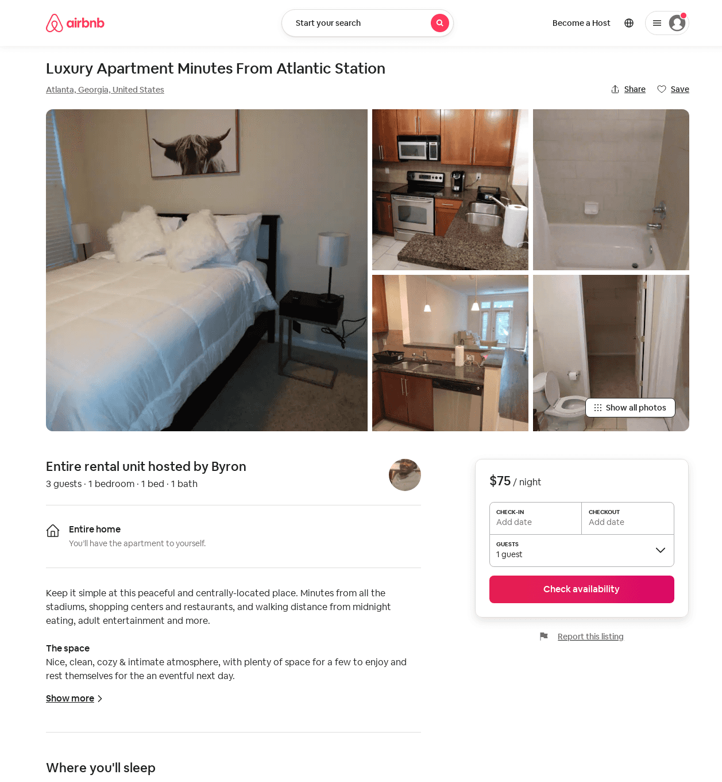
Listing 52941934
1
3
$43 - $100
4.31
1
Byron
428598500
1
https://www.airbnb.com/rooms/52941934
Aug 2022

Slide 41
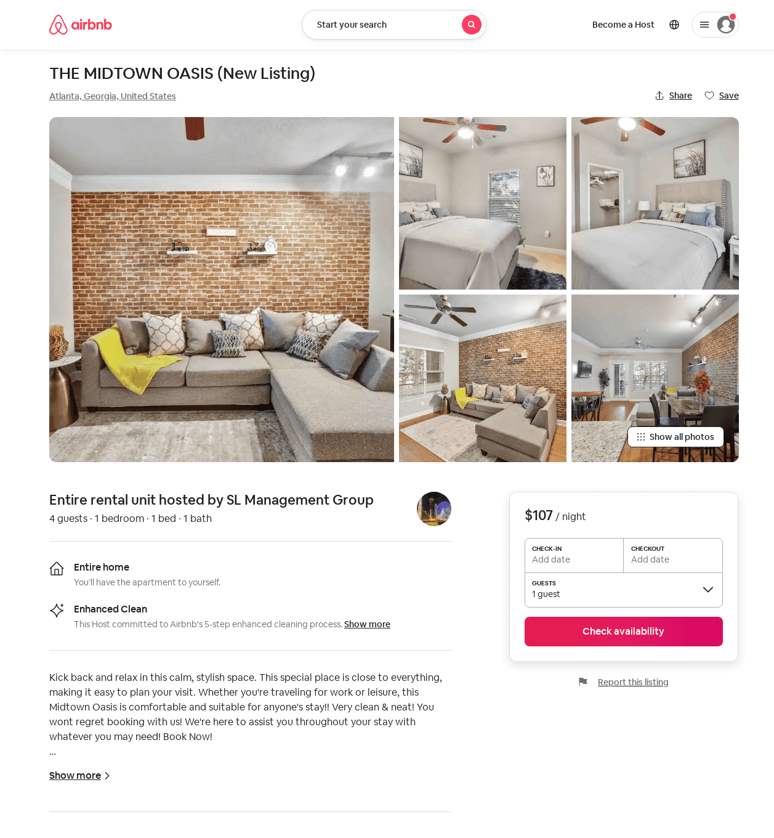
Listing 53006830
1
4
$65 - $131
4.82
2
SL Management Group
370296422
1
https://www.airbnb.com/rooms/53006830
Aug 2022

Slide 42
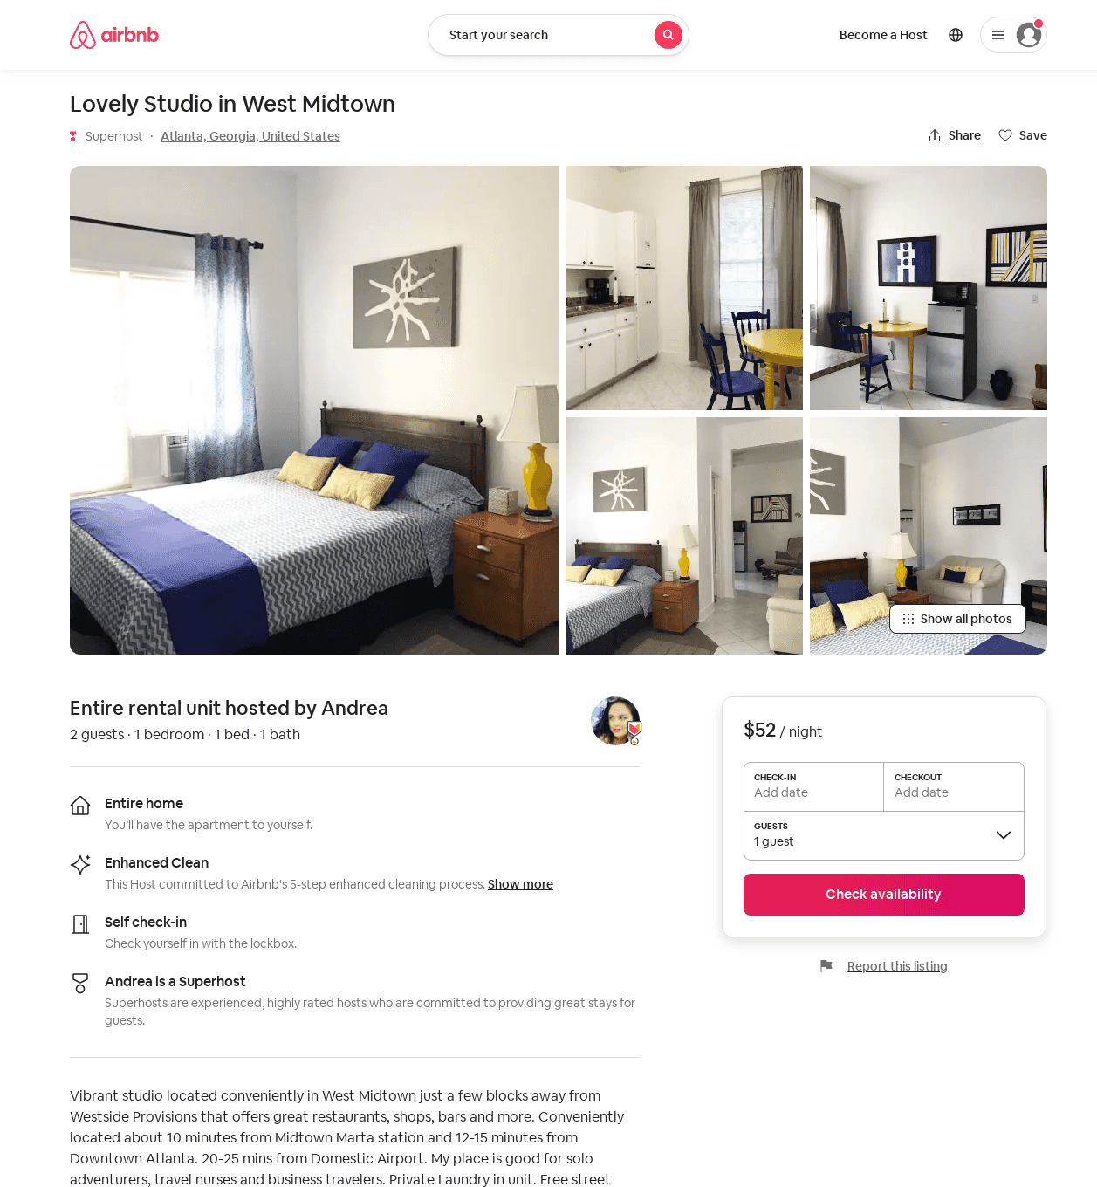
Listing 53309808
1
2
$52 - $90
30
Andrea
25567237
5
https://www.airbnb.com/rooms/53309808
Aug 2022

Slide 43
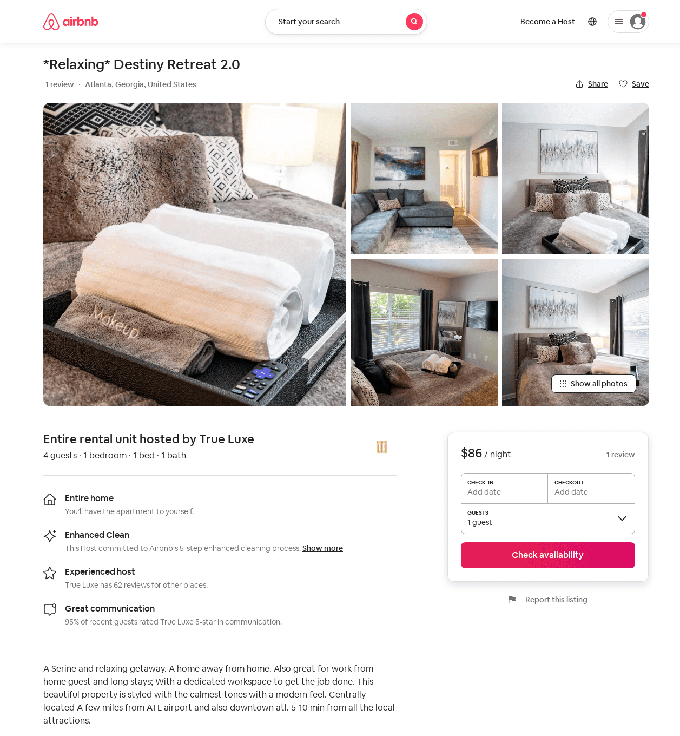
Listing 52923469
1
4
$84 - $130
4.33
1
True Luxe
326342139
2
https://www.airbnb.com/rooms/52923469
Aug 2022

Slide 44
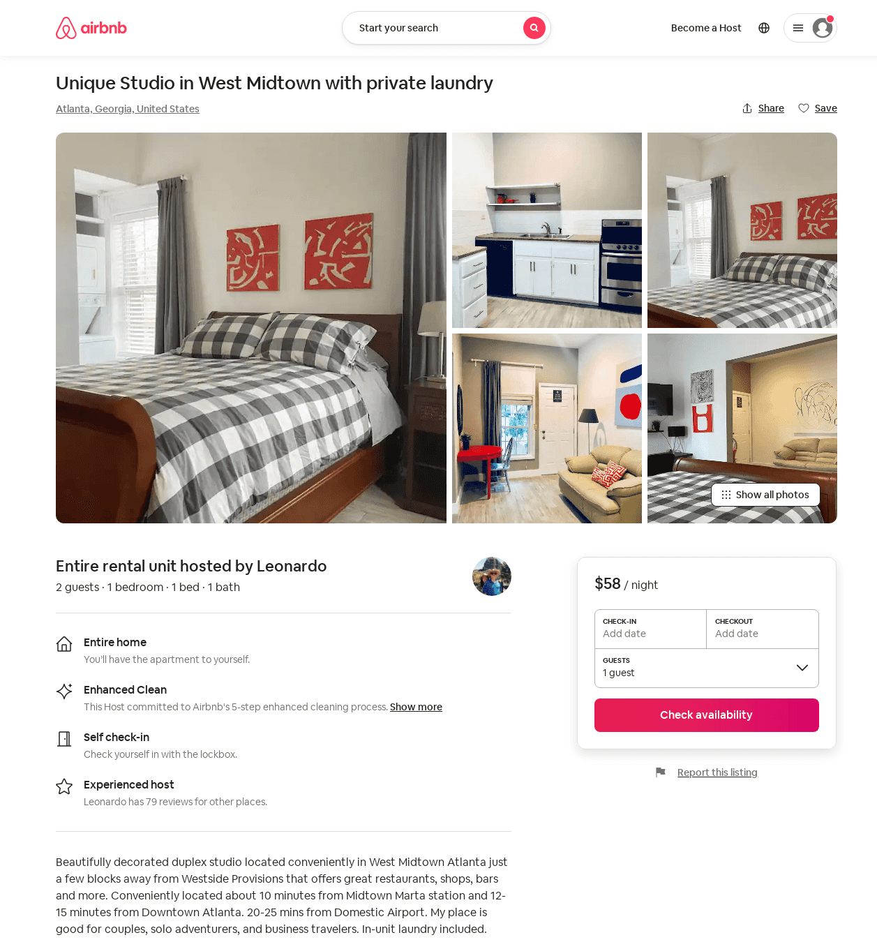
Listing 53359584
1
2
$55 - $120
30
Andrea
25567237
5
https://www.airbnb.com/rooms/53359584
Aug 2022

Slide 45
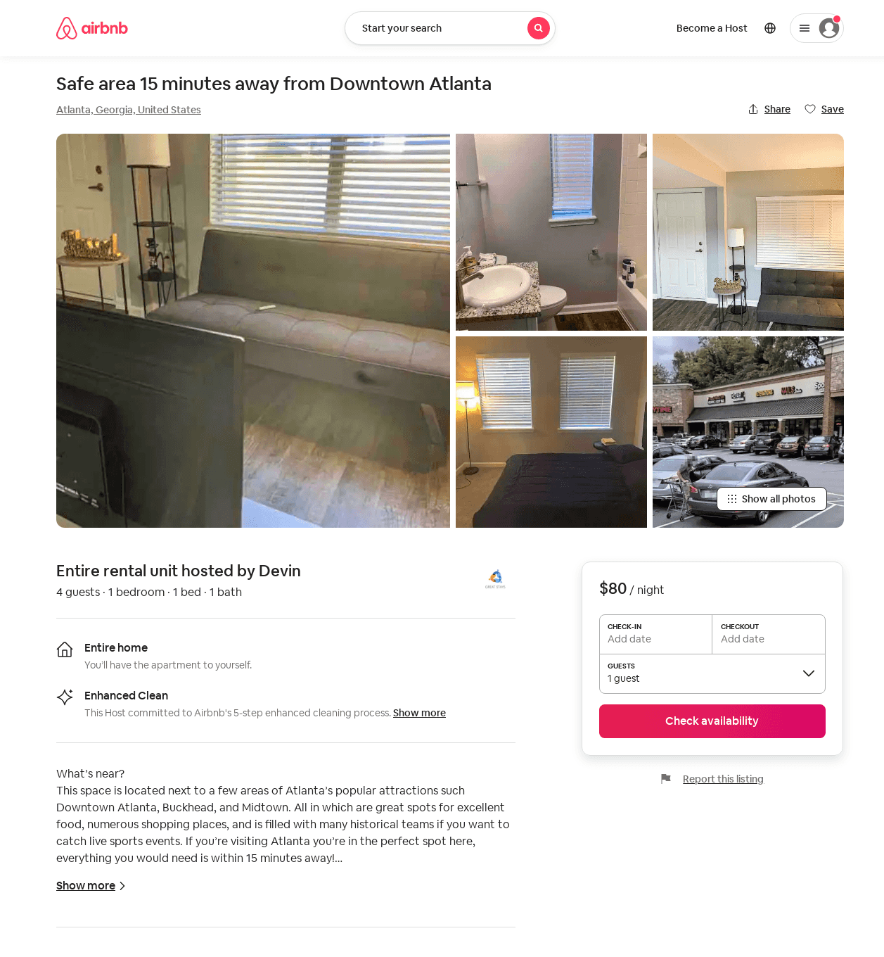
Listing 25546178
1
4
$65 - $149
4.58
2
Devin
87620436
1
https://www.airbnb.com/rooms/25546178
Aug 2022

Slide 46
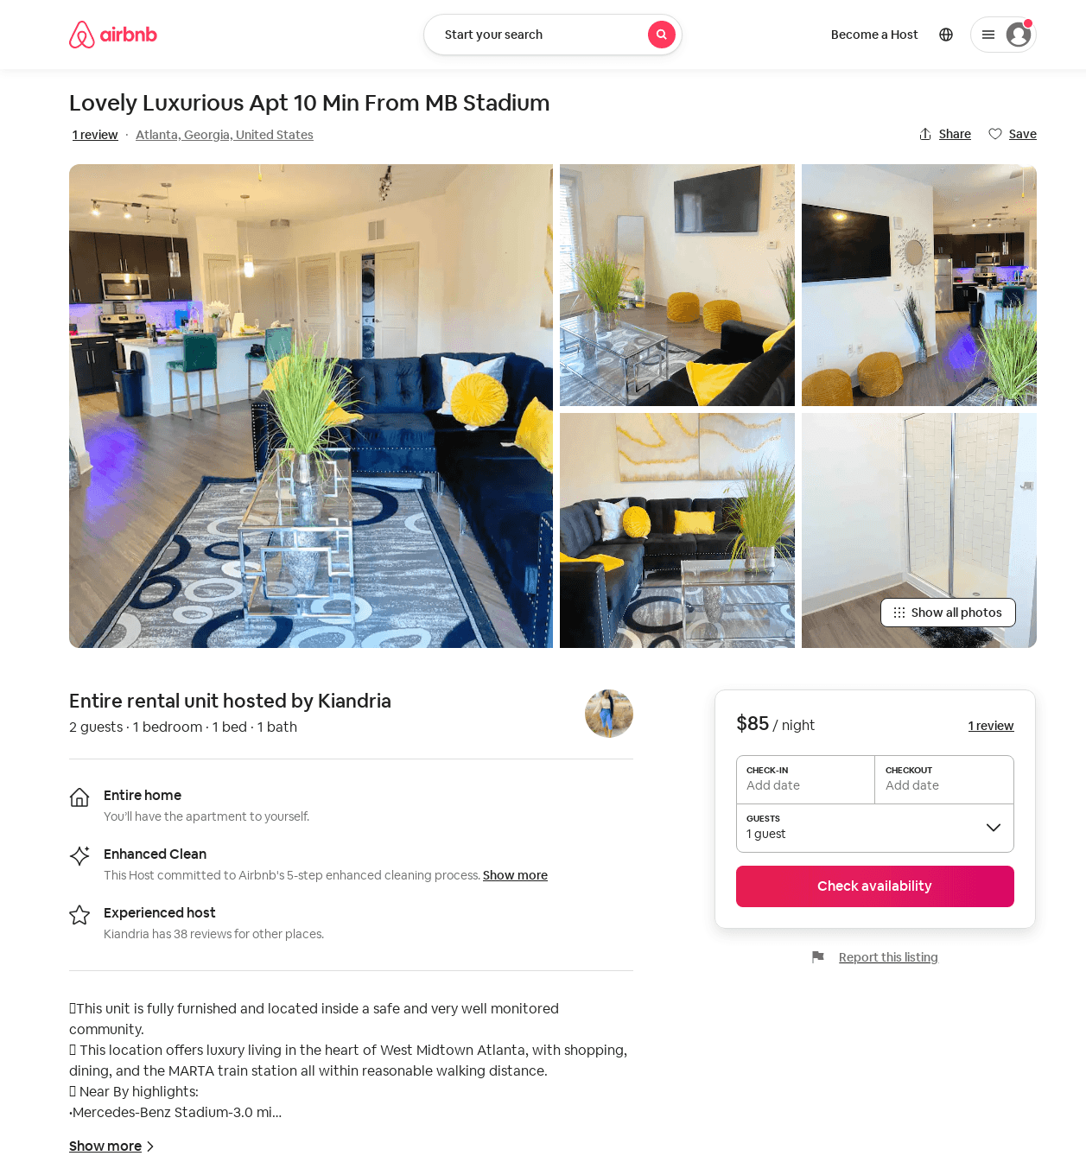
Listing 49365160
1
2
$51 - $105
4.25
1
Kiandria
241116202
2
https://www.airbnb.com/rooms/49365160
Jul 2022

Slide 47
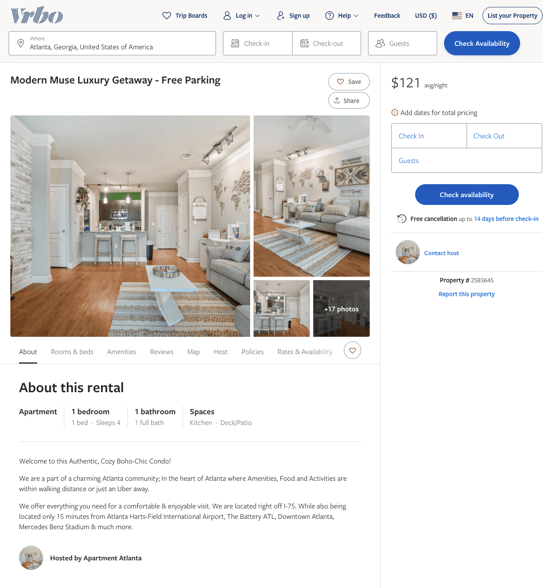
Listing 2583645
1
4
$100 - $125
5
1
https://www.vrbo.com/2583645
Aug 2022

Slide 48
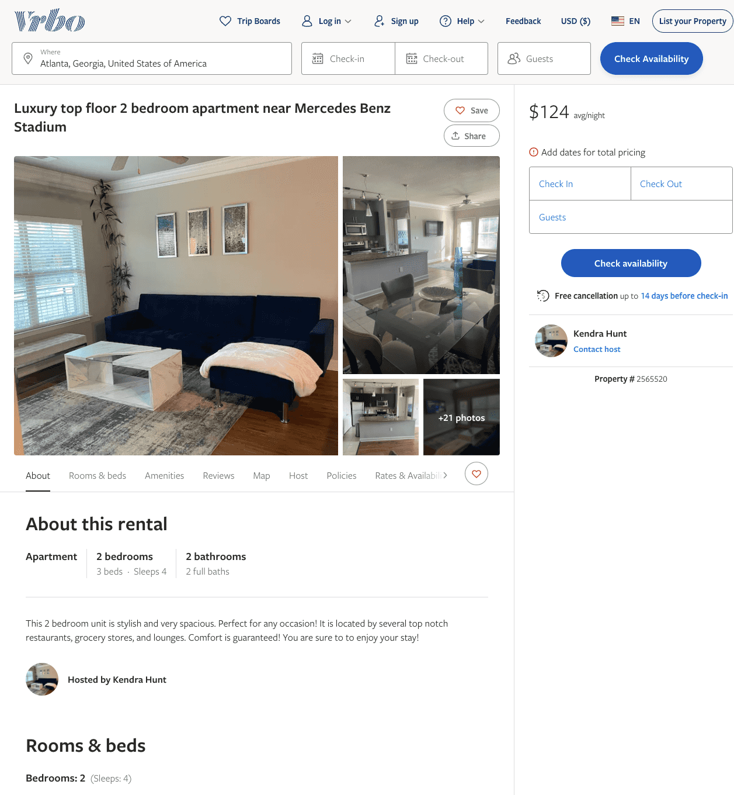
Listing 2565520
2
4
$124
5
1
Kendra Hunt
https://www.vrbo.com/2565520
Aug 2022

Slide 49
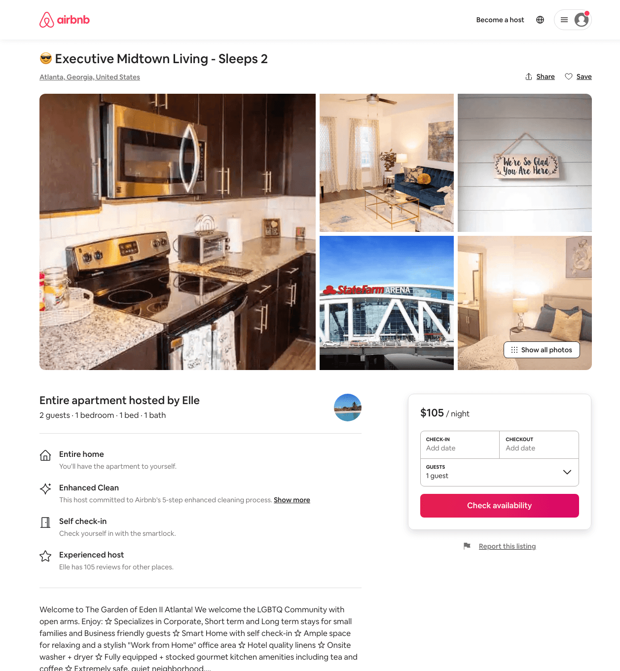
Listing 46236189
1
2
$70 - $120
28
Jhanelle
102668570
2
https://www.airbnb.com/rooms/46236189
Aug 2022

Slide 50
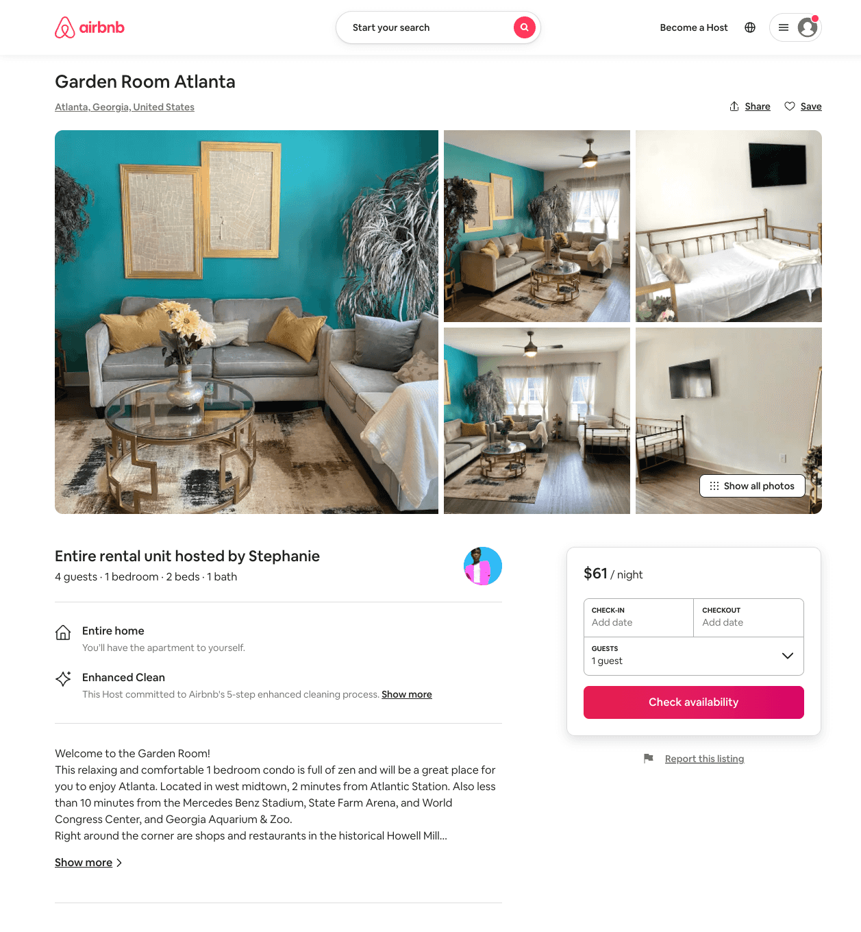
Listing 54160803
1
4
$61 - $119
4.59
1
Stephanie
439100126
1
https://www.airbnb.com/rooms/54160803
Aug 2022

Slide 51
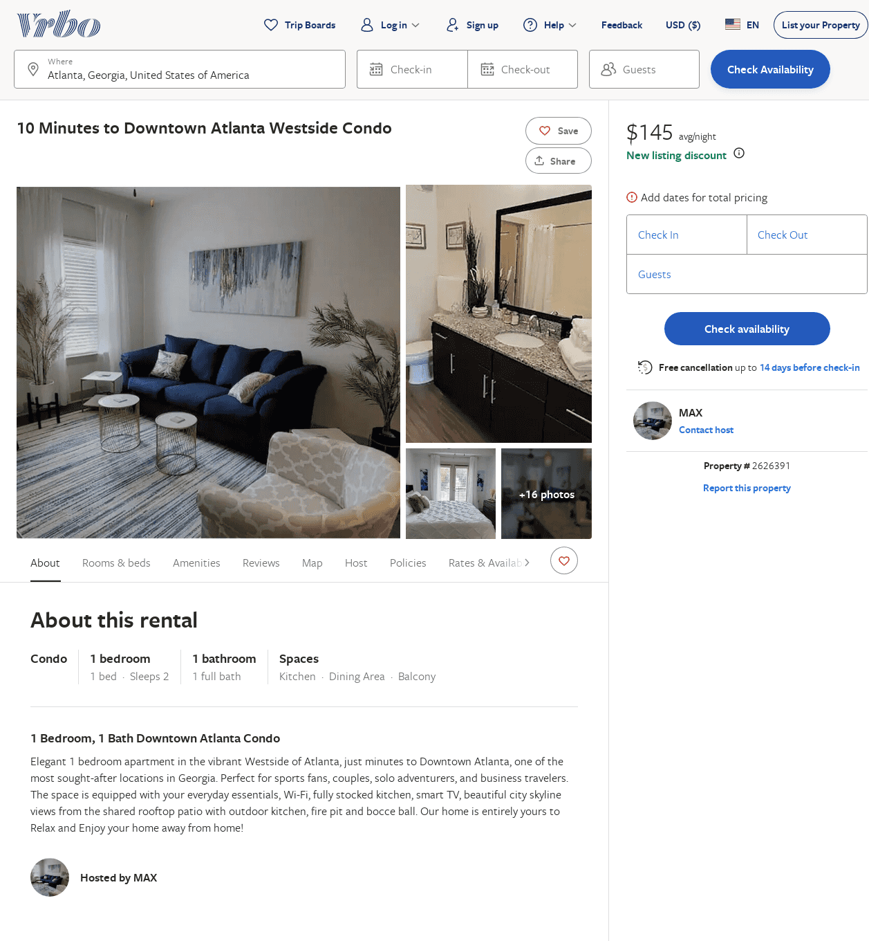
Listing 2626391
1
2
$126
1
MAX
https://www.vrbo.com/2626391
Aug 2022

Slide 52
Listing 2673573
1
2
$113
2
Prestige Living
https://www.vrbo.com/2673573
Aug 2022

Slide 53
Listing 2704995
1
2
$95
4.8
1
https://www.vrbo.com/2704995
Aug 2022

Slide 54
Listing 9681273
2
4
$107
5
2
Evolve
https://www.vrbo.com/9681273ha
Aug 2022

Slide 55
Listing 2754399
1
2
$126
1
https://www.vrbo.com/2754399
Aug 2022

Slide 56
Listing 52530236
1
3
$79
4.92
2
The Ultimate Success
417573485
1
https://www.airbnb.com/rooms/52530236
Aug 2022

Slide 57
Listing 2857014
1
3
$90
1
https://www.vrbo.com/2857014
Aug 2022

Slide 58
Listing 2912927
1
4
$127
1
Tony
https://www.vrbo.com/2912927
Aug 2022

Slide 59
Listing 30898607
2
6
2
Bt
55480490
2
https://www.airbnb.com/rooms/30898607
Aug 2022

Slide 60
Listing 53663745
1
6
2
Zacharia
349753686
1
https://www.airbnb.com/rooms/53663745
Aug 2022

Slide 61
Listing 25826894
1
3
4.75
2
Didi
188546662
1
https://www.airbnb.com/rooms/25826894
Aug 2022

Slide 62
Listing 46564301
1
4
1
Cupid
55671203
2
https://www.airbnb.com/rooms/46564301
Aug 2022

