Slide 2
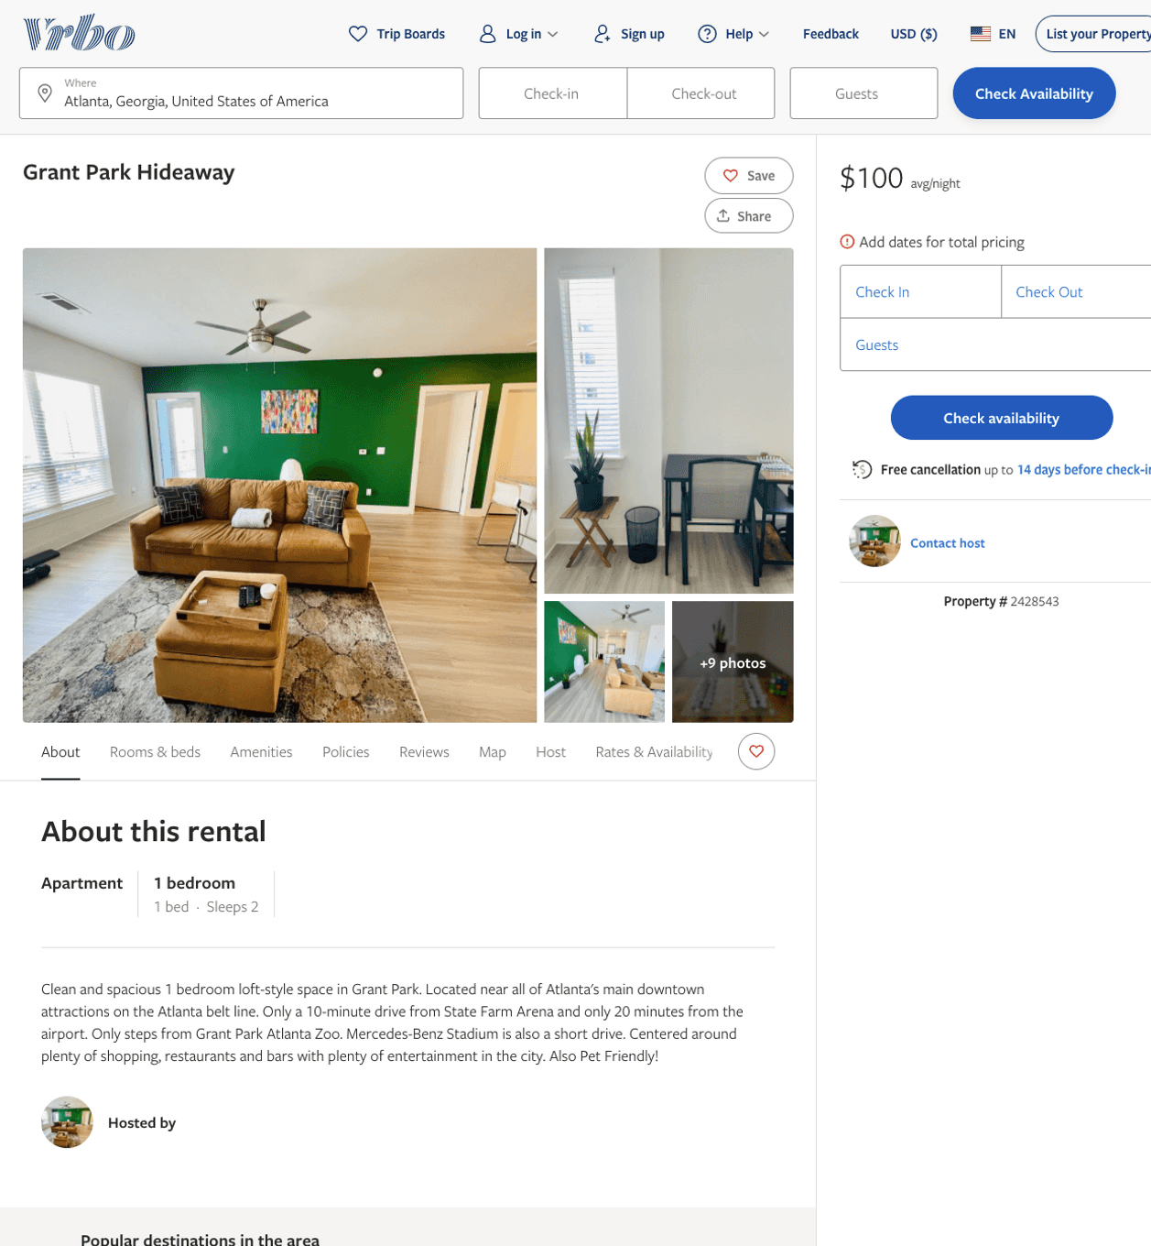
Listing 2428543
1
2
$100 - $110
3
https://www.vrbo.com/2428543
Aug 2022

Slide 3
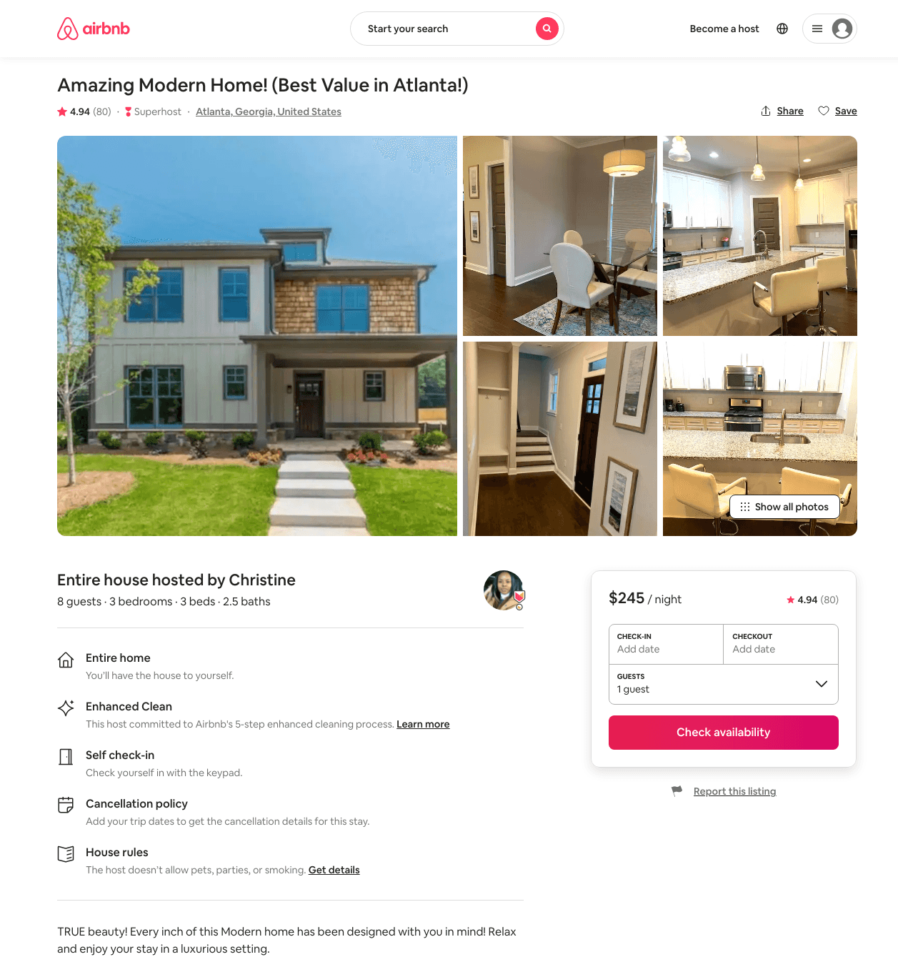
Listing 39119153
3
8
$189 - $295
4.84
2
Christine
35662766
2
https://www.airbnb.com/rooms/39119153
Aug 2022

Slide 4
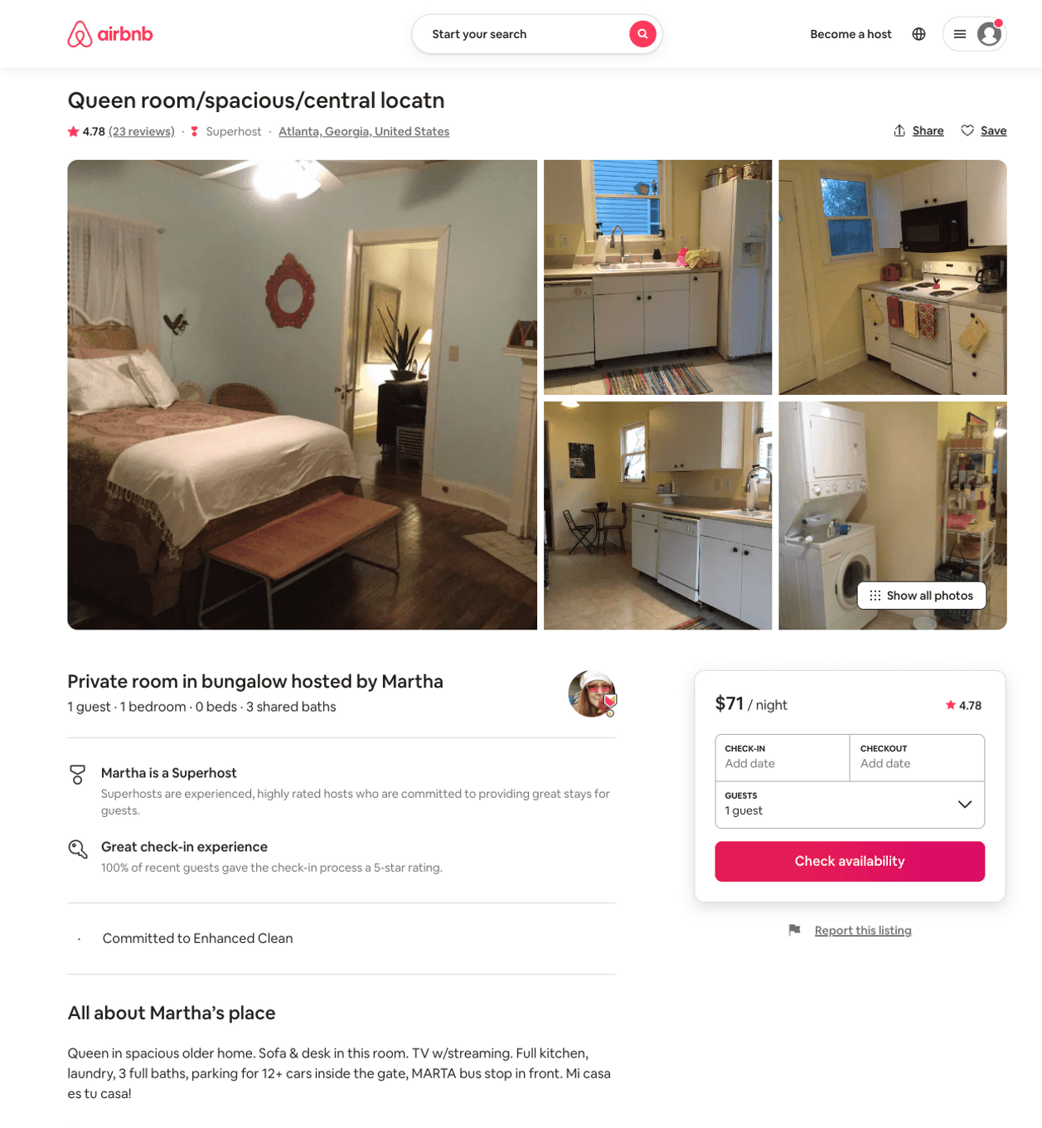
Listing 9765301
1
1
$46 - $71
4.80
14
Martha
44590876
6
https://www.airbnb.com/rooms/9765301
Aug 2022

Slide 5
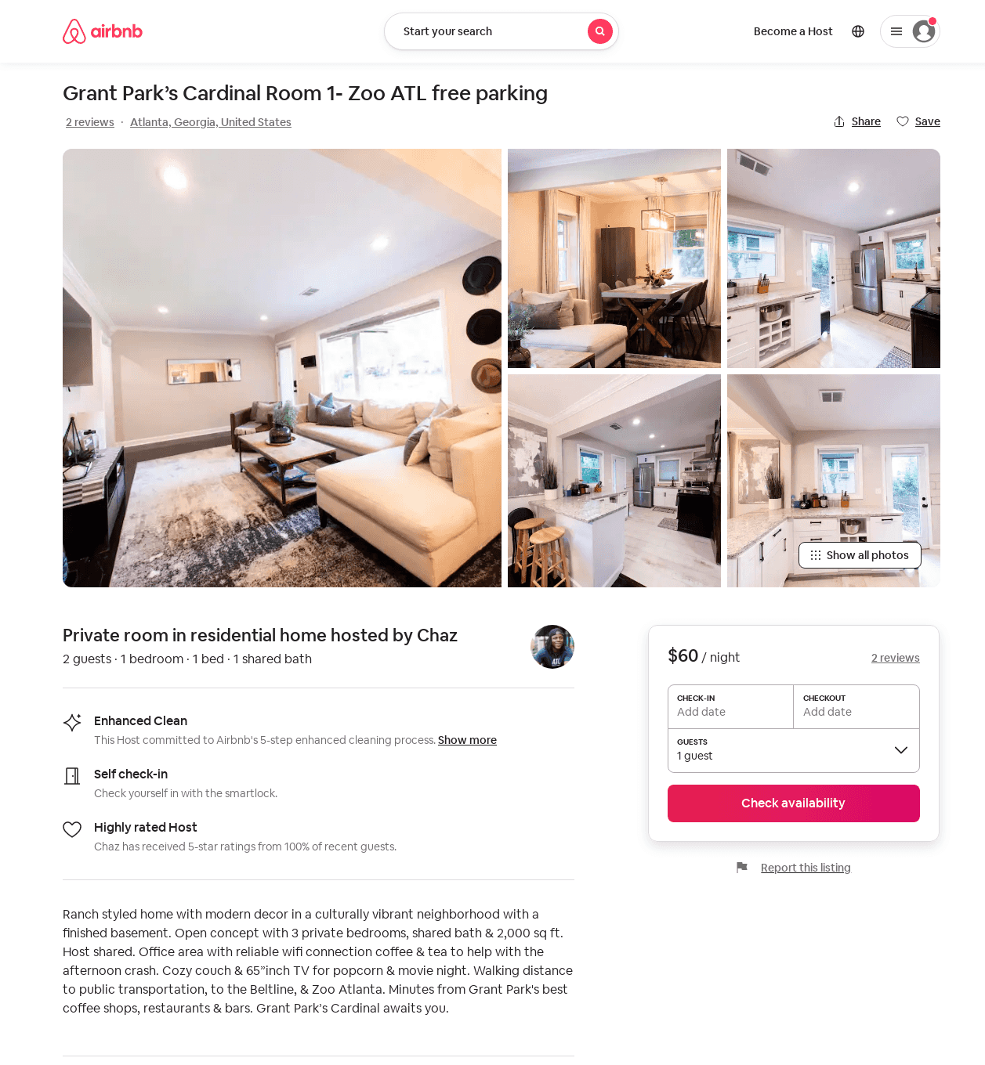
Listing 52871049
3
2
$46 - $54
5.0
2
Chaz
127683989
4
https://www.airbnb.com/rooms/52871049
Aug 2022

Slide 6
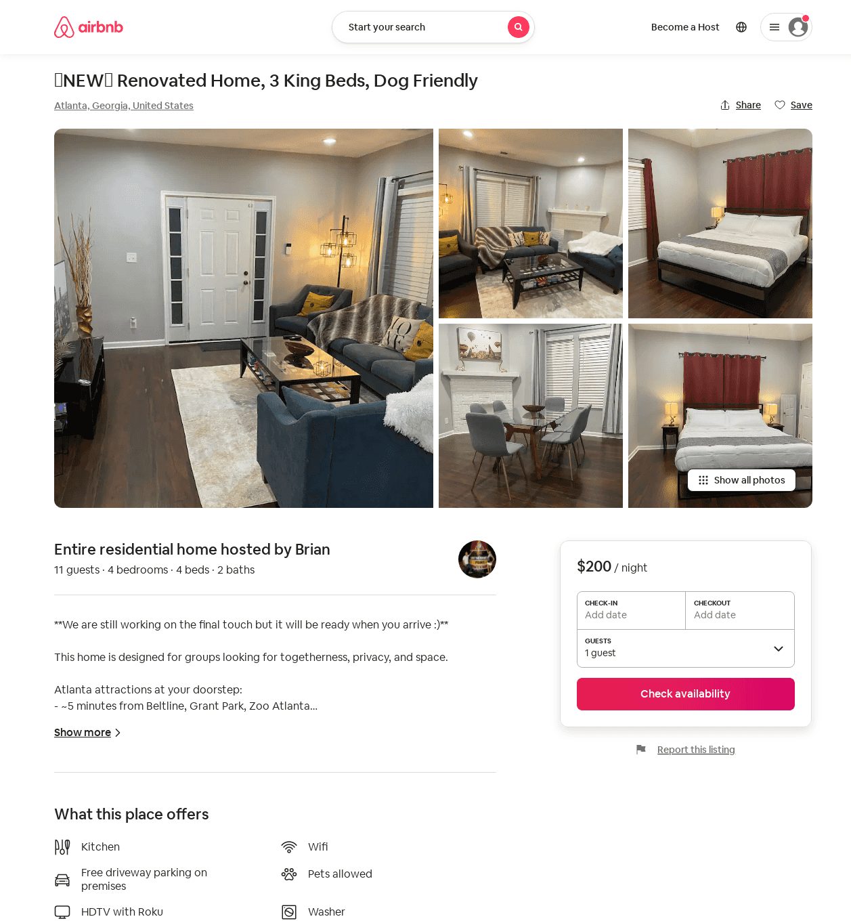
Listing 54168640
4
11
$184 - $238
4.91
2
Brian
91455810
1
https://www.airbnb.com/rooms/54168640
Aug 2022

Slide 7
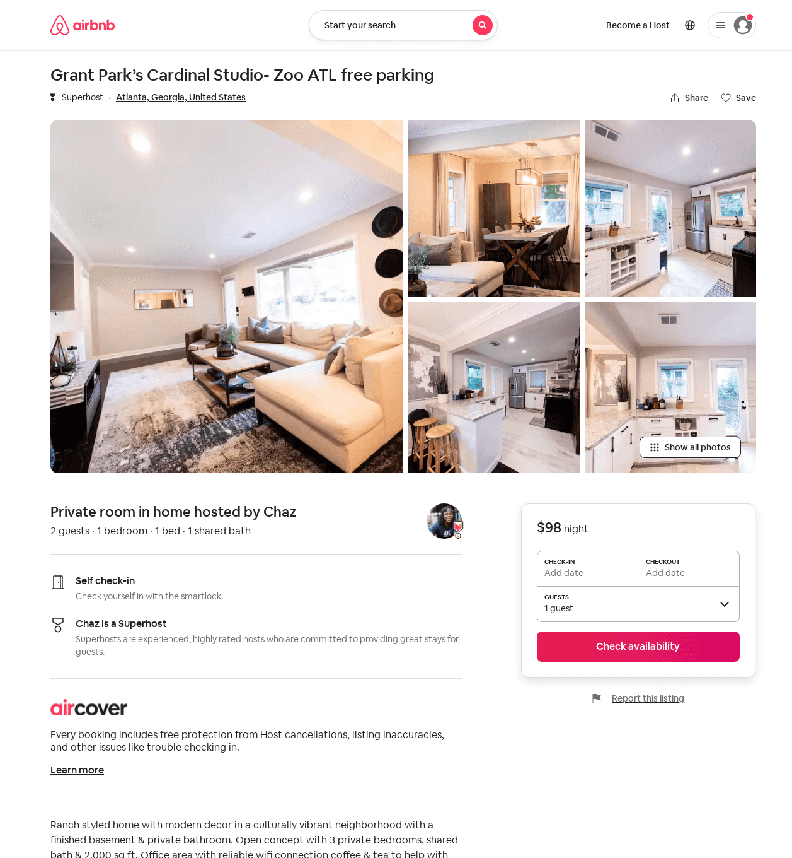
Listing 49984811
1
2
$98
2
Chaz
127683989
4
https://www.airbnb.com/rooms/49984811
Aug 2022

