Slide 2
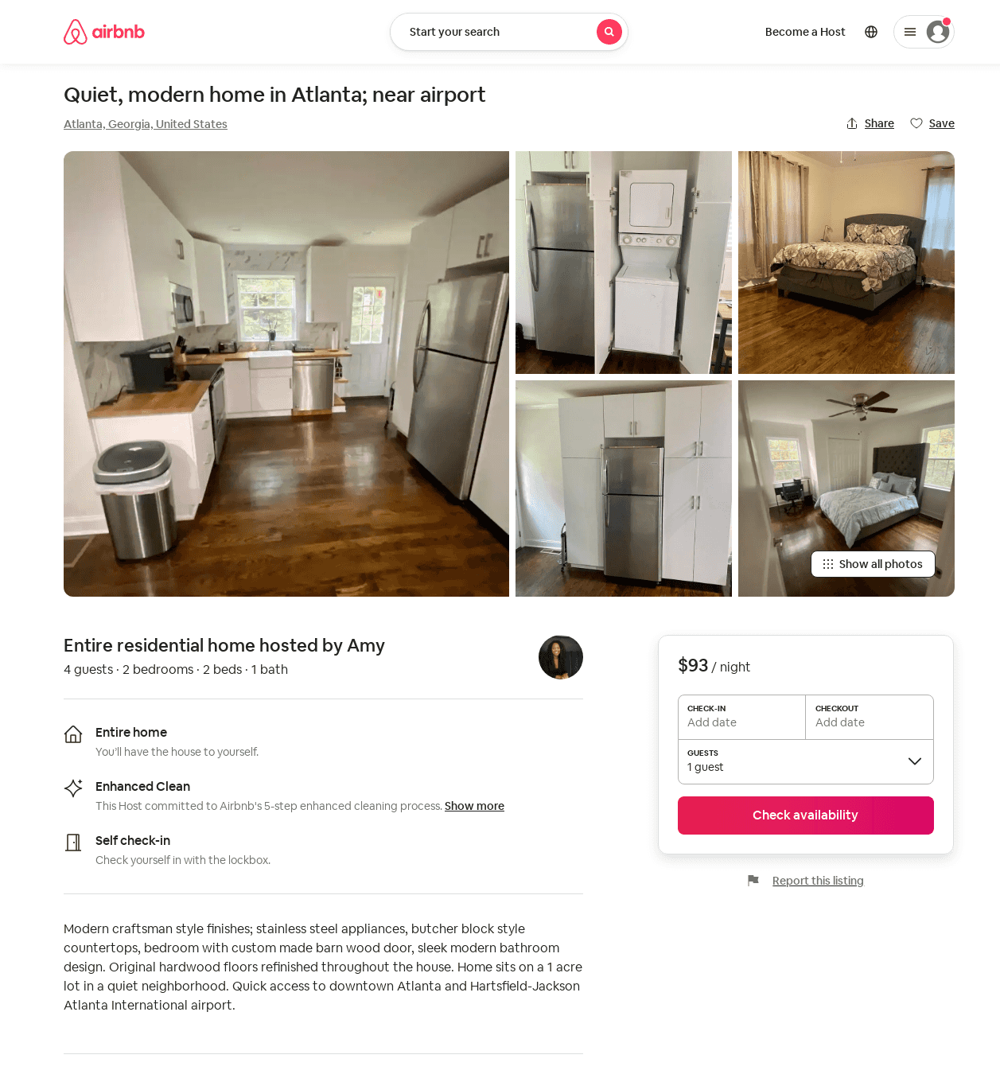
Listing 52957572
2
3
$93
28
Amy
26255498
1
https://www.airbnb.com/rooms/52957572
Jun 2022

Slide 3
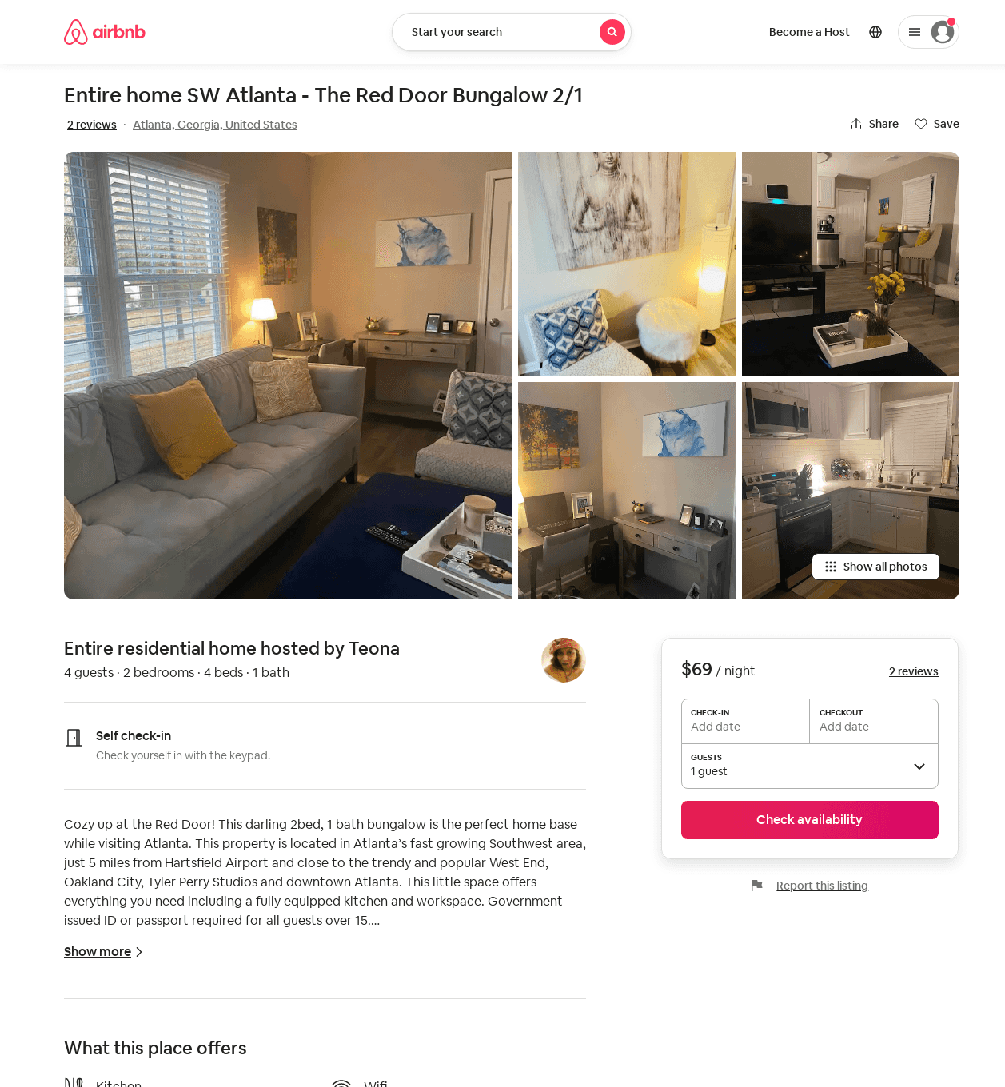
Listing 53982686
2
4
$69 - $98
4.75
7
Teona
77997322
2
https://www.airbnb.com/rooms/53982686
Jun 2022

Slide 4
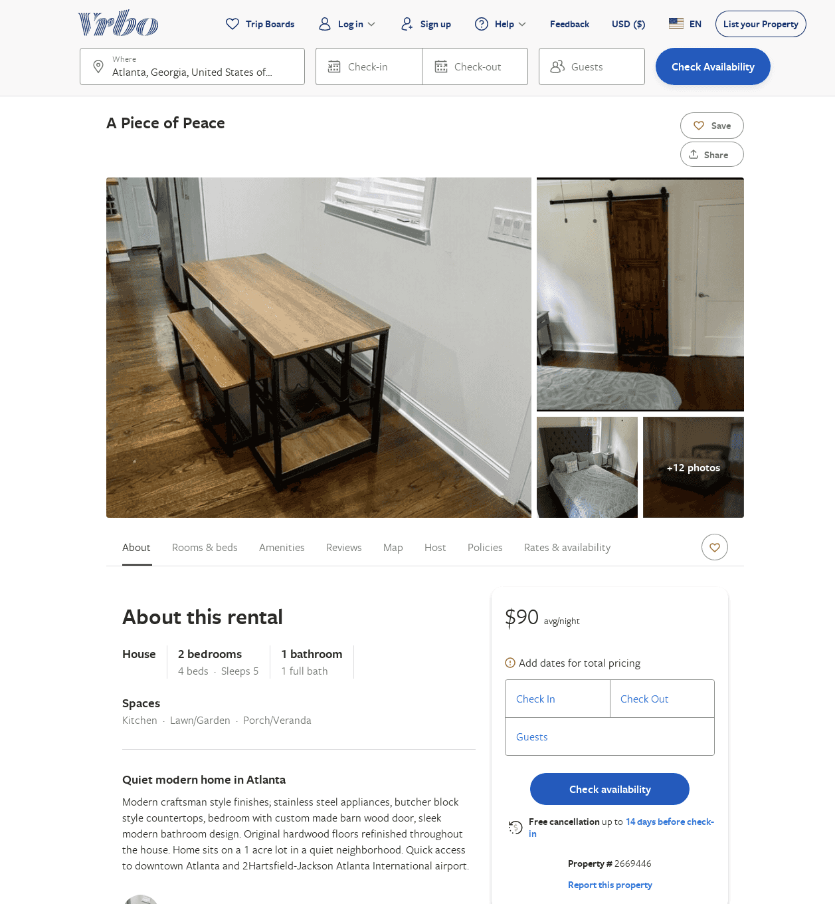
Listing 2669446
2
5
$90
28
Amy Oraefo
https://www.vrbo.com/2669446
Aug 2022

Slide 5
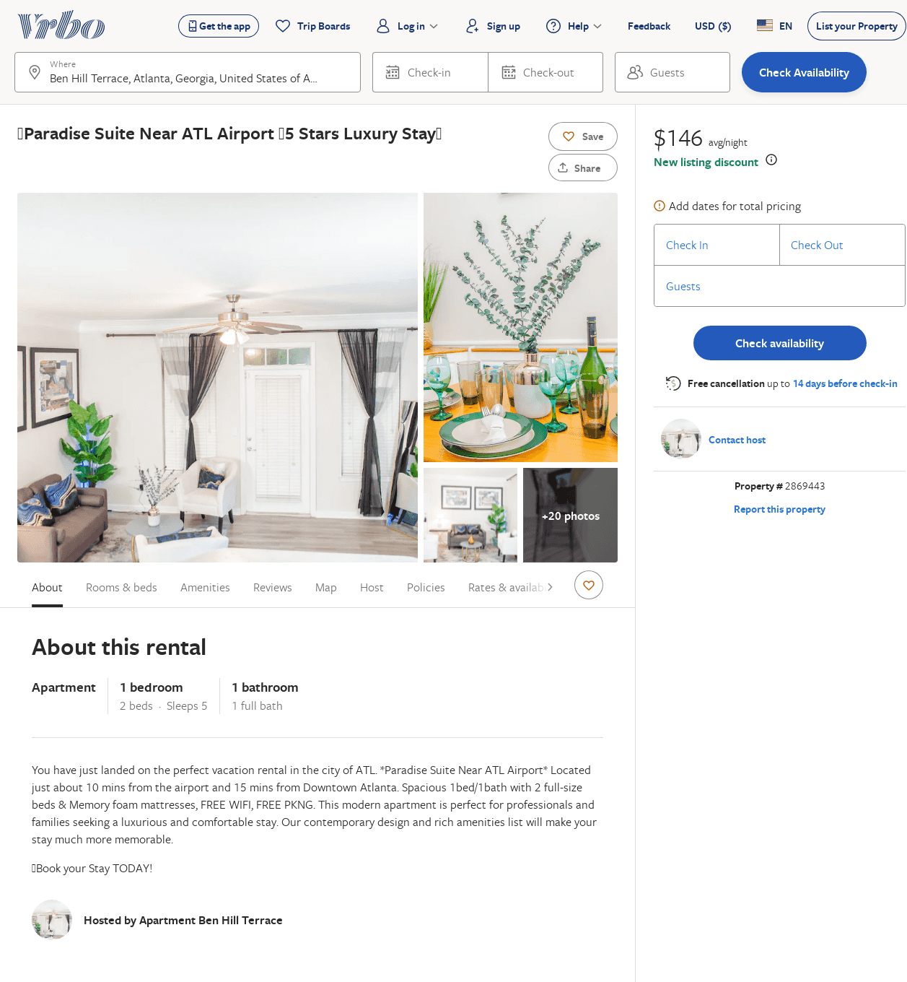
Listing 2869443
1
5
$150
1
https://www.vrbo.com/2869443
Aug 2022

