Slide 2
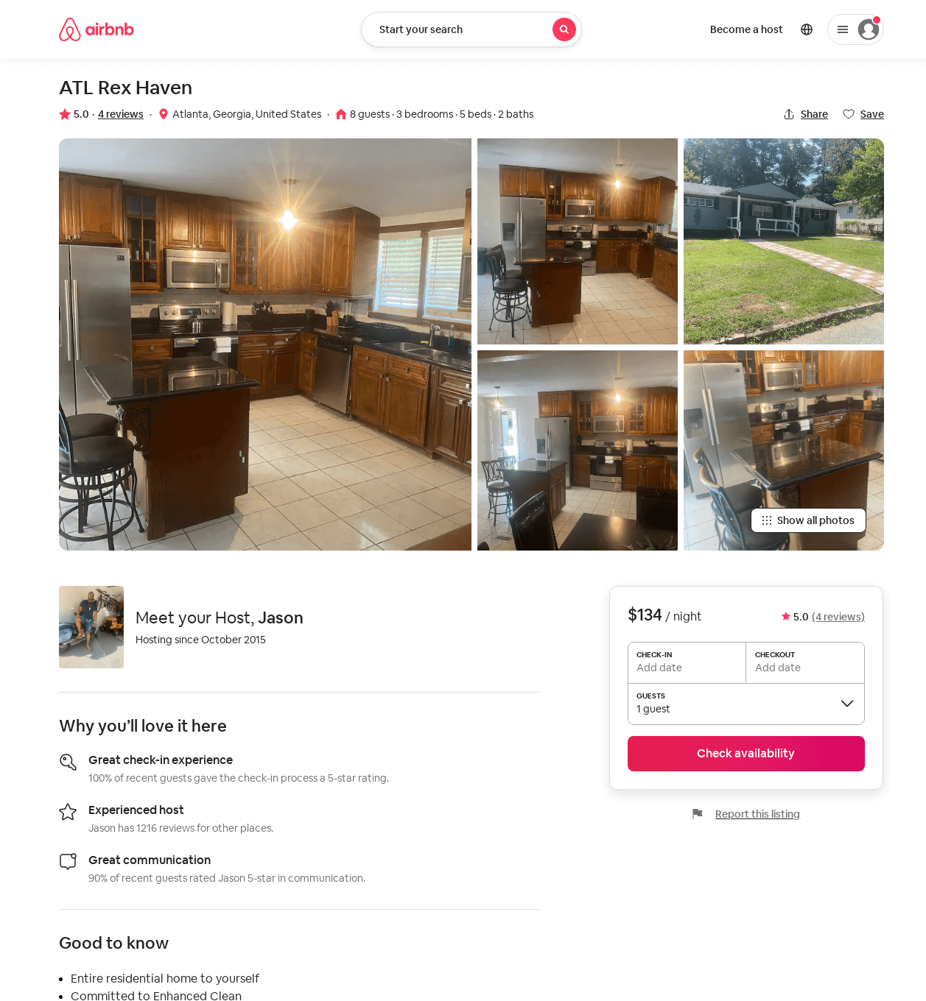
Listing 49968204
3
7
$95 - $138
4.85
2
Jason
47351539
2
https://www.airbnb.com/rooms/49968204
Aug 2022

Slide 3
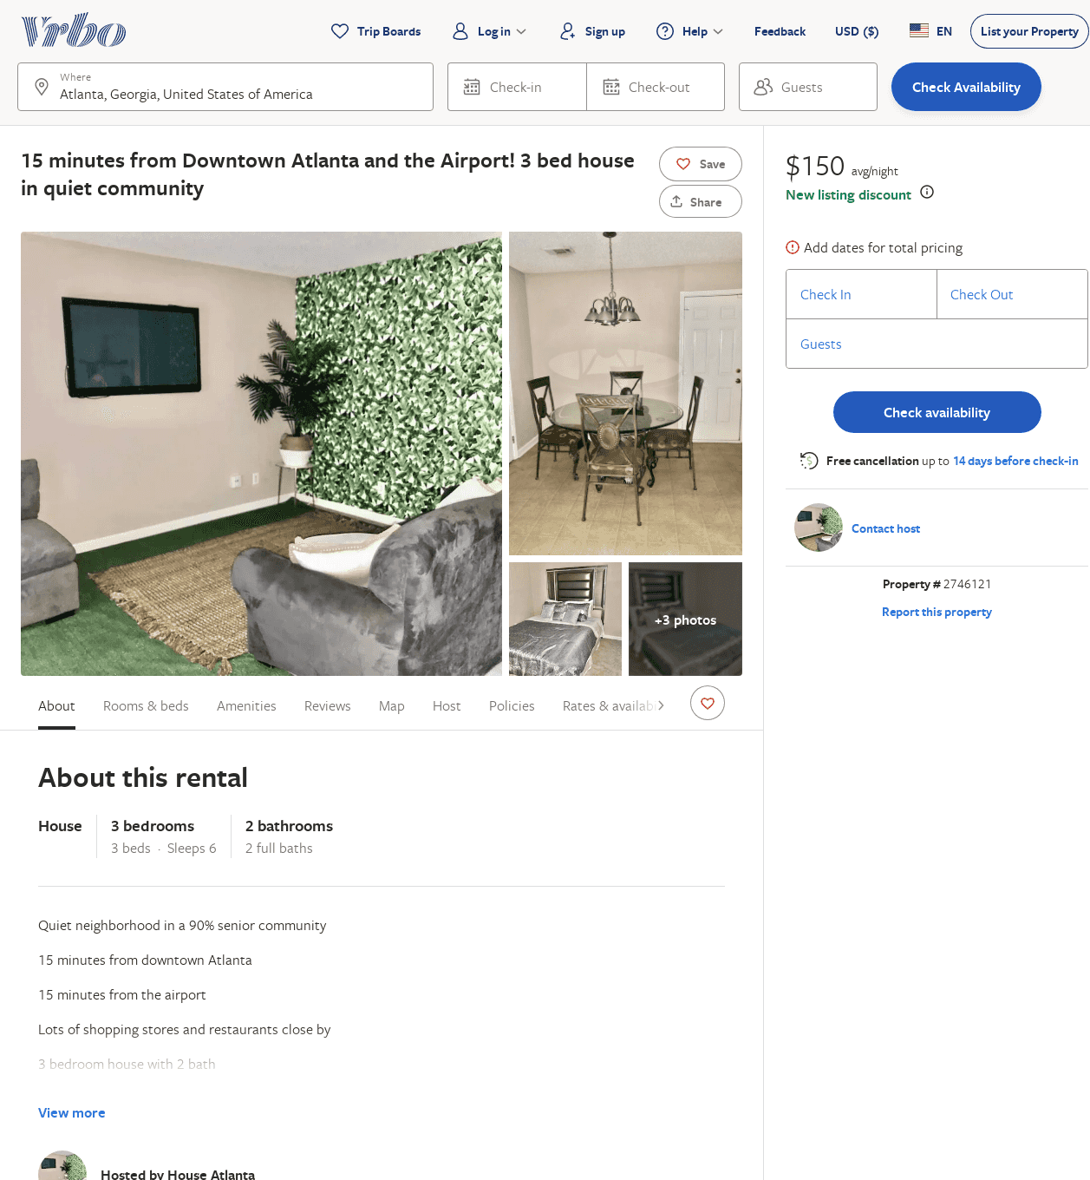
Listing 2746121
3
6
$150
4.6666665
2
https://www.vrbo.com/2746121
Aug 2022

