Slide 2
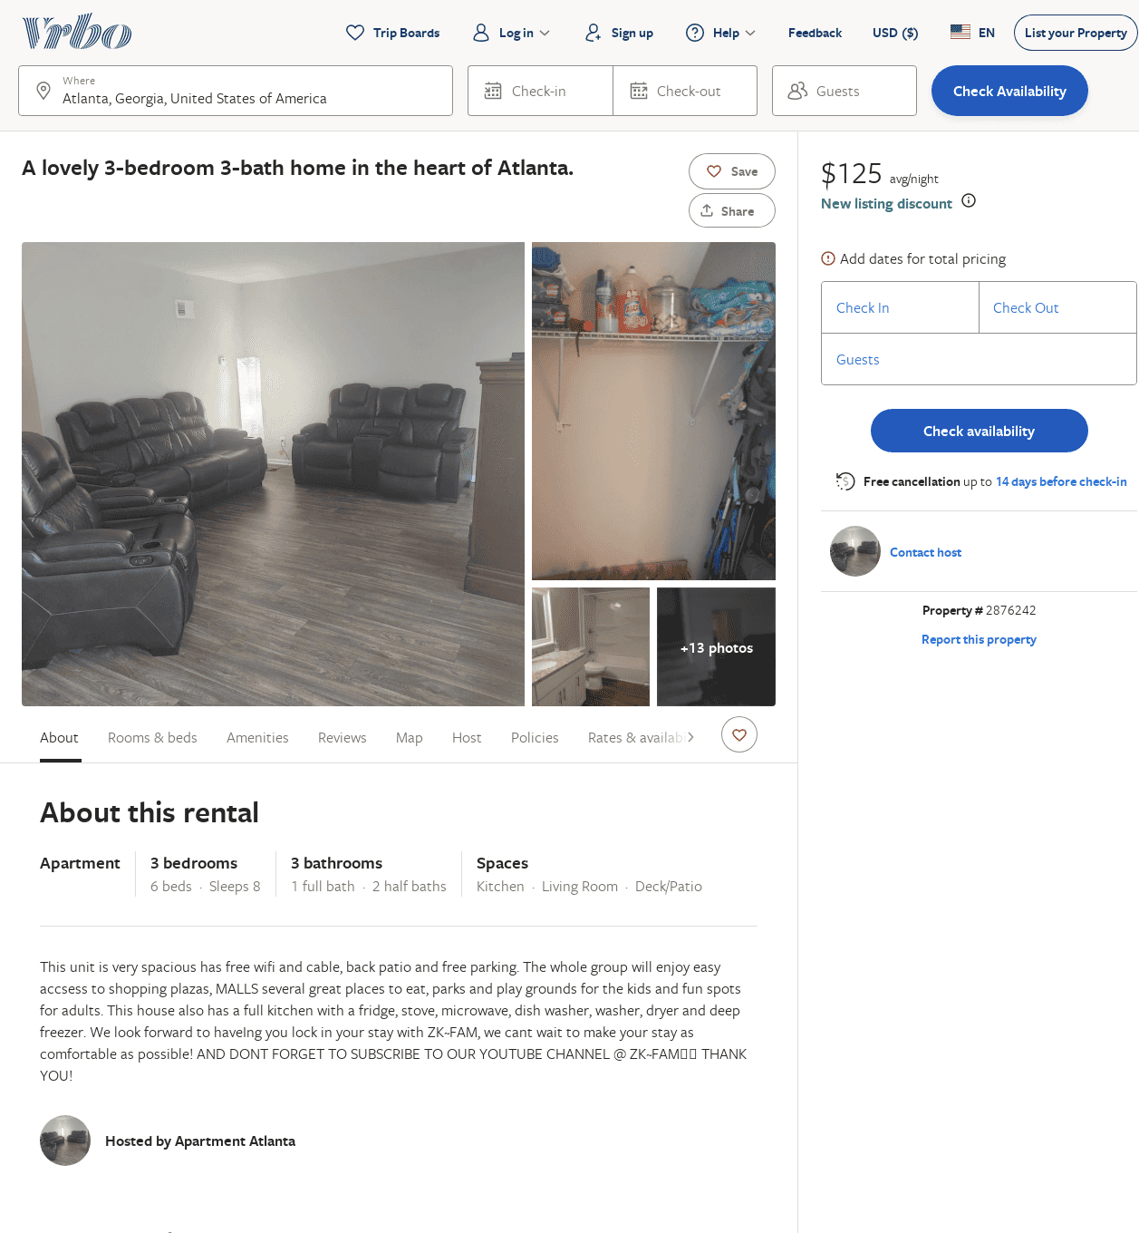
Listing 2876242
3
8
$126
1
https://www.vrbo.com/2876242
Aug 2022

