Slide 2
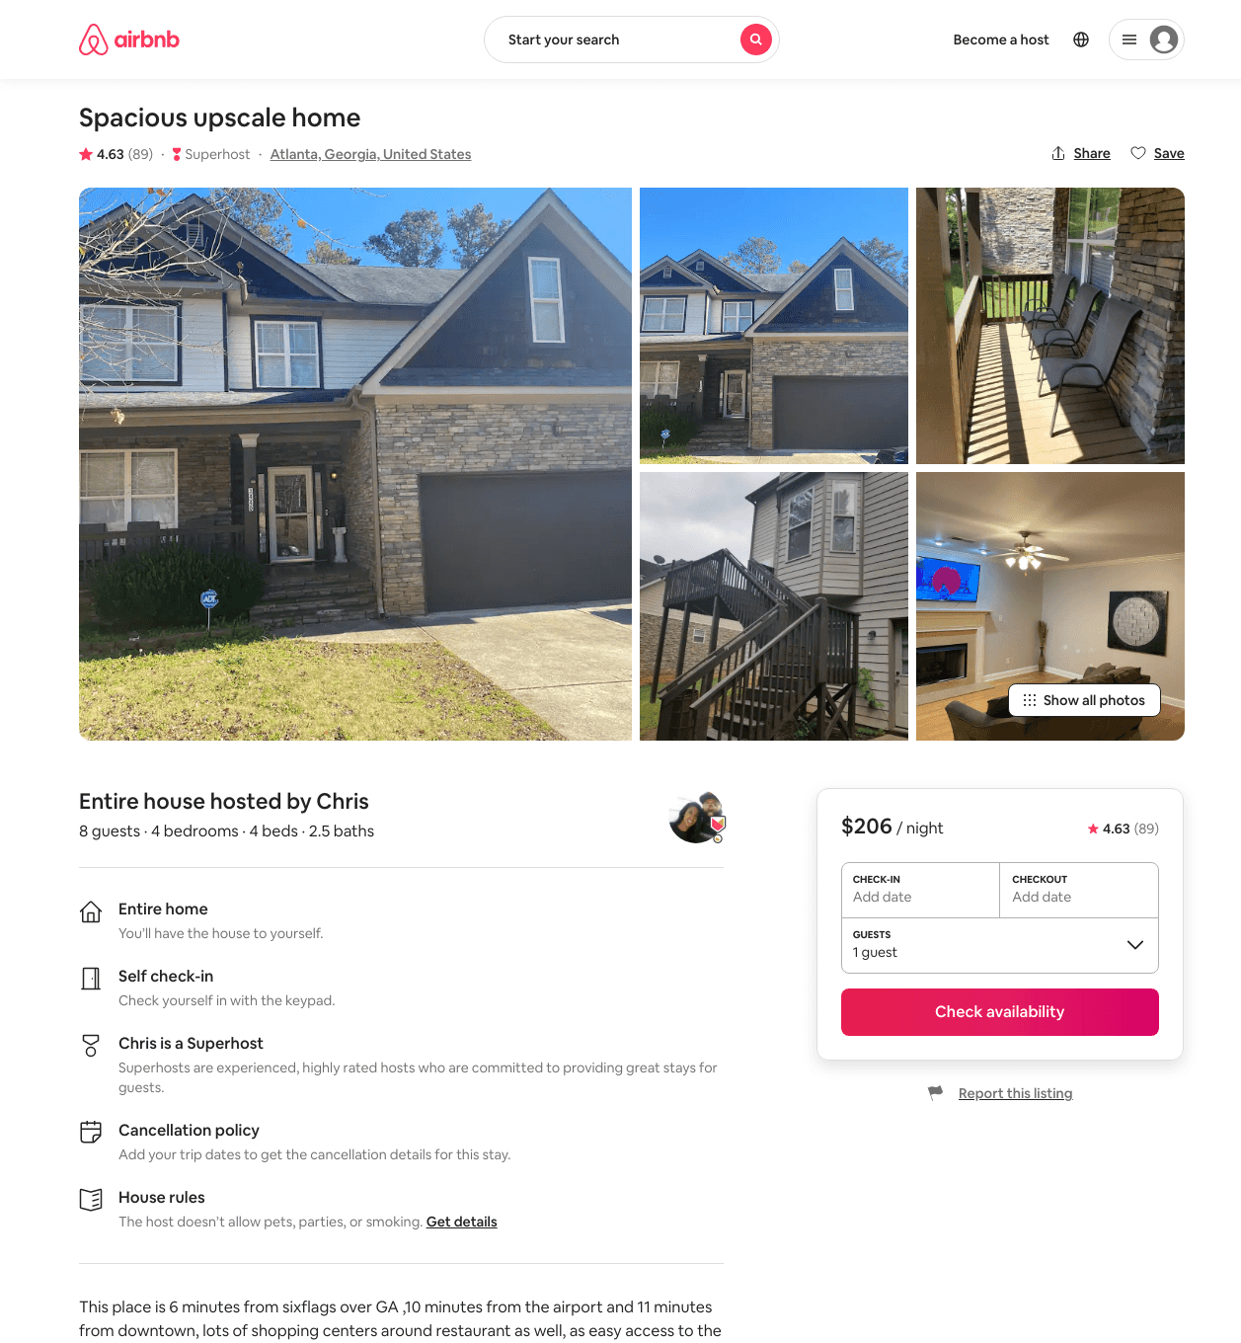
Listing 21812802
4
8
$160 - $234
4.61
2
Chris
158987549
1
https://www.airbnb.com/rooms/21812802
Jul 2022

Slide 3
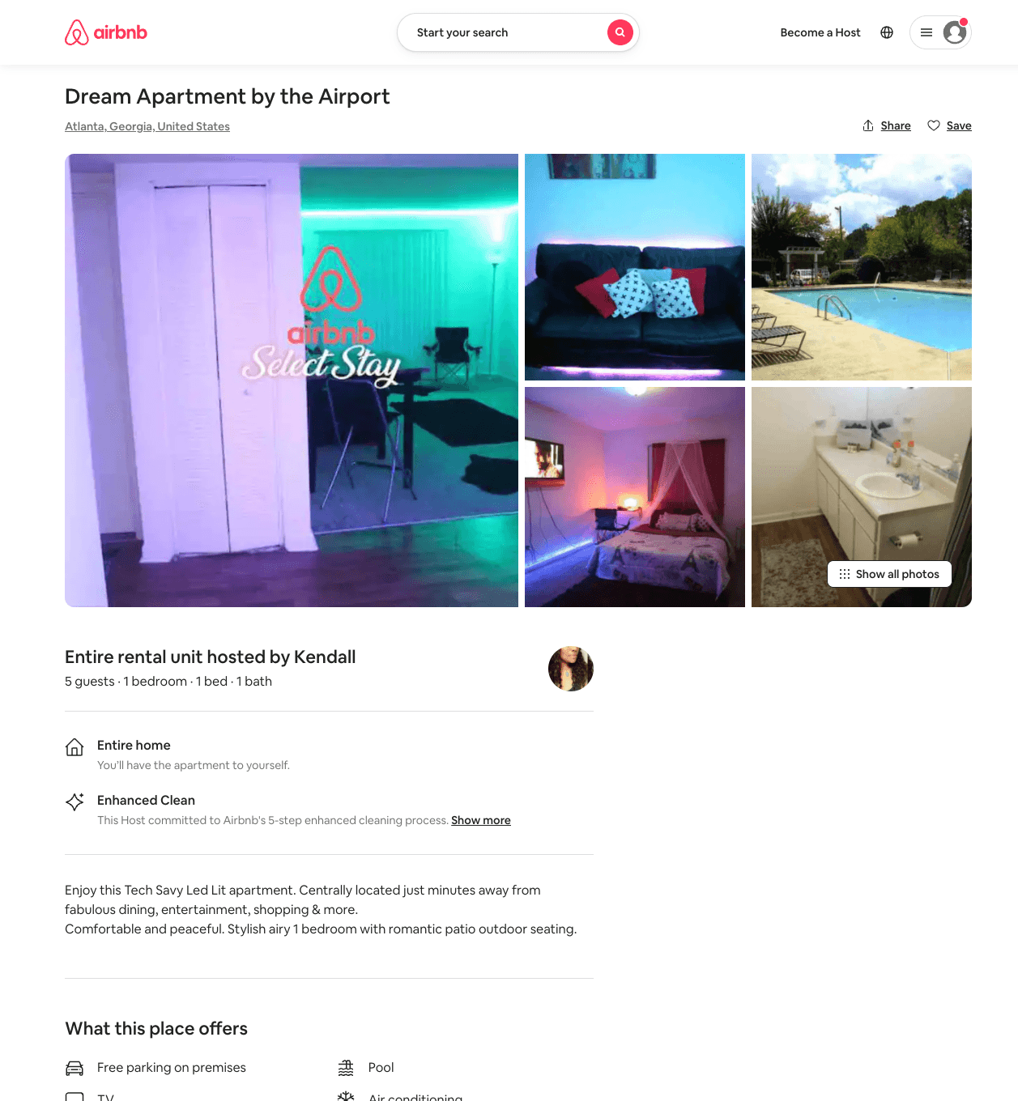
Listing 53705057
1
5
$240 - $300
1
Kendall
434959306
1
https://www.airbnb.com/rooms/53705057
Aug 2022

