Slide 2
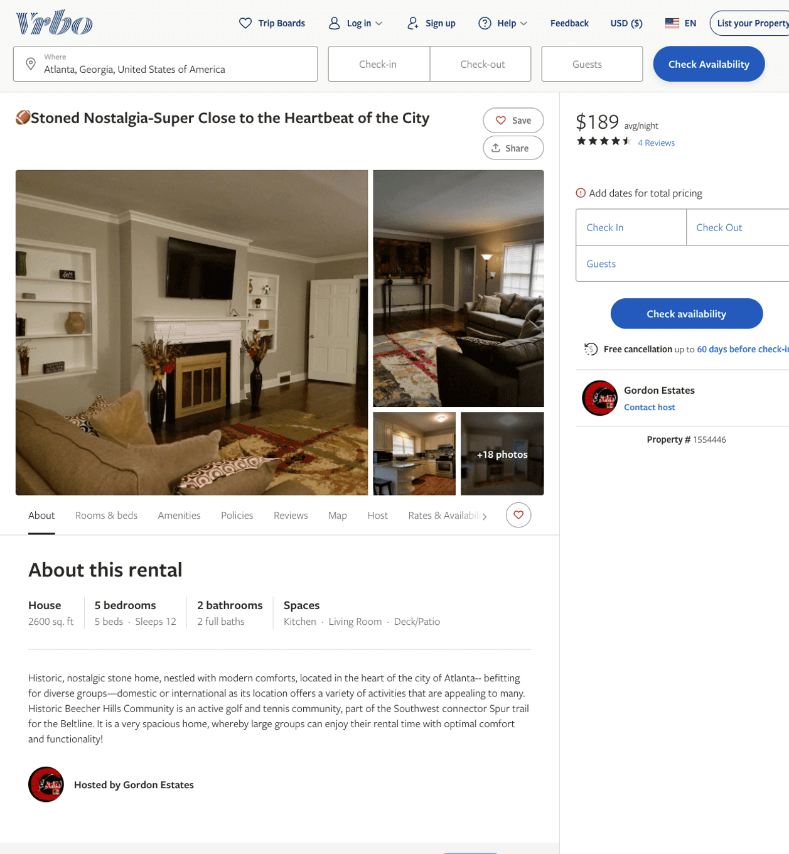
Listing 1554446
5
12
$189 - $215
4.7777777
2
Gordon Estates
https://www.vrbo.com/1554446
Aug 2022

Slide 3
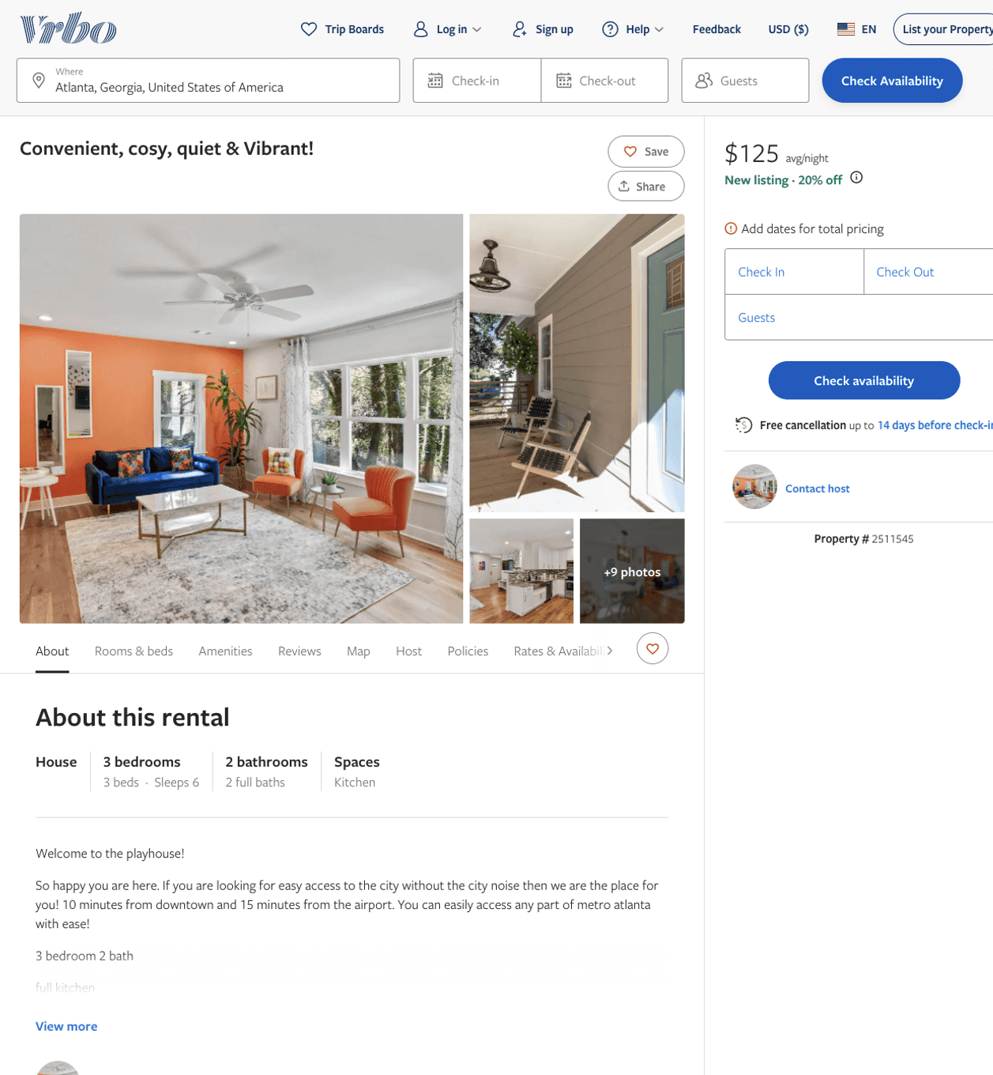
Listing 2511545
3
6
$125 - $300
4
1
Dismas
https://www.vrbo.com/2511545
Aug 2022

Slide 4
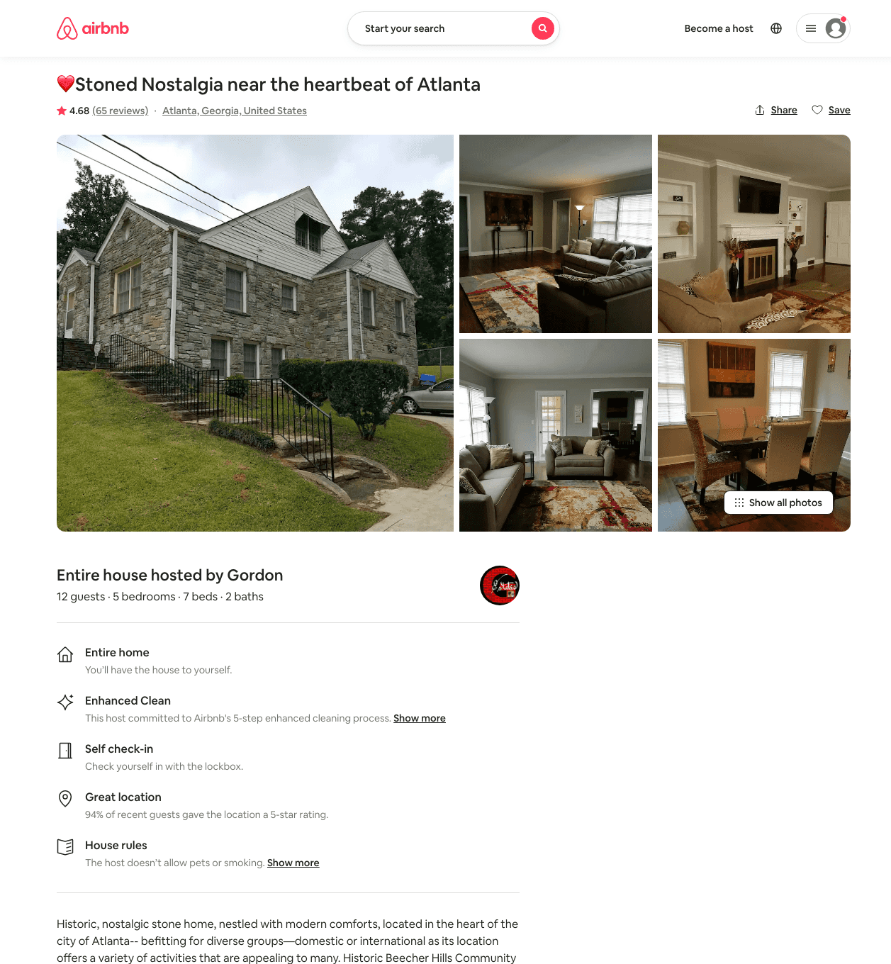
Listing 27454337
5
12
$189 - $241
4.66
2
Gordon
206869749
2
https://www.airbnb.com/rooms/27454337
Aug 2022

Slide 5
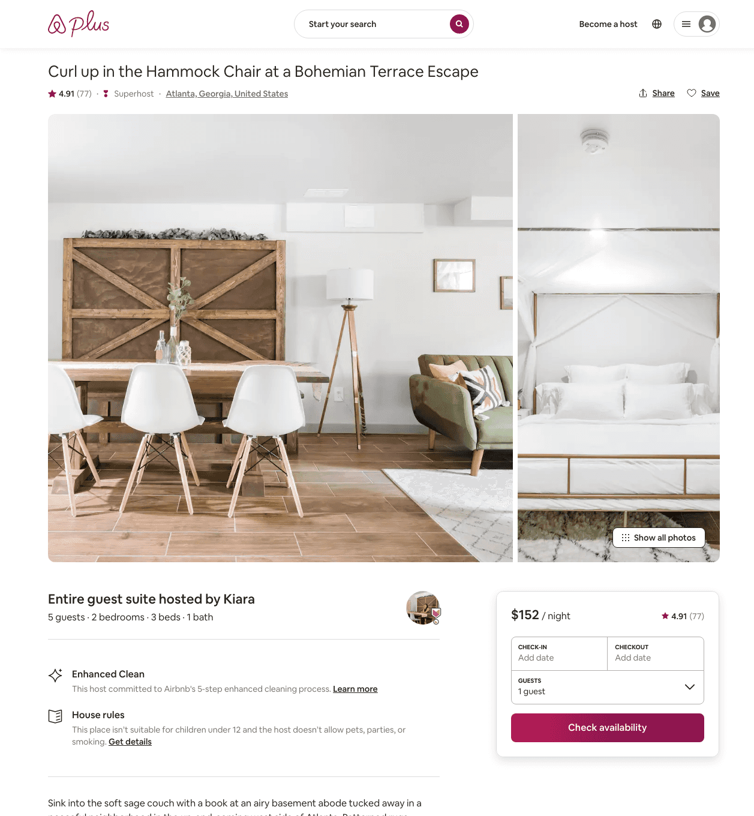
Listing 31555882
2
5
$119 - $157
4.88
1
Kiara
66818684
1
https://www.airbnb.com/rooms/31555882
Aug 2022

Slide 6
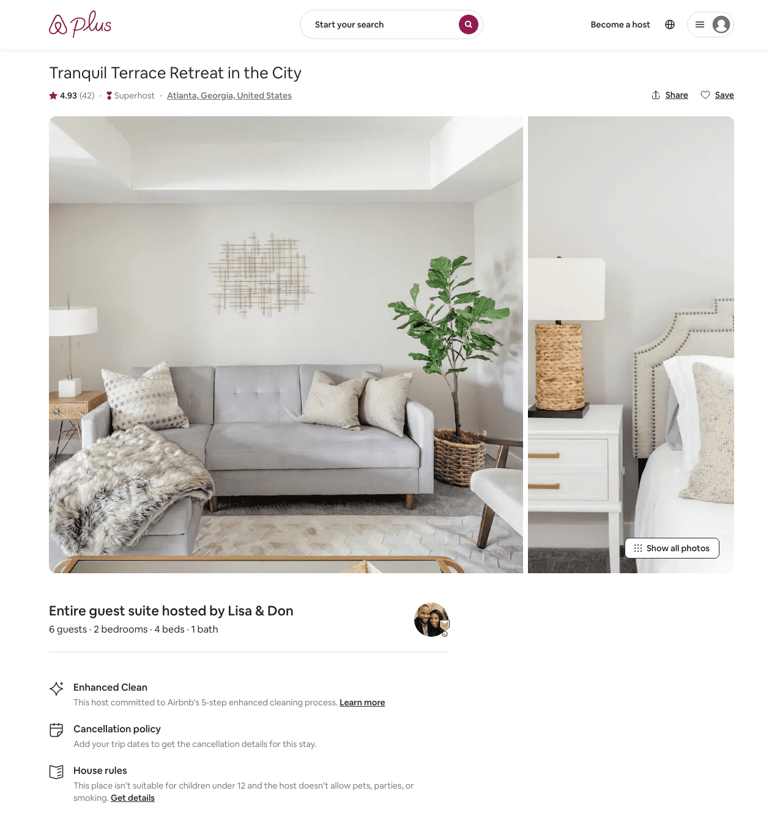
Listing 31762822
2
6
$122 - $170
4.91
2
Lisa & Don
12404608
1
https://www.airbnb.com/rooms/31762822
Aug 2022

Slide 7
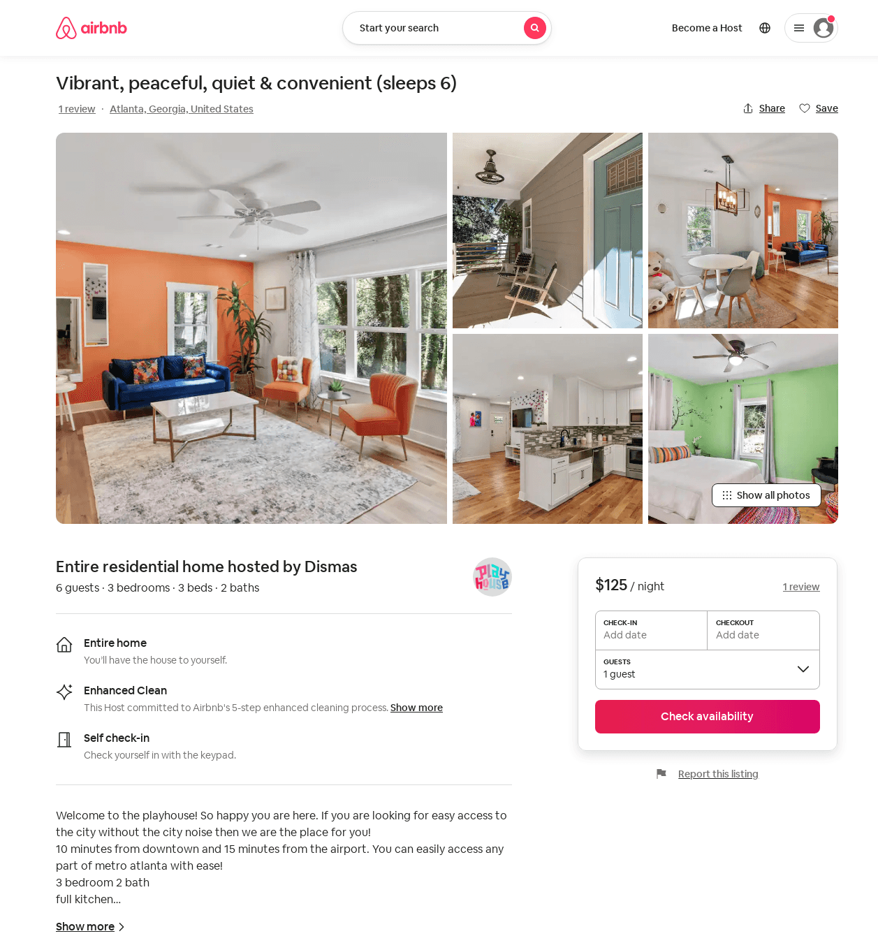
Listing 52282974
3
6
$103 - $159
4.88
1
Dismas
423176575
1
https://www.airbnb.com/rooms/52282974
Aug 2022

Slide 8
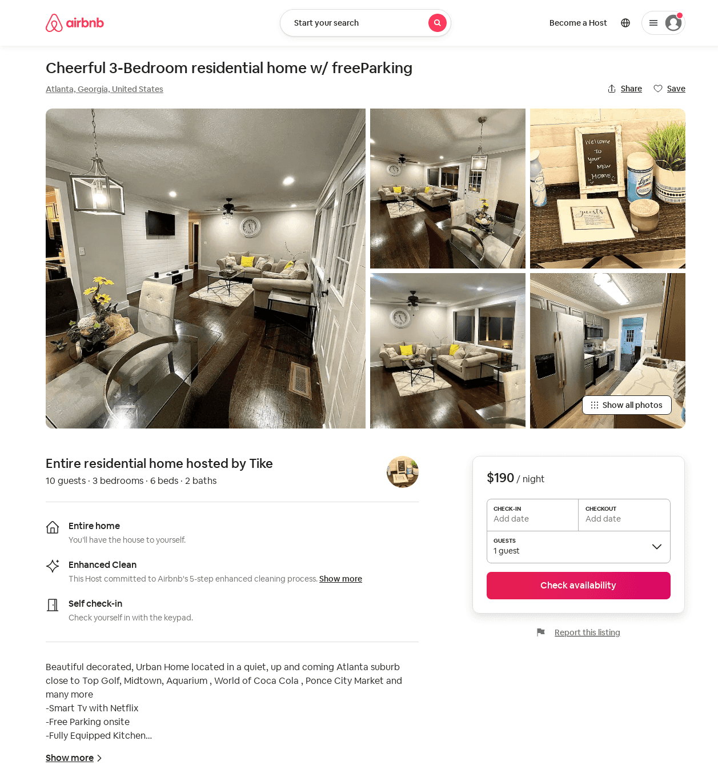
Listing 53114754
3
10
$152 - $215
4.86
2
Tike
134122918
1
https://www.airbnb.com/rooms/53114754
Aug 2022

Slide 9
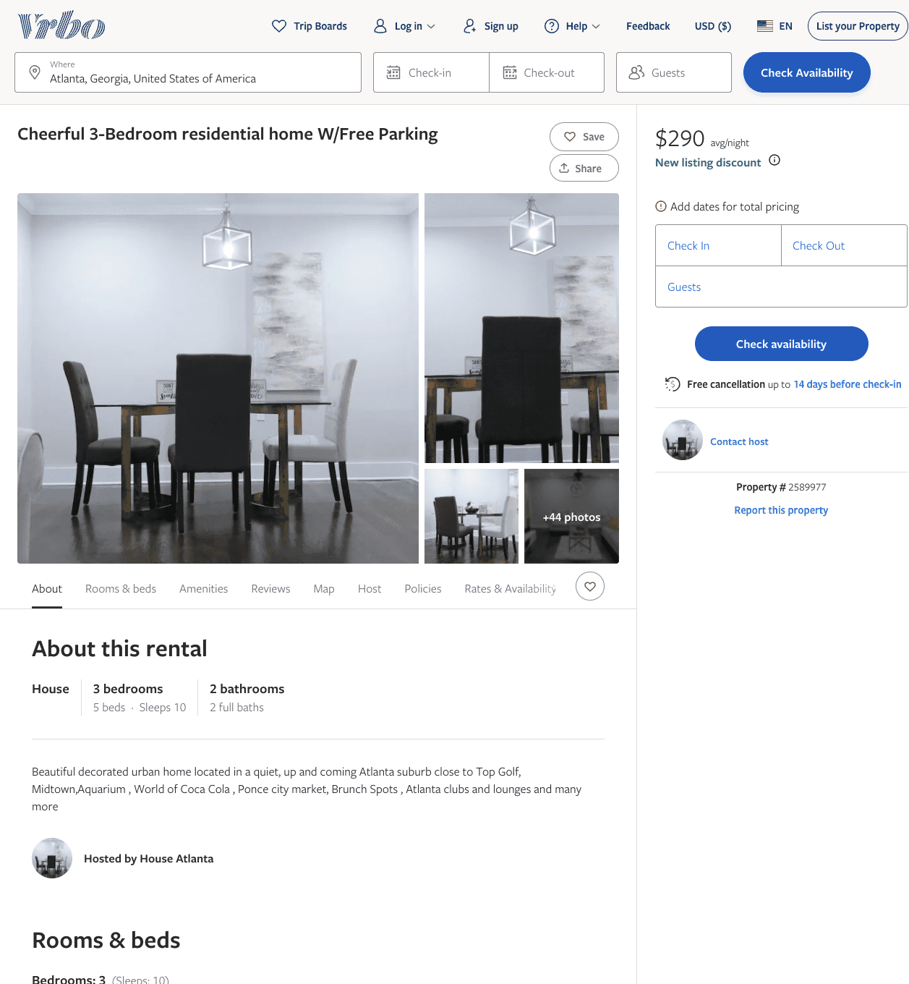
Listing 2589977
3
10
$185 - $290
4.714286
2
https://www.vrbo.com/2589977
Aug 2022

Slide 10
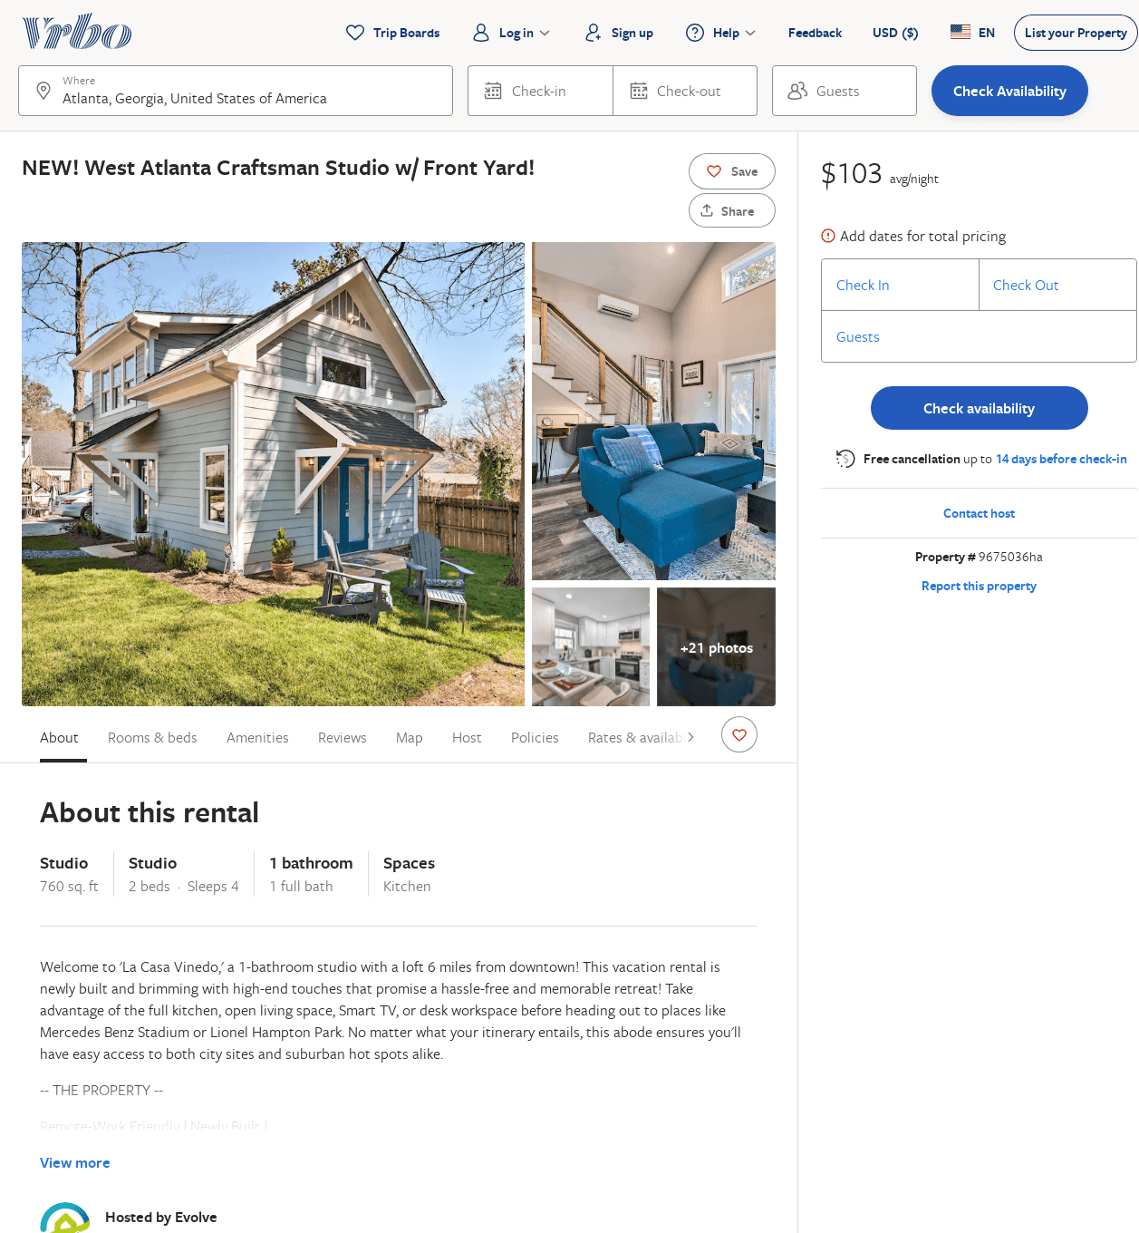
Listing 9675036
0
4
$102
2
Evolve
https://www.vrbo.com/9675036ha
Aug 2022

Slide 11
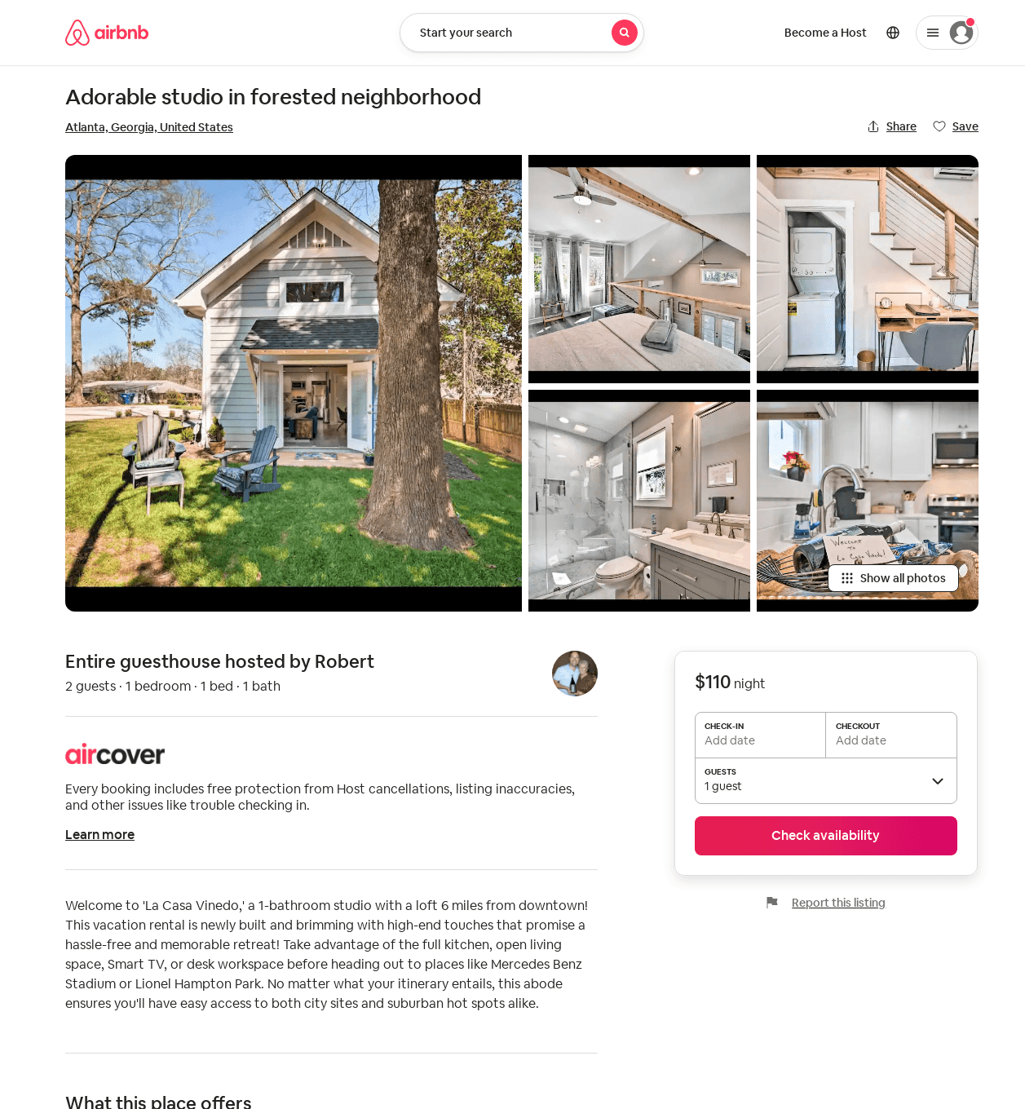
Listing 51681016
1
2
2
Robert
12633960
1
https://www.airbnb.com/rooms/51681016
Aug 2022

