Slide 2
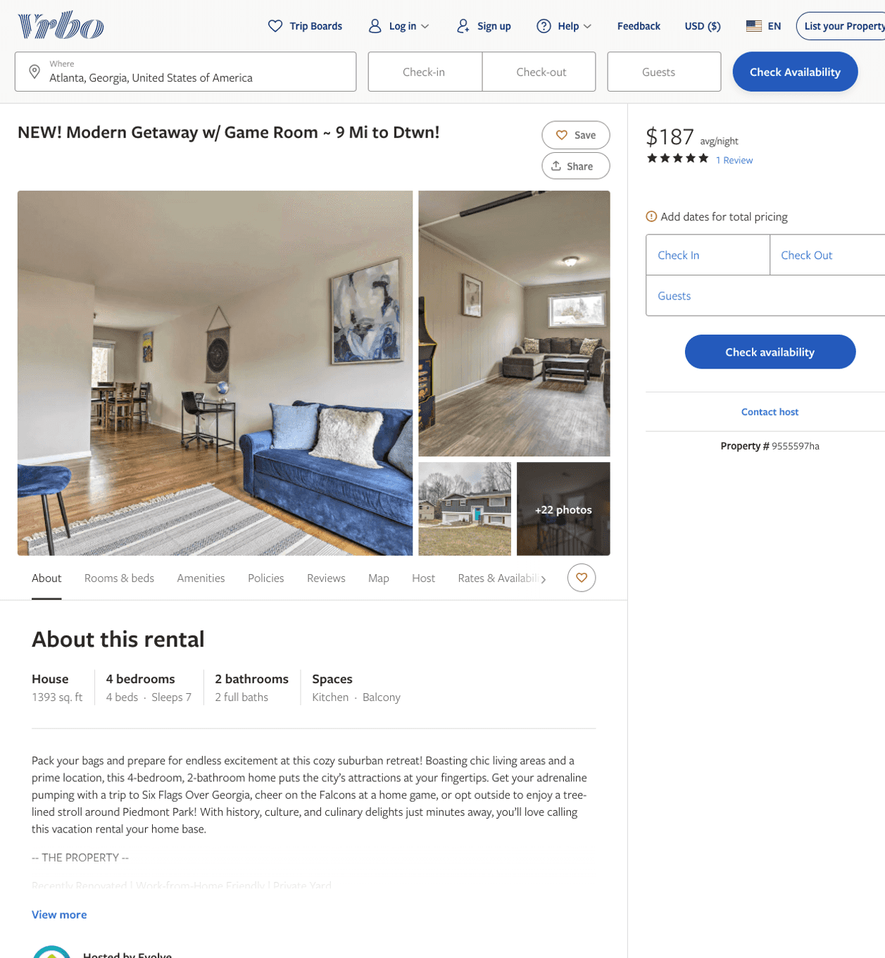
Listing 9555597
4
7
$107 - $187
5
2
Evolve
https://www.vrbo.com/9555597ha
Aug 2022

Slide 3
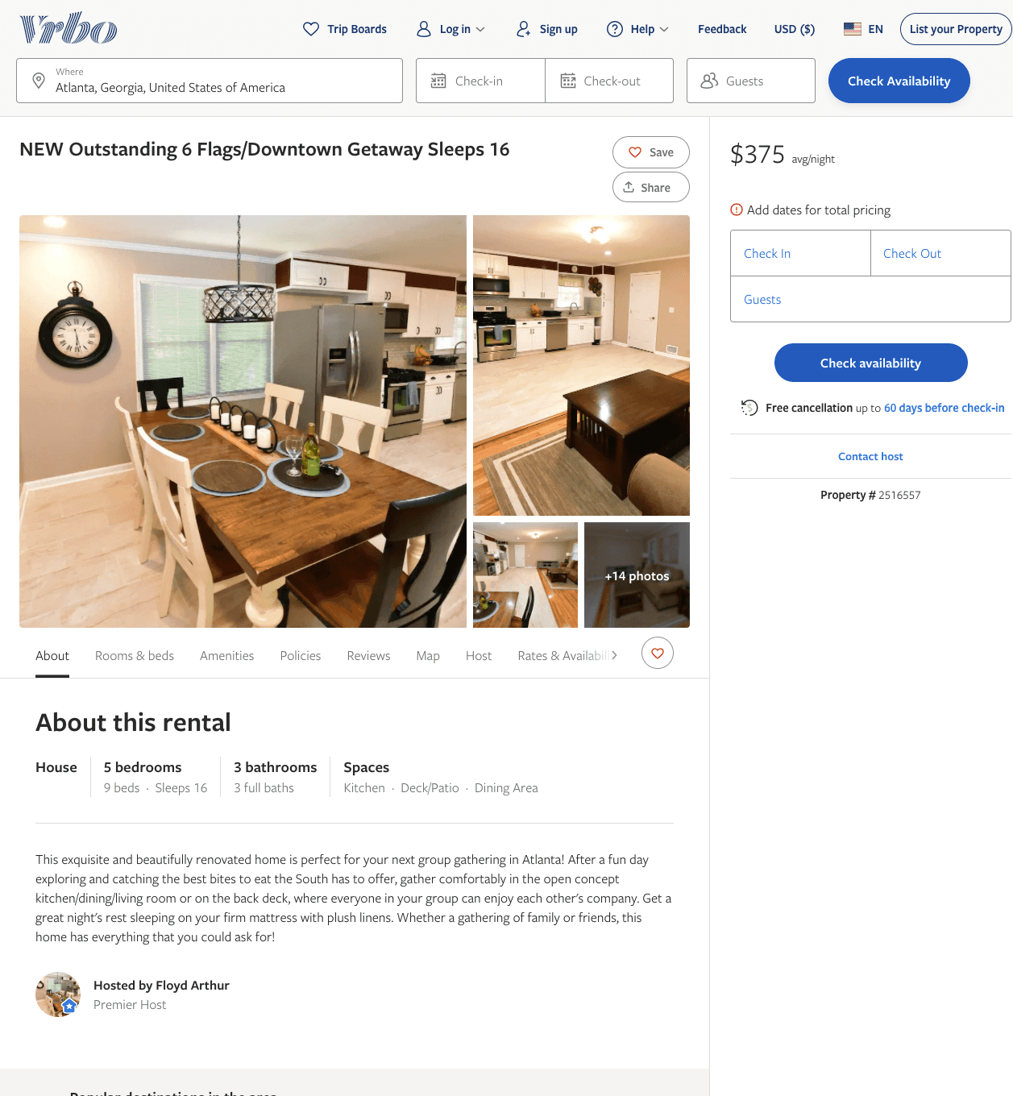
Listing 2516557
5
16
$354 - $471
5
2
Floyd Arthur
https://www.vrbo.com/2516557
Aug 2022

Slide 4
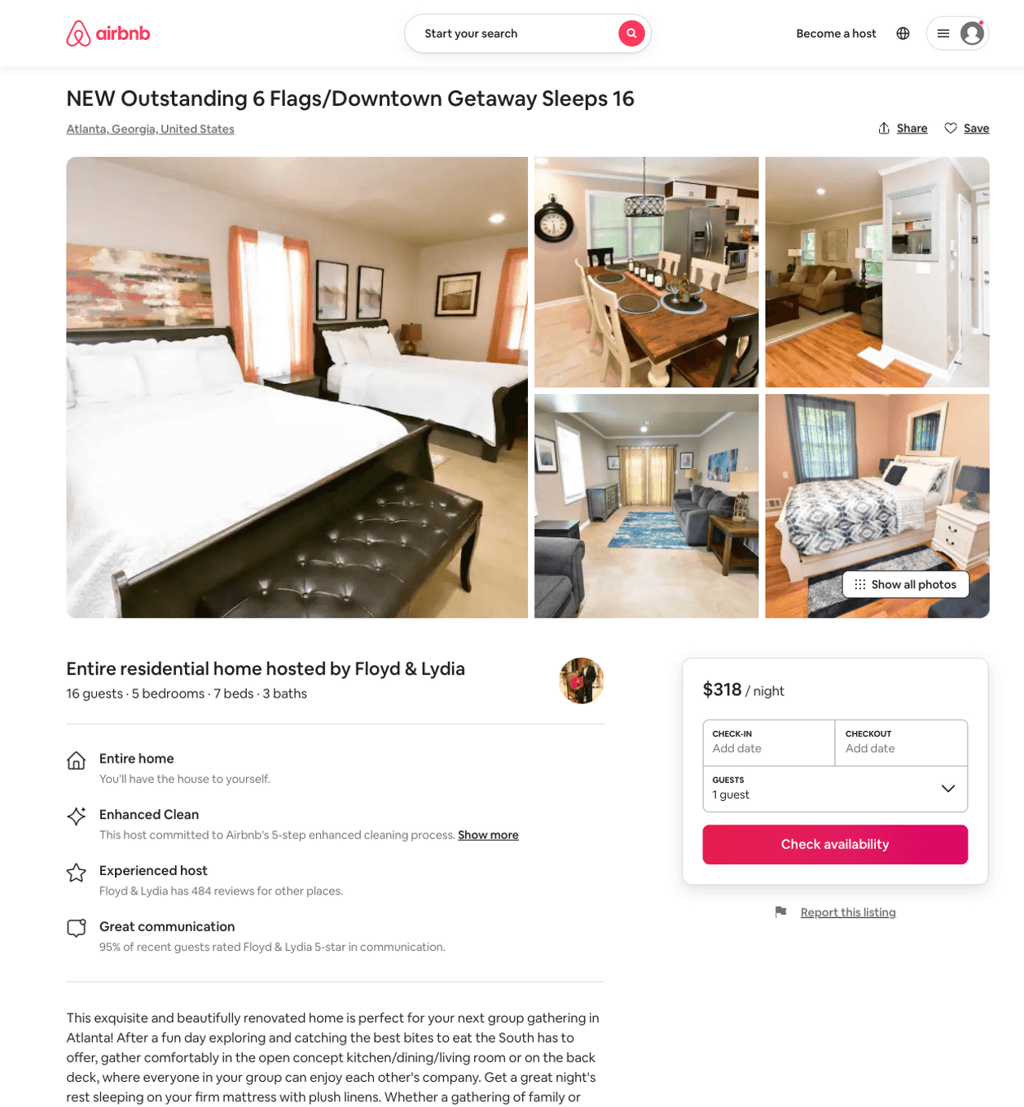
Listing 51330322
5
16
$304 - $437
4.69
2
Floyd & Lydia
114231426
3
https://www.airbnb.com/rooms/51330322
Aug 2022

Slide 5
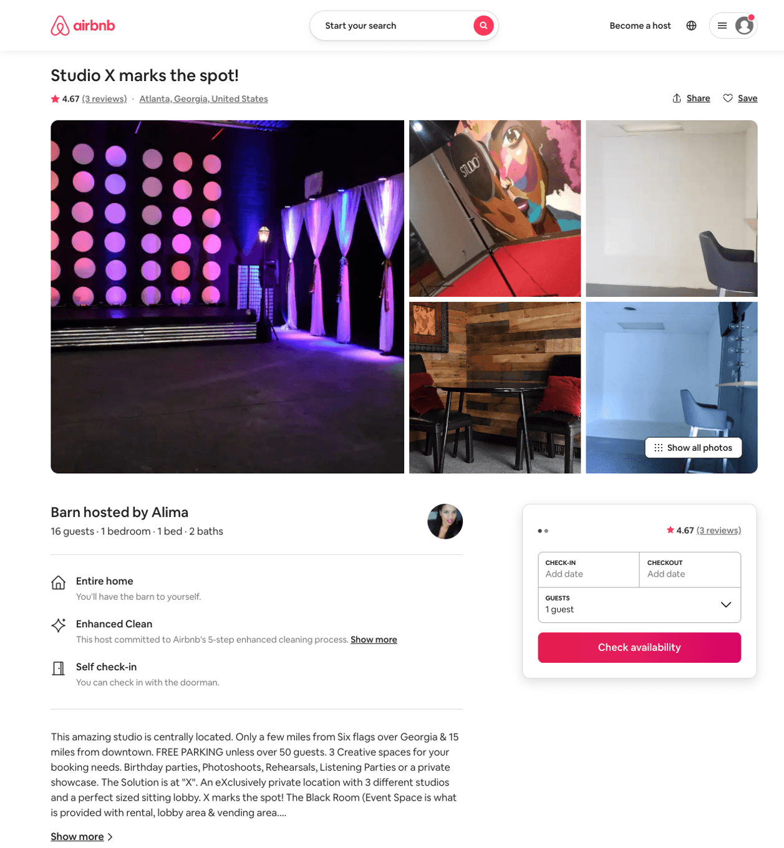
Listing 29677668
1
16
$999
4.67
1
Alima
21693987
3
https://www.airbnb.com/rooms/29677668
Jul 2022

