Slide 2
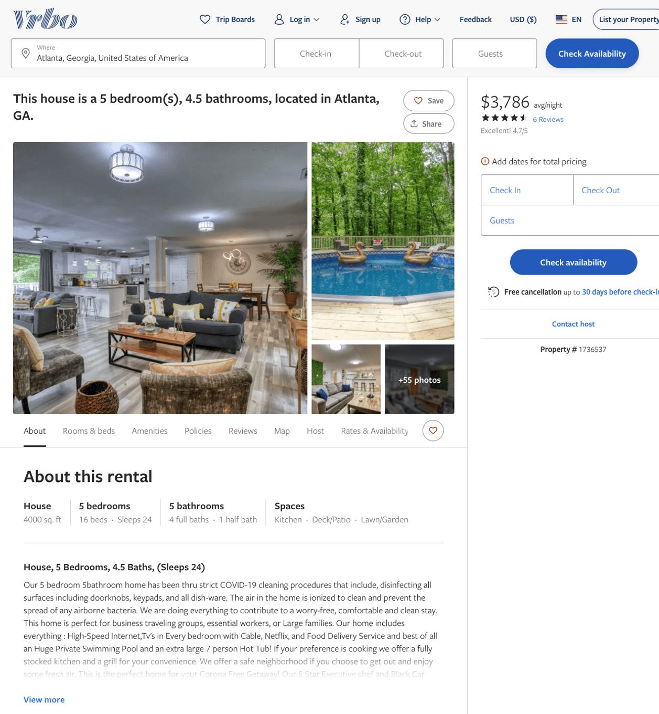
Listing 1736537
5
16
$2,206 - $3,814
4.642857
1
anthony williams
https://www.vrbo.com/1736537
Aug 2022

Slide 3
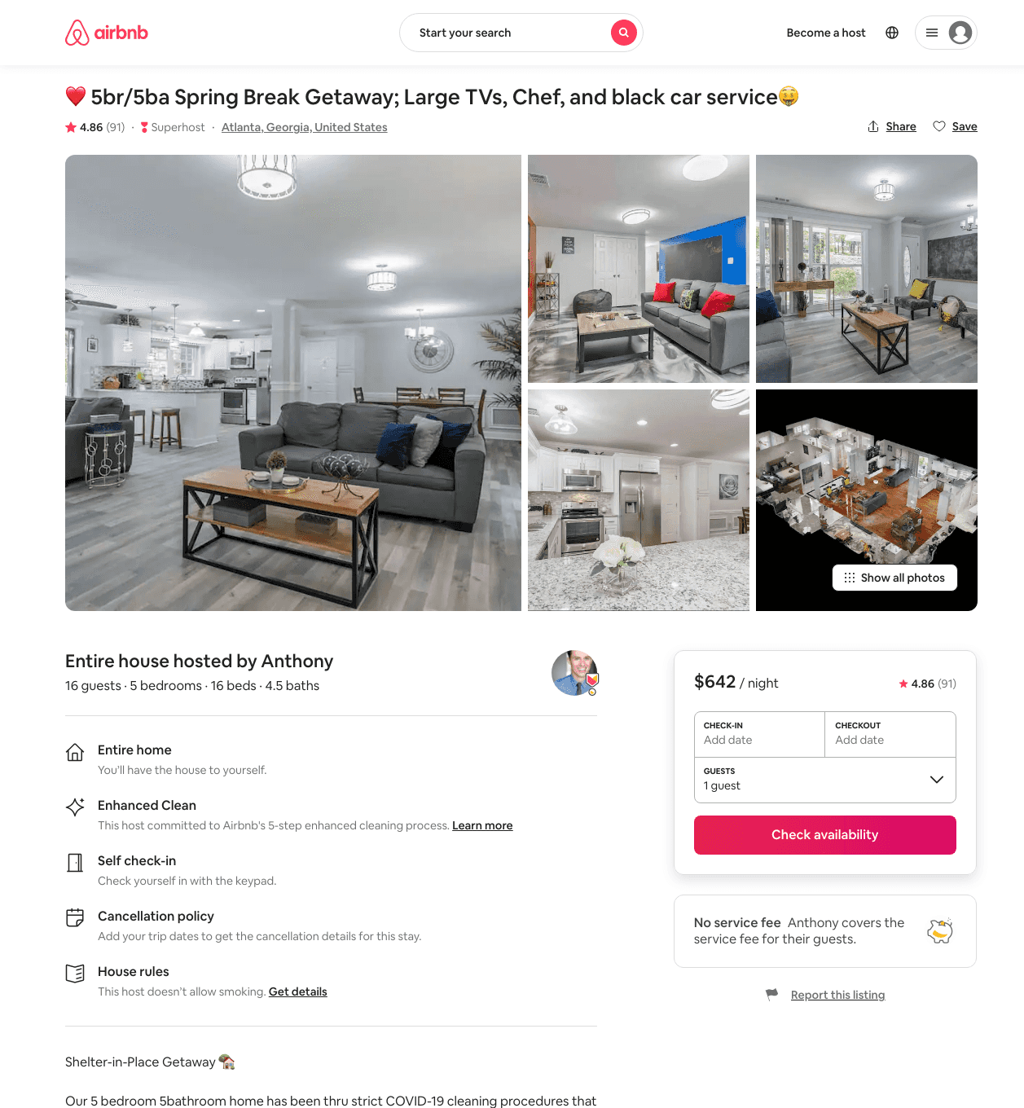
Listing 37611333
5
16
$443 - $1549
4.81
1
William
234095061
5
https://www.airbnb.com/rooms/37611333
Aug 2022

Slide 4
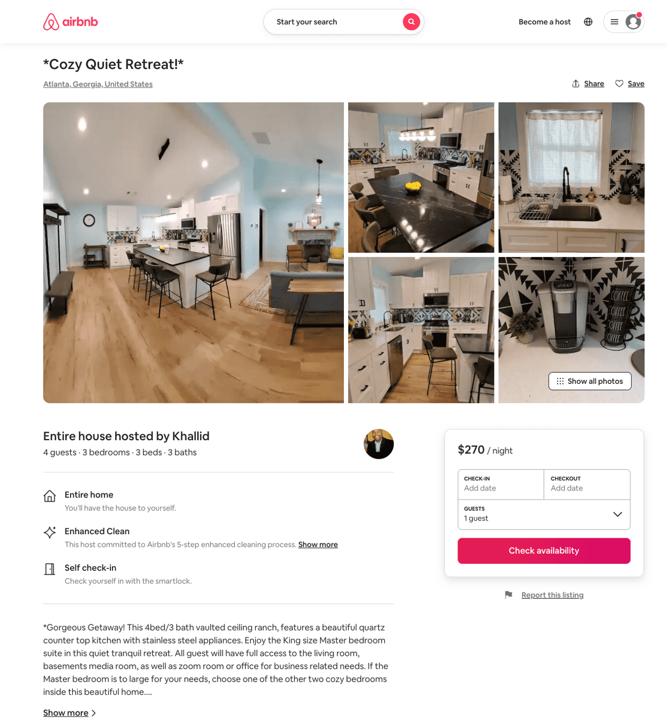
Listing 50312570
3
6
$150 - $325
5.0
2
Khallid
299129570
1
https://www.airbnb.com/rooms/50312570
Jun 2022

Slide 5
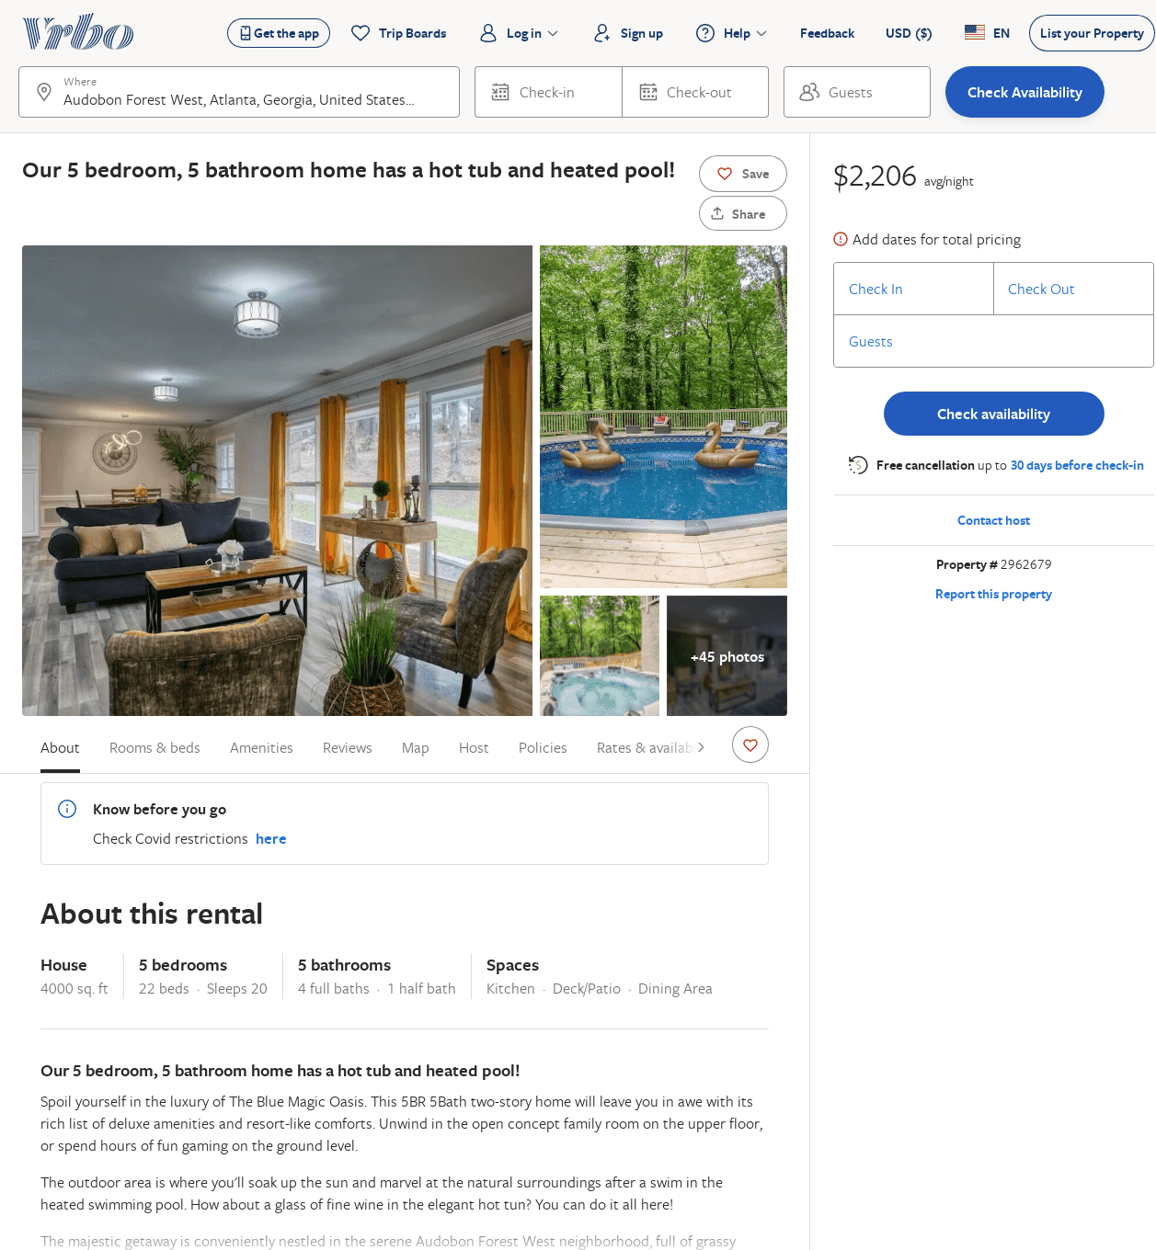
Listing 2962679
5
20
$2,206
1
anthony williams
https://www.vrbo.com/2962679
Aug 2022

