Slide 2
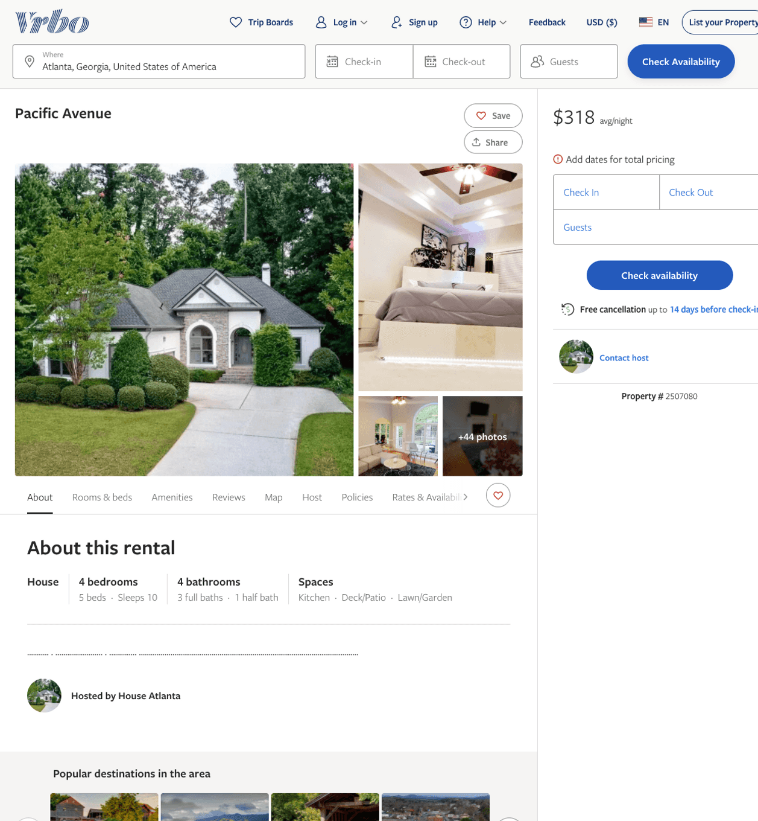
Listing 2507080
4
10
$268 - $423
4.3
2
Authentic Reservations
https://www.vrbo.com/2507080
Aug 2022

Slide 3
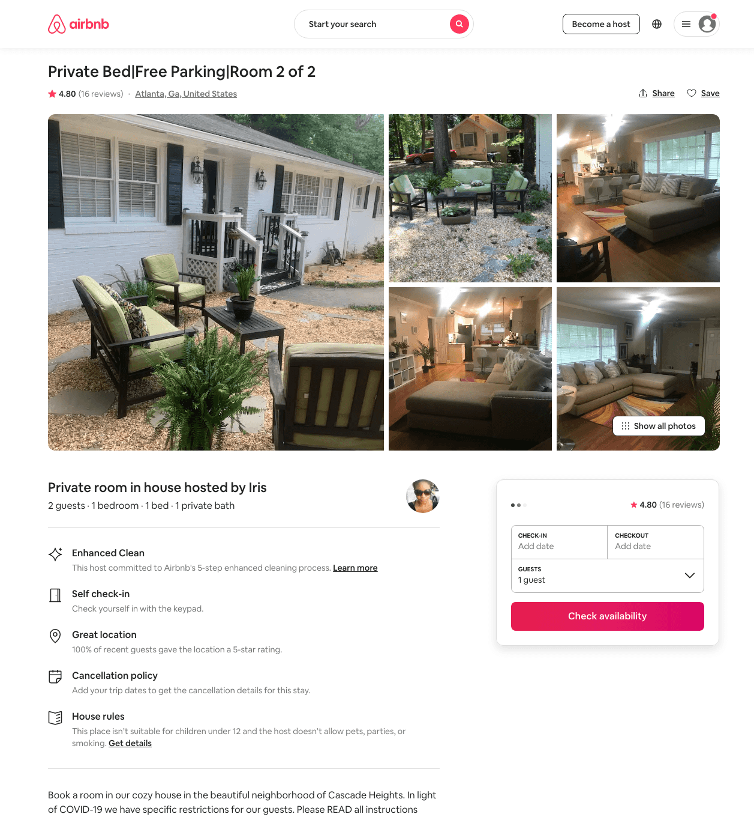
Listing 37686398
1
2
$25 - $27
4.88
5
Iris
57524811
2
https://www.airbnb.com/rooms/37686398
Aug 2022

Slide 4
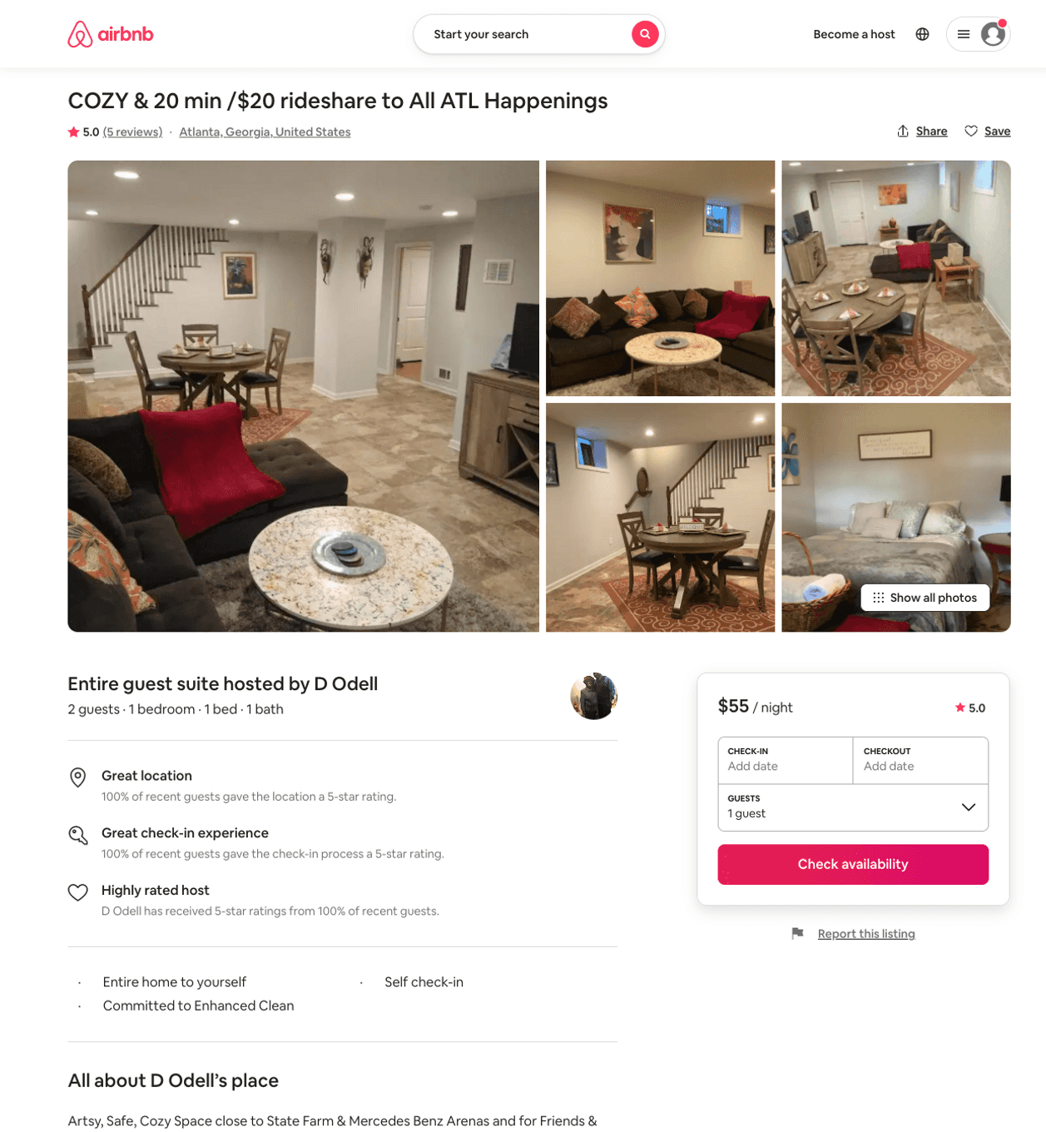
Listing 41563363
1
2
$55 - $60
4.77
4
D Odell
213641750
1
https://www.airbnb.com/rooms/41563363
Aug 2022

Slide 5
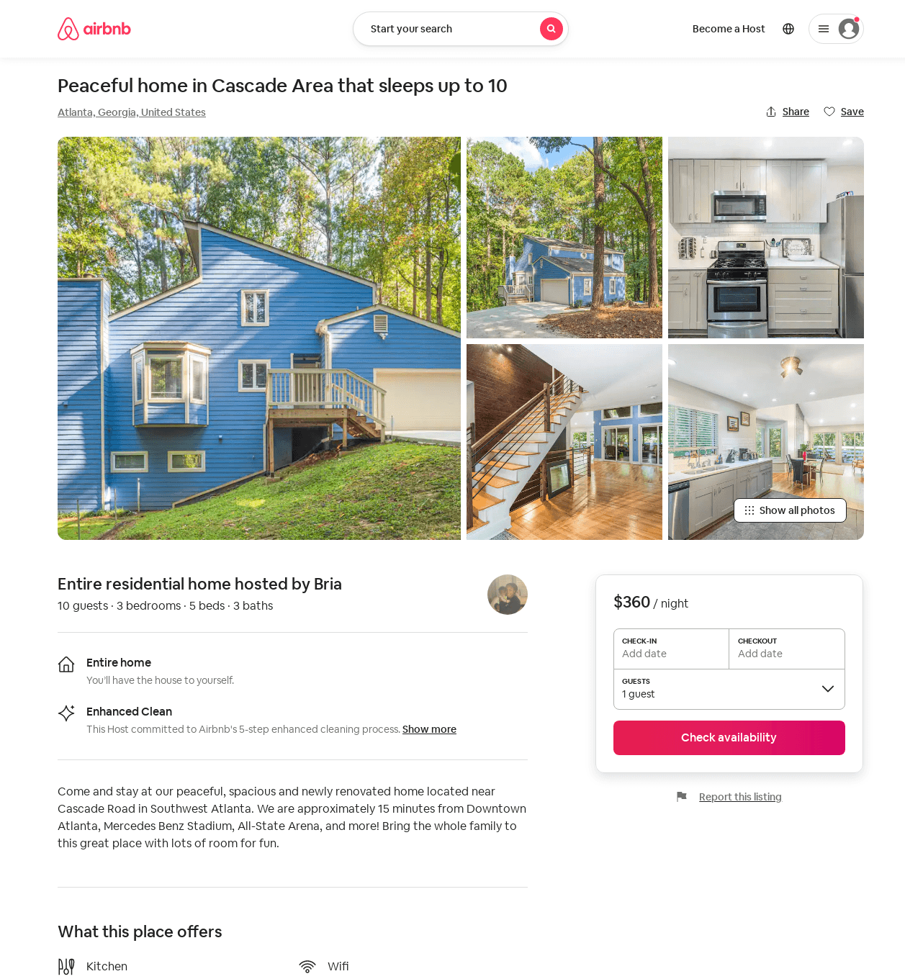
Listing 52610173
4
10
$300 - $450
5.0
3
Bria
62167965
3
https://www.airbnb.com/rooms/52610173
Aug 2022

Slide 6
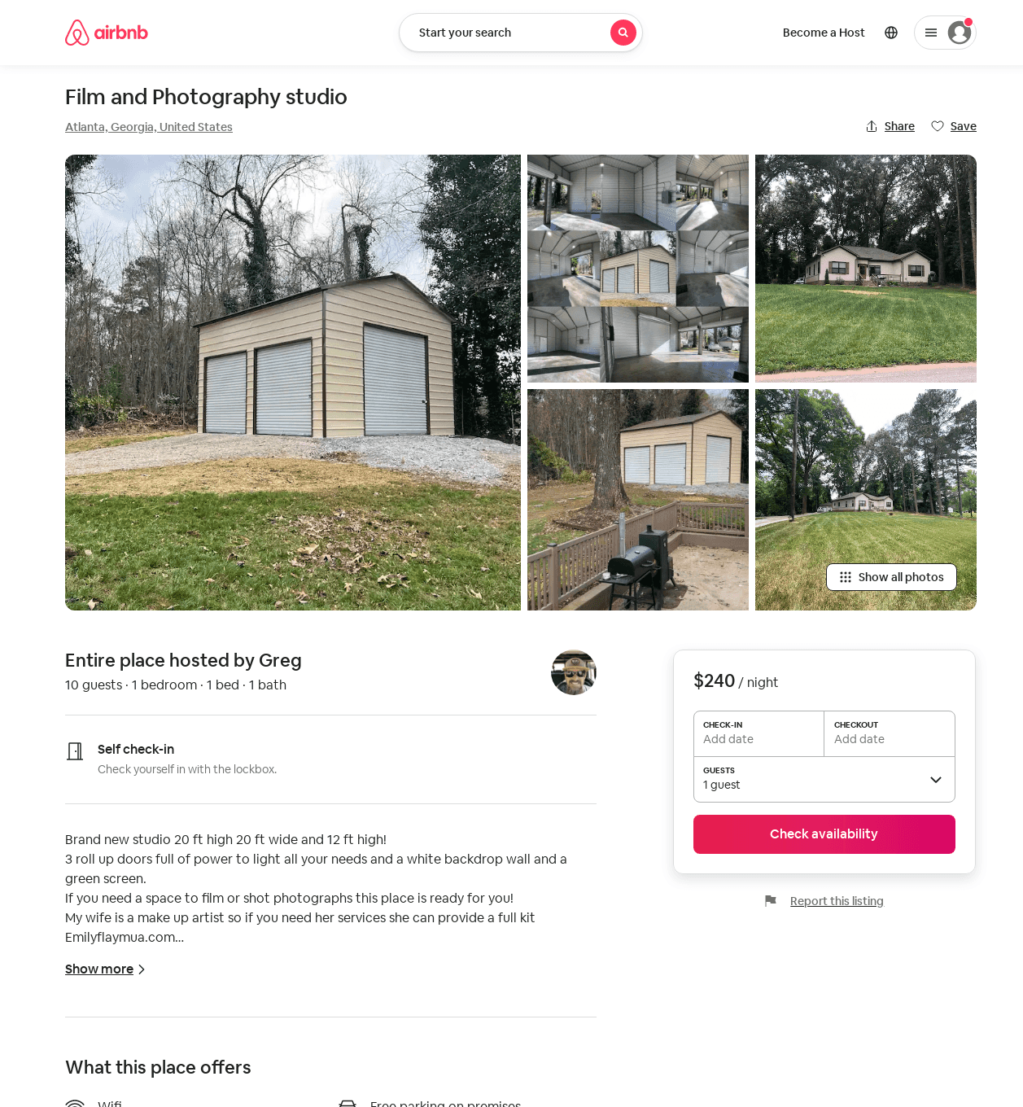
Listing 54272904
10
$240 - $300
1
Greg
413661463
1
https://www.airbnb.com/rooms/54272904
Aug 2022

