Slide 2
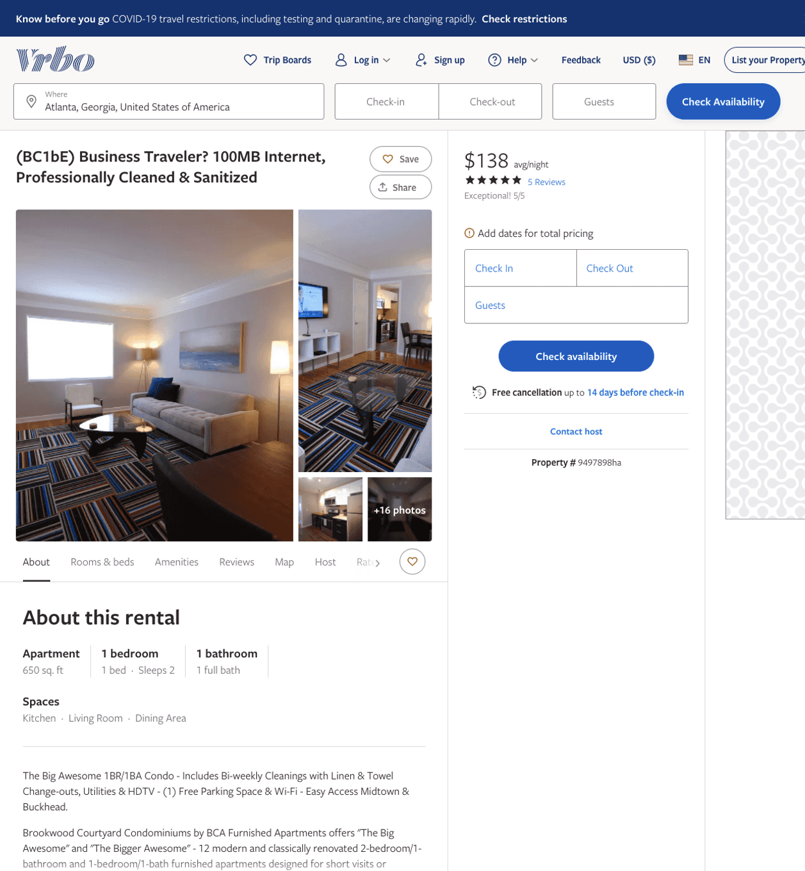
Listing 9497898
1
2
$130 - $145
5
1
Alex & Michael
https://www.vrbo.com/9497898ha
Aug 2022

Slide 3
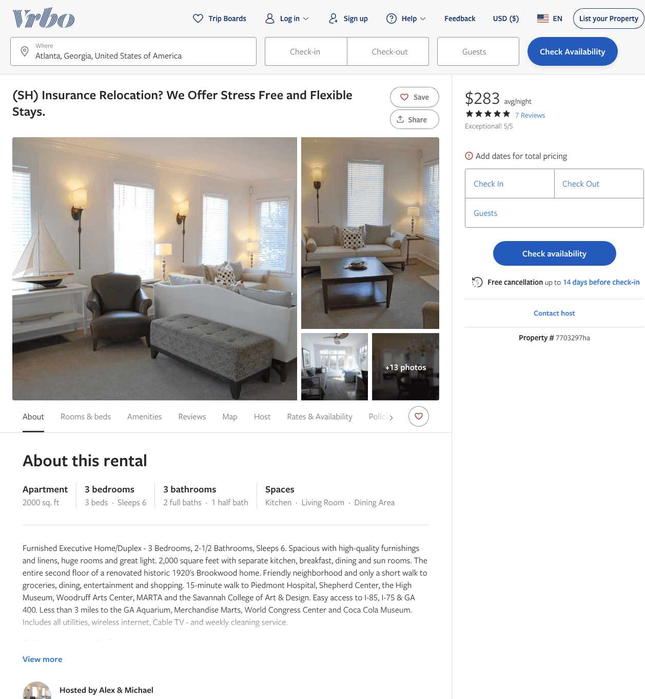
Listing 7703297
3
6
$283 - $322
5
120
Alex & Michael
https://www.vrbo.com/7703297ha
Aug 2022

Slide 4
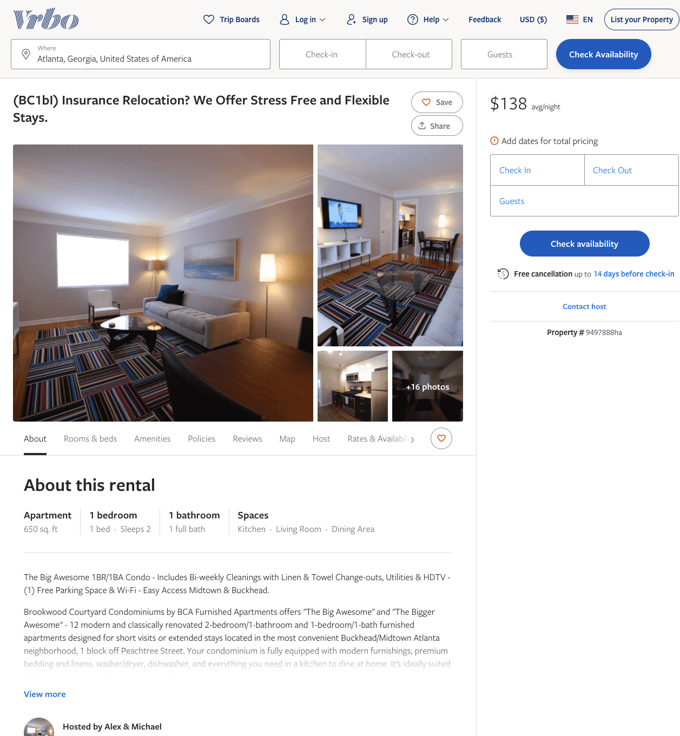
Listing 9497888
1
2
$130 - $145
1
Alex & Michael
https://www.vrbo.com/9497888ha
Aug 2022

Slide 5
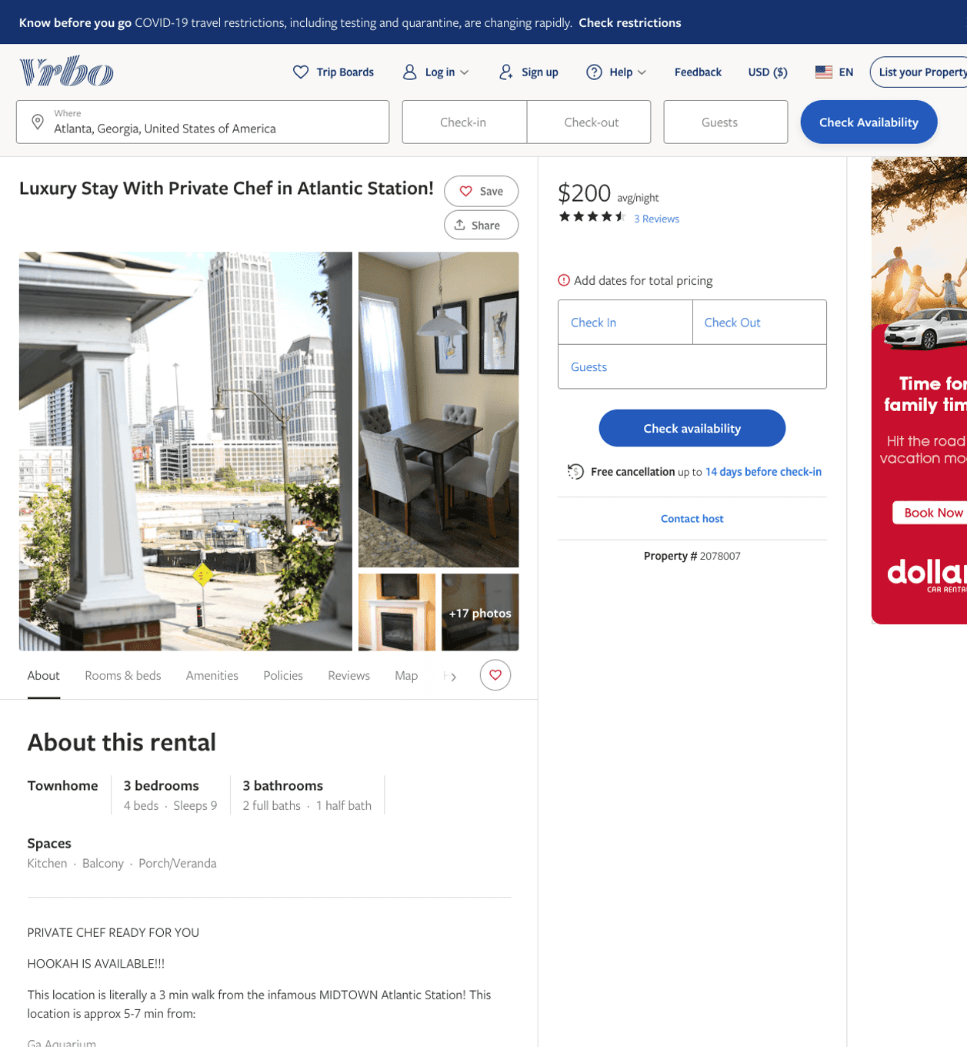
Listing 2078007
201 16TH ST NW 7
3
9
$180 - $250
4.714286
1
willie
https://www.vrbo.com/2078007
Aug 2022

Slide 6
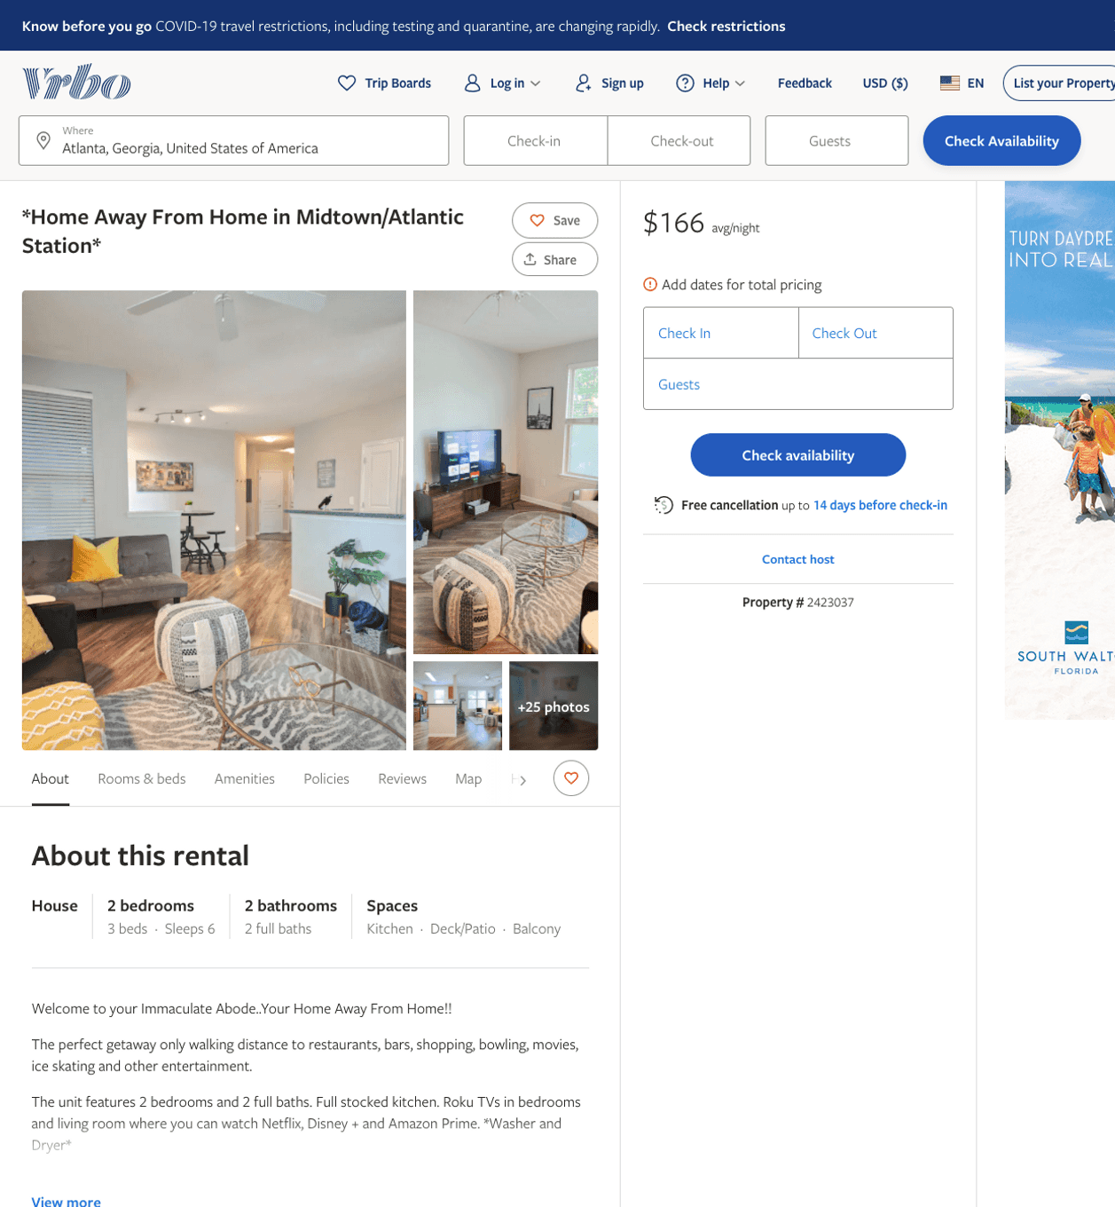
Listing 2423037
2
6
$151 - $166
5
2
Marilyn
https://www.vrbo.com/2423037
Aug 2022

Slide 7
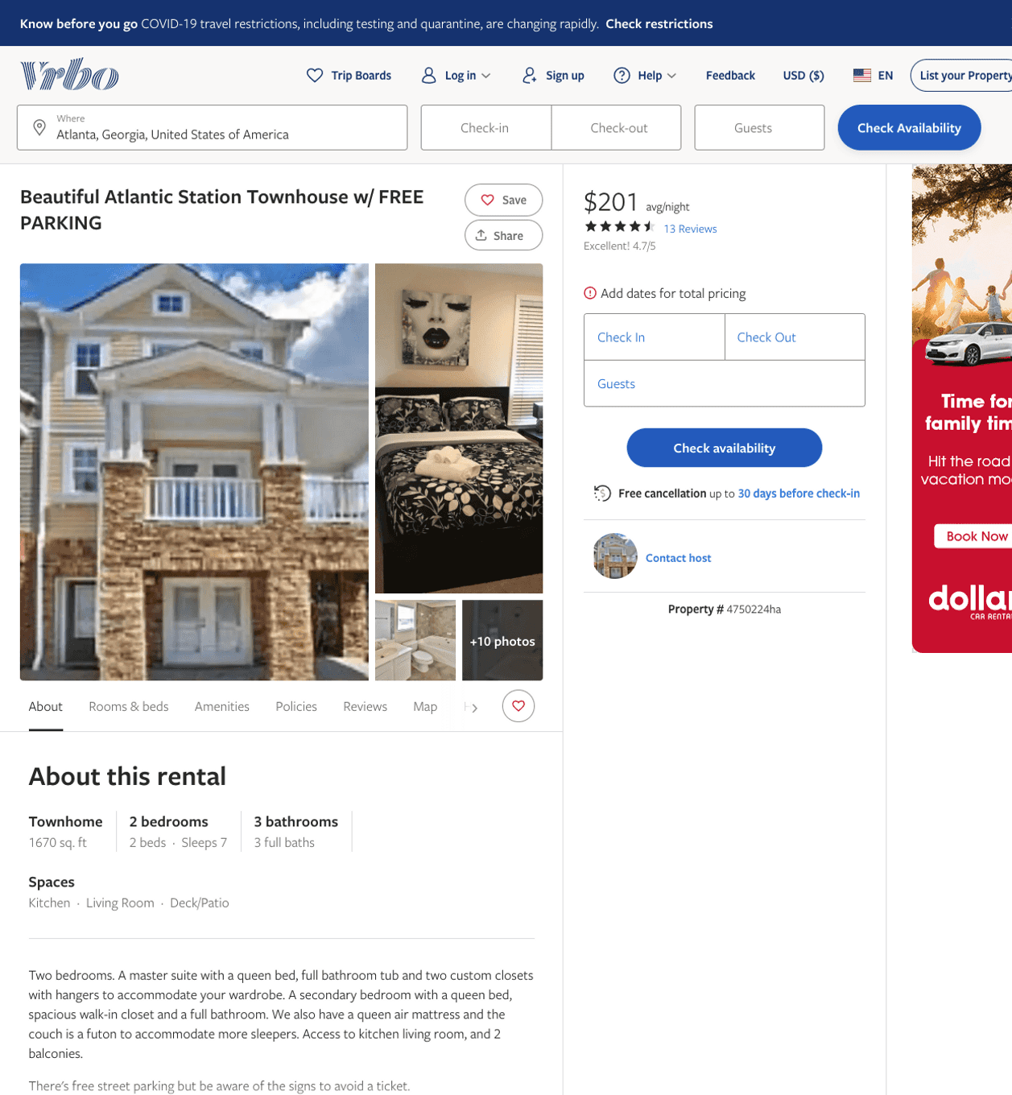
Listing 4750224
201 16TH ST NW 1
2
7
$201 - $248
4.7777777
2
https://www.vrbo.com/4750224ha
Aug 2022

Slide 8
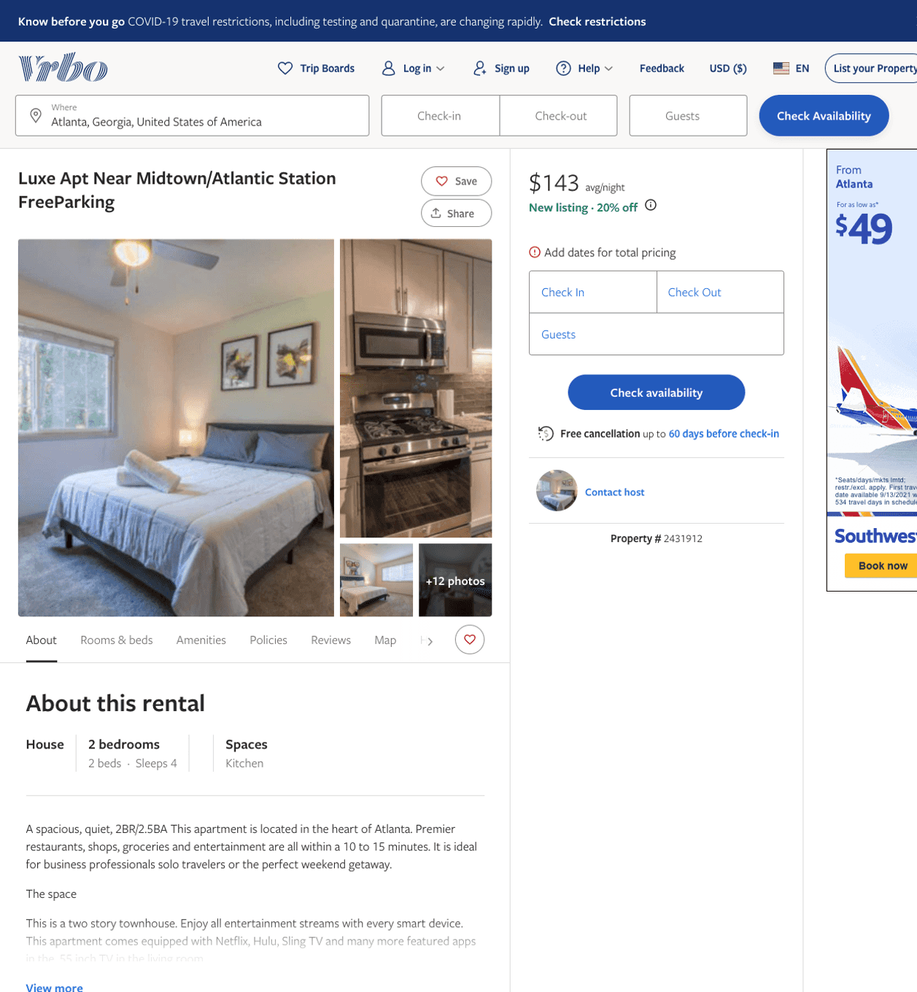
Listing 2431912
2
4
$143 - $176
3.5
2
https://www.vrbo.com/2431912
Aug 2022

Slide 9
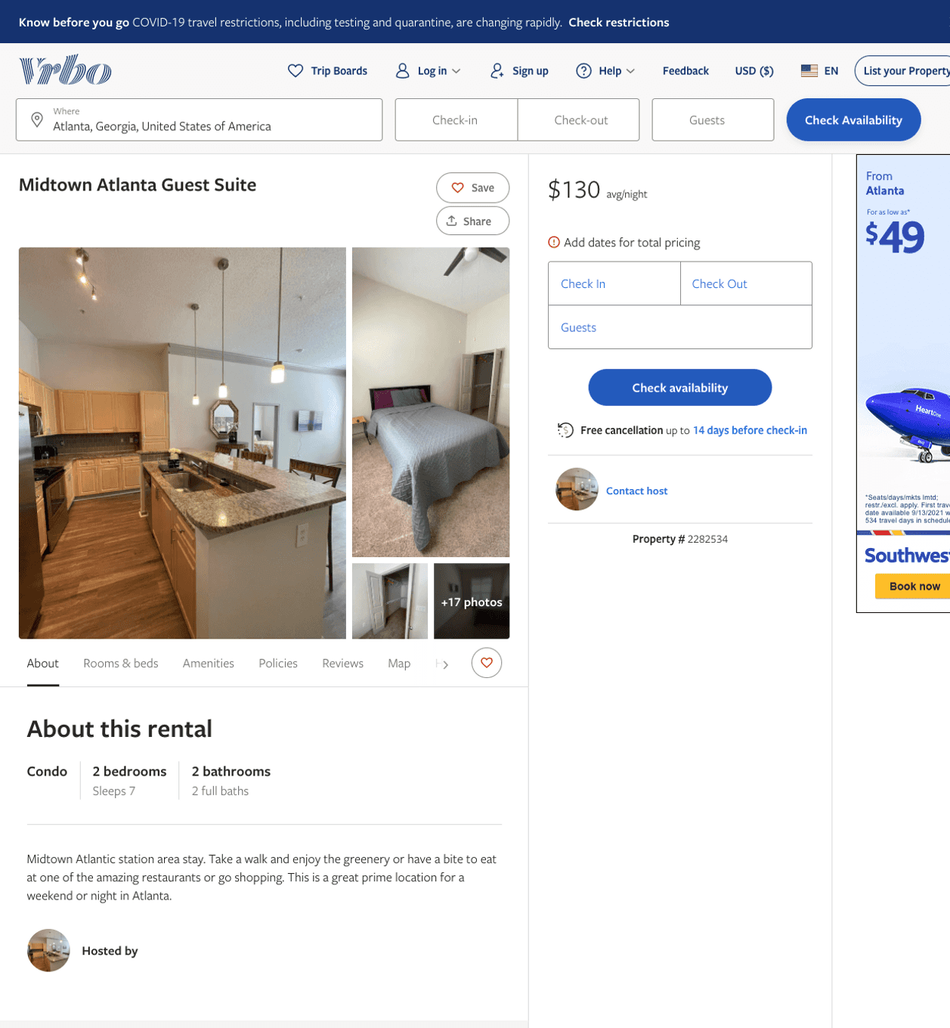
Listing 2282534
2
7
$124 - $99
5
2
https://www.vrbo.com/2282534
Aug 2022

Slide 10
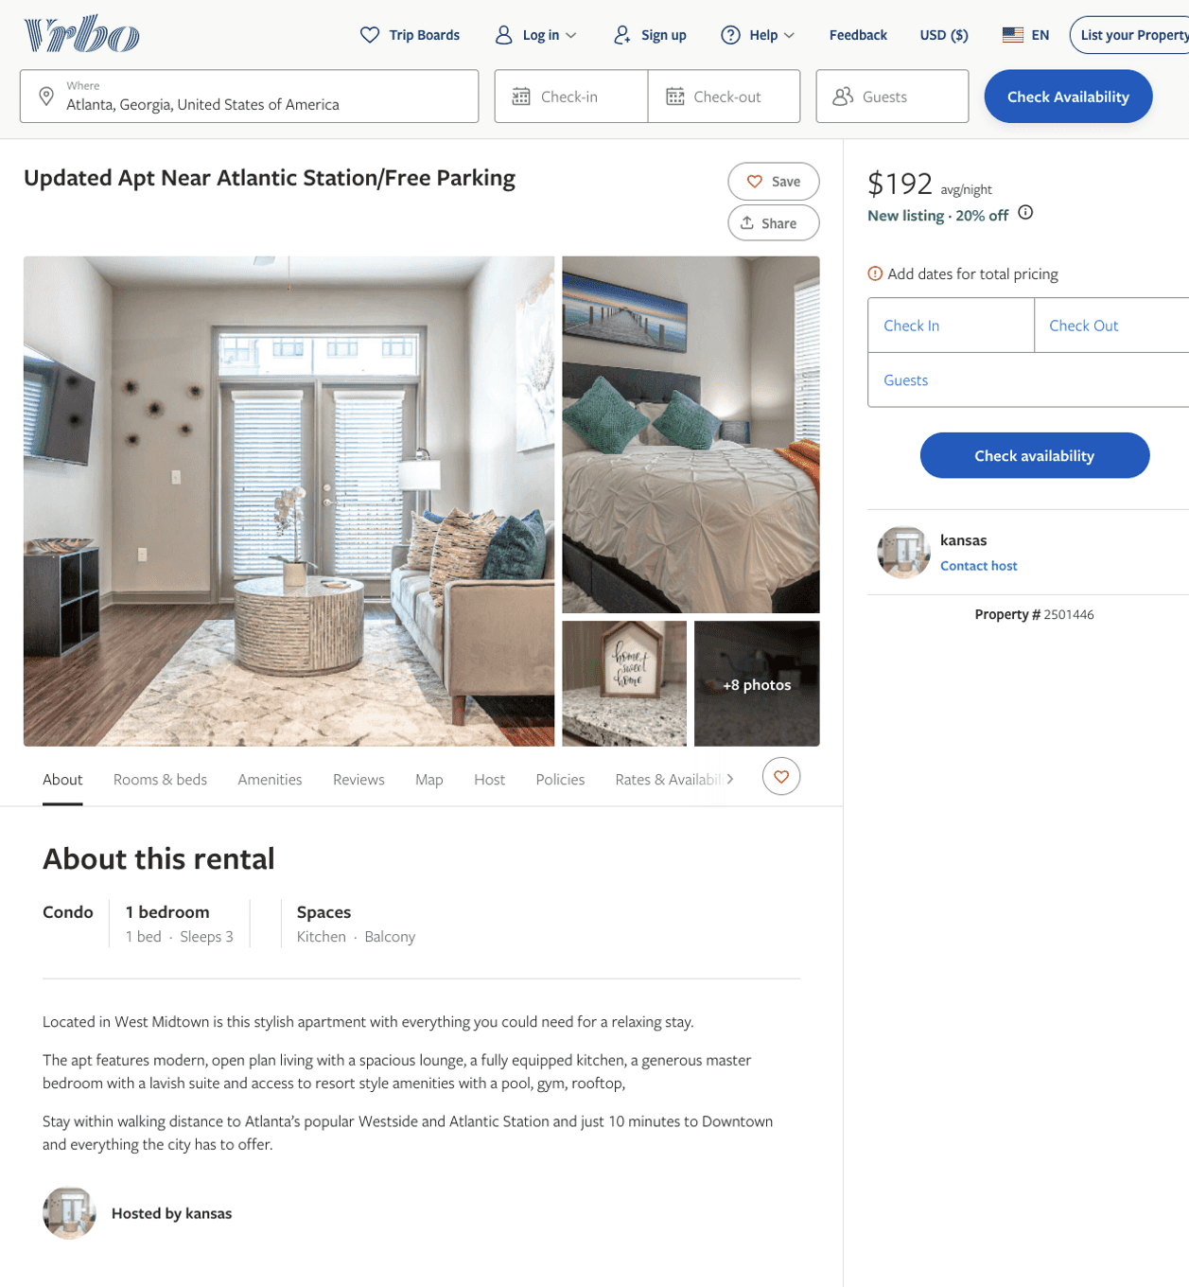
Listing 2501446
1
3
$169 - $211
2
kansas
https://www.vrbo.com/2501446
Aug 2022

Slide 11
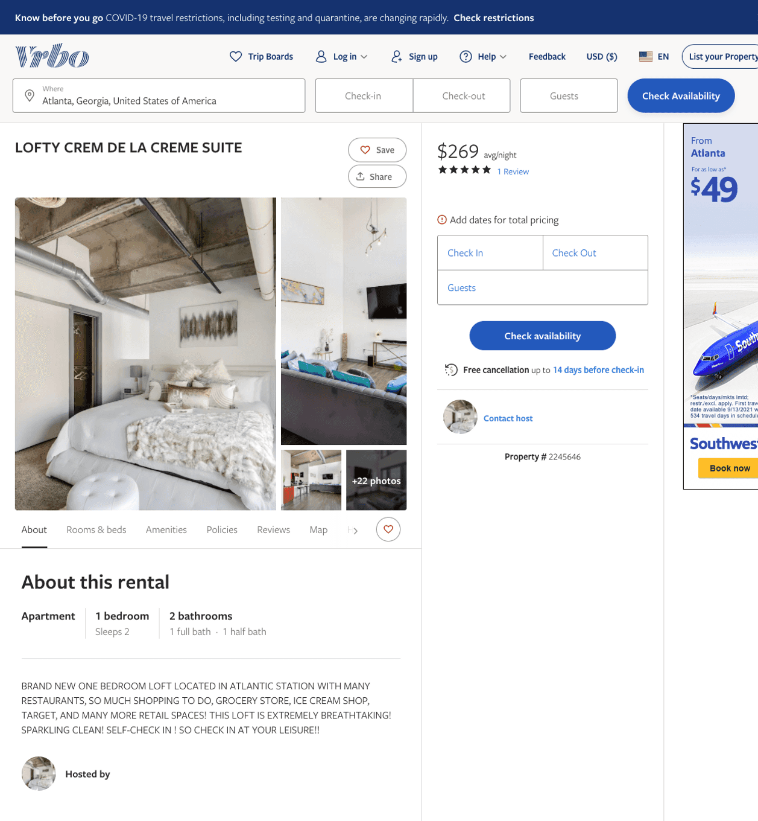
Listing 2245646
1
2
$269
5
1
https://www.vrbo.com/2245646
Aug 2022

Slide 12
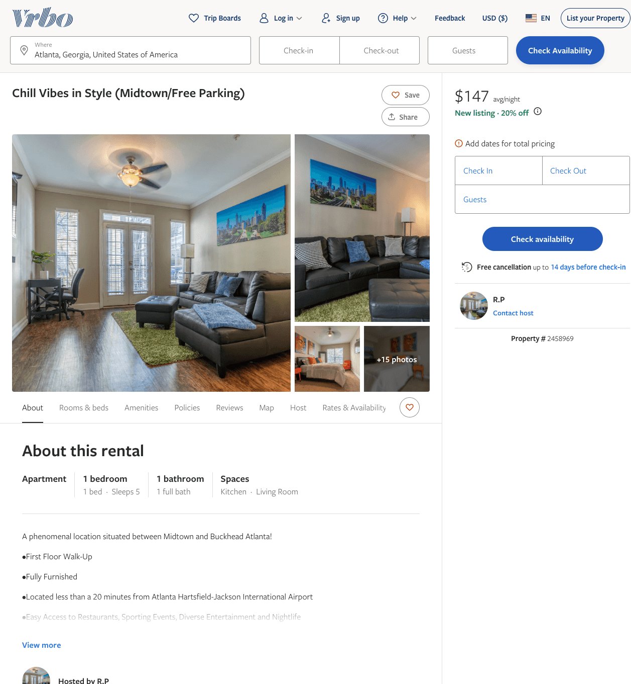
Listing 2458969
1
5
$140 - $208
5
2
R.P
https://www.vrbo.com/2458969
Aug 2022

Slide 13
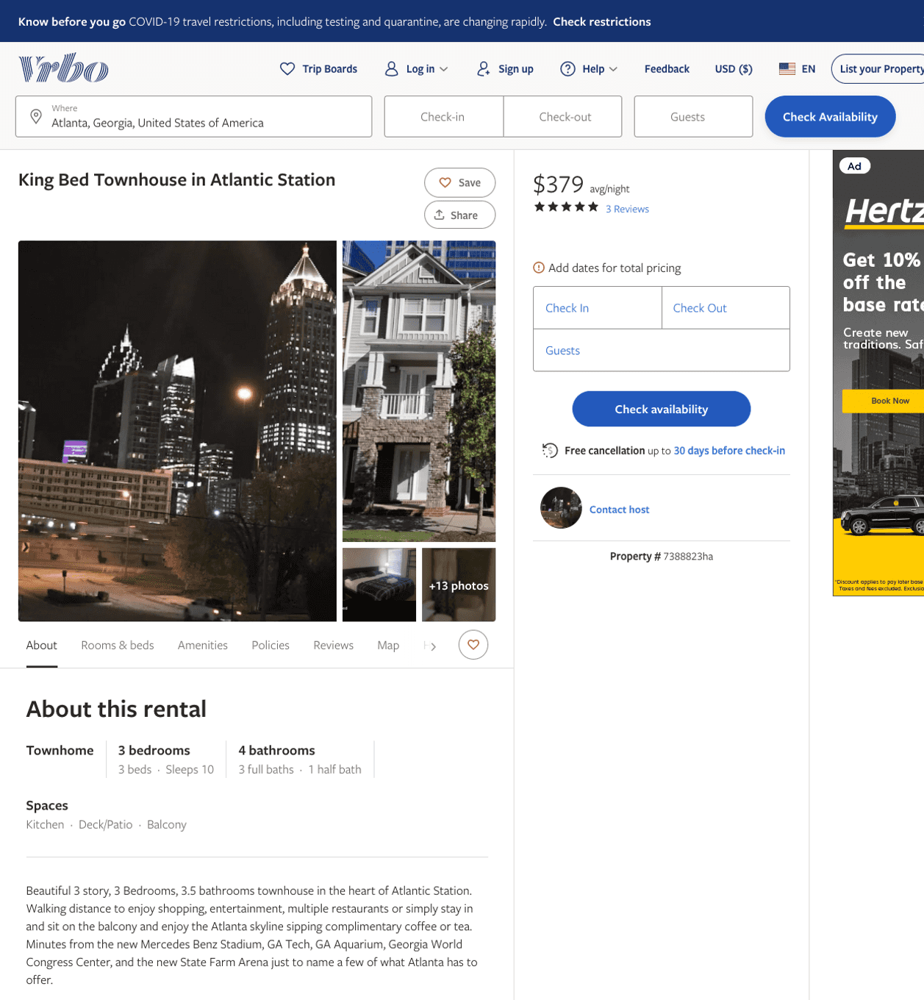
Listing 7388823
201 16TH ST NW 4
3
10
$379
5
2
https://www.vrbo.com/7388823ha
Aug 2022

Slide 14
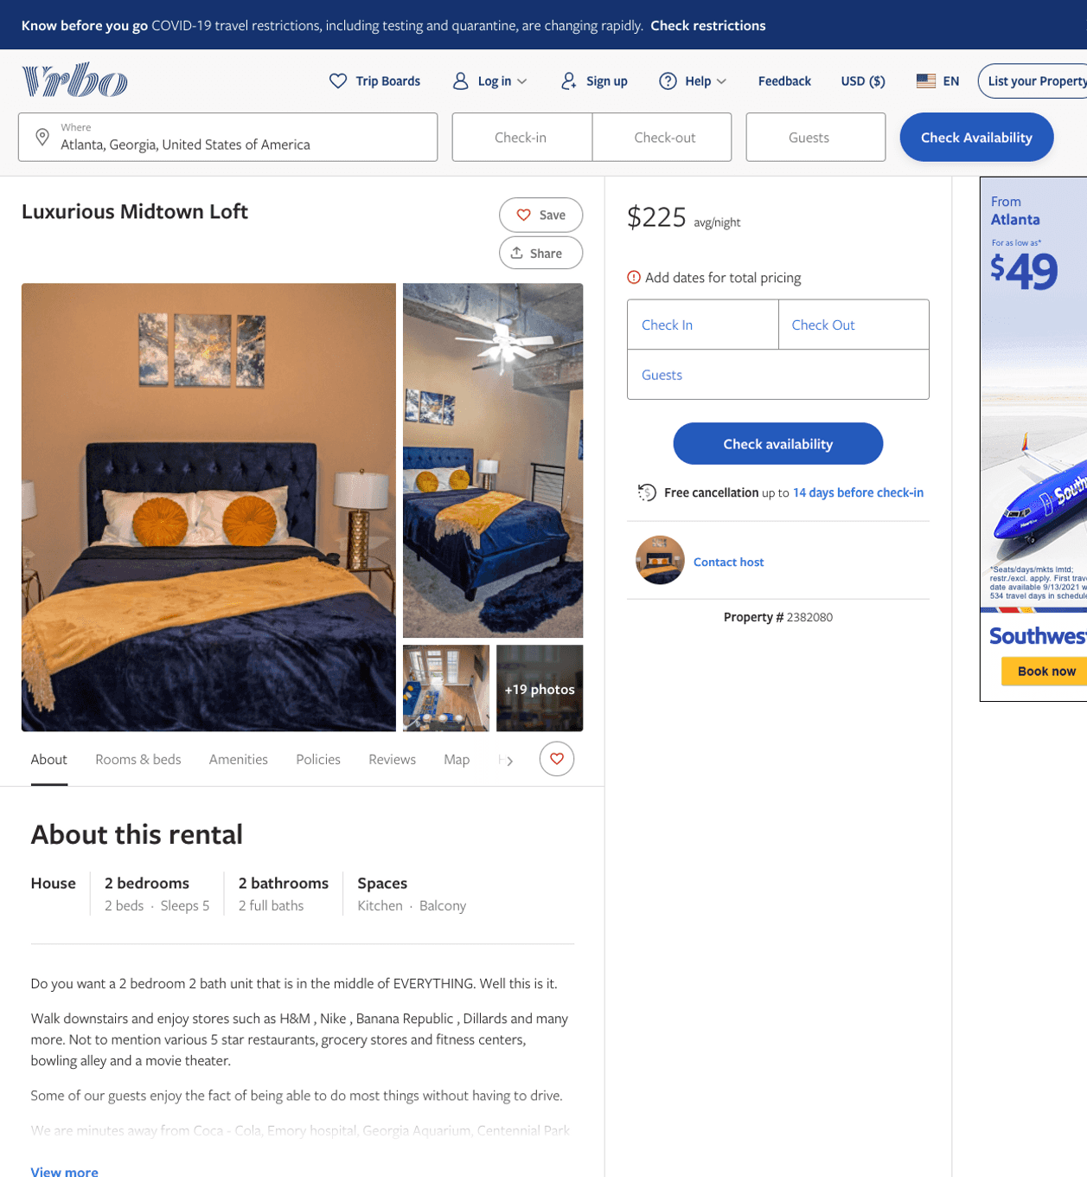
Listing 2382080
2
5
$177 - $253
5
1
https://www.vrbo.com/2382080
Aug 2022

Slide 15
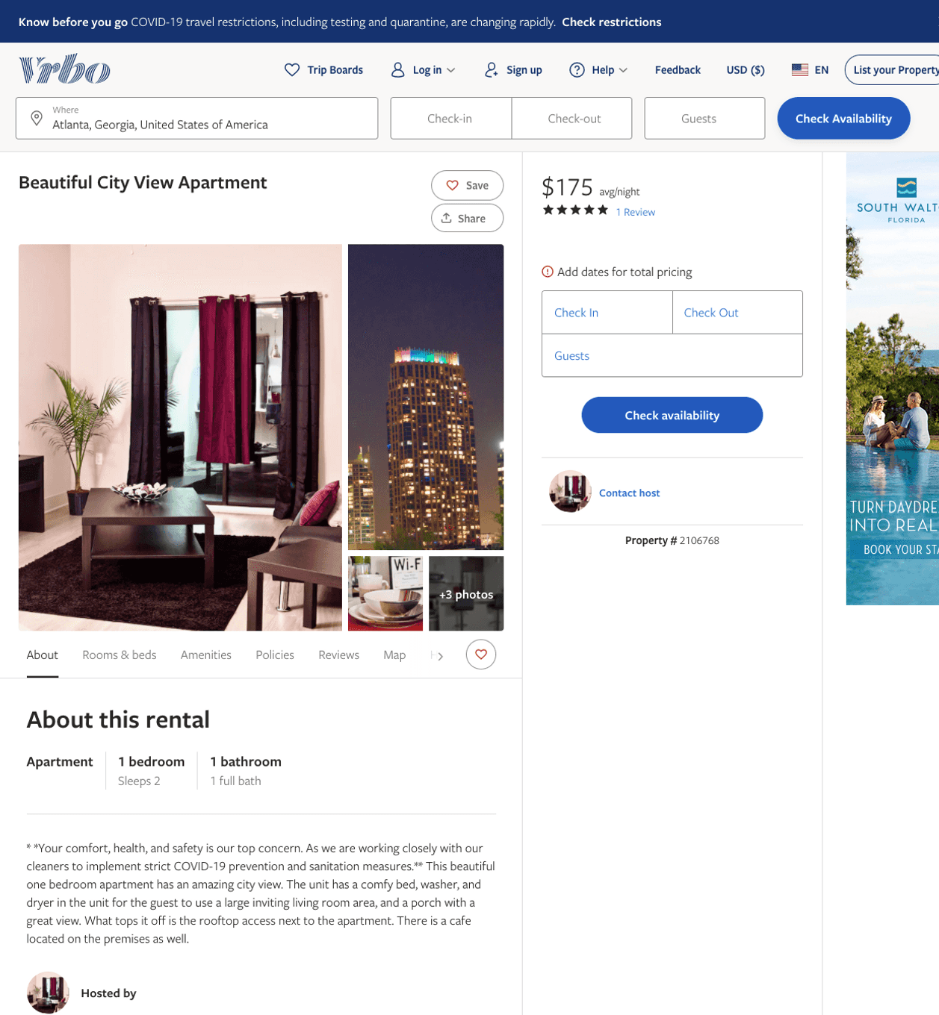
Listing 2106768
1
2
$175
5
1
https://www.vrbo.com/2106768
Aug 2022

Slide 16
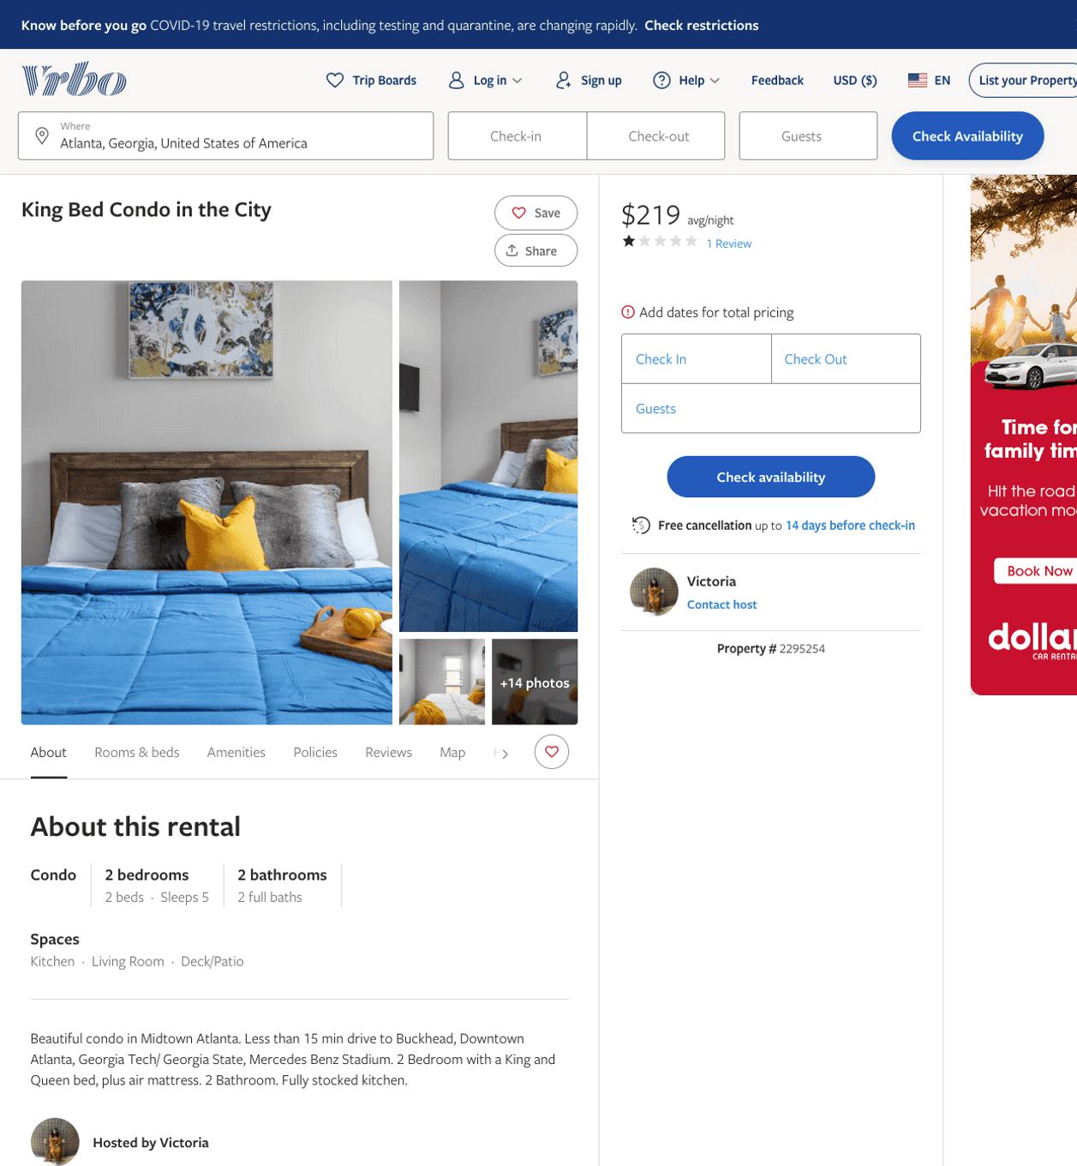
Listing 2295254
2
5
$195 - $219
1
3
Victoria
https://www.vrbo.com/2295254
Aug 2022

Slide 17
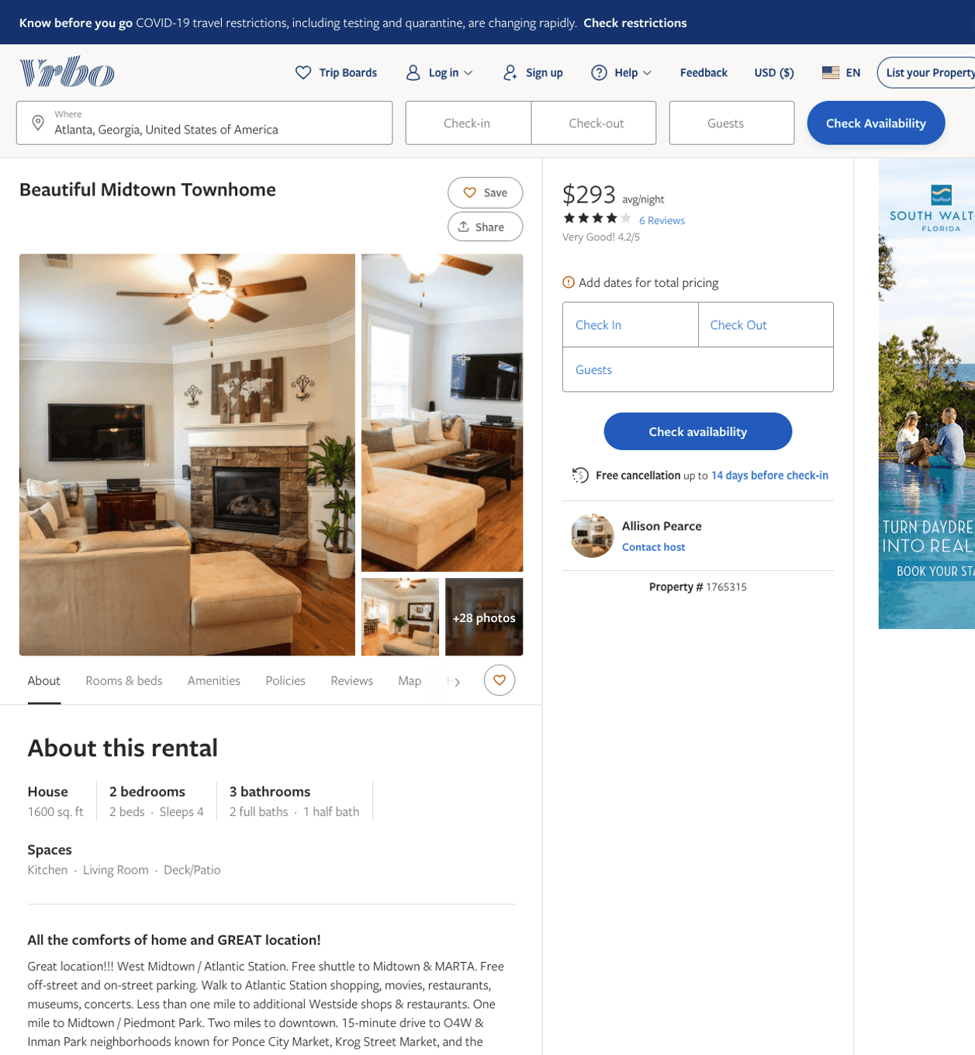
Listing 1765315
2
4
$293
4.1666665
2
Allison Pearce
https://www.vrbo.com/1765315
Aug 2022

Slide 18
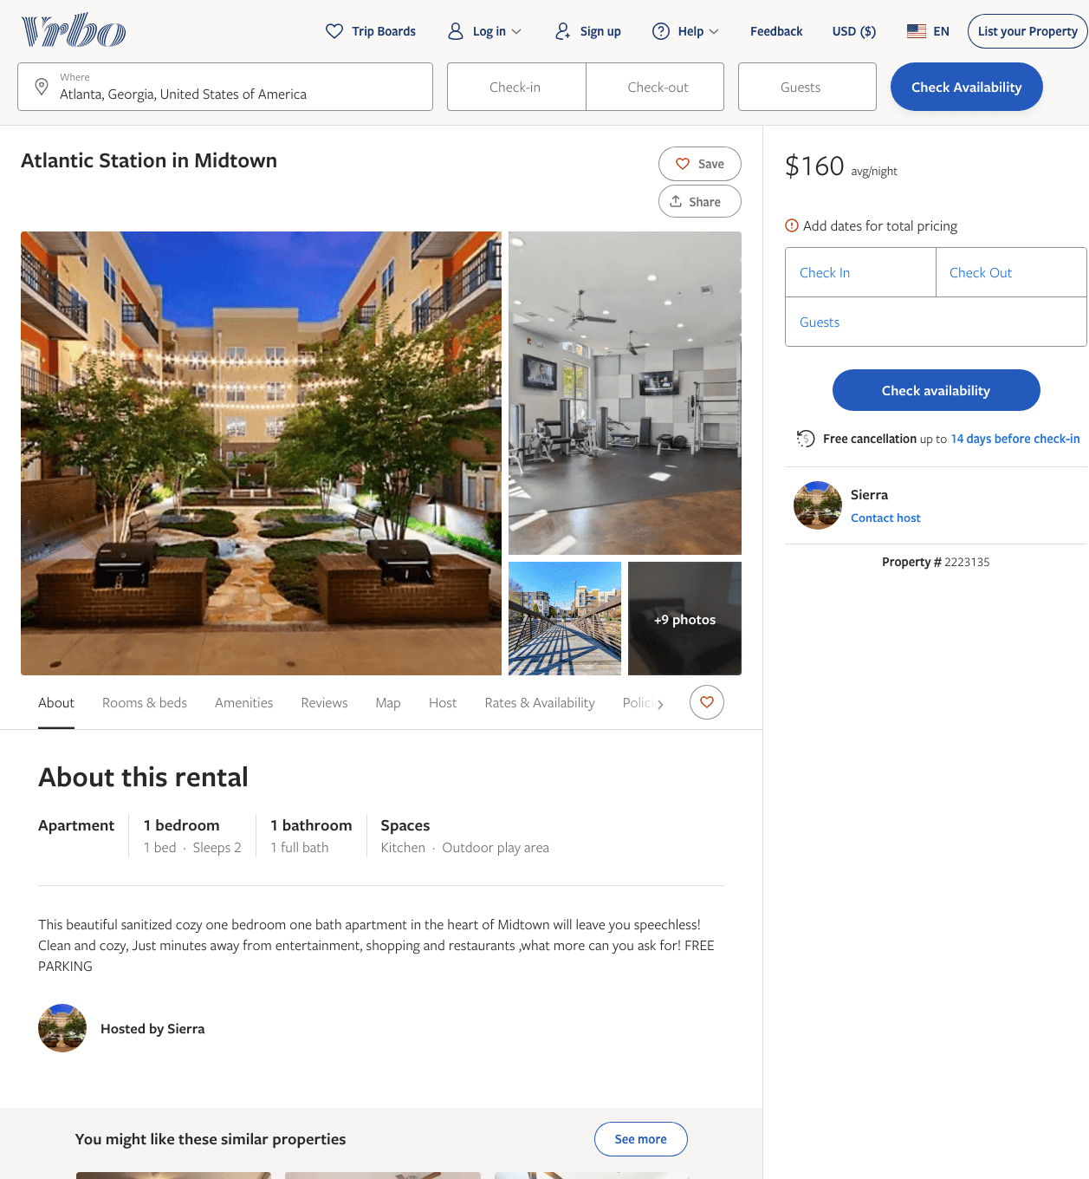
Listing 2223135
391 STATE ST NW
1
2
$145 - $160
1
Sierra
https://www.vrbo.com/2223135
Aug 2022

Slide 19
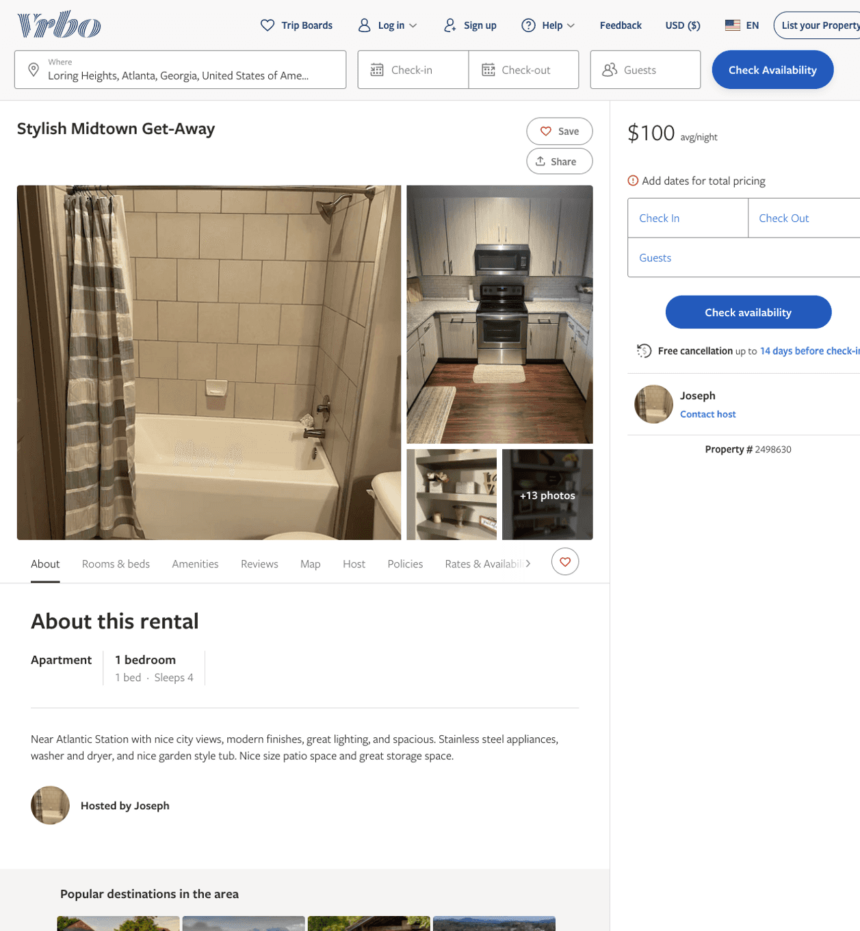
Listing 2498630
1
4
$100 - $230
1
Joseph
https://www.vrbo.com/2498630
Aug 2022

Slide 20
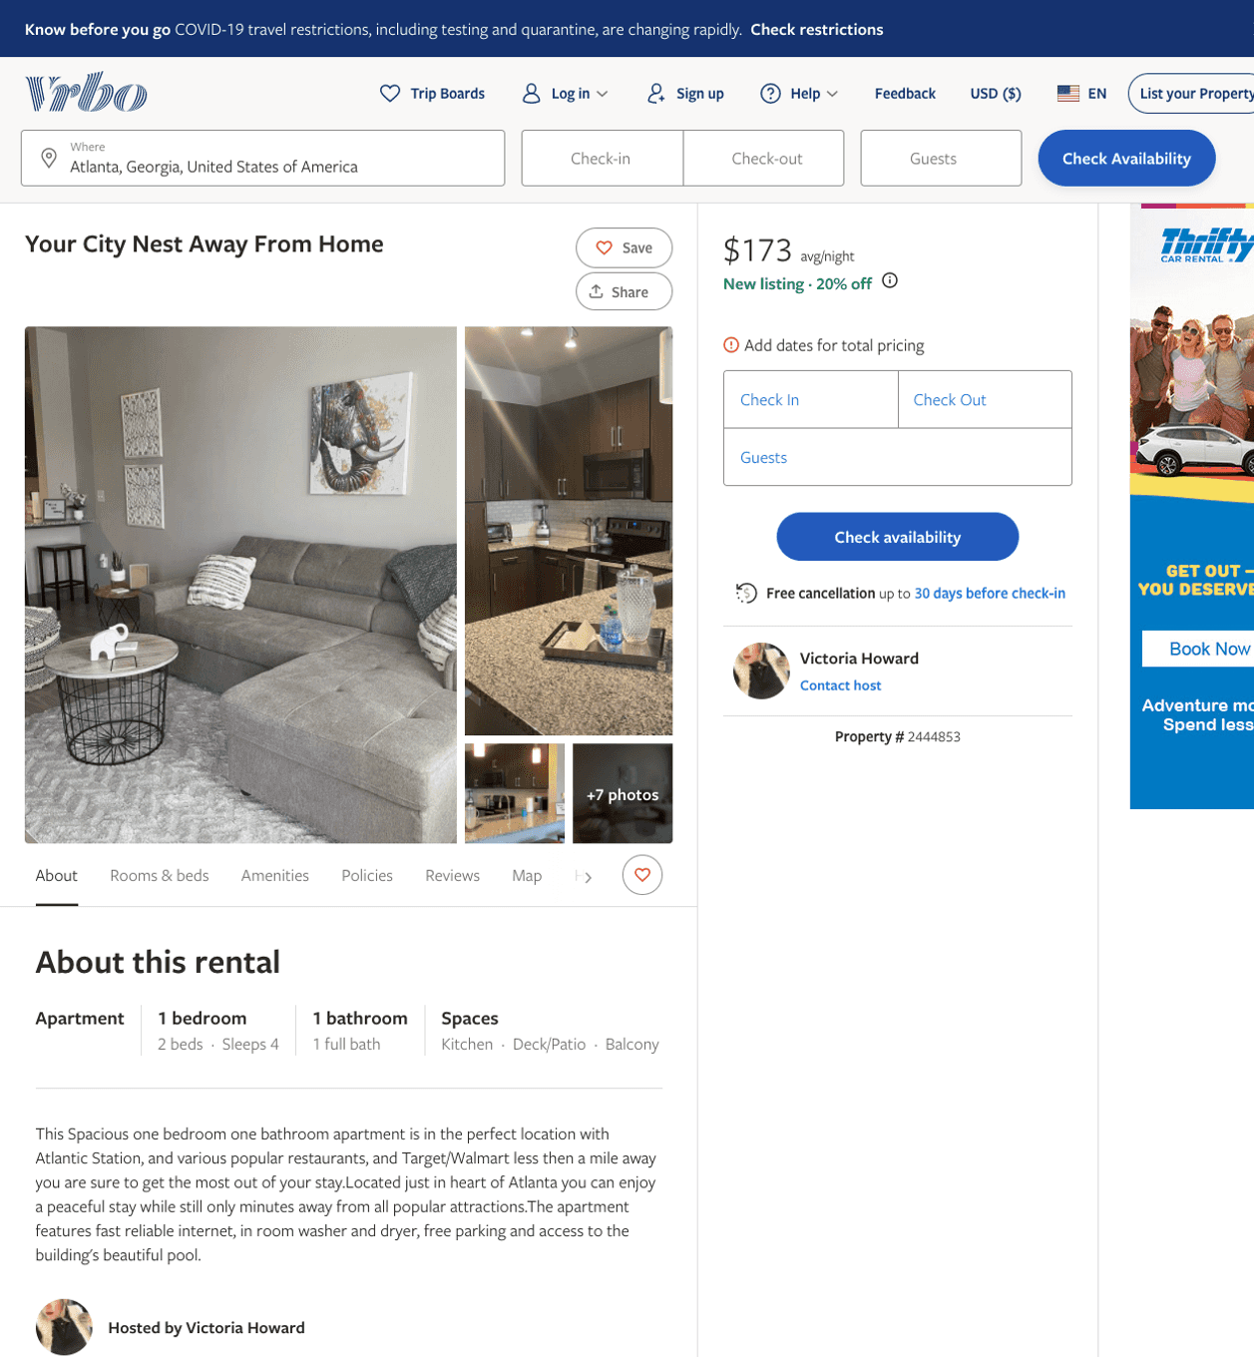
Listing 2444853
1
4
$133 - $213
2
Victoria Howard
https://www.vrbo.com/2444853
Aug 2022

Slide 21
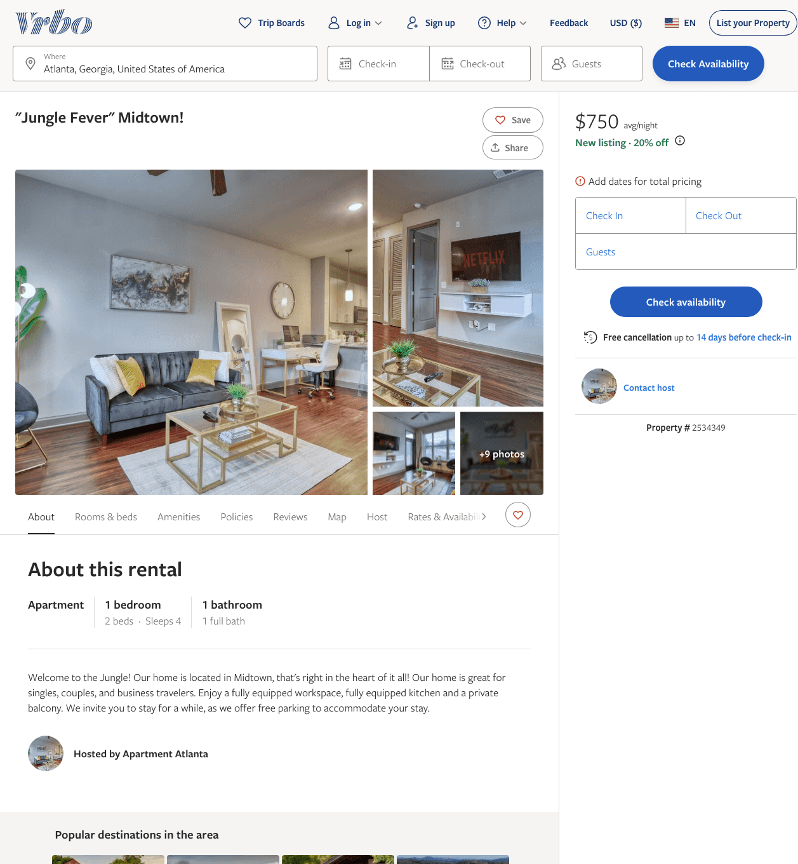
Listing 2534349
1
4
$180 - $660
5
1
Jamaica
https://www.vrbo.com/2534349
Aug 2022

Slide 22
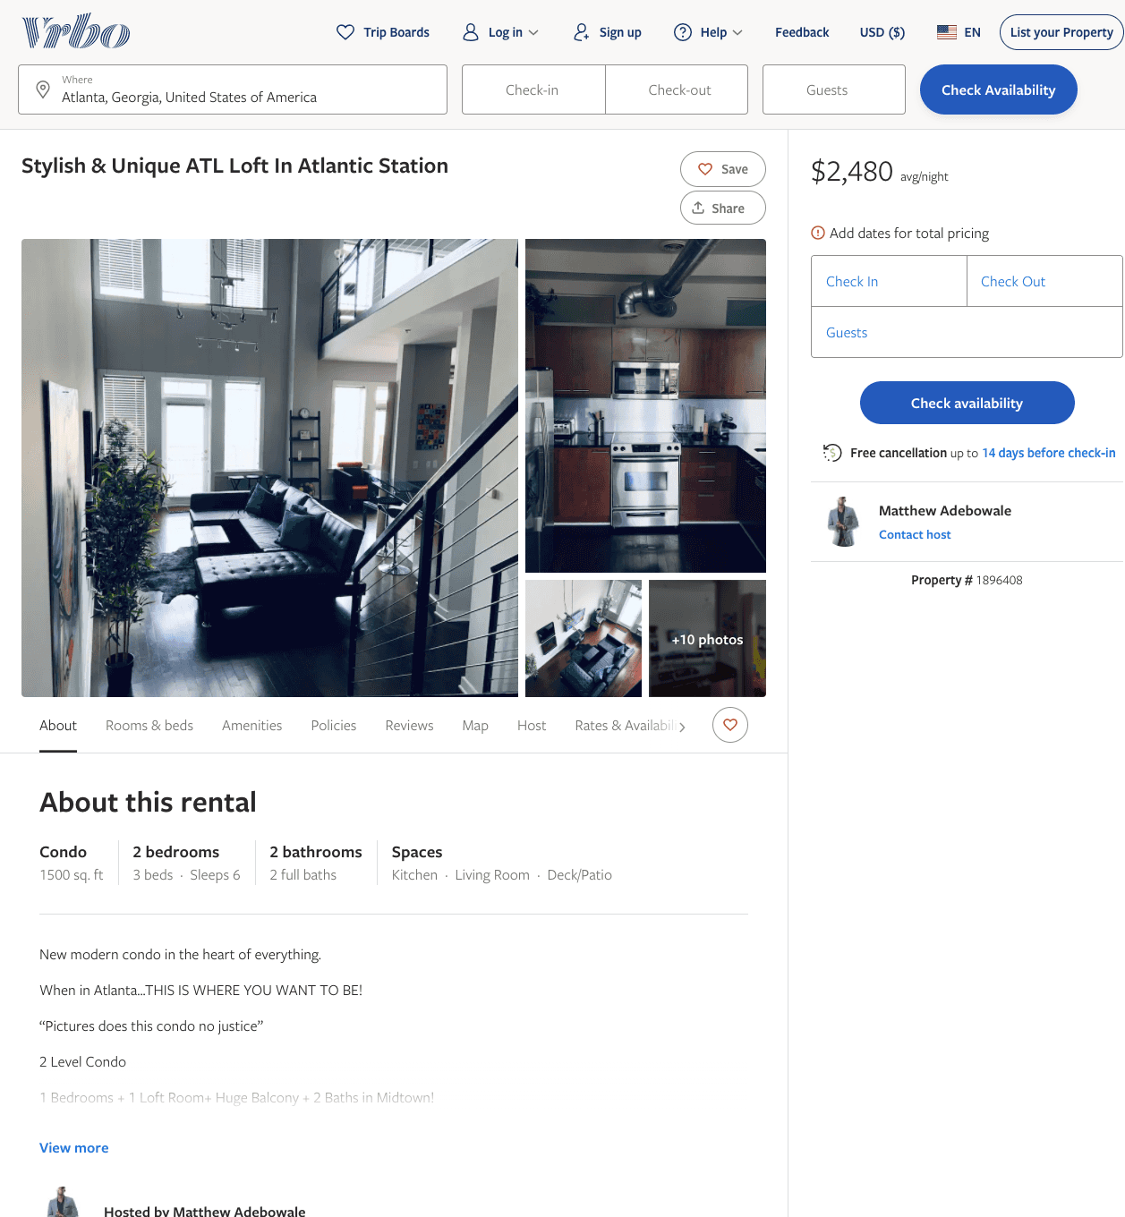
Listing 1896408
2
6
$2,480
1
Matthew Adebowale
https://www.vrbo.com/1896408
Aug 2022

Slide 23
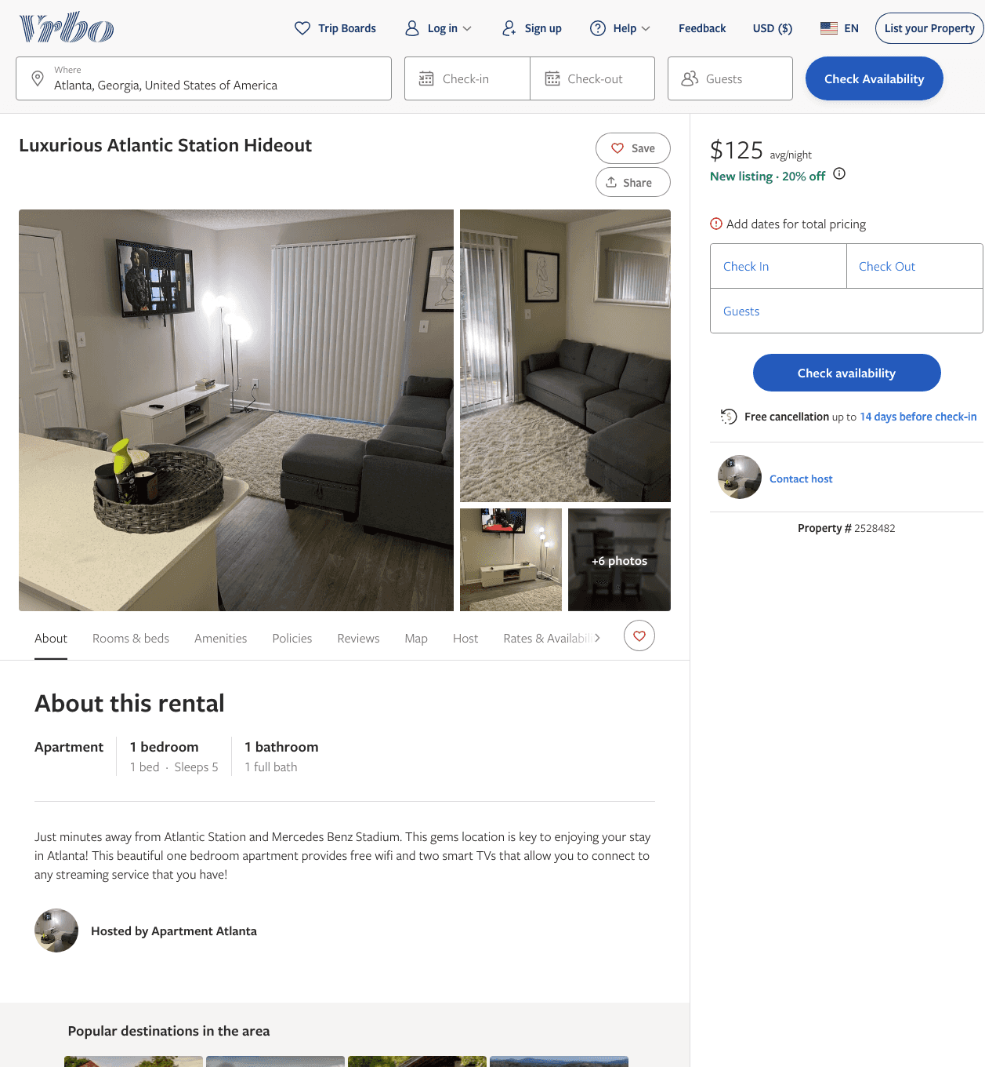
Listing 2528482
1
5
$125
5
1
https://www.vrbo.com/2528482
Aug 2022

Slide 24
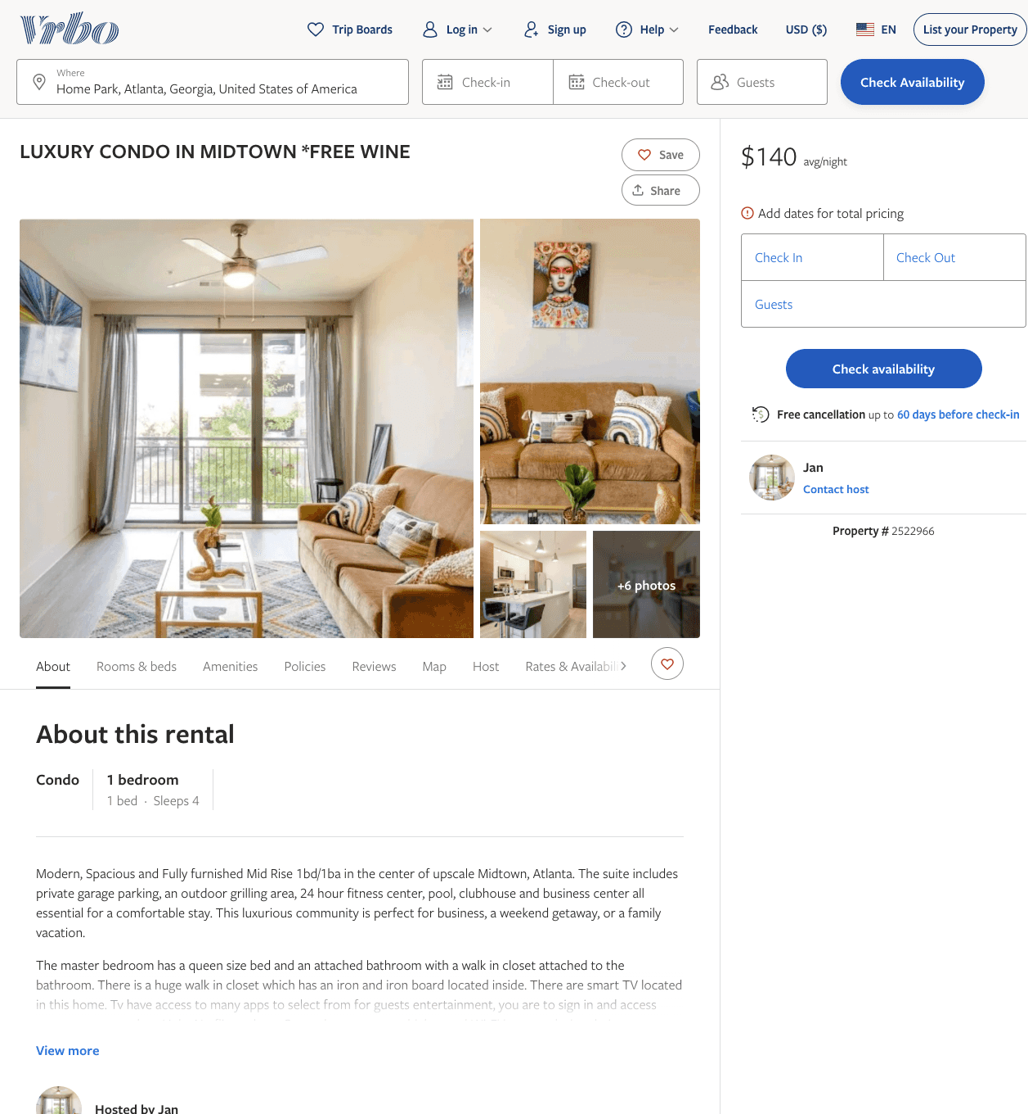
Listing 2522966
1
4
$122 - $189
2
Jan
https://www.vrbo.com/2522966
Aug 2022

Slide 25
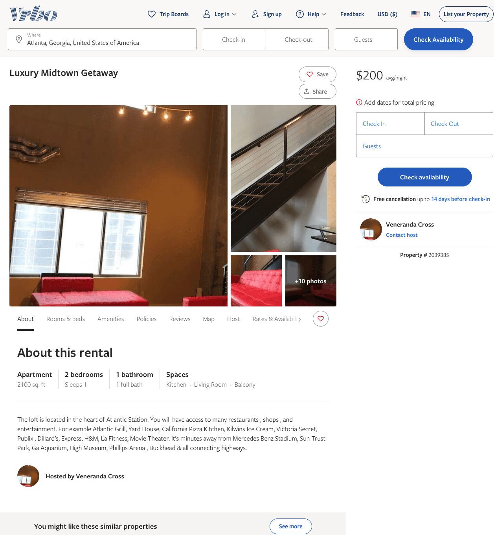
Listing 2039385
2
1
$200
30
Veneranda Cross
https://www.vrbo.com/2039385
Aug 2022

Slide 26
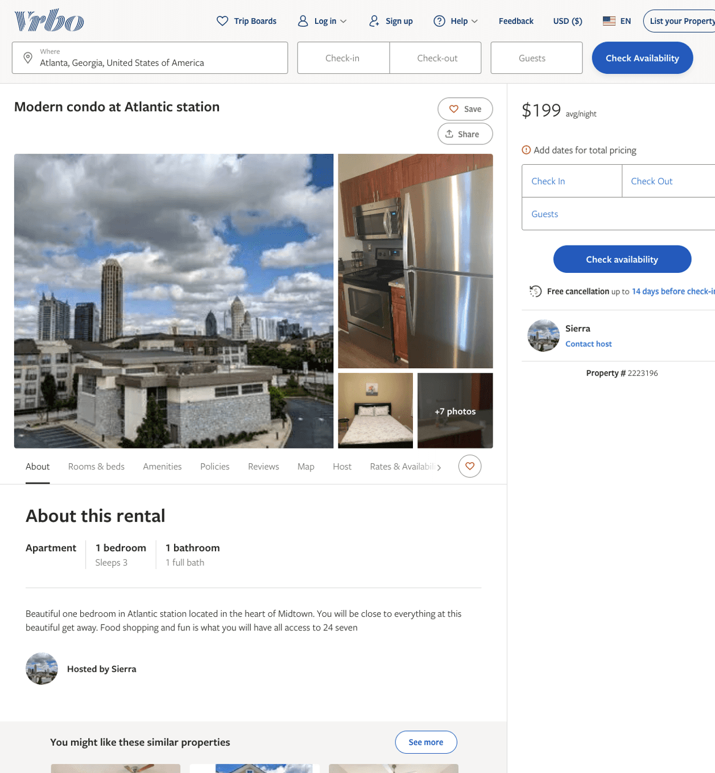
Listing 2223196
1
3
$199
1
Sierra
https://www.vrbo.com/2223196
Aug 2022

Slide 27
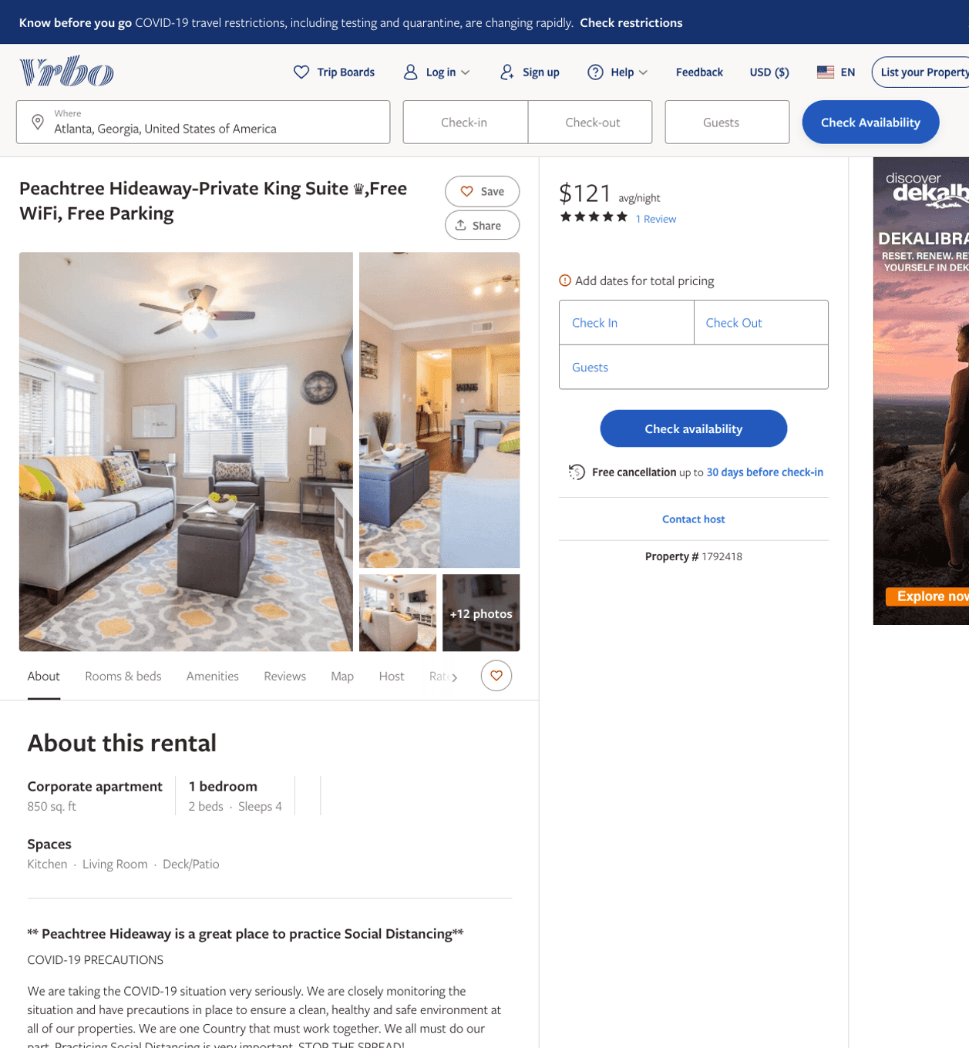
Listing 1792418
1
4
$121
5
2
Suite Connect
https://www.vrbo.com/1792418
Aug 2022

Slide 28
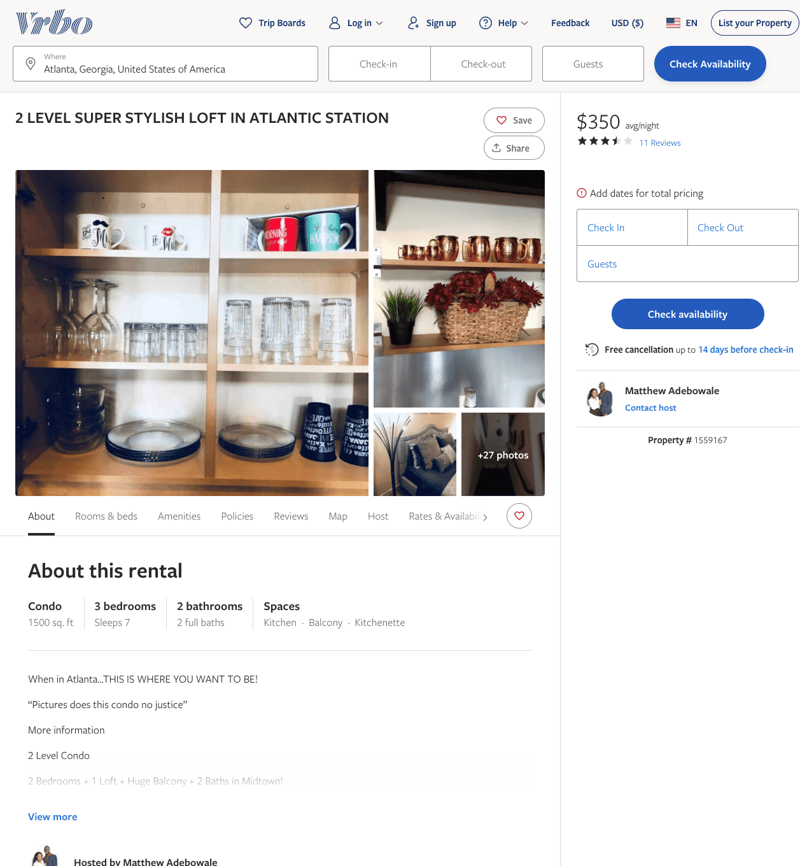
Listing 1559167
3
7
$2,400 - $350
3.5454545
1
Matthew Adebowale
https://www.vrbo.com/1559167
Aug 2022

Slide 29
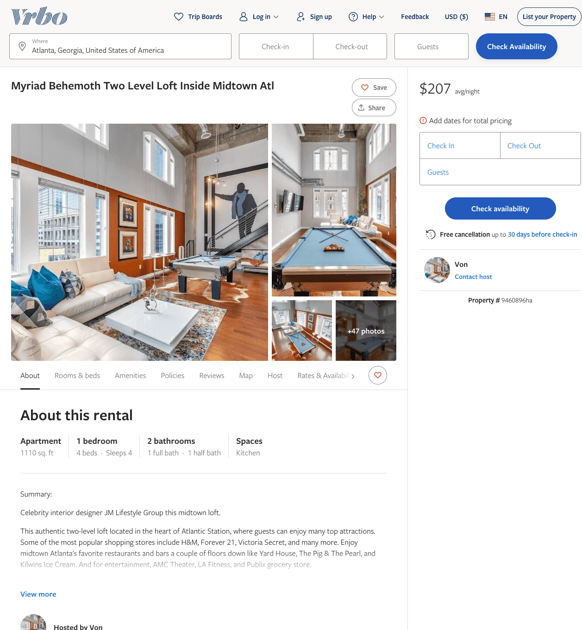
Listing 9460896
1
4
$207 - $225
1
Von
https://www.vrbo.com/9460896ha
Aug 2022

Slide 30
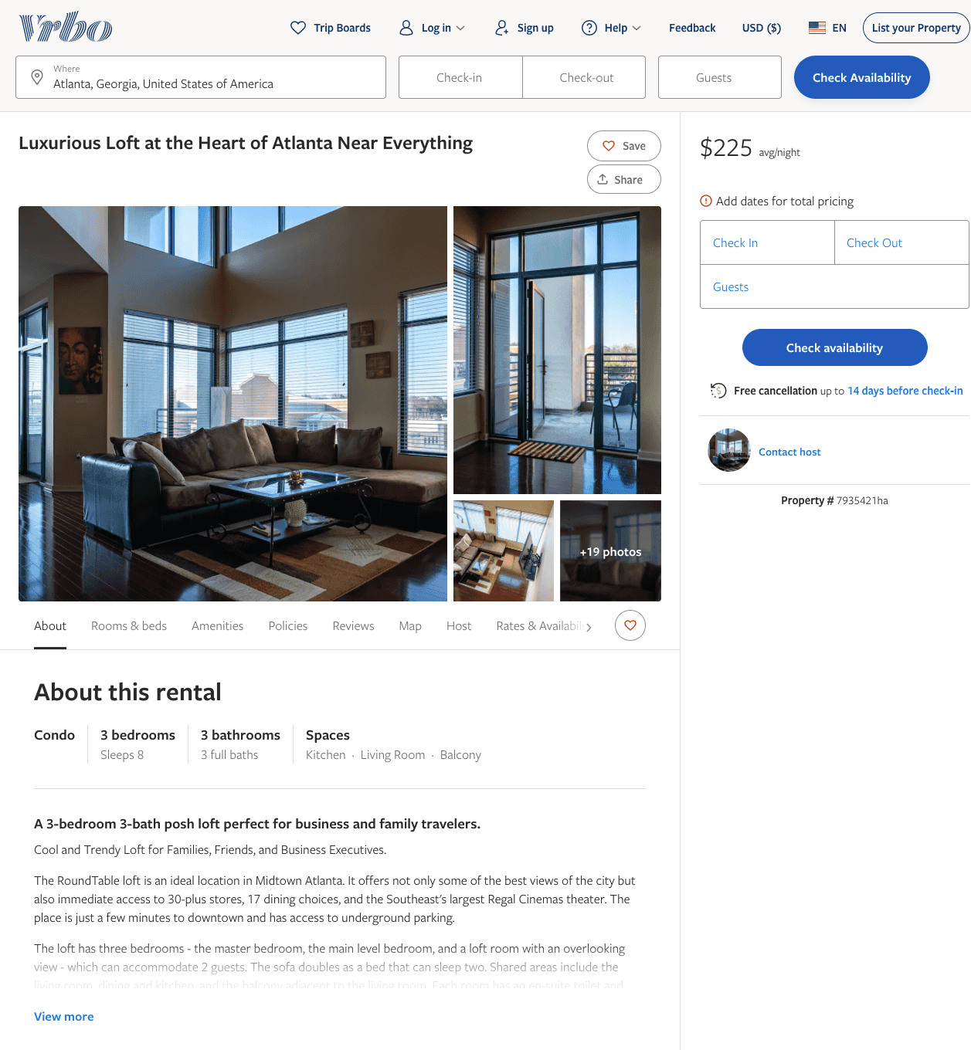
Listing 7935421
3
8
$225
1
https://www.vrbo.com/7935421ha
Aug 2022

Slide 31
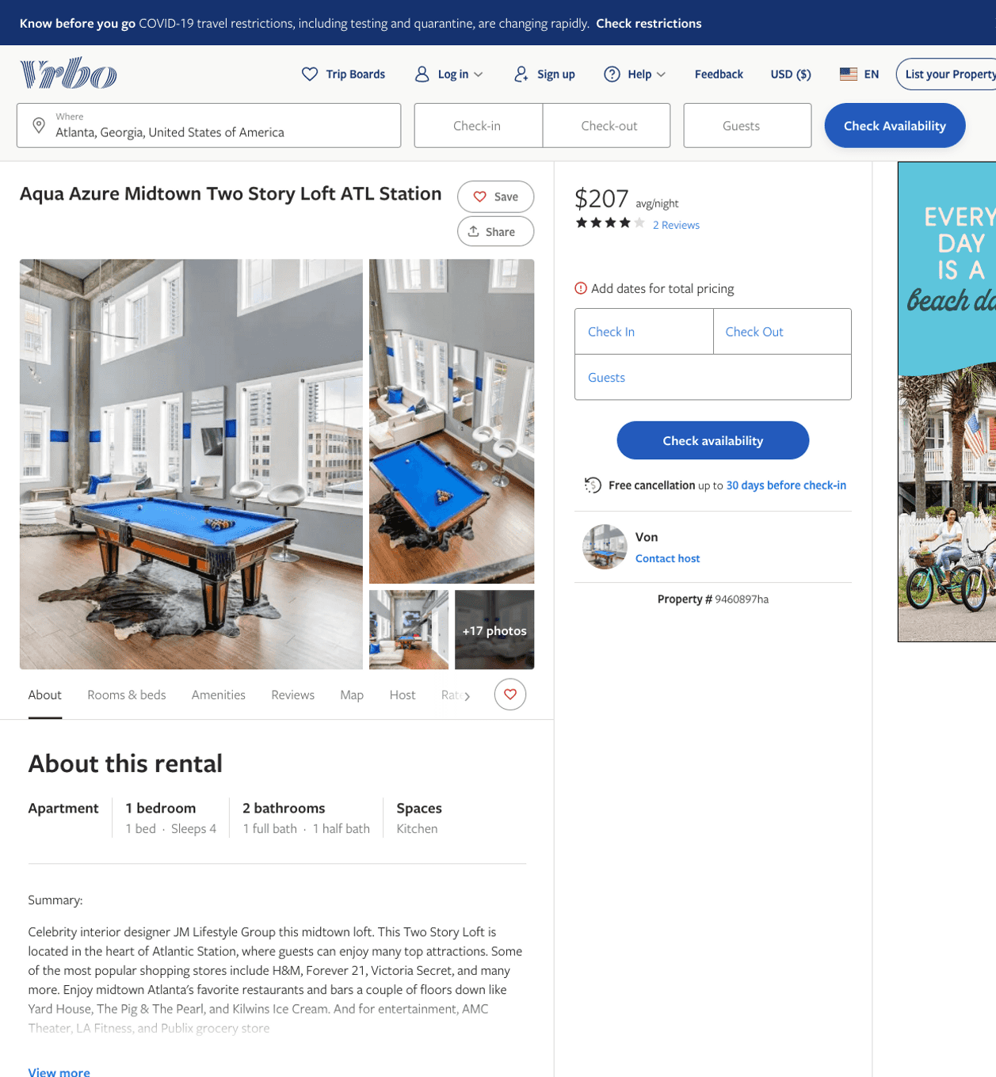
Listing 9460897
1
4
$207 - $233
4
1
Von
https://www.vrbo.com/9460897ha
Aug 2022

Slide 32
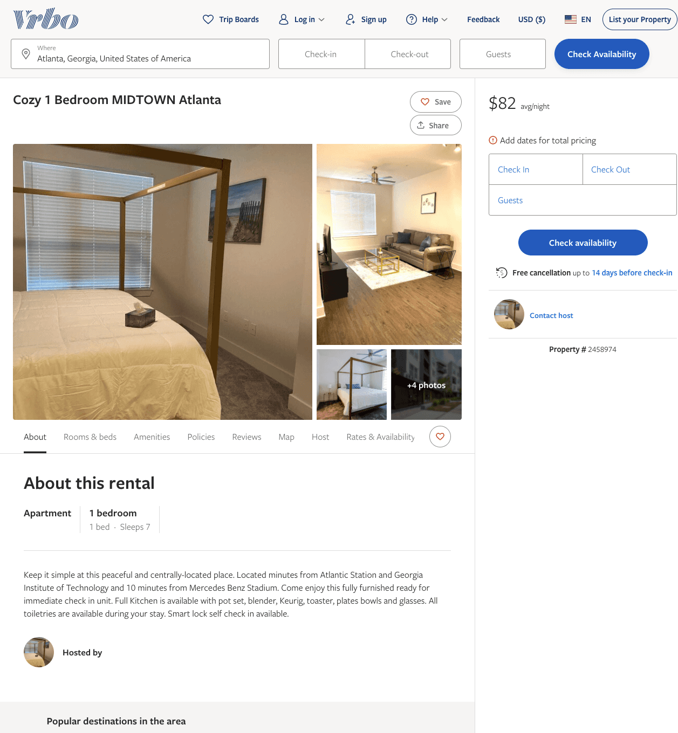
Listing 2458974
1
7
$108 - $82
2
https://www.vrbo.com/2458974
Aug 2022

Slide 33
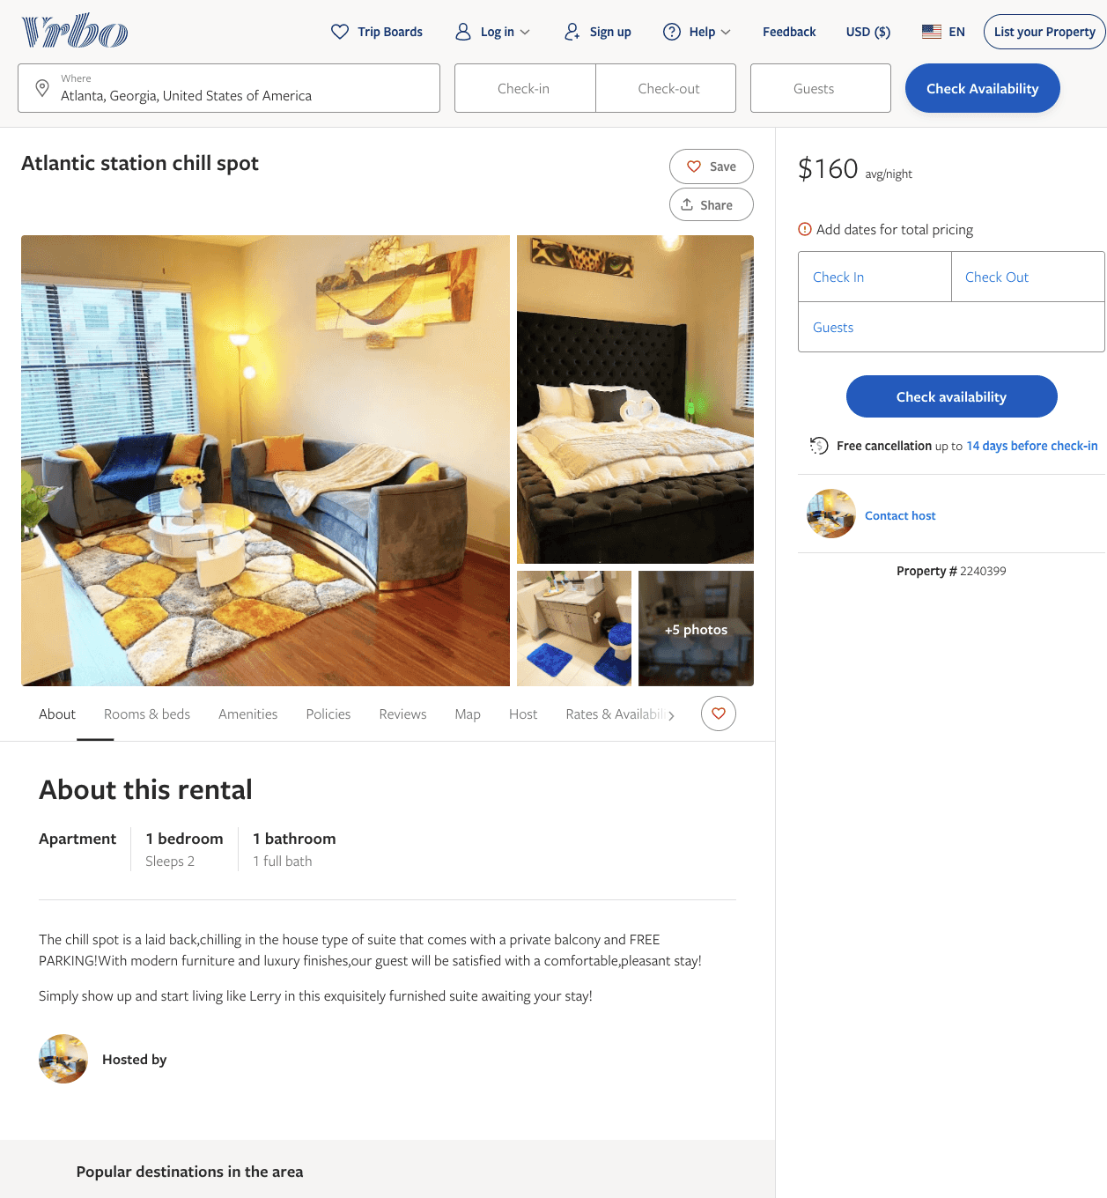
Listing 2240399
1
2
$160
1
https://www.vrbo.com/2240399
Aug 2022

Slide 34
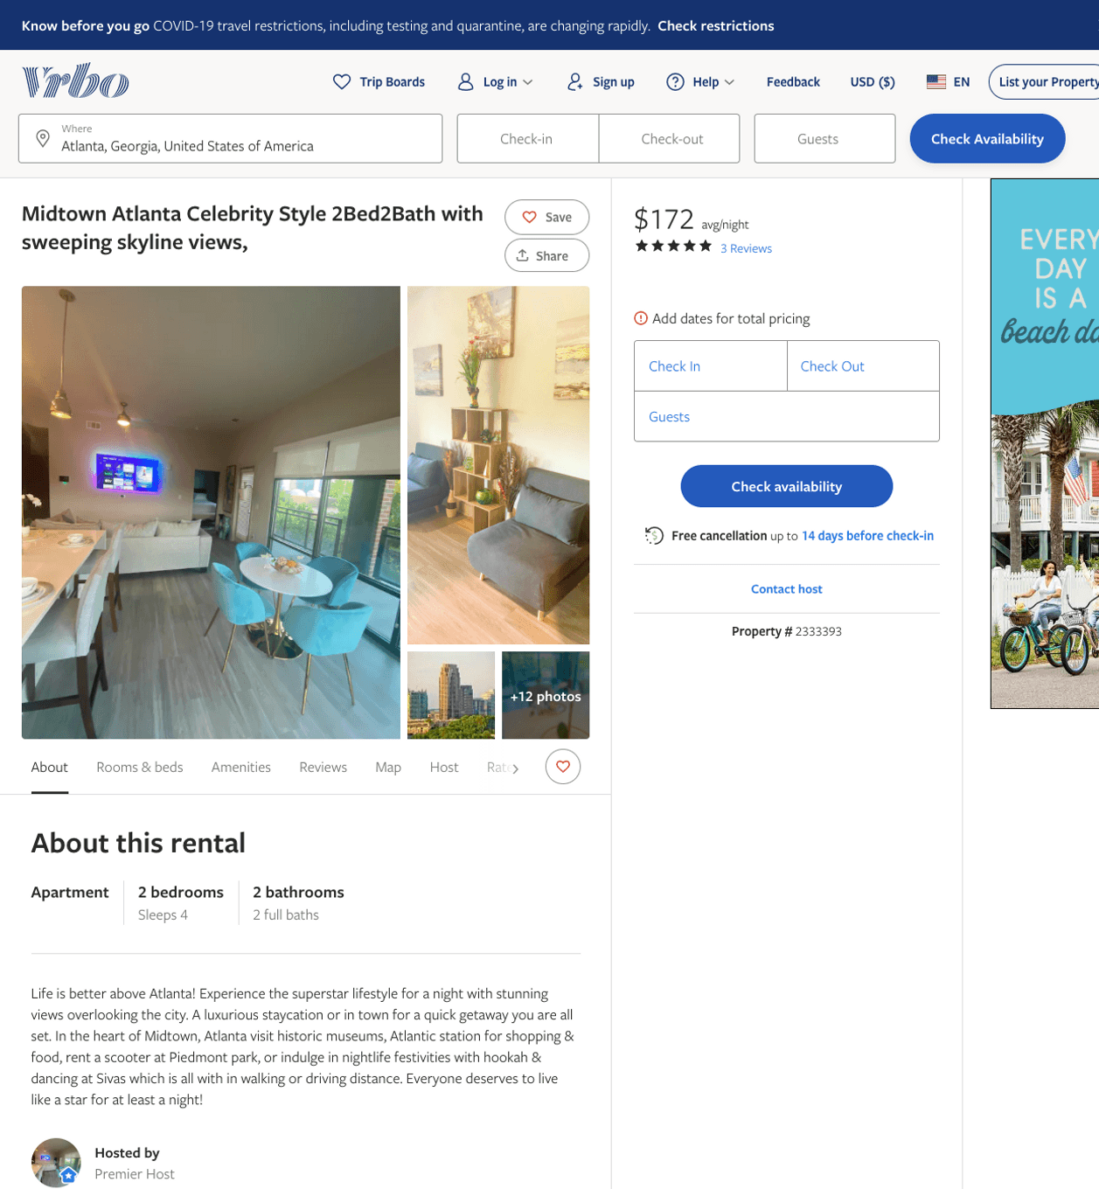
Listing 2333393
2
4
$154 - $211
4.3333335
3
https://www.vrbo.com/2333393
Aug 2022

Slide 35
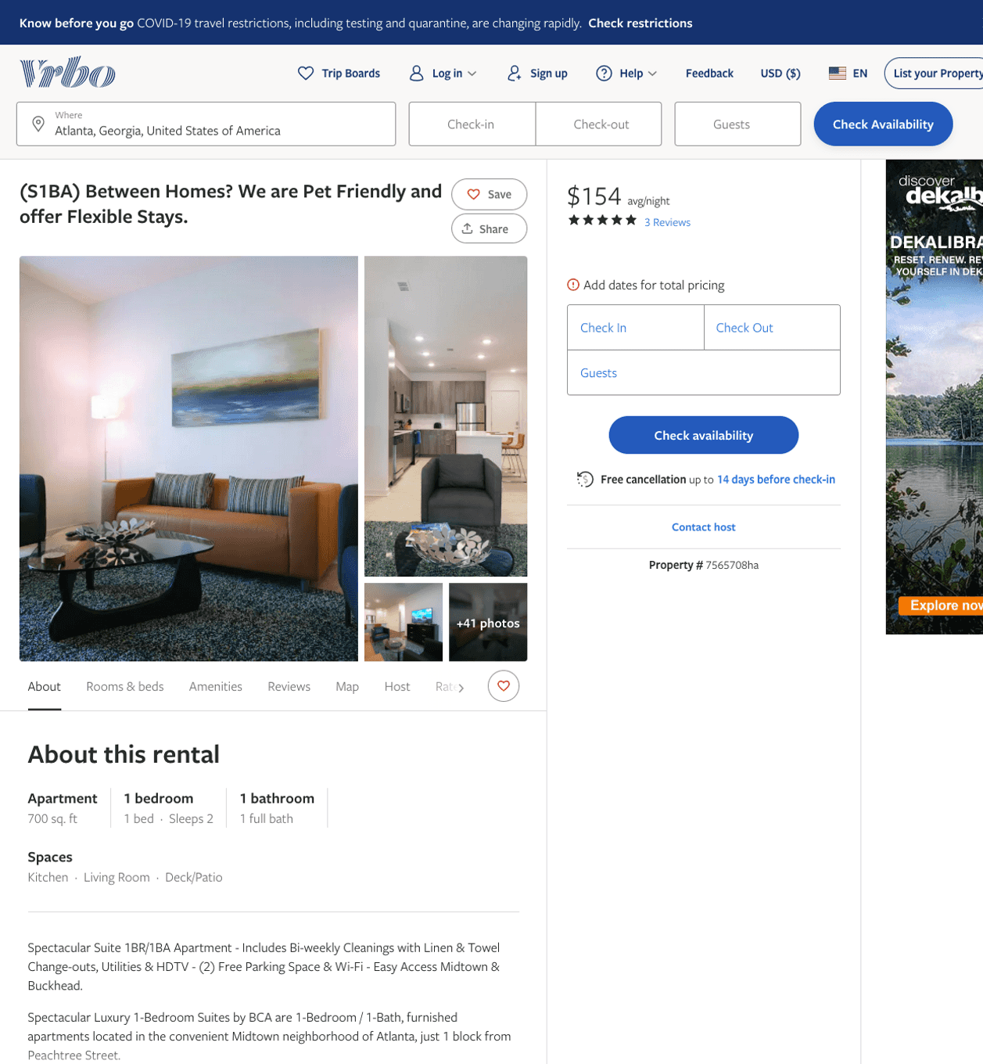
Listing 7565708
1
2
$147 - $159
5
3
Alex & Michael
https://www.vrbo.com/7565708ha
Aug 2022

Slide 36
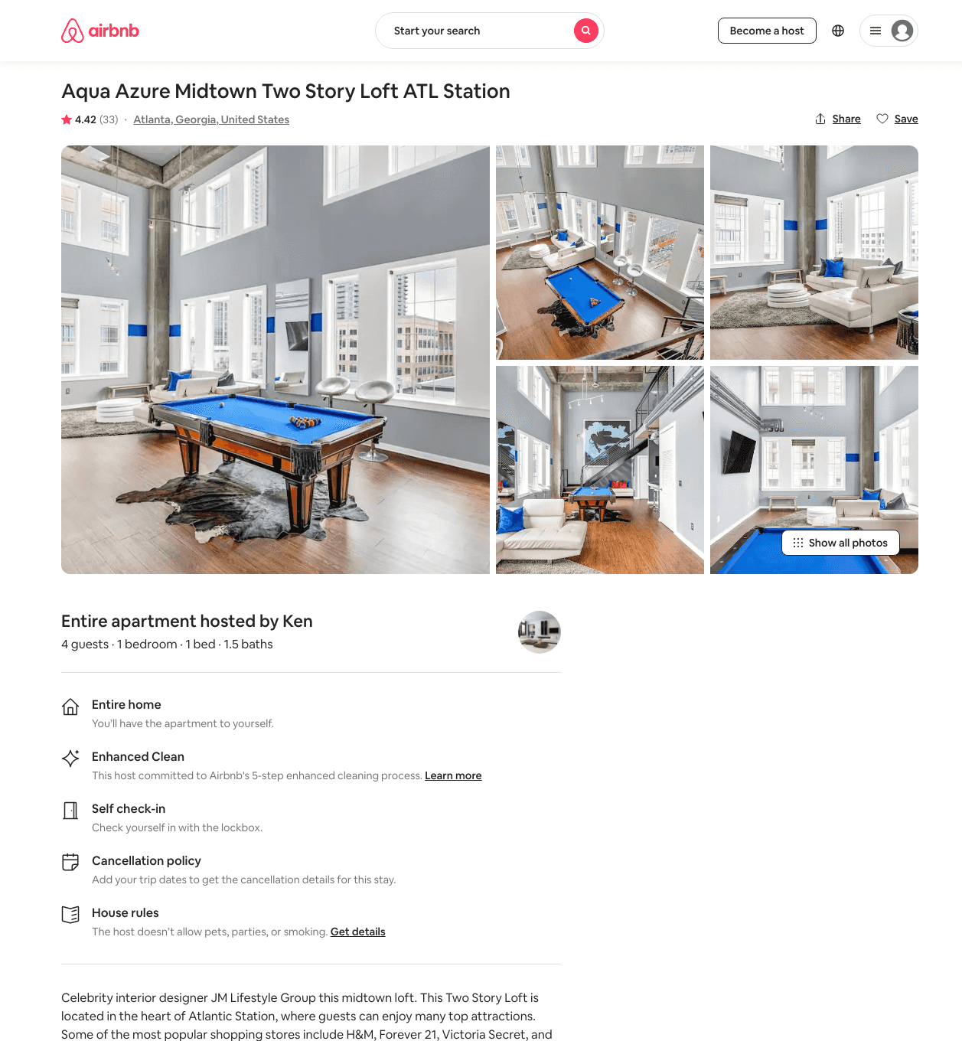
Listing 42814724
1
4
$203 - $353
4.42
1
Ken
152102544
8
https://www.airbnb.com/rooms/42814724
Aug 2022

Slide 37
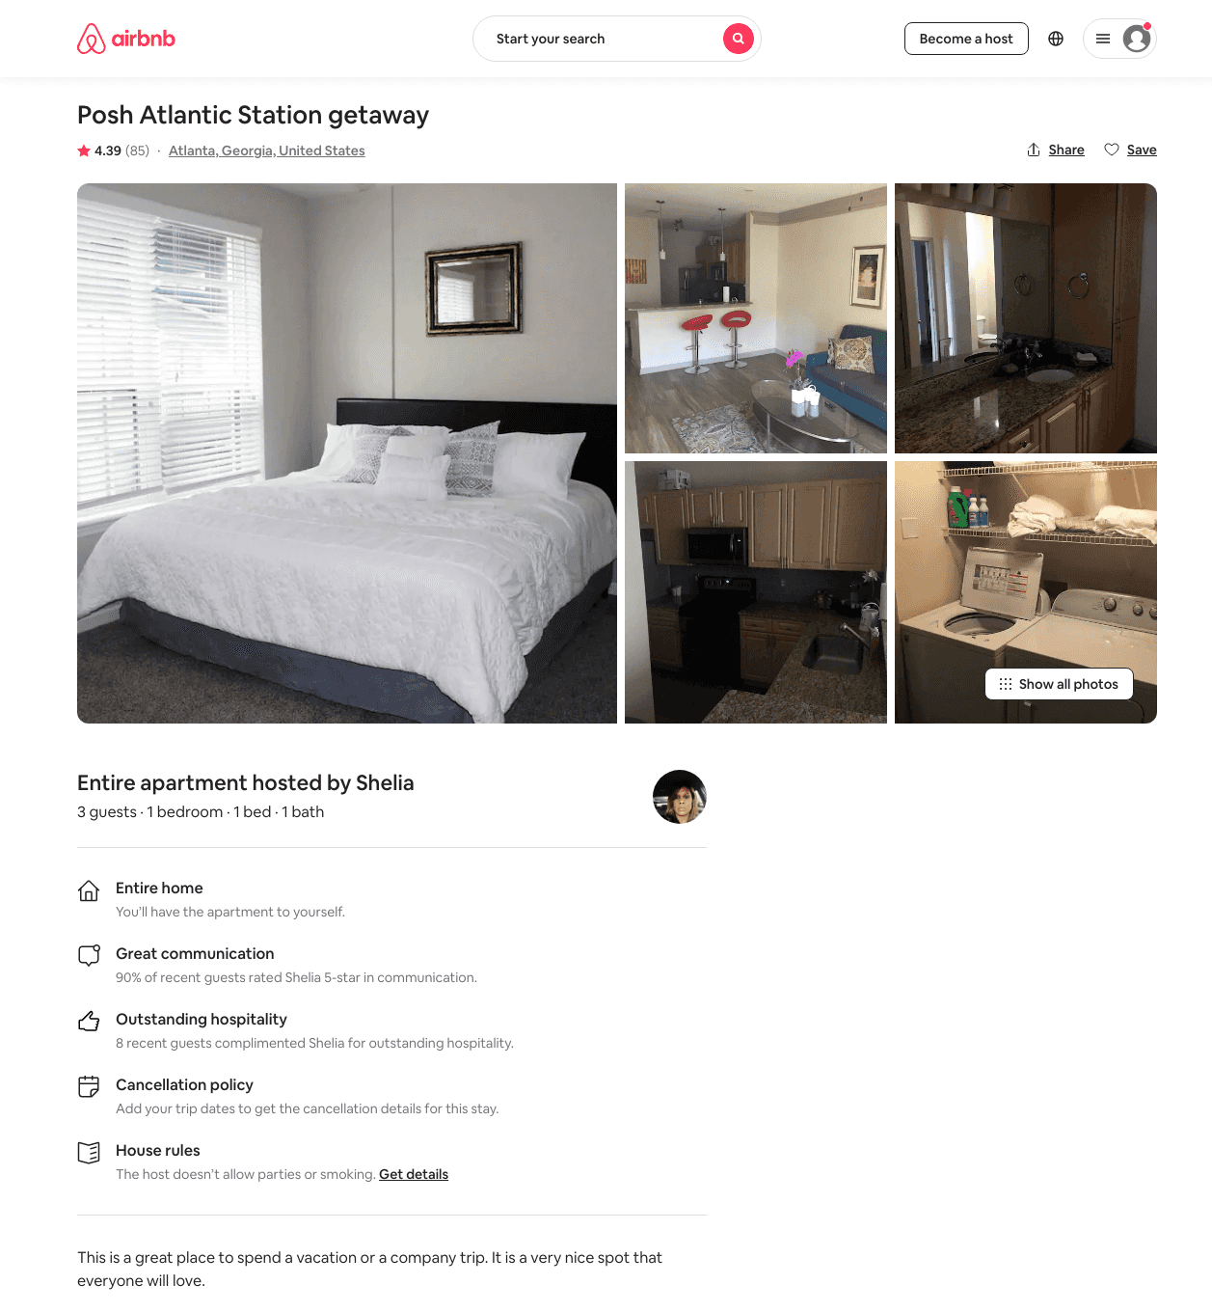
Listing 31918396
1
3
$65 - $135
4.43
1
Shelia
80621478
1
https://www.airbnb.com/rooms/31918396
Aug 2022

Slide 38
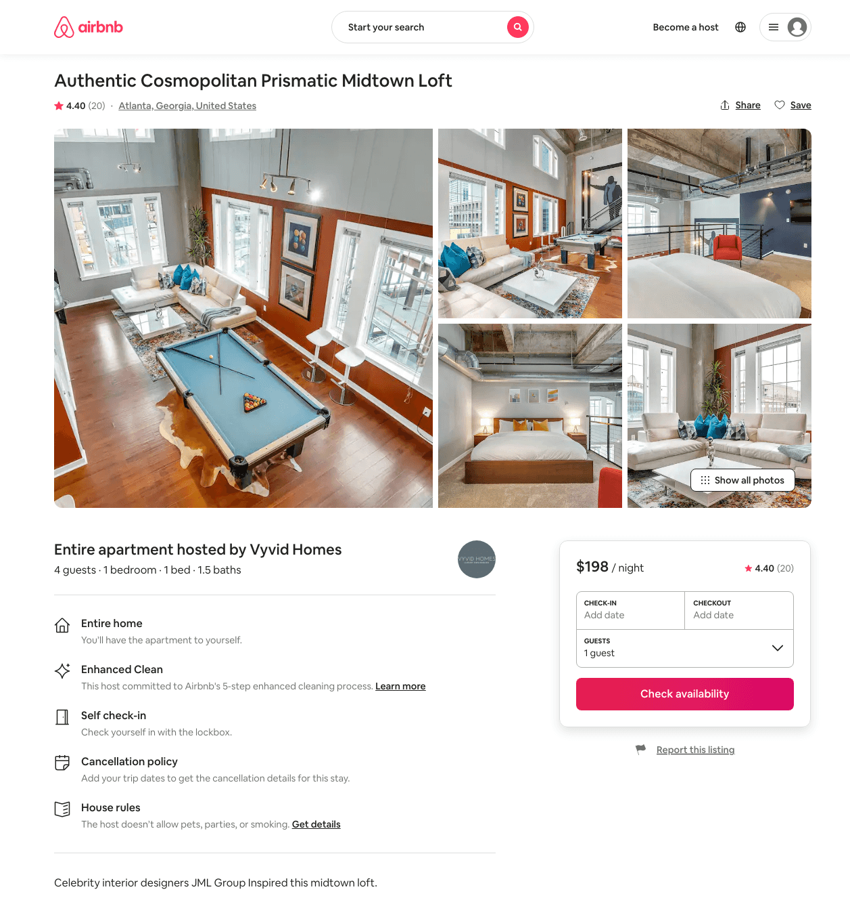
Listing 41161826
1
4
$179 - $195
4.40
1
Vyvid Homes
31816953
20
https://www.airbnb.com/rooms/41161826
Aug 2022

Slide 39
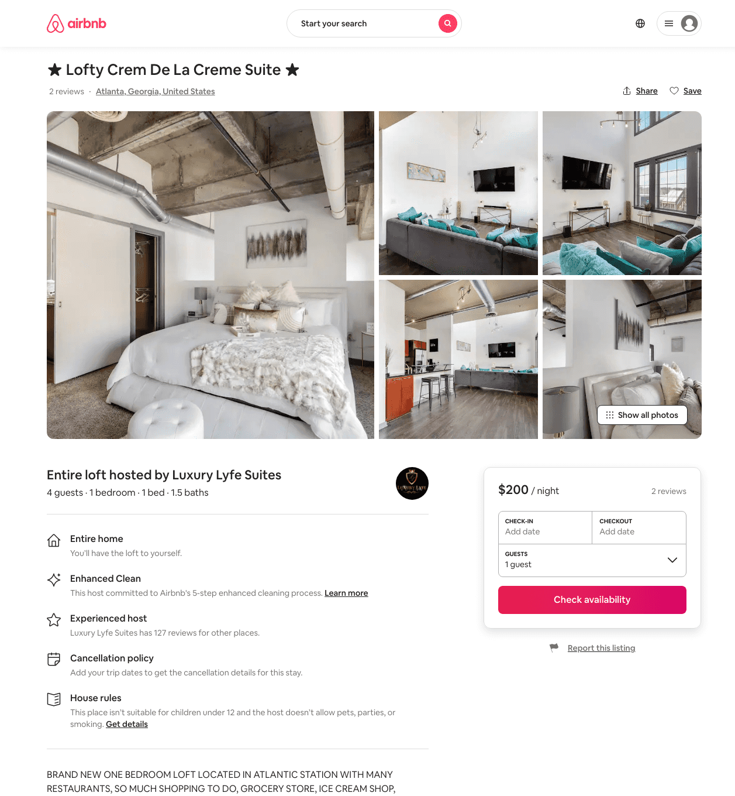
Listing 48493213
1
4
$139 - $364
4.45
1
Luxury Lyfe Suites
237419161
9
https://www.airbnb.com/rooms/48493213
Aug 2022

Slide 40
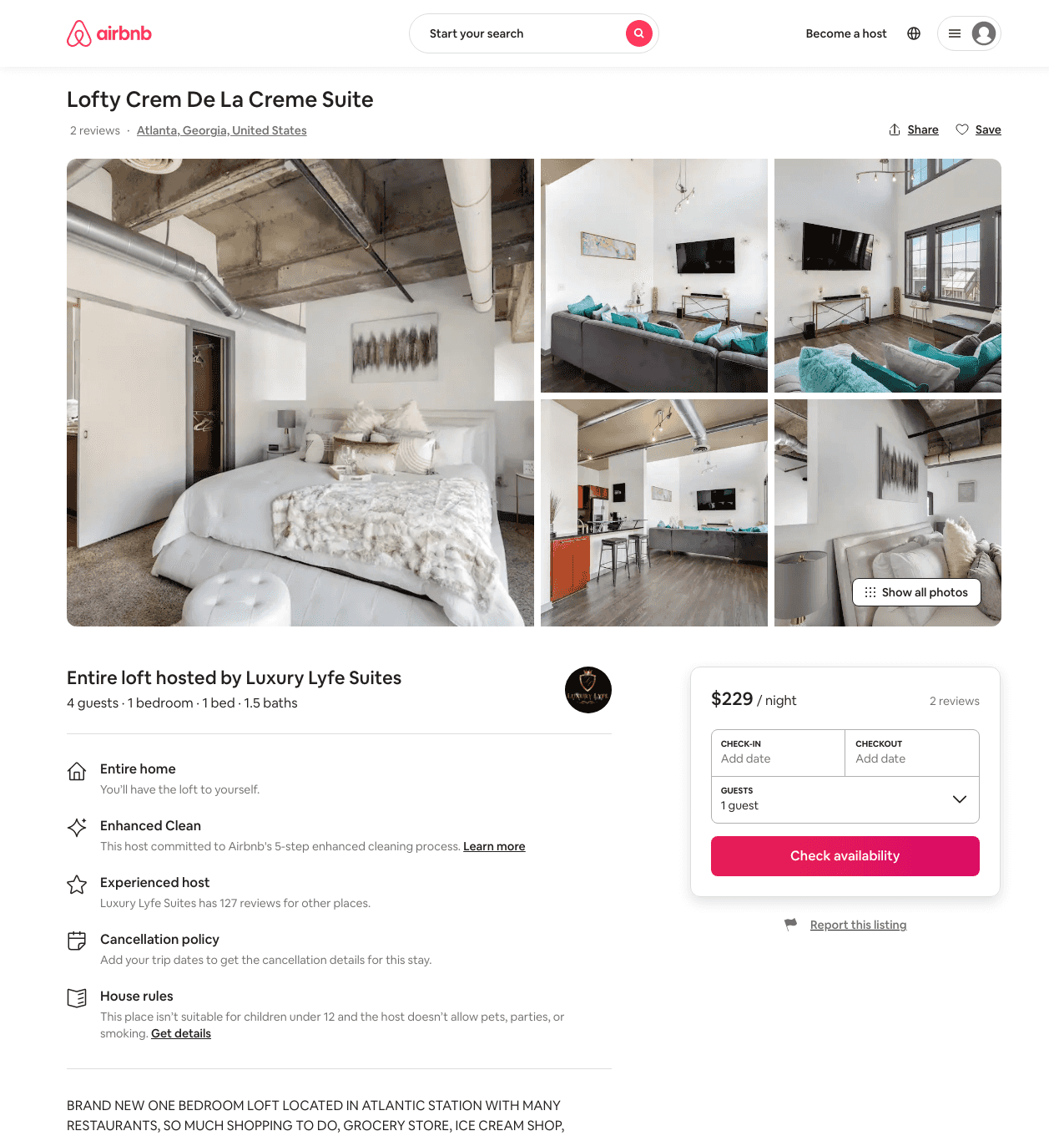
Listing 48490445
1
4
$139 - $233
4.62
1
Luxury Lyfe Suites
237419161
9
https://www.airbnb.com/rooms/48490445
Aug 2022

Slide 41
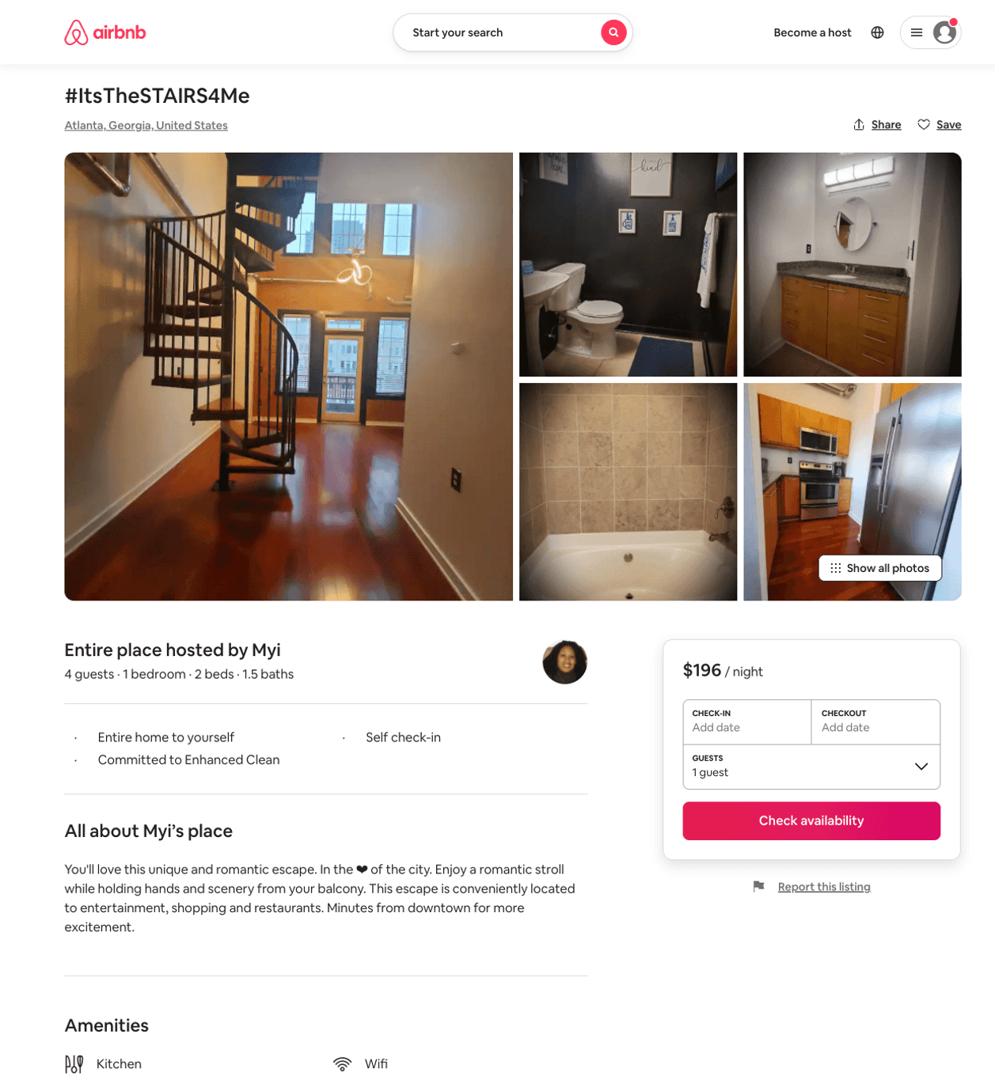
Listing 50575656
1
3
$106 - $699
4.36
2
Myi
119953602
2
https://www.airbnb.com/rooms/50575656
Aug 2022

Slide 42
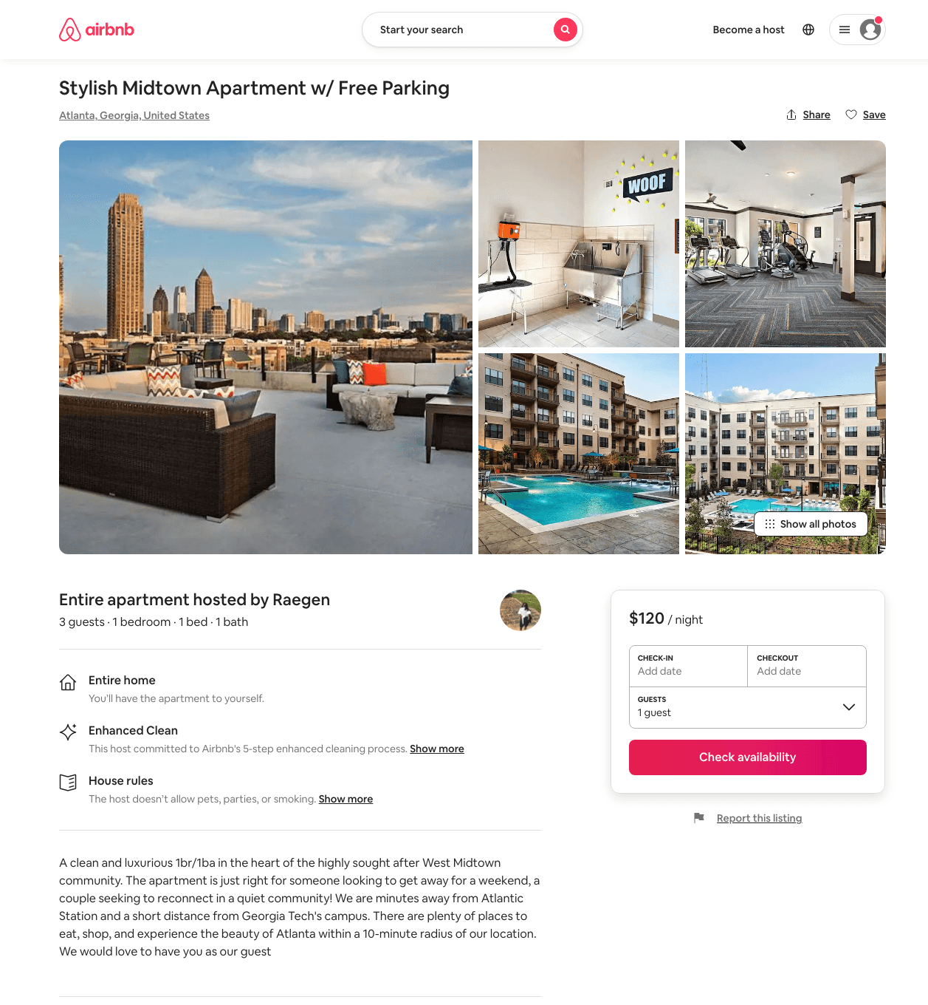
Listing 49615159
1
2
$96 - $119
4.70
2
Raegen
400200913
1
https://www.airbnb.com/rooms/49615159
Aug 2022

Slide 43
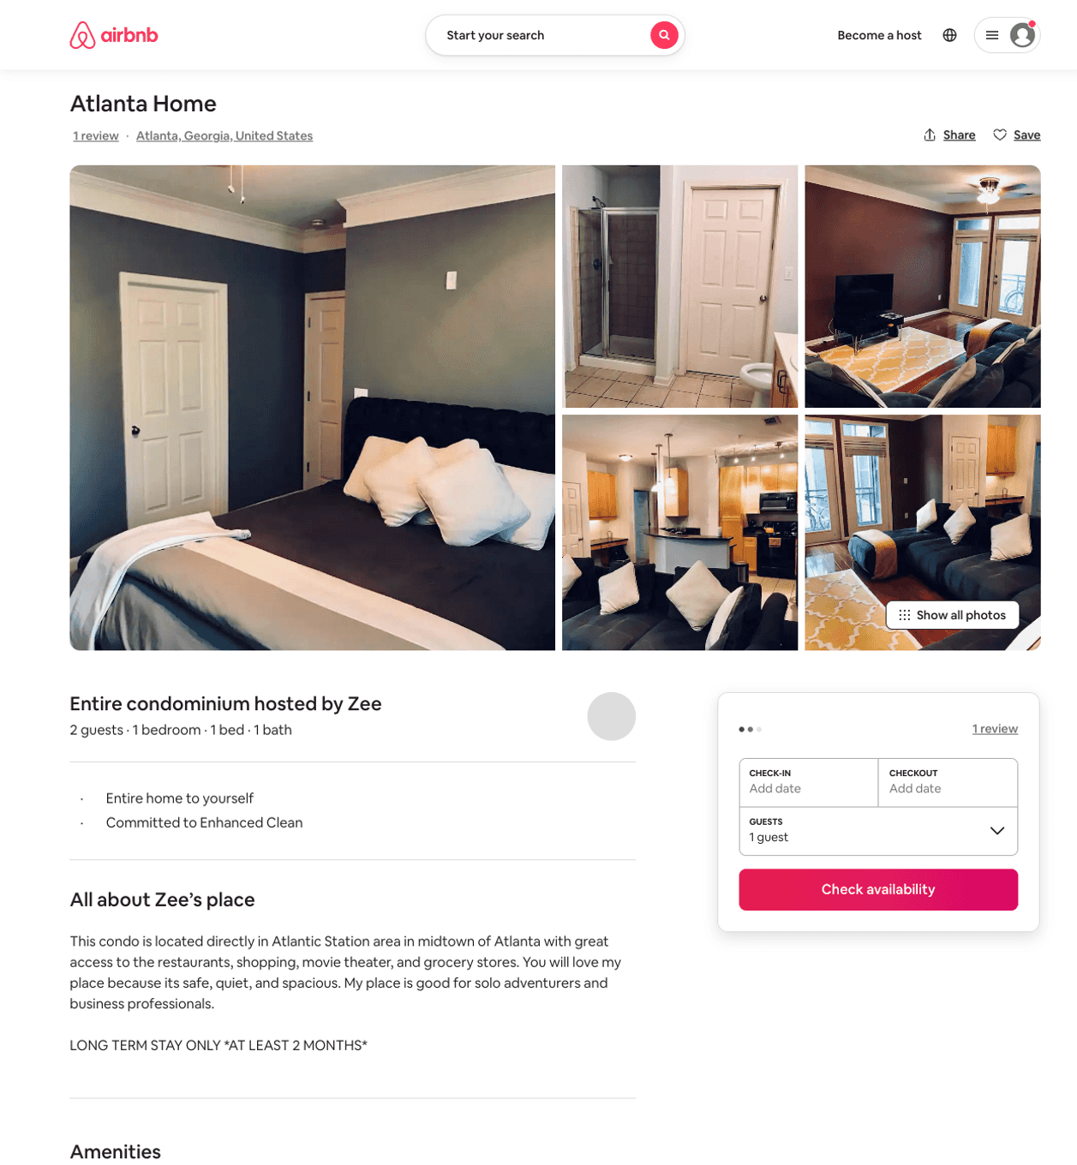
Listing 25577663
1
2
$65 - $72
90
Zee
30216740
1
https://www.airbnb.com/rooms/25577663
Aug 2022

Slide 44
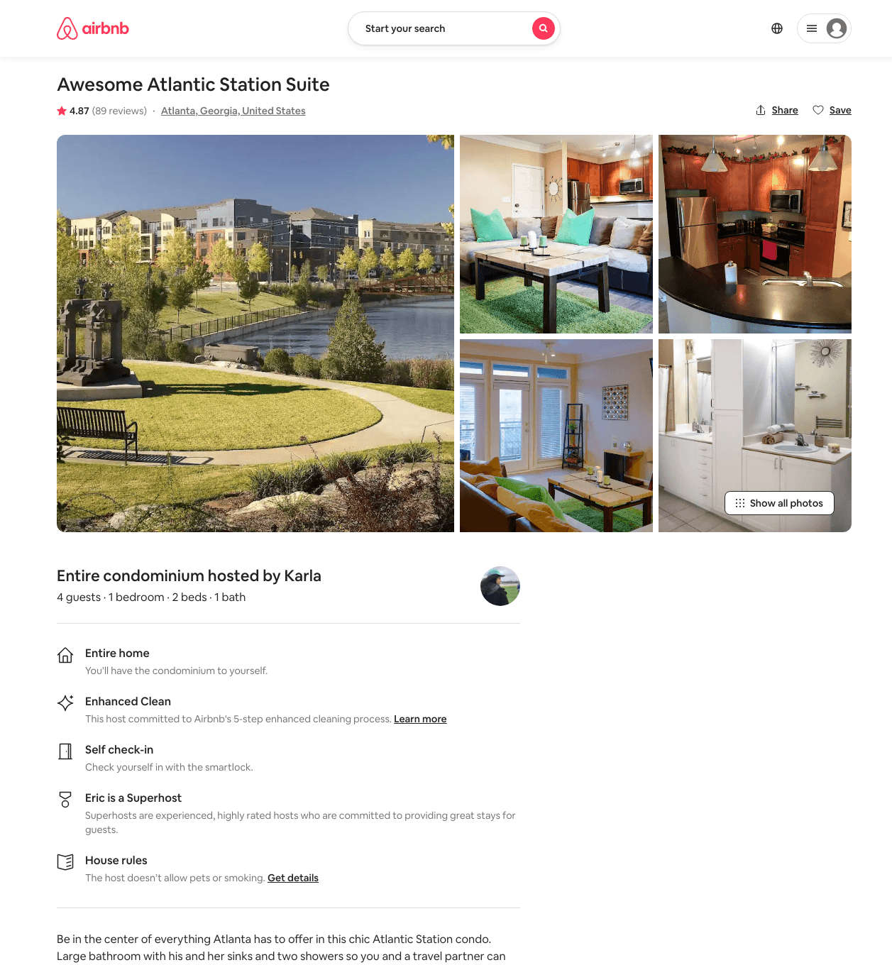
Listing 5481386
400 17TH ST NW
1
4
$109 - $149
4.85
2
Eric
11697855
1
https://www.airbnb.com/rooms/5481386
Aug 2022

Slide 45
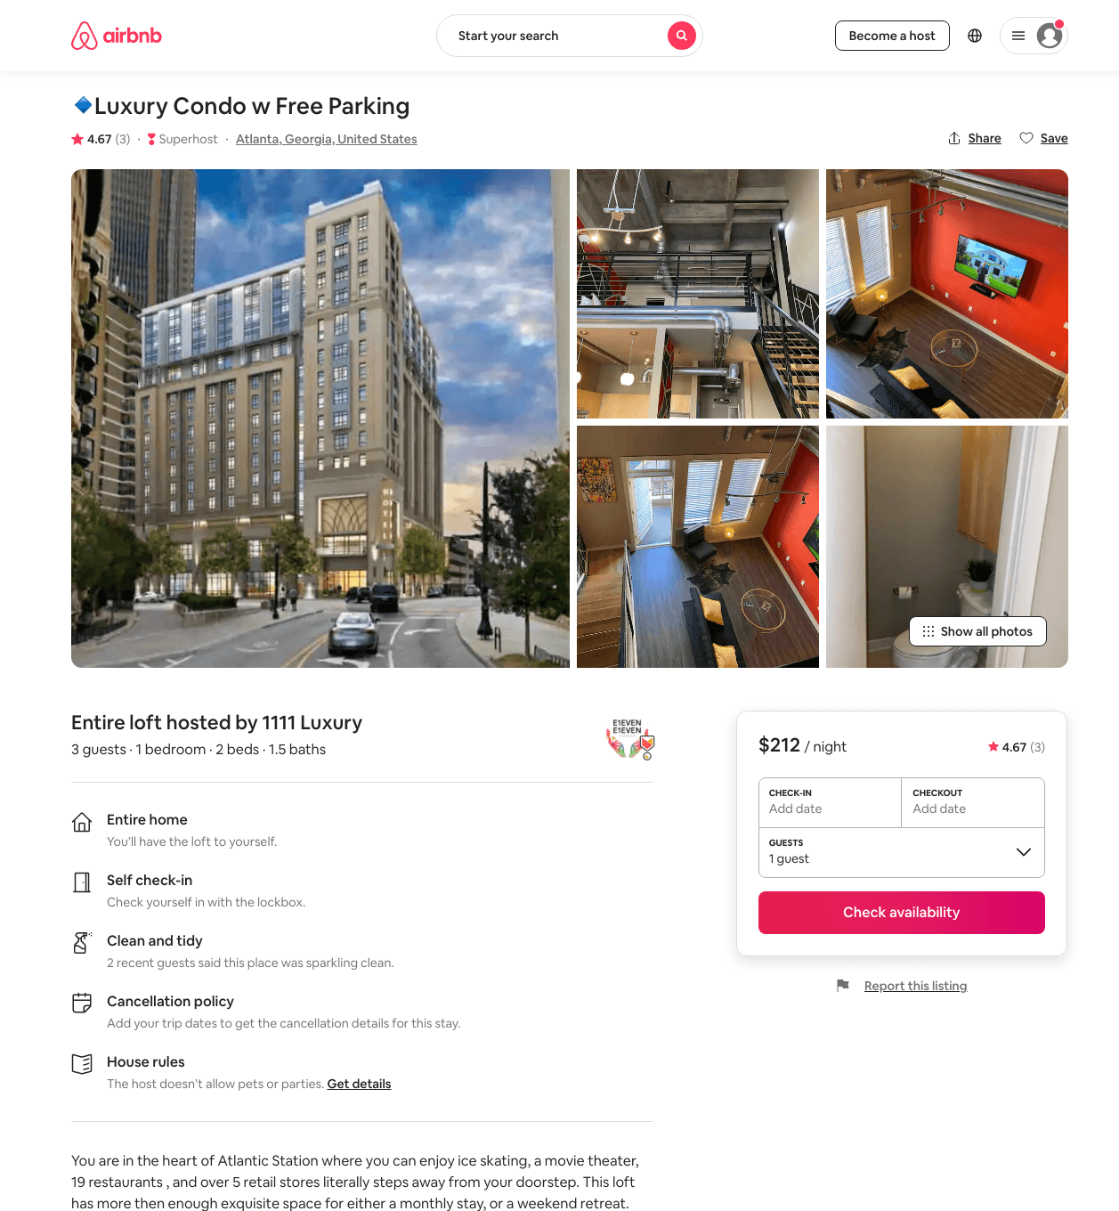
Listing 47488845
1
3
$129 - $379
4.47
2
1111 Luxury
32074249
2
https://www.airbnb.com/rooms/47488845
Aug 2022

Slide 46
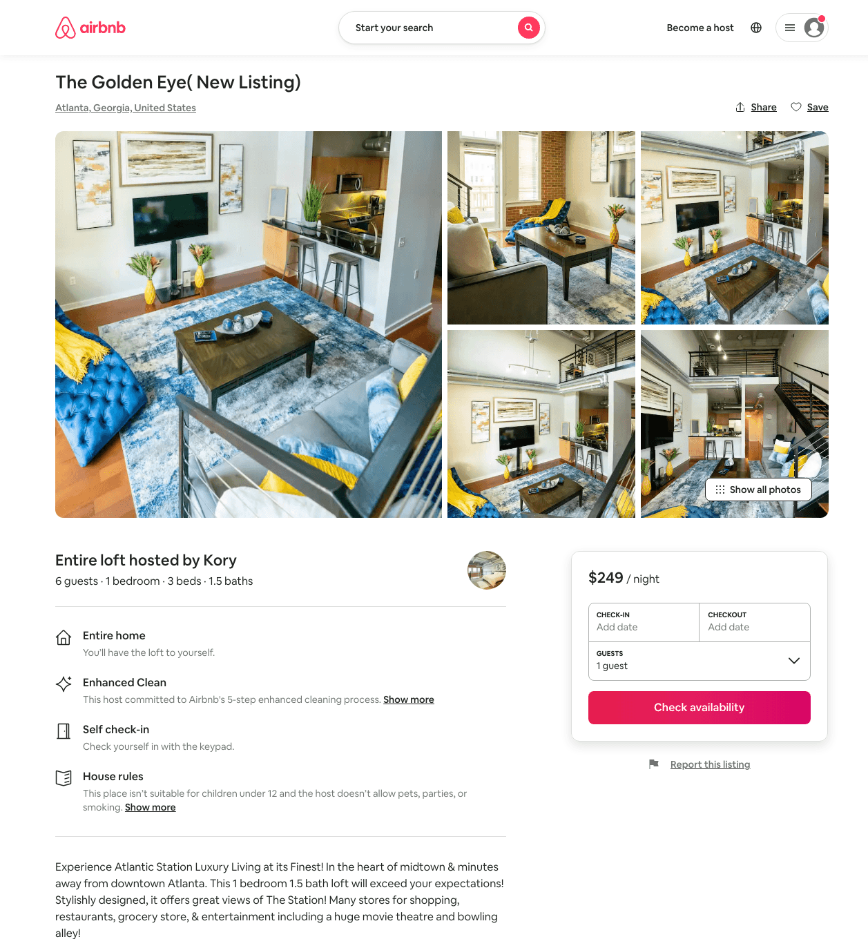
Listing 49853345
1
6
$120 - $249
4.55
2
Urban Luxe
402047873
1
https://www.airbnb.com/rooms/49853345
Aug 2022

Slide 47
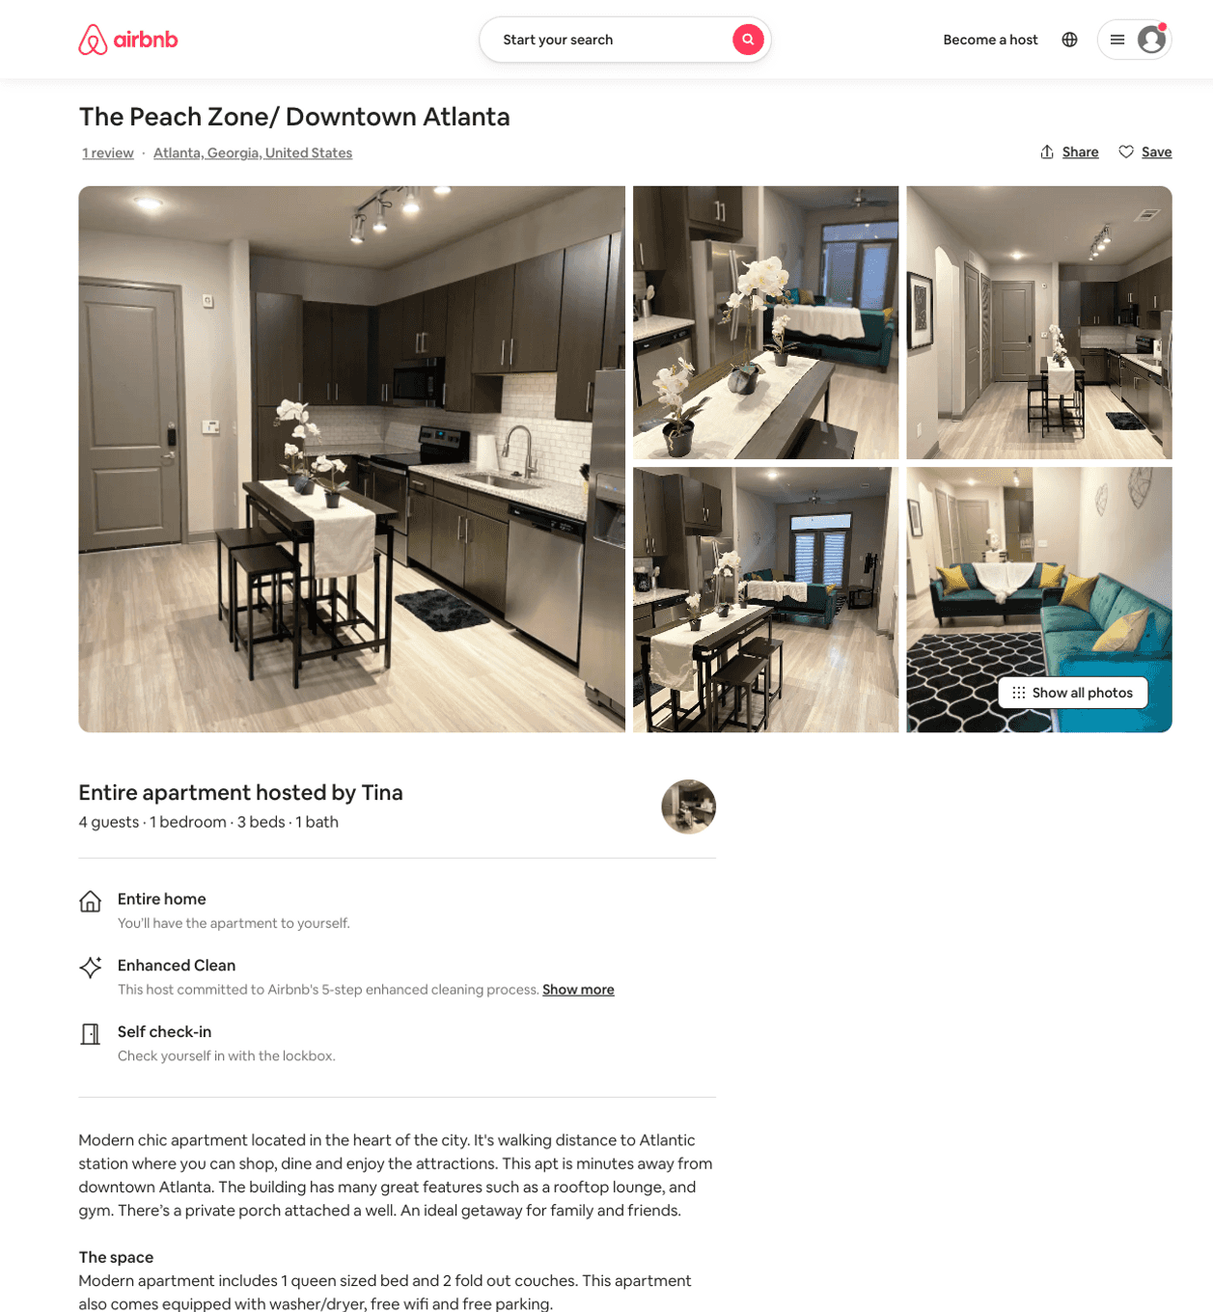
Listing 50328074
1
4
$77 - $123
4.59
1
Tina
395319230
2
https://www.airbnb.com/rooms/50328074
Jul 2022

Slide 48
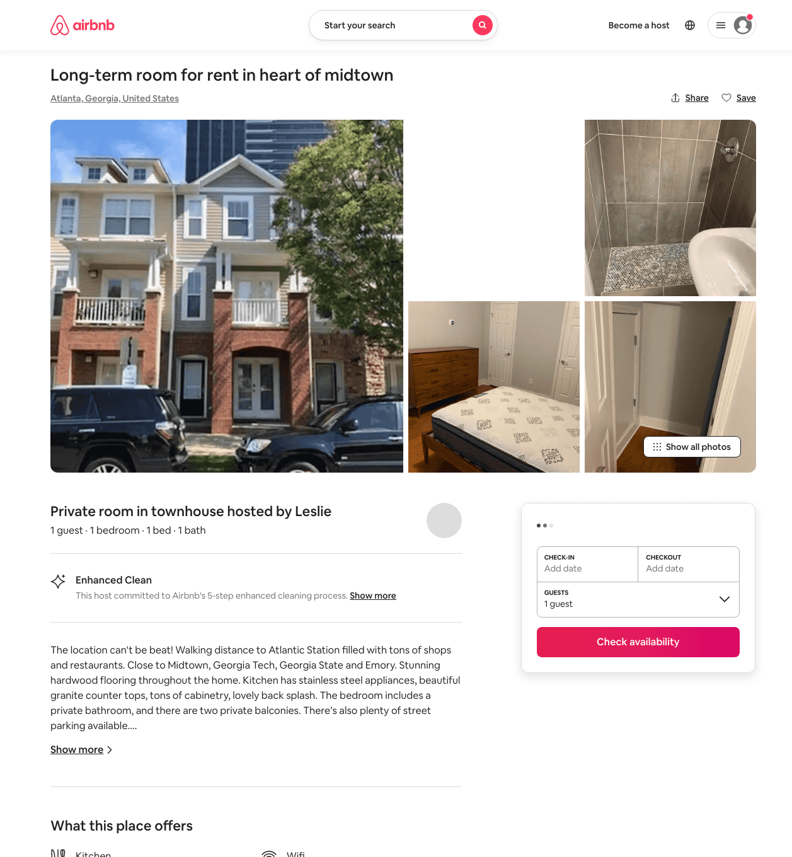
Listing 36267290
217 16TH ST NW 2
1
2
$55 - $85
5.0
7
Leslie
17983693
2
https://www.airbnb.com/rooms/36267290
Aug 2022

Slide 49
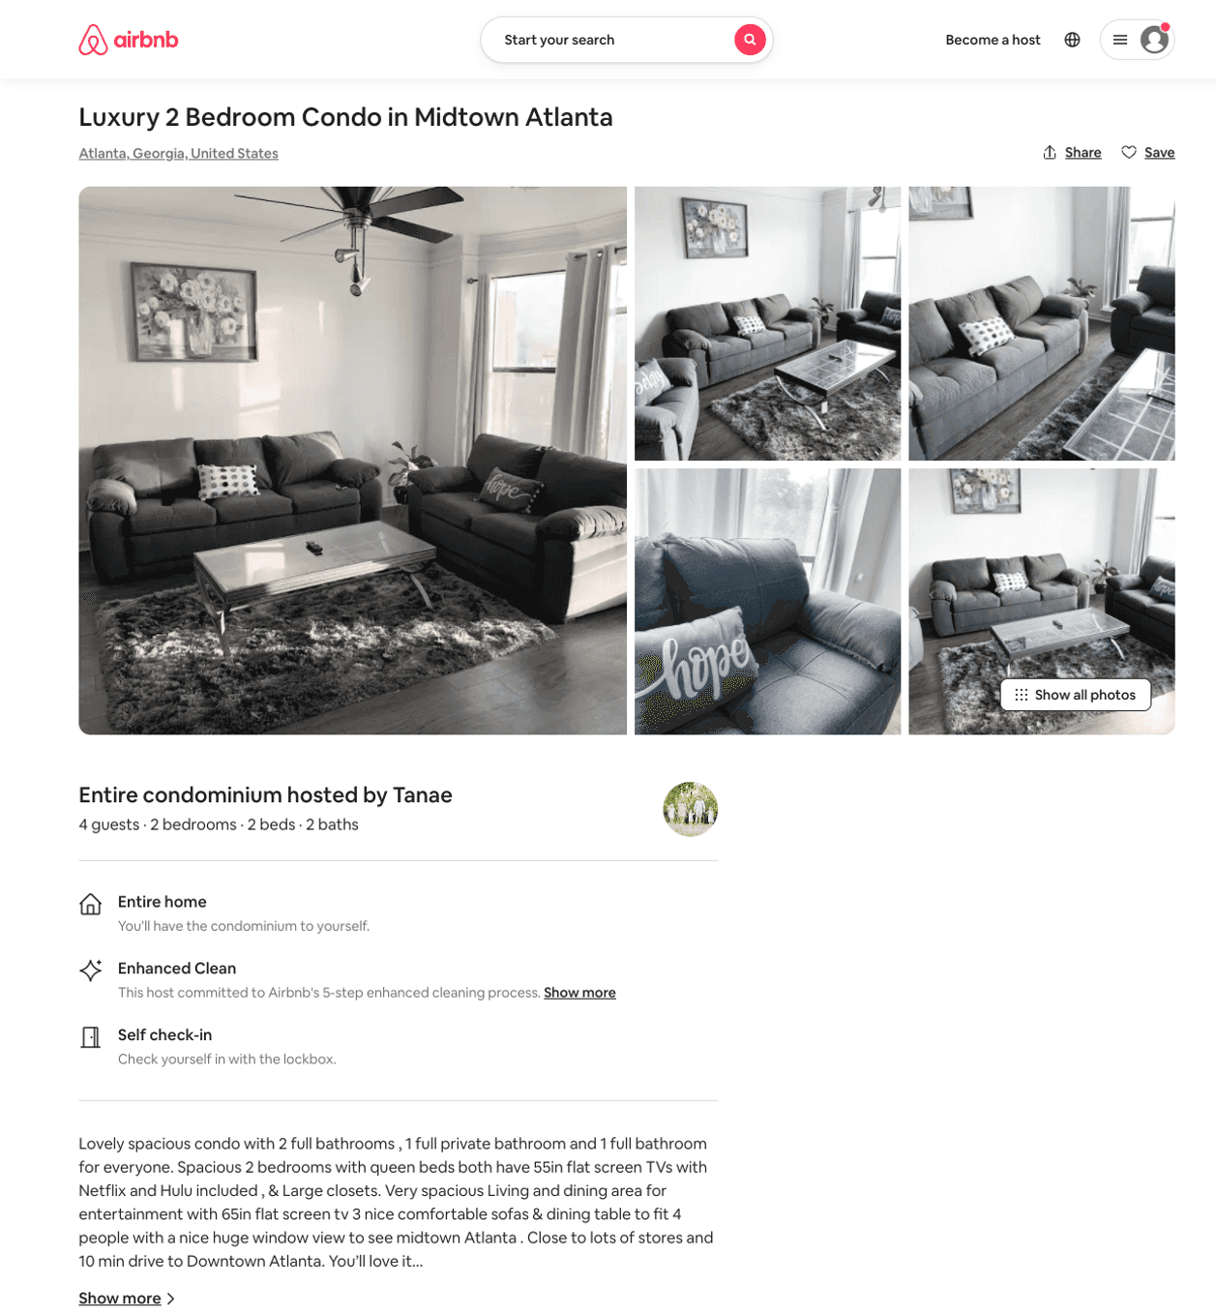
Listing 50444348
400 17TH ST NW
2
4
$140 - $185
4.26
3
Tanae
159447977
1
https://www.airbnb.com/rooms/50444348
Aug 2022

Slide 50
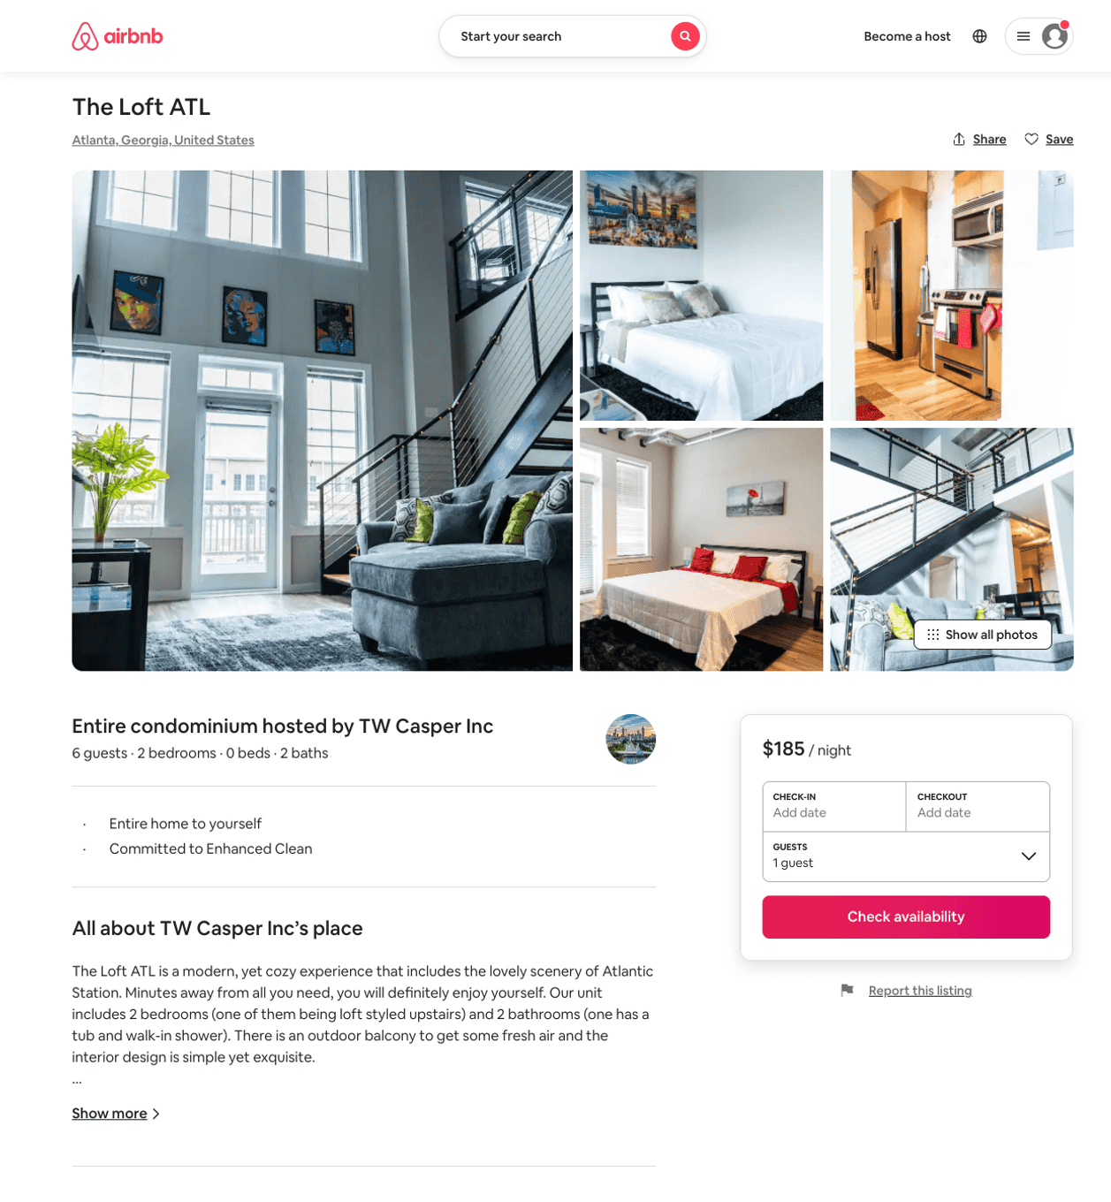
Listing 50546910
2
5
$162 - $219
4.77
2
TW Casper Inc
367480436
5
https://www.airbnb.com/rooms/50546910
Aug 2022

Slide 51
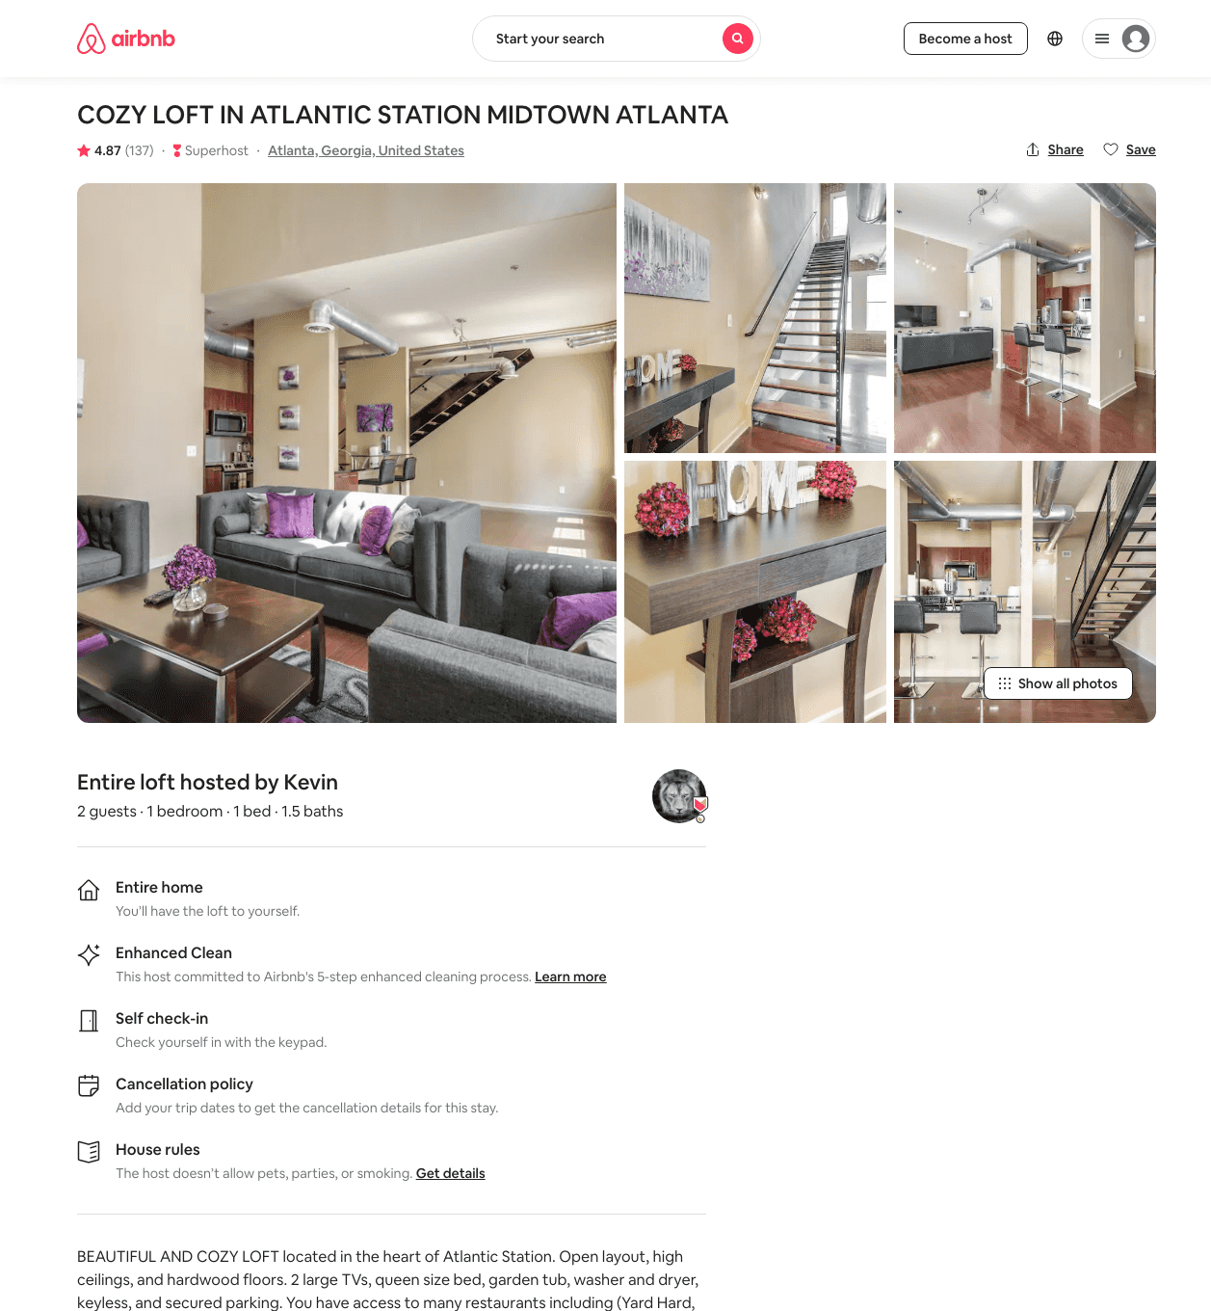
Listing 36556710
1
2
$116 - $176
4.82
1
Marie
133827904
1
https://www.airbnb.com/rooms/36556710
Aug 2022

Slide 52
Listing 48266066
1
3
$77 - $148
4.77
1
Yoletty
274744765
2
https://www.airbnb.com/rooms/48266066
Aug 2022

Slide 53
Listing 49233141
1
4
$106 - $158
4.87
1
Victoria
381687942
2
https://www.airbnb.com/rooms/49233141
Aug 2022

Slide 54
Listing 21323766
2
6
$171 - $296
4.79
2
Elle
118427394
4
https://www.airbnb.com/rooms/21323766
Aug 2022

Slide 55
Listing 31616208
1
2
$136 - $196
4.82
1
Charles
43834831
1
https://www.airbnb.com/rooms/31616208
Aug 2022

Slide 56
Listing 48554361
1
3
$81 - $174
4.60
1
Kris
391763890
2
https://www.airbnb.com/rooms/48554361
Aug 2022

Slide 57
Listing 46123653
2
8
$79 - $2300
4.82
1
Avanna
111469086
6
https://www.airbnb.com/rooms/46123653
Aug 2022

Slide 58
Listing 45635023
2
4
$189 - $275
4.91
1
Paris
369693086
3
https://www.airbnb.com/rooms/45635023
Aug 2022

Slide 59
Listing 48506374
1
3
$196 - $350
4.67
2
Freshlife360
40892887
2
https://www.airbnb.com/rooms/48506374
Aug 2022

Slide 60
Listing 40945733
2
4
$180 - $203
4.73
2
Colette
318706448
1
https://www.airbnb.com/rooms/40945733
Jun 2022

Slide 61
Listing 37650542
1
2
$121 - $211
4.85
2
Crystál
70827054
1
https://www.airbnb.com/rooms/37650542
Jul 2022

Slide 62
Listing 9795811
400 17TH ST NW
1
3
$120 - $144
4.94
2
B
28554819
1
https://www.airbnb.com/rooms/9795811
Aug 2022

Slide 63
Listing 50871563
2
5
$141 - $250
4.83
2
Gabriel
411302658
1
https://www.airbnb.com/rooms/50871563
Aug 2022

Slide 64
Listing 50813744
1
3
$89 - $150
4.77
2
Cammie
410730249
1
https://www.airbnb.com/rooms/50813744
Aug 2022

Slide 65
Listing 50898267
1
4
$76 - $105
4.67
1
Tina
395319230
2
https://www.airbnb.com/rooms/50898267
Jul 2022

Slide 66
Listing 32083481
Studio
2
$300
1
Pt
92288316
1
https://www.airbnb.com/rooms/32083481
Aug 2022

Slide 67
Listing 39053487
2
6
$200 - $229
4.86
1
Hasan
299315013
2
https://www.airbnb.com/rooms/39053487
Jun 2022

Slide 68
Listing 51157720
2
6
$211 - $586
2
Nichole
83040188
1
https://www.airbnb.com/rooms/51157720
Jul 2022

Slide 69
Listing 51307030
2
4
$149 - $225
4.61
2
C Cozy Suites
261667084
3
https://www.airbnb.com/rooms/51307030
Aug 2022

Slide 70
Listing 51603096
1
4
$94 - $151
2
Tayani
375117537
1
https://www.airbnb.com/rooms/51603096
Jul 2022

Slide 71
Listing 45440698
3
6
$136 - $183
4.77
3
Jay
234769560
10
https://www.airbnb.com/rooms/45440698
Aug 2022

Slide 72
Listing 51571915
2
6
$115 - $195
5.0
2
Marilyn
384105711
3
https://www.airbnb.com/rooms/51571915
Aug 2022

Slide 73
Listing 51654263
1
4
$108 - $188
4.89
2
Dgkkn Enterprises
389246623
4
https://www.airbnb.com/rooms/51654263
Aug 2022

Slide 74
Listing 52586175
1
4
$79 - $149
4.88
3
Mayu
216565735
11
https://www.airbnb.com/rooms/52586175
Aug 2022

Slide 75
Listing 50890657
1
3
$102 - $154
4.68
1
Kansas
161711643
1
https://www.airbnb.com/rooms/50890657
Aug 2022

Slide 76
Listing 21096405
1
4
$224
4.46
1
Ken
152102544
8
https://www.airbnb.com/rooms/21096405
Aug 2022

Slide 77
Listing 52242996
2
6
$120 - $150
3
Kirsten
86427863
1
https://www.airbnb.com/rooms/52242996
Jun 2022

Slide 78
Listing 52685276
1
4
$229 - $339
20
Sean
122366288
1
https://www.airbnb.com/rooms/52685276
Aug 2022

Slide 79
Listing 52737203
1
2
$71 - $127
4.65
1
Luxury Lyfe Suites
237419161
9
https://www.airbnb.com/rooms/52737203
Aug 2022

Slide 80
Listing 49918213
1
4
$151 - $235
5.0
7
Elle
367270546
4
https://www.airbnb.com/rooms/49918213
Aug 2022

Slide 81
Listing 18484443
1
4
$89 - $158
3
Quincy
128236189
1
https://www.airbnb.com/rooms/18484443
Jun 2022

Slide 82
Listing 52882319
3
7
$127 - $354
4.89
2
Antanique
259197429
1
https://www.airbnb.com/rooms/52882319
Aug 2022

Slide 83
Listing 2409285
1
3
$108 - $136
2
None
https://www.vrbo.com/2409285
Aug 2022

Slide 84
Listing 53051001
2
4
$190 - $249
4.71
2
Jael
384447326
1
https://www.airbnb.com/rooms/53051001
Aug 2022

Slide 85
Listing 52991684
1
3
$79 - $81
4.18
1
Ron
428985081
1
https://www.airbnb.com/rooms/52991684
Aug 2022

Slide 86
Listing 53256074
1
3
$74 - $101
4.54
1
April
337097948
1
https://www.airbnb.com/rooms/53256074
Jul 2022

Slide 87
Listing 53448503
1
4
$76 - $120
4.59
1
Southern
432784818
1
https://www.airbnb.com/rooms/53448503
Aug 2022

Slide 88
Listing 53547207
2
5
$251 - $324
4.92
1
Universal Rentals
60560861
3
https://www.airbnb.com/rooms/53547207
Aug 2022

Slide 89
Listing 53514102
2
6
$124 - $275
4.83
2
Georgia Conciliate
223795812
1
https://www.airbnb.com/rooms/53514102
Aug 2022

Slide 90
Listing 53494859
2
4
$189
4.67
2
Joy
238053341
13
https://www.airbnb.com/rooms/53494859
Aug 2022

Slide 91
Listing 31415002
1
3
$180
5.0
2
Chukwuemeka
235310435
1
https://www.airbnb.com/rooms/31415002
Aug 2022

Slide 92
Listing 53533566
2
4
$1600
1
Erica
51144669
1
https://www.airbnb.com/rooms/53533566
Jul 2022

Slide 93
Listing 282484
3
8
$279 - $284
4.5238094
6
Sarah Elan
https://www.vrbo.com/282484
Aug 2022

Slide 94
Listing 2578477
1
4
$107 - $150
5
1
https://www.vrbo.com/2578477
Aug 2022

Slide 95
Listing 53937926
1
2
$152 - $180
5.0
2
Asha
66816601
1
https://www.airbnb.com/rooms/53937926
Aug 2022

Slide 96
Listing 54096844
3
6
$123 - $289
4.88
4
Stay N Rest
318602293
3
https://www.airbnb.com/rooms/54096844
Aug 2022

Slide 97
Listing 53683706
2
6
$140 - $250
4.94
2
The House Of Jolie
132513305
1
https://www.airbnb.com/rooms/53683706
Aug 2022

Slide 98
Listing spacious-atl-loft-2story-3br-atlantic-station
undefined
8
8.1
https://www.booking.com/hotel/us/spacious-atl-loft-2story-3br-atlantic-station.html
Sep 2022

Slide 99
Listing 36544055
1
3
$98 - $137
4.80
2
Mazie
83081251
1
https://www.airbnb.com/rooms/36544055
Aug 2022

Slide 100
Listing 2734066
2
8
$277
1
Yvonne
https://www.vrbo.com/2734066
Aug 2022

Slide 101
Listing 2761589
2
4
$244
2
Ryan Strong
https://www.vrbo.com/2761589
Aug 2022

Slide 102
Listing 2775872
2
5
$195
5
5
https://www.vrbo.com/2775872
Aug 2022

Slide 103
Listing 2687508
2
6
$265
4
2
Deidre
https://www.vrbo.com/2687508
Aug 2022

Slide 104
Listing 2784838
1
3
$92
1
Keierica Howard
https://www.vrbo.com/2784838
Aug 2022

Slide 105
Listing 2790721
2
5
$160
2
cmi
https://www.vrbo.com/2790721
Aug 2022

Slide 106
Listing 2801584
3
6
$165
4.3333335
2
Authentic Reservations
https://www.vrbo.com/2801584
Aug 2022

Slide 107
Listing 2810830
1
4
$150
3
https://www.vrbo.com/2810830
Aug 2022

Slide 108
Listing 2835666
2
7
$158
3
https://www.vrbo.com/2835666
Aug 2022

Slide 109
Listing 49982527
2
5
$254
4.20
1
Chris
116115557
1
https://www.airbnb.com/rooms/49982527
Aug 2022

Slide 110
Listing 41372620
1
4
$85
35
Ryan
121913632
5
https://www.airbnb.com/rooms/41372620
Aug 2022

Slide 111
Listing 542121457820880000
1
2
$95
5.0
2
LaTonya
232631824
1
https://www.airbnb.com/rooms/542121457820880000
Jun 2022

Slide 112
Listing 20848869
1
2
$109
4.83
2
Megan
49414522
1
https://www.airbnb.com/rooms/20848869
Jun 2022

Slide 113
Listing 27921239
1
2
4.71
1
Rj
141021879
1
https://www.airbnb.com/rooms/27921239
Jun 2022

Slide 114
Listing 50158996
1
4
2
Lux Royalty
404710743
1
https://www.airbnb.com/rooms/50158996
Aug 2022

Slide 115
Listing 2899759
3
11
$549
1
https://www.vrbo.com/2899759
Aug 2022

Slide 116
Listing 34125264
3
10
4.72
2
James
226863781
4
https://www.airbnb.com/rooms/34125264
Aug 2022

Slide 117
Listing 53557316
1
4
3
Sametha
36645304
1
https://www.airbnb.com/rooms/53557316
Aug 2022

Slide 118
Listing 2954140
2
4
$150
2
https://www.vrbo.com/2954140
Aug 2022

Slide 119
Listing 2951345
2
5
$275
1
https://www.vrbo.com/2951345
Aug 2022

Slide 120
Listing 41563574
1
2
35
Ryan
121913632
5
https://www.airbnb.com/rooms/41563574
Aug 2022

Slide 121
Listing 2938851
2
8
$219
2
https://www.vrbo.com/2938851
Aug 2022

