Slide 2
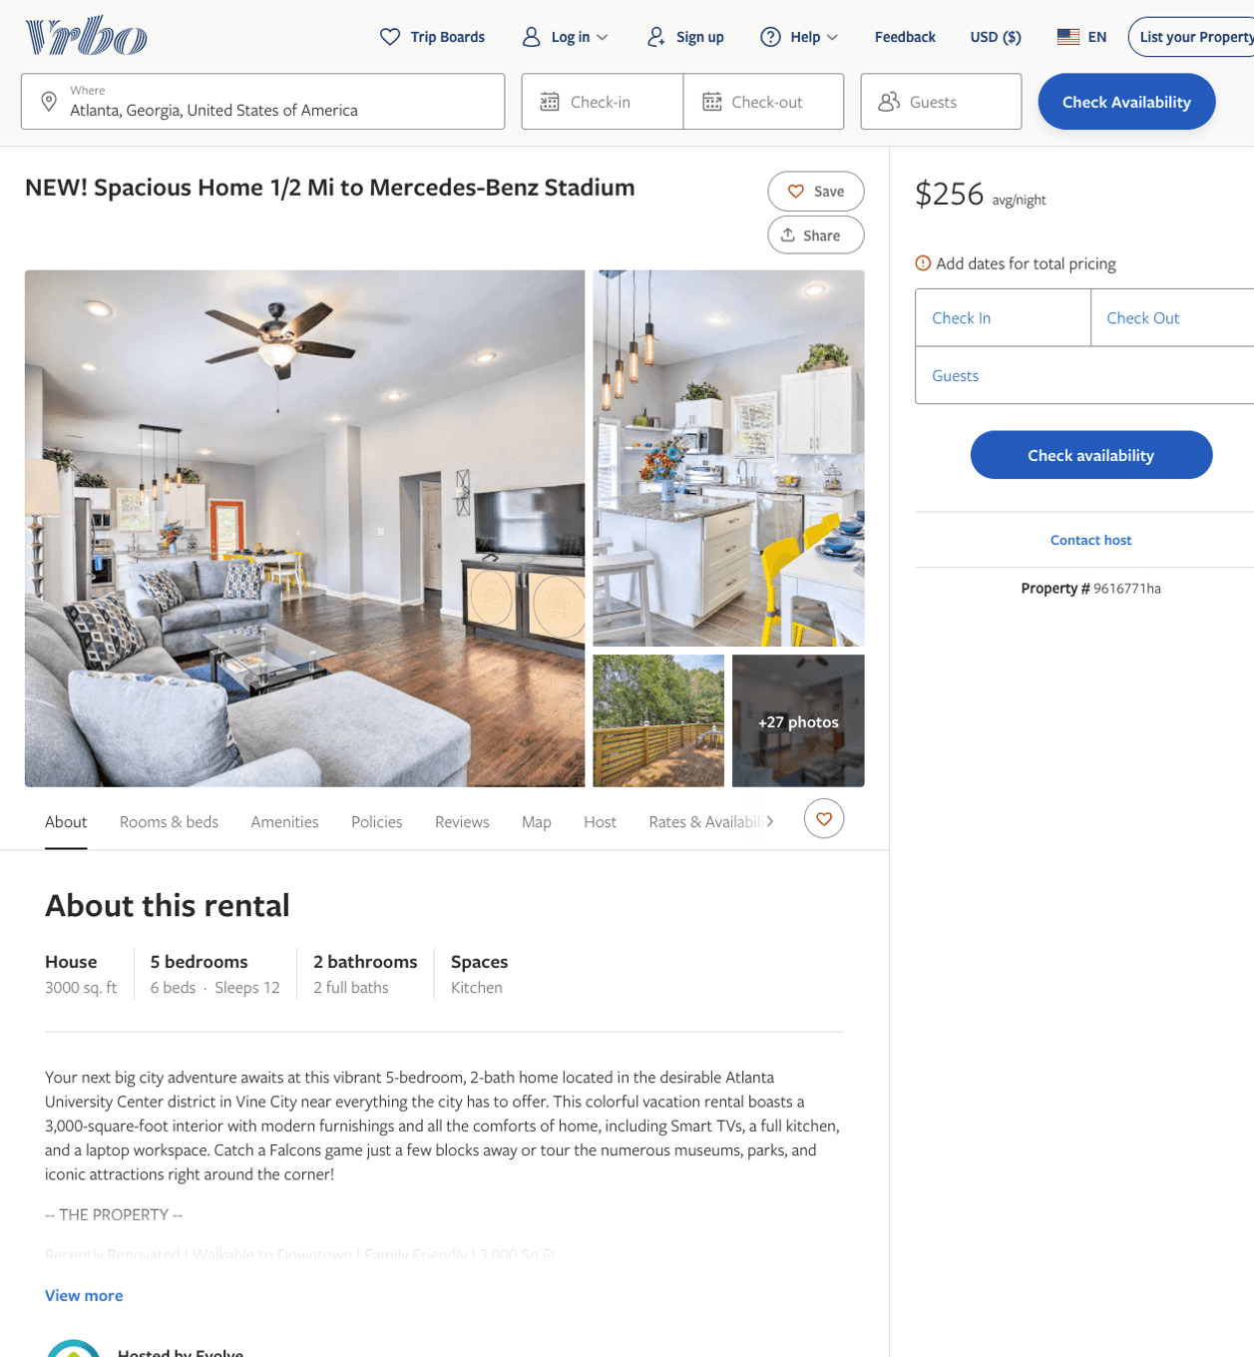
Listing 9616771
5
12
$279 - $415
4.5
2
Evolve
https://www.vrbo.com/9616771ha
Aug 2022

Slide 3
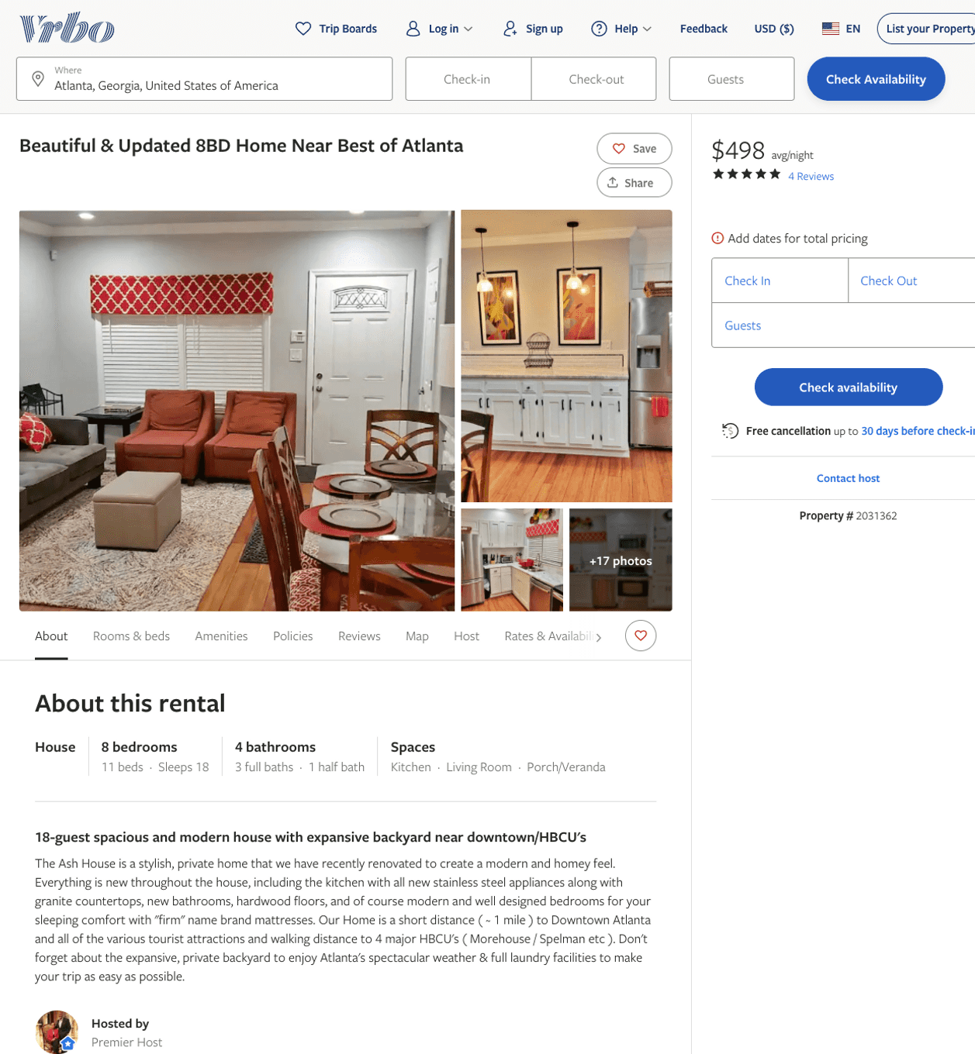
Listing 2031362
8
18
$373 - $498
4.6923075
2
Floyd Arthur
https://www.vrbo.com/2031362
Aug 2022

Slide 4
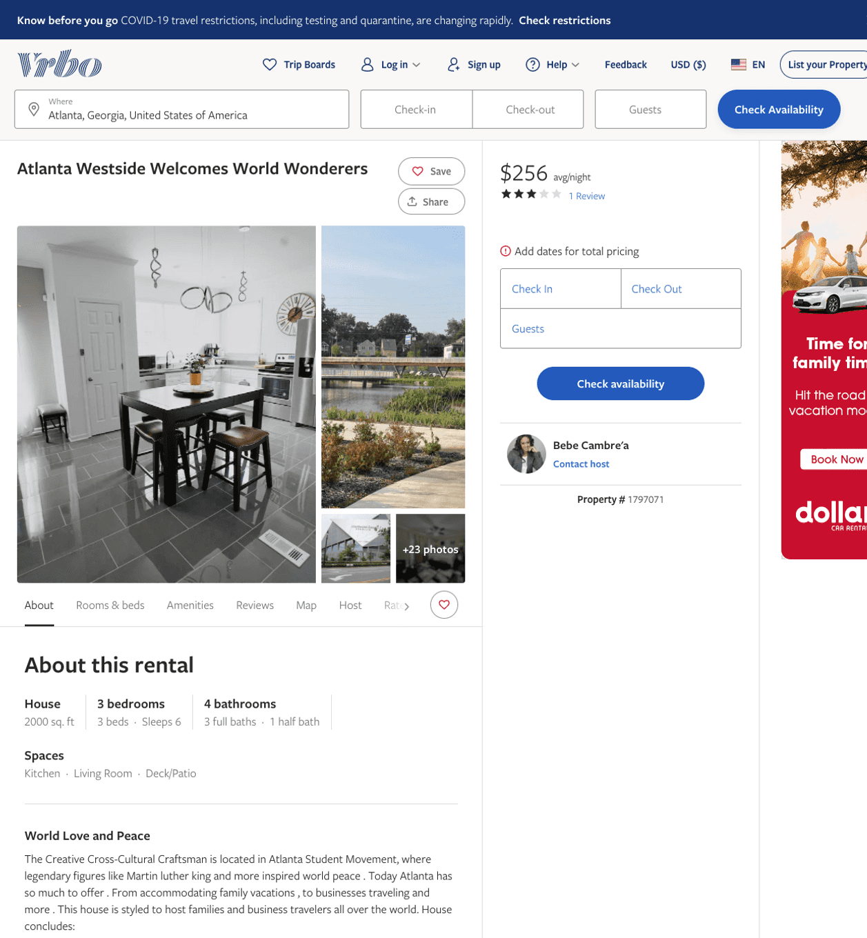
Listing 1797071
3
7
$256 - $318
3
2
Bebe Cambre'a
https://www.vrbo.com/1797071
Aug 2022

Slide 5
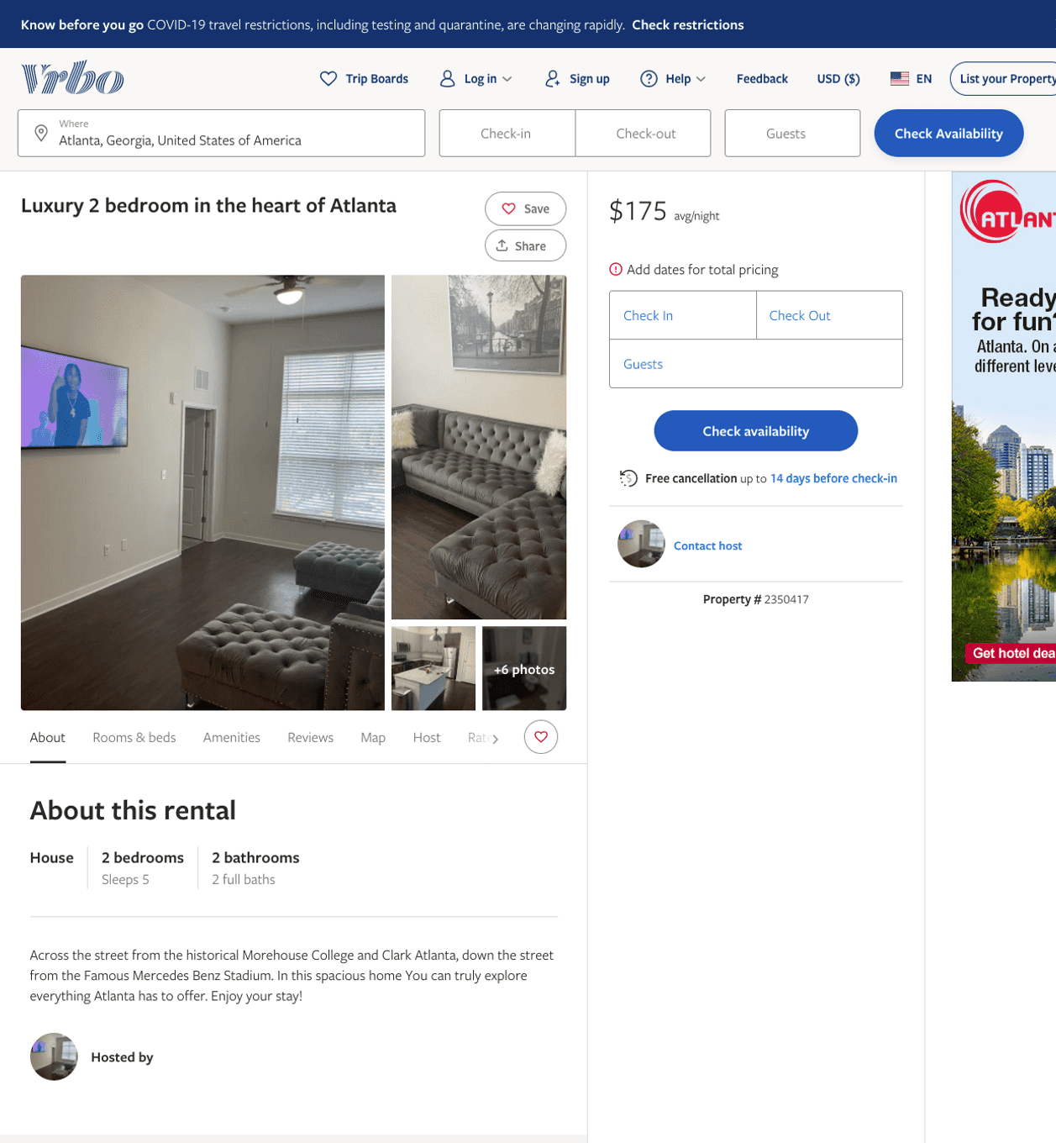
Listing 2350417
2
5
$175
1
2
https://www.vrbo.com/2350417
Aug 2022

Slide 6
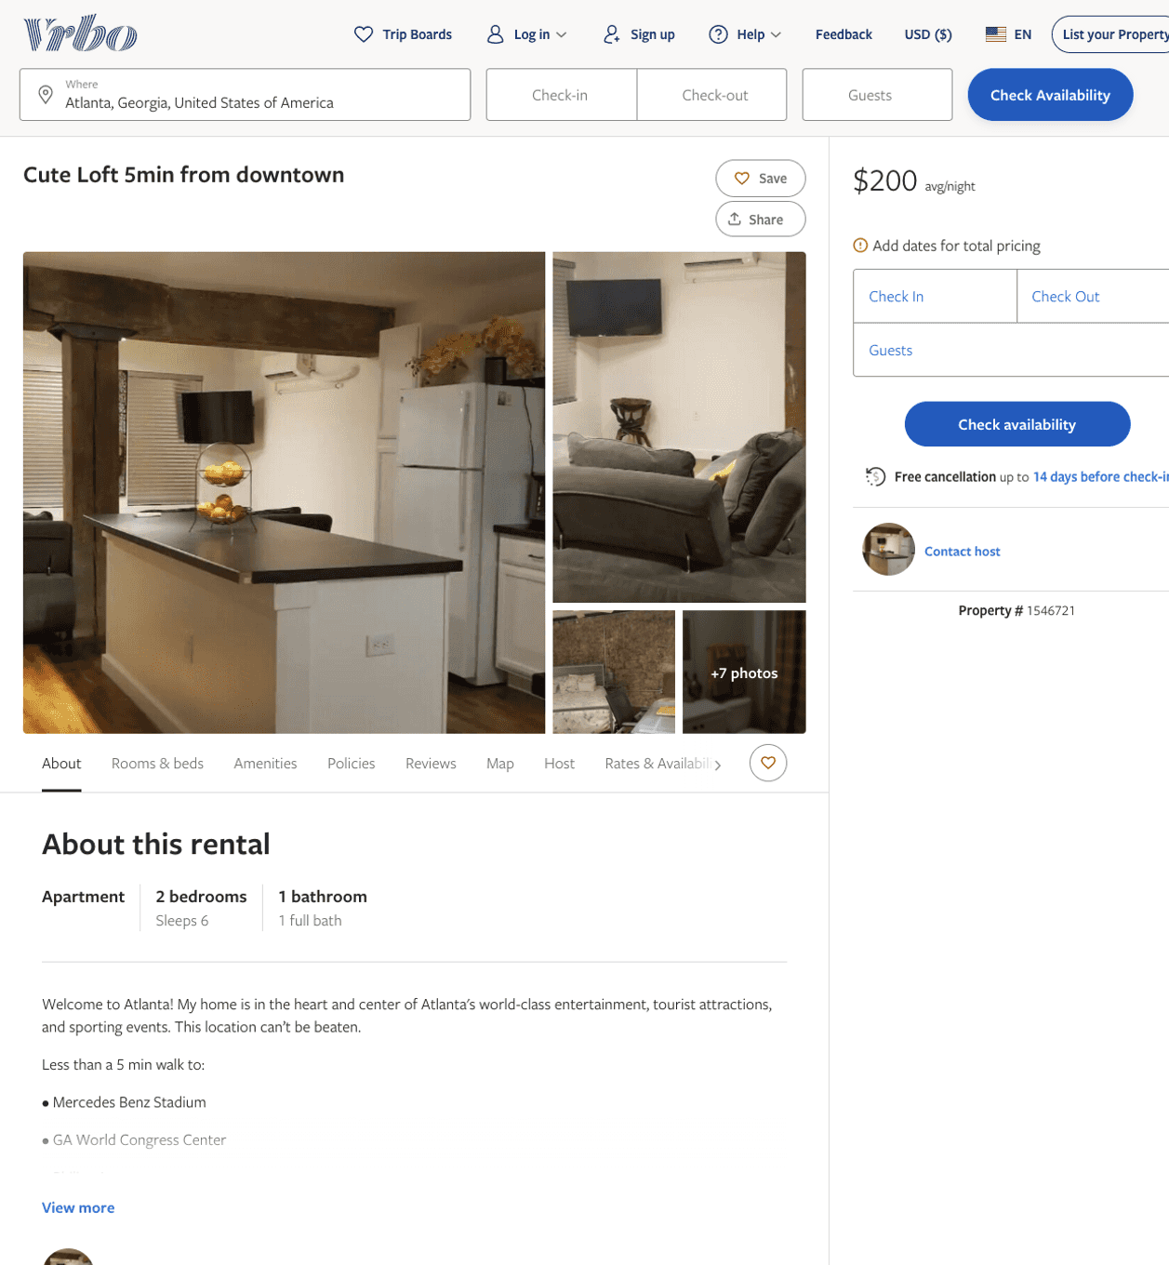
Listing 1546721
2
6
$200
3
https://www.vrbo.com/1546721
Aug 2022

Slide 7
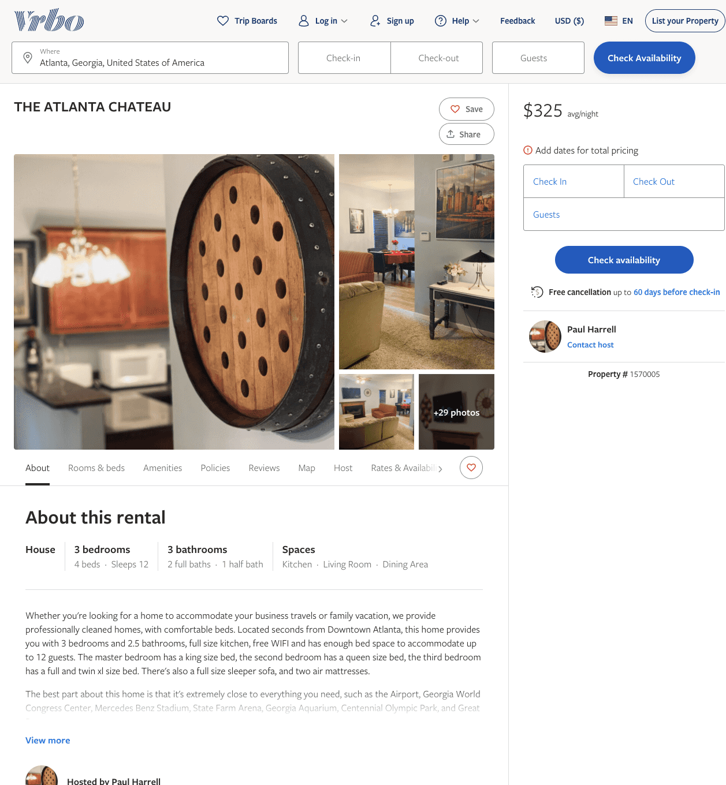
Listing 1570005
3
12
$325
2
Paul Harrell
https://www.vrbo.com/1570005
Aug 2022

Slide 8
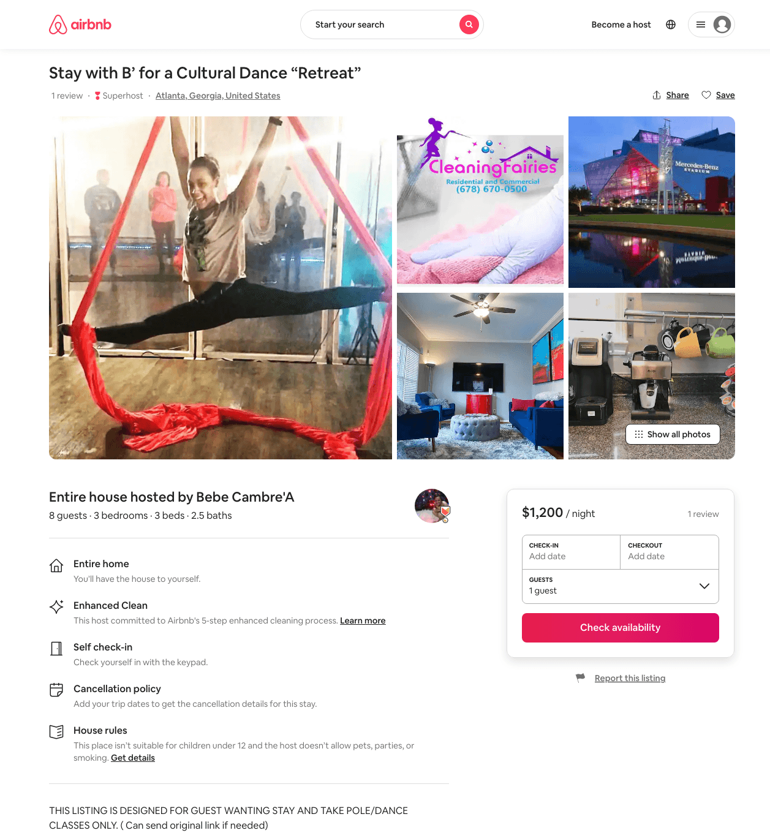
Listing 42794037
3
8
$800 - $1500
1
Bebe Cambre'A
35100818
4
https://www.airbnb.com/rooms/42794037
Aug 2022

Slide 9
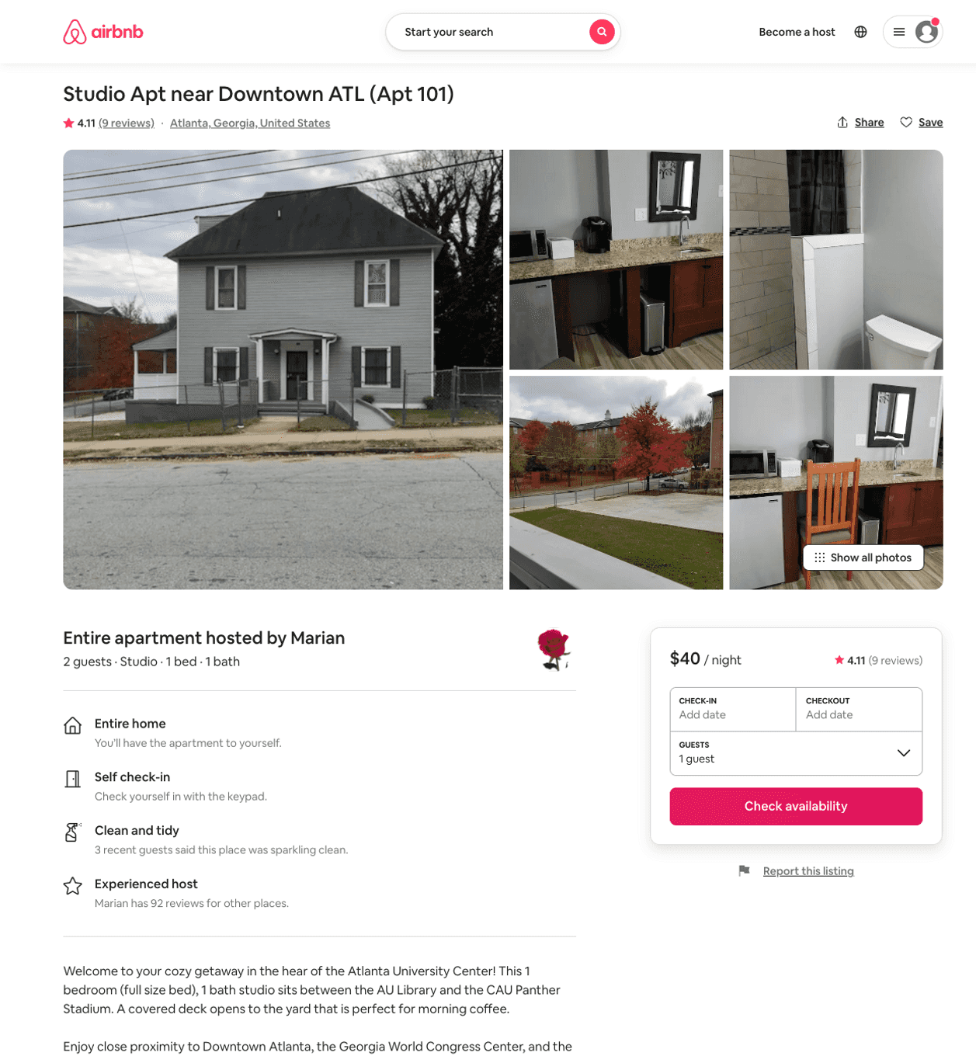
Listing 47957936
Studio
2
$36 - $61
4.29
28
Marian
90704065
4
https://www.airbnb.com/rooms/47957936
Aug 2022

Slide 10
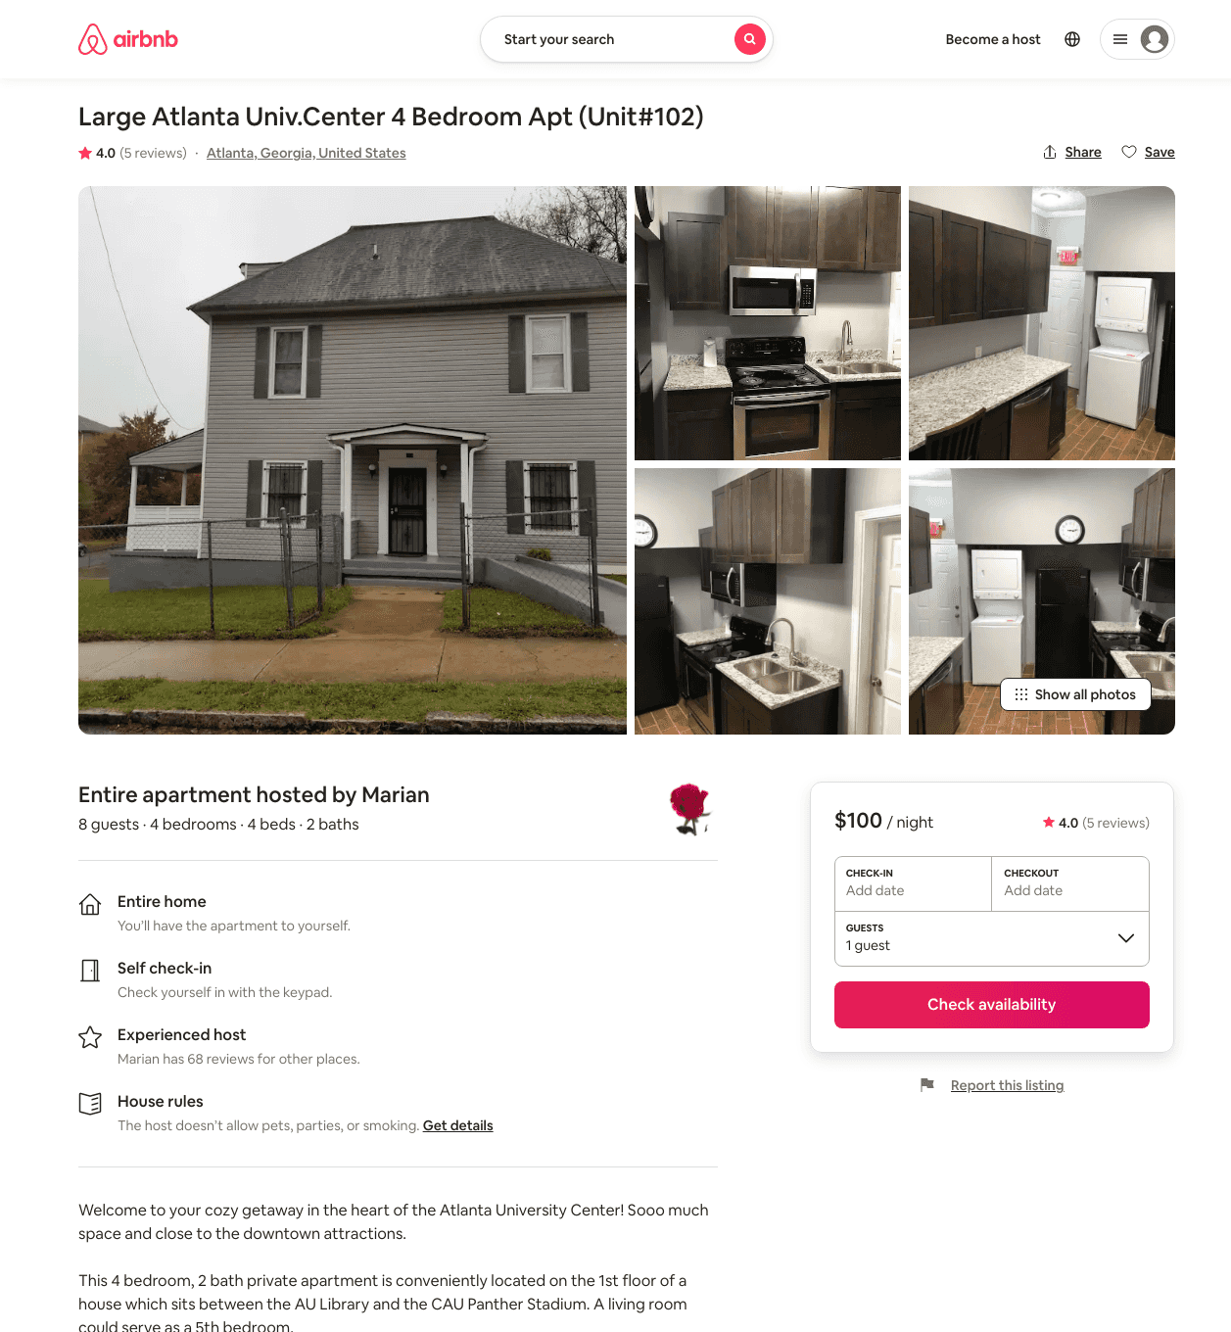
Listing 47534347
4
8
$94 - $140
4.21
3
Marian
90704065
4
https://www.airbnb.com/rooms/47534347
Jun 2022

Slide 11
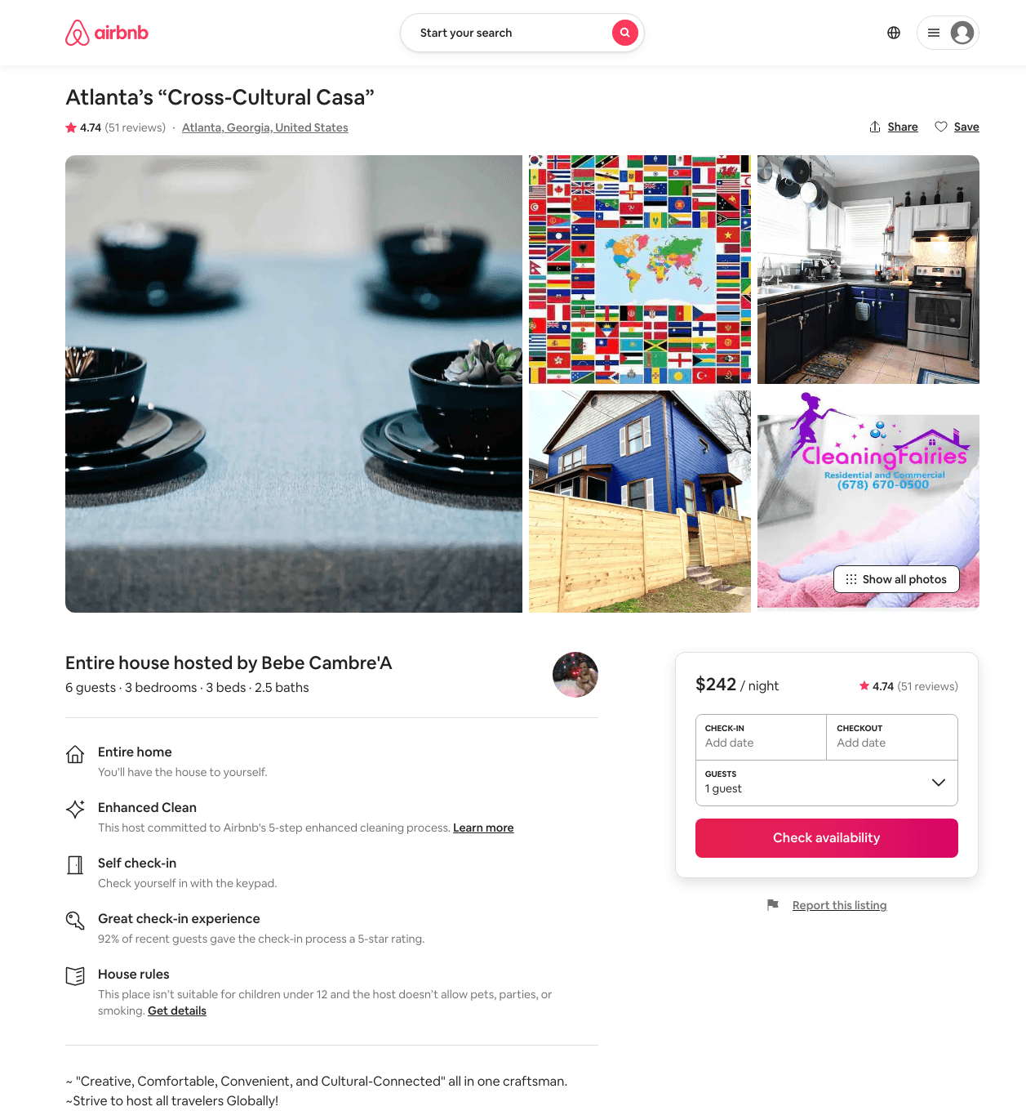
Listing 23018208
3
7
$173 - $385
4.77
2
Bebe Cambre'A
35100818
4
https://www.airbnb.com/rooms/23018208
Jun 2022

Slide 12
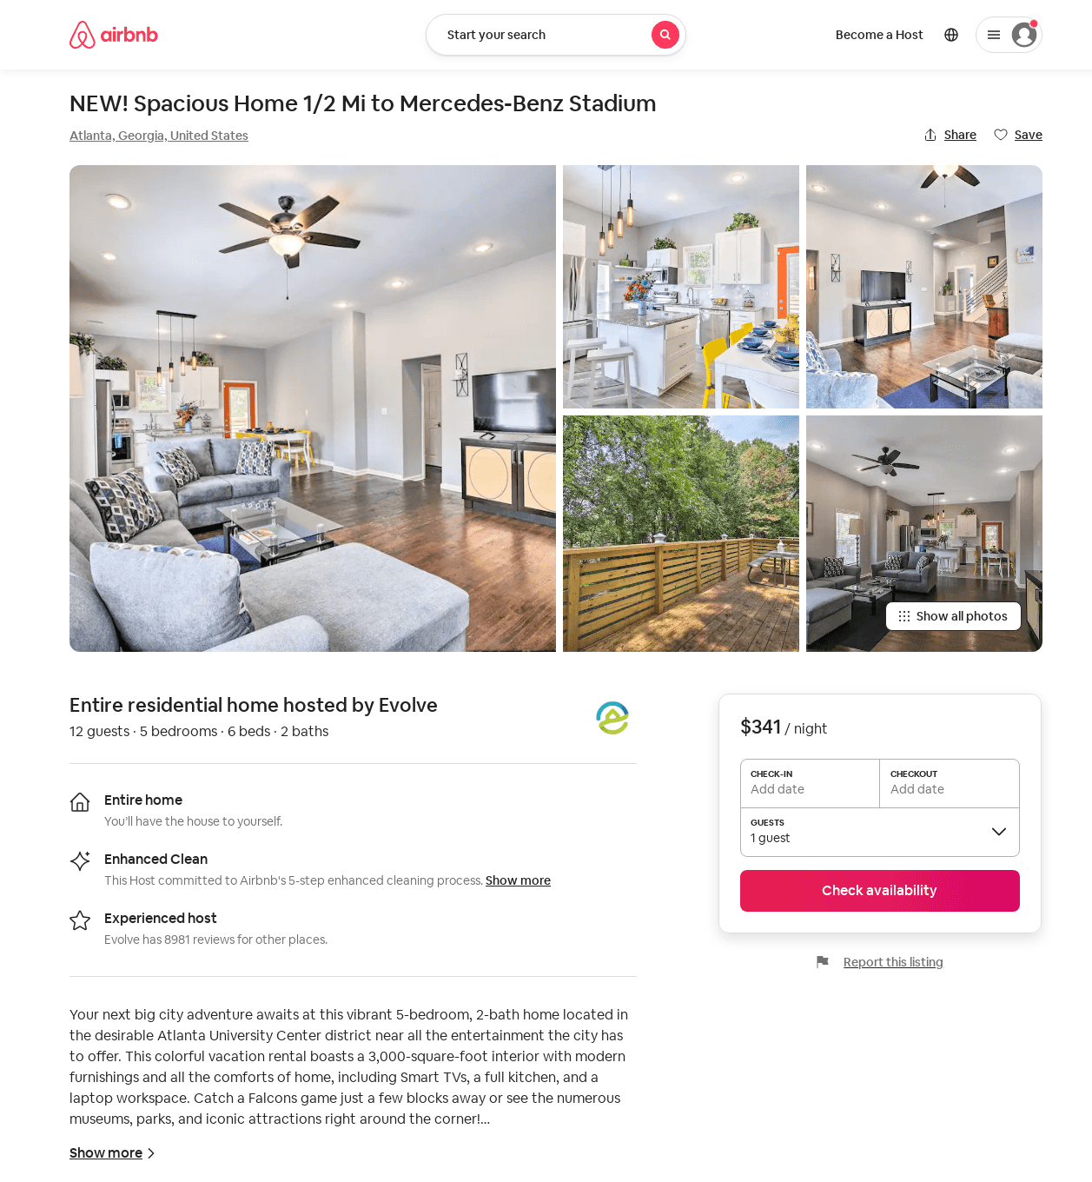
Listing 52772142
5
12
$256 - $355
4.57
2
Evolve
121682456
51
https://www.airbnb.com/rooms/52772142
Aug 2022

Slide 13
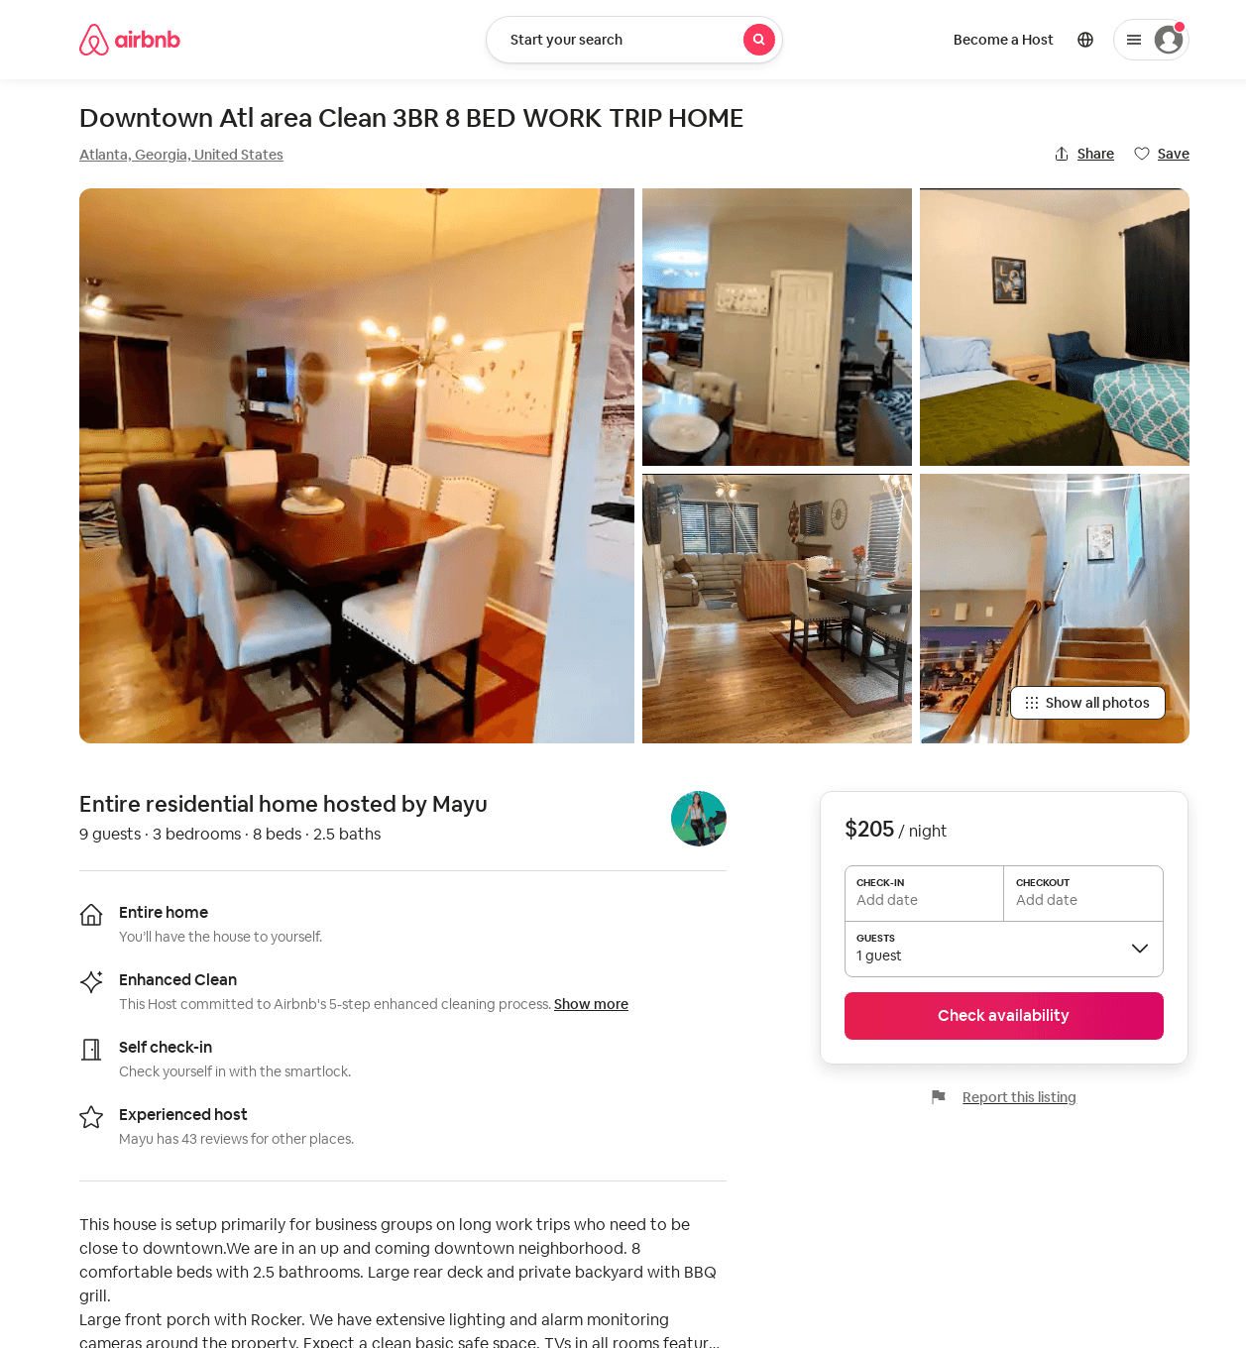
Listing 53208697
3
9
$201 - $278
10
Mayu
216565735
11
https://www.airbnb.com/rooms/53208697
Aug 2022

Slide 14
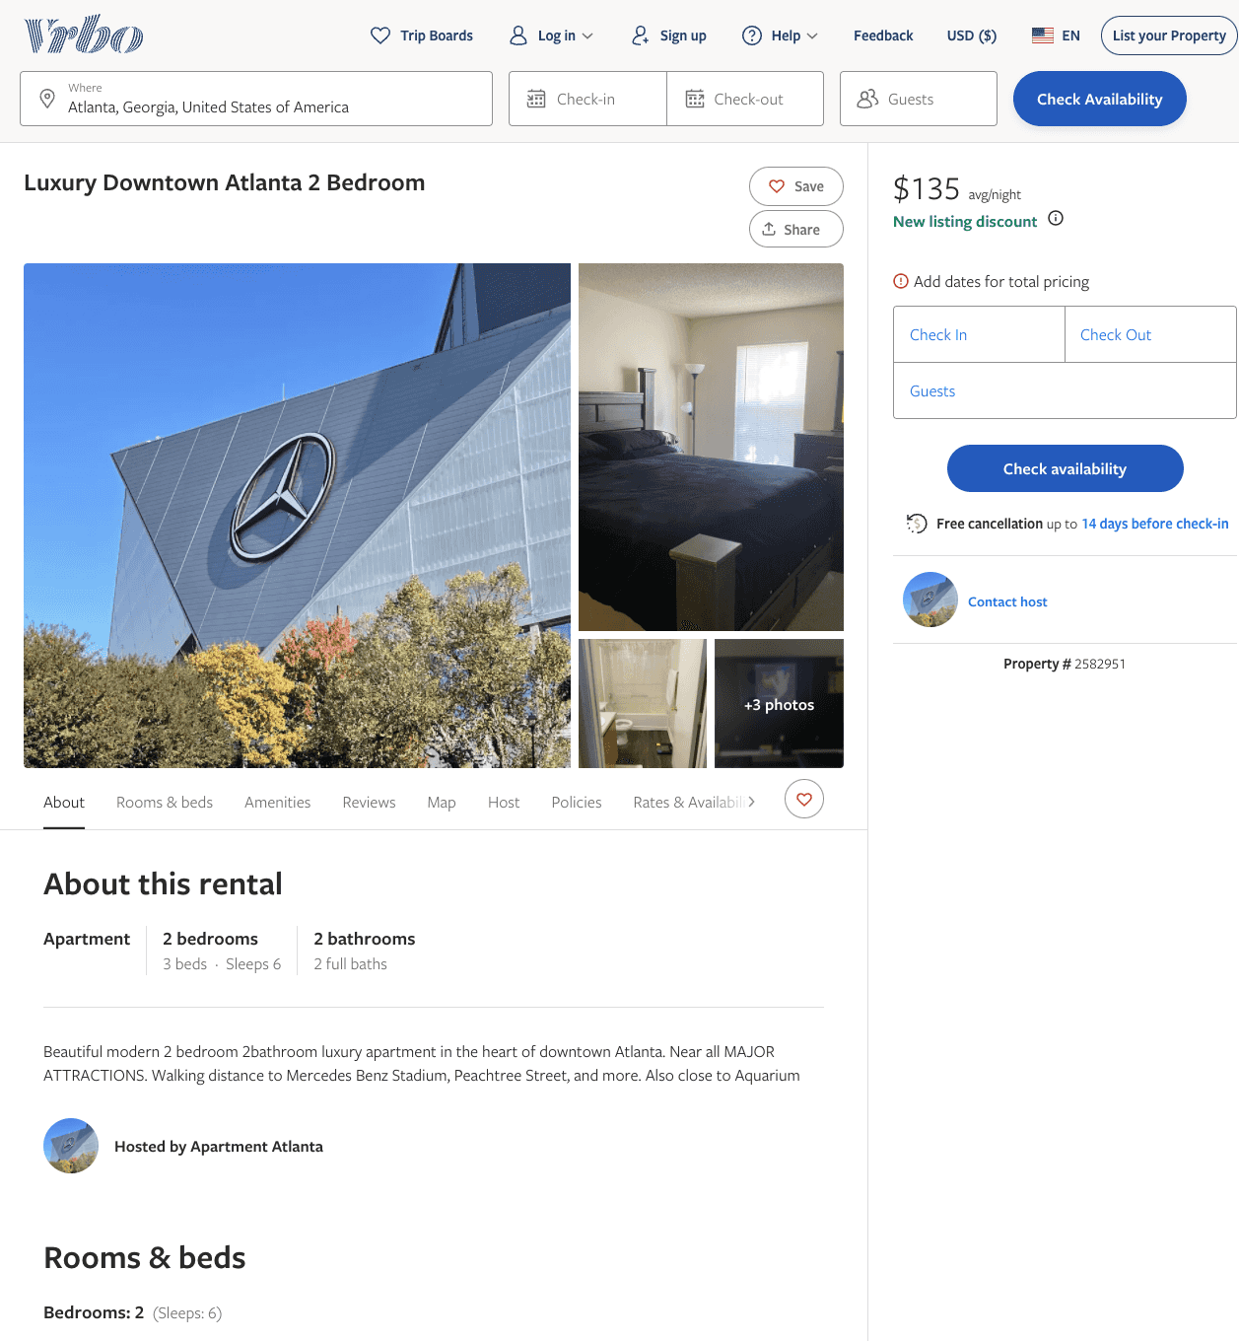
Listing 2582951
2
5
$121 - $139
4.5
2
Brittany Thompson
https://www.vrbo.com/2582951
Aug 2022

Slide 15
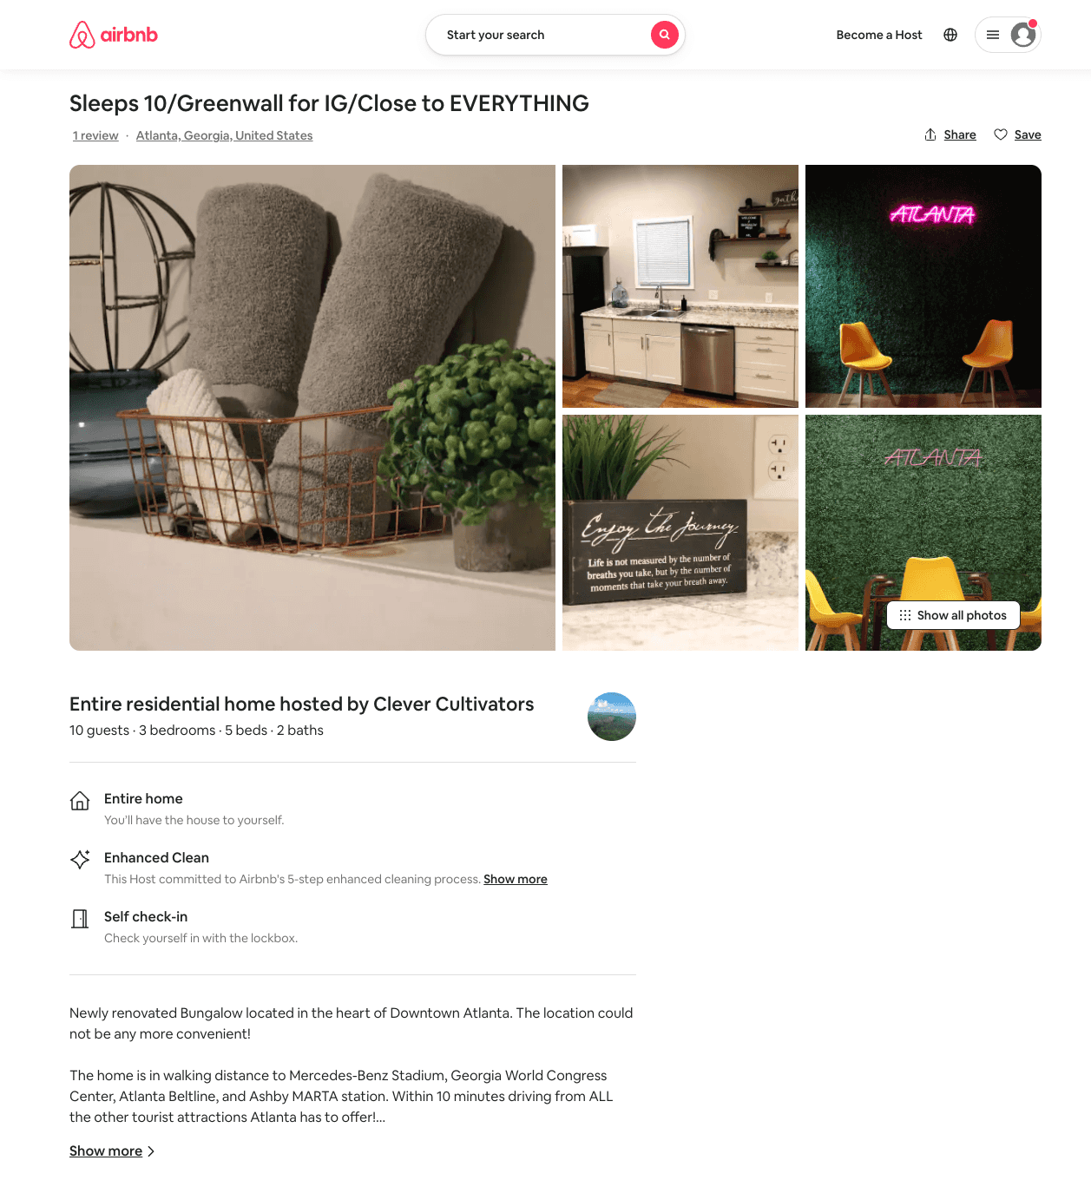
Listing 53272805
3
10
$106 - $148
4.92
2
CC Real Estate
431277601
1
https://www.airbnb.com/rooms/53272805
Jul 2022

Slide 16
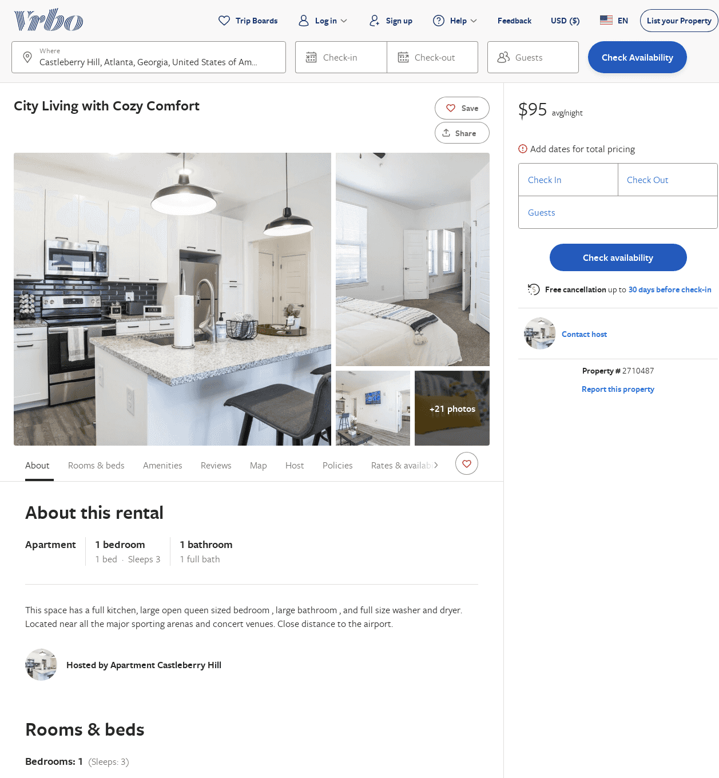
Listing 2710487
1
2
$95
4.5
1
https://www.vrbo.com/2710487
Aug 2022

Slide 17
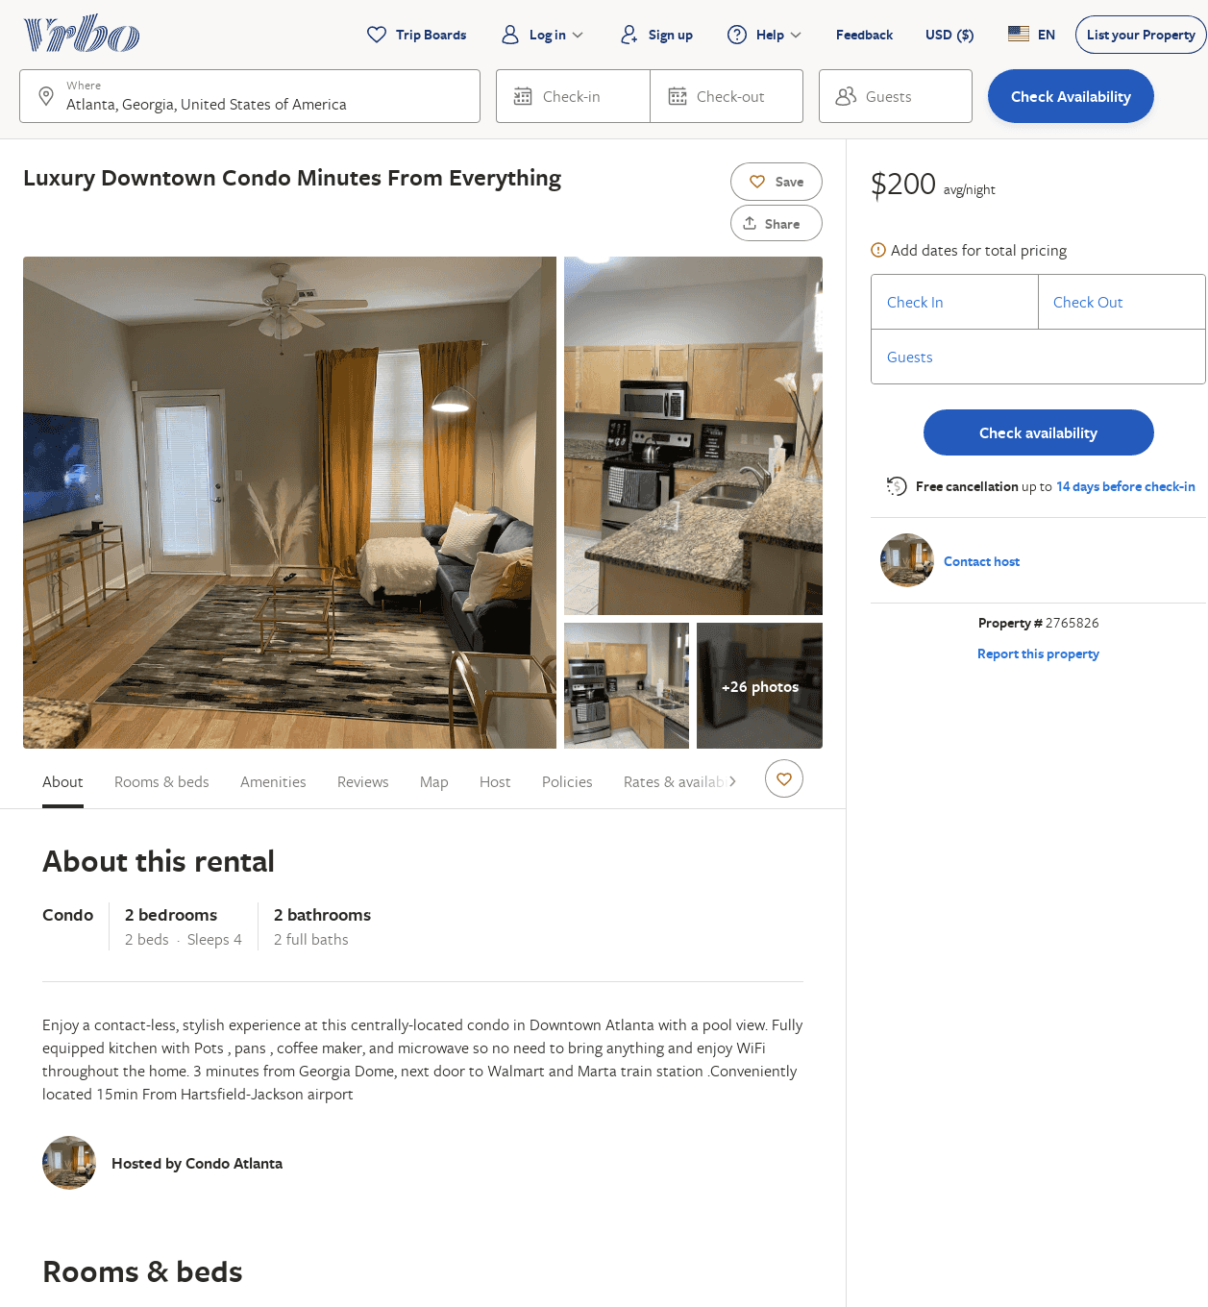
Listing 2765826
2
4
$200
1
1
https://www.vrbo.com/2765826
Aug 2022

Slide 18
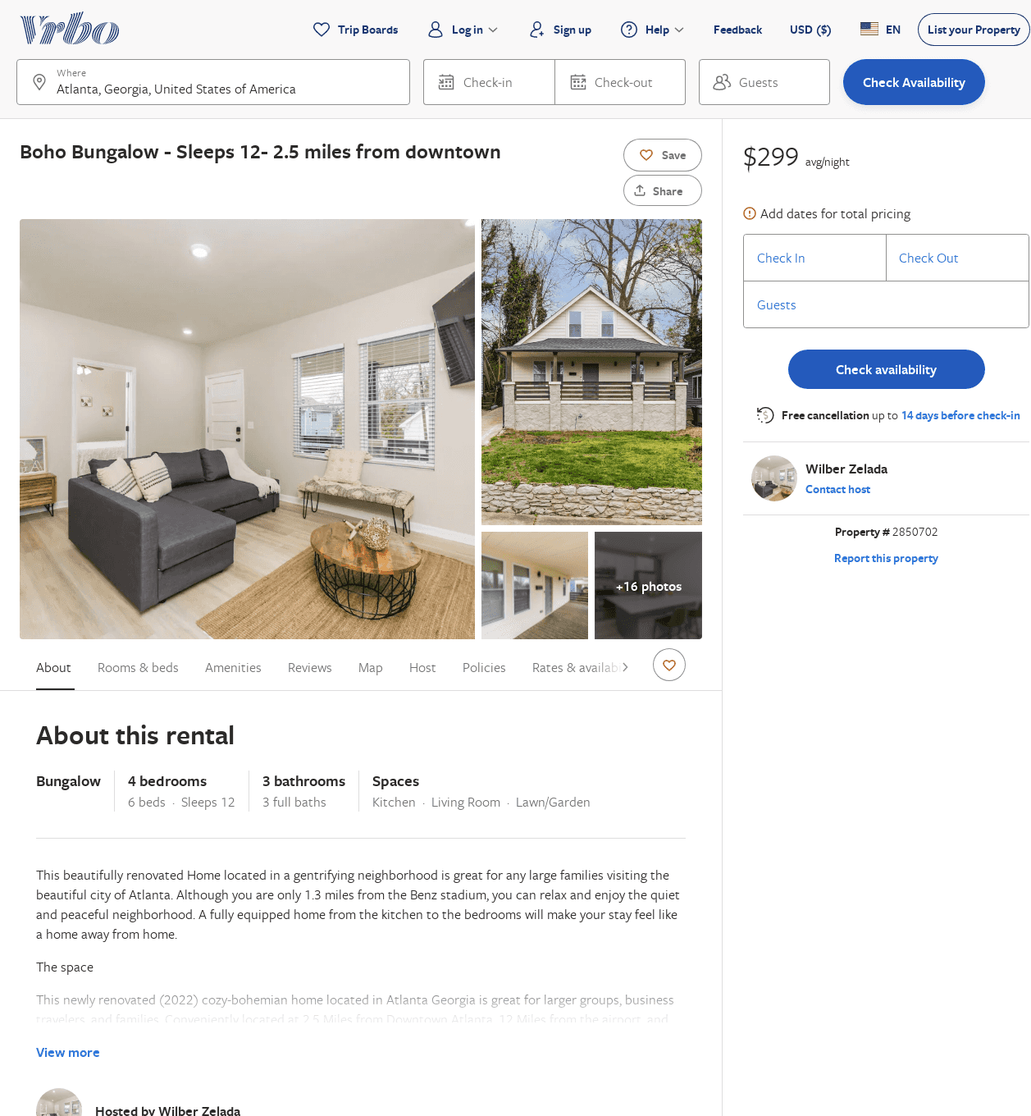
Listing 2850702
4
12
$255
5
2
Wilber Zelada
https://www.vrbo.com/2850702
Aug 2022

