Slide 2
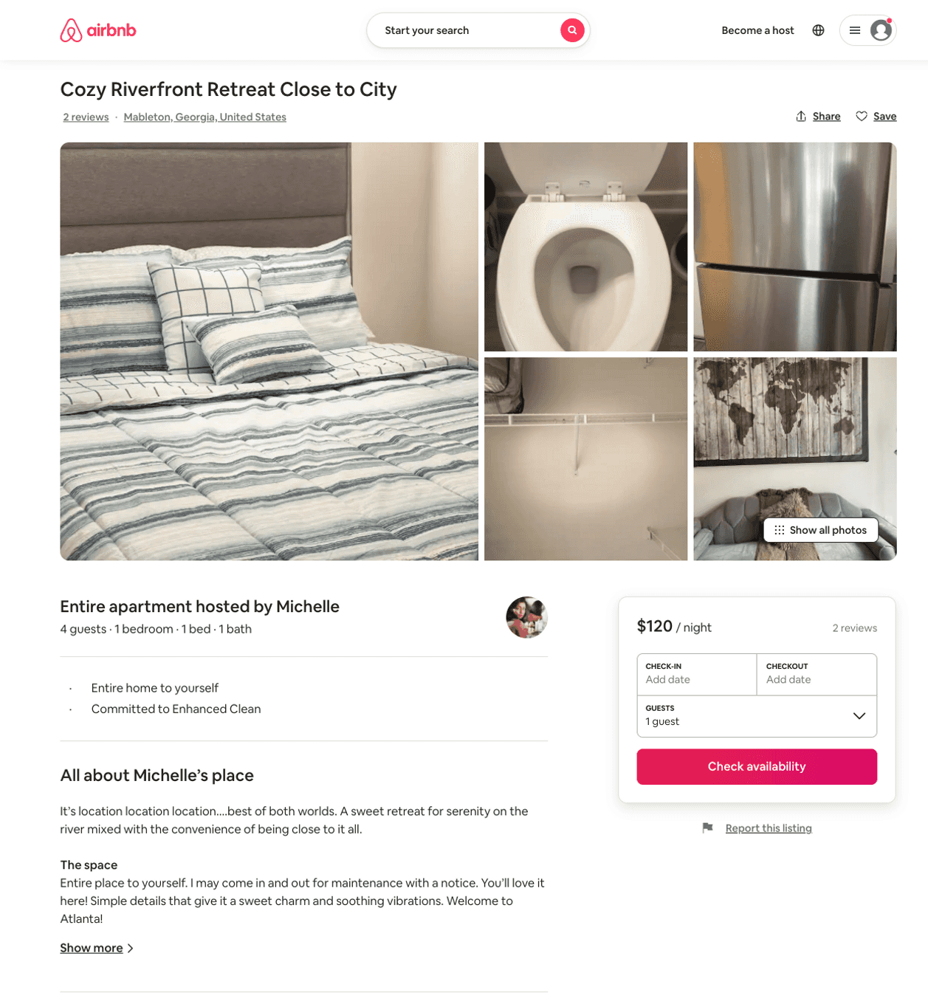
Listing 50073450
1
4
$85 - $120
4.53
1
Michelle
82463072
1
https://www.airbnb.com/rooms/50073450
Aug 2022

