Slide 2
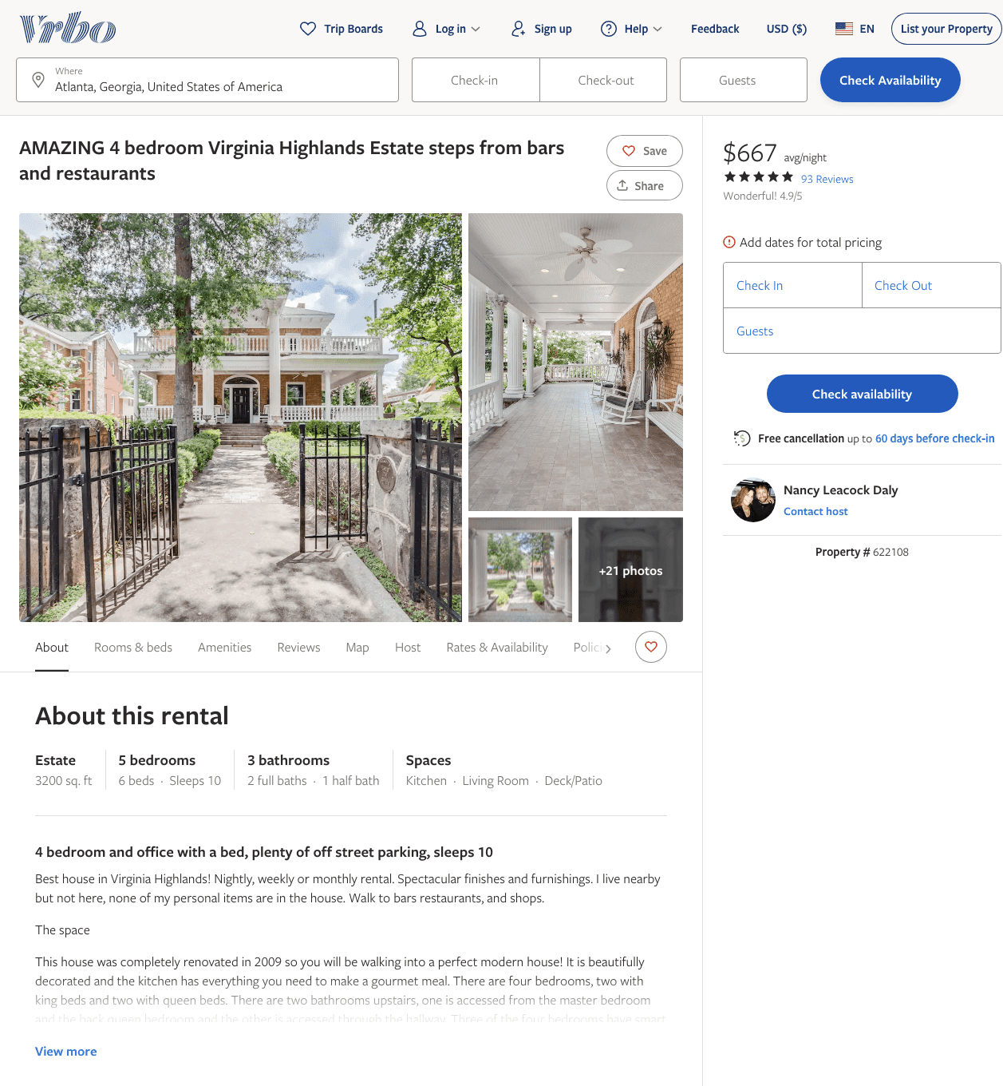
Listing 622108
5
10
$625 - $687
4.8846154
3
Nancy Leacock Daly
https://www.vrbo.com/622108
Aug 2022

Slide 3
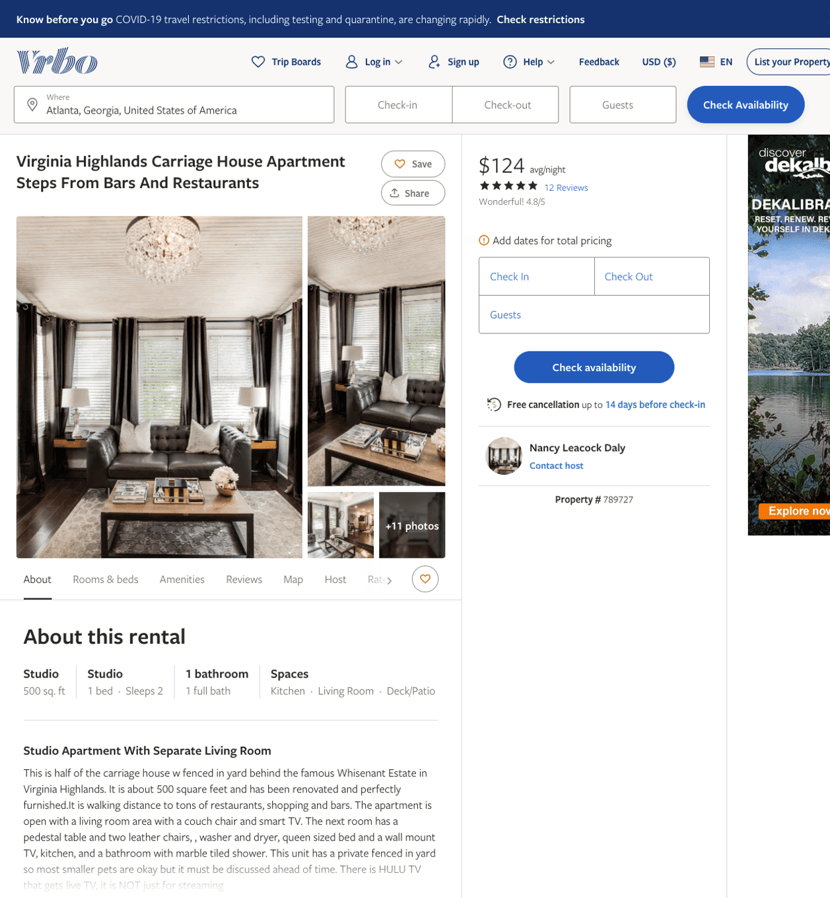
Listing 789727
0
2
$124
4.769231
6
Nancy Leacock Daly
https://www.vrbo.com/789727
Aug 2022

Slide 4
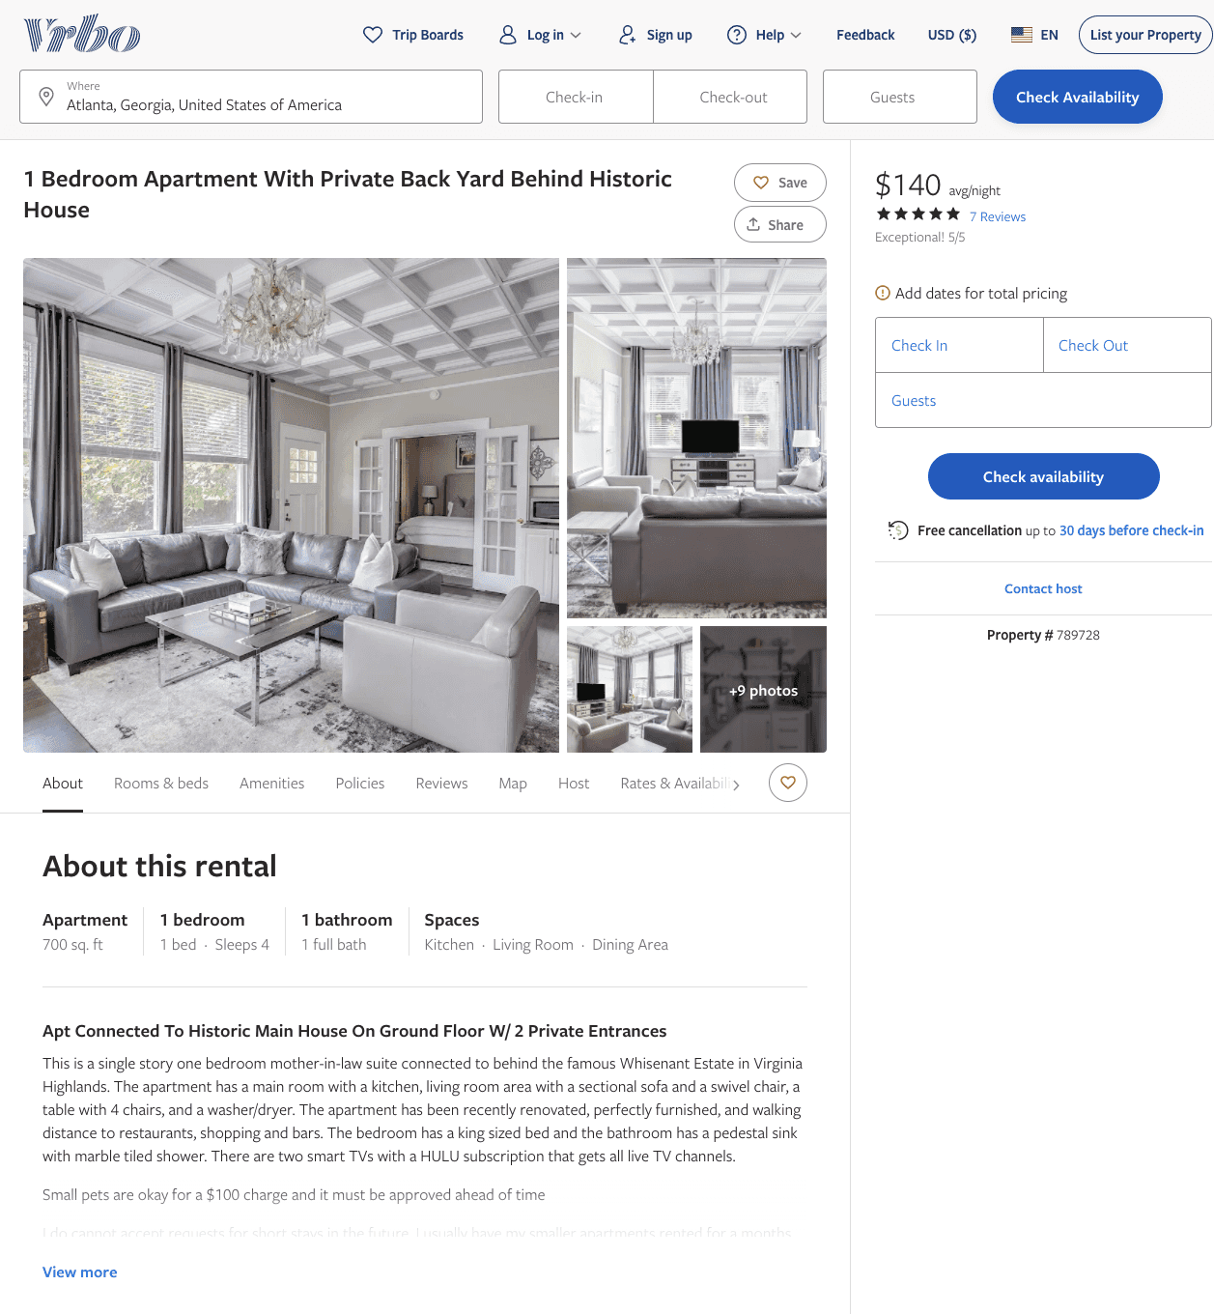
Listing 789728
1
4
$140
5
6
Nancy Leacock Daly
https://www.vrbo.com/789728
Aug 2022

Slide 5
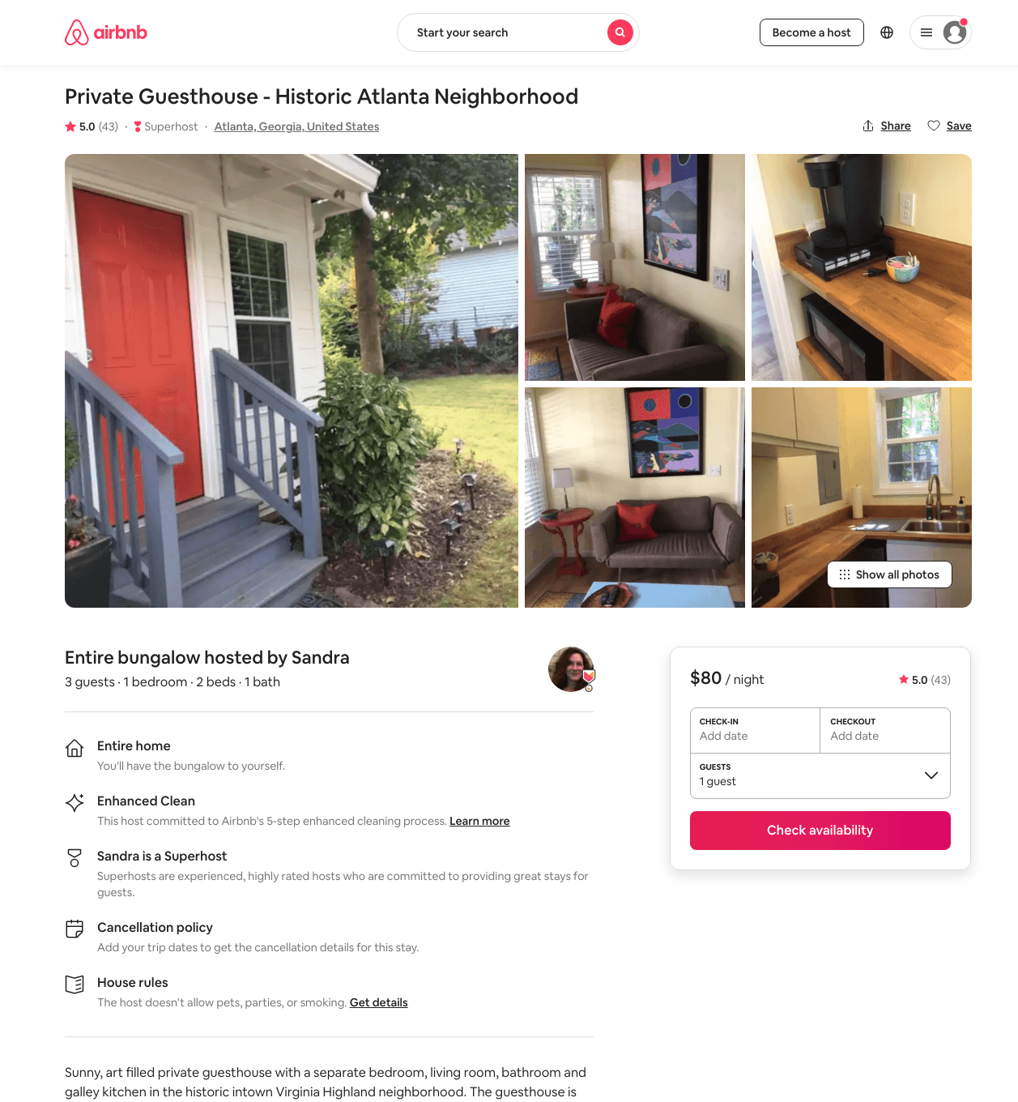
Listing 39082421
1
2
$80 - $90
4.97
1
Sandra
152592982
1
https://www.airbnb.com/rooms/39082421
Aug 2022

Slide 6
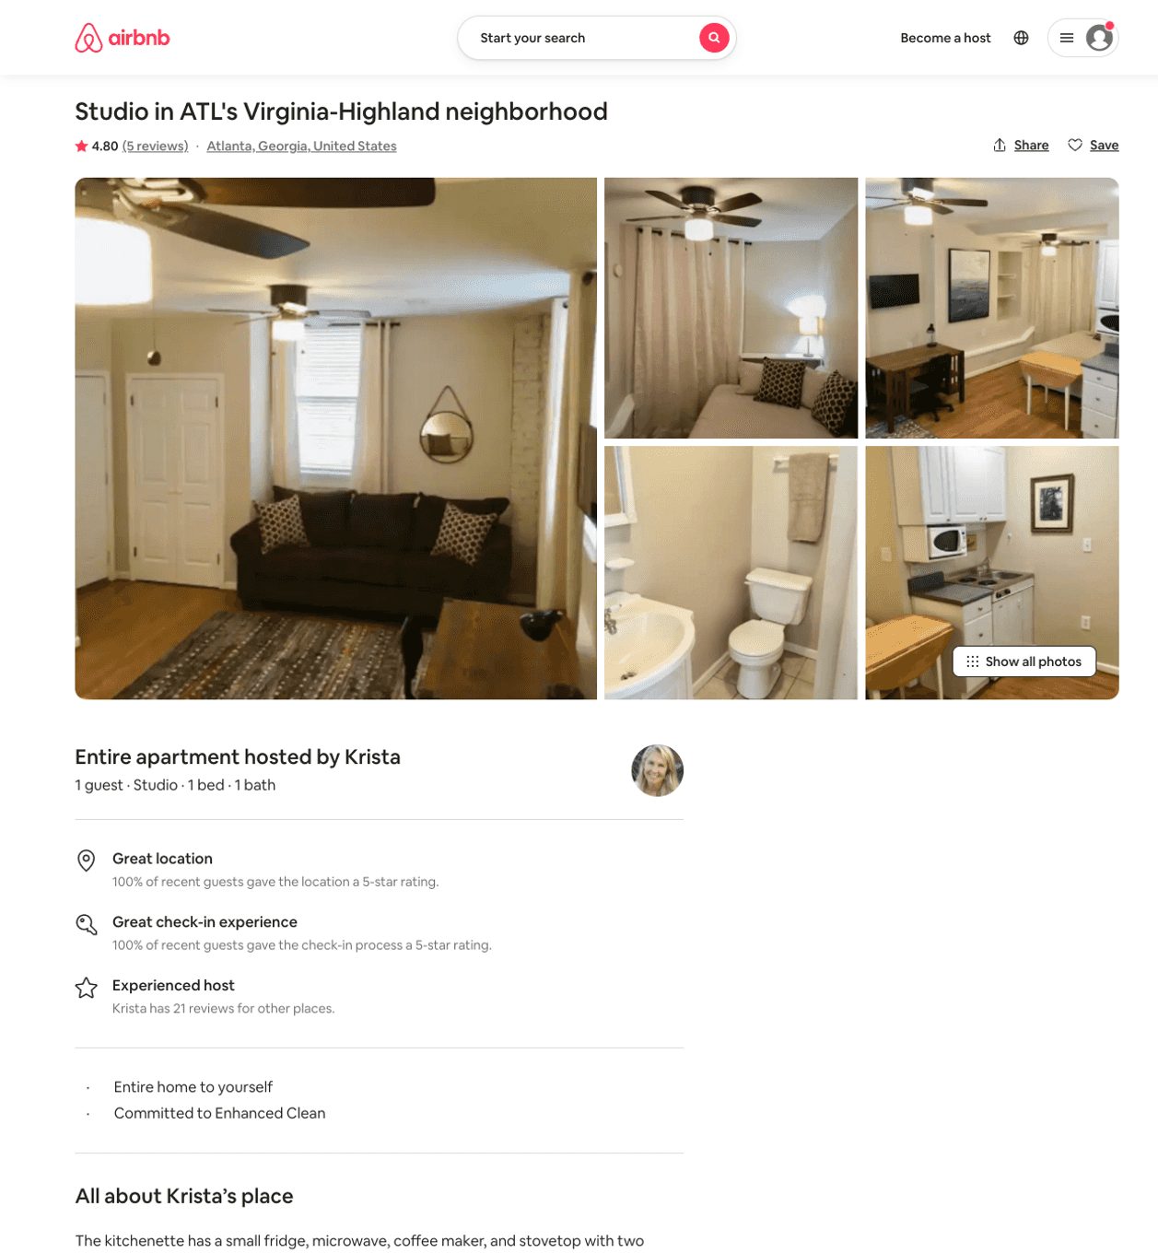
Listing 43819118
Studio
1
$170
4.90
7
Krista
104420607
3
https://www.airbnb.com/rooms/43819118
Aug 2022

Slide 7
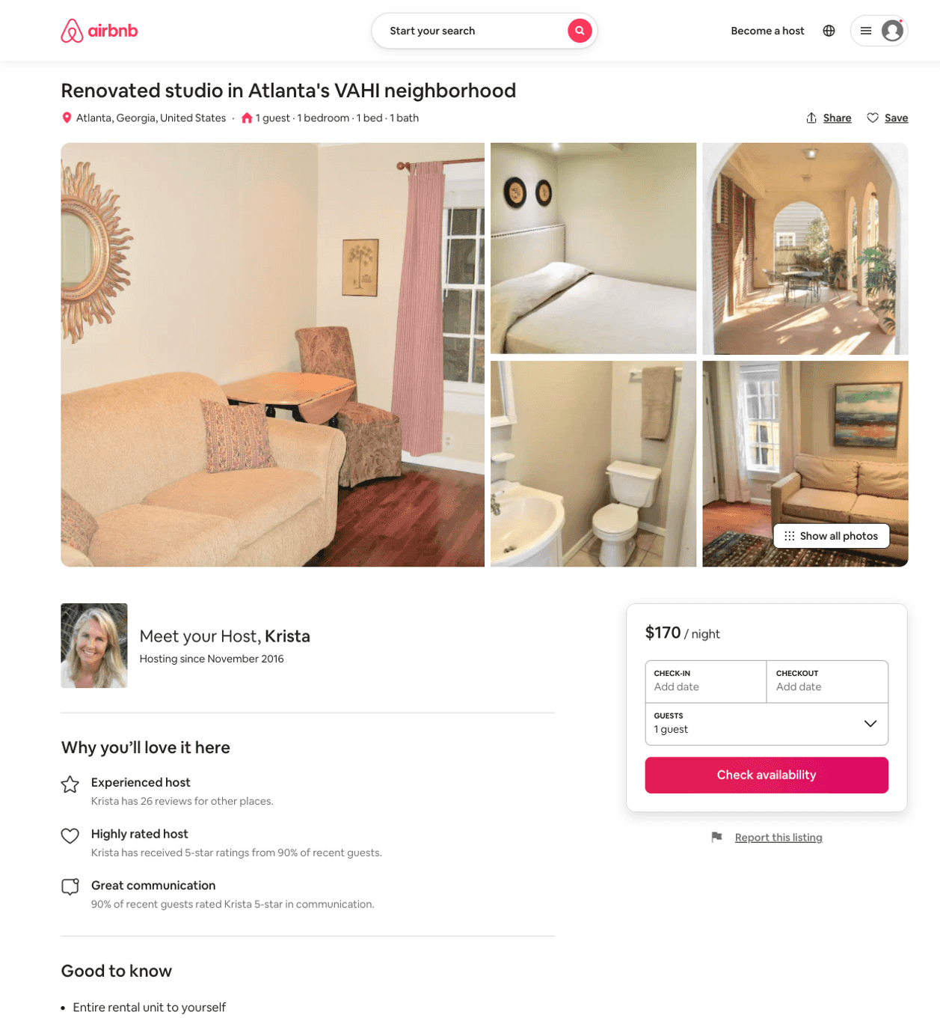
Listing 51849456
1
1
$170
7
Krista
104420607
3
https://www.airbnb.com/rooms/51849456
Jun 2022

Slide 8
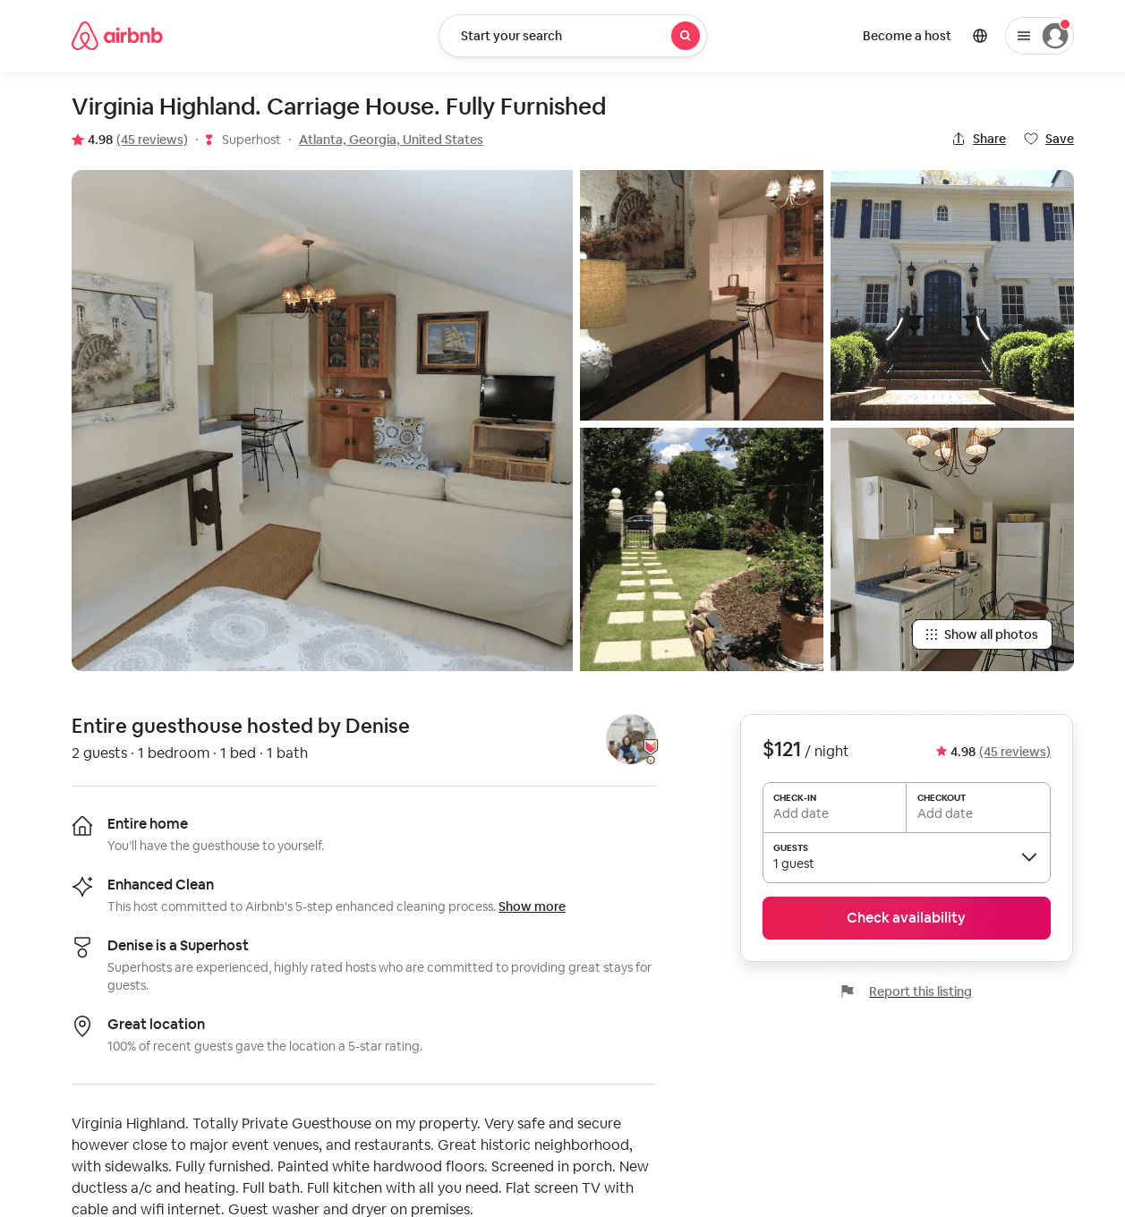
Listing 7089879
1
2
$121
4.99
3
Denise
22114816
1
https://www.airbnb.com/rooms/7089879
Jun 2022

