Slide 2
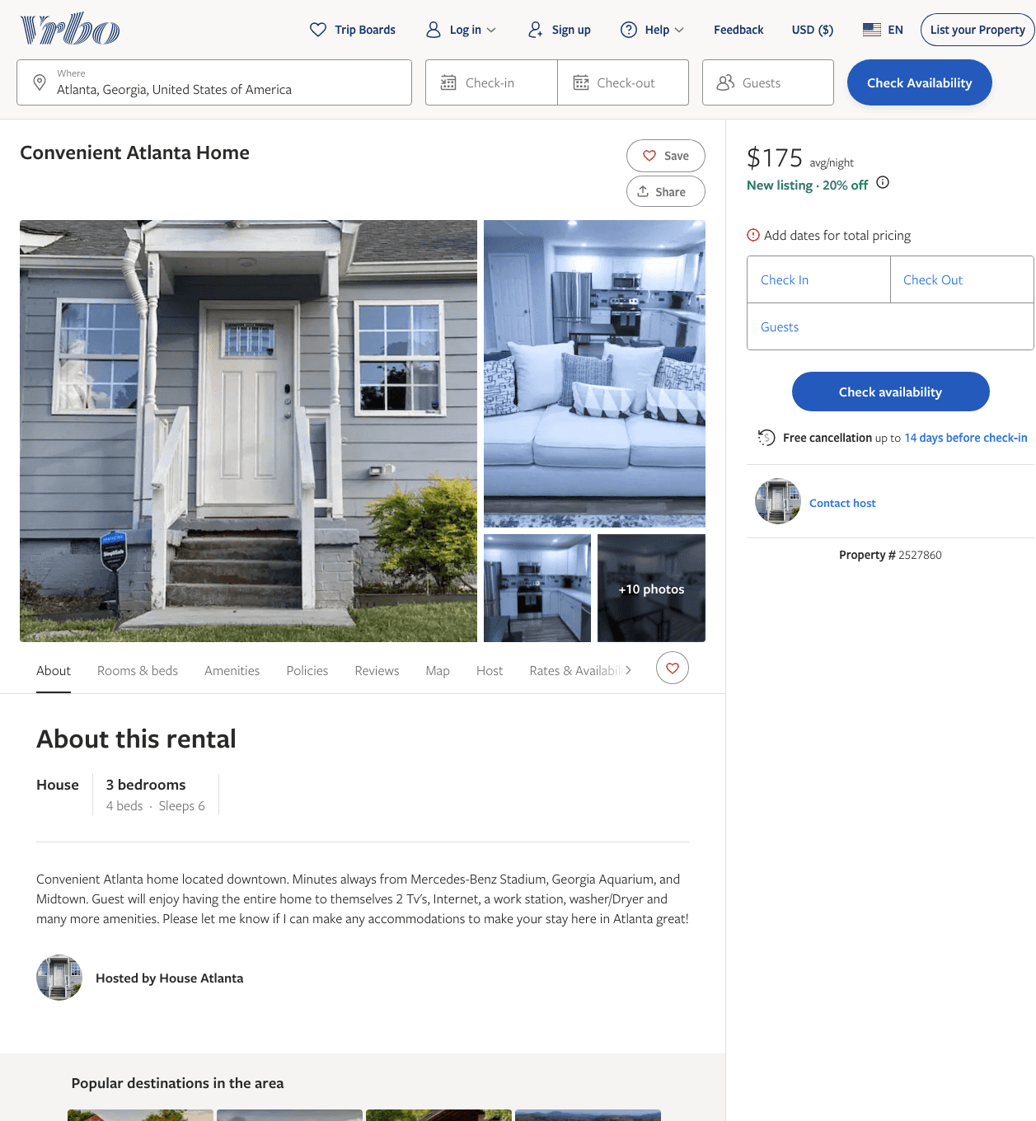
Listing 2527860
3
6
$158 - $204
2
Ashton Soles
https://www.vrbo.com/2527860
Aug 2022

Slide 3
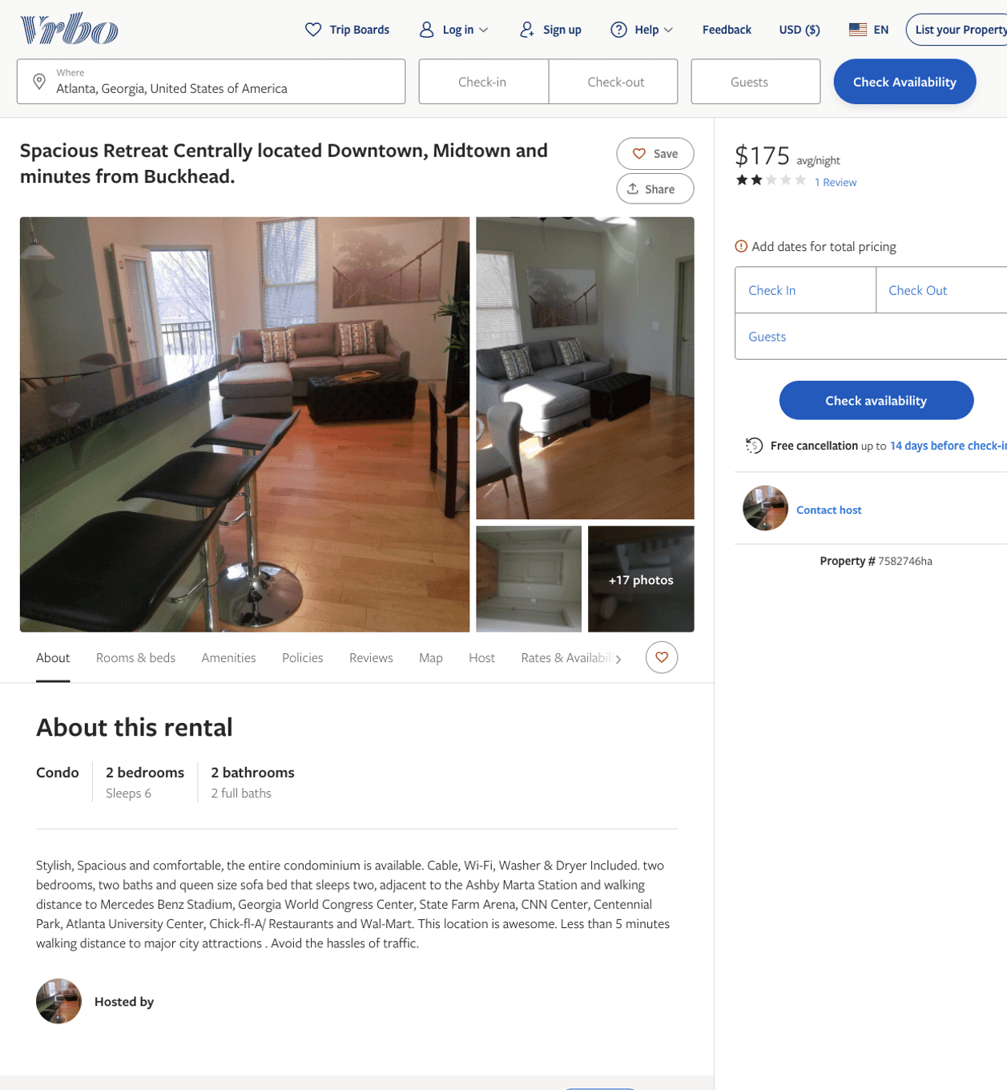
Listing 7582746
2
6
$175
2
3
https://www.vrbo.com/7582746ha
Aug 2022

Slide 4
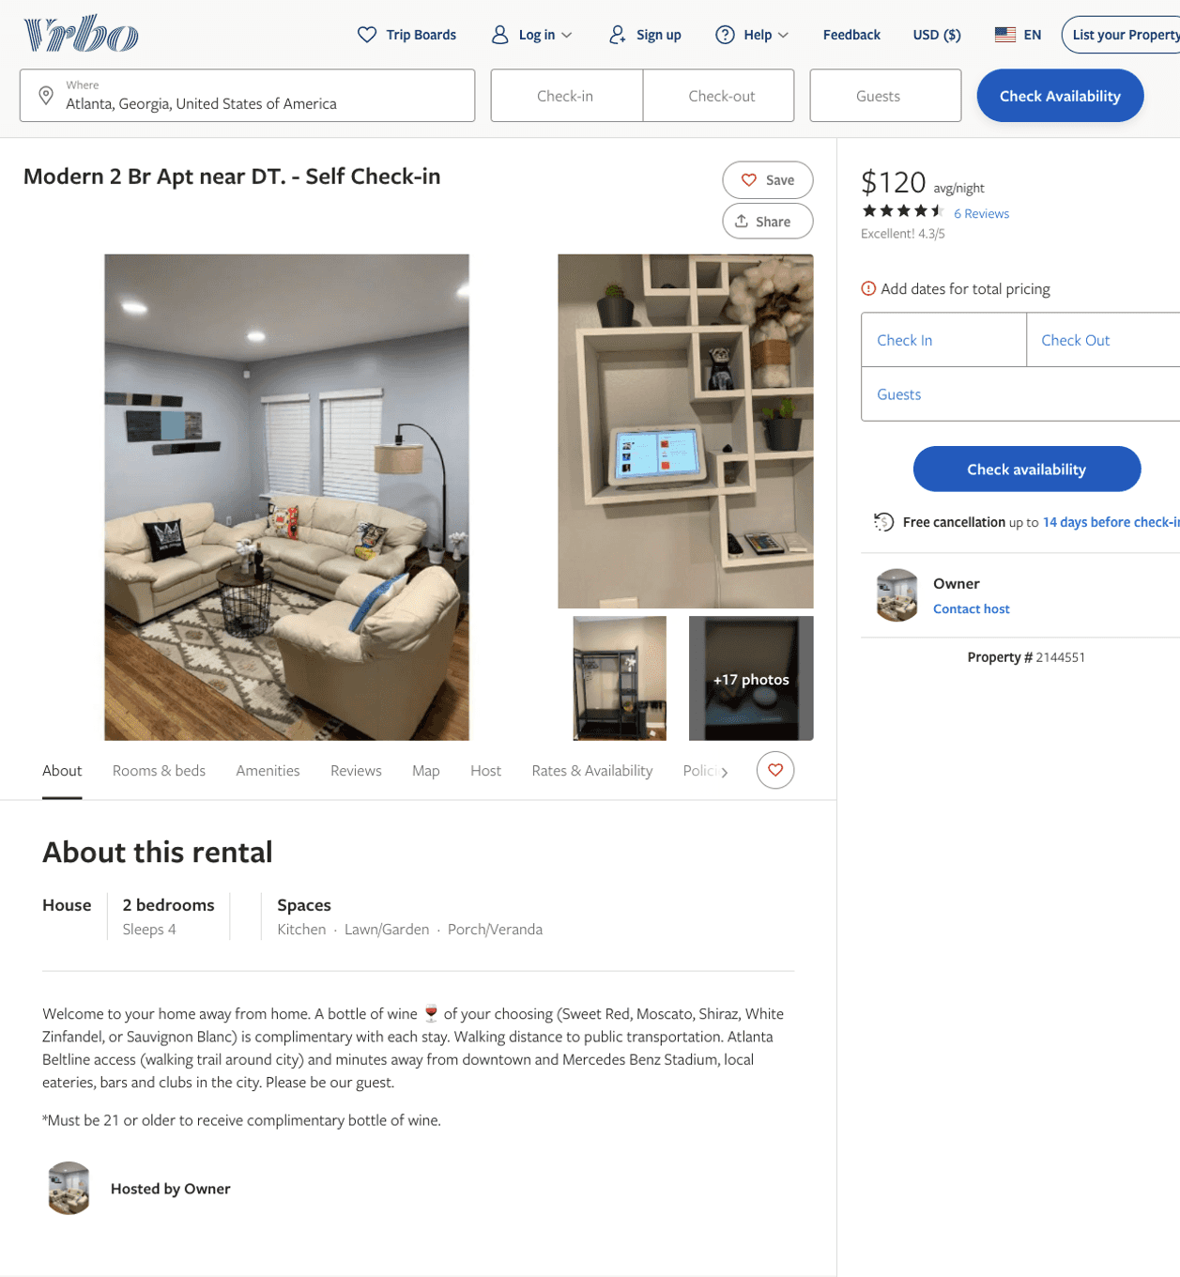
Listing 2144551
2
4
$120
4.3333335
5
Owner
https://www.vrbo.com/2144551
Aug 2022

Slide 5
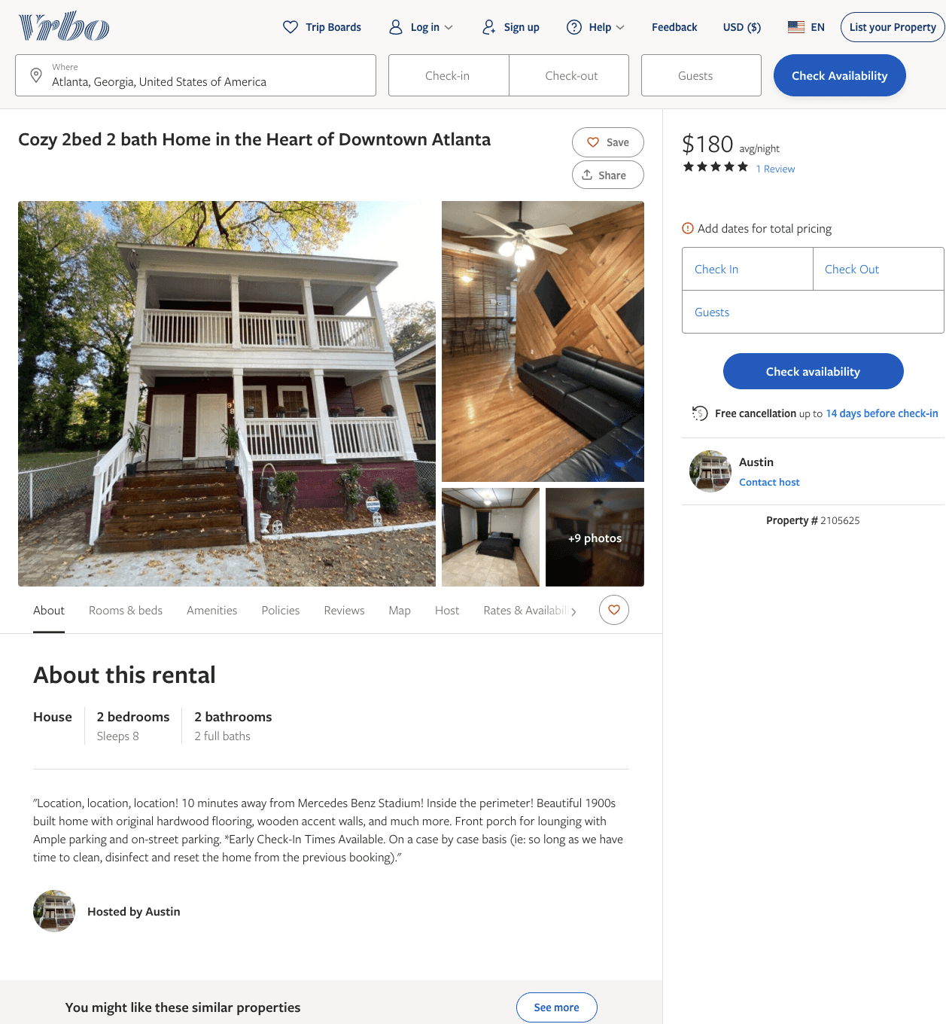
Listing 2105625
2
8
$180
5
1
Austin
https://www.vrbo.com/2105625
Aug 2022

Slide 6
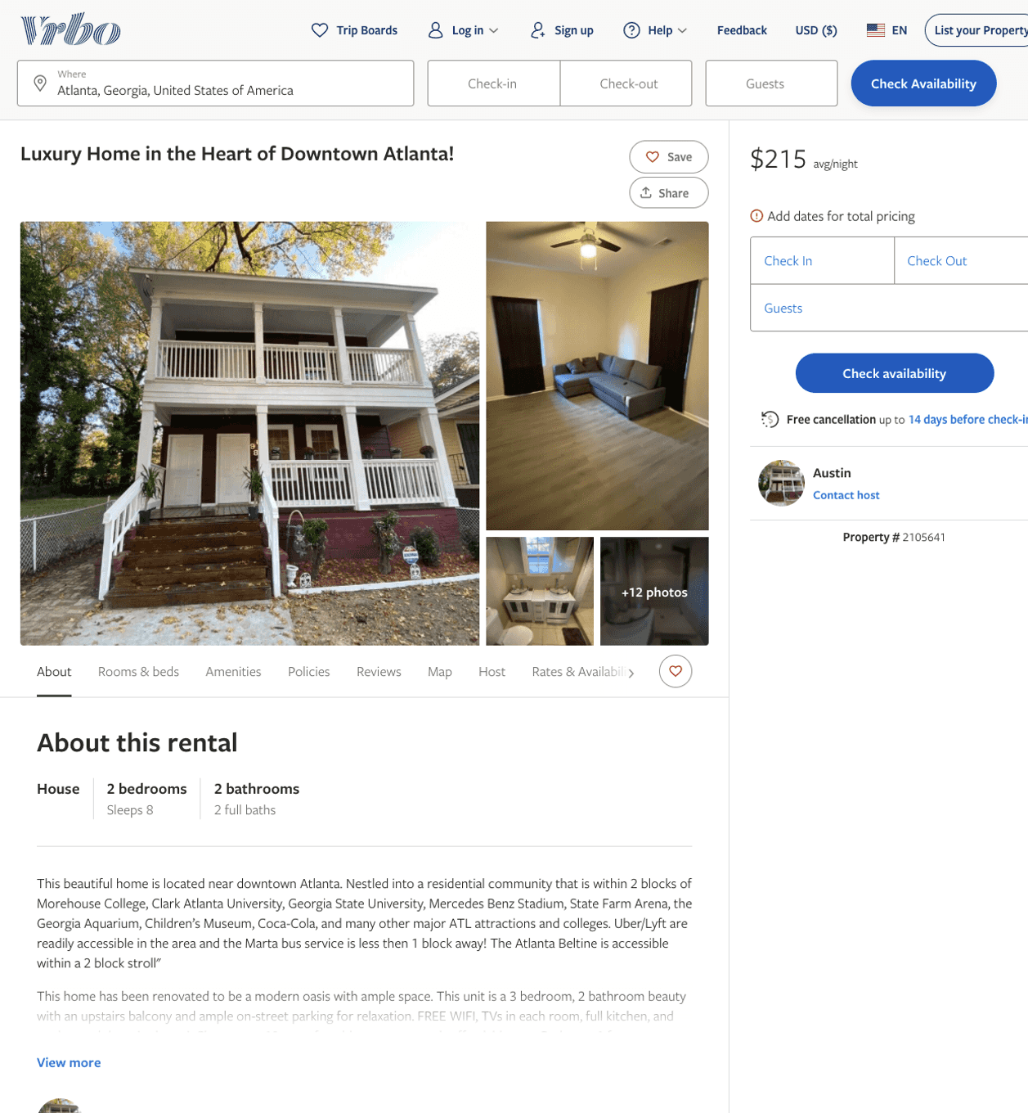
Listing 2105641
2
8
$215
1
Austin
https://www.vrbo.com/2105641
Aug 2022

Slide 7
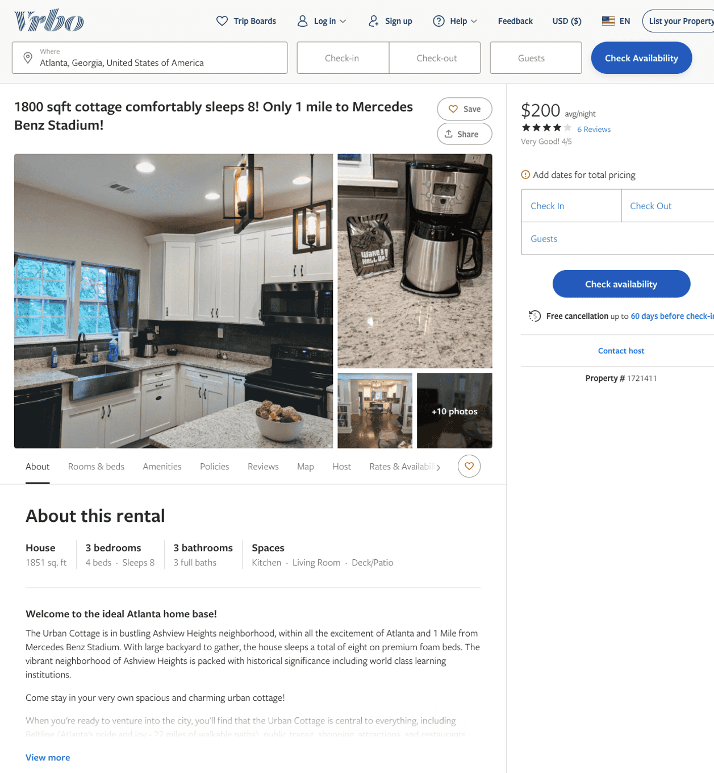
Listing 1721411
3
8
$200 - $248
4
2
April
https://www.vrbo.com/1721411
Aug 2022

Slide 8
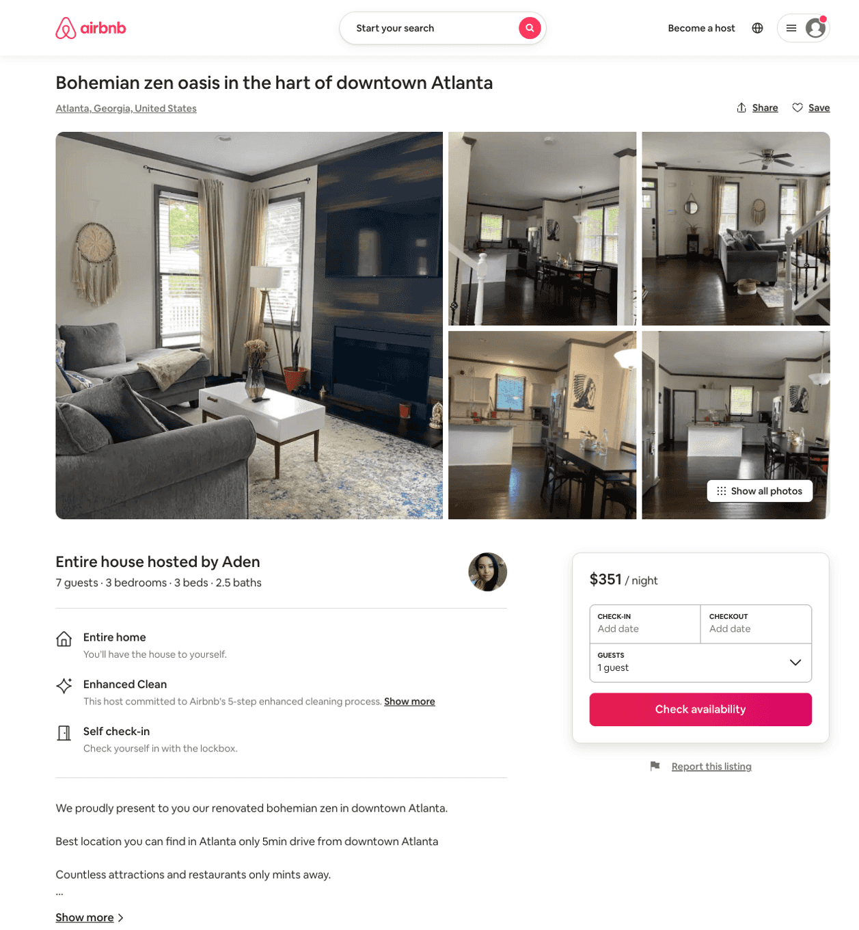
Listing 44049210
3
6
$189 - $318
4.45
2
Aden
100565642
1
https://www.airbnb.com/rooms/44049210
Jul 2022

Slide 9
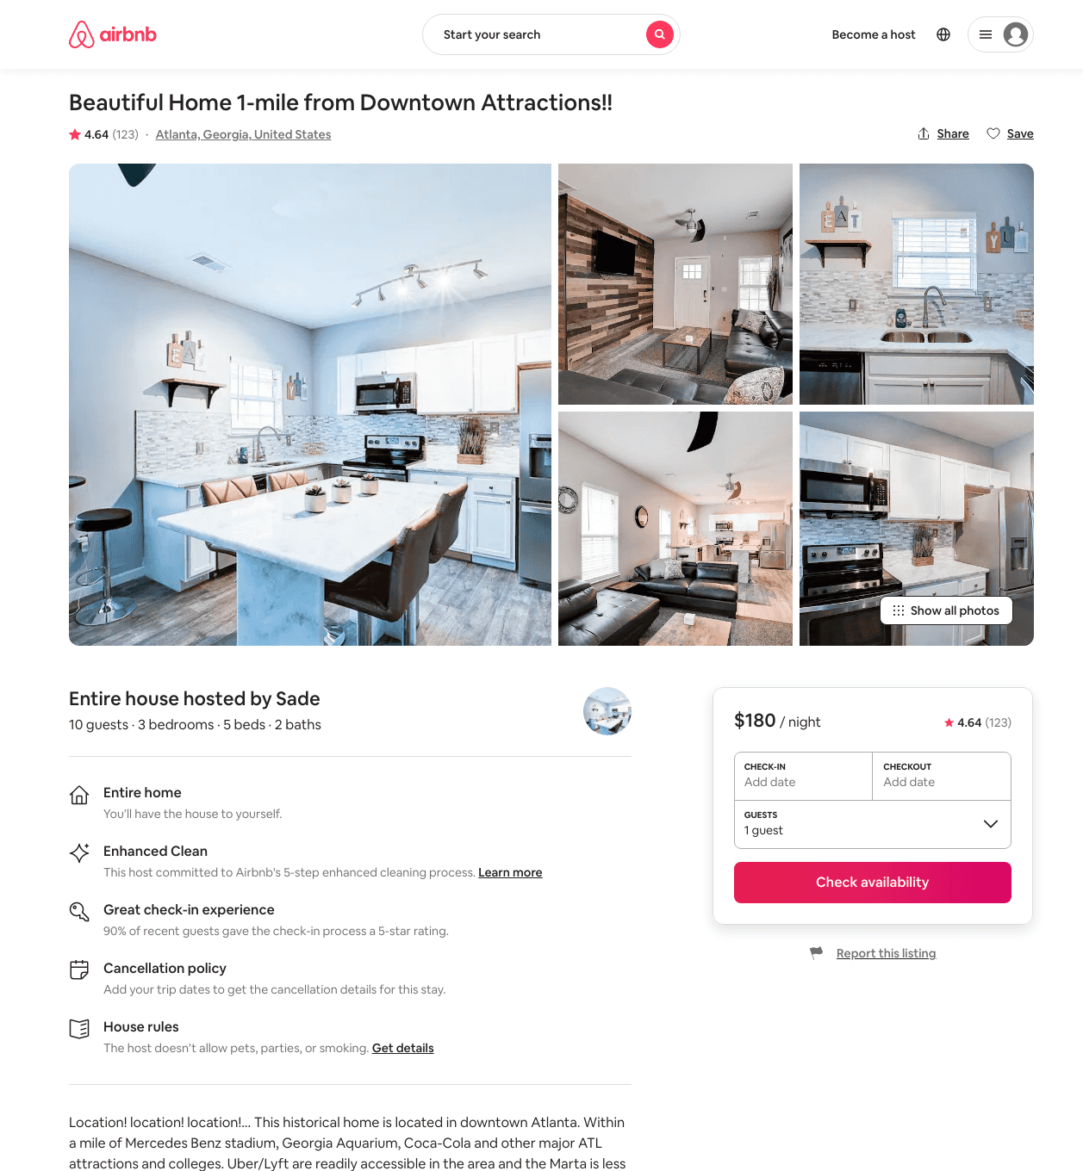
Listing 28741864
3
10
$112 - $595
4.56
2
Sade
90818991
1
https://www.airbnb.com/rooms/28741864
Aug 2022

Slide 10
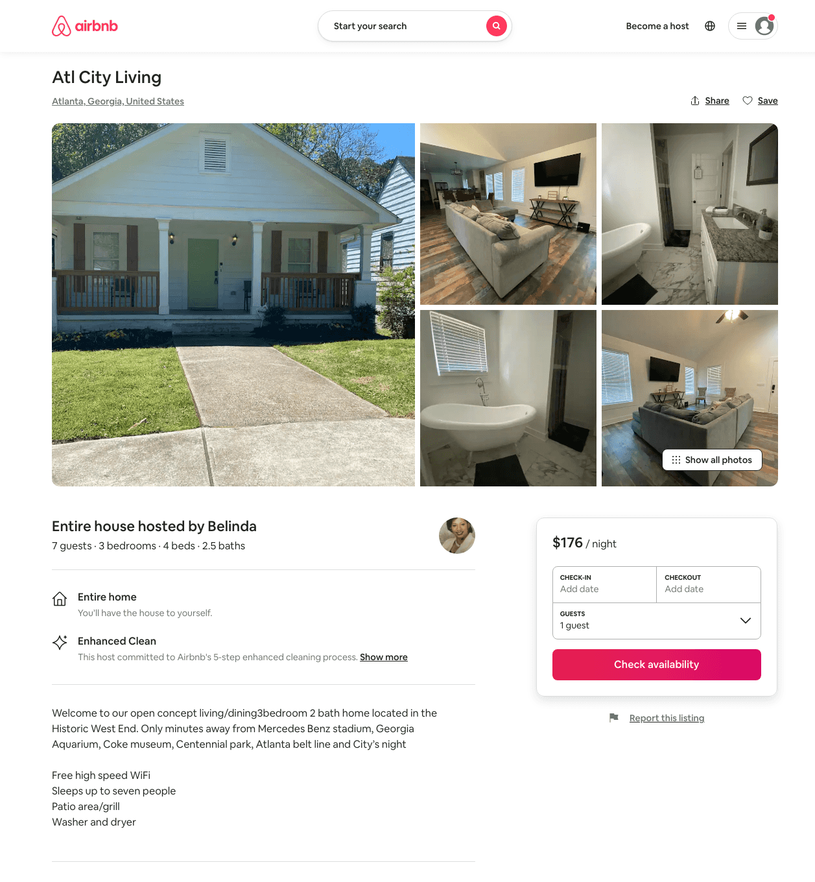
Listing 49715869
3
6
$176 - $250
4.81
2
Belinda
393511526
3
https://www.airbnb.com/rooms/49715869
Aug 2022

Slide 11
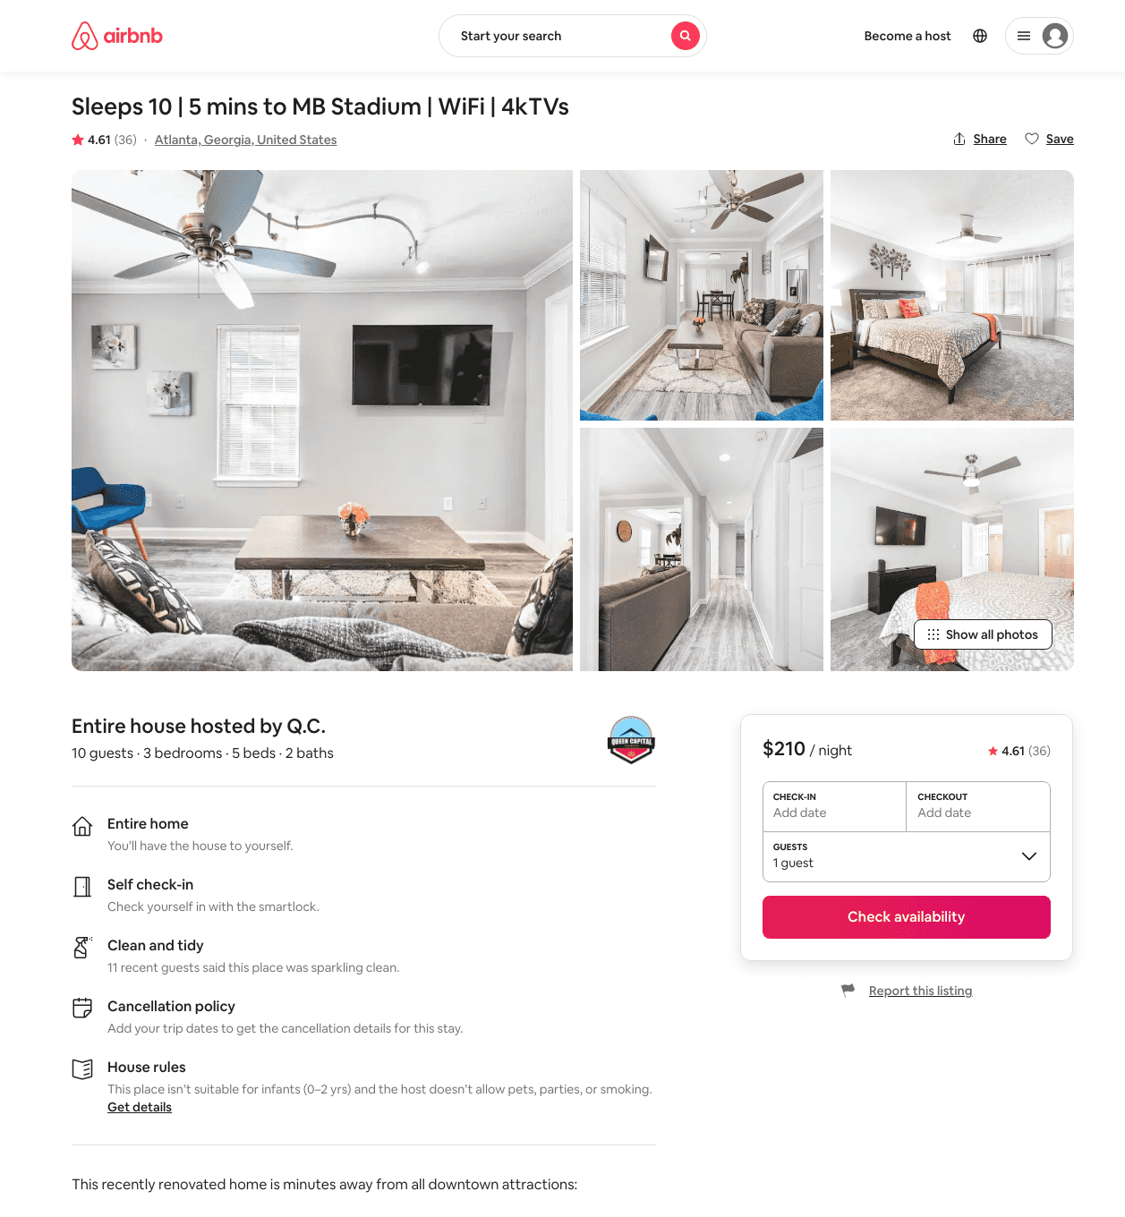
Listing 40866209
3
10
$133 - $217
4.41
2
Q.C.
278815354
5
https://www.airbnb.com/rooms/40866209
Aug 2022

Slide 12
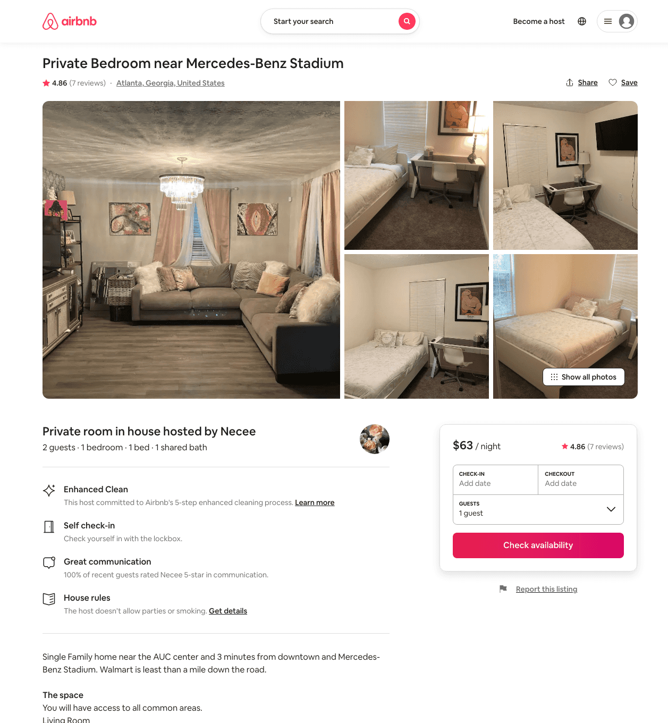
Listing 30338488
1
1
$63
4.82
2
Necee
112167470
2
https://www.airbnb.com/rooms/30338488
Aug 2022

Slide 13
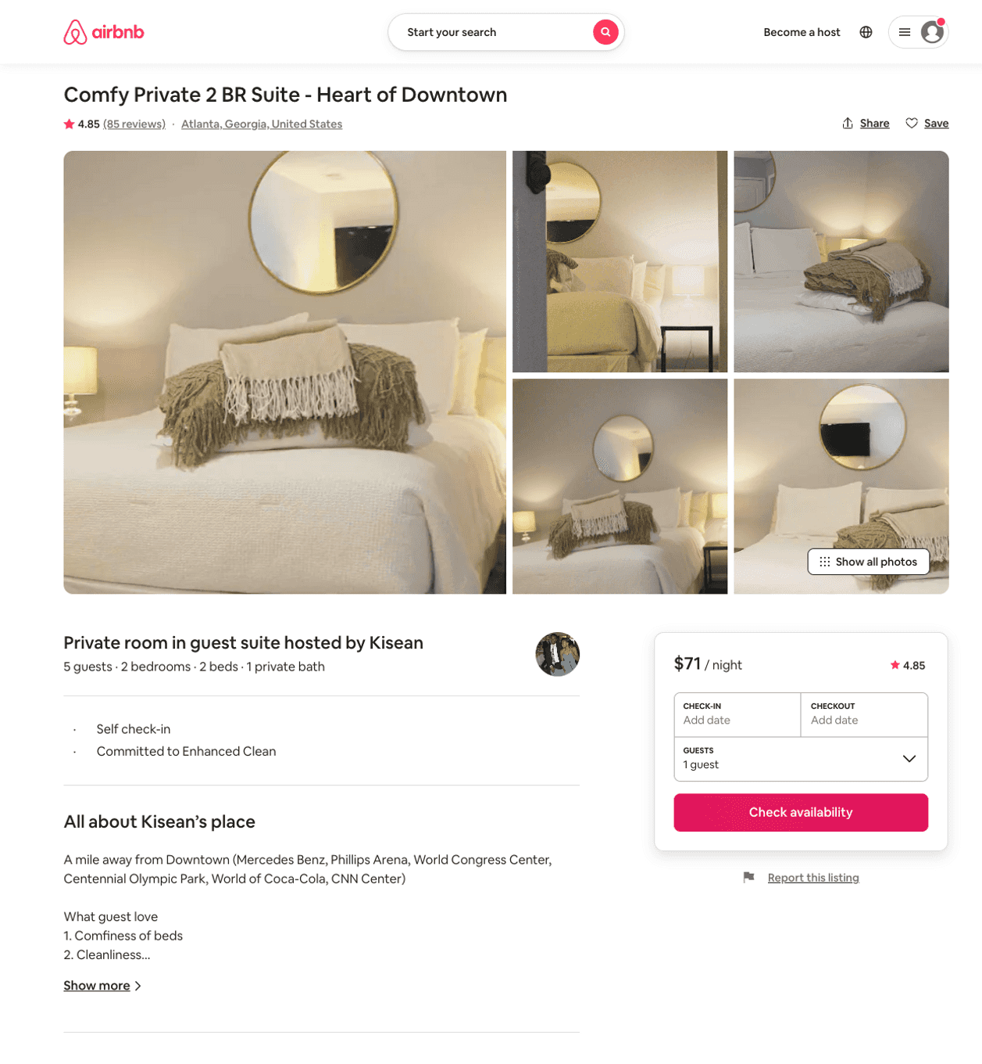
Listing 21715577
2
5
$65 - $86
4.81
1
Kisean
158111431
1
https://www.airbnb.com/rooms/21715577
Aug 2022

Slide 14
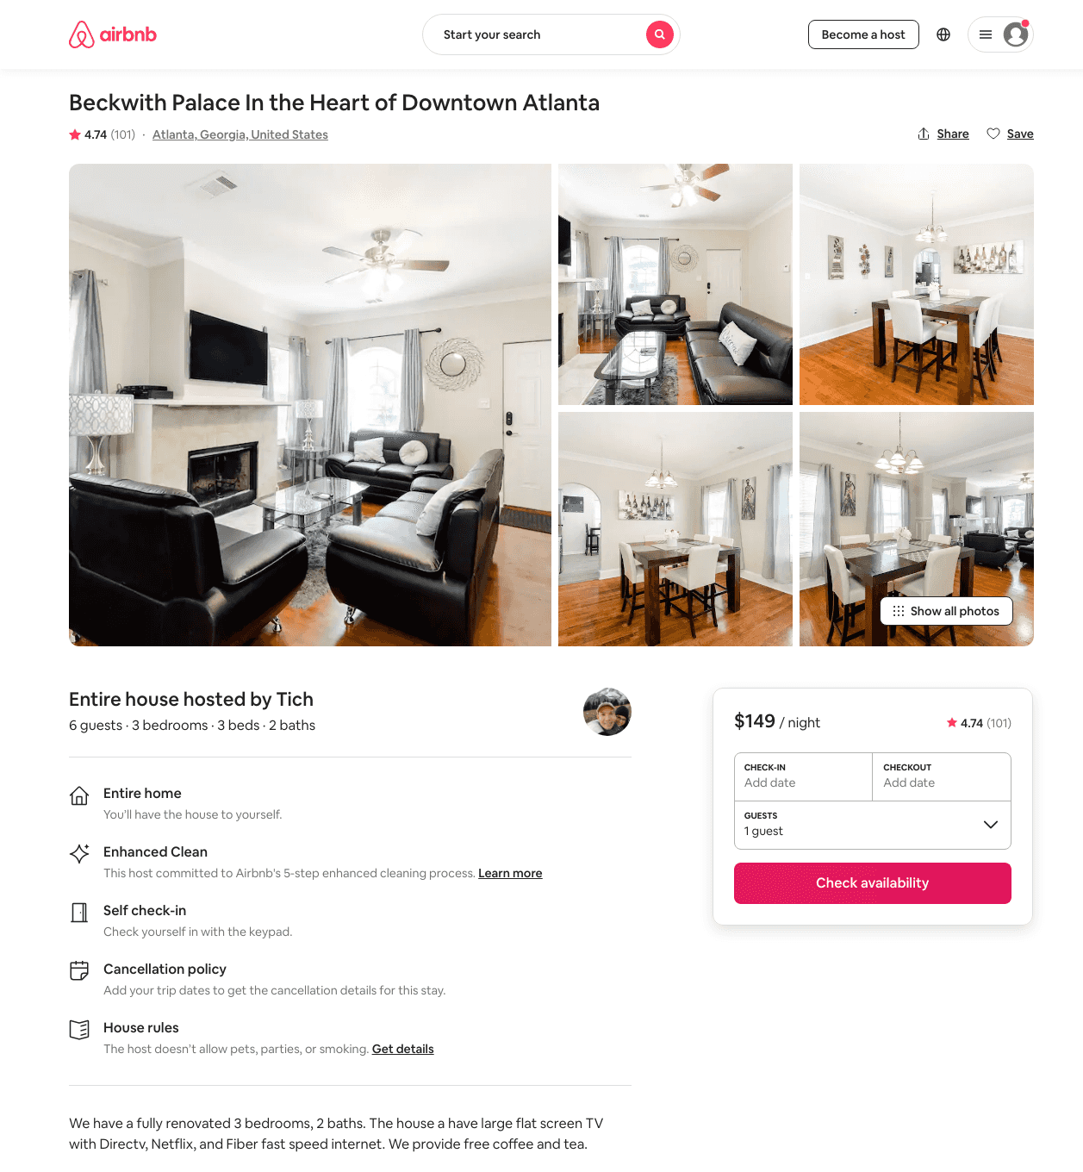
Listing 30427749
3
6
$133 - $202
4.72
2
Tich
228450990
1
https://www.airbnb.com/rooms/30427749
Jun 2022

Slide 15
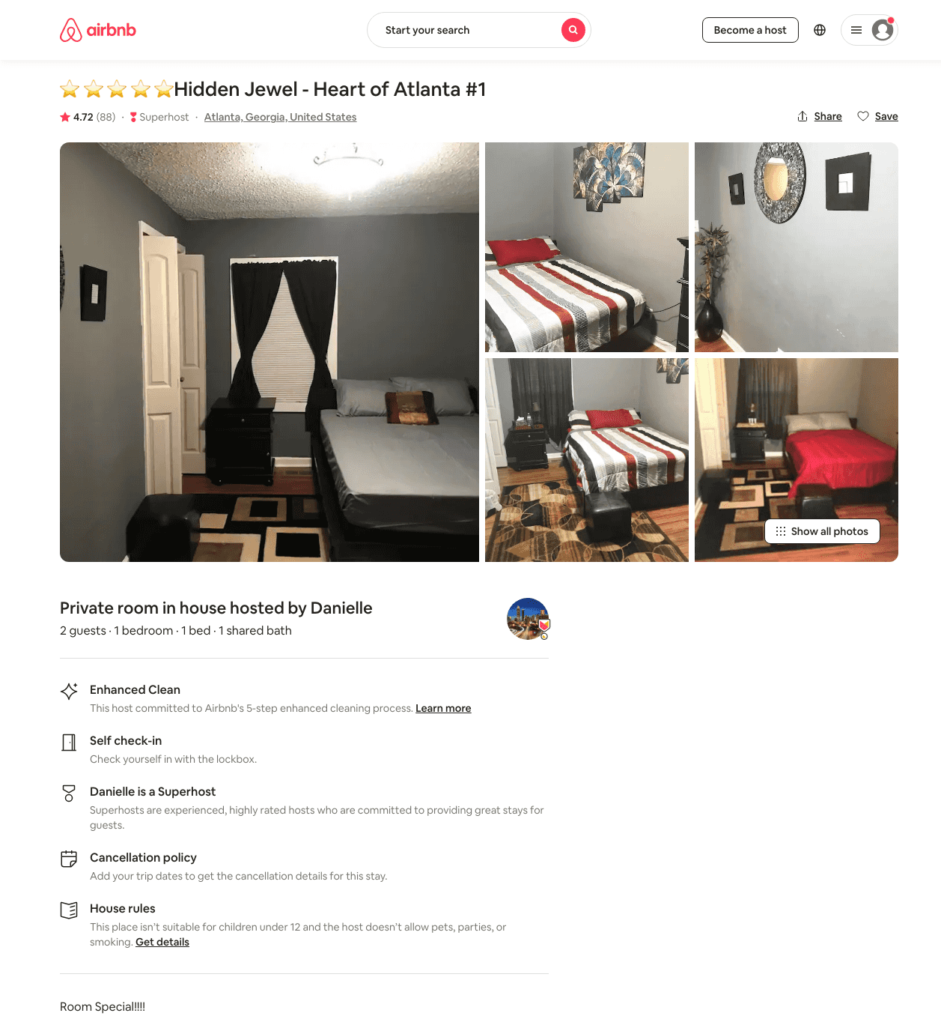
Listing 33315551
1
2
$27 - $57
4.73
1
Danielle
191749166
3
https://www.airbnb.com/rooms/33315551
Aug 2022

Slide 16
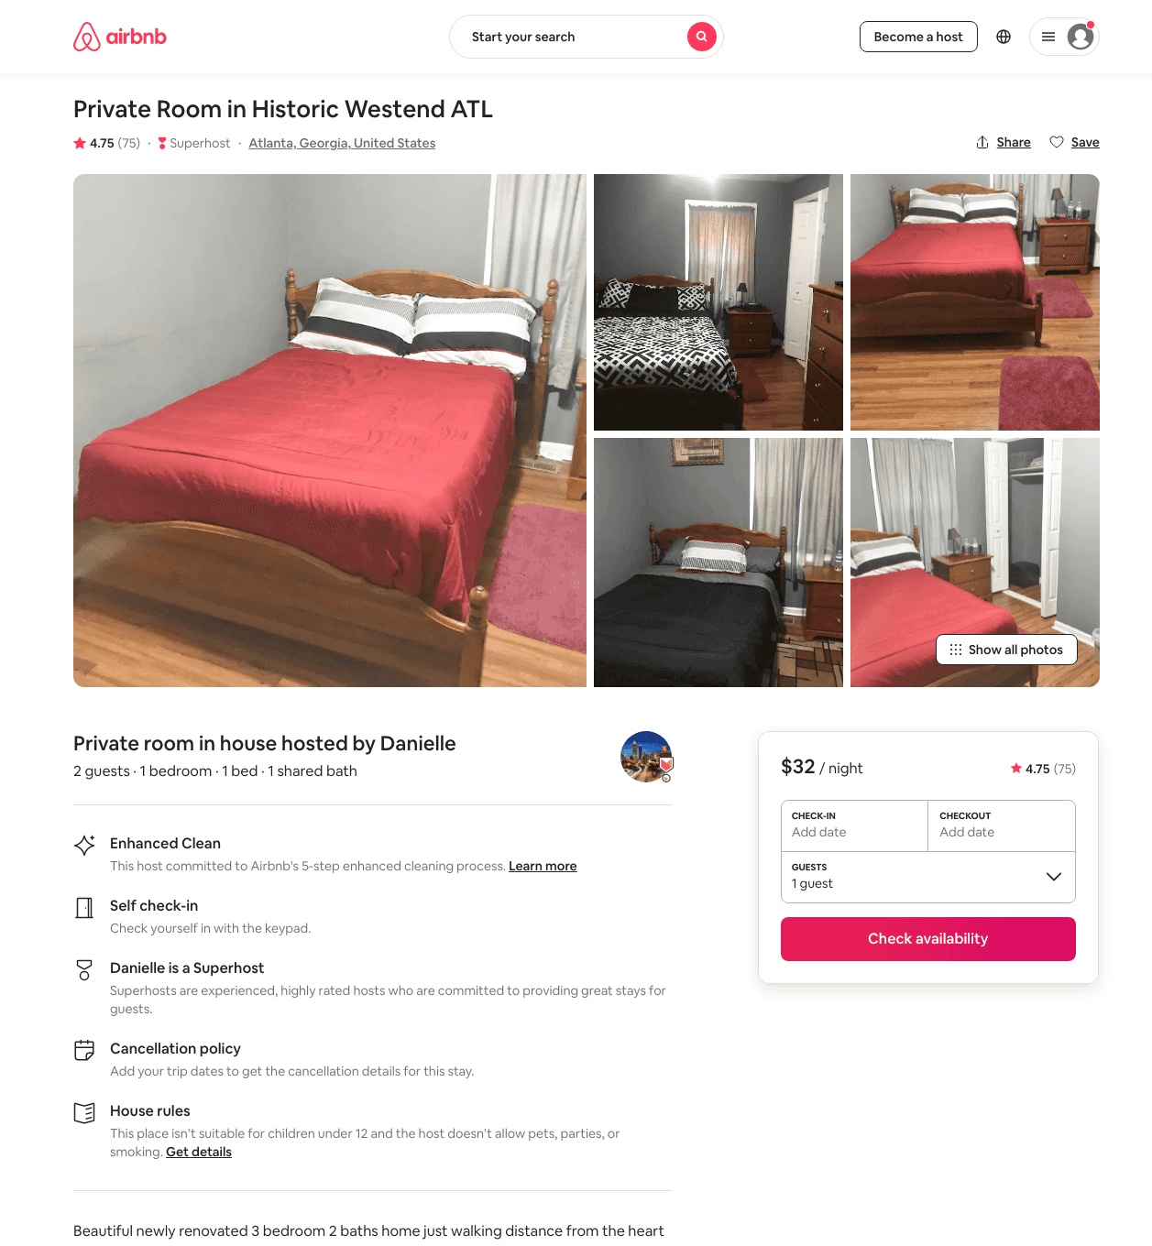
Listing 33116985
1
2
$18 - $63
4.61
1
Danielle
191749166
3
https://www.airbnb.com/rooms/33116985
Jun 2022

Slide 17
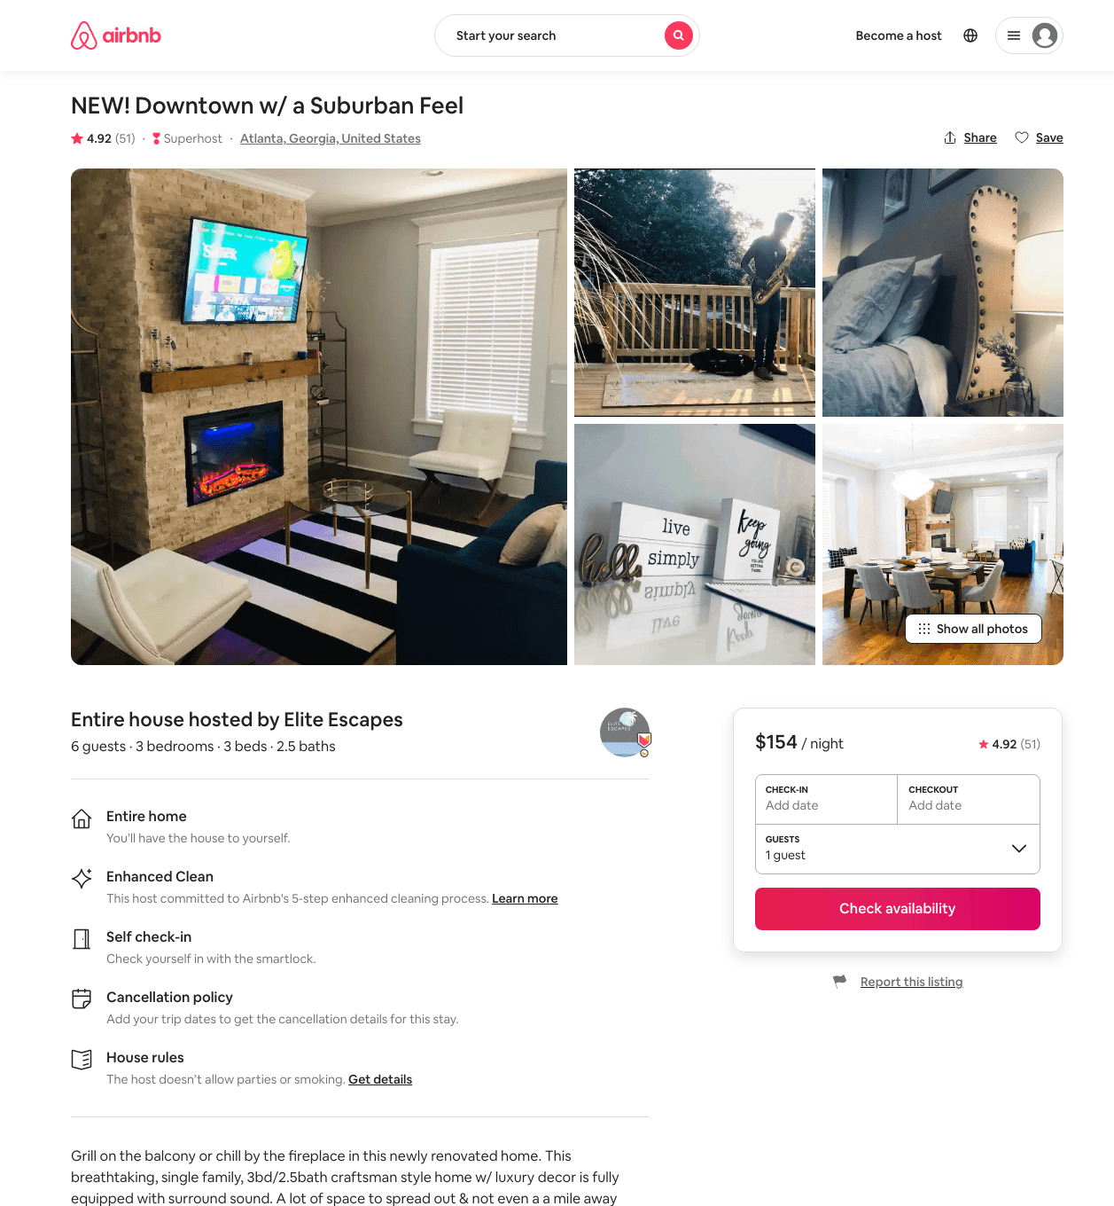
Listing 45191046
3
8
$146 - $209
4.87
2
Elite Escapes Properties
49508059
1
https://www.airbnb.com/rooms/45191046
Aug 2022

Slide 18
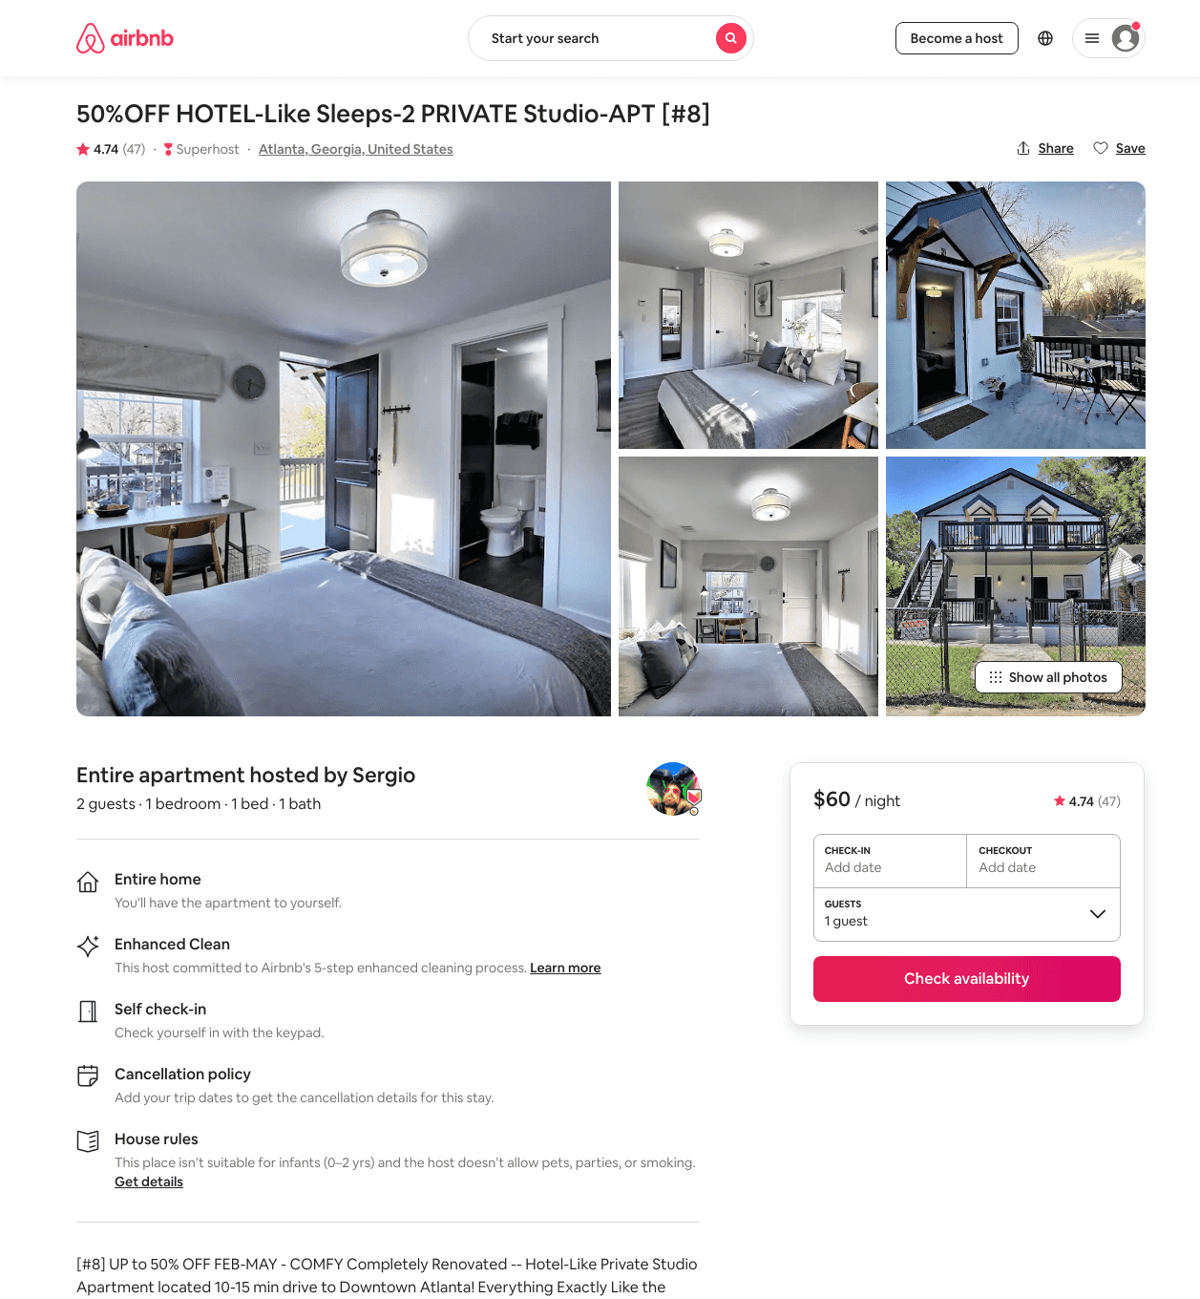
Listing 43078777
1
2
$39 - $74
4.65
2
Sergio
106508052
7
https://www.airbnb.com/rooms/43078777
Aug 2022

Slide 19
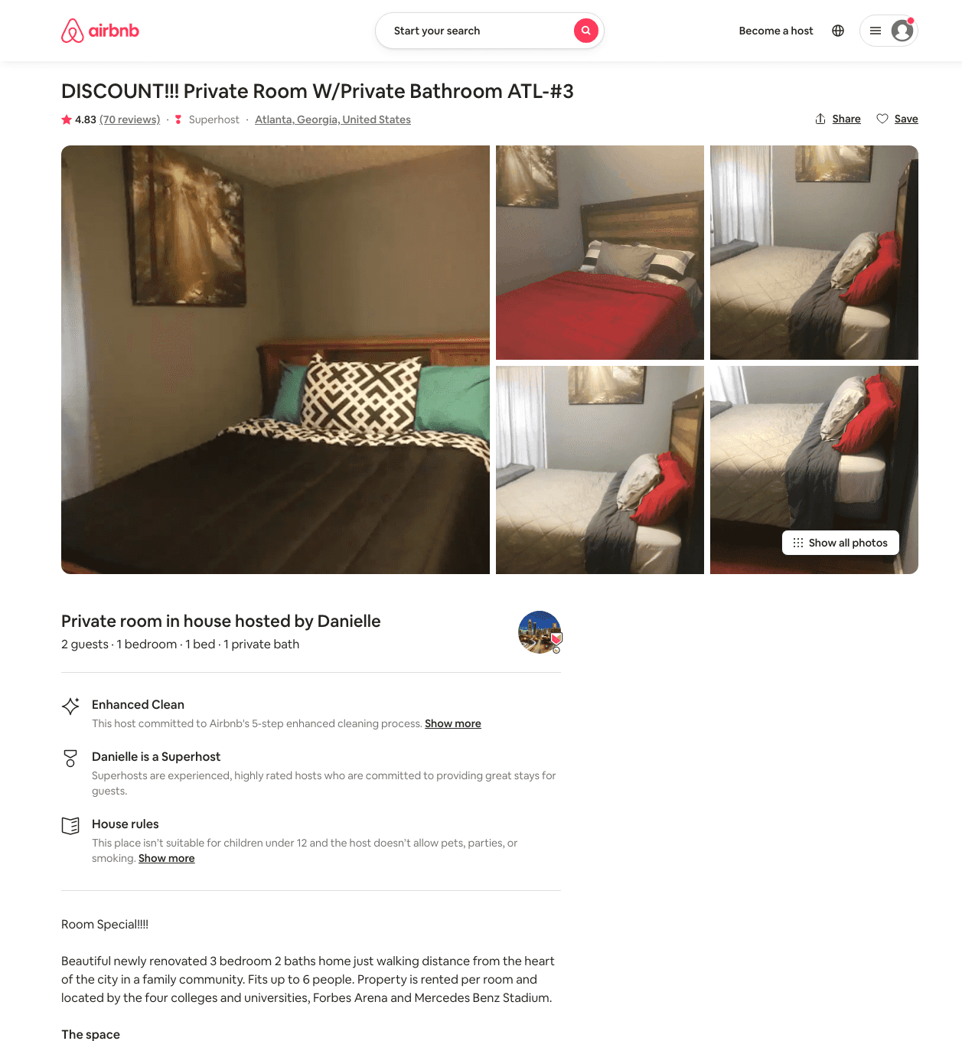
Listing 33101056
1
2
$30 - $44
4.71
1
Danielle
191749166
3
https://www.airbnb.com/rooms/33101056
Jun 2022

Slide 20
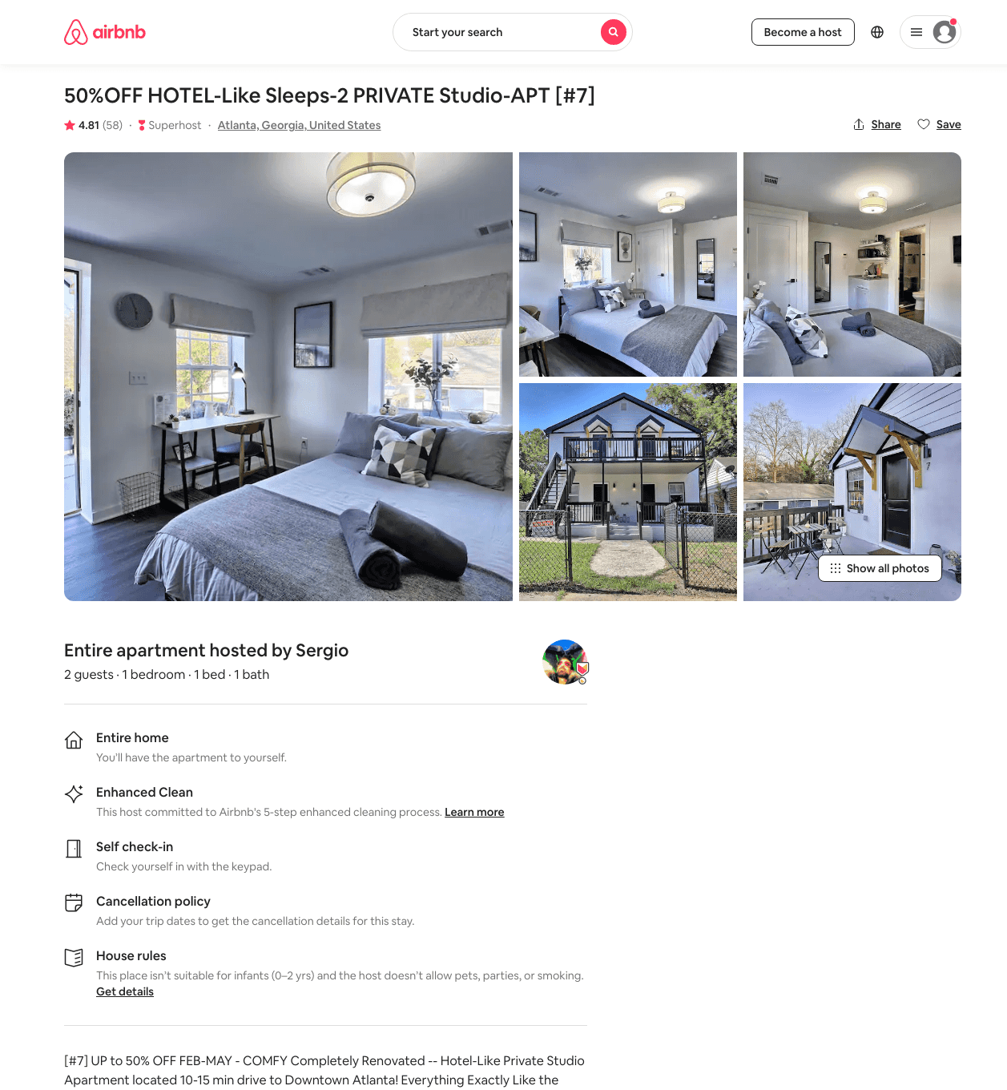
Listing 43078695
1
2
$40 - $80
4.71
2
Sergio
106508052
7
https://www.airbnb.com/rooms/43078695
Aug 2022

Slide 21
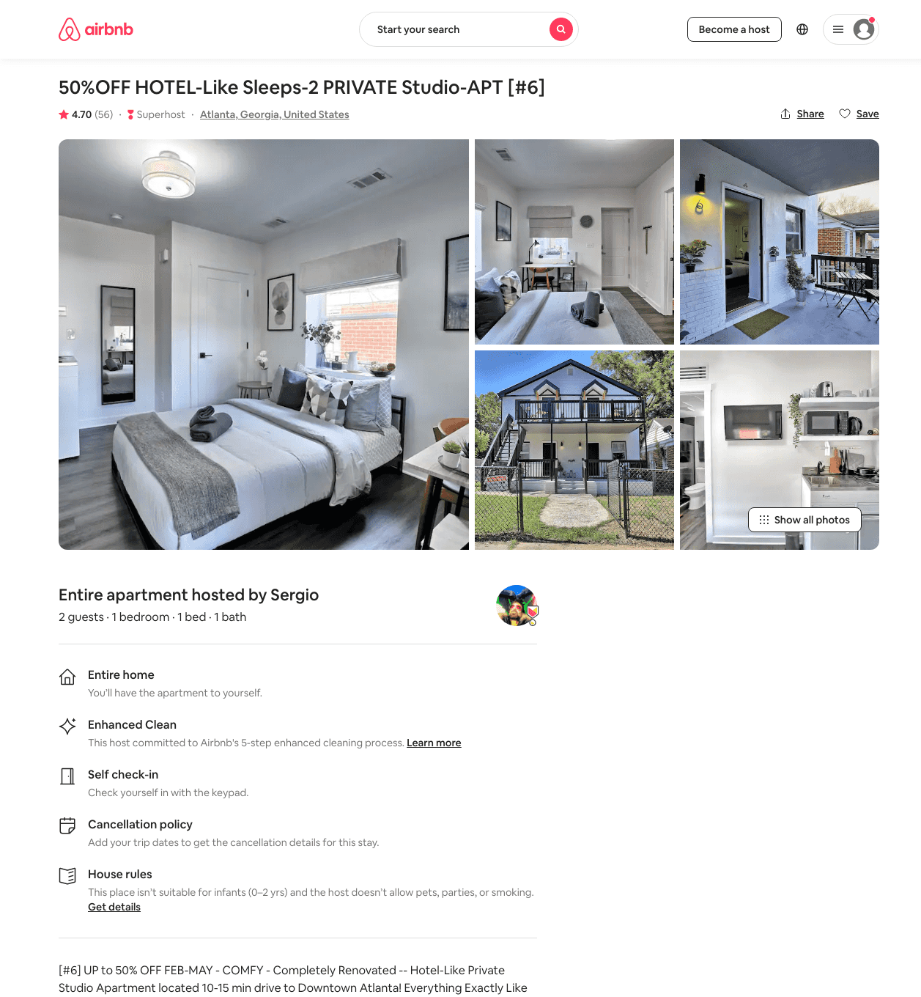
Listing 43078682
1
2
$36 - $73
4.58
2
Sergio
106508052
7
https://www.airbnb.com/rooms/43078682
Aug 2022

Slide 22
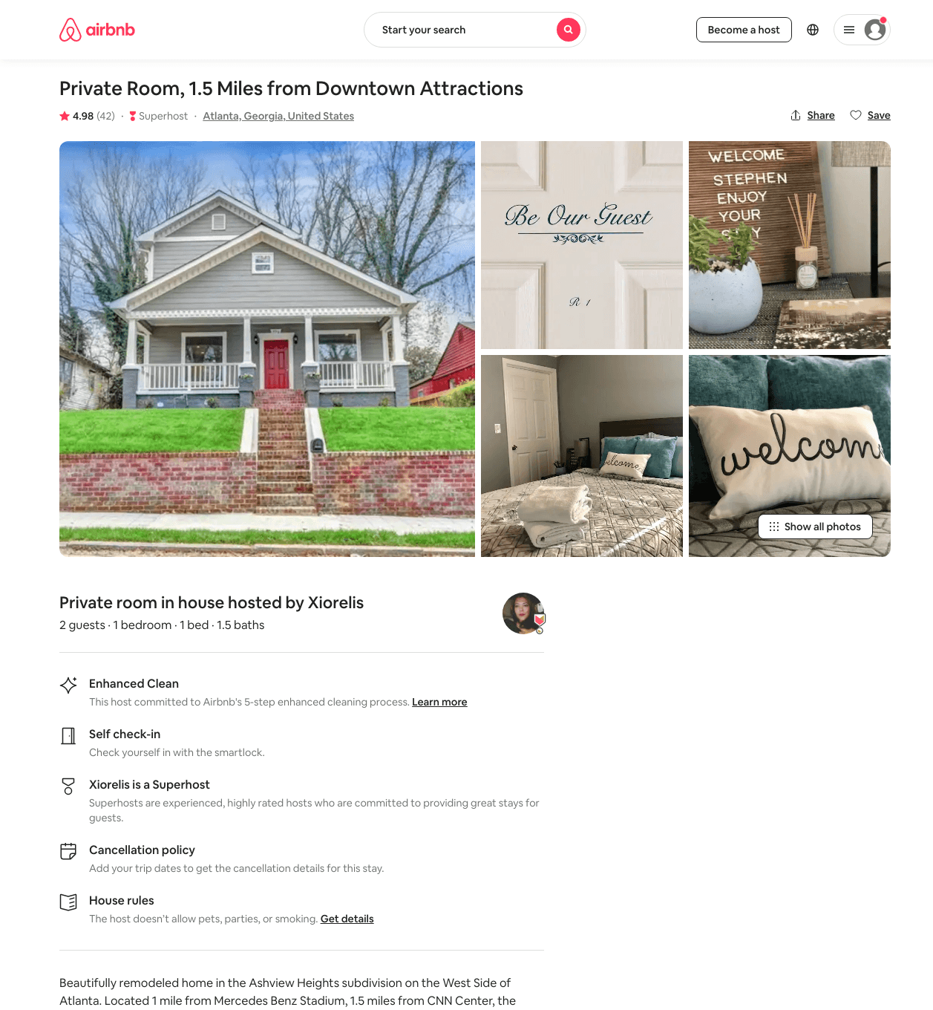
Listing 35039136
1
2
$50
4.98
30
Xiorelis
263949928
1
https://www.airbnb.com/rooms/35039136
Aug 2022

Slide 23
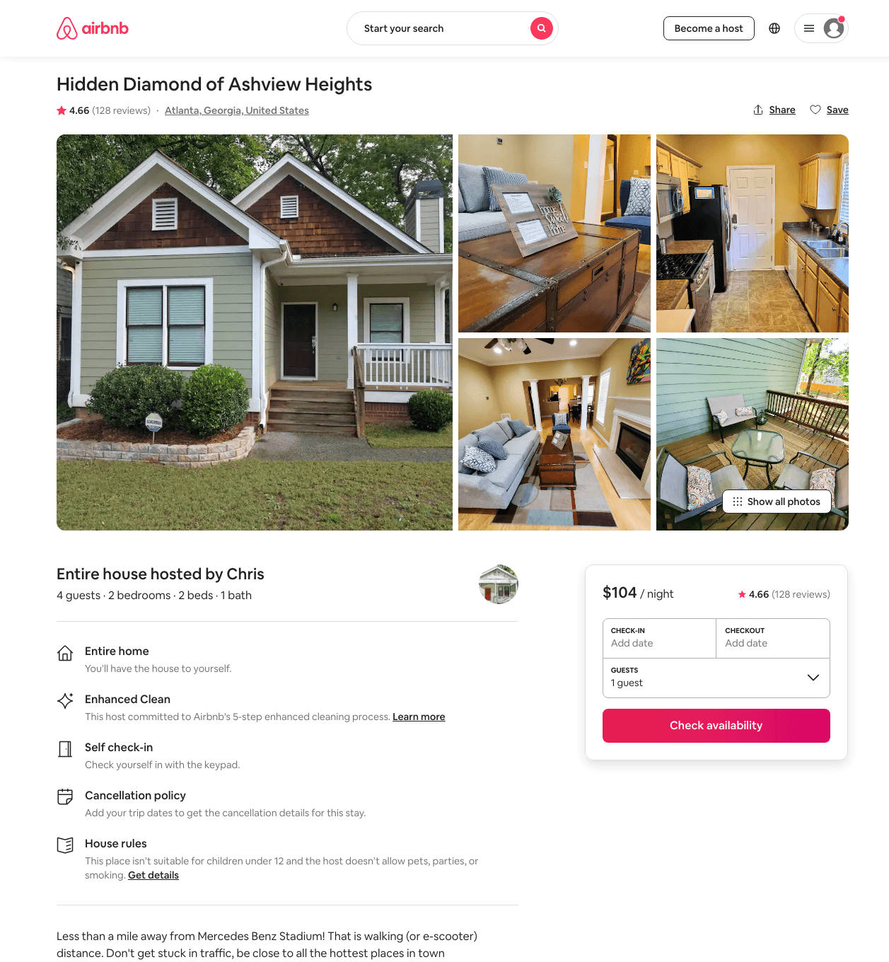
Listing 14854215
2
4
$94 - $134
4.72
4
Chris
92997198
2
https://www.airbnb.com/rooms/14854215
Aug 2022

Slide 24
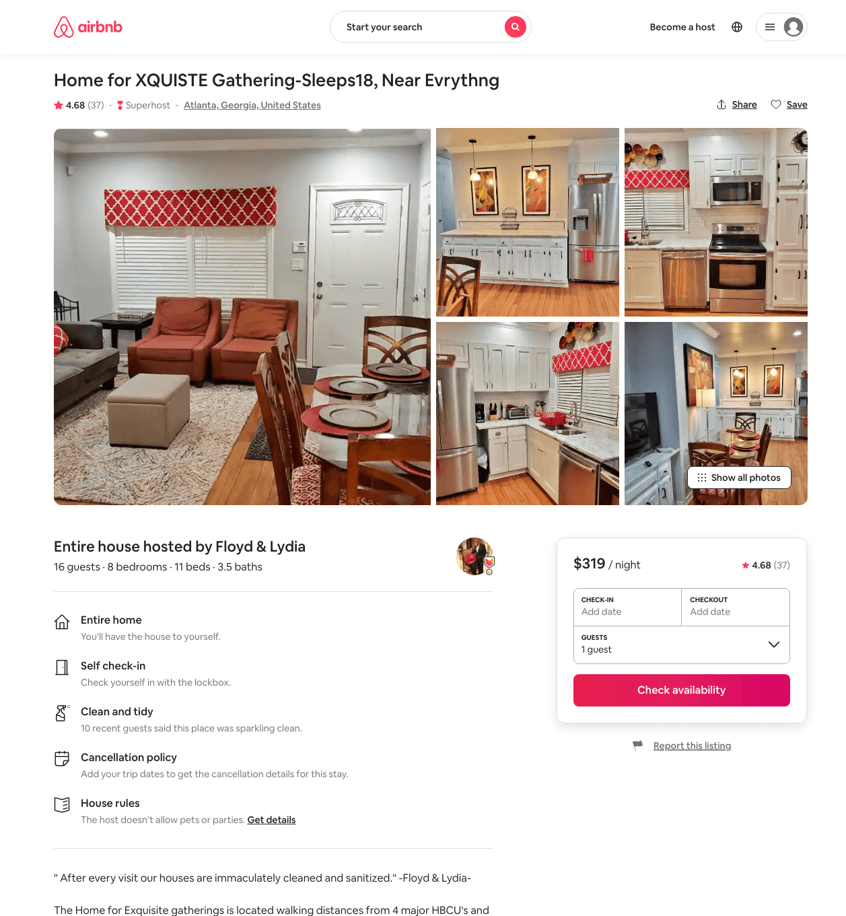
Listing 42268652
8
16
$311 - $436
4.68
2
Floyd & Lydia
114231426
3
https://www.airbnb.com/rooms/42268652
Aug 2022

Slide 25
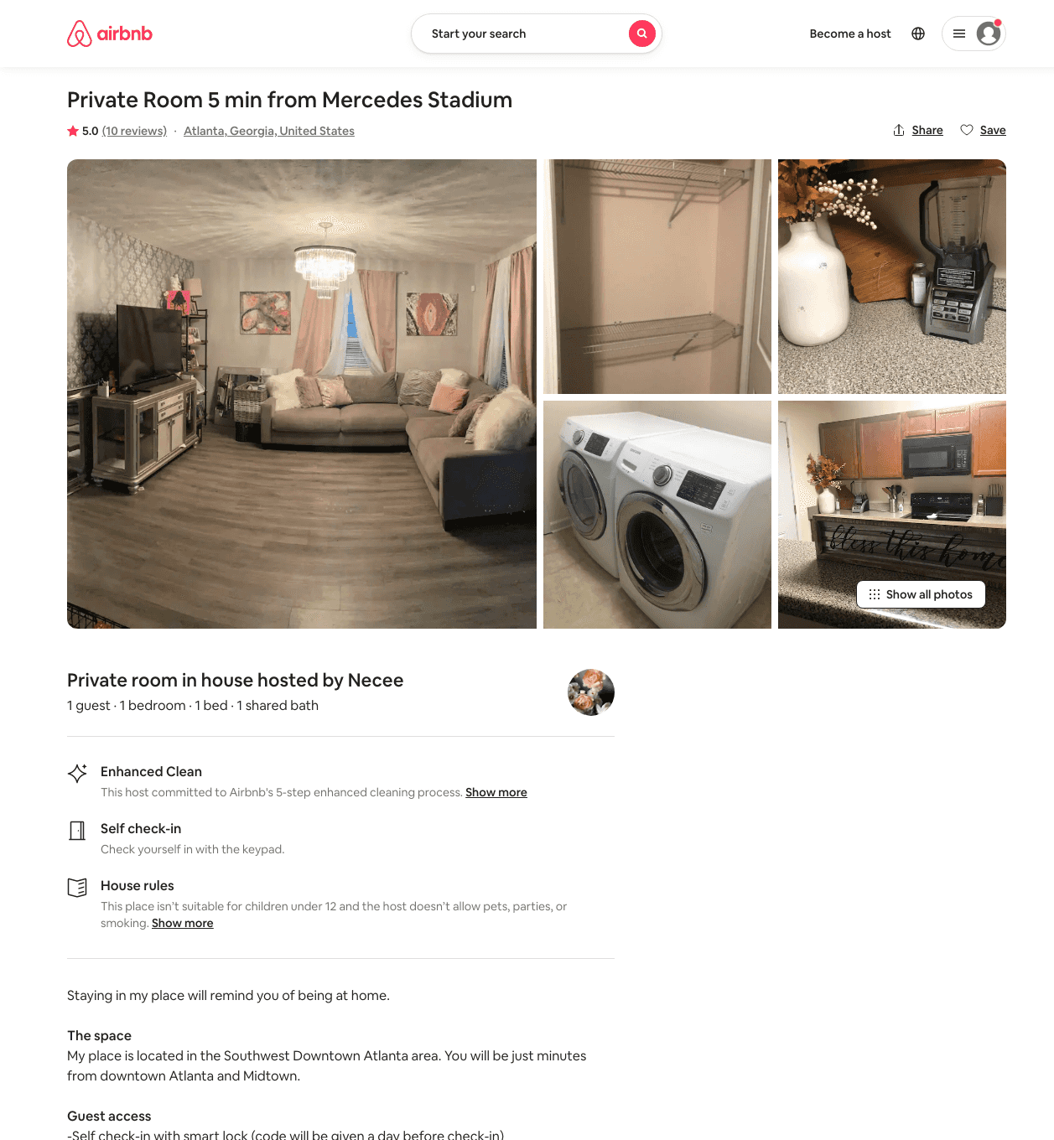
Listing 30338024
1
2
$60
4.94
2
Necee
112167470
2
https://www.airbnb.com/rooms/30338024
Aug 2022

Slide 26
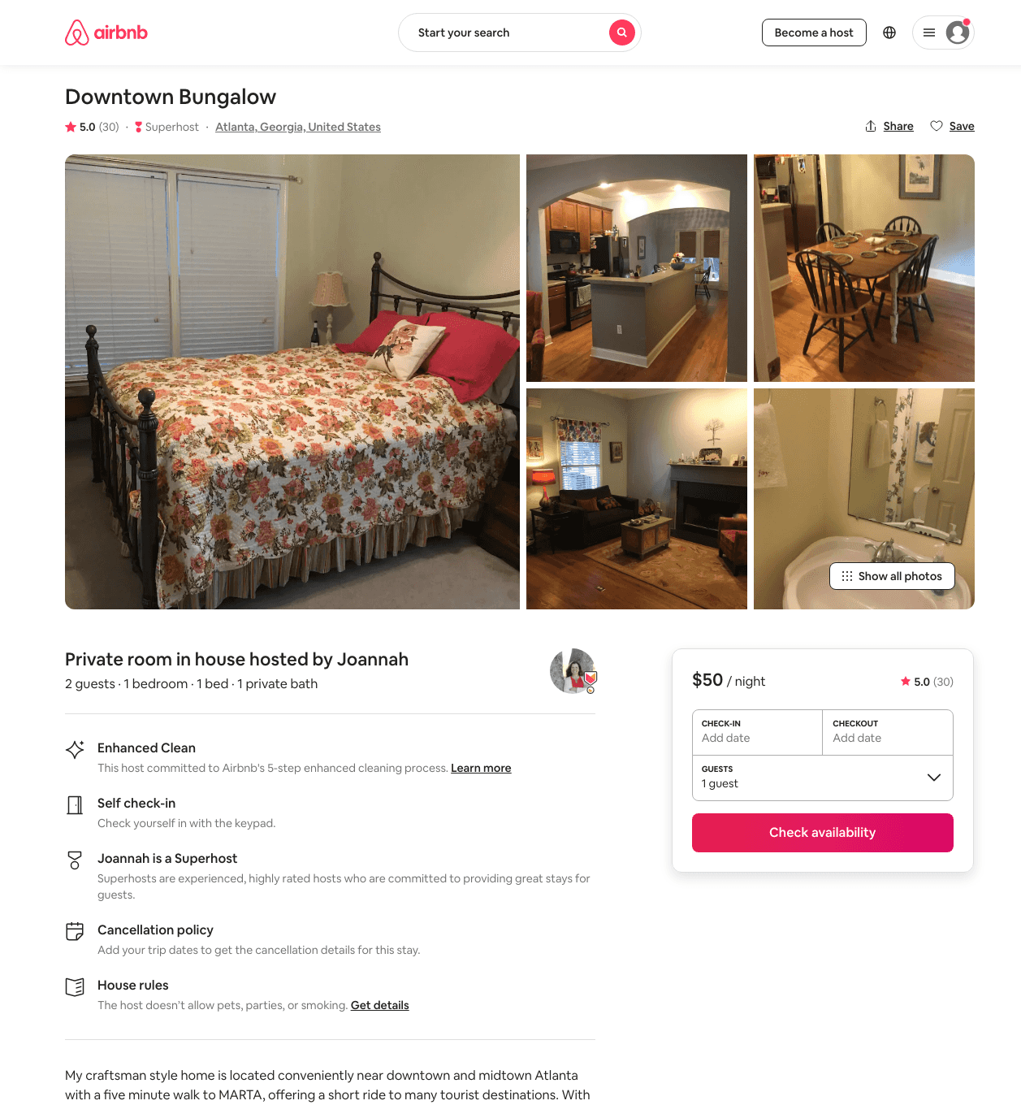
Listing 20411861
1
2
$50
4.96
1
Joannah
45508243
1
https://www.airbnb.com/rooms/20411861
Aug 2022

Slide 27
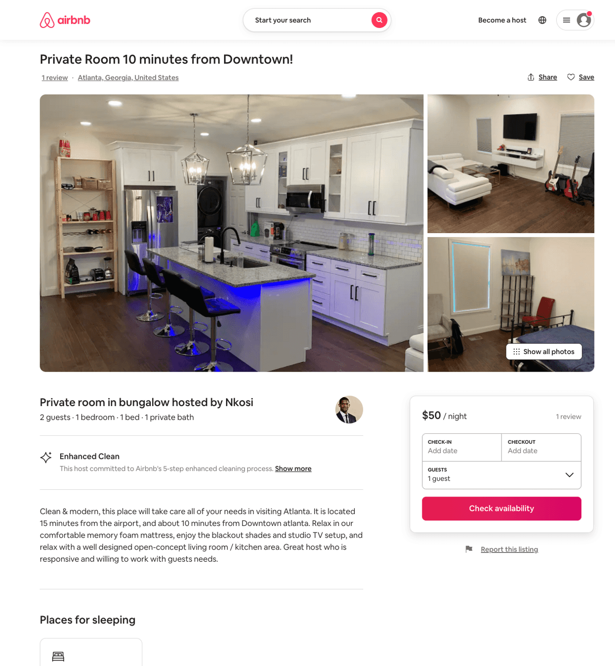
Listing 50013105
3
6
$47 - $283
4.81
2
Nkosi
118382089
1
https://www.airbnb.com/rooms/50013105
Aug 2022

Slide 28
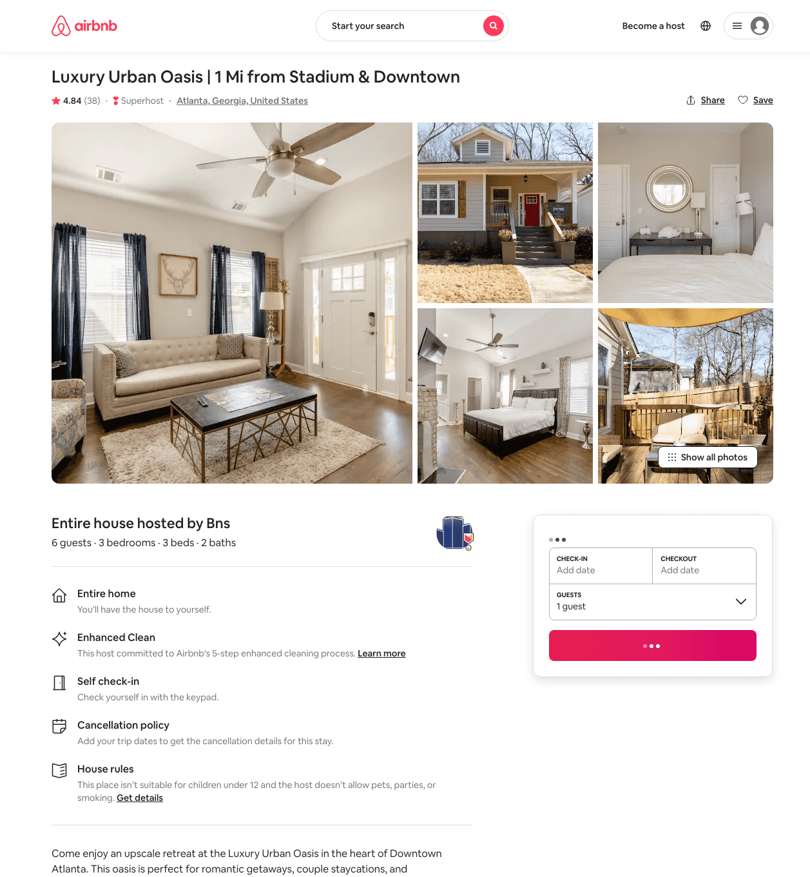
Listing 34155302
3
6
$197 - $1000
4.86
2
Bns
214990672
2
https://www.airbnb.com/rooms/34155302
Aug 2022

Slide 29
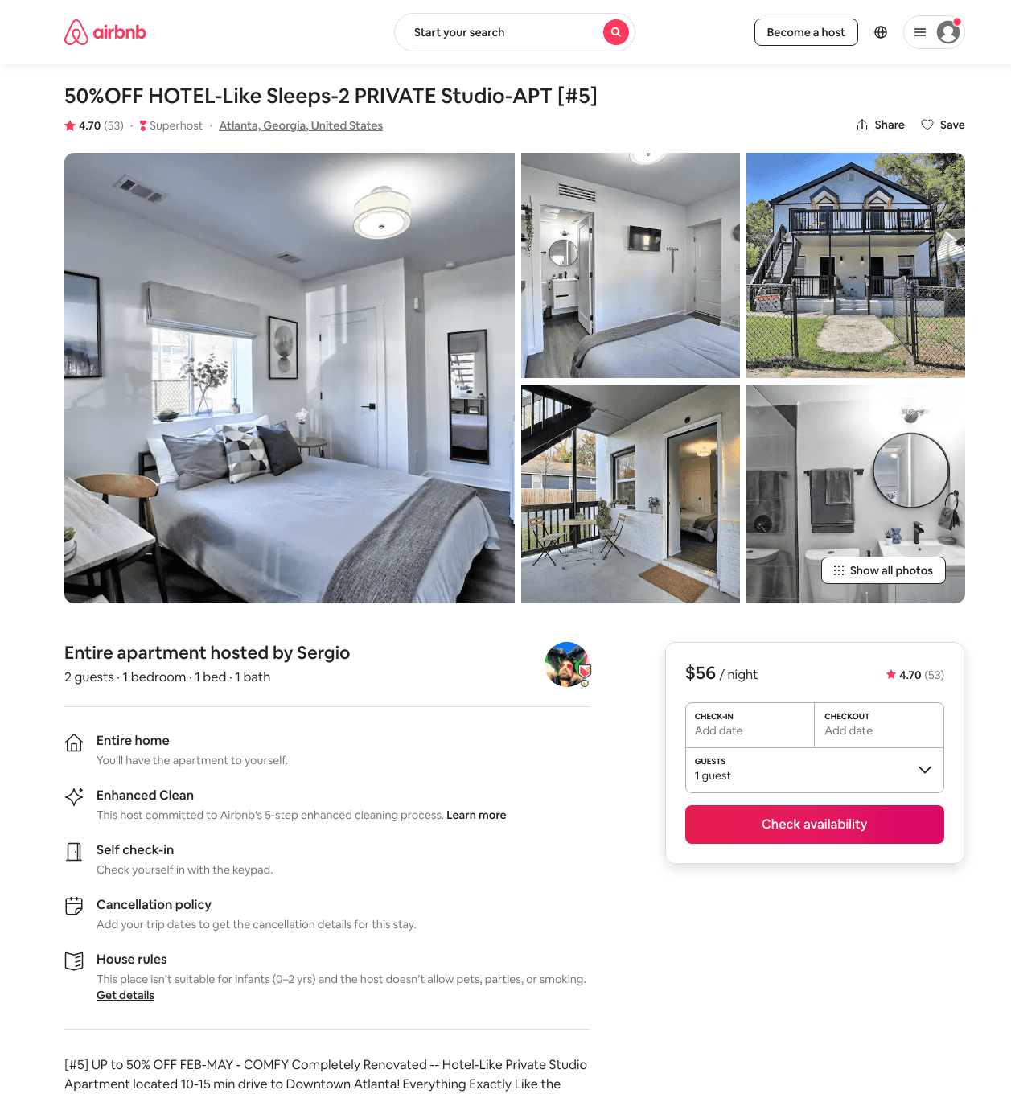
Listing 42998717
1
2
$30 - $63
4.37
2
Sergio
106508052
7
https://www.airbnb.com/rooms/42998717
Jun 2022

Slide 30
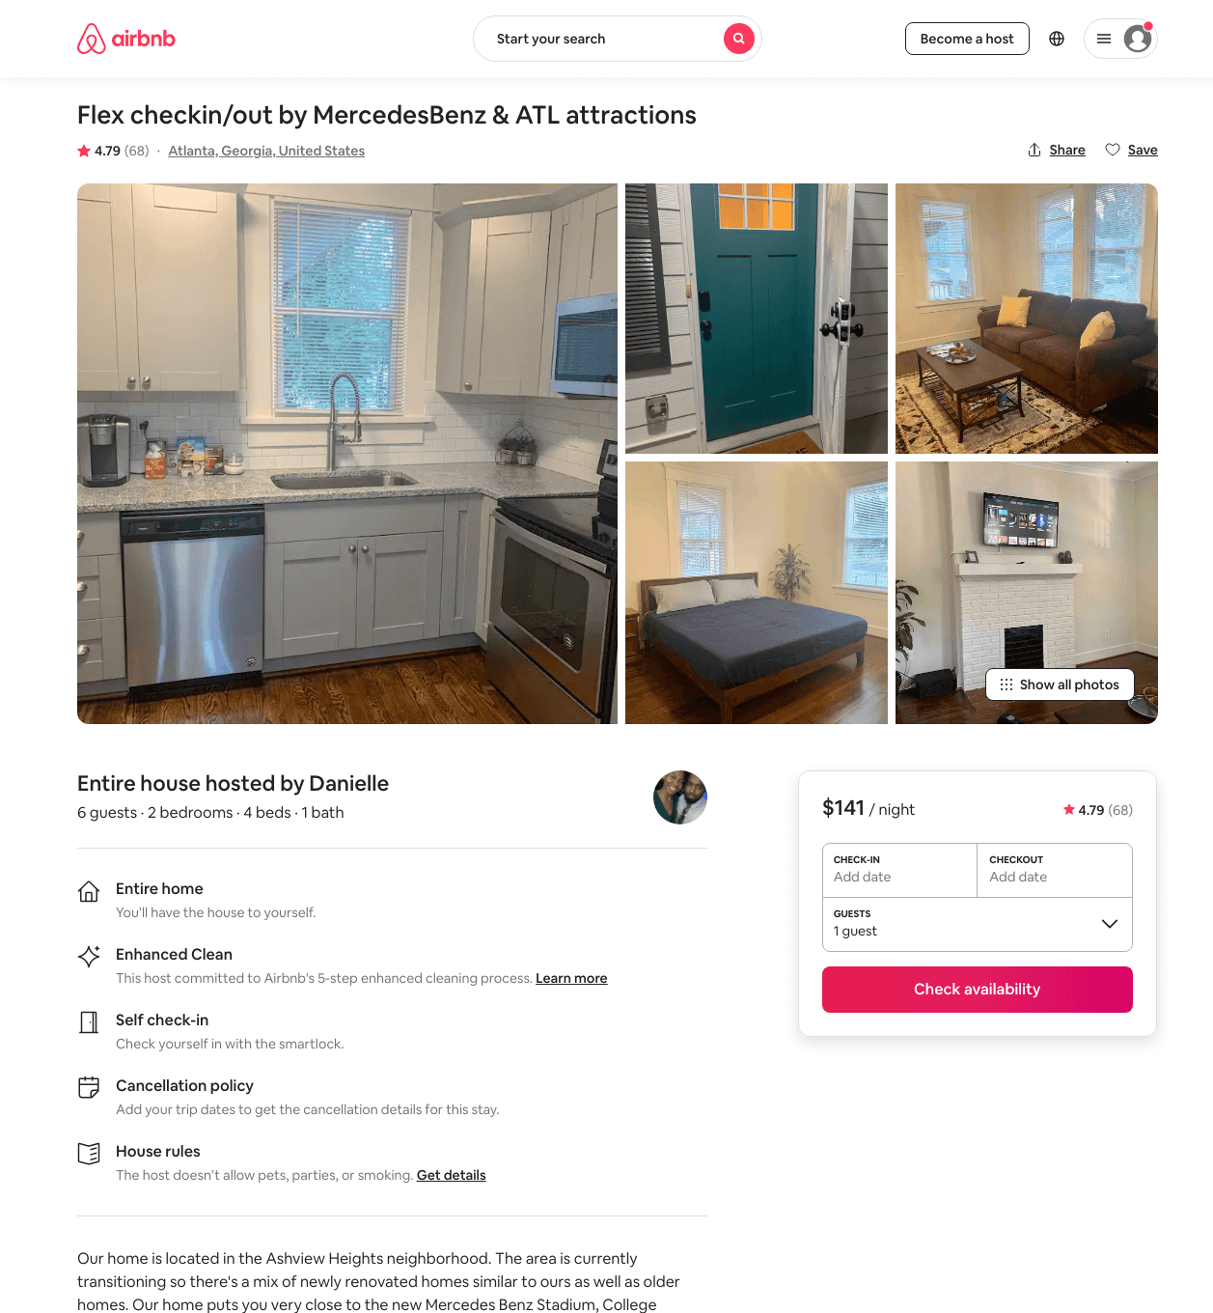
Listing 27467872
2
6
$93 - $165
4.68
2
Danielle
108618426
1
https://www.airbnb.com/rooms/27467872
Aug 2022

Slide 31
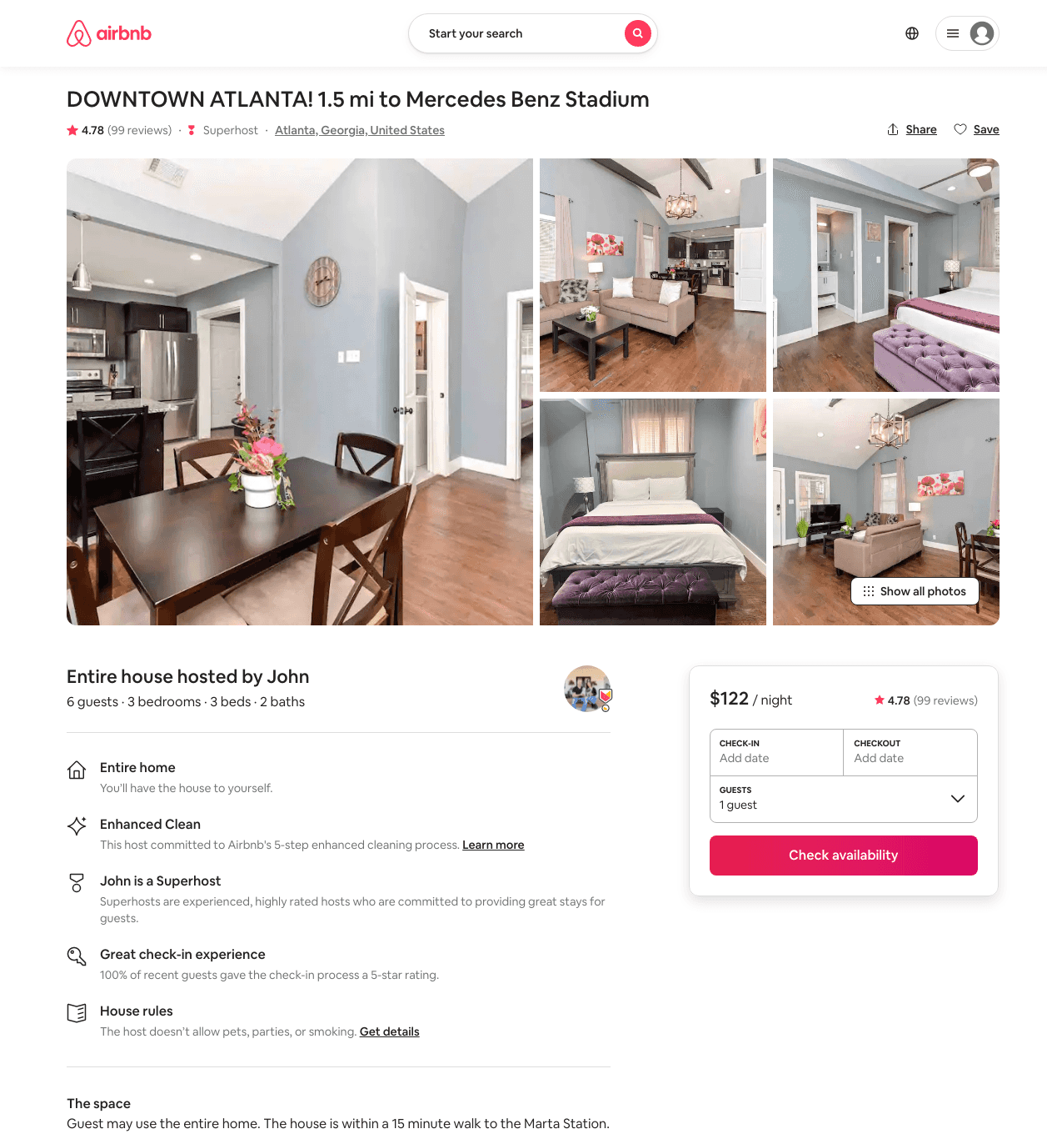
Listing 28043827
3
6
$122 - $140
4.82
3
John
195805984
2
https://www.airbnb.com/rooms/28043827
Aug 2022

Slide 32
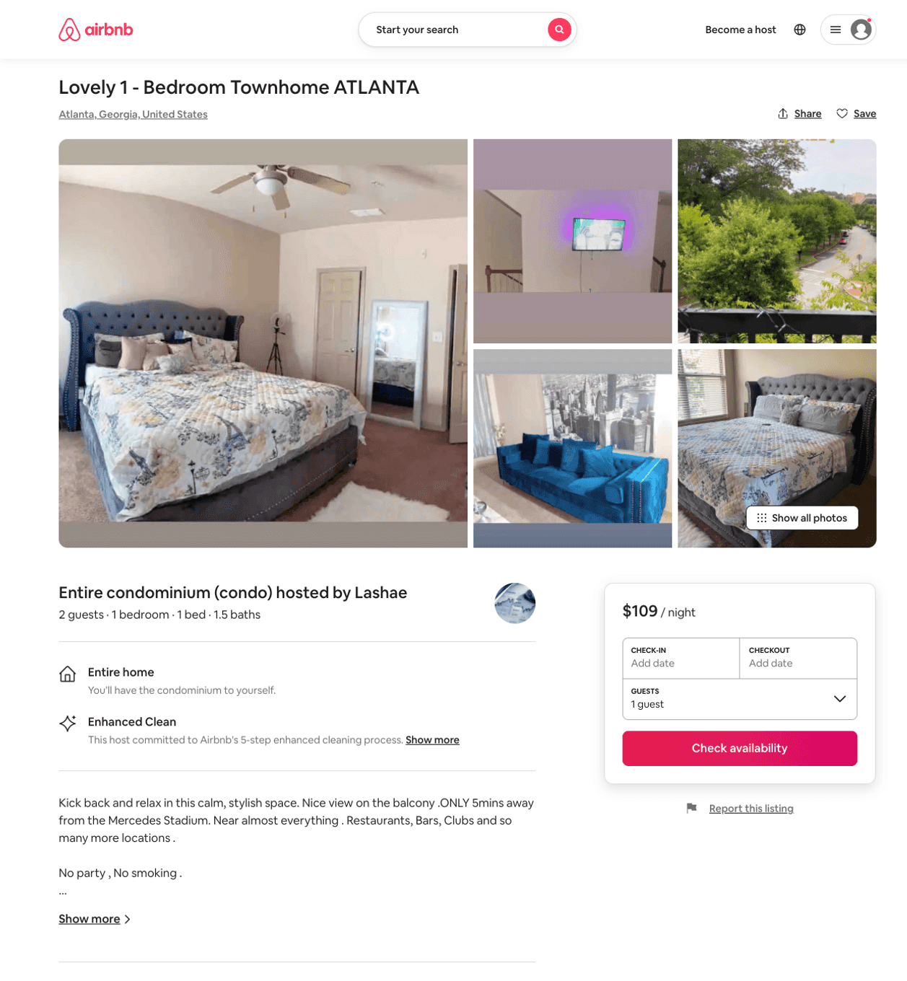
Listing 51601947
1
2
$107 - $109
2
Lashae
403269647
1
https://www.airbnb.com/rooms/51601947
Jun 2022

Slide 33
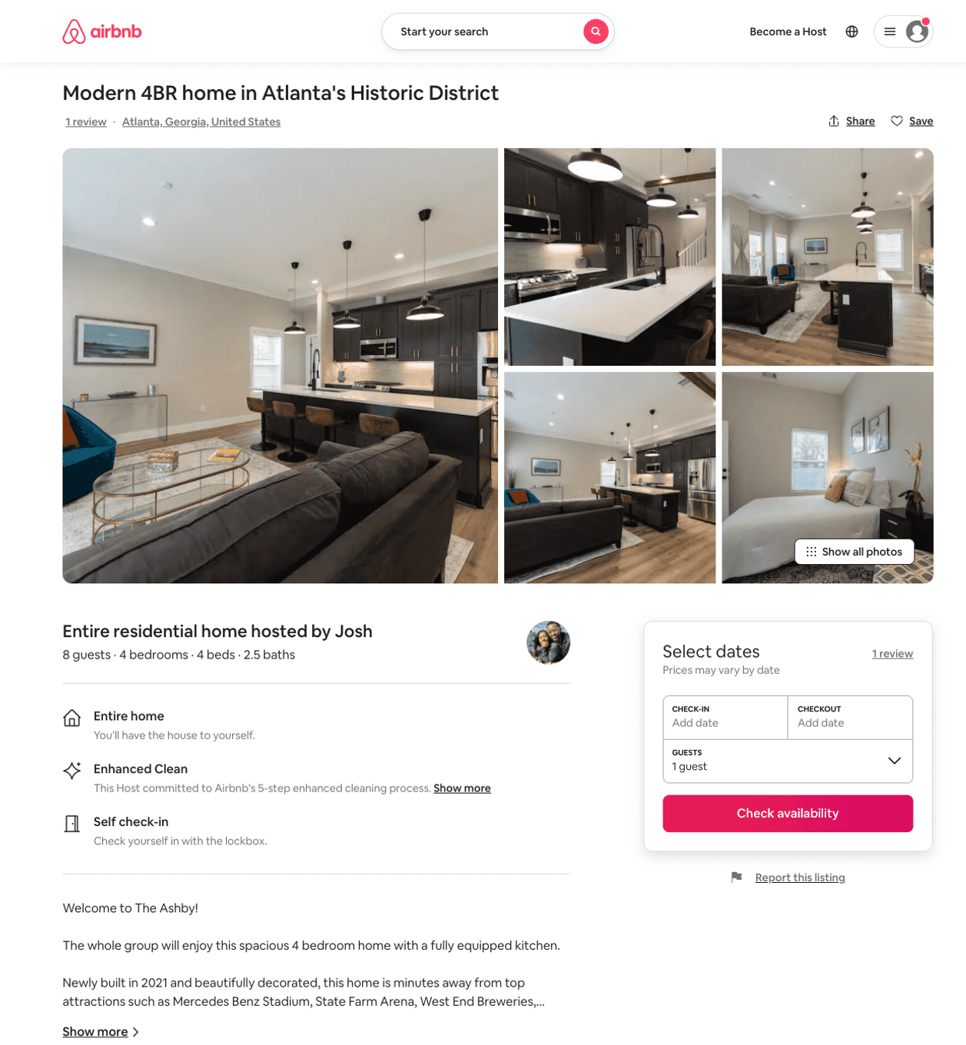
Listing 52266400
4
8
$275 - $362
4.67
2
Josh
57674288
1
https://www.airbnb.com/rooms/52266400
Aug 2022

Slide 34
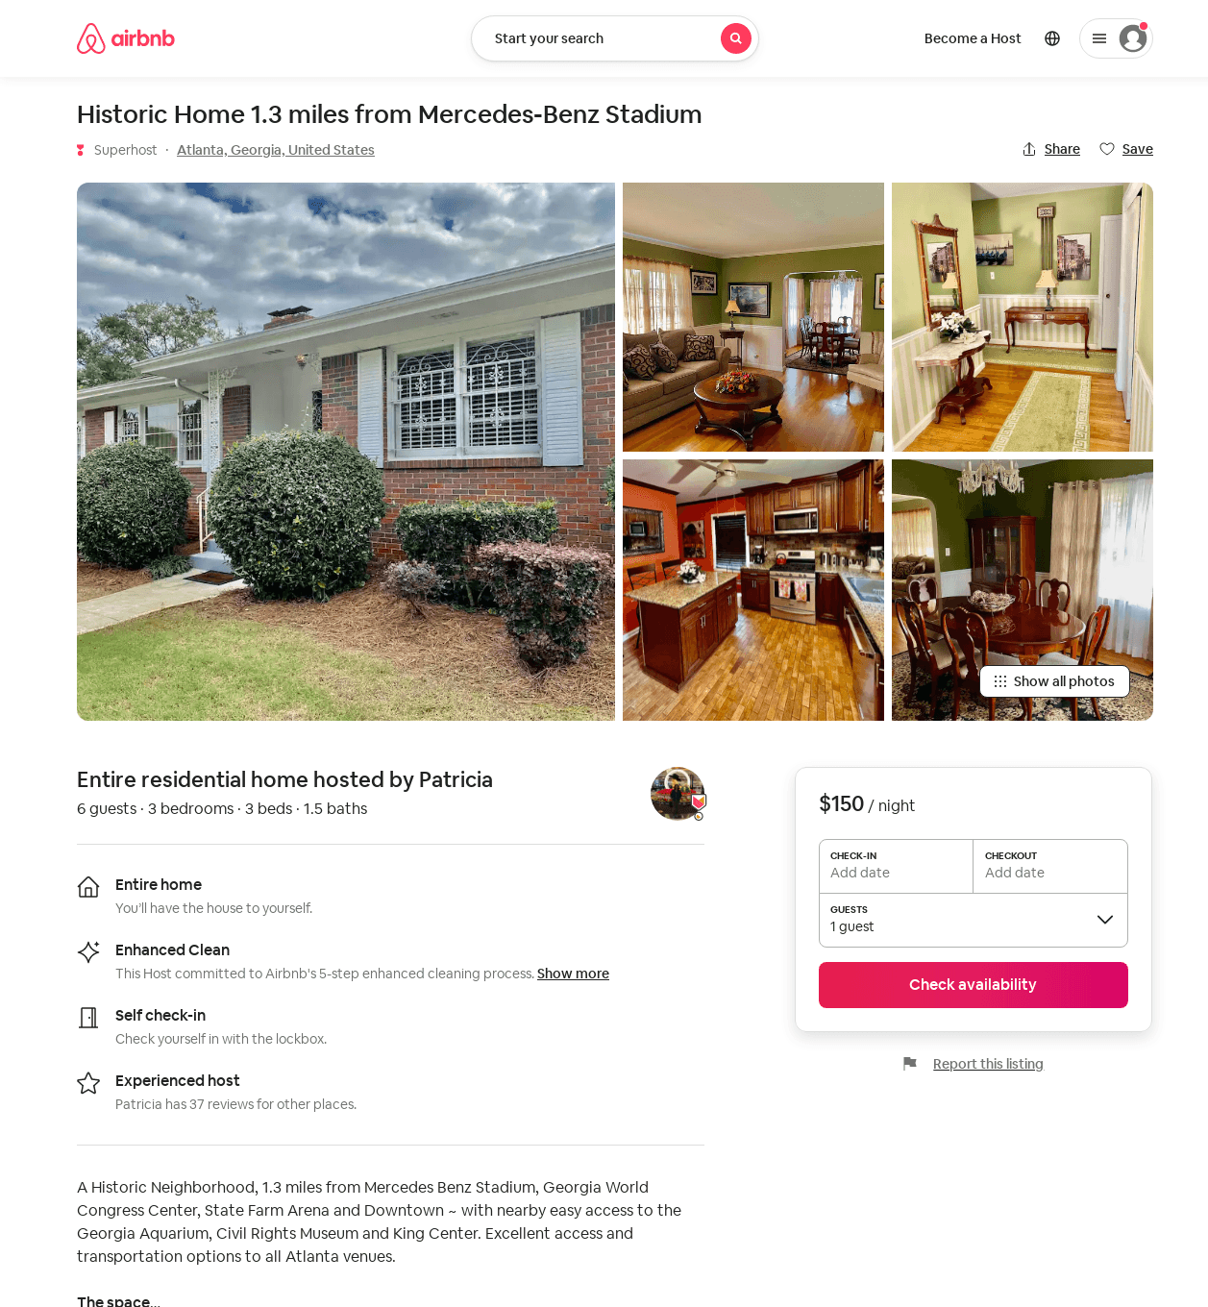
Listing 29682795
3
6
$150 - $175
5.0
3
Patricia
170744480
1
https://www.airbnb.com/rooms/29682795
Jun 2022

Slide 35
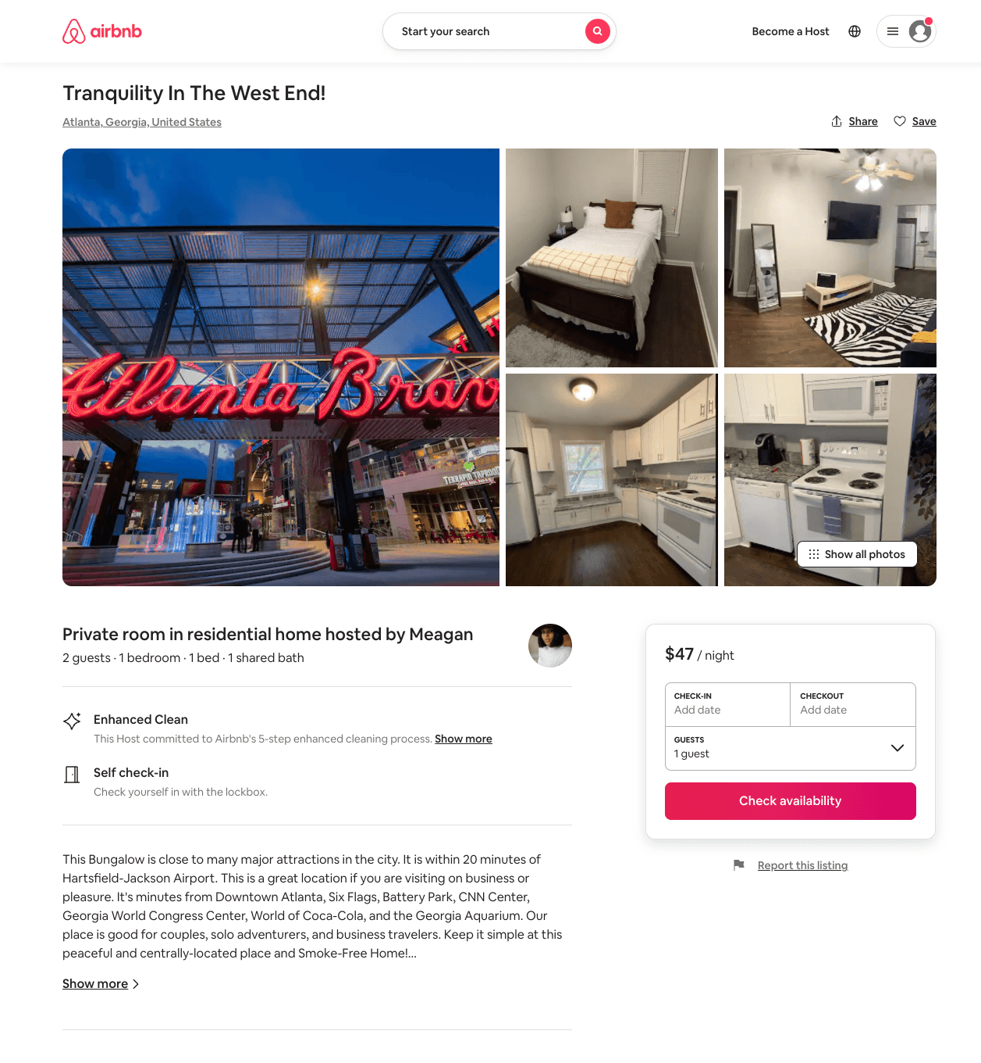
Listing 53249248
1
2
$43 - $60
5.0
1
Meagan
131830351
3
https://www.airbnb.com/rooms/53249248
Jun 2022

Slide 36
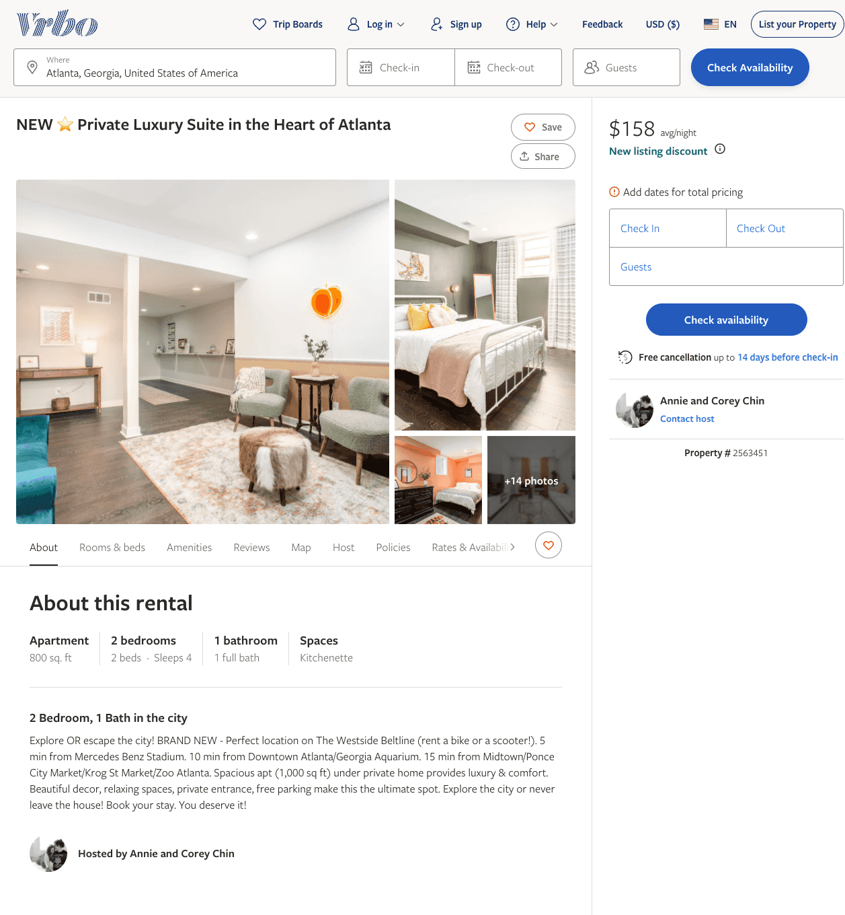
Listing 2563451
2
4
$158 - $199
4
2
Annie and Corey Chin
https://www.vrbo.com/2563451
Aug 2022

Slide 37
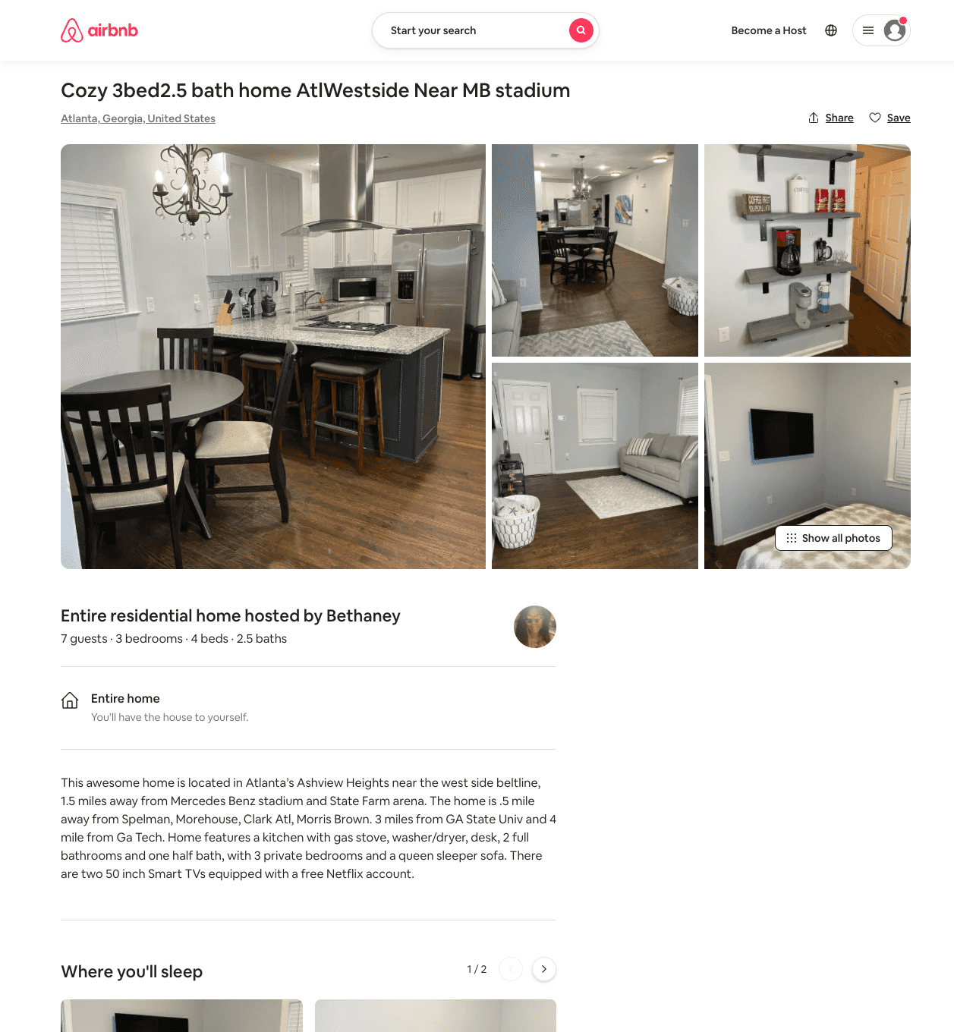
Listing 54112419
3
8
$125 - $152
4.94
2
Bethaney
438665132
1
https://www.airbnb.com/rooms/54112419
Jun 2022

Slide 38
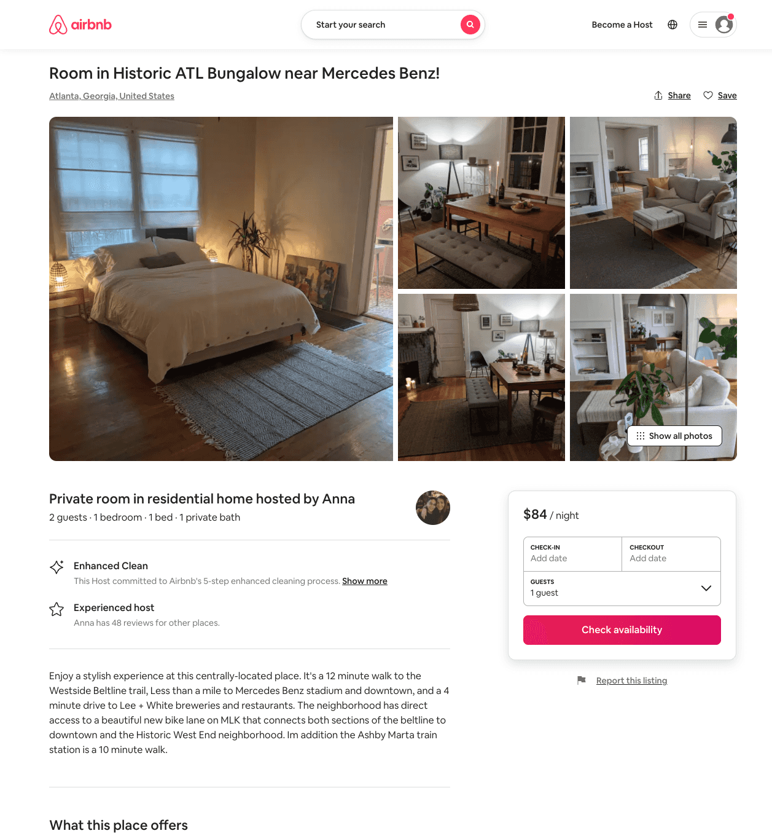
Listing 54266371
1
2
$84
1
Anna
128692862
2
https://www.airbnb.com/rooms/54266371
Aug 2022

Slide 39
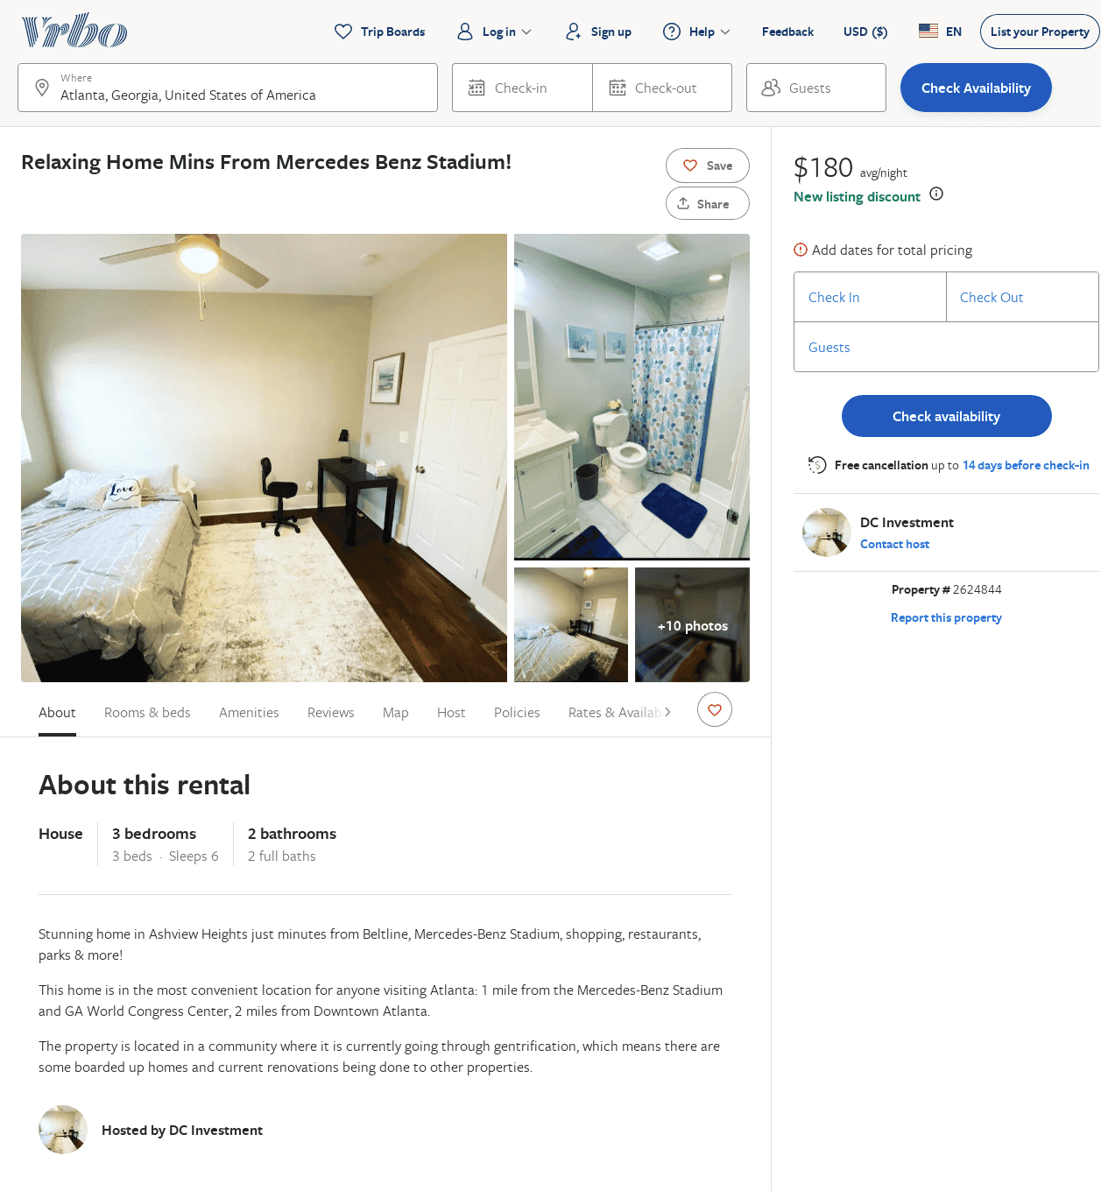
Listing 2624844
3
6
$163
2
DC Investment
https://www.vrbo.com/2624844
Aug 2022

Slide 40
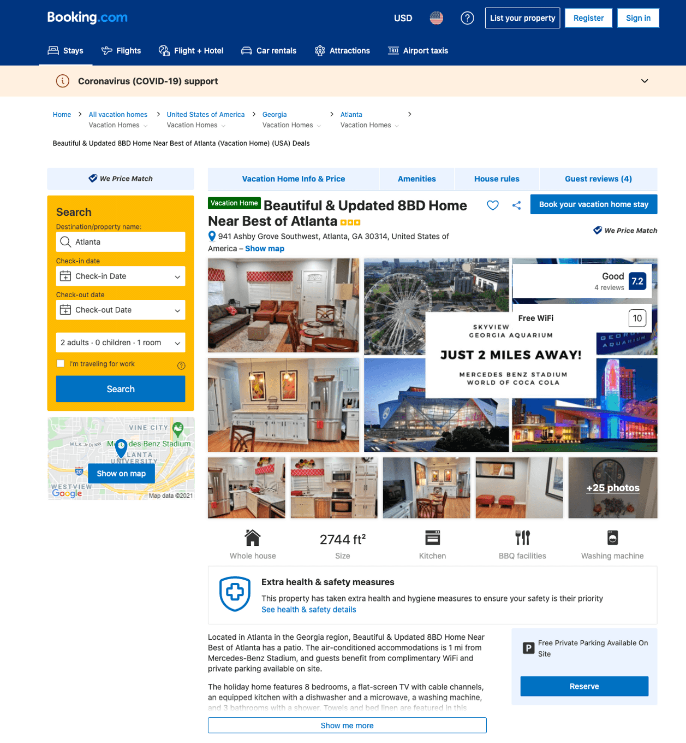
Listing home-for-xquiste-gathering-sleeps18-near-evrythng
undefined
16
7.2
https://www.booking.com/hotel/us/home-for-xquiste-gathering-sleeps18-near-evrythng.html
Sep 2022

Slide 41
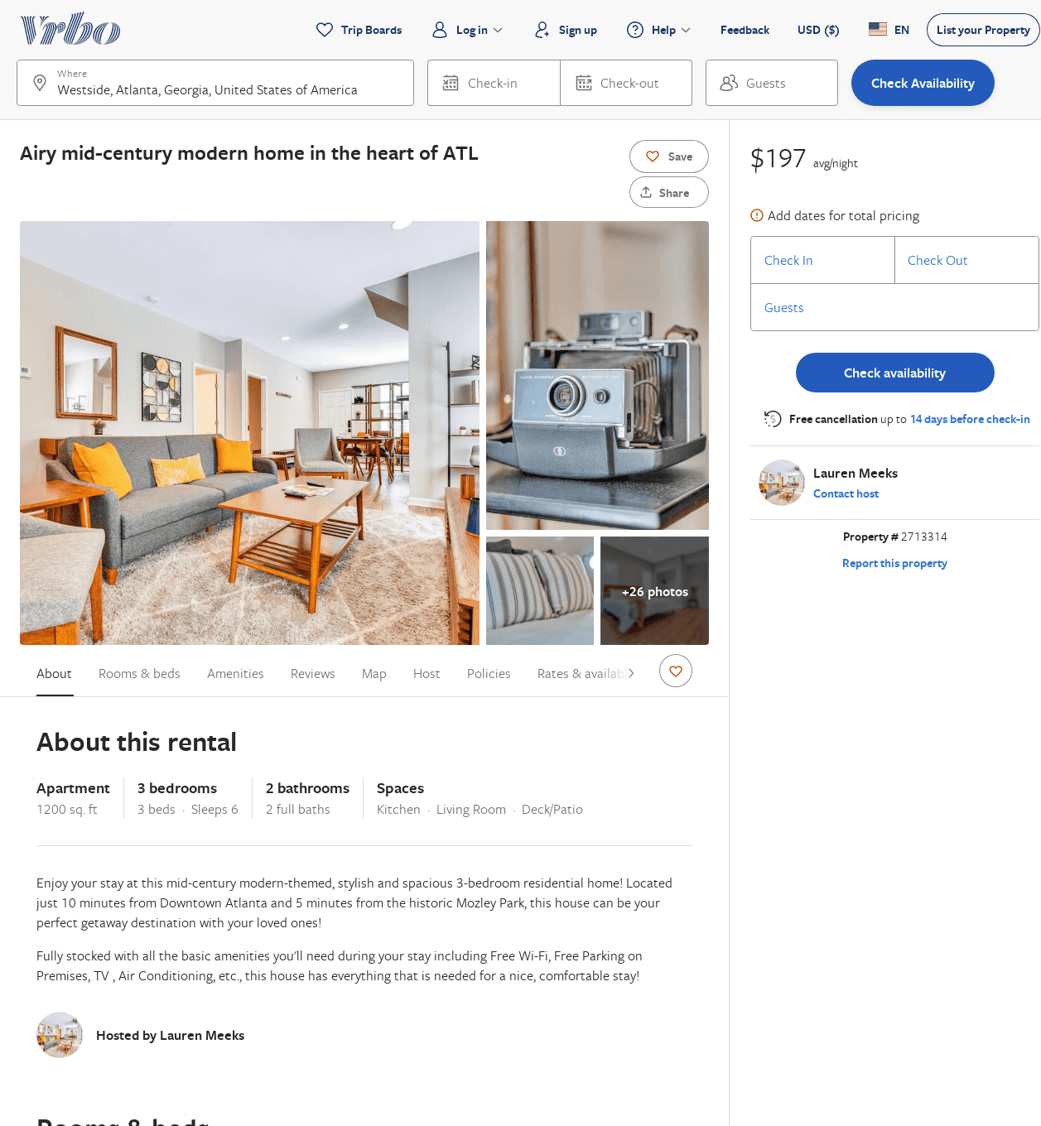
Listing 2713314
3
6
$154
2
2
Lauren Meeks
https://www.vrbo.com/2713314
Aug 2022

Slide 42
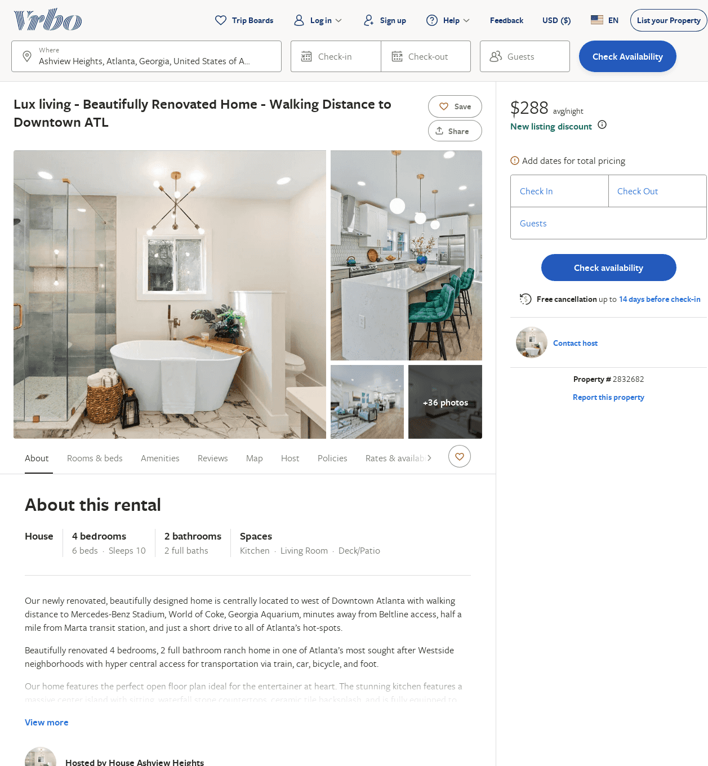
Listing 2832682
4
10
$290
2
https://www.vrbo.com/2832682
Aug 2022

Slide 43
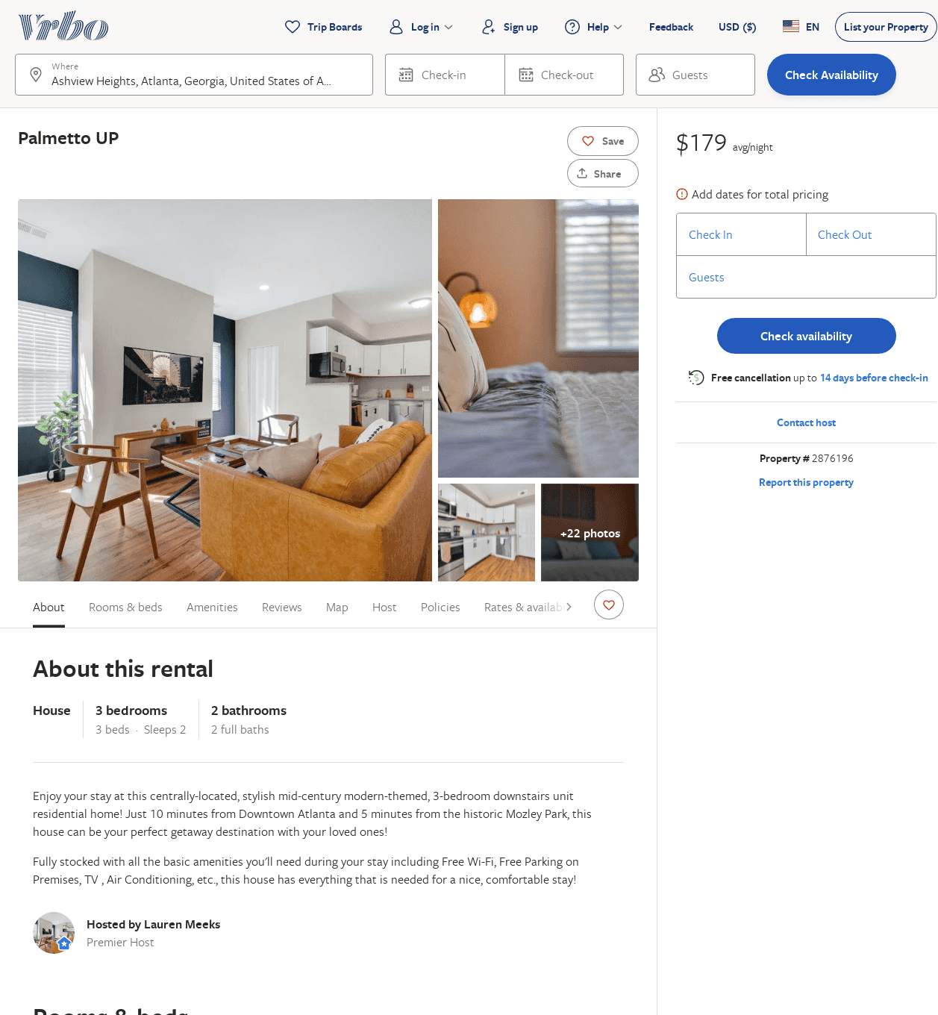
Listing 2876196
3
2
$153
2
Lauren Meeks
https://www.vrbo.com/2876196
Aug 2022

Slide 44
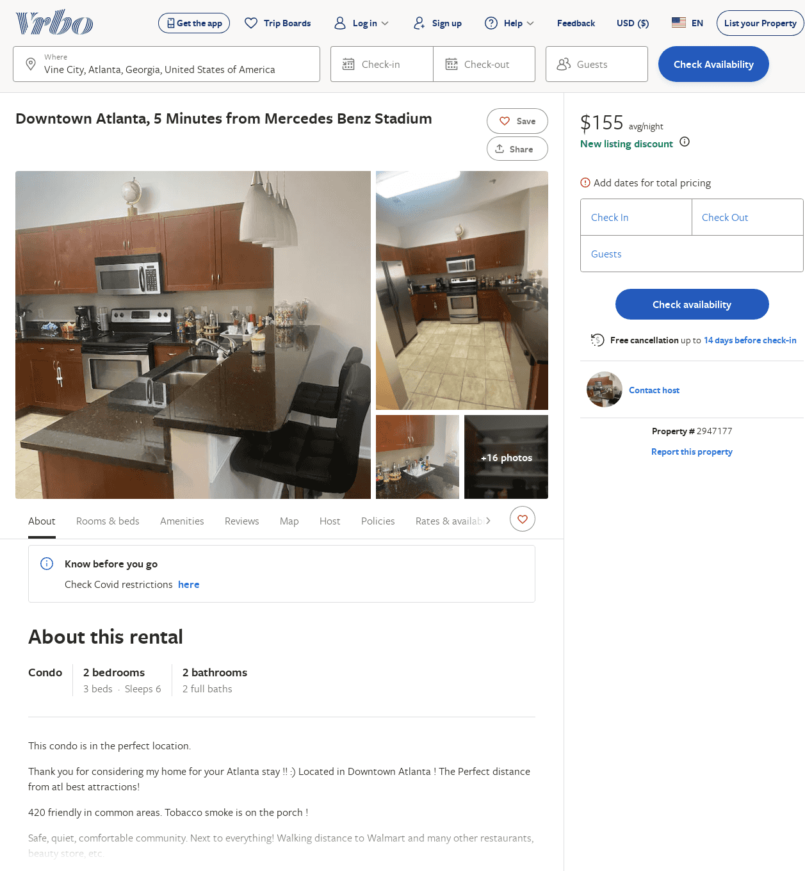
Listing 2947177
2
6
$155
2
https://www.vrbo.com/2947177
Aug 2022

