Slide 2
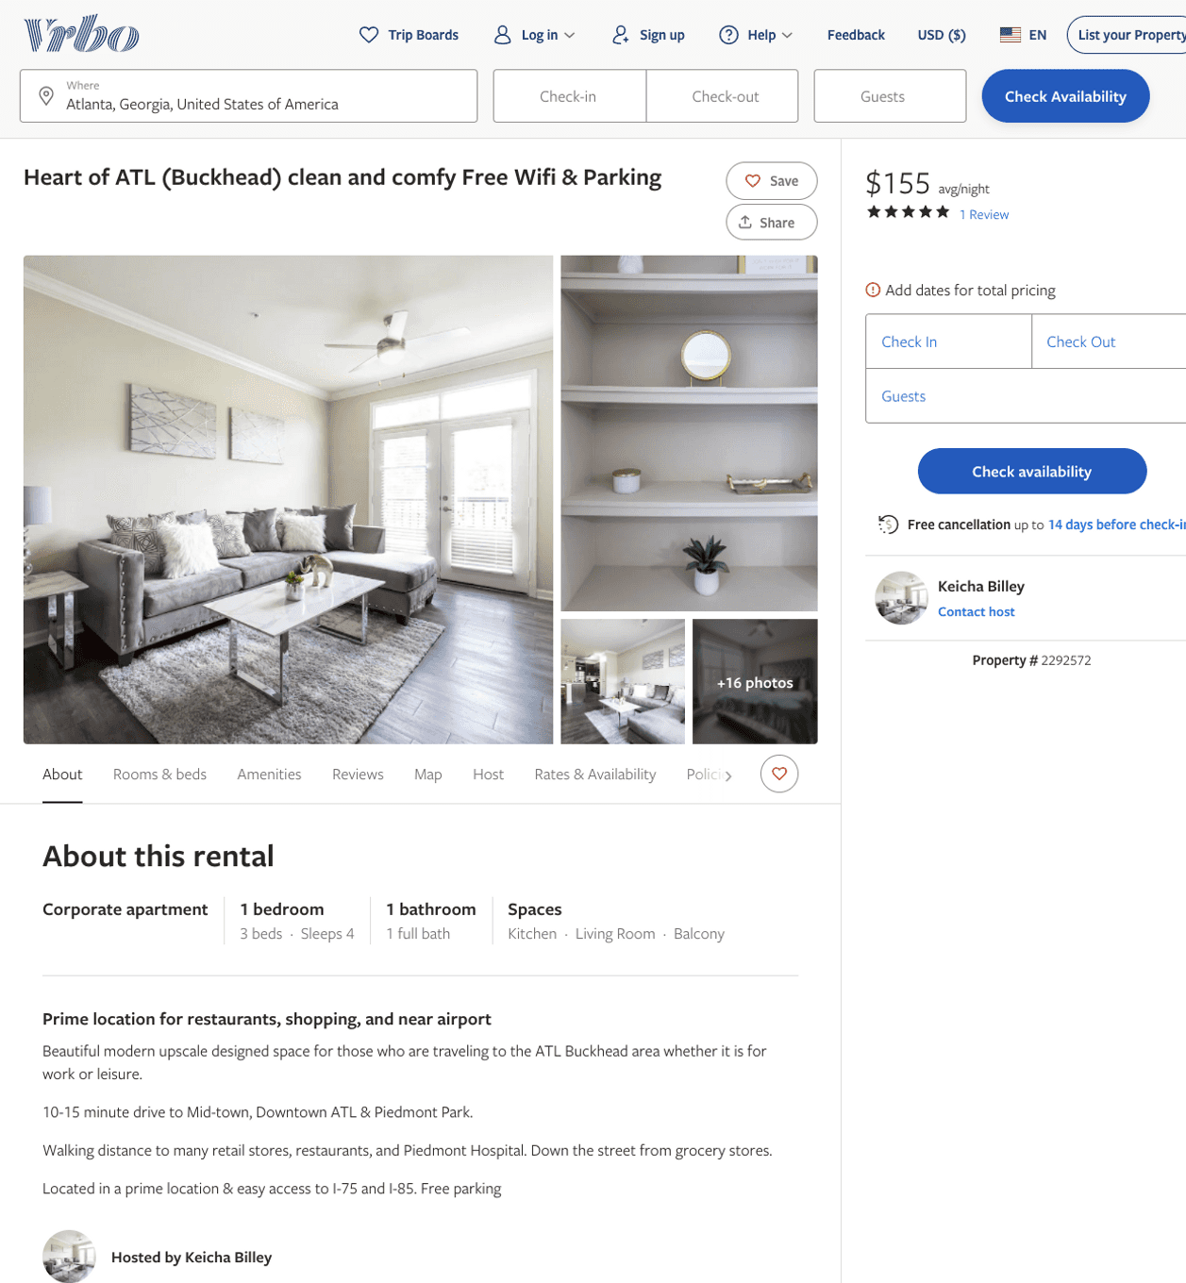
Listing 2292572
1
4
$133 - $155
5
2
Keicha Billey
https://www.vrbo.com/2292572
Aug 2022

Slide 3
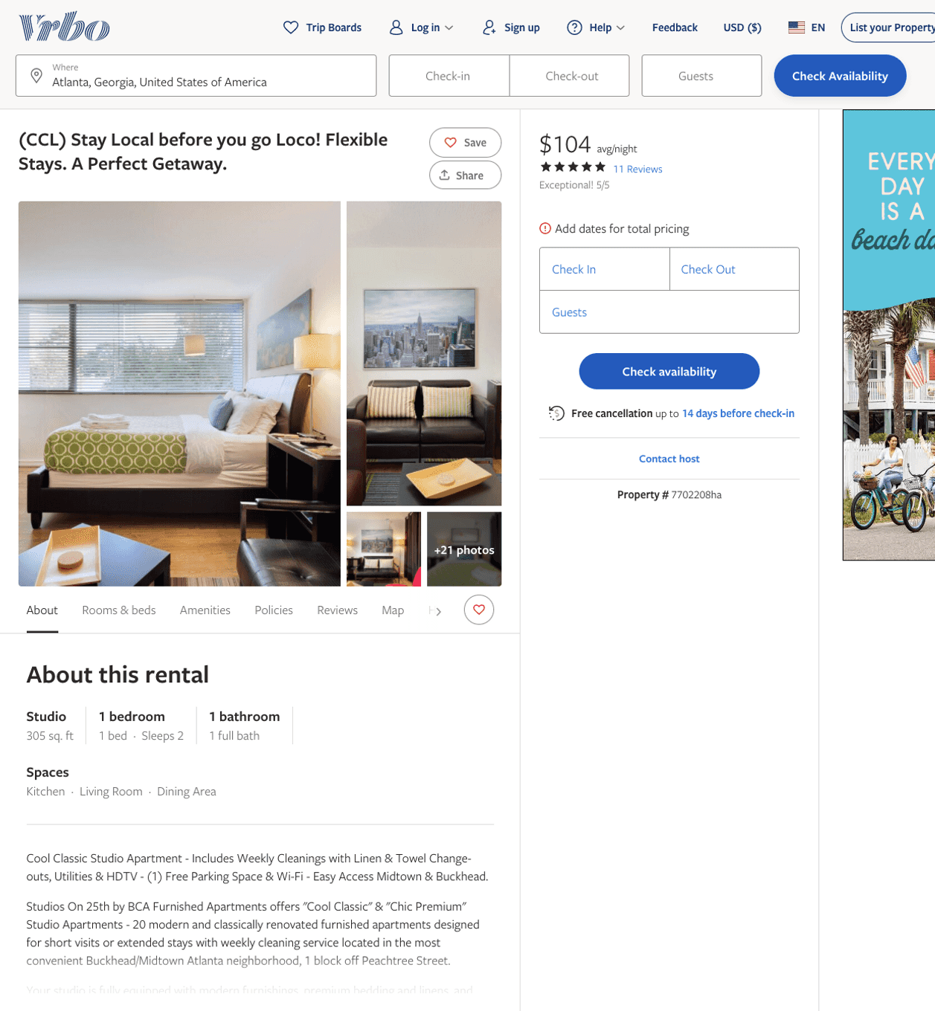
Listing 7702208
1
2
$100 - $93
5
1
Alex & Michael
https://www.vrbo.com/7702208ha
Aug 2022

Slide 4
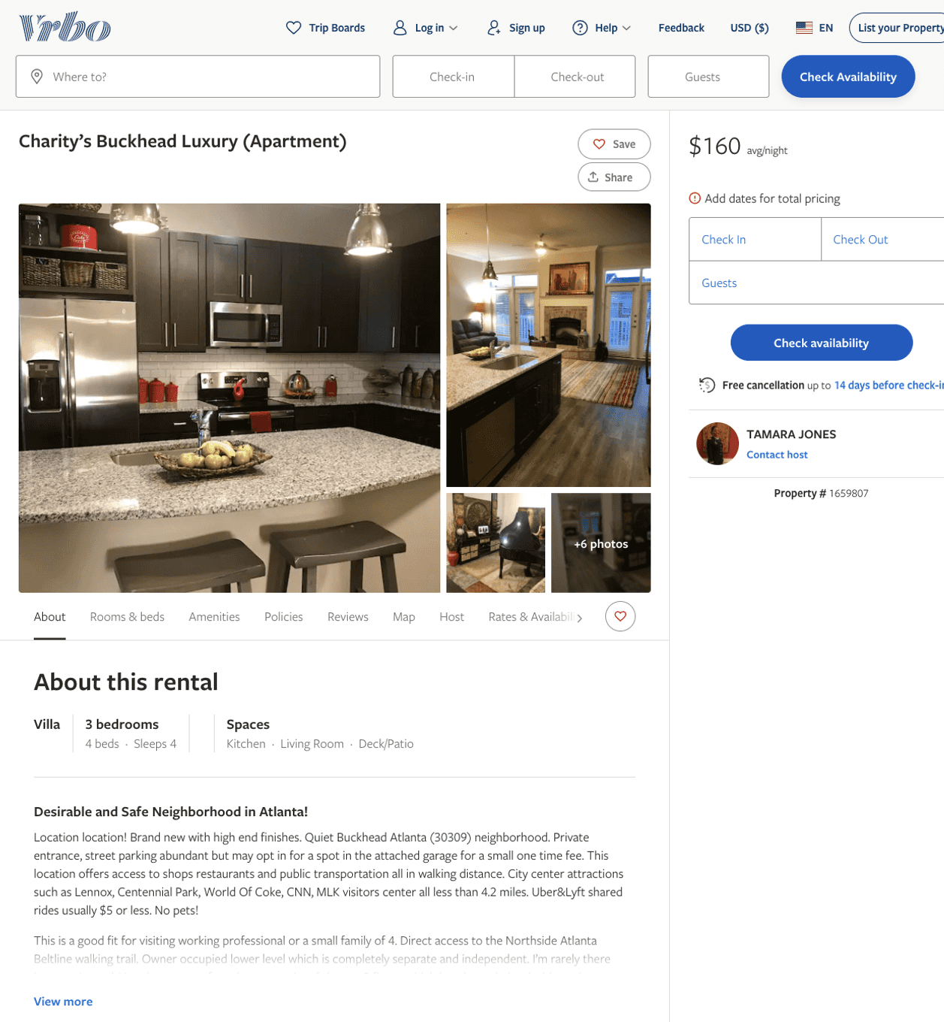
Listing 1659807
3
4
$160 - $322
4
TAMARA JONES
https://www.vrbo.com/1659807
Aug 2022

Slide 5
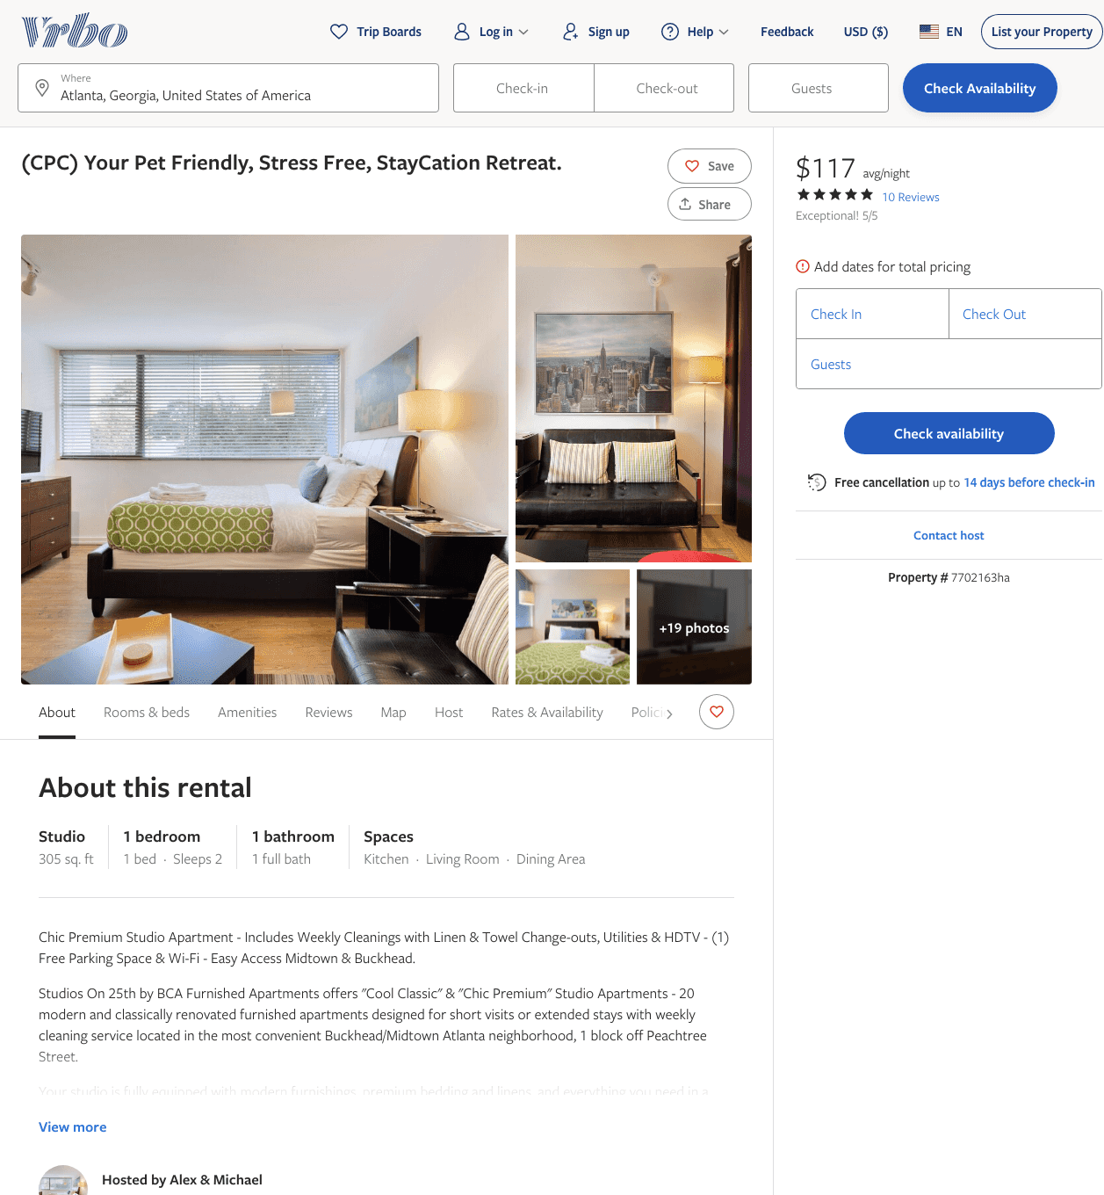
Listing 7702163
1
2
$109 - $123
5
1
Alex & Michael
https://www.vrbo.com/7702163ha
Aug 2022

Slide 6
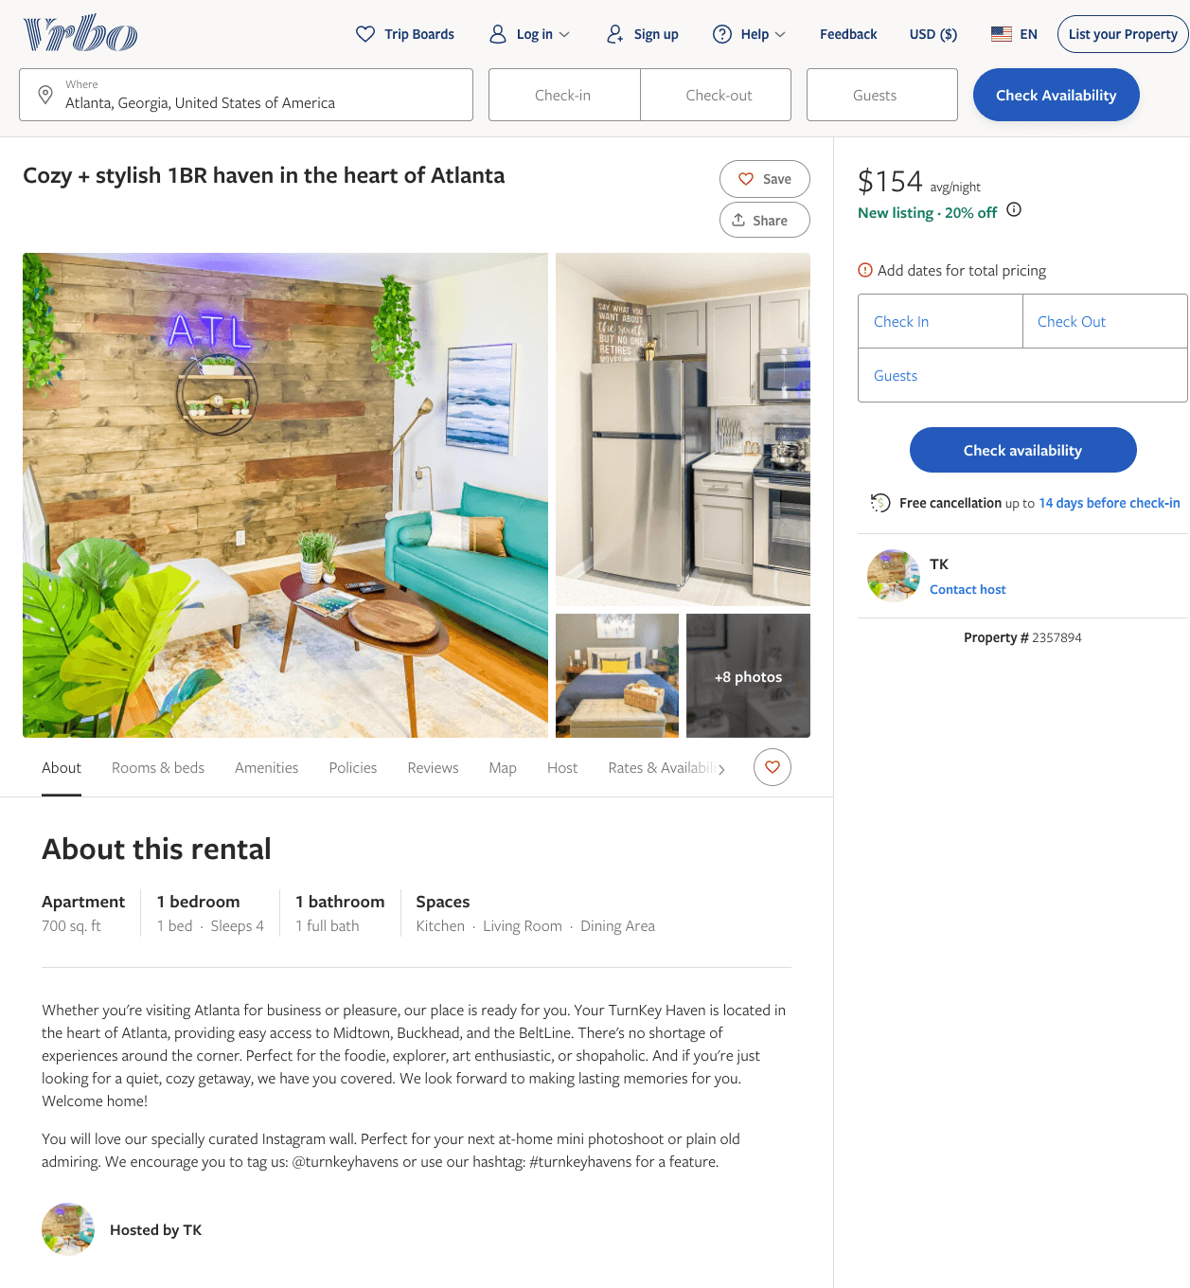
Listing 2357894
1
4
$149 - $91
2
TK
https://www.vrbo.com/2357894
Aug 2022

Slide 7
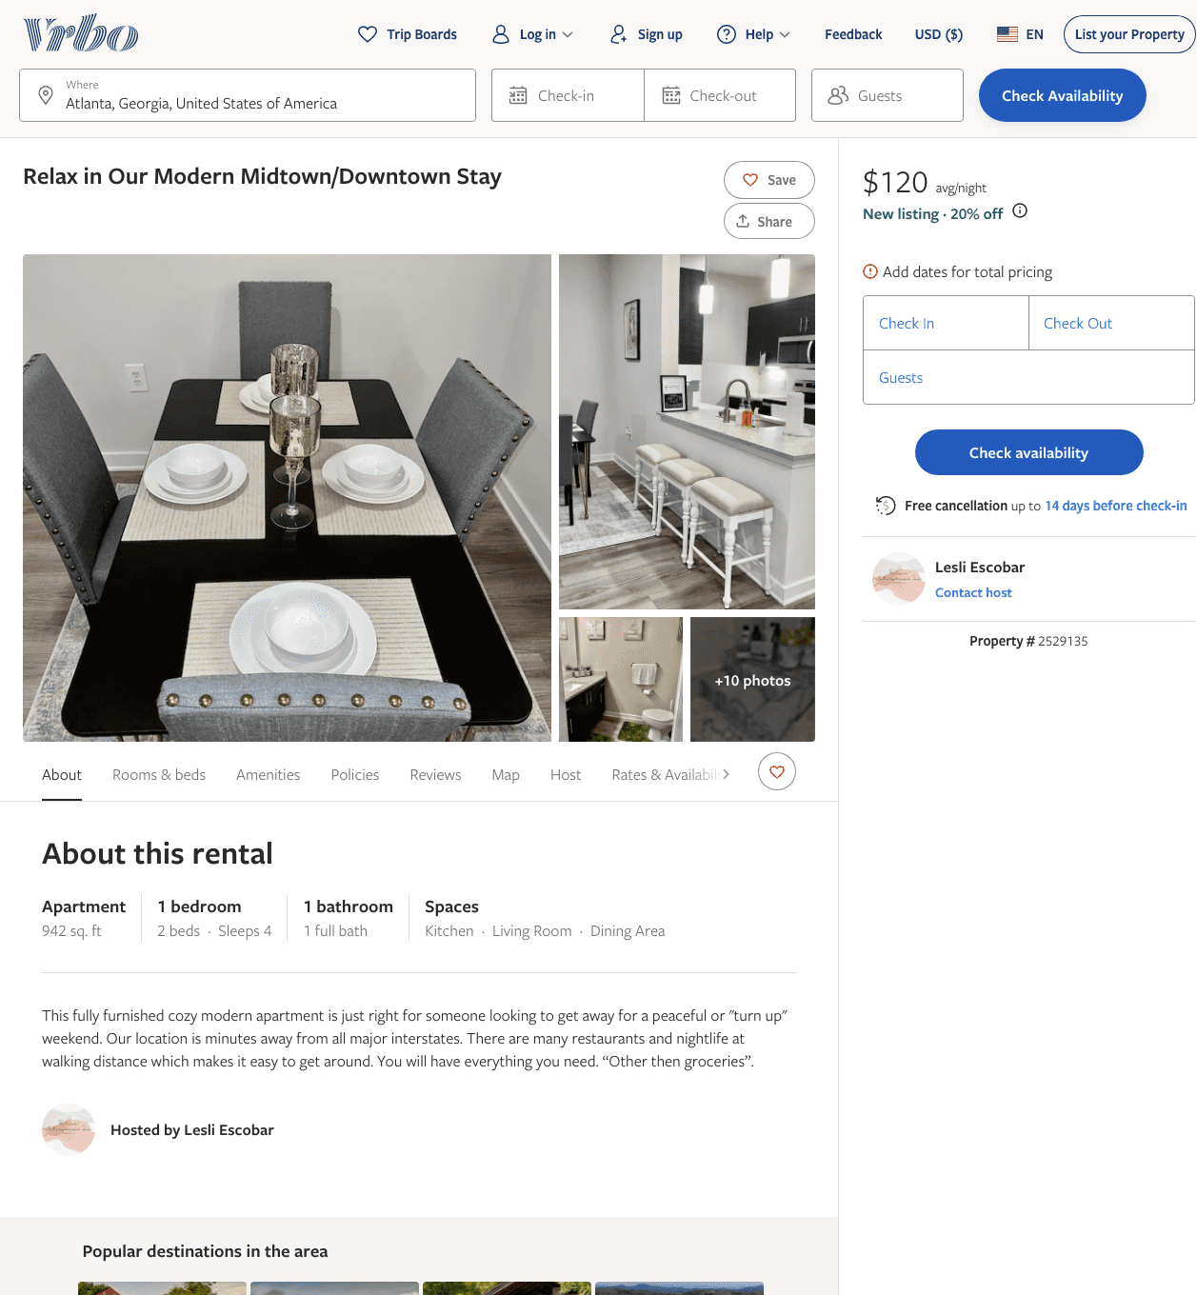
Listing 2529135
1
4
$120 - $130
2
Lesli Escobar
https://www.vrbo.com/2529135
Aug 2022

Slide 8
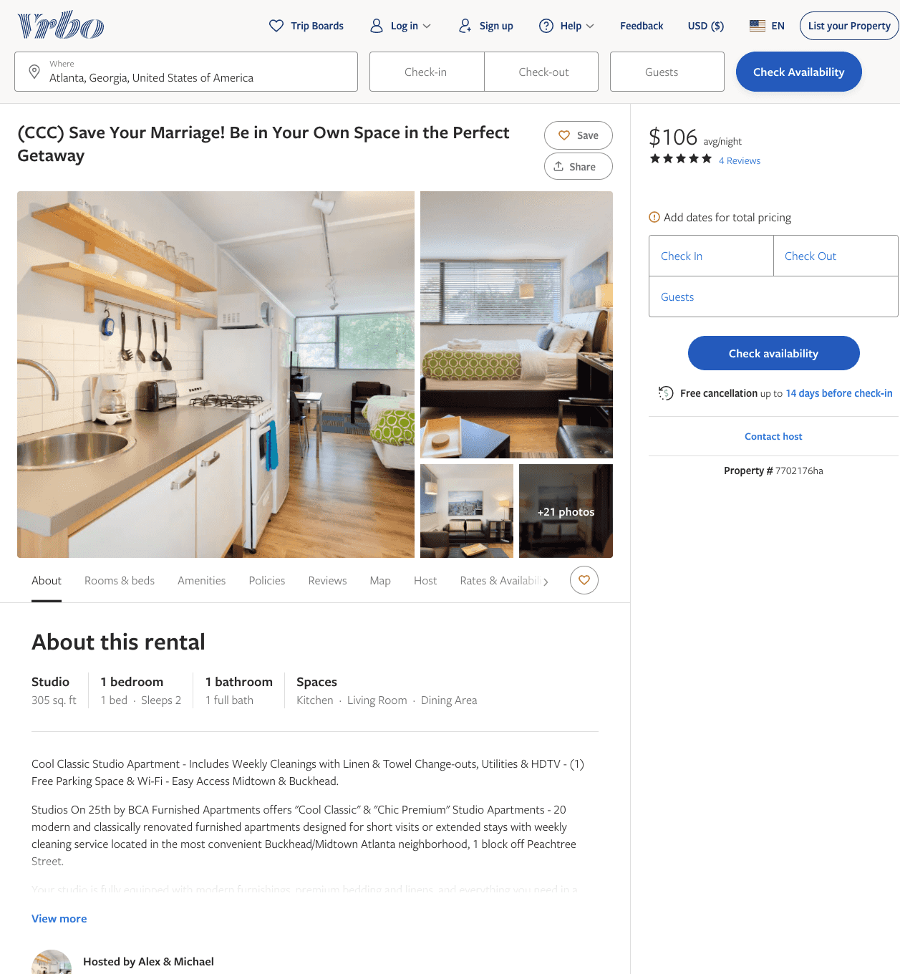
Listing 7702176
1
2
$103 - $99
4.857143
1
Alex & Michael
https://www.vrbo.com/7702176ha
Aug 2022

Slide 9
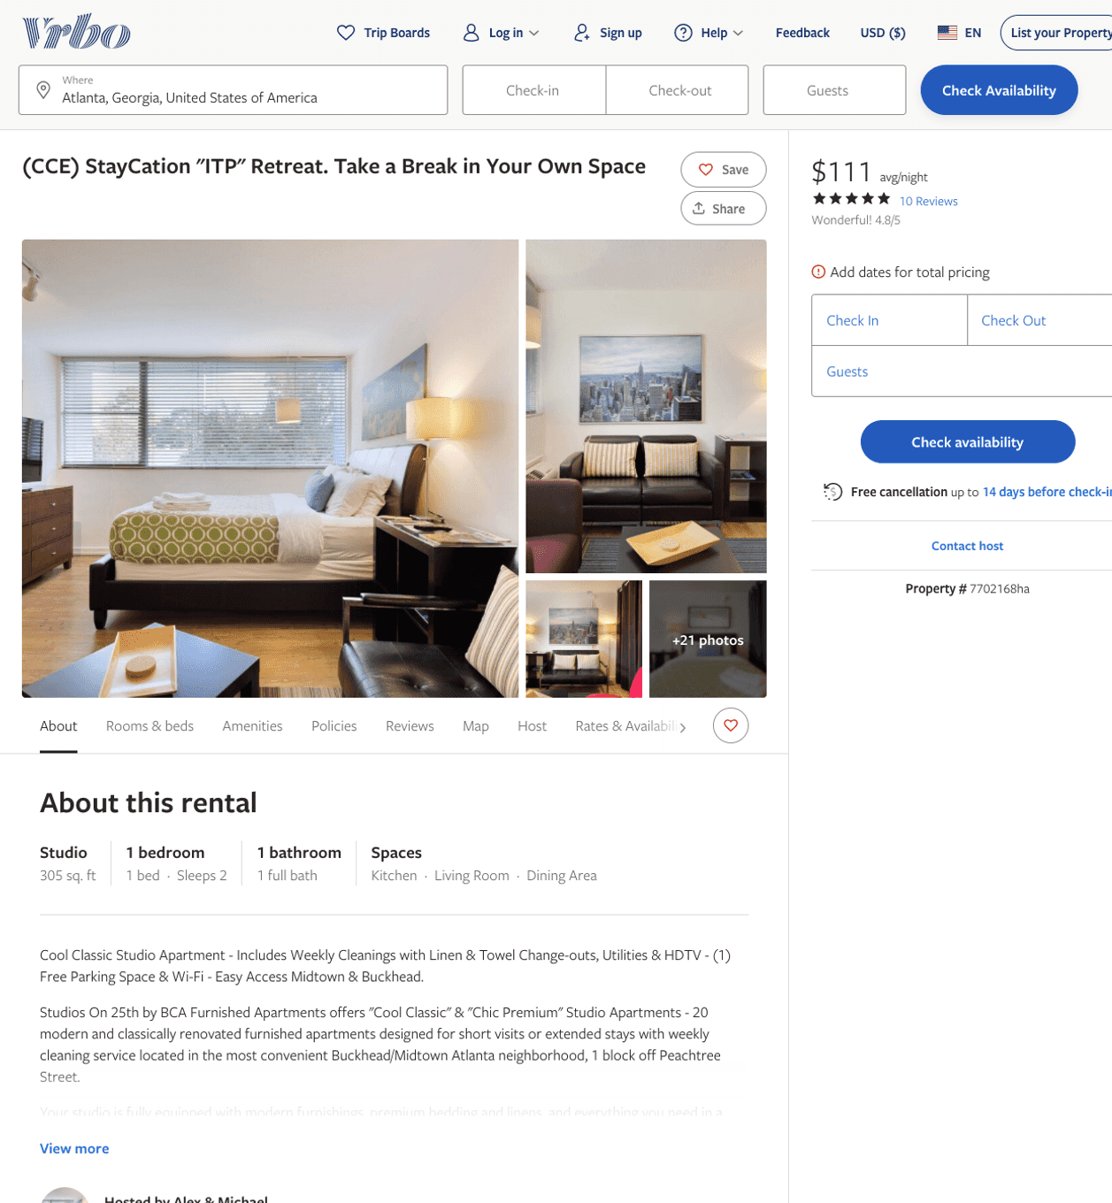
Listing 7702168
1
2
$100 - $99
4.8235292
1
Alex & Michael
https://www.vrbo.com/7702168ha
Aug 2022

Slide 10
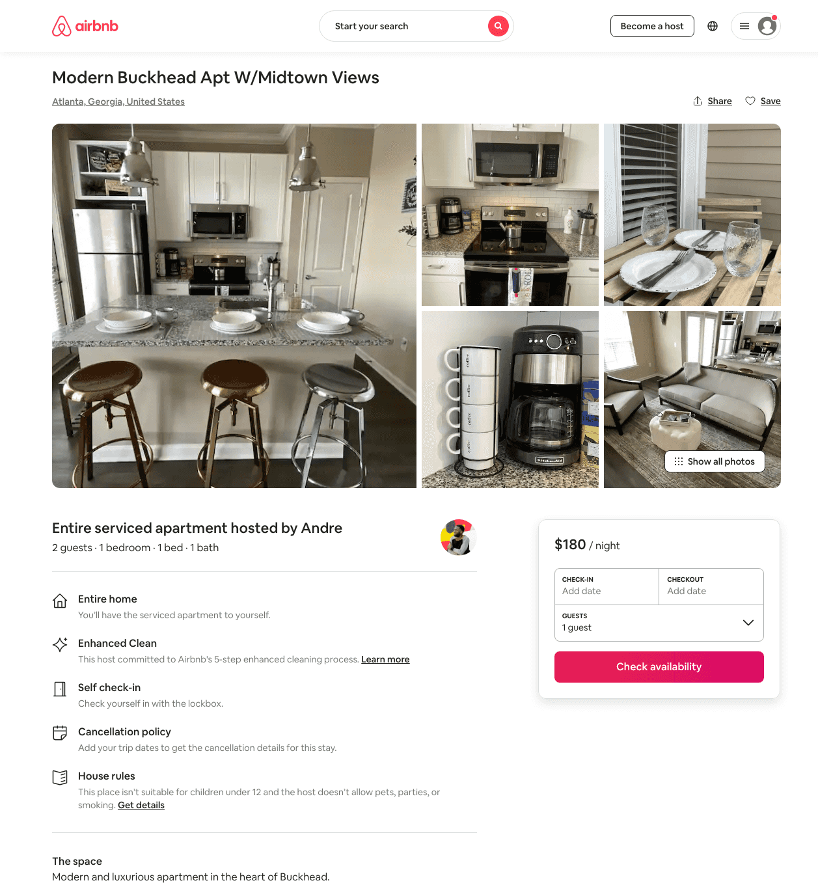
Listing 11401195
1
2
$86 - $333
4.72
1
Andre
48441579
2
https://www.airbnb.com/rooms/11401195
Aug 2022

Slide 11
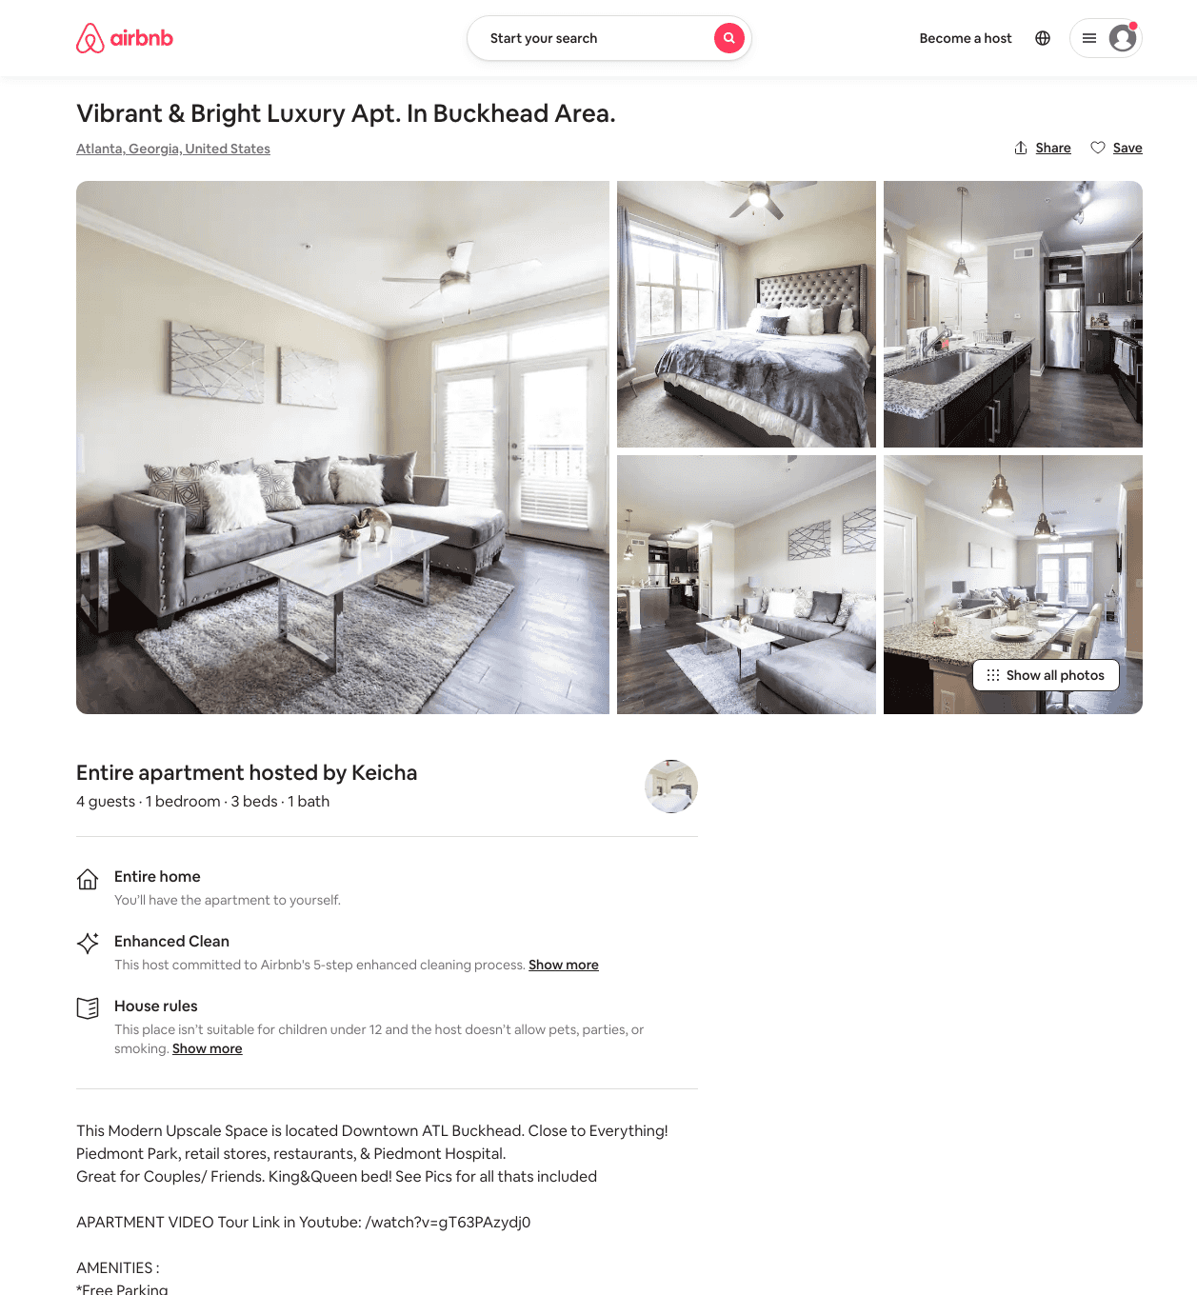
Listing 49425681
1
6
$100 - $189
4.79
30
Kay
324272705
1
https://www.airbnb.com/rooms/49425681
Jul 2022

Slide 12
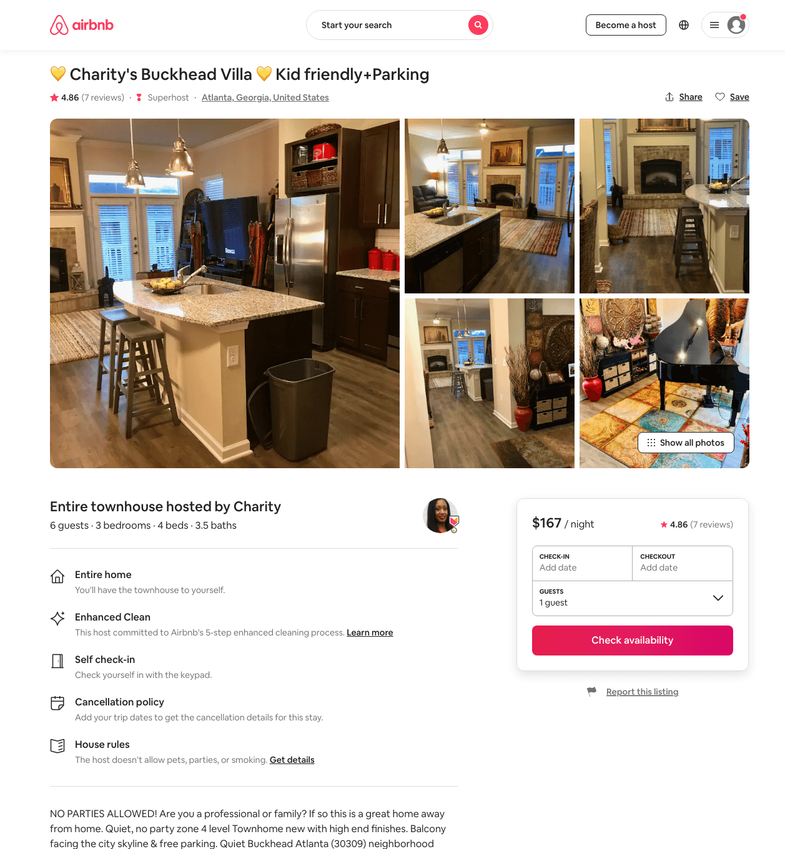
Listing 43533209
3
6
$118 - $185
4.96
4
Charity
44792815
1
https://www.airbnb.com/rooms/43533209
Aug 2022

Slide 13
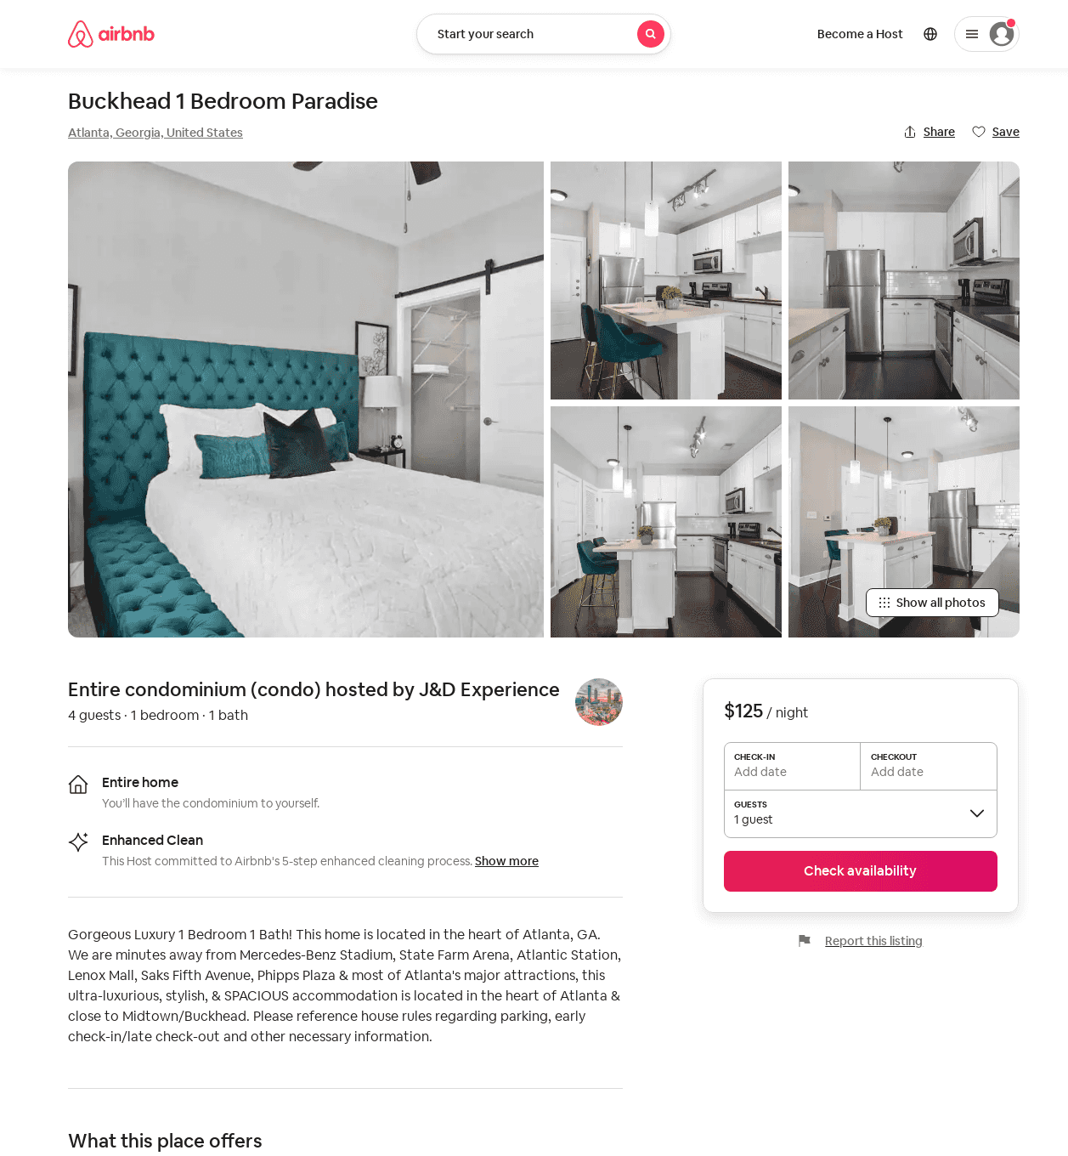
Listing 53202909
1
4
$85 - $131
4.0
2
J&D Experience
430703714
2
https://www.airbnb.com/rooms/53202909
Aug 2022

Slide 14
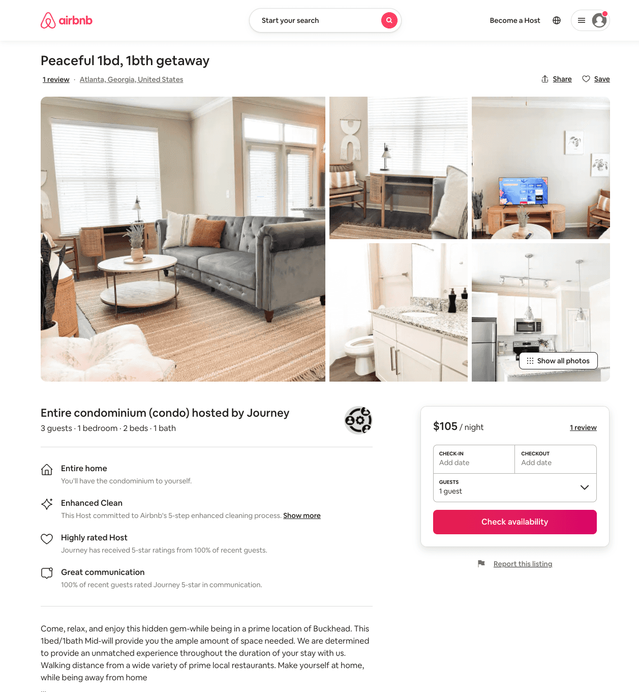
Listing 54113376
1
3
$80 - $105
4.45
1
Journey
438495392
3
https://www.airbnb.com/rooms/54113376
Aug 2022

Slide 15
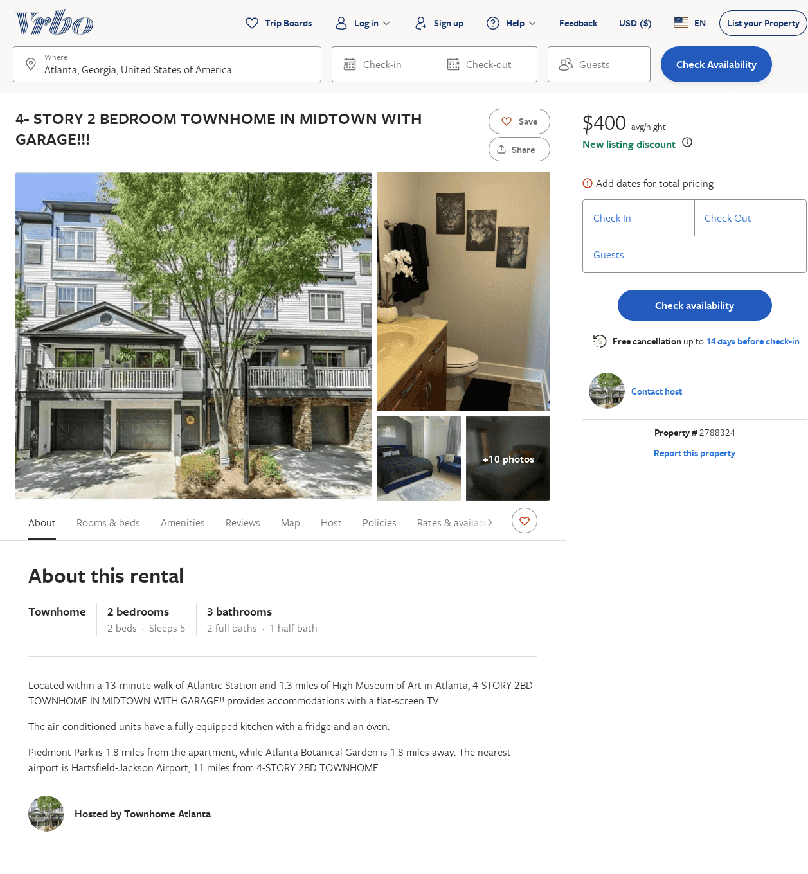
Listing 2788324
2
5
$400
2
https://www.vrbo.com/2788324
Aug 2022

Slide 16
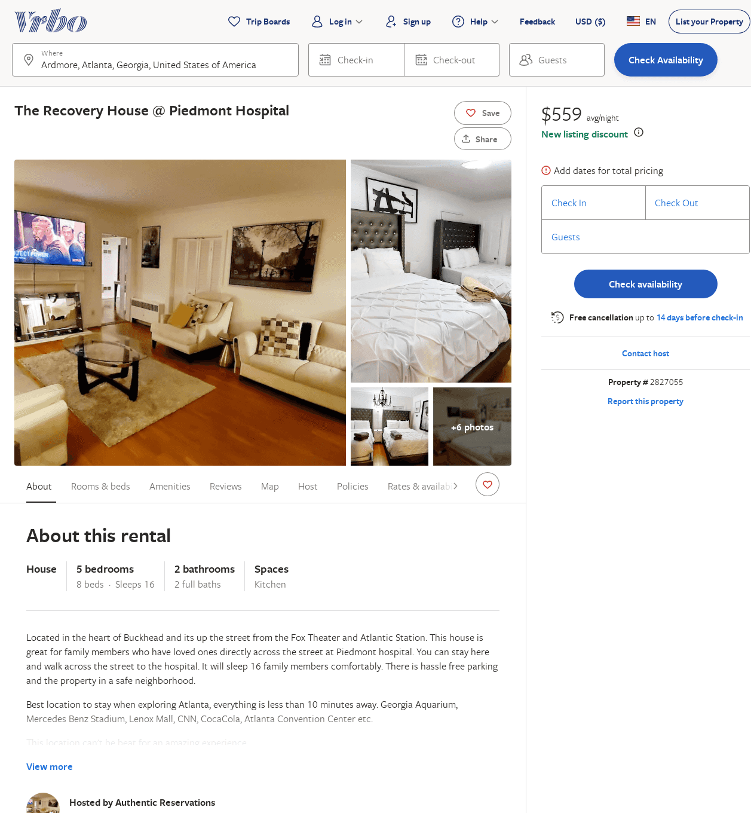
Listing 2827055
5
16
$425
2
Authentic Reservations
https://www.vrbo.com/2827055
Aug 2022

