Slide 2
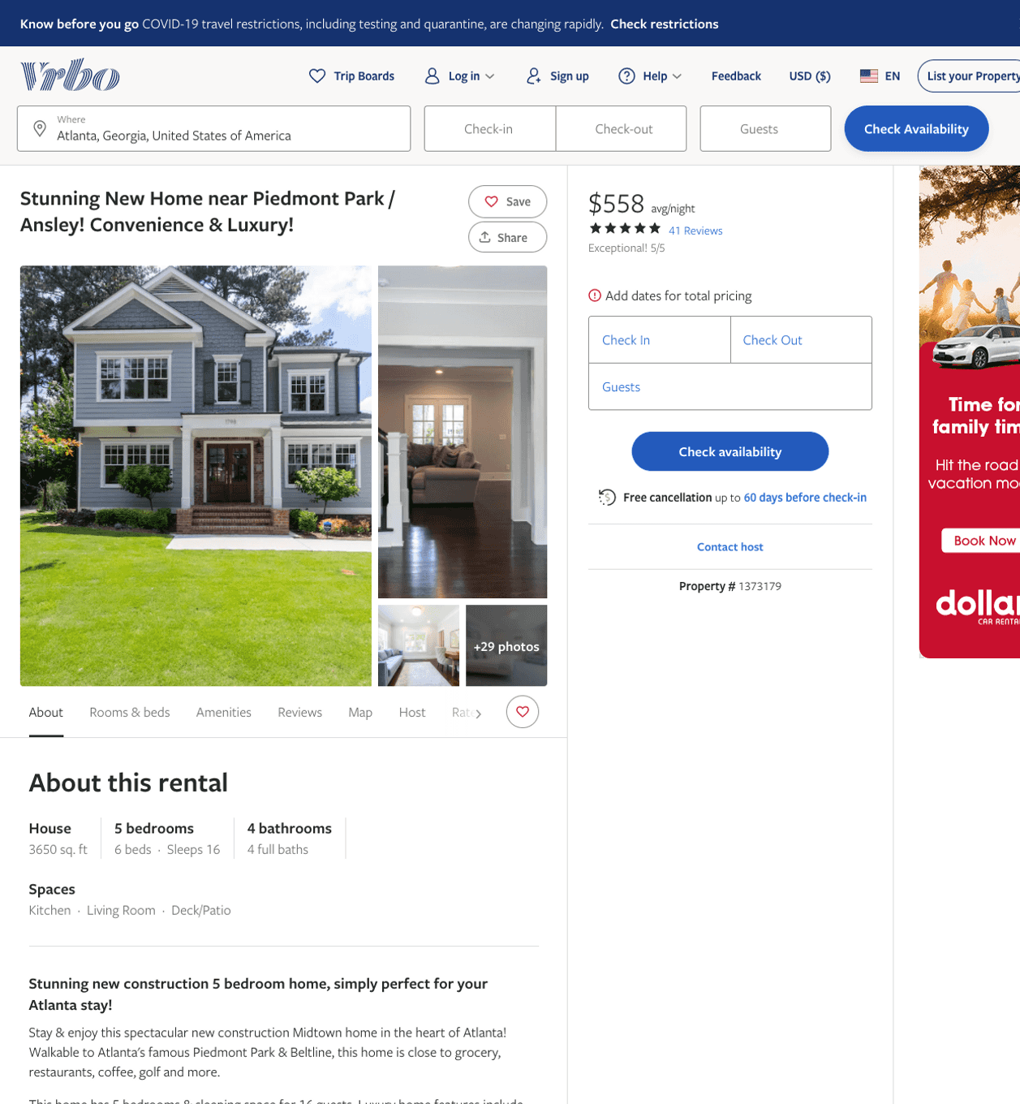
Listing 1373179
5
16
$400 - $571
4.9074073
1
Michael
https://www.vrbo.com/1373179
Aug 2022

Slide 3
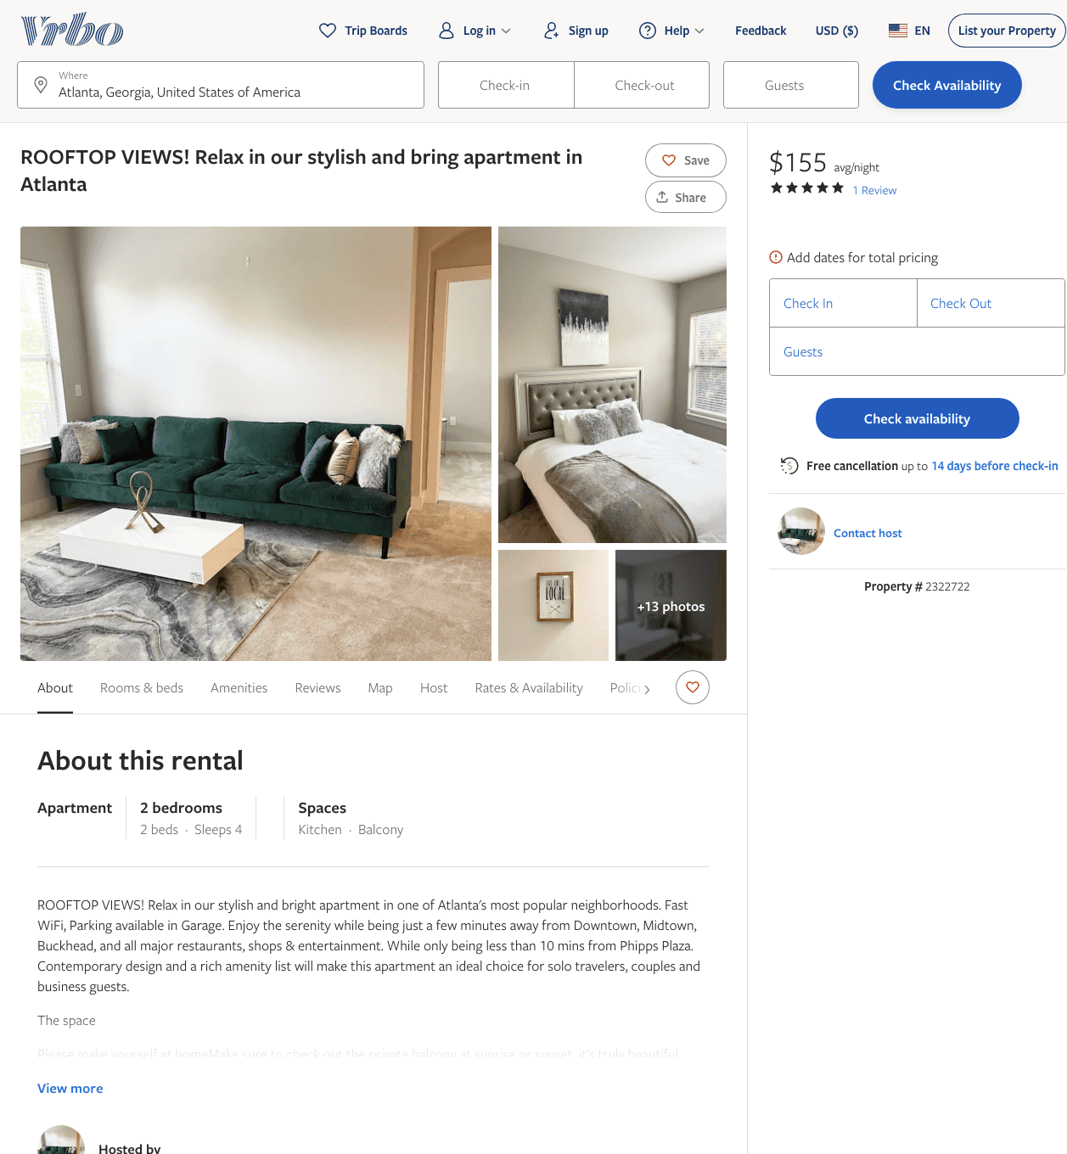
Listing 2322722
2
4
$155 - $198
5
2
https://www.vrbo.com/2322722
Aug 2022

Slide 4
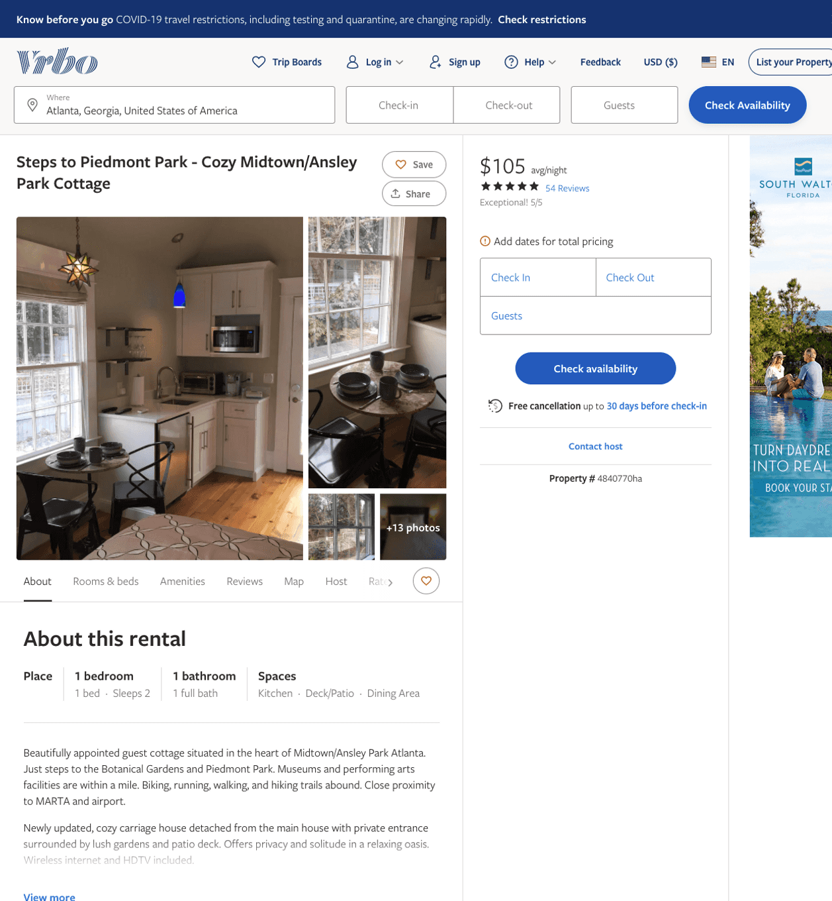
Listing 4840770
1
2
$105 - $113
4.983871
2
Greg Ziomek
https://www.vrbo.com/4840770ha
Aug 2022

Slide 5
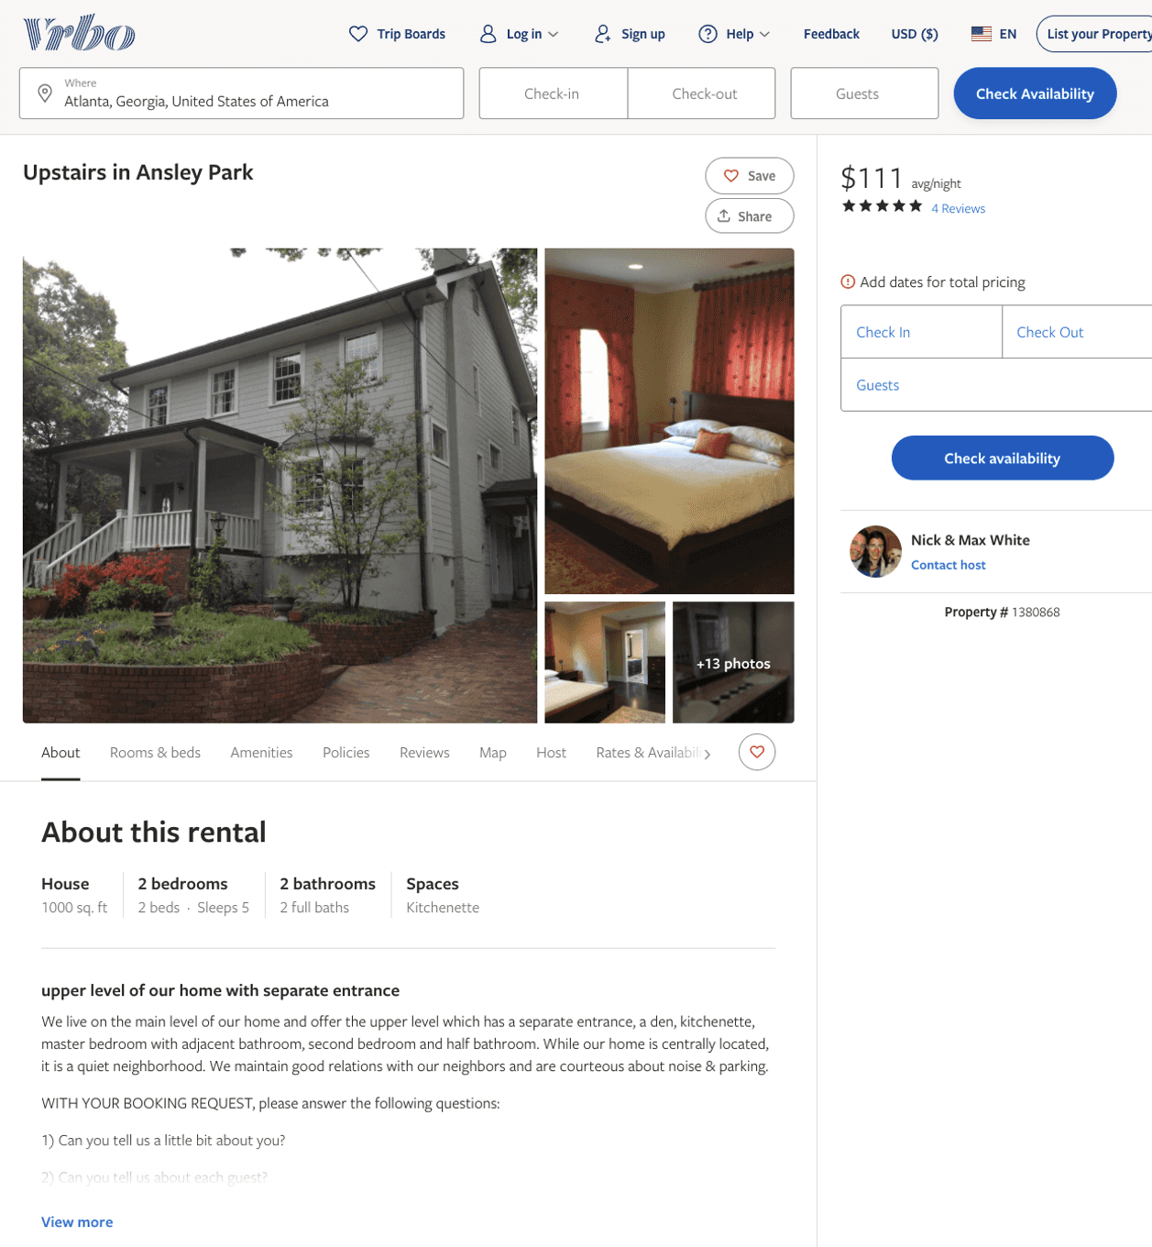
Listing 1380868
2
5
$111 - $94
5
30
Nick & Max White
https://www.vrbo.com/1380868
Aug 2022

Slide 6
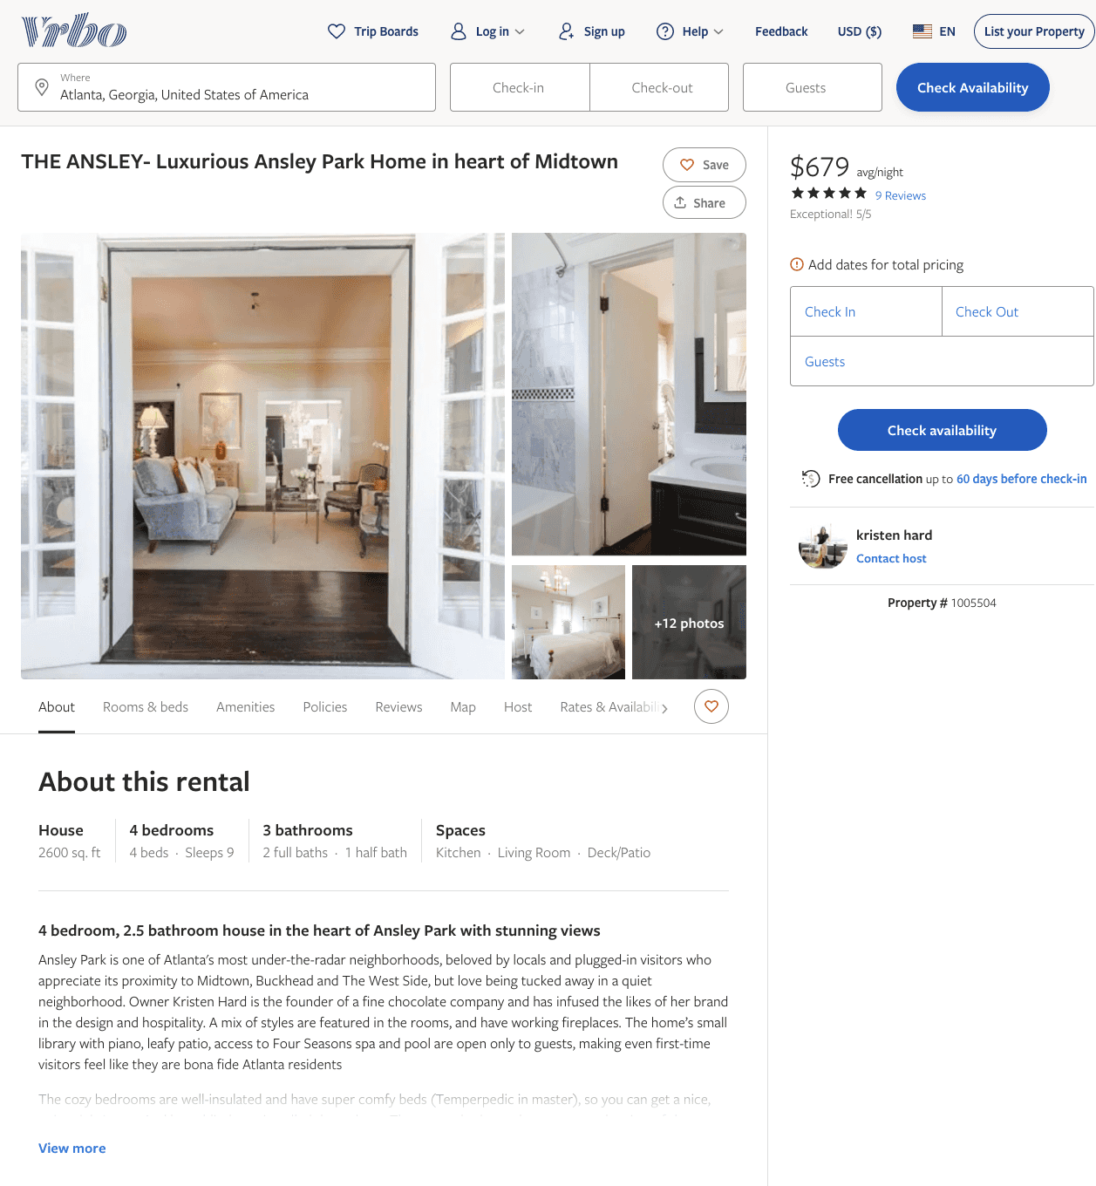
Listing 1005504
4
9
$616 - $679
5
2
kristen hard
https://www.vrbo.com/1005504
Aug 2022

Slide 7
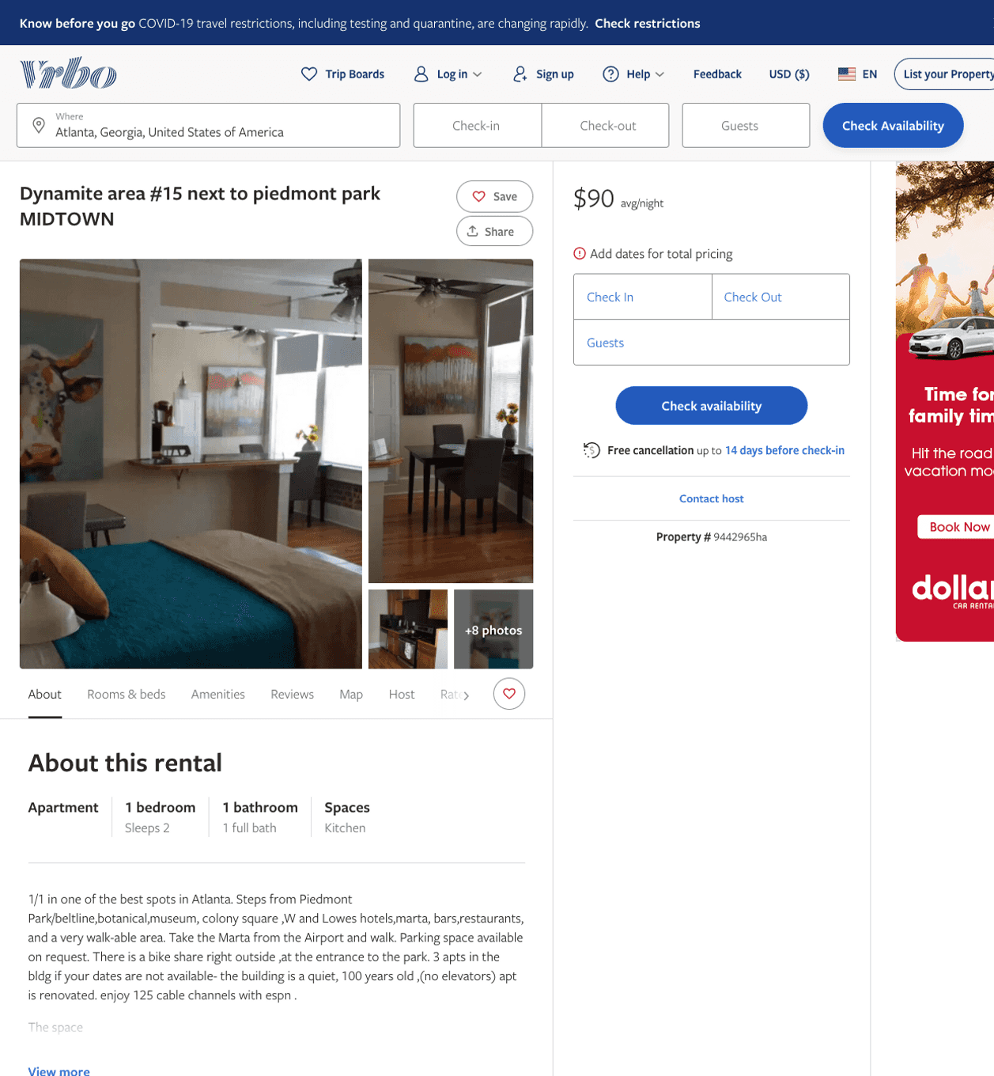
Listing 9442965
1
2
$90 - $93
1
shelley dean
https://www.vrbo.com/9442965ha
Aug 2022

Slide 8
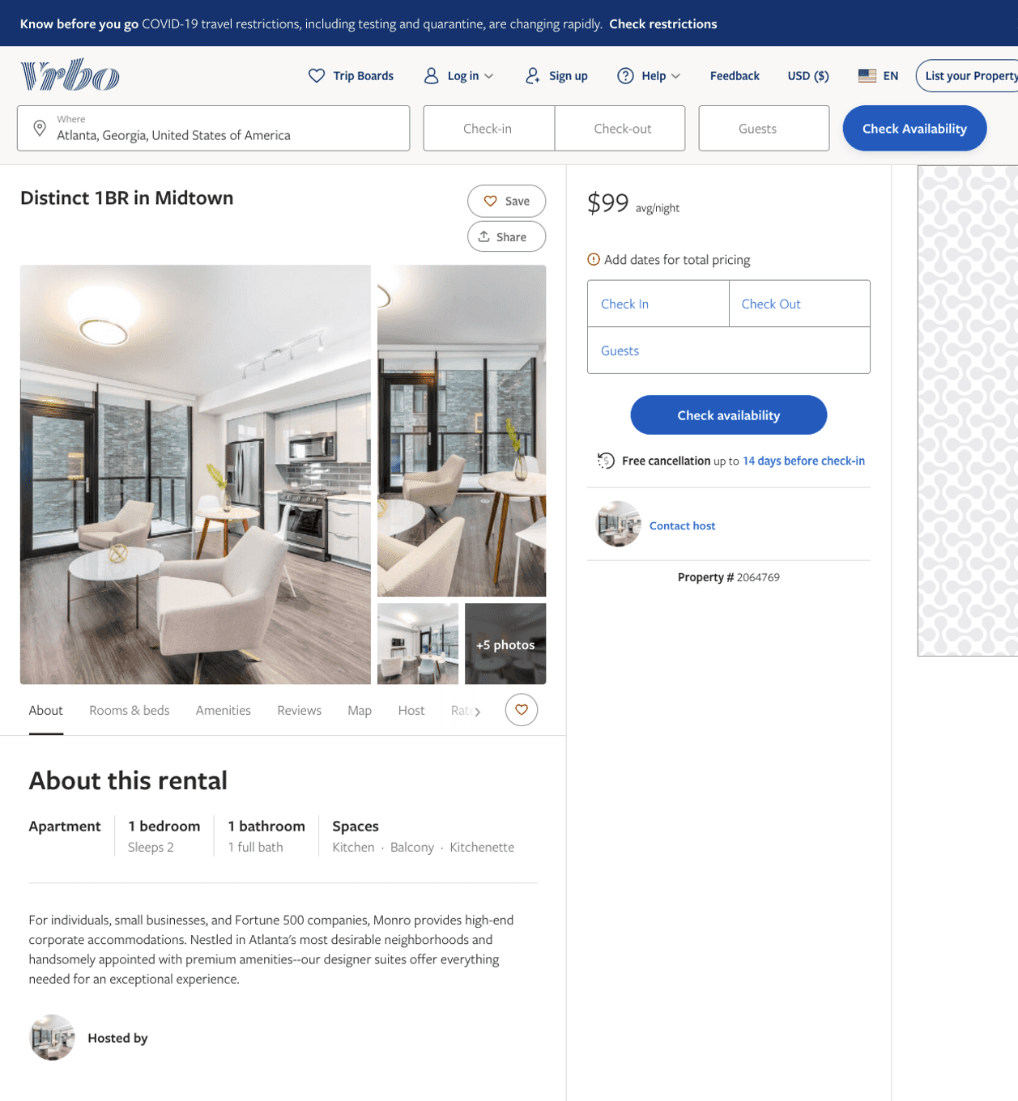
Listing 2064769
1
2
$99
30
https://www.vrbo.com/2064769
Aug 2022

Slide 9
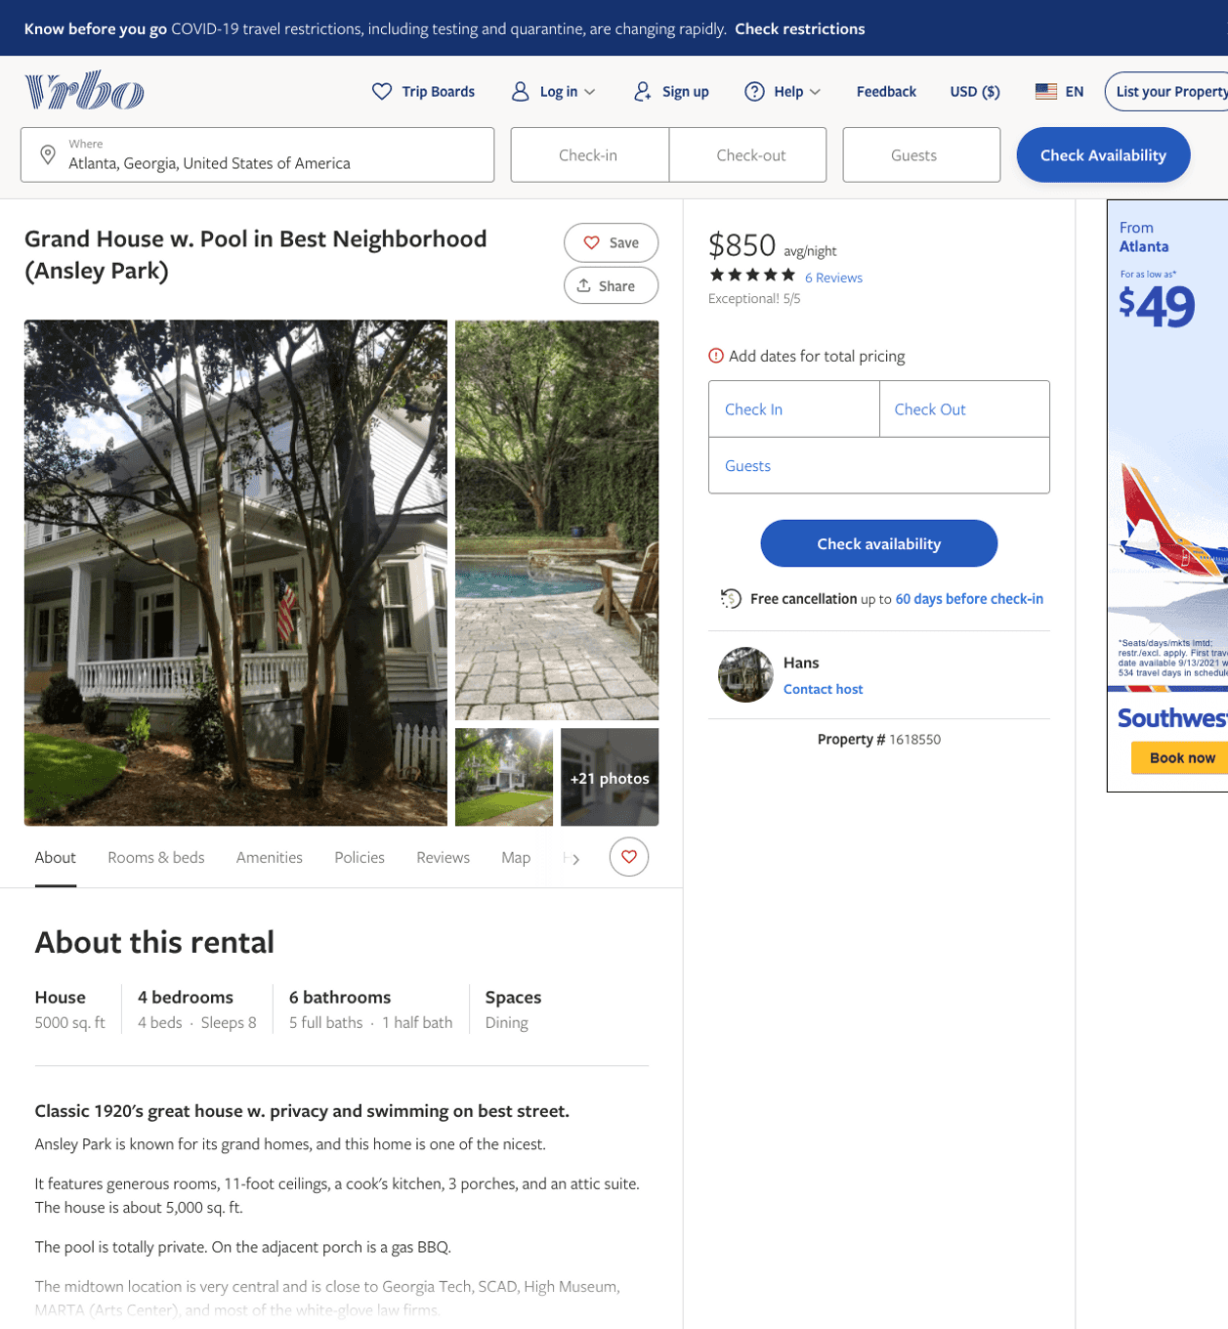
Listing 1618550
4
8
$850
5
3
Hans
https://www.vrbo.com/1618550
Aug 2022

Slide 10
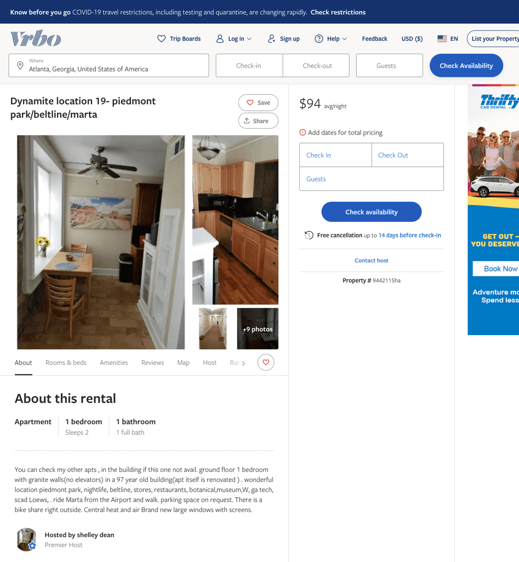
Listing 9442115
1
2
$90 - $94
1
shelley dean
https://www.vrbo.com/9442115ha
Aug 2022

Slide 11
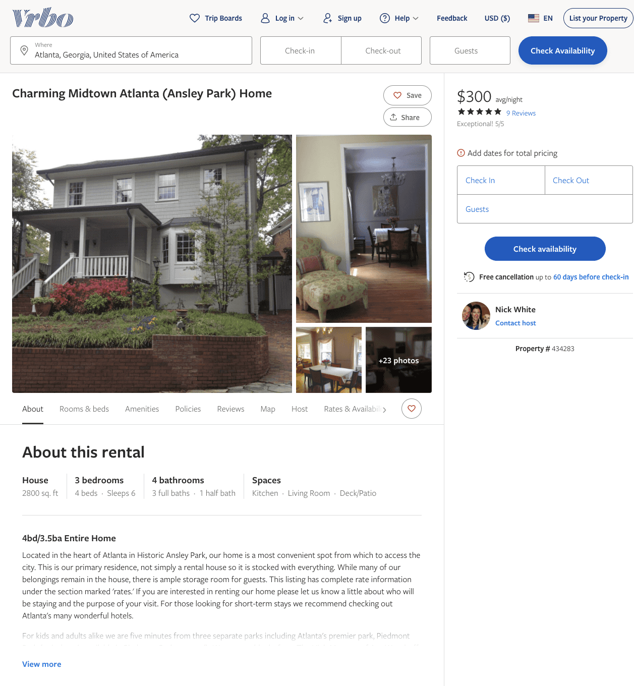
Listing 434283
3
6
$300
5
30
Nick White
https://www.vrbo.com/434283
Aug 2022

Slide 12
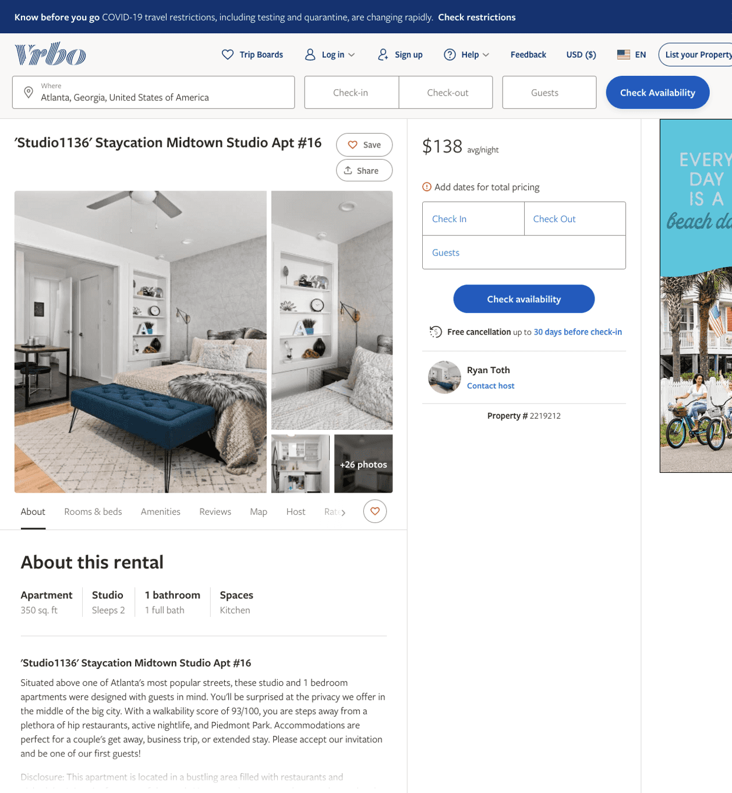
Listing 2219212
0
2
$104 - $166
1
Stay-ATL
https://www.vrbo.com/2219212
Aug 2022

Slide 13
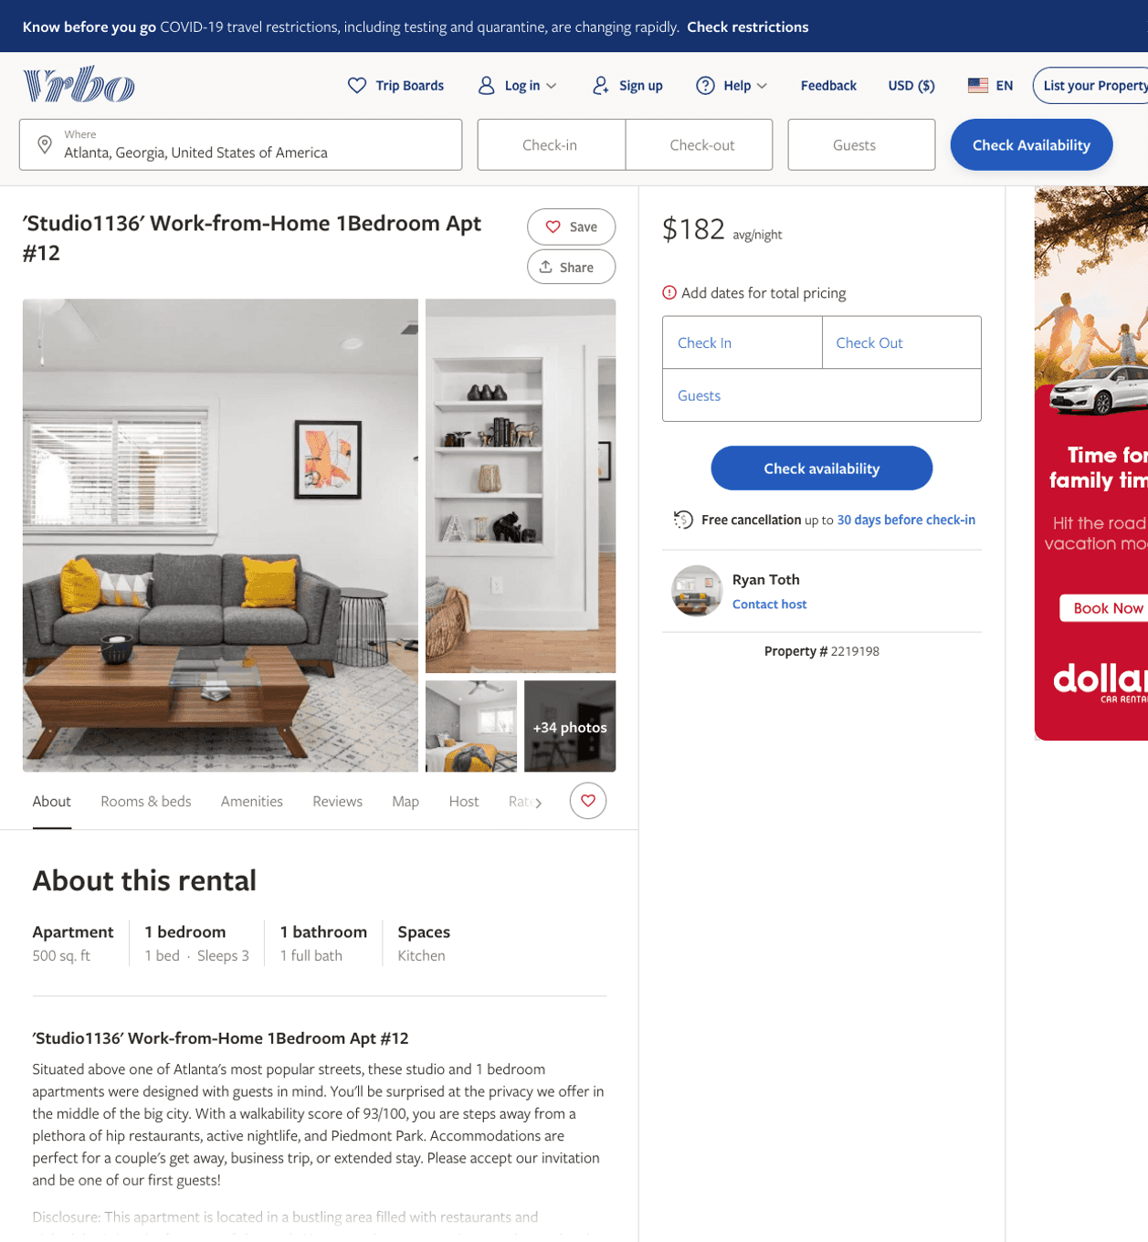
Listing 2219198
1
3
$111 - $188
1
Stay-ATL
https://www.vrbo.com/2219198
Aug 2022

Slide 14
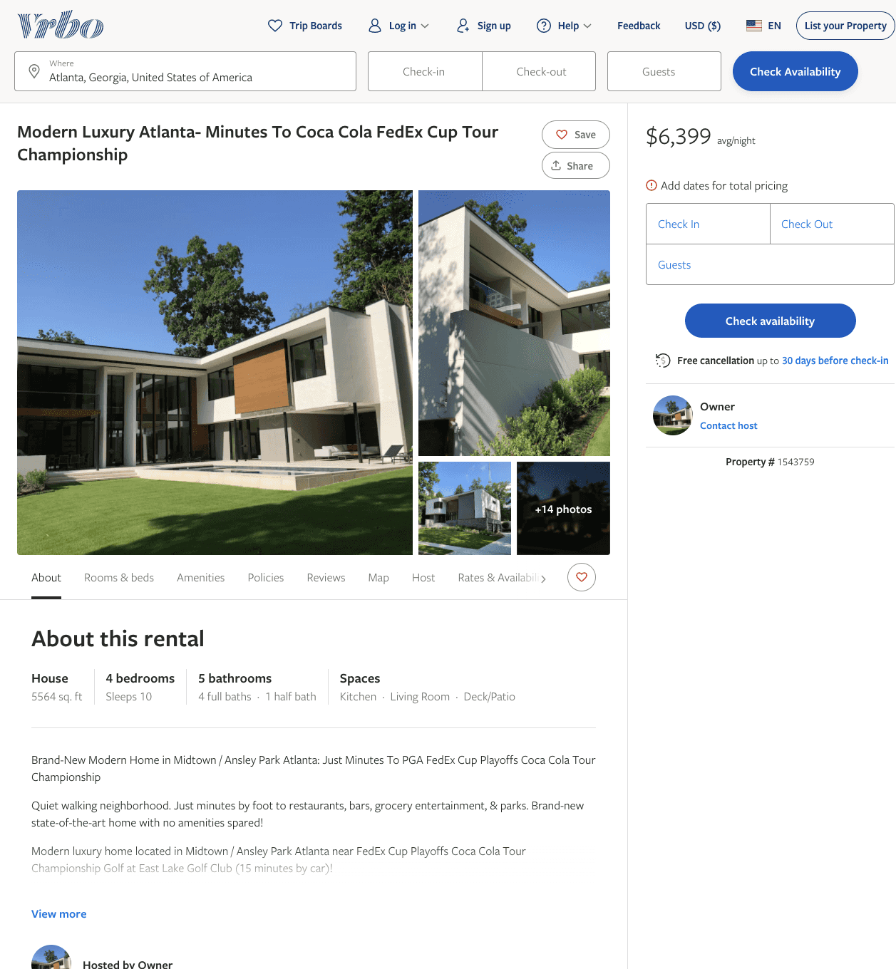
Listing 1543759
4
10
$6,399 - $7,999
4
Owner
https://www.vrbo.com/1543759
Aug 2022

Slide 15
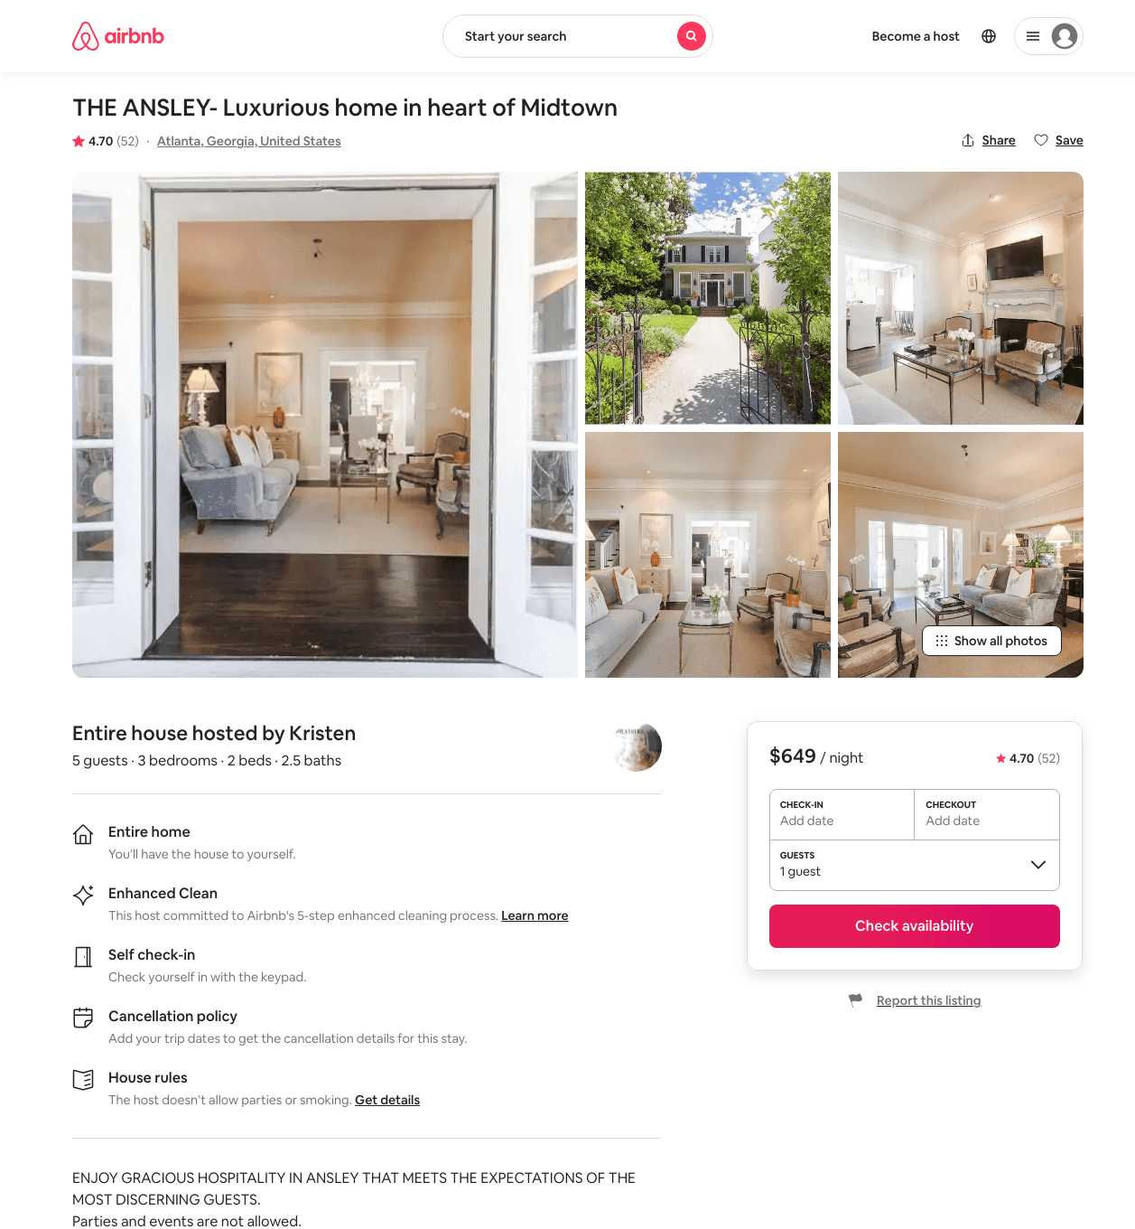
Listing 1811970
3
7
$563 - $649
4.69
2
Kristen
5115928
1
https://www.airbnb.com/rooms/1811970
Aug 2022

Slide 16
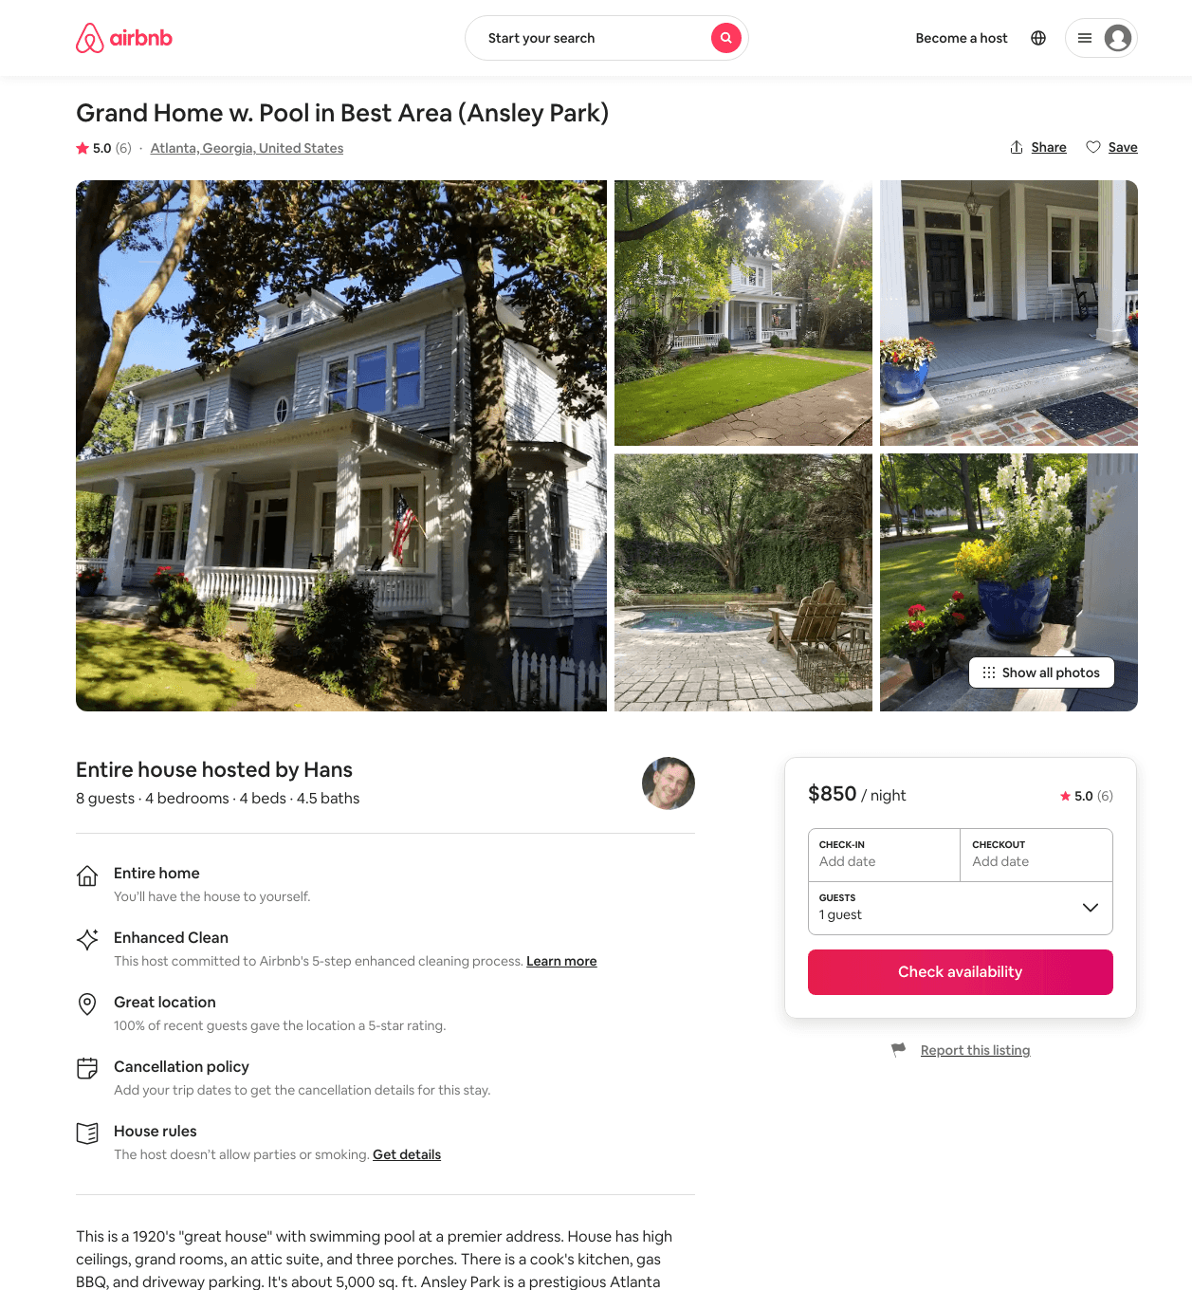
Listing 31468774
4
8
$764 - $860
5.0
3
Hans
2350523
1
https://www.airbnb.com/rooms/31468774
Aug 2022

Slide 17
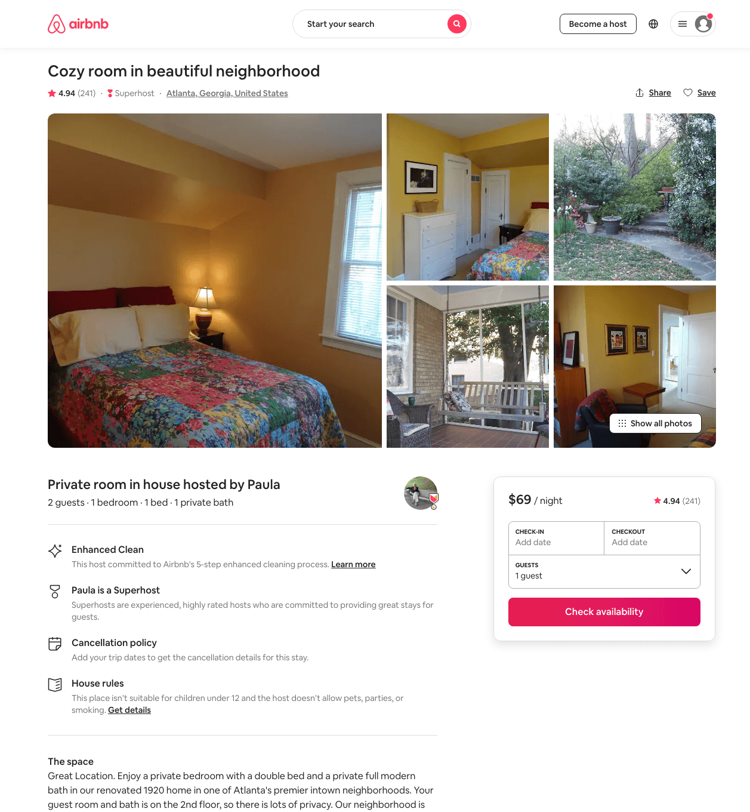
Listing 1034764
1
2
$68 - $70
4.94
1
Paula And Chuck
3311000
1
https://www.airbnb.com/rooms/1034764
Aug 2022

Slide 18
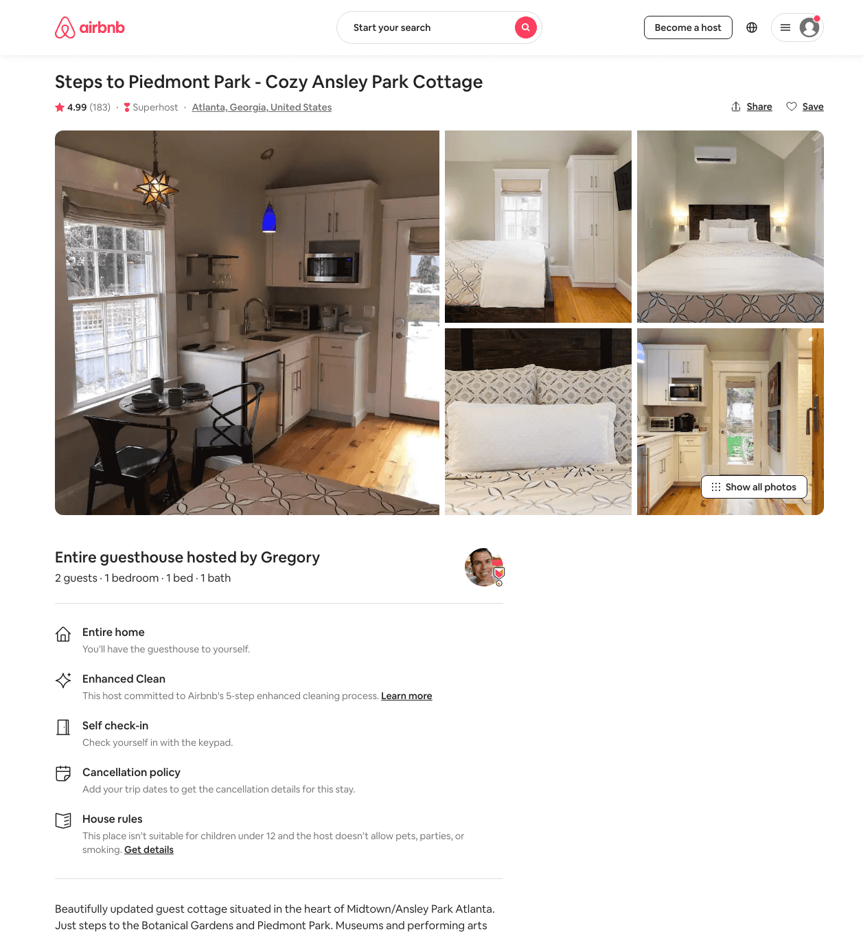
Listing 20600794
1
2
$94 - $119
4.98
2
Gregory
26670230
1
https://www.airbnb.com/rooms/20600794
Aug 2022

Slide 19
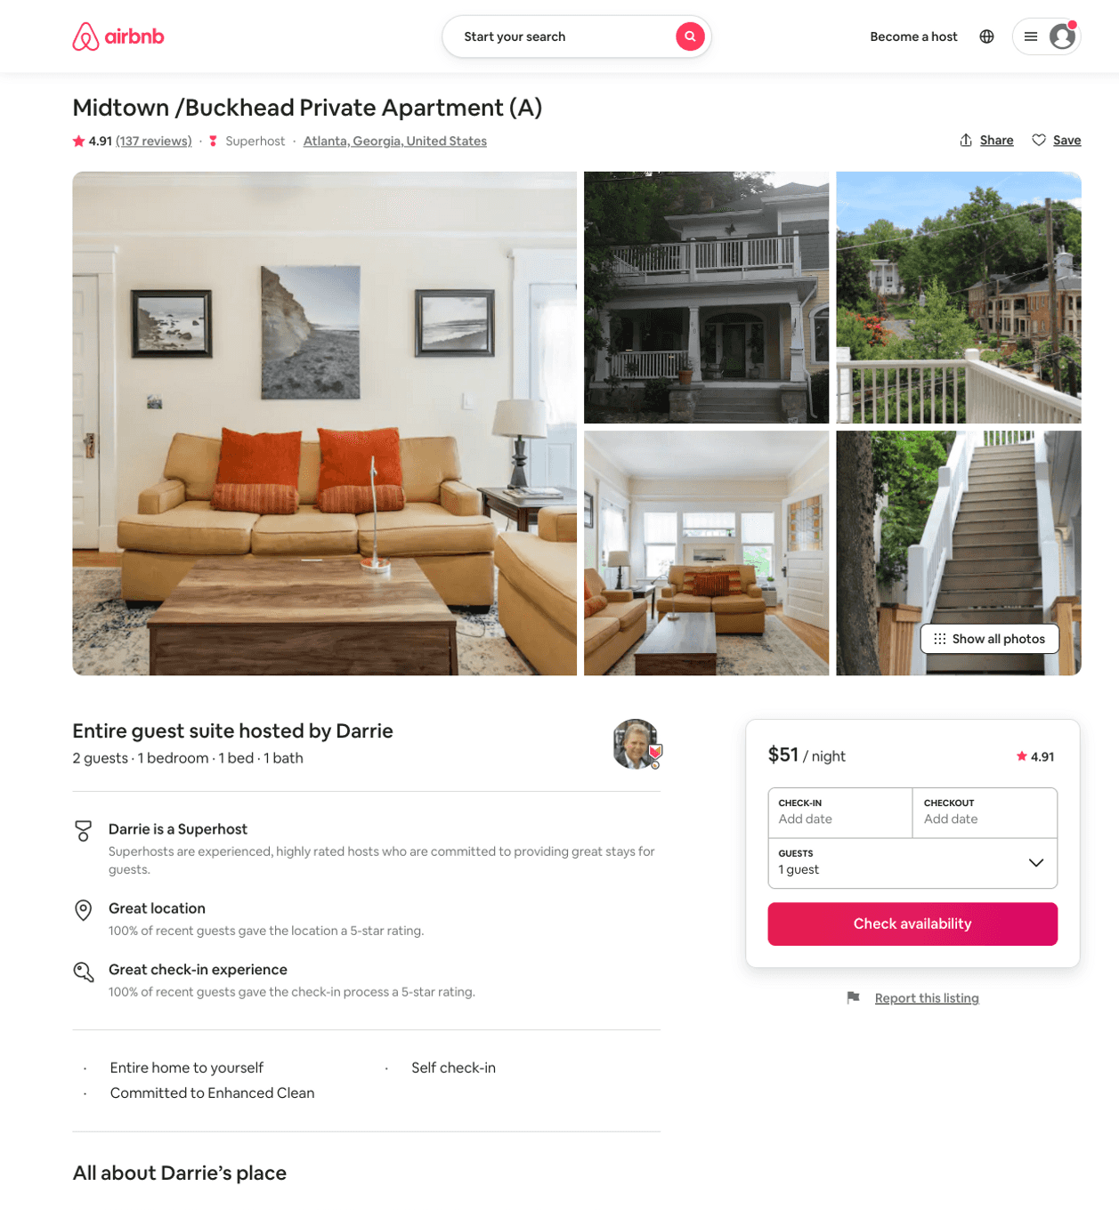
Listing 21630310
1
2
$50 - $75
4.89
2
Darrie
5959330
2
https://www.airbnb.com/rooms/21630310
Aug 2022

Slide 20
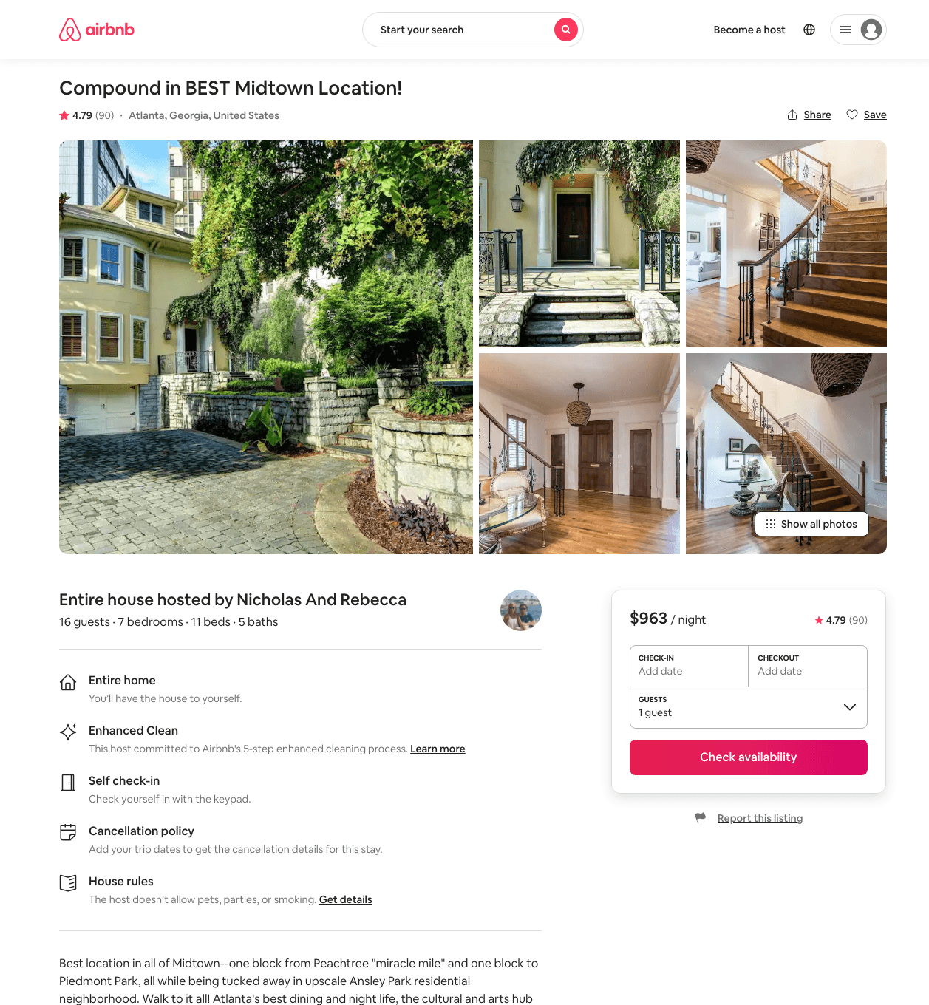
Listing 21009897
7
16
$785 - $1563
4.84
1
Nicholas And Rebecca
42640004
4
https://www.airbnb.com/rooms/21009897
Aug 2022

Slide 21
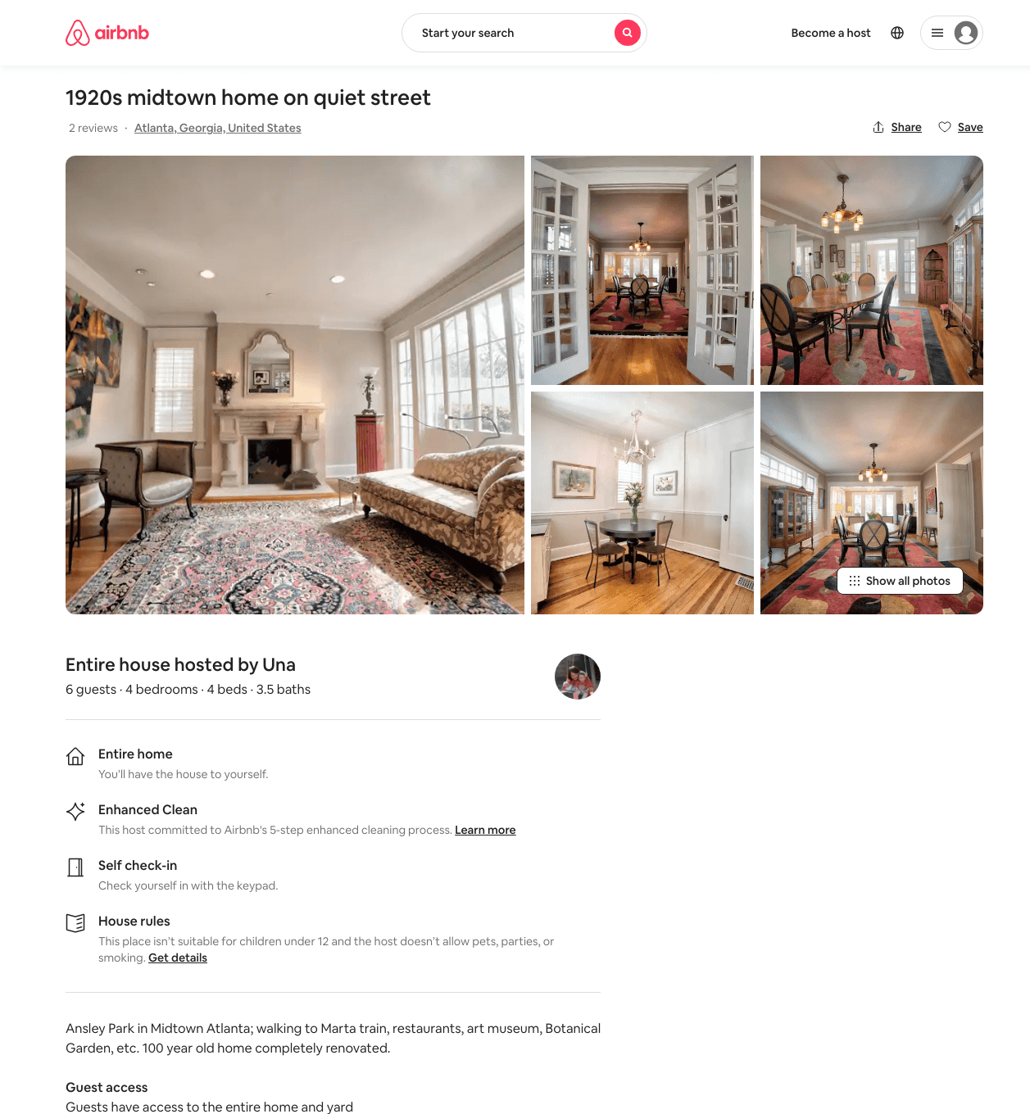
Listing 21066036
4
6
$450 - $500
4.86
4
Una
74862708
1
https://www.airbnb.com/rooms/21066036
Aug 2022

Slide 22
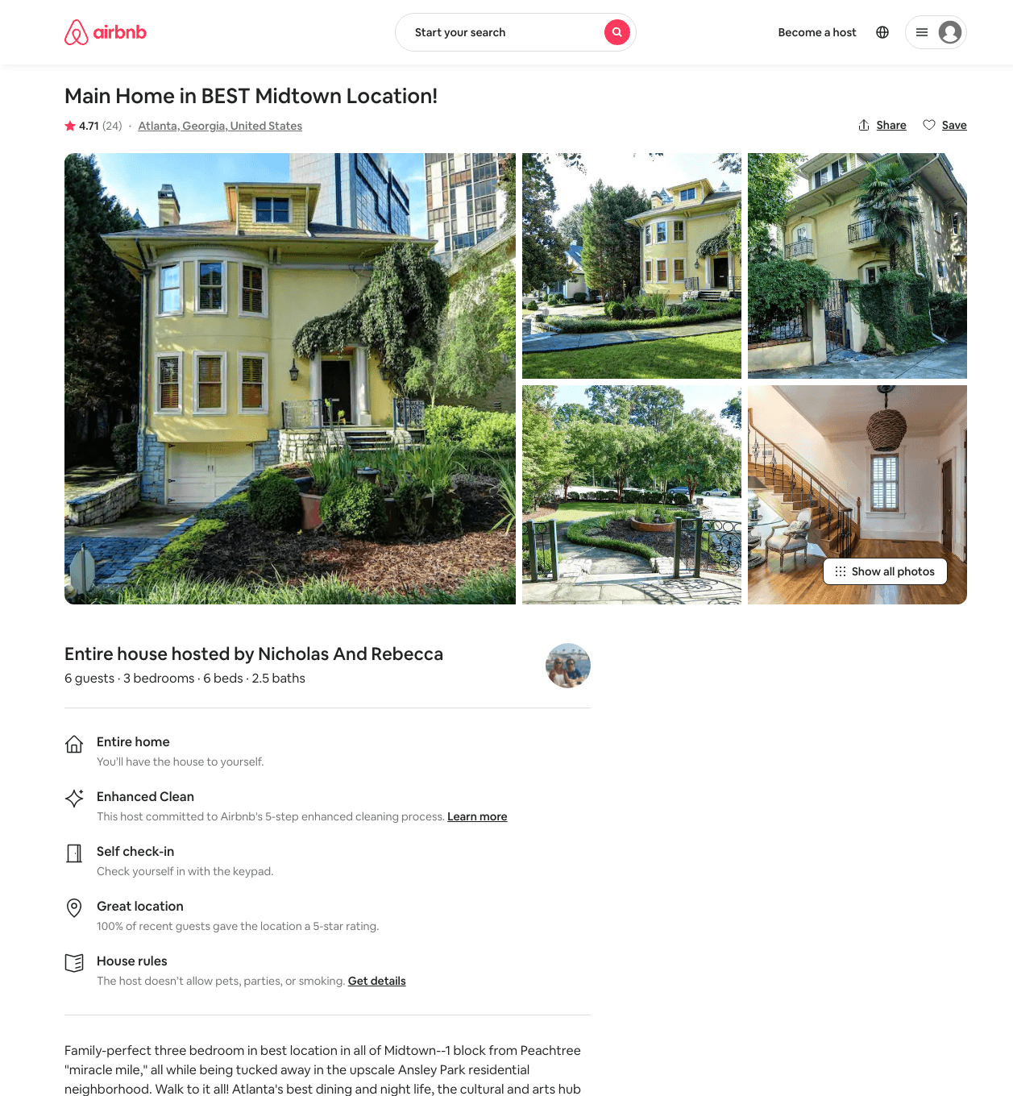
Listing 21008688
3
6
$349 - $857
4.77
1
Nicholas And Rebecca
42640004
4
https://www.airbnb.com/rooms/21008688
Aug 2022

Slide 23
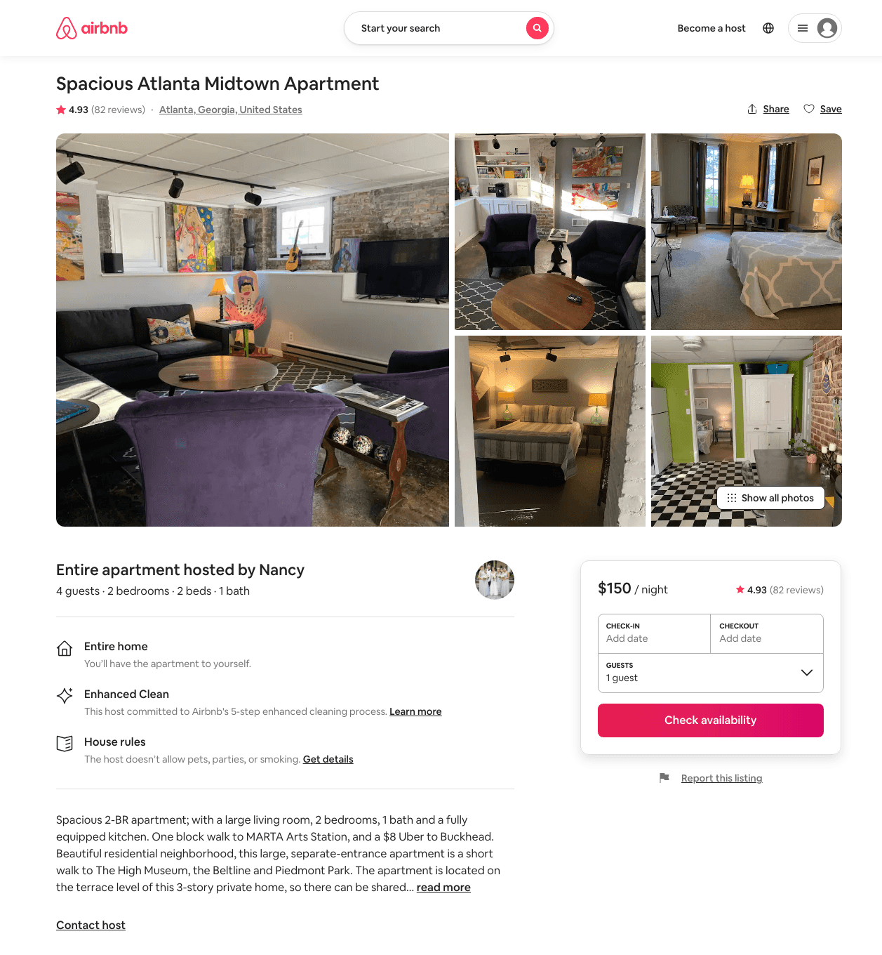
Listing 12271843
2
4
$150 - $171
4.93
2
Nancy
31622221
1
https://www.airbnb.com/rooms/12271843
Jun 2022

Slide 24
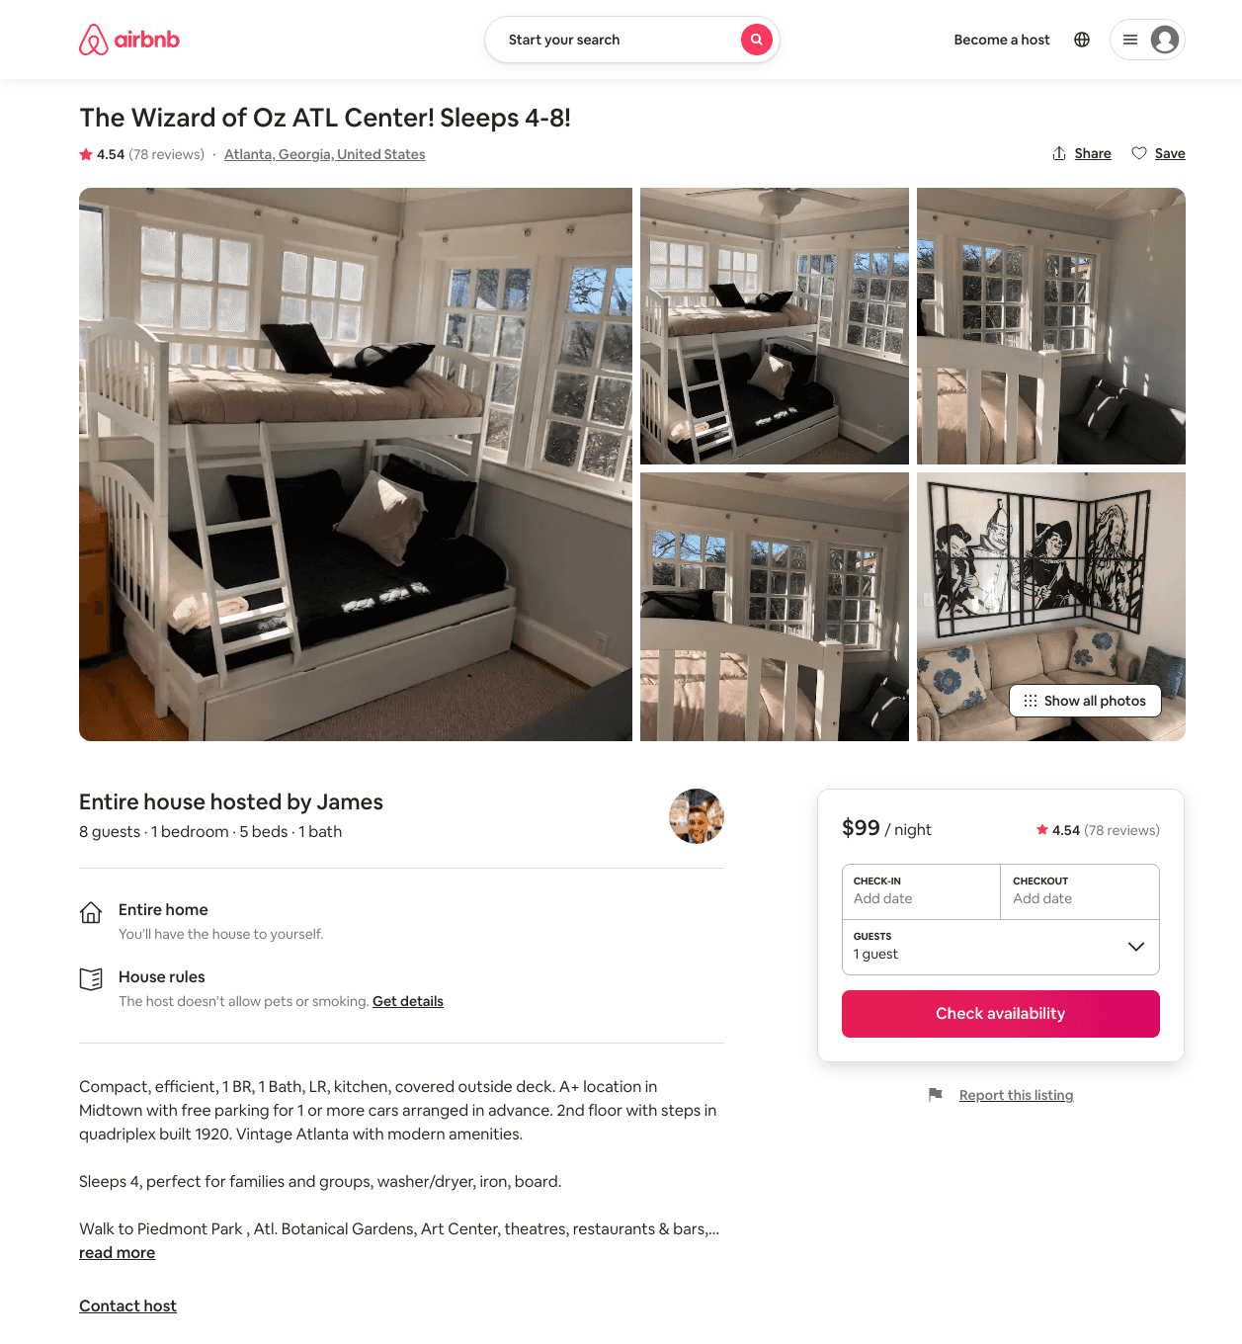
Listing 21476529
1
8
$99
4.54
1
James
391553
1
https://www.airbnb.com/rooms/21476529
Aug 2022

Slide 25
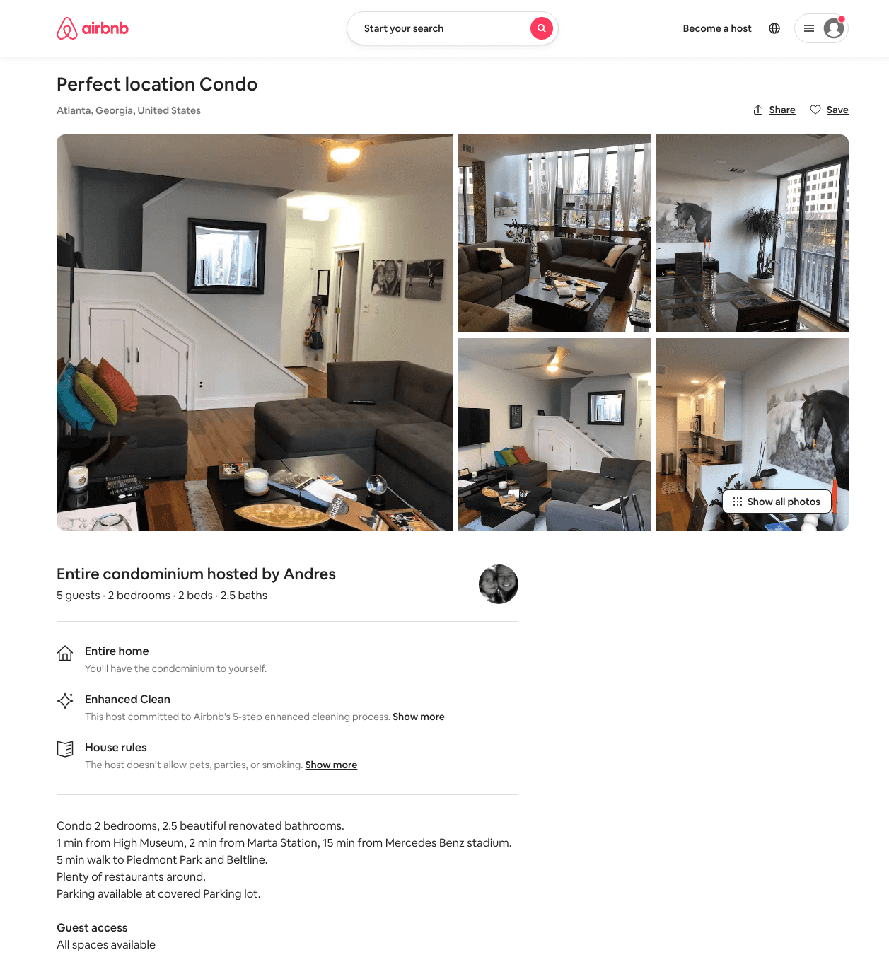
Listing 31381012
2
5
$900
1
Andres
14281677
1
https://www.airbnb.com/rooms/31381012
Aug 2022

Slide 26
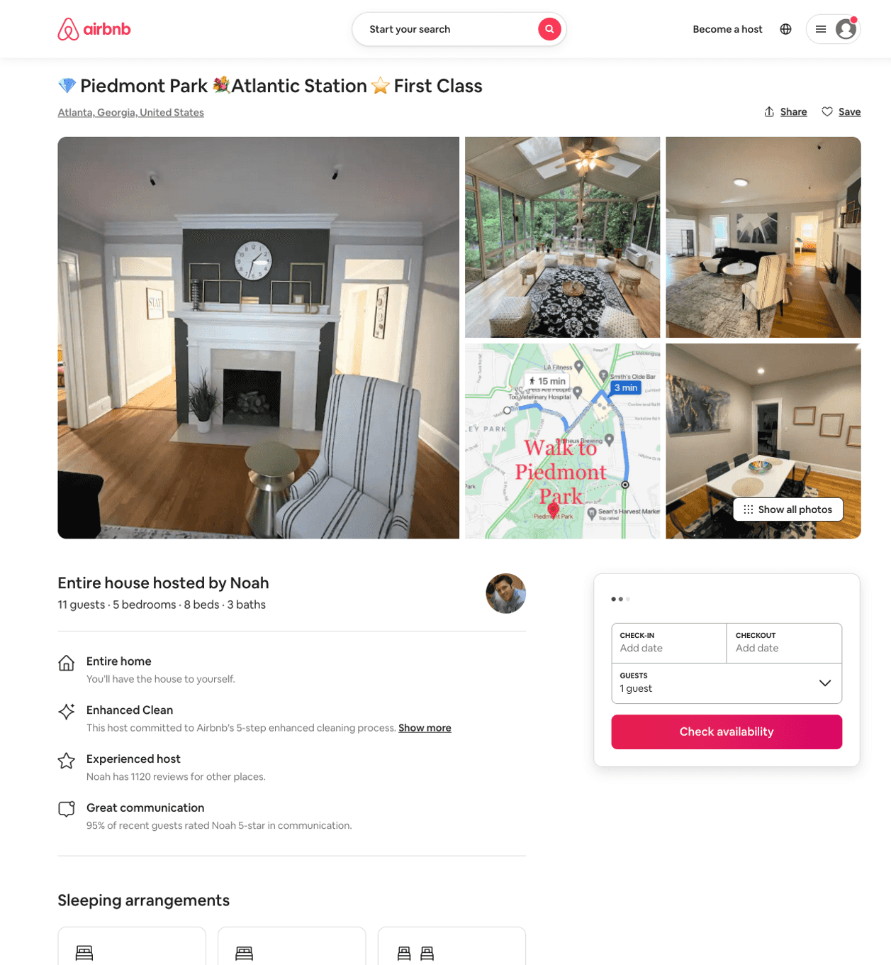
Listing 50447056
5
11
$265 - $607
4.60
7
Noah
2498001
1
https://www.airbnb.com/rooms/50447056
Aug 2022

Slide 27
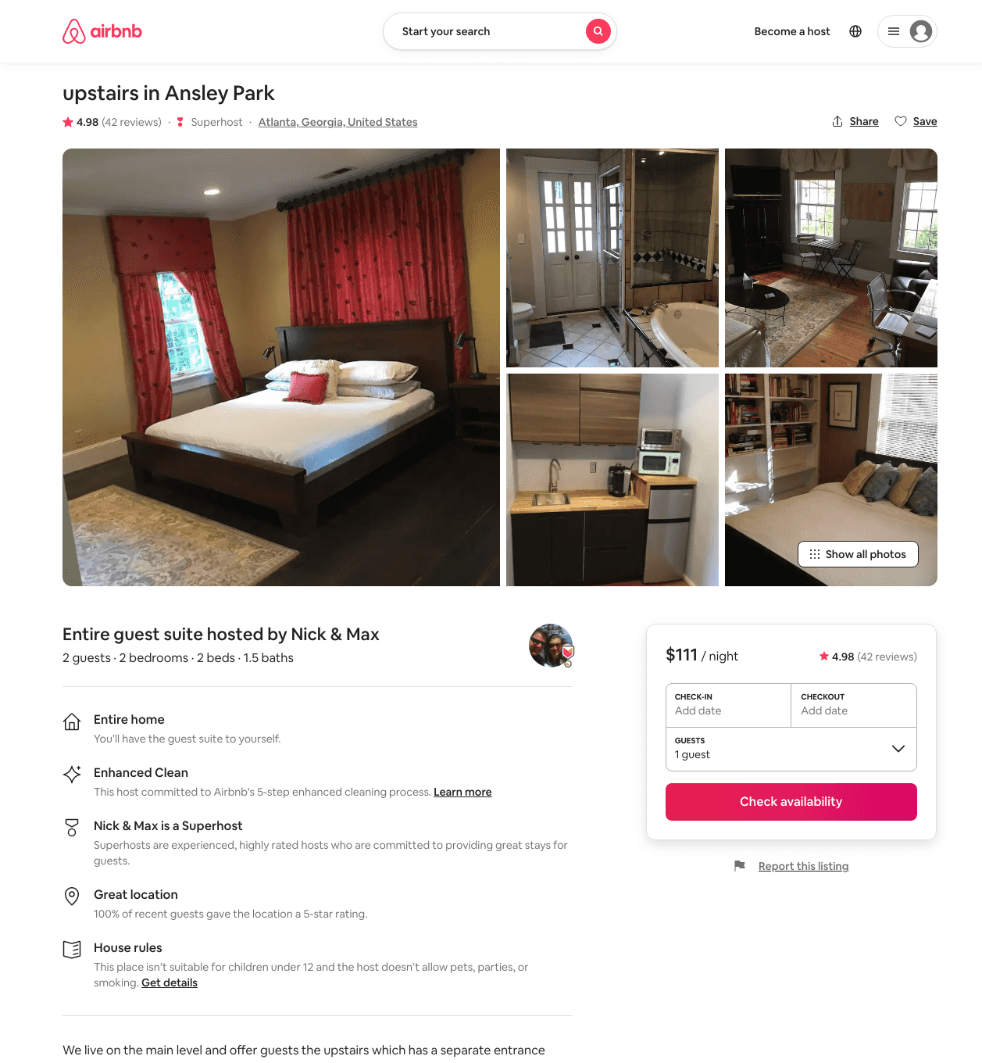
Listing 575417
2
3
$90 - $111
4.98
30
Max
2830220
2
https://www.airbnb.com/rooms/575417
Aug 2022

Slide 28
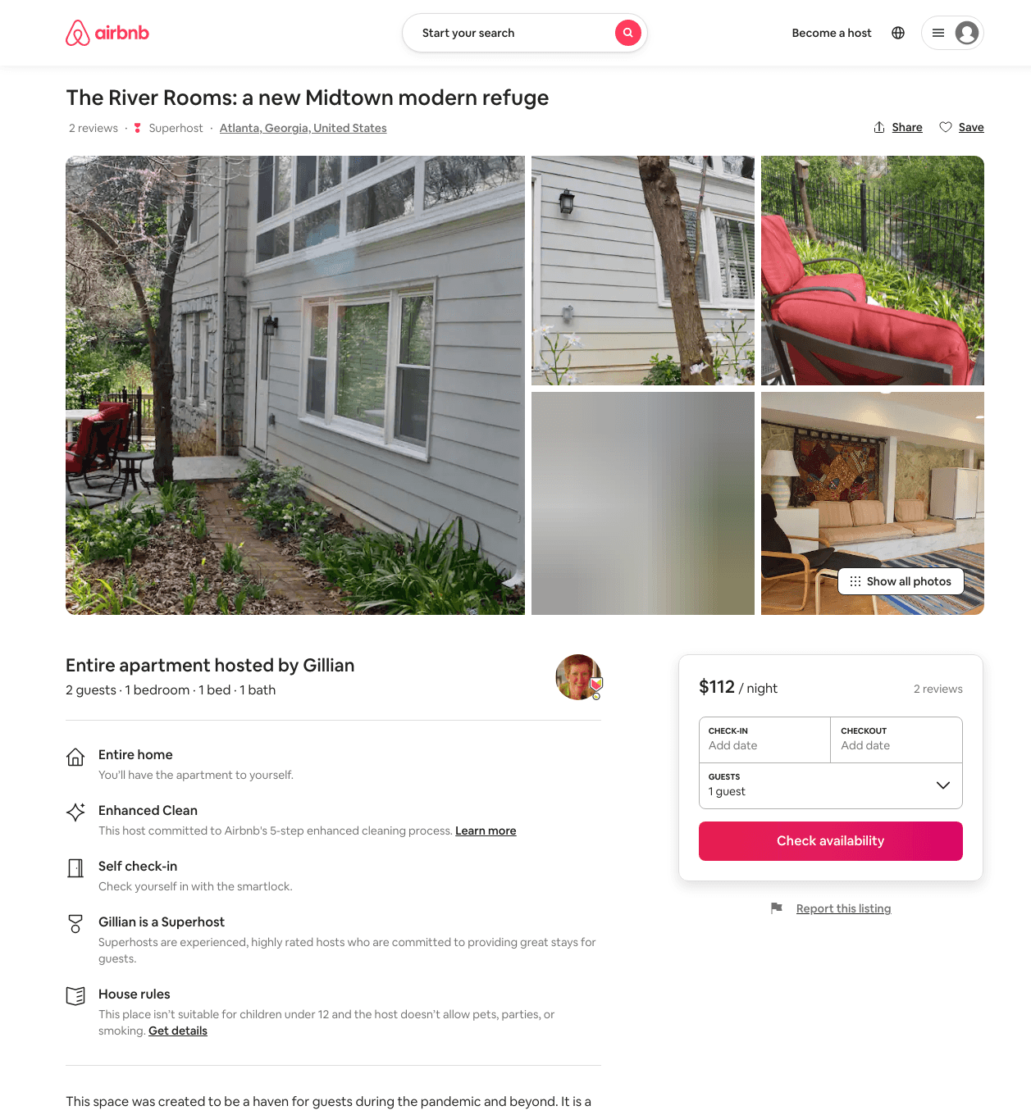
Listing 42472944
1
2
$112 - $120
5.0
4
Gillian
5864344
1
https://www.airbnb.com/rooms/42472944
Aug 2022

Slide 29
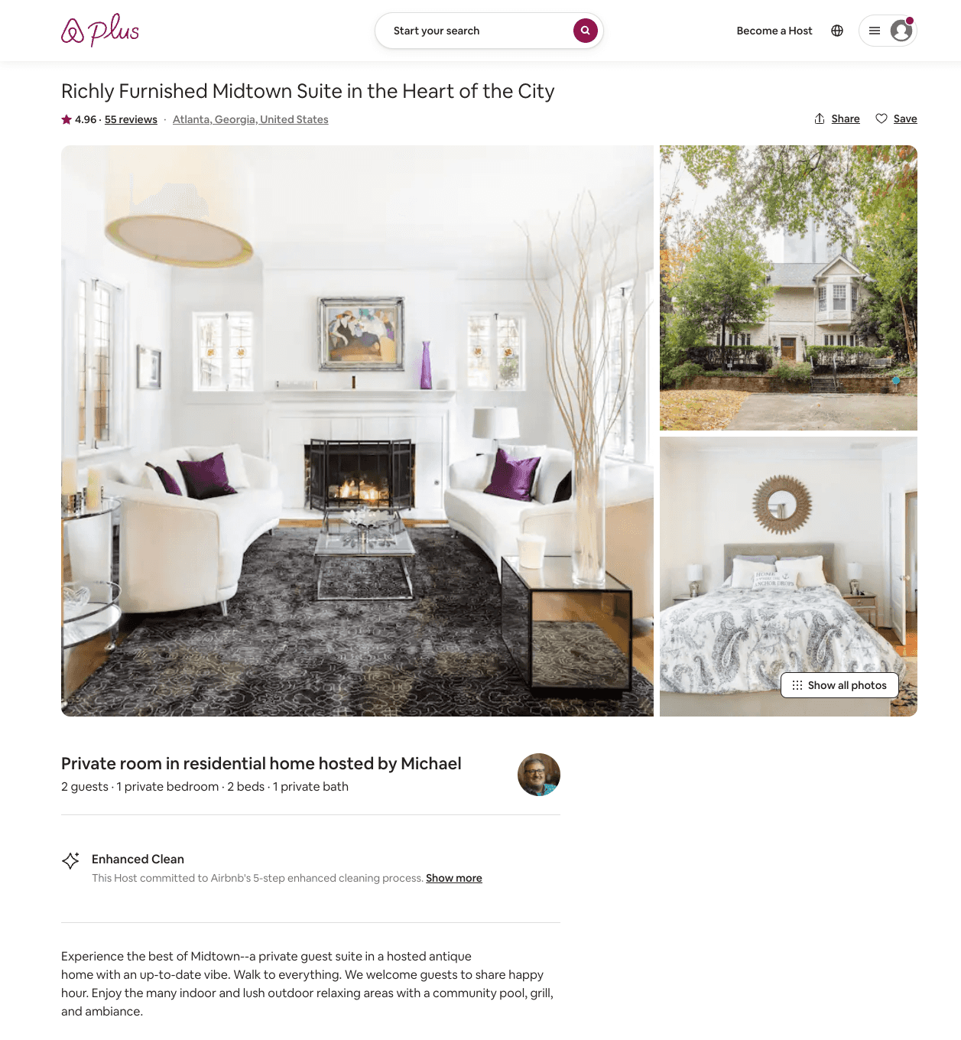
Listing 16573172
1
2
$99 - $122
4.95
2
Michael
1477716
1
https://www.airbnb.com/rooms/16573172
Jul 2022

Slide 30
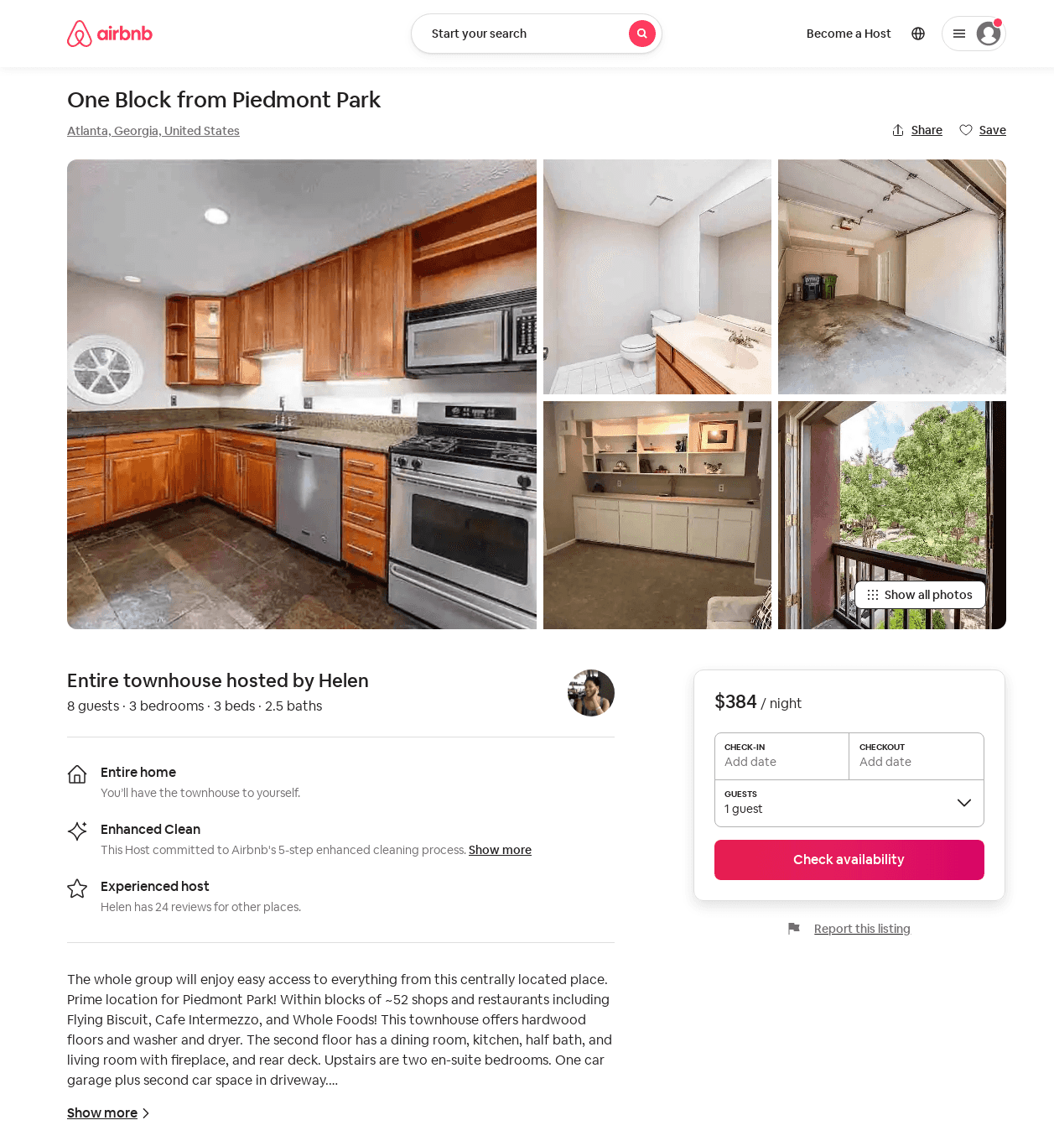
Listing 53195101
3
8
$179 - $400
4.79
2
Helen
2436948
2
https://www.airbnb.com/rooms/53195101
Aug 2022

Slide 31
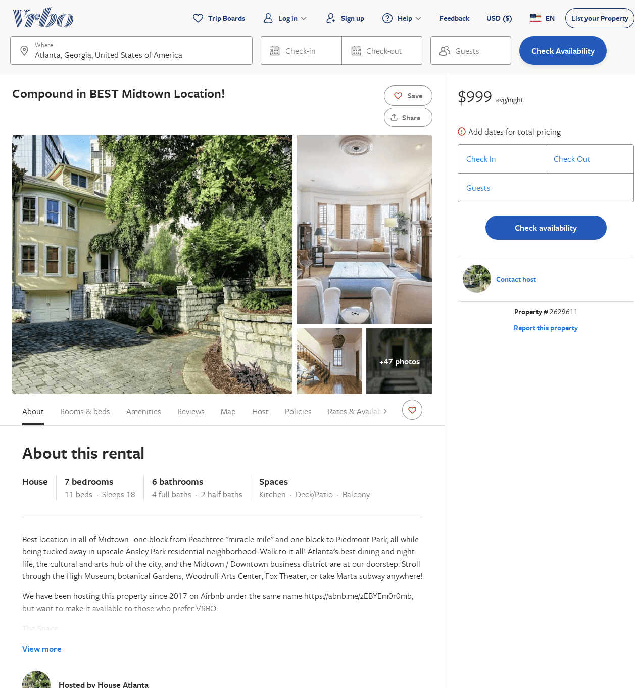
Listing 2629611
7
18
$999
1
https://www.vrbo.com/2629611
Aug 2022

Slide 32
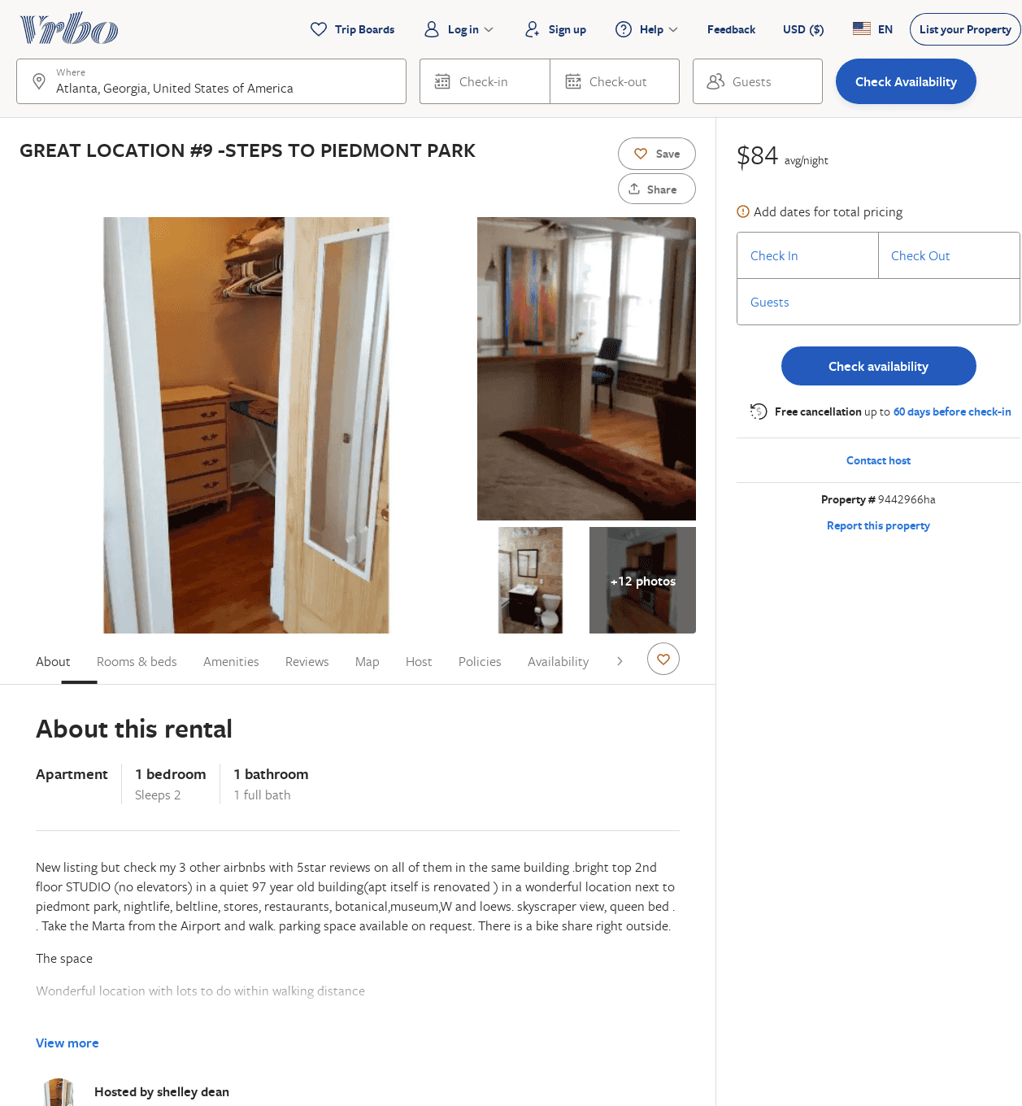
Listing 9442966
1
2
$88
1
shelley dean
https://www.vrbo.com/9442966ha
Aug 2022

Slide 33
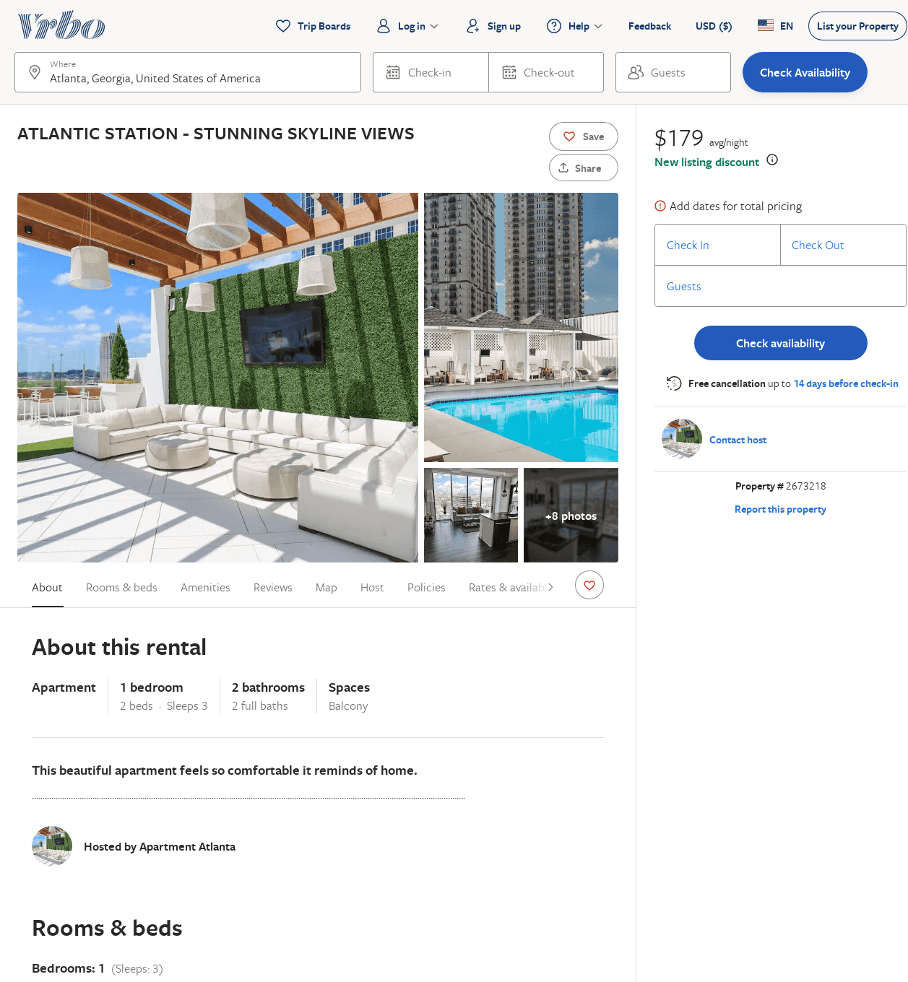
Listing 2673218
1
3
$224
4.571429
2
Brittany Page
https://www.vrbo.com/2673218
Aug 2022

Slide 34
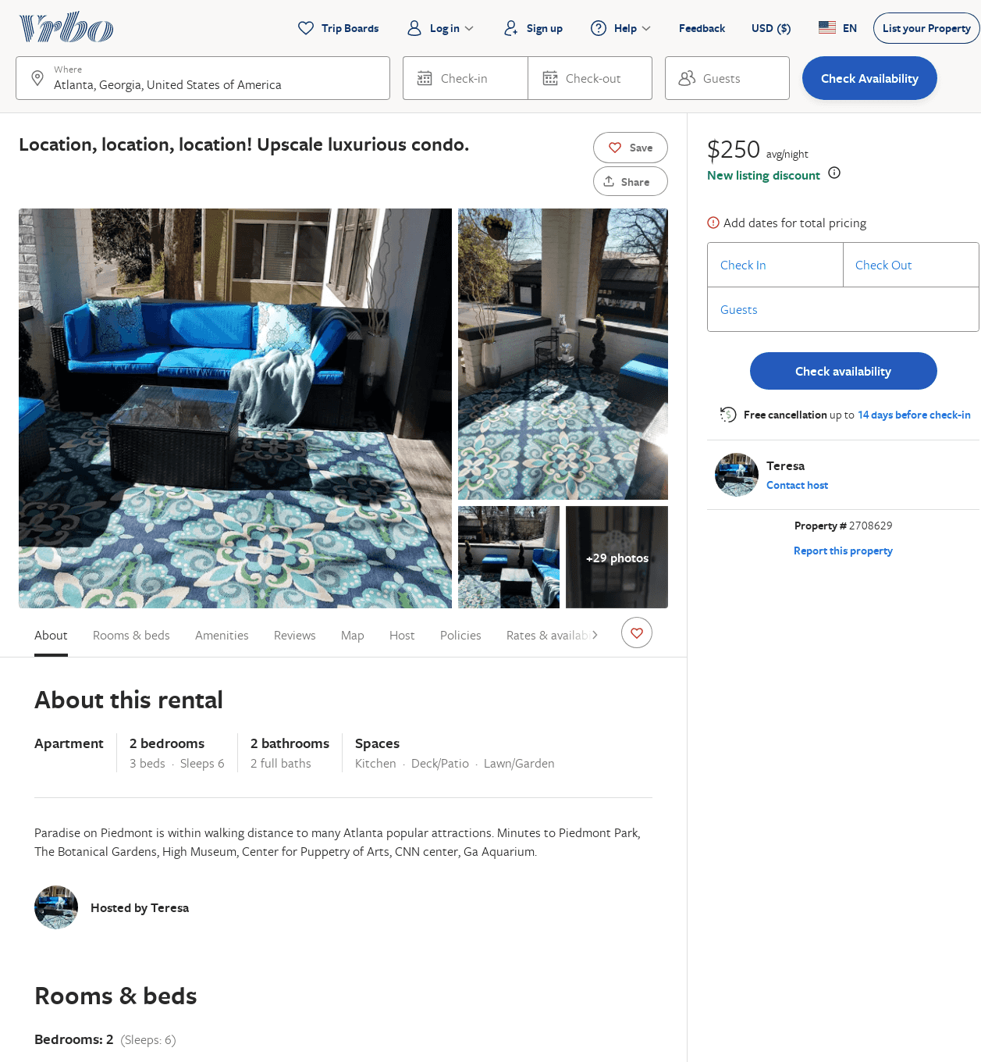
Listing 2708629
3
8
$352
5
3
Teresa/TRG Properties
https://www.vrbo.com/2708629
Aug 2022

Slide 35
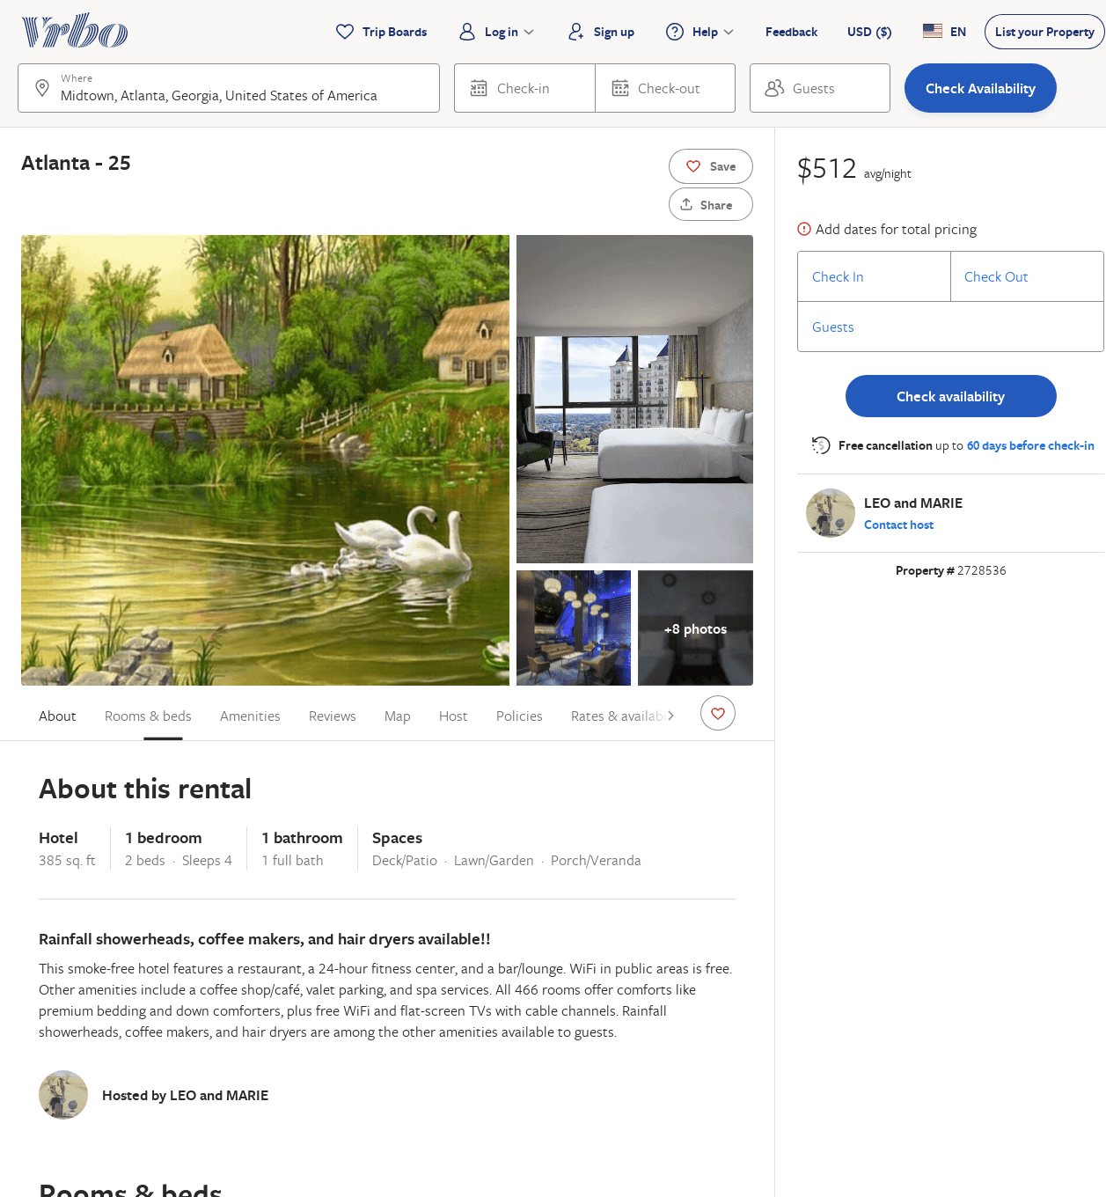
Listing 2728536
1
4
$512
2
LEO and MARIE
https://www.vrbo.com/2728536
Aug 2022

Slide 36
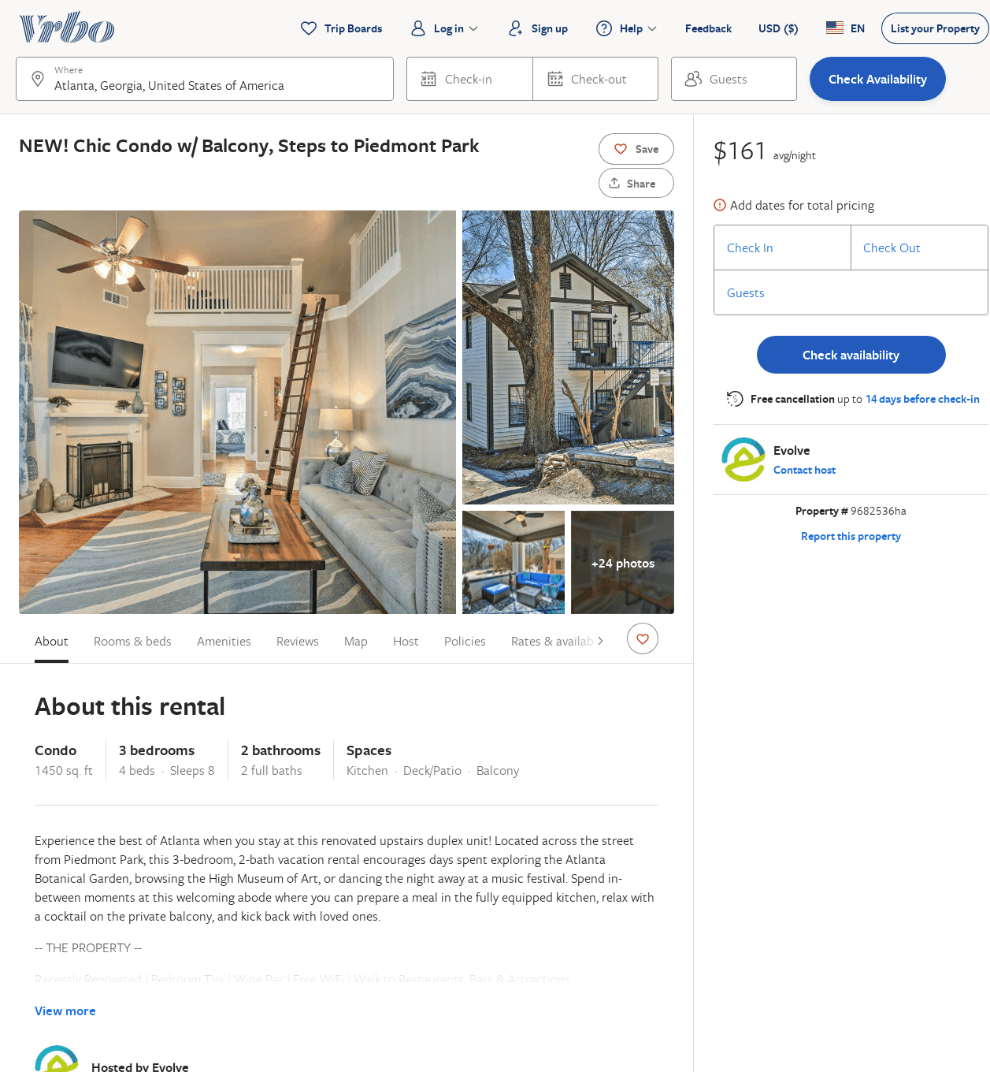
Listing 9682536
3
8
$136
2
Evolve
https://www.vrbo.com/9682536ha
Aug 2022

Slide 37
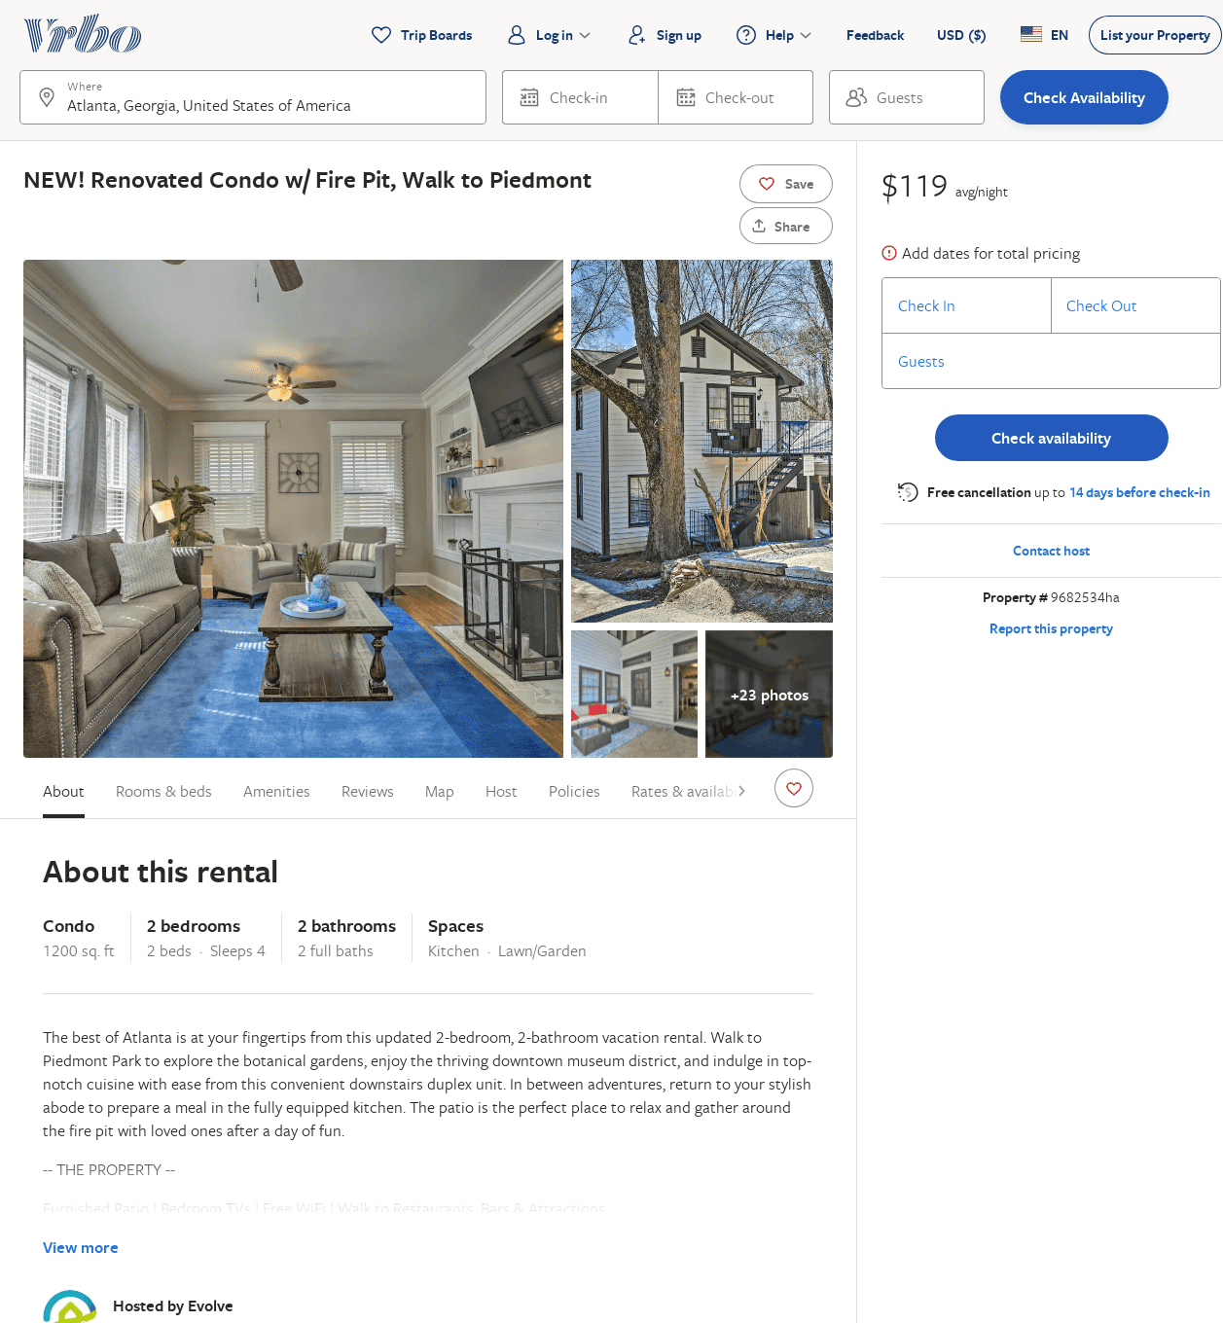
Listing 9682534
2
4
$104
2
Evolve
https://www.vrbo.com/9682534ha
Aug 2022

Slide 38
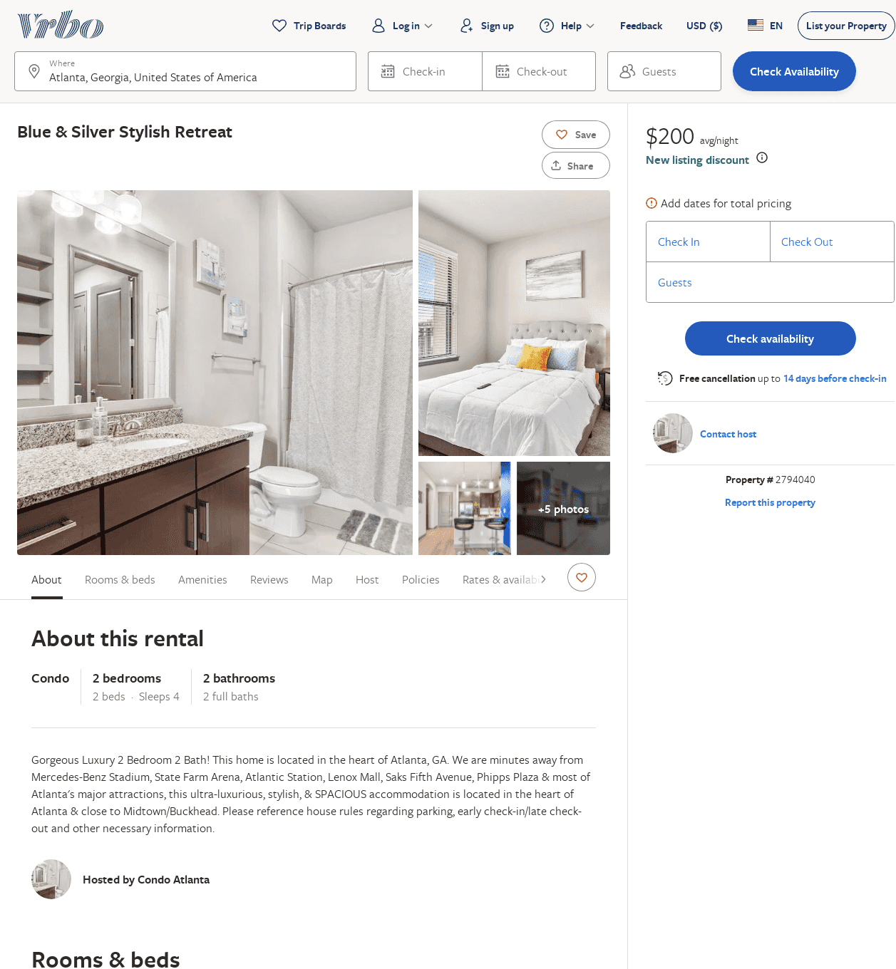
Listing 2794040
2
4
$200
2
https://www.vrbo.com/2794040
Aug 2022

Slide 39
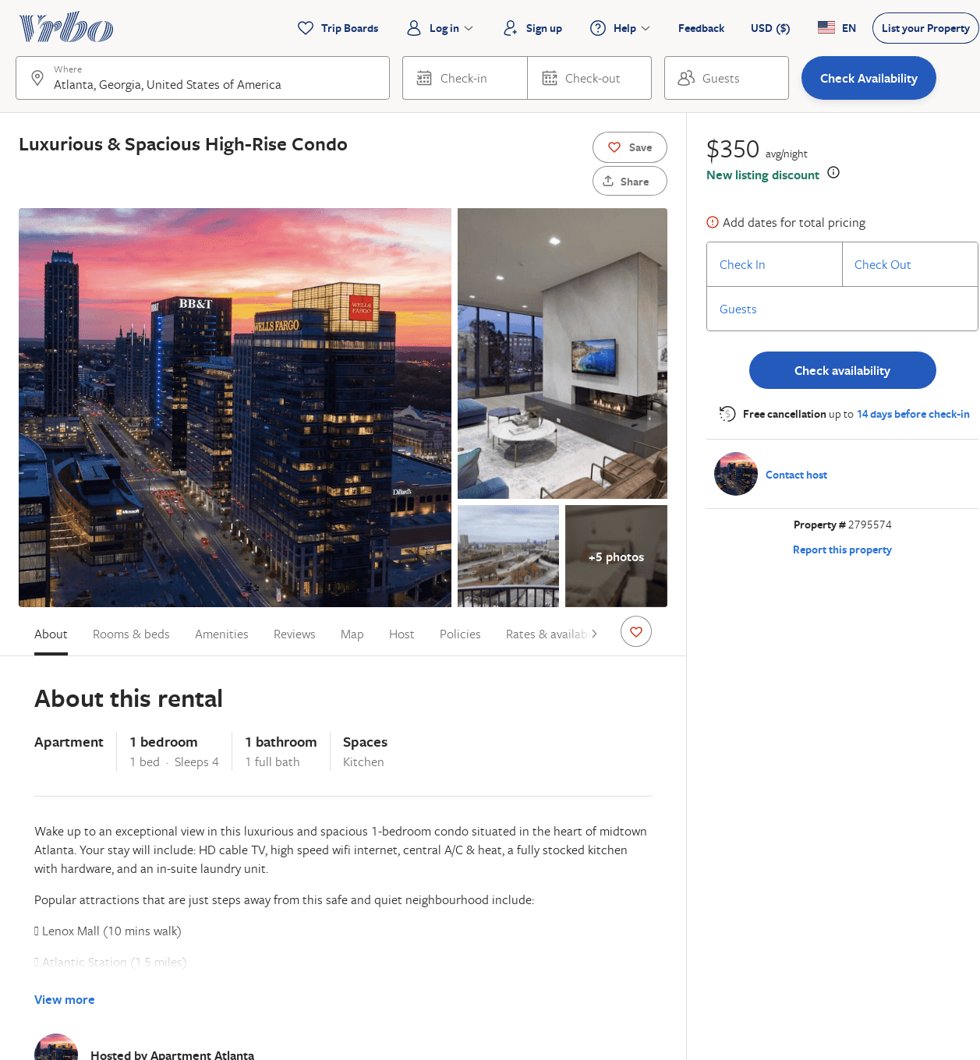
Listing 2795574
1
4
$144
2
https://www.vrbo.com/2795574
Aug 2022

Slide 40
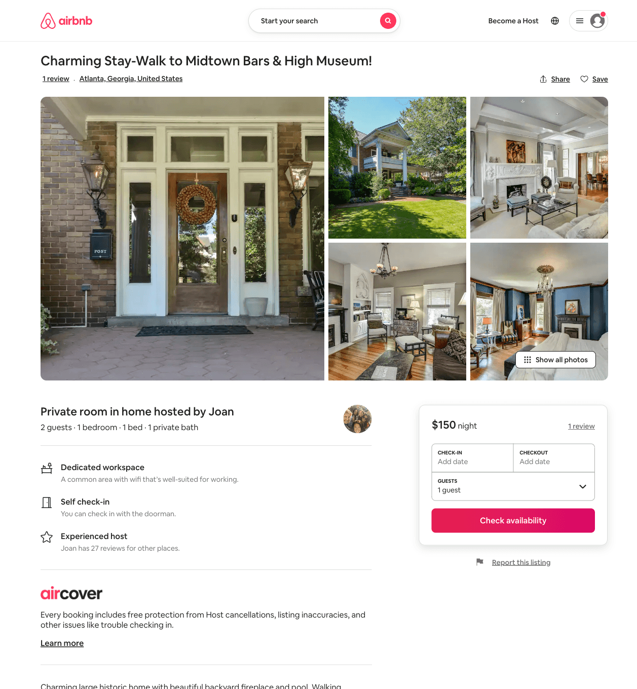
Listing 1738144
1
2
$150
7
Joan
8890269
2
https://www.airbnb.com/rooms/1738144
Jun 2022

Slide 41
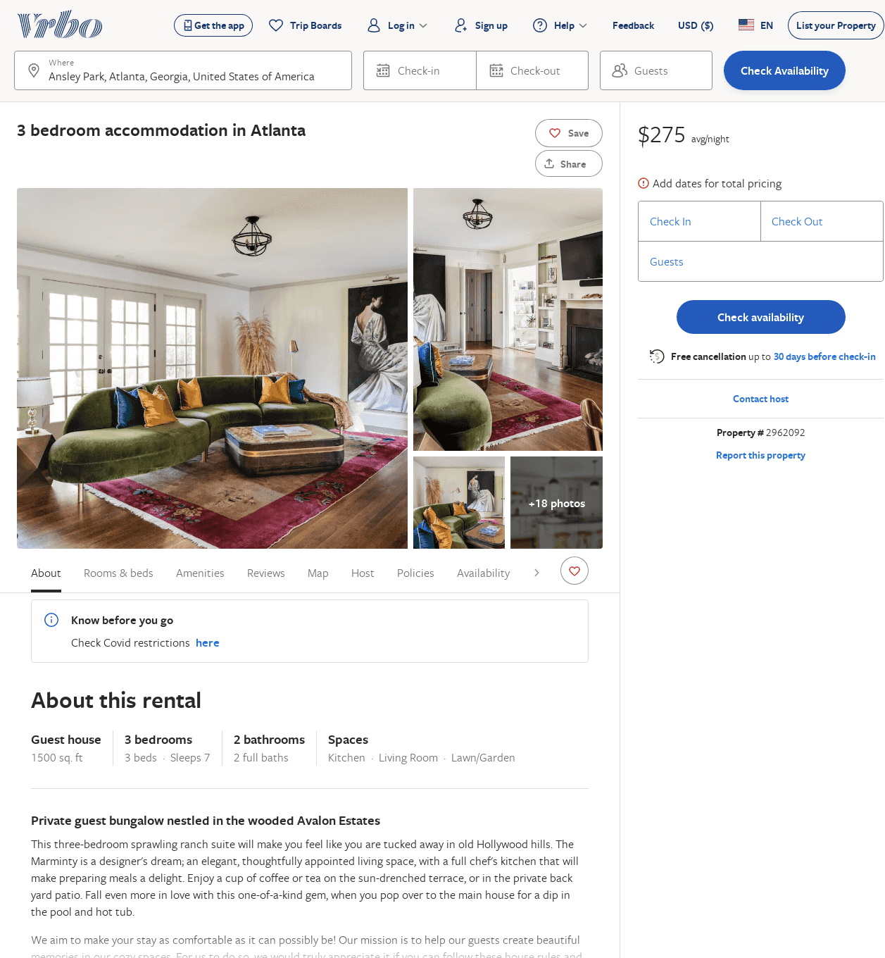
Listing 2962092
3
7
$275
3
Minty Living
https://www.vrbo.com/2962092
Aug 2022

Slide 42
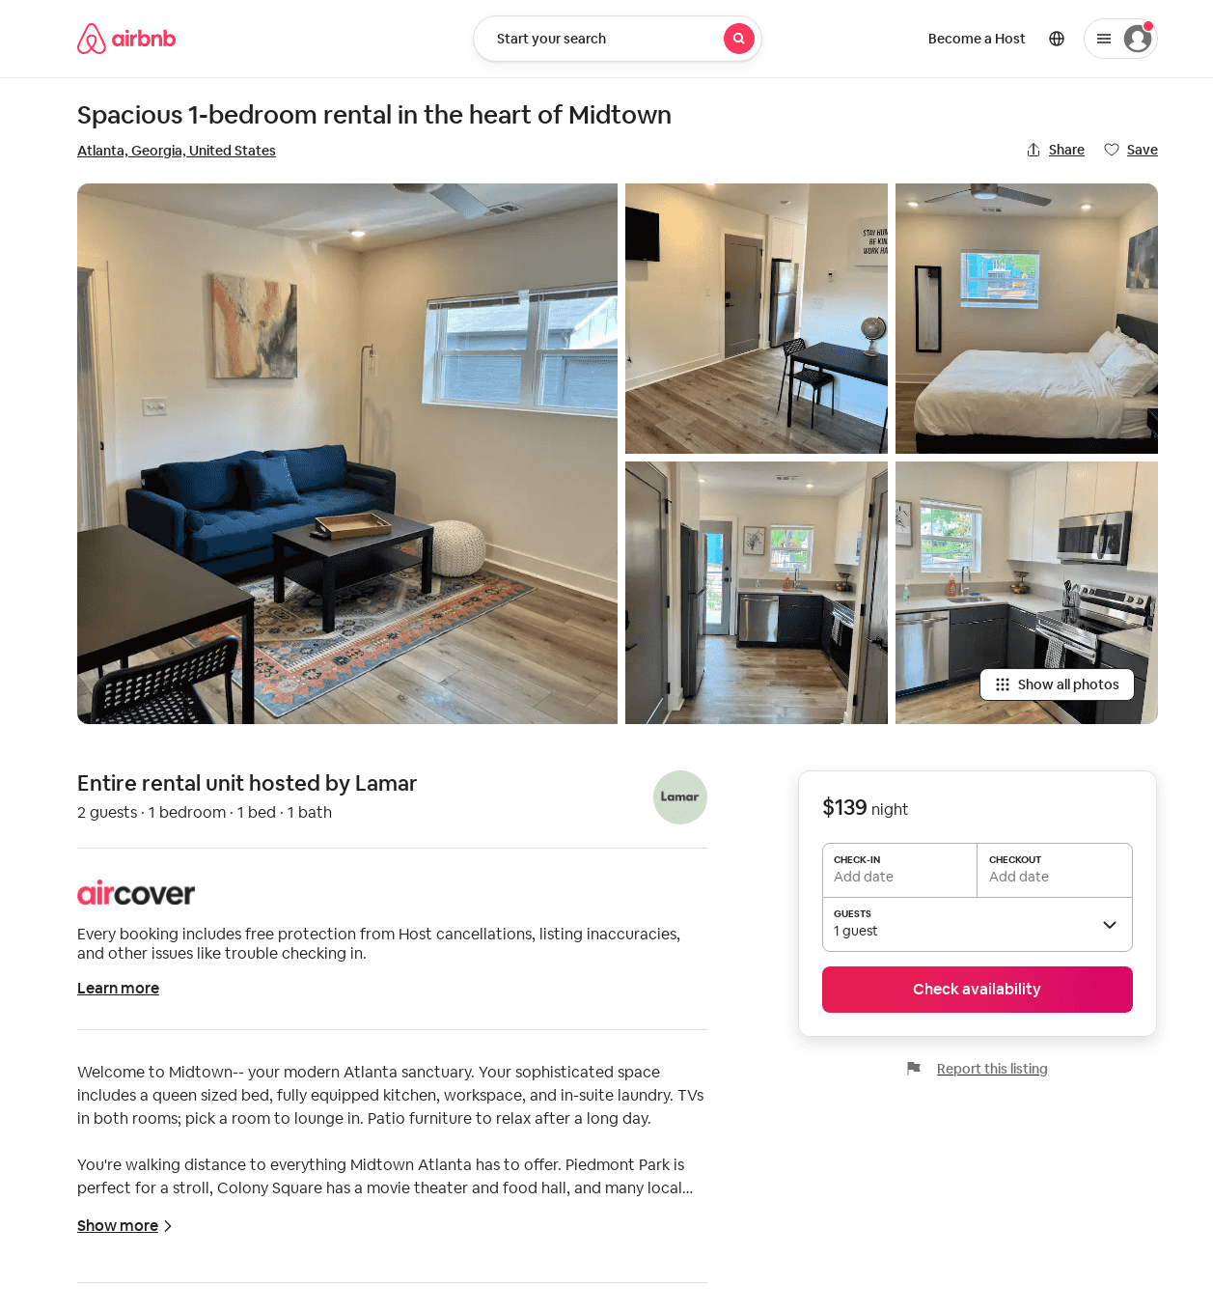
Listing 697030533623744100
1
2
29
Lamar
345865045
1
https://www.airbnb.com/rooms/697030533623744100
Aug 2022

