Slide 2
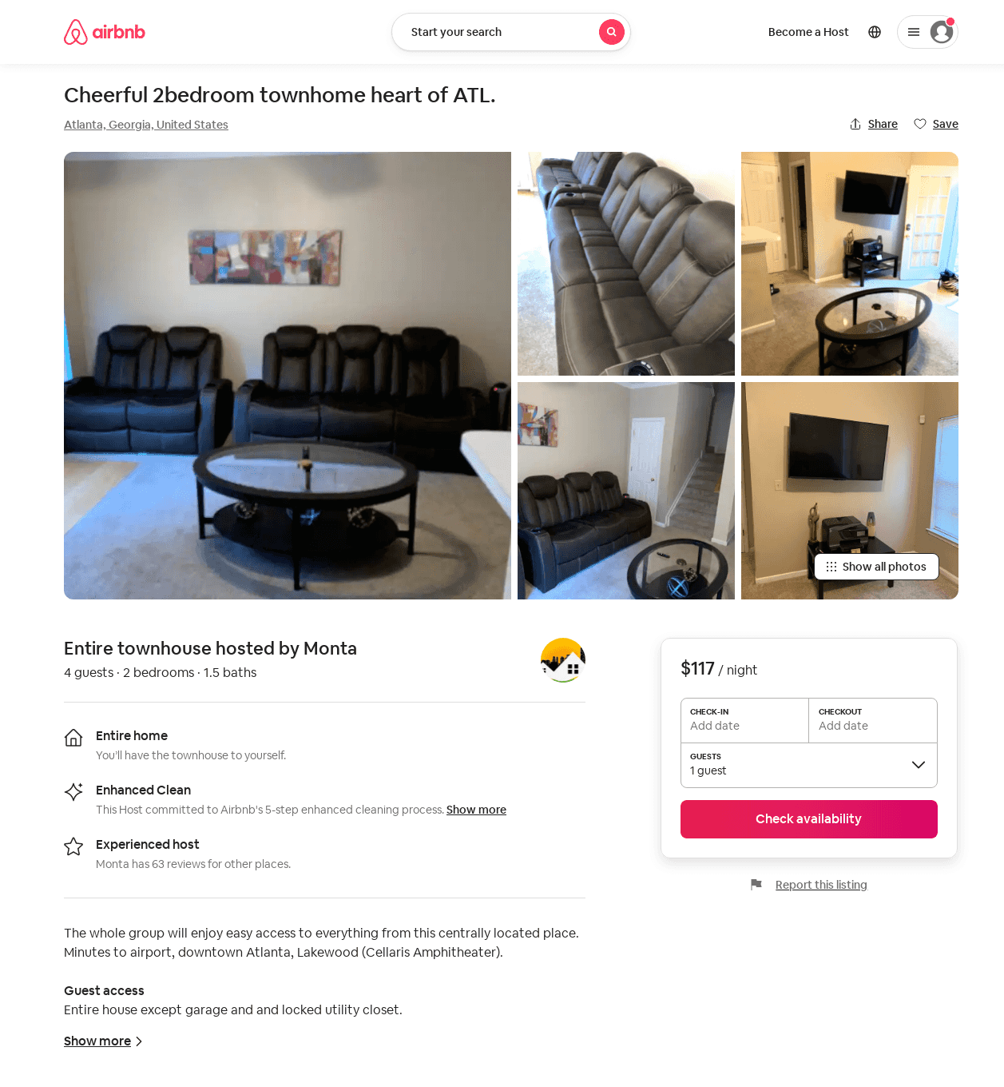
Listing 53022810
2
4
$117 - $142
2
Monta
181665900
2
https://www.airbnb.com/rooms/53022810
Jun 2022

Slide 3
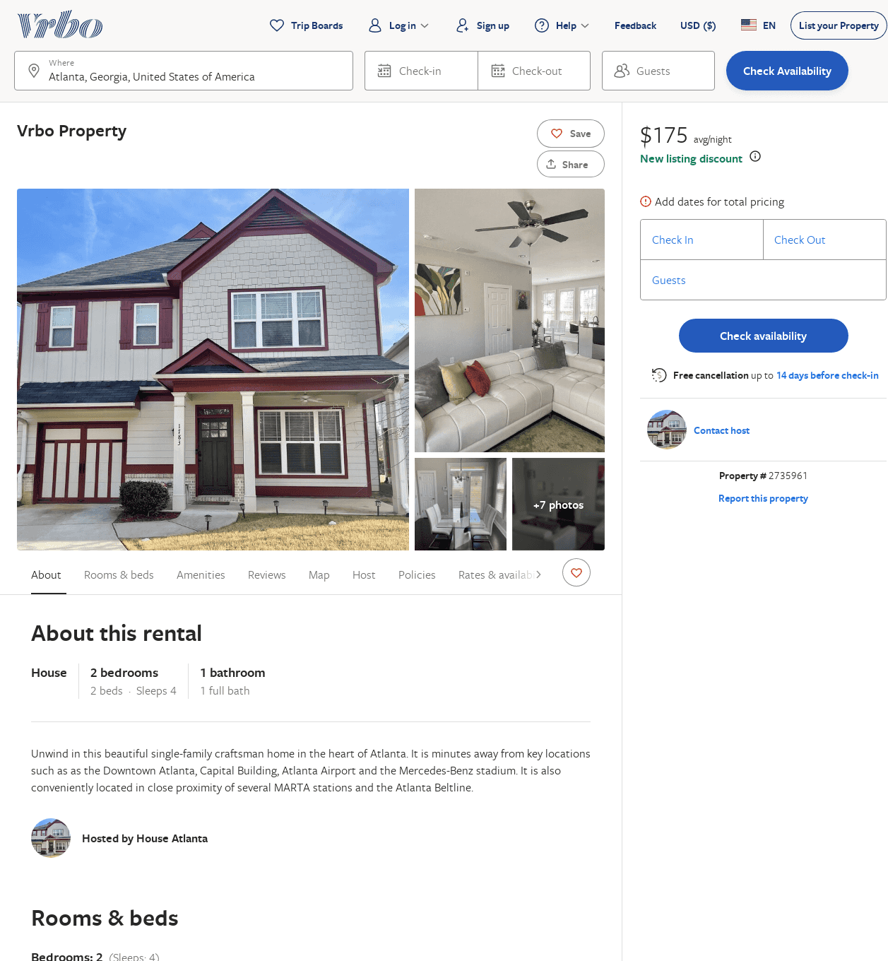
Listing 2735961
2
4
$175
3
https://www.vrbo.com/2735961
Aug 2022

