Slide 2
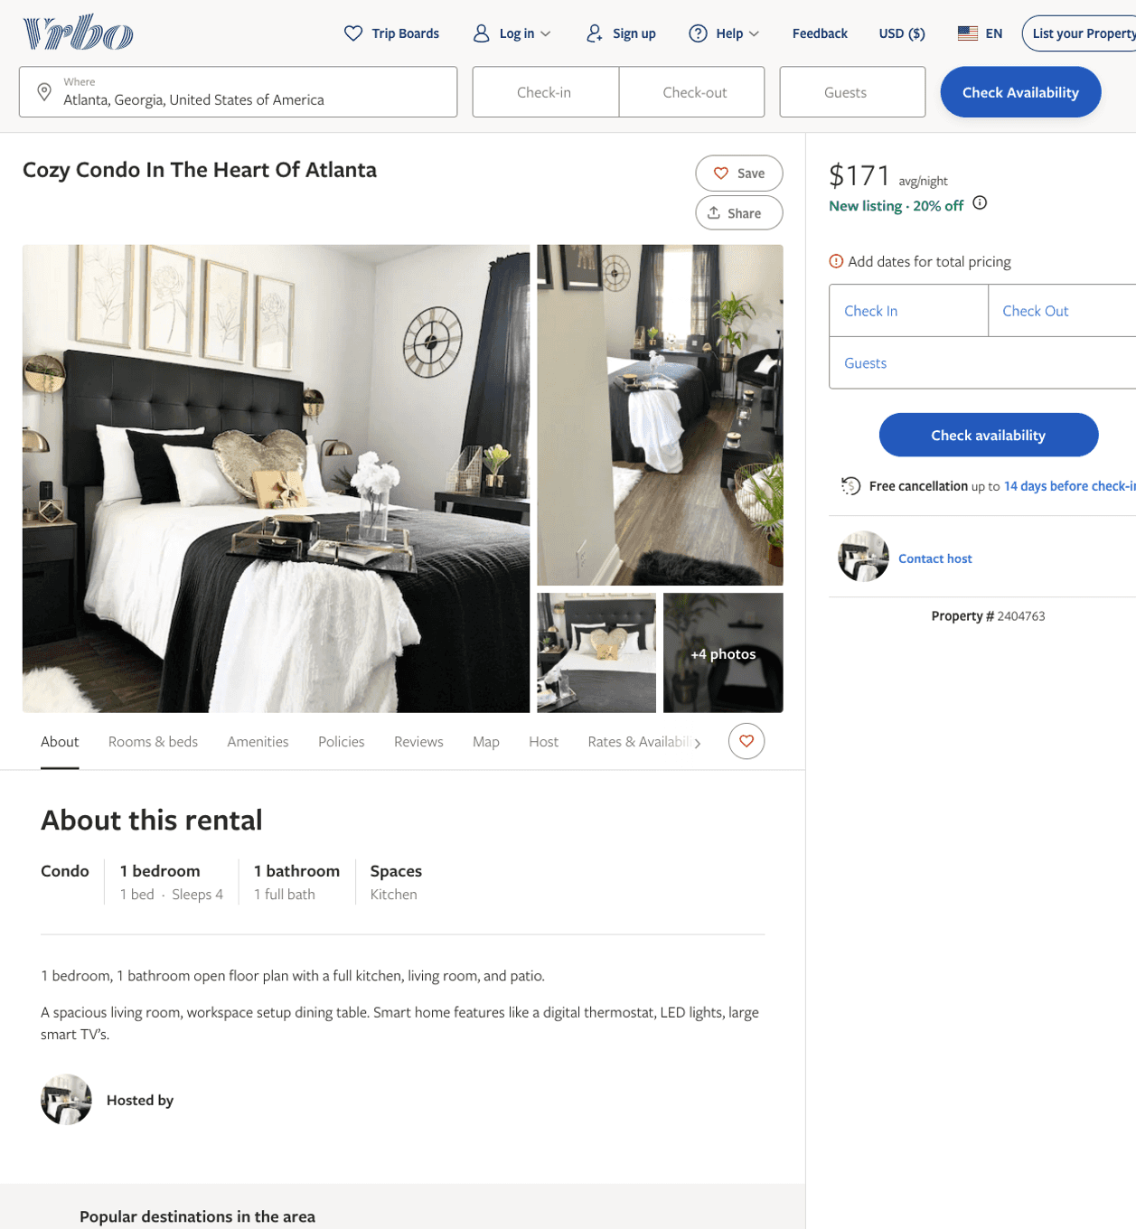
Listing 2404763
1
4
$171
1
2
https://www.vrbo.com/2404763
Aug 2022

Slide 3
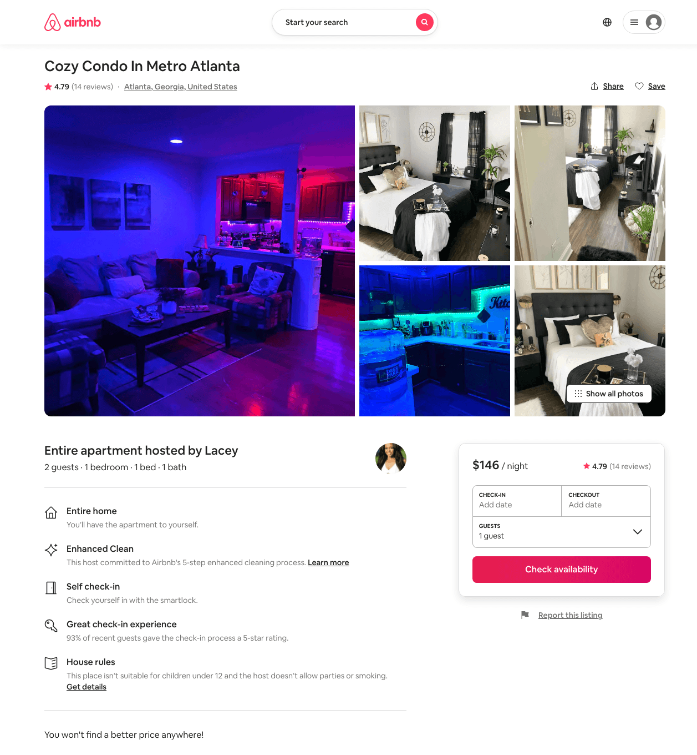
Listing 41591570
1
4
$99 - $146
4.66
2
Lacey
19071062
2
https://www.airbnb.com/rooms/41591570
Aug 2022

Slide 4
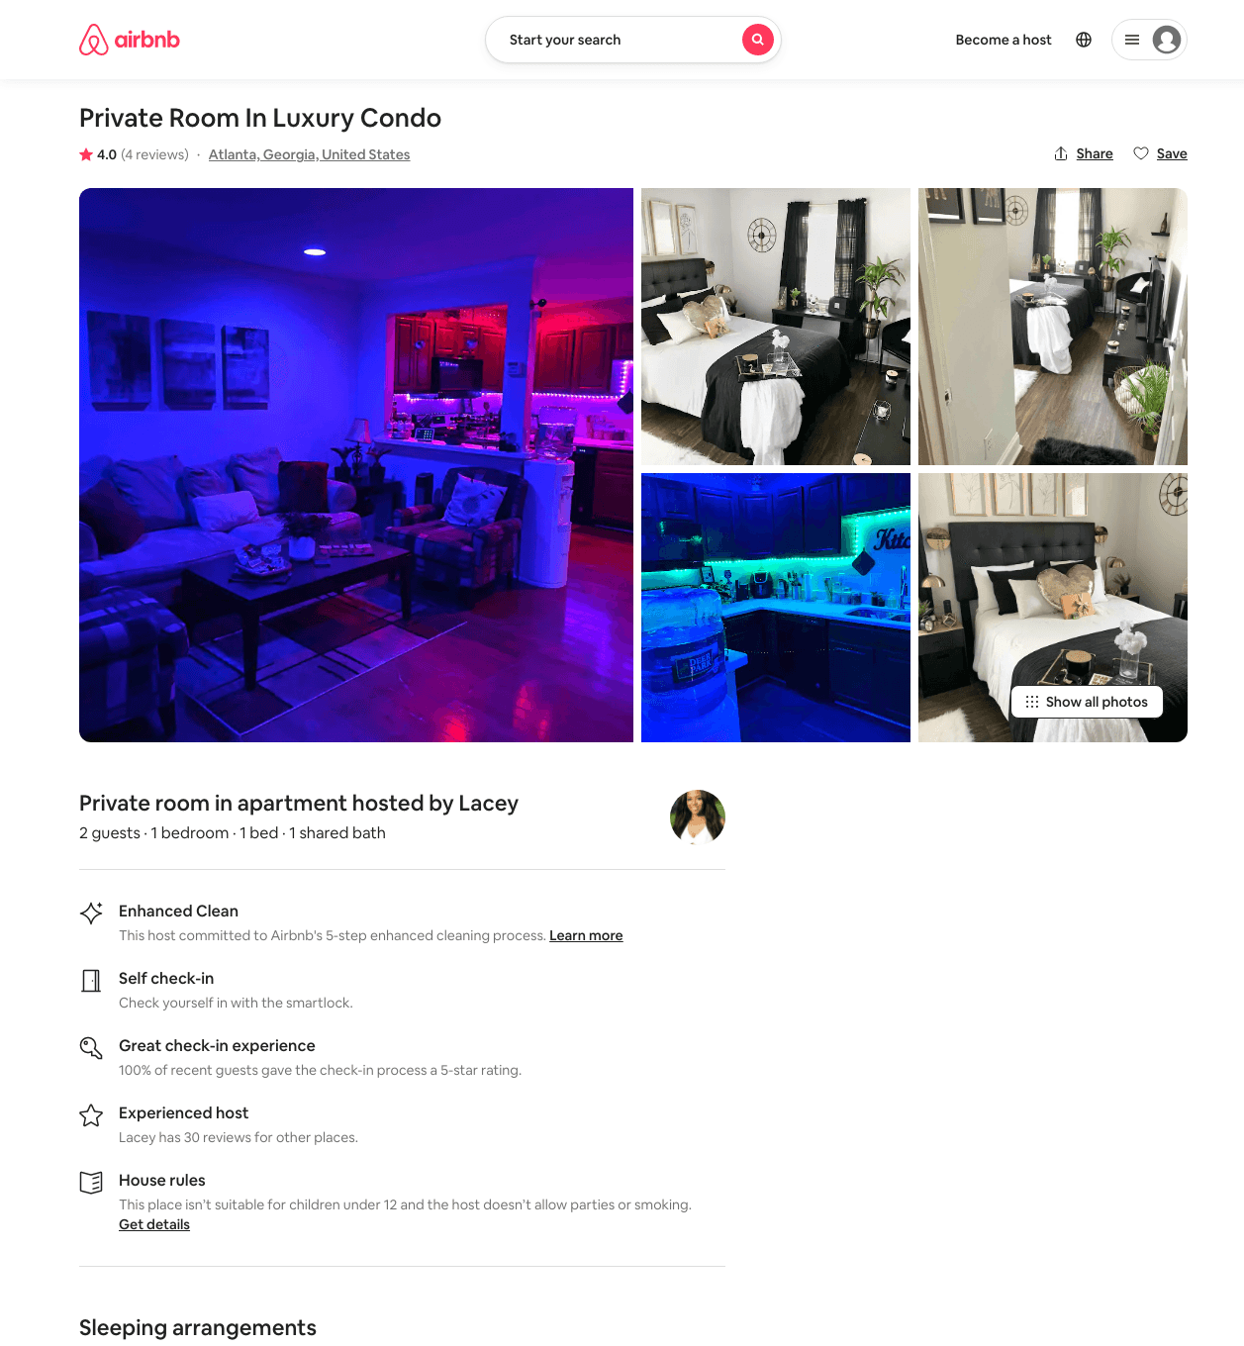
Listing 47831201
1
2
$99
4.33
1
Lacey
19071062
2
https://www.airbnb.com/rooms/47831201
Aug 2022

Slide 5
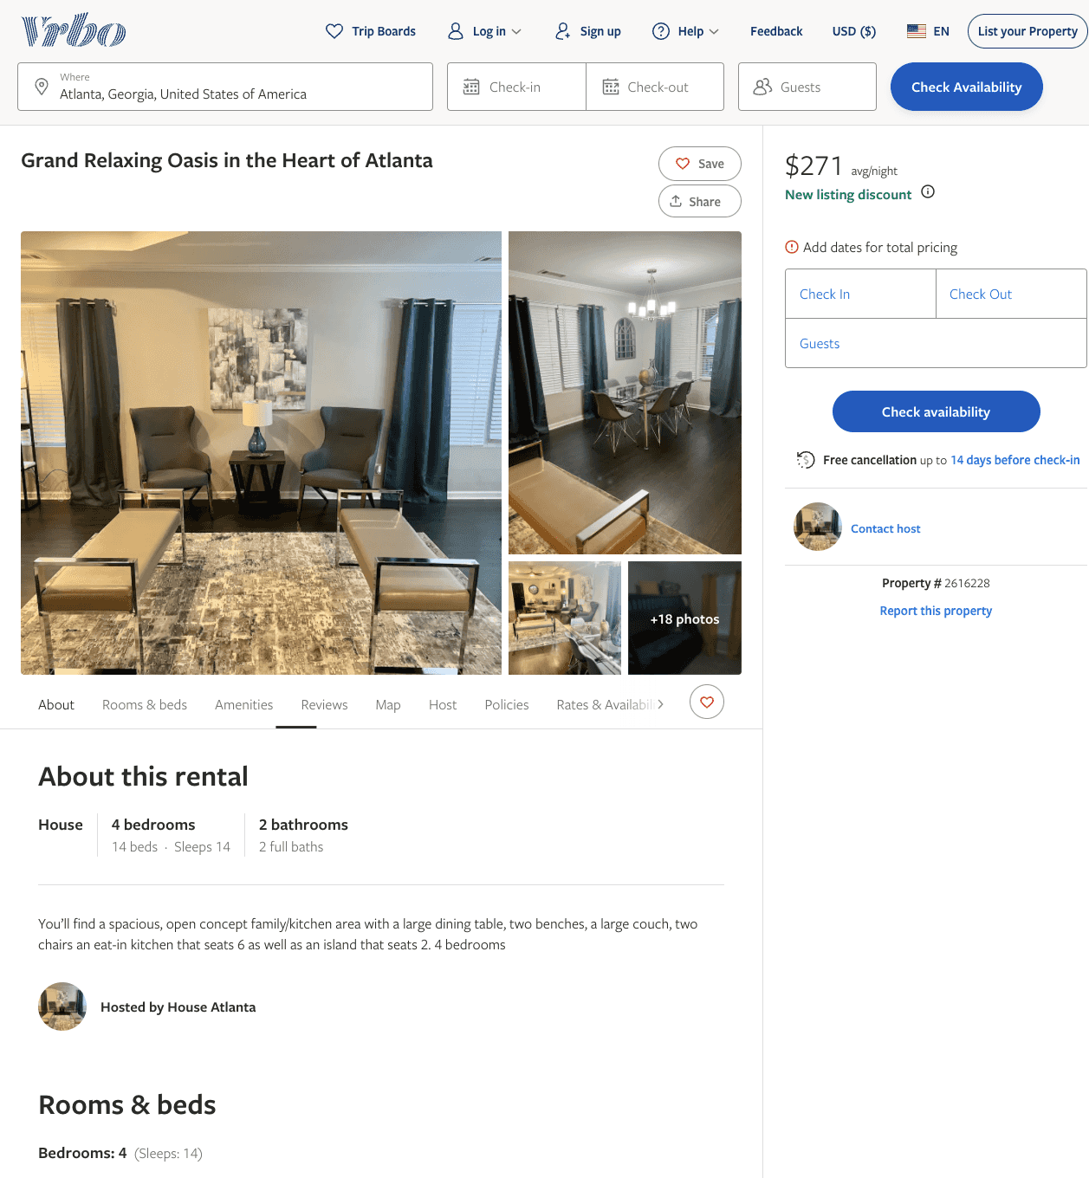
Listing 2616228
4
14
$259
5
3
https://www.vrbo.com/2616228
Aug 2022

Slide 6
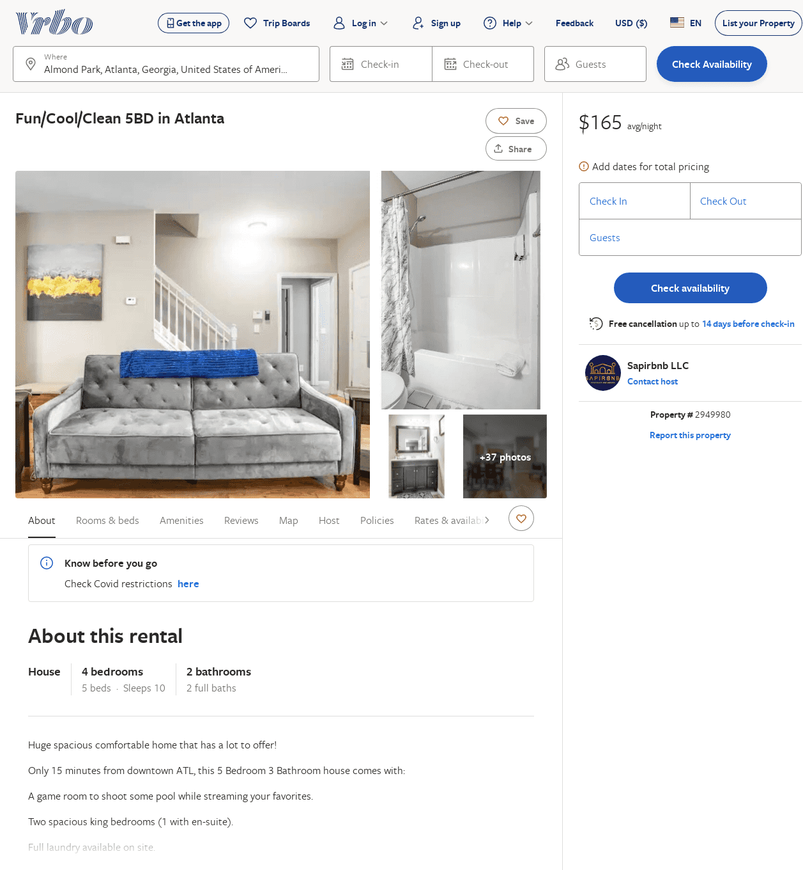
Listing 2949980
4
10
$165
2
Sapirbnb LLC
https://www.vrbo.com/2949980
Aug 2022

