Slide 2
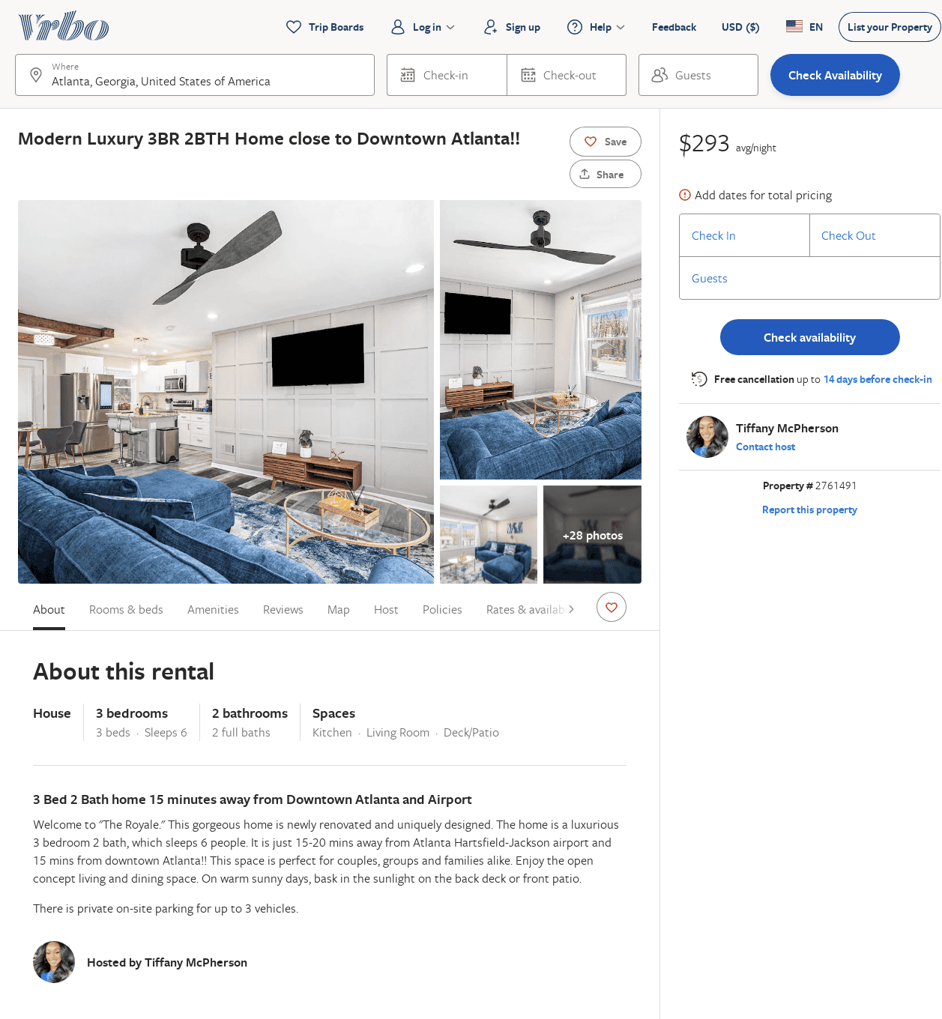
Listing 2761491
3
6
$237
2
Tiffany McPherson
https://www.vrbo.com/2761491
Aug 2022

Slide 3
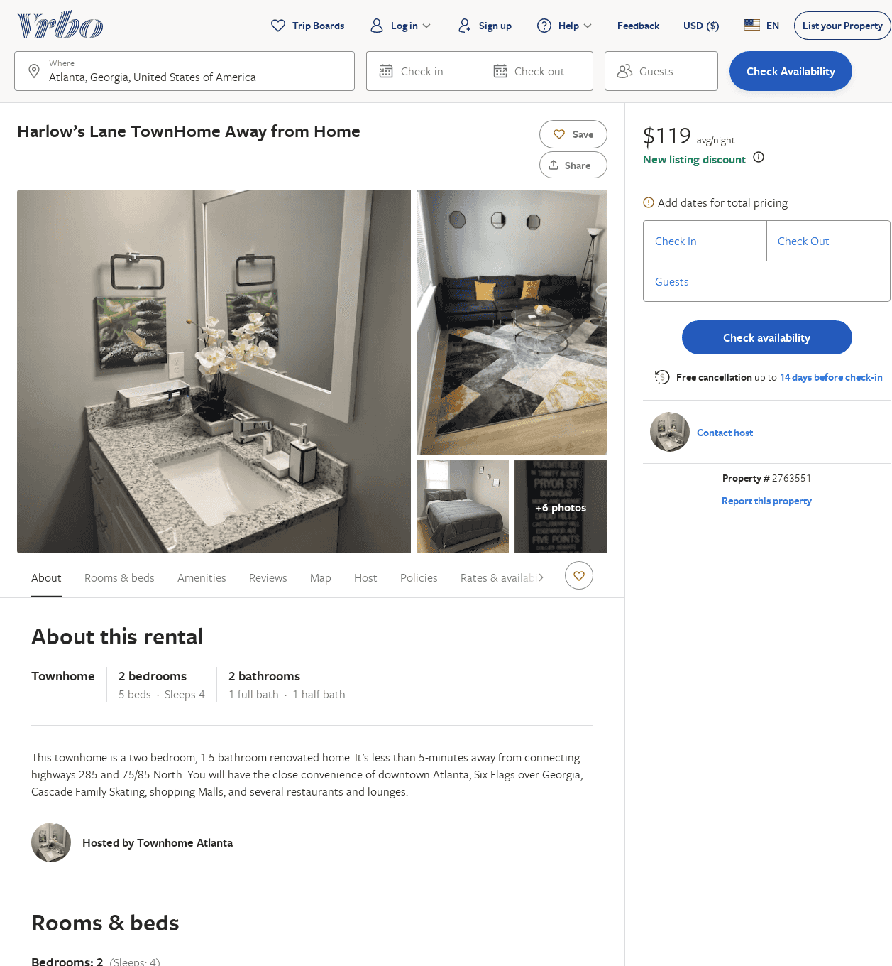
Listing 2763551
2
4
$102
4
2
https://www.vrbo.com/2763551
Aug 2022

Slide 4
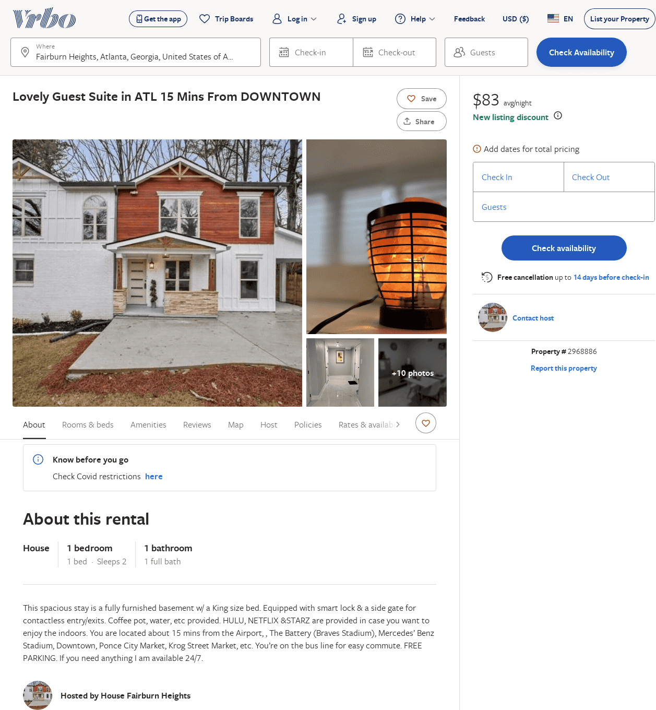
Listing 2968886
1
2
$83
2
https://www.vrbo.com/2968886
Aug 2022

