Slide 2
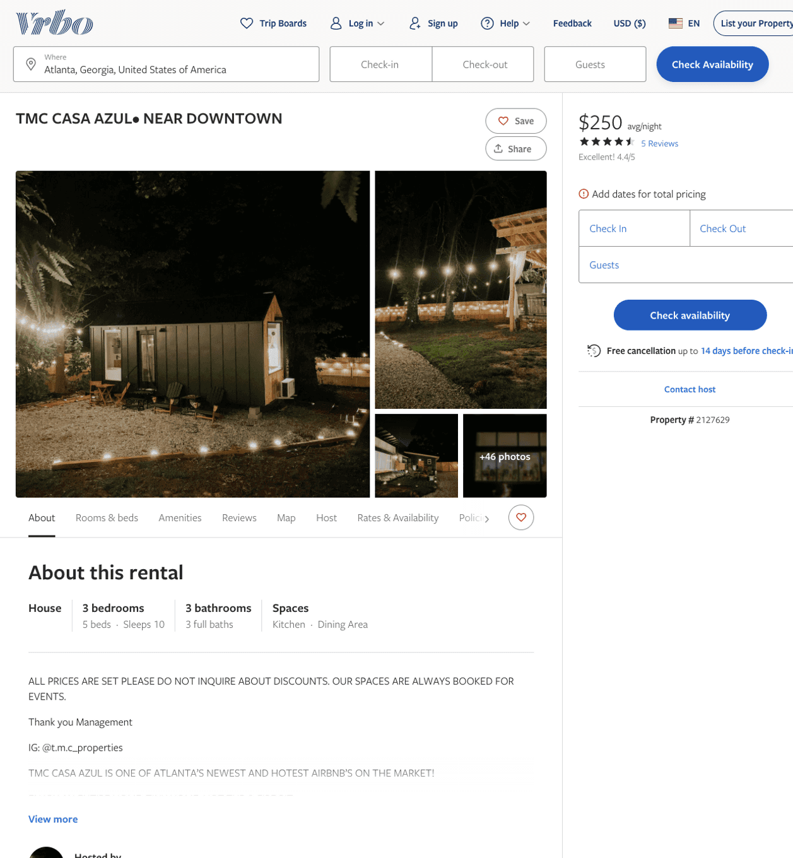
Listing 2127629
3
10
$250 - $320
4.5833335
1
https://www.vrbo.com/2127629
Aug 2022

Slide 3
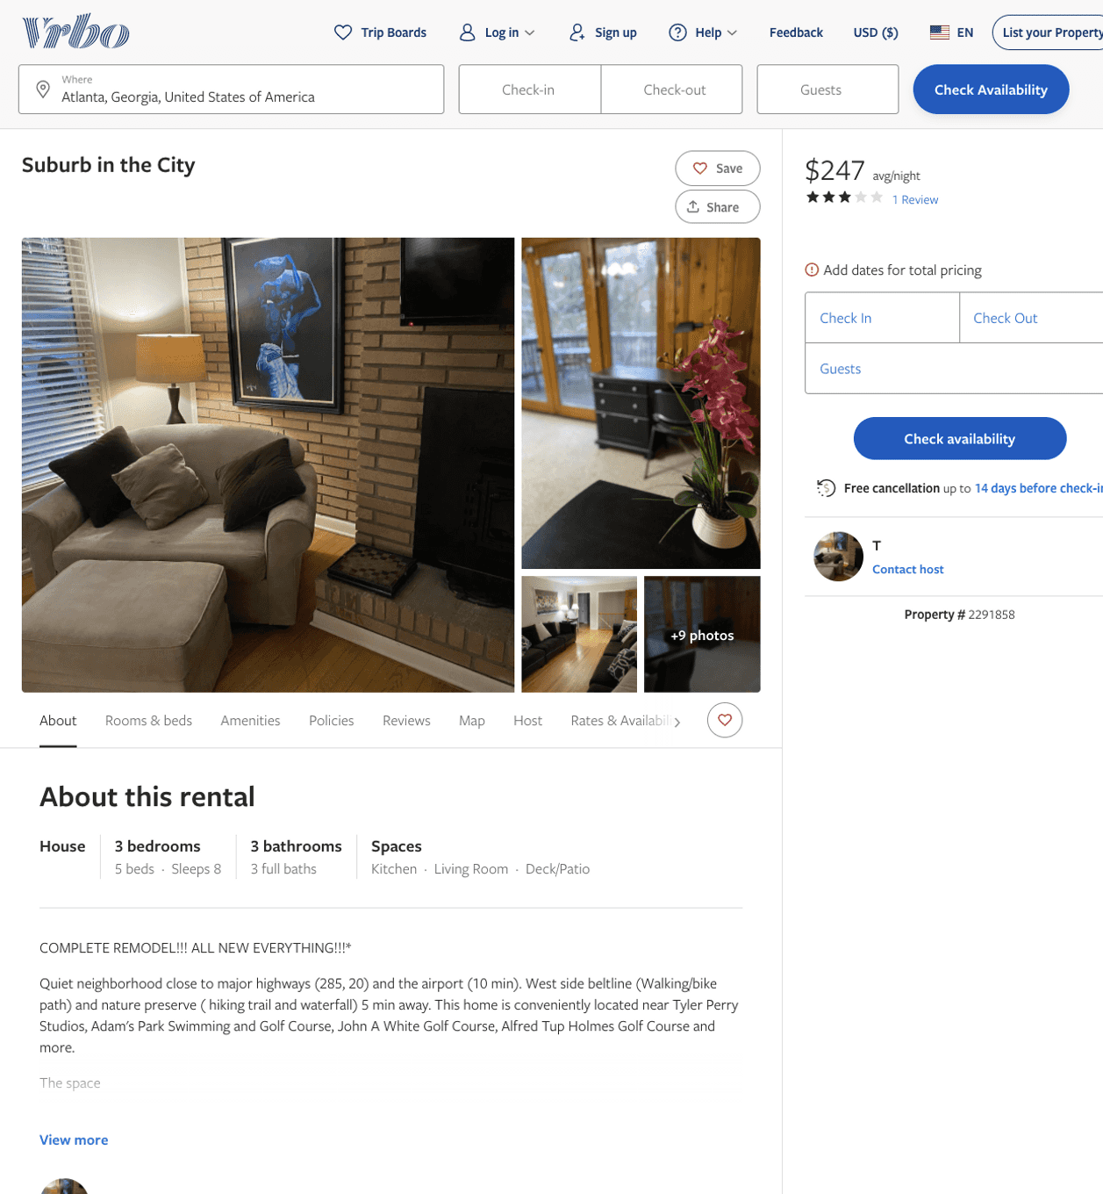
Listing 2291858
3
8
$245 - $247
3
3
T
https://www.vrbo.com/2291858
Aug 2022

Slide 4
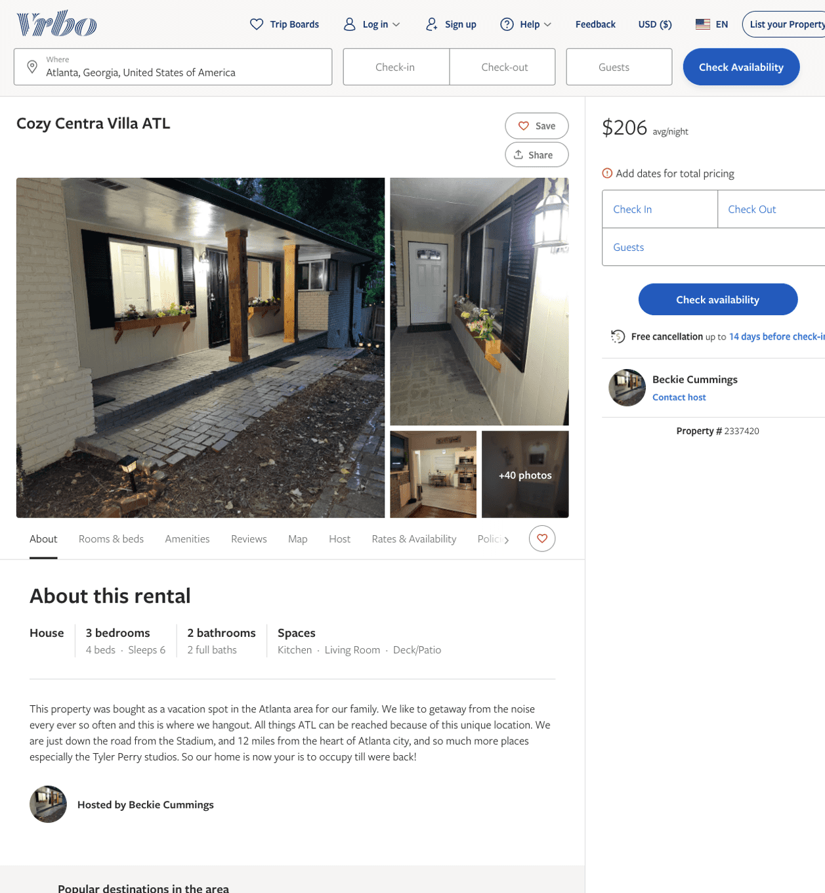
Listing 2337420
3
6
$206 - $218
3
Beckie Cummings
https://www.vrbo.com/2337420
Aug 2022

Slide 5
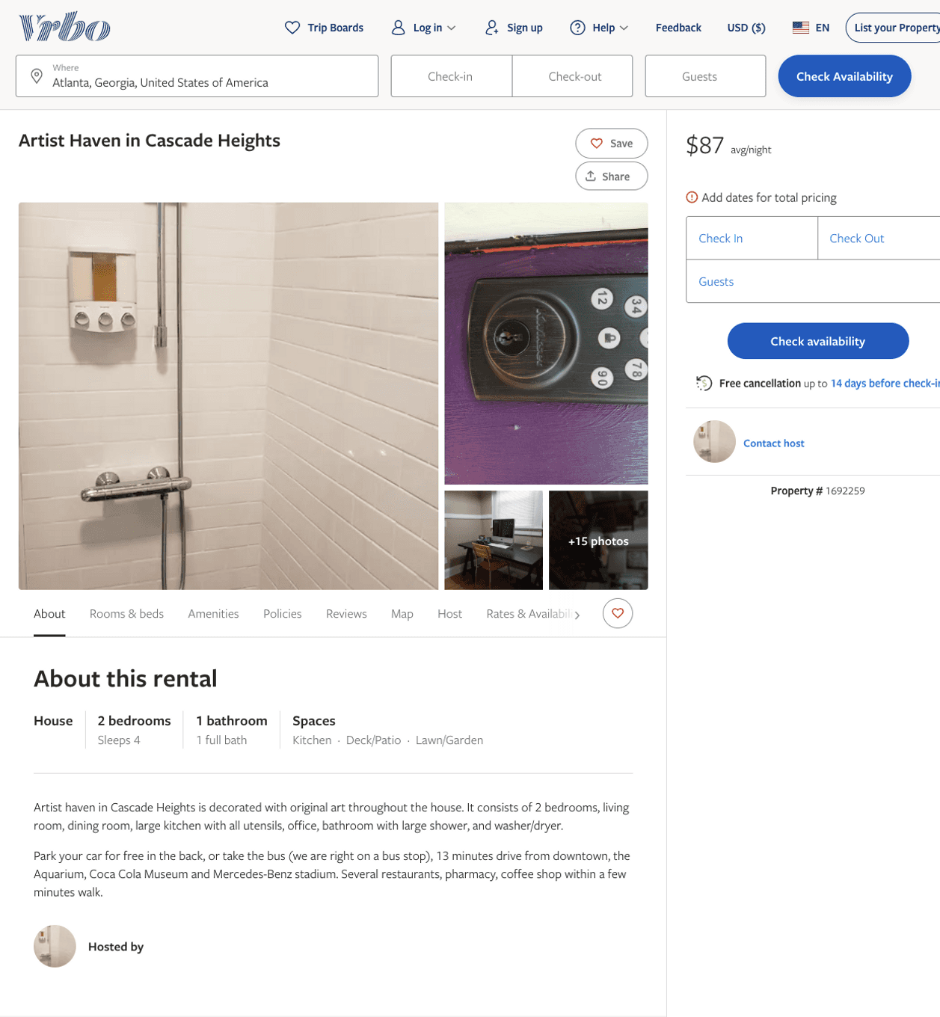
Listing 1692259
2
4
$102 - $98
3
https://www.vrbo.com/1692259
Aug 2022

Slide 6
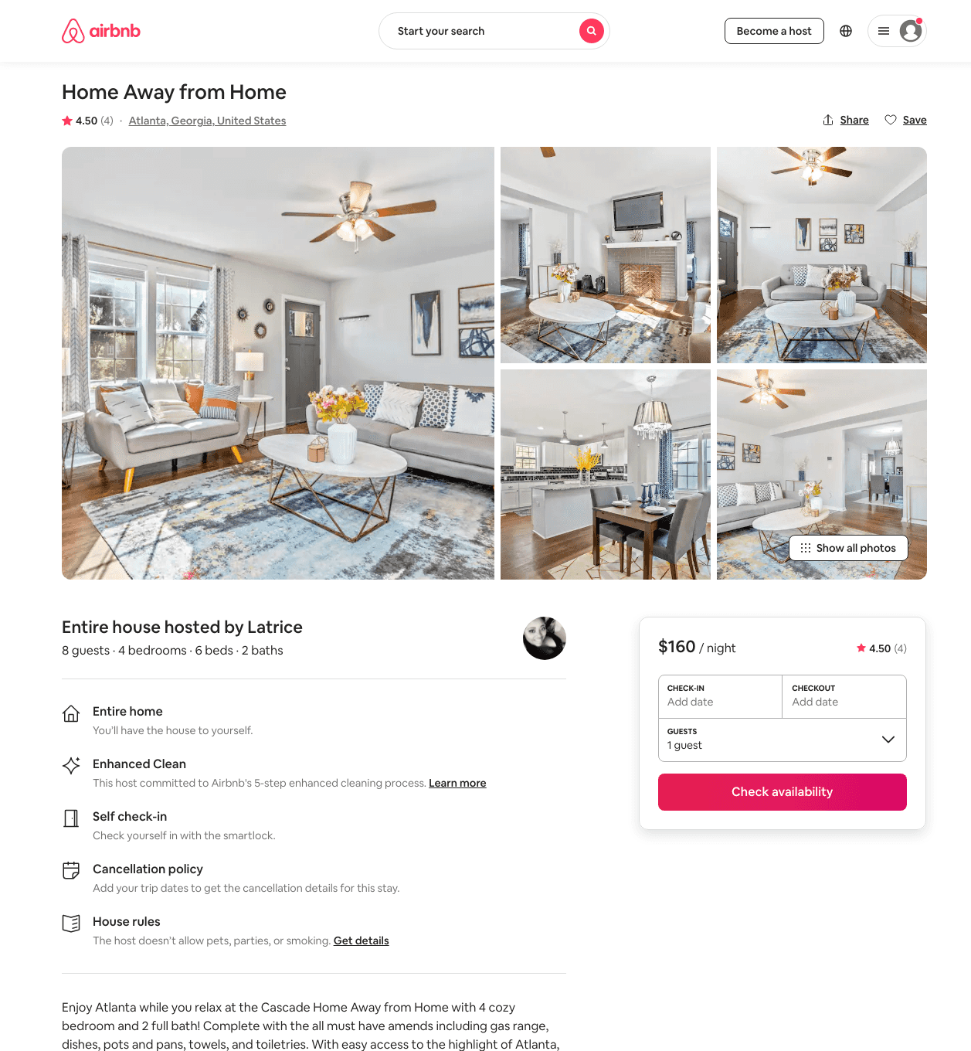
Listing 48317448
4
8
$161 - $366
4.51
1
Latrice
83908972
1
https://www.airbnb.com/rooms/48317448
Aug 2022

Slide 7
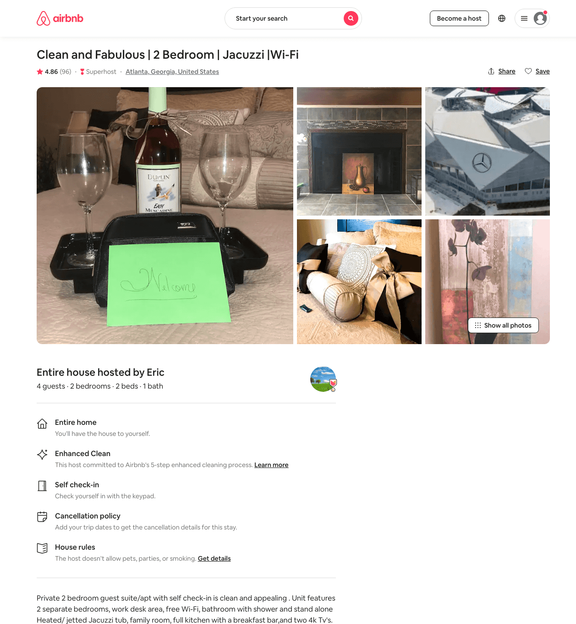
Listing 24394392
2
4
$120 - $164
4.84
29
Eric
184123786
1
https://www.airbnb.com/rooms/24394392
Aug 2022

Slide 8
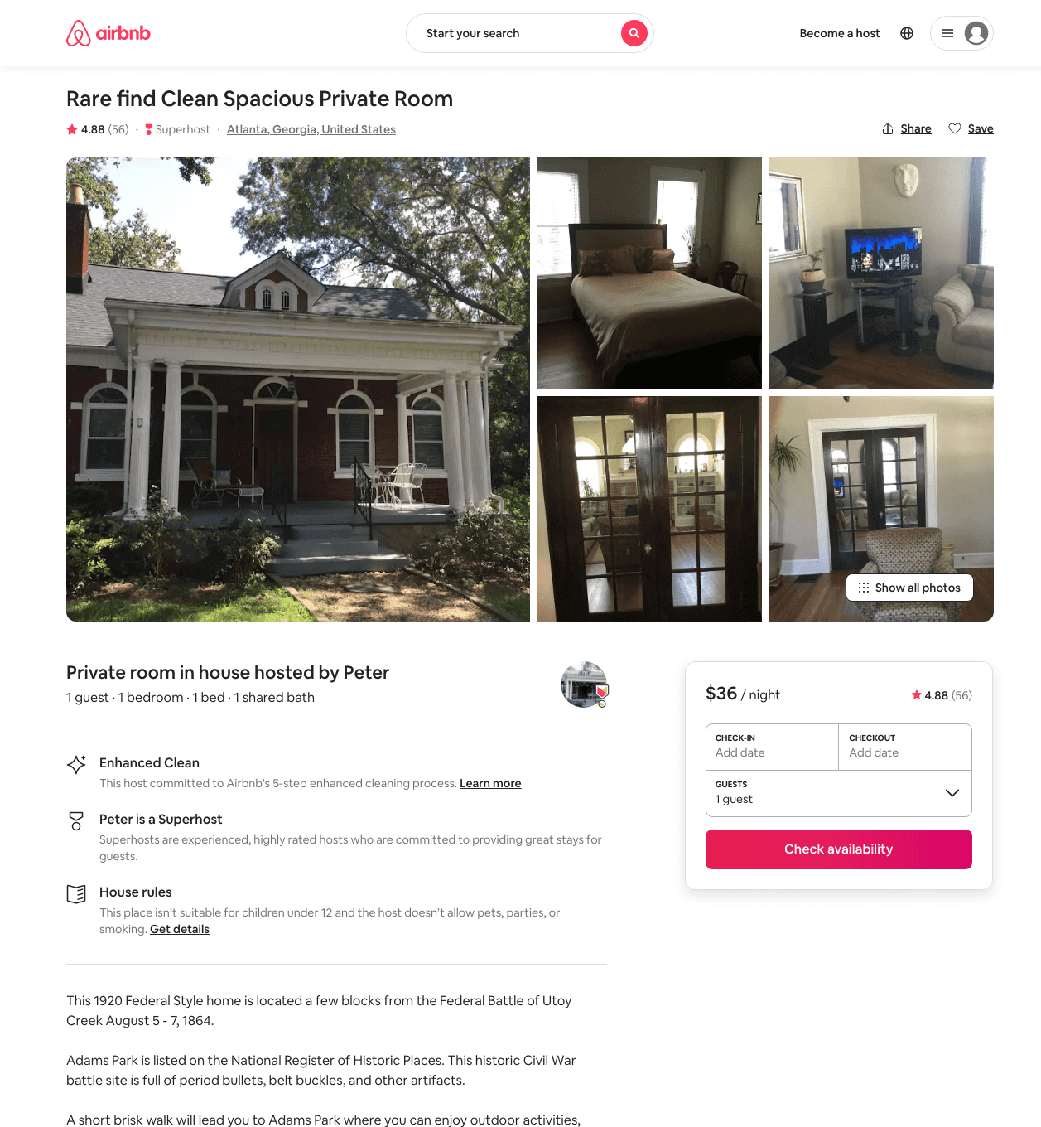
Listing 19340730
1
1
$36 - $48
4.89
1
Peter
46652371
2
https://www.airbnb.com/rooms/19340730
Aug 2022

Slide 9
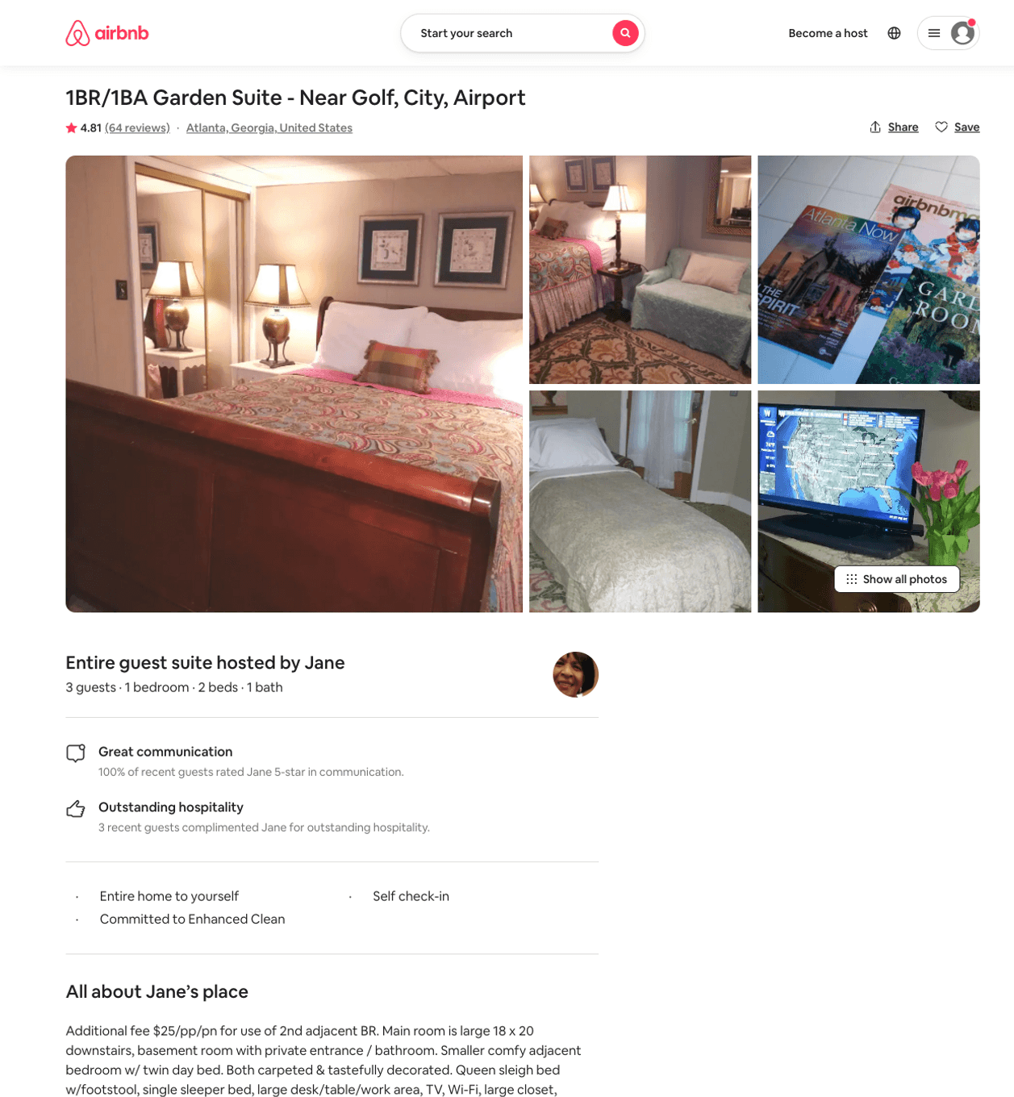
Listing 8594286
1
3
$66 - $99
4.82
2
Jane
24511004
3
https://www.airbnb.com/rooms/8594286
Jun 2022

Slide 10
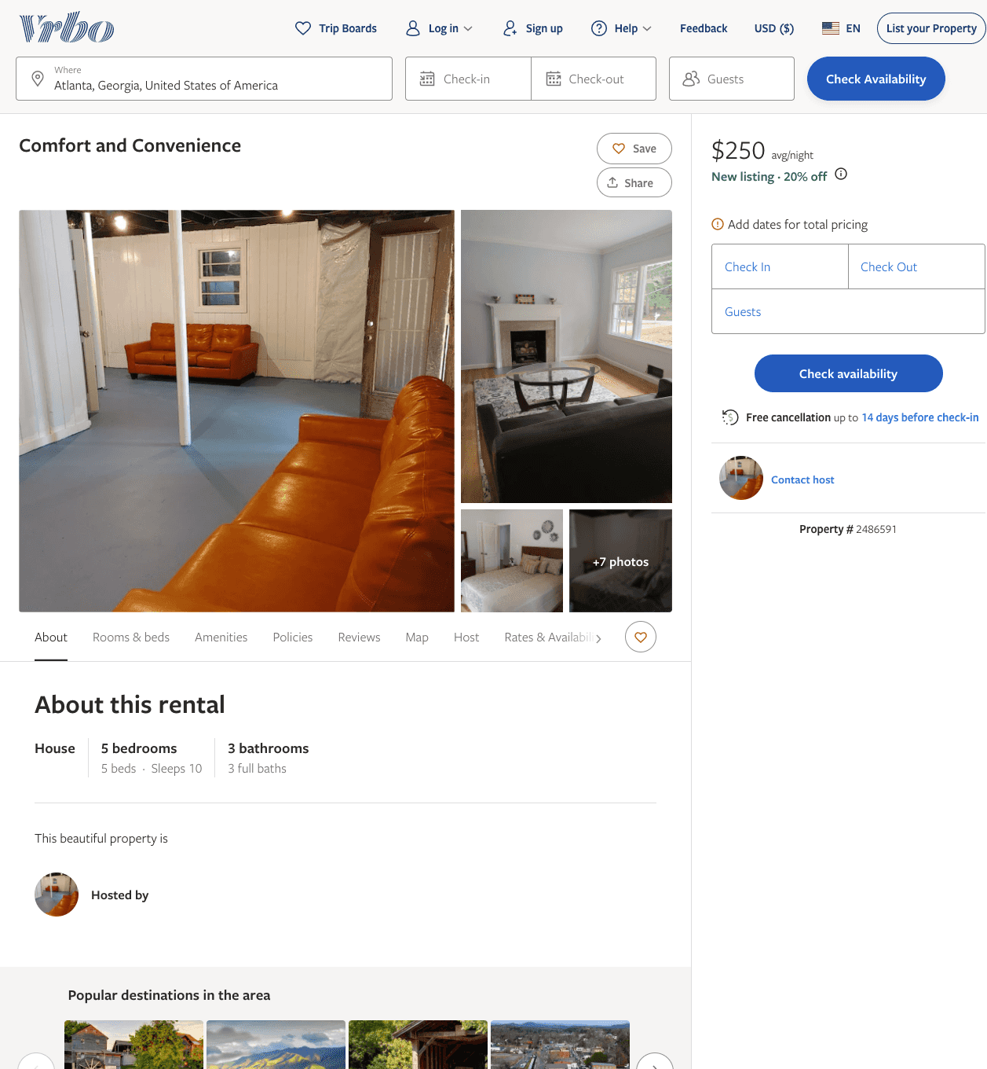
Listing 2486591
5
10
$210 - $250
3
https://www.vrbo.com/2486591
Aug 2022

Slide 11
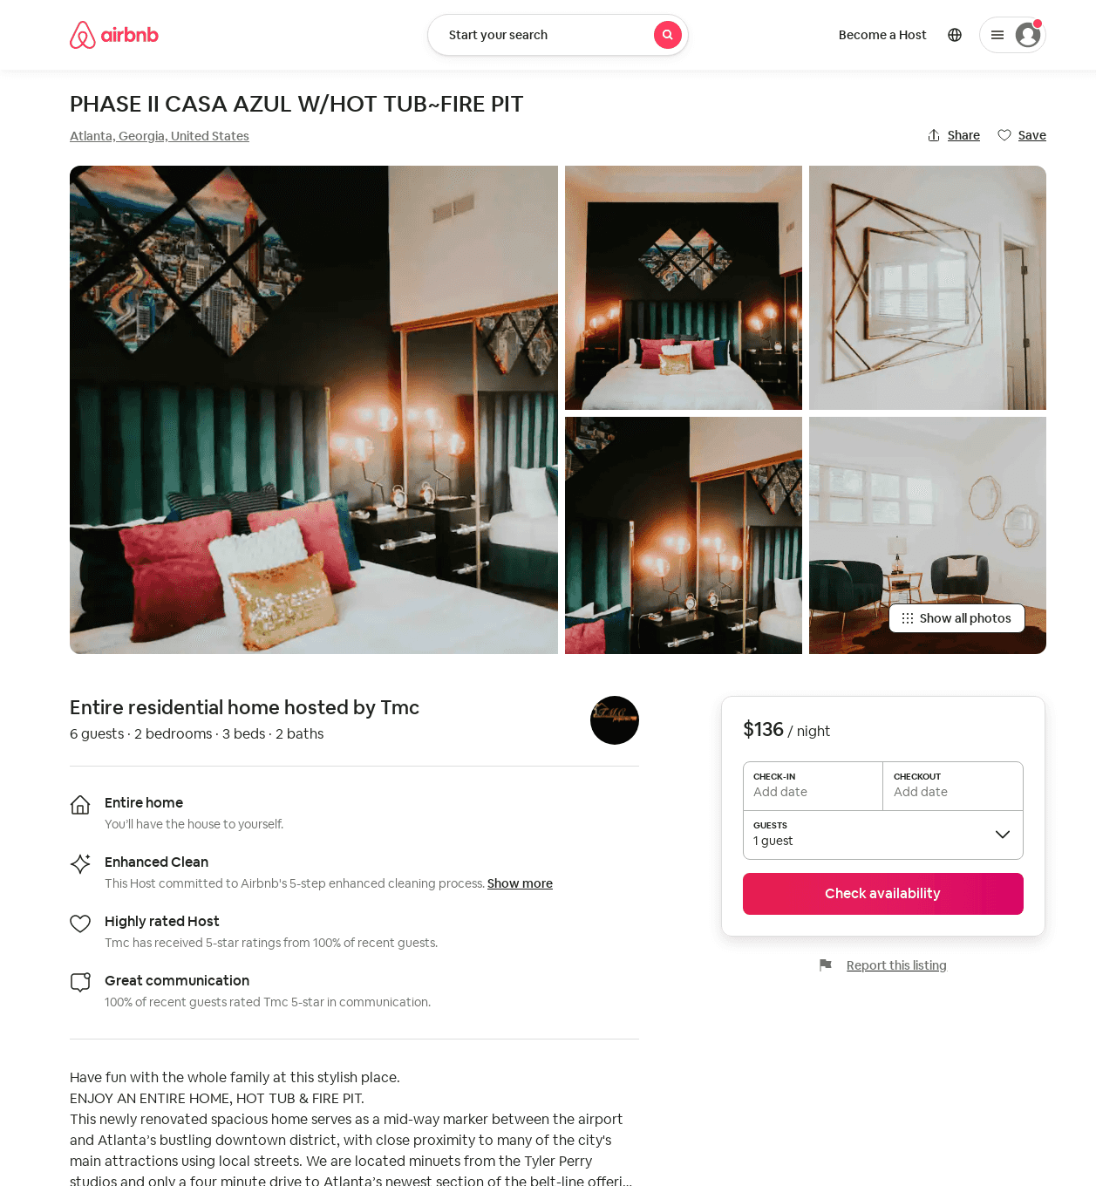
Listing 53219970
2
6
$140 - $281
4.75
1
Tmc
57413249
3
https://www.airbnb.com/rooms/53219970
Jul 2022

Slide 12
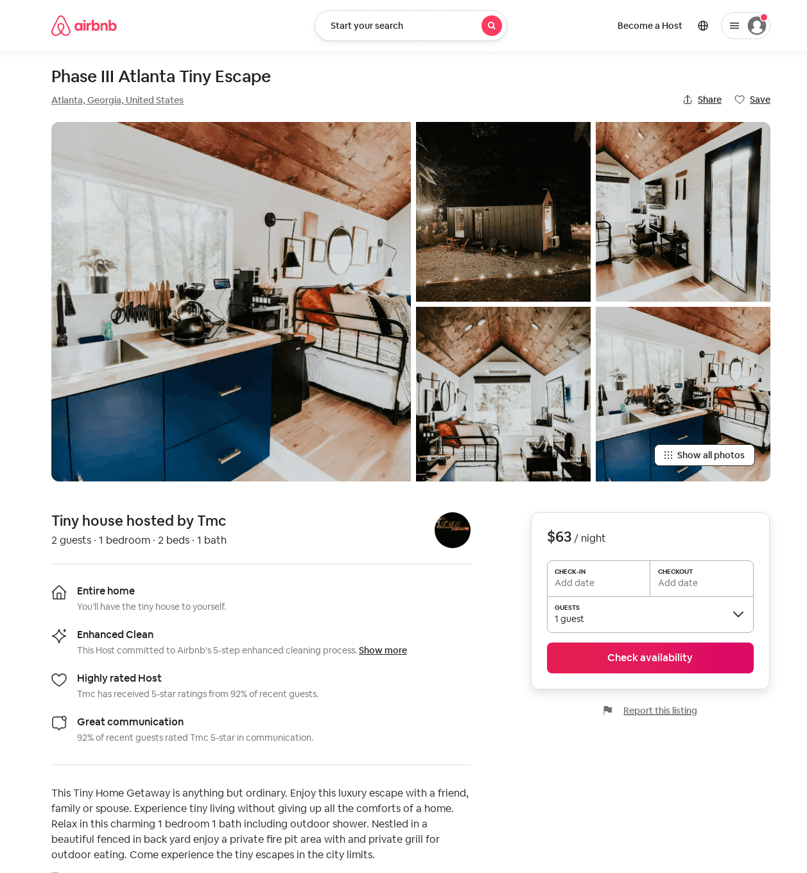
Listing 53671065
1
2
$59 - $117
4.81
1
Tmc
57413249
3
https://www.airbnb.com/rooms/53671065
Jun 2022

Slide 13
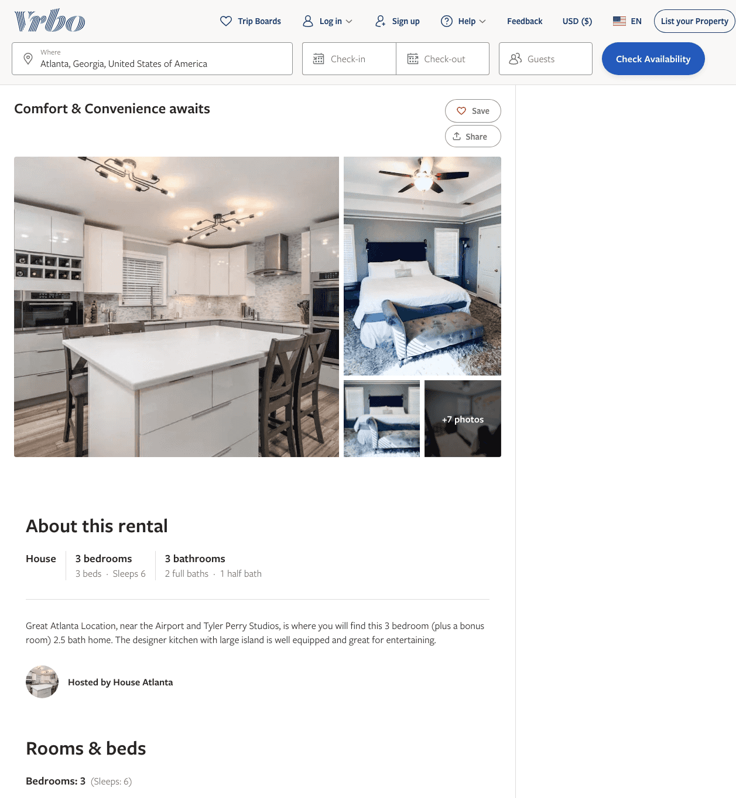
Listing 2598750
3
6
$289
2
https://www.vrbo.com/2598750
Aug 2022

Slide 14
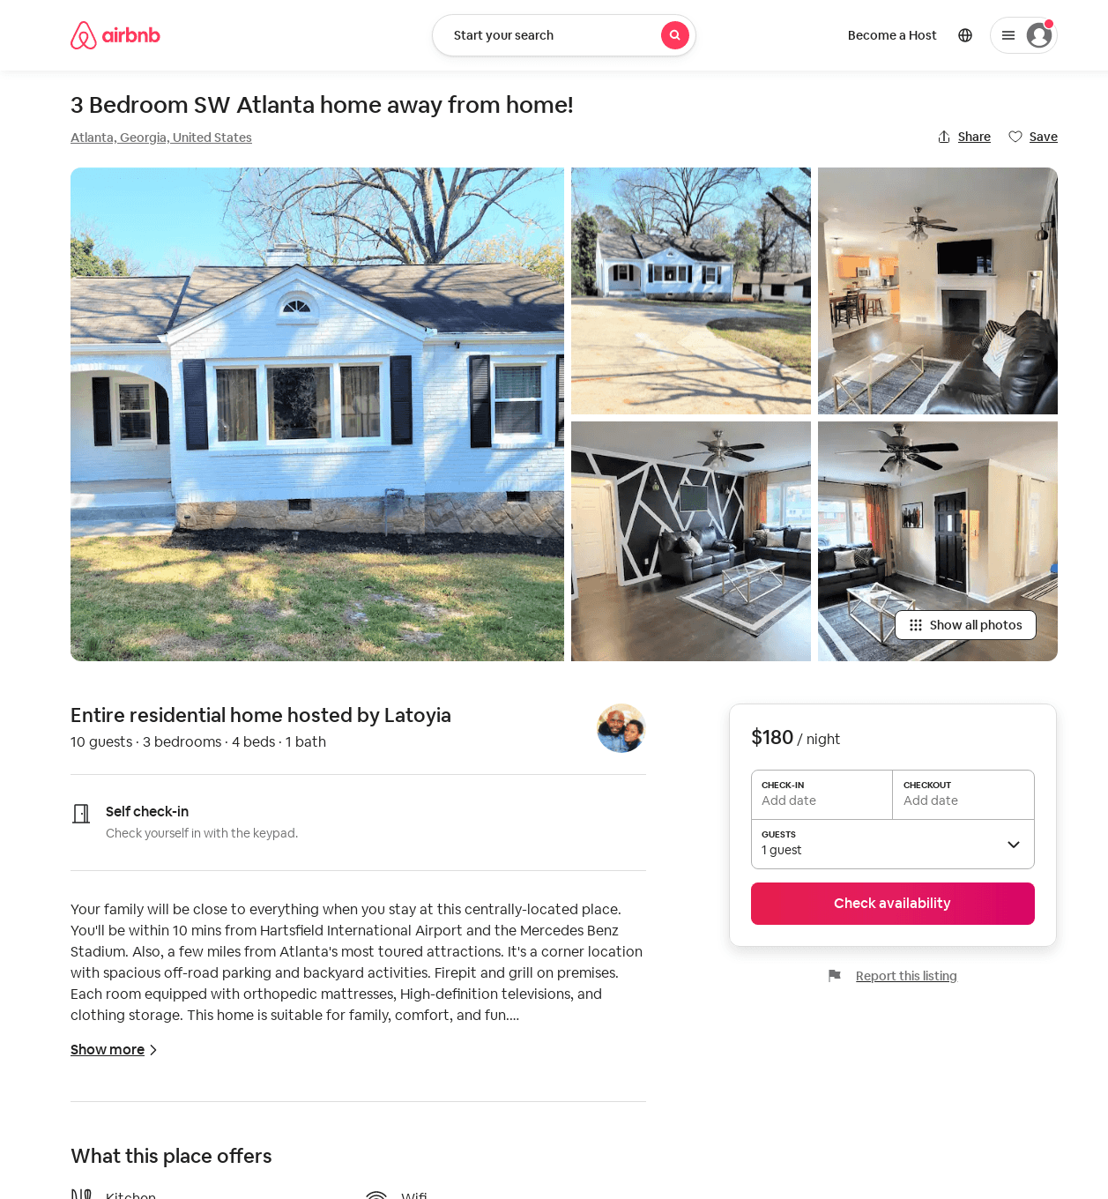
Listing 53684471
3
8
$180 - $197
4.71
2
Latoyia
178642158
1
https://www.airbnb.com/rooms/53684471
Aug 2022

Slide 15
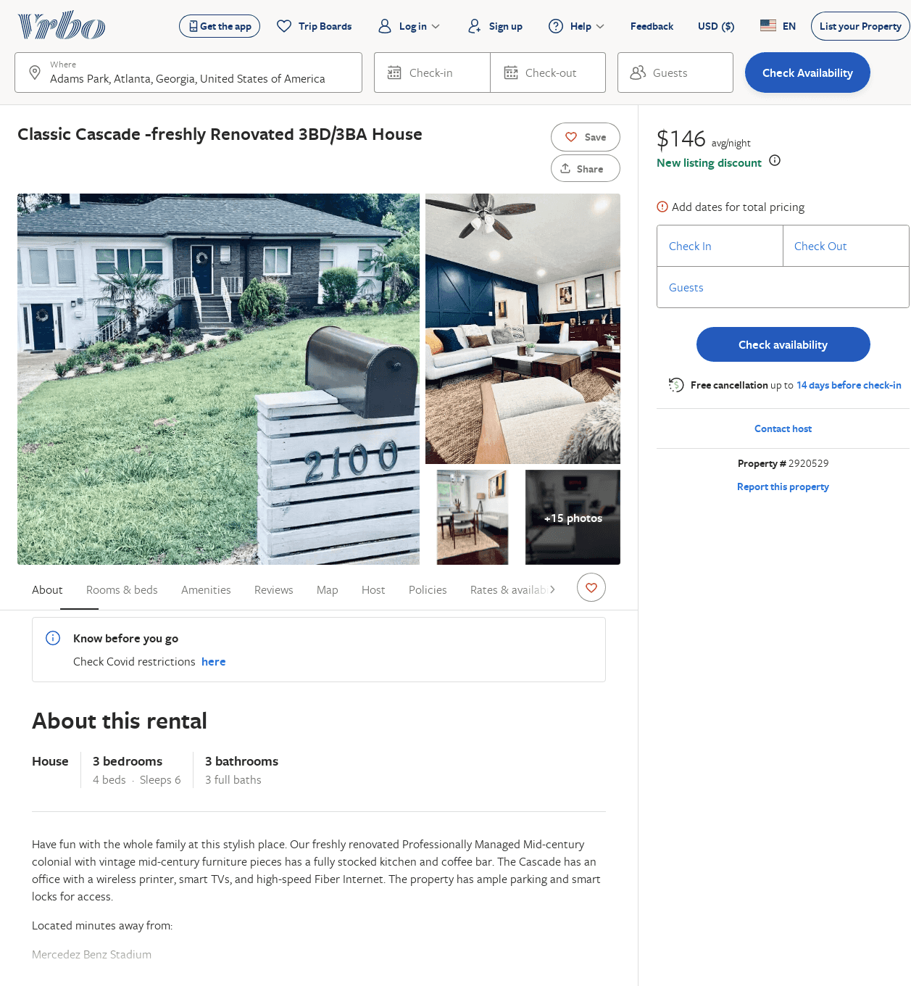
Listing 2920529
3
6
$137
2
Jon Walchle
https://www.vrbo.com/2920529
Aug 2022

