Slide 2
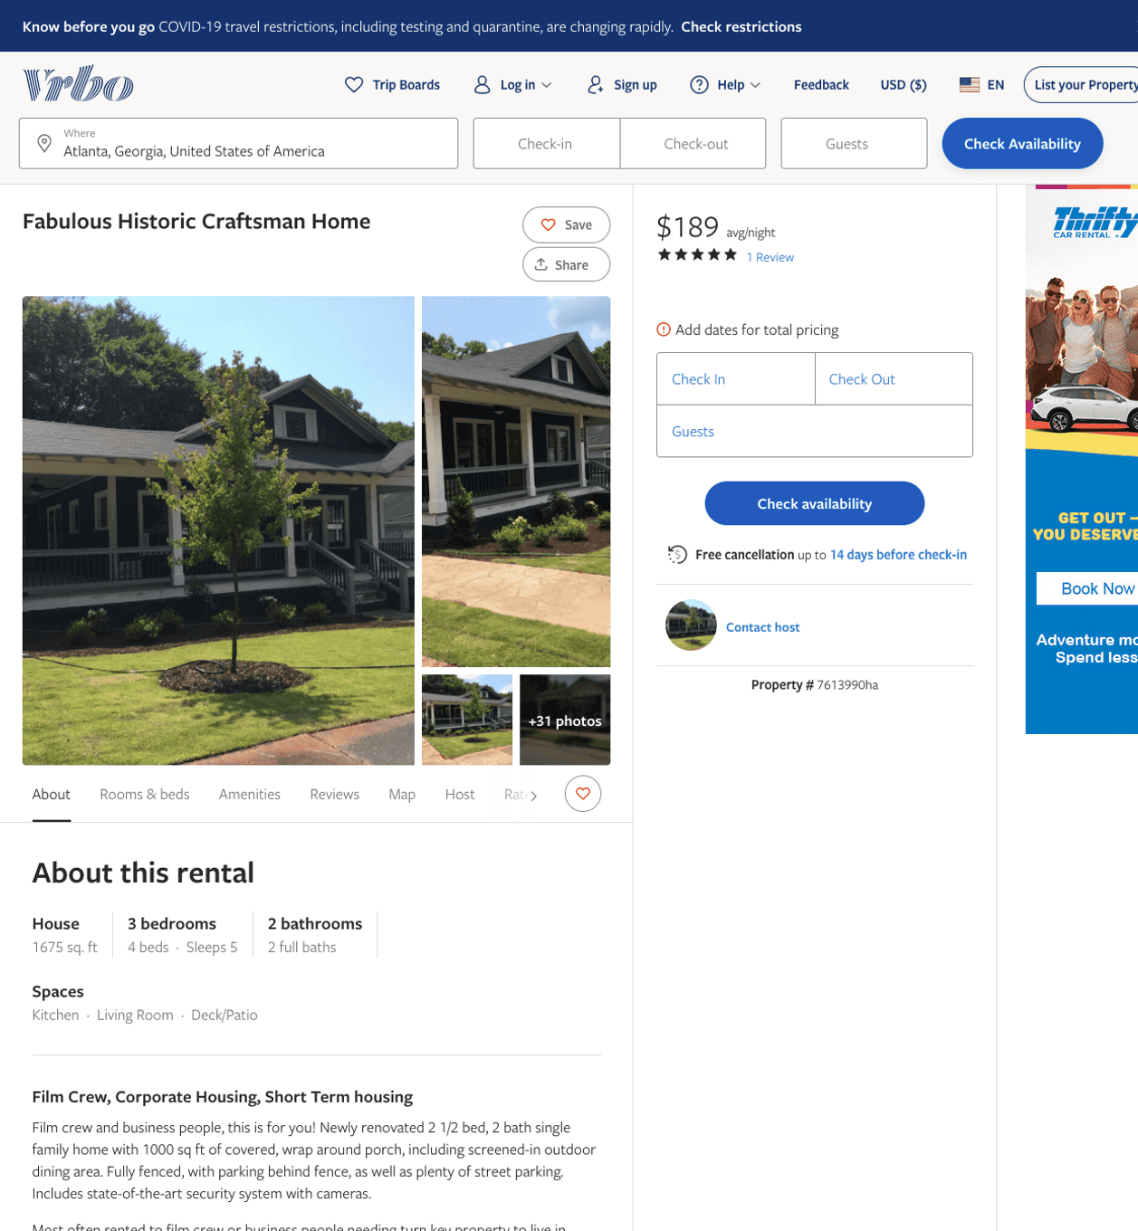
Listing 7613990
3
5
$173 - $238
5
3
https://www.vrbo.com/7613990ha
Aug 2022

Slide 3
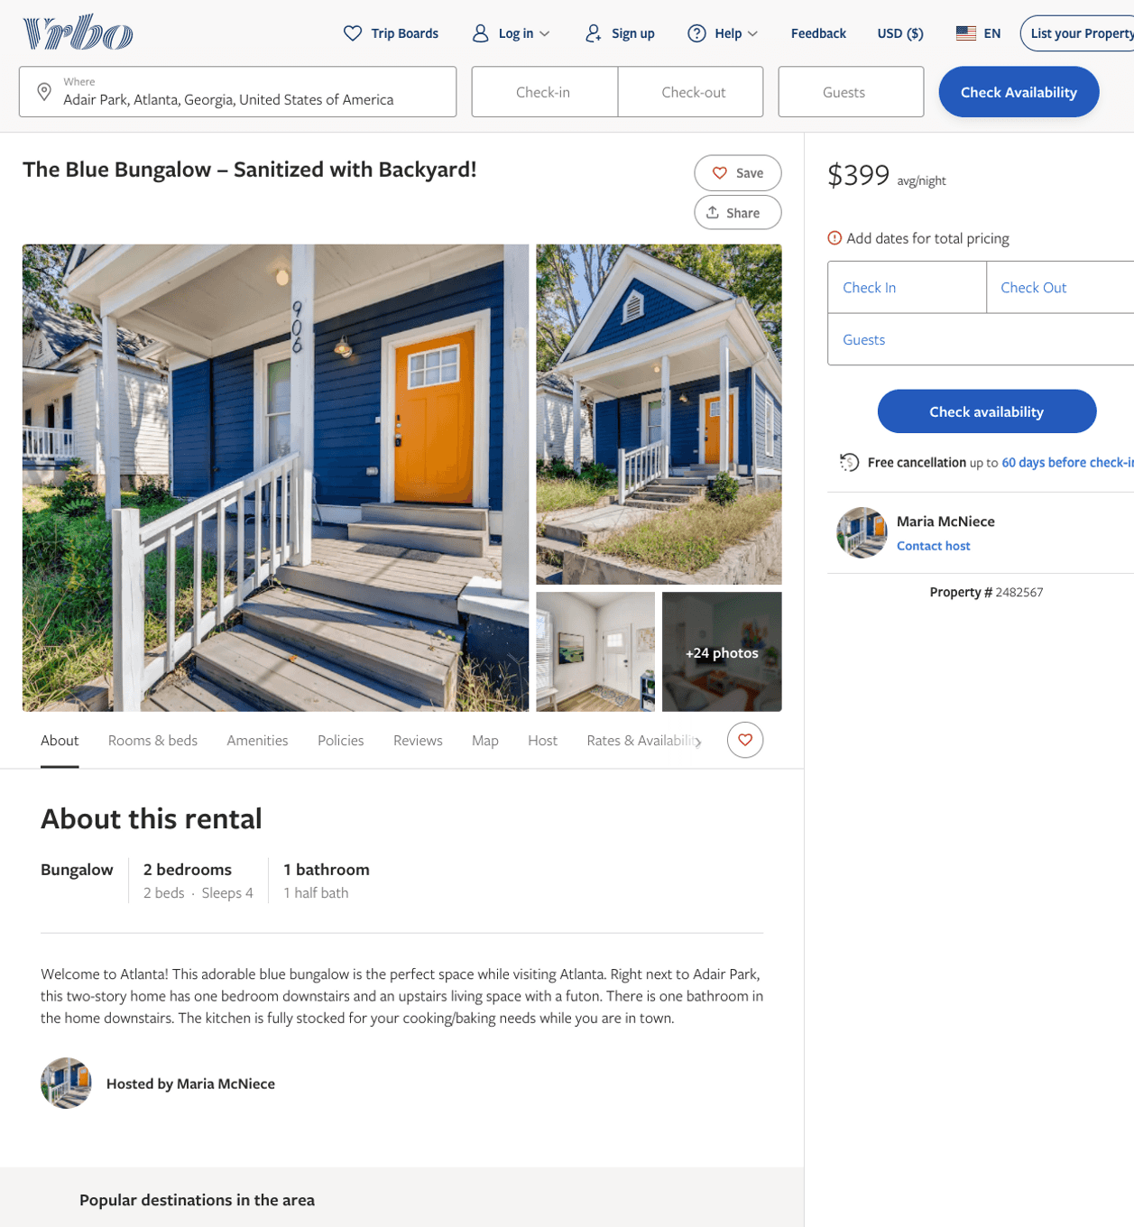
Listing 2482567
2
4
$113 - $87
5
1
Maria McNiece
https://www.vrbo.com/2482567
Aug 2022

Slide 4
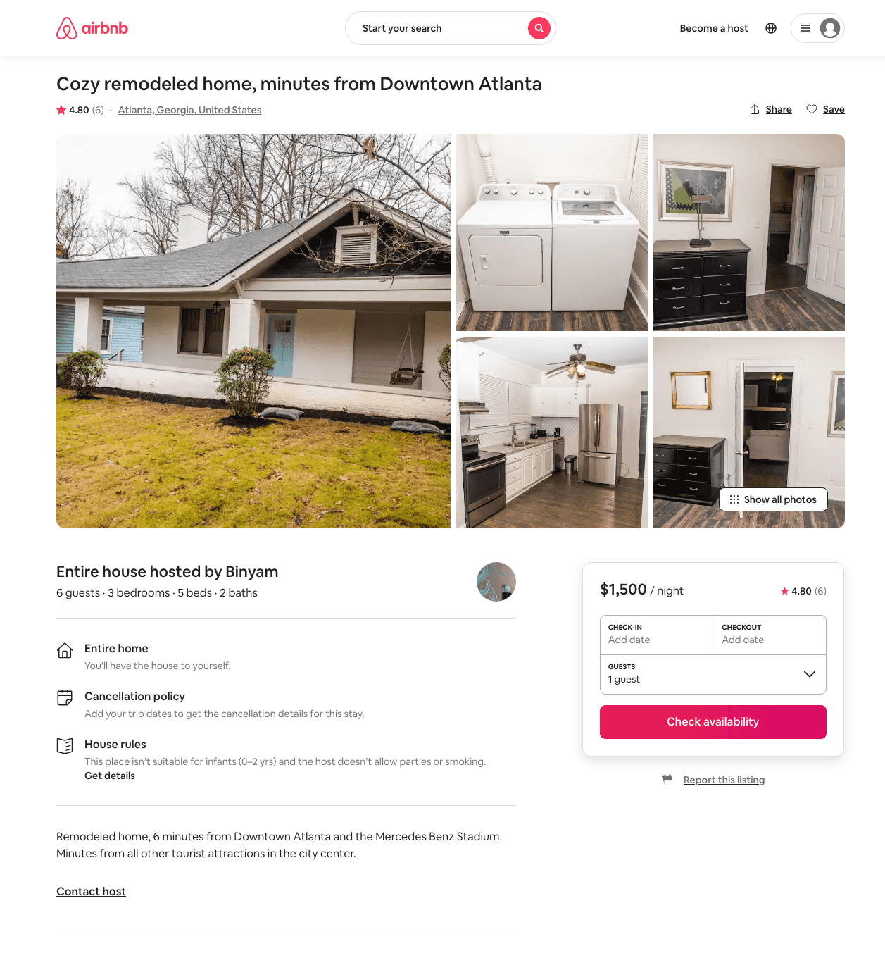
Listing 31709896
3
6
$1500
4.80
2
Binyam
11882848
1
https://www.airbnb.com/rooms/31709896
Aug 2022

Slide 5
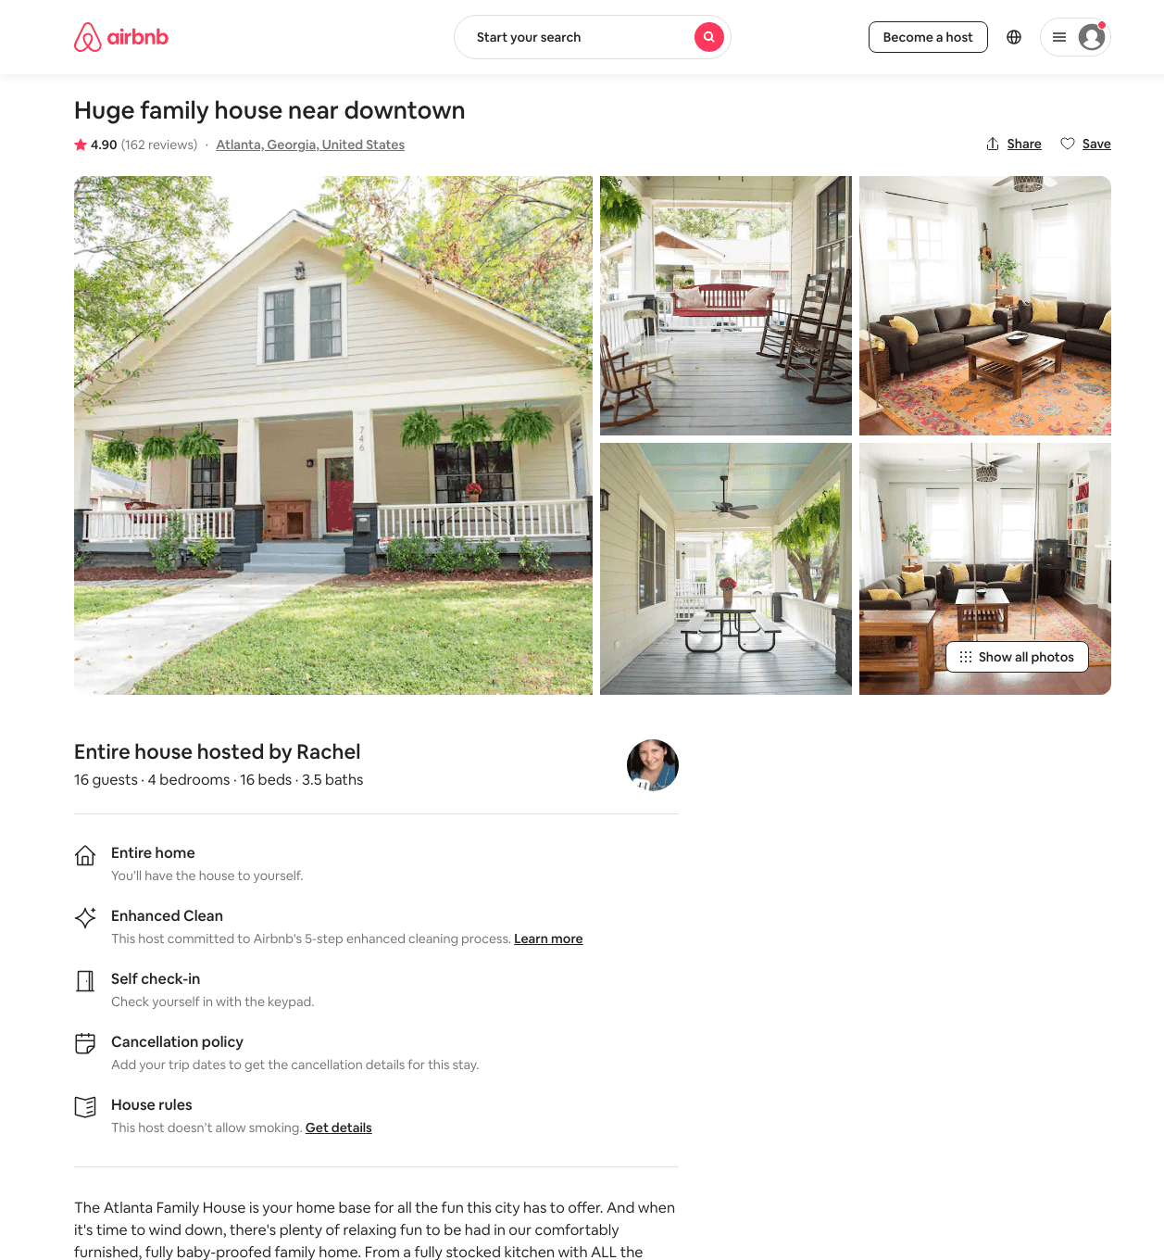
Listing 8525536
4
16
$351 - $421
4.88
2
Rachel
6130605
1
https://www.airbnb.com/rooms/8525536
Aug 2022

Slide 6
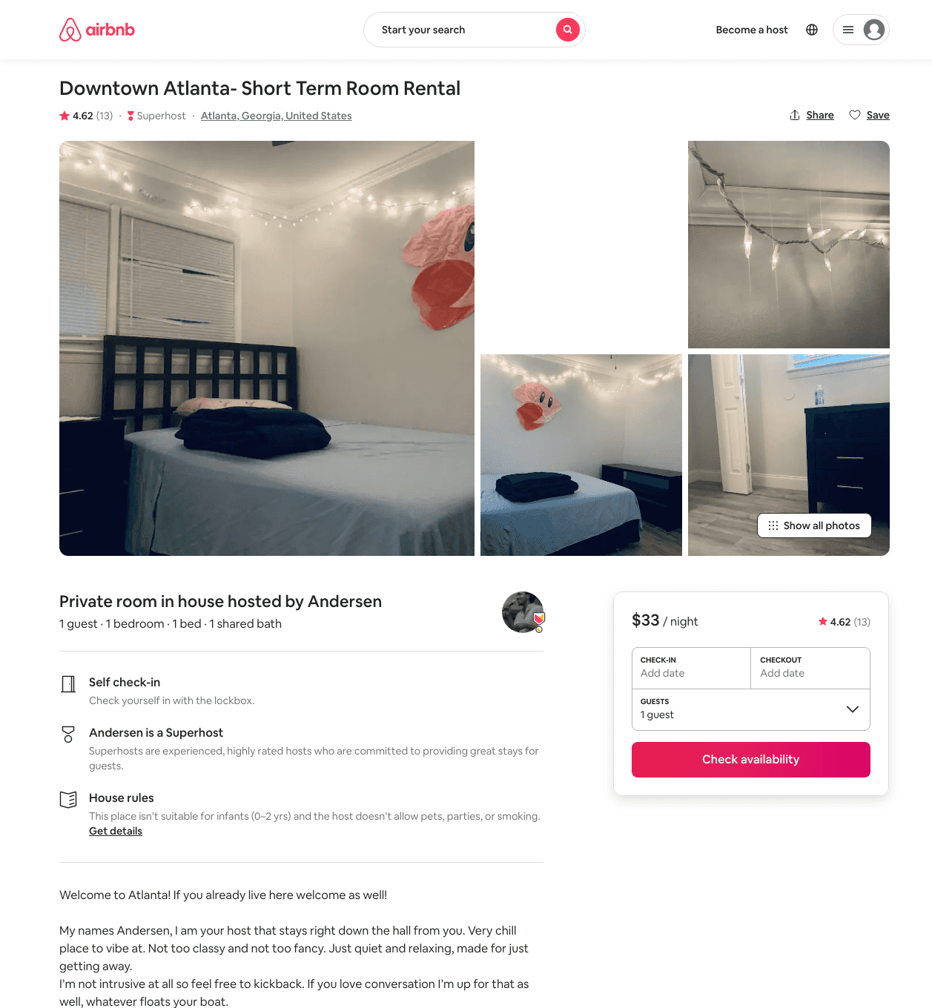
Listing 41034955
1
1
$33 - $42
4.74
3
Andersen
169296999
3
https://www.airbnb.com/rooms/41034955
Aug 2022

Slide 7
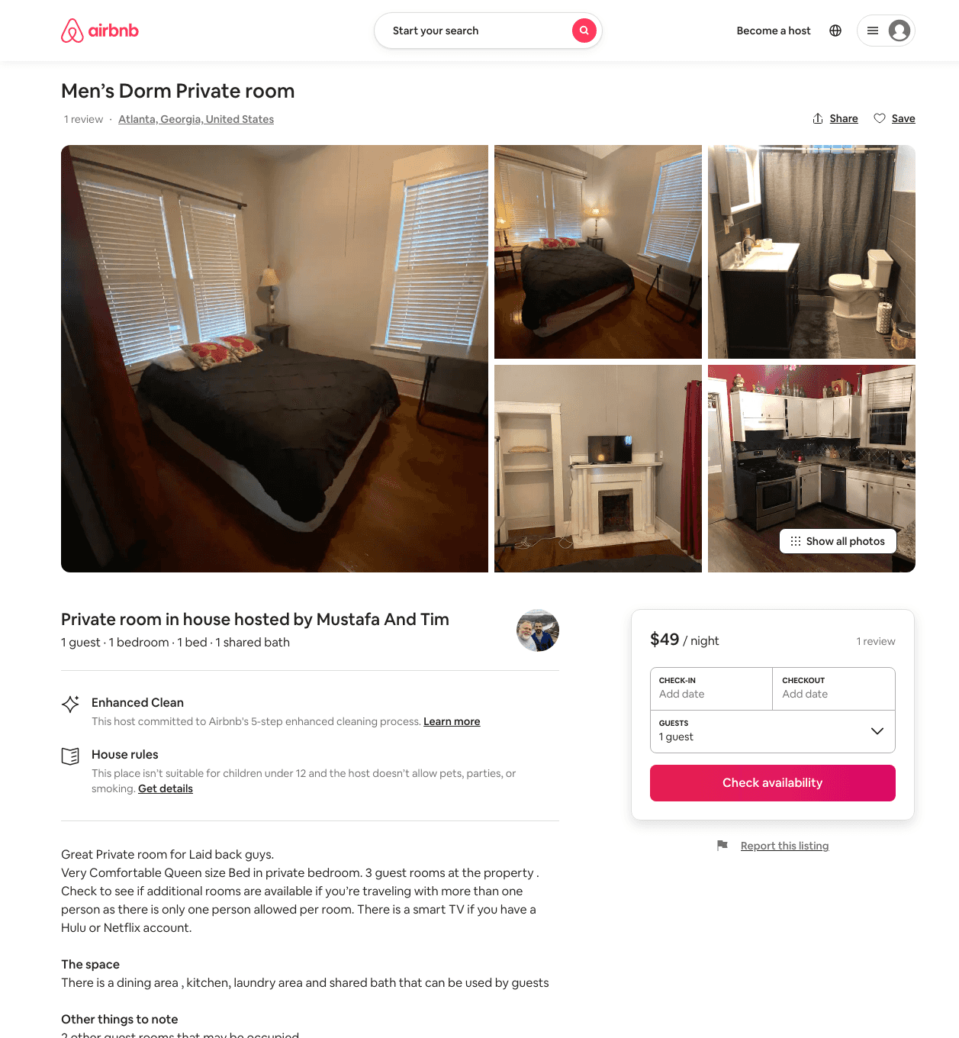
Listing 49059854
1
1
$33 - $63
4.55
1
Mustafa And Tim
361748054
4
https://www.airbnb.com/rooms/49059854
Aug 2022

Slide 8
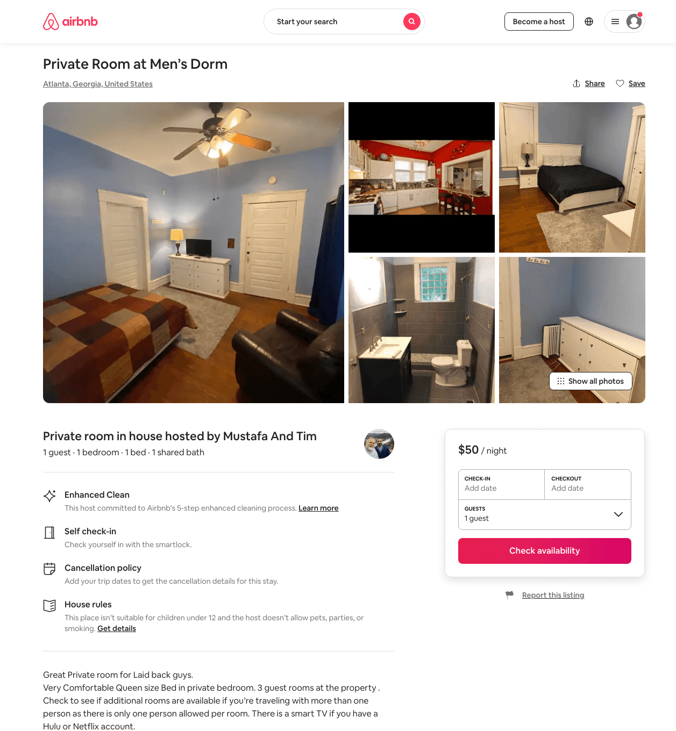
Listing 44676512
1
1
$34 - $63
4.88
1
Mustafa And Tim
361748054
4
https://www.airbnb.com/rooms/44676512
Aug 2022

Slide 9
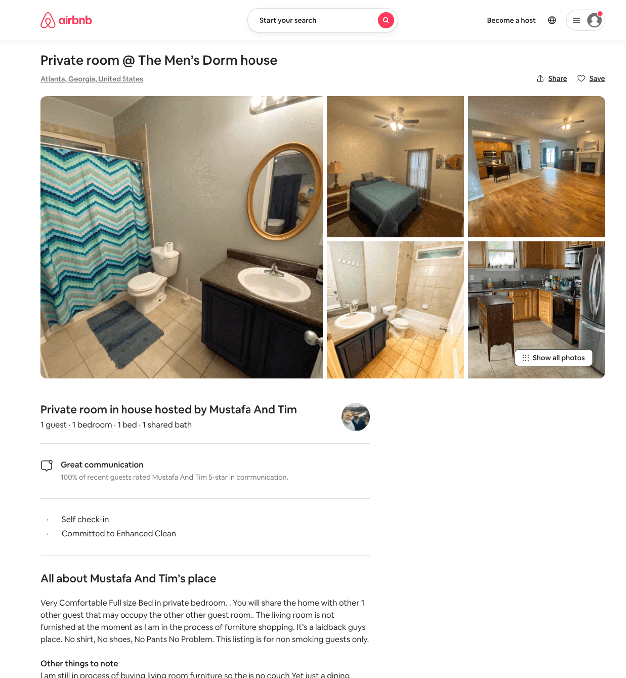
Listing 45053954
1
1
$35 - $66
5.0
2
Mustafa And Tim
361748054
4
https://www.airbnb.com/rooms/45053954
Aug 2022

Slide 10
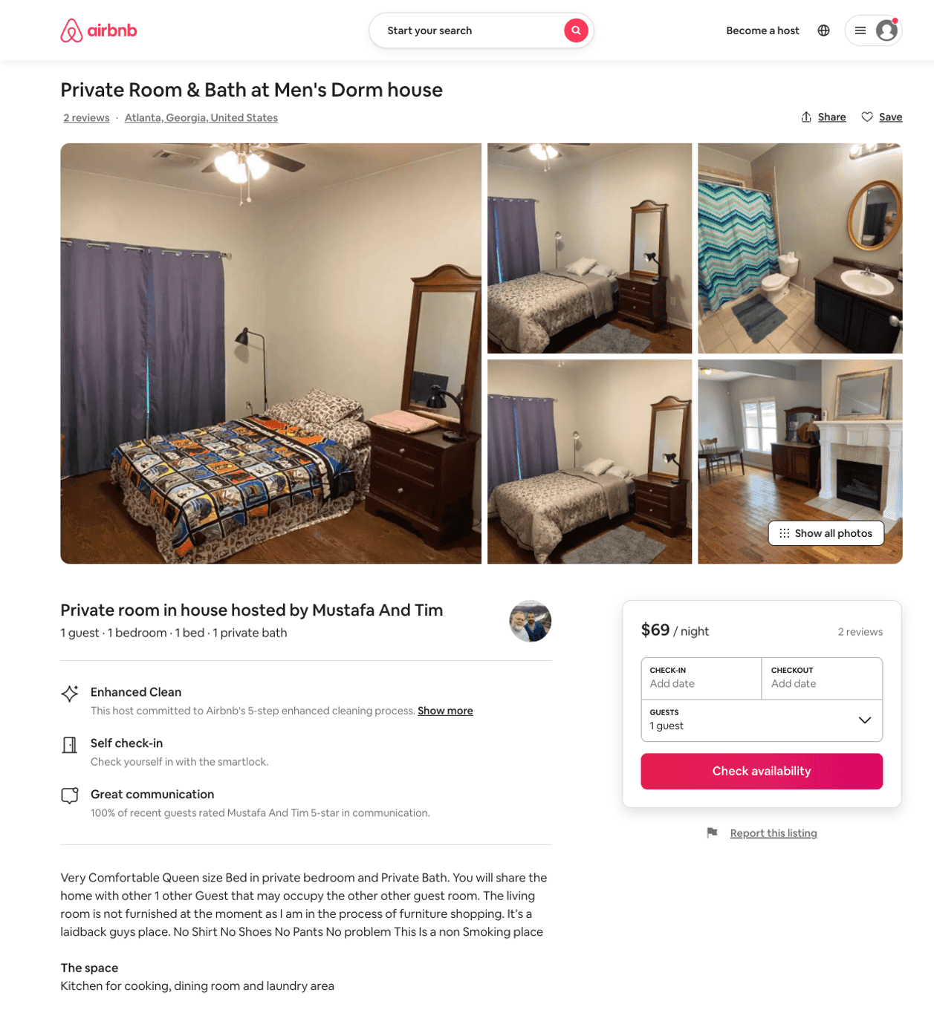
Listing 44713701
1
1
$56 - $69
5.0
1
Mustafa And Tim
361748054
4
https://www.airbnb.com/rooms/44713701
Aug 2022

Slide 11
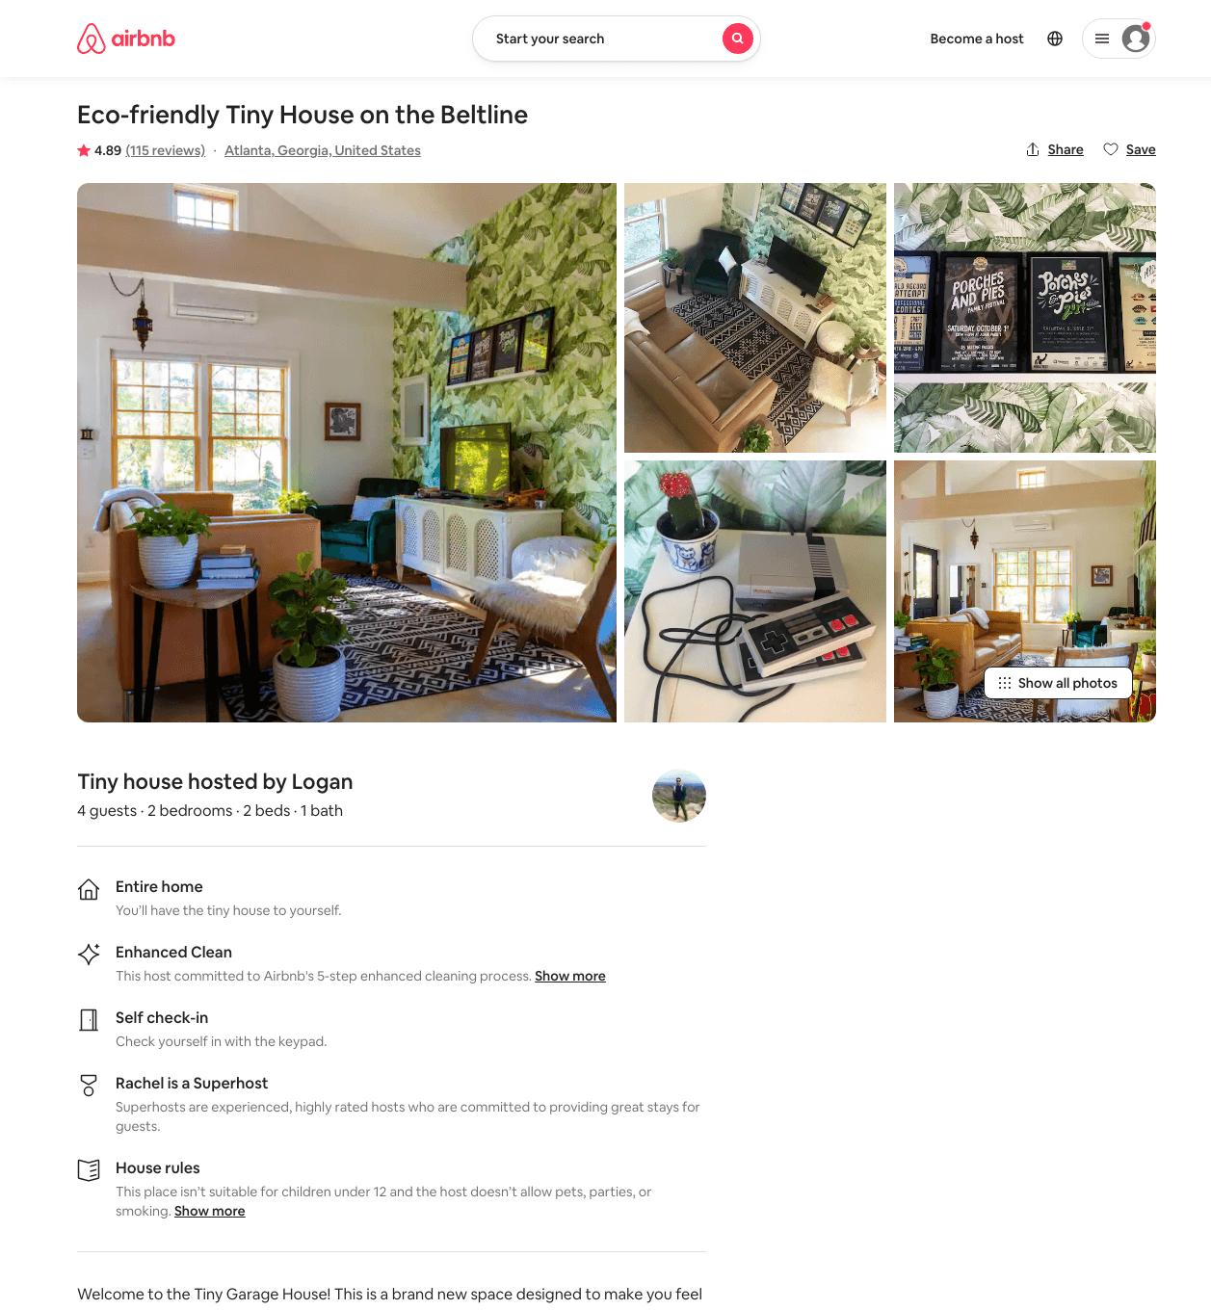
Listing 37810539
2
4
$88 - $112
4.90
1
Rachel
102240964
1
https://www.airbnb.com/rooms/37810539
Aug 2022

Slide 12
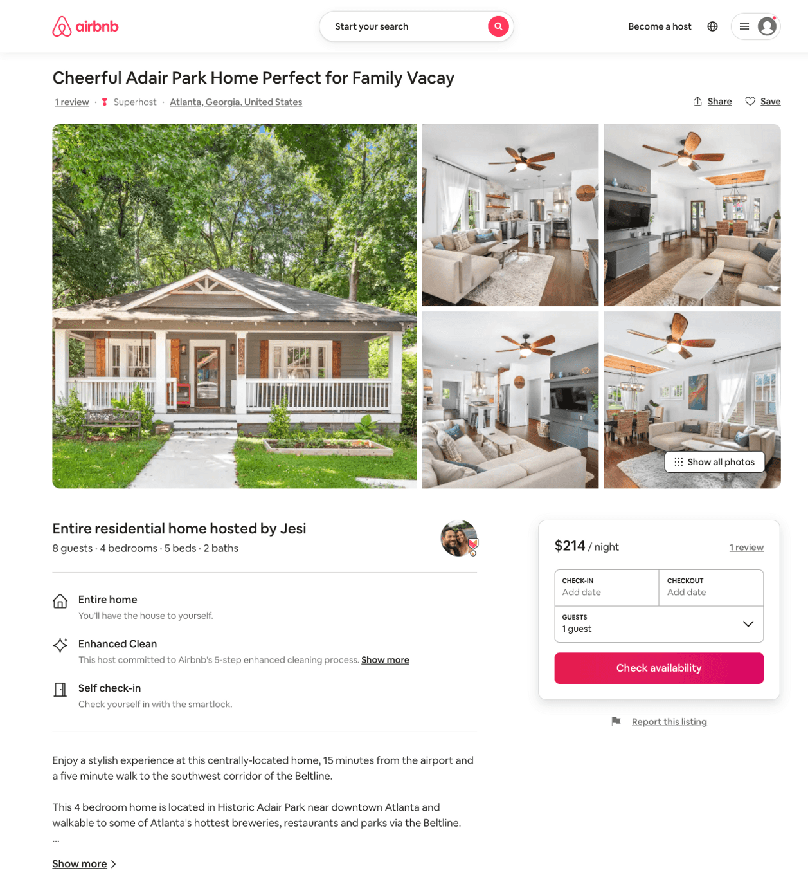
Listing 51249315
4
8
$178 - $301
4.77
2
Talia
1851902
6
https://www.airbnb.com/rooms/51249315
Aug 2022

Slide 13
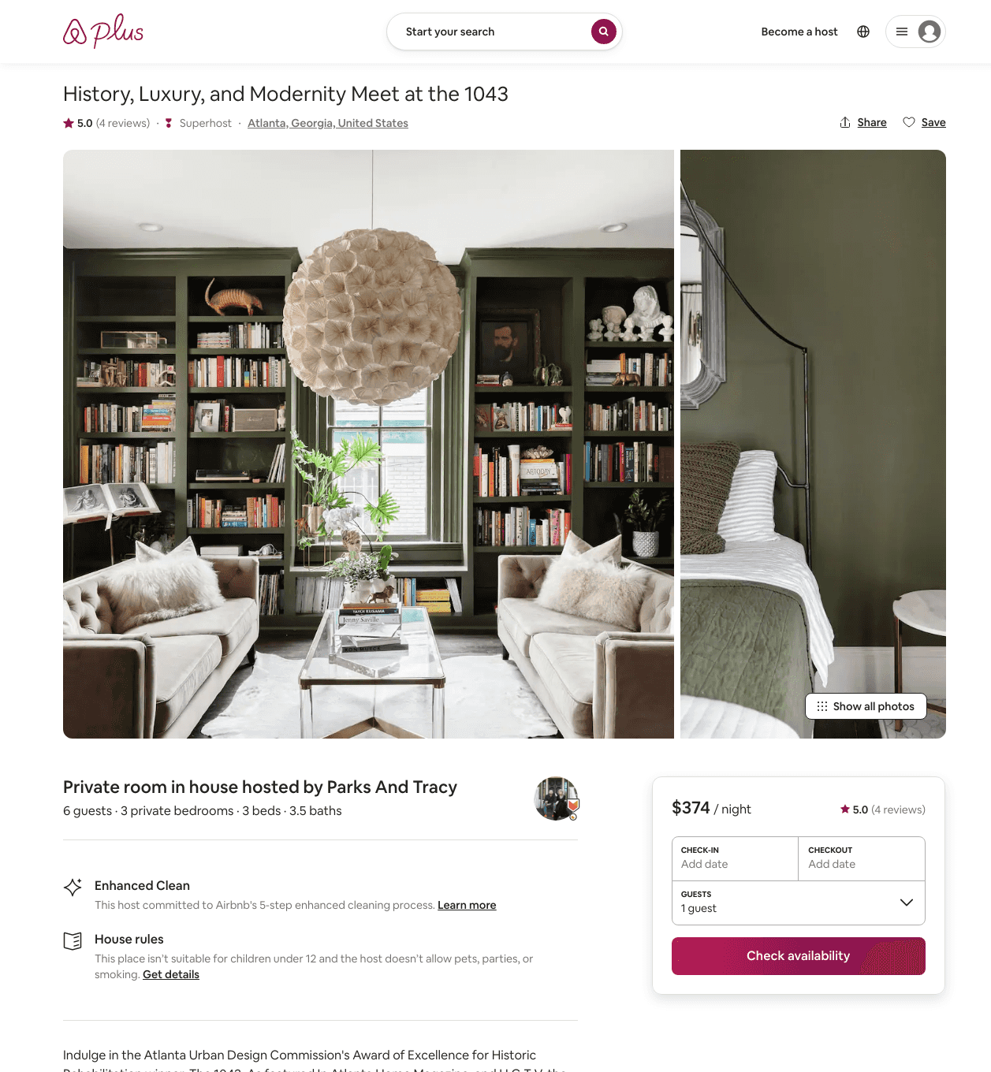
Listing 31359195
3
6
$374
5.0
1
Parks And Tracy
110969048
4
https://www.airbnb.com/rooms/31359195
Aug 2022

Slide 14
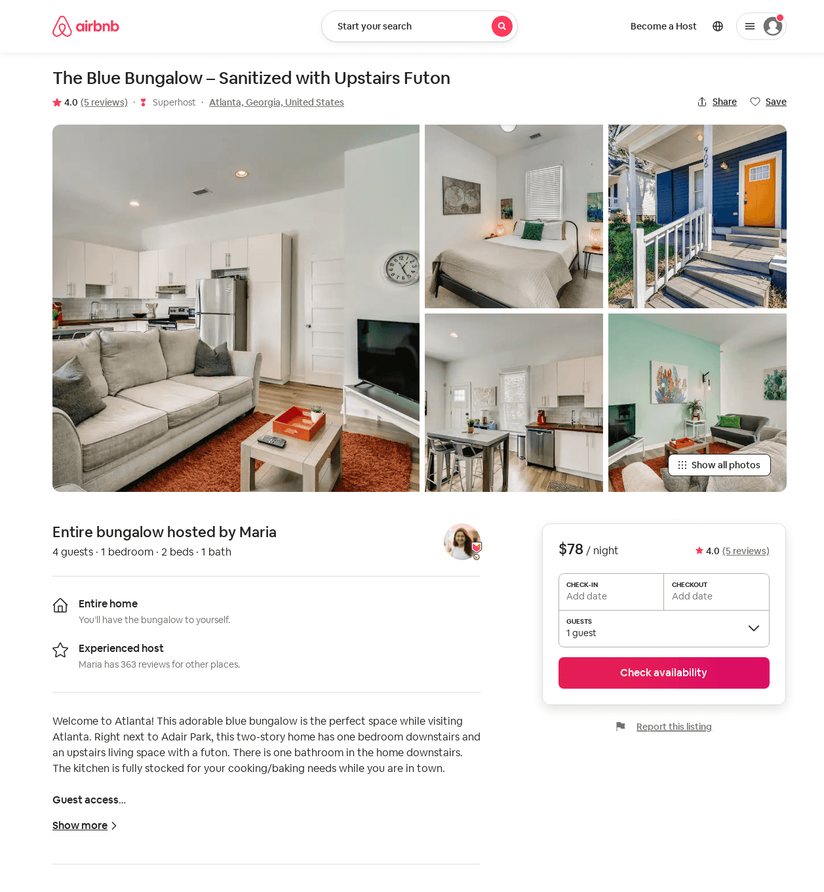
Listing 52512901
1
4
$78 - $79
4.63
1
Maria
230939573
13
https://www.airbnb.com/rooms/52512901
Aug 2022

Slide 15
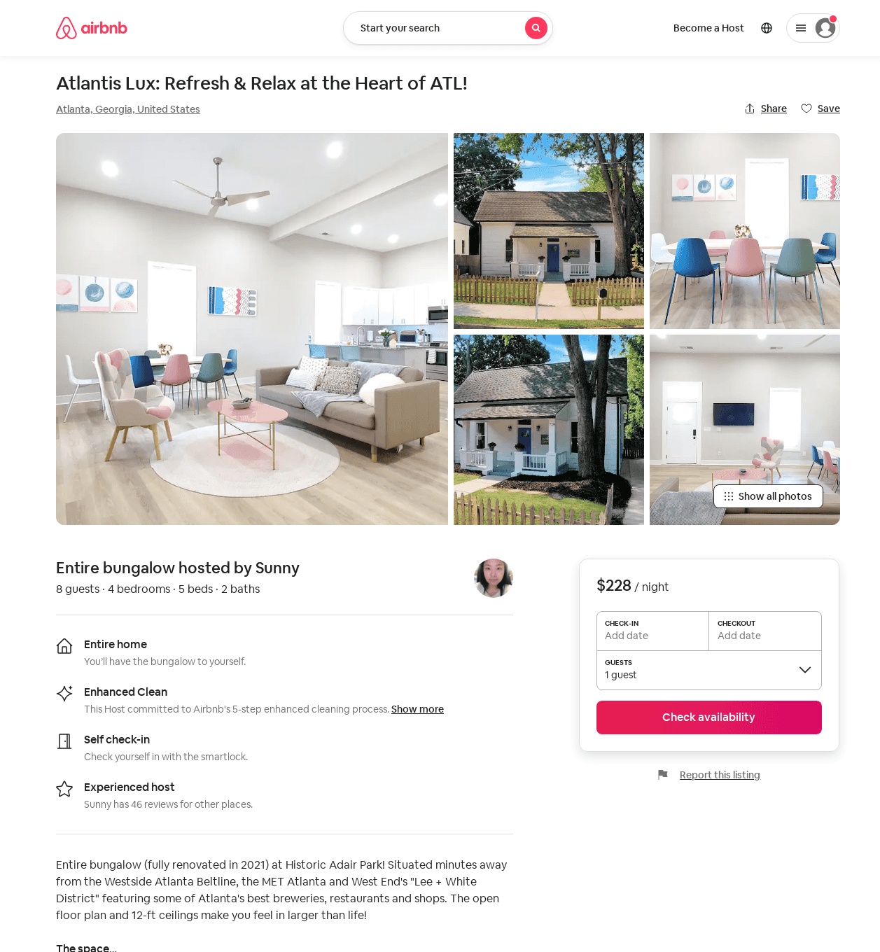
Listing 53134132
4
8
$190 - $228
4.82
2
Jinyong
123783215
1
https://www.airbnb.com/rooms/53134132
Aug 2022

Slide 16
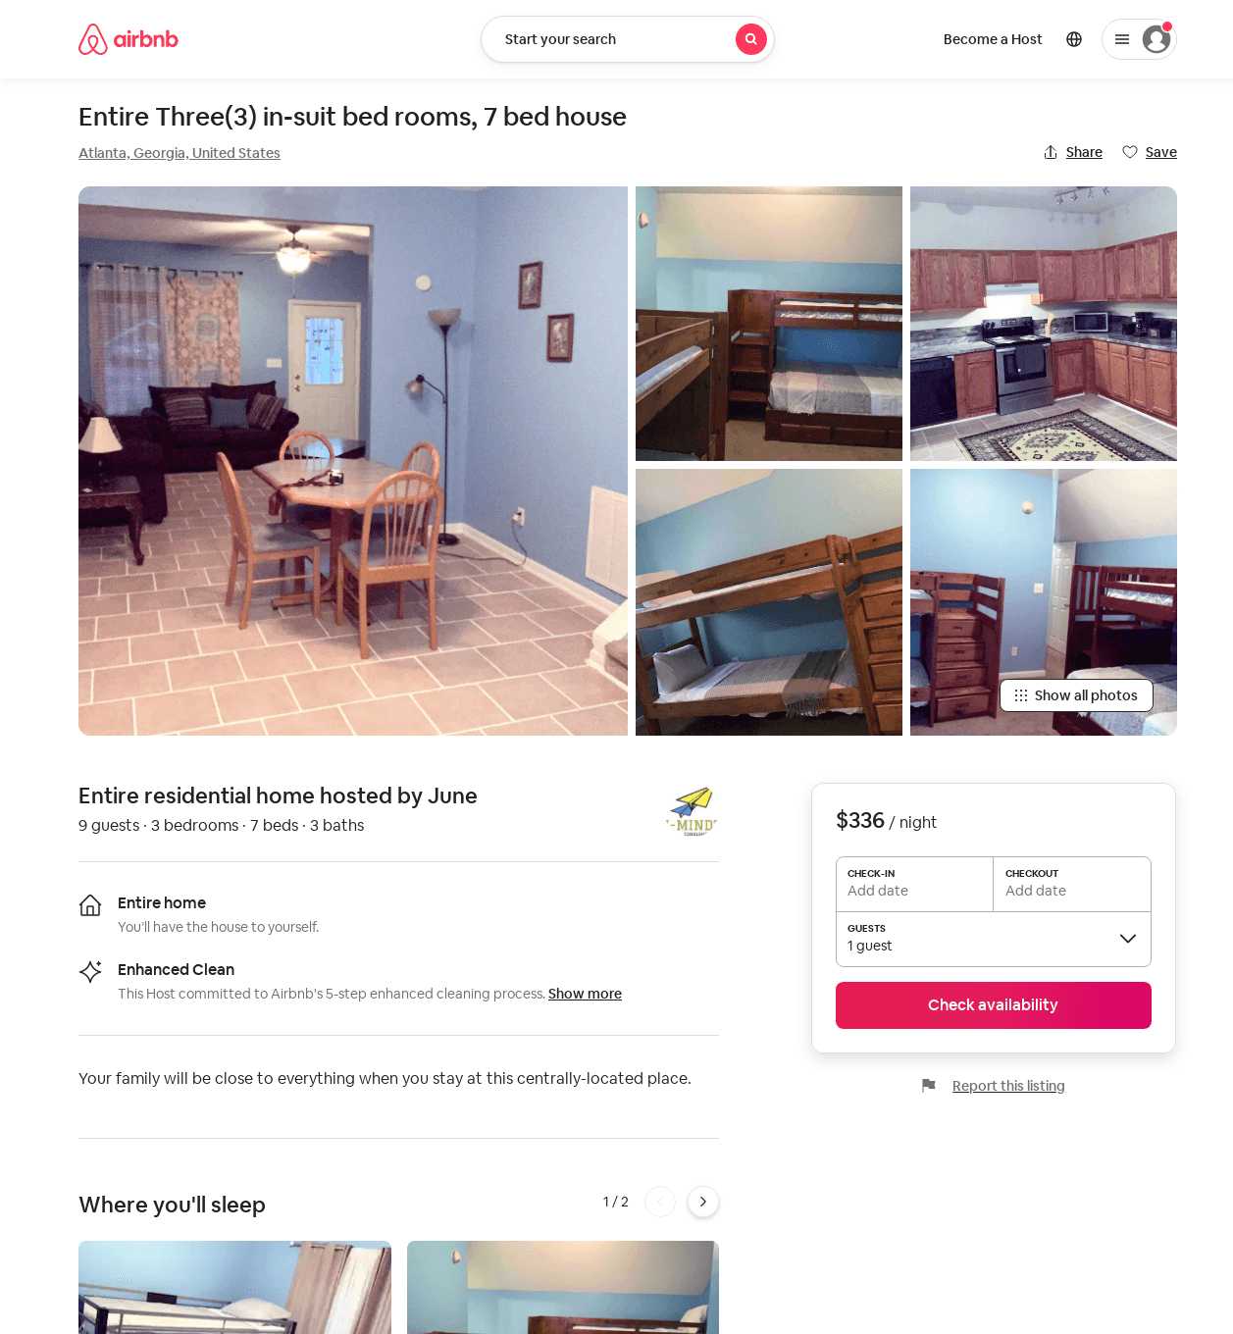
Listing 53940834
3
9
$336 - $420
1
June
366436216
5
https://www.airbnb.com/rooms/53940834
Jul 2022

Slide 17
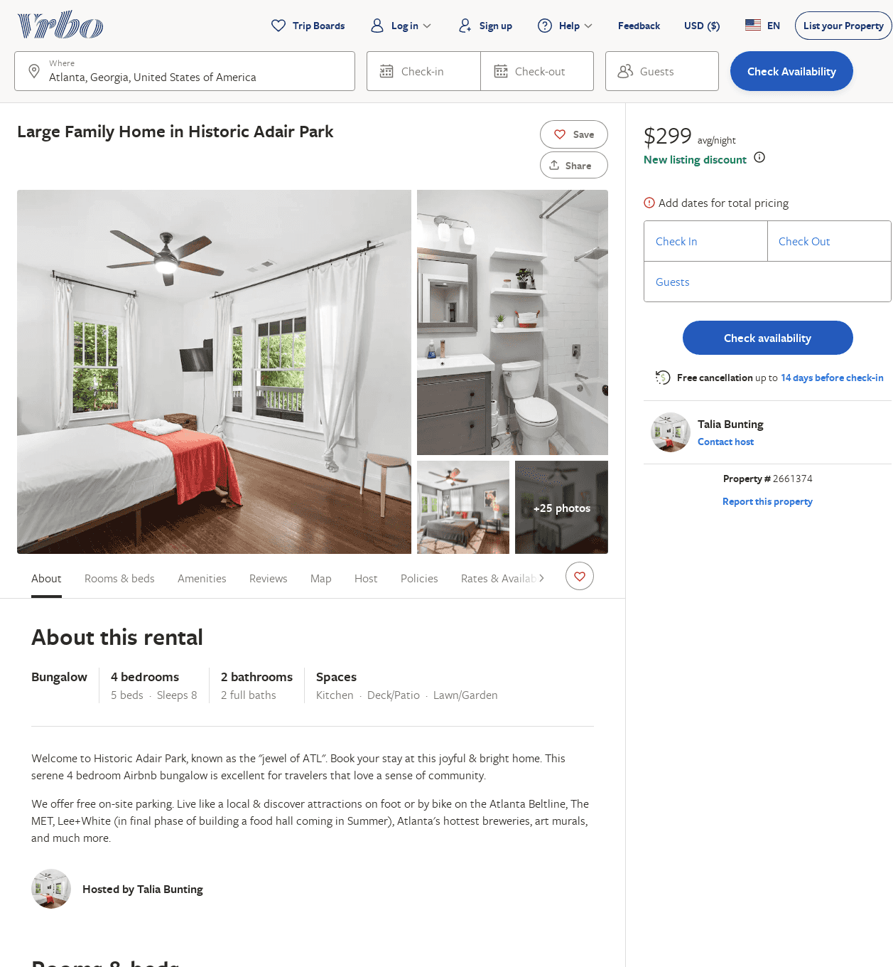
Listing 2661374
4
8
$322
4
1
Talia Bunting
https://www.vrbo.com/2661374
Aug 2022

Slide 18
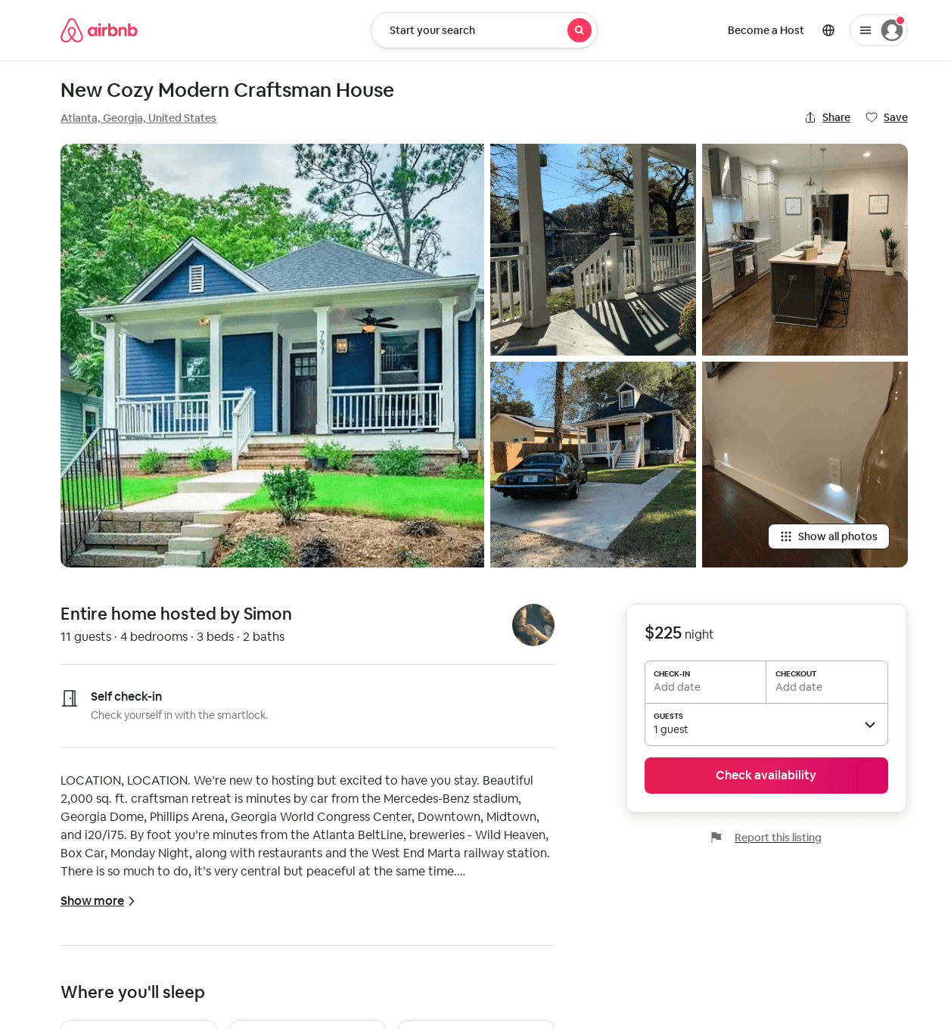
Listing 52834664
4
11
$225
5.0
1
Simon
201222502
1
https://www.airbnb.com/rooms/52834664
Jun 2022

Slide 19
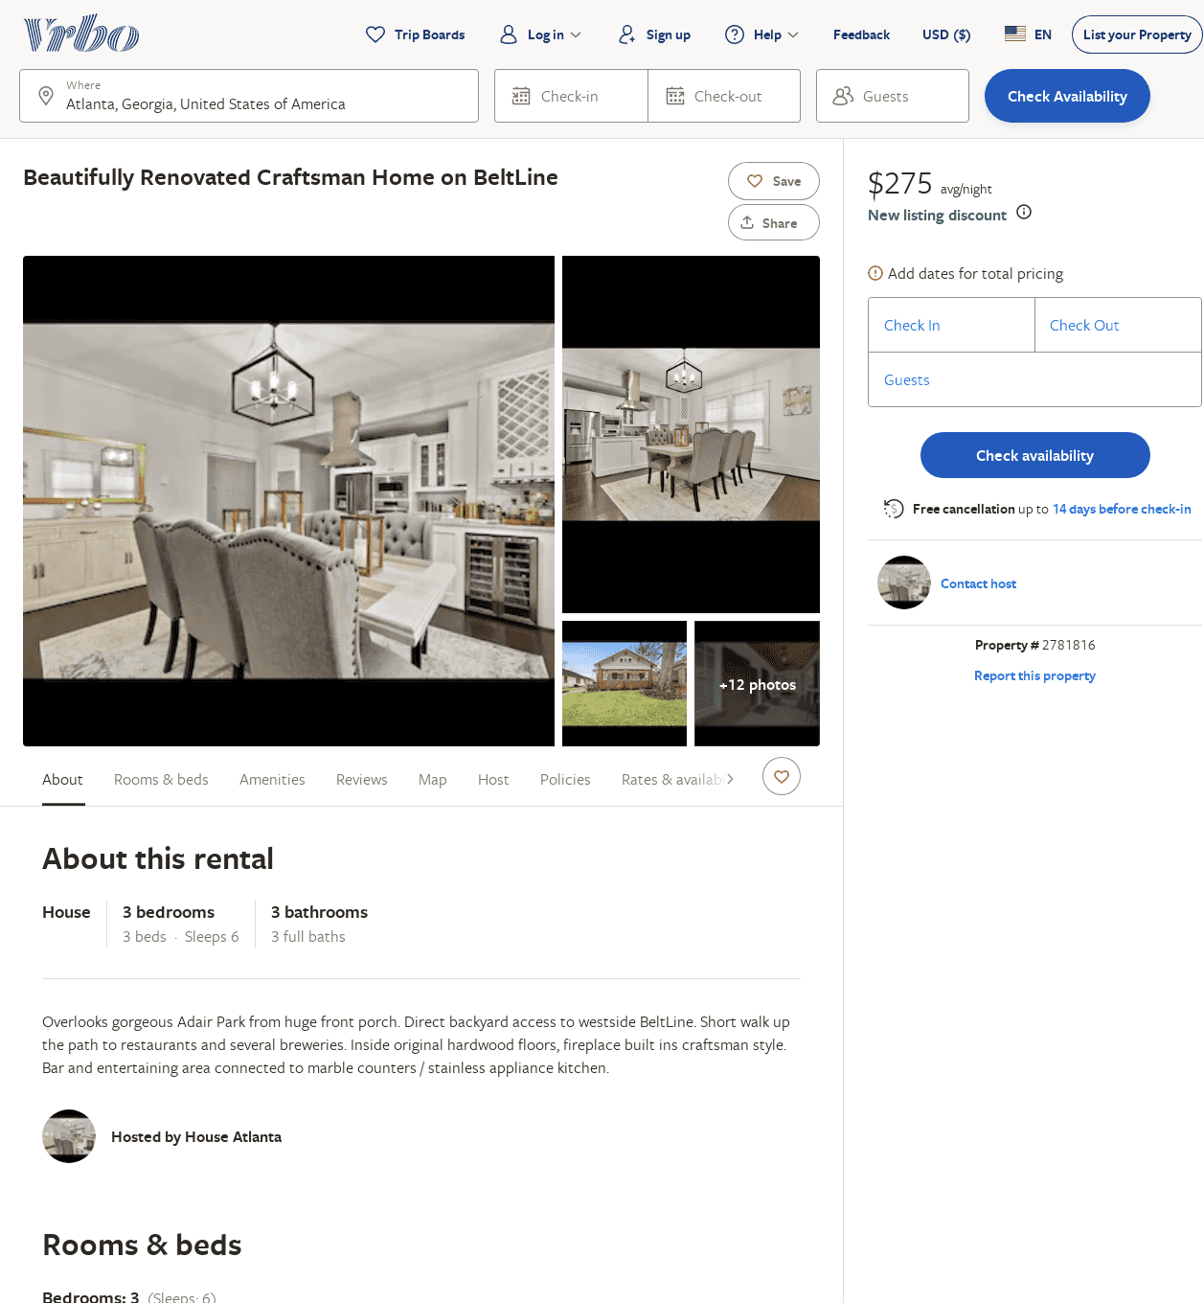
Listing 2781816
3
6
$275
2
https://www.vrbo.com/2781816
Aug 2022

Slide 20
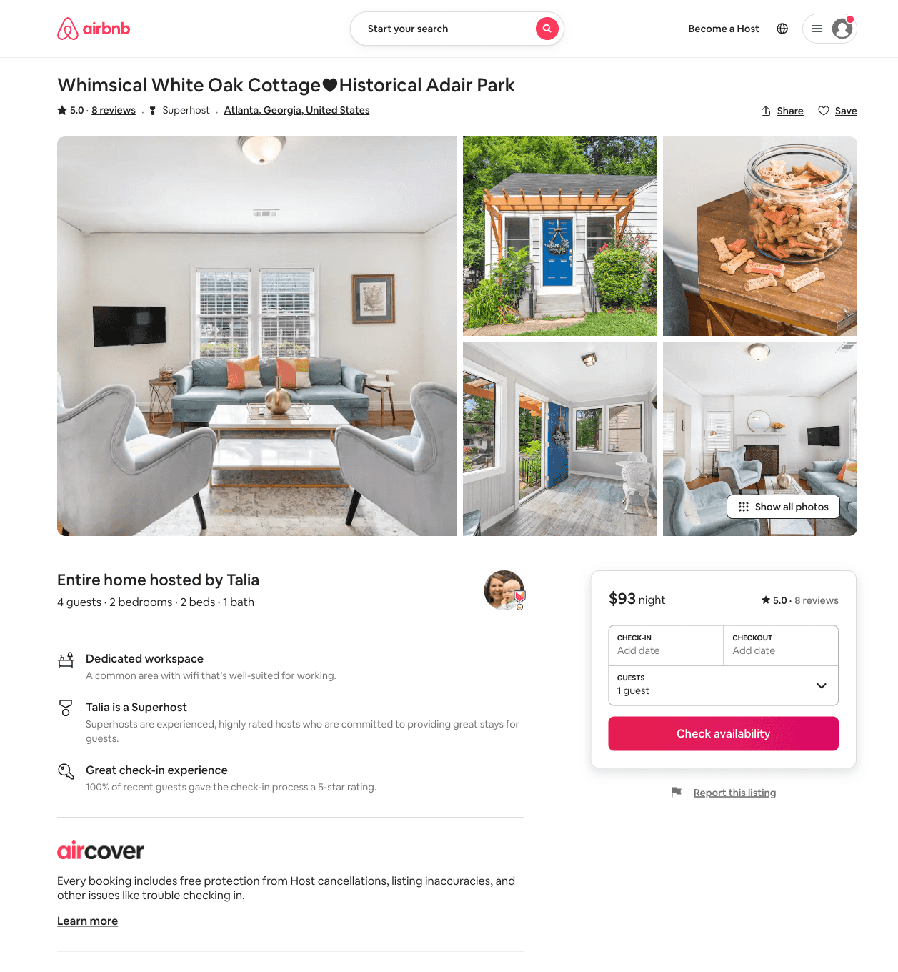
Listing 42626555
2
4
$96
4.67
1
Talia
1851902
6
https://www.airbnb.com/rooms/42626555
Aug 2022

Slide 21
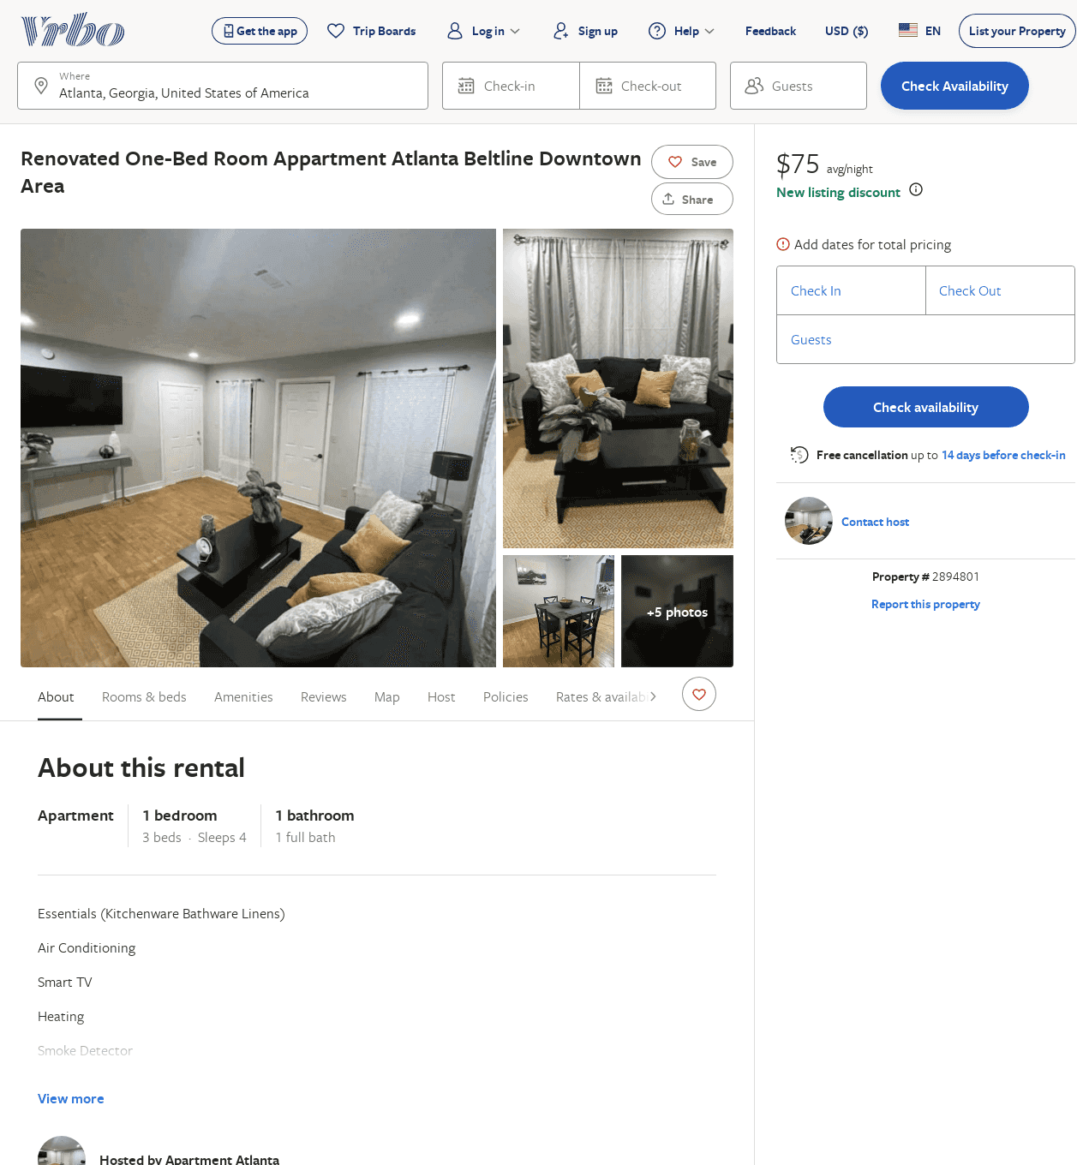
Listing 2894801
1
4
$75
30
https://www.vrbo.com/2894801
Aug 2022

Slide 22
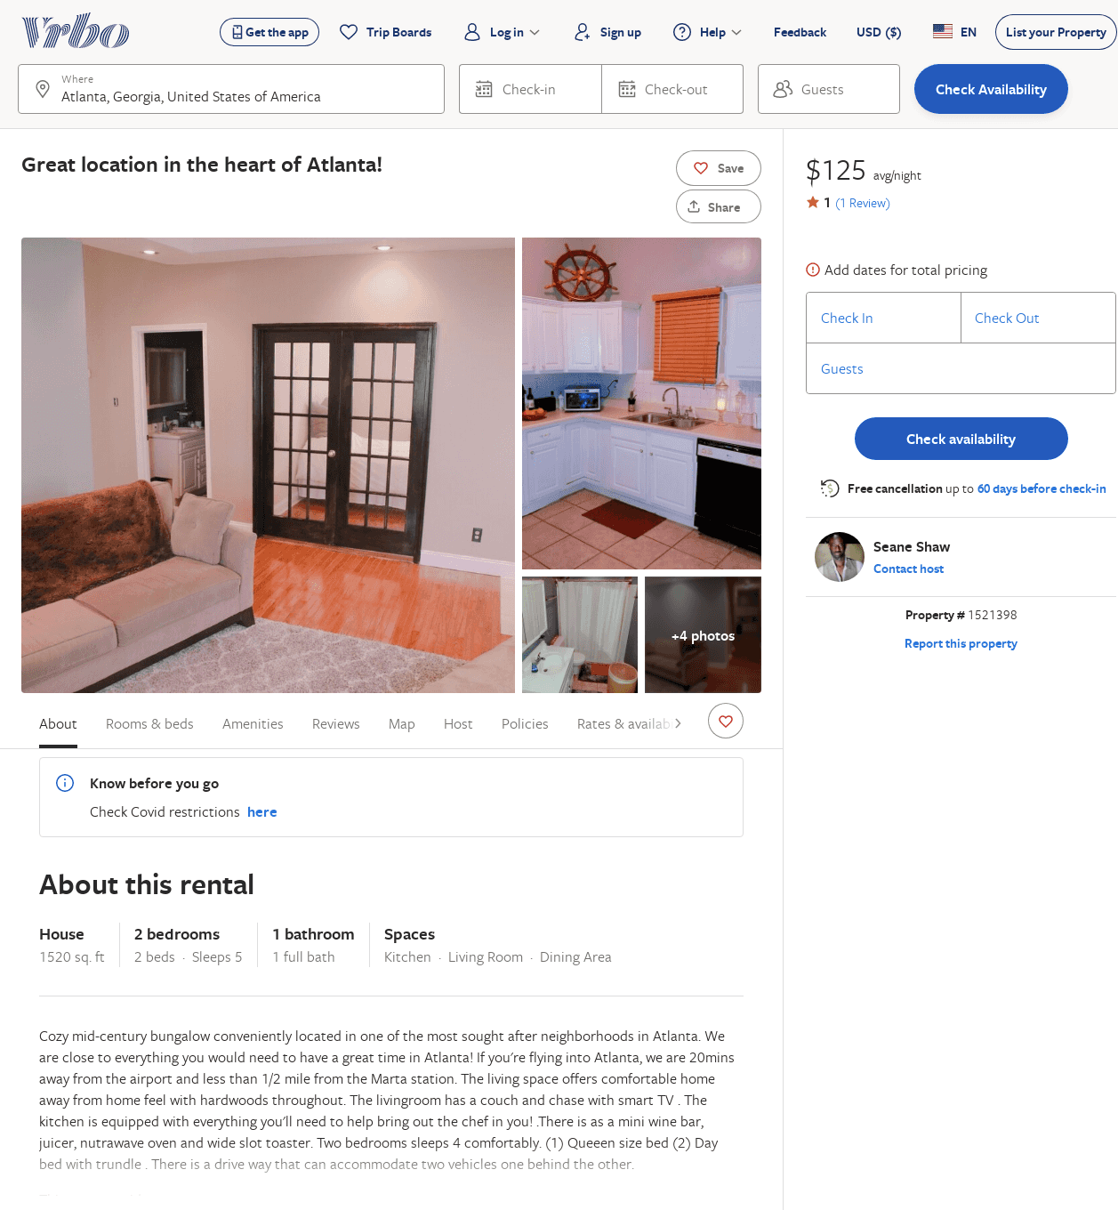
Listing 1521398
2
5
$125
1
3
Seane Shaw
https://www.vrbo.com/1521398
Aug 2022

Slide 23
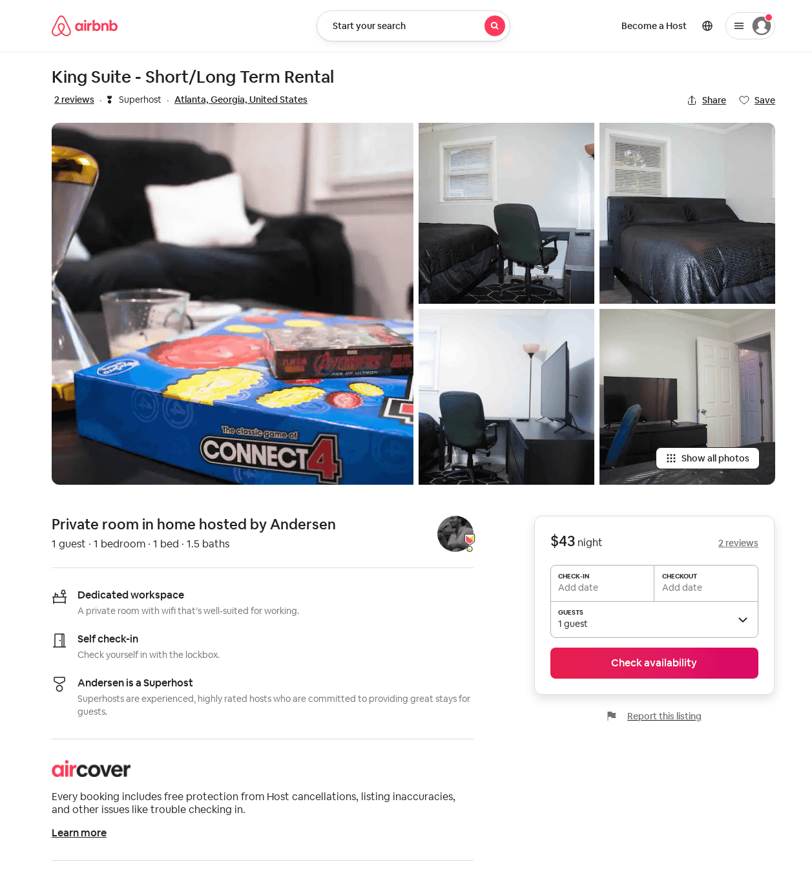
Listing 42636208
1
1
3
Andersen
169296999
3
https://www.airbnb.com/rooms/42636208
Aug 2022

